Slide 1



MOUNTAINEER-03 (NCT05253651) is a global, open-label, randomized, phase 3 study of tucatinib with trastuzumab and mFOLFOX6 versus standard of care for the first-line treatment of HER2+ and RAS wild-type mCRC
Tanios Bekaii-Saab, MD
Professor , Mayo Clinic College of Medicine and Science Leader, GI Cancer Program , MCCCC

Slide 2
Background and Rationale
Colorectal cancer (CRC) is the third most common cancer and the second leading cause of cancer-related death worldwide
HER2 amplification is present in approximately 3%–5% of patients with mCRC and approximately 5%–14% of patients with RAS/BRAF wild-type mCRC
There was a recent FDA-approval for Tucatanib and Trastuzumab for HER2+ mCRC . This represents a first approval of its kind in mCRC.
Tucatinib is a highly selective HER2-directed tyrosine Kinase inhibitor ( TKI)
Preclinical data in CRC, show strong evidence supporting the increased activity of tucatinib in combination with trastuzumab relative to other agents

Slide 3
Background and Rationale ( cont.)
Results from the primary endpoint analysis from the phase 2 MOUNTAINEER trial (NCT03043313) showed durable and clinically meaningful antitumor activity of tucatinib and trastuzumab in patients with previously treated RAS wild-type, HER2+ mCRC
  cORR of 38.1%, median DOR per BICR of 12.4 months Median duration of follow-up of 16.3 months for all patients and 20.7 months for patients treated with tucatinib and trastuzumab
  Tucatinib plus trastuzumab was well tolerated with a low discontinuation rate (5.8%) and no deaths due to AEs Most common AE was diarrhea, which was predominately low grade (Grade 3 events, 3.5% and no Grade 4 events)

Slide 4
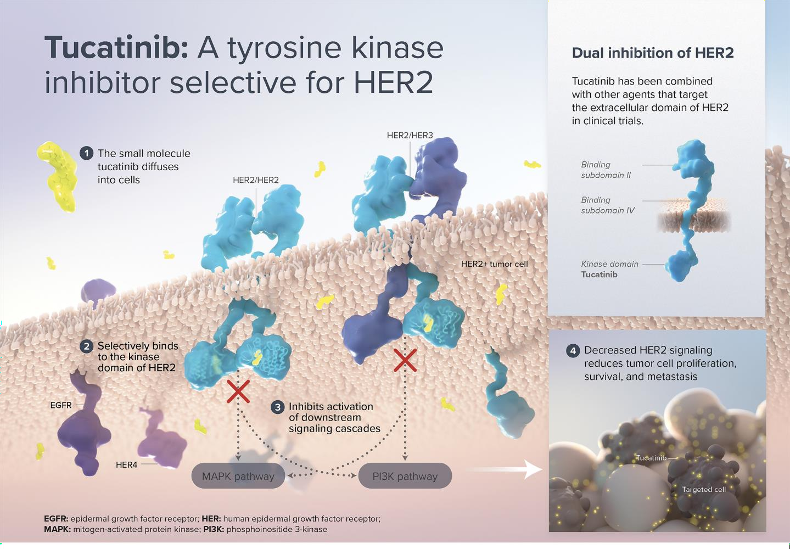
Tucatinib Proposed Mechanism of Action

Slide 5
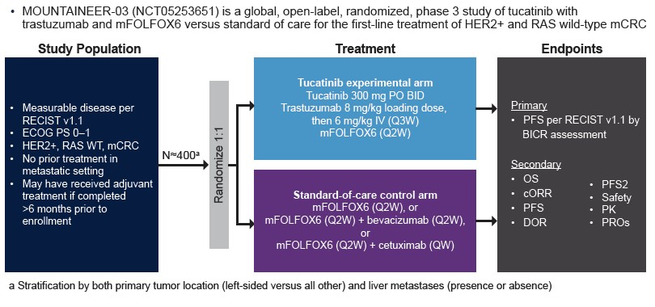
Study Design

Slide 6
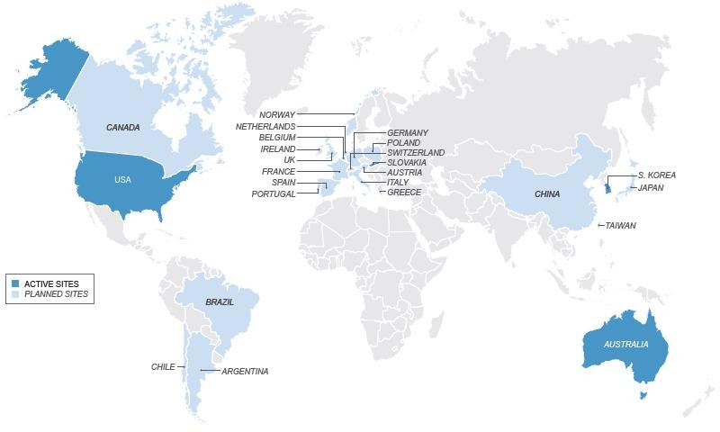
Summary
MOUNTAINEER-03 is investigating the efficacy and safety of tucatinib in combination with trastuzumab and mFOLFOX6 in comparison to mFOLFOX6 given with or without either bevacizumab or cetuximab as first- line treatment in patients with HER2+ mCRC
Enrollment began in 2022 and is ongoing in the United States, Slovakia, South Korea, and Australia

Slide 7
References
1.
Baidoun F, Elshiwy K, Elkeraie Y, et al. Curr Drug Targets. 2021;22(9):998-1009.
2.
Cancer Stat Facts: Colorectal Cancer. National Cancer Institute. Updated 2019. Accessed January 4, 2023. https://seer.cancer. gov/statfacts/html/colorect.html
3.
Kahi CJ, Boland CR, Dominitz JA, et al. Gastroenterology 2016;150:758–768.e11.
4.
Heinemann V, Singh M, Hardstock F, et al. Clin Colorectal Cancer. 2022;21(2):122-131.
5.
Van Cutsem E, Cervantes A, Adam R, et al. Ann Oncol. 2016;27(8):1386-1422.
6.
Benson AB, Venook AP, Al-Hawary MM, et al. J Natl Compr Canc Netw. 2021;19(3):329-359.
7.
Kang A, Bloudek L, Mordi U, et al. J Manag Care Spec Pharm. 2021;S20-21.
8.
Patel JN, Fong MK, Jagosky M. J Pers Med. 2019;9(1):3.
9.
Sartore-Bianchi A, Amatu A, Porcu L, et al. The Oncologist. 2019;24(10):1395-1402.
Strickler JH, Ng K, Cercek A, et al. J Clin Oncol. 2021;39(3 Suppl):Abstract TPS153.
Bertotti A, Papp E, Jones S, et al. Nature. 2015;526:263-267.
Jeong JH, Kim J, Hong YS, et al. Clin Colorectal Cancer. 2017;16(3):e147-152.
Raghav K, Loree JM, Morris JS, et al. JCO Precis Oncol. 2019;3:1-13.
Sawada K, Nakamura Y, Yamanaka T, et al. Clin Colorectal Cancer. 2018;17(3):198-205.
Kulukian A, Lee P, Taylor J, et al. Mol Cancer Ther. 2020;19(4):976-987.
TUKYSA [prescribing information]. Bothell, WA: Seagen, Inc.; 2021.
Strickler J, Cercek A, Siena S, et al. Ann Oncol. 2022;33(Suppl 4):S375-376.

Slide 8


Thank you!

