Slide 1



INTEGRATE IIa: Randomised double-blind Phase III study of regorafenib versus placebo in refractory advanced Gastro-Oesophageal Cancer (AGOC).
Nick Pavlakis^{1,2}, Kohei Shitara³, Katrin Sjoquist^{1,4}, Andrew Martin¹, Anthony Jaworski¹, Sonia Yip^{1,4}, Yung-Jue Bang⁵, Thierry Alcindor⁶, Chris O’Callaghan⁷, Niall Tebbutt⁸, Andrew Strickland⁹, Sun Young Rha¹⁰, Keun-Wook Lee^{11, 2}, John Zalcberg^{13,14}, Timothy Price¹⁵, John Simes¹, David Goldstein¹⁶
1. NHMRC Clinical Trials Centre, University of Sydney, Sydney, Australia; 2. Royal North Shore Hospital, Sydney, Australia; 3. Department of Gastrointestinal Oncology, National Cancer Center Hospital East, Chiba, Japan; Cancer Care Centre, St. George Hospital, Sydney, Australia;
4. Sydney Catalyst Translational Cancer Research Centre, Sydney, Australia; 5. Department of Internal Medicine, Seoul National University Hospital, Seoul, Republic of Korea; 6. McGill University Health Centre, Montreal, QC, Canada; 7. Canadian Cancer Trials Group (CCTG), Kingston, ON, Canada; 8. Austin Hospital, Melbourne, Sydney; 9. Monash Health, Melbourne, Australia; 10. Yonsei University Health System
– Severance Hospital, Seoul, Korea; 11. Seoul National University College of Medicine,, Seongnam, Korea; 12. Seoul National University Bundang Hospital, Seongnam, Korea; 13. Dept Medical Oncology, Alfred Health, Melbourne, Australia. 14. School of Public Health Monash University, Melbourne, Australia; 15. The Queen Elizabeth Hospital, Adelaide, Australia; 16. Australia Cancer Survivors Centre, Prince of Wales Hospital, University of New South Wales, Sydney, Australia
Presented at the 2023 ASCO Gastrointestinal Cancers Symposium (LBA294.)

Slide 2
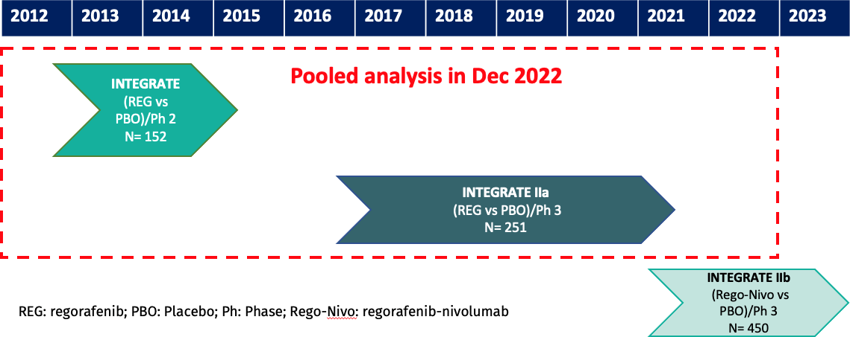
Background
2
Refractory advanced gastric and oesophago-gastric junction cancer (AGOC) has limited options¹.
Regorafenib, an oral multi-targeted tyrosine kinase inhibitor (TKI) prolonged progression free survival versus placebo across all regions/subgroups in the INTEGRATE Phase II randomised trial².
The Phase III INTEGRATE II study was designed to examine if regorafenib improves overall survival after failure of at least 2 lines of treatment.
INTEGRATE II was amended as a trial platform in December 2019 to INTEGRATE IIa (regorafenib vs placebo) and INTEGRATE IIb (regorafenib + nivolumab vs chemotherapy).
1. Smyth EC, et al. Lancet 2020; 396: 635–648. 2. Pavlakis N, et al. J Clin Oncol 2016; 34: 2728–2735.

Slide 3
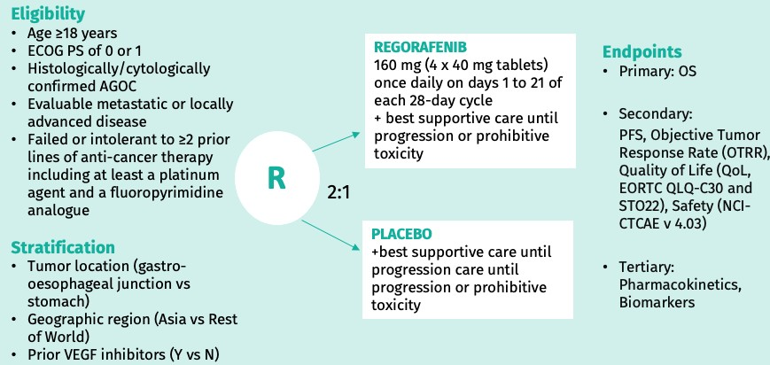
Methods – study design
3
Phase III International, multi-centre, randomized controlled clinical trial: Regorafenib (REGO) v placebo (PBO)
Statistical plan
Primary objective: Overall Survival (OS) in ITT population.
A sequential closed testing procedure was applied to the null hypotheses of no treatment effect first in the pooled cohort (INTEGRATE I + INTEGRATE
IIa), then INTEGRATE IIa cohort, which with 221 events would have 80% power to detect an overall OS hazard ratio (HR) of 0.67, with 5% two-sided alpha as a standalone study.

Slide 4
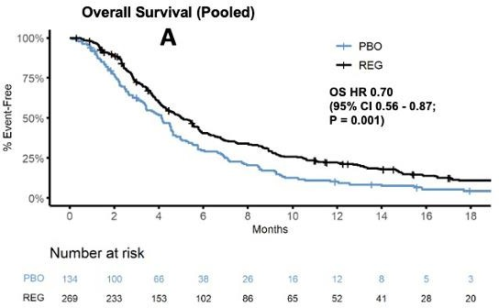
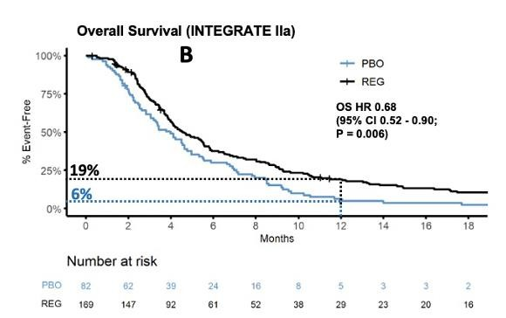
Results*
Between Oct 2016 and Sep 2021, 251 patients were randomized in INTEGRATE IIa from 6 countries: 157 from Asia (Korea, Taiwan, Japan) and 94 from Australia, New Zealand and Canada).
The study population was well balanced in demographic and stratification factors.
No significant heterogeneity was seen between INTEGRATE and INTEGRATE IIa on OS (p=0.90).
REGO improved OS:
‒ HR 0.70 (95% CI:0.56 to 0.87; p= 0.001) in the
pooled study population (INTEGRATE and INTEGRATE IIA)
‒ After 238 events in INTEGRATE IIa, OS HR 0.68 with 12 -month survival of 19% vs 6%.
*Analysis uses data extracted Dec 13, 2022

Slide 5
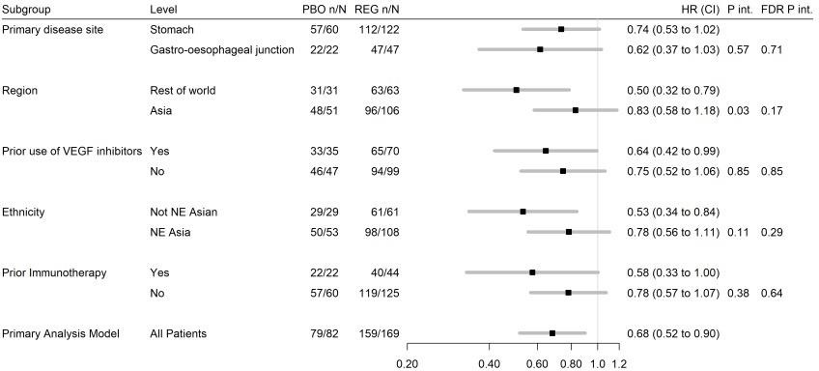
Results*
REGO improved OS:
‒ No statistically significant regional differences (Asia versus non-Asia), with
benefit seen in all pre-specified sub-groups
*Analysis uses data extracted Dec 13, 2022

Slide 6
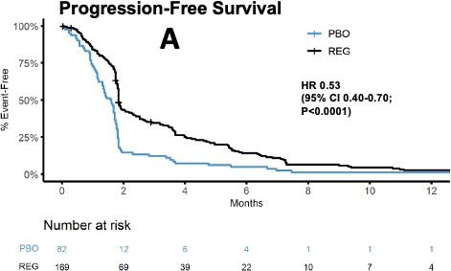
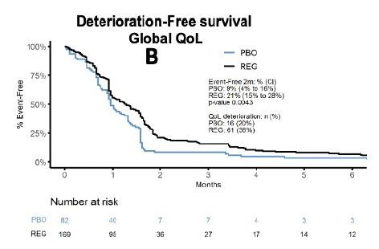
Results*
REGO improved PFS: HR=0.53; 95% CI: 0.40-0.70; p<0.0001)
REGO delays deterioration in global QoL compared with PBO (p = 0.0043).
*Analysis uses data extracted Dec 13, 2022

Slide 7
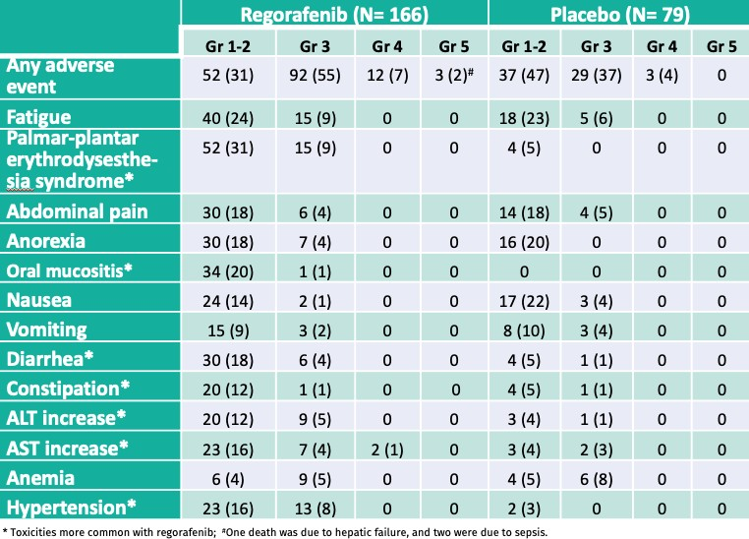
Results*
REGO toxicity profile was similar to that seen in previous reports.
*Analysis uses data extracted Dec 13, 2022

Slide 8
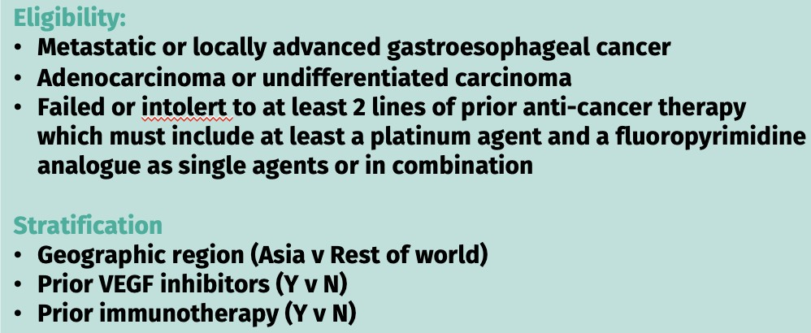
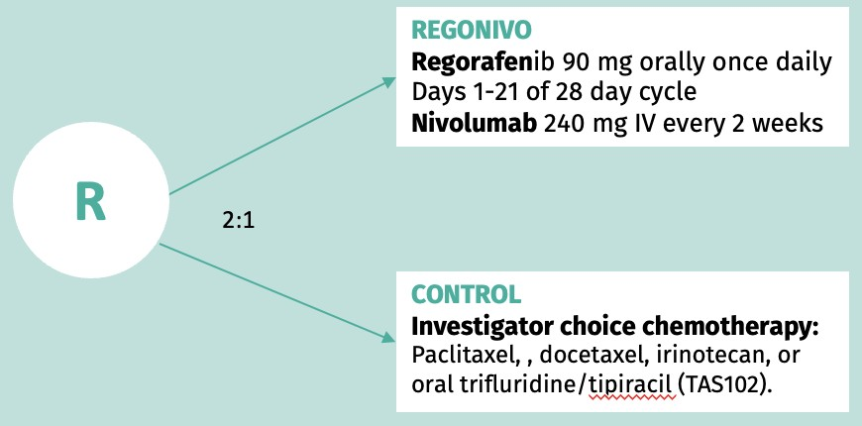

Conclusions
8
Regorafenib significantly improves survival compared with placebo in patients with refractory AGOC, delaying deterioration in global QoL with no new toxicity signals
The benefit is consistent in all pre-planned subgroups, offering a new treatment option in this setting.
INTEGRATE IIb is an ongoing international Phase III RCT in pre-treated patients with AGOC comparing regorafenib + nivolumab to standard chemotherapy (NCT0487936).

Slide 9
Thank you!

