Slide 1



Real-world dosing of regorafenib in patients with unresectable hepatocellular carcinoma (uHCC): Final analysis of the prospective, observational REFINE study
Richard S. Finn, Philippe Merle, Masafumi Ikeda, Heinz-Josef Klümpen, Gianluca Masi, Alessandro Granito, Ho Yeong Lim, Masatoshi Kudo, Shukui Qin, René Gerolami, Yi-Hsiang Huang, Do Young Kim, Matthias Pinter, Naoya Kato, Masayuki Kurosaki, Kazushi Numata, Javeed Khan, Kirhan Ozgurdal, Yoon Jun Kim

Slide 2
Background
The prospective, observational REFINE study aimed to evaluate the real-world safety and effectiveness of regorafenib in patients with uHCC for whom a decision to treat with regorafenib had been made before study enrollment
REFINE included patient populations that were excluded from the phase 3 RESORCE study¹
Interim analyses of REFINE supported the safety and effectiveness of regorafenib in patients with uHCC in routine clinical practice and demonstrated that second-line regorafenib after prior sorafenib in patients with better liver function was associated with more favorable safety and prolonged OS^{2,3}
Here, we present the full data from the final analysis of REFINE

Slide 3
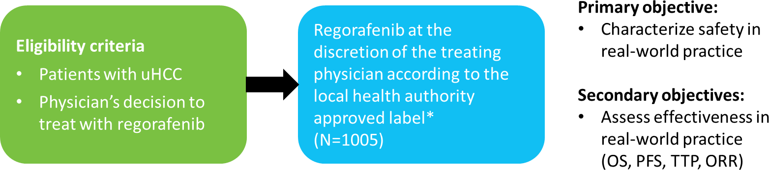
Methods
REFINE was conducted between September 2017 and January 2022 in countries across Europe, North America, Asia, Latin America, the Middle East, and North Africa
*Labeled dose: 160 mg once daily, 3 weeks on/1 week off in a 4-week cycle; the decision on the dose and duration of regorafenib treatment is at the discretion of the treating physician, based on the recommendations in the local product information.
ORR, objective response rate; OS, overall survival; PFS, progression-free survival; TTP, time to progression; uHCC, unresectable hepatocellular carcinoma.
3
[

Slide 4
Demographics and disease characteristics (1)
Characteristic | All patients (N=1005)
Male sex, n (%) | 835 (83)
Median age (range), years | 66 (21–94)
Race, n (%) Asian White Black or African American Unknown/Not reported | 567 (56) 254 (25) 20 (2) 164 (16)
ECOG PS, n (%) 0/1 ≥2 Missing | 829 (82) 60 (6) 116 (12)
Child–Pugh classification, n (%) A B C Not evaluable Missing | 618 (61) 123 (12) 5 (<1) 26 (3) 233 (23)
ALBI grade, n (%) 1 2 3 Missing | 318 (32) 480 (48) 37 (4) 170 (17)
Characteristic | All patients (N=1005)
Child–Pugh classification, stratified by ALBI grade, n (%)* | ALBI grade 1 | ALBI grade 2 | ALBI grade 3 | Missing
A (n=618) | 248 (40) | 313 (51) | 2 (<1) | 55 (9)
B (n=123) | 8 (7) | 82 (67) | 24 (20) | 9 (7)
Missing (n=233) | 56 (24) | 74 (32) | 6 (3) | 97 (42)
BCLC stage, n (%) 0 A B C D Missing | 2 (<1) 13 (1) 133 (13) 625 (62) 19 (2) 213 (21)
Extrahepatic spread, n (%) Yes No Missing | 591 (59) 413 (41) 1 (<1)
Macrovascular invasion (multiple responses), n (%) Yes Portal vein thrombosis Hepatic vein invasion Lack of portal blood flow Missing | 346 (34) 279 (28) 79 (8) 9 (1) 3 (<1)
4

Slide 5
Demographics and disease characteristics (2)
Characteristic | All patients (N=1005)
Etiology of uHCC (multiple responses), n (%) Hepatitis B Alcohol use Hepatitis C NASH Genetic/metabolic Other Missing | 382 (38) 250 (25) 242 (24) 66 (7) 29 (3) 138 (14) 26 (3)
Median time from diagnosis to start of regorafenib (IQR), months | 24.7 (10.7–45.5)
Median time since most recent progression/relapse to start of regorafenib (IQR), months | 0.6 (0.2–1.4)
Number of prior systemic treatment lines, n (%) None 1 (prior sorafenib treatment) 1 (prior non-sorafenib treatment) ≥2 | 12 (1) 827 (82) 21 (2) 145 (14)
Characteristic | All patients (N=1005)
Most common prior systemic treatments (any treatment line, ≥2% of patients), n (%) Sorafenib Nivolumab Lenvatinib | 965 (96) 47 (5) 40 (4)
Use of prior non-systemic treatment, n (%) TACE Radiofrequency ablation Partial hepatectomy Hepatic artery infusion Percutaneous ethanol injection Transplantation Other | 746 (74) 584 (58) 239 (24) 195 (19) 44 (4) 41 (4) 24 (2) 84 (8)
Use of a prior immune checkpoint inhibitor, n (%) | 97 (10)
Use of a multikinase inhibitor other than sorafenib, n (%) | 65 (6)
Use of systemic treatment after regorafenib, n (%) Lenvatinib Cabozantinib Nivolumab Ramucirumab | 324 (32) 126 (13) 110 (11) 52 (5) 37 (4)
Sorafenib intolerant, n (%) | 91 (9)
5
IQR, interquartile range; NASH, nonalcoholic steatohepatitis; TACE, transarterial chemoembolization; uHCC, unresectable hepatocellular carcinoma.

Slide 6
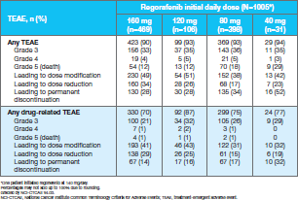
REFINE Study: Safety

Slide 7
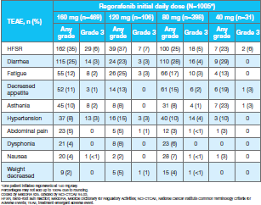
REFINE Study: Safety

Slide 8
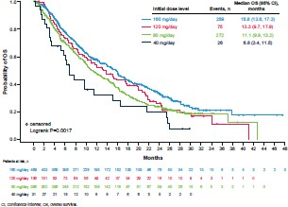
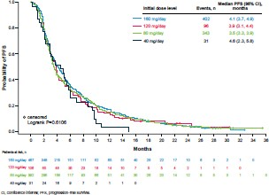
REFINE Study: Efficacy
OS
PFS

Slide 9
REFINE Study: Conclusions
Results of this final analysis of the REFINE real-world study show that most patients with uHCC initiated regorafenib at 160 mg/day (including those who received regorafenib as third- or later-line treatment) or 80 mg/day
A higher proportion of patients from Asia initiated regorafenib at the recommended dose, and a higher proportion of patients initiating regorafenib at 160 mg/day had better liver function at study entry compared with patients starting at lower doses
Safety was similar regardless of initial dose
Duration of treatment and median PFS were similar across initial dose groups, while median OS was longer in patients who initiated regorafenib at 160 mg/day compared with patients starting at lower doses
Longer OS in patients initiating at 160 mg/day compared with other doses may be related to a higher proportion of patients classed as Child–Pugh A and ALBI grade 1, and different treatment practices in Asian compared with non-Asian countries

Slide 10


Thank you!

