Slide 1
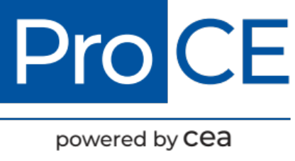
Best Practices for Pharmacists to
Optimize Use of Obesity Treatment Options and Overcome Barriers to Care
Module 1: Obesity Overview
Module 2: Treatment Guidelines and Pharmacotherapy Options
Supported by an educational grant from Novo Nordisk Inc.

Slide 2
About These Slides
Please feel free to use and share some or all of these slides in your noncommercial presentations to colleagues or patients
When using our slides, please retain the source attribution:
These slides may not be published, posted online, or used in commercial presentations without permission. Please contact info@ProCE.com for details
Slide credit: ProCE.com
Notes:
Disclaimer: The materials published on the Clinical Care Options Web site reflect the views of the authors of the CCO material, not those of Clinical Care Options, LLC, the CME providers, or the companies providing educational grants. The materials may discuss uses and dosages for therapeutic products that have not been approved by the United States Food and Drug Administration. A qualified healthcare professional should be consulted before using any therapeutic product discussed. Readers should verify all information and data before treating patients or using any therapies described in these materials.

Slide 3
Best Practices for Pharmacists to Optimize Use of Obesity Treatment Options and Overcome Barriers to Care
Overview, Guidelines, and Pharmacotherapy Options for the Management of Obesity
Supported by an educational grant from Novo Nordisk Inc.

Slide 4


Faculty
Megan Adelman, PharmD, BCPS, BCGP, CDCES
Family Medicine Clinical Specialist
Cleveland Clinic, Akron General
Akron, Ohio
Elizabeth Pogge, PharmD, MPH, BCPS-AQ Cardiology, BCGP, FASCP, FAzPA
Professor
Department of Pharmacy Practice
College of Pharmacy-Glendale
Midwestern University
Glendale, Arizona

Slide 5
Disclosures
The faculty reported the following relevant financial relationships or relationships to products or devices they have with ineligible companies related to the content of this educational activity:
Megan Adelman, PharmD, BCPS, BCGP, CDCES, has no relevant conflicts of interest
to report.
Elizabeth Pogge, PharmD, MPH, BCPS-AQ Cardiology, BCGP, FASCP, FAzPA, has no relevant conflicts of interest to report.
The planners/managers reported the following relationships.
ProCE staff and planners have no relevant conflicts of interest to report.

Slide 6
Best Practices for Pharmacists to Optimize Use of Obesity Treatment Options and Overcome Barriers to Care
Module 1: Obesity Overview
Supported by an educational grant from Novo Nordisk Inc.

Slide 7
Learning Objective
Recognize the pathophysiology and common comorbidities associated with obesity and the benefits of long-term weight loss

Slide 8
Background
In 2017-2018¹
73.6% of US adults over 20 are overweight (BMI 25-30 kg/m²) or obese
42.5% are obese (BMI >30 kg/m²)
Healthy People 2020 goal²
Promote health and reduce chronic disease risk through the consumption of a healthful diet and the achievement and maintenance of a healthy body weight
US annual cost of overweight and obesity³
~21% of annual medical spending
1. www.cdc.gov/nchs/fastats/obesity-overweight.htm.
2. www.healthypeople.gov/2020/topicsobjectives2020/overview.aspx?topicid=29.
3. www.healthycommunitieshealthyfuture.org/learn-the-facts/economic-costs-of-obesity.

Slide 9
Obesity Epidemic in the United States
Social
Technology
Economic
Notes:
Economic; food supply is low in cost and abundant, palatable foods are easy to access with high caloric density and are readily available in prepackaged and fast-food resturants. Social:community factors such as surroundsings (healthy lunches, safe neighborhoods, food deserts). Technology; labor saving technology has reduced physical acitivty and increased screen time. More electronic devices and less physical demanding jobs; sedentary lifestyle.

Slide 10
Genetics vs Environment
Obesity
Genetics: leptin
Genetics: cholecystokinin
Genetics: ghrelin
Genetics: GLP-1
Environment: technology
Environment: food
Environment: lack of activity
Gut flora??
Pi-Sunyer. Obes Res. 2020;10:97ss.
Notes:
GLP-1, glucagon-like peptide-1.

Slide 11
Obesity-Related Complications
Obesity
Male hypogonadism, female infertility
Cardiovascular disease, hypertension, hyperlipidemia
Type 2 diabetes
Asthma
Fatty liver disease
GERD,
sleep apnea
Osteoarthritis
Depression
Garvey. Endocrine Practice. 2016;22:1.
Notes:
GERD, gastroesophageal reflux disease.
Speaker Notes:
This is not an all inclusive list but are some of the most common complications associated with obesity. Stress incontinence, GERD, and depression are also linked to obesity. Cancer???

Slide 12
Social Determinants of Obesity
Economic stability
Education access and quality
Healthcare access and quality
Neighborhood and built environments
Social and community context
www.tfah.org/wp-content/uploads/2021/09/2021ObesityReport_Fnl.pdf.
Notes:
Speaker Notes:
Social determinants of health- defined as the conditions in the environment where people are born, live, learn, work, pay, worship, and age that affect a wide range of health, functioning, and quality of life outcomes and risk. 5 buckes; economic stability, 2; education access and quality; 3; healthcare access and quality, 4; neighborhood and built environments; 5 social and community context.
Benefits of long-term weight loss
Management goals

Slide 13
Screening for Obesity
 | BMI, kg/m² | Obesity Class
Underweight | <18.5 | N/A
Normal weight | 18.5-24.9 | N/A
Overweight | 25.0-29.9 | N/A
Obesity | 30.0-34.9 | I
Obesity | 35.0-39.9 | II
Extreme obesity | ≥40 | III
Waist circumference ≥40 inches in men and ≥35 inches in women is considered a risk factor for obesity-related complications
Jensen. Circulation. 2014;129:S102.
Notes:
Speaker Notes:
Additional screening tools such as body fat can also be calculated and used.

Slide 14
Management Goals
Obesity-related counseling should be offered to those with BMI ≥25 kg/m²
A 3% to 5% weight loss can result in meaningful reductions in triglycerides, blood glucose, hemoglobin A1c, and the risk of developing type 2 diabetes
Set an initial weight loss goal of 5% to 10% of current body weight over 6 mo
After 6 mo, focus on weight maintenance before attempting further weight loss
Participating in a weight loss program long-term can help improve weight maintenance
Jensen. Circulation. 2014;129:S102.
Notes:
Speaker Notes:
Benefits of long term weight loss and management goals. END of part 1; 15 minutes

Slide 15
Practice Points
Offer obesity-related counseling to those with BMI ≥25 kg/m²
Counsel patients that obesity is a multifactorial disease that includes both environmental and genetic factors
Counsel patients that even 3-5% weight loss can reduce the risk of obesity-related cardiometabolic diseases
Participating in a weight loss program long-term can help improve weight maintenance

Slide 16
Best Practices for Pharmacists to Optimize Use of Obesity Treatment Options and Overcome Barriers to Care
Module 2: Treatment Guidelines and Pharmacotherapy Options
Supported by an educational grant from Novo Nordisk Inc.

Slide 17
Learning Objectives
Summarize treatment guidelines, lifestyle modifications, and evidence-based pharmacotherapy options for the management of obesity

Slide 18
Guideline Recommendations

Slide 19
Treatment of Obesity: Lifestyle Intervention
Dietary Therapy
Individualized
Increase Physical Activity
Behavioral Therapy
Self-monitoring (food, exercise, weight)
Aerobic physical activity progressing to >150 min/ wk on 3-5 separate days
Reduced-calorie healthy meal plan (500-750 kcal daily deficit)
Meal plan options: Mediterranean, DASH,
low carb, low fat, etc
Resistance exercise:
2-3 times/wk
Goal setting
Education
Stimulus control
Stress reduction
Consider adding pharmacotherapy to lifestyle intervention in patients who qualify
Garvey. Endocrine practice. 2016;22:1.
Notes:
DASH, Dietary Approaches to Stop Hypertension.
Speaker Notes:
CMS covers obesity therapy done by providers; over 6 months; up to 14 sessions, pharmacist are not considered providers in all settings.

Slide 20
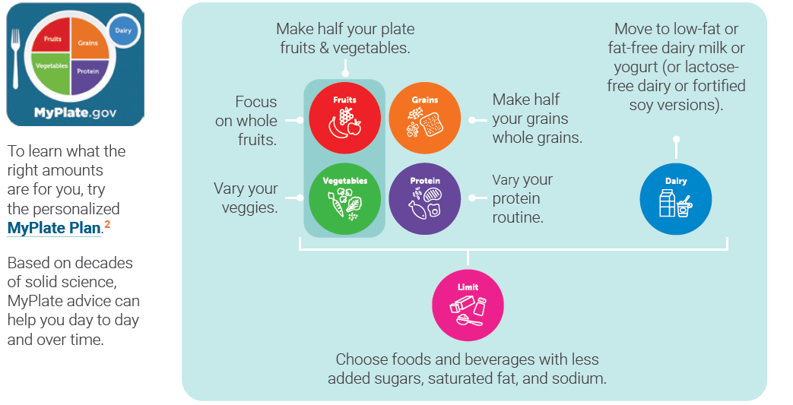
2020-2025 USDA Dietary Guidelines
USDA. Dietary Guidelines for American 2020-2025. 9th edition.
Notes:
USDA, US Department of Agriculture.

Slide 21

Hidden Diet Derailers
Alcohol
Sugar-sweetened beverages
Condiments
Snack food, junk food, and candy
Skipping meals
Notes:
Low calorie intake is less than 1200 for women and 1800 for men.

Slide 22
Patient Counseling Tips: Diet
Do not drink your calories, except for milk
Track your food intake
Limit the extras to 200 calories/day
Increase water intake
Make nonstarchy vegetables the star of your plate
Limit restaurant meals to once/wk

Slide 23
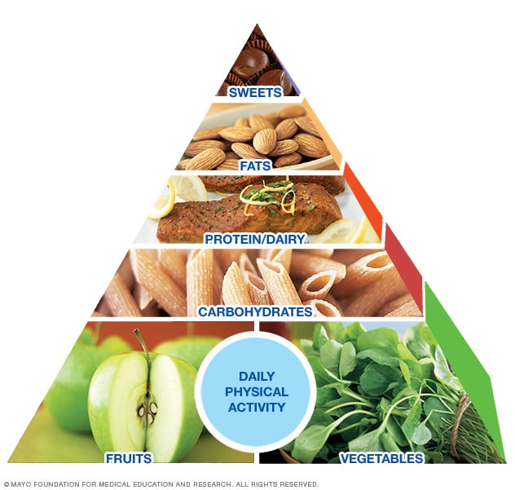
Bests Diets for 2021: US News
Mediterranean diet
DASH diet
Flexitarian diet
MIND diet
Mayo Clinic diet
Mayo Clinic Diet
health.usnews.com/best-diet/best-diets-overall
Image used with permission of Mayo Foundation for Medical Education and Research, All rights reserved.
Notes:
DASH, Dietary Approaches to Stop Hypertension; MIND, Mediterranean-DASH Intervention for Neurodegenerative Delay.
Discuss each of these diets

Slide 24
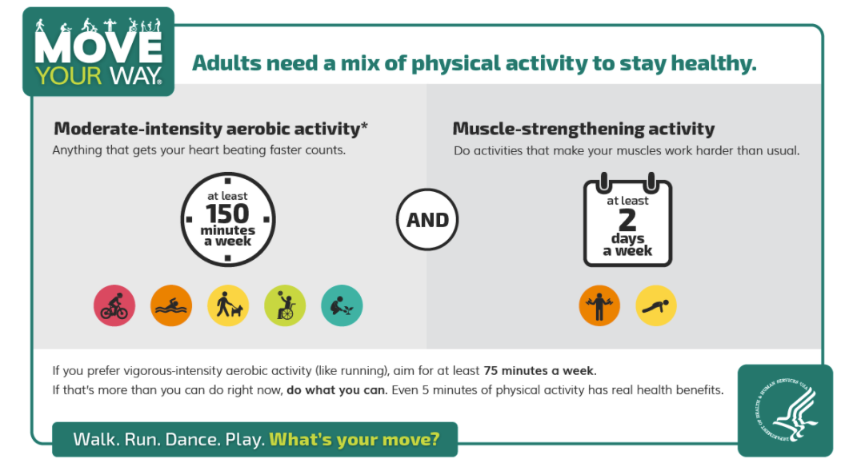
Move Your Way Public Message
Practical Tips
Start low and go slow… BUT GO
Schedule in activity— make it a priority
Increase daily activity
Make it fun
Vary the exercise routine
Exercise in a group
health.gov/moveyourway

Slide 25
Behavioral Therapy
High-intensity (≥14 sessions over 6 mo) comprehensive weight loss programs provided individually or in a group session
CMS provides reimbursement for up to 20 sessions/yr
Do a food log… there is an app that!
Weigh in regularly (weekly)
Practical Tips
Close the kitchen
Keep food out of sight
Practice mindful eating
Get adequate sleep and reduce stress
Identify and avoid triggers
https://www.cms.gov/medicare-coverage-database/view/ncd.aspx?NCDId=353
Notes:
CMS, Centers for Medicare & Medicaid Services.
A sustained weight loss of 3-5% can reduce risk factors for cardiovascular disease (blood pressure, glucose, lipids)
Best if done by a trained healthcare professional
Face-to-face sessions
> 14 sessions over 6 months

Slide 26
Reversible Factors: Medications
Medication Class | Associated With Weight Gain | Weight Neutral/Promote Weight Loss
Antidepressants | Selective serotonin reuptake inhibitors, mirtazapine, tricyclic antidepressants | Bupropion
Antipsychotics | Clozapine, olanzapine, risperidone, quetiapine, paliperidone | Zonisamide, ethosuximide
Mood stabilizers/ anticonvulsants | Divalproex, valproic acid, pregabalin, gabapentin, lithium? | Lamotrigine, lithium?, topiramate, felbamate, ziprasidone, zonisamide
Antidiabetic agents | Insulin, sulfonylureas, sulfonylureas/rosiglitazone | Glucagon-like polypeptide-1 agonist, metformin, sodium–glucose cotransporter-2 inhibitors
Hormonal contraception | Injectable contraceptives | Barrier methods, oral contraceptives
Corticosteroids | Prednisone, methylprednisolone | Nonsteroidal anti-inflammatories
Apovian. J Clin Endocrinol Metab. 2015; 100:342. Ethosuximide PI. Topiramate PI. Felbamate PI. Chaudhury. Front Endocrinol. 2017;8:6. Verhaegen. Current Obesity Reports. 2021;10:1.
Notes:
Speaker notes:
Ziprasidone is considered weight neutral; people lose weight when switching from olanzapine to ziprasidone.
"Long-acting injectable depot medroxyprogesterone acetate is the only hormonal contraceptive that is consistently associated with weight gain; other hormonal methods are unlikely to increase weight independent of lifestyle choices. “
Lithium is interesting as the PI states both weight loss and weight gain. The guidelines by Apovian lists it as weight gain but another review by Domecq states it is weight neutral.

Slide 27
Pharmacologic Treatment of Obesity
Used adjunctively for patients with BMI ≥30 kg/m² or BMI ≥27 kg/m² with concomitant obesity-related disease or risk factors
Always implement with dietary therapy and physical activity
Assess efficacy monthly for the first 3 mo, then every 3-6 mo
Effective response after 3 mo (≥5% of body weight), can continue therapy; otherwise discontinue
Jensen. Circulation. 2014;129:S102. Garvey. Endocrine practice. 2016;22:1. Apovian. J Clin Endocrinol Metab. 2015;100:342.
Notes:
Weight loss drugs that have been FDA approved should be used with adjunctive dietary therapy and physical activity. The are approved for patient’s with BMI greater than 30 or those with BMI greater than 27 with concomitant risk factors or diseases. The current risk factors or diseases that are considered important enough to warrant therapy are hypertension, dyslipidemia, coronary heart disease, type 2 diabetes, and sleep apnea.

Slide 28
Pharmacotherapy Options

Slide 29
Clinical Trials for Weight Loss Medications
Key characteristics of clinical trials
Average age: 40-50 yr
Primarily female: 70%-85%
Baseline weight ~100 kg (BMI 36-38 kg/m²)
Average clinical trial length ~1 yr
Average percentage weight loss of completers: 5%-10%
Notes:
Speaker Notes:
An Endocrine Society clinical practice guideline states that medication should be discontinued if weight loss is less than 5 percent of body weight within the first 3 months

Slide 30
Current FDA-Approved Weight Loss Medications
Medication | Mechanism of Action | Weight Loss Above Diet and Lifestyle Alone, Mean Weight Loss; Duration of Study¹
Benzphetamine, diethylpropion, phendimetrazine, phentermine- C-III/IV | Norepinephrine-releasing agent | 7.9 Ib; 2-24 wk
Phentermine/topiramate ER- C-IV | Norepinephrine-releasing agent + GABA receptor modulation | 14.5 Ib (recommended dose) 18.9 Ib (high dose); 1 yr
Naltrexone/bupropion | Opioid receptor antagonist Dopamine and norepinephrine reuptake inhibitor | 10.5 Ib; 1 yr
Liraglutide, semaglutide | GLP-1 agonist | Liraglutide: 12.8 Ib; 1 yr Semaglutide: 27.9 Ib; 68 wk²
Orlistat | Lipase inhibitor (30% reduction in fat calorie absorption) | OTC: 6.5-7.5 Ib; 1 yr Rx: 6.5-7.5 Ib; 1 yr
1. Apovian. J Clin Endocrinol Metab. 2015;100:342. 2. Wilding. NEJM. 2021;384:989.
Notes:
C-III/IV, Schedule III/IV Controlled Substance; C-IV, Schedule IV Controlled Substance, ER, extended release; GABA, γ-aminobutyric acid; GLP-1, glucagon-like polypeptide-1; OTC, over the counter; Rx, prescription.

Slide 31
FDA Approved Weight Loss Medications: Dosing
Medication | Dosage
Benzphetamine, diethylpropion, phendimetrazine, phentermine- C-III/IV | Phentermine: 37.5 mg PO once daily
Phentermine/topiramate ER | 3.75/23 mg PO daily (starting dose), 7.5/46 mg PO daily (recommended dose), 15/92 mg PO daily (high dose)
Naltrexone/bupropion | Each tablet contains 8/90 mg (titrate up weekly) 2 tablets PO twice daily (high dose): 32/360 mg daily
Liraglutide, semaglutide | Titrate dose weekly with liraglutide and monthly with semaglutide Liraglutide: 0.6 mg SQ once daily (starting dose), 3.0 mg SQ once daily (high dose) Semaglutide: 0.25 mg SQ once weekly (starting dose), 2.4 mg SQ once weekly (high dose)
Orlistat | OTC: 60 mg PO TID with meals Rx: 120 mg PO TID with meals
Apovian. J Clin Endocrinol Metab. 2015;100:342. Liraglutide PI. Semaglutide PI.
Notes:
C-III/IV, Schedule III/IV Controlled Substance; ER, extended release; OTC, over the counter; Rx, prescription.

Slide 32
FDA Approved Weight Loss Medications:
Adverse Events
Medication | Adverse Events | Notes
Benzphetamine, diethylpropion, phendimetrazine, phentermine- C-III/IV | ↑ blood pressure, ↑ heart rate, insomnia, agitation, dizziness, ischemic events, dry mouth, constipation | Only indicated for short term use (~12 wk); risk of dependance
Phentermine/topiramate ER | Mood changes, ↑ heart rate, cognitive impairment, dry mouth, insomnia, metabolic acidosis, ↑ SCr, constipation | Teratogenic; REMS medication only available through certified pharmacies
Naltrexone/bupropion | Mood changes, nausea, constipation, dry mouth, insomnia, dizziness | Box warning: suicidality and antidepressants; do not take with chronic opioid therapy Do not take with seizure disorder
Liraglutide, semaglutide | Nausea, diarrhea, dyspepsia, tachycardia, hypoglycemia, delayed gastric emptying, pancreatitis | Risk of thyroid carcinoma Given as a subcutaneous injection
Orlistat | Gastrointestinal (flatus with discharge, fecal urgency, fatty stools), liver damage (rare) | Take multivitamin separated by >2 hr
Apovian. J Clin Endocrinol Metab. 2015;100:342. Phentermine/topiramate ER PI.
Naltrexone/bupropion PI. Liraglutide PI. Semaglutide PI.
Notes:
C-III/IV, Schedule III/IV Controlled Substance; ER, extended release; REMS, Risk Evaluation and Mitigation Strategy; SCr, serum creatinine;
Speaker Notes:
CV risk reduction data; discuss this in the presentation.

Slide 33
Practice Points
Include lifestyle counseling for all patients with obesity
Behavioral therapy may be beneficial for some patients
Use technology such as free apps
Pharmacotherapy may be used adjunctively for BMI ≥30 kg/m² or
BMI ≥27 kg/m² with concomitant obesity-related disease or risk factors
There are multiple FDA-approved weight loss pharmacotherapy options—choose the one that best fits your patient

