Slide 1



IBD Resource Center for Primary Care and Gastroenterology Professionals:
Your One-Stop Shop for Managing IBD
Produced in partnership with Practicing Clinicians Exchange and Clinical Care Options, LLC
This educational activity is supported by educational grants from Amgen Inc; Ferring Pharmaceuticals, Inc; and Takeda Pharmaceuticals U.S.A, Inc.
Notes:
IBD, inflammatory bowel disease.

Slide 2
Diagnosis, Management, and Monitoring of IBD: Early Diagnosis and Individualizing Therapy
Bruce E. Sands, MD, MS
Dr. Burrill B. Crohn Professor of Medicine
Chief, Dr. Henry D. Janowitz Division of Gastroenterology
Mount Sinai Hospital
Chief, Division of Gastroenterology
Mount Sinai Health System
Director, Digestive Disease Institute
Icahn School of Medicine at Mount Sinai
New York, New York
Notes:
IBD, inflammatory bowel disease.

Slide 3
Disclosures
The faculty reported the following financial relationships or relationships to products or devices they or their spouse/life partner have with commercial interests related to the content of this CME/CE activity:
Bruce E. Sands, MD, MS: researcher: Janssen, Theravance Biopharma R&D; consultant: Abivax, AbbVie, Alimentiv, Amgen, Arena, Artugen Therapeutics, AstraZeneca, Bacainn Therapeutics, Boehringer Ingelheim, Boston, Bristol-Myers Squibb, Calibr, Celltrion Healthcare, ClostraBio, Enthera, Evommune, Ferring, Galapagos, Gilead Sciences, GlaxoSmithKline, GossamerBio, Immunic, Index, Innovation, Ironwood, Janssen, Kaleido, Kallyope, Lilly, MiroBio, MRM Health, Morphic Therapeutic, Pfizer, Progenity, Prometheus Biosciences, Protagonist Therapeutics, Q32 Bio, Sun Pharma, Surrozen, Takeda, Target RWE, Teva Branded Pharmaceutical Products R&D, Thelium, Theravance Biopharma R&D, TLL Pharma, USWM Enterprises, Ventyx Biosciences, Viela Bio; ownership interest: Ventyx Biosciences.
The planners/managers reported the following relationships:
Abigail Meyers, PA-C: consultant/advisor/speaker: Boston University, myCME.
Kim Nealy, PharmD and Ruth Cohen Cooper, CHCP have no relevant financial relationships to disclose.

Slide 4
Learning Objectives
Describe early signs and symptoms of IBD to prevent delays in diagnosis and treatment initiation
Implement strategies for individualizing initial therapy in patients with IBD based on available agents and guidelines
Notes:
IBD, inflammatory bowel disease.

Slide 5
Early Diagnosis

Slide 6
Signs and Symptoms of IBD
Nocturnal
Urgency
Bleeding
Large, Inflamed Skin Tags
Chronic Diarrhea
Unexplained Weight Loss
Chronic
Recurrent
Anemia
Perianal Fistula or Abscess
Pain
Anal
Abdominal
Mild Fever
High Fecal Calprotectin
Presence of Extraintestinal Manifestations
Inflammatory Ocular Conditions
Oral Aphthous Ulcers
Arthritis or Arthralgia
Dermatologic Conditions
Slide credit: clinicaloptions.com and practicingclinicians.com
Atia. Crohn’s & Colitis. 2020;2:1. Danese. J Crohns Colitis. 2015;9:601.
Notes:
IBD, inflammatory bowel disease.

Slide 7
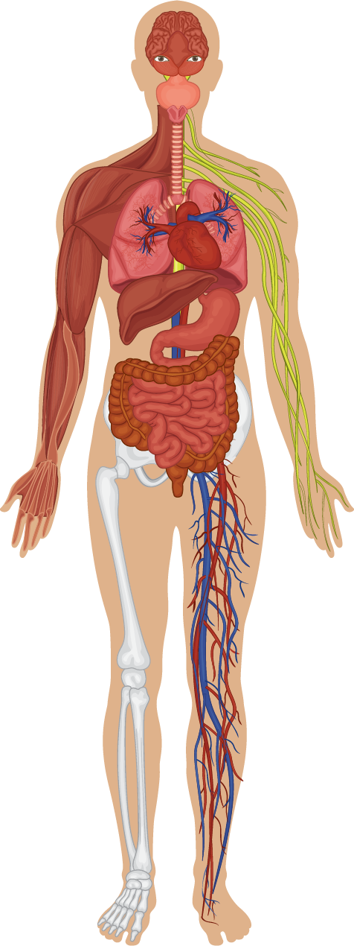

Extraintestinal Manifestations
Ocular
Uveitis
Iritis
Episcleritis
Pulmonary
Airway disease (large or small)
Chronic bronchitis
May be related to or independent of underlying IBD activity
Oral
Aphthous ulcers
Hepatobiliary
Cholelithiasis
Primary sclerosing cholangitis
Dermatologic
Psoriasis
Erythema nodosum
Pyoderma gangrenosum
Musculoskeletal
Spondyloarthritis
Peripheral arthralgias and arthritis
Develop in 25% to 40% of patients with IBD over time
Renal
Nephrolithiasis
Hematologic
Anemia
Venous thromboembolism
Brown. Surg Clin North Am. 2015;95:1245. Levine. Gastroenterol Hepatol. 2011;7:235.
Peyrin-Biroulet. Clin Gastroenterol Hepatol. 2017;15:25. Rothfuss. World J Gastroenterol. 2006;12:4819.
Slide credit: clinicaloptions.com and practicingclinicians.com
Notes:
IBD, inflammatory bowel disease.

Slide 8
Differential Diagnosis: Other GI Disorders
Irritable Bowel Syndrome
Small Intestine Bacterial Overgrowth
Infectious Colitis
Celiac Disease
Ischemic Colitis
Lactose Intolerance
Microscopic Colitis
Medication Adverse Events
Clostridium Difficile Infection
Colorectal Cancer
Langan. Am Fam Physician. 2007;76:1323. Lichtenstein. Am J Gastroenterol. 2009;104:465. Moses. Curr Sports Med Rep. 2005;4:91.
Slide credit: clinicaloptions.com and practicingclinicians.com
Notes:
GI, gastrointestinal.

Slide 9
AGA Recommendations:
Laboratory Workup for Chronic Diarrhea
Statement | Strength of Recommendation | Quality of Evidence
Use fecal calprotectin or fecal lactoferrin to screen for IBD | Conditional | Low
Do not use ESR or CRP to screen for IBD | Conditional | Low
Test for Giardia | Strong | High
Do not test stool for ova and parasites (except Giardia), unless travel to or immigration from high-risk areas | Conditional | Low
Test for celiac disease with tTG-IgA and second test for celiac disease if IgA deficiency | Strong | Moderate
Test for bile acid diarrhea | Conditional | Low
Menees. Am J Gastroenterol. 2015;110:444. Smalley. Gastroenterology. 2019;157:851.
Slide credit: clinicaloptions.com and practicingclinicians.com
Notes:
AGA, American Gastroenterological Association; CRP, C-reactive protein; ESR, erythrocytic sedimentation rate; IBD, inflammatory bowel disease; IgA, immunoglobulin A; tTG-IgA, tissue transglutaminase type 2 immunoglobulin A.

Slide 10
Case Study (cont’d): Initial Workup
Kate’s fecal calprotectin level is 326 μg/g (normal <250 μg/g)
Tests for Giardia, celiac disease, and bile acid diarrhea are negative
What are next steps in diagnostic process if you suspect IBD?
Notes:
IBD, inflammatory bowel disease.

Slide 11
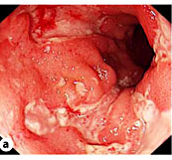
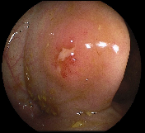
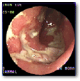
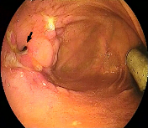
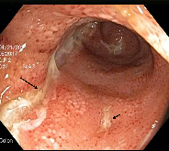
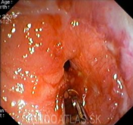
Crohn’s Disease Endoscopic Characteristics
Goal for Endoscopic Healing
CD
Cobblestoning
Serpiginous ulcerations
Aphthoid ulcerations
Segmental involvement
Healthy mucosa intercalated with diseased mucosa
Stenosis
Fistulas
Rectal sparing (typically)
Images courtesy of Dr Jerome Wayne. Lee. Clin Endosc. 2016;49:370.
Slide credit: clinicaloptions.com and practicingclinicians.com
Notes:
CD, Crohn’s disease.

Slide 12
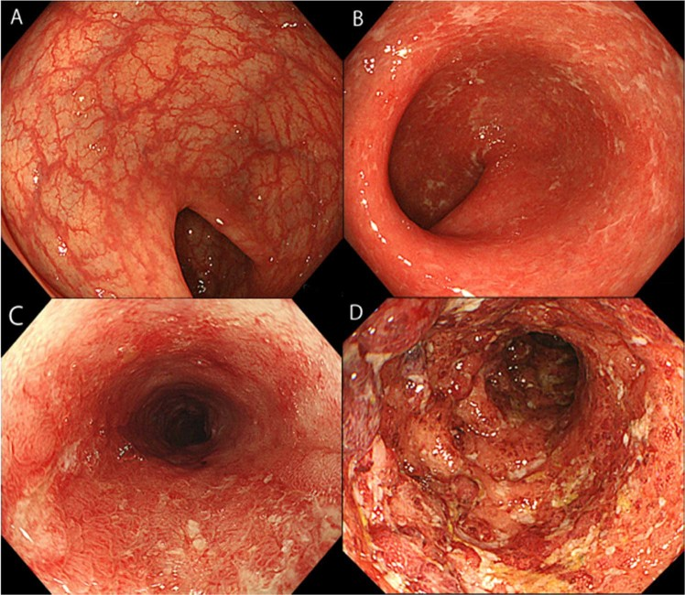
Ulcerative Colitis Endoscopic Characteristics
UC
Diffuse inflammation
Rectal origin, proximal progression
Edematous mucosa
Erythema
Loss of vascular markings
Mucosal friability
Erosions
Ulceration
Spontaneous bleeding
Pseudopolyps
Takenaka. Sci Rep. 2019;9:17751. To view a copy of this license,
visit http://creativecommons.org/licenses/by/4.0/. Lee. Clin Endosc. 2016;49:370.
Slide credit: clinicaloptions.com and practicingclinicians.com
Notes:
UC, ulcerative colitis.
Endoscopic image of Mayo endoscopic subscore (MES). (A) Endoscopic image of MES 0 (no friability and granularity and intact vascular pattern). (B) Endoscopic image of MES 1 (mild erythema or decreased vascular pattern). (C) Endoscopic image of MES 2 (marked erythema, absent vascular pattern, friability, and erosions). (D) Endoscopic image of MES 3 (spontaneous bleeding and ulceration).

Slide 13
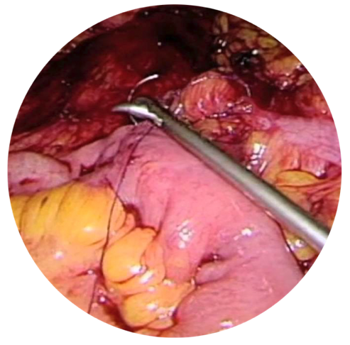
Risk Stratification CD
Low Risk for
Rapid Progression
High Risk for
Rapid Progression
>30 yr | Age at diagnosis | <30 yr
Limited | Anatomic involvement | Extensive
No | Perianal and/or severe rectal disease | Yes
Superficial | Ulcers | Deep
No | Prior surgical resection | Yes
No | Stricturing and/or penetrating behavior | Yes
Sandborn. Gastroenterology. 2014;147:702.
Slide credit: clinicaloptions.com and practicingclinicians.com
Notes:
CD, Crohn’s disease.

Slide 14
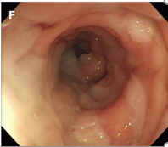
Risk Stratification UC
Low Risk for
Rapid Progression
High Risk for
Rapid Progression
>40 yr | Age at diagnosis | <40 yr
Proctitis | Anatomic extent | Extensive
Mayo 1 | Endoscopy activity | Mayo 3 UCEIS ≥7
Superficial | Ulcers | Deep
Normal | Albumin | Low
Normal | CRP | Elevated
No | Hospitalization | Yes
Rubin. Am J Gastroenterol. 2019;114:384.
Slide credit: clinicaloptions.com and practicingclinicians.com
Notes:
CRP, C-reactive protein; UC, ulcerative colitis; UCEIS, Ulcerative Colitis Endoscopic Index of Severity.

Slide 15
Choosing and Individualizing Treatment

Slide 16
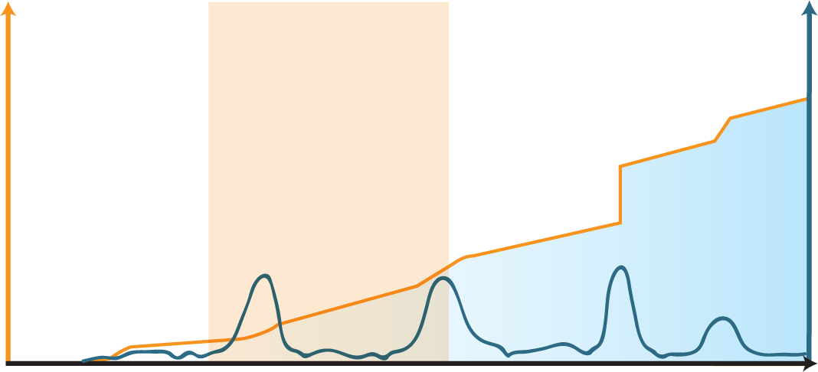
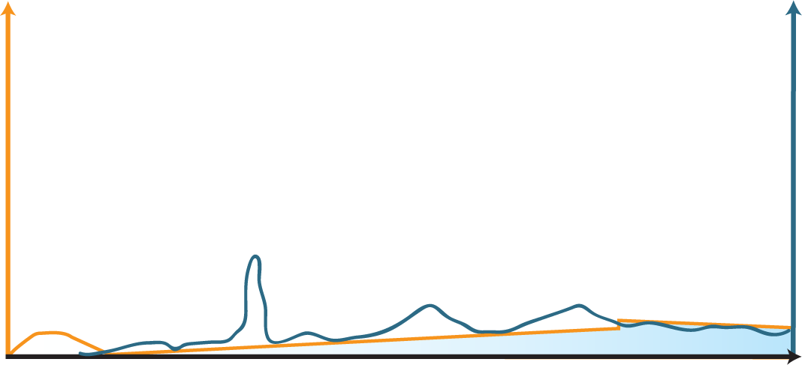
Why Is Early Treatment Important in IBD?
Natural Course of CD
Theoretical Impact of Early Effective Treatment on Disease Progression
Window of opportunity
Stricture
Surgery
Digestive Damage
Fistula/
abscess
Digestive Damage
Tight control and monitoring
Inflammatory Activity*
Inflammatory Activity*
Stricture
Subclinical
Inflammation
Early Disease
Late Disease
Subclinical
Inflammation
Early Disease
Late Disease
Diagnosis
Diagnosis
*Assessed by CDAI, CDEIS, and/or CRP.
Similar principles hypothesized in UC but not as clear
Still, effective treatment needed in UC and CD to provide adequate control of symptoms and mucosal inflammation (treat-to-target approach)
Colombel. Gastroenterology. 2017;152:351. Pariente. Inflamm Bowel Dis. 2011;17:1415.
Slide credit: clinicaloptions.com and practicingclinicians.com
Notes:
CD, Crohn’s disease; CDAI, Crohn’s Disease Activity Index; CDEIS, Crohn’s Disease Endoscopic Index of Severity; CRP, C-reactive protein; IBD, inflammatory bowel disease; UC, ulcerative colitis.

Slide 17
Guiding Principles of Selection of Early Therapy
Evolving perspectives on evaluating disease in relation to therapeutic needs
Personalize according to patient preferences (risk–benefit preferences, convenience), comorbidities, demographic factors, prior treatments
Disease Activity | Disease Severity
Snapshot of symptoms, perhaps also objective measures, that patient is experiencing now (eg, mild, moderate, or severe; mild to moderate; or moderate to severe) Not suﬃcient to guide selection of therapy | Newer concept, reflecting entire course of disease: “the movie” Range of variables that includes not only symptoms, but also objective findings, past treatment experience, surgery, biomarkers, functional aspects
Peyrin-Biroulet. Clin Gastroenterol Hepatol. 2016;14:348.
Slide credit: clinicaloptions.com and practicingclinicians.com

Slide 18
Pieces of Therapy Choice Puzzle in IBD
DRUG
PATIENT
Efficacy
Individual Characteristics
Indication
Rapidity of onset
Durability
Pharmacokinetics/TDM
Combination vs monotherapy
Ages, stages, comorbidities, and preferences
Positioning and sequence
Disease
Characteristics
Safety
CD extent
Disease behavior/complication
Disease severity
Early vs late
EIMs
Infection
Cancer
Specific concerns by
agent or mechanism
Prior treatment success or failure
Slide credit: clinicaloptions.com and practicingclinicians.com
Notes:
CD, Crohn’s disease; EIM, extraintestinal manifestation; IBD, inflammatory bowel disease; TDM, therapeutic drug monitoring.

Slide 19
Features of Small Molecules vs Biologics
Small Molecules | Feature | Biologics
Small (single molecule) | Molecular weight | Large (mixture)
Simple, well defined | Structure | Complex, heterogeneous
Stable at range of temperatures | Thermostability | Prone to denaturing in extreme temperatures
By chemical synthesis | Production | In a living cell culture
Cheaper (in theory) | Cost of production | More expensive (in theory)
Nonimmunogenic | Immunogenicity | Potentially immunogenic
Oral (mostly), depending on absorption | Route of administration | Parenteral
Potentially problematic | Drug–drug interactions | Not likely
Potential for both off-target and on-target adverse events | Adverse events | Adverse events likely to be on-target effects
Slide credit: clinicaloptions.com and practicingclinicians.com

Slide 20
Agents for IBD
Class | Examples | CD | UC
Corticosteroids | Budesonide | Induction | Induction
 | Prednisone | Induction | Induction
Aminosalicylates | Mesalamine | Limited evidence of efficacy | Induction/maintenance
 | Sulfasalazine | Limited evidence of efficacy | Limited evidence of efficacy
Immunomodulators
Thiopurines | AZA | Maintenance | Maintenance
 | 6-MP | Maintenance | Maintenance
Immunosuppressive | Methotrexate | Limited benefit (alone) | No benefit (alone)
Immunomodulators also are used as adjunct therapy with TNF inhibitors
Feuerstein. Gastroenterology. 2020;158:1450. Feuerstein. Gastroenterology. 2021;160:2496. Ko. Gastroenterology. 2019;156:748.
Slide credit: clinicaloptions.com and practicingclinicians.com
Notes:
6-MP, 6-mercaptopurine; AZA, azathioprine; IBD, inflammatory bowel disease; CD, Crohn’s disease; UC, ulcerative colitis.

Slide 21
Biologic and Small-Molecule Therapy Options
Class | Examples | CD | UC
Biologic Agents
TNF inhibitors | Adalimumab | Induction/maintenance | Induction/maintenance
 | Certolizumab | Induction/maintenance | --
 | Golimumab | -- | Induction/maintenance
 | Infliximab | Induction/maintenance | Induction/maintenance
α4β7 integrin inhibitor | Vedolizumab | Induction/maintenance | Induction/maintenance
IL-12/23 inhibitor | Ustekinumab | Induction/maintenance | Induction/maintenance
IL-23 inhibitor | Risankizumab | Induction/maintenance | --
Small-Molecule Agents
S1P modulator | Ozanimod | -- | Induction/maintenance
JAK inhibitors | Tofacitinib | -- | Induction/maintenance
 | Upadacitinib | -- | Induction/maintenance
Feuerstein. Gastroenterology. 2020;158:1450. Feuerstein. Gastroenterology. 2021;160:2496.
Ko. Gastroenterology. 2019;156:748. Risankizumab PI. accessdata.fda.gov/scripts/cder/daf/.
Slide credit: clinicaloptions.com and practicingclinicians.com
Notes:
CD, Crohn’s disease; IL, interleukin; UC, ulcerative colitis.

Slide 22
Guideline-Directed Therapy:
Initial Treatment of Crohn’s Disease
Low-Risk Patient
Moderate-/High-Risk Patient
Ileum and/or proximal colon,
none to minimal symptoms
Options
Budesonide 9 mg/day with
or without AZA
Tapering course of prednisone with or without AZA
Options
Anti–TNF-α monotherapy over
no therapy or thiopurine monotherapy
Anti–TNF-α + thiopurine over thiopurine monotherapy or
anti–TNF-α monotherapy
Methotrexate for patients who
do not tolerate thiopurine in combination with anti–TNF-α
If Rx failure
Diffuse or left colon,
none to minimal symptoms
Options
Tapering course of prednisone with or without AZA
Ustekinumab ± IS
Vedolizumab ± IS
Feuerstein. Gastroenterology. 2021;160:2496. Sandborn. Gastroenterology. 2014;147:702.
Lichtenstein. Am J Gastroenterol. 2018;113:481.
Slide credit: clinicaloptions.com and practicingclinicians.com
Notes:
AZA, azathioprine; IS, immunosuppressant; Rx, prescription.

Slide 23
Proposed Algorithms for First-line
Therapy in High-Risk Crohn’s Disease
Severe Disease
Risk Averse
Infliximab or adalimumab (for most patients) in combination with thiopurine or methotrexate
Higher inflammatory burden, higher disease severity, perianal disease, severe extraintestinal manifestations, obese:
Infliximab > adalimumab
Combination therapy >> monotherapy
Significant comorbidities or contraindications
to TNF-α inhibitor:
Ustekinumab monotherapy
Prior serious infections
Prior malignancy
Advanced age, multiple comorbidities
Moderate
Disease Severity
Higher
Disease Severity
Vedolizumab monotherapy
Ustekinumab monotherapy
Nguyen. Clin Gastroenterol Hepatol. 2020;18:1268.
Slide credit: clinicaloptions.com and practicingclinicians.com
Notes:
Severe disease: high structural damage, inflammatory burden, and impact on QoL

Slide 24
Case Study (cont’d): What If Kate Had UC?
Specialist workup reveals:
  Colonoscopy with biopsy
    Continuous, symmetric inflammation from rectum to splenic flexure
    Acute and chronic inflammation
    Normal mucosa proximal to splenic flexure
GI specialist determines that Kate has UC
How does this impact therapeutic approach?
Notes:
GI, gastrointestinal; UC, ulcerative colitis.

Slide 25
AGA Guidelines: Treatment of
Mild to Moderate Ulcerative Colitis
Medication Choice
Standard-dose mesalamine or diazo-bonded 5-ASA > low-dose mesalamine, sulfasalazine, or no treatment
Standard-dose mesalamine or diazo-bonded 5-ASA > budesonide
Suboptimal Response | Refractory to Optimized Therapy
Increase to high dose | Add prednisone or budesonide MMX
Route of Administration
Proctitis | Rectal suppositories
Proctosigmoiditis | Rectal enema
Extensive | Oral + rectal therapy
Mesalamine > steroid topical therapy
Patient Considerations
Patients in remission on sulfasalazine or with prominent arthritis may choose to remain on therapy if others are cost prohibitive | Use once-daily dosing with oral mesalamine: no difference in induction outcomes | Patients who place higher value on convenience over efficacy may choose oral therapy
Ko. Gastroenterology. 2019;156:748.
Slide credit: clinicaloptions.com and practicingclinicians.com
Notes:
AGA, American Gastroenterological Association; 5-ASA, 5-aminosalicylates; MMX, multimatrix.

Slide 26
AGA Guidelines: Induction of Remission in
Moderate to Severe Ulcerative Colitis
 | Recommendation
Recommended Therapy | Biologic Naive | Previous Infliximab (Particularly Those With Primary Nonresponse)
TNF inhibitor | Infliximab preferred over adalimumab based on relative efficacy
Vedolizumab | Vedolizumab preferred over adalimumab based on relative efficacy
Ustekinumab | Effective but not ranked in guidelines | Ustekinumab preferred over adalimumab or vedolizumab
Tofacitinib | Effective but not FDA approved for TNF naive | Tofacitinib preferred over adalimumab or vedolizumab
Feuerstein. Gastroenterology. 2020;158:1450.
Slide credit: clinicaloptions.com and practicingclinicians.com
Notes:
AGA, American Gastroenterological Association; UC, ulcerative colitis.
AGA suggests early use of biologic agents (with or without immunomodulator therapy) rather than gradual step-up after failure of 5-ASA

Slide 27
Positioning Therapies in Moderate to Severe
IBD by Subpopulations
Factors to Consider | Preferred Treatment
Age >65 yr | Vedolizumab or ustekinumab
Inpatient | Infliximab (induction and maintenance) Cyclosporine induction (followed by vedolizumab, ustekinumab, or azathioprine maintenance) If low albumin: cyclosporine
Significant cancer history, lymphoma | Ustekinumab or vedolizumab
Pregnancy | TNF inhibitor, azathioprine, ustekinumab, or vedolizumab
Steroid-responsive, mild/moderate disease | Thiopurine or ozanimod (UC)
Extraintestinal manifestation: arthritis | TNF inhibitor, upadacitinib (UC), or tofacitinib (UC)
Previous TNF inhibitor failure | Ustekinumab, upadacitinib (UC), or tofacitinib (UC)
Singh. Clin Gastroenterol Hepatol. 2020;18:2179.
Slide credit: clinicaloptions.com and practicingclinicians.com
Notes:
IBD, inflammatory bowel disease; UC, ulcerative colitis.

Slide 28
Treatment AEs
Class/Medication | Common | Rare
Corticosteroids | Bone loss, cataracts, diabetes, glaucoma, hypertension, insomnia, mood changes, opportunistic infection, osteopenia/osteoporosis, weight gain | Avascular necrosis of the hip
Aminosalicylates | Nausea, vomiting, headache, reversible male infertility (sulfasalazine), paradoxical worsening of colitis | Interstitial nephritis, pancreatitis
Immunomodulators
AZA/6-MP | Nausea, vomiting, hepatotoxicity, myelotoxicity, opportunistic infection, pancreatitis | Lymphoma, NMSC | Lymphoma, NMSC
Methotrexate | Nausea, vomiting, hepatotoxicity, myelotoxicity, opportunistic infection, teratogenicity | Fibrosing alveolitis | Fibrosing alveolitis
Slide credit: clinicaloptions.com and practicingclinicians.com
accessdata.fda.gov/scripts/cder/daf/.
Notes:
6-MP, 6-mercaptopurine; AE, adverse event; AZA, azathioprine; NMSC, nonmelanoma skin cancer.

Slide 29
Treatment AEs
Class/Medication | Common | Rare
Biologics
TNF inhibitors | Infections, infusion/injection site reactions, psoriasiform dermatitis | Demyelination, heart failure, serious infections, lymphoma, melanoma, lupus-like syndrome
Vedolizumab | Nasopharyngitis, fever, URIs, fatigue, cough, infusion-related reactions
Ustekinumab | Vomiting (induction), infections | Malignancy, psoriasis development, posterior reversible encephalopathy syndrome (PRES)
Risankizumab | Arthralgia, headache | Infections
Small Molecules
Ozanimod | URIs, hepatotoxicity | Serious infections, reduced pulmonary function, hypertension, macular edema, bradyarrhythmia/AV conduction delays
Tofacitinib, upadacitinib | Nasopharyngitis, elevated cholesterol levels, increased blood creatine phosphokinase | Serious infections, including herpes zoster, MACE, malignancy, mortality, thrombosis
Kornbluth. Am J Gastroenterol. 2010;105:501. Ferrante. Lancet. 2022;399:2031. www.accessdata.fda.gov/scripts/cder/daf/.
Slide credit: clinicaloptions.com and practicingclinicians.com
Notes:
MACE, major adverse cardiovascular events; TNF, tumor necrosis factor; URI, upper respiratory tract infections.

Slide 30
Summary Choices in IBD With Limited Head-to-Head Data
Individual Patient Characteristics
Pregnancy
Lifestyle Considerations
Young woman with steroid-dependent UC planning to start a family
Businesswoman with Crohn’s ileitis
who travels often for work
Any biologic (anti-TNF w/robust data)
Adalimumab or ustekinumab
Unfavorable Pharmacokinetics
Failed Anti-TNF
Shared
Decision-making
Older woman with ileocolonic CD
in whom you want to avoid immunomodulator who has
HLA-DQA1*05 genotype
Man with long history of UC, failed IFX
Ustekinumab, upadacitinib,
or tofacitinib
Ustekinumab or vedolizumab
Newly Diagnosed
Perianal Disease
Newly diagnosed man with moderate CD or UC with personal history of lymphoma
Woman admitted with severe rectal CD with perirectal abscess s/p drainage and seton placement
Ustekinumab or vedolizumab
Anti-TNF (+ azathioprine)
Slide credit: clinicaloptions.com and practicingclinicians.com
Notes:
CD, Crohn’s disease; IBD, inflammatory bowel disease; IFX, infliximab; s/p, status post; UC, ulcerative colitis.
Goal - summary slide, will get into more specifics in different/respective modules

Slide 31
Diagnosis, Management, and Monitoring of IBD: Treat-to-Target and Therapeutic Drug Monitoring
Bruce E. Sands, MD, MS
Dr. Burrill B. Crohn's Professor of Medicine
Chief, Dr. Henry D. Janowitz Division of Gastroenterology
Mount Sinai Hospital
Chief, Division of Gastroenterology
Mount Sinai Health System
Director, Digestive Disease Institute
Icahn School of Medicine at Mount Sinai
New York, New York
Notes:
IBD, inflammatory bowel disease.

Slide 32
Learning Objectives
Apply the treat-to-target approach in patients with IBD
Detail how therapeutic drug monitoring is used to assess patients for appropriate drug concentrations
Notes:
IBD, inflammatory bowel disease.

Slide 33
Treat to Target

Slide 34
Goals of Therapy
Early Diagnosis
Distinction between disease activity and disease severity
Rapid Induction of Remission
Clinical and objective
Mucosal healing
Stable, Sustained Maintenance
Prevention
of relapse
Maintenance
of mucosal healing
Prevention of Disease/Drug Complications
Vaccination, cancer prevention, monitoring
Decreased hospitalizations and surgery
Manage Psychosocial Comorbidities
Depression
Anxiety
Sexual dysfunction
Cost-Effective Care
Improved adherence
Effective, durable therapy
Slide credit: clinicaloptions.com and practicingclinicians.com

Slide 35
STRIDE-II: Treatment Targets in CD and UC
Symptomatic response
Symptomatic remission and normalization of CRP
Decrease in calprotectin to acceptable range, normal growth (children)
Endoscopic healing, normalized QoL and absence of disability
Active disease
Consider but not formal targets:
CD: Transmural healing
UC: Histologic healing
Therapy according to risk
Targets not reached
Short-term targets
Intermediate targets
Long-term targets
Turner. Gastroenterology. 2021;160:1570.
Slide credit: clinicaloptions.com and practicingclinicians.com
Notes:
CD, Crohn's disease; CRP, C-reactive protein; QoL, quality of life; UC, ulcerative colitis.
Change therapy if Treatment target not reached within expected time frame

Slide 36
Treat to Target: Recommendations in Crohn's Disease
Composite endpoint
Defined as resolution of abdominal pain and normalization of bowel habit
Assessed at minimum of 3 mo during active disease
Patients’ individual goals should also
be addressed
Defined as resolution of ulceration
Should be assessed within 6-9 mo after start of therapy
When endoscopy cannot adequately evaluate inflammation, assess
resolution of inflammation by
cross-sectional imaging
Clinical/PRO remission
AND
Endoscopic remission
Adjunctive measures
Biomarkers: CRP and fecal calprotectin are adjunctive measures of inflammation, not targets, for monitoring CD
Histology: histologic remission is not considered a target
Peyrin-Biroulet. Am J Gastroenterol. 2015;110:1324.
Slide credit: clinicaloptions.com and practicingclinicians.com
Notes:
CD, Crohn's disease; CRP, C-reactive protein; PRO, patient-reported outcomes.
STRIDE (Selecting Therapeutic Targets in IBD) was a consensus programme by the IOIBD to evaluate potential treatment targets for IBD for use in a T2T strategy. An international group of IBD specialists developed 12 recommendations for treating to target in Crohn's disease and ulcerative colitis ─ including treatment targets for each condition ─ based on systematic literature review and expert opinion.
As shown in this slide, the composite treatment target recommended for Crohn's disease was clinical/PRO remission plus endoscopic remission, acknowledging the importance of measuring the patient experience as well as biological manifestations. The focus on both symptomatic and endoscopic remission is consistent with evolving regulatory guidance for the conduct of clinical trials.*
Biomarkers were considered to be adjunctive measures of inflammation to facilitate patient monitoring (and prompt further endoscopic or radiologic evaluation), rather than treatment targets. Histologic healing was also not recommended as a treatment target in clinical practice, because of insufficient evidence.
*FDA 2016, https://www.fda.gov/downloads/Drugs/GuidanceComplianceRegulatoryInformation/Guidances/UCM515143.pdf; 2. EMA 2016 http://www.ema.europa.eu/docs/en_GB/document_library/Scientific_guideline/2016/07/WC500211431.pdf.

Slide 37
Treat to Target: Recommendations in Ulcerative Colitis
Composite endpoint
Defined as resolution of rectal bleeding and normalization of bowel habit
Should be assessed at minimum of 3 mo during active disease
Patients’ individual goals (eg, QoL, mood disorders, fatigue, work productivity) should also be addressed: normalization of QoL as ultimate goal
Defined as resolution of friability and ulceration at flexible sigmoidoscopy or colonoscopy
(Mayo 0-1)
Should be assessed within 3-6 mo after start of therapy
Clinical/PRO remission
AND
Endoscopic remission
Adjunctive measures of disease activity that may be useful in selected cases
Biomarkers: CRP and fecal calprotectin are adjunctive measures of inflammation,
not targets, for monitoring UC
Histopathology: sensitive measure of inflammation but is not a target due to lack
of evidence of clinical utility
Peyrin-Biroulet. Am J Gastroenterol. 2015;110:1324.
Slide credit: clinicaloptions.com and practicingclinicians.com
Notes:
CD, Crohn's disease; CRP, C-reactive protein; PRO, patient-reported outcomes; QoL, quality of life.
STRIDE (Selecting Therapeutic Targets in IBD) was a consensus programme by the IOIBD to evaluate potential treatment targets for IBD for use in a T2T strategy. An international group of IBD specialists developed 12 recommendations for treating to target in Crohn's disease and ulcerative colitis ─ including treatment targets for each condition ─ based on systematic literature review and expert opinion.
As shown in this slide, the composite treatment target recommended for Crohn's disease was clinical/PRO remission plus endoscopic remission, acknowledging the importance of measuring the patient experience as well as biological manifestations. The focus on both symptomatic and endoscopic remission is consistent with evolving regulatory guidance for the conduct of clinical trials.*
Biomarkers were considered to be adjunctive measures of inflammation to facilitate patient monitoring (and prompt further endoscopic or radiologic evaluation), rather than treatment targets. Histologic healing was also not recommended as a treatment target in clinical practice, because of insufficient evidence.
*FDA 2016, https://www.fda.gov/downloads/Drugs/GuidanceComplianceRegulatoryInformation/Guidances/UCM515143.pdf; 2. EMA 2016 http://www.ema.europa.eu/docs/en_GB/document_library/Scientific_guideline/2016/07/WC500211431.pdf.

Slide 38
CALM Trial: Tight Control in Crohn’s Disease
Prednisone burst and taper
Escalation driven by CDAI, fecal calprotectin, CRP, and prednisone use
No adalimumab
Adalimumab 160 → 80 → 40 QOW
Adalimumab 40 QW
Adalimumab
40 QW + AZA
Tight Control
Prednisone burst and taper
Clinical Management
Wk | -9 to -1 | 0-11 | 12-23 | 24-35 | 36-48
Outcome | Clinical Management | Tight Control | P Value
Deep remission | 23.0 | 36.9 | .014
Biological remission | 15.6 | 29.5 | .006
CDEIS <4 plus CDEIS <4 in all segments | 23.8 | 29.5 | .229
Complete endoscopic remission | 16.4 | 18.0 | .728
Colombel. Lancet. 2018;390:2779. Yzet. J Crohns Colitis 2019;13:S024.
Slide credit: clinicaloptions.com and practicingclinicians.com
Notes:
AZA, azathioprine; CDAI, Clinical Disease Activity Index; CDEIS, Crohn's Disease Endoscopic Index of Severity; CRP, C-reactive protein.
Clinical Management: week -1: CDAI decrease of <70 points compared with baseline or CDAI >200; weeks 11, 23, 35: CDAI decrease of <100 points compared with baseline or CDAI ≥200, Prednisone use
Tight control group: CDAI ≥150, CRP ≥5 mg/L, Fecal calprotectin ≥250 µg/g, Prednisone use

Slide 39
Therapeutic Drug Monitoring

Slide 40
Definitions: Reactive and Proactive TDM
Reactive TDM
  Measurement of drug concentration and antibody levels in the setting of
  PNR or SLR to a biologic agent
  Aim: to inform about reasons for loss or lack of response and to facilitate therapeutic decisions
Proactive TDM
  Measurement of trough concentration and antibody levels with the goal of optimizing biologic therapy to achieve a threshold drug concentration
  Aim: to improve response rates and prevent SLR
Papamichael. Curr Opin Rheumatol. 2020;32:371.
Slide credit: clinicaloptions.com and practicingclinicians.com
Notes:
PNR, primary nonresponse; SLR, secondary loss of response; TDM, therapeutic drug monitoring.

Slide 41
Reactive vs Proactive TDM of Biologics
Reactive
Rationalizes and better directs the management of PNR and SLR to biologics
More cost-effective than empiric
anti-TNF therapy optimization
Proactive
Associated with better therapeutic outcomes compared with empiric optimization and/or reactive TDM of anti-TNF therapy
Can optimize monotherapy instead of combination therapy with an immunomodulator
Associated with better therapeutic outcomes
compared with empiric
anti-TNF therapy optimization
Infliximab de-escalation or discontinuation when in clinical remission
Rationalizes and better directs the management of PNR and SLR to biologics
Associated with better therapeutic outcomes
compared with empiric
anti-TNF therapy optimization
Papamichael. Curr Opin Rheumatol. 2020;32:371.
Slide credit: clinicaloptions.com and practicingclinicians.com
Notes:
PNR, primary nonresponse; SLR, secondary loss of response; TDM, therapeutic drug monitoring; TNF, tumor necrosis factor.
Rationalizes and better directs the management of PNR and SLR to biologics
Seow. Gut. 2010;59:49.
Roblin. Am J Gastroenterol. 2014;109:1250.
Yanai. Clin Gastroenterol Hepatol. 2015;13:522.
Restellini. Inflamm Bowel Dis. 2018;24:2165.
Roblin. Gut. 2020;69:1206.
More cost-effective than empiric anti-TNF therapy optimization
Velayos. Clin Gastroenterol Hepatol. 2013;11:654.
Steenholdt. Gut. 2014;63:919.
Roblin. J Mark Access Health Policy. 2015;3.
Martelli. J Gastroenterol. 2017;52:19.
Guidi. J Crohns Colitis. 2018;12:1079.
Yao. Inflamm Bow Dis. 2020;izaa073.
Associated with better therapeutic outcomes
compared with empiric
anti-TNF therapy optimization
Billiet. Aliment Pharmacol Ther. 2016;44:673.
Kelly. Inflamm Bowel Dis. 2017;23:1202.
Kamperidis. Frontline Gastroenterol. 2019;10:330.
Proactive:
Optimized monotherapy instead of combination therapy with an immunomodulator
Lega. Inflamm Bowel Dis. 2019;25:134.
Drobne. Aliment Pharmacol Ther. 2019;49:880.
Associated with better therapeutic outcomes compared with empiric optimization and/or reactive TDM of anti-TNF therapy
Vaughn. Inflamm Bowel Dis. 2014;20:1996.
Vande Casteele. Gastroenterology. 2015;148:1320.
Papamichael. Clin Gastroenterol Hepatol. 2017;5:1580.
Papamichael. J Crohns Colitis. 2019;13:976.
Assa. Gstroenterology. 2019;157:985.
Sanchez-Hernandez. Br J Clin Pract. 2020;86:1165.
Lyles. Inflamm Bowel Dis. 2020;izaa102.
Syed. Crohns Colitis 360. 2020;2:otaa050.
Infliximab de-escalation* or discontinuation† when in
clinical remission
†Louis. Gastroenterology. 2012;142:63.
†Papamichael. Clin Gastroenterol Hepatol. 2015:13:1103.
*Drobne. Clin Gastroenterol Hepatol. 2015;13:514.
†Ben-horin. Aliment Pharmacol Ther. 2015;42:356.
*Amiot. Clin Res Hepatol Gastroenterol. 2016;40:90.
†Kang. J Crohn’s Colitis. 2018;12:644.
*Lucidarme. Alimet Pharmacol Ther. 2019;49:147.
*Petitcollin. Clin Pharmacol Ther. 2019;106:605.
†Bots. Scand J Gastroenterol. 2019;54:281.

Slide 42
High Rates of Primary Nonresponse and Secondary
Loss of Response Despite Advent of Anti-TNF Therapy
PNR in IBD¹
SLR in CD²
100
60
80
50
40
60
Rate of Primary Nonresponse (%)
Rate of Loss of Response (%)
30
40
20
20
10
0
0
ADA (CHARM)
ADA (CLASSIC I)
ADA (GAIN)
ADA (UC Trial)
ADA (Hungary)
IFX (Leuven)
IFX (Minnesota)
IFX (France)
IFX (Mayo)
IFX (Toronto)
IFX (ACT1+2)
IFX (ACCENT I)
ADA (Leuven)
ADA (New York)
ADA (Rotterdam)
ADA (CHARM)
ADA (CLASSIC II)
IFX (Pittsburgh)
IFX (Leuven)
IFX (PIBDCRG)
IFX (REACH)
IFX (ACCENT II)
IFX (ACCENT I)
CZP (PRECISE II)
CZP (WELCOME)
1. Ben-Horin. Autoimmun Rev. 2014;13:24. 2. Ben-Horin. Aliment Pharmacol Ther. 2011;33:987.
Slide credit: clinicaloptions.com and practicingclinicians.com
Notes:
ADA, adalimumab; CD, Crohn's disease; CZP, certolizumab pegol; IBD, inflammatory bowel disease; IFX, infliximab; PNR, primary nonresponse; SLR, secondary loss of response; TNF, tumor necrosis factor.

Slide 43
Mechanisms of PNR and SLR
Mechanistic Failure
IBD not responding despite optimal drug trough concentrations Disease may be driven by inflammatory mediators that are not blocked by a particular drug Unlikely to respond to other drugs in the same class
Non‒Immune-Mediated PK Failure
IBD does not adequately respond to therapy in context of subtherapeutic trough concentrations and absence of antidrug antibodies Results from rapid drug clearance, often in setting of high inflammatory burden
Immune-Mediated PK Failure
Patient has low or undetectable trough concentration and high titer of antidrug antibodies Results from immune-mediated formation of neutralizing antidrug antibodies
Feuerstein. Gastroenterology. 2017;153:827.
Slide credit: clinicaloptions.com and practicingclinicians.com
Notes:
IBD, inflammatory bowel disease; PK, pharmacokinetic; PNR, primary nonresponse; SLR, secondary loss of response.

Slide 44
Factors That Influence Pharmacokinetics
Factor | Impact on Monoclonal Antibodies
 | Serum Drug Concentration | Notes
Presence of antidrug antibodies | Decreased | 3-fold increased clearance Worse clinical outcomes Increased with resumed dosing after therapy interruption
Concomitant immunomodulator | Increased | Reduces formation of antidrug antibodies Decreased drug clearance Better clinical outcomes
High baseline TNF | Possibly decreased | May increase clearance
Low albumin | Decreased | Increased clearance Worse clinical outcomes
High baseline CRP | Decreased | Increased clearance
Body size | Decreased | High BMI may increase clearance
Sex | Decreased | Men have higher clearance
HLA-DQA1*05 | Decreased | Increases formation of antidrug antibodies
Adapted from Ordas I et al. Clin Pharmacol Ther 2012
Ordas. Clin Pharmacol Ther. 2012;91:635. Feuerstein. Gastroenterology. 2017;153:827. Israel. Gastroenterology & Hepatology. 2019;15:335.
Baert. Clin Gastroenterol Hepatol. 2014;12:1474.
Slide credit: clinicaloptions.com and practicingclinicians.com
Notes:
CRP, C-reactive protein; TNF, tumor necrosis factor.

Slide 45
Individualizing Therapy Using Therapeutic Drug Monitoring: AGA’s Anti-TNF Therapy Clinical Decision Support Tool
Adults With IBD Treated With Anti-TNF Agents
Reactive TDM (check trough and ADAbs)
Active IBD*
Quiescent IBD
(clinically and endoscopically)
Anti-TNF trough adequate?
(on maintenance therapy, for achieving clinical response/remission)
Continue anti-TNF therapy
No recommendation for or against routine proactive TDM
Yes
No
Suspect mechanistic failure
Consider switching to drug of different class
Optimizing index therapy may be a reasonable alternative
Check ADAb Levels
Low/absent trough; no detectable ADAbs
Absent trough, high-titer ADAbs
Consider nonimmune-mediated pharmacokinetic failure
Optimize index therapy
Consider immune-mediated pharmacokinetic failure
Switch therapy
Low trough with low- or high-titer ADAbs
*Objective findings of active disease based on biochemical markers,
endoscopic or radiologic disease activity, ± symptoms.
Approach uncertain
AGA. Gastroenterology. 2017;153:858.
Slide credit: clinicaloptions.com and practicingclinicians.com
Notes:
ADAb, antidrug antibody; AGA, American Gastroenterology Association; IBD, inflammatory bowel disease; TNF, tumor necrosis factor.

Slide 46
Possible Benefits of Proactive TDM:
During and Early After Induction Therapy
Improved Clinical Outcomes
Reduced PNR
Reduced subsequent secondary LoR
Less inappropriate switching out of class for presumed PNR
Improved QoL
More rapid attainment of remission
Less corticosteroid exposure
Less need for combination therapy with IMM
Potential Benefits of TDM of Anti-TNF Agents During Induction
Pharmacoeconomic Benefits
Increased patient retention on first biologic
Reduced need for subsequent dose escalation
Increased potential for subsequent de-escalation
Pharmacokinetic Benefits
More rapid achievement of therapeutic drug concentrations
Reduced immunogenicity due to less subtherapeutic drug concentrations
Sparrow. JCC. 2020;14:542.
Slide credit: clinicaloptions.com and practicingclinicians.com
Notes:
IMM, immunosuppressive; LoR, loss of response; PNR, primary nonresponse; QoL, quality of life; TDM, therapeutic drug monitoring; TNF, tumor necrosis factor.

Slide 47
Case Study: Assessing Kate’s Symptoms
Kate’s laboratory workup revealed the following:
  Elevated CRP
  Low albumin level
  C difficile negative
  Stool ova and parasite negative
  MRE showing 20 cm of active ileal inflammation
  Low infliximab levels
  No detectable antidrug antibodies
How do you assess
her lab results?
What factors were likely contributors to her symptoms?
What is the next best step for her therapy?
Slide credit: clinicaloptions.com and practicingclinicians.com
Notes:
CRP, C-reactive protein; MRE, magnetic resonance enterography.
Goal here:
How do you assess her lab results? Insufficient dose on her infliximab, no anti-drug antibodies contributing
Factors that could have contributed: albumin being low, high CRP
Options: increase dose or decrease interval; could consider adding an immunomodulator?

Slide 48
Therapeutic Drug Monitoring: Speculative Thresholds
Concentrations may vary by induction vs maintenance and indication
Above these levels, low chance (~10%) for further improvement
Agent | Speculative Threshold for Maintenance Therapy (μg/mL)
Infliximab¹ | ≥5.0
Adalimumab¹ | ≥7.5
Certolizumab¹ | ≥20.0
Golimumab² | >2.4
1. Feuerstein. Gastroenterology. 2017;153:827. 2. Samaan. Aliment Pharmacol Ther. 2020;52:292.
Slide credit: clinicaloptions.com and practicingclinicians.com
Notes:
Above these levels low chance (approx. 10%) for further improvement

Slide 49
What About TDM for Non-TNF Agents?
Rate of Antidrug Antibodies Through Wk 44
UNITI and IM-UNITI: low rates of antibodies to ustekinumab in CD¹
  N = 914 patients in the induction trials
    2 (0.2%) positive for antibodies through Wk 8
  N = 1154 patients in the maintenance study
    27 (2.3%) had antibodies detected through Wk 44
  No infusion reactions reported
GEMINI 1/2: low rates of antibodies to vedolizumab in CD + UC²
  Among 1966 patients receiving continuous vedolizumab
    74 (4%) were AVA positive during GEMINI
  5% of patients developed an infusion reaction
2%
UST
Rate of Antidrug Antibodies Through Wk 52
4%
VDZ
1. Adedokun. Gastroenterology. 2018;154:1660. 2. Wyant. DDW 2019. Abstr Tu174.
Slide credit: clinicaloptions.com and practicingclinicians.com
Notes:
AVA, anti-vedolizumab antibody; CD, Crohn's disease; TDM, therapeutic drug monitoring; TNF, tumor necrosis factor; UC, ulcerative colitis; UST, ustekinumab; VDZ, vedolizumab.

Slide 50
What About TDM for Non-TNF Agents?
Rate of Antidrug Antibodies Through Wk 44
UNITI and IM-UNITI: low rates of antibodies to ustekinumab in CD¹
  N = 914 patients in the induction trials
    2 (0.2%) positive for antibodies through Wk 8
  N = 1154 patients in the maintenance study
    27 (2.3%) had antibodies detected through Wk 44
  No infusion reactions reported
GEMINI 1/2: low rates of antibodies to vedolizumab in CD + UC²
  Among 1966 patients receiving continuous vedolizumab
    74 (4%) were AVA positive during GEMINI
  5% of patients developed an infusion reaction
2%
UST
Rate of Antidrug Antibodies Through Wk 52
4%
VDZ
Low rates of immunogenicity with vedolizumab and ustekinumab
1. Adedokun. Gastroenterology. 2018;154:1660. 2. Wyant. DDW 2019. Abstr Tu174.
Slide credit: clinicaloptions.com and practicingclinicians.com
Notes:
AVA, anti-vedolizumab antibody; CD, Crohn's disease; TDM, therapeutic drug monitoring; TNF, tumor necrosis factor; UC, ulcerative colitis; UST, ustekinumab; VDZ, vedolizumab.

Slide 51
Prior Immunogenicity to Anti‑TNF Biologics Not Associated With Increased ADA to VDZ or UST
Patients with VDZ/UST and anti-TNF drug and ADA titers
N = 152
Prior anti-TNF ADA
N = 41
(27%)
No prior anti-TNF ADA
N = 111
(63%)
Patients with VDZ/UST ADA
N = 1
(2.4%)
Patients without VDZ/UST ADA
N = 40
(97.6%)
Patients with VDZ/UST ADA
N = 1
(0.9%)
Patients without VDZ/UST ADA
N = 110
(99.1%)
Costable. Dig Dis Sci. 2022;67:2480.
Slide credit: clinicaloptions.com and practicingclinicians.com
Notes:
ADA, antidrug antibodies; AVA, anti-vedolizumab antibody; TNF, tumor necrosis factor; UST, ustekinumab; VDZ, vedolizumab.

Slide 52
Vedolizumab Concentrations in Maintenance
Clinical and CRP Corticosteroid-Free Remission | Median Vedolizumab Concentration, µg/mL (IQR)
IBD (P = .002)
Remission (n = 82) | 12.7 (8.4-19.4)
No remission (n = 162) | 10.1 (5.9-15.5)
UC (P = .007)
Remission (n = 36) | 15.0 (11.0-21.8)
No remission (n = 75) | 10.7 (7.4-17.4)
CD (P = .056)
Remission (n = 46) | 10.9 (7.5-17.0)
No remission (n = 87) | 8.6 (5.3-14.9)
Corticosteroid-Free Endoscopic Remission | Median Vedolizumab Concentration, µg/mL (IQR)
IBD (P = .003)
Remission (n = 30) | 14.2 (8.4-21.2)
No remission (n = 53) | 8.5 (5.5-13.8)
UC (P = .26)
Remission (n = 10) | 11.3 (8.8-21.2)
No remission (n = 18) | 9.75 (5.5-13.8)
CD (P = .008)
Remission (n = 20) | 15.0 (8.3-20.7)
No remission (n = 35) | 7.5 (5.0-13.8)
Ungaro. JCC. 2019;13:963.
Slide credit: clinicaloptions.com and practicingclinicians.com
Notes:
CD, Crohn's disease; CRP, C-reactive protein; IBD, inflammatory bowel disease; IQR, interquartile range; UC, ulcerative colitis.

Slide 53
Reactive and Proactive TDM: Issues to Consider
What is the relationship between drug levels and response?
How might that be different in TDM (eg, population-level data vs real-world use in individual patients)?
  Is more necessarily better?
What is the role of non-TNF agents in TDM?
How established is reactive TDM? Data gaps?
How strong is the evidence for proactive TDM? Data gaps?
What is “early” proactive TDM and the evidence for that?
Slide credit: clinicaloptions.com and practicingclinicians.com
Notes:
TDM, therapeutic drug monitoring; TNF, tumor necrosis factor.

Slide 54
Engage With All Educational Offerings In This
IBD Core Curriculum!
Section 1
Section 2
Section 3
Diagnosis, Management, and Monitoring of IBD
  Medical Minute 1: Early Diagnosis and Individualizing Therapy
  Medical Minute 2: Treat-to-Target and Therapeutic Drug monitoring
  PDF Resource: Infographic on Therapeutic Drug Monitoring
  Downloadable Slideset
Clinical Challenges in IBD Management
  Medical Minute 3: Pregnancy and Shared Decision-Making
  Medical Minute 4: Biologic Failure and Advances in Surgery
  Medical Minute 5: Healthcare Disparities and Navigating COVID-19
  ClinicalThought Commentary: Addressing Collaborative Care
  Downloadable slideset
A Team-Based Approach to IBD
  Medical Minute 6: Collaborative and Holistic Care
  PDF Resource: Routine Health Maintenance
  Downloadable slideset

Slide 55
Go Online for More CCO and PCE
Coverage of IBD!
For more education and updates on IBD management, go online: clinicaloptions.com and practicingclinicians.com

