Slide 1
Targeting CGRP for the Treatment of Migraine
Nada Hindiyeh, MD
Headache Neurologist
Notes:
CGRP, calcitonin gene-related peptide.

Slide 2
About These Slides
Please feel free to use and share some or all of these slides in your noncommercial presentations to colleagues or patients
When using our slides, please retain the source attribution:
These slides may not be published, posted online, or used in commercial presentations without permission. Please contact permissions@clinicaloptions.com for details
Slide credit: clinicaloptions.com
Notes:
Disclaimer: The materials published on the Clinical Care Options Web site reflect the views of the authors of the CCO material, not those of Clinical Care Options, LLC, the CME providers, or the companies providing educational grants. The materials may discuss uses and dosages for therapeutic products that have not been approved by the United States Food and Drug Administration. A qualified healthcare professional should be consulted before using any therapeutic product discussed. Readers should verify all information and data before treating patients or using any therapies described in these materials.

Slide 3
Faculty Disclosures
The faculty reported the following relevant financial relationships or relationships to products or devices they have with ineligible companies related to the content of this educational activity:
Nada Hindiyeh, MD: consultant/advisor/speaker: Impel Neuropharma, Lilly, Lundbeck.

Slide 4
Learning Objectives
Identify diagnostic criteria for migraine
Assess safety and efficacy of molecules that target CGRP for acute and preventive migraine treatment
Construct a patient-centered plan for migraine treatment with a CGRP agent
Notes:
CGRP, calcitonin gene-related peptide.

Slide 5
Primary Headache Disorders
Migraine
Tension-type headache
Trigeminal autonomic cephalalgias
Other primary headache disorders
  Associated with physical exertion
  NDPH
  Nummular headache
Image not available.
Headache Classification Committee of the International Headache Society. Cephalalgia. 2018;38:1
Notes:
NDPH, new daily persistent headache.

Slide 6
Secondary Causes of Headache
S | Systemic signs | Fever, weight loss | Infection, inflammation, carcinomatous meningitis
 | Secondary risk factors | Cancer, HIV, immunosuppression
N | Neurologic symptoms/signs | Focal deficits, altered consciousness | Encephalitis, mass lesion, stroke
O | Onset: sudden | Abrupt, thunderclap headache | SAH, IPH, RCVS
O | Older | New onset headache >50 yrs of age | Temporal arteritis, SDH, tumor
P | Positional | Worse laying flat or upright | Intracranial hypertension or hypotension
 | Prior headache history | Change in pattern | Neoplasms, vascular or nonvascular disorders
 | Pregnancy | New onset headache | Cranial or cervical vascular disorders, cerebral venous sinus thrombosis
Do, et al. Neurology. 2019;92:134.
Notes:
IPH, intraparenchymal hemorrhage; RCVS, reversible cerebral vasoconstriction syndrome; SAH, subarachnoid hemorrhage; SDH, subdural hematoma.

Slide 7
Migraine Disability
Globally: 1.04 billion people reported to have migraine in 2016
Migraine is the second leading cause of disability
Affects at least 39 million people in the US
  16% of US adults: 21% women; 11% men

Slide 8
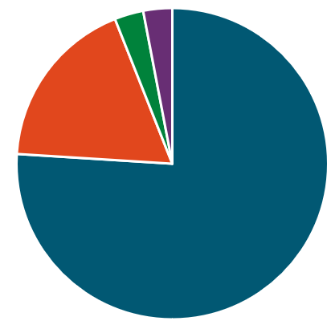
How Likely Is It That an Episodic Headache Is Migraine?
Prospective, open-label study of 1203 patients with primary/secondary concern of episodic headache
  >90% seen in primary care
Self-report or physician diagnosis of migraine almost always correct
Self-report or physician diagnosis of nonmigraine almost always later found to be migraine
Migraine should be the default diagnosis for recurrent and disruptive headache that is brought to the attention of a healthcare professional
Unclassifiable
3%
Episodic TTH
3%
Probable
migraine
18%
IHS-defined migraine
76%
Diagnosis
Tepper et al. Headache. 2004;44:856-864
Notes:
IHS, International Headache Society; TTH, tension-type headache.

Slide 9
Diagnostic Misconceptions
Image not available.
Image not available.
Tension-Type Headache
Bilateral pain
Squeezing/pressure sensation
(“band-like”)
Migraine
Unilateral pain
Throbbing in nature
Associated with nausea and vomiting and/or photophobia and phonophobia
Headache Classification Committee of the International Headache Society. Cephalalgia. 2018;38:1.
www.brgeneral.org/healthy-lifestyle-blog/2018/november/4-major-types-of-headaches-and-where-they-hurt/.

Slide 10
ICHD-3: Migraine vs Tension Headache
Migraine | Tension-Type Headache
<15 days/mo (episodic) Lasting from 4-72 hr |  | Lasting from 30 min to 7 days
≥2 of the following: Unilateral (59%) Pulsating (85%) Moderate to severe intensity Aggravated by routine physical activity |  | ≥2 of the following: Bilateral Pressing/tightening (nonpulsating) quality Mild to moderate intensity Not aggravated by routine physical activity
≥1 of the following: Nausea (73%) and/or vomiting (29%) Photophobia and phonophobia |  | No nausea or vomiting 1 or neither: photophobia or phonophobia
Headache Classification Committee of the International Headache Society. Cephalalgia. 2018;38:1.
practicalneurology.com/articles/2014-apr/the-clinical-features-of-migraine-with-and-without-aura.

Slide 11
ICHD-3: Migraine With or Without Aura
Without Aura | With Aura
B. Lasting from 4-72 hr | B. ≥1 fully reversible aura symptom(s) Visual, sensory, speech/language, motor, brainstem, retinal
C. ≥2 of the following: Unilateral Pulsating Moderate/severe intensity Aggravated by routine physical activity | C. ≥3 of the following: ≥1 aura symptom spreads over 5 min ≥2 aura symptoms occur in sequence Each aura symptom lasts 5-60 min ≥1 aura symptom is unilateral ≥1 aura symptom is positive Aura accompanied or followed by headache in ≤60 min
D. ≥1 of the following: Nausea/vomiting Photophobia and phonophobia
Headache Classification Committee of the International Headache Society. Cephalalgia. 2018;38:1.

Slide 12
ICHD-3: Chronic Migraine
Chronic
A. Occur ≥15 days/mo for >3 mo and fulfill criteria B and C for chronic migraine
B. ≥5 attacks fulfill B-D for migraine without aura and/or B-C for migraine with aura
C. Fulfill any of the following on ≥8 days/mo for >3 mo: C-D for migraine without aura B-C for migraine with aura Patient thinks it is migraine at onset and relieved by triptan or ergot derivative
D. Not better accounted for by another ICHD-3 diagnosis
Headache Classification Committee of the International Headache Society. Cephalalgia. 2018;38:1.

Slide 13

ID Migraine™: Simplified Diagnostic Criteria for Migraine
Symptoms in the last 3 mo:
Light sensitivity with headache
Nausea with headache
Decreased ability to function with headache
Any 2 of the 3 above symptoms = migraine

Slide 14
Phases of a Migraine Attack
Fatigue
Yawning
Mood changes
Neck stiffness
Difficulty concentrating
Food cravings
Frequent urination
Nausea
Photophobia
Phonophobia
Visual
Sensory
Speech
Throbbing
Nausea
Vomiting
Photophobia
Phonophobia
Fatigue
Difficulty concentrating
Neck stiffness
Mood changes
Pain/Severity
Premonitory
hrs to days
Aura
5-60 min
Headache
4-72 hr
Postdrome
24-48 hr
Time
americanmigrainefoundation.org/resource-library/timeline-migraine-attack/

Slide 15
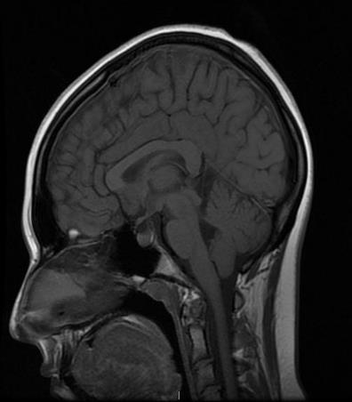





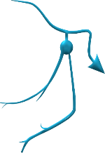

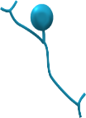
Migraine Pathophysiology
Pain perception
Cortex
Cortical spreading depolarization, altered connectivity
Migraine aura and cognitive symptoms
Thalamus
Sensitization of alteration of thalamocortical circuits
Sensory sensitivity and allodynia
Trigeminocervical Complex
Pain transmission or sensitization
Headache and neck pain
Hypothalamus
Activation in premonitory phase
Premonitory symptoms
Throbbing pain
Release of CGRP
Multiple potential sources or sites of action
Headache and other symptoms
Target for small-molecule antagonists and antibodies
Charles. Lancet Neurol. 2018;17:174.

Slide 16
Chronic Migraine: Prevalence
Worldwide prevalence: 0%-4.6%
  Most general populations reporting: 1%-2%
Prevalence increases throughout adolescence
Peaks in midlife
Declines after age 50 yr
Higher prevalence in women
Schwedt. BMJ. 2014;348:g1416. Burch et al. Neurol Clin. 2019;37:631. americanheadachesociety.org/news/migraine-evolves-age/. Mungoven et al.
Front Pain Res (Lausanne). 2021;2:705276. Stovner et al. J Headache Pain. 2021;23:34.

Slide 17
Migraine Chronification
2%-3% of patients with EM progress to CM annually
Risk factors for conversion to CM:
  Number of headache days at baseline
  First-degree relative with CM
  Ineffective acute treatment, medication overuse
  Obesity
  Snoring and sleep apnea
  Psychiatric comorbidities
  Stressful life events
  Temporomandibular joint disorders
  Head trauma
  Female gender
1-Yr Evolution of Disease in People
Diagnosed With Migraine
Bigal et al. Curr Neurol Neurosci Rep. 2011;11:139. Lipton et al. Neurology. 2019;93:e2224. Torres-Ferrús et al. J Headache Pain. 2020;21:42.
Notes:
CM, chronic migraine; EM, episodic migraine.

Slide 18
Modifiable Risk Factor: Medication Overuse
Most common cause of CM symptoms
  Worldwide prevalence of CM with medication overuse headache is 1%-2%
~50% of patients with CM have medication overuse headache that will revert to EM following drug withdrawal
  Can take several months
Higher risk: barbiturates, opioids
Lower risk: triptans, NSAIDs (in patients with 10-14 headache days/mo)
Schwedt et al. J Headache Pain. 2018;19:38. Headache Classification Committee of the International Headache Society. Cephalalgia. 2018;38:1. Vandenbussche et al. J Headache Pain. 2018;19:50.
Notes:
CM, chronic migraine; EM, episodic migraine; NSAID, nonsteroidal anti-inflammatory drug.

Slide 19
Chronic Migraine: A Fluid State
AMPP study: 383 people with CM at baseline
  33.9% had persistent CM at 2-yr follow-up
  26.1% reverted to EM at 2-yr follow-up
  40% fluctuated between EM and CM over study period
CaMEO study: 769 people with CM at baseline
  50.1% had persistent CM at 3-mo follow-up
  49.9% reverted to EM at 3-mo follow-up
  31% fluctuated between EM and CM over 15-mo period
Potential factors for reversion to EM
Adherence to migraine prophylaxis
Lower baseline headache frequency
Absence of cutaneous allodynia
Physical exercise
Cessation of overused migraine abortive agents
Manack et al. Neurology 2011;76:711. Scher et al. Neurology. 2017;89:461. Serrano et al. J Headache Pain. 2017;18:101.
Notes:
CM, chronic migraine; EM, episodic migraine.

Slide 20
Migraine Barriers to Care: CaMEO Study
27.6%
20.9%
Diagnosed accurately
12.5%
Treated appropriately (minimally appropriate acute/preventive treatment)
Consulted a healthcare professional
EM
n = 7930
40.8%
CM
n = 1254
13.4%
7.3%
Buse et al. Headache. 2021;61:628.
Notes:
CM, chronic migraine; EM, episodic migraine.

Slide 21
Migraine Treatments
Preventive
Acute
Pharmacologic
Nonpharmacologic

Slide 22
Principles of Acute Migraine Treatment
All patients with migraine need a strategy for acute treatment
Goal of treatment response
  Quick return to normal state and functionality
  (~ within 2 hr)
  Sustained pain freedom without recurrence (“one and done”)
  Optimal self-care, reduce need for medical resources
Avoid medication overuse
  Associated with transformation from EM to CM
  Limit acute medication use to 2 headache days/wk (avg) or 10 days/mo
Clinical pearls
  Ensure full/appropriate dose is being trialed
  Avoid opioid- and butalbital-containing medications
  Encourage use of headache diary
If treatment is ineffective
  Change formulation/route of administration
  Change drug
  Be sure there are no interfering medications or overuse
  Add adjunct
  Reconsider diagnosis
Ailani et al. Headache. 2021;61:1021. Becker. Continuum (Minneap Minn) 2015;21:953.

Slide 23
Acute Treatment Options
Triptans | Ergots | Nonspecific Treatments | Gepants | 5-HT_{1F} Receptor Agonist
Almotriptan Eletriptan Frovatriptan Naratriptan Rizatriptan Sumatriptan Sumatriptan + naproxen Zolmitriptan | Dihydroergotamine Ergotamine + caffeine | Antiemetics/neuroleptics Promethazine Prochlorperazine Metoclopramide Odansetron Diclofenac, ketorolac, other NSAIDs | Rimegepant Ubrogepant | Lasmiditan
Various routes of administration (oral, nasal spray, suppository, etc) and combinations are available
Notes:
NSAID, nonsteroidal anti-inflammatory drug.

Slide 24
Novel Therapeutic Target: CGRP
Calcitonin gene-related peptide
  37 amino acid neuropeptide
  Potent vasodilator and neuromodulator
  Found to be elevated during acute headache attacks
    Triptans can normalize these levels
  Chronically elevated in people with chronic migraine
  In migraine patients, administration of CGRP triggers an attack phenotypically similar to a spontaneous attack
    In nonmigraine patients, administration of CGRP triggers mild headache
Agents Targeting CGRP:
Gepants: CGRP receptor antagonists; small molecules that bind to the CGRP receptor, blocking the release of CGRP
CGRP monoclonal antibodies: large macromolecules that either bind to and deactivate CGRP ligand or CGRP receptor
Wattiez et al. Expert Opin Ther Targets. 2020;24:91. Russell et al. Physiol Rev. 2014;94:1099.
Cernuda-Morollón et al. Neurology. 2013;81:1191. Tepper. Headache. 2020;60:1037.
Notes:
CGRP, calcitonin gene-related peptide.

Slide 25
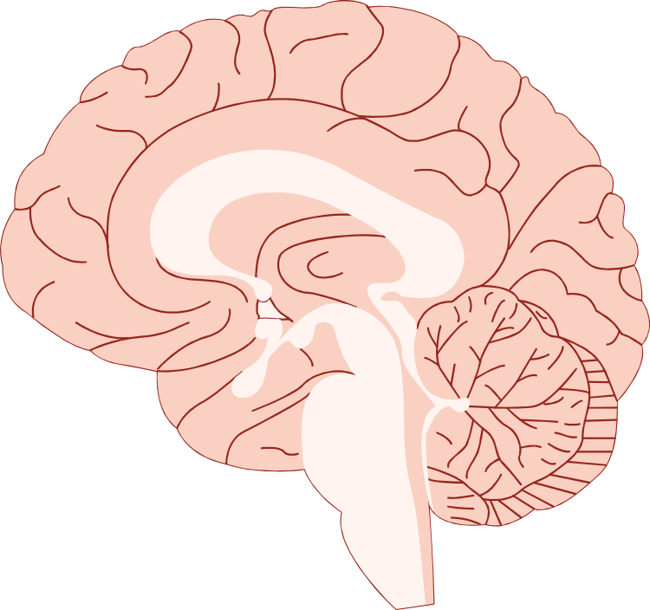
Where Is CGRP?
Widely distributed in the central and peripheral nervous system
Does not cross the blood–brain barrier
Select Sites of Action of CGRP in Migraine
Cortex
Trigeminal Nerve
Postjunction Cell
Pain
Thalamus
Synapse
Vesicle
CGRP
Dura
CGRP Receptor
Trigeminal Ganglion
Inhibition of Pain Transmission
Trigeminal Nucleus Caudalis
Normalization of Dilated Blood Vessels
Bell. J Med Chem. 2014;57:7838.
Notes:
CGRP, calcitonin gene-related peptide.

Slide 26
Gepants, CGRP Receptor Antagonists: How It All Started
Olcegepant (2000): IV infusion, first CGRP receptor antagonist to be studied as a migraine abortive
  Terminated migraine with similar speed as triptans in clinical trials
  Poor oral bioavailability
Telcagepant (2008): oral agent with efficacy and tolerability vs placebo in acute trials
  Also effective compared with rizatriptan and zolmitriptan
  Long-term prophylaxis studies found hepatotoxicity AEs
MK-3207: phase II studies found hepatotoxicity AEs (likely compound related, not mechanism based)
BI 44370 TA: efficacious in phase II studies, but halted due to commercial issues and AE profile
Diener. Lancet Neurol. 2014;13:1065. Recober et al. Idrugs. 2007;10:566. Yao et al. Neural Regen Res. 2013;8:938.
Notes:
AE, adverse event; CGRP, calcitonin gene-related peptide.

Slide 27
Gepants: Who Should Try Them?
New acute treatment for migraine
Patients who have failed treatment with/in whom the following agents are contraindicated:
  Triptans/DHE
    Risk for cardiovascular AEs/worsening of existing cardiovascular conditions
  Antiemetics
    Risk for sedation, drowsiness, dizziness
  NSAIDs
    Risk for GI side effects
Those with cardiovascular disease and/or who are at risk for MOH
Robbins. Pract Pain Manag. 2020;20. Tepper. Headache. 2020;60:1037.
Xanders et al. americanheadachesociety.org/wp-content/uploads/2021/01/AHS-First-Contact-Acute-Treatment-Options.pdf.
Notes:
AE, adverse event; DHE, dihydroergotamine; GI, gastrointestinal; MOH, medication overuse headache; NSAID, nonsteroidal anti-inflammatory drug.

Slide 28
Currently Available Gepants for Acute Treatment
 | Rimegepant | Ubrogepant
Dosing | 75 mg orally or sublingual, as needed Not to exceed 1 dose in 24 hr | 50 mg or 100 mg orally, as needed May take second dose ≥2 hr later Not to exceed 200 mg in 24 hr
Adverse events | Nausea | Nausea and somnolence
An NDA for intranasal zavegepant was accepted by the FDA in May 2022
Rimegepant PI. Ubrogepant PI. www.prnewswire.com/news-releases/us-fda-accepts-for-review-biohavens-new-drug-application-nda-filing-of-intranasal-zavegepant-for-the-acute-treatment-of-migraine-301552566.html.
Notes:
NDA, new drug application.

Slide 29
Migraine Prophylaxis
When to consider
  4+ migraine days/mo
  Debilitating symptoms, even if infrequent attacks
  Failure/overuse of acute therapies
    10+ days/mo acute therapy
    15+ days/mo NSAIDs/nonopioid analgesics/acetaminophen
  Patient preference
Goals are to reduce
  Number of migraine days (by 50%)
  Migraine duration, severity, disability
  Acute treatment use
Clinical pearls
  Distinguish between EM and CM
  Set realistic treatment expectations
  Adequate trial is 2+ mo at goal dose
  Start with lower dose, titrate slowly
Ailani et al. Headache. 2021;61:1021
Notes:
CM, chronic migraine; EM, episodic migraine; NSAID, nonsteroidal anti-inflammatory drug.

Slide 30
Lifestyle Modifications for Migraine Prevention
Encourage patients to maintain sleep/wake time, meal schedule, moderate aerobic exercise schedule
Supplement interventions
Magnesium (contraindicated in neuromuscular disease, renal impairment)
    May cause diarrhea
Riboflavin
    May cause urine discoloration
CoenzymeQ10 (contraindicated in biliary obstruction, hepatic insufficiency)
    May cause nausea, diarrhea
Melatonin
    May cause daytime sleepiness
Behavioral interventions
Relaxation training
Biofeedback combined with relaxation training
Electromyography biofeedback
Cognitive behavioral therapy
Combination treatment
americanheadachesociety.org/wp-content/uploads/2022/05/AHS-First-Contact-PreventativeTreatment.pdf. americanheadachesociety.org/news/incorporating-nutraceuticals-for-migraine-prevention/. americanheadachesociety.org/wp-content/uploads/2022/05/AHS-First-Contact-Behavioral-Treatment.pdf.

Slide 31
Pharmacologic Options for Migraine Prevention
Drug | Contraindications/Precautions | Comorbid Applications
Antiepileptics
Topiramate* | Renal impairment, metabolic acidosis, teratogenicity | Overweight or obesity
Divalproex sodium,* sodium valproate | Liver impairment, pancreatitis, teratogenicity
Antidepressants (TCAs, SNRIs)
amitriptyline, nortriptyline | Tachycardia, cardiac conduction abnormalities, suicidality | Depression, insomnia
venlafaxine | Suicidality, renal/hepatic impairment, uncontrolled hypertension | Depression, anxiety, hot flashes
Antihypertensives (β-blockers, ARBs)
Propranolol,* metoprolol,* timolol* | Bradycardia, asthma, hypotension, heart failure | Hypertension, essential tremor
Candesartan | Hyperkalemia | Hypertension
Neuromuscular blockers
OnabotulinumtoxinA* | Neuromuscular/neuromuscular junction disease | Chronic migraine
*FDA approved for migraine prophylaxis.
americanheadachesociety.org/wp-content/uploads/2022/05/AHS-First-Contact-PreventativeTreatment.pdf.
Notes:
ARB, angiotensin receptor blocker; SNRI, serotonin–norepinephrine reuptake inhibitor; TCA, tricyclic antidepressant.

Slide 32
Currently Available Gepants for Migraine Prevention
 | Rimegepant | Atogepant
Indication | EM prevention | EM prevention
Dosing | 75 mg orally every other day Not to exceed 75 mg in 24 hr Safety of >18 doses/mo not yet evaluated | 10 mg, 30 mg, or 60 mg orally daily
Adverse events | Nausea, abdominal pain/dyspepsia No clinical signs of hepatotoxicity No evidence of MOH | Nausea, fatigue, constipation No clinical signs of hepatotoxicity No evidence of MOH
Phase II/III studies ongoing to investigate oral zavegepant as migraine prevention
Rimegepant PI. Atogepant PI. De Vries et al. Expert Opin Pharmacother. 2021;22:973.
americanmigrainefoundation.org/resource-library/gepants-ditans-therapies/. NCT04804033.
Notes:
EM, episodic migraine; MOH, medication overuse headache.

Slide 33
CGRP Monoclonal Antibodies
Large macromolecules made of proteins
Mechanism of action
  Directly target the ligand (CGRP) (ie, they bind to and neutralize the excessive CGRP released at perivascular trigeminal sensory nerve fibers)
  OR target the CGRP receptor
Minimum (0.1%-0.5%) possibility of passing the blood–brain barrier
  Primary site of action: peripheral—in structures involved in migraine pathophysiology—including trigeminal ganglia
Albanese et al. J Clin Med. 2022;11:1228. Edvinsson et al. Cephalgia. 2019;39:366. Raffaelli et al. Neurotherapeutics. 2018;15:324.
33
Notes:
CGRP, calcitonin gene-related peptide.

Slide 34

Monoclonal Antibodies
Smooth muscle cell
Trigeminal nerve ending
mAb
Dura mater
Skull
CGRP
Cerebral blood vessels
CGRP
receptor
mAb
Subarachnoid space
Trigeminal nucleus caudalis
(within trigeminal cervical complex)
Dural blood vessel
Trigeminal nerves
Trigeminal ganglion
CGRP
mAb
mAb
Notes:
CGRP, calcitonin gene-related peptide; mAb, monoclonal antibody.

Slide 35
Currently Available CGRP Monoclonal Antibodies
 | Eptinezumab | Erenumab | Fremanezumab | Galcanezumab
Indication(s) | EM and CM prevention | EM and CM prevention | EM and CM prevention | EM and CM prevention, episodic cluster headache
Target | CGRP molecule | CGRP receptor | CGRP molecule | CGRP molecule
Dosing | Quarterly: 100 mg or 300 mg IV | Monthly: 70 mg or 140 mg SC | Monthly: 225 mg SC Quarterly: 675 mg SC | Monthly: 240 mg SC loading dose, then 120 mg/mo*
Adverse events | Nasopharyngitis, hypersensitivity reactions | Injection-site reactions, constipation, hypertension | Injection-site reactions | Injection-site reactions
Utility in patients who have trouble with medication adherence
Insurance coverage is variable and needs to be considered
Notes:
CGRP, calcitonin gene-related peptide; CM, chronic migraine; EM, episodic migraine.

Slide 36
Efficacy Data of CGRP mAbs From Phase III Trials
Eptinezumab:
EM
Eptinezumab:
CM
Erenumab:
EM
Erenumab:
CM
Fremanezumab
EM
Fremanezumab
CM
Galcanezumab:
EM
Galcanezumab:
CM
Reduction in Monthly Migraine Headache Days
All statistically significant;
not head-to-head
Holland et al. Neurology. 2018;91:e2211. Stauffer et al. JAMA Neurol. 2018;75:1080. Dodick et al. JAMA 2018;319:5. VanderPluym et al. Neurology. 2018;91:e1152. Goadsby et al. NEJM. 2017;377:2123. Lipton et al. Neurology. 2019;92:e2250. Ashina et al. Cephalalgia. 2020;40:241. Silberstein et al. NEJM. 2017;377:2113. Stauffer et al. JAMA Neurol. 2018;75:1080. Sklijarveski et al. Cephalagia 2018;38:1442.
Notes:
CGRP, calcitonin gene-related peptide; CM, chronic migraine; EM, episodic migraine; mAb, monoclonal antibody.

Slide 37
Case Example: Incorporating CGRP Into Clinical Practice
Patient Profile:
44-yr-old woman with a history of EM since age 13 transformed to CM at age 40
Currently having 21 headache days/mo, of those 16 are MHDs
Feeling debilitated by her headaches, missing several days of work per mo, finding it difficult to care for her daughter and help with her daughter’s school activities
Having difficulty both falling and staying asleep
Previous treatment and outcomes:
Has tried and failed topiramate and propranolol
On nortriptyline 40 mg for the last 6 mo with a slight improvement in headache frequency, down to 15 headache days per mo with 8 MHDs and significant improvement in sleep; however, she was still underperforming at work and feeling disabled half the days of
the mo
She has tried NSAIDs, sumatriptan, zolmitriptan in the past and is currently using rizatriptan 15 days per mo, although with little benefit
Notes:
CGRP, calcitonin gene-related peptide; CM, chronic migraine; EM, episodic migraine; MHD, migraine headache day; NSAID, nonsteroidal anti-inflammatory drug.

Slide 38
Case Example (cont’d):
Incorporating CGRP Into Clinical Practice
Clinical diagnosis: CM and MOH
Preventive treatment strategy:
  Start CGRP mAb: galcanezumab, 240 mg loading dose, followed by 120 mg monthly SC autoinjector
  Continue nortriptyline nightly
  Incorporate daily aerobic exercise, meal, and sleep schedule
Acute treatment strategy:
  Start rimegepant 75 mg as needed for migraine
  Reduce use of rizatriptan to no more than 10 days per mo, can add or substitute for rimegepant
Notes:
CGRP, calcitonin gene-related peptide; CM, chronic migraine; mAb, monoclonal antibody; MOH, medication overuse headache.

Slide 39
Case Conclusion:
Incorporating CGRP Into Clinical Practice
4-mo follow-up:
  Headache days reduced to 4 days/mo
  Headaches are mild to moderate and relieved by rimegepant within 2 hr
  Felt like she had her life back and was back to her regular routine
  Plan to follow up in another 6-8 mo, and if sustained improvement, consider taking a break from CGRP mAb and maintaining prevention through lifestyle modifications
Notes:
CGRP, calcitonin gene-related peptide; mAb, monoclonal antibody.

Slide 40
Key Summary Points
Migraine is common and should be default diagnosis for any recurrent, disabling headache
CGRP is thought to play an important role in migraine pathophysiology
CGRP antagonists (gepants) can be used for acute treatment of migraine and prevention of EM
CGRP mAbs can be used for the prevention of EM and CM
Notes:
CGRP, calcitonin gene-related peptide; CM, chronic migraine; EM, episodic migraine; mAb, monoclonal antibody.

Slide 41
Go Online for More CCO
Neurology Coverage!
Downloadable slides from this meeting
Additional educational activities on neurologic and psychiatric topics from expert faculty
www.clinicaloptions.com/neurology-psychiatry
clinicaloptions.com

