Slide 1
Achieving “Progress” in Progressive
Multiple Sclerosis: Advances in Therapy
Daniel Kantor, MD, FAAN
Florida Society of Neurology
Florida Atlantic University
Nova Southeastern University
Florida
Supported by an educational grant from Sanofi Genzyme.

Slide 2

About These Slides
Please feel free to use, update, and share some or all of these slides in your noncommercial presentations to colleagues or patients
When using our slides, please retain the source attribution:
These slides may not be published, posted online, or used in commercial presentations without permission. Please contact permissions@clinicaloptions.com for details
Slide credit: clinicaloptions.com
Notes:
Disclaimer: The materials published on the Clinical Care Options Web site reflect the views of the authors of the CCO material, not those of Clinical Care Options, LLC, the CME providers, or the companies providing educational grants. The materials may discuss uses and dosages for therapeutic products that have not been approved by the United States Food and Drug Administration. A qualified healthcare professional should be consulted before using any therapeutic product discussed. Readers should verify all information and data before treating patients or using any therapies described in these materials.

Slide 3
Faculty
Daniel Kantor, MD, FAAN
President Emeritus
Florida Society of Neurology
Notes:
This slide lists the faculty who were involved in the production of these slides.

Slide 4
Disclosures
The faculty reported the following relevant financial relationships or relationships to products or devices they have with ineligible companies related to the content of this educational activity:
Daniel Kantor, MD, FAAN, has disclosed that he has received consulting fees from Bristol Myers Squibb, Janssen Pharmaceuticals, and Sandoz, and fees for non-CME services from Bristol Myers Squibb and Janssen Pharmaceuticals.
Notes:
This slide lists the disclosure information of the faculty and staff involved in the development of these slides.

Slide 5

Patient’s Examination
The best teaching is that taught
by the patient himself
– Sir William Osler 1903
Slide credit: clinicaloptions.com

Slide 6
M*STAR
Person
With MS
M ultiple
*
S clerosis
T eam
A pproach
R ule
Slide credit: clinicaloptions.com
Notes:
PwMS, persons with multiple sclerosis.

Slide 7

MS Team
Job
PCP
PT/OT
Friends/Community
Person
With MS
MS Nurse
Case Manager
Significant Other
Neurologist,
Nurse Practitioner,
PA
Family
MS Community
Slide credit: clinicaloptions.com
Notes:
MS, multiple sclerosis; OT, occupational therapy; PCP, primary care provider; PT, physical therapy; PA, physician assistant.

Slide 8
What Is MS?
Lifetime autoimmune diagnosis
Central nervous system
  Spinal cord > optic nerve > brain stem
Demyelination and axonal loss
Genetically susceptible individual exposed to environmental trigger(s)
McGinley. JAMA. 2021;325:765.
Slide credit: clinicaloptions.com
Notes:
MS, multiple sclerosis.

Slide 9
Updates in MS Epidemiology
MS prevalence is higher than previously reported in many world regions; lower mortality is in part driving this trend
Geographic gradients for MS risk persist
Use of algorithms with large population datasets will provide a basis for efficient morbidity and mortality surveillance in the future
Modifiable risk factor for MS onset should be targeted for MS prevention: smoking, obesity, sunlight exposure
Use of large diverse cohorts of MS cases and controls with appropriate technology should be used to understand risk factors that trigger and perpetuate MS
Walton. Mult Scler. 2020;26:1816. Simpon. J Neurol Neurosurg Psychiatry. 2011;82:1132. McGinley. JAMA. 2021;325:765.
Slide credit: clinicaloptions.com
Notes:
MS, multiple sclerosis.

Slide 10
Different Types of MS
Relapsing
  Most of what is focused on in past research
Progressive
  Becoming more important to address
Slide credit: clinicaloptions.com
Notes:
MS, multiple sclerosis.

Slide 11
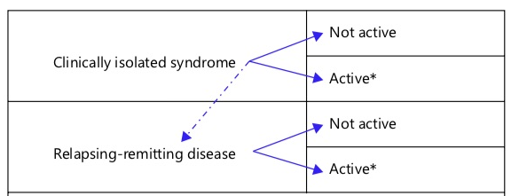
Relapsing MS
Clinically isolated syndrome | Not active
 | Active
Relapsing-remitting disease | Not active
 | Active
Activity = clinical relapses and/or MRI (gadolinium-enhancing MRI lesions; new/enlarging T2 lesions).
Lublin. Eur Neurol. 2014;72(suppl. 1):1.
Slide credit: clinicaloptions.com
Notes:
MS, multiple sclerosis.

Slide 12
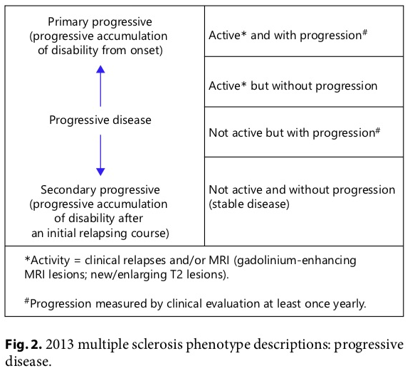
Progressive MS
Primary progressive MS (progressive accumulation of disability from onset) Progressive disease Secondary progressive MS (progressive accumulation of disability after an initial relapsing course) | Active* and with progression†
 | Active* but without progression
 | Not active but with progression†
 | Not active and without progression (stable disease)
*Activity = clinical relapses and/or MRI (gadolinium-enhancing MRI lesions; new/enlarging T2 lesions).
†Progression measured by clinical evaluation at least once yearly.
Lublin. Eur Neurol. 2014;72(suppl. 1):1.
Slide credit: clinicaloptions.com
Notes:
MS, multiple sclerosis.

Slide 13



RRMS
SPMS
PPMS
Lublin. Neurology. 2014;83:278.
Slide credit: clinicaloptions.com
Notes:
PPMS, primary progressive multiple sclerosis; RRMS, relapsing-remitting multiple sclerosis; SPMS, secondary progressive multiple sclerosis.

Slide 14
RRMS
SPMS
PPMS
Lublin. Neurology. 2014;83:278.
Slide credit: clinicaloptions.com
Notes:
PPMS, primary progressive multiple sclerosis; RRMS, relapsing-remitting multiple sclerosis; SPMS, secondary progressive multiple sclerosis.

Slide 15
RRMS
SPMS
PPMS
Lublin. Neurology. 2014;83:278.
Slide credit: clinicaloptions.com
Notes:
PPMS, primary progressive multiple sclerosis; RRMS, relapsing-remitting multiple sclerosis; SPMS, secondary progressive multiple sclerosis.

Slide 16
MS Symptoms
N = 1702
Symptoms, % (N = 1702)¹ | Initial
Sensory in limbs | 31
Visual loss | 16
Motor (subacute) | 9
Diplopia | 7
Gait disturbance | 5
Motor (acute) | 4
Sensory in face | 3
Balance problems | 3
Vertigo | 2
Lhermitte's sign | 2
Bladder problems | 1
Multiple | 14
Symptoms, % (N = 301)² | Initial | Ever
Sensory | 34 | 87
Weakness | 22 | 89
Visual | 13 | 49
Ataxia | 11 | 82
Diplopia | 8 | 51
Vertigo | 4 | 36
Fatigue | 2 | 57
Facial pain | 2 | 35
Headache | 2 | 30
Bladder | 1 | 71
Facial weakness | 1 | 16
1. Olek. J Am Osteopath Assoc. 1999;99:574. 2. Swingler. Q J Med. 1992;83:325.
Slide credit: clinicaloptions.com
Notes:
MS, multiple sclerosis.

Slide 17
Progression in MS
RRMS: accumulate disability from relapses
SPMS
  Active
    Relapses
    MRI changes
  Non-active
PPMS
  With relapses
  Without relapses
Lublin. Neurology. 2014;83:278.
Slide credit: clinicaloptions.com
Notes:
PPMS, primary progressive multiple sclerosis; RRMS, relapsing-remitting multiple sclerosis; SPMS, secondary progressive multiple sclerosis.

Slide 18
Burden of Progressive MS
Symptoms
  Cost of symptomatic therapy
  Absenteeism/presenteeism
  Caregiver/partner lost productivity
Disability
  Work accommodations
  No longer working
Mental health
  Strain on relationships/divorce
  Depression
Salter. J Med Econ. 2017;20:493. Landfeldt. Mult Scler Relat Disord. 2018;24:145. Biernacki. Brain Behav. 2019;9:e01466.
Slide credit: clinicaloptions.com
Notes:
MS, multiple sclerosis.

Slide 19
FDA-Approved
Disease-Modifying Therapies for MS
Notes:
MS, multiple sclerosis.

Slide 20
1992
Slide credit: clinicaloptions.com

Slide 21
2021: 1/2
Name | Dose | Route | Frequency
Interferon β-1a | 30 mcg | IM | Weekly
Interferon β-1a | 44 mcg | SC | 3 times per wk
Pegylated β-interferon 1a | 125 mcg | SC | Every 2 wk
Interferon β-1b | 250 mcg | SC | Every other day
Glatiramer acetate* | 20 or 40 mg | SC | Daily or 3 times per wk
Natalizumab | 300 mg | IV | Monthly
Fingolimod | 0.25† or 0.5 mg | Oral | Daily
Teriflunomide | 7 or 14 mg | Oral | Daily
Dimethyl fumarate | 240 mg | Oral | Twice daily
Alemtuzumab | 12 mg | IV | Yr 1: 5 days; Yr 2: 3 days
Ocrelizumab | 600 mg | IV | Twice yearly
*Generic available. †Pediatric dose.
Lublin. Neurology. 2014;83:278. β-interferon 1a IM PI. β-interferon 1a SC PI. Pegylated β-interferon 1a PI. Natalizumab PI.
β-interferon 1b PI. Glatiramer Acetate PI. Fingolimod PI. Teriflunomide PI. Dimethyl Fumarate PI. Alemtuzumab PI. Ocrelizumab PI.
Slide credit: clinicaloptions.com
Notes:
IM, intramuscular; SC, subcutaneous; IV, intravenous

Slide 22
2021: 2/2
Name | Dose | Route | Frequency
Siponimod | 4 x 0.25 or 2 mg | Oral | Daily
Cladribine | 10 mg | Oral | 8-20 times per yr x 2 yr
Diroximel fumarate | 2 x 231 mg | Oral | Twice daily
Ozanimod | 0.92 mg | Oral | Daily
Monomethyl fumarate | 2 x 95 mg | Oral | Twice daily
Ponesimod | 20 mg | Oral | Daily
Ofatumumab | 20 mg | SC | Monthly
Mitoxantrone* | Variable | IV | Variable
*Generic.
Lublin. Neurology. 2014;83:278. Siponimod PI. Cladribine PI. Diroximel fumarate PI.
Ozanimod PI. Monomethyl fumarate PI. Ponesimod PI. Ofatumumab PI. Mitoxantrone PI.
Slide credit: clinicaloptions.com
Notes:
SC, subcutaneous; IV, intravenous

Slide 23
Intersecting Spheres of Treatment
Self-injectable
Intravenous
Monoclonal
Antibodies
Oral
Alemtuzumab
Interferon-β
Fumarate
IM
SC
1a
Peg
1a
Glatiramer
Acetate
Dimethyl
Diroximel
Natalizumab
Ocrelizumab
1b
Monomethyl
Fingolimod
Teriflunomide
Siponimod
Mitoxantrone
Ofatumumab
Ponesimod
S1P Modulators
Immunosuppressant
Ozanimod
Cladribine
McGinley. JAMA. 2021;325:765.
Slide credit: clinicaloptions.com

Slide 24
Existing and Emerging MS Therapies
Biotin
Siponimod
Ofatumumab
Laquinimod
Ocrelizumab
Daclizumab
Dalfampridine SR
Masitinib
SC IFNβ-1b
Natalizumab
Dextromethorphan + Quinidine
Alemtuzumab
IM IFNβ-1a
SC IFNβ-1b
Pegylated IFNβ-1a
Cladribine*
Glatiramer acetate
GA 3 times weekly
Fingolimod
Mitoxantrone
Teriflunomide
SC IFNβ-1a
Dimethyl fumarate
(BG-12)
1995
2000
2005
2009
2010
2011
2012
2013
2014
Approval date
Approved Therapies
Phase III Completed
In Phase III
*In March 2011, the FDA did not approve cladribine and requested that the manufacturer provide an improved understanding of its safety risks and overall benefit/risk profile.
Slide credit: clinicaloptions.com
Notes:
24
GA, glatiramer acetate; IFN, interferon; MS, multiple sclerosis; SR, sustained release.

Slide 25
Proactive Medications
Goal of MS disease-modifying therapies (DMAs, DMDs) are to prevent:
  Relapses
  Progression of physical disability
No diet has been proven to do this
No supplement or vitamin has been proven to do this
McGinley. JAMA. 2021;325:765.
Slide credit: clinicaloptions.com
Notes:
DMA, disease-modifying agent; DMD, disease-modifying agent; MS, multiple sclerosis.

Slide 26
How Do They Work?
We do not fully understand how MS DMTs work
But we can classify them as:
  Immunomodulators
    (changing how the immune system works)
  Keeping immune cells away from CNS
  Immunosuppressants
  Resetting the immune system
McGinley. JAMA. 2021;325:765.
Slide credit: clinicaloptions.com
Notes:
CNS, central nervous system; DMT, disease-modifying therapy; MS, multiple sclerosis.

Slide 27
So, How Do They Work in Progressive MS?
We do not fully understand how MS DMTs work
Possible mechanisms
  Remyelination
    Myelin scaffolding for axonal repair
  Axonal repair
  Energy metabolism
  Neuroprotection
Ciotti. Curr Treat Options Neurol. 2018;20:12. Heidker. Neural Regen Res. 2017;12:1262.
Slide credit: clinicaloptions.com
Notes:
DMT, disease-modifying therapy; MS, multiple sclerosis.

Slide 28
What Do We Know About Efficacy?
Compared with:
Placebo
  Interferons
  Glatiramer acetate
  Natalizumab
  Fingolimod
  Teriflunomide
  Dimethyl fumarate
  Siponimod
  Cladribine
  Mitoxantrone
Interferon-β1a IM
  Fingolimod
  Ozanimod
Interferon-β1a SC
  Alemtuzumab
  Ocrelizumab
Teriflunomide PO
  Ofatumumab
  Ponesimod
β-interferon 1a IM PI. β-interferon 1a SC PI. Pegylated β-interferon 1a PI. Glatiramer acetate PI. Natalizumab PI.
Fingolimod PI. Teriflunomide PI. Dimethyl fumarate PI. Siponimod PI. Cladribine PI. Mitoxantrone PI. Ozanimod PI.
Ofatumumab PI. Ponesimod PI. Alemtuzumab PI. Ocrelizumab PI.
Slide credit: clinicaloptions.com

Slide 29
FDA Approval
Relapsing forms of MS
  Clinically isolated syndrome
  RRMS
  Active SPMS
PPMS
Mitoxantrone
  Secondary (chronic) progressive
  Progressive relapsing
  Worsening RRMS
Mitoxantrone PI.
Slide credit: clinicaloptions.com
Notes:
PPMS, primary progressive multiple sclerosis; RRMS, relapsing-remitting multiple sclerosis; SPMS, secondary progressive multiple sclerosis.

Slide 30
PPMS Efficacy
Ocrelizumab vs placebo (24% relative risk reduction)
3-mo confirmed disability progression:
T25FW: 59% vs. 49% of people had a 20% decline
39.3%
32.9%
96/244
160/487
% People With Disability Progression
Placebo
Ocrelizumab
Montalban. NEJM. 2017;376:209. Ocrelizumab PI.
Slide credit: clinicaloptions.com
Notes:
PPMS, primary progressive multiple sclerosis; T25FW, timed 25-foot walk.

Slide 31
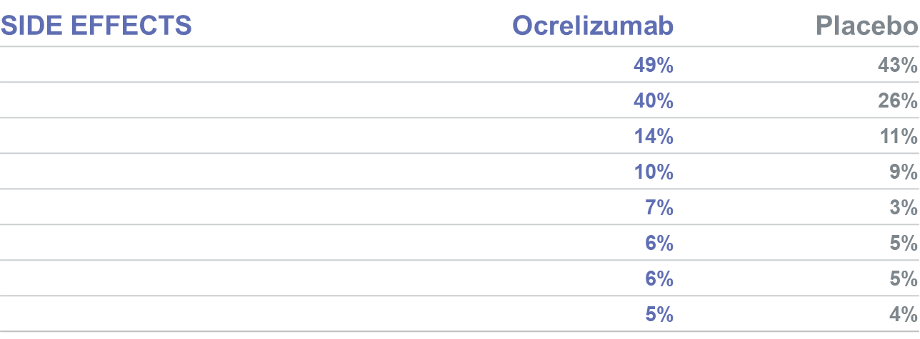
PPMS Safety
Most common adverse events (≥ 5% and more than placebo)
Adverse Events
Ocrelizumab
Placebo
Ocrelizumab PI.
Slide credit: clinicaloptions.com
Notes:
PPMS, primary progressive multiple sclerosis

Slide 32
SPMS Efficacy
Siponimod vs placebo (21% relative risk reduction)
3-month confirmed disability progression:
32%
^{26%}
173/545
288/1096
% People With Disability Progression
Placebo
Siponimod
Kappos. Lancet. 2018;391:1263.
Slide credit: clinicaloptions.com
Notes:
SPMS, secondary progressive multiple sclerosis.

Slide 33
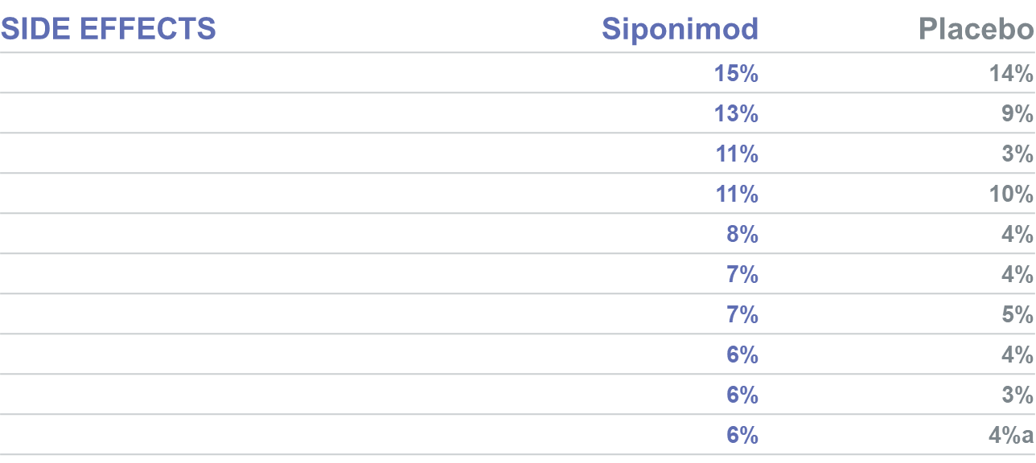
SPMS Safety
Most common adverse events (≥5% and more than placebo)
Adverse Events
Siponimod
Placebo
4%
Siponimod PI.
Slide credit: clinicaloptions.com
Notes:
SPMS, secondary progressive multiple sclerosis.

Slide 34
2 Sides to Every Story
Patients understand common MS terms, use them often, and find them useful. Terms were usually first heard by patients at diagnosis and in patient information
  Patients often undertake their own research on more complex aspects of MS
Familiarity with terms for scales, biomarkers, and tests was more variable and more dependent on individual treatment pathways and participation in clinical trials
MS terms have an emotional impact on patients: This should inform HCPs’ approach to discussions with their patients and development of new terminology
Including detailed definitions of MS clinical terms in active conversations with patients, especially those related to disease progression, would ensure that patients have the best tools to help understand their disease trajectory and MS management
Burtchell. Neurol Ther. 2019;8:185.
Slide credit: clinicaloptions.com
Notes:
HCP, health care professional; MS, multiple sclerosis.

Slide 35
Future
Other B-cell monoclonal antibodies
Ibudilast
Masitinib
BTK inhibitors
  Evobrutinib
  Fenebrutinib
  Tolebrutinib
Allogeneic EBV T-cell therapy ATA188
Gold nanocrystal suspension, CNM Au8
Stem cells
Piehl F. J Intern Med. 2021;289:771-791. Shirani. Neurotherapeutics. 2016;13:58.
Slide credit: clinicaloptions.com
Notes:
BTK, Bruton’s tyrosine kinase; EBV, Epstein-Barr virus.

Slide 36
Things to Fix
(If Needed)‏
Visible | Invisible | Private
Gait | Fatigue | Urination
Balance/coordination | Vertigo | Bowel
Weakness | Pain/tingling | Sex
Tremors | Visual | Sleep
Spasticity | Spasms
Affect | Depression
Speech/cognitive difficulties | Cognition
McGinley. JAMA. 2021;325:765.
Slide credit: clinicaloptions.com

Slide 37
Multimodal Approach to Managing MS Symptoms
Communication
Education
Physical modalities and activities
Occupational and other therapies
Pharmacological interventions
Understanding factors that can affect symptoms
Crayton. Neurology. 2004;63(suppl 5):S12.
Slide credit: clinicaloptions.com
Notes:
MS, multiple sclerosis.

Slide 38
Patient Voice
Education
Support groups
  In person
  Online
Not for profits
Slide credit: clinicaloptions.com

Slide 39
Not for Profits
National Multiple Sclerosis Society (NMSS)
Multiple Sclerosis Association of America (MSAA)
Multiple Sclerosis Foundation (MS Focus)
Multiple Sclerosis Coalition
Multiple Sclerosis Insight
Slide credit: clinicaloptions.com

Slide 40
Go Online for More CCO
Coverage of Multiple Sclerosis!
Interactive Medical Minute video of all the key data with expert faculty commentary and a patient’s perspective
Additional CME/CE-certified slideset on Progressive MS with expert faculty commentary on all the key studies
clinicaloptions.com/neurology-psychiatry

