Slide 1
Optimizing Outcomes for
Patients With Relapsed Metastatic Cervical Cancer
Supported by educational grants from Genmab and Seagen Inc.

Slide 2

About These Slides
Please feel free to use and share some or all of these slides in your noncommercial presentations to colleagues or patients
When using our slides, please retain the source attribution:
These slides may not be published, posted online, or used in commercial presentations without permission. Please contact permissions@clinicaloptions.com for details
Slide credit: clinicaloptions.com
Notes:
Disclaimer: The materials published on the Clinical Care Options Web site reflect the views of the authors of the CCO material, not those of Clinical Care Options, LLC, the CME providers, or the companies providing educational grants. The materials may discuss uses and dosages for therapeutic products that have not been approved by the United States Food and Drug Administration. A qualified healthcare professional should be consulted before using any therapeutic product discussed. Readers should verify all information and data before treating patients or using any therapies described in these materials.

Slide 3
Program Faculty
Linda Duska, MD, MPH
Professor
Division of Gynecologic Oncology
Department of Obstetrics and Gynecology
University of Virginia School of Medicine
Charlottesville, Virginia
Ritu Salani, MD, MBA
Professor and Division Director
Division of Gynecologic Oncology
Department of Obstetrics and Gynecology
University of California, Los Angeles
Los Angeles, California
Shannon N. Westin, MD, MPH
Associate Professor
Division of Surgery
Department of Gynecologic Oncology and Reproductive Medicine
University of Texas MD Anderson Cancer Center
Houston, Texas

Slide 4
Faculty Disclosures
The faculty reported the following relevant financial relationships or relationships to products or devices they have with ineligible companies related to the content of this educational activity:
Linda R. Duska, MD, MPH: research support paid to institution: Advaxis, Arch Therapeutics, Eisai, Genentech, GlaxoSmithKline, ImmunoGen, K-Group Beta, Leap Therapeutics, Lycera, Merck, Mersana Therapeutics, Morab, OncoQuest, Pfizer, Plexxikon, Seagen, Syndax, Tesaro; data safety monitoring board: Inovio Pharmaceuticals; scientific advisory board: Regeneron
Ritu Salani, MD, MBA: consultant/advisor/speaker: Arcus, Genentech, GlaxoSmithKline, Instil Bio, Merck, Regeneron, Seagen.
Shannon N. Westin, MD, MPH: research support: AstraZeneca, Bayer, Clovis Oncology, Cotinga, GlaxoSmithKline, Mereo, Novartis, OncXerna, Roche/Genentech, Zentalis; consultant: Agenus, AstraZeneca, Caris, Clovis Oncology, Eisai, EQRX, GlaxoSmithKline, ImmunoGen, Karyopharm, Lilly, Merck, Mereo, Mersana, Roche/ Genentech, Vincerx, Zentalis.
Notes:
This slide lists the disclosure information of the faculty and staff involved in the development of these slides.

Slide 5
Agenda
Cervix Cancer Overview
  HPV infection and tumorigenesis
  HPV vaccination and preventative measures
Current Treatments Algorithms for Advanced/Metastatic Cervix Cancer
  Novel therapies in development: case-based discussion of current data
    Immunotherapy
    Antibody–drug conjugates
    Combination strategies
Audience Questions and Answer Session

Slide 6
Cervix Cancer Overview

Slide 7
Cervical Cancer: Overview
Third most common gynecologic cancer in the United States
Fourth most common cause of all cancers in women globally
570,000 cases and 311,000 deaths annually (2018)
Corresponds to 900 deaths/day worldwide
>90% caused by human papillomavirus
Nearly 100% preventable
  HPV vaccination is key
  Screening and treatment of preinvasive lesions
Sellors. IARC 2003. ISBN-13. Siegel. CA Cancer J Clin. 2021;71:7. who.int/health-topics/cervical-cancer
Slide credit: clinicaloptions.com

Slide 8
Cancer of the Cervix: Tumorigenesis and Prevention
Risk Factors for Developing Cervical Cancer
Primary risk factor: HPV infection
(>150 related viruses)
  Infection can occur on skin surface and tissue lining the genitals, anus, mouth, and throat
  Can spread during skin-to-skin contact
  Some HPV viruses can cause warts on hands and feet, and others affect the lips or tongue
HPV infection is common, and in most people, the body can clear the infection by itself
Other risk factors: unprotected sex, smoking, weakened immune system
Cervical Cancer Is Almost Exclusively HPV Related
Nearly 100% preventable
HPV can infect epithelial cells in the cervix mucosa
~90% of HPV-infected areas recover within 2 yr
Over 10-30 yr, HPV DNA can integrate into epithelial cells
Potential for invasive cancerous cell in 0.8% of cases
cancer.org/cancer/cervical-cancer/causes-risks-prevention/risk-factors. Sellors. IARC 2003. ISBN-13.
Siegel. CA Cancer J Clin. 2021;71:7. who.int/health-topics/cervical-cancer. Stark. Acta Facultatis Medicae Naissensis. 2018;35:5.
Slide credit: clinicaloptions.com
Notes:
HPV, human papilloma virus.

Slide 9
Cervical Cancer: Challenges
12
Rate of new cases
10
Death rate
8
Rate per 100,000 Persons
6
4
2
0
2000
2004
2008
2012
2016
2019
1992
1996
Yr
Steady but disproportionate decline in both the incidence and death rates
in cervical cancer reflect lack of effective salvage treatments for those with recurrent disease
seer.cancer.gov/statfacts/html/cervix.html
Slide credit: clinicaloptions.com

Slide 10
Cervical Cancer: Incidence per 100,000 Women by State
Southern states have a disproportionately high incidence of cervical cancer
  West Virginia: 11.6
  Kentucky: 10.9
  Alabama: 9.6
  Louisiana: 9.6
  Mississippi: 9.3
4.5-5.3
7.0-8.1
N/A
5.6-6.9
8.2-11.6
kff.org/other/state-indicator/cervical-cancer-rate-by-re
Slide credit: clinicaloptions.com
Notes:
N/A, not available.

Slide 11
Low Rates of Vaccination May Contribute to High Incidence Rates of Cervical Cancer
Adolescents Who Are Up to Date on HPV Vaccinations (%)
≤39%
40% to 49%
50% to 59%
≥60%
cdc.gov/hpv
Slide credit: clinicaloptions.com
Notes:
HPV, human papillomavirus.

Slide 12
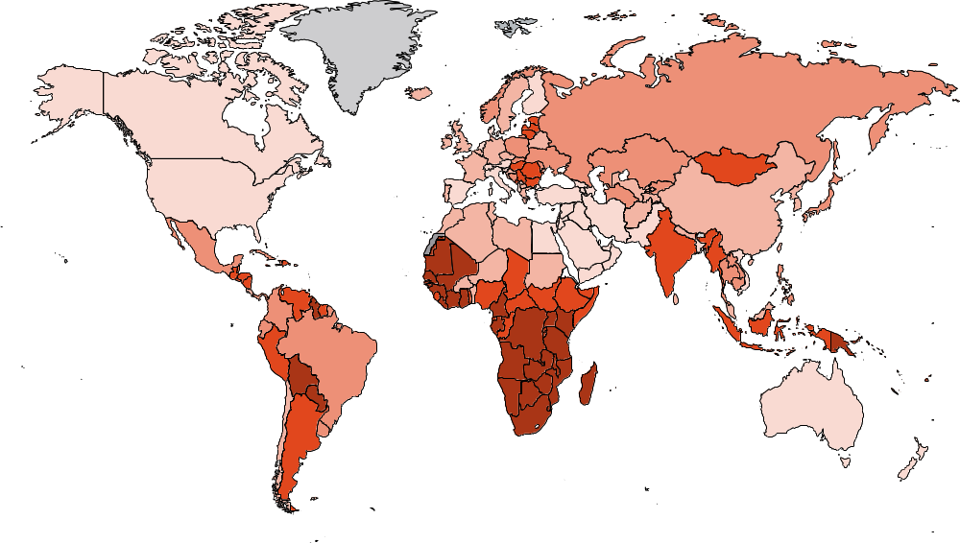
Global Incidence Rates of Cervical Cancer
ASR (World) per 100,000
≥25.2
16.7-25.2
11.7-16.7
7.0-11.7
<7.0
Not applicable
No data
gco.iarc.fr/today/online-analysis-map
Slide credit: clinicaloptions.com
Notes:
HPV, human papillomavirus.

Slide 13
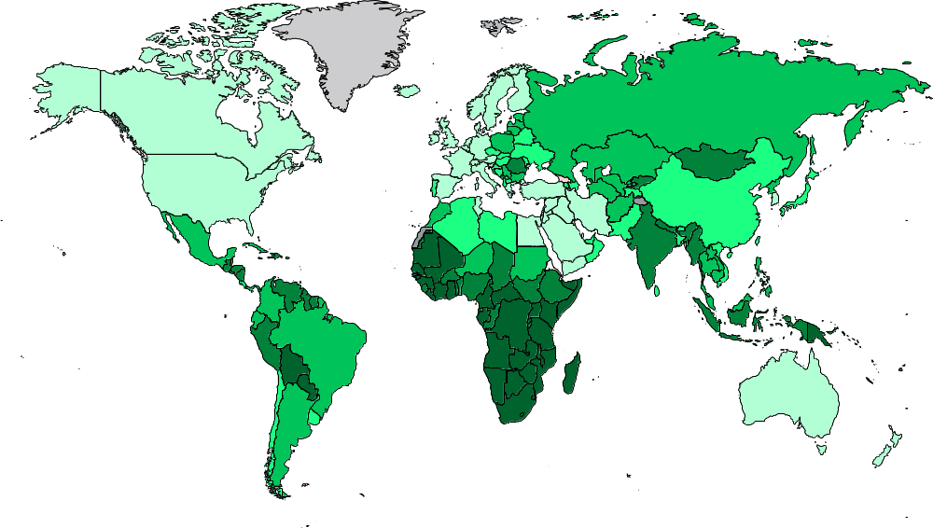
Global Mortality Rates of Cervical Cancer
ASR (World) per 100,000
≥16.4
9.0-16.4
5.7-9.0
2.8-5.7
<2.8
Not applicable
No data
gco.iarc.fr/today/online-analysis-map
Slide credit: clinicaloptions.com
Notes:
HPV, human papillomavirus.

Slide 14
Cervical Cancer: US Incidence and Mortality Rates by Race
Black and Hispanic/Latinx patients have a higher incidence of cervical cancer and worse mortality than White patients
Rate per 100,000 Women
*Based on data recorded in 2017. †Based on data recorded in 2019.
†Reflects death rates for American Indian/Alaska Native and Asian/Pacific Islander populations.
kff.org
Slide credit: clinicaloptions.com

Slide 15
Current Treatments Algorithms for Advanced/Metastatic Cervix Cancer

Slide 16
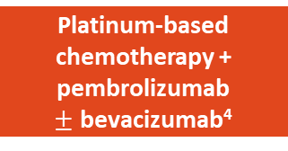
Cervical Cancer: Summary of Available Treatment Options
Initial diagnosis¹
Colposcopy/biopsy
Cervical dysplasia²
Early disease
Locally advanced disease
36%^{1,3}
Metastatic disease
16%^{1,3}
44%^{1,3}
CIN 2/3
FIGO I_{A1}
FIGO I_{A2}
FIGO I_{B2} + II_{A}
FIGO I_{B3} /
II_{B}/III_{B}
FIGO IV_{A}
FIGO IV_{B}
Cone biopsy
Cryotherapy
Laser therapy
LEEP
Surgery followed by
adjuvant treatment depending
on risk factors
Chemoradiotherapy (preferred)
Surgery if feasible
Platinum-based chemotherapy + pembrolizumab
$±$ bevacizumab⁴
1L
Pembrolizumab (PD-L1+/ MSI-H/dMMR/TMB-H), larotrectinib for NTRK gene fusion, bevacizumab, or single-agent chemotherapy
Tisotumab vedotin⁵
2L+
NCCN. Clinical practice guidelines in oncology: cervical cancer. v.1.2022. nccn.org.
2. cancer.gov/publications/dictionaries/cancer-terms/def/cin-2-3
3. SEER Cancer Stat Facts: Cervical Cancer. National Cancer Institute. Bethesda, MD.
4. Pembrolizumab PI.
2. Tisotumab vedotin PI.
Slide credit: clinicaloptions.com
Notes:
1L, first line; 2L, second line; CIN, cervical intraepithelial neoplasia; CPS, combined positive score; CT, chemotherapy; dMMR, mismatch repair deficient; FIGO, International Federation of Gynaecology and Obstetrics; LEEP, loop electrosurgical excision procedure; MSI-H: microsatellite instability high; TMB-H, tumor mutational burden high.

Slide 17
GOG 240: Paclitaxel + Cisplatin or Topotecan ± Bevacizumab in Recurrent/Persistent Cervical Cancer
Randomized, open-label phase III study
Paclitaxel 135 or 175 mg/m² IV + Cisplatin 50 mg/m² IV +
Bevacizumab 15 mg/kg IV
Women with primary stage IVB recurrent/persistent cervical cancer and no prior chemotherapy for recurrence;
GOG PS ≤1
(N = 452)
CT + bevacizumab
Paclitaxel 135 or 175 mg/m² IV + Cisplatin 50 mg/m² IV
Q3W
until disease progression or unacceptable toxicity, or CR
1:1:1:1
Paclitaxel 175 mg/m² IV +
Topotecan 0.75 mg/m² Days 1-3 +
Bevacizumab 15 mg/kg IV
Stratification factors: stage IVB vs recurrent/persistent disease, PS, prior cisplatin as radiation sensitizer
Paclitaxel 175 mg/m² IV +
Topotecan 0.75 mg/m² Days 1-3
CT alone
Primary endpoints: OS, safety
Secondary endpoints: PFS, ORR
Tertiary endpoints: HRQoL, plasma markers of angiogenesis, cell-free DNA
Tewari. Lancet. 2017;390:1654. NCT00803062.
Slide credit: clinicaloptions.com
Notes:
CR, complete response; CT, chemotherapy; GOG PS, Gynecologic Oncology Group performance status; HRQoL, health-related quality of life; ORR, objective response rate; OS, overall survival; PFS, progression-free survival; PS, performance status.

Slide 18
Paclitaxel + Cisplatin or Topotecan ± Bevacizumab in Cervical Cancer (GOG 240): Mature OS Results
ITT Population
*Not Previously Irradiated
100
 | Bev (n = 227) | No Bev (n = 225)
Events, n (%) | 178 (79) | 170 (75)
Median OS, mo | 16.8 | 13.3
100
 | Bev (n = 46) | No Bev (n = 45)
Events, n | 24 | 34
Median OS, mo | 24.5 | 16.8
80
80
60
60
HR: 0.64 (95% CI: 0.37-1.10; P = .11)
OS Probability (%)
HR: 0.77 (95% CI: 0.62-0.95; P = .0068)
OS Probability (%)
40
40
20
20
0
0
0
12
24
36
48
60
0
12
24
36
48
60
Mo
Mo
Bev
No Bev
227
225
142
114
75
54
30
17
6
2
0
0
Bev
No Bev
46
45
34
29
22
13
9
4
2
1
0
0
*Underpowered
Tewari. Lancet. 2017;390:1654.
Slide credit: clinicaloptions.com
Notes:
Bev, bevacizumab; ITT, intention-to-treat; OS, overall survival.

Slide 19
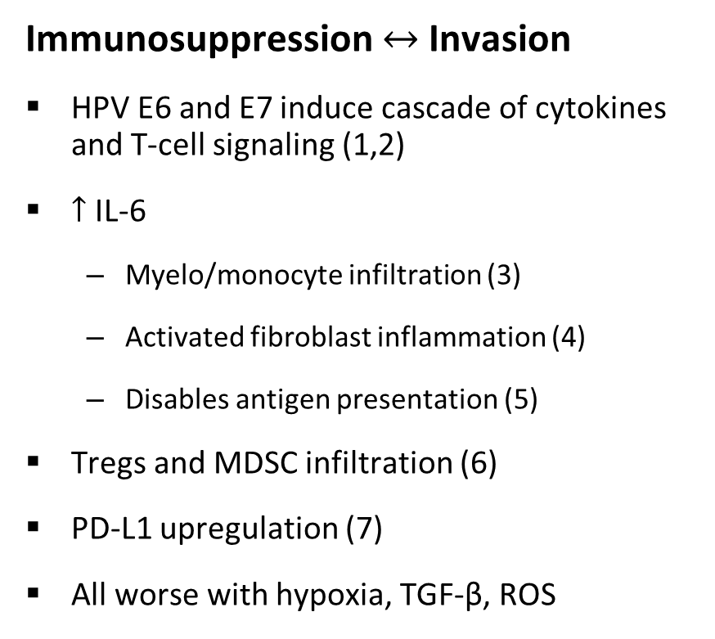
Rationale for Immunotherapy in Cervical Cancer:
Cervical Cancer Immunosuppression
Image not available
Immunosuppression $↔$Invasion
HPV E6 and E7 induce cascade of cytokines and T-cell signaling (1,2)
$↑$ IL-6
  Myelo/monocyte infiltration (3)
  Activated fibroblast inflammation (4)
  Disables antigen presentation (5)
Tregs and MDSC infiltration (6)
PD-L1 upregulation (7)
All worse with hypoxia, TGF-β, ROS
Smola. Ther Adv Vaccines. 2017;5:69.
Slide credit: clinicaloptions.com
Notes:
APC, antigen-presenting cell; CTL, cytotoxic T-cell; HPV, human papillomavirus; MDSC, myeloid-derived suppressor cell; ROS, reactive oxygen species; Th17, T-helper type 17; Treg, regulatory T-cell.

Slide 20
Additional Molecular Testing in Cervical Cancer
NCCN guidelines recommend testing for molecular biomarkers in patients with recurrent progressive or metastatic cervical cancer²
  PD-L1 (CPS ≥1%)
  MMR/MSI
  NTRK gene fusion testing
  TMB testing through validated and/or FDA-approved assay
NCCN. Clinical practice guidelines in oncology: cervical cancer. v.1.2022. nccn.org.
Slide credit: clinicaloptions.com

Slide 21
KEYNOTE-158 Phase II Basket Trial (Update): Pembrolizumab Monotherapy in Advanced Cervical Cancer
Ongoing, international, multicohort, open-label phase II study
FDA Approval June 2018
For patients with recurrent/metastatic cervical cancer who are PD-L1+ (CPS1 ≥1), MSI-H or dMMR status
Adult patients with
advanced cervical cancer
that progressed on or
was intolerant to ≥1 line
of standard therapy;
ECOG PS 0-1; tumor sample for biomarker analysis
(N = 98)
Pembrolizumab 200 mg Q3W
For 2 yr or until unacceptable toxicity, progression, or withdrawal
Primary endpoint: ORR per RECIST v1.1 (per independent central review)
  Previous interim analysis showed 12.2% ORR (0% ORR in PD-L1–negative tumors)
Secondary endpoints: DoR, PFS, OS, safety
This is an updated analysis of cervical cancer cohort with median 36.9 mo of follow-up
1. Chung. JCO. 2019;37:1470. 2. Chung. SGO 2021. Abstr 41.
Slide credit: clinicaloptions.com
Notes:
CPS, combined positive score; CR, complete response; dMMR, mismatch repair deficient; DoR, duration of response; ECOG PS, Eastern Cooperative Oncology Group performance status; MSI-H, microsatellite instability high; ORR, overall response rate; OS, overall survival; PFS, progression-free survival; PR, partial response; RECIST, Response Evaluation Criteria in Solid Tumors.

Slide 22
KEYNOTE-158 Update: Efficacy
Parameter | Overall (N = 98) | PD-L1+ (n = 82) | PD-L1- (n = 15)
ORR, % (95% CI) | 14.3 (8.0-22.8) | 17.1 (9.7-27.0) | 0 (0-21.8)
Best response, n (%) CR PR SD | 5 (5.1) 9 (9.2) 16 (16.3) | 5 (6.1) 9 (11.0) 13 (15.9) | 0 0 3 (20.0)
Lesion Size Best Change From Baseline
100
PD-L1 positive
PD-L1 negative
PD-L1 unknown
80
60
40
20
+20%
0
Change From BL (%)
-20
Median time to response: 2.3 mo
(range: 1.6-17.6)
Median DoR: not reached (range: 3.7-35.2+)
Ongoing responses: 7/14 (50%) responses ongoing at data cutoff
-40
-30%
-60
-80
-100
Chung. SGO 2021. Abstr 41.
Slide credit: clinicaloptions.com
Notes:
BL, baseline; CR, complete response; DoR, duration of response; ORR, overall response rate; PR, partial response; SD, stable disease.

Slide 23
KEYNOTE-158 Update: PFS and OS
PFS
OS
n/N | Events
88/98 | 89.8%
n/N | Death
81/98 | 82.7%
100
100
80
17.2%
80
40.2%
12.9%
23.7%
60
8.6%
60
15.9%
PFS Probability (%)
OS Probability (%)
40
2.1 mo
40
9.3 mo
20
20
0
0
0
3
6
9
12
15
18
21
24
27
30
33
36
39
0
3
6
9
12
15
18
21
24
27
30
33
36
39
42
Patients
at Risk, n
Mo
Patients
at Risk, n
Mo
98
33
23
17
16
15
12
12
12
10
9
8
3
0
98
82
71
51
39
30
28
23
22
19
16
16
10
1
0
Chung. SGO 2021. Abstr 41.
Slide credit: clinicaloptions.com
Notes:
OS, overall survival; PFS, progression-free survival.

Slide 24
GARNET Basket Trial of Dostarlimab in Solid Tumors: Updated Efficacy Results
Multicenter, open-label, single-arm phase I study (N = 740)
Variable | Cohort F dMMR Basket (n = 106)
Median follow-up time, mo* | 16.7
Confirmed responses, n | 41
ORR,† % (95% CI) CR, n (%) PR, n (%) SD, n (%) PD, n (%) NE, n (%) | 38.7 (29.4-48.6) 8 (7.5) 33 (31.1) 26 (24.5) 32 (30.2) 7 (6.6)
DCR,‡ % (95% CI) | 63.2 (53.3-72.4)
Median DoR, mo (range) | NR (5.59-30.13+)
FDA Tumor-Agnostic Approval August 2021
Dostarlimab has FDA approval for adult patients with dMMR recurrent or advanced solid tumors
*Median follow-up time is a post hoc analysis of time since initial response; data cutoff date: March 1, 2020, with update on DoR and safety in November 2020.
†Responses required confirmation at a subsequent follow-up scan; SD had to be observed at ≥12 wk to qualify as SD. ‡Includes confirmed CR, PR, or SD at ≥12 wk.
Berton. ASCO 2021. Abstr 2564. NCT02715284.
Slide credit: clinicaloptions.com
Notes:
CR, complete response; DCR, disease control rate; dMMR, deficient mismatch repair; DoR, duration of response; NE, not evaluable; NR, not reached; ORR, objective response rate; PD, progressive disease; PFS, progression-free survival; PR, partial response; RECIST, Response Evaluation Criteria in Solid Tumors; SD, stable disease.

Slide 25
KEYNOTE-826: Pembrolizumab + CT vs Placebo + CT in Cervical Cancer: Study Design
FDA Approval October 2021
Pembrolizumab in combination with chemotherapy, with or without bevacizumab, for patients with persistent recurrent or metastatic cervical cancer whose tumors express PD-L1 (CPS ≥1),
as determined by an FDA-approved test
International, randomized, double-blind phase III trial
Stratified by metastatic disease (yes vs no), PD-L1 CPS
(<1 vs 1 to <10 vs ≥10), planned bevacizumab (yes vs no)
Pembrolizumab* 200 mg IV Q3W +
CT † IV Q3W ±
Bevacizumab 15 mg/kg IV Q3W
Adults with persistent, recurrent, or metastatic cervical cancer; no prior systemic chemotherapy; ECOG PS 0-1
(N = 548)
Treatment until death, radiographic progression, unacceptable toxicity, or study completion
Placebo* IV Q3W +
CT† IV Q3W ±
Bevacizumab 15 mg/kg IV Q3W
*≤35 cycles pembrolizumab/placebo. †CT: ≤6 cycles: paclitaxel
175 mg/m² + (cisplatin 50 mg/m² or carboplatin AUC 5 mg/mL/min).
Dual primary endpoints: OS and PFS
Secondary endpoints: ORR, DoR, 12-mo PFS, safety
Exploratory endpoints: PROs assessed per EuroQol EQ-5D-5L VAS
Colombo. NEJM. 2021;386:1856. Pembrolizumab PI.
Slide credit: clinicaloptions.com
Notes:
AUC, area under the curve; CPS, combined positive score; CT, chemotherapy; DoR, duration of response; ECOG PS, Eastern Cooperative Oncology Group performance status; EuroQol EQ-5D-5L VAS, European Quality of Life 5-dimension, 5-level visual analogue scale; ORR, overall response rate; OS, overall survival; PFS, progression-free survival; PRO, patient-reported outcome.

Slide 26
KEYNOTE-826: PFS
ITT Population
PD-L1 CPS ≥1 (FDA Approval)
100
100
Median PFS, Mo
10.4
8.2
Median PFS, Mo
10.4
8.2
80
Pembro
Placebo
80
Pembro
Placebo
60
60
PFS (%)
PFS (%)
Pembrolizumab
Pembrolizumab
40
40
20
20
HR: 0.65 (95% CI: 0.53-0.79; P <.001)
HR: 0.62 (95% CI: 0.50-0.77; P <.001)
Placebo
0
Placebo
0
0
3
6
9
12
15
18
21
24
27
0
3
6
9
12
15
18
21
24
27
Patients at Risk, n
Pembro
Placebo
Mo
Patients at Risk, n
Pembro
Placebo
Mo
308
309
263
259
229
195
155
113
123
89
110
71
70
39
35
13
10
1
0
0
273
275
238
229
208
170
143
103
112
81
101
63
66
38
34
13
10
1
0
0
100
PD-L1 CPS ≥10
Median PFS, Mo
10.4
8.1
80
Pembro
Placebo
60
PFS (%)
Pembrolizumab
40
20
HR: 0.58 (95% CI: 0.44-0.77; P <.001)
Placebo
0
Patients at Risk, n
Pembro
Placebo
0
3
6
9
12
15
18
21
24
27
Mo
158
159
138
131
124
95
80
60
62
47
58
35
35
19
21
3
7
0
0
0
Slide credit: clinicaloptions.com
Colombo. NEJM. 2021;386:1856.
Notes:
CPS, combined positive score; ITT, intention-to-treat; pembro, pembrolizumab; PFS, progression-free survival.

Slide 27
KEYNOTE-826: OS
ITT Population
100
PD-L1 CPS ≥1 (FDA Approval)
100
80
80
60
Pembrolizumab
60
Pembrolizumab
OS (%)
OS (%)
40
40
20
Placebo
20
Placebo
HR: 0.67 (95% CI: 0.54-0.84; P <.001)
0
HR: 0.64 (95% CI: 0.50-0.81; P <.001)
0
Patients
at Risk, n
Pembro
Placebo
Patients at Risk, n
Pembro
Placebo
0
3
6
9
12
15
18
21
24
27
30
0
3
6
9
12
15
18
21
24
27
30
Mo
Mo
308
309
291
295
277
268
254
234
228
191
201
160
145
116
89
60
36
28
6
4
0
0
273
275
260
261
250
235
229
206
204
168
181
140
132
100
82
55
34
25
6
4
0
0
100
PD-L1 CPS ≥10
80
60
Pembrolizumab
OS (%)
40
20
Placebo
0
HR: 0.61 (95% CI: 0.44-0.84; P = .001)
Patients at Risk, n
Pembro
Placebo
0
3
6
9
12
15
18
21
24
27
30
Mo
158
159
149
151
144
135
132
116
118
95
106
81
76
56
46
31
21
15
3
1
0
0
Slide credit: clinicaloptions.com
Colombo. NEJM. 2021;386:1856.
Notes:
CPS, combined positive score; ITT, intention-to-treat; OS, overall survival; pembro, pembrolizumab.

Slide 28
KEYNOTE-826: PFS and OS in Key Patient Subgroups
(All Comers)
Outcome | Median PFS, Mo |  |  | Median OS, Mo
 | Pembro | Placebo | HR (95% CI) | Pembro | Placebo | HR (95% CI)
Overall (N = 617) | 10.4 | 8.2 | 0.65 (0.53-0.79) | 24.4 | 16.5 | 0.67 (0.54-0.84)
Histology Squamous (n = 447) Nonsquamous (n = 169) | 10.4 11.6 | 6.9 8.4 | 0.63 (0.50-0.80) 0.66 (0.43-1.00) | 23.5 NR | 14.2 21.3 | 0.61 (0.47-0.80) 0.76 (0.47-1.23)
Platinum use Carboplatin (n = 495) Cisplatin (n = 120) | 10.2 15.2 | 7.4 8.4 | 0.69 (0.55-0.86) 0.47 (0.28-0.77) | 21.4 NR | 15.9 21.3 | 0.69 (0.54-0.89) 0.59 (0.32-1.09)
Concomitant bevacizumab Yes (n = 389) No (n = 228) | 15.2 6.3 | 10.2 6.2 | 0.61 (0.47-0.79) 0.74 (0.54-1.01) | NR 16.8 | 24.7 12.6 | 0.63 (0.47-0.87) 0.74 (0.53-1.04)
Prior CRT only Yes (n = 243) No (n = 374) | 10.3 10.4 | 6.3 8.4 | 0.62 (0.45-0.86) 0.69 (0.53-0.90) | 21.3 NR | 12.6 19.4 | 0.64 (0.45-0.91) 0.71 (0.53-0.97)
Tewari. ASCO 2022. Abstr 5506. Colombo. NEJM. 2021;385:1856.
Notes:
CRT, chemoradiotherapy; NR, not reached; OS, overall survival; pembro, pembrolizumab; PFS, progression-free survival.

Slide 29
KEYNOTE-826: PFS and OS in PD-L1 CPS ≥1 Subgroup
Outcome | PFS | OS
 | HR (95% CI) | HR (95% CI)
Overall (N = 548) | 0.62 (0.50-0.77) | 0.64 (0.50-0.81)
Histology Squamous (n = 409) Nonsquamous (n = 138) | 0.61 (0.48-0.78) 0.59 (0.37-0.93) | 0.60 (0.46-0.79) 0.70 (0.41-1.20)
Platinum use Carboplatin (n = 447) Cisplatin (n = 99) | 0.68 (0.53-0.85) 0.39 (0.22-0.68) | 0.65 (0.50-0.85) 0.53 (0.27-1.04)
Concomitant bevacizumab Yes (n = 346) No (n = 202) | 0.61 (0.46-0.80) 0.66 (0.47-0.92) | 0.62 (0.45-0.87) 0.67 (0.47-0.96)
Prior CRT only Yes (n = 215) No (n = 333) | 0.55 (0.39-0.78) 0.68 (0.52-0.90) | 0.56 (0.39-0.81) 0.72 (0.52-1.00)
Tewari. ASCO 2022. Abstr 5506. Colombo. NEJM. 2021;385:1856.
Notes:
CPS, combined positive score; CRT, chemoradiotherapy; OS, overall survival; PFS, progression-free survival.

Slide 30
KEYNOTE-826: ORR in Key Patient Subgroups
(All-Comer and CPS ≥1 Populations )
Outcome | All-Comer ORR, % |  |  | CPS ≥1 ORR, %
 | Pembro | Placebo | Diff in ORR, % (95% CI) | Pembro | Placebo | Diff in ORR, % (95% CI)
Overall | 65.9 | 50.8 | 15.3 (7.8-22.6) | 68.1 | 50.2 | 18.0 (10.1-25.7)
Histology Squamous Nonsquamous | 65.3 67.6 | 45.5 62.2 | 20.3 (11.4-29.0) 8.1 (-6.8-21.7) | 67.0 71.7 | 46.2 60.3 | 20.4 (11.1-29.4) 13.8 (-2.2-28.1)
Platinum use Carboplatin Cisplatin | 62.2 82.0 | 48.6 61.0 | 14.0 (5.4-22.3) 19.6 (3.5-35.2) | 64.5 64.6 | 48.5 59.6 | 16.1 (7.2-24.8) 26.1 (9.4-42.6)
Concomitant bevacizumab Yes No | 75.5 49.1 | 60.6 34.5 | 15.1 (5.8-24.3) 14.6 (1.8-27.0) | 77.1 52.0 | 60.2 33.7 | 17.3 (7.5-26.9) 18.3 (4.7-31.3)
Prior CRT only Yes No | 61.6 68.9 | 43.2 55.5 | 18.7 (6.4-30.5) 13.5 (3.9-22.9) | 64.3 70.8 | 40.8 55.8 | 23.8 (10.8-36.1) 15.0 (4.9-24.7)
Tewari. ASCO 2022. Abstr 5506.
Notes:
CPS, combined positive score; CRT, chemoradiotherapy; ORR, objective response rate; pembro, pembrolizumab.

Slide 31
KEYNOTE-826: PFS/OS Across
Protocol-Specified Subgroups
PFS
OS
Events, n/
Patients, n
HR for Disease Progression or Death (95% CI)
Events, n/
Patients, n
Subgroup
Subgroup
HR for Death (95% CI)
Overall
Age
<65 yr
≥65 yr
Overall
Age
<65 yr
≥65 yr
406/617
0.65 (0.53-0.79)
312/617
0.67 (0.54-0.84)
345/517
61/100
0.63 (0.50-0.78)
0.77 (0.42-1.42)
265/517
47/100
0.64 (0.50-0.82)
0.88 (0.47-1.64)
Race
White
Non-White
Race
White
Non-White
239/360
139/221
0.70 (0.53-0.91)
0.64 (0.45-0.90)
189/360
107/221
0.68 (0.50-0.91)
0.70 (0.47-1.04)
ECOG PS score
0
1
ECOG PS score
0
1
197/348
207/267
0.65 (0.48-0.87)
0.69 (0.52-0.93)
141/348
169/267
0.68 (0.49-0.96)
0.68 (0.50-0.94)
PD-L1 combined positive score
<1
1 to <10
≥10
PD-L1 combined positive score
<1
1 to <10
≥10
51/69
152/231
203/317
0.94 (0.52-1.70)
0.68 (0.49-0.94)
0.58 (0.44-0.77)
40/69
118/231
154/317
1.00 (0.53-1.89)
0.67 (0.46-0.97)
0.61 (0.44-0.84)
Concomitant bevacizumab
Yes
No
Concomitant bevacizumab
Yes
No
234/389
172/228
0.61 (0.47-0.79)
0.74 (0.54-1.01)
166/389
146/228
0.63 (0.47-0.87)
0.74 (0.53-1.04)
Metastatic disease at diagnosis
Yes
No
Metastatic disease at diagnosis
Yes
No
137/190
269/427
0.92 (0.64-1.30)
0.58 (0.45-0.75)
104/190
208/427
0.84 (0.56-1.26)
0.61 (0.46-0.80)
0.25
0.5
1.0
2.0
4.0
0.25
0.5
1.0
2.0
4.0
Pembrolizumab Better
Placebo Better
Pembrolizumab Better
Placebo Better
Colombo. NEJM. 2021;386:1856.
Slide credit: clinicaloptions.com
Notes:
ECOG PS, Eastern Cooperative Oncology Group performance status; OS, overall survival; PFS, progression-free survival.

Slide 32
KEYNOTE-826: ORR and DoR
PD-L1 CPS ≥1
All-Comer
PD-L1 CPS ≥10
100
68.1
(62.2-73.6)
100
65.9
(60.3-71.2)
100
69.6
(61.8-76.7)
80
50.2
(44.1-56.2)
80
50.8
(45.1-56.5)
80
49.1
(41.1-57.1)
60
60
60
ORR, % (95% CI)
40
PR: 45.4
40
PR: 44.5
40
PR: 47.5
PR: 37.1
PR: 37.9
20
PR: 37.7
20
20
CR: 22.2
CR: 22.7
CR: 13.1
CR: 21.4
CR: 12.9
CR: 11.3
0
0
0
Pembro + CT ± Bev
Placebo + CT ± Bev
Pembro + CT ± Bev
Placebo + CT ± Bev
Pembro + CT ± Bev
Placebo + CT ± Bev
100
100
100
Pembro + CT ± Bev
Placebo + CT ± Bev
80
80
80
60
60
60
Ongoing Response (%)
40
40
Median, mo (range)
18.0 (1.3+ to 24.2+)
10.4 (1.5+ to 22.0+)
40
Median, mo (range)
18.0 (1.3+ to 24.2+)
10.4 (1.5+ to 22.0+)
Median, mo (range)
21.1 (1.3+ to 24.2+)
9.4 (2.1+ to 21.5+)
20
20
20
0
0
0
0
3
6
9
12
15
18
21
24
27
0
3
6
9
12
15
18
21
24
27
0
3
6
9
12
15
18
21
24
27
Mo
Mo
Mo
Colombo. ESMO 2021. Abstr LBA2. Colombo. NEJM. 2021;386:1856.
Slide credit: clinicaloptions.com
Notes:
Bev, bevacizumab; CPS, combined positive score; CR, complete response; CT, chemotherapy; DoR, duration of response; ORR, overall response rate; pembro, pembrolizumab; PR, partial response.

Slide 33
KEYNOTE-826: Safety Overview
Event, n (%) | All-Cause AEs |  | Treatment-Related AEs |  | Immune-Mediated AEs†
 | Pembro* (n = 307) | Placebo* (n = 309) | Pembro* (n = 307) | Placebo* (n = 309) | Pembro* (n = 307) | Placebo* (n = 309)
Any grade | 305 (99.3) | 307 (99.4) | 298 (97.1) | 300 (97.1) | 104 (33.9) | 47 (15.2)
Grade ≥3 | 251 (81.8) | 232 (75.1) | 210 (68.4) | 198 (64.1) | 35 (11.4) | 9 (2.9)
Serious | 153 (49.8) | 131 (42.4) | 93 (30.3) | 71 (23.0) | 22 (7.2) | 7 (2.3)
Led to death | 14 (4.6) | 14 (4.5) | 2 (0.7)‡ | 4 (1.3)§ | 1 (0.3)‡ | 0
Led to discontinuation Any treatment All treatment | 115 (37.5) 18 (5.9) | 82 (26.5) 15 (4.9) | 96 (31.3) 10 (3.3) | 69 (22.3) 6 (1.9) | 16 (5.2) 3 (1.0) | 1 (0.3) 0
*Arm also include CT ± bevacizumab. †Events were considered regardless of attribution to treatment by the investigator. ‡Autoimmune encephalitis (also immune mediated) and intestinal perforation. §Embolism, female genital tract fistula, large intestine perforation, and pulmonary sepsis.
Median tx duration pembro vs placebo: 10.0 vs 7.7 mo
  Pembro or placebo: 13 vs 11
  Bevacizumab: 13 vs 11
Colombo. ESMO 2021. Abstr LBA2. Colombo. NEJM. 2021;386:1856.
Slide credit: clinicaloptions.com
Notes:
AE, adverse event; CT, chemotherapy; pembro, pembrolizumab; tx, treatment.

Slide 34
General Principles for Managing AEs
With Single-Agent Immunotherapy in Cervical Cancer
Educate patients about toxicities and to contact you immediately if they occur
  Let other healthcare professionals know that they are receiving immunotherapy
Assess for irAEs at each cycle for the first
3 months, including laboratory tests
Thyroid tests every cycle for first 3 months
and then every 2-3 cycles
Maintain low threshold for steroids or immunosuppression if irAE is concerning
Infliximab for severe/refractory colitis/diarrhea
Grade | Management
1 (mild) | Symptomatic management Continue therapy Immunosuppression not needed
2 (mild to moderate) | Symptomatic management Consider discontinuing until resolution to grade 1 Consider immunosuppression if intolerable or persistent Involve consultants as needed
3 or 4 (severe) | Discontinue therapy Start immunosuppression Refer/involve consultants At resolution, gradually taper off immunosuppression Educate patients to recognize potential toxicities and to contact you if they occur
Brahmer. JCO. 2018;36:1714. Haanen. Ann Oncol. 2017;28(suppl 4):iv119.
Slide credit: clinicaloptions.com
34
Notes:
AEs, adverse evet; irAEs, immune-related adverse event.

Slide 35
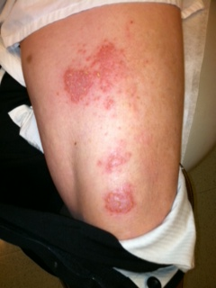
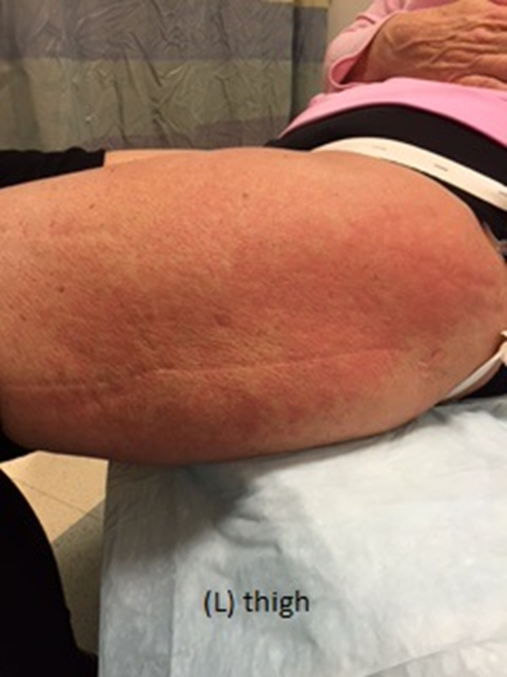
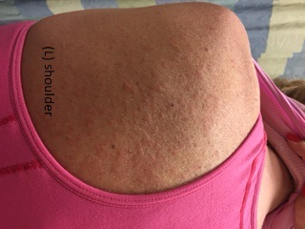
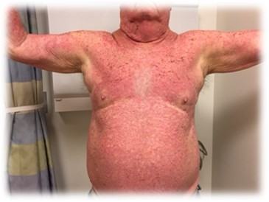
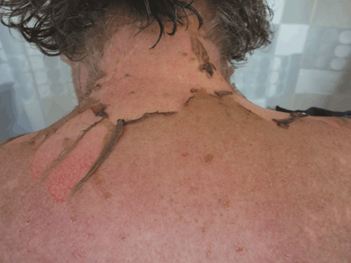

Examples of irAEs (Dermatologic) Grading
Grade 1:
Mild, asymptomatic,
no intervention required
Grade 2:
Moderate, local or non-invasive intervention required
Grade 3:
Severe or medically significant, but not life-threatening
Grade 4:
Life-threatening consequences; urgent intervention required
Grade 1-3 example images: courtesy of Krista M. Rubin, MS, RN, FNP-BC, at Massachusetts General Hospital Cancer Center, Boston, Massachusetts.
Mundi. Int J Case Rep Imag. 2016;7:300.
Slide credit: clinicaloptions.com

Slide 36
Special Considerations for Managing AEs With Pembrolizumab and Chemotherapy From KEYNOTE-826
Pembrolizumab
Bevacizumab
CT
Educate nurses and patients about irAEs
Monitor blood pressure and urine protein
Assess need for dose reductions
Monitor for irAEs and assist provider in managing irAEs
If undergoing surgery, ensure bevacizumab is withheld for 4 weeks
Evaluate for use of GCSF support if indicated
Review home medications for use of long-term steroids
Evaluate for use of other supportive medications as needed (eg, duloxetine, olanzapine)
Continue pembrolizumab for up to 35 cycles
Every 3 weeks (200 mg) or every 6 weeks (400 mg)
Colombo. NEJM. 2021;385:1856.
36
Slide credit: clinicaloptions.com
Notes:
AEs, adverse event; CT, chemotherapy; GCSF, granulocyte colony stimulating factor; irAE, immune-related adverse event.

Slide 37
Tisotumab Vedotin: A Non-IO Option
Tisotumab vedotin is an FDA approved antibody–drug conjugate directed to tissue factor and covalently linked to the microtubule-disrupting agent MMAE via a protease-cleavable linker^{1,2}
Tissue factor is a protein highly expressed in cervical cancer and other solid tumors³⁻⁶
Multimodal MoA of tisotumab vedotin^{1,2,7}
  Direct cytotoxicity
  Bystander killing
  Immunogenic cell death
  ADCC
  ADCP
Image not available
1. Breij. Cancer Res. 2014;74:1214. 2. De Goeij. Mol Cancer Ther. 2015;14:1130. 3. Forster. Clin Chim Acta. 2006;364:12.
4. Pan. Mol Med Rep. 2019;19:2077. 5. Cocco. BMC Cancer. 2011;11:263. 6. Zhao. Exp Ther Med. 2018;16:4075. 7. Alley. AACR 2019. Abstr 221.
Slide credit: clinicaloptions.com
Notes:
ADCC, antibody-dependent cellular cytotoxicity; ADCP, antibody-dependent cellular phagocytosis; IO, immunotherapy; MMAE, monomethyl auristatin E; MoA, mechanism of action; TF, tissue factor.

Slide 38
innovaTV 204/GOG 3023/ENGOT cx6: Study Design
International, multicenter, single-arm phase II study evaluating tisotumab vedotin in patients with previously treated recurrent and/or metastatic cervical cancer
FDA Approval September 2021
Tisotumab vedotin is approved by the FDA for recurrent or metastatic cervical cancer with disease progression on or after chemotherapy
Recurrent or extrapelvic metastatic cervical cancer
progressed during or after doublet chemotherapy with bevacizumab (if eligible);
received ≤2 prior systemic regimens; ECOG PS 0-1
(N = 102*)
Tumor responses assessed using CT or MRI at baseline, every 6 wk for the first 30 wk, and
every 12 wk thereafter
Tisotumab vedotin
2.0 mg/kg IV Q3W
(n = 101)
Until PD or unacceptable toxicity
Primary endpoint: ORR per RECIST v1.1 by IRC
Secondary endpoint: ORR per RECIST v1.1 by investigator, DoR, TTR, PFS by IRC and investigator, OS, and safety
Exploratory endpoint:
biomarker analysis and safety
*Study sample size calculated assuming a confirmed ORR of 21% to 25% with tisotumab vedotin
and to provide ≥80% power to exclude an ORR of ≤11%.
Coleman. Lancet Oncol. 2021;22:609. NCT03438396.
Slide credit: clinicaloptions.com
Notes:
DoR, duration of response; ECOG PS, Eastern Cooperative Oncology Group performance status; IRC, independent review committee; ORR, overall response rate; OS, overall survival; PD, progressive disease; PFS, progression-free survival; RECIST, Response Evaluation Criteria in Solid Tumors; TTR; time to relapse.

Slide 39
Phase II innovaTV 204: Efficacy
+
Maximum Change in Target Lesion
Size From BL (%)
100
75
Median DoR 8.3 mo
(95% CI) (4.2-NR)
50
25
0
-25
-50
 | N = 101
Confirmed ORR, % (95% CI) | 24 (15.9-33.3)
CR, n (%) | 7 (7)
PR, n (%) | 17 (17)
SD, n (%) | 49 (49)
PD, n (%) | 24 (24)
Not evaluable, n (%) | 4 (4)
-75
Confirmed Best Overall Response CR PR SD PD
-100
Data cutoff: February 6, 2020. Median duration of follow-up: 10.0 mo + indicates a change >100%. Horizontal dashed lines indicate 20% increase and 30% decrease in target lesion diameters from baseline for RECIST v1.1 assessment. Colored bars represent the best overall confirmed response. CR, PR, SD, and PD were based on RECIST v1.1 as evaluated by IRC.
Coleman. Lancet Oncol. 2021;22:609.
Slide credit: clinicaloptions.com
Notes:
BL, baseline; CR, complete response; DoR, duration of response; IRC, independent review committee; NR, not reached; ORR, overall response rate; PD, progressive disease; PR, partial response; RECIST, Response Evaluation Criteria In Solid Tumors; SD, stable disease.

Slide 40
Phase II innovaTV 204: Prespecified AEs of Interest
100
Ocular, Bleeding, and Peripheral Neuropathy TRAEs
N = 101
 | Ocular | Bleeding | Peripheral Neuropathy
Time to onset (median, mo) | 1.4 | 0.3 | 3.1
Events resolved, % | 86 | 90 | 21
Time to resolution§ (median, mo) | 0.7 | 0.5 | 0.6
Patients (%)
80
Grade 1
2
Grade 2
60
Grade 3
2
40
27
3
7
20
34
9
25
17
0
Ocular TRAEs
Bleeding TRAEs
Peripheral Neuropathy
TRAEs
Ocular AEs were mostly mild to moderate, resolved, and manageable with an eye care plan
Most bleeding events were grade 1 epistaxis (28%), and majority resolved
Most peripheral neuropathy events (known MMAE-related toxicity) were grade 1 and manageable with dose modifications;
resolution was limited by follow-up period
Patients should be seen by an eye care provider to examine their eyes before starting treatment, prior to each dose, and as needed for any new or worsening signs and symptoms of ocular AEs
Coleman. Lancet Oncol. 2021;22:609. Tisotumab vedotin PI.
Slide credit: clinicaloptions.com
Notes:
AE, adverse event; MMAE, monomethyl auristatin E; SMQ, standardized MedDRA queries; TRAE, treatment-related adverse event.

Slide 41
Lifileucel (TIL; LN-145), an Autologous Tumor-Infiltrating Lymphocyte Tx, in Patients With CC: Study Design
A prospective, multicenter, single-arm, multi-cohort phase II of lifileucel TIL therapy in cervical cancer
Cohort 1*
Patients 18 yr or older with recurrent, metastatic or persistent squamous cell carcinoma, adenosquamous carcinoma, or adenocarcinoma of
the cervix; ≥1 measurable lesion
per RECIST v1.1; progression on
1-3 previous systemic therapies
(planned N = 138)
1-wk preconditioning lymphodepletion
(cyclophosphamide, fludarabine)
Lifileucel infusion
IL-2 600,000 IU/kg
up to 6 doses
Tumors are surgically harvested and shipped to central facilities for TIL generation in a 22-day manufacturing process; final lifileucel product is cryopreserved and returned to treatment site.
Primary endpoint cohort 1/2:
ORR per RECIST v1.1 (time frame >6 mo)
Secondary endpoints cohort 1/2: safety, DoR, DCR, PFS, ORR by investigator (per RECIST v1.1)
*Other cohorts include patients previously treated with PD-1 or PD-L1 (cohort 2); combination cohort with TIL + pembrolizumab (US only; cohort 3); patients not meeting inclusion criteria for Cohort 1 or 2 (cohort 4); patients previously treated with lifileucel receiving a second treatment (cohort 5).
Jazaeri. J Clin Onc. 2019;37:2538. NCT03108495.
Slide credit: clinicaloptions.com
Notes:
CC, cervical cancer; DCR, disease control rate; DoR, duration of response; RECIST, response evaluation criteria in solid tumors; ORR, overall response rate; PFS, progression-free survival; RECIST, Response Evaluation Criteria in Solid Tumors; TIL tumor-infiltrating lymphocyte; Tx, therapy.

Slide 42
Lifileucel in Patients With CC (Cohort 1): Results
  Median follow-up: 7.4 mo
  78% of patients had reduction in tumor burden
  Mean TIL cells infused: 28 x 10⁹
  Median IL-2 doses: 6.0
Best Overall Response (n = 27)
70
60
PD
SD
PR
CR
50
40
30
20
10
0
-10
Change From Baseline (%)
-20
-30
-40
-50
ORR: 44.4%
-60
-70
-80
-90
-100
LN-145 results in 44% ORR in previously treated cervical cancer
  PR: 33.3%
  CR: 11.1%
FDA breakthrough therapy designation of new TIL therapy for advanced cervical cancer
Jazaeri. J Clin Onc. 2019;37:2538.
Slide credit: clinicaloptions.com
Notes:
CC, cervical cancer; CR, complete response; ORR, overall response rate; PD, progressive disease; PR, partial response; SD, stable disease; TIL, tumor-infiltrating lymphocyte.

Slide 43
Combination Strategies

Slide 44
ENGOT Cx8/GOG 3024/innovaTV 205: Study Design
Global, open-label phase Ib/II trial
Phase I Dose Escalation
Phase II Dose Expansion
DL1: TV 1.3-2.0 mg/kg Q3W +
Bevacizumab 7.5-15.0 mg/kg Q3W
(n = 15)
Cohort 1*
No prior systemic therapy for recurrent/metastatic CC
TV 2.0 mg/kg IV Q3W +
Pembrolizumab 200 mg IV Q3W
(n = 33)
Patients with recurrent or metastatic cervical cancer;
ECOG PS 0/1
(N = 220 estimated)
DL2: TV 1.3-2.0 mg/kg Q3W +
Pembrolizumab 200 mg Q3W
(n = 13)
Cohort 2*
Disease progression on/after 1-2 prior systemic therapies
TV 2.0 mg/kg IV Q3W +
Pembrolizumab 200 mg IV Q3W
(n = 35)
DL3: TV 1.3-2.0 mg/kg Q3W +
Carboplatin AUC 5 Q3W
(n = 13)
Cohort 3
No prior systemic therapy for recurrent/metastatic CC
TV 2.0 mg/kg IV Q3W +
Carboplatin AUC 5 IV Q3W
(n = 33)
Phase I results: No DLTs, MTD was not reached, acceptable safety profile, evident anti-tumor activity
  RP2D: TV 2.0 mg/kg + bevacizumab 15 mg/kg Q3W;
  TV 2.0 mg/kg + pembrolizumab 200 mg Q3W; TV 2.0 mg/kg + carbo AUC 5 Q3W
Primary endpoint (phase II): ORR per RECIST v1.1
Secondary endpoints: AEs and laboratory parameters, DoR, time to response, PFS, OS
*Pembrolizumab is administered for up to 35 cycles.
Monk. IGCS 2021. Abstr O013. NCT03786081. Lorusso. ASCO 2022. Abstr 5507.
Slide credit: clinicaloptions.com
Notes:
AE, adverse event; AUC, area under the curve; CC, cervical cancer; DL, dose level; DLT, dose-limiting toxicity; DoR, duration of response; ECOG, Eastern Cooperative Oncology Group; MTD, maximum tolerated dose; ORR, overall response rate; OS, overall survival; PFS, progression-free survival; PS, performance status; RECIST, Response Evaluation Criteria in Solid Tumors; RP2D, recommended phase II dose; TV, tisotumab vedotin.

Slide 45
ENGOT Cx8/GOG 3024/innovaTV 205:
Baseline Characteristics
Characteristic |  | 1L TV + Pembro (n = 33) | 2L/3L TV + Pembro (n = 35) | 1L TV + Carbo (n = 33)
Median age, yr (range) |  | 47 (29-76) | 47 (31-73) | 51 (25-78)
White race, n (%) |  | 31 (93.9) | 27 (77.1) | 28 (84.8)
Non-Hispanic/Latino race, n (%) |  | 32 (97.0) | 29 (82.9) | 29 (87.9)
ECOG PS 0/1, n (%) |  | 25 (75.8)/8 (24.2) | 22 (62.9)/13 (37.1) | 21 (63.6)/12 (36.4)
Cancer recurrence at time of screening, n (%) |  | 26 (78.8) | 31 (88.6) | 30 (90.9)
Histology, n (%) | Squamous Adenocarcinoma Adenosquamous Other | 22 (66.7) 11 (33.3) 0 0 | 19 (54.3) 15 (42.9) 0 1 (2.9) | 24 (72.7) 8 (24.2) 1 (3.0) 0
PD-L1 CPS ≥1, n (%) |  | 28 (96.6)* | 22 (81.5)* | NA
Prior radiotherapy, n (%) |  | 25 (75.8) | 30 (85.7) | 27 (81.8)
Prior chemoradiation, n (%) |  | 24 (72.7) | 19 (54.3) | 23 (69.7)
Prior lines of systemic regimen,† n (%) | 0 1 2 | 33 (100) 0 0 | 0 25 (71.4) 10 (28.6) | 33 (100) 0 0
Prior bevicizumab, n (%) |  | NA | 19 (54.3) | NA
*Based on evaluable biopsies, 29 patients for 1L and 27 for 2L/3L. †Systemic treatment in the recurrent or metastatic setting, excluding CRT.
Lorusso. ASCO 2022. Abstr 5507.
Slide credit: clinicaloptions.com
Notes:
1L, first-line; 2L, second-line; 3L, third-line; carbo, carboplatin; CPS, combined positive score; CRT, chemoradiation; ECOG, Eastern Cooperative Oncology Group; NA, not available; pembro, pembrolizumab; PS, performance status; TV, tisotumab vedotin.

Slide 46
ENGOT Cx8/GOG 3024/innovaTV 205:
Best Reduction in Target Lesion Size
1L TV + Pembrolizumab
(n = 28)
2L/3L TV + Pembrolizumab
(n = 33)
1L TV + Carboplatin
(n = 32)
80
80
80
60
60
60
40
40
40
20
78% of patients had
a reduced target lesion size
20
74% of patients had
a reduced target lesion size
20
85% of patients had
a reduced target lesion size
Change From BL (%)
0
0
0
-20
-20
-20
-40
-40
-40
-60
-60
-60
-80
-80
-80
-100
-100
-100
Complete response
Partial response
Stable disease
Progressive disease
Not evaluable
Reduction in target lesion was observed across treatment arms
Lorusso. ASCO 2022. Abstr 5507.
Slide credit: clinicaloptions.com
Notes:
1L, first-line; 2L, second-line; 3L, third-line; BL, baseline; TV, tisotumab vedotin.

Slide 47
ENGOT Cx8/GOG 3024/innovaTV 205:
Response Rates for 1L TV + Pembrolizumab
Parameter | 1L TV + Pembro (n = 32)
Confirmed ORR, % (95% CI) CR, n (%) PR, n (%) SD, n (%) PD, n (%) NE, n (%) | 40.6 (23.7-59.4) 5 (15.6) 8 (25.0) 14 (43.8) 1 (3.1) 4 (12.5)
DCR, % (95% CI) | 84.4 (67.2-94.7)
Median DoR,* mo (range) | NR (2.8-21.9+)
Median time to response, mo (range) | 1.4 (1.2-2.8)
Median PFS,† mo (95% CI) | 5.3 (4.0-12.2)
Median OS,‡ mo (range) | NR (0.5-24.9+)
Patients With Confirmed Response
Complete response
Partial response
Progressive disease
Ongoing response
On treatment
Off treatment
New treatment
0
5
10
15
20
25
Mo
*8 patients censored. †12 patients censored. ‡19 patients censored.
At a median follow-up of 18.8 mo, >50% of responders in 1L TV + pembrolizumab cohort have an ongoing response
Lorusso. ASCO 2022. Abstr 5507.
Slide credit: clinicaloptions.com
Notes:
1L, first-line; CR, complete response; DCR, disease control rate; DoR, duration of response; NE, not evaluable; NR, not reached; ORR, overall response rate; OS, overall survival; PD, progressive disease; pembro, pembrolizumab; PFS, progression-free survival; PR, partial response; SD, stable disease; TV, tisotumab vedotin.

Slide 48
ENGOT Cx8/GOG 3024/innovaTV 205:
Response Rates for 2L/3L TV + Pembrolizumab
Parameter | 2L/3L TV + Pembro (n = 34)
Confirmed ORR, % (95% CI) CR, n (%) PR, n (%) SD, n (%) PD, n (%) NE, n (%) | 38.2 (22.2-56.4) 3 (8.8) 10 (29.4) 12 (35.3) 7 (20.6) 2 (5.9)
DCR, % (95% CI) | 73.5 (55.6-87.1)
Median DoR,* mo (95% CI) | 14.0 (2.8-NR)
Median time to response, mo (range) | 1.4 (1.3-5.8)
Median PFS,† mo (95% CI) | 5.6 (2.7-14.2)
Median OS,‡ mo (95% CI) | 15.3 (9.9-NR)
Patients With Confirmed Response
Complete response
Partial response
Progressive disease
Ongoing response
On treatment
Off treatment
New treatment
0
5
10
15
20
25
Mo
*5 patients censored. †10 patients censored. ‡14 patients censored.
At a median follow-up of 15.0 mo, 40% of responders in 2L/3L TV + pembrolizumab cohort have an ongoing response
Lorusso. ASCO 2022. Abstr 5507.
Slide credit: clinicaloptions.com
Notes:
2L, second-line; 3L, third-line; CR, complete response; DCR, disease control rate; DoR, duration of response; NE, not evaluable; NR, not reached; ORR, overall response rate; OS, overall survival; PD, progressive disease; pembro, pembrolizumab; PFS, progression-free survival; PR, partial response; SD, stable disease; TV, tisotumab vedotin.

Slide 49
ENGOT Cx8/GOG 3024/innovaTV 205:
Response Rates for 1L TV + Carboplatin
Parameter | 1L TV + Carbo (n = 33)
Confirmed ORR, % (95% CI) CR, n (%) PR, n (%) SD, n (%) PD, n (%) NE, n (%) | 54.5 (36.4-71.9) 4 (12.1) 14 (42.4) 12 (36.4) 2 (6.1) 1 (3.0)
DCR, % (95% CI) | 90.9 (75.7-98.1)
Median DoR,* mo (95% CI) | 8.6 (4.2-11.5)
Median time to response, mo (range) | 1.4 (1.1-4.4)
Median PFS,† mo (95% CI) | 6.9 (4.0-11.1)
Median OS,‡ mo (range) | NR (0.8+ to 22.1+)
Patients With Confirmed Response
Complete response
Partial response
Progressive disease
Ongoing response
On treatment
Off treatment
New treatment
0
5
10
15
20
25
Mo
*4 patients censored. †9 patients censored. ‡22 patients censored.
At a median follow-up of 14.6 mo, >50% of responders in 1L had a response with a >90% DCR
Lorusso. ASCO 2022. Abstr 5507.
Slide credit: clinicaloptions.com
Notes:
1L, first-line; carbo, carboplatin; CR, complete response; DCR, disease control rate; DoR, duration of response; NE, not evaluable; NR, not reached; ORR, overall response rate; OS, overall survival; PD, progressive disease; PFS, progression-free survival; PR, partial response; SD, stable disease; TV, tisotumab vedotin.

Slide 50
ENGOT Cx8/GOG 3024/innovaTV 205:
Adverse Events in >25% of Patients
Most TEAEs were grade 1/2; AEs consistent with those of each agent
1 grade 5 AE with 1L TV + pembro considered related to treatment by investigator due to disseminated intravascular coagulation
80
1L TV + Pembrolizumab*
80
2L/3L TV + Pembrolizumab†
80
1L TV + Carboplatin‡
Grade 1/2
Grade 3+
Grade 1/2
Grade 3+
15
Grade 1/2
Grade 3+
60
3
60
60
3
6
9
0
0
0
3
0
3
0
40
3
40
40
3
Proportion of Patients, %
0
0
29
9
0
39
15
12
0
3
3
0
3
3
0
0
64
6
0
0
58
52
48
45
12
3
3
0
49
3
0
0
0
49
55
46
20
42
39
39
39
20
46
34
37
9
9
6
6
20
33
42
39
39
33
33
30
33
27
27
27
26
31
29
31
31
23
26
26
26
30
30
30
18
17
17
20
20
18
0
0
0
PSN
Pyrexia
PSN
PSN
Nausea
Dry eye
Fatigue
Anemia
Alopecia
Epistaxis
Pruritus
Diarrhea
Fatigue
Nausea
Dry eye
Fatigue
Anemia
Nausea
Dry eye
Arthralgia
Diarrhea
Epistaxis
Alopecia
Asthenia
Anemia
Alopecia
Epistaxis
Constipation
Vomiting
Arthralgia
Diarrhea
Vomiting
Conjunctivitis
Constipation
Hypokalemia
Conjunctivitis
Neutropenia
Constipation
Decreased appetite
Abdominal pain
Decreased appetite
Hypomagnesemia
Conjunctivitis
Urinary tract infection
Decreased appetite
*24.2% of patients (n = 8) discontinued TV due to AEs. †34.3% of patients (n = 12) discontinued TV due to AEs. ‡21.2% of patients (n = 7) discontinued TV due to AEs;
ocular AEs and peripheral neuropathy were associated with treatment discontinuation.
Lorusso. ASCO 2022. Abstr 5507.
Slide credit: clinicaloptions.com
Notes:
1L, first-line; 2L, second-line; 3L, third-line; PSN, peripheral sensory neuropathy; TEAE, treatment-emergent adverse event; TV, tisotumab vedotin.

Slide 51
ENGOT Cx8/GOG 3024/innovaTV 205:
Adverse Events of Special Interest
AEs, % | 1L TV + Pembro | 2L/3L TV + Pembro | 1L TV + Carbo
Ocular Grade 1/2 Grade 3 | 9 58 | 3 51 | 9 58
Bleeding Grade 1/2 Grade 3 | 6* 61 | 9† 61 | 6 52
Peripheral neuropathy Grade 1/2 Grade 3 | 3 49 | 3 37 | 12 48
*Includes 1 patient with grade 5 disseminated intravascular coagulation.
† Includes 1 patient with grade 4 hematuria.
AEs of special interest with tisotumab vedotin were mostly grade 1-2 and were consistent across cohorts
Lorusso. ASCO 2022. Abstr 5507.
Slide credit: clinicaloptions.com
Notes:
1L, first-line; 2L, second-line; 3L, third-line; AE, adverse event; carbo, carboplatin; pembro, pembrolizumab; TV, tisotumab vedotin.

Slide 52
Management of Ocular AEs With Tisotumab Vedotin:
Care Plan and Mitigation Approaches
Mitigation of ocular AEs during infusion:
Confirm administration of corticosteroid and vasoconstrictor eye drops before infusion
Apply cold packs covering the eyes after administration of vasoconstrictor eye drops
and leaving/changing pads during infusion
  Keep cold packs on for ~20 min after infusion
  Patient to self-administer corticosteroid eye drops 2x throughout the remainder of the day
Mitigation/assessment of ocular AEs during infusion:
Use corticosteroid eye drops 3x day for 2-3 days after infusion
Administer lubricating eye drops for the duration of treatment and 30 days after the last dose
Monitor for new or worsening ocular signs/
symptoms and promptly refer to eye care provider if warranted
Resources for Healthcare Professionals
Eye care checklist | tivdakhcp.com/TivdakHCP_Tivdak_Eye_Care_Checklist.pdf
Dosing and administration and eye care guide | tivdakhcp.com/TivdakHCP_Dosing_Administration_ and_Eye_Care_Guide.pdf
Resources for Patients
Important facts | seagendocs.com/Tivdak_Important_Facts.pdf
Eye care guide | tivdakhcp.com/Tivdak_Eye_Care_Guide_for_Patients.pdf
Eye drops tracker | tivdakhcp.com/Eye_Drop_Tracker.pdf
TV wallet card | tivdakhcp.com/Tivdak_Wallet_Card.pdf
Tisotumab vedotin PI.
Slide credit: clinicaloptions.com
Notes:
AE, adverse event; TV, tisotumab vedotin.

Slide 53
Special Considerations for Managing AEs With Tisotumab Vedotin From Phase II innovaTV 204
SAEs occurred in 43% of patients
Fatal AEs occurred in 4% of patients on trial
AEs leading to permanent discontinuation occurred in 13% of patients
AEs leading to dose interruption occurred in 47% of patients
AEs leading to dose reduction in 23% of patients
Most common grade 3/4 AEs: fatigue, hemorrhage, peripheral neuropathy, and corneal AEs
  Peripheral neuropathy: grade 2, withhold dose until grade 1, then resume at lower dose; grade 3/4, permanently d/c
  Hemorrhage: in CNS, of any grade, permanently d/c; if grade 2, withhold until resolved; if grade 3,
  first occurrence, withhold until resolved; second occurrence of grade 3, or grade 4, permanently d/c
Clinically relevant AEs occurred in <10% of patients and included DVT and pneumonitis
Dose reductions schedule recommendations: follow drug prescribing information
Tisotumab vedotin PI.
Slide credit: clinicaloptions.com
Notes:
AE, adverse event; CNS, central nervous system; d/c, discontinue; DVT, deep vein thrombosis; SAE, serious adverse event.

Slide 54
Ongoing Studies of Interest

Slide 55
Preliminary Data for Agents in Development
for Recurrent/Metastatic Cervical Cancer (2L+)
Agent | N | Trial Status | Available Results
Phase III EMPOWER-CERVICAL 1: cemiplimab vs investigator’s choice CT¹ | 608 | Active not recruiting | ORR: 50% vs 19% Median PFS: 2.8 vs 2.9 mo Median OS: 12.0 vs 8.5 mo
Phase I/II CheckMate 358: nivolumab monotherapy in recurrent or metastatic cervical, vaginal, or vulvar cancer² | 24 | Active not recruiting | Median follow-up of 19.2 mo Cervical ORR: 26.3% DoR: NR Vaginal/vulvar ORR: 20.0% DoR: 5.0 mo
Phase II of balstilimab in recurrent/metastatic cervical cancer^{*3} | 161 | Active not recruiting | ORR: 15.0
Balstilimab + zalifrelimab*³ | 34 | Active | ORR: 21.7
*FDA fast track designation.
1. Tewari. IGCS 2021. Abstr 331. 2. Naumann. JCO. 2019;37:2825.
3. O’Malley. Gynecol Oncol. 2021;163:274. Clinicaltrials.gov
Slide credit: clinicaloptions.com
Notes:
2L, second line; CT, chemotherapy; ORR, overall response rate; OS, overall survival; PDUFA, Prescription Drug User Fee Act; PFS, progression-free survival; TIL, tumor infiltrating lymphocyte.

Slide 56
Select Randomized Phase III Immunotherapy Trials in Recurrent/Metastatic Cervical Cancer
Study | Population | Treatment Arms | Estimated N | Trial Status | Primary Endpoints
R2810-ONC- ISA-1981 (NCT04646005) | HPV16-positive recurrent/metastatic cervical cancer Progression after first-line therapy | Cemiplimab + ISA101b (HPV16 vaccine) | 105 | Recruiting | ORR (time frame: 36 mo)
STAR (NCT04068753) | Recurrent or progressive cervical cancer Measurable RECIST v1.1 ECOG PS 0/1 | Niraparib + dostarlimab | 66 | Recruiting | Response (CR or PR) at 1 yr
ClinicalTrials.gov.
Slide credit: clinicaloptions.com
Notes:
CRT, chemoradiotherapy; CT, chemotherapy; OS, overall survival.

Slide 57
Select Phase III Immunotherapy Trials in Recurrent/Metastatic Cervical Cancer
Study | Population | Treatment Arms | Estimated N | Trial Status | Primary Endpoints
BEATcc (NCT03556839) | Prior CRT Histology Chemotherapy backbone: cisplatin or carboplatin | Atezolizumab + bevacizumab and cisplatin or carboplatin/paclitaxel | 404 | Active not recruiting | OS
CALLA (NCT03830866) | FIGO 2009 IB2-IIB node+ IIIA-IVA any nodal status Measurable RECIST v1.1 ECOG PS 0/1 | CRT ± durvalumab (for 2 yr) | 770 | Active not recruiting | PFS
ClinicalTrials.gov.
Slide credit: clinicaloptions.com
Notes:
CRT, chemoradiotherapy; CT, chemotherapy; OS, overall survival.

Slide 58
Select Randomized Phase III Immunotherapy Trials in Recurrent/Metastatic Cervical Cancer
Study | Population | Treatment Arms | Estimated N | Trial Status | Primary Endpoints
KEYNOTE-A18 (NCT04221945) | High-risk, locally-advanced cervical cancer with FIGO 2014 Stage IB2-IIB (with node-positive disease) or FIGO 2014 Stages III-IVA Squamous cell carcinoma, adenocarcinoma, or adenosquamous carcinoma | Chemotherapy ± pembrolizumab | 980 | Recruiting | PFS (by RECIST); OS (up to ~46 mo)
ClinicalTrials.gov.
Slide credit: clinicaloptions.com
Notes:
CRT, chemoradiotherapy; CT, chemotherapy; OS, overall survival.

Slide 59
Take-home Messages:
New Approaches in Cervical Cancer
Base treatment decisions on the results of molecular profiling and evidence-based recommendations
Educate patients to recognize toxicities associated with novel agents such as tisotumab vedotin and to contact their medical providers for management if these toxicities occur
A multidisciplinary approach is key for managing toxicities of novel therapeutic agents
Slide credit: clinicaloptions.com

Slide 60
Go Online for More CCO
Coverage of Gynecologic Malignancies!
Expert analyses and downloadable slides from annual conference coverage of gynecologic malignancies
On-demand webcast from an ASCO 2022 satellite live symposium
ClinicalThought™ commentary on the frequently asked questions in gynecologic malignancies
Interactive Decision Support Tools for ovarian, endometrial, and cervical cancers,
each featuring the latest management recommendations from 5 experts (coming soon!)
clinicaloptions.com/oncology
clinicaloptions.com/ChicagoAnnual2022Program

