Slide 1

Considerations in Selecting Therapy for Previously Treated CLL
Provided by the National Comprehensive Cancer Network
in partnership with Clinical Care Options, LLC
Supported by educational grants from AstraZeneca, BeiGene, Lilly, Pharmacyclics LLC, an AbbVie Company and Janssen Biotech, Inc.

Slide 2

About These Slides
Please feel free to use, update, and share some or all of these slides in your noncommercial presentations to colleagues or patients
When using our slides, please retain the source attribution:
These slides may not be published, posted online, or used in commercial presentations without permission. Please contact permissions@clinicaloptions.com for details
Slide credit: clinicaloptions.com
Notes:
Disclaimer: The materials published on the Clinical Care Options Web site reflect the views of the authors of the CCO material, not those of Clinical Care Options, LLC, the CME providers, or the companies providing educational grants. The materials may discuss uses and dosages for therapeutic products that have not been approved by the United States Food and Drug Administration. A qualified healthcare professional should be consulted before using any therapeutic product discussed. Readers should verify all information and data before treating patients or using any therapies described in these materials.

Slide 3
Faculty
Jennifer Woyach, MD
Professor
Division of Hematology
Department of Internal Medicine
The Ohio State University
Columbus, Ohio
Jennifer Woyach, MD: consultant/advisor/speaker: AbbVie, AstraZeneca, BeiGene, Genentech, Janssen, Loxo, NewWave, Pharmacyclics; researcher: Schrödinger.
Notes:
This slide lists the faculty who were involved in the production of these slides.

Slide 4
Faculty Disclosures
Brian Hill, MD, PhD: consultant/advisor/speaker: AbbVie, AstraZeneca, BeiGene, Genentech, Pharmacyclics.
Jennifer Woyach, MD: consultant/advisor/speaker: AbbVie, AstraZeneca, BeiGene, Genentech, Janssen, Loxo, NewWave, Pharmacyclics; researcher: Schrödinger.
Notes:
This slide lists the disclosure information of the faculty and staff involved in the development of these slides.

Slide 5
Initial Considerations When Approaching Relapsed CLL
Relapse can take different forms
  Increase in WBC after time-limited therapy is complete
  Detection of lymph nodes by CT scan
  Detection of lymph nodes by exam
  Increase in WBC during continuous treatment
  Return of autoimmune conditions
  Symptomatic increase of nodes
  Return of fatigue or other constitutional symptoms
Don’t treat
Don’t treat (yet)
Start treatment

Slide 6
Initial Considerations When Approaching Relapsed CLL
Category | Reasons for Treatment
CLL-related symptoms | Significant B symptoms (eg, night sweats, weight loss, fever without infection, severe fatigue)
Tumor burden | Progressive or symptomatic lymphadenopathy Progressive or symptomatic splenomegaly Lymphocyte doubling time <6 mo (if ALC >30 x 10⁹/L) or lymphocytosis increase ≥50% in 2 mo Threatened end-organ function (eg, enlarged LN obstructing biliary tree)
Bone marrow failure | Progressive anemia (Hb <10 mg/dL) Progressive thrombocytopenia (platelets <100k/mm³)
Immune dysfunction | Autoimmune anemia and/or thrombocytopenia poorly responsive to corticosteroids or other standard therapy
Hallek. Blood. 2018;131:2745.
Notes:
ALC, absolute lymphocyte count; CLL, chronic lymphocytic leukemia; Hgb, hemoglobin; LN, lymph node.

Slide 7
Pretherapy Prognostic Factors for Relapsed CLL
IGHV does not change, so no need to repeat
FISH
Stimulated cytogenetics
TP53 mutation

Slide 8
What Was the Initial Treatment?
Chemoimmunotherapy?
Venetoclax + obinutuzumab?
BTK inhibitor given continuously?

Slide 9
If Initial Treatment Was Chemoimmunotherapy . . .
Lots of options!
  Ibrutinib
  Acalabrutinib
  Zanubrutinib
What do the data say?
  Venetoclax + rituximab
  Idelalisib + rituximab
  Duvelisib
  Repeat chemoimmunotherapy regimen (only in cases of long remission)

Slide 10
BTK Inhibitors Demonstrate Long Remission Durations: RESONATE
Randomized, open-label phase III trial of ibrutinib vs ofatumumab for patients with CLL/SLL, ≥1 prior therapy, and measurable nodal disease (N = 391)
100
Ibrutinib
(n = 195)
44.1
(38.5-56.2)
Ofatumumab
(n = 196)
8.1
(7.8-8.3)
80
Median PFS, mo
(95% CI)
HR (95% CI)
0.148 (0.113-0.196)
60
PFS (%)
40
Ibrutinib
Ofatumumab
20
0
0
3
6
9
12
15
18
21
24
27
30
33
36
39
42
45
48
51
54
57
60
63
66
69
72
Mo
Munir. Am J Hematol. 2019;94:1353.

Slide 11
BTK Inhibitors Demonstrate Long Remission Durations: ASCEND
Randomized, open-label phase III trial of acalabrutinib vs idelalisib + rituximab or bendamustine + rituximab for patients with R/R CLL, ≥1 prior systemic therapy, and no prior BCL-2 or B-cell receptor inhibitor therapy (N = 310)
Acalabrutinib vs IdR/BR
100
80
Median PFS: NR
60
PFS (%)
62%
40
Acala: IdR/BR
HR (95% CI): 0.28 (0.20, 0.38)
P <.0001
19%
20
Acala (n = 155)
IdR/BR (n = 155)
Median PFS: 16.8 mo
0
0
3
6
9
12
15
18
21
24
27
30
33
36
39
42
45
48
51
54
Mo
Jurczak. ASCO 2022. Abstr 7538.
Notes:
BR, bendamustine/rituximab; CLL, chronic lymphocytic leukemia; CNS, central nervous system; CV, cardiovascular; ECOG, Eastern Cooperative Oncology Group; IdR, idelalisib/rituximab; iwCLL, International Workshop on Chronic Lymphocytic Leukemia; ORR, overall response rate; OS, overall survival; PD, progressive disease; PFS, progression-free survival; PS, performance status; R/R, relapsed/refractory.

Slide 12
Cytogenetics Are Still Important
Ibrutinib PFS
Acalabrutinib PFS
100
1.0
80
0.8
60
PFS (%)
0.6
40
R/R del(13q)
R/R trisomy 12
No abnormality
R/R del(11q)
R/R del(17p)
Proportion of PFS
20
0.4
All patients (n = 134)
del(17p) (n = 27)
del(11q) (n = 21)
Complex karyotype (n = 29)
0
0.2
0
6
12
18
24
30
36
42
48
54
60
66
72
Mo From Initiation of Ibrutinib
Profile | Median PFS, Mo | 5-Yr PFS, %
del(17p) (n = 34) | 26 | 19
del(11q) (n = 28) | 55 | 33
Trisomy 12 (n = 5) | NR | 80
del(13q) (n = 13) | NR | 91
No abnormality (n = 16) | NR | 66
0
0
2
4
6
8
10
12
14
16
18
20
22
24
26
28
Mo From Initiation of Study Treatment
O’Brien. Blood. 2018;131:1910. Byrd. NEJM. 2016;374:323.

Slide 13
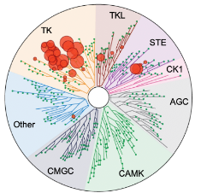
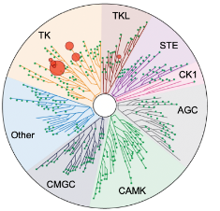
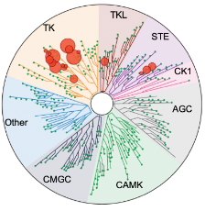
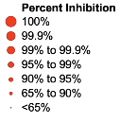
Which BTK Inhibitor Is Best?
Ibrutinib
Acalabrutinib
Zanubrutinib
Kaptein. ASH 2018. Abstr 1871.
Notes:
AE, adverse event; MCL, mantle cell lymphoma; R/R, relapsed/refractory.

Slide 14
Acalabrutinib vs Ibrutinib: ELEVATE-RR
Randomized phase III noninferiority trial of acalabrutinib vs ibrutinib for patients with previously treated CLL; presence of del(17p) or del(11q); no significant CV disease; no prior BTK, PI3K, Syk, or BCL-2 inhibitors (N = 533)
100
HR: 1.00 (95% CI: 0.79-1.27; noninferiority met)
80
60
PFS (%)
40
 | Median PFS, Mo (95% CI)
Acalabrutinib (n = 268) Ibrutinib (n = 265) | 38.4 (33.0-38.6) 38.4 (33.0-41.6)
20
0
0
3
6
9
12
15
18
21
24
27
30
33
36
39
42
45
48
51
54
57
Mo
Byrd. ASCO 2021. Abstr 7500. Byrd. JCO. 2021;39:3441.

Slide 15
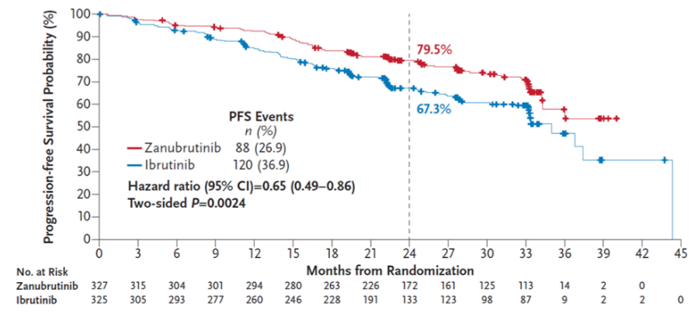
Zanubrutinib vs Ibrutinib: ALPINE
ASH Presentation
Final Analysis Update
LBA-6, Dec 13, 9:00 AM
Randomized phase III trial of zanubrutinib vs ibrutinib for patients with CLL relapsed or refractory to ≥1 previous line of treatment; no prior BTKi (planned N = 652; interim analysis: n = 415)
Brown. ASH 2022. Abstr LBA-6.
Notes:
AE, adverse event; CLL, chronic lymphocytic leukemia; DoR, duration of response; ECOG, Eastern Cooperative Oncology Group; iwCLL, International Workshop on Chronic Lymphocytic Leukemia; PD, progressive disease; PS, performance status; QoL, quality of life; R/R, relapsed/refractory.

Slide 16
Venetoclax + Rituximab Induces Long Remission Durations: MURANO
Randomized, open-label phase III trial of venetoclax + rituximab vs bendamustine + rituximab for patients with R/R CLL; 1-3 prior tx lines (with ≥1 CT-containing regimen) (N = 389)
PFS
PFS by EOT MRD
100
100
80
80
60
60
PFS (%)
Landmark PFS (%)
40
40
20
EOT
20
0
0
0
6
12
18
24
30
36
42
48
54
60
66
72
0
6
12
18
24
30
36
42
48
Mo
Mo Since EOT
Median PFS, Mo
(95% CI)
53.6 (48.4-57.0)
17.0 (15.5-21.7)
HR
(95% CI)
0.19 (0.15-0.26)
P <.0001
 | PFS Since EOT, %
Category | 24-Mo | 36-Mo
uMRD (<10⁻⁴), n = 83 | 85.4 | 61.3
Low-MRD+ (≥10⁻⁴-10⁻²), n = 23 | 52.2 | 40.7
High-MRD+ (≥10⁻²) n = 12 | 8.3
VenR (n = 194)
BR (n = 195)
Seymour. Blood. 2022;140:839.
Notes:
C, cycle; CLL, chronic lymphocytic leukemia; CT, chemotherapy; DoR, duration of response; IRC, independent review committee; MRD, minimal residual disease; PD, progressive disease; R/R, relapsed/refractory; SLL, small lymphocytic leukemia; tx, treatment.

Slide 17
PI3K Inhibitors Demonstrate (Some) Efficacy
Randomized phase III trials of PI3K inhibitors for previously treated CLL
Idela + R
(n = 110)
19.4
(12.3-NR)
Placebo + R
(n = 110)
6.5
(4.0-7.3)
Duv
13.3
(12.1-16.8)
Ofa
9.9
(9.2-11.3)
PFS, median mo (95% CI)
Median PFS, mo (95% CI)
100
HR: 0.52; P <.0001
100
80
Idela + R
Placebo + R
80
Duvelisib (n = 160)
60
Ofatumumab (n = 159
60
Probability of PFS (%)
PFS by ICR (%)
40
40
20
20
0
0
0
2
4
6
8
10
12
14
16
18
20
22
24
0
3
6
9
12
15
18
21
24
27
30
33
36
Mo Since Treatment Assignment
Mo
Sharman. JCO. 2019;37:1391. Flinn. Blood. 2018;132:2446.

Slide 18
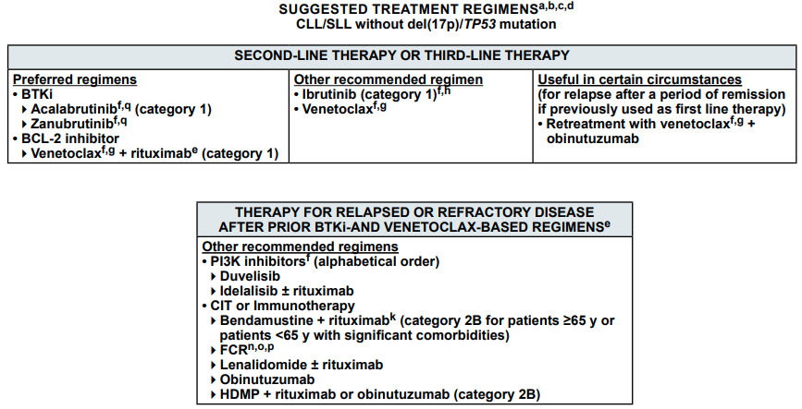
What Do These Data Tell Us?
In the postchemotherapy setting, both BTK and BCL-2 inhibitors are very effective
Reproduced with permission from the NCCN Clinical Practice Guidelines in Oncology (NCCN Guidelines®) for CLL/SLL v1.2023.
© National Comprehensive Cancer Network, Inc 2022. All rights reserved. To view the most recent and complete version of the guideline, go online to nccn.org.

Slide 19

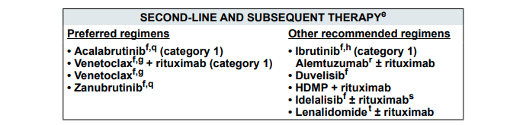
What Do These Data Tell Us?
In the postchemotherapy setting, both BTK and BCL-2 inhibitors are very effective
Reproduced with permission from the NCCN Clinical Practice Guidelines in Oncology (NCCN Guidelines®) for CLL/SLL v1.2023.
© National Comprehensive Cancer Network, Inc 2022. All rights reserved. To view the most recent and complete version of the guideline, go online to nccn.org.

Slide 20
If Prior Treatment Was Covalent BTK Inhibitor . . .
Options remain for targeted therapies: venetoclax + rituximab, idelalisib + rituximab, duvelisib
If progression occurs after ibrutinib discontinued for toxicity, treatment with acalabrutinib is effective
If progression occurs after acalabrutinib discontinued for toxicity, zanubrutinib or other treatments (venetoclax, PI3K inhibitor) are likely effective
If progression occurs during treatment with ibrutinib or acalabrutinib, venetoclax has been shown to be effective (PI3K inhibitors less so)
Resistance to ibrutinib and acalabrutinib and, with less certainty, zanubrutinib is driven by mutations in BTK (C481S)
In the presence of this mutation, covalent inhibitors bind noncovalently, and binding kinetics and short half-life make these agents less effective
However, the mutation does not appear to alter CLL dependence on the BCR pathway

Slide 21
Venetoclax Is Effective After Ibrutinib Discontinuation
Open-label phase II study of venetoclax for patients with relapsed or refractory CLL after BCR inhibitor
(N = 91 previously treated with ibrutinib)
ORR: 65%
Median PFS: 25 mo
MRD negative in peripheral blood
(n = 57 assessed): 42%
PFS by MRD Status
100
75
PFS (%)
HR: 0.23 (95% CI: 0.07-0.80; P = .021)
MRD negative: median NR
(95% CI: 19.2-NR) (n = 24)
MRD positive: 24.7 mo
(95% CI: 15.4-NR) (n = 33)
50
25
0
0
2
4
6
8
10
12
14
16
18
20
22
24
26
28
30
Mo After First Dose
Jones. Lancet Oncol. 2018;19:65.

Slide 22
How Would This Be Different if Venetoclax + Obinutuzumab Were the Prior Therapy?
Many options for targeted therapies
  Ibrutinib
  Acalabrutinib
  Zanubrutinib
  Idelalisib + rituximab
  Duvelisib
Could also consider repeating initial therapy depending on remission duration
What do the data show?

Slide 23
Post-Venetoclax Strategies
Multicenter, retrospective cohort study of outcomes in patients with CLL who discontinued venetoclax-based therapy (N = 326)
Post Venetoclax:
PFS for BTKi in BTKi-Naive Patients
Post Venetoclax:
PFS for PI3Ki in Pi3Ki-Naive Patients
1.00
1.00
0.75
0.75
PFS
PFS
0.50
0.50
0.25
0.25
ORR: 84%; median PFS: 32 mo
ORR: 47%; median PFS: 5 mo
0
0
0
10
20
30
40
50
0
5
10
15
20
Mo
Mo
Patients at Risk, n
42 | 21 | 8 | 4 | 2 | 0
Patients at Risk, n
17 | 9 | 4 | 3 | 1
Mato. Clin Cancer Res. 2020;26:3589.

Slide 24
What If Prior Treatment Were Ibrutinib + Venetoclax
No prospective data exists (yet)
Retrospective and anecdotal data suggest retreatment with either component, or potentially both, is effective

Slide 25
Additional ASH 2022 Abstracts
Abstract | Title | Presenter | Time
LBA-6 | Zanubrutinib Demonstrates Superior Progression-Free Survival (PFS) Compared With Ibrutinib for Treatment of Relapsed/Refractory Chronic Lymphocytic Leukemia and Small Lymphocytic Lymphoma (R/R CLL/SLL): Results From Final Analysis of ALPINE Randomized Phase 3 Study | Brown | Dec 13, 9:00 AM
4434 | Phase 1/2 Study of Acalabrutinib Monotherapy in Patients With Relapsed/Refractory Chronic Lymphocytic Leukemia: Final Results With >4 Years of Follow-up | Furman | Dec 12, 6:00 PM
3133 | Assessing the Burden of Adverse Events in a Head-to-Head Trial of Acalabrutinib Versus Ibrutinib in Previously Treated Chronic Lymphocytic Leukemia (CLL) | Seymour | Dec 11, 6:00 PM
96 | Venetoclax Consolidation Achieves Durable Off-Treatment Remissions in Patients With High-Risk CLL Who Have Been on Ibrutinib More Than a Year | Thompson | Dec 10, 10:45 AM
797 | Real-World Comparison of Time to Next Treatment for Patients With CLL Initiated on First-line Treatment With Ibrutinib Versus Acalabrutinib | Jacobs | Dec 12, 11:30 AM

Slide 26
Conclusions
Therapy for relapsed CLL is rapidly changing, and patients with relapsed disease have a number of therapeutic options
Therapy of relapsed CLL depends heavily on what was chosen for frontline treatment
  Optimal sequencing of therapy is unknown
There is not a role for chemoimmunotherapy in the relapsed setting (limited role in treating CLL/SLL)
There is still progress to be made!

Slide 27

Go Online for More CCO/NCCN
Coverage of CLL!
Downloadable slidesets from today’s presentation (available now!)
On-demand webcast from today’s webinar (available soon at education.nccn.org/CLL)
ClinicalThought commentary where experts answer key questions on the treatment of CLL (coming soon!)
Capsule Summaries of all the key data from ASH 2022 and expert analyses of the
clinical implications
clinicaloptions.com/oncology
NCCN.org

