Slide 1
Expert Guidance and Resources to Personalize Care and Improve Outcomes for Patients With RCC
This program is supported by an educational grant from Bristol-Myers Squibb.
Notes:
RCC, renal cell carcinoma.

Slide 2

About These Slides
Please feel free to use, update, and share some or all of these slides in your noncommercial presentations to colleagues or patients
When using our slides, please retain the source attribution:
These slides may not be published, posted online, or used in commercial presentations without permission. Please contact permissions@clinicaloptions.com for details
Slide credit: clinicaloptions.com
Notes:
Disclaimer: The materials published on the Clinical Care Options Web site reflect the views of the authors of the CCO material, not those of Clinical Care Options, LLC, the CME providers, or the companies providing educational grants. The materials may discuss uses and dosages for therapeutic products that have not been approved by the United States Food and Drug Administration. A qualified healthcare professional should be consulted before using any therapeutic product discussed. Readers should verify all information and data before treating patients or using any therapies described in these materials.

Slide 3
Faculty
Brian A. Costello, MD, MS
Associate Professor of Oncology and Urology
Division of Medical Oncology
Mayo Clinic
Rochester, Minnesota
Brian A. Costello, MD, MS, has no relevant conflicts of interest to report.
Notes:
This slide lists the faculty who were involved in the production of these slides.

Slide 4
First-line Treatment for
Patients With Advanced RCC:
What Is The Right Choice?
Notes:
RCC, renal cell carcinoma.

Slide 5
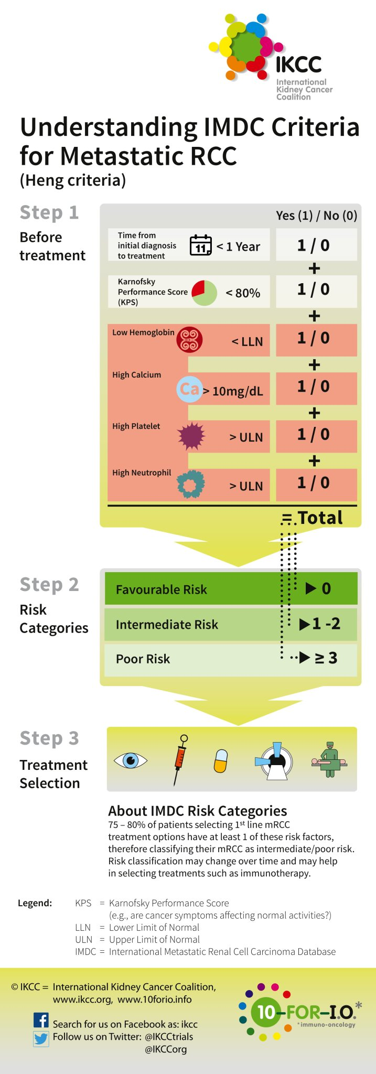

IMDC (Heng) Criteria for Metastatic RCC
International Kidney Cancer Coalition. Heng. JCO. 2009;27:5794.
Slide credit: clinicaloptions.com
Notes:
IMDC, International Metastatic Renal Cell Carcinoma Database; LLN, lower limit of normal; RCC, renal cell carcinoma; ULN, upper limit of normal.

Slide 6
IMDC Prognostic Criteria
Favorable: 0 risk factors
Intermediate: 1-2 risk factors
Poor: 3+ risk factors
100
Favorable
Intermediate
Poor
80
60
OS (%)
40
20
0
0
12
24
36
48
60
Mos Since Therapy Initiation
No. of Events/No. at Risk
Favorable
Intermediate
Poor
11/133
61/301
94/152
16/110
50/182
19/36
4/62
17/82
1/3
2/22
2/18
0/1
0/3
0/3
0/0
Heng. JCO. 2009;27:5794.
Slide credit: clinicaloptions.com
Notes:
IMDC, International Metastatic RCC Database Consortium.

Slide 7
First-line Systemic Therapy for Advanced Clear-Cell RCC
Favorable Risk
Intermediate or Poor Risk
Axitinib + pembrolizumab
Active surveillance (under certain circumstances)
Pazopanib
Sunitinib
Ipilimumab + nivolumab
Axitinib + pembrolizumab
Cabozantinib
Other regimens to consider for specific patients
Ipilimumab + nivolumab
Axitinib + avelumab
Cabozantinib
Axitinib
High-dose IL-2*
Other regimens to consider for specific patients
Pazopanib
Sunitinib
Axitinib + avelumab
Axitinib
High-dose IL-2*
Temsirolimus†
*In patients with excellent performance status and normal organ function. †Based on the poor risk model of the global ARCC trial, including Karnofsky performance status of 60-70, hemoglobin < LLN, corrected calcium > 10 mg/dL, LDH > 1.5 x ULN, and multiorgan metastases.
Slide credit: clinicaloptions.com
Notes:
IL, interleukin; LDH, lactate dehydrogenase; LLN, lower limit of normal; ULN, upper limit of normal.

Slide 8
CARMENA: Prospective, Multicenter, Open-Label, Randomized Phase III Noninferiority Study
Multicenter, randomized, open-label noninferiority phase III trial
Primary endpoint: OS
Secondary endpoints: PFS, ORR (RECIST v1.1), clinical benefit, safety
Stratified by center, MSKCC risk group (intermediate vs high risk)
Confirmed metastatic clear-cell RCC/biopsy;
ECOG PS 0/1; amenable to nephrectomy
eligible for sunitinib; brain metastases absent/controlled by treatment;
no prior systemic therapy for RCC
(N = 450)
Nephrectomy
(n = 226)
3-6 wks
Sunitinib 50 mg QD*
4 wks on/2 wks off
(n = 226)
Follow-up for minimum of 2 yrs
Sunitinib 50 mg QD* 4 wks on/2 wks off
(n = 224)
*Dose reductions/interruptions allowed for managing AEs.
Méjean. ASCO 2018. Abstr LBA3. Méjean. NEJM. 2018;379:417.
Slide credit: clinicaloptions.com
Notes:
AE, adverse event; ECOG, Eastern Cooperative Oncology Group; mets, metastases; MSKCC, Memorial Sloan Kettering Cancer Center; PS, performance status; RCC, renal cell carcinoma; RECIST, Response Evaluation Criteria in Solid Tumors.

Slide 9
CARMENA: Overall Survival (ITT)
100
Median OS, Mos
Nephrectomy → sunitinib 13.9
Sunitinib alone 18.4
90
80
70
64.4
HR: 0.89 (95% CI: 0.71-1.10; noninferiority ≤ 1.20)
Median follow-up: 50.9 mos (range: 0-86.6)
60
50
55.2
Patients Who Were Alive (%)
42.6
40
35.0
29.1
30
20
25.9
10
0
0
12
24
36
48
60
72
84
96
Mos
Patients at Risk, n
Nephrectomy→ sunitinib
Sunitinib alone
226
224
110
128
61
76
40
44
19
26
11
8
4
3
1
1
0
0
Méjean. NEJM. 2018;379:417.
Slide credit: clinicaloptions.com
Notes:
ITT, intention-to-treat.

Slide 10
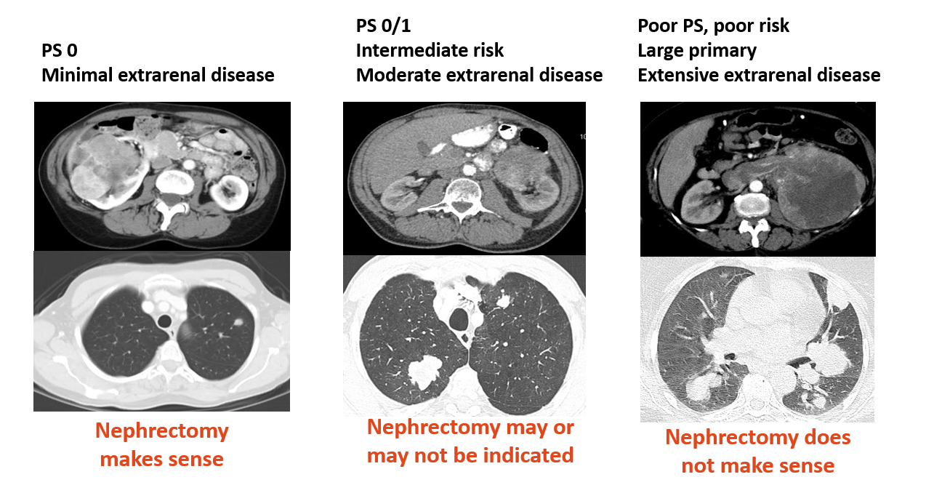
Considerations for Nephrectomy
PS 0/1
Intermediate-risk
Moderate extrarenal disease
Poor PS, poor-risk
Large primary
Extensive extrarenal disease
PS 0
Minimal extrarenal disease
Nephrectomy
makes sense
Nephrectomy may or may not make sense
Nephrectomy does not make sense
Slide credit: clinicaloptions.com
Notes:
PS, performance status.

Slide 11
Active Surveillance
In a subset of patients with slow growing mets, systemic therapy may be deferred
Some retrospective data and one prospective trial
  Mitchell and colleagues^{[1]}
    Retrospective ACAD-COMM mRCC database (2007-2011)
    60/268 (22%) of patients at Duke—no systemic therapy within 1 yr of mRCC diagnosis
    Median follow up: 53 mos; 5-yr OS: 59%
  Rini and colleagues^{[2]}
    Multicenter, prospective trial of “active surveillance,” N = 48 (2008-2013)
    Median follow up: 38 mos; median time on surveillance: 14.9 mos
    Median TTP: 9.4 mos; median OS: 44.5 mos
1. Mitchell. Clin Genitourin Cancer. 2015;13:e159. 2. Rini. Lancet Oncol. 2016;17:1317.
Slide credit: clinicaloptions.com
Notes:
mets, metastases; mRCC, metastatic renal cell carcinoma; TTP, time to tumor progression.

Slide 12
Prospective Phase II Observational Study in
Patients With Asymptomatic Metastatic RCC
Patients with clinically evident metastatic RCC of any histologic subtype (N = 48)
First documentation (radiographic or histologic) of metastatic RCC up to
12 mos prior to registration on study
No prior systemic therapy for RCC in the metastatic or neo/adjuvant setting
Prior XRT (including for CNS metastases) and prior nephrectomy/metastasectomy permitted but not required
No disease-related symptoms
Measurable/evaluable disease per RECIST v1.0
Initiation of systemic treatment
per doctor/ patient discretion
CT every 3 mos in Yr 1, every 4 mos in Yr 2,
then every 6 mos
FKSI-DRS (QoL) and HADS (anxiety/depression) assessments administered at baseline and at every CT scan timepoint
Peripheral blood for immune cell quantification drawn at baseline and at every CT scan time point
Rini. Lancet Oncol. 2016;17:1317.
Slide credit: clinicaloptions.com
Notes:
CNS, central nervous system; CT, chemotherapy; FKSI-DRS, Functional Assessment of Cancer Therapy-Kidney Symptom Index-disease related symptoms; HADS, hospital anxiety and depression scale; QoL, quality of life; RCC, renal cell carcinoma; RECIST, Response Evaluation Criteria in Solid Tumors; XRT, radiation therapy.

Slide 13
Prospective Observation Study: Outcomes
1.0
OS
38.6 mos
14.9 mos
9.4 mos
Median absolute change in tumor burden during surveillance: 1.3 cm
  Relative change: 31%
  Median growth rate: 0.09 cm/mo
23/43 (53%) patients with progressive disease immediately started systematic therapy after progression and 20/43 (47%) continued on surveillance
  Median additional surveillance period for these patients: 15.8 mos
Observation time
0.9
Time to progression
0.8
0.7
0.6
0.5
Percent
0.4
0.3
0.2
0.1
0
0
6
12
18
24
30
36
42
48
54
60
Mos
Rini. Lancet Oncol. 2016;17:1317.
Slide credit: clinicaloptions.com

Slide 14
MaRCC Registry: Prospective Observational Registry Data
MaRCC Registry
(N = 504)
46 US sites: Academic (N = 20), Community (N = 26)
March 24, 2014 to December 22, 2016
Without both start and end date for ST (N = 11)
Inconsistent start and end dates for ST (n = 2)
On study for only 1 day (n = 2)
Evaluable Patients
(N = 489)
Physician’s initial choice of
management on PTSAS
New ST selected for patient
(n = 280)
14% Favorable
65% Intermediate
22% Poor
(N = 305)
Other reason for no ST selected for patient
(n = 41)
Length of time from
survey completion to ST
Started ST ≤ 90 days after PTSAS completion
(n = 25)
28%
20% Community
80% Academic
Active Surveillance Cohort (N = 143)
60% Favorable
38% Intermediate
2% Poor risk
Slide courtesy of Dr. Michael Harrison, Duke University. Publication in press.
Slide credit: clinicaloptions.com
Notes:
ST, systemic treatment.

Slide 15

Prospective Observational Registry Data
Systemic Therapy–Free Survival
OS (AS vs ST Patients)
1.0
1.0
AS
ST
Early treatment → lead time bias?
Increased costs?
0.8
0.8
Median: NR (95% CI: 122 mos to NR)
0.6
0.6
Probability of
Systemic-Therapy Free Survival
Probability of OS
0.4
0.4
0.2
0.2
Median: 30 mos (95% CI: 25-44)
0
Median time on surveillance: 54 mos (95% CI: 32-90)
0
0
6
12
18
24
30
36
42
48
54
60
0
12
24
36
48
60
72
Mos From Metastatic Diagnosis to Systemic Therapy
Pts at Risk, n
AS
ST
Mos From Metastatic Diagnosis
Pts at Risk,
n
143
304
138
206
112
132
72
46
44
17
31
8
23
6
143
124
105
87
73
61
47
41
38
29
24
Suggests clinicians were able to select patients for AS with very good results based on their clinical judgment and/or intuitive sense
Slide courtesy of Dr. Michael Harrison, Duke University. Publication in press.
Slide credit: clinicaloptions.com
Notes:
AS, active surveillance; NR, not reached; ST, systemic treatment

Slide 16
The Argument for Active Surveillance
In selected patients (favorable risk, others?) active surveillance:
  Avoids the certain toxicity of systemic therapy
  Without clearly compromising the benefit of therapy when initiated
Current management guidelines list active surveillance as useful in certain circumstances
The selection and outcomes of patients undergoing active surveillance for mRCC have not been well described
Slide courtesy of Dr. Michael Harrison, Duke University.
Slide credit: clinicaloptions.com
Notes:
mRCC, metastatic renal cell carcinoma.

Slide 17
Considerations for Systemic Therapy for RCC
Multiple good systemic therapy options for mRCC, with no obvious clear choice in some cases
Good-risk patients and those with “favorable/intermediate risk” can have survival of many yrs—with and without therapy
Consider debulking nephrectomy and/or active surveillance in selected patients
Beware of irAEs; please see patients OFTEN
Predictive biomarkers of response yet to be identified
Slide credit: clinicaloptions.com
Notes:
irAE, immune-related adverse event; mRCC, metastatic renal cell carcinoma; RCC, renal cell carcinoma.

Slide 18
Frontline RCC Therapy: Recent Phase III Trials
CheckMate 214: ipilimumab/nivolumab vs sunitinib (OS benefit)
KEYNOTE-426: pembrolizumab/axitinib vs sunitinib (OS benefit)
CheckMate 9ER: nivolumab/cabozantinib vs sunitinib (OS benefit)
Others:
  Avelumab/axitinib vs sunitinib (PFS benefit, FDA approved)
  Atezolizumab/bevacizumab vs sunitinib (PFS benefit, not approved)
  Pembrolizumab/lenvatinib vs sunitinib (completed, not yet reported)
Slide credit: clinicaloptions.com

Slide 19
CheckMate 214: Nivolumab + Ipilimumab vs Sunitinib for Untreated Advanced RCC
Randomized phase III study in which patients with untreated advanced RCC were treated with nivolumab + ipilimumab vs sunitinib (N = 1096; extended follow-up: minimum 48 mos)
Outcome | Patient (N = 1096)
 | Nivo + Ipi (n = 550) |  | Sunitinib (n = 546)
ORR, % (95% CI) | 39.1 (35-43) |  | 32.4 (29-37)
 | P = .0134
Median PFS, mos (95% CI) | 12.2 (9.7-16.5) |  | 12.3 (9.8-15.2)
 | HR: 0.89 (95%: 0.76-1.05)
Median OS, mos (95% CI) | NR (46.7-NE) | 38.4 (32.0-45.0)
 | HR: 0.69 (95%: 0.59-0.81)
100
OS (ITT)
Nivolumab + ipilimumab
80
Sunitinib
70.7%
60
53.4%
Nivo + Ipi
OS (%)
60.5%
40
43.3%
Sunitinib
20
HR: 0.69
(95% CI: 0.59-0.81)
0
0
6
12
18
24
30
36
42
48
54
60
66
Mos
Albiges. ESMO Open. 2020;5:epub001079.
Slide credit: clinicaloptions.com
Notes:
Ipi, ipilimumab; ITT, intention-to-treat; NE, not estimable; Nivo, nivolumab; NR, not reached; RCC, renal cell carcinoma.

Slide 20
KEYNOTE-426: Pembrolizumab + Axitinib in
Treatment-Naive Advanced RCC
Randomized phase III study for patients with untreated advanced RCC were treated with pembrolizumab + axitinib vs sunitinib (N = 861; extended follow-up: minimum 23 mos)
PFS in ITT Population
OS in ITT Population
100
100
Median PFS, Mos (95% CI)
Pembro + Axi 15.4 (12.7-18.9)
Sunitinib 11.1 (9.1-12.5)
90
90%
90
80
80
74%
70
70
79%
60
60%
60
66%
OS (%)
PFS (%)
50
50
38%
40
48%
40
Median OS, Mos (95% CI)
Pembro + Axi NR (NR-NR)
Sunitinib 35.7 (33.3-NR)
30
30
20
27%
20
10
HR: 0.71 (95% CI: 0.60-0.84; P* < .0001)
10
HR: 0.68 (95% CI: 0.55-0.85; P* < .0003)
0
0
0
6
12
18
24
30
36
42
0
6
12
18
24
30
36
42
Mos
Mos
Patients at Risk, n
Patients at Risk, n
432
429
300
248
234
159
180
112
109
61
37
19
2
0
0
0
432
429
408
379
385
336
346
306
305
268
168
134
23
16
0
0
*Nominal P value.
Powles. Lancet Oncol. 2020;21:1563.
Slide credit: clinicaloptions.com
Notes:
Axi, axitinib; ITT, intention-to-treat; NR, not reached; Pembro, pembrolizumab; RCC, renal cell carcinoma.

Slide 21
KEYNOTE-426: Pembrolizumab + Axitinib in
Treatment-Naive Advanced RCC
Response^{[1]} | Pembrolizumab/Axitinib (n = 432) | Sunitinib (n = 429)
ORR, % (95% CI) | 60 (55.4-64.8) | 40 (35.2-44.7)
Best overall response, n (%)
CR | 38 (9) | 13 (3)
PR | 222 (51) | 158 (37)
SD | 100 (23) | 150 (35)
PD | 49 (11) | 74 (17)
Not evaluable | 7 (2) | 6 (1)
Not assessed | 16 (4) | 28 (7)
Median DoR, mos (range) | 23.5 (19.4-29.0) | 15.9 (13.8-20.4)
The median time to response for pembrolizumab + axitinib was 2.8 mos (range: 1.5-16.6) and
2.9 mos (range: 2.1-15.1) for sunitinib^{[2]}
1. Powles. Lancet Oncol. 2020;21:1563. 2. Rini. NEJM 2019;380:1116.
Slide credit: clinicaloptions.com
Notes:
DoR, duration of response; PD, progressive disease; RCC, renal cell carcinoma; SD, stable disease; TTR, time to relapse.

Slide 22
JAVELIN Renal 101: Avelumab + Axitinib in
Treatment-Naive Advanced RCC
Randomized phase III study for patients with untreated advanced RCC were treated with avelumab + axitinib vs sunitinib (N = 886; median follow-up: ~ 19 mos)
PFS in ITT Population
OS in ITT Population
PFS (%)
100
Median PFS, Mos (95% CI)
Avelumab + axitinib: 13.3 (11.1-15.3)
Sunitinib: 8.0 (6.7-9.8)
HR: 0.69 (95% CI: 0.574-0.825; P < .0001)
OS (%)
100
90
90
80
80
70
70
60
60
50
50
Median OS, Mos (95% CI)
Avelumab + axitinib: NR (30.0-NE)
Sunitinib: NR (27.4-NE)
HR: 0.8 (95% CI: 0.616-1.027; P = .0392)
40
40
30
30
20
20
10
10
0
0
0
2
4
6
8
10
12
14
16
18
20
22
24
26
28
30
32
34
0
2
4
6
8
10
12
14
16
18
20
22
24
26
28
30
32
34
Mos
Mos
Choueiri. Ann Oncol. 2020;31:1030.
Slide credit: clinicaloptions.com
Notes:
ITT, intention-to-treat; NE, not estimable; NR, not reached; RCC, renal cell carcinoma.

Slide 23
CheckMate 9ER: First-line Nivolumab + Cabozantinib vs Sunitinib in Advanced or Metastatic RCC
Randomized phase III study for patients with untreated advanced RCC were treated with nivolumab + cabozantinib vs sunitinib (N = 651; median follow-up: 18.1 mos)
PFS in ITT Population (Primary Endpoint)
Key Outcomes | Nivo + Cabo (n = 323) | Sunitinib (n = 328)
Median PFS, mos | 16.6 | 8.3
Median OS, mos | NR | NR
 | HR: 0.60 (98.89% CI: 0.40-0.89; P = .001)
ORR, % | 55.7* | 27.1*
CR | 8.0 | 4.6
PR | 47.7 | 22.6
SD | 32.2 | 42.1
PD | 5.6 | 13.7
Median DoR, mos | 20.2 | 11.5
1.0
0.8
0.6
Probability of PFS
Nivo + Cabo
0.4
0.2
HR: 0.51 (95% CI: 0.41-0.64; P < .0001)
Sunitinib
0
0
3
6
9
12
15
18
21
24
27
Pts at Risk, n
Nivo + Cabo
Sunitinib
Mos
323
328
279
228
234
159
196
122
144
79
77
31
35
10
11
4
4
1
0
0
PFS benefit observed across all subgroups assessed
*P < .0001
Choueiri. ESMO 2020. Abstr 696O.
Slide credit: clinicaloptions.com
Notes:
Cabo, cabozantinib; Nivo, nivolumab.

Slide 24
CheckMate 9ER: Summary of Nivolumab + Cabozantinib vs Sunitinib in Advanced RCC
In CheckMate 9ER, first-line nivolumab + cabozantinib significantly improved efficacy outcomes vs sunitinib in patients with advanced RCC
  PFS: risk of PD or death decreased by 49%
  OS: risk of death decreased by 40%
  ORR: increased by 29%
Survival and response benefits of nivolumab + cabozantinib noted across patient subgroups (eg, IMDC risk status, PD-L1 expression level, bone mets)
Nivolumab + cabozantinib well tolerated, with few discontinuations
Quality of life per PROs was significantly better with nivolumab + cabozantinib
Nivolumab + cabozantinib now FDA approved as first-line therapy for advanced RCC
Choueiri. ESMO 2020. Abstr 696O.
Slide credit: clinicaloptions.com
Notes:
IMDC, International Metastatic RCC Database Consortium; PD, progressive disease; PRO, patient-reported outcome; RCC, renal cell carcinoma.

Slide 25
Data on Patients with Favorable Risk Disease

Slide 26
CheckMate 214: OS and Response by
IMDC Risk Category
OS in Intermediate-Risk and Poor-Risk Patients
OS in Favorable-Risk Patients
100
100
88.2%
80
80
66.4%
85.1%
68.9%
Nivo + Ipi
60
50.0%
Nivo + Ipi
60
65.1%
OS (%)
OS (%)
40
52.4%
40
Sunitinib
35.8%
Nivo + Ipi (n = 125)
Nivo + Ipi (n = 425)
Sunitinib
20
Sunitinib (n = 422)
20
Sunitinib (n = 124)
0
HR: 0.65 (95% CI: 0.54-0.78)
0
HR: 0.93 (95% CI: 0.62-1.40)
0
6
12
18
24
30
36
42
48
54
60
66
0
6
12
18
24
30
36
42
48
54
60
66
Mos
Mos
Outcome in Favorable-Risk Patients | Nivo + Ipi (n = 125) | Sunitinib (n = 124) | HR (95% CI) | P Value
ORR, % (95% CI) | 29.6 (22-38) | 51.6 (43-61) | -- | < .0005
Median PFS, mos (95% CI) | 12.4 (9.7-18.0) | 28.9 (22.1-38.4) | 1.84 (1.29-2.62) | --
Albiges. ESMO Open. 2020;5:epub001079.
Slide credit: clinicaloptions.com
Notes:
IMDC, International Metastatic Renal Cell Carcinoma Database Consortium; Ipi, ipilimumab; Nivo, nivolumab.

Slide 27
KEYNOTE-426: OS, PFS, and ORR in IMDC Favorable-Risk Group
OS^{[1]}
HR: 1.06 (95% CI: 0.60-1.86;
P = .58*)
PFS^{[1]}
HR: 0.76 (95% CI: 0.57-1.09;
P = .078*)
ORR^{[2]}
69.6% vs 50.4%
100
100
90
90
Events, n
77
75
Median, Mos (95% CI)
20.8 (15.4-28.8)
18.0 (12.5-20.8)
100
CR
PR
80
80
90
85%
88%
70
70
80
11% CR
60
60
70
45%
50
50
60
OS (%)
PFS (%)
6% CR
40
40
50
ORR (%)
30
30
35%
40
Events, n Median
26 NR
24 NR
30
20
20
10
10
20
0
0
10
Patients at Risk, n
0
6
12
18
24
30
36
42
0
6
12
18
24
30
36
42
0
Mos
Mos
Pembro + Axi
Sunitinib
P + A
S
138
131
134
129
131
123
126
118
110
108
63
60
12
9
0
0
138
131
111
99
88
66
67
46
41
26
13
8
0
0
0
0
1. Powles. Lancet Oncol. 2020;21:1563. 2. Plimack. ASCO 2020. Abstr 5001.
Slide credit: clinicaloptions.com
*Nominal P value.
Notes:
A, axitinib; Axi, axitinib; IMDC, International Metastatic RCC Database Consortium; NR, not reached; P, pembrolizumab; Pembro, pembrolizumab; S, sunitinib.

Slide 28
Data on Patients with Intermediate or
Poor Risk Disease

Slide 29
What is the long-term “big picture” benefit achieved in patients with IMDC intermediate-/poor-risk RCC receiving these new standard regimens?
Notes:
IMDC, International Metastatic Renal Cell Carcinoma Database; RCC, renal cell carcinoma.

Slide 30
OS for Intermediate-/Poor-Risk Disease
CheckMate 214: Nivo + Ipi vs Sunitinib Intermediate-/Poor-Risk Disease (n = 847)^{[1]}
KEYNOTE-426: Axitinib + Pembro vs Sunitinib
Intermediate-/Poor-Risk Disease (n = 592)^{[2,3]}
100
100
90
69%
56%
80
80
66.4%
70
60
50.0%
60
OS (%)
Nivo + Ipi
50
40
52.4%
OS (%)
40
35.8%
30
Median OS, Mos (95% CI)
NR
28.8 (23.7-34.3)
20
Median OS, Mos (95% CI)
48.1*(35.6-NE)
26.6 (22.1-33.5)
Sunitinib
Nivo + Ipi (n = 425)
Sunitinib (n = 422)
20
HR: 0.65
(95% CI: 0.54-0.78)
Pembro + Axi
Sunitinib
HR: 0.63
(95% CI: 0.50-0.81)
0
10
0
6
12
18
24
30
36
42
48
54
60
66
0
Mos
0
6
12
18
24
30
36
42
Mos
Similar outcome on same comparator arm
Early separation of curves for both
Longer follow-up for CheckMate 214
*Nivo + Ipi 47 mos median OS may be unstable due to censoring.
1. Albiges. ESMO Open. 2020;5:epub001079. 2. Plimack. ASCO 2020. Abstr 5001. 3. Powles. Lancet Oncol. 2020;21:1563.
Slide credit: clinicaloptions.com
Notes:
Axi, axitinib; Ipi, ipilimumab; NE, not estimable; Nivo, nivolumab; NR, not reached; Pembro, pembrolizumab;

Slide 31
Response Rate for IMDC Intermediate-/Poor-Risk Disease
CheckMate 214: Nivo + Ipi^{[1]}
KEYNOTE-426: Axitinib + Pembro^{[2,3]}
Response, % | Patients (n = 425)
Confirmed ORR | 41.9
CR | 10.4
PR | 31.5
SD | 30.8
PD | 19.3
Response, % | Median F/U: 16.6 Mos (n = 294) | Minimum F/U 23 Mos (n = 294)
ORR | 55.4 | 55.8
CR | 6.5 | 8
PR | 49.0 | 47.8
SD | 23.5 | Not reported
PD | 14.6 | Not reported
1. Albiges. ESMO Open. 2020;5:epub001079. 2. Soulières. IKCS 2019. 3. Plimack. ASCO 2020. Abstr 5001.
Slide credit: clinicaloptions.com
Notes:
F/U, follow-up; IMDC, International Metastatic Renal Cell Carcinoma Database; Ipi, ipilimumab; Nivo, nivolumab; PD, progressive disease; Pembro, pembrolizumab; SD, stable disease.

Slide 32
Is There Durable Benefit From Therapy?
Response Duration With Current Regimens
CheckMate 214: Nivo + Ipi in ITT Responders
(n = 225)^{[1]}
KEYNOTE-426: Axitinib + Pembro in ITT Responders (n = 259)^{[2]}
100
Overall Response (%)
24 mos: curve starts to plateau for Nivo + Ipi
80
Median DoR, Mos
Pembro + Axi: 23.5 (95% Cl: 19.4-29.0)
Sunitinib: 15.9 (95% Cl: 13.8-20.4)
100
71%
60
80
64%
47%
24 mos: Curve not yet at plateau
38%
40
Median DoR, Mos
Nivo + Ipi NR
Sunitinib 18.0
HR: 0.51 (95% CI: 0.38-0.68)
60
Overall Response (%)
Pembro + Axi
40
20
Sunitinib
20
0
0
0
3
6
9
12
15
18
21
24
27
30
33
36
39
0
6
12
18
24
30
36
42
Mos From Randomization
Mos
Patients at Risk, n (number censored)
Patients at Risk, n (number censored)
Nivo + Ipi
Sunitinib
225
(0)
186
(0)
205
(5)
164
(9)
175
(10)
136
(17)
160
(13)
116
(19)
146
(16)
98
(21)
136
(19)
86
(24)
120
(27)
72
(30)
111
(29)
60
(34)
102
(34)
49
(37)
90
(43)
40
(40)
55
(77)
27
(48)
20
(112)
7
(64)
4
(127)
0
(69)
0
(131)
0
(69)
218 (11)
124 (16)
172 (16)
89 (25)
136 (22)
52 (40)
58 (80)
18 (65)
12 (121)
4 (78)
0 (132)
0 (82)
0 (132)
0 (82)
Pembro + Axi
Sunitinib
260 (0)
171 (0)
1. Motzer. Lancet Oncol. 2019;20:1370. 2. Powles. Lancet Oncol. 2020;21:1563.
Notes:
Axi, axitinib; DoR, duration of response; Ipi, ipilimumab; ITT, intention-to-treat; Nivo, nivolumab; NR, not reached;; Pembro, pembrolizumab;

Slide 33
PFS for IMDC Intermediate-/Poor-Risk Disease
CheckMate 214: Nivo + Ipi vs Sunitinib (n = 847)^{[1]}
KEYNOTE-426: Axitinib + Pembro vs Sunitinib (n = 592)^{[2]}
100
1
Median PFS, Mos
Nivo + Ipi 11.2 (8.4-16.1)
Sunitinib 8.3 (7.0-11.8)
90
Median PFS, Mos
Pembro + Axi 12.7 (11.3-18.0)
Sunitinib 8.3 (6.7-10.1)
80
0.8
70
0.6
60
PFS (%)
50
34%
23%
0.4
36.4%
32.7%
40
Nivo + Ipi
30
0.2
25.1%
20
?
HR: 0.74 (95% CI: 0.62-0.88)
12.3%
Sunitinib
10
HR: 0.69 (95% CI: 0.56-0.84)
0
0
0
6
12
18
24
30
36
42
48
54
60
0
6
12
18
24
30
36
42
Mos
Patients at Risk, n
P + Axi
Sunitinib
Mos
294
298
189
149
146
93
113
66
68
35
23
11
2
0
0
0
1. Albiges. ESMO Open. 2020;5:epub001079. 2. Powles. Lancet Oncol. 2020;21:1563.
Slide credit: clinicaloptions.com
Notes:
Axi, axitinib; IMDC, International Metastatic Renal Cell Carcinoma Database; Ipi, ipilimumab; Nivo, nivolumab; P, pembrolizumab; Pembro, pembrolizumab.

Slide 34
Immune-Related AEs

Slide 35
Treatment-Related AEs for Combination Therapy vs TKI Alone
CheckMate 214: Nivo + Ipi vs Sunitinib in ITT Population^{[1]}
KEYNOTE-426: Axitinib + Pembro vs Sunitinib in
ITT Population^{[2]}
Nivo + Ipi Group
(n = 547)
Sunitinib Group (n = 535)
Pembro + Axitinib
Sunitinib
Diarrhea
28.2
3.8
5.8
52.7
Diarrhea
51.5
42.6
Fatigue
37.8
4.4
9.5
49.7
Hypertension
42.9
43.5
Palmar-plantar erythrodysesthesia
1.1
9.2
43.6
28.4
39.8
2.2
16.8
Palmar–plantar erythrodysesthesia
Hypertension
40.9
31.2
34.4
Nausea
20.1
1.5
1.3
38.3
Fatigue
Dysgeusia
5.7
33.6
Hypothyroidism
33.8
29.9
Mucosal inflammation
2.6
2.8
28.8
Nausea
22.4
27.3
Stomatitis
4.4
2.6
28.0
22.8
26.1
Hypothyroidism
16.3
26.0
Decreased appetite
Decreased appetite
13.9
1.3
1.1
25.2
Dysgeusia
10.5
30.8
Grade 1/2
Grade 3-5
Grade 1/2
Grade 3-5
Vomiting
11.0
1.9
21.5
ALT increased
24.5
13.2
Dyspepsia
2.9
18.1
AST increased
23.1
14.1
Thrombocytopenia
0.5
4.3
17.8
Asthenia
13.5
1.8
2.4
17.2
Stomatitis
14.5
20.2
Anemia
6.6
4.3
15.5
Mucosal inflammation
13.1
21.4
Rash
22.7
1.6
12.9
Dysphonia
23.1
3.1
Increased lipase concentration
16.8
10.4
6.7
11.4
2.3
22.6
Pruritus
29.3
9.2
Thrombocytopenia
60
50
40
30
20
10
0
10
20
30
40
50
60
100
90
80
70
60
50
40
30
20
10
0
10
20
30
40
50
60
70
80
90
100
Patients (%)
Patients (%)
Nivo + Ipi grade 3/4 AEs
Nivo + Ipi any-grade AEs
Sunitinib grade 3/4 AEs
Sunitinib any-grade AEs
1. Motzer. Lancet Oncol. 2019;20:1370. 2. Soulières. IKCS 2019.
Slide credit: clinicaloptions.com
Notes:
AE, adverse event; ALT, alanine aminotransferase; AST, aspartate aminotransferase; Ipi, ipilimumab; ITT, intention-to-treat; Nivo, nivolumab.

Slide 36

CheckMate 214: Health-Related Quality of Life in IMDC Intermediate-/Poor-Risk Patients
10
9
8
7
Nivolumab + ipilimumab
6
5
4
3
2
1
Mean Change From Baseline FKSI-19 Score
0
-1
-2
-3
-4
-5
-6
Sunitinib
-7
-8
-9
-10
0
4
8
12
16
20
24
28
32
36
40
44
48
52
56
60
64
68
72
76
80
84
88
92
96
100
0
104
Patients at Risk, n
Nivolumab + ipilimumab
Sunitinib
Wk
425
422
347
371
281
284
239
221
212
184
180
147
166
127
152
113
143
104
139
93
125
80
108
64
76
43
44
26
Rini. NEJM. 2019;380:1116.
Slide credit: clinicaloptions.com
Notes:
IMDC, International Metastatic Renal Cell Carcinoma Database.

Slide 37
Considerations for Toxicity With IO/IO vs IO/TKI
Event, % | CheckMate 214: Nivo + Ipi^{[1]} | KEYNOTE-426: Axitinib + Pembro^{[3]}
Any Tx-related AEs (immune related) | 94 (81) | 96 (56)
Grade 3/4 Tx-related AEs | 48 | 66
Discontinued for Tx-related AEs | 23 | 21 (7 both drugs)
Death from Tx-related causes | 1 | 1
Event, % | CheckMate 214: Nivo + Ipi^{[1,2]} | KEYNOTE-426: Axitinib + Pembro
Immune-related AEs requiring systemic corticosteroids ≥ 40 mg prednisone daily or equivalent | 60 29 | NR
Resolution of immune-related AEs GI, renal, hepatic, or pulmonary Skin Endocrine | > 80 74 45.6 | NR
1. Albiges. ESMO Open. 2020;5:epub001079 2. Motzer. Lancet Oncol. 2019;20:1370. 3. Powles. Lancet Oncol. 2020;21:1563.
Slide credit: clinicaloptions.com
Notes:
AE, adverse event; GI, gastrointestinal; Ipi, ipilimumab; Nivo, nivolumab; NR, not reported; Pembro, pembrolizumab; Tx, treatment.

Slide 38
First-line Treatment Considerations for RCC: Summary
Multiple good systemic therapy options for metastatic RCC, with no obvious clear choice in some cases
Favorable-risk patients, and those with “favorable intermediate” risk, can have survival of many yrs—with and without therapy
Consider debulking nephrectomy and/or active surveillance in selected patients
Patients with:
IMDC intermediate-/poor-risk disease
No significant autoimmune disease
VEGF contraindications
A need to avoid chronic VEGF AEs
Consider
Nivo + Ipi
Consider IO + TKI
Patients with
IMDC favorable- or intermediate-risk disease
Intermediate- or poor- risk disease who need rapid response
A need to avoid irAEs associated with dual IO therapy
Slide credit: clinicaloptions.com
Notes:
AE, adverse event; IMDC, International Metastatic Renal Cell Carcinoma Database; IO, immuno-oncology; Ipi, ipilimumab; Nivo, nivolumab; Pembro, pembrolizumab; RCC, renal cell carcinoma.

Slide 39
Phase III Trials on the Radar Screen For First-Line Therapy
Study | Treatment | Setting | Phase | Status | N
Metastatic RCC
CLEAR (NCT02811861) | Len + Pembro vs Sunitinib vs Len + Eve | First line | III | Completed accrual | 1100
CheckMate-9ER (NCT03141177) | Cabo + Nivo vs Sunitinib | First line | III | Completed accrual | 500+
COSMIC 313 (NCT03937219) | Cabo + Nivo + Ipi vs Nivo + Ipi | First line | III | Accruing | 700+
Locally Advanced/Adjuvant
KEYNOTE 564 (NCT03142334) | Pembro vs Placebo | T2, T3, N1 M1 NED | III | Completed accrual | 950
CHECKMATE-914 (NCT03138512) | Nivo + Ipi vs Placebo | T2, T3, T4, N1, NED | III | Accruing | 800
ClinicalTrials.gov
Slide credit: clinicaloptions.com
Notes:
Cabo, cabozantinib; Eve, everolimus; Ipi, ipilimumab; Len, lenvatinib; Pembro, pembrolizumab; RCC, renal cell carcinoma.

Slide 40
Treatment Options for
Patients With RCC Progressing on Previous Therapy
Notes:
RCC, renal cell carcinoma.

Slide 41
Sequencing of Approved Agents 2012-2015:
Simpler Times
VEGF TKI
Sunitinib
Pazopanib
Axitinib
Sorafenib
Everolimus
TKI
mTORi
TKI
TKI
TKI
mTORi
mTOR inhibitor
Slide credit: clinicaloptions.com

Slide 42
FDA Approved Regimens for Advanced RCC
Cabozantinib Lenvatinib + Everolimus
2016
Nivolumab + Ipilimumab
2018
IL-2
1992
Sorafenib
2005
Temsirolimus
2007
Axitinib
2012
2019
Pembro + Axitinib
Avelumab + Axitinib
2015
Nivolumab
2017
Sunitinib
(Adjuvant)
2020
2006
Sunitinib
2009
Pazopanib
Bev + IFN
Everolimus
Slide credit: clinicaloptions.com
Notes:
Bev, bevacizumab; IFN, interferon; IL, interleukin; RCC, renal cell carcinoma.

Slide 43
Therapies for Relapsed or Refractory Stage IV RCC
Second-line treatments for advanced or metastatic RCC may include targeted therapies and immunotherapy combinations
Immunotherapy-Based Regimens
Targeted Therapies
Other Targeted Treatments for Select Circumstances
Nivolumab
Nivolumab + ipilimumab
Axitinib + pembrolizumab
Axitinib + avelumab
Cabozantinib
Axitinib
Lenvatinib + everolimus
Everolimus
Pazopanib
Sunitinib
Bevacizumab
Sorafenib
High-dose IL-12
Temsirolimus
Slide credit: clinicaloptions.com
Notes:
IL, interleukin; RCC, renal cell carcinoma.

Slide 44
Sequencing of Approved Agents:
Now
VEGF TKI
mTORi
IO + IO
TKI + mTORi
IO + TKI
IO
Slide credit: clinicaloptions.com

Slide 45
Pivotal Randomized Trials in Clear-Cell RCC
Post TKI Therapy
Phase III
Phase II
Parameter | RECORD-1^{[1,2]} | AXIS^{[3,4]} | METEOR^{[5,6]} | CheckMate 025^{[7]} | LEN EVE^{[8]}
 | Everolimus vs Placebo | Axitinib vs Sorafenib | Cabozantinib vs Everolimus | Nivolumab vs Everolimus | Lenvatinib + Everolimus vs Everolimus
Patients, n | 410 | 723 | 658 | 821 | 153
MSKCC risk, %
Good | 29 | 28 | 46 | 36 | 23
Intermediate | 56 | 37 | 42 | 49 | 36
Poor | 15 | 33 | 13 | 15 | 40
Prior TKI | Anti-VEGF | Sunitinib | Anti-VEGF | Anti-VEGF | Anti-VEGF
Line of therapy | 2nd or beyond | 2nd | 2nd or beyond | 2nd or 3rd | 2nd
ORR, % | 2 vs 0 | 19 vs 9 | 21 vs 5 | 25 vs 5 | 43 vs 3
Median OS, mos | 14.8 vs 14.0 | 20.1 vs 19.2 | 21.4 vs 17.1 | 25.0 vs 19.6 | 25.5 vs 15.4
1. Motzer. Lancet. 2008;372:449. 2. Motzer. Cancer. 2010;116:4256. 3. Rini. Lancet. 2011;378:1931. 4. Motzer. Lancet Oncol. 2013;14:552. 5. Choueiri. NEJM. 2015;373:1814. 6. Motzer. Br J Cancer. 2018;118:1176. 7. Motzer. NEJM. 2015;373:1803. 8. Motzer. Lancet. 2015;16:1473.
Slide credit: clinicaloptions.com
Notes:
MSKCC, Memorial Sloan Kettering Cancer Center; RCC, renal cell carcinoma.

Slide 46

Phase II KEYNOTE-146/Study 111 of Lenvatinib + Pembrolizumab After Progression on Previous IO Therapy
A multicenter, open-label phase Ib/II study, RCC cohort (N = 104)
Patients metastatic clear-cell RCC with PD after anti–PD-1/ PD-L1 therapy; ≥ 1 previous lines of therapy
(N = 104)
Primary Endpoint:
ORR at 24 wks
Key Secondary Endpoints:
ORR, PFS, DoR
Safety and tolerability
Lenvatinib 20 mg QD PO
Pembrolizumab 200 mg Q3W IV
Baseline Characteristic | Patients (N = 104)
1/ ≥ 2 Prior anticancer regimens, % | 39 / 62
Prior ICI regimen, %ª Anti–PD-L1/anti–PD-1 in combination or as monotherapy Anti–PD-L1/anti–PD-1 and anti-VEGF in combination or sequentially Ipilimumab/nivolumab | 100 65 37
Median duration of prior ICI therapy, mos (IQR) | 7 (3-13)
Lee. ASCO 2020. Abstr 5008.
Slide credit: clinicaloptions.com
Notes:
DoR, duration of response; ICI, immune checkpoint inhibitor; IO, immuno-oncology; IQR, interquartile range; RCC, renal cell carcinoma

Slide 47
Response to Lenvatinib + Pembrolizumab:
Best Response by Previous Therapy
Event | Anti–PD-1/PD-L1 (n = 104) | Anti–PD-1/PD-L1 and Anti-VEGF (n = 68) | Nivo + Ipi (n = 38)
ORR, % (95% CI) | 55 (45-65) | 59 (46-71) | 47 (31-64)
Best objective response, % PR SD PD NE | 55 36 5 5 | 59 32 6 4 | 47 42 8 3
Median DoR, mos (95% CI) | 12 (9-18) | 9 (7-17) | NR (7-NR)
Lee. ASCO 2020. Abstr 5008.
Slide credit: clinicaloptions.com
Notes:
DoR, duration of response; Ipi, ipilimumab; NE, not estimable; Nivo, nivolumab; PD, progressive disease; SD, stable disease.

Slide 48
Response to Lenvatinib + Pembrolizumab:
Change in Tumor Size
40
20
0
Percentage Change
-20
-30
-40
-50
-60
-75
-80
-100
Note: Each bar represents 1 patient.
Lee. ASCO 2020. Abstr 5008.
Slide credit: clinicaloptions.com

Slide 49
Response to Lenvatinib + Pembrolizumab:
Change in Tumor Size by Prior Anti-VEGF Therapy
40
20
0
-20
Percentage Change
-30
-40
-50
-60
-80
-75
-100
Prior anti-VEGF
No Prior anti-VEGF
Note: Each bar represents 1 patient.
Lee. ASCO 2020. Abstr 5008.
Slide credit: clinicaloptions.com

Slide 50
Response to Lenvatinib + Pembrolizumab:
Change in Tumor Size by Prior IO Therapy
40
20
0
-20
Percentage Change
-30
-40
-50
-60
-80
-75
Prior Nivolumab + Ipilimumab
No Prior anti-CTLA-4
-100
Note: Each bar represents 1 patient.
Lee. ASCO 2020. Abstr 5008.
Slide credit: clinicaloptions.com
Notes:
IO, immuno-oncology.

Slide 51
Considerations for Next-Line Treatment Selection
If disease control > 1 yr on first-line single-agent VEGF inhibitor, continue VEGF inhibition with sequential single agents, such as cabozantinib or axitinib
If brief response to single-agent VEGF inhibition, consider a VEGF IO combination: axitinib + pembrolizumab (based on lenvatinib + pembrolizumab data)
If no response to first-line VEGF inhibition, drop VEGF and switch to immunotherapy: ipilimumab + nivolumab or nivolumab
If no response to combination VEGF + IO switch to second-line VEGF, such as cabozantinib or axitinib or lenvatinib + everolimus
  Phase III data support sequential VEGF therapy
  Limited data to support sequential IO therapy
Slide credit: clinicaloptions.com
Notes:
IO, immuno-oncology.

Slide 52
Managing AEs Associated With RCC Therapy
Notes:
AE, adverse event; RCC, renal cell carcinoma.

Slide 53
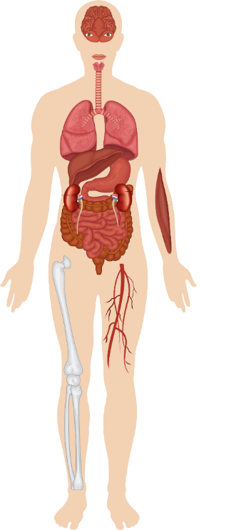
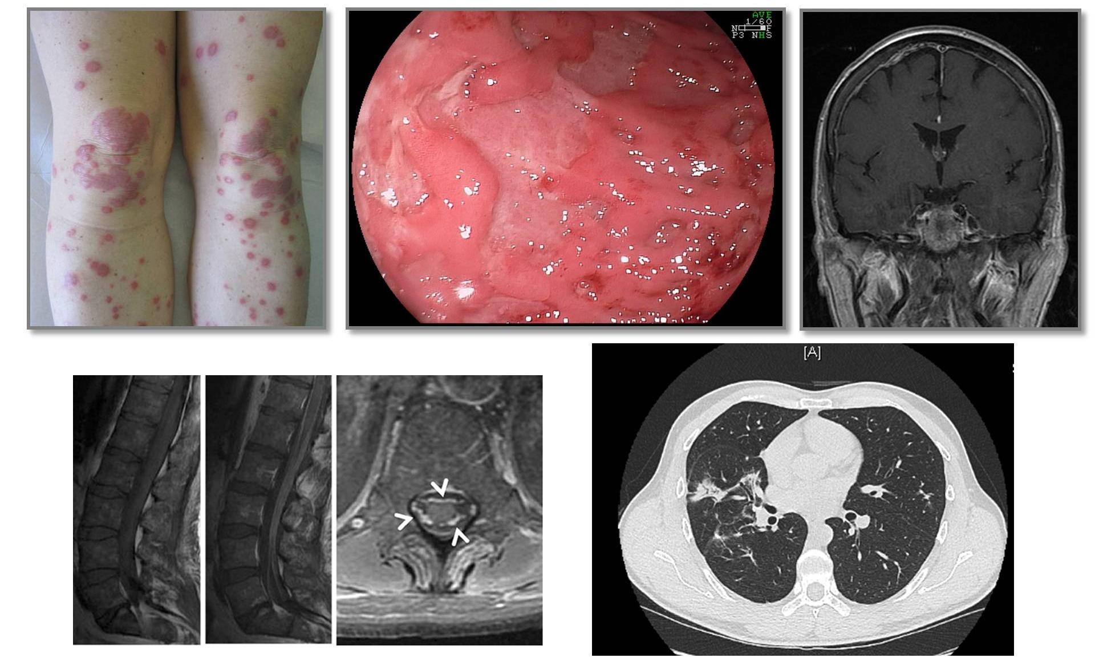
A New Spectrum of Adverse Events With IO-Based Therapy
Encephalitis
Aseptic Meningitis
Hypophysitis
Dry Mouth
Uveitis
Orbital Inflammation
Hypothyroidism
Pneumonitis
Hepatitis
Cardiotoxicity
Pancreatitis
Autoimmune Diabetes
Adrenal
Insufficiency
Rash and Vitiligo
Enterocolitis
Pruritus
Myalgia/Myositis
Arthralgia
Michot. Eur J Cancer. 2016;54:139. Steven. Rheumatology (Oxford). 2019;58(Suppl 7):vii29. Robert. ASCO 2017. Education session: Checkpoint inhibitor immunotherapy. Clinical images reproduced with permission of Dr. Caroline Robert, MD, PhD.
Slide credit: clinicaloptions.com
Notes:
IO, immuno-oncology.

Slide 54
Frequency of irAEs With ICI Monotherapy
Distribution of Grade 1/2 irAEs^{[1]}
Distribution of Grade 3-5 irAEs^{[1]}
40
57
CTLA-4
PD-1
PD-L1
15
18
CTLA-4
PD-1
PD-L1
30
10
Patients (%)
Patients (%)
20
5
10
0
0
Skin
GI
Skin
GI
Skin
GI
Skin
GI
Skin
GI
Skin
GI
Pulm
Endoc
Pulm
Endoc
Pulm
Endoc
Pulm
Pulm
Pulm
Hepatic
Hepatic
Hepatic
Endoc
Endoc
Endoc
Arthralgia
Neurol or Ocul
Arthralgia
Neurol or Ocul
Arthralgia
Neurol or Ocul
Arthralgia
Hepatic
Arthralgia
Hepatic
Arthralgia
Hepatic
Neurol or Ocul
Neurol or Ocul
Neurol or Ocul
Incidence of irAEs varies among malignancies
  Colitis more common in melanoma, pneumonitis more common in NSCLC^{[2]}
1. Michot. Eur J Cancer. 2016;54:139. 2. Owen. ESMO 2018. Abstr 1772P.
Slide credit: clinicaloptions.com
Notes:
Endoc, endocrine; GI, gastrointestinal; ICI, immune checkpoint inhibitor; irAE, immune-related adverse event; Neurol, neurology; NSCLC, non-small-cell lung cancer; Ocul, ocular; Pulm, pulmonary.

Slide 55

General Principles for Managing irAEs
Consult promptly with relevant specialists for affected organ systems (eg, GI, dermatology)
Management generally based on severity of symptoms
  Mild (grade 1): supportive care, consider holding ICI
  Moderate (grade 2): hold ICI, re-dose if AE improves, consider low-dose steroids (prednisone 0.5-1 mg/kg/day)
  Severe (grade 3): discontinue ICI, monitor closely (likely inpatient), start high-dose steroids (prednisone 1-2 mg/kg/day) with a slow taper (≥ 1 mo) → If not improving in 1-3 days, increase immunosuppression
For steroid-refractory AEs, consider adding infliximab, mycophenolate mofetil, etc
  Diarrhea → consider adding infliximab or vedolizumab
  Hepatitis → consider adding mycophenolate mofetil
  Pneumonitis → consider adding infliximab, mycophenolate mofetil, or IVIG
Brahmer. JCO. 2018;36:1714.
Slide credit: clinicaloptions.com
Notes:
AE, adverse event; GI, gastrointestinal; ICI, immune checkpoint inhibitor; irAE, immune-related adverse event.

Slide 56
Go Online for More CCO
Coverage of RCC!
Downloadable slides from the module
Management of irAEs, an Interactive Decision Support Tool
Downloadable slides and expert analysis of key data from annual oncology conferences
clinicaloptions.com/oncology
clinicaloptions.com/RCC2020SeriesSlides
clinicaloptions.com/immuneAEtool

