Slide 1

Planning Effective Preventive Care
Plans Consistent With a Patient’s
Current Anatomical Structure
Lauren Radziejewski, DNP, APRN
Medical Director
Galileo Health
New York, New York
Supported by an educational grant from Merck Sharp & Dohme Corp.

Slide 2

About These Slides
Please feel free to use and share some or all of these slides in your noncommercial presentations to colleagues or patients
When using our slides, please retain the source attribution:
These slides may not be published, posted online, or used in commercial presentations without permission. Please contact permissions@clinicaloptions.com for details
Slide credit: clinicaloptions.com
Notes:
Disclaimer: The materials published on the Clinical Care Options website reflect the views of the authors of the CCO material, not those of Clinical Care Options, LLC, the CME providers, or the companies providing educational grants. The materials may discuss uses and dosages for therapeutic products that have not been approved by the United States Food and Drug Administration. A qualified healthcare professional should be consulted before using any therapeutic product discussed. Readers should verify all information and data before treating patients or using any therapies described in these materials.

Slide 3
Faculty Disclosures
Lauren Radziejewski, DNP, APRN, has no relevant financial relationships to disclose.

Slide 4
Overview: Optimizing Care for Transgender Patients
Align your practice with patient’s goals and needs
Create safe and affirming environment that is comfortable for patients
In addition to avoiding explicit biases, pay close attention to effects of implicit biases
Care is straightforward but may require alteration of traditional daily practice

Slide 5
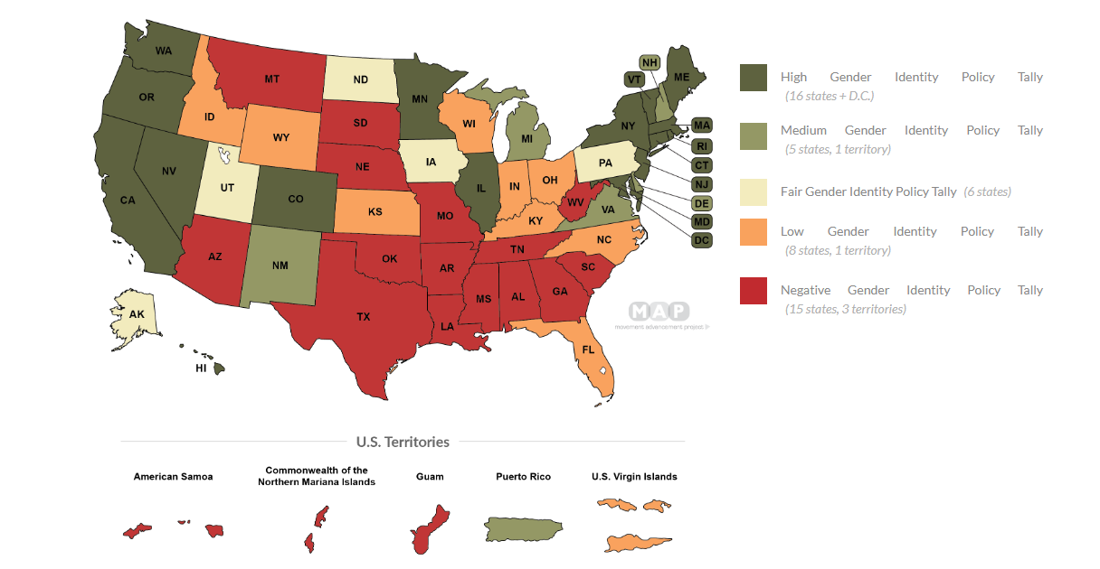
Gender Identity Policy Tallies by State
A state’s policy tally scores the laws and policies
within each state that shape LGBTQ people’s lives, experiences, and equality
  Major categories of laws covered by policy tally include: Relationship and Parental Recognition, Nondiscrimination, Religious Exemptions, LGBTQ Youth, Health Care, Criminal Justice, and Identity Documents
 | Gender Identity Policy Tally
High (75%-100% of points possible) | 16.5-22
Medium (50%-74.9% of points possible) | 11-16.25
Fair (25%-49.9% of points possible) | 5.5-10.5
Low (0-24.9% of points possible) | 0-5.25
Negative (<0 points) | <0
Total Points Possible | 22
US Territories
American Samoa
Commonwealth of Northern Mariana Islands
Guam
Puerto Rico
US Virgin Islands
lgbtmap.org/equality-maps
Notes:
LGBTQ, lesbian, gay, bisexual, transgender, queer or questioning.

Slide 6
US Transgender Survey: Injustice at Every Turn
Survey of 27,715 people in US who identify as transgender, trans, genderqueer, nonbinary, and other identities on the transgender and gender-nonconforming identity spectrum
Respondents reported:
10%
47%
40%
30%
29%
Experiencing
violence from a family member*
Being sexually assaulted at some point in their lifetime
Attempting suicide (vs 4.6% of general US population)
Being fired, denied a promotion, or mistreated in workplace*
Living in poverty
(vs 12% of general
US population)
*Due to being transgender.
James. Report of 2015 US Transgender Survey; 2016.

Slide 7
US Transgender Survey: Healthcare Setting
Negative Experiences When Seeing HCP Over Past Year
Had to teach HCP about transgender people to get appropriate care | 24%
HCP asked unnecessary or invasive questions about their gender status not related to reason for healthcare visit | 15%
HCP refused to give transition-related care | 8%
Verbally harassed in healthcare setting | 6%
HCP used harsh or abusive language when treating them | 5%
HCP refused care not related to gender transition | 3%
HCP was physically rough or abusive when treating | 2%
Physically attacked by someone during healthcare visit | 1%
Sexually assaulted in healthcare setting | 1%
33%
≥1 negative
experience in healthcare setting
in prior year
James. Report of 2015 US Transgender Survey; 2016.
Notes:
HCP, healthcare professional.

Slide 8
Building Preventive Care Plan: Overview
Use organ-based approach
Detach patient from gendered terminology
Reframe using your general practice skills
  All modifications for transgender patients would be applicable to
  any patient you see
Anchor yourself into practice points you already know
Center for Excellence for Transgender Health. Guidelines for primary and gender-affirming care.

Slide 9
Preventive Care Plans: The Basics
Your care plan will use familiar basics
Medical and social history
Risk stratification
Shared decision-making
Family health history
Center for Excellence for Transgender Health. Guidelines for primary and gender-affirming care.

Slide 10
Empowering Transgender Patients Through
Shared Decision-Making
Shared decision-making is crucial
When someone is marginalized, their
power is removed
Continuing to practice shared decision-making throughout care gives the patient their power back
in healthcare setting
HCP
Expert guidance
Professional experience
Clinical evidence
Therapeutic goals
SDM
Information sharing
Collaboration
Deliberation
Trust
Patient
Lifestyle
Values
Treatment preferences
Personal goals
Cost
Patient: Empowerment, self management, treatment adherence
HCP: Understanding, job satisfaction, patient-centered care
IMPROVED HEALTH OUTCOMES
Moore. Womens Health Issues. 2015;25:276. Peek. J Gen Internal Med. 2016;31:677.
Notes:
HCP, healthcare professional; SDM, shared decision-making.

Slide 11
Focus on Organ Systems
In absence of explicit clinical evidence, HCP should focus on organ systems
There are times when clinical judgment will be necessary to determine if/when not to perform a test
  When procedure or test may be
  triggering or traumatic
  When application of guidelines is limited
In these cases, risk stratification
and clear communication can guide
decision-making with your patient
Recommended Organs for Inventory
Penis
Testes
Prostate
Breasts
Vagina
Cervix
Uterus
Ovaries
Center for Excellence for Transgender Health. Guidelines for primary and gender-affirming care.
Notes:
HCP, healthcare professional.

Slide 12
Taking Medical History From Transgender Patient
Many patients may feel uncomfortable giving their history, particularly if it involves trauma
  Give your patient permission to take breaks
Take medical history based on organs patient has
Avoid gendered terminology, for example:
  “Do you have any children?” vs “How many pregnancies have you had?”
  People with cervixes should be “screened for cervical cancer” vs “have a Pap smear”
Don’t avoid discussing organs because you may be uncomfortable; find gentle ways to discuss these topics
Mirror patient terminology
Provide patients with right amount of information
  Discuss with patient if they would like a “play by play” about what you are seeing and
  next steps in examination
Center for Excellence for Transgender Health. Guidelines for primary and gender-affirming care.

Slide 13
Taking Social History
24%
89%
Transgender patients are at increased risk of drug and alcohol abuse, sexual violence, and unwanted sexual contact
It is important to discuss these things, even though they may be uncomfortable
Social history may need to be conducted in >1 sitting
Experienced physical violence from an intimate partner
Did not have all IDs matching their name and preferred gender
30%
82%
Experienced homelessness at some point in their life
Work(ed) in underground economy (sex work, drug sales, or other criminalized work)
Center for Excellence for Transgender Health. Guidelines for primary and gender-affirming care.
James. Report of the 2015 US Transgender Survey; 2016.
Notes:
ID, identification.

Slide 14
Taking Family History
It is not uncommon for transgender patients to be estranged from their genetic family
Family history discussions may be difficult and elicit a range of emotions
Consider building history over multiple sessions
Double check to ensure they are discussing their biological family
and not their chosen family
Negative Experiences Among Transgender Individuals With Supportive vs Unsupportive Families
0%
10%
20%
30%
40%
50%
60%
Experienced Homelessness
27%
45%
Attempted Suicide
37%
54%
Currently
Experiencing Serious Psychological Distress
31%
50%
% of respondents whose families were supportive
% of respondents whose families were unsupportive
Center for Excellence for Transgender Health. Guidelines for primary and gender-affirming care.
James. Report of the 2015 US Transgender Survey; 2016.

Slide 15
Risk Stratification
Organ Inventory
Difficult Conversations
Patient
Feels Safe
Once you have collected your patient’s family, medical, and social history, you can create your care plan for preventive maintenance
Use shared decision-making and risk stratification at each step to
avoid triggering patients and causing unnecessary harm
Center for Excellence for Transgender Health. Guidelines for primary and gender-affirming care.

Slide 16
Breast Cancer Screening
Limited data on rate of breast cancer in people assigned male sex at birth who identify as female and have been receiving long-term hormonal therapy
Screening decisions should be based on organ present and current general guidelines
  In absence of rigorous data for transgender women, screen according to guidelines for cisgender women
Transgender women may not have had exposure to information about mammograms and may require some education
Try to use nongendered language such as, “People with breasts should have screening
for cancer”
For transgender men who have had gender-affirming mastectomy, consider genetic risk
Center for Excellence for Transgender Health. Guidelines for primary and gender-affirming care.
NCCN. Clinical practice guidelines in oncology: breast cancer screening and diagnosis. v.1.2022. nccn.org. de Blok. BMJ. 2019;365:l1652.

Slide 17
Cervical Cancer Screening
Cervical cancer screening may be HIGHLY triggering in people who have cervixes
Increased risk of sexual assault can make it even more difficult
Consider offering screening at another time to give patient time to prepare
Consider offering to let another HCP do the screening
If patient cannot tolerate cervical cancer screening, consider self-sampling for HPV
Do not make assumptions about types of sexual contact your patient is having (ie, transgender men may still be having receptive vaginal intercourse)
Center for Excellence for Transgender Health. Guidelines for primary and gender-affirming care. USPTF. JAMA. 2018;320:674.
ACOG. Updated cervical cancer screening guidelines. Reisner. PLoS One. 2018;13:e0190172.
Notes:
HCP, healthcare professional; HPV, human papillomavirus.

Slide 18
Prostate Cancer Screening
Transgender women receiving long-term suppressive therapy for testosterone likely will have a prostate that is not palpable
  Impact of long-term testosterone-suppressive therapy on prostate cancer risk is unknown
Documented cases of prostate cancer have been reported in transgender women with various surgical and hormone use histories
Shared decision-making should be used when guidelines lack good evidence
It is reasonable to begin PSA screening in people with a prostate in their 50s or 60s, especially those who started hormone therapy later in life
Center for Excellence for Transgender Health. Guidelines for primary and gender-affirming care.
Grossman. JAMA. 2018;319:1901. NCCN. Clinical practice guidelines in oncology: prostate cancer early detection. v.1.2022. nccn.org.
Notes:
PSA, prostate-specific antigen.

Slide 19
Surgical Anatomy
Pap smears are not necessary after vaginoplasty
  Patients could get HPV, but they have no cervix
Prostate is not removed with vaginoplasty, and patients may still require screening for prostate cancer
Transgender women get both yeast infections and bacterial vaginosis
Urethral stricture/urethrocele is very common complication of phalloplasty, and multiple revisions may be required
  Patients should be prepared for this before undertaking procedure
Center for Excellence for Transgender Health. Guidelines for primary and gender-affirming care.
Notes:
HPV, human papillomavirus.

Slide 20
Discussing Sexual Practices
Do not use gendered stereotypes and concepts
To maximize preventive health, you want to understand in what ways patient has contact with penises, vaginas, or both
Consider practicing this conversation
Record information in chart using same nongendered terminology
Do not make assumptions about the way your patient might use their anatomy for sex

Slide 21
HIV Infection Prevention and Screening
Transgender women, especially transgender women of color, are at uniquely high risk of HIV infection
HIV and STD screening should be discussed at every visit
  Inform them about postexposure prophylaxis if they decline PrEP
There are not good data on impact of PrEP efficacy (tissue concentration) in surgical vagina
HIV prevalence among transgender women in 7 US cities, 2019-2020
  Among transgender women interviewed, 42% had HIV
  Racial and ethnic disparities exist among transgender women with HIV
62%
of Black/African American transgender women had HIV
35%
of Hispanic/Latina transgender women had HIV
17%
of White transgender women had HIV
cdc.gov/hiv/group/gender/transgender/hiv-prevalence.html
cdc.gov/hiv/group/gender/transgender/hiv-prevention.html
Notes:
PrEP, pre-exposure prophylaxis; STD, sexually transmitted disease.

Slide 22
Fertility Planning Prior to Hormone Treatment:
Special Considerations
Reproductive options should be discussed with patients before initiating hormone therapy or surgery
Cryopreservation of sperm prior to or in early stages of hormone therapy
  Sperm counts may not return to pretreatment levels after discontinuation of
  hormone replacement therapy
Harvest and cryopreservation of ova prior to hysterectomy/oophorectomy
Pregnancy remains possible after initiation of testosterone
  Generally requires discontinuation
  Full fertility may not return
Center for Excellence for Transgender Health. Guidelines for primary and gender-affirming care. Douglas. Obstet Gynecol. 2022;139:1012. Ethics Committee of the American Society for Reproductive Medicine. Fertil Steril. 2015;104:1111.

Slide 23
Pregnancy
Patients with intact uteruses can become pregnant after testosterone therapy, but they may have additional risks
When noncisgender people are asked to do a pregnancy test, it can
be triggering
  Determine if it is necessary; have they had exposure to sperm?
Transgender women may need to be counseled that they do not need birth control
Hassan. Case Rep Endocrinol. 2022;2022:6246867.

Slide 24
Patient-Centered Care
Empower Your Patient With Shared Decision-making
Build Your Care Plan With a Harm Reduction Lens
Revisit Care Plan With Patient Periodically
Present Your Care Plan to Your Patient

Slide 25
Key Takeaways
Build organ-based gender-affirming care plans
  Focus on organs that are present
Use nongendered terms
Meet patients where they are in terms of their care and what
they want for their own bodies
Strive to give power back to patient at all times
  Patient should be ultimate decision maker, and you are expert consultant

Slide 26
Go Online for More CCO
Coverage of Transgender Care!
Video and audio podcasts of transgender patient experiences in the healthcare system
ClinicalThought commentaries with expert insight on optimizing transgender patient care
CME/CE/CPE-certified microlearning text modules on best practices for transgender healthcare
CME/CE/CPE-certified video simulations on best practices for transgender healthcare
clinicaloptions.com/oncology

