Slide 1
Integrating PrEP in Asia
A collaboration between Clinical Care Options, LLC and Albert Einstein College of Medicine, in partnership with Institute for HIV Research and Innovation (IHRI).
Stephane Wen-Wei Ku, MD
Attending Physician
Division of Infectious Diseases
Department of Internal Medicine
Taipei City Hospital Renai Branch
Taipei, Taiwan
Supported by an educational grant from Gilead Sciences, Inc.

Slide 2
Faculty and Disclosures
Stephane Wen-Wei Ku, MD
Attending Physician
Division of Infectious Diseases
Department of Internal Medicine
Taipei City Hospital Renai Branch
Taipei, Taiwan
Stephane Wen-Wei Ku, MD, has no relevant financial relationships to disclose.
Notes:
This slide lists the faculty who were involved in the production of these slides.

Slide 3
Learning Objectives
Take steps to start providing PrEP for key populations who can benefit, as a crucial component of reducing barriers to PrEP update
Apply a solid understanding of PrEP regimens and essential aspects of PrEP delivery to proactively incorporate PrEP into services for key populations
Notes:
PrEP, pre-exposure prophylaxis.

Slide 4
Pretest: I am aware of strategies to integrate PrEP services for the benefit of key populations.
Strongly disagree
Disagree
Neither agree nor disagree
Agree
Strongly agree
Notes:
LO: Apply a solid understanding of PrEP regimens and essential aspects of PrEP delivery to proactively incorporate PrEP into services for key populations

Slide 5
Case 1
Notes:
1.Patient spontaneously come to clinic with STIs, how to evaluate this and bring up another method of prevention

Slide 6
Case 1: Ms K
29-yr-old heterosexual cisgender woman
1 fixed, cisgender male partner, who reported having multiple sex partners of both genders outside the relationship
Uses condoms “most of the time” during vaginal sex with her partner
Has a history of gonorrhea vaginitis from 1 yr ago
Never received any test for HIV
Visiting your clinic for vaginal discharge and dysuria

Slide 7
What Would You Like to Talk About With Ms K?
Testing and possible treatment for urinary tract infection and other STIs for her and her male partner
Screening for HIV
Methods of contraception
PrEP for HIV for her and her male partner
Prevention for other STIs such as DoxyPEP for her and her male partner
Notes:
PrEP, pre-exposure prophylaxis; STI, sexually transmitted infection.

Slide 8
The Collateral Benefits of PrEP
Empowers users by allowing greater control of their HIV risk, rather than relying on partners to use condoms, take ART, or accurately disclose their HIV sero-status
Results in improved mental health among PrEP users
  Reduced anxiety around acquiring HIV
Provides an additional layer of protection for safer conception among serodiscordant couples desiring pregnancy
Addresses unarticulated concerns around reduced sensation, interference with erectile dysfunction and disruption of spontaneity with condoms
Grant. Curr Opin HIV AIDS. 2016;11:3. aidsmap.com/about-hiv/prep-sex-intimacy-and-mental-health.
Achterbergh. EClinicalMedicine. 2020;26:100505.
Notes:
ART, antiretroviral therapy; PrEP, pre-exposure prophylaxis.

Slide 9
Integrating PrEP by Meeting People
Where They Are
Notes:
PrEP, pre-exposure prophylaxis.

Slide 10
Gain-Framed Counseling Increased PrEP Uptake Among Transgender Women in Thailand
Gain-framed counseling: Encourage clients to focus on protection and healthy behavior
1149 transgender women not on PrEP received gain-framed counseling at the Tangerine clinic in Bangkok, Thailand in June 2020
398 (35%) accepted PrEP after gain-framed counseling
  80% new initiations, 20% restarted PrEP after previous discontinuation
Srimanus. AIDS 2022. Abstr OAC0503.
Notes:
PrEP, pre-exposure prophylaxis.

Slide 11
Gain-Framed Counseling Increased PrEP Uptake Among Transgender Women in Thailand
With gain-framed counseling, overall PrEP uptake increased to 147%, with a 715% increase among transgender women without self-perceived HIV risk
Trend in PrEP Use Among Transgender Clients at Tangerine Clinic
After the Implementation of Gain-Framed PrEP Counseling
100.0%
94.4%
97.7%
83.7%
92.3%
100.0%
100.0%
85.7%
100.0%
75.0%
76.9%
75.0%
74.4%
52.0%
48.0%
25.0%
23.1%
25.0%
25.6%
16.3%
14.3%
5.6%
7.7%
0.0%
2.3%
0.0%
0.0%
0.0%
Jun
(n = 17)
Jul
(n = 36)
Aug
(n = 44)
Sep
(n = 43)
Oct
(n = 26)
Nov
(n = 14)
Dec
(n = 6)
Jan
(n = 7)
Feb
(n = 9)
Mar
(n = 20)
Apr
(n = 26)
May
(n = 28)
Jun
(n = 90)
Jul
(n = 25)
2020
2021
Clients with no self-perceived risk
Clients with self-perceived risk
Srimanus. AIDS 2022. Abstr OAC0503.
Notes:
PrEP, pre-exposure prophylaxis.

Slide 12








Key Population-Led Health Services Fill Gaps in Thailand
ACCESSIBILITY
AVAILABILITY
ACCEPTABILITY
QUALITY
Located in hot spots
Flexible service hours suitable for key population’s lifestyle
1-stop service
Needs-based and client-centered services, such as hormone monitoring, STI, legal consultation, harm reduction
Staff are members of key population communities who truly understand their lifestyle
Services are gender-oriented, and free from stigma and discrimination
Staff are trained and qualified in accordance with national standards
Strong linkages with and high acceptance from public health sectors
ihri.org/prep.
Notes:
PrEP, pre-exposure prophylaxis; STI, sexually transmitted infection.
PrEP first introduced in 2014. PrEP uptake in Thailand hasincreased from 3,000 users in 2019 (before UHC) to more than 16,000 in2021 despite COVID-19 challenges
80% usersobtain PrEP from key population-led services
•Availability, accessibility, acceptability & quality prioritized:Key population-led services integrated into nat
PrEP first introduced in 2014 PrEP uptake in Thailand has increased from 3,000 users in 2019 (before UHC) to more than 16,000 in 2021 despite COVID-19 challenges
80% users obtain PrEP from key population-led services
•Availability, accessibility, acceptability & quality prioritized:Key population-led services integrated into national approach
Innovations in COVID-19 improved service delivery: express clinics, self sampling, mobile drug delivery, digital health
Gain-framing messaging, raising risk awareness by syphilis screening -> increased uptake among trans women

Slide 13
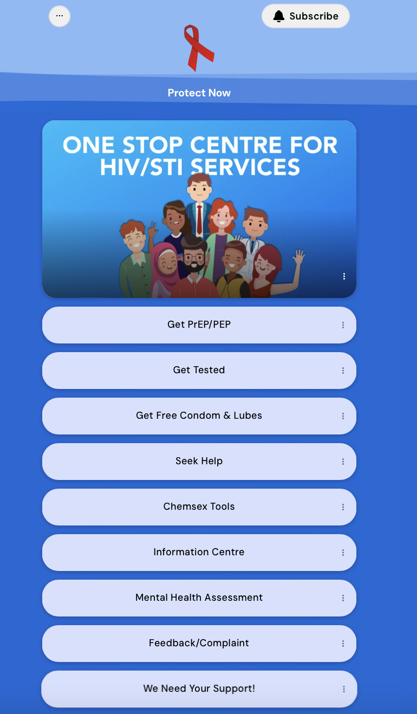
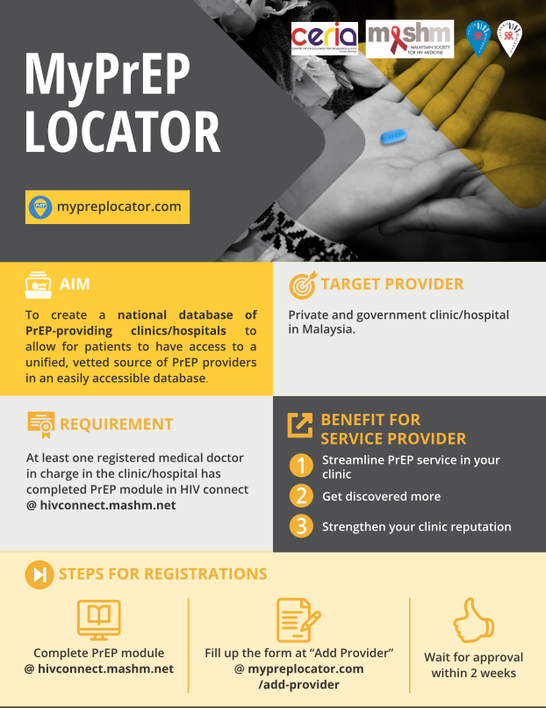
Partnering With Community PrEP Navigators in the Malaysian Public Sector Enhances Access
Role of the PrEP navigator
Educates the community
Assists with access to PrEP services
Confirms adherence to medications and appointments
Coordinates with other healthcare workers
Monitors and reports data regarding PrEP uptake and adherence
National directory of PrEP providers: resources
Azwa. Satellite 108. AIDS 2024. Salabarría-Peña. Eval Program Plann. 2022;90:101999. Pagkas-Bather. BMC Public Health. 2020;20:248. mypreplocator.com. linktr.ee/protectnow.
Notes:
PrEP, pre-exposure prophylaxis.

Slide 14
Poll: In which of the following settings do you integrate PrEP counseling?
STI screening
Gender-affirming hormone therapy
Contraception
Harm reduction
All of the above
None of the above

Slide 15
PrEP as Part of a Broader Range of Services
Notes:
PrEP, pre-exposure prophylaxis.

Slide 16
Case 2: Mr L
44-yr-old single, cisgender man who has sex with men
Rarely using condom during anal sex; had last condomless anal sex yesterday
Received PEP for HIV 2 times; 1 time last yr and the other earlier this yr
Had last negative HIV test 3 mo ago
Had no previous history of STIs
Recently started using crystal methamphetamine and “slamming” during sex
Visiting your clinic for another course of PEP
Notes:
PEP, post-exposure prophylaxis; STI, sexually transmitted infection.

Slide 17
What Would You Like to Talk About With Mr L?
PEP for HIV and possibly other STIs such as DoxyPEP
Screening for HIV and other STIs
Dosing regimens of PrEP for HIV: daily vs event-driven
Chemsex and possibly problematic use of crystal methamphetamine
Harm reduction for “slamming”, or intravenous injection of crystal methamphetamine
Notes:
PEP, post-exposure prophylaxis; PrEP, pre-exposure prophylaxis; STI, sexually transmitted infection.

Slide 18
Potential for Expansion of PrEP Services:
Harm Reduction
Harm reduction services
STI screening
Gender-affirming hormone therapy
Countries with PrEP services for people who inject drugs
Identified PrEP services for people who inject drugs
No services identified or no data available
Not applicable
Shaw. Harm Reduct J. 2023;20:16.
Notes:
PrEP, pre-exposure prophylaxis; STI, sexually transmitted infection.

Slide 19
Potential for Expansion of PrEP Services: Harm Reduction Strategies for Chemsex
Proposed scheme of harm-reduction strategies for chemsex:
Drug
Before the chemsex session
During the chemsex session
After the chemsex session
Personal habits
Nutrition and hydration
Intoxication and overdose management
Rest and self-care
Conscious planning
Discussing preferences
NSP
IEC
VCT
PrEP
Condom and lubricant use
PEP
HAV, HBV, and HPV vaccines
STI treatment
Suppressive ART
HIV
Sex
Strong. Lancet HIV. 2022;9:e717.
Notes:
ART, antiretroviral therapy; HAV, hepatitis A virus; HBV, hepatitis B virus; HPV, human papillomavirus; IEC, information education and communication; NSP, needle and syringe programs; PEP, post-exposure prophylaxis; PrEP, pre-exposure prophylaxis; STI, sexually transmitted infection; VCT, voluntary counselling and testing

Slide 20
Potential for Expansion of PrEP Services:
STI Screening
Harm reduction services
STI screening
Gender-affirming hormone therapy
STI screening can be an opportunity to expand when PrEP is offered
Lab monitoring while on PrEP can be an opportunity to expand STI screening
Ong. J Int AIDS Soc. 2021;24:e25673. cdc.gov/hivnexus/hcp/prep/index.html.
Notes:
PrEP, pre-exposure prophylaxis; STI, sexually transmitted infection.

Slide 21
Potential for Expansion of PrEP Services:
Gender-Affirming Hormone Therapy
Harm reduction services
STI screening
Gender-affirming hormone therapy
HPTN 091:
Open-label study in transgender women evaluating impact of integrated:
  Peer health navigation
  HIV prevention services
  Gender-affirming hormone therapy
At end of study, all participants were highly engaged in PrEP
NCT04742491. Poteat. HIVR4P 2024. Abstr OA2002.
Notes:
PrEP, pre-exposure prophylaxis; STI, sexually transmitted infection.

Slide 22
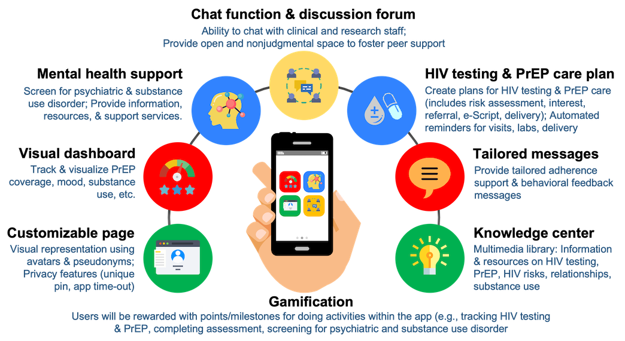
Differentiated Service Delivery Models: M-Health Interventions
To accelerate PrEP scale-up and overcome barriers, differentiated and simplified PrEP services are needed
JomPrEP app: Clinic integrated platform utilized in Malaysia
Shrestha. JMIR Res Protoc. 2022;11:e43318. jomprep.com.
Image reproduced with permission: creativecommons.org/licenses/by/4.0/.
Notes:
PrEP, pre-exposure prophylaxis.

Slide 23







Differentiated Service Delivery Models: Pharmacy-Based PrEP Service Delivery Model in Malaysia
R
x
Recruitment of study participants
Study enrollment (informed consent)
Appointment booking at preferred pharmacy (6 study sites)
Individual arrives at pharmacy
Pharmacists assess PrEP eligibility using digital checklist-based assessment tool
Assist on-site free HIV screening using oral fluid HIV self-test kits
Provide PrEP counselling
Eligible + willing to start/
continue PrEP (new/restarting/
continuing users)
Pharmacists request 30-day/90-day electronic prescription from physicians via telemedicine platform
(Same-day PrEP)
Collaboration with NGOs & physicians/PrEP clinic providers (within 10 km) for lab testing needs & referrals
Follow-up with pharmacists
Refer when necessary
Routine HIV screening at every follow-up
Real-world implementation
Involving out-of-pocket expenses* to inform future viability & sustainability of service in private pharmacy setting.
*Participants pay for PrEP medication (available at special rebate price of RM65) at the pharmacy & any laboratory tests done outside of pharmacy. Baseline kidney function test required within 3 mo of initiation.
Shrestha. JMIR Res Protoc. 2022;11:e43318. jomprep.com. Azwa. Satellite 108. AIDS 2024.
Notes:
NGO, non-governmental organization; PrEP, pre-exposure prophylaxis.

Slide 24
Go Online for More CCO
Coverage of HIV!
Didactic modules to review the latest data and recommendations for HIV care and prevention
Downloadable slides of key data to review and share
Downloadable resources that you can use in your practice
ClinicalThought commentaries featuring expert perspectives
clinicaloptions.com

Slide 25
Posttest: I am aware of strategies to integrate PrEP services for the benefit of key populations.
Strongly disagree
Disagree
Neither agree nor disagree
Agree
Strongly agree
Notes:
LO: Apply a solid understanding of PrEP regimens and essential aspects of PrEP delivery to proactively incorporate PrEP into services for key populations

