Slide 1
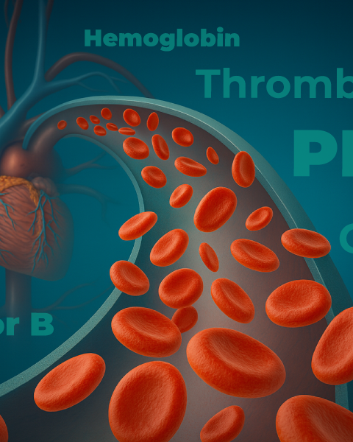
Clinical Focus in Paroxysmal Nocturnal Hemoglobinuria: New Strategies for Evading the Complement Cascade
Provided by Clinical Care Options, LLC dba Decera Clinical Education
Supported by an educational grant from Novartis Pharmaceuticals Corporation.

Slide 2
Faculty
Carlos M. De Castro, MD
Professor of Medicine, DUMC
Division of Malignant Hematology and Cellular Therapy
Department of Medicine
Duke University
Duke Cancer Institute
Durham, North Carolina
David Dingli, MD, PhD, FRCP, FRCPEd, FACP, FRCPath
Consultant Hematologist and Director of Bone Marrow Transplant Program
Professor of Medicine
Division of Hematology
Mayo Clinic College of Medicine and Science
Rochester, Minnesota

Slide 3
Disclosures
The faculty reported the following relevant financial relationships or relationships to products or devices they have with ineligible companies related to the content of this educational activity:
Carlos M. De Castro, MD: consultant/advisor/speaker: Alexion/AstraZeneca, Apellis, BioCryst, Genentech, Novartis, Omeros; data and safety monitoring board: Regeneron.
David Dingli, MD, PhD, FRCP, FRCPEd, FACP, FRCPath: consultant/advisor/speaker: Alexion, Bristol Myers Squibb, Johnson & Johnson, Merck Sharp & Dohme, Novartis, Regeneron.

Slide 4
Learning Objectives
Upon completion of this activity, learners should be able to:
Evaluate current recommendations for managing PNH, including challenges to optimal outcomes, potential therapeutic targets in the complement cascade, and evidence for emerging complement-targeted therapies
Differentiate the mechanisms of action for conventional and emerging complement-targeted therapies in PNH
Select appropriate complement-targeted therapies for treating patients with PNH by analyzing efficacy and safety evidence, indications, disease-related factors, and patient needs and preferences
Implement recommended patient-centered strategies to identify and manage complications associated with PNH

Slide 5
About These Slides
Please feel free to use and share some or all of these slides in your noncommercial presentations to colleagues or patients
When using our slides, please retain the source attribution:
Slide credit: deceraclinical.com/education
These slides may not be published, posted online, or used in commercial presentations without permission. Please contact permissions@deceraclinical.com for details
Notes:
Disclaimer: The materials published on the Decera Clinical Education website reflect the views of the authors of the Decera Clinical Education material, not those of Decera Clinical Education, the CME providers, or the companies providing educational grants. The materials may discuss uses and dosages for therapeutic products that have not been approved by the FDA. A qualified healthcare professional should be consulted before using any therapeutic product discussed. Readers should verify all information and data before treating patients or using any therapies described in these materials.

Slide 6
New and Emerging Approaches for Paroxysmal Nocturnal Hemoglobinuria

Slide 7
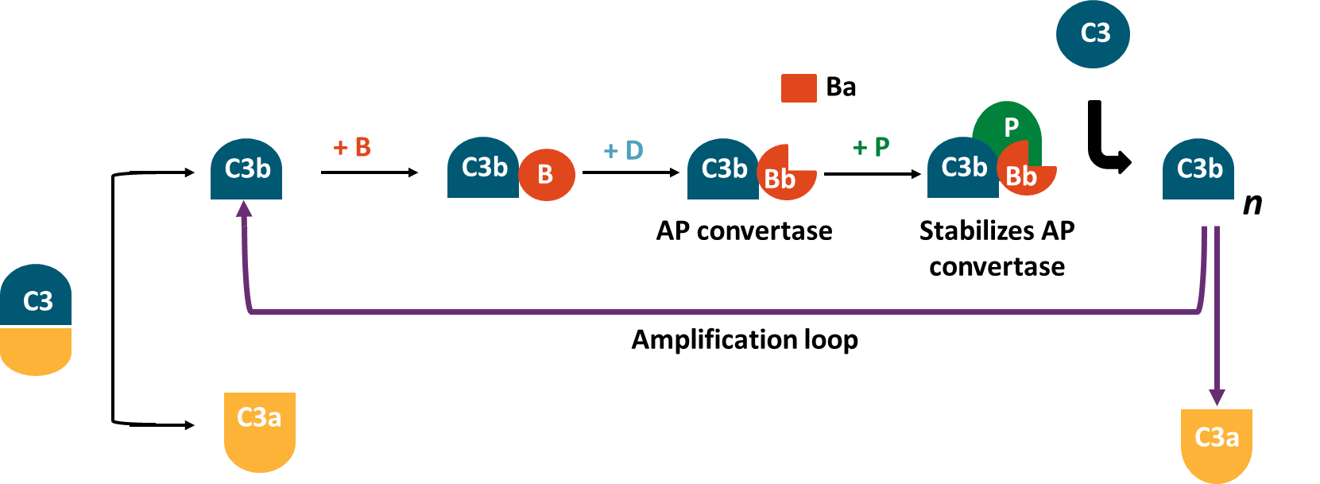
Complement Activation
Classical
pathway
Lectin
pathway
Alternative
pathway
MASPs
C4, C2
C3b or C3 (H₂O)
C1, C4, C2
FB, FD, P
Proximal
pathway
C3 convertase
CD55
C3
C3a (inflammation)
C3b (opsonization)
C3b
C5 convertase
Terminal
pathway
C5a (inflammation)
C5b (initiates MAC)
C5
CD59
Membrane attack complex
C5b, C6, C7, C8, C9
Adapted from Shi. Ther Adv Hematol. 2024;15:20406207241307500.

Slide 8
PNH Molecular Pathogenesis: PIGA Mutation and Glycosylphosphatidylinositol (GPI) Anchors
Acquired somatic mutation in PIGA → first step in GPI biosynthesis
Mutation is in hematopoietic stem cells
  Phenotype is seen in all cell lineages
Clonal expansion occurs (various mechanisms proposed)
  GPI-negative cells have fitness advantage (immune environment)
  Additional mutations (HMGA2, JAK2, BCR-ABL, CLR, etc)
  Neutral drift
Continuous low-grade activation of C3 (“tickover” mechanism)
Loss of GPI-anchored proteins: CD55 and CD59
Red blood cells lack CD46, CR1
Luzzatto. Blood. 2025;145:3077. Colden. Front Immunol. 2022;12:83017.

Slide 9
Clinical Pathogenesis of PNH
Hemolysis Continues
Effects of Nitric Oxide
Some conditions increase rate of hemolysis
Untreated PNH: intravascular hemolysis
Patients on therapy with C5 inhibitor can have extravascular hemolysis
Kidney damage: multifactorial
Intravascular hemolysis depletes nitric oxide
Nitric oxide is required for smooth muscle relaxation
  Abdominal pain, esophageal spasm, erectile dysfunction
Nitric oxide is required for endothelial function
  Thrombosis risk
  Pulmonary hypertension: various reasons
Agrawal. Cureus. 2025;17:e97611. Kokoris. Int J Mol Sci. 2024;25:12104.

Slide 10
Disease Presentation: Suspicion of PNH
Hemolytic anemia
  Hb, reticulocyte count, hyperbilirubinemia (unconjugated)
Coombs negative
Intravascular hemolysis
  LDH, haptoglobin, hemosiderinuria
Thrombosis (usual and unusual)
  D-dimer
Marrow failure syndrome
Unusual signs and symptoms:
  Muscle spasms, renal insufficiency, abdominal pain, erectile dysfunction, pulmonary hypertension
  Unexplained iron deficiency
Diagnosis: flow cytometry
Godby. Mayo Clin Proc. 2025;100:2206. Huang. J Formos Med Assoc. 2025;[Epub].

Slide 11
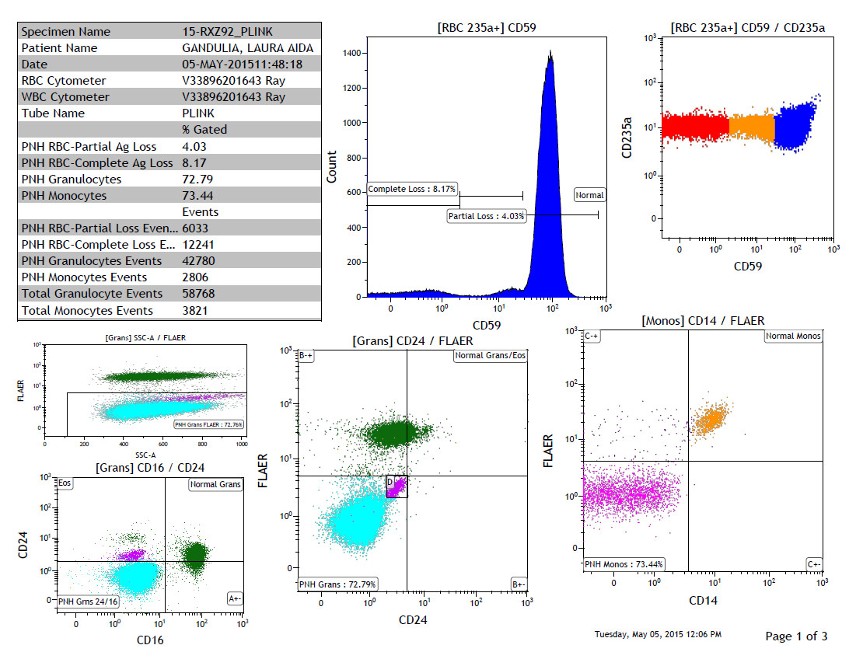
Diagnosis of PNH: Flow Cytometry
Specimen Name | 15-RXZ92 PLINK
RBC Cytometer | V33896201643 Ray
WBC Cytometer | V33896201643 Ray
Tube Name | PLINK
 | % Gated
PNH RBC-Partial Ag Loss | 4.03
PNH RBC-Complete Ag Loss | 8.17
PNH Granulocytes | 72.79
PNH Monocytes | 73.44
 | Events
PNH RBC-Partial Loss Events | 6033
PNH RBC-Complete Loss Events | 12241
PNH Granulocytes Events | 42780
PNH Monocytes Events | 2806
Total Granulocyte Events | 58768
Total Monocytes Events | 3821
[RBC 235a+] CD59
[RBC 235a+] CD59/CD235a
1400
10³
1200
1000
10²
800
Complete Loss:
8.17%
Count
10¹
CD235a
600
Normal
400
Partial Loss: 4.03%
10⁰
200
0
0
10⁰
10¹
10²
10³
0
0
10⁰
10¹
10²
10³
10³
[Grans] SSC-A/FLAER
CD59
CD59
10²
[Grans] CD24/FLAER
[Monos] CD14/FLAER
FLAER
10³
B-+
Normal Grans/Eos
10³
C-+
Normal Monos
10¹
10⁰
PHN Grans FLAER: 72.76%
0
10²
10²
0
200
400
600
800
1000
SSC-A
[Grans] CD16/CD24
10¹
10¹
10³
Eos
Normal Grans
FLAER
D
FLAER
10²
CD24
10⁰
10⁰
10¹
10⁰
PNH Grans: 72.79%
B+-
PNH Monos: 73.44%
C+-
0
PNH Grans 24/16
A+-
0
0
10⁰
10¹
10²
10³
0
0
10⁰
10¹
10²
10³
0
10⁰
10¹
10²
10³
Example Data. Dr. David Dingli
CD16
CD24
CD24

Slide 12
PNH: Differential Diagnosis and Recommended Testing
Differential Diagnosis
Recommended Testing
Hemolytic anemia:
  Hereditary
  Autoimmune
  Thalassemia
  Traumatic hemolysis
Other causes of anemia/BMF
CBC
Reticulocyte count
Chemistry panel
LDH
Haptoglobin
Coombs test
D-dimer
Flow cytometry for PNH
Huang. J Formos Med Assoc. 2025;[Epub]. Agrawal. Cureus. 2025;17:e97611.

Slide 13
Therapy for Classic Hemolytic PNH
Does the patient need therapy directed at the clone?
  Clone size, hemoglobin, transfusion history, PNH phenotype (II vs III)
  Prior thrombosis
  Comorbidities
Complement-directed therapy
Anticoagulation?
Supportive care
  Immunizations
  Iron and vitamin replacement
Patient education
Huang. J Formos Med Assoc. 2025;[Epub].

Slide 14
PNH: Current Classification and Standard of Care
Classic hemolytic PNH
  Clone size >50%
PNH with marrow failure syndrome
  Clone size on granulocytes generally 20%-30%
Subclinical PNH
  Clone size on granulocytes <10%
Approved Therapies Directed at Complement
Target | Drug(s) | Route | Schedule
C5 blockade | Crovalimab | SubQ | Q4W
 | Eculizumab | IV | Q2W
 | Ravulizumab | IV | Q8W
C3 blockade | Pegcetacoplan | SubQ | 2-3 times/wk
Factor B inhibition | Iptacopan | PO | BID
Factor D inhibition | Danicopan | PO | TID
Huang. J Formos Med Assoc. 2025;[Epub]. Gerber. Clin Adv Hematol Oncol. 2025;23(suppl 8):1.

Slide 15
Eculizumab and Ravulizumab in PNH
PNH RBC Proportions (Mean ± SE) in Eculizumab Treatment¹
Change From Baseline in FACIT-Fatigue Scores (Mean ± SE) During Eculizumab Treatment¹
60
*
*
14
*
*
*
*
*
55
*
12
*
*
*
*
50
10
8
*
PNH Type III RBCs (%)
Change From Baseline FACIT-Fatigue Score
45
*
6
40
*P <.001
4
*P <.001
35
2
30
0
0
4
8
12
16
20
24
28
32
36
40
44
48
52
0
4
8
12
16
20
24
28
32
36
40
44
48
52
100
Proportion of Patients Achieving LDH-N Over Time in the Ravulizumab and Eculizumab Treatment Groups²
80
Ravulizumab
Eculizumab
60
57
58
53
55
56
50
50
48
46
47
47
50
49
51
46
47
49
46
50
46
46
49
Patients Achieving
LDH Normalization (%)
44
41
45
40
38
20
18
19
3
3
0
Day
8
Day
15
Day
22
Day
29
Day
43
Day
57
Day
71
Day
85
Day
99
Day
113
Day
127
Day
141
Day
155
Day
169
Day
183
1. Brodsky. Blood. 2008;111:1840. 2. Lee. Blood. 2019;133:530.

Slide 16
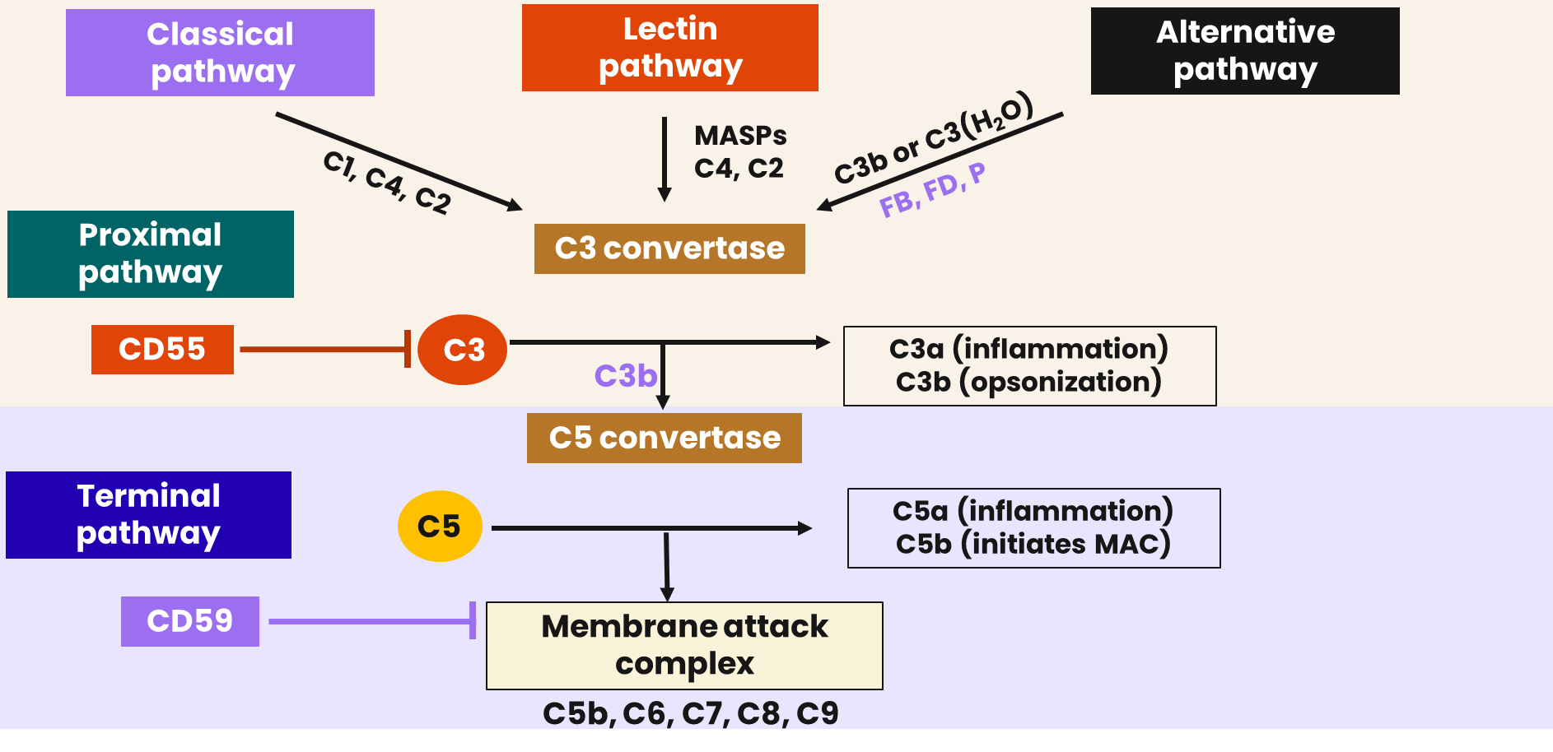
Recent Practice-Changing Approvals of Complement Inhibitors in PNH
Danicopan
Iptacopan
CD55 and
Pegcetacoplan
Adapted from Shi. Ther Adv Hematol. 2024;15:20406207241307500. Gerber. Clin Adv Hematol Oncol. 2025;23(suppl 8):1.

Slide 17
PEGASUS: Pegcetacoplan vs Eculizumab in Patients With PNH
International, open-label, randomized phase III trial
Primary endpoint: mean change in Hb level from baseline to Wk 16
Key secondary endpoints: percentage of patients not requiring transfusion from baseline to Wk 16, LS mean change in LDH level and FACIT-Fatigue score from baseline to Wk 16, safety
Stratified by no. of packed red cell transfusions during 12 mo before screening (<4 vs ≥4), platelet count (<100,000 vs ≥100,000 x 10⁹/L)
4-Wk Run-in
16-Wk Randomized
Controlled Period
32-Wk Open-label
Pegcetacoplan Period
Adults with PNH; hemoglobin <10.5 g/dL while receiving stable doses of eculizumab for
≥3 mo before screening
(N = 80)
Pegcetacoplan
(n = 41)
Pegcetacoplan SC
1080 mg twice weekly
+ Eculizumab*
Pegcetacoplan
Eculizumab
(n = 39)
ECU +
PEG
*Patients continued to receive their current dose of eculizumab.
Hillmen. NEJM. 2021;384:1028.

Slide 18
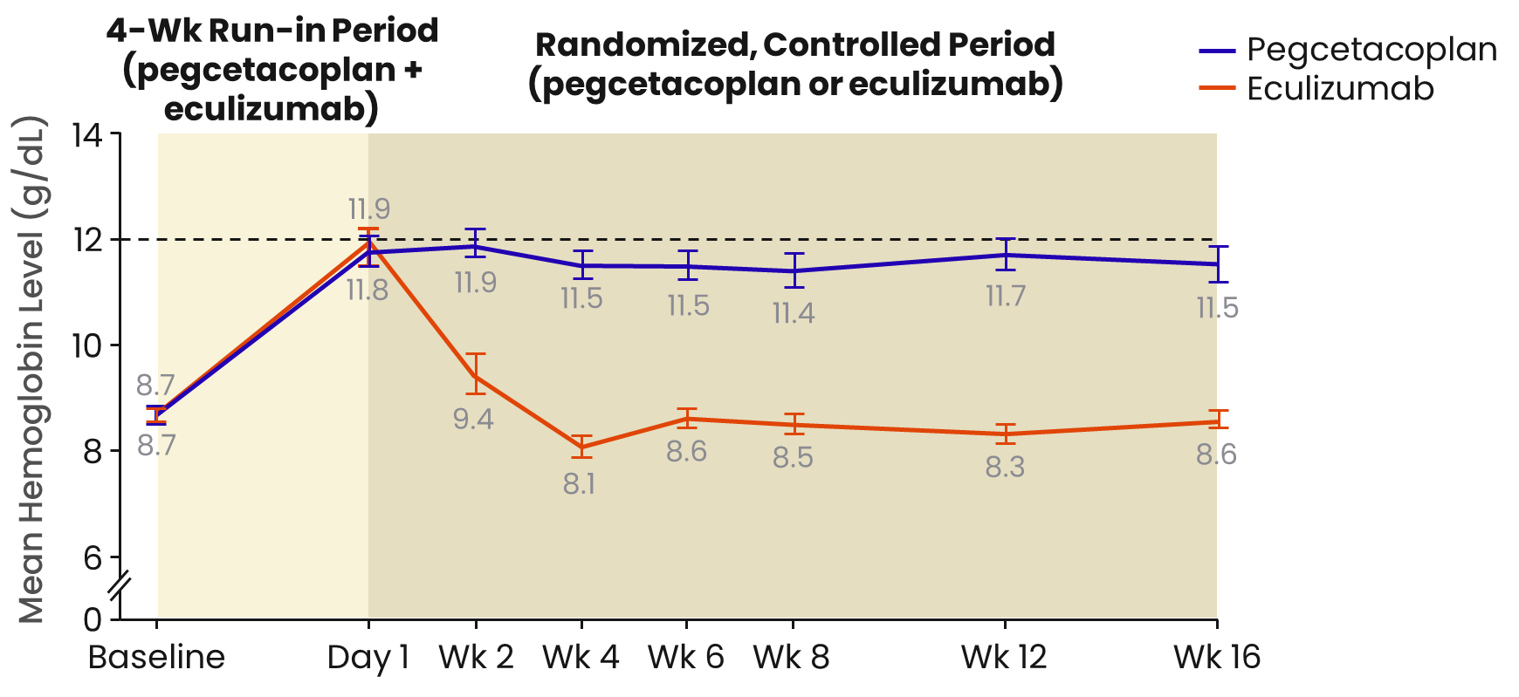
PEGASUS: Mean Hb Levels of Pegcetacoplan vs Eculizumab
 | Patients, n |  | Adjusted Change in LS Mean Hemoglobin, g/dL ± SE
Subgroup | Pegcetacoplan | Eculizumab | Pegcetacoplan | Eculizumab | Difference (95% CI)
Censored for transfusion events, all values after intercurrent events set to missing | 41 | 39 | 2.37 ±0.36 | -1.47 ± 0.67 | 3.84 (2.33-5.34)
All data, regardless of transfusion events | 41 | 39 | 2.66 ±0.25 | -0.03 ± 0.26 | 2.69 (1.99-3.38)
No. of transfusions in prior 12 mo <4 ≥4 | 20 21 | 16 23 | 2.97 ±0.36 2.11 ±0.60 | -0.01 ± 0.49 -4.02 ± 2.40 | 2.98 (1.73-4.23) 6.13 (0.79-11.48)
Hillmen. NEJM. 2021;384:1028.

Slide 19
Long-term Efficacy of Pegcetacoplan in Patients With PNH
PRINCE
Pegcetacoplan SC
1080 mg twice weekly
(n = 35)
Adults with PNH; C5 inhibitor–naive patients
(N = 53)
26
weeks
Supportive Care excluding complement inhibitors
(n = 18)
PEGASUS
PRINCE
1
2.5 yr PRINCE
0.8
3 yr PEGASUS
0.6
Probability of Transfusion Avoidance
100
86.4%
83.5%
0.4
80
79.2%
79.5%
74.8%
PEGASUS
PRINCE
71.2%
0.2
60
Transfusion Avoidance
Rate (%)
0
0
200
400
600
800
945
1000
1096
40
Days
20
0
Yr 0-1
Yr 1-2
Yr 2-2.5 (PRINCE)
Yr 2-3 (PRINCE)
de Castro. Adv Ther. 2025;42:4641.

Slide 20
APPLY-PNH: Oral, Twice-Daily Iptacopan in Adults With PNH and Residual Anemia
International, open-label, randomized phase III trial
Coprimary endpoints: proportion of patients with ≥2 g/dL Hb increase from baseline, proportion of patients with Hb ≥12 g/dL, each w/o RBCTs
Key secondary endpoints: transfusion avoidance, changes in Hb level from baseline, FACIT-F score, ARC and LDH level, rates of clinical breakthrough hemolysis, safety
Stratified by prior SoC therapy, RBCTs in prior 6 mo
24-Wk Randomized
Treatment Period
24-Wk Treatment
Extension Period
Adults with PNH and clone size ≥10%; mean Hb <10 g/dL; on stable SoC therapy (ECU/RAV) for ≥6 mo
(N = 97)
Iptacopan PO 200 mg BID
(n = 62)
Iptacopan PO 200 mg BID
Anti-C5 SoC*
(n = 35))
Iptacopan PO 200 mg BID
*Patients continued with same anti-C5 antibody therapy as had received prior to randomization. ECU: maintenance (fixed) dose followed by IV infusion Q2W. RAV: IV infusion Q8W; maintenance dose based on body weight.
de Latour. NEJM. 2024;390:994

Slide 21
APPLY-PNH: Results of Iptacopan on Anemia and Mean Hb
Increase from baseline in Hb of ≥2 g/dL in the absence of RBC transfusions
Hb ≥12 g/dL in the absence
of RBC transfusions
51/60
patients treated with iptacopan
0/35
patients treated with SoC
42/60
patients treated with iptacopan
0/35
patients treated with SoC
Observed
Mean Hb (SD) over time during the 24-wk randomized treatment period‡
15
100
Difference =
80.3%
(95% CI: 71.3-87.6)
P <.0001
100
Difference =
67.0%
(95% CI: 56.3-76.9)
P <.0001
14
13
80
80
12
12 g/dL
Mean Hb Level
(g/dL; SD)
11
60
60
10
Estimated Proportion of Patients (%)
9
Population
estimate
40
82.3%
40
68.8%
8
7
BL
Wk 1
Wk 2
Wk 4
Wk 6
Wk 8
Wk 12
Wk 16
Wk 18
Wk 20
Wk 22
Wk 24
20
20
Study Visit
1.8%
Patients with available data
Iptacopan
Anti-C5 SoC
2.0%
62
35
61
29
59
27
60
32
59
32
59
31
60
33
59
28
59
34
59
32
57
32
61
34
0
0
Adjusted mean Hb change from baseline was +3.59 (95% CI: 3.32-3.86) g/dL for iptacopan vs -0.04 (95% CI: -0.42 to 0.35) g/dL for SoC, with a difference of +3.63 (95% CI: 3.18-4.08) g/dL (P <.0001)
de Latour. NEJM. 2024;390:994

Slide 22
APPLY-PNH: Impact of Iptacopan on Fatigue
Transfusion avoidance
60/62
patients treated with iptacopan
14/35
patients treated with SoC
Observed
Mean FACIT-Fatigue score (SD) during the 24-wk randomized treatment period
100
A post hoc sensitivity analysis using a different approach for handling missing data confirmed the significance of the prespecified analysis:
96.7% (95% CI: 91.3-100.0)
38.9% (95% CI: 23.1-55.8)
Difference = 57.8% (95% CI: 39.8-74.2) P <.0001
50
Difference =
70.3%
(95% CI: 52.6-84.9)
P <.0001
80
45
40
Mean FACIT-Fatigue Score (SD)
60
35
Estimated Proportion
of Patients (%)
Population
estimate
96.4%
30
40
25
20
20
15
BL
Wk 1
Wk 2
Wk 6
Wk 12
Wk 18
Wk 20
Wk 22
Wk 24
26.1%
Study Visit
0
Patients with available data
Iptacopan
Anti-C5 SoC
62
33
60
27
57
28
61
32
57
29
58
29
59
28
56
28
60
30
Adjusted mean change from baseline in FACIT-Fatigue score was +8.59 (95% CI: 6.72-10.47) for iptacopan vs +0.31 (95% CI: -2.20 to 2.81) for SoC, with a difference of +8.29 (95% CI: 5.28-11.29) (P <.0001)
de Latour. NEJM. 2024;390:994

Slide 23
APPULSE-PNH: Iptacopan in Patients With PNH Who Switched From Current SoC
International, single-arm, open-label phase IIIb trial
Primary endpoint: change in Hb levels from baseline
Key secondary endpoints: proportion of hematological responders, change in ARC levels from baseline, percentage change in LDH levels from baseline, safety
24-Wk Treatment Period
Adults with PNH; mean Hb ≥10 g/dL; on stable anti-C5 for ≥6 mo; no RBC transfusions for ≥6 mo
(N = 52)
Iptacopan PO 200 mg BID
NCT05630001. Kulasekararaj. EHA 2025. Abstr S183.

Slide 24
APPULSE-PNH
Adjusted mean change from baseline in Hb between Day 126 and 168†
16
3
15
14
Mean Hb, g/dL (± SD)
2
13
12
Adjusted Mean Change From Baseline in Hb (g/dL; 95% CI)
11
12 g/dL
1
10
+2.01
(1.74, 2.29)
+2.37
(2.01, 2.74)
+1.44
(1.04, 1.84)
Baseline†
1
2/3
4
8
12
16
18
20
22
24
Wk
0
Patients with available data
All
(N = 52)
Baseline
Hb <12 g/dL
(N = 32)
Baseline
Hb ≥12 g/dL
(N = 20)
52
49
50
51
52
51
48
49
51
50
100
90
80
60
Healthy general population ∼43.5
70
60
50
Mean Clone Size
(%; ± SD)
50
40
40
30
Mean FACIT-Fatigue Score (SD)
20
30
10
20
Baseline*
4
8
16
20
24
Wk
10
Patients with available data
PNH RBCs
PNH granulocytes
49
48
44
43
41
39
45
43
46
43
46
45
0
Baseline*
Wk 12
Wk 24
Kulasekararaj. EHA 2025. Abstr S183.

Slide 25
ALPHA Long-term Study With Danicopan as Add-on Treatment to Anti-C5 for Patients With PNH and cs-EVH
Randomized, double-blind, placebo-controlled phase III trial (data cutoff:
Sept 20, 2022)
Primary endpoint: change in Hb from baseline to Wk 12
Secondary endpoints: change from baseline to Wk 24 in: Hb, ARC, LDH, C3 deposition on PNH RBCs, and FACIT-Fatigue scores; proportion of patients with transfusion avoidance or Hb increase ≥2 g/dL without transfusion, safety
Primary Endpoint
(Wk 12)
Secondary Endpoints
(Wk 24)
Treatment Period 1
Treatment Period 2
Danicopan 150 mg TID‡ +
Eculizumab or Ravulizumab
(n = 42)§
Danicopan 150 mg TID‡ +
Eculizumab or Ravulizumab
(n = 40)
2-yr long-term extension:
Danicopan +
Eculizumab or Ravulizumab
Adults (≥18 yr) with PNH and
cs-EVH*; receiving stable eculizumab or ravulizumab treatment ≥6 mo
(N = 86†)
2:1
Placebo +
Eculizumab or Ravulizumab
(n = 21)§
Danicopan 150 mg TID‡ +
Eculizumab or Ravulizumab
(n = 20)
*cs-EVH defined as Hb ≤9.5 g/dL, ARC ≥120 x 10⁹/L. †n = 23 excluded from prespecified efficacy analysis. ‡Escalation to 200 mg TID at investigator’s discretion as per clinical response. §Efficacy data set.
Kulasekararaj. ASH 2023. Abstr 576. Kulasekararaj. Blood. 2024;145:811.

Slide 26
ALPHA: Hemoglobin Levels Over Time
Danicopan Improved Hemoglobin Levels at Wk 12 and Maintained Improvement Through Wk 48
Treatment
Period 1
Treatment
Period 2
Long-term Extension
13
Danicopan-danicopan
Placebo-danicopan
12
11
10
9
Mean (SD) Hemoglobin (g/dL)
8
7
6
5
0
Baseline
1
2
3
4
6
8
10
12
13
14
15
16
18
20
22
24
28
32
36
40
44
48
52
56
60
64
68
72
D-D: 7.66 g/dL (0.94)
P-D: 7.74 g/dL (1.04)
D-D: 10.75 g/dL (1.40)
P-D: 8.46 g/dL (1.13)
D-D: 10.78 g/dL (1.73)
P-D: 10.46 g/dL (1.70)
D-D: 10.36 g/dL (1.74)
P-D: 10.51 g/dL (1.43)
Wk | BL | 1 | 2 | 3 | 4 | 6 | 8 | 10 | 12 | 13 | 14 | 15 | 16 | 18 | 20 | 22 | 24 | 28 | 32 | 38 | 40 | 44 | 48
D-D, n | 42 | 38 | 41 | 35 | 40 | 38 | 35 | 26 | 36 | 31 | 35 | 30 | 33 | 29 | 30 | 31 | 35 | 32 | 30 | 24 | 22 | 20 | 15
P-D, n | 21 | 19 | 19 | 18 | 20 | 20 | 20 | 18 | 20 | 17 | 18 | 17 | 20 | 17 | 16 | 15 | 16 | 16 | 13 | 13 | 11 | 9 | 10
LSM (SEM) Change at Wk 12
D-D: 2.94 g/dL (0.21)
P-D: 0.50 g/dL (0.31)
LSM (SEM) Change at Wk 24
D-D: 3.17 g/dL (0.30)
P-D: 2.26 g/dL (0.34)
Kulasekararaj. ASH. 2023. Abstr 576. Kulasekararaj. Blood. 2024;145:811.

Slide 27
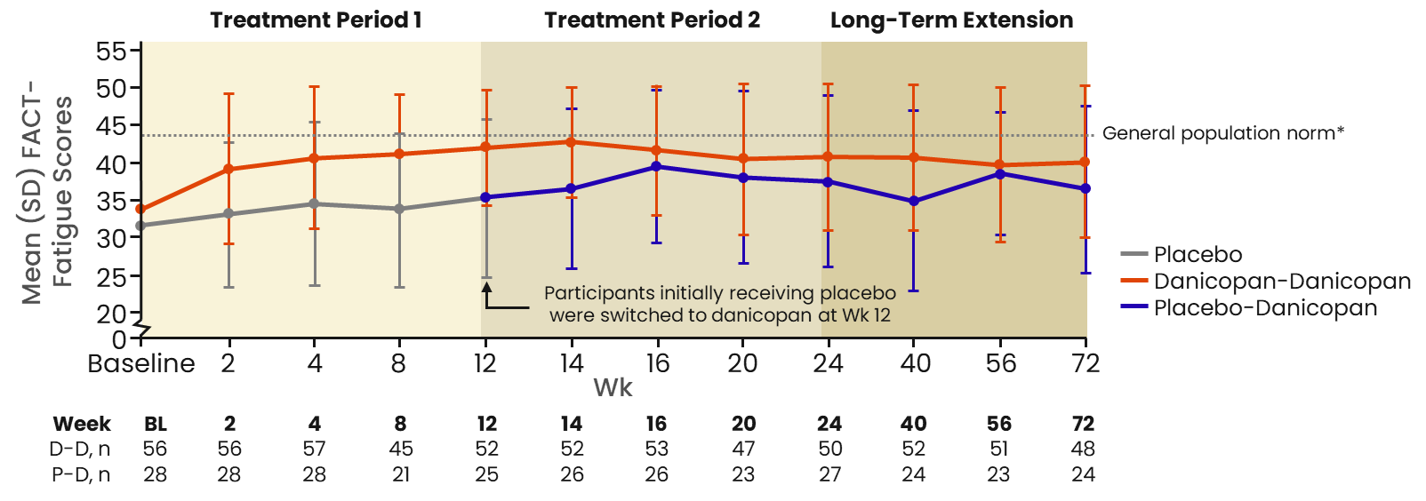
ALPHA: Fatigue Scores After Week 12 With Danicopan as Add-on Treatment
100
***
80
78.9
80.0
81.5
81.5
73.1
80.0
79.2
Placebo
Danicopan-Danicopan
Placebo (Wk 0-12)-Danicopan (Wk 13-72)
Treatment Received Over Time
60
Proportion of
Participants* (%)
40
27.6
Participants initially receiving placebo were switched to
danicopan at Wk 12
20
17.2
8.8
0
n = 57
n = 29
n = 57
n = 29
n = 55
n = 27
n = 54
n = 56
n = 50
n = 24
24 Wk Prior to Receiving Study Drug
Wk 0-12
Wk 12-24
Wk 24-48
Wk 48-72
Mean Change in FACIT-Fatigue Score Over Time
Kulasekararaj. ASH 2023. Abstr 576. Kulasekararaj. Blood. 2024;145:811.

Slide 28
Crovalimab: Properties
Formation of drug target drug complexes (DTDC) can occur with drug switching
(SNP causes lack of C5 binding to eculizumab)
C5 with SNP
Eculizumab
C5
Crovalimab
Crovalimab binds wild-type and mutant C5
C5
Antibody is engineered for protection from degradation. It is then recycled.
DTDC
Lysosome for degradation
Adapted from Röth. Blood. 2020;135:912.

Slide 29
COMPOSER: 3-Part Adaptive Phase I/II Trial of Crovalimab in Healthy Volunteers and Patients With PNH
Mean tC5 concentrations over time in PNH patients and HVs
Part 1
Part 2
Part 3
Male
healthy volunteers
(n = 15)
Tx-naive
patients with PNH
(n = 11)
Patients with PNH pretreated
with eculizumab
(n = 24)
360
320
280
240
10 patients enrolled
and completed tx
19 patients enrolled,
16 completed tx,
3 ongoing tx*
Mean Total C5 Concentration (μg/mL)
200
160
10 patients
15 patients
120
80
25 patients
-10
0
10
20
30
40
50
60
70
80
90
100
110
120
Eculizumab pretreated PNH patients
Eculizumab baseline tC5
Treatment-naive PNH patients
Treatment-naive baseline tC5
Health volunteers
Healthy volunteer baseline tC5
23 patients at time of cutoff*
Days
*Treatment cessation due to differences in patients.
Röth. Blood. 2020;135:912.

Slide 30
COMMODORE 2: Crovalimab vs Eculizumab in Patients With PNH Naive to Complement Inhibitor
Parameter | Crovalimab (n = 135) | Eculizumab (n = 69)
Median tx duration, wk (range) | 19.7 (0.1-23.1) | 22.0 (6.1-26.1)
Patients with ≥1 AE (any grade, any cause), n (%) | 105 (77.8) | 55 (79.7)
All-grade AEs in ≥10% of patients, n (%) Infusion-related reaction Neutrophils decreased WBCs decreased Hypokalemia Pyrexia Upper respiratory tract infection Hypocalcemia | 21 (15.6) 17 (12.6) 16 (11.9) 15 (11.0) 12 (8.9) 11 (8.1) 8 (5.9) | 9 (13.0) 7 (10.1) 7 (10.1) 9 (13.0) 7 (10.1) 9 (13.0) 7 (10.1)
All-grade TRAEs, n (%) | 45 (33.3) | 24 (34.8)
Grade 3-5 AEs, n (%) | 24 (17.8) | 17 (24.6)
AEs leading to death, n (%) | 2 (1.5) | 1 (1.4)
SAEs, n (%) | 14 (10.4) | 9 (13.0)
Treatment-related SAEs, n (%) | 4 (3.0) | 1 (1.4)
AEs leading to dose modification, n (%) | 5 (3.7) | 3 (4.3)
AEs leading to d/c, n (%) | 1 (0.7) | 1 (1.4)
Treatment effect for the co-primary and secondary efficacy endpoints
Crovalimab
(n = 134)
Eculizumab
(n = 69)
OR
(95% CI)
Hemolysis control
(OR)
79.3
79.0
1.0
(0.6 to 1.8)
0.0 0.2 0.4 0.6 0.8 1.0 1.2 1.4 1.6 1.7 2.0
Diff
(95% CI)
Transfusion
avoidance (%)
65.7
68.1
-2.8
(-15.7 to 11.1)
-20 -15 -10 -5 0 5 10 15 20
Diff
(95% CI)
Breakthrough
hemolysis (%)
3.9
(-5.3 to 14.8)
10.4
14.5
Hb stabilization (%)
63.4
60.9
2.2
(-11.4 to 16.3)
FACIT-Fatigue
7.8
5.2
2.6
(0.7 to 4.6)
-20 -15 -10 -5 0 5 10 15 20
Favors eculizumab
Favors crovalimab
Röth. Am J Hematol. 2024;99:1768.

Slide 31
Complement Inhibition in PNH
 | Target | FDA/EMA Status | Administration
Eculizumab | C5 | Approved | IV
Ravulizumab | C5 | Approved | IV
Crovalimab | C5 | Approved | IV loading and SC maintenance
Pegcetacoplan | C3 | Approved | SC
Iptacopan | Factor B | Approved | Oral
Danicopan | Factor D | Approved | Oral
Pozelimab | C5 | Investigational | IV loading and SC maintenance
Cemdisiran | C5 | Investigational | SC
Zaltenibart | MASP-3 | Investigational | IV
KP104 | C5 and C3 convertase | Investigational | IV loading and SC maintenance
Introduction of complement inhibitors, which initially targeted C5, transformed the clinical landscape of PNH
Subsequent introduction of proximal complement inhibitors further improved disease control
Therapies have generally been safe and well tolerated
Kelly. Drugs. 2025;85:1413.

Slide 32
Phase II Trial of Pozelimab and Cemdisiran in Patients With PNH
International, open-label, randomized phase II trial
Primary endpoint: incidence and severity of TEAEs through Wk 28
Key secondary endpoints: percent change of LDH from pretreatment to EoT; adequate control and normalization of LDH, transfusion avoidance
28-Wk Randomized
Treatment Period
52 wk
52 wk
Cemdisiran SC 200 mg Q4W +
Pozelimab SC 400 mg SC Q4W
(n = 12)
Adults with PNH receiving pozelimab monotherapy in OLE trial NCT04162470 willing to switch to combination tx
(N = 24)
Optional
OLEP
Safety
follow-up
Cemdisiran SC 200 mg Q4W +
Pozelimab SC 400 mg Q2W
(n = 12)
Jang. E J Haem. 2025;6:e70095.

Slide 33
Phase II: Pozelimab and Cemdisiran Outcomes
130
Hemoglobin (g/L)
Pozelimab Q2W + cemdisiran
Pozelimab Q4W + cemdisiran
120
110
Mean (± SE)
Physical Functioning
100
95
90
1
8
15
29
57
85
113
141
169
197
85
Patients at Risk, n
Pozelimab Q2W + cemdisiran
Pozelimab Q4W + cemdisiran
Visit (Study Day)
11
12
11
12
10
11
12
10
12
11
12
12
12
12
12
12
12
12
12
12
Mean (± SE)
80
FACIT Fatigue
45
75
40
1
15
29
57
85
113
141
169
197
Mean (± SE)
Visit (Study Day)
35
Patients at Risk, n
Pozelimab Q2W + cemdisiran
Pozelimab Q4W + cemdisiran
8
9
10
11
11
12
12
10
12
12
12
12
10
11
11
12
11
12
1
15
29
57
85
113
141
169
197
Patients at Risk, n
Pozelimab Q2W + cemdisiran
Pozelimab Q4W + cemdisiran
Visit (Study Day)
8
9
10
11
11
12
12
10
12
12
12
12
10
11
11
12
11
12
Jang. E J Haem. 2025;6:e70095.

Slide 34
Phase II Trial of Tesidolumab in Patients With Variant and Nonvariant C5: Key Clinical Endpoints
2500
-40
40
The yr before therapy
The yr after therapy
2000
30
1500
-60
Target
LDH (% Change From Baseline)
Blood Transfusions (Units/Yr)
LDH (U/L)
20
1000
-80
500
10
0
-100
-4
0
4
8
12
16
20
24
28
32
36
40
44
48
52
0
A
B
C
D
E
F
G
H
I
-4
0
4
8
12
16
20
24
28
32
36
40
44
48
52
Study Wk
Study Wk
Patient ID
ULN
800
60
150
50
600
40
Tesidolumab Concentration (μg/mL)
LLN
FACIT-Fatigue Score
400
30
Hemoglobin (g/L)
100
20
200
10
50
0
0
-4
0
4
8
12
16
20
24
28
32
36
40
44
48
52
-4
0
4
8
12
16
20
24
28
32
36
40
44
48
52
-4
0
4
8
12
16
20
24
28
32
36
40
44
48
52
Study Wk
Study Wk
Study Wk
Patient ID
A B C D
E F G H I
C5 status:
Variant
Non variant
Nishimura. Hematologica. 2022;107:1483.

Slide 35



Considerations for Treatment Selection in PNH
Consideration of HSCT
Pregnancy
Patient-related considerations: access to care, adherence challenges, patient preferences, and a heightened risk of thromboembolic events in racial/ethnic minorities
Storage
requirements
Dosing method/route
of administration

Slide 36
Allogeneic Transplant for PNH
Mainly for patients with associated bone marrow failure syndrome (aplastic anemia)
High risk of complications
Recurrent thrombosis
Rarely in patients with classic hemolytic PNH who do not respond to complement-directed therapy

Slide 37
Addressing the Burden of Paroxysmal Nocturnal Hemoglobinuria: Potential Complications and Patient-Centered Care

Slide 38
PNH and Disease Burden
Physical Burden | Treatment Burden | Emotional Burden | Financial Burden
Health status Breakthrough hemolysis Vaccine status | Diagnostic delays Side effects Weighing decisions Infections | Mental health | Loss of time spent working Cost of medications Travel or accommodations
Ueda. Ann Hematol. 2025;104:3575.

Slide 39
Challenges of Delayed Diagnosis of PNH
Clinical Manifestations and Symptoms of PNH
Intravascular hemolysis
Anemia
Fatigue
Hemoglobinuria
Headache
Dyspnea
Abdominal pain
Erectile dysfunction
Acute/chronic renal failure
Thrombosis in odd locations
Fewer than 40% of patients with PNH receive their diagnosis within 12 mo of symptom onset
On average, diagnosis takes ~2 yr
  In 24% of patients, it may take over 5 yr to diagnose PNH
79% of patients consult more than 1 physician before receiving their diagnosis
  Of these, 38% see more than 5 specialists
Schrezenmeier. Ann Hematol. 2020;99:1505. Hill. Nat Rev Dis Primers. 2017;3:17028. Bektas. J Manag Care Spec Pharm. 2020;26:S8.

Slide 40
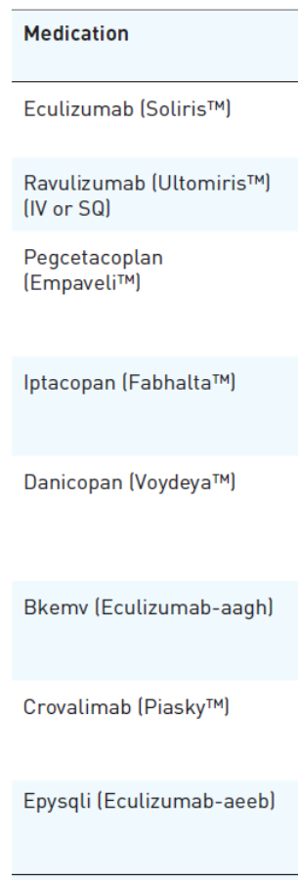
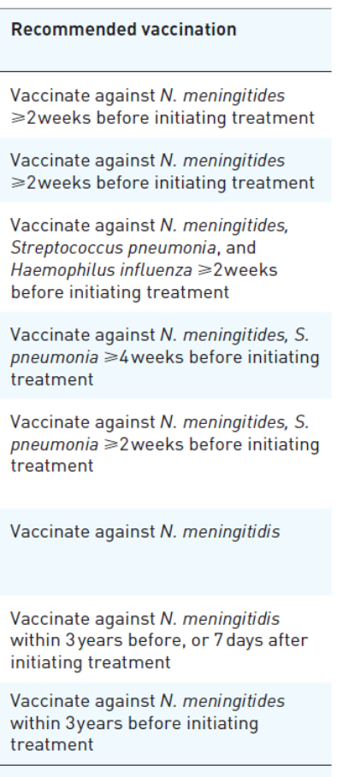
FDA-Approved PNH Medications: Vaccinations and Infections
Drug | Approval Date | PNH Indication | MoA | Vaccinate Against (Recommended)
Eculizumab | 3.16.2007 | Adults with PNH | mAb against C5 | N. meningitides >2 wk before tx
Ravulizumab | 12.21.2018 | Adult and pediatric patients >1 mo of age | mAb against C5 | N. meningitides >2 wk before tx
Pegcetacoplan | 5.14.2021 | Adults with PNH | Binds C3 and activates fragment C3b | N. meningitides, S. pneumonia, and H. influenza >2 wk before tx
Iptacopan | 12.6.2023 | Adults with PNH | Binds Factor B | N. meningitides, S. pneumonia >4 wk before tx
Danicopan | 3.29.2024 | Add-on therapy to ravulizumab or eculizumab in adults with PNH experiencing EVH | Binds reversibly to Factor D | N. meningitides, S. pneumonia >2 wk before tx
Bkemv (Eculizumab biosimilar) | 5.28.2024 | Adults with PNH | Biosimilar mAb against C5 | N. meningitides
Crovalimab | 6.24.2024 | Adult and pediatric patients >13 yr old with PNH and body weight >40 kg | mAb against C5 | N. meningitides within 3 yr before or 7 days after tx
EpYSQLI (Eculizumab biosimilar) | 7.19.2024 | Adults with PNH | Biosimilar mAb against C5 | N. meningitides within 3 yr before tx
Shi. Ther Adv Hematol. 2024;15:20406207241307500.

Slide 41
Treatment-Related Adverse Events Associated With Complement Inhibitors in PNH
Iron deficiency
Transient immune complex reactions
Thrombosis
Increased lipid levels
Fatigue
Diarrhea
Anemia
Injection site reactions
Shi. Ther Adv Hematol. 2024;15:20406207241307500.

Slide 42
Persistent Anemia in PNH
Common while on C5 blockade (~25% may require transfusions)
Iron or other nutritional deficiency
Associated bone marrow failure (reticulocyte count)
Inflammation
Chronic kidney disease
Persistent intravascular hemolysis
Breakthrough hemolysis
  Check trough CH50, LDH, bilirubin
Extravascular hemolysis
  Retic, bilirubin, Coombs (positive for C3), flow cytometry for RBCs coated with C3d

Slide 43


Disease Burden: Breakthrough Hemolysis in PNH
Hemolysis in untreated PNH
Pharmacokinetic breakthrough hemolysis
Pharmacodynamic breakthrough hemolysis
Membrane Attack Complex C5b-9
C5 convertase
C5
C3b
Free C5
PNH treated with C5 inhibition
Eculizumab
Opsonized red cells are phagocytosed and undergo extravascular hemolysis in the reticuloendothelial system
Time
Dosing interval
C3b
Extravascular hemolysis
Intravascular hemolysis
Brodsky RA. Blood 2021.137:1304..

Slide 44
Managing Breakthrough Hemolysis in PNH
Need for prompt identification and management
Signs and symptoms
Evaluating severity
Prevention strategies
Recommended management

Slide 45

Pregnancy and PNH
High risk of thrombosis, miscarriage
Pregnancy in a patient with PNH should be planned
Most experience is with eculizumab (vs ravulizumab)
Dose adjustment to keep drug therapeutic (CH50)
Anticoagulation from second trimester until postpartum
Best managed by a team experienced in high-risk pregnancy and a PNH expert

Slide 46
Communication: Patient Discussions and Strategies to Address Disease Burden of PNH
Patient
Fatigue and other symptoms
Adverse effects from treatment
Financial issues
Mental health and stress
Bektas. J Manag Care Spec Pharm. 2020;26:S8. Schrezenmeier. Ann Hematol. 2020;99:1505.

Slide 47




Education for Patients and Their Caregivers: Resources for Patients With PNH
Aplastic Anemia and MDS International Foundation (AAMDSIF): www.aamds.org
National Organization for Rare Disorders (NORD): rarediseases.org/
PNH Global Alliance: pnhglobalalliance.org/
myPNHteam: www.mypnhteam.com/about

Slide 48
Go Online for More Coverage of PNH!
Additional CME/CE-certified podcast on Modern Management of PNH | Decera Clinical Education with expert faculty commentary
deceraclinical.com/education/activities/oncology/modern-management-of-pnh/121615/info

