Slide 1
Advances in Systemic Amyloidosis:
A Spotlight on New Disease-Modifying
Therapies Across the Clinical Spectrum
Supported by an educational grant from Janssen Biotech, Inc., administered by Janssen Scientific Affairs, LLC.

Slide 2

About These Slides
Please feel free to use, update, and share some or all of these slides in your noncommercial presentations to colleagues or patients
When using our slides, please retain the source attribution:
These slides may not be published, posted online, or used in commercial presentations without permission. Please contact permissions@clinicaloptions.com for details
Slide credit: clinicaloptions.com
Notes:
Disclaimer: The materials published on the Clinical Care Options website reflect the views of the authors of the CCO material, not those of Clinical Care Options, LLC, the CME providers, or the companies providing educational grants. The materials may discuss uses and dosages for therapeutic products that have not been approved by the United States Food and Drug Administration. A qualified healthcare professional should be consulted before using any therapeutic product discussed. Readers should verify all information and data before treating patients or using any therapies described in these materials.

Slide 3
Faculty
Shaji K. Kumar, MD
Mark and Judy Mullins Professor of Hematological Malignancies
Chair, Myeloma Amyloidosis Dysproteinemia Group
Consultant, Division of Hematology
Mayo Clinic
Rochester, Minnesota
Shaji K. Kumar, MD, has disclosed that he has received funds for research support from AbbVie, Bristol-Myers Squibb, Celgene, Genentech, Janssen, MedImmune, Oncopeptides, Takeda, and TeneoBio and consulting fees from AbbVie, Bristol-Myers Squibb, Celgene, Genentech, Janssen, Oncopeptides, and Takeda
Beth Faiman, PhD, MSN, APRN-BC, AOCN
Nurse Practitioner
Cleveland Clinic Taussig Cancer Institute
Cleveland, Ohio
Beth Faiman, PhD, MSN, APRN-BC, AOCN, has disclosed that she has received consulting fees from Bristol-Myers Squibb, GlaxoSmithKline, Karyopharm, and Sanofi.

Slide 4
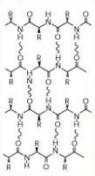

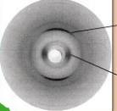
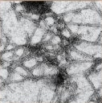
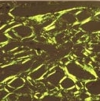
Systemic Amyloidosis: Pathogenesis
Amyloid fibrils
Transthyretin
Fibril axis
Apolipoprotein AI
4.7 Å
10 Å
Lysozyme
Congo red
4.7 Å
Immunoglobulin κ light chain
10 Å
Transmission electron microscopy
Polarized light microscopy
Adapted from Merlini. NEJM. 2003;349:583.
Slide credit: clinicaloptions.com

Slide 5
Systemic Amyloidosis: Classification
Fibril Protein | Precursor Protein | Systemic vs Localized | Acquired vs Hereditary | Target Organs
AL, AH | Ig, light or heavy chain | Both | Both | All; CNS only rarely
AA | (Apo) serum amyloid A | Systemic | Acquired | All except PNS, CNS
ALECT2 | Leukocyte chemotactic factor-2 | Systemic | Acquired | Kidney (primarily), liver
ATTRv | Transthyretin variants | Systemic | Hereditary | Heart, PNS, ANS, eye, leptomeninges
AFib | Fibrinogen A α-chain variants | Systemic | Hereditary | Kidney (primarily)
Apolipoproteins (AI, AII, CII, CIII) | Apolipoprotein variants | Systemic | Hereditary | All variants (kidney); AApoAI variant also affects heart, liver, PNS, testis, larynx, skin
ALys, AGel | Lysozyme variants Gelsolin variants | Systemic | Hereditary | Kidney PNS, cornea, kidney, heart
Aβ2Mv | β₂-microglobulin variant | Systemic | Hereditary | ANS
ATTRwt | Wild-type, aging | Systemic | Acquired | Cardiac (primarily); also lung, ligaments, tenosynovium
AApoAIV | Apolipoprotein AIV; wild-type, aging | Systemic | Acquired | Kidney medulla, systemic
Asem1 | Semenogelin 1; wild-type, aging | Localized | Acquired | Seminal vesicles
Aβ2M AIns (insulin) AEnf (enfuvirtide) | Wild-type, iatrogenic (dialysis) Iatrogenic Iatrogenic | Systemic Localized Localized | Acquired Acquired Acquired | Musculoskeletal, injection sites
Picken. Acta Haematol. 2020;143:322.
Slide credit: clinicaloptions.com
Notes:
ANS, autonomic nervous system; CNS, central nervous system; Ig, immunoglobulin; PNS, peripheral nervous system.

Slide 6
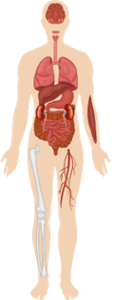
Systemic Amyloidosis: Organ Involvement
Lung
AL, ATTRwt, ATTRv
AA, AApoAIV, Aß2M
Heart
AL, ATTRwt, ATTRv
AApoAI, AFib, ALys, AGel
Liver
AL, ALECT2, AA
AApol, ALys, ATTR
Kidney
AL, AA, ALECT2
AFib, ALys, ATTRv, AApolAI, AII, AIV
AGel, A Cys
Intestines
AL, AA, ATTRv
AApoAI, ALys, Alect2, AFib, Aß2M
Peripheral nerves
AL, ATTRv, AGel
AApol, AFib, Aß2Mv
Adapted from Picken. Acta Haematol. 2020;143:322.
Slide credit: clinicaloptions.com
Notes:
AL, amyloid light chain; ATTR, amyloid transthyretin; ATTRv, variant amyloid transthyretin; ATTRwt, wild-type amyloid transthyretin.

Slide 7
Amyloidosis: Clinical Presentation
Cerebral hemorrhage, stroke, dementia
Periorbital purpura
Impaired vision
Symptom | Ig AL | ATTRwt | ATTRv
Atypical MGUS or smoldering myeloma | X | -- | --
Diastolic dysfunction, HFpEF | X | X | X
Proteinuria, nondiabetic | X | -- | --
Small-fiber neuropathy | X | -- | X
Autonomic dysfunction | X | -- | X
Hepatomegaly, no imaging defects | X | -- | --
Purpura on face and/or neck | X | -- | --
Macroglossia | X | -- | --
Bilateral carpal tunnel | X | X | X
Spinal stenosis/ pseudoclaudication | X | X | X
Biceps rupture | -- | X | --
Jaw claudication, xerostomia, submandibular swelling
Macroglossia
Dysphagia, hoarseness
Orthostatic hypotension
Heart failure, arrhythmias, conduction abnormalities, syncope, hypotension, chest pain
Dyspnea, cough
Hepatomegaly, hepatic failure
Hyposplenism
Fatigue, anorexia, weight loss
Proteinuria, nephrotic syndrome, renal failure
GI dysmotility, malabsorption, ulceration, GI bleeding
Carpal tunnel syndrome
Easy bruising
Urinary retention, Erectile dysfunction
Nail dystrophy
Muscle weakness
Ankle edema
Painful paresthesia
Gertz. JAMA. 2020;324:79. Adapted from Muchtar. J Intern Med. 2021;289:268.
Slide credit: clinicaloptions.com
Notes:
AL, amyloid light chain; ATTR, amyloid transthyretin; ATTRv, variant amyloid transthyretin; ATTRwt, wild-type amyloid transthyretin; GI, gastrointestinal; HFpEF, heart failure with preserved ejection fraction; Ig, immunoglobulin; MGUS, monoclonal gammopathy of undetermined significance.

Slide 8
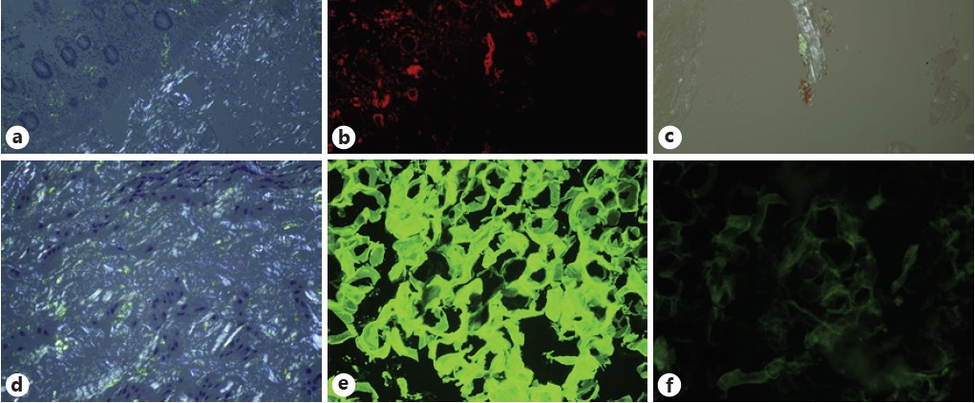
Amyloidosis: Tissue Diagnosis
Same colon biopsy, more visible amyloid deposits
Bone marrow biopsy, positive for amyloid
Colon biopsy, positive for amyloid
Panels E, F: fat biopsy stained with
anti-λ light-chain antibody and anti-κ
light-chain antibody; demonstrates
λ light-chain restriction
Carpal tunnel biopsy, positive for amyloid
Picken. Acta Haematol. 2020;143:322.
Slide credit: clinicaloptions.com

Slide 9
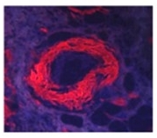
Amyloidosis: Identifying the Protein of Origin
Laser microdissection
Heat-mediated antigen retrieval
Trypsin digestion
Congo red staining
Protein identification report
Tandem mass spectrometry
Bioinformatics
Adapted from Theis. J Mass Spectrom. 2013;48:1067.
Slide credit: clinicaloptions.com

Slide 10
Amyloidosis: Mass Spectrometry
Proteomic Diagnostic Signature for 21 Amyloid Types
Dasari. Mayo Clin Proc. 2020;95:1852.
Slide credit: clinicaloptions.com
Notes:
Ig, immunoglobulin.

Slide 11
Distribution of New Cases of Amyloidosis at Mayo Clinic Rochester (2012-2017)
No. of Cases
As of December 2017, 7676 cases of amyloidosis were
seen at the Mayo Clinic Rochester
Courtesy of Shaji Kumar, MD.
Slide credit: clinicaloptions.com
Notes:
AH, amyloid heavy chain; AL, amyloid light chain.
Amyloid Light chain measurement Dispenzieri 15
Mayo Dispenzieri 10

Slide 12
Systemic Amyloidosis: Diagnostic Approach
Patient Presentation
Cardiac-specific signs of amyloidosis
  Diastolic heart failure/heart failure with preserved ejection fraction/infiltrative cardiomyopathy
Noncardiac signs of amyloidosis
  Nondiabetic proteinuria/nondiabetic neuropathy/
  hepatomegaly and diarrhea/MGUS neuropathy,
  atypical MGUS, or smoldering myeloma
Amyloid Detection: Methods
For cardiac-specific signs: PYP or DPD scan
  Scan results graded 0-3 based on radionucleotide uptake between ribs/sternum and heart
Noncardiac signs: Ig screen with serum and urine immunofixation
  Presence of M-protein/abnormal Ig free light-chain levels
Abnormal Ig Detected: AL Amyloidosis Likely
  Confirm with SC fat aspiration or lip or bone marrow biopsy; stain with Congo red
  Congo red positive
    Proceed with typing of deposits (IHC or proteomics)
    Stage with troponin, NT-proBNP, or free light chain
  Congo red negative
    Consider cardiac MRI
    Organ-specific biopsy if high index of suspicion
      Positive biopsy: Proceed with typing of deposits (IHC or proteomics)
      Negative biopsy: Amyloidosis excluded
Normal Ig With PYP or DPD Scan Grade ≥2:
ATTR Amyloidosis Likely
  Confirm with ECG; eGFR, troponin, and NT-proBNP levels; and germline DNA sequencing
    Normal sequence: ATTRwt amyloidosis confirmed; begin therapy
    Abnormal sequence: ATTRv confirmed; begin therapy and genetic counseling
Gertz. JAMA. 2020;324:79.
Slide credit: clinicaloptions.com
Notes:
AL, amyloid light chain; ATTR, amyloid transthyretin; ATTRv, variant amyloid transthyretin; ATTRwt, wild-type amyloid transthyretin; DPD, 3,3-diphosphono-1,2-propanodicarboxylic acid; ECG, electrocardiogram; eGFR, estimated glomerular filtration rate; Ig, immunoglobulin; IHC, immunohistochemistry; MGUS, monoclonal gammopathy of undetermined significance; NT-proBNP, N-terminal prohormone B-type natriuretic peptide; PYP, ^{99m}Technetium pyrophosphate.

Slide 13
AL Amyloidosis
Notes:
AL, amyloid light chain

Slide 14

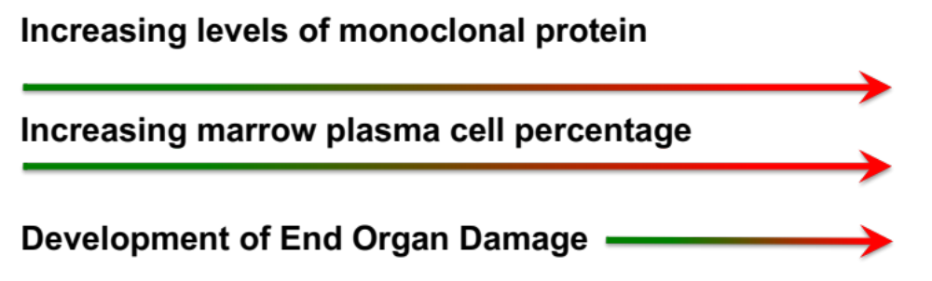
Monoclonal Gammopathies: A Spectrum
Serum Protein Electrophoresis
Used to detect an “M spike” in serum
M spike = large amount of monoclonal Ig proteins
100
Smoldering myeloma
MGUS
80
Normal
MGUS
Normal
Smoldering myeloma
Normal
Multiple myeloma
73
78
60
66
Probability of Progression (%)
51
40
20
4
16
21
0
10
0
5
10
15
20
25
Yr Since Diagnosis
Kyle. NEJM 2007;356:2582.
Slide credit: clinicaloptions.com
Notes:
MGUS, monoclonal gammopathy of undetermined significance.

Slide 15
Distribution of Monoclonal Gammopathies:
Mayo Clinic, Rochester, Minnesota
N = 56,391 (January 1960 - December 2017)
SMM 3.8% (2128)
Lymphoproliferative
2.7% (1507)
Solitary or extramedullary
1.7% (975)
AL amyloidosis
9.4% (5286)
Waldenstrom macroglobulinemia*
2.9% (1622)
Multiple
myeloma
17.9% (10,112)
Other
4.6% (2586)
MGUS†
57% (32,175)
* Includes SWM (n = 244).
† Includes LC MGUS (n = 2133).
Courtesy of Robert Kyle, MD.
Slide credit: clinicaloptions.com
Notes:
AL, amyloid light chain; LC, light chain; MGUS, monoclonal gammopathy of undetermined significance; SMM, smoldering myeloma; SWM, smoldering Waldenstrom macroglobulinemia.

Slide 16
MGUS/Amyloidosis: Early Detection
MGUS
Initial Diagnosis
Progression to AL by N-Glycosylation of Light Chains
6 mo f/u
If stable:
100
80
60
Progression Free of AL (%)
Low risk
Int risk
High risk
40
No glycosylation
Glycosylation
2-3 yr
f/u
Yearly f/u
Biannual f/u
20
P <.001
0
0
5
10
15
20
25
Yr From MGUS Diagnosis
Monitoring
Patients at Risk 389 333 263 191 108 26
NT-proBNP
Albuminuria
Alkaline phosphatase
25 20 15 8 3 0
n Events 5-Yr Rate (95% CI) 10-Yr Rate (95% CI) 15-Yr Rate (95% CI) 20-Yr Rate (95% CI)
No glycosylation 389 7 99.2% (98.3-100) 99.2% (98.3-100) 97.8% (96.0-99.6) 96.9% (94.5-99.4)
Glycosylation 25 4 95.5% (87.1-100) 90.7% (79.2-100) 78.6% (61.8-100) 78.6% (61.8-100)
Hamed. Blood Cancer J. 2021;11:97. Dispenzieri. Leukemia. 2020;34:2749.
Slide credit: clinicaloptions.com
Notes:
AL, amyloid light chain; f/u, follow-up; Int, intermediate; MGUS, monoclonal gammopathy of undetermined significance; NT-proBNP, N-terminal prohormone B-type natriuretic peptide.

Slide 17
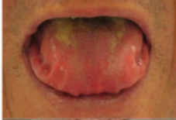

AL Amyloidosis: Clinical Presentation
Patients With Symptoms (%)
Impressions from teeth and palate
Bilateral periorbital purpura
Symptom
Panel A and B of Figure 1 of Desport et al are used in their original form with added labels under the terms and conditions of the Creative Commons Attribution 2.0 International license (CC BY 2.0: creativecommons.org/licenses/by/2.0/).
If AL amyloidosis is suspected:
STEP 1. Screen for monoclonal process
STEP 2. Demonstrate tissue deposition of amyloid
STEP 3. Confirm protein of origin
Figure courtesy of Shaji K. Kumar, MD. Desport. Baker. Methodist Debakey Cardiovasc J. 2012;8:3. Orphanet J Rare Dis. 2012;7:54.
Slide credit: clinicaloptions.com
Notes:
AL, amyloid light chain.

Slide 18
AL Amyloidosis: Screening for Monoclonal Protein
Result, n (%) | N = 110
Result, n (%) | Abnormal | Normal
Serum IF | 76 (69) | 34 (31)
Urine IF | 86 (83) | 17 (17)
Serum or urine IF | 104 (95) | 6 (5)
Abnormal FLC ratio | 100 (91) | 10 (9)
Serum IF, urine IF, and FLC | 109 (99) | 1 (1)
In patients with AL amyloidosis, urine IF should be performed for optimal diagnostic sensitivity
Not performing urine IF led to missing 6% of amyloidogenic clones in 1 study
Katzmann. Clin Chem. 2005;51:878. Merlini. Hematol Meet Rep. 2008;2:9
Slide credit: clinicaloptions.com
Notes:
AL, amyloid light chain; FLC, free light chain; IF, immunofixation.

Slide 19
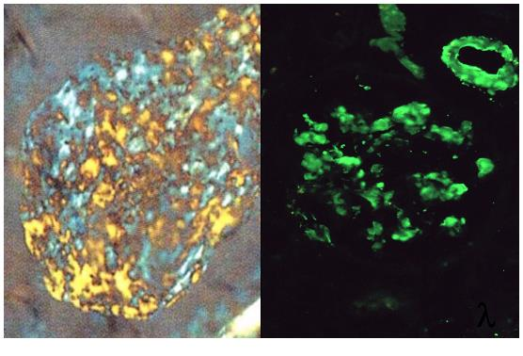
Detecting and Typing Amyloid Protein
Amyloid Typing: By IHC, IF
λ light-chain AL amyloidosis by mass spectrometry:
  λ light-chain positive/κ light-chain negative
Organ-directed biopsy
Figures courtesy of Shaji K. Kumar, MD.
Slide credit: clinicaloptions.com
Notes:
AL, amyloid light chain; IF, immunofixation; IHC, immunohistochemistry.

Slide 20
Amyloidosis: Initial Workup
Identification of involved organs and degree of involvement
Courtesy of Shaji K. Kumar, MD.
Slide credit: clinicaloptions.com
Notes:
GI, gastrointestinal.

Slide 21
Considerations for Amyloidosis Workup
Cardiac Considerations
Other Organ Considerations
Serum NT-ProBNP: If elevated, troponin may be elevated¹
ECG: low voltages, arrhythmias¹
ECHO: increased septal thickness, abnormal strain, diastolic dysfunction¹
MRI scans: cardiac nulling²
^{99m}Tc-HDP scintigraphy: Identify ATTR amyloidosis³
Renal: nephrotic range proteinuria; elevated creatinine less common^{4,5}
Liver: elevated alkaline phosphatase, elevated bilirubin (uncommon)⁶
Nerve: abnormal EMG studies⁷
GI: decreased serum carotene, abnormal motility, increased fecal fat^{8,9}
Coagulation: factor X deficiency⁴
1. Kyriakou. BMC Cardiovasc Disord. 2018;18:221. 2. Mahalingam. Indian J Radiol Imag. 2018;28:427. 3. Gertz. JAMA .2020;324:79.
4. Sanchorawala. Clin J Am Soc Nephrol. 2006;1:1331. 5. Yilmaz. Kidney Blood Pres Res. 2103;37:33. 6. Hydes. Gastroenterol Hepatol. 2012;8:205. 7. Shin. Mt Sinai J Med. 2012;79:733. 8. Petre. Aliment Pharmacol Ther. 2008;27:1006. 9. Kumar. Blood. 2010;116:5126.
Slide credit: clinicaloptions.com
Notes:
^{99m}Tc-HDP, ^{9m}Tc-hydroxymethylene diphosphonate; ATTR, amyloid transthyretin; ECG, electrocardiogram; ECHO, echocardiogram; EMG, electromyography; GI, gastrointestinal; NT-proBNP, N-terminal prohormone B-type natriuretic peptide.

Slide 22
AL Amyloidosis: OS by Mayo Clinic Stage and
Other Staging Systems
OS by Mayo Clinic Stage (n = 758)
Staging System | Markers/Thresholds | Stages
Cardiac (NT-proBNP based) | NT-proBNP >332 ng/L cTnT >0.035 ng/mL (or cTnl >0.1 ng/mL) | I. 0 markers above cutoff II. 1 marker above cutoff IIIa. Both markers above cutoff and NT-proBNP <8500 ng/L IIIb. Both markers above cutoff and NT-proBNP ≥8500 ng/L
Revised Mayo Clinic | NT-proBNP >1800 ng/L cTnT >0.025 ng/mL dFLC >180 mg/L | I. 0 markers above cutoff II. 1 marker above cutoff III. 2 markers above cutoff IV. 3 markers above cutoff
Renal | eGFR <50 mL/min per 1.73 m² proteinuria >5 g per 24 hr | I. Both eGFR above and proteinuria below cutoffs II. Either eGFR below or proteinuria above cutoffs III. Both eGFR below and proteinuria above cutoffs
Median OS ,
Mo
NR
68.8
16.7
6.7
Stage I
Stage II
Stage III
Stage IV
100
Stage 1
Stage 2
Stage 3
Stage 4
80
60
OS (%)
40
20
0
0
12
24
36
48
60
Follow-up From Diagnosis (Mo)
Kumar. JCO. 2012;30:989. Milani. Mediterr J Hematol Infect Dis. 2018;10:e2018022.
Slide credit: clinicaloptions.com
Notes:
AL, amyloid light chain; cTnI, cardiac troponin-I; cTnT, cardiac troponin-T; dFLC, difference between involved and uninvolved free light chains; eGFR, estimated glomerular filtration rate; NR, not reached; NT-proBNP, N-terminal prohormone B-type natriuretic peptide; OS, overall survival

Slide 23
Newly Diagnosed AL Amyloidosis:
Changes in Survival Over Time
Retrospective analysis of 1551 patients with newly diagnosed AL amyloidosis
1.0
2-Yr OS, %
0.8
2010-2014
2005-2009
2000-2004
60
54
42
0.6
Probability of Survival
0.4
0.2
P <.001
0
0
24
48
72
96
120
Mo From Diagnosis
Patients at Risk, n
422
604
525
177
321
257
131
248
132
106
205
19
94
121
0
78
45
0
Muchtar. Blood. 2017;129:2111.
Slide credit: clinicaloptions.com
Notes:
AL, amyloid light chain; OS, overall survival.

Slide 24
AL Amyloidosis Goals for Therapy and
Measuring Response
Goals for Therapy
Response | Criteria
aCR | Negative serum and urine IFE Normal FLC ratio
VGPR | dFLC <40 mg/L
PR | dFLC decrease >50%
NR | Other
Deep response: normalization or near normalization of serum free light chain
Durable response
Minimizing toxicity: risk-adapted therapy that does not lead to mortality or decompensate patients
Supportive care
Measuring Response in AL Amyloidosis
Measurable disease: dFLC >50 mg/L
Hematologic response
  Reduction in M protein (SPEP, UPEP, FLC)
Organ response
  Cardiac: NT-ProBNP, septal thickness
  Liver: liver span, alkaline phosphatase
  GI: fecal fat, serum carotene
  Nerve: EMG potentials
  Renal: 24-hr urine protein, creatinine
Palladini. JCO. 2012;30:4541. Fotiou. Hemasphere. 2020;4:e454. Mutchar. Leukemia. 2018;32:2240.
Slide credit: clinicaloptions.com
Notes:
aCR, amyloid complete response; AL, amyloid light chain; dFLC, difference between involved and uninvolved free light chains; EMG, electromyography; FLC, free light chain; GI, gastrointestinal; IFE, immunofixation; NR, not reached; NT-proBNP, N-terminal prohormone B-type natriuretic peptide; PR, partial response; SPEP, serum protein electrophoresis; UPEP, urine protein electrophoresis; VGPR, very good partial response.
24

Slide 25
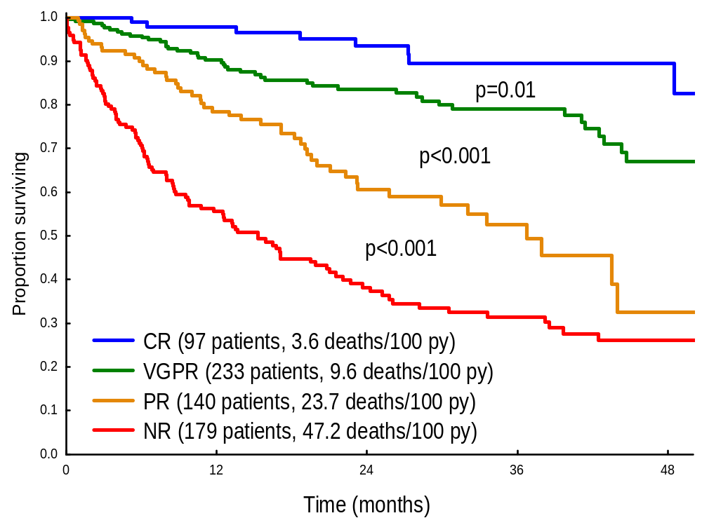
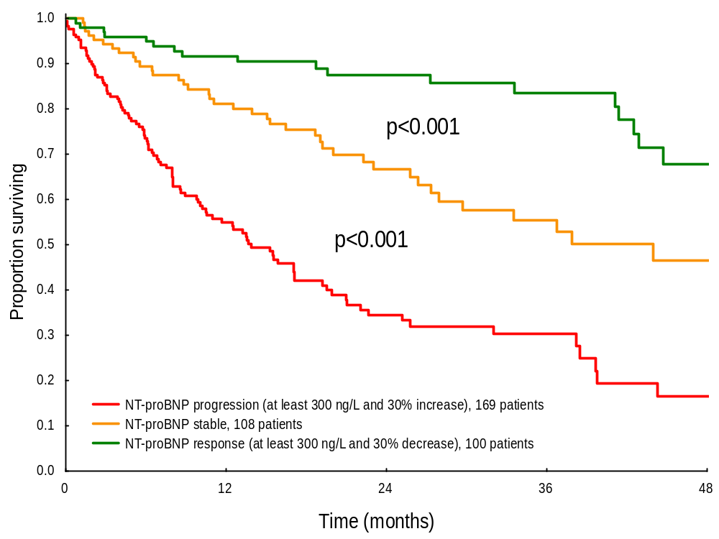
OS in Amyloidosis by Hematologic and Organ Response
Multicenter analysis of 816 patients with AL amyloidosis
2-Yr OS by 6-Mo Hematologic Response (n = 649)
2-Yr OS by 6-Mo NT-proBNP Response (n = 377*)
P = .01
P <.001
P <.001
Proportion Surviving
Proportion Surviving
P <.001
P <.001
Mo
Mo
*Baseline NT-proBNP ≥650 ng/L.
Palladini. JCO. 2012;30:4541.
Slide credit: clinicaloptions.com
Notes:
AL, amyloid light chain; CR, complete response; NR, no response; NT-proBNP, N-terminal prohormone B-type natriuretic peptide; OS, overall survival; PR, partial response; VGPR, very good partial response; py, patient-year.

Slide 26
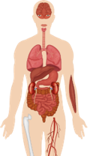

Treatment Strategies for AL Amyloidosis
Plasma cell directed
Alkylators, steroids
ASCT
IMiDs, proteasome inhibitors
Antibodies
Bone Marrow Plasma Cells
Bone Marrow Free Light Chains
Misfolded protein
Protein synthesis
Fibril inhibitors
Doxycycline
Amyloid deposits
SAP
Amyloid-directed
therapy
Anti-AL antibody
Anti-SAP antibody
SAP depleters
EGCG
Organ dysfunction and death
Aimo. Int J Cardiol. 2018;271:152. Zhang. JACC Basic Transl Sci. 2019;4:438.
Slide credit: clinicaloptions.com
Notes:
AL, amyloid light chain; ASCT, autologous stem cell transplant; EGCG, epigallocatechin-3-gallate; IMiD, immunomodulatory drug; SAP, serum amyloid P component.

Slide 27
OS by Autologous Stem Cell Transplantation in
AL Amyloidosis Treatment
Retrospective case-controlled study of 126 patients with AL amyloidosis
100
4-Yr OS, %
71
41
PBSCT
Control
80
60
Patients Alive (%)
40
PBSCT cases (n = 63)
Controls (n = 63)
Unmatched controls 1970-2001 (n = 806)
20
P <.001
0
0
1
2
3
4
Follow-up (Yr)
Dispenzieri. 2004;103:3960.
Slide credit: clinicaloptions.com
Notes:
AL, amyloid light chain; OS, overall survival; PBSCT, peripheral blood stem-cell transplantation.

Slide 28
Retrospective Study: Melphalan + Dexamethasone vs HD Melphalan + ASCT: Response and Survival
Retrospective study of newly diagnosed patients (N = 100) with AL amyloidosis
High rate of transplant-related mortality: 24%
OS (N = 100)
100
Melphalan/Dex
56.9
HD Melphalan
22.2
80
Median OS, Mo
P = .04
Melphalan + dexamethasone
60
Hematologic Response*
40
Response | Melphalan/ Dex (n = 19) | HD Melphalan (n = 18)
ORR, n (%) | 14 (74) | 13 (72)
CR, n | 9 | 11
PR, n | 5 | 2
High-dose melphalan + stem-cell rescue
20
0
0
10
20
30
40
50
60
70
80
*Measured by serum free light chain assay.
Mo Since Randomization
Jaccard. NEJM. 2007;357:1083.
Slide credit: clinicaloptions.com
Notes:
AL, amyloid light chain; ASCT, autologous stem cell transplantation; CR, complete response; Dex, dexamethasone; HD, high dose; ORR, overall response rate; OS, overall survival; PR, partial response.
28

Slide 29
Stem Cell Transplantation vs Melphalan + Dexamethasone in AL Amyloidosis: Survival
OS
PFS
100
100
80
80
60
60
OS (%)
PFS (%)
40
40
20
M + D
SCT
20
M + D
SCT
0
0
Patients
at Risk, n
0
1
2
3
4
5
Patients
at Risk, n
0
1
2
3
4
5
Yr
Yr
M + D
24 18 17 15 11 6
M + D
24 14 9 5 2 2
SCT
48 45 42 39 21 11
SCT
48 34 28 21 10 3
Gertz. Cancer. 2016;122:2197.
Slide credit: clinicaloptions.com
Notes:
AL, amyloid light chain; D, dexamethasone; M, melphalan; OS, overall survival; PFS, progression-free survival; SCT, stem cell transplantation.

Slide 30
CIBMTR Experience Treating Amyloidosis:
Responses, Survival
Best Response, n (%) | 2001-2006 (n = 197) | 2007-2012 (n = 157) | P
Hematologic |  |  | .005
CR | 60 (30) | 58 (37)
PR | 44 (22) | 53 (34)
SD | 42 (21) | 25 (16)
PD | 7 (4) | 3 (2)
Noneval* | 22 (11) | 14 (9)
Missing | 22 (11) | 4 (3)
Renal |  |  | .30
Response | 61 (31) | 51 (32)
SD | 48 (24) | 47 (30)
PD | 7 (4) | 10 (6)
Noneval* | 22 (11) | 14 (9)
Missing | 59 (30) | 35 (22)
Early Mortality
OS
n 30 Days 100 Days
1995-2000 140 11% (7%-17%) 20% (14%-27%)
2001-2006 596 5% (4%-7%) 11% (8%-13%)
2007-2012 800 3% (2%-4%) 5% (4%-7%)
20
100
16
80
12
60
Early Mortality (%)
OS (%)
8
40
n 5-Yr OS
4
20
1995-2000 140 55% (46%-63%)
2001-2006 596 61% (57%-65%)
2007-2012 800 77% (72%-82%)
P <.001
P <.001
0
0
0
20
40
60
80
100
0
1
2
3
4
5
Days
Yr
*Died in first 100 days after transplant.
D’Souza. JCO. 2015;33:3741.
Slide credit: clinicaloptions.com
Notes:
CIBMTR, Center for International Blood and Marrow Transplant Research; CR, complete response; HCT, hematopoietic cell transplantation; OS, overall survival; PD, progressive disease; PR, partial response; SD, stable disease.

Slide 31
Long-term Survival in Amyloidosis
OS in All Patients
1.0
0.8
Variable | HR (95% CI) | P Value
Heart involvement present | 1.76 (1.12-2.75) | .01
Complete response at Day 100 | 0.24 (0.14-0.41) | <.001
Bone marrow plasma cells at diagnosis ≥10% | 1.27 (0.81-1.97) | .29
Creatinine clearance <45 mL/min | 1.41 (0.80-2.49) | .23
Melphalan dose, 200 mg/m² vs not | 0.62 (0.39-0.99) | .044
0.6
Estimated 15-yr OS: 33%
Observed 15-yr OS: 30%
Proportion Surviving
0.4
0.2
0
0
3
6
9
12
15
18
Yr Since SCT
At Risk 159 110 87 70 59 50 20
OS in Patients With and Without Heart Involvement
1.0
No heart involvement
Heart involvement
0.8
0.6
Estimated 15-yr OS: 43%
Proportion Surviving
0.4
0.2
P = .006
0
At Risk
0
3
6
9
12
15
18
No heart
Yr Since SCT
involvement
81 66 54 45 40 34 11
Heart
78 44 33 25 19 16 9
involvement
Slide credit: clinicaloptions.com
Sidana. Am J Hematol. 2019;94:1020.
Notes:
OS, overall survival; SCT, stem cell transplantation.

Slide 32
Transplant Eligibility in Amyloidosis: Mayo Criteria
“Physiologic” age 70 yr or younger
Performance score ≤2
Systolic BP ≥90 mm Hg
Troponin T <0.06 ng/mL
CrCl ≥30 mL/min* (unless on chronic dialysis)
New York Heart Association class I/II*
≤2 organs significantly involved
*Selected patients may become eligible for PBSCT with cardiac and renal transplantation.
Vaxman. Oncology. 2021;35:471.
Slide credit: clinicaloptions.com
Notes:
32
BP, blood pressure; CrCl, creatinine clearance; PBSCT, peripheral blood stem-cell transplantation.

Slide 33
Induction Prior to ASCT in AL Amyloidosis
P = .0004
Retrospective study: patients with newly diagnosed AL amyloidosis who received induction therapy before ASCT
P = .075
PFS
100
1.0
P = .048
NS
80
0.8
32
16
24
60
0.6
Patients (%)
PFS
47
13
13
PR
VGPR
CR
17
0.4
40
0.2
≥VGPR mPFS: NR
<VGPR mPFS: 34.1 mo
20
8
46
44
34
P = .0009
18
0
0
0
20
40
60
80
100
120
Induction therapy pre-ASCT
Yes
(n = 65)
No
(n = 51)
Yes
(n = 80)
No
(n = 219)
PFS (Mo)
Median OS was prolonged in patients who achieved a ≥VGPR before transplant vs ≤PR (NR vs 128 mo, respectively; P = .02)
BMPC >10%
BMPC ≤10%
Hwa. Am J Hemtol. 2016;91:984. Vaxman. Bone Marrow Transplant. 2021;56:928.
Slide credit: clinicaloptions.com
Notes:
AL, amyloid light chain; ASCT, autologous stem cell transplantation; BMPC, bone marrow plasma cells; CR, complete response; mPFS, median progression-free survival; NR, not reached; NS, not significant; PFS, progression-free survival; PR, partial response; VGPR, very good partial response.

Slide 34
SCT in AL Amyloidosis: 1-Yr OS by Weight Gain
Retrospective analysis of 126 patients who were treated with high-dose melphalan plus SCT from 1997-2003
OS by Percentage of
Body Weight Gained
OS
1.0
1.0
≤2% weight gain
≤2% weight gain
0.8
0.8
>2% to 8.2% weight gain
1-Yr
Mortality
>2% weight gain
0.6
0.6
Patient Survival
≤2% weight gain 9.8%
>2% weight gain 33.9% P = .002
>8.3% weight gain 66.7% P = .001
Patient Survival
0.4
0.4
>8.3% weight gain
0.2
0.2
0
0
0
5
10
15
20
25
30
35
0
5
10
15
20
25
30
35
Mo
Mo
Leung. Blood. 2005;106:3353.
Slide credit: clinicaloptions.com
Notes:
AL, amyloid light chain; OS, overall survival; SCT, stem cell transplantation.

Slide 35
Retrospective Analysis: Amyloidosis OS from Transplant with Melphalan Conditioning
Study of patients with newly diagnosed AL amyloidosis who received ASCT at initial therapy at Mayo Clinic (2000-2015; N = 457)
OS, Entire Cohort
OS, ≥VGPR
1.0
1.0
Full intensity
Reduced dose
0.8
0.8
0.6
0.6
Probability of Survival
Probability of Survival
0.4
0.4
0.2
4-yr OS: 86% vs 54%
0.2
4-yr OS: 94% vs 83%
P <.001
P <.001
0
0
0
2
4
6
8
10
12
0
2
4
6
8
10
12
Yr From Transplant
Yr From Transplant
Patients at Risk, n
Patients at Risk, n
314 255 201 130 91 51 20
143 97 66 45 30 19 6
236 202 166 110 77 47 19
78 74 57 40 27 17 6
Tandon. Bone Marrow Transplant. 2017;52:1126.
Slide credit: clinicaloptions.com
Notes:
AL, light chain amyloidosis; ASCT, autologous stem cell transplantation; OS, overall survival; VGPR, very good partial response.

Slide 36
Retrospective Analysis: PFS With Posttransplant Consolidation in AL Amyloidosis
mPFS with <VGPR: 22.4 mo with consolidation vs 8.8 mo without consolidation
  Greater benefit correlated with deeper responses
Consolidation regimens: IMiD (29%), PI (33%), IMiD + PI (28%), Dara + IMiD (3%), alkylator (4%), rituximab (3%)
Among patients with <VGPR, trend for better OS with response to consolidation
No benefit for those with ≥VGPR
PFS (All Patients)
PFS in Patients With <VGPR
100
Consolidation mPFS: 38 mo
No consolidation mPFS: 59 mo
100
Consolidation mPFS: 22.4 mo
No consolidation mPFS: 8.8 mo
80
80
60
60
P <.0001
PFS (%)
P = .002
PFS (%)
40
40
20
20
0
0
0
20
40
60
80
100
120
0
20
40
60
80
100
Patients at Risk
Survival (Mo)
Patients at Risk
Survival (Mo)
72
372
44
251
27
185
10
129
5
90
2
56
0
30
47
39
24
7
14
5
9
1
4
1
1
0
Al Saleh. Am J Hematol. 2019;94:1066.
Slide credit: clinicaloptions.com
Notes:
AL, amyloid light chain; Dara, daratumumab; IMiD, immunomodulatory drug; mPFS, median progression-free survival; OS, overall survival; PFS, progression-free survival; PI, proteasome inhibitor; VGPR, very good partial response.

Slide 37
Response-Adapted Strategy to Determine Which Patients With AL Amyloidosis Benefit From ASCT
Prospective database analysis of 139 patients with AL amyloidosis who received CyBorD; patients who did not have a satisfactory response to CyBorD received ASCT
100
100
CyBorD only (n = 63)
  ≥VGPR: 51%
  45% satisfactory responses
CyBorD + ASCT (n = 55)
  ≥VGPR: 65%
5-yr OS: 86% (CyBorD + ASCT) vs 84% (CyBorD alone)
No differences in 6- and 12-mo survival in landmark analyses
Duration of response similar between groups: 60 vs 49 mo
80
80
60
60
Survival Probability (%)
Survival Probability (%)
40
40
20
20
OS w/satisfactory response to CyBorD
21
OS, CyBorD → ASCT
0
0
0
12
24
36
48
60
0
12
24
36
48
60
Mo
Mo
100
100
17
80
80
60
60
TMTD (%)
TMTD (%)
40
40
20
20
TNTD w/CyBorD only
TNTD w/CyBorD → ASCT
0
CyBorD
0
CyBorD→ ASCT
0
12
24
36
48
60
0
12
24
36
48
60
Mo
Mo
Slide credit: clinicaloptions.com
Basset. Blood Adv. 2020;4:4175.
Notes:
AL, amyloid light chain; ASCT, autologous stem cell transplantation; CyBorD, cyclophosphamide, bortezomib, dexamethasone; OS, overall survival; TNTD, time to next treatment or death; VGPR, very good partial response.

Slide 38
mSMART: Newly Diagnosed AL Amyloidosis, SCT Eligible
Consider adding doxycycline for ≥1 yr
If daratumumab is not accessible, use CyBorD with weekly bortezomib
If CR, consider no ASCT for patients with low disease burden and proceed as if transplant ineligible
Induction daratumumab + CyBorD
2-4 cycles
Stem cell collection
Mel200 + ASCT
If CrCl <30 mL/min, use melphalan 140 mg/m²
Consider changing therapy if in VGPR but <CR; rerefer to amyloidosis treatment center
≥Hematologic VGPR
Yes
No
Relapsed/refractory algorithm
Observation
Use myeloma-type maintenance for patients with overt multiple myeloma or patients with:
  BMPCs ≥20%
  High risk (per FISH): del(17p), t(4;14), t(14;16), and t(14;20)
Refer to myeloma mSMART guidelines for choice of maintenance
msmart.org/treatment-guidlines
Slide credit: clinicaloptions.com
Notes:
AL, amyloid light chain; ASCT, autologous stem cell transplantation; BMPC, bone marrow plasma cells; CR, complete response; CrCl, creatinine clearance; CyBorD, cyclophosphamide, bortezomib, dexamethasone; FISH, fluorescence in situ hybridization; MEL200, melphalan 200 mg; SCT, stem cell transplantation; VGPR, very good partial response.

Slide 39
Survival With Melphalan/Dex in Advanced AL Amyloidosis Not Eligible for ASCT
1.0
1.0
0.8
0.8
Median OS: 5.1 yr
N = 46 patients ineligible for ASCT referred to Italian amyloidosis treatment center from 1999-2002
0.6
0.6
Survival with and without hematologic response
Cumulative Proportion Surviving
Cumulative Proportion Surviving
0.4
Median PFS: 3.8 yr
0.4
0.2
OS
PFS
0.2
Responders (30 patients)
Nonresponders (11 patients)
0
0
0
1
2
3
4
5
6
7
0
1
2
3
4
5
6
7
Survival Time (Yr)
Survival Time (Yr)
Hematologic response to melphalan/Dex: 67% (n = 31)
  CR: 33% (n = 15)
  Median TTR: 4.5 mo
Median f/u 5 yr (3.5-6.7 yr)
Palladini. Blood. 2004;103:2936. Palladini. Blood. 2007;110:787.
Slide credit: clinicaloptions.com
Notes:
AL, amyloid light chain; ASCT, autologous stem cell transplantation; CR, complete response; Dex, dexamethasone; f/u, follow-up; OS, overall survival; PFS, progression-free survival; TTR, time to response.
The monoclonal component reappeared in 4 patients after a median of 2.0 years (range, 0.8-2.5 years). In all relapsing patients, CR was restored after 3 cycles (4 cycles in 1 patient) of M-Dex, and is maintained after a median follow-up of 3.0 years (range, 2.1-5.1 years). One patient developed a myelodysplastic syndrome after 2 cycles of M-Dex. This low incidence is probably due to exposure to a modest total dose of melphalan (median, 288 mg; range, 48-912 mg), also considering the additional cycles performed in the 4 relapsing patients.

Slide 40
Phase III EMN-03: MDex vs BMDex in Untreated Systemic AL Amyloidosis
Randomized, open-label, multicenter study
Patients stratified by cardiac stage
(I vs II vs IIIa w/NT-proBNP <8500 ng/L)
Bortezomib 1.3 mg/m² Day 1, 4, 8, 11 of 28-day cycle
(cycles 1-2), then Day 1, 8, 15, 22 of 35-day cycle (cycles 3-8)
Melphalan 0.22 mg/kg, Day 1-4 of each cycle
Dexamethasone 40 mg, Day 1-4 of each cycle
Treatment continued until:
MDex cycle 9 or BMDex cycle 8
CR after cycle 6
PR + organ response after cycle 6
<PR after cycle 3
Progression to clonal plasma cell disease
Patients with untreated systemic AL amyloidosis; not eligible for ASCT (w/MEL200); ECOG PS 0-2;
M protein >10 g/L; involved FLC
>75 mg/L; symptomatic organ involvement
(N = 110)
Excluded patients with advanced cardiac disease or overt multiple myeloma
Melphalan 0.22 mg/kg, Day 1-4 of each cycle
Dexamethasone 40 mg, Day 1-4 of each cycle
Q28D
Primary endpoint: hematologic response after 3 cycles
Secondary endpoints: CR and VGPR after 3 cycles (and at end of therapy), hematologic ORR at end of therapy, organ responses, QoL, OS, PFS, safety
Kastritis. JCO. 2020;38:3252.
Slide credit: clinicaloptions.com
Notes:
AL, amyloid light chain; ASCT, autologous stem cell transplantation; BMDex, bortezomib, melphalan, dexamethasone; CR, complete response; ECOG PS, Eastern Cooperative Oncology Group performance status; FLC, free light chain; MDex, melphalan, dexamethasone; MEL200, melphalan 200 mg; NT-proBNP, N-terminal prohormone B-type natriuretic peptide; ORR, overall response rate; OS, overall survival; PFS, progression-free survival; PR, partial response; QoL, quality of life; VGPR, very good partial response.

Slide 41
MDex vs BMDex in Untreated Systemic AL Amyloidosis (EMN-03): Survival
Deaths: 31 patients in MDex arm vs 17 in BMDex arm (HR: 0.50)
Median follow-up: 50 mo
PFS
OS
1.00
MDex
BMDex
1.00
MDex
BMDex
0.75
0.75
PFS (%)
OS (%)
0.50
0.50
0.25
0.25
HR: 0.46 (95% CI: 0.28-0.74)
Log-rank test P = .001
HR: 0.50 (95% CI: 0.27-0.90)
Log-rank test P = .020
0
0
0
6
12
18
24
30
36
42
48
54
60
66
72
0
6
12
18
24
30
36
42
48
54
60
66
72
Mo
Mo
Patients at Risk
MDex
BMDex
Patients at Risk
MDex
BMDex
56
53
35
45
25
39
21
36
18
33
13
30
13
26
10
20
9
15
7
9
1
8
0
3
0
1
56
53
51
47
39
45
36
43
32
43
27
39
24
34
20
27
15
21
12
13
6
11
5
5
4
3
Kastritis. JCO. 2020;38:3252.
Slide credit: clinicaloptions.com
Notes:
AL, amyloid light chain; BMDex, bortezomib, melphalan, dexamethasone; MDex, melphalan, dexamethasone; OS, overall survival; PFS, progression-free survival.

Slide 42
TOURMALINE-AL1: Ixazomib + Dexamethasone vs Physician’s Choice
Primary endpoint was not met at primary analysis
Data favored Ixa + Dex
Best hematologic response rate:
  53% with Ixa + Dex vs 51% with physician’s choice (P = .76)
CR:
  26% with Ixa + Dex vs 18% with physician’s choice (P = .22)
Randomized, open-label, international phase III trial
Primary endpoints: hematologic response rate and 2-yr vital organ deterioration or mortality rate
Cardiac risk stage (I vs II vs III), relapsed or refractory disease, previous PI (yes or no)
28-day cycles
Ixa 4 mg on Day 1, 8, 15
Dex* 20 mg on Day 1, 8, 15, 22
(n = 85)
Patients with relapsed/refractory AL amyloidosis cardiac and/or renal involvement
N = 168
Until PD or unacceptable toxicity
1:1
Physician’s Choice†
(n = 83)
*Dex could be increased to 40 mg if no grade >2 toxicities
after 4 wk in either Ixa or physician’s choice arms.
†Dex (20 mg) + either melphalan (0.22 mg/kg PO), lenalidomide
(15 mg), cyclophosphamide (500 mg PO), or thalidomide (50-200 mg).
Patients received MDex to best response + 2 cycles (max 18 mo or
600-mg melphalan dose).
Dispenzieri. Leukemia. 2021;[Epub]. Kastritis. ASCO 2020. Abstr 8546. Dispenzieri. ASH 2019. Abstr 139.
Slide credit: clinicaloptions.com
Notes:
AL, amyloid light chain; CR, complete response; Dex, dexamethasone; Ixa, ixazomib; MDex, melphalan, dexamethasone; PD, progressive disease

Slide 43
Immunomodulatory Drugs:
Considerations in Amyloidosis Treatment
Thalidomide, lenalidomide, and pomalidomide all have been studied
Significant toxicity with thalidomide
Lenalidomide/dexamethasone and lenalidomide/cyclophosphamide/ dexamethasone are all active
Transient worsening of cardiac status often seen with IMiDs
Drop in blood pressure is seen often with these drugs
Pomalidomide/dexamethasone is active
Slide credit: clinicaloptions.com
Notes:
IMiD, immunomodulatory drug.

Slide 44
ANDROMEDA: Daratumumab + VCd vs VCd Alone in Newly Diagnosed AL Amyloidosis
Randomized, open-label phase III trial
Primary endpoint: overall CHR in ITT population
Secondary endpoints: MOD-PFS, organ responses, time to hematologic response, OS, safety
Adults with AL amyloidosis with
≥1 organ affected; no prior tx for MM or AL amyloidosis; cardiac stage I-IIIa; eGFR
≥20 mL/min
(N = 388)
Dara SC 1800 mg QW
cycles 1-2; Q2W cycles 3-6
+ VCd* QW for 6 cycles
(n = 195)
Dara SC 1800 mg Q4W
until MOD-PFS* or
max 24 cycles
(n = 195)
Observed until MOD-PFS
(if Dara SC d/c before
MOD-PFS)
Screening at Day 28
VCd* QW for 6 cycles
(n = 193)
Observed until MOD-PFS†
*SC bortezomib (1.3 mg/m²), cyclophosphamide (300 mg/m² orally), or IV (500 mg max weekly) and dexamethasone (40 mg orally or IV) once a wk for six 28-day cycles.
†MOD-PFS composite endpoint including end-stage cardiac disease, end-stage renal disease, hematologic progression per consensus guidelines, and death.
Kastritis. NEJM. 2021;385:46. Kastritis. ASCO 2021. Abstr 8003. NCT03201965.
Slide credit: clinicaloptions.com
Notes:
AL, amyloid light chain; CHR, complete hematologic response; Dara, daratumumab; d/c, discontinued; eGFR, estimated glomerular filtration rate; ITT, intention-to-treat; MM, multiple myeloma; MOD, major organ deterioration; OS, overall survival; PFS, progression-free survival; tx, treatment; VCd, bortezomib, cyclophosphamide, dexamethasone.

Slide 45
ANDROMEDA: Overall Confirmed Hematologic, Cardiac, and Renal Responses at 6 Mo in ITT
Response | Dara + VCd (n = 195) | VCd (n = 193)
Any hematologic, n (%) [95% CI] | 179 (91.8) [87.0–95.2] | 148 (76.7) [70.1–82.5]
CR, n (%) [95% CI], P <.001 | 104 (53.3) [46.1-60.5] | 35 (18.1) [13.0-24.3]
≥VGPR, n (%) | 153 (78.5) | 95 (49.2)
VGPR, n (%) | 49 (25.1) | 60 (31.1)
PR, n (%) | 26 (13.3) | 53 (27.5)
No response, n (%) | 8 (4.1) | 38 (19.7)
Progressive disease, n (%) | 0 | 0
Response not evaluable, n (%) | 8 (4.1) | 7 (3.6)
Involved free LC level ≤20 mg/L, n/N (%) | 136/193 (70.5) | 39/193 (20.2)
dFLC <10 mg/L, n/N (%) | 119/188 (63.3) | 56/190 (29.5)
Cardiac response,* n (%) [95% CI] | 118 (41.5) [32.5-51.0] | 117 (22.2) [15.1-30.8]
Renal response,† n (%) [95% CI] | 117 (53.0) [43.5–62.3] | 113 (23.9) [16.4–32.8]
*Patients evaluated for cardiac response had BL NT-proBNP value of ≥650/L or BL NYHA class III or IV. †Evaluable patients had BL urinary protein excretion >0.5 g/day.
Kastritis. NEJM. 2021;385:46.
Slide credit: clinicaloptions.com
Notes:
AL, light chain; BL, baseline; CR, complete response; Dara, daratumumab; dFLC, difference between involved and uninvolved free light chains; ITT, intention-to-treat; LC, light chain; NT-proBNP, N-terminal prohormone B-type natriuretic peptide; NYHA, New York Heart Association; PR, partial response; VCd, bortezomib, cyclophosphamide, dexamethasone; VGPR, very good partial response.

Slide 46
ANDROMEDA: Most Common Adverse Events
 | Dara + VCd (n = 193) |  | VCd (n = 188)
Adverse Event,* n (%) | Any Grade | Grade 3/4 | Any Grade | Grade 3/4
Diarrhea | 69 (35.8) | 11 (5.7) | 57 (30.3) | 7 (3.7)
Peripheral edema | 69 (35.8) | 6 (3.1) | 68 (36.2) | 11 (5.9)
Constipation | 66 (34.2) | 3 (1.6) | 54 (28.7) | 0
Peripheral sensory neuropathy | 60 (31.1) | 5 (2.6) | 37 (19.7) | 4 (2.1)
Fatigue | 52 (26.9) | 8 (4.1) | 53 (28.2) | 6 (3.2)
Nausea | 52 (26.9) | 3 (1.6) | 52 (27.7) | 0
Upper respiratory tract infection | 50 (25.9) | 1 (0.5) | 21 (11.2) | 1 (0.5)
Lymphopenia | 36 (18.7) | 25 (13.0) | 28 (14.9) | 19 (10.1)
Hypokalemia | 24 (12.4) | 3 (1.6) | 28 (14.9) | 10 (5.3)
Neutropenia | 21 (10.9) | 10 (5.2) | 12 (6.4) | 5 (2.7)
Pneumonia | 21 (10.9) | 15 (7.8) | 12 (6.4) | 8 (4.3)
Syncope | 14 (7.3) | 10 (5.2) | 12 (6.4) | 12 (6.4)
Cardiac failure | 18 (9.3) | 12 (6.2) | 14 (7.4) | 9 (4.8)
*Adverse events of any grade in >25% of patients in either arm; grade 3 or 4 events in ≥5% of patients in either arm.
Kastritis. NEJM. 2021;385:46.
Slide credit: clinicaloptions.com
Notes:
Dara, daratumumab; VCd, bortezomib, cyclophosphamide, dexamethasone.

Slide 47
ANDROMEDA: Survival Free from Major Organ Deterioration or Hematologic Progression in ITT Population
100
Dara + VCd
80
60
EFS (%)
VCd
40
20
HR: 0.58 (95% CI: 0.36-0.93; P = .02)
0
0
2
4
6
8
10
12
14
16
18
20
22
Mo Since Randomization
Patients at Risk, n
Dara + VCd
VCd
195
193
178
163
166
134
147
111
114
65
86
44
60
29
44
20
27
10
10
7
1
1
0
0
Slide credit: clinicaloptions.com
Kastritis. NEJM. 2021;385:46.
Slide credit: clinicaloptions.com
Notes:
Dara, daratumumab; EFS, event-free survival; ITT, intention-to-treat; VCd, bortezomib, cyclophosphamide, dexamethasone.

Slide 48
ANDROMEDA: Health-Related QoL
Patients treated with Dara-VCd experienced clinical improvements without any decrement in health-related QoL over 6 cycles
After cycle 6, improvements in GHS and fatigue were reported in patients in the Dara-VCd group
These findings further support the value of Dara-VCd in patients with AL amyloidosis
Sanchorawala. ASH 2020. Abstr 1640.
Slide credit: clinicaloptions.com
Notes:
AL, amyloid light chain; Dara, daratumumab; GHS, global health status; QoL, quality of life; VCd, bortezomib, cyclophosphamide, dexamethasone.

Slide 49
mSMART: Relapsed/Refractory AL Amyloidosis
Dara refractory?
Yes
No
Bortezomib refractory
Not bortezomib refractory
Second line
Pom-Dex or Len-Dex*
Dara-based therapy
CyBorD†
Third line
Paucity of data, but ASCT, carfilzomib,‡ venetoclax,§ or bendamustine can be considered
*Starting dose of Len: ≤15 mg/day.
† Melphalan/Dex or Ixa/Dex options if significant neuropathy.
‡Not recommended if cardiac involvement.
§For patients with t(11;14), be cautious of infection risk.
msmart.org/treatment-guidlines
Slide credit: clinicaloptions.com
Notes:
AL, amyloid light chain; ASCT, autologous stem cell transplant; Dara, daratumumab; Dex, dexamethasone; CyBorD, cyclophosphamide, bortezomib, dexamethasone; Ixa, ixazomib; Len, lenalidomide; Pom, pomalidomide; Dex, dexamethasone

Slide 50
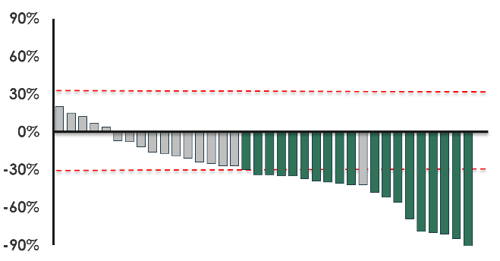

Phase I/II Trial of Birtamimab in Previously Treated AL Amyloidosis: Cardiac Biomarkers and Best Responses
Birtamimab (NEOD001): investigational mAb targeting circulating soluble and deposited aggregated amyloid
Final expansion cohort data in patients with AL amyloidosis and organ dysfunction (N = 42)
  Total cardiac evaluable (n = 36); 19 responders (53%); 17 stable (47%)
Evaluable patients with BL
NT-proBNP ≥650 ng/mL without progressive renal dysfunction^{3,4}:
  Response: >30% and
  >300 ng/mL reduction in NT-proBNP
  Progression: >30% and >300 ng/mL increase in NT-proBNP
  Stable disease: neither response nor progression
Median time to initial response: 2 mo
NT-proBNP Change From BL (%)
*
$†$
*30% decline; 453-ng/mL reduction from BL. †42% decline; 271-ng/mL reduction from BL.
.
1. Gertz. Clin. Lymphoma Myeloma Leuk. 2017;17:E22. 2. NCT01707264. 3. Comenzo. Leukemia. 2012;26:2317.
4. Palladini. JCO. 2012;30:4541.
Slide credit: clinicaloptions.com
Notes:
AL, amyloid light chain; BL, baseline; mAb, monoclonal antibody; NT-proBNP, N-terminal prohormone B-type natriuretic peptide.

Slide 51
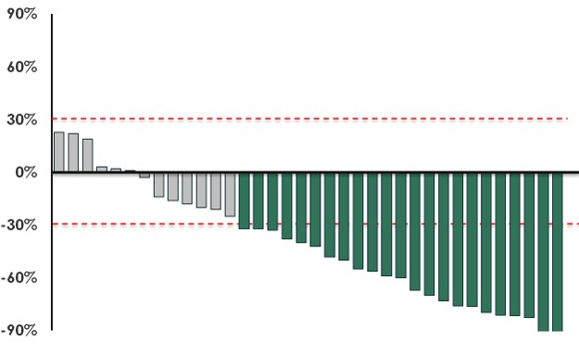
Phase I/II Trial of Birtamimab in Previously Treated
AL Amyloidosis: Renal Biomarkers, Best Responses
Total renal evaluable (n = 36): 23 responders (64%); 13 stable (36%)
Evaluable patients with BL proteinuria >0.5 g/24 hr:
  Response: >30% reduction in proteinuria or a decrease to
  <0.5 g/24 hr in absence of renal progression
  Progression: >25% worsening in eGFR
  Stable disease: neither response nor progression
Median time to initial response: 4 mo
Proteinuria Change From BL (%)
1. Gertz. Clin. Lymphoma Myeloma Leuk. 2017;17:E22. 2. NCT01707264.
Slide credit: clinicaloptions.com
Notes:
AL, amyloid light chain; BL, baseline; eGFR, estimated glomerular filtration rate.

Slide 52
ATTR Amyloidosis
Notes:
ATTR, amyloid transthyretin

Slide 53
Natural History of ATTRwt: Mayo Clinic Series
Retrospective review of patients (N = 414) diagnosed with ATTRwt at
Mayo Clinic (1965-2013)
Male gender: 91% diagnosed antemortem vs 69% diagnosed postmortem (P <.001)
At diagnosis
  Atrial fibrillation/flutter diagnosis: 62%
  History of carpal tunnel: 39%
  Fat aspirate positive for amyloid: 13%
  LVEF <40% at diagnosis: 28%
Gorgan. J Am Coll Cardiol 2016;68:1014.
Slide credit: clinicaloptions.com
Notes:
ATTRwt, wild-type amyloid transthyretin; LVEF, left ventricular ejection fraction.

Slide 54
ATTR Amyloidosis: Clinical Presentation
ATTRmt (hereditary)
  Genetic mutations
    Val122IIe (4% AA in
    United States)
    Thr60Ala
    Val30Met
  Heart failure and/or peripheral or autonomic neuropathy
    Only 50% positive family history
    Heterogeneous penetrance
ATTRwt (wild-type)
  Heart failure
    Carpal tunnel syndrome
    Biceps tendon rupture
    Spinal stenosis
    Atrial fibrillation (common, often several years prior to heart failure)
Jacobson. NEJM 1997;336:466. Rapezzi. Eur Heart J 2013;34:520. Sekijima. GeneReviews. Hereditary Transthyretin Amyloidosis. 2017. Gertz. JAMA 2020;324:79. Mints. ESC Heart Fail 2018;5:772.
Slide credit: clinicaloptions.com
Notes:
AA, African American’ ATTR, amyloid transthyretin; ATTRmt, mutant amyloid transthyretin; ATTRwt, wild-type amyloid transthyretin.

Slide 55
ATTR Amyloidosis: Spectrum of Cardiac and Nerve Phenotypes Based on Amyloidogenic TTR Mutation
~50% of hereditary ATTR has no family history
Family genetic counseling is an early intervention likely key to changing natural history
Eligibility for clinical trials and transplantation
PYP for ATTR diagnosis
  Genotype mandatory
Genotype-Phenotype Correlations in ATTR
T49A
G47A
Late onset
A36P
F64L
E89Q
V30M
W41L
R34T
H88R
S50R
S23N
C10R
T60A
F33L
L111M
I68L
Early onset
V30M
V122I
“Neurologic”
Phenotype
“Cardiac”
Adapted from Rapezzi. Eur Heart J. 2013;34:520.
Slide credit: clinicaloptions.com
Notes:
ATTR, amyloid transthyretin; PYP, ^{99m}Technetium pyrophosphate.

Slide 56
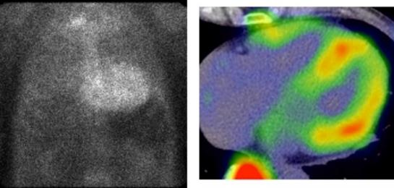
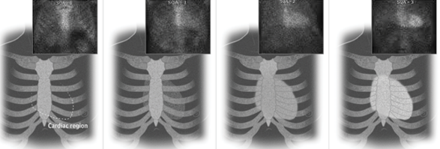
^{99m}Technetium-Pyrophosphate Imaging for
ATTR Cardiac Amyloid and Caveats
^{99m}Technetium-pyrophosphate imaging for ATTR cardiac amyloid
  Grade 0: clear cardiac region/opaque ribs and sternum
  Grade 1: cardiac region slightly opaque, but less opaque than ribs and sternum
  Grade 2: opacity of cardiac region and ribs and sternum are equal
  Grade 3: cardiac region more opaque than ribs and sternum
Can facilitate diagnosis without biopsy
  Ensure no M protein is present, as AL amyloid also can be positive
  Ensure cardiac localization (ie, SPECT)
  A negative scan does not rule out ATTR amyloid
Myocardial uptake in ATTR amyloidosis (SPECT/CT image)
Anterior Posterior
Positive cardiac uptake (planar scintigraphy image)
Grade 0
Grade 1
Grade 2
Grade 3
Gertz. JAMA 2020;324:79. mayoclinic.org/medical-professionals/cardiovascular-diseases/news/new-attr-amyloidosis-treatment/mac-20457052
Slide credit: clinicaloptions.com
Notes:
AL, amyloid light chain; ATTR, amyloid transthyretin; SPECT, single photon emission CT.

Slide 57
ATTRwt: Risk Stratification and Mortality
Death Rates Based on Staging System
Biomarker Cut Points
NT-proBNP >3000 pg/mL
Troponin T >0.05 ng/mL*
100
Neither
1 above
2 above
Expected
75
*Equivalent value using hs-TnT: 65 ng/L.
50
Stage 1: Neither biomarker above
cut points
Stage 2: Either biomarker above cut point
Stage 3: Both biomarkers above cut points
Death (%)
25
P <.001
0
0
2
4
6
Patients at Risk, n
Yr
No. at risk
68
47
39
38
27
13
13
10
3
7
3
1
Grogan. J Am Coll Cardiol. 2016;68:1014.
Slide credit: clinicaloptions.com
Notes:
ATTRwt, wild-type amyloid transthyretin; hs-TnT, high-sensitivity troponin-T; NT-proBNP, N-terminal prohormone B-type natriuretic peptide.

Slide 58
Current and Investigational Drugs for ATTR Amyloidosis
Liver: stop production*
 | ATTRwt | ATTRmt (Nerve) | ATTRmt (Heart)
Diflunisal | Experience | RCT | Experience
Tafamidis | RCT | RCT* | RCT
Patisiran | In trials | RCT | In trials
Inotersen | In trials | RCT | In trials
Doxycycline | In vitro | In vitro | In vitro
TUDCA | In vitro | In vitro | In vitro
EGCG | In vitro | In vitro | In vitro
Acoramidis (AG10) |  | In trials
TTR silencers
Inotersen,†¶ patisiran†¶
Stabilize protein
TTR stabilizers
Tafamidis,‡ diflunisal,§ acoramidis^{ǁ}
Fibril disrupter
Amyloid disrupters
Doxycycline + TUDCA
Monoclonal antibody (PRX0004)^{ǁ}
*Liver transplant: hereditary only, may become obsolete; heart transplant: increasing, especially ATTRwt. †FDA approved, ATTRmt neuropathy. ‡FDA approved, ATTR cardiac. §RCT data on neuropathy. ^{ǁ}Clinical trials underway.
¶Cardiac trials starting, including next-generation preparations.
*Only approved in Europe and UK.
Plumadore. Am J Health System Pharm. 2021;[Epub].
Slide credit: clinicaloptions.com
Notes:
ATTR, amyloid transthyretin; ATTRmt, mutant amyloid transthyretin; ATTRwt, wild-type amyloid transthyretin; EGCG, epigallocatechin-3-gallate; RCT, randomized, controlled trial; TUDCA, tauroursodeoxycholic acid.

Slide 59
Oligonucleotide Drugs for ATTR Amyloidosis
Normal Transthyretin Synthesis
Inotersen
Patisiran
Wild-type TTR
Mutant TTR
Wild-type TTR
Mutant TTR
Wild-type TTR
Mutant TTR
Transcription
Transcription
Transcription
Wild-type TTR mRNA
Mutant TTR mRNA
Wild-type TTR mRNA
Mutant TTR mRNA
Wild-type TTR mRNA
Mutant TTR mRNA
NUCLEUS
Ribonuclease H
Inotersen
Liver Cells
5’
3’
RNA-induced silencing complex
Target
mRNA cleavage
Patisiran
5’
3’
Target
mRNA cleavage
mRNA available for translation
mRNA degradation
mRNA degradation
CYTOPLASM
mRNA available for translation greatly reduced
Stabilizers: diflunisal, tafamidis
Bloodstream and Tissues
Suppression
of dissociation
Tetramer
Monomers
Misfolded monomers
Oligomers
Amyloid fibril
EXTRACELLULAR SPACE
Modified from Buxbaum NEJM. 2018;379:82.
Slide credit: clinicaloptions.com
Notes:
ATTR, amyloid transthyretin.

Slide 60
Phase III ATTR-ACT: Tafamidis vs Placebo in
Patients With Transthyretin Cardiomyopathy
Multicenter, international, placebo-controlled, double-blind, randomized clinical trial of TTR stabilizer tafamidis
30 mo
≤60 additional mo
Extension Study
Tafamidis
80 mg (n = 176)
Tafamidis
80 mg
Patients with transthyretin genetic variants (ATTRv) or ATTRwt resulting in amyloid cardiomyopathy; history of heart failure; thickened intraventricular septal wall; NT-proBNP ≥600 pg/mL
(N = 441)
July 2018
Tafamidis
20 mg (n = 88)
Tafamidis
20 mg
Randomization
Tafamidis
80 mg
Tafamidis
80 mg
Placebo
(n = 177)
Tafamidis
20 mg
Stratified by TTR genotype (ATTRv vs ATTRwt)
Primary endpoint: combination of all-cause mortality and CV-related hospitalizations
Secondary endpoints: all-cause mortality, CV hospitalizations/yr, cardiomyopathy-related changes, CV mortality, stabilized transthyretin
Maurer. Circ Heart Fail. 2017;10:e003815. Damy. Eur J Heart Fail. 2021;23:277.
Slide credit: clinicaloptions.com
Notes:
ATTR, amyloid transthyretin; ATTRv, variant amyloid transthyretin; ATTRwt, wild-type amyloid transthyretin; CV, cardiovascular; NT-proBNP, N-terminal prohormone B-type natriuretic peptide.

Slide 61
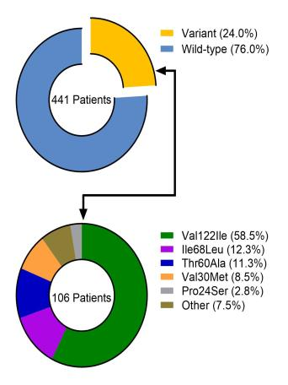
Tafamidis vs Placebo in Patients With
Transthyretin Cardiomyopathy (ATTR-ACT): Survival
OS (All-Cause Mortality)
Distribution of Patients by Genotype
1.0
0.8
Pooled tafamidis
0.6
Probability of Survival
Placebo
0.4
0.2
HR: 0.70
(95% CI: 0.51-0.96)
Strongest signal: NYHA class I/II
0
0
3
6
9
12
15
18
21
24
27
30
33
Mo Since First Dose
30% reduction in all-cause mortality with tafamidis vs placebo (P <.001)
Alive at Mo 30: 70.5% with tafamidis vs 57.1% with placebo
Average CV-related hospitalizations after Mo 30 (per patient):
0.30/yr with tafamidis vs 0.46 with placebo
Maurer. NEJM. 2018;379:1007.
Slide credit: clinicaloptions.com
Notes:
CV, cardiovascular; NYHA, New York Heart Association; OS, overall survival.

Slide 62
Go Online for More CCO
Coverage of Amyloidosis!
ClinicalThought commentaries on amyloidosis
clinicaloptions.com/oncology

