Slide 1
Emerging HER2-Targeted Antibody–Drug Conjugates in Gynecologic Cancers
Provided by Clinical Care Options, LLC
Supported by educational grants from AstraZeneca and Daiichi Sankyo, Inc.

Slide 2

About These Slides
Please feel free to use and share some or all of these slides in your noncommercial presentations to colleagues or patients
When using our slides, please retain the source attribution:
These slides may not be published, posted online, or used in commercial presentations without permission. Please contact permissions@clinicaloptions.com for details
Slide credit: clinicaloptions.com
Notes:
Disclaimer: The materials published on the Clinical Care Options website reflect the views of the authors of the CCO material, not those of Clinical Care Options, LLC, the CME providers, or the companies providing educational grants. The materials may discuss uses and dosages for therapeutic products that have not been approved by the United States Food and Drug Administration. A qualified healthcare professional should be consulted before using any therapeutic product discussed. Readers should verify all information and data before treating patients or using any therapies described in these materials.

Slide 3
Faculty and Disclosures
Kathleen N. Moore, MD, MS
Virginia Kerley Cade Chair in Developmental Therapeutics
Deputy Director
Associate Director Clinical Research
Stephenson Cancer Center at OU Health
Oklahoma City, Oklahoma
Kathleen N. Moore, MD, MS: consultant/advisor/speaker: Aadi, AstraZeneca, Blueprint, Caris, Duality, Eisai, Genentech/Roche, GlaxoSmithKline, ImmunoGen, Janssen, Lilly, Merck, Mersana, Novartis, Regeneron, Verastem, Zentalis.

Slide 4
Tumor Agnostic Prevalence of HER2 Alterations (Mutations and Amplifications)
Mutation
Amplification
Multiple alterations
15%
Alteration Frequency
15%
5%
Mutation data
CAN data
+
+
+
+
+
+
+
+
+
+
+
+
+
+
+
+
+
+
+
+
+
+
+
+
+
+
+
+
+
+
+
+
+
+
+
+
+
+
+
+
+
+
+
+
+
+
+
+
+
+
+
+
+
+
+
+
+
+
+
+
+
+
+
+
+
+
+
+
Glioma
Melanoma
Leukemia
CNS Cancer
Bladder Cancer
Breast Cancer
Anal Cancer
Vaginal Cancer
Sellar Tumor
Histiocytosis
Thymic Tumor
Cervical Cancer
Colorectal Cancer
Ovarian Cancer
Small Bowel Cancer
Ampullary Cancer
Pancreatic Cancer
Endometrial Cancer
Appendiceal Cancer
Soft Tissue Sarcoma
Salivary Gland Cancer
Hepatobiliary Cancer
Nerve Sheath Tumor
Renal Cell Carcinoma
Esophagogastric Cancer
Small-Cell Lung Cancer
Head and Neck Cancer
Mature B-Cell Neoplasms
Non-Small-Cell Lung Cancer
Peripheral Nervous System
Cancer of Unknown Primary
Skin Cancer, Nonmelanoma
Gastrointestinal Neuroendocrine
Mature T and NK Neoplasms
Raghav. Clin Cancer Res. 2023;29:3251.
Notes:
CNS, central nervous system.

Slide 5
Implications of HER2/neu Testing in Serous/Carcinosarcoma EC
HER2 overexpression and/or gene amplification seen in 25%-30% of serous EC cases^{1,2}
  HER2+ status in serous EC associated with response to trastuzumab
  Carboplatin, paclitaxel, and trastuzumab recommended for stage III/IV or recurrent HER2+ EC³
  Trastuzumab deruxtecan now recommended for 2L+ treatment of EC that is HER2+ (IHC 3+/2+)³
Testing for HER2*^{1,2}
Can be associated with significant intratumor heterogeneity
  2 degrees of difference in staining intensity observed in >50% of cells
Parameter/Cutoff^{1,2} | Endometrial Serous Carcinoma
HER2 IHC 3+ (protein level) | >30%, strong complete or basolateral/lateral
HER2 FISH (gene amplification) | HER2/CEP17 ratio ≥2.0
*Consider HER2 testing for p53 abnormal carcinomas regardless of histology.
1. Buza. Arch Pathol Lab Med. 2020;145:687. 2. Fader. Clin Cancer Res. 2020;26:3928.
3. NCCN. Clinical practice guidelines in oncology: uterine neoplasms. v.2.2024. nccn.org.
Notes:
2L, second-line; EC, endometrial cancer; FISH, fluorescence in situ hybridization; IHC, immunohistochemistry.

Slide 6
Clinical Implications of Key Biomarkers in EC
Biomarker | FDA-Approved EC Biomarker | Predictive of Response to Tx |  | Prognostic | Exploratory
dMMR | ✓ | ✓ |  | ✓
MSI | ✓* | ✓ | PD-1/PD-L1 | ✓
TMB high | ✓* | ✓
p53 |  | ✓ | Selinexor (WT) | ✓ | ✓
HER2 | ✓* | ✓ | Trastuzumab, T-DXd | ✓
ER/PgR |  | ✓ | Hormone tx | +/- | ✓
NTRK fusion | ✓* | ✓ | Larotrectinib, entrectinib
L1CAM |  |  |  | ✓ | ✓
CTNNB1 |  |  |  | ✓ | ✓
POLE |  |  |  | ✓ | ✓
PD-L1 |  |  |  | +/- | ✓
ARID1A |  |  |  |  | ✓
PI3K/AKT/mTOR |  |  |  |  | ✓
*Tumor agnostic.
Walsh. Gynecol Oncol. 2023;168:48. Pembrolizumab PI.
NCCN. Clinical practice guidelines in oncology: uterine neoplasms. v.2.2024. nccn.org.
Notes:
dMMR, mismatch repair deficient; EC, endometrial cancer; ER/PgR, estrogen receptor/progesterone receptor; IO, immuno-oncogenic therapy; MSI, microsatellite instability; TMB, tumor mutational burden; tx, therapy; WT, wild-type.

Slide 7
Molecular Testing in Ovarian and/or Cervical Cancers
In ovarian cancer, the NCCN guidelines recommend molecular testing to identify patients who could potentially benefit from targeted therapies
Actionable biomarkers include
  HER2 status (by IHC)
  BRCA1/2 and/or HRD
  MSI/MMR and TMB
  BRAF status
  FRα (FOLR1) status by IHC
  RET or NTRK fusions
In advanced, recurrent, or metastatic cervical cancer, the NCCN guidelines recommend HER2 testing by IHC (reflex testing to FISH for equivocal IHC)
  HER2 expression detected in 77% of cases
  Strong HER2 expression observed in 35% of cases correlated with gene amplification
NCCN. Clinical practice guidelines in oncology: ovarian cancer. v.1.2024. nccn.org. Kihana. Cancer. 1994;73;148.
Notes:
HRD, homologous recombination deficiency; IHC, immunohistochemistry; MMR, mismatch repair; MSI, microsatellite instability; NCCN, National Comprehensive Cancer Network; TMB, tumor mutational burden.

Slide 8
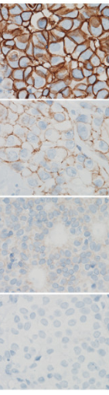
ASCO/CAP Guidelines for HER2 Classification: IHC
Immunohistochemistry | Interpretation | Recommendation
HER2 positive | IHC 3+ = circumferential membrane staining that is complete, intense and in >10% of tumor cells | Should recommend HER2-targeted therapy if there is no apparent histopathologic discordance and if clinically appropriate
HER2 equivocal | IHC 2+ weak to moderate complete membrane staining observed in >10% of tumor cells | Order a reflex test using ISH or order a new test (new specimen if available, using IHC or ISH)
HER2 negative | IHC 1+ = incomplete membrane staining that is faint/barely perceptible and in >10% of tumor cells IHC 0 = no staining is observed or membrane staining that is incomplete and is faint/barely perceptible and in ≤10% of tumor cells | Do not recommend HER2-targeted therapy if the HER2 test result is negative and if there is no apparent histopathologic discordance
Wolf. JCO. 2018;36:2105. Kamangar. Cancer Care. 2022. Image from Nitta. Diagn Pathol 2012;7:60.
Licensed under Creative Commons Attribution 3.0 Unported License (CC BY 3.0).
Notes:
ASCO, American Society of Clinical Oncology/ College of American Pathologist; IHC, immunohistochemistry; ISH, in situ hybridization.

Slide 9
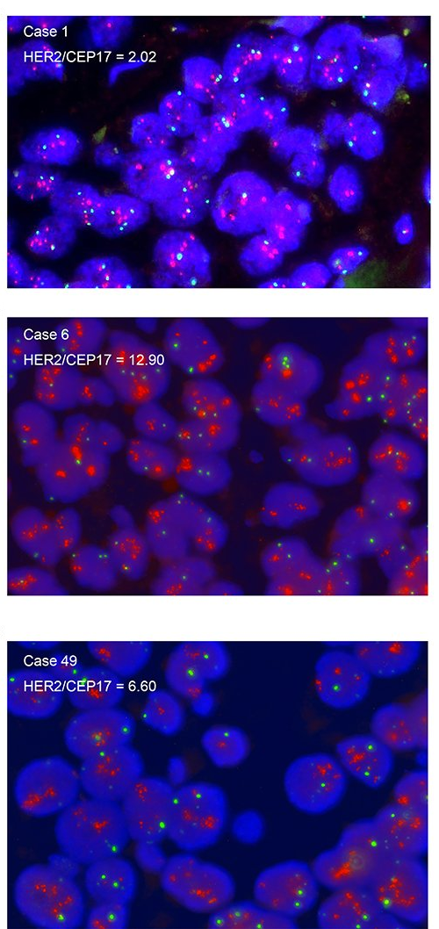
ASCO/CAP Guidelines for HER2 Classification: ISH
Dual Probe in Situ Hybridization
Group 1
Group 2
Group 3
Group 4
Group 5
HER2
Positive
Equivocal
Negative
Initial HER2/CEP17
≥2.0 and
≥2.0 and
<2.0 and
<2.0 and
<2.0 and
Initial HER2 copy no.
≥4.0
<4.0
≥6.0
≥4.0; <6.0
<4.0
If not already tested by IHC, perform
reflex IHC on same specimen
If IHC 2+, or IHC already performed, second reviewer recounts ISH. If recount results are the same as initial results, then HER2 status is confirmed
HER2
negative with
comment
HER2
positive
HER2
negative with
comment
Wolf. JCO. 2018;36:2105. Ran. Onco Targets Ther. 2020;13:4385.
Notes:
IHC, immunohistochemistry; ISH, in situ hybridization.

Slide 10
Guideline and Expert Recommendations for Type and Frequency of HER2 Testing in Gynecologic Cancers
Tumor Type | HER2 Testing |  | HER2 Testing Frequency
 | Test Type | Recommendation
Serous/carcinosarcomas endometrial cancer | Histology/IHC + reflex* FISH (+ amplification) NGS | ✓ ✓ - | Recommended for all serous and carcinosarcoma tumors and P53 abnormal carcinomas regardless of histology
Ovarian cancer | Histology/IHC + reflex* FISH (+ amplification) NGS | ✓ ✓ - | Consider HER2 testing in treatment-resistant/recurrent disease
Cervical cancer | Histology/IHC + reflex* FISH (+ amplification) NGS | ✓ ✓ - | Recommended for advanced, metastatic, or recurrent cervical carcinoma
*Reflex to FISH.
NCCN. Clinical practice guidelines in oncology: uterine neoplasms. v.2.2024. nccn.org.
NCCN. Clinical practice guidelines in oncology: ovarian cancer. v.1.2024. nccn.org.
NCCN. Clinical practice guidelines in oncology: cervical cancer. v.1.2024. nccn.org.
Notes:
Dx, diagnosis; GI, gastrointestinal; GU, genitourinary; Gyn, gynecologic; IHC, immunohistochemistry; FISH, fluorescence in-situ hybridization; NGS, next generation sequencing.

Slide 11
Clinical Data for Anti-HER2 Therapy in
Gynecologic Cancers

Slide 12
Phase II of Carboplatin + Paclitaxel + Trastuzumab vs CT Treatment for Stage III/IV or Recurrent HER2+ USC
Overall Population
Stage III or IV Undergoing
Primary Treatment
Patients With Recurrent Disease
Median PFS, Mo (90% CI)
17.7
9.3
HR: 0.125 (90% CI: 0.033-0.483; P = .0035*)
1.0
Median PFS, Mo (90% CI)
12.9
8.0
1.0
1.0
0.8
0.8
CP + T
CP
0.8
Median PFS, Mo (90% CI)
9.2
7.0
CP + T
CP
0.6
0.6
0.6
CP + T
CP
Probability of PFS
0.4
0.4
0.4
0.2
0.2
0.2
HR: 0.46 (90% CI: 0.28-0.76; P = .0050*)
0
HR: 0.44 (90% CI: 0.23-0.83; P = .015*)
0
0
0
12
24
36
48
60
72
84
0
12
24
36
48
60
72
84
0
3
6
9
12
15
18
21
24
Trastuzumab
Mo Since On-Treatment Date
Trastuzumab
Mo Since On-Treatment Date
Trastuzumab
Mo Since On-Treatment Date
No
Yes
28
30
6
19
5
9
5
7
5
5
5
2
4
0
1
No
Yes
20
21
6
16
5
9
5
7
5
5
5
2
4
0
1
No
Yes
8
9
8
8
5
7
0
6
3
1
1
0
*1-sided P value.
Updated survival analysis at median-follow-up of 25.9 mo
  Median OS: 29.6 vs 24.4 mo
Fader. Clin Cancer Res. 2020;26:3928.
NCCN. Clinical practice guidelines in oncology: uterine neoplasms. v.2.2022. nccn.org.
Notes:
CT, chemotherapy; SoC, standard of care; USC, uterine serous carcinoma.

Slide 13
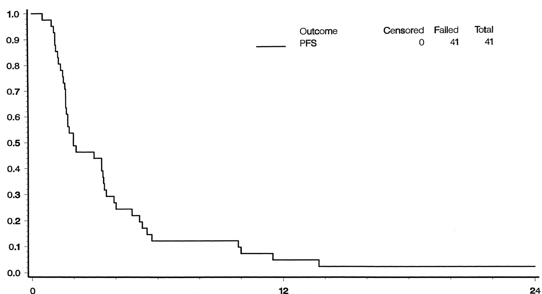
Phase II GOG Trial of Trastuzumab in Recurrent, Refractory Ovarian Cancer With HER2 Overexpression
Patient population:
Patients (n = 95) with persistent/recurrent epithelial ovarian or primary peritoneal carcinoma with HER2 overexpression (IHC 3+ or 2+) documented by IHC
Trastuzumab: initiated at 4 mg/kg IV then 2 mg/kg/wk (n = 45)
  Treatment given indefinitely if no toxicity
  If stable disease or response at 8 wks, offered a higher dose of 4 mg/kg at progression
Results:
ORR: 7.3%
  1 CR and 2 PRs
PFS With Trastuzumab
Probability of PFS
Safety:
There were only mild expected toxicities and no treatment-related deaths
Mo on Study
Bookman. JCO. 2003;21:283.
Notes:
CR, complete response; IHC, immunohistochemistry; ORR, objective response rate; PR, partial response.

Slide 14
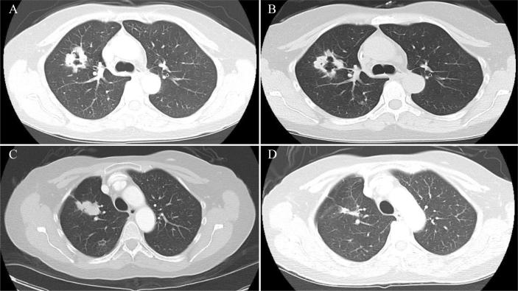
A Case Report for Trastuzumab/Pertuzumab in Adv CC
Patient case: 46-years-old female with recurrent cervical cancer (Panel A-D)
Initially treated with 7 cycles of topotecan, paclitaxel, and bevacizumab
Lung mets developed unresponsive to topotecan, paclitaxel, and bevacizumab and later confirmed to be ERBB2/HER2+ (Panel B)
Treatment with topotecan, paclitaxel,
and bevacizumab ceased and the patient began a clinical trial with trastuzumab-pertuzumab (Panel C)
Continued tx outside trial on 7/8/2015 on T-DM1 (Panel D)
Fortman. Gynecol Oncol Rep. 2019;31:100520.
Notes:
Adv, advanced; CC, cervical cancer; T-DM1, trastuzumab emtansine

Slide 15
Novel Anti-HER2 ADCs in Gynecologic Cancers
Notes:
ADC, antibody–drug conjugate.

Slide 16
HER2-Targeted ADC: Trastuzumab deruxtecan
Humanized anti-HER2 IgG1 mAb with same AA sequence as trastuzumab
High drug:antibody ratio: ~8
Stable linker-payload
Tumor-selectable cleavable linker
High potency, membrane-permeable payload with short systemic half-life
Bystander killing effect
Tetrapeptide-based cleavable linker
O
O
OH
O
O
N
Cys
O
H
O
H
O
H
N
N
N
N
N
N
N
O
N
O
H
O
H
O
✄
H
O
F
Cysteine residue
HO
O
NH
Drug/linker
O
N
F
N
O
Topoisomerase I inhibitor (DXd) payload
(exatecan derivative)
OH
O
Nakada. Chem Pharm Bull (Tokyo). 2019;67:173. Trail. Pharmacol Ther. 2018;181:126. Ogitani. Cancer Sci. 2016;107:1039.
Notes:
ADC, antibody-drug conjugate; AA, amino acid; Cys, Cysteine; IgG, immunoglobulin; mAb, monoclonal antibody.
Figure:
1/Nakada/2019/p178/Figure8/col1/para1/
all/p183/col2/para2/
L1-8;
2/Ogitani/ClinCanRes/2016/p5098/col2/para1/ln1-2/
p5100/Figure1A
3/Trail/2018/
p127/fig 1
All boxes: 1/Nakada/2019/p178/Figure 8/
box 1: 2/Ogitani/ClinCanRes/2016/p5098/col1/para2/ln4;
box 2: 2/Ogitani/ClinCanRes/2016/p5100/col1/para1/all; Figure 1C;
box 3: 2/Ogitani/ClinCanRes/2016/p5100/Figure 1 B;
box 4: 1/Nakada/2019/p180/col2/para1/ln1-3; 3/Ogitani/ClinCanRes/2016/p5105/Figure 5 D;
box 5: 2/Ogitani/ClinCanRes/2016/p5100/col2/para2/ln4-8; p5101/Figure 2 E;
box 6: 2/Ogitani/ClinCanRes/2016/p5098/col1/para2/ln3-4;
box 7: 4/Ogitani/CaSci/2016/p1044/col1/para1/ln28-32;
3 components:
1/Nakada/2019/p178/Figure 8/ col1/para1/all;
2/Ogitani/ClinCanRes/2016/p5098/col1/para2/ln2-4

Slide 17
Phase II DESTINY-PanTumor02: T-DXd in HER2-Positive Gynecologic Cancers Cohorts
Now FDA approved for the treatment of patients with inoperable or metastatic tumors that express HER2 who have received prior systemic treatment
International, open-label, multicohort phase II trial
Patients with advanced solid tumors ineligible for curative tx; HER2 expression (IHC 3+ or 2+); progressed after prior tx or with no satisfactory alternatives; prior HER2-targeted tx permitted; ECOG/WHO PS 0/1
(N = 268)
Gyn Cancers* Cohort
(n = 120)
T-DXd 5.4 mg/kg IV Q3W
*Endometrial, ovarian, and cervical cancers.
Primary endpoint: confirmed ORR by investigator assessment (RECIST v1.1)
Secondary endpoints: DoR, DCR, PFS, OS, safety
HER2 expression determined by local testing
  If not feasible, central testing performed with semiquantitative IHC assay for HER2 overexpression (HercepTest) per ASCO/CAP gastric cancer guidelines
  All participants centrally confirmed
NCT04482309. Meric-Bernstam. ASCO 2023. Abstr LBA300. Meric-Bernstam. JCO. 2024;42:47.
Makker. SGO 2024. Trastuzumab deruxtecan PI.
Notes:
DCR, disease control rate; DoR, duration of response; EC, endometrial cancer; ECOG, Eastern Cooperative Oncology Group; ORR, overall response rate; OS, overall survival; PFS, progression-free survival; PS, performance status; RECIST, Response Evaluation Criteria in Solid Tumors; T-DXd, trastuzumab deruxtecan; tx, treatment.

Slide 18
DESTINY-PanTumor02: T-DXd Responses in Gynecologic Cancers by HER2 Status
ORR in CC Cohort
ORR in EC Cohort
ORR in OC Cohort
100
100
100
Best Overall Response | CC Cohort (n = 40) | EC Cohort (n = 40) | OC Cohort (n = 40)
ORR, n (%) CR PR SD PD | 20 (50) 2 (5) 18 (45.0) 11 (27.5) 7 (17.5) | 23 (57.5) 8 (20.0) 15 (37.5) 12 (30.0) 4 (10.0) | 18 (45) 4 (10) 14 (35) 14 (35) 7 (17.5)
Median DoR, mo (95% CI) | 14.2 (4.1-NE) | NR (9.9-NE) | 11.3 (4.1-22.1)
85
80
75
80
80
64
60
60
57
60
50
45
Confirmed ORR (%)
47
40
40
40
40
37
20
Overall, median PFS was 6.9 mo and median OS was 13.4 mo
20
20
n=
40
8
20
n=
40
13
17
n=
40
11
19
0
0
0
All
IHC
3+
IHC
2+
All
IHC
3+
IHC
2+
All
IHC
3+
IHC
2+
Meric-Bernstam. JCO. 2024;42:47. Makker. SGO 2024.
Notes:
CC, cervical cancer; CR, complete response; EC, endometrial cancer; ILD, interstitial lung disease; NE, not evaluable; NR, Not reached; OC, ovarian cancer; ORR, overall response rate; PD, progressive disease; PR, partial response; SD, stable disease; TEAE, treatment-emergent adverse event.

Slide 19
DESTINY-PanTumor02: Safety Summary
Most patients (88.3%) experienced a drug-related TEAE, with 45% having a grade ≥3 event
13 patients (10.8%) experienced ILD/pneumonitis adjudicated (grade 1: 3.3%; grade 2: 6.7%) as T-DXd related, with 1 grade 5 (0.8%) event
1 other death (pneumonia/ organizing pneumonia) related
to T-DXd
Drug-Related TEAEs in ≥10% of All Patients With
Gynecologic Cancers (n = 120)
Nausea
4.2
64.2
Fatigue
6.7
44.2
Diarrhea
5.0
32.5
Anemia
13.3
30.8
Neutropenia
19.2
28.3
Vomiting
0.8
27.5
Decreased appetite
3.3
19.2
Alopecia
18.3
Any grade
Thrombocytopenia
6.7
15.0
Grade ≥3
Transaminase
elevation
11.7
0
10
20
30
40
50
60
70
80
Patients (%)
Meric-Bernstam. JCO. 2024;42:47. Makker. SGO 2024.

Slide 20
Global, Open-Label Phase I/IIa of HER2-Targeting ADC (DB-1303) in Recurrent/Metastatic EC
DB-1303, a novel humanized anti-HER2 IgG1 mAb-based ADC with a maleimide tetrapeptide cleavable linker and topoisomerase I inhibitor payload (8:1 drug: antibody ratio)
Phase II: dose expansion cohorts
Phase I: dose escalation*
Cohort 2a: previous trastuzumab and HER2+ (IHC 3+, 2+ and ISH-positive) gastric or GEJ adenocarcinoma, n = 30; HER2+ esophageal carcinoma, n = 10; and HER2+ CRC, n = 15
Patients with pathology IHC/NGS documented* HER2-positive or HER2-expressing† endometrial cancer; measurable disease per RECIST v1.1; ECOG PS ≤1
(N = 463)
Doses 2.2 mg/kg to 12.0 mg/kg tested in a classic 3+3 design with 1 patient treated at initial dose and 3-6 patients for subsequent dose increment thereafter
RP2D/MTD:
8 mg/kg
Cohort 2b: HER2 overexpression + HER2-low EC* (UC+USC), n = 30-60
Dose Extension:
if approved by SMC, cohort size can be backfilled to 15-20 at any dose ≥4.4 mg/kg. Up to 57 may be enrolled (HER2-low BC; HER2+ BC; HER2+/low EC; HER2mut NSCLC)
Cohort 2c: HR+/HER2-low (IHC 2+/ISH-negative, or 1+) BC, n = 30-50
Cohort 2d: HER2+ (IHC 3+, 2+/ISH-positive) BC, n = 20-40
Cohort 2e: NSCLC with activating HER2 mutation, n = 15-30
Cohort 2f: HER2+ (n = 10) or HR+/HER2-low (n = 10) BC that failed previous treatment with T-DXd
Objectives in phase I: MTD/RP2D (primary); efficacy, pharmacokinetics, and immunogenicity (secondary)
Objectives in phase II: safety, tolerability, and efficacy (primary); pharmacokinetics, antidrug antibodies, efficacy (secondary)
*Preexisting diagnosis of HER2 status or fresh biopsy by IHC 3+, 2+, 1+, or ISH+ or HER2 amplification or mutation by NGS.
Data cutoff: May 8, 2023
NCT05150691. Lin. Eur J Cancer. 2022;174:S91. Moore. ESGO 2023. Abstr 430.
Notes:
ADC, antibody-drug conjugate; BC, breast cancer; CRC, colorectal cancer; EC, endometrial cancer; ECOG PS, Eastern Cooperative Oncology Group Performance Status; GEJ, gastroesophageal junction; IHC, immunohistochemistry; ISH, in situ hybridization; mAb, monoclonal antibody; MTD, maximum tolerated dose; NGS, next-generation sequencing; NSCLC, non-small cell lung cancer; RECIST, response evaluation criteria in solid tumors; RP2D, recommended phase 2 dose; SMC, safety monitoring committee; UC, uterine carcinosarcoma; USC, uterine serous carcinoma.

Slide 21
Phase I/IIa of DB-1303: Responses
NEW
Depth of Response
Change in Response Over Time
120
HER2 IHC Status
1+
2+
3+
Dose Level
7 mg/kg
8 mg/kg
Dose Level
7 mg/kg
8 mg/kg
Response
100
PD
PR
SD
90
60
50
30
Change From BL (%)
0
Change From BL (%)
-30
0
-60
-90
-50
-120
ISH+
ISH+
ISH+
ISH+
ISH+
ISH+
ISH+
ISH+
ISH+
ISH+
ISH+
ISH+
ISH+
ISH+
ISH+
ISH+
-100
Patient
0
10
20
30
Duration of Treatment (Wk)
Best overall response (pooled 7-8 mg/kg): 61.5%; unconfirmed DCR: 94.1%
93% of patients experienced any grade TEAEs; grade ≥ 3 TEAEs in 29%; no AESIs (LVEF decrease of grade ≥3; ILD/pneumonitis; infusion reactions of grade ≥3)
Participants with no postbaseline tumor assessments were excluded from these figures.
Moore. ESGO 2023. Abstr 430.
Notes:
BL, baseline; DCR, disease control rate; IHC, immunohistochemistry; ILD, interstitial lung disease; ISH, in situ hybridization; LVEF, left ventricular ejection fraction; mAb, monoclonal antibody; PD, progressive disease; PR, partial response; SD, stable disease; TEAEs, treatment-emergent adverse events.

Slide 22

When Should You Incorporate Anti-HER2 in Patients With Gynecologic Cancers?
HER2 testing by validated IHC assay?
IHC 3+
IHC 2+
IHC 1+
IHC 0+
Treatment Sequencing Based on
Tumor Type
HER2 Positive
Reflex +
Reflex -
HER2 Low
HER2 Negative
1L: Carbo/pac + trastuzumab
2L+: T-DXd (now approved if IHC 3+; NCCN IHC 3+ and 2+)
Clinical trial: DB-1303
USC
HER2 Positive
2L+: T-DXd (now approved if IHC 3+; NCCN IHC 3+ and 2+)
OC
CC
HER2 status confirmed?
Notes:
1L, first line; 2L, second line; carbo, carboplatin; CC, cervical cancer; IHC, immunohistochemistry; NCCN, National Comprehensive Cancer Network; OC, ovarian cancer; pac, paclitaxel; T-DXd, trastuzumab deruxtecan; USC, uterine serous ovarian cancer.

Slide 23
Managing the Safety Profile of Anti-HER2 ADCs in Patients With Gynecologic Cancers
Notes:
ADC, antibody–drug conjugate.

Slide 24
Administration Considerations for T-DXd in Gynecologic Cancers
Consideration | T-DXd
Premedication | Consider antiemetics for nausea and vomiting
Starting dosage | 5.4 mg/kg IV Q3W until PD/unacceptable toxicity
Dose reductions | First: 4.4 mg/kg Second: 3.2 mg/kg Third: discontinue
Key toxicities managed with dose modifications | ILD/pneumonitis: stop at first sign of ILD/pneumonitis Neutropenia: consider growth factor support and dose modifications Thrombocytopenia: consider dose modification LVEF: consider dose modification
DDIs | Very limited/not clinically meaningful
Trastuzumab deruxtecan PI.
Notes:
CINV, chemotherapy-induced nausea and vomiting; DDI, drug–drug interaction; ILD, interstitial lung disease; LVEF, left ventricular ejection fraction; PD, progressive disease; T-DXd, trastuzumab deruxtecan.

Slide 25
Strategies to Manage ILD
Associated With HER2-Directed T-DXd
Monitor
Confirm
Manage
Suspected ILD
Assessments should include:
High-resolution CT
Pulmonologist consult; if indicated, ID consult
Blood culture and CBC; other blood tests
as needed
Consider bronchoscopy and BAL if indicated and feasible
PFTs and pulse oximetry
Arterial blood gases, if indicated
As soon as ILD suspected, collect 1 blood sample for PK assessment, if feasible
Rule out other causes of ILD (eg, progression, infection, other drugs, radiotherapy)
All ILD events should be followed until resolution and after drug discontinuation
Grade 1: Hold until resolved to
grade 0; consider corticosteroids
(0.5 mg/kg/day prednisolone), then:
  If resolved ≤28 days from onset:
  maintain dose
  If resolved >28 days after onset:
  reduce dose by 1 level
Grades 2-4: Permanently discontinue treatment and promptly initiate systemic corticosteroid treatment,
eg, ≥1 mg/kg/day prednisolone or equivalent for ≥14 days followed by taper for ≥4 wk
Urge patients to immediately report cough, dyspnea, fever, and/or new or worsening pulmonary symptoms
Monitor patients for signs/symptoms of ILD
Promptly investigate
evidence of ILD
Evaluate patients with suspected ILD by radiographic imaging and assess as follows
Fam-trastuzumab deruxtecan-nxki PI. Tarantino. JAMA Oncol. 2021;7:1873.
Notes:
ADC, antibody–drug conjugate; BAL, bronchoalveolar lavage; CBC, complete blood count; CT, chemotherapy; ILD, interstitial lung disease; PFT, pulmonary function test; PK, pharmacokinetics; T-DM1, trastuzumab emtansine; T-DXd, trastuzumab deruxtecan.

Slide 26
Go Online for More CCO
Coverage of Anti-HER2 ADCs in Solid Tumors!
ClinicalThought commentary including experts' takeaways on the use of anti-HER2 ADCs for genitourinary, gastrointestinal, and gynecologic cancers
On-demand CME-certified text modules for genitourinary and gastrointestinal cancers (coming soon!)
Updates to Interactive Decision Support Tool providing expert recommendations tailored to specific scenarios for patients with advanced endometrial cancer
clinicaloptions.com/oncology
clinicaloptions.com/EndometrialThinkTank

