Slide 1
Recent Evidence for Treatment Augmentation
With Second-Generation Antipsychotics in Major Depressive Disorder
Rakesh Jain, MD, MPH
Clinical Professor
Department of Psychiatry
Texas Tech Health Sciences Center, School of Medicine
Midland, Texas
Supported by an educational grant from Otsuka and Lundbeck Alliance

Slide 2

About These Slides
Please feel free to use, update, and share some or all of these slides in your noncommercial presentations to colleagues or patients
When using our slides, please retain the source attribution:
These slides may not be published, posted online, or used in commercial presentations without permission. Please contact permissions@clinicaloptions.com for details
Slide credit: clinicaloptions.com
Notes:
Disclaimer: The materials published on the Clinical Care Options Web site reflect the views of the authors of the CCO material, not those of Clinical Care Options, LLC, the CME providers, or the companies providing educational grants. The materials may discuss uses and dosages for therapeutic products that have not been approved by the United States Food and Drug Administration. A qualified healthcare professional should be consulted before using any therapeutic product discussed. Readers should verify all information and data before treating patients or using any therapies described in these materials.

Slide 3
Disclosures
The faculty reported the following financial relationships or relationships to products or devices they or their spouse/life partner have with commercial interests related to the content of this CME/CE activity:
Rakesh Jain, MD, MPH, has disclosed that he has received consulting fees from Acadia, Alfasigma, Alkermes, Allergan, Eisai, Evidera, Impel, Janssen, Lilly, Lundbeck, Merck, Neos Therapeutics, Neurocrine, Osmotica, Otsuka, Pamlab, Pfizer, Shire, Sunovion, Supernus, Takeda, and Teva; has received fees for non-CME services from Alkermes, Allergan, Ironshore, Janssen, Lilly, Lundbeck, Merck, Neos Therapeutics, Neurocrine, Otsuka, Pamlab, Pfizer, Shire, Sunovion, Takeda, Teva, and Tris; has received funds for research support from Allergan, Lilly, Lundbeck, Otsuka, Pfizer, Shire, and Takeda; and that his spouse/partner has received consulting fees from Lilly, Otsuka, Pamlab, and Sunovion and fees for non-CME services from Lilly.
Notes:
This slide lists the disclosure information of the faculty and staff involved in the development of these slides.

Slide 4
Partial Response and Nonresponse to Antidepressant Treatment
Remission
Return to “wellness” or disappearance of symptoms
Most frequently measured as HAM‐D ≤ 7 or MADRS ≤ 10
Recovery
Remission for ≥ 2 mos
Remission
Recovery
Remission/recovery
“Normalcy”
Partial Response
(or Response)
Improvement of symptoms
≥ 50% decrease in HAM‐D or MADRS
Symptoms
Response
Syndrome
Relapse/
recurrence
Relapse/
recurrence
Relapse
Return of symptoms after remission
Recurrence
Return of symptoms after recovery
Relapse
Recurrence
First episode
Second episode
Third episode
McIntyre. Clin Ther. 2006;28:1882. Zimmerman. J Psychiatr Res. 2004;38:577.
Saltiel. Neuropsychiatr Dis Treat. 2015;11:875. Lenox-Smith. J Affect Disord. 2014;169:149.
Slide credit: clinicaloptions.com
Notes:
HAM-D, Hamilton Depression Rating Scale; MADRS, Montgomery-Asberg Depression Rating Scale.

Slide 5
When MDD Treatment Fails
30%
In 30% to 45% of patients, remission is not achieved
with a single antidepressant, even at adequate dosage
and period^{[1]}
  Antidepressant efficacy decreases with successive trials^{[2]}
  More than 2 failed trials: treatment-resistant depression
70%
1. Fava. J Clin Psychiatry. 2000;61 Suppl 1:26. 2. Rush. Am J Psychiatry. 2006;163:1905. 3. Russell. J Clin Psychiatry. 2004;65:341.
Slide credit: clinicaloptions.com
Notes:
MDD, major depressive disorder.

Slide 6
MDD Treatment Augmentation: Florida Best Practice Psychotherapeutic Medication Guidelines
Level 1: Monotherapy
SSRI
SNRI
Vortioxetine
Bupropion
Mirtazapine
Level 2: Add
Evidence-based psychotherapy
Second-generation antipsychotic FDA-approved as adjunctive treatment for MDD
Intranasal esketamine or intravenous racemic ketamine
Another antidepressant (do not combine SSRI and SNRI)
Level 3: SSRI/SNRI +
Lithium
T3
L-methylfolate
S-adenosylmethionine
Quetiapine (tolerability concerns)
Level 4: Consider
MAOI augmentation
(AVOID CONTRAINDICATED COMBINATIONS)
FL-methylfolate triple drug combinations*
SSRI/ SNRI + mirtazapine + bupropion
SSRI/SNRI + mirtazapine + lithium
SSRI/SNRI + bupropion + second- generation antipsychotic
*Little evidence to support/refute this approach
McIntyre. J Clin Psychiatry 2017;78:703.
Slide credit: clinicaloptions.com
Notes:
MAOI, Monoamine oxidase inhibitor; MDD, major depressive disorder; SNRI, serotonin and norepinephrine reuptake inhibitors; SSRI, selective serotonin reuptake inhibitors.

Slide 7
MDD Treatment Augmentation:
Second-Generation Antipsychotics
Agent | FDA Approval for MDD Treatment Augmentation
Aripiprazole^{[1]} | 2007
Olanzapine/ fluoxetine^{[2]} | 2009
Quetiapine XR^{[3]} | 2009
Brexpiprazole^{[4]} | 2015
Agent | FDA Approval for MDD Treatment Augmentation
Asenapine | No
Clozapine | No
Cariprazine | No
Iloperidone | No
Lumateperone | No
Lurasidone | No
Paliperidone | No
Risperidone | No
Sulpiride | No
Ziprasidone | No
1. Aripiprazole PI. 2. Olanzapine/fluoxetine PI. 3. Quetiapine XR PI. 4. Brexpiprazole PI.
Slide credit: clinicaloptions.com
Notes:
MDD, major depressive disorder.

Slide 8
MDD Treatment Augmentation With
Second-Generation Antipsychotics: Considerations
Efficacy
Best studied strategy, good efficacy^{[1]}
FDA approved options
Included in guideline recommendations^{[2]}
Tolerability (varies by agent)^{[3]}
Neuroendocrine
  Prolactin
Metabolic
  Weight, lipids, glucose regulation
Extrapyramidal symptoms
  Tardive dyskinesia, neuroleptic malignant syndrome, akathisia, parkinsonism, dystonic reactions
1. Papakostas. J Clin Psychiatry. 2009;70 Suppl 6:16. 2. McIntyre. J Clin Psychiatry 2017;78:703.
3. Keepers. APA Practice Guideline. 2020. https://www.psychiatry.org/psychiatrists/practice/clinical-practice-guidelines.
Slide credit: clinicaloptions.com
Notes:
MDD, major depressive disorder.

Slide 9
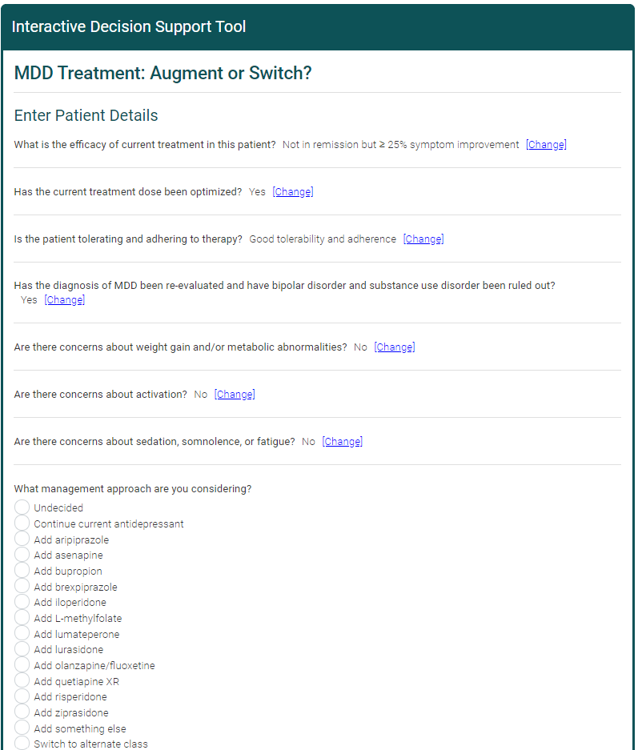
CCO Online Interactive Treatment Decision Support Tool for MDD Treatment
Enter specific patient characteristics and get recommendations from a panel of 5 experts
  Leslie Citrome, MD, MPH
  Christoph U. Correll, MD
  Rakesh Jain, MD, MPH
  Roger McIntyre, MD, FRCPC
  Michael E. Thase, MD
Available at clinicaloptions.com/AdvancingMDDTreatment
Slide credit: clinicaloptions.com

Slide 10
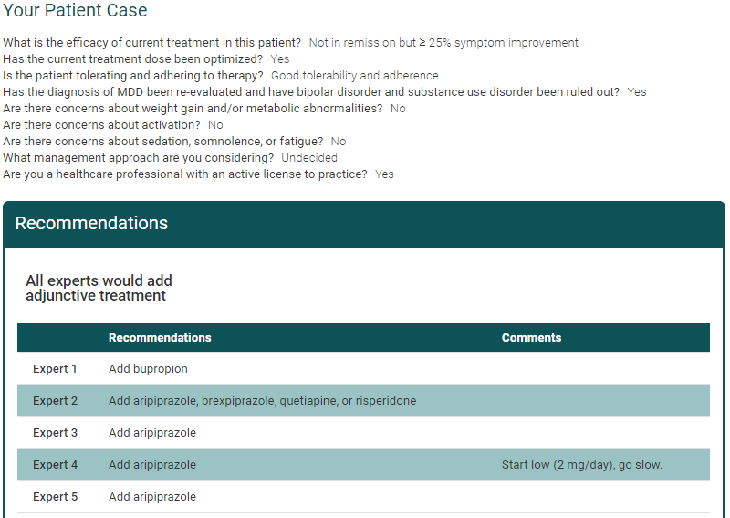
Expert Recommendations for Case: Patient Not in Remission but ≥ 25% Symptom Improvement
Slide credit: clinicaloptions.com

Slide 11
MDD Treatment Augmentation With
Second-Generation Antipsychotics: 2009 Meta-Analysis
Meta-analysis of 16 randomized, placebo-controlled trials of adjunctive second-generation antipsychotics in patients with treatment-resistant major depressive disorder (N = 3480)
Treatment, N
Control, N
Response Rate
Quetiapine
Fixed OR (95% CI) P Value
All agents:
More effective than placebo
  No differences in ORs among agents
Had higher rates of discontinuation for adverse events than did placebo
Khullar 2006
Mattingly 2006
McIntyre 2006
Earley 2007
El-Khalili 2008
8
24
29
327
289
677
7
13
29
160
143
352
Subtotal
1.60 (1.24-2.08) .0004
Risperidone
137
62
12
211
131
33
11
175
Mahmoud 2007
Keitner 2009
Reeves 2008
1.83 (1.18-2.82) .007
Subtotal
Aripiprazole
181
185
174
540
172
184
169
525
Berman 2007
Marcus 2008
Berman 2008
2.07 (1.58-2.72) < .00001
Subtotal
Olanzapine
Shelton 2001
10
146
230
102
98
586
10
142
56
104
102
414
Shelton 2005
Corya 2006
Thase 2006
Thase II 2006
1.39 (1.05-1.84) .02
Subtotal
1.69 (1.46-1.95) .00001
Test for overall effect
2014
1466
0.5
1
2
5
10
Slide credit: clinicaloptions.com
Nelson. Am J Psychiatry. 2009;166:980.
Favors Control
Favors Treatment
Notes:
MDD, major depressive disorder; OR, odds ratio.

Slide 12
MDD Treatment Augmentation With
Second-Generation Antipsychotics: 2015 Meta-Analysis
Meta-analysis of 18 randomized, placebo-controlled trials of adjunctive second-generation antipsychotics at standard and low doses in patients with treatment-resistant major depressive disorder (N = 4422)
Quetiapine XR (250-400 mg) | 1.85 (0.19 to 7.14) | 1.85 (0.79 to 3.57) | 0.99 (0.36 to 4.00) | 1.45 (0.42 to 9.09) | 1.54 (0.57 to 6.25) | 5.68 (1.38 to 90.42) | 6.40 (2.94 to 17.83)
-0.03 (-0.49 to 0.38) | Risperidone | 0.57 (0.18 to 3.62) | 0.30 (0.09 to 2.05) | 0.73 (0.22 to 4.78) | 0.52 (0.16 to 3.47) | 2.10 (0.47 to 43.16) | 2.37 (0.87 to 11.14)
-0.06 (-0.34 to 0.19) | -0.04 (-0.45 to 0.41) | Quetiapine XR (150-250 mg) | 1.09 (0.12 to 1.42) | 0.85 (0.25 to 5.26) | 0.90 (0.34 to 3.57) | 3.32 (0.81 to 52.63) | 3.73 (1.77 to 10.13)
-0.12 (-0.48 to 0.16) | -0.10 (-0.51 to 0.29) | -0.06 (-0.40 to 0.22) | Aripiprazole (Standard) | 0.51 (0.12 to 1.42) | 0.87 (0.22 to 2.36) | 7.59 (0.60 to 37.02) | 2.72 (1.34 to 6.82)
-0.16 (-0.59 to 0.17) | -0.14 (-0.60 to 0.29) | -0.10 (-0.51 to 0.24) | -0.04 (-0.34 to 0.24) | Aripiprazole (Low) | 1.25 (0.21 to 4.26) | 10.26 (0.58 to 53.19) | 2.88 (1.00 to 12.96)
-0.16 (-0.51 to 0.13) | -0.14 (-0.54 to 0.27) | -0.10 (-0.43 to 0.20) | -0.04 (-0.30 to 0.25) | 0 (-0.32 to 0.36) | Olanzapine/ Fluoxetine (Standard) | 8.53 (1.08 to 36.67) | 3.52 (1.74 to 8.48)
-0.40 (-0.91 to 0.06) | -0.38 (-0.92 to 0.17) | -0.34 (-0.83 to 0.13) | -0.28 (-0.72 to 0.18) | -0.24 (-0.72 to 0.27) | -0.24 (-0.64 to 0.16) | Olanzapine/ Fluoxetine (Low) | 0.43 (0.09 to 4.05)
-0.43 (-0.72 to -0.21) | -0.41 (-0.77 to -0.06) | -0.37 (-0.64 to -0.14) | -0.31 (-0.49 to -0.12) | -0.27 (-0.53 to 0.01) | -0.27 (-0.48 to -0.08) | -0.03 (-0.45 to 0.38) | Placebo
All standard-dose agents:
More effective than placebo
Had higher rates of discontinuation for adverse events than did placebo
Efficacy by Depression Symptom Score, standardized mean differences (95% CI)
Tolerability by OR of adverse event discontinuation (95% CI)
Zhou. Int J Neuropsychopharmacol. 2015;18:pyv060.
Slide credit: clinicaloptions.com
Notes:
MDD, major depressive disorder; OR, odds ratio.

Slide 13
MDD Treatment Augmentation With Second-Generation Antipsychotics: Efficacy by Degree of Resistance
Meta-analysis of 11 randomized, controlled trials of adjunctive second-generation antipsychotics in patients with treatment-resistant MDD (N = 3341)
Meta-Regression of Response Rate
.6
Improved efficacy with increasing rates of resistance
.5
.4
Response, log of Risk Ratio
.3
.2
History of Treatment Failures:
0
2
2 to 4
Wang. Int J Neuropsychopharmacol. 2015;18:pyv023.
Slide credit: clinicaloptions.com
Notes:
MDD, major depressive disorder.

Slide 14
MDD Treatment Augmentation: Key Studies of
Second-Generation Antipsychotics
 |  |  | N |  | Mean Change in MADRS After 6 Wks
Agent | Comparator | MDD Population | Treatment | Comparator | Treatment | Comparator | P value
Aripiprazole + antidepressant^{[1]} | Placebo | Incomplete response | 184 | 178 | -8.80 | -5.80 | < .001
Olanzapine/ fluoxetine^{[2]} | Fluoxetine | Treatment resistant | 462 | 342 | -12.28 | -8.48 | < .001
Olanzapine/ fluoxetine^{[2]} | Olanzapine | Treatment resistant | 462 | 342 | -12.28 | -8.52 | < .001
Quetiapine XR + antidepressant^{[3]} | Placebo | Inadequate response | 148* | 148 | -14.70* | -11.70 | < .01
Brexpiprazole + antidepressant^{[4]} | Placebo | Inadequate response | 175 | 178 | -8.36 | -5.15 | .0002
All are superior to placebo, but none has been shown to be superior to others
*300 mg/day.
1. Berman. J Clin Psychiatry. 2007;68:843. 2. Tohen. J Clin Psychiatry. 2010;71:451.
3. El-Khalili. Int J Neuropsychopharmacol. 2010;13:917. 4. Thase. J Clin Psychiatry. 2015;76:1224.
Slide credit: clinicaloptions.com
Notes:
MADRS, Montgomery-Asberg Depression Rating Scale; MDD, major depressive disorder.

Slide 15
MDD Treatment Augmentation With Aripiprazole
Multicenter, randomized, double-blind, placebo-controlled phase III study in patients with MDD and incomplete response to antidepressant therapy (N = 362)
0
Placebo +
SSRI
(n = 172)
Aripiprazole +
SSRI
(n = 181)
-2
-4
-6
Mean Change
in MADRS Total Score
-8
*
-10
*
*
*
*
-12
-14
*P < .001
-16
Baseline
1
2
3
4
5
6
Wk
Berman. J Clin Psychiatry. 2007;68:843.
Slide credit: clinicaloptions.com
Notes:
MADRS, Montgomery-Asberg Depression Rating Scale; MDD, major depressive disorder; SSRI, selective serotonin reuptake inhibitors.

Slide 16
MDD Treatment Augmentation With Aripiprazole: Safety
Adverse Events, n (%) | Aripiprazole + Antidepressant (n = 182) | Placebo + Antidepressant (n = 176)
Any | 149 (81.9) | 110 (62.5)
Akathisia | 42 (23.1) | 8 (4.5)
Restlessness | 26 (14.3) | 6 (3.4)
Upper respiratory tract infection | 15 (8.2) | 7 (4.0)
Insomnia | 14 (7.7) | 4 (2.3)
Blurred vision | 12 (6.6) | 3 (1.7)
Fatigue | 11 (6.0) | 6 (3.4)
Headache | 11 (6.0) | 19 (10.8)
Diarrhea | 6 (3.3) | 10 (5.7)
Dry mouth | 6 (3.3) | 11 (6.3)
Nausea | 5 (2.7) | 9 (5.1)
Berman. J Clin Psychiatry. 2007;68:843.
Slide credit: clinicaloptions.com
Notes:
MDD, major depressive disorder.

Slide 17
Olanzapine/Fluoxetine in Treatment-Resistant MDD
Pooled analysis of 5 outpatient studies of olanzapine/fluoxetine in patients with treatment-resistant MDD (N = 1146)
0
Fluoxetine
(n = 203)
Olanzapine
(n = 197)
Olanzapine/fluoxetine
combination
(n = 198)
-2
-4
-6
*
Mean Change
in MADRS Total Score
-8
-10
*
†
-12
*
*
*
*
*
-14
*P < .001 vs fluoxetine
†P ≤ .011 vs olanzapine
†
†
*
*
†
†
†
-16
Baseline
1
2
3
4
5
6
7
8
Wk
Tohen. J Clin Psychiatry. 2010;71:451.
Slide credit: clinicaloptions.com
Notes:
MADRS, Montgomery-Asberg Depression Rating Scale; MDD, major depressive disorder.

Slide 18
Olanzapine/Fluoxetine in Treatment Resistant MDD: Safety
Adverse Events, % | Olanzapine/ Fluoxetine (n = 462) | Fluoxetine (n = 342) | Olanzapine (n = 342) | P Values
 |  |  |  | Overall | Olanzapine/ Fluoxetine vs Fluoxetine | Olanzapine/ Fluoxetine vs Olanzapine
Increase weight | 35.0 | 6.8 | 39.7 | < .001 | < .001 | .353
Increased appetite | 32.0 | 5.8 | 30.7 | < .001 | < .001 | .829
Dry mouth | 28.5 | 8.7 | 31.7 | < .001 | < .001 | .514
Somnolence | 17.5 | 5.3 | 12.1 | < .001 | < .001 | .158
Fatigue | 14.0 | 7.8 | 14.1 | .070 | .055 | 1.00
Headache | 12.5 | 19.4 | 13.1 | .103 | .060 | .882
Peripheral edema | 12.0 | 1.0 | 7.5 | < .001 | < .001 | .177
Hypersomnia | 10.5 | 2.4 | 11.1 | < .001 | < .001 | .873
Tremor | 10.5 | 8.7 | 8.0 | .686 | .615 | .490
Tohen. J Clin Psychiatry. 2010;71:451.
Slide credit: clinicaloptions.com
Notes:
MDD, major depressive disorder.

Slide 19
MDD Treatment Augmentation With Quetiapine XR
Multicenter, randomized, double-blind, placebo-controlled phase III study of in patients with MDD and incomplete response to antidepressant therapy (N = 446)
0
Placebo + antidepressant
(n = 143)
Quetiapine XR
150 mg/day + antidepressant
(n = 143)
Quetiapine XR
300 mg/day + antidepressant
(n = 146)
-2
-4
-6
Mean Change
in MADRS Total Score
-8
†
-10
‡
†
-12
*P < .05
†P < .01
‡P < .001
(all vs placebo)
†
-14
*
†
-16
Baseline
1
2
3
4
5
6
Wk
El-Khalali. Int J Neuropsychopharmacology. 2010;13:917.
Slide credit: clinicaloptions.com
Notes:
MADRS, Montgomery-Asberg Depression Rating Scale; MDD, major depressive disorder.

Slide 20
MDD Treatment Augmentation With Quetiapine XR: Safety
Adverse Events, n (%) | Quetiapine XR 150 mg + Antidepressant (n = 148) | Quetiapine XR 300 mg + Antidepressant (n = 149) | Placebo + Antidepressant (n = 148)
Dry mouth | 52 (35.1) | 66 (44.3) | 13 (8.8)
Somnolence | 43 (29.1) | 43 (28.9) | 6 (4.1)
Sedation | 25 (16.9) | 33 (22.1) | 6 (4.1)
Dizziness | 17 (11.5) | 21 (14.1) | 8 (5.4)
Constipation | 11 (7.4) | 16 (10.7) | 5 (3.4)
Nausea | 13 (8.8) | 15 (10.1) | 12 (8.1)
Headache/fatigue | 16 (10.8)/23 (15.5) | 11 (7.4)/10 (6.7) | 20 (13.5)/7 (4.7)
Diarrhea | 10 (6.8) | 10 (6.7) | 10 (6.8)
Increased appetite | 8 (5.4) | 10 (6.7) | 8 (5.4)
Increased weight | 3 (2.0) | 9 (6.0) | 1 (0.7)
Irritability | 9 (6.1) | 5 (3.4) | 9 (6.1)
Insomnia | 16 (10.8) | 12 (8.1) | 10 (6.8)
El-Khalali. Int J Neuropsychopharmacology. 2010;13:917.
Slide credit: clinicaloptions.com
Notes:
MDD, major depressive disorder.

Slide 21
MDD Treatment Augmentation With Brexpiprazole
Randomized, placebo-controlled phase III study of adjunctive brexpiprazole in patients with MDD and incomplete response to antidepressant therapy (N = 353)
0
Placebo +
antidepressant
(n = 178)
Brexpiprazole + antidepressant
(n = 175)
-2
†
-4
-6
Mean (SE) Change
in MADRS Total Score
-8
*
‡
-10
‡
‡
-12
*P < .05
†P < .01
‡P < .001
(all vs placebo)
-14
-16
Baseline
1
2
3
4
5
6
Wk
Thase. J Clin Psychiatry. 2015;76:1224.
Slide credit: clinicaloptions.com
Notes:
MADRS, Montgomery-Asberg Depression Rating Scale; MDD, major depressive disorder; SE, standard error.

Slide 22
MDD Treatment Augmentation With Brexpiprazole: Safety
Treatment-Related Adverse Events, n (%) | Brexpiprazole + Antidepressant (n = 188) | Placebo + Antidepressant (n = 191)
≥ 1 treatment-related adverse event | 111 (59.0) | 89 (46.6)
Serious adverse events | 2 (1.1) | 2 (1.0)
Discontinuation due to treatment-related adverse event | 6 (3.2) | 0
Treatment-related adverse event occurring in ≥ 5% of brexpiprazole group Weight gain Akathisia | 15 (8.0) 14 (7.4) | 6 (3.1) 2 (1.0)
Thase. J Clin Psychiatry. 2015;76:1224.
Slide credit: clinicaloptions.com
Notes:
MDD, major depressive disorder.

Slide 23
Antipsychotics: Impact of AEs on Adherence
Survey of N = 876 community-dwelling people with schizophrenia
Adverse Event Clusters*
Likelihood of Complete Adherence
Agitation
Tremors
Restlessness/feeling jittery
Insomnia
Increased blood glucose levels
Weight gain
Painful menstrual periods
Gynecomastia and galactorrhea
Decreased interest in sex
Sexual dysfunction
Sedation
Difficulty thinking/concentrating
Sleepiness
Dizziness
Nausea/vomiting
Constipation
EPS/agitation
OR: 0.57
Metabolic
OR: 0.64
Reduced Adherence
Prolactin/endocrine
OR: 0.69
Sedation/cognition
OR: 0.70
Gastrointestinal
OR: 0.79
0
0.5
1.0
1.5
2.0
2.5
3.0
3.5
Reduced Adherence
*Odds ratios based on multivariable logistic regression with adherence as dependent variable.
Adjusted Odds Ratios
DiBonaventura. BMC Psychiatry. 2012;12:20.
Slide credit: clinicaloptions.com
Notes:
AE, adverse event; OR, odds ratio.

Slide 24
Second-Generation Antipsychotics: Weight Gain Among Adults in Short-term Randomized Controlled Studies
 | Weight Gain ≥ 7% of Baseline
Medication^{[1]} | Schizophrenia | Bipolar Mania | MDD | Bipolar Depression
Iloperidone | 10 | -- | -- | --
Asenapine | 35 | 19 | -- | --
Lurasidone | 67 | -- | -- | 58^{[2]}
Brexpiprazole | 17 | -- | 52 | --
Cariprazine (≤ 6 mg/day) | 34 | No difference | -- | --
Aripiprazole | 21 | No difference | 22 | --
Olanzapine/fluoxetine | 6 | 6 | 3 | 6^{[2,3]}
Paliperidone | 35 | -- | -- | --
Quetiapine IR | 6 | 8 | -- | 16^{[2]}
Quetiapine XR | 22 | 20 | 29 | 16^{[2]}
Risperidone (≤ 8 mg/day) | 18 | 18 | -- | --
Ziprasidone | 16 | 58 | -- | --
1. Citrome. Int J Clin Pract. 2015;69:1211. 2. Citrome. CNS Spectr. 2014;19(suppl 1):4. 3. Citrome. Expert Opin Pharmacother. 2011;12:2751.
Slide credit: clinicaloptions.com
Notes:
MDD, major depressive disorder.

Slide 25
Second-Generation Antipsychotics: Metabolic AEs
Systematic review and network analysis of 100 randomized, controlled trials
of 18 antipsychotics in schizophrenia (N = 25,952)
Subset of Agents FDA Approved in MDD Augmentation | P-Score Ranking of AEs From 0 to 1*
 | Weight Increase | Glucose Increase | LDL-C Increase | Total C Increase | HDL-C Decrease | TG Increase
Aripiprazole | .26 | .55 | .48 | .50 | .26 | .33
Brexpiprazole | .45 | .40 | .66 | .52 | .18 | .23
Quetiapine XR | .65 | .47 | .91 | .82 | .59 | .71
Olanzapine/fluoxetine | .92 | .67 | .96 | .91 | .76 | .83
*P-score ≥ .50 shown in red.
Pillinger. Lancet Psychiatry. 2020;7:64.
Slide credit: clinicaloptions.com
Notes:
AE, adverse event; C, cholesterol; HDL-C, high-density lipoprotein cholesterol; LDL-C, low-density lipoprotein cholesterol; MDD, major depressive disorder; TG, triglycerides.

Slide 26
Antipsychotic-Associated Weight Gain:
Pharmacologic Interventions
Meta-analysis of 32 randomized, controlled trials of 15 different medications (N = 1482)
6
4
Significant difference vs placebo
Favors Placebo
2
Weighted Mean Difference in Bodyweight Change, kg (95% CI)
0
-2
-4
Favors Intervention
-6
Orlistat
Metformin
Reboxetine
Nizatidine
Fluoxetine
Topiramate
Famotidine
Sibutramine
Amantadine
Rosiglitazone
D-Fenfluramine
Dextroamphetamine
Metformin + Sibutramine
Maayan. Neuropsychopharmacology. 2010;35:1520.
Slide credit: clinicaloptions.com

Slide 27
AEs: Medical Risk Prevention Strategies
At Treatment Initiation
(Primary Prevention)
Healthy lifestyle counseling/intervention
Start with lower-risk antipsychotic
If AE is Present
(Secondary Prevention)
Healthy lifestyle counseling/intervention
Consider changing to lower-risk antipsychotic
Consider weight loss intervention
If AE Progresses/Serious
(Tertiary Prevention)
Healthy lifestyle counseling/intervention
Consider changing to lower-risk antipsychotic
Add targeted treatment for pathological values
Consider referral to specialist
Correll. CNS Spectr. 2007;12:12.
Slide credit: clinicaloptions.com
Notes:
AE, adverse event.

Slide 28
Algorithm to Manage Treatment-Emergent Akathisia
Reduce dose
Switch to low
potency first-generation
antipsychotic
Switch to clozapine
My approach in MDD augmentation:
avoid unapproved antipsychotics
Change
antipsychotic
Switch to second-generation
antipsychotic with
lower akathisia potential
(eg, quetiapine)
Akathisia in schizophrenia and mood disorders
Anticholinergics (mainly with parkinsonism):
Biperiden (2-6 mg/day)
Benztropine (1.5-8 mg/day)
Trihexyphenidyl (2-10 mg/day)
Beta-blockers:
Propranolol
(40-80 mg/day)
5-HT_{2A} antagonist:
Mirtazapine (15 mg/day)
Add antiakathisia
agent
First line
Second line
Amantadine (100 mg/day)
Clonidine (up to 0.15 mg/day)
Benzodiazepines:
Lorazepam (1-2 mg/day)
Clonazepam (0.5-1 mg/day)
Diazepam (5-15 mg/day)
5-HT_{2A} antagonist:
Mianserin (up to 0.15 mg/day)
Cyproheptadine (8-16 mg/day)
Salem. Current Neuropharmacol. 2017;15:789.
Slide credit: clinicaloptions.com
Notes:
MDD, major depressive disorder.

Slide 29
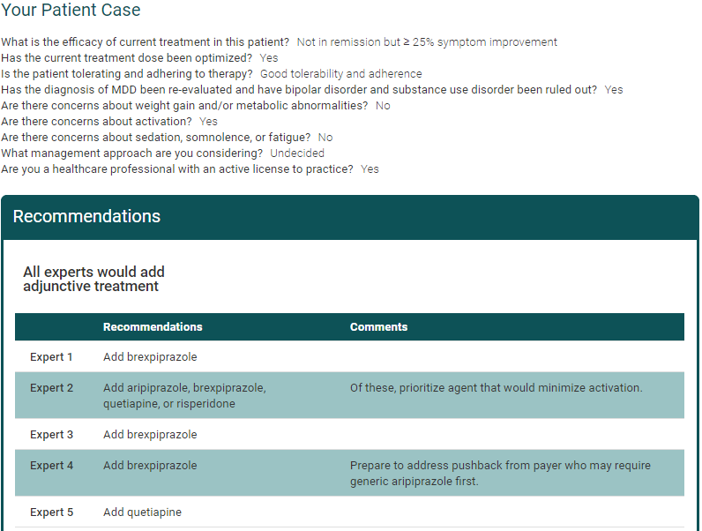
Expert Recommendations for Treatment Augmentation:
Activation/Akathisia Concerns
Slide credit: clinicaloptions.com

Slide 30
Second-Generation Antipsychotics: Sexual AEs
Review based on few systemic studies^{[1]}
Aripiprazole, brexpiprazole also associated with sedation and weight gain,
but no evidence of sexual dysfunction in registration trials^{[2-4]}
Antipsychotic Agent | Libido/Arousal | Orgasm | Sedation | Weight | Other
Clozapine | ↓↓ | ↓ | ↑↑↑ | ↑↑↑ | Priapism
Olanzapine | ↓ | ↓ | ↑ | ↑↑↑ | Priapism
Risperidone | ↓ | ↓ | ↑ | ↑ | Priapism
Ziprasidone | ↓ | ↓ | ↑ | (↑)
Sulpiride | ↓↓ | ↓ | ↑ | ↑
Quetiapine | ↓ | ↓ | ↑↑ | ↑
Symbols: ↓ = inhibits/reduces; ↑ = promotes/increases.
1. Kristensen E. Dan Med Bull. 2002;49:349. 2. Fava. Prim Care Companion CNS Disord. 2011;13:PCC.10m00994. 3. Pillinger. Lancet Psychiatry. 2020;7:64. 4. Brexpiprazole Prescribing Information.
Slide credit: clinicaloptions.com
Notes:
AE, adverse event.

Slide 31
Algorithm to Manage Treatment-Emergent
Sexual Dysfunction
Patient warrants
treatment with
antipsychotic
Choose a
medication with a
more favorable
SD profile
Watch and wait
Reduce dose
Drug holiday
Nonpharmacologic
options
YES
Patient already
has SD or is
concerned about
developing SD?
Choose any
appropriate
medication and
monitor for SD
Patient develops
sexual AE
Patient and
physician amenable
to regimen change?
NO
NO
YES
Is the current regimen
fully effective for the
primary psychiatric
target symptoms?
YES
NO
Add an antidote to
current regimen
Change to a
medication known
to cause fewer
sexual AEs
Clayton. Psychiatr Clin North Am. 2016;39:427.
Slide credit: clinicaloptions.com
Notes:
AE, adverse event; SD, sexual dysfunction.

Slide 32
Clinical Manifestations of Hyperprolactinemia
Anxiety, depression, hostility
Decreased bone mineral density and osteoporosis
Infertility
Disturbed menstrual cycles
Anovulation, amenorrhea, or irregular cycles
Decreased testosterone levels and sperm mobility
Sexual dysfunction
  Decreased libido/arousal;
  un- or hypo-orgasmia
Increased risk of cardiovascular disorders
Breast engorgement and galactorrhea
Increased risk of breast cancer
Increased risk of tardive dyskinesia?
Abnormal function of the immune system?
Halbreich. Psychoneuroendocrinology. 2003;28:53.
Slide credit: clinicaloptions.com

Slide 33
Variation in Antipsychotics: Effect on Prolactin Increase
Meta-analysis of 212 studies of patients with schizophrenia (N = 43,049 )^{[1]}
Prolactin Increase, Standardized Mean Difference (95% Cl)
Aripiprazole -0.22 (-0.46 to 0.03)
Quetiapine -0.05 (-0.23 to 0.13)
Asenapine 0.12 (-0.12 to 0.37)
Olanzapine 0.14 (0 to 0.28)
Chlorpromazine 0.16 (-0.48 to 0.8)
Iloperidone 0.21 (-0.09 to 0.51)
Ziprasidone 0.25 (0.01 to 0.49)
Lurasidone 0.34 (0.11 to 0.57)
Sertindole 0.45 (0.16 to 0.74)
Halperidol 0.70 (0.56 to 0.85)
Risperidone 1.23 1.06 to 1.40)
Paliperidone 1.30 (1.08 to 1.51)
Brexpiprazole, not shown, does not generally increase prolactin levels^{[2]}
-0.5
0
0.5
1.0
1.5
More Prolactin Increase
With Placebo
More Prolactin Increase
With Active Drug
1. Leucht. Lancet. 2013;382:951. 2. Ivkovic. J Clin Psychopharmacol. 2019;39:13.
Slide credit: clinicaloptions.com

Slide 34
MDD Treatment Augmentation With Second-Generation Antipsychotics: Managing Adverse Events
Consider potential advantages and disadvantages for individual patients before prescribing
Dosing in MDD (in combination with antidepressants) is typically lower than in bipolar disorder and psychosis
  Lower dose may minimize risk of adverse events
Monitor:
  Adverse events, including sedation, weight gain, akathisia and extrapyramidal symptoms
  Weight, body mass index, and metabolic indices at baseline and regular intervals
McIntyre. J Clin Psychiatry 2017;78:703.
American Psychiatric Association, Practice Guideline for the Treatment of Patients with Major Depressive Disorder; 2010.
Slide credit: clinicaloptions.com
Notes:
MDD, major depressive disorder.

Slide 35
Summary
Goal of treating major depression remains full symptomatic and functional remission and recovery
4 second-generation antipsychotics are approved by the FDA for use as antidepressant augmentation
  All have demonstrated efficacy
Adverse events often manageable with short- and long-term vigilance
  Weight gain, hyperprolactinemia, sexual dysfunction, tardive dyskinesia, are among the issues to monitor
Slide credit: clinicaloptions.com

Slide 36
Go Online for More CCO
Coverage of Depression!
CME-certified activities with expert faculty commentary
Additional unlocked slidesets with key information
Interactive Decision Support Tool on when to augment or switch MDD treatment
clinicaloptions.com/internalmedicine

