Slide 1

Improving Provider Awareness About Healthcare Equity: Improving All Patients’ Access to Care in Cervical Cancer
Provided by Clinical Care Options, LLC, in partnership with Smart Patients
Supported by educational grants from Eisai; GSK; Karyopharm Therapeutics Inc.; Merck Sharp & Dohme, LLC; and Seagen and Genmab.

Slide 2

About These Slides
Please feel free to use, update, and share some or all of these slides in your noncommercial presentations to colleagues or patients
When using our slides, please retain the source attribution:
These slides may not be published, posted online, or used in commercial presentations without permission. Please contact permissions@clinicaloptions.com for details
Slide credit: clinicaloptions.com
Notes:
Disclaimer: The materials published on the Clinical Care Options website reflect the views of the authors of the CCO material, not those of Clinical Care Options, LLC, the CME providers, or the companies providing educational grants. The materials may discuss uses and dosages for therapeutic products that have not been approved by the United States Food and Drug Administration. A qualified healthcare professional should be consulted before using any therapeutic product discussed. Readers should verify all information and data before treating patients or using any therapies described in these materials.

Slide 3
Faculty and Disclosures
Shannon N. Westin, MD, MPH
Professor
Division of Surgery
Department of Gynecologic Oncology and Reproductive Medicine
University of Texas MD Anderson Cancer Center
Houston, Texas
Shannon N. Westin, MD, MPH, consultant/advisor: AstraZeneca, Caris, Clovis,
Eisai, EQRX, Genentech/Roche, GlaxoSmithKline, ImmunoGen, Lilly, Merck, Mereo, Mersana, NGM Bio, Nuvectis, Seagen, Verastem, Vincerx, Zentalis; researcher: AstraZeneca, AvengeBio, Bayer, Bio-Path, Clovis, Genentech/Roche, GlaxoSmithKline, Mereo, Novartis, Zentalis.

Slide 4
Cervical Cancer: Overview
Third most common gynecologic cancer in the United States
Corresponds to ~740 deaths/day worldwide
>90% caused by human papillomavirus
Nearly 100% preventable
  HPV vaccination is key
Risk Factors for Developing Cervical Cancer
Primary risk factor: HPV infection
(>150 related viruses)
  Infection can occur on skin surface and tissue lining the genitals, anus, mouth, and throat
  Can spread during skin-to-skin contact
  Some HPV viruses can cause warts on hands and feet, and others affect the lips or tongue
HPV infection is common, and in most people, the body can clear the infection by itself
Other risk factors: unprotected sex, smoking, weakened immune system
cancer.org/cancer/cervical-cancer/causes-risks-prevention/risk-factors.
Sellors. IARC 2003. ISBN-13. Siegel. CA Cancer J Clin. 2023;73:17.
who.int/health-topics/cervical-cancer. Stark. Acta Facultatis Medicae Naissensis. 2018;35:5.
Siegel. CA Cancer J Clin. 2023;73:17. Small. Cancer. 2017;123:2404.
who.int/health-topics/cervical-cancer.
Notes:
HPV, human papilloma virus.

Slide 5
Cervical Cancer: Challenges
12
Rate of new cases
10
Death rate
8
Rate per 100,000 Persons
6
4
2
0
1992
1996
2000
2004
Yr
2008
2012
2016
2020
Steady but disproportionate decline in both the incidence and death rates
in cervical cancer reflect lack of effective salvage treatments for those with recurrent disease
seer.cancer.gov/statfacts/html/cervix.html

Slide 6
Cervical Cancer: US Incidence and Mortality Rates by Race
Rate per 100,000 Women | Overall | White | Black | Hispanic/ Latin Descent | Other
Incidence* | 7.5 | 7.0 | 8.6 | 9.3 | --
Mortality† | 2.2 | 2.1 | 3.2 | 2.4 | 1.8‡
*Based on data recorded in 2018. †Based on data recorded in 2020.
‡Reflects death rates for American Indian/Alaska Native and Asian/Pacific Islander populations.
Black and Hispanic/Latin descent women have a higher incidence of cervical cancer and worse mortality compared with White women
www.kff.org/other/state-indicator/cervical-cancer-rate-by-re

Slide 7
Cervical Cancer: Incidence per 100,000 Women by State
Southern states have a disproportionately high incidence of cervical cancer
  West Virginia: 10.5
  Kentucky: 8.9
  Alabama: 8.3
  Louisiana: 9.5
  Mississippi: 8.7
4.3-6.0
9.2-10.8
6.1-7.5
Missing
7.7-9.1
N/A
kff.org/other/state-indicator/cervical-cancer-rate-by-re
Notes:
N/A, not available.

Slide 8
Low Rates of Vaccination May Contribute to High Incidence Rates of Cervical Cancer
Adolescents Who Are Up to Date on HPV Vaccinations (%)
≤39%
40% to 49%
50% to 59%
≥60%
HPV vaccination is recommended
up to 26 yr of age
Adults aged 27-45 yr not previously vaccinated might consider HPV vaccination after speaking with their doctor
cdc.gov/hpv
Notes:
HPV, human papillomavirus.

Slide 9
Distrust and Limited Access to HCPs May Result in
Lower HPV Vaccination Rates Among Underrepresented Racial/Ethnic Minority Patients
Distrust and lack of access are driven by isolation, racial differences in communication, lack of insurance, and/or transportation
Low availability of HCPs (pediatricians) in rural areas may contribute to low vaccination rates
Poor health literacy cited as reason for lack of screening or distrust of HPV vaccine
Staples. Vaccine. 2021;39:5385.
Notes:
HCP, healthcare professional; HPV, human papillomavirus.

Slide 10
Leveraging Community Pharmacies as “Vaccines for Children” Providers May Help Increase HPV Vaccination
Overcoming economic barriers, lack of access, and low awareness/education about vaccines in rural, medically underserved areas
  Community pharmacy in Alabama was enlisted as Vaccines for Children provider of free vaccines to eligible adolescents in 8-mo pilot study
  Demographic characteristics of vaccinated adolescents
    Black: 62.9%
    White: 33.7%
    Other: 3.4%
HPV Vaccination in Adolescents 10-18 Yr of Age,
July 29, 2019 - March 10, 2020 (N = 55)
40
35
30
25
HPV Vaccine Administered (%)
20
15
10
5
0
HPV + Tdap + MCV
HPV Only
HPV + Tdap
HPV + MCV
HPV + Flu
HPV + Tdap + Flu
Daniel. BMC Public Health. 2021;21:1266.
Notes:
HPV, human papillomavirus; MCV, meningococcal conjugate vaccine; Tdap, tetanus, diphtheria, pertussis.

Slide 11
Screening and
HPV Testing in Cervical Cancer

Slide 12
ACS/USPSTF Guidelines on
Cervical Cancer Screening Frequency
HPV testing as primary screening target
Women aged 21-29 yr: screening every 3 yr with cervical cytology alone
Women aged 30-65 yr
  Screening every 3 yr with cervical cytology alone
  Screening every 5 yr with hrHPV testing alone
  Screening every 5 yr with hrHPV testing in combination with cytology (cotesting)
Considers previous patient health history in the selection of testing frequency
USPSTF. JAMA. 2018;320:674. Fontham. CA Cancer J Clin. 2020;70:321.
Notes:
ACOG, American College of Obstetricians and Gynecologists; ASCCP, American Society for Colposcopy and Cervical Pathology; HPV, human papillomavirus; hrHPV, high-risk human papillomavirus; USPSTF, US Preventive Services Task Force.

Slide 13
Health Disparities in Screening for Cervical Cancer
Cervical Cancer Screening in Previous 5 Yr for Women Aged 18-66 Yr With ≥1 Pap Test
(United States, June 2017)
Predictor | Pap Test in Previous 5 Yr (n = 482) |  | HPV Test in Previous 5 Yr (n = 333)
 | OR (95% CI) | P Value | OR (95% CI) | P Value
Race: White vs Black | 2.49 (1.12-4.54) | .02 | 1.56 (0.89-2.72) | .12
Education (vs ≥4-yr college degree as reference) High school diploma or less Some college 2-yr college degree | 0.30 (0.14-0.66) 0.53 (0.23-1.22) 0.46 (0.20-1.09) | .002 .13 .07 | 1.11 (0.57-2.17) 1.03 (0.53-2.04) 0.94 (0.46-1.93) | .75 .92 .86
Health insurance: government provided vs private | 1.91 (1.08-3.37) | .03 | 1.38 (0.80-2.35) | .24
Annual household income: <$30,000 vs ≥$30,000 | 0.82 (0.47-1.42) | .47 | 0.53 (0.31-0.92) | .02
Other significant determinants not listed above included knowledge score (for HPV test) and age (for both Pap and HPV test).
Johnson. Public Health Rep. 2020;135:483.
Notes:
HPV, human papilloma virus; OR, odds ratio; Pap, Papanicolaou.

Slide 14
Barriers to Cervical Cancer Screening for White, Black, and Hispanic Women
Patients (%)
P = .002
P = .046
Akinlotan. J Community Health. 2017;42:770.

Slide 15
Navigating the Healthcare Ecosystem: Expanding
Access to Care for Underrepresented Women of Color
Underrepresented Women Screened for Cervical Cancer
in Randomized Trial According to
Intervention (%) (N = 601)¹
Studies document the feasibility and effectiveness of mailed HPV self-sampling for cervical cancer screening among underrepresented women¹⁻⁵
  42 of 49 (86%) women who were HPV positive were successfully navigated to follow-up Pap smear and/or colposcopy
  Only 2 of 265 women who completed HPV self-sampling required repeat testing due to inadequate sample collection
1. Carrasquillo. J Gen Intern Med. 2018;33:1077. 2. Kobetz. Cancer Causes Control. 2018;29:793. 3. Scarinci. Womens
Health Issues. 2013;23:e123. 4. Wong. Int J Environ Res Public Health. 2020;17:6245. 5. Zhu. J Gen Intern Med. 2021;1.
Notes:
CHW, community health worker; HPV, human papilloma virus; Pap, Papanicolaou.

Slide 16
Individualizing Cervical Cancer Care With Current and Emerging Practice-Changing Clinical Data for Cervical Cancer

Slide 17

Cervical Cancer:
Treatment Options
Initial diagnosis
Colposcopy/biopsy¹⁻³
Cervical dysplasia
Early disease
Locally advanced disease
Metastatic disease
FIGO IVB not amenable
to local tx (surgery → adjuvant tx)
CIN 2/3
FIGO I_{A1},
no LVSI
FIGO I_{A2}–I_{B1},
no LVSI
FIGO I_{A1}–I_{A2} + LVSI
FIGO I_{B1} not meeting conservative surgery criteria, FIGO I_{B2} ,
FIGO II_{A1}
FIGO I_{B3}, II_{A2}, II_{B}, III, IV_{A}
Cone biopsy
Cryotherapy
Laser therapy
LEEP
Surgery followed by
adjuvant treatment depending
on risk factors
Platinum-based CT + pembrolizumab
$±$ bevacizumab
CRT (preferred for I_{B3}, II_{A2}; required for II_{B}, III, IV_{A}) or surgery (I_{B3}, II_{A2} only)
1L
Surgery (preferred)
or CRT
Tisotumab vedotin,^{1,4} pembrolizumab^{1,5} (PD-L1+/ MSI-H/dMMR/TMB-H), nivolumab¹ for PD-L1+, selpercatinib¹ for RET fusion, larotrectinib or entrectinib for NTRK gene fusion,¹ bevacizumab,¹ or
single-agent CT¹
2L+
NCCN. Clinical practice guidelines in oncology: cervical cancer. v.1.2023. nccn.org.
2. cancer.gov/publications/dictionaries/cancer-terms/def/cin-2-3. 3. SEER Cancer Stat Facts:
Cervical Cancer. National Cancer Institute. Bethesda, MD. 4. Tisotumab vedotin PI. 5. Pembrolizumab PI.
Notes:
1L, first line; 2L, second line; CIN, cervical intraepithelial neoplasia; CPS, combined positive score; CRT, chemoradiotherapy; CT, chemotherapy; dMMR, mismatch repair deficient; FIGO, International Federation of Gynaecology and Obstetrics; LEEP, loop electrosurgical excision procedure; LVSI, lymphovascular space invasion; MSI-H: microsatellite instability high; TMB-H, tumor mutational burden high.

Slide 18
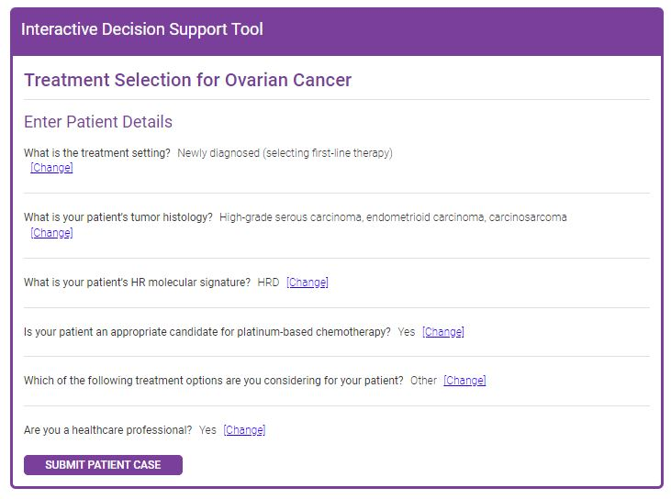


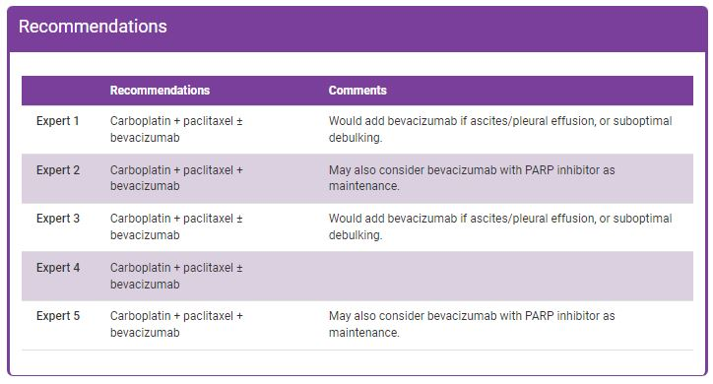
Interactive Decision Support Tools for
Advanced Gynecologic Cancers
Endometrial/
Ovarian Cancer Tool
Cervical Cancer
Tool
HCP enters patient characteristics
Recommendations from 5 experts
Tool available at: clinicaloptions.com/GYNCI2022tool or as an app in your app store

Slide 19
Black and White Women With Cervical Cancer
Receive Different Treatments
Overall Treatment Received
1.0
Impact of Brachytherapy Use
80
White
Black
Non-Black/no BT
Black/no BT
Non-Black/BT
Black/BT
*
0.8
60
*
0.6
*
Adjusted OS (Probability)
40
*
Patients (%)
0.4
20
0.2
*
0
0
2
4
6
8
10
12
0
Surgery
CT
CT and EBRT
EBRT
Without Brachytherapy
Brachytherapy
No Treatment
Follow-up (Yr)
*P <.01
Non-Black/no BT
Black/no BT
Non-Black/BT
Black/BT
12725
3042
12805
3027
6784
1458
8387
1977
3653
821
4644
1083
1897
396
2742
595
894
185
1210
314
324
63
484
104
60
9
65
17
Fleming. PLoS One. 2014;9:e104344.
Notes:
BT, brachytherapy; CT, chemotherapy; EBRT, external beam radiation therapy.

Slide 20
Uniformity of Treatment and Guideline-Concordant Care May Help Reduce Health Disparities in Cervical Cancer
Adjusted Likelihood of Receipt of Guideline-Adherent Care Based on Hospital Volume
Trends in Receipt of Guideline-Based Care by Race
65
70
Non-Hispanic White
Non-Hispanic Black
Hispanic
60
65
55
60
Patients Receiving
Guideline-Based Care (%)
55
50
Predicted Probability (%)
45
50
Non-Hispanic White
Non-Hispanic Black
Hispanic
45
40
40
35
P <.05
35
30
2004
2005
2006
2007
2008
2009
2010
2011
2012
30
Low-Volume Hospitals
Intermediate-Volume Hospitals
High-Volume Hospitals
Research indicates that when appropriate guideline-based care for cervical cancer is provided, a survival improvement is observed regardless of race, ethnicity, stage, and hospital volume
Uppal. Obstet Gynecol. 2017;129:295.

Slide 21
Black Patients With Cervical Cancer Who Receive Care Comparable With White Women Achieve Similar Survival Outcomes
Parameter | Overall | White | Black | P Value
Mean age, yr | 44.1 | 41.8 | 44.4 | NR
Histology, % Squamous Adenocarcinoma Adenosquamous | 75 12 6 | 74 13 6 | 78 10 7 | .58
Grade, % 1 2 3 | 13 48 39 | 16 45 39 | 12 49 39 | .58
Stage, % I II III IV | 72 15 11 4 | 71 14 12 3 | 73 16 10 1 | .56
100
White
Black
80
60
OS Probability (%)
P = .59
40
20
0
0
12
24
36
48
60
72
84
96
108
120
132
Mo
Farley. Cancer. 2001;91:869.
Notes:
NR, not reported; OS, overall survival.

Slide 22
Clinical Advances in the Management of Cervical Cancer

Slide 23
KEYNOTE-158 Phase II Basket Trial (Update):
Pembrolizumab Monotherapy in Advanced CC
FDA Approval June 2018
For patients with cervical cancer who are
PD-L1+ (CPS1 ≥1), MSI-H, or dMMR status
Adult patients with advanced squamous cell carcinoma that progressed on or intolerant to
≥ first-line standard therapy; ECOG PS 0/1; tumor sample for biomarker analysis
(N = 98)
Pembrolizumab 200 mg Q3W
For 2 yr or until unacceptable toxicity, progression, or withdrawal
Primary endpoint: ORR per RECIST v1.1 per BICR
  Overall ORR: 14% (PD-L1 positive: 17%;
  0% ORR in PD-L1 negative)
  Median PFS: 2.1 mo
  An updated analysis of cervical cancer cohort with median 36.9 mo of follow-up showed:
    Median OS: 9.3 mo
    No new safety signals
Chung. JCO. 2019;37:1470. Chung. SGO 2021. Abstr 41.
Notes:
CPS, combined positive score; dMMR, mismatch repair deficient; DCR, disease control rate; DoR, duration of response; ECOG, Eastern Cooperative Oncology Group; MSI-H: microsatellite instability–high; ORR, objective response rate; OS, overall survival; PFS, progression-free survival; PS, performance status; RECIST, Response Evaluation Criteria in Solid Tumors.

Slide 24
GARNET: Updated Efficacy Results
Multicenter, open-label, single-arm phase I study (N = 740)
Variable | Cohort F dMMR Basket (n = 106)
Median follow-up time, mo* | 16.7
Confirmed responses, n | 41
ORR,† % (95% CI) CR, n (%) PR, n (%) SD, n (%) PD, n (%) NE, n (%) | 38.7 (29.4-48.6) 8 (7.5) 33 (31.1) 26 (24.5) 32 (30.2) 7 (6.6)
DCR,‡ % (95% CI) | 63.2 (53.3-72.4)
Median DoR, mo (range) | NR (5.59-30.13+)
FDA Tumor-Agnostic Approval August 2021
Dostarlimab has FDA approval for adult patients with dMMR recurrent or advanced solid tumors
The ongoing phase II STAR trial is evaluating dostarlimab + niraparib in patients with recurrent or progressive cervical cancer; primary endpoint:
CR or PR by RECIST v1.1
(NCT04068753)
*Median follow-up time is a post hoc analysis of time since initial response; data cutoff date: March 1, 2020, with update on DoR and safety in November 2020.
†Responses required confirmation at a subsequent follow-up scan; SD had to be observed at ≥12 wk to qualify as SD. ‡Includes confirmed CR, PR, or SD at ≥12 wk.
Berton. ASCO 2021. Abstr 2564. NCT02715284.
Notes:
CR, complete response; DCR, disease control rate; dMMR, mismatch repair deficient; DoR, duration of response; NE, not evaluable; NR, not reached; ORR, objective response rate; PD, progressive disease; PFS, progression-free survival; PR, partial response; RECIST, Response Evaluation Criteria in Solid Tumors; SD, stable disease.

Slide 25
Pembrolizumab + CT ± Bevacizumab vs Placebo + CT ±
Bevacizumab in CC (KEYNOTE-826): Study Design
FDA Approval October 2021
Pembrolizumab in combination with chemotherapy, with or without bevacizumab, for patients with persistent, recurrent, or metastatic cervical cancer whose tumors express PD-L1 (CPS ≥1), as determined by an FDA-approved test.
International, randomized, double-blind phase III trial
Stratified by metastatic disease (yes vs no), PD-L1 CPS
(<1 vs 1 to <10 vs ≥10), planned bevacizumab (yes vs no)
Pembrolizumab* 200 mg IV Q3W +
CT † IV Q3W ±
Bevacizumab 15 mg/kg IV Q3W
Adults with persistent, recurrent, or metastatic cervical cancer; no prior systemic chemotherapy; ECOG PS 0-1
(N = 548)
Treatment until death, radiographic progression, unacceptable toxicity, or study completion
Placebo* IV Q3W +
CT† IV Q3W ±
Bevacizumab 15 mg/kg IV Q3W
*≤35 cycles pembrolizumab/placebo. †CT: ≤6 cycles: paclitaxel
175 mg/m² + (cisplatin 50 mg/m² or carboplatin AUC 5 mg/mL/min).
Dual primary endpoints: OS and PFS
Secondary endpoints: ORR, DoR, 12-mo PFS, safety
Exploratory endpoints: PROs assessed per EuroQol EQ-5D-5L VAS
Colombo. NEJM. 2021;385:1856. Pembrolizumab PI. Tewari. ASCO 2022. Abstr 5506.
Notes:
AUC, area under the curve; CPS, combined positive score; CT, chemotherapy; DoR, duration of response; ECOG, Eastern Cooperative Oncology Group; EuroQol EQ-5D-5L VAS, European Quality of Life 5-dimension, 5-level visual analogue scale; ORR, overall response rate; OS, overall survival; PFS, progression-free survival; PRO, patient-reported outcome; PS, performance status; RECIST, Response Evaluation Criteria in Solid Tumors.

Slide 26
KEYNOTE-826: Baseline Characteristics
Characteristic | Pembro* (n = 308) | Placebo* (n = 309)
Median age, yr (range) | 51 (25-82) | 50 (22-79)
ECOG PS 1, n (%) | 128 (41.6) | 139 (45.0)
PD-L1 CPS, n (%) <1 1 to <10 ≥10 | 35 (11.4) 115 (37.3) 158 (51.3) | 34 (11.0) 116 (37.5) 159 (51.5)
Prior therapy, n (%) CRT or RT with surgery CRT or RT only Surgery only None | 71 (23.1) 156 (50.6) 23 (7.5) 58 (18.8) | 79 (25.6) 142 (46.0) 24 (7.8) 64 (20.7)
Characteristic, n (%) | Pembro* (n = 308) | Placebo* (n = 309)
Stage at initial diagnosis† I II III IIIA IIIB IVA IVB | 67 (21.8) 85 (27.6) 5 (1.6) 4 (1.3) 46 (14.9) 7 (2.3) 94 (30.5) | 58 (18.8) 93 (30.1) 8 (2.6) 8 (2.6) 42 (13.6) 4 (1.3) 96 (31.1)
Disease status at entry Metastatic‡ Persistent/recurrent with distant metastases Persistent/recurrent without distant metastases | 58 (18.8) 199 (64.6) 51 (16.6) | 64 (20.7) 179 (57.9) 66 (21.4)
Bevacizumab use during study | 196 (63.6) | 193 (62.5)
Study population was ~60% non-Hispanic White and ~40% non-White
*Arm also included CT ± bevacizumab. †Per FIGO 2009/NCCN 2017 criteria. ‡Includes patients with para-aortic lymph node involvement.
These patients were diagnosed with stage IVB disease and entered the study with no prior treatment for cervical cancer.
Colombo. NEJM. 2021;385:1856.
Notes:
CT, chemotherapy; CPS, combined positive score; CRT, chemoradiotherapy; ECOG, Eastern Cooperative Oncology Group; Pembro, pembrolizumab; PS, performance status; RT, radiotherapy.

Slide 27
KEYNOTE-826: PFS and OS
PFS | Pembrolizumab* | Placebo | HR (95% CI) | P Value
ITT population, n Median, mo PD-L1 CPS ≥1,† n Median, mo PD-L1 CPS ≥10, n Median, mo | 308 10.4 273 10.4 158 10.4 | 309 8.2 275 8.2 158 8.1 | 0.96 (0.53-0.79) 0.62 (0.50-0.77) 0.58 (0.44-0.77) | .001 .001 .001
OS | Pembrolizumab* | Placebo | HR (95% CI) | P Value
ITT population, n 24 mo OS, % PD-L1 CPS ≥1,† n 24 mo OS, % PD-L1 CPS ≥10, n 24 mo OS, % | 308 50.4 273 53.0 158 54.4 | 309 40.4 275 41.7 158 44.6 | 0.67 (0.54-0.84) 0.64 (0.50-0.81) 0.61 (0.44-0.84) | .001 .001 .001
*Arm also included CT ± bevacizumab. †FDA approval.
Colombo. NEJM. 2021;385:1856.
Notes:
CPS, combined positive score; ITT, intention-to-treat; OS, overall survival; PFS, progression-free survival.

Slide 28
KEYNOTE-826: Final Analysis of OS
Outcome | PD-L1 CPS ≥1 |  | PD-L1 CPS ≥10 |  | All-Comers
Outcome | Pembro (n = 273) | Placebo (n = 275) | Pembro (n = 158) | Placebo (n = 159) | Pembro (n = 308) | Placebo (n = 309)
Median OS, mo | 28.6 | 16.5 | 29.6 | 17.4 | 26.4 | 16.8
 | HR: 0.60 (95% CI: 0.49-0.74)* |  | HR: 0.58 (95% CI: 0.44-0.78)* |  | HR: 0.63 (95% CI: 0.52-0.77)*
12-mo OS, % | 75.5 | 63.2 | 75.9 | 61.6 | 74.9 | 63.7
24-mo OS, % | 53.5 | 39.4 | 54.4 | 42.5 | 52.1 | 38.7
*Nominal P <.0001
Similar OS benefit with pembrolizumab regardless of concomitant bevacizumab
Monk. ASCO 2023. Abstr 5500.
Notes:
CPS, combined positive score; OS, overall survival; Pembro, pembrolizumab.

Slide 29
KEYNOTE-826: PFS/OS Across Protocol-Specified Subgroups
PFS
OS
No. of Events/ No. of Patients
HR for Disease Progression or Death (95% Cl)
No. of Events/ No. of Patients
Subgroup
Subgroup
HR for Death (95% Cl)
Overall
Age
<65 yr
≥65 yr
Overall
Age
<65 yr
≥65 yr
406/617
0.65 (0.53-0.79)
312/617
0.67 (0.54-0.84)
345/517
61/100
0.63 (0.50-0.78)
0.77 (0.42-1.42)
265/517
47/100
0.64 (0.50-0.82)
0.88 (0.47-1.64)
Race
White
Non-White
Race
White
Non-White
239/360
139/221
0.70 (0.53-0.91)
0.64 (0.45-0.90)
189/360
107/221
0.68 (0.50-0.91)
0.70 (0.47-1.04)
ECOG PS score
0
1
ECOG PS score
0
1
197/348
207/267
0.65 (0.48-0.87)
0.69 (0.52-0.93)
141/348
169/267
0.68 (0.49-0.96)
0.68 (0.50-0.94)
PD-L1 combined positive score
<1
1 to <10
≥10
PD-L1 combined positive score
<1
1 to <10
≥10
51/69
152/231
203/317
0.94 (0.52-1.70)
0.68 (0.49-0.94)
0.58 (0.44-0.77)
40/69
118/231
154/317
1.00 (0.53-1.89)
0.67 (0.46-0.97)
0.61 (0.44-0.84)
Concomitant bevacizumab
Yes
No
Concomitant bevacizumab
Yes
No
234/389
172/228
0.61 (0.47-0.79)
0.74 (0.54-1.01)
166/389
146/228
0.63 (0.47-0.87)
0.74 (0.53-1.04)
Metastatic disease at diagnosis
Yes
No
Metastatic disease at diagnosis
Yes
No
137/190
269/427
0.92 (0.64-1.30)
0.58 (0.45-0.75)
104/190
208/427
0.84 (0.56-1.26)
0.61 (0.46-0.80)
0.25
0.5
1.0
2.0
4.0
0.25
0.5
1.0
2.0
4.0
Pembrolizumab Better
Placebo Better
Pembrolizumab Better
Placebo Better
Colombo. NEJM. 2021;385:1856.
Notes:
ECOG, Eastern Cooperative Oncology Group; OS, overall survival; PFS, progression-free survival; PS, performance status.

Slide 30
innovaTV 204: International, Multicenter, Phase II Study of Tisotumab Vedotin in Recurrent/Metastatic CC
FDA Approval September 2021
Tisotumab vedotin is approved by the FDA for recurrent or metastatic cervical cancer with disease progression on or after chemotherapy
Recurrent or extrapelvic metastatic cervical cancer
progressed during or after doublet chemotherapy with bevacizumab (if eligible);
received ≤2 prior systemic regimens; ECOG PS 0/1
(N = 102*)
Tumor responses assessed using CT or MRI at baseline, every 6 wk for the first 30 wk, and
every 12 wk thereafter
Tisotumab vedotin
2.0 mg/kg IV Q3W
(n = 101)
Until PD or unacceptable toxicity
Confirmed Best Overall Response
Primary endpoint: ORR per RECIST v1.1 by IRC
Secondary endpoint: ORR per RECIST v1.1 by investigator,
DoR, TTR, PFS by IRC and investigator, OS, and safety
Exploratory endpoint: biomarker analysis and safety
Parameter | Tisotumab Vedotin (N = 101)
ORR, % (95% CI) | 24 (15.9-33.3)
Median DoR, mo (95% CI) | 8.3 (4.2- NR)
Race: 95% White
*Study sample size calculated assuming a confirmed ORR of 21% to 25% with tisotumab vedotin
and to provide ≥80% power to exclude an ORR of ≤11%.
Coleman. Lancet Oncol. 2021;22:609. NCT03438396.
Notes:
DoR, duration of response; ECOG, Eastern Cooperative Oncology Group; IRC, independent review committee; ORR, overall response rate; OS, overall survival; PD, progressive disease; PFS, progression-free survival; PS, performance status; RECIST, Response Evaluation Criteria in Solid Tumors; TTR; time to relapse.

Slide 31
Phase II innovaTV 204: Prespecified AEs of Interest
100
Ocular, Bleeding, and Peripheral Neuropathy TRAEs
N = 101
 | Ocular | Bleeding | Peripheral Neuropathy
Time to onset (median, mo) | 1.4 | 0.3 | 3.1
Events resolved, % | 86 | 90 | 21
Time to resolution (median, mo) | 0.7 | 0.5 | 0.6
Patients (%)
80
Grade 1
2
Grade 2
60
Grade 3
2
40
27
3
7
20
34
9
25
17
0
Ocular TRAEs
Bleeding TRAEs
Peripheral
Neuropathy TRAEs
Ocular AEs were mostly mild to moderate, resolved, and manageable with an eye care plan
Most bleeding events were grade 1 epistaxis (28%), and majority resolved
Most peripheral neuropathy events (known MMAE-related toxicity) were grade 1 and manageable with dose modifications;
resolution was limited by follow-up period
Patients should be seen by an eye care provider to examine their eyes before starting treatment,
prior to each dose, and as needed for any new or worsening signs and symptoms of ocular AEs
Coleman. Lancet Oncol. 2021;22:609. Tisotumab vedotin PI.
Notes:
AE, adverse event; MMAE, monomethyl auristatin E; SMQ, standardized MedDRA queries; TRAE, treatment-related adverse event.

Slide 32
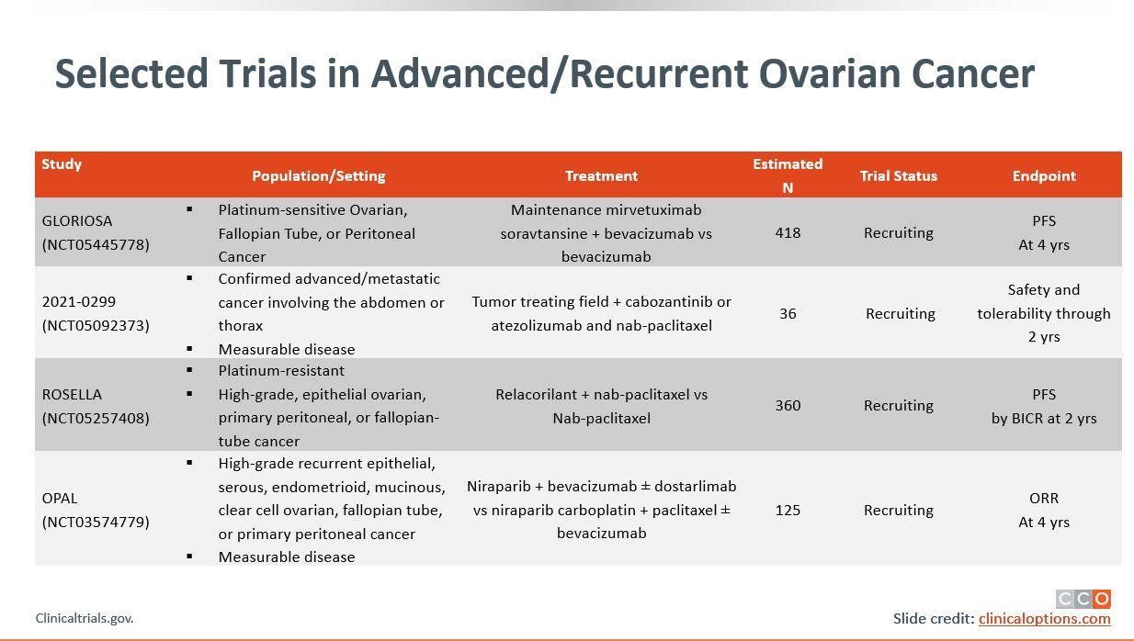
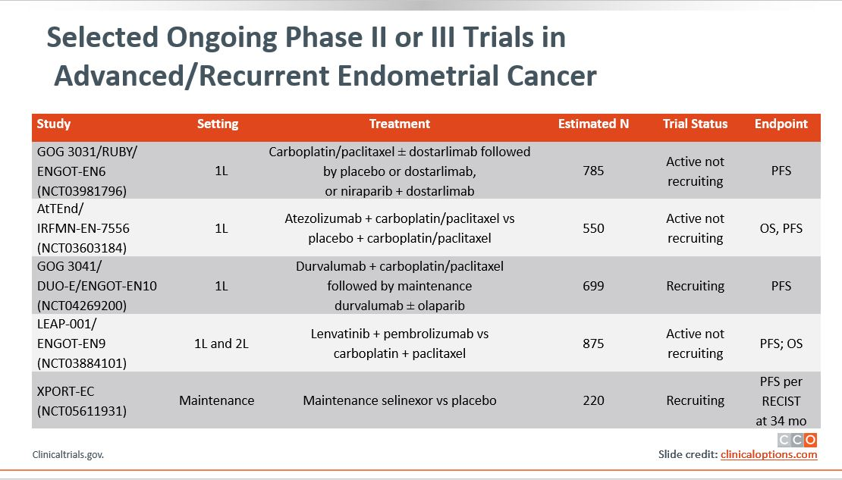
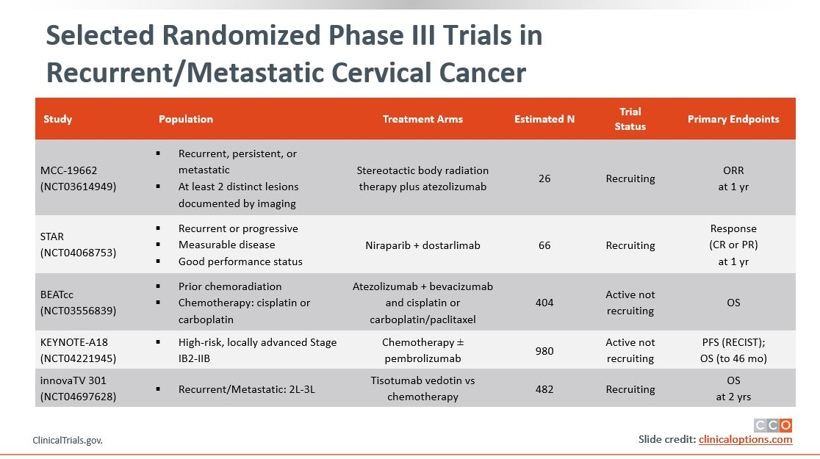
Addressing Potential Healthcare Disparities in
Clinical Trial Enrollment
To address potential disparities in care, discuss patients’:
  Satisfaction with treatment (AEs and symptom distress associated with poorer adherence)
  Satisfaction with HCP communication
    Feeling understood and respected by their HCPs
    Being involved in shared decision-making
    Building trust and confidence in their HCPs
    Understanding disease and treatment
  Resources, support system, and ability to get to and from the clinic for visits
  Provide help in navigating insurance claims and financial assistance programs for prescribed medications
Listen to and understand each patient’s goals to help develop manageable plans for achieving healthcare goals
Visit clinicaltrials.gov for available clinical trials near you
Pozzar. Gynecol Oncol. 2017;147:714. Patel. Gynecol Oncol. 2020;157:323.
Igwe. Gynecol Oncol. 2016;142:520. Nyakudarika. Cancer. 2021;127:3809.
Notes:
AE, adverse event; HCP, healthcare professional.

Slide 33



Navigating the Healthcare Ecosystem:
Addressing Potential Healthcare Disparities
Communication
Improving patient–provider communication
Acknowledging patient beliefs/values
Minimizing healthcare provider bias
Increasing representation of underrepresented providers of color (MD, NP, PA) to oncology workforce
Cost
Reducing treatment costs with manufacturer grants and assistance programs
Providing grants to cover transportation costs
and dependent care
Gaps in Outcomes Research
Increasing representation of underrepresented groups of patient in clinical trials
Evaluating genetic/molecular differences in tumor biology based on race
Oncology pharmacist, nurses and patient navigators are an integral part of oncology treatment and patient care
  Have a key role in empowering patients and their families to take charge of their health
  Can provide education, resources, and healthcare planning advice
Esnaola. ASCO 2021. Chatterjee. Front Oncol. 2016;6:36. J Onc Nav Surviv. 2019;10.

Slide 34
Take-home Messages—
Achieving Health Equity in Cervical Cancer
Low vaccination rate is a key contributor to higher incidence of cervical cancer in
Black and Hispanic patients vs White patients, and low adoption of brachytherapy in
Black patients is associated with lower survival vs White patients
  Providing targeted health education and leveraging community pharmacies improved vaccination rates
  Use of brachytherapy and novel agents (eg, immunotherapy, antibody‒drug conjugates)
  can improve outcomes for all patients with cervical cancer regardless of race/ethnicity
For Black patients, education and receipt of treatment at high-volume centers may result in improved outcomes, particularly education on the potential benefits of clinical trial participation
  Increased participation of Black patients in clinical trials of novel agents can inform data gaps

Slide 35
Go Online for More CCO
Coverage of Gynecologic Malignancies!
CME/CPE/CNE-certified on-demand webcast (coming soon!)
ClinicalThought commentaries and PDF resources for gynecologic cancers that may help increase awareness on health disparities and provide additional aid to your patients
On-demand CME/CPE/CNE-certified text modules for ovarian and endometrial cancer with healthcare professionals’ insight and commentary
clinicaloptions.com/oncology
clinicaloptions.com/GYNCI2022tool
clinicaloptions.com/immuneAETool
clinicaloptions.com/CervicalTool2022

