Slide 1

NRG1: An Emerging Tumor-Agnostic Target
Provided by Clinical Care Options, LLC
In partnership with the American Society of Clinical Pathology
Supported by an educational grant from Elevation Oncology, Inc.

Slide 2

About These Slides
Please feel free to use, update, and share some or all of these slides in your noncommercial presentations to colleagues or patients
When using our slides, please retain the source attribution:
These slides may not be published, posted online, or used in commercial presentations without permission. Please contact permissions@clinicaloptions.com for details
Slide credit: clinicaloptions.com
Notes:
Disclaimer: The materials published on the Clinical Care Options website reflect the views of the authors of the CCO material, not those of Clinical Care Options, LLC, the CME providers, or the companies providing educational grants. The materials may discuss uses and dosages for therapeutic products that have not been approved by the United States Food and Drug Administration. A qualified healthcare professional should be consulted before using any therapeutic product discussed. Readers should verify all information and data before treating patients or using any therapies described in these materials.

Slide 3
Faculty
Stephen V. Liu, MD
Associate Professor of Medicine Director, Thoracic Oncology Lombardi Comprehensive
Cancer Center
Georgetown University Washington, DC
Ryma Benayed, PhD
Associate Attending
Department of Pathology
Director, Clinical NGS Laboratory
Molecular Dx Service
Memorial Sloan Kettering
Cancer Center
New York, New York
Notes:
This slide lists the faculty who were involved in the production of these slides.

Slide 4
Faculty Disclosures
Stephen V. Liu, MD, has disclosed that he has received consulting fees from Amgen, AstraZeneca, BeiGene, Blueprint, Bristol-Myers Squibb, Daiichi Sankyo, Eisai, Elevation Oncology, Genentech/Roche, Gilead Sciences, Guardant Health, Janssen, Jazz, Lilly, Merck/MSD, Novartis, Regeneron, Takeda, and Turning Point Therapeutics and funds for research support (paid to his institution) from Alkermes, Bayer, Blueprint, Bristol-Myers Squibb, Elevation Oncology, Genentech, Lilly, Merck, Merus, Pfizer, Rain Therapeutics, RAPT, and Turning Point Therapeutics.
Ryma Benayed, PhD, has disclosed that she has received consulting fees from Hitachi, Loxo Oncology, and Roche Dx and fees for non-CME/CE services from Illumina.

Slide 5

NRG1 Physiology
Serves as a ligand for ErbB3 (HER3) or
ErbB4 (HER4)^{1,2}
Contains EGF-like domain necessary for
ErbB (HER) activation
NRG1 binding prompts heterodimerization³⁻⁵
  HER2 favored partner but EGFR possible
Downstream signaling cascades¹
NRG1
HER2
HER2
HER3
CD79a
P
P
P
P
P13K/AKT
(Cell proliferation/survival)
NRG1
IGc2
EGF
Neuregulin
1. Jones. Ann Oncol. 2017; 28:3092. 2. Jonna. Clin Cancer Res. 2019;25:4966.
3. Schram. ESMO 2019. Abstr 7145. 4. Schram. ESMO 2019. Abstr 685TiP. 5. Schram. J Thorac Oncol. 2021;16:S675.
Slide credit: clinicaloptions.com
Notes:
IGc2, immunoglobulin domain.

Slide 6
NRG1 Gene Fusions
Family of genomic events¹
Retain EGF-like domain of NRG1¹
Partner often provides a transmembrane region to tether the EGF-like domain to the cell surface in proximity to ErbB3/ErbB4^{1,2}
Partner
NRG1
CD74 – Exon 6
CD74 – Exon 8
SDC4 – Exon 2
SLC3A2 – Exon 5
TNC – Exon 10
MDK – Exon 4
TM
EGF
TM
EGF
EGF
TM
EGF
EGF-L
EGF
TM
EGF
1. Jonna. Clin Cancer Res. 2019;25:4966. 2. Liu. Lung Cancer. 2021;158:25.
Slide credit: clinicaloptions.com

Slide 7
NRG1 Pathophysiology
Physiology to pathophysiology^{1,2}
NRG1
NRG1
HER2
HER2
HER3
HER2
HER3
EGF-like domain
NRG1 fusion
P
P
P
P
P
P
P
P
P13K/AKT
(Cell proliferation/survival)
P13K/AKT
(Cell proliferation/survival)
1. Schram. ESMO 2019. Abstr 7145. 2. Schram. ESMO 2019. Abstr 685TiP.
Slide credit: clinicaloptions.com

Slide 8
NRG1 Fusion Signaling
Abnormal signaling due to NRG1 fusion¹
  Autocrine
  Juxtacrine
  Paracrine
NRG1 fusions display striking heterogeneity^{1,2}
  Multiple fusion partners
  (unclear significance)
  Different comutations
BCR
P
P
P
P
EGF life
SFK
BTK
PLCγ
CD19
CD79a
CD79b
HER3
HER2
EGF life
SFK
SFK
SYK
P
P
SYK
PI3K
P
P
P
PKCβ
IKKγ
NFAT activation
IKKβ
IKKα
P
P
NRG1
fusion
(juxtacrine)
NRG1
fusion
(paracrine)
NRG1
fusion
(autocrine)
P
P
AKT/mTOR activation
MAPK activation
MAPK and PI3K
pathways
NF-κB activation
1. Dimou. Clin Can Res. 2019;25:4865. 2. Jonna. Clin Cancer Res. 2019;25:4966.
Slide credit: clinicaloptions.com

Slide 9
NRG1 Fusions: Incidence Across Tumor Types
Retrospective analysis of specimens tested from 2015-2019¹
  RNA sequencing or whole transcriptome sequencing
Rare events overall¹⁻³
  Seen in 0.2% of cases
  Seen across multiple cancer types
    Enrichment in invasive mucinous
    lung adenocarcinoma (10%-30%)
    Cholangiocarcinoma, sarcoma,
    ovarian cancer, CRC, NSCLC,
    breast cancer
NRG1 Frequency Across Tumor Types (%)¹
0.0
0.1
0.2
0.3
0.4
0.5
0.6
GBC (3/580)
0.5
PDAC (3/623)
0.5
RCC (1/211)
0.5
Ovarian (3/686)
0.4
NSCLC (25/9592)
0.3
Breast (2/1106)
0.2
Sarcoma (1/627)
0.2
0.1
Overall Frequency:
41/21,858 (0.2%)
Other (1/937)
Bladder (1/945)
0.1
CRC (1/1690)
0.1
1. Jonna. Clin Cancer Res. 2019;25:4966. 2. Laskin. Ann Oncol. 2020;31:1693. 3. Drilon. Cancer Discov. 2018;8:686.
Slide credit: clinicaloptions.com
Notes:
CRC, colorectal cancer; GBC, gallbladder cancer; NSCLC, non-small-cell lung cancer; PDAC, pancreatic ductal adenocarcinoma; RCC, renal cell carcinoma.

Slide 10
NRG1 Fusions in Lung Cancer
NRG1
  Multiple fusion partners
  (unclear significance)¹
  Rarely occurs with other
  driver mutations^{1,2}
    TP53 comutations common
  Median TMB: 0.9 mutations/Mb (95% CI: 0.9-1.8)³
  PD-L1 expression in 28%
  (high expression ≥50% in 4%)³
PD-L1 Status in 110 NRG1 Fusion–Positive
Lung Cancer Samples³
24%
(n = 11/46)
42%
(n = 46/110)
58%
(n = 64/110)
72%
(n = 33/46)
4%
(n = 2/46)
PD-L1 expression unknown
PD-L1 expression known
0%
1% to 49%
≥50%
1. Jonna. Clin Cancer Res. 2019;25:4966. 2. Jonna. Targeted Therapies of Lung Cancer 2020. Abstract OA3. 3. Drilon. JCO. 2021; 39:2791.
Slide credit: clinicaloptions.com
Notes:
Mb, megabase; TMB, tumor mutation burden.

Slide 11
Overview of Gene Fusion Detection Approaches
Gene fusion is common in the
tested tumor type
Gene fusion event has low frequency in the tested tumor type
(NRG1 fusions)
RT-PCR¹
FISH²
IHC²
NGS: targeted DNA sequencing
Negative: Further confirmation usually needed
Positive: Identification of fusion partner gene is sometimes needed
3
No drivers detected
(mutations, CNVs, SNVs)
NGS: targeted RNA sequencing
NGS
Not ideal when fusion gene is known to have multiple partners.
Gene partner cannot be identified.
Rarely, equivocal NRG1 fusion events need confirmation by IHC.
Ryma Benayed, PhD. Personal communication.
Slide credit: clinicaloptions.com
Notes:
CNV, copy number variation; FISH, fluorescence in situ hybridization; IHC, immunohistochemistry; NGS, next-generation sequencing; RT-PCR, reverse transcriptase-polymerase chain reaction; SNV, single nucleotide variant.

Slide 12
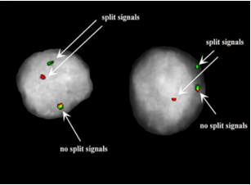
Detection of NRG1 Fusions by FISH Break-Apart Assay
NRG1
5’
3’
Advantages
  Have been used for many years
  Rapid turnaround time
Disadvantages
  Single gene detection at a time
  Identity of fusion partner remains unknown
Trombetta. Oncotarget. 2018;9:9661. Creative Commons Attribution License 3.0 (CC BY 3.0).
Slide credit: clinicaloptions.com
Notes:
FISH, fluorescence in situ hybridization.

Slide 13
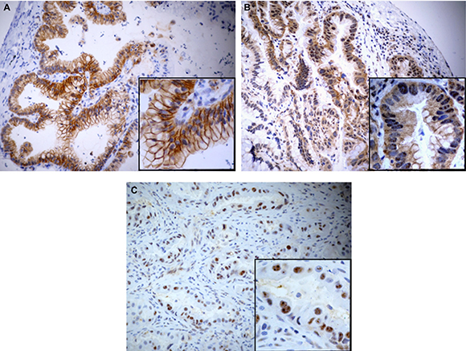
Detection of NRG1 Fusions by IHC
Requires use of phosphorylated
ErbB3 (pHER3) antibody
Advantages
  Widely used for many years
  Reported sensitivity: 100% and 97% among cohort of FFPE lung cancer samples
  Has high correlation with FISH results
Disadvantage
  Identity of fusion partner remains unknown
Trombetta. Oncotarget. 2018;9:9661. Creative Commons Attribution License 3.0 (CC BY 3.0).
Slide credit: clinicaloptions.com
Notes:
FFPE, formalin-fixed paraffin-embedded; FISH, fluorescence in situ hybridization; IHC, immunohistochemistry.

Slide 14


Next-Generation Sequencing for NRG1 Detection
Targeted DNA sequencing: hybridization capture–based NGS
Gene panels typically assay for 300-700 genes
Gene-specific
capture probes
Magnetic
streptavidin beads
DNA libraries are prepared
Hybridization of probes to gene targets
Gene enrichment: capture of targeted genes
Amplify and sequence
Slide credit: clinicaloptions.com
Notes:
NGS, next-generation sequencing.

Slide 15
Detection of NRG1 Fusions by DNA-Based NGS^{1,2}
Requires deep and uniform coverage of exons and introns for
gene fusion detection
Cancer gene exons:
All protein-coding exons of 505 genes
  Actionable mutations
  Targets of investigational agents
  Frequently mutated in cancer
  Cancer susceptibility genes
Cancer gene introns: for gene fusion detection
70 introns of 20 rearranged genes
Noncoding regions:
  TERT promoter
  Microsatellites
  >1000 common SNPs
Target territory = 1.52 Mb
Genes Known to Be Involved in Fusions
ALK | ETV6 | NAB2 | RELA
BRAF | EWSR1 | NTRK1 | RET
CD74 | FGFR2 | NTRK2 | ROS1
DNAJB1 | FGFR3 | NUT/C15orf55 | TFE3
EGFR | MET | PAX8 | TMPRSS2
CD74-NRG1 = fusion partner-gene
1. Drilon. Cancer Discov. 2018;8:686. 2. Chang. Clin Cancer Res. 2021;27:4066.
Slide credit: clinicaloptions.com
Notes:
Mb, megabase; NGS, next-generation sequencing; SNP, single nucleotide polymorphism.

Slide 16
DNA-Based NGS is Suboptimal for NRG1 Fusion Detection
DNASeq
RNASeq
Large introns
Excessive sequencing
Optimal
eg, NTRK3, NRG1
Repetitive introns
Cannot align reads
Optimal
eg, ROS1 intron 31
Low tumor
sample
Below sensitivity of assay
MAY overcome limitations of DNASeq if gene fusion is highly expressed in sample
Complex genomic events
Capture impossible
Optimal
MSKCC laboratory experience: Of >60,000 solid tumor cases by DNA sequencing,
only 0.04% were positive for NRG1 fusions
Davies. Clin Cancer Res. 2019;25:4586.
Slide credit: clinicaloptions.com
Notes:
MSKCC, Memorial Sloan Kettering Cancer Center; NGS, next-generation sequencing; Seq, sequencing.

Slide 17

Targeted RNA-Based NGS is Optimal for
NRG1 Fusion Detection: PCR-Based Technology
Gene | RefSeq Transcript | Targeted Exons | Primer Direction
NRG1 | NM_004495 | 1, 2, 3, 6 | 5’
NRG1 | NM_013957 | 4, 5, 8 | 5’
NRG1 | NM_013962 | 1 | 5’
NRG1 | NM_013959 | 1, 3 | 5’
NRG1 | NM_001159996 | 1, 3 | 5’
NRG1 | NM_013956 | 10, 8 | 5’
Gene panels: 50-200 genes
5’
3’
CD74
NRG1
Ryma Benayed, PhD. Personal communication.
Slide credit: clinicaloptions.com
Notes:
NGS, next-generation sequencing; PCR, polymerase chain reaction; RefSeq, Reference Sequence.

Slide 18
Comprehensive NRG1 Detection by
DNA-Based NGS vs RNA-Based NGS
Analysis of 2522 lung adenocarcinoma samples by DNA vs RNA NGS
  36/232 samples previously
  identified as driver negative by
  DNASeq were driver positive
  by RNASeq
Missed by DNASeq but Detected by RNASeq
CD74
Ex1-8
Ex6-12
NRG1
N = 2
SLC3A2
Ex1-5
Ex6-12
NRG1
Gene Fusion | n = 36
ROS1 | 10
MET exon 14 | 6
NRG1 | 5
Other/targetable | 5
ALK | 4
RET | 3
Other/nontargetable | 3
N = 2
SDC4
Ex1-2
Ex6-12
NRG1
N = 1
Summary
Only CD74 introns 4-6 are captured by DNASeq
NRG1 introns are not captured by DNASeq
In the DNA, most rearrangements involve the intron
Benayed. Clin Cancer Res. 2019;25:4712.
Slide credit: clinicaloptions.com
Notes:
Ex, exon; NGS, next-generation sequencing; Seq, sequencing.

Slide 19
Detection of NRG1 Fusions Across
Tumor Types (MSKCC Experience)
14
Samples, n | DNASeq | RNASeq
28 | Not detected | Detected
2 | Detected | Detected
4 | Not performed | Detected
12
10
8
Patients (n)
6
4
2
0
Lung Adenocarcinoma
Cancer of Unknown Primary
Pancreatic Adenocarcinoma
Endometrial
Stromal Sarcoma
Intrahepatic Cholangiocarcinoma
Breast Cancer
Sarcoma, NOS
Atypical Nevus
Gallbladder Cancer
Ryma Benayed, PhD. Personal communication.
Tumor Type
Slide credit: clinicaloptions.com
Notes:
MSKCC, Memorial Sloan Kettering Cancer Center; NOS, not otherwise specified; Seq, sequencing.

Slide 20
NRG1 Fusion Partners Across Different Tumor Types¹⁻⁴
Lung Adeno
CADM1
CD74
F11R
GALNT7
SLC3A2
SDC4
VAMP2
Breast Cancer
TNKS
FUT10
PLAT
PLCB3
DIP2C
DLGAP2
FRY
CUP, GBC, ESS, Cholangio, Atyp Nevus
STAU2
MTUS1
RBPMS
VTCN1
CPQ
Pancreatic Cancer
ATP1B1
CD44
NOTCH2
ROCK1
SLC4A4
Sarcoma
HMBOX1
PPHLN1
1. Chang. Clin Cancer Res. 2021;27:4066. 2. Drilon. Cancer Discov. 2018;8:686.
3. Jonna. Clin Cancer Res. 2019;25:4966. 4. Laskin. Ann Oncol. 2020;31:1693.
Slide credit: clinicaloptions.com
Notes:
Adeno, adenocarcinoma; atyp nevus, atypical nevus; cholangio, cholangiocarcinoma; CUP, carcinoma of unknown primary; GBC, gallbladder cancer; ESS, endometrial stromal sarcoma.

Slide 21
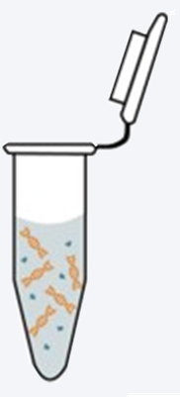

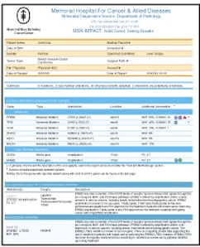
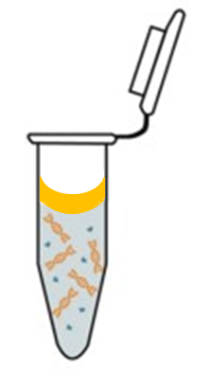
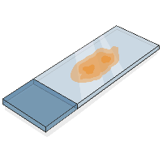
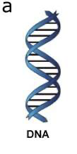


Optimizing Specimen Availability for
Comprehensive Gene Fusion Detection
Extraction
NGS
Clinical Decision
FFPE sample
DNA sequencing
Mineral oil
DNA protocol
Lysate
Actionable event identified
Targeted therapy or clinical trial
Residual lysate saved
If clinically indicated
RNA sequencing
RNA protocol
No driver identified
SoC or consider clinical trial
27,000 DNASeq cases (2018-2020)
4116 (15.2%) of these were reflexed to RNASeq
Ryma Benayed, PhD. Personal communication.
Slide credit: clinicaloptions.com
Notes:
FFPE; formalin-fixed paraffin-embedded; NGS, next-generation sequencing; Seq, sequencing; SoC, standard of care.

Slide 22
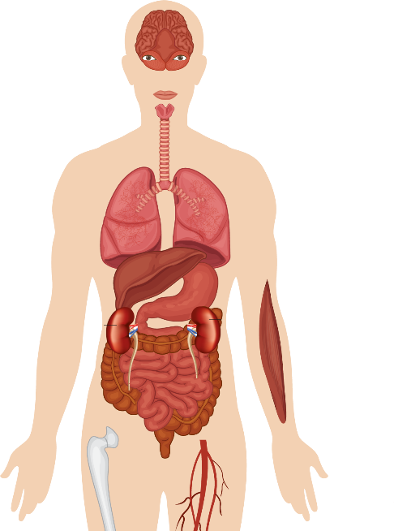

eNRGy1 Registry: NRG1 Fusion
Partners and Frequent Sites of Metastases
Brain 21%
Retina 2%
ATP1B1
CADM1
DIP2B
F11R
FLYWCH1
ITGB1
KRAS
MDK
MRPL13
PLCG2
RBPMS
TNC
VAMP2
VAPB
Sinus 2%
Unknown
(n = 18/110)
16%
Lung 71%
Mediastinum 2%
Lymph nodes 23%
Pleura 16%
Soft tissue 2%
CD74
(n = 45/110)
41%
Other
(n = 16/110)
15%
Liver 9%
Adrenal gland 9%
Kidney 5%
Peritoneum 2%
FGFR1
(n = 3/110)
3%
SLC3A2
(n = 22/110)
20%
Bone 34%
Muscle 2%
SDC4
(n = 6/110)
5%
Drilon. JCO. 2021;39:2791.
Slide credit: clinicaloptions.com

Slide 23
eNRGy1 Registry: Clinical Outcomes
Relatively poor outcomes with standard therapy
Response, n (%) | Plat-Doublet Chemo (n = 15) | Taxane-Based Chemo (n = 7) | Combined Chemo/Immunotx (n = 9) | Single-Agent Immunotx (n = 5) | Targeted Therapy With Afatinib (n = 20)
CR | 0 | 0 | 0 | 0 | 0
PR | 2 (13) | 1 (14) | 0 | 1 (20) | 5 (25)
SD | 7 (47) | 1 (14) | 4 (44) | 1 (20) | 3 (15)
PD | 6 (40) | 5 (71) | 5 (56) | 3 (60) | 12 (60)
ORR | 2 (13) | 1 (14) | 0 | 1 (20) | 5 (25)
Survival, Mo (95% CI) | Plat-Doublet Chemo | Taxane-Based Chemo | Combined Chemo/Immunotx | Single-Agent Immunotx | Targeted Therapy With Afatinib
Median PFS | 5.8 (2.2-9.8) | 4.0 (0.8-5.3) | 3.3 (1.4-6.3) | 3.6 (0.9-undefined) | 2.8 (1.9-4.3)
Drilon. JCO. 2021;39:2791.
Slide credit: clinicaloptions.com
Notes:
Chemo, chemotherapy; CR, complete response; immunotx, immunotherapy; ORR, objective response rate; PD, progressive disease; PFS, progression-free survival; plat, platinum; PR, partial response; SD, stable disease.

Slide 24
Therapies Targeting NRG1
No FDA-approved treatments
Several ongoing clinical trials^{1,2}
  Primarily tumor-agnostic designs
  Challenges
    Rare events
    RNA-based testing needed for identification
    Poor outcomes with standard therapy
1. Liu. Lung Cancer. 2021;158:25. 2. Schram. ASCO 2021. Abstr 3003.
Slide credit: clinicaloptions.com

Slide 25
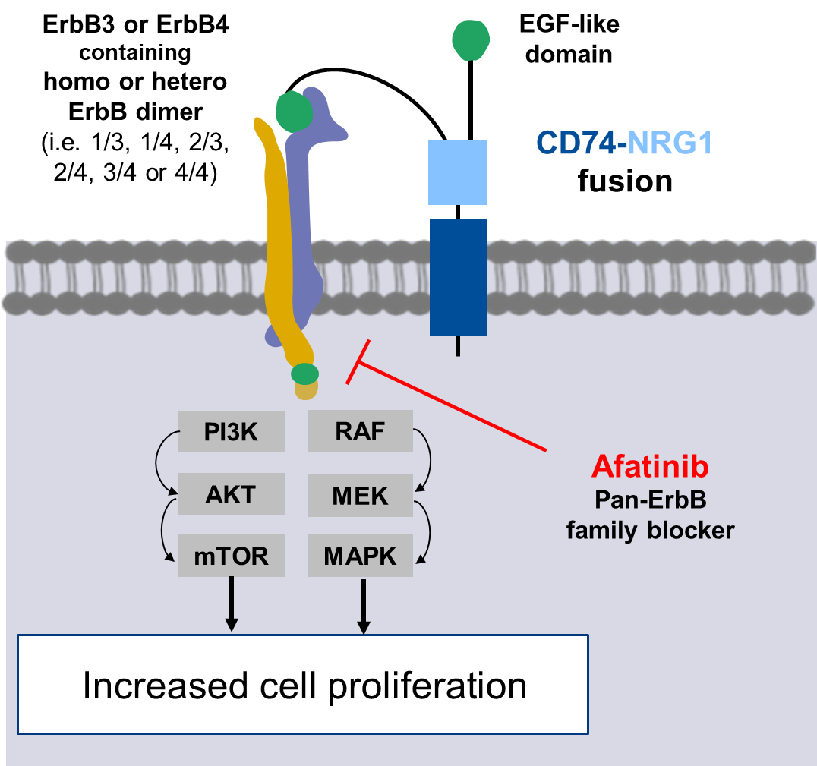
Afatinib for NRG1 Fusion–Driven Tumors
Irreversible pan-ErbB family inhibitor^{1,2}
  Multiple case reports and series showing response
  Some studies show durability
  Unclear denominator (reporting bias)
  Prospective ongoing study
  TAPUR substudy
    NCT02693535
Downstream Signaling of NRG1 and
Mechanism of Action of Afatinib²
ErbB3 or ErbB4
containing
homo or hetero
ErbB dimer
(ie, 1/3, 1/4, 2/3, 2/4,
3/4, or 4/4)
EGF-like domain
CD74-NRG1
fusion
PI3K
RAF
Afatinib
Pan-ErbB
family blocker
AKT
MEK
mTOR
MAPK
Increased cell proliferation
1. Cadranel. Oncologist. 2021;26:7. 2. Duruisseaux. WCLC 2019. Abstr P1.14-25.
Slide credit: clinicaloptions.com

Slide 26
Seribantumab: Preclinical Activity in an
Ovarian Cancer PDX Model With an NRG1 Fusion
HER3 monoclonal antibody
  Blocks ligand-dependent activation and phosphorylation of HER3
  Blocks heterodimerization
  Ongoing phase II CRESTONE trial (NCT04383210)
Mean Tumor Volume
Vehicle
Afatinib (5 mg/kg QD)
Seribantumab (1 mg BIW)
Seribantumab (2.5 mg BIW)
Treatment
No Treatment
2500
2000
Tumor Volume Change in PDX Models
1500
Tumor Volume (mm³)
Afatinib
Seribantumab
1000
750
5 mg/kg
QD
1 mg
BIW
2.5 mg
BIW
5 mg
BIW
10 mg
BIW
500
500
Vehicle
Afatinib (5 mg/kg QD)
Seribantumab (1 mg BIW)
Seribantumab (2.5 mg BIW)
Seribantumab (5 mg BIW)
Seribantumab (10 mg BIW)
250
0
Change in Tumor
Volume (%)
0
15
30
45
60
75
90
0
0
-50
Treatment Time (Days)
-100
Odintsov. Clin Cancer Res. 2021;27:3154.
Slide credit: clinicaloptions.com
Notes:
PDX, patient-derived xenograft.

Slide 27
CRESTONE: Ongoing Phase II Study of
Seribantumab in NRG1 Fusion–Positive Tumors
Open-label, multicenter phase II study
Primary endpoint: objective response rate
Cohort 1*
Received prior standard tx excluding ErbB-directed tx
(n ≥55)
Adults ≥18 yr with recurrent, locally advanced, or metastatic solid tumors that are
NRG1 fusion positive;
≥1 prior tx; ECOG PS 0-2; availability of fresh or archived tumor sample; no other known oncogenic driver mutation
(N = 75)
Cohort 2*
Received prior standard tx including ErbB-directed tx
(n ≤10)
Cohort 3*
Lacking EGF-like domain or insufficient tissue for central confirmation
and received prior standard tx ± ErbB-directed tx (n ≤10)
*Seribantumab IV infusions at various doses during the induction, consolidation, and maintenance dosing phases.
Odintsov. Clin Cancer Res. 2021;27:3154. NCT04383210.
Slide credit: clinicaloptions.com
Notes:
ECOG, Eastern Cooperative Oncology Group; PS, performance status; tx, therapy.

Slide 28
Zenocutuzumab (MCLA-128): Activity and
Safety in NRG1 Fusion–Driven Solid Tumors
Bispecific antibody targeting HER2 and HER3 with ADCC^{1,2}
  Blocks NRG1 from binding HER3
  January 2021: FDA fast track designation for NRG1-positive cancers
80
Efficacy of Zenocutuzumab in Ongoing Phase I/II Trial²
Confirmed ORR, % (n/N)
PD
All tumor types
PDAC
NSCLC
Other
29 (13/45)
42 (5/12)
25 (6/24)*
22 (2/9)
60
Safety²
Majority of AEs were grade 1-2
No severe GI/skin toxicity or clinical cardiotoxicity
40
PD
PD
PD
PD
20
PD
SD
UNK
SD
SD
SD
0
Best % Change
PD
-20
SD
SD
SD
SD
SD
Tumor Type
PDAC
NSCLC
Breast
CRC
CUP
SD
SD
PD
SD
SD
SD
SD
SD
SD
SD
-40
Cholangiocarcinoma
Pancreatic neuroendocrine carcinoma
RCC
Endometrial soft tissue sarcoma
SD
SD
SD
PR
PR
PR
PD
PR
PR
PR
PR
PR
-60
PR
PR
*SD
-80
PR
-100
PR
34/45 (76%) patients had tumor reduction
*1 additional PR confirmed after the cutoff date; NSCLC ORR 29% (7/24).
PR
1. Liu. Lung Cancer. 2021;158:25. 2. Schram. ASCO 2021. Abstr 3003.
Slide credit: clinicaloptions.com
Notes:
ADCC, antibody-dependent cellular cytotoxicity; AE, adverse event; CRC, colorectal cancer; CUP, carcinoma of unknown primary; GI, gastrointestinal; NSCLC, non-small-cell lung cancer; ORR, objective response rate; PDAC, pancreatic ductal adenocarcinoma; PR, partial response; RCC, renal cell carcinoma.

Slide 29
Ongoing Phase I/II Trial of Zenocutuzumab Monotherapy in NRG1 Fusion–Positive Solid Tumors
Open-label, multicenter, dose-escalation phase I/II study
Primary endpoint: ORR by INV
Secondary endpoints: DoR, ORR by central review, safety
Part 2 (Dose Expansion) at RP2D
Adults ≥18 yr with locally advanced unresectable or metastatic solid tumors harboring an NRG1 fusion; ECOG PS 0-1; previously treated with or unable to receive standard tx; able to provide a tumor biopsy sample
Patients With Pancreatic Cancer
Zenocutuzumab 750 mg IV Q2W until PD
Part 1
Dose escalation phase
Patients With NSCLC
Zenocutuzumab 750 mg IV Q2W until PD
Patients With Other Solid Tumors (Basket)
Zenocutuzumab 750 mg IV Q2W until PD
Schram. ASCO 2021. Abstr 3003. NCT02912949.
Slide credit: clinicaloptions.com
Notes:
DoR, duration of response; ECOG, Eastern Cooperative Oncology Group; INV, investigator; NSCLC, non-small-cell lung cancer; ORR, objective response rate; PD, progressive disease; PS, performance status; RP2D, recommended phase II dose; tx, therapy.

Slide 30
Emerging Research on the Role of
NRG1 Fusions in Solid Tumors: Conclusions
NRG1 fusions are rare but actionable events with an overall frequency
across tumor types of 0.2%
  Incidence in GBC, PDAC, and RCC of 0.5%
  Identified across tumor types including NSCLC, pancreatic cancer, breast cancer, colorectal cancer, cholangiocarcinoma, and sarcoma, among others
    Enrichment in invasive mucinous lung adenocarcinoma (10%-30%)
Targeted RNA-based NGS is recommended to optimally detect NRG1 fusions
Ongoing trials of afatinib, seribantumab, and zenocutuzumab are enrolling patients with NRG1 fusion–positive solid tumors
Slide credit: clinicaloptions.com
Notes:
GBC, gallbladder cancer; NGS, next-generation sequencing; NSCLC, non-small-cell lung cancer; PDAC, pancreatic ductal adenocarcinoma; RCC, renal cell carcinoma.

Slide 31
Go Online for More CCO
Coverage of NRG1 and Solid Tumors!
Text module associated with this downloadable slideset
ClinicalThought™ on NRG1 Oncogenic Gene Fusions Across Solid Tumors:
What You Should Know About Testing, an expert-authored commentary
clinicaloptions.com/oncology

