Slide 1
Enhancing Outcomes in Limited-Stage Small-Cell Lung Cancer With Recent Therapeutic Advancements
Provided by Clinical Care Options, LLC
Supported by educational grants from Boehringer Ingelheim Pharmaceuticals, Inc. and Jazz Pharmaceuticals, Inc.​

Slide 2

About These Slides
Please feel free to use and share some or all of these slides in your noncommercial presentations to colleagues or patients
When using our slides, please retain the source attribution:
These slides may not be published, posted online, or used in commercial presentations without permission. Please contact permissions@clinicaloptions.com for details
Slide credit: clinicaloptions.com
Notes:
Disclaimer: The materials published on the Clinical Care Options website reflect the views of the authors of the CCO material, not those of Clinical Care Options, LLC, the CME providers, or the companies providing educational grants. The materials may discuss uses and dosages for therapeutic products that have not been approved by the FDA. A qualified healthcare professional should be consulted before using any therapeutic product discussed. Readers should verify all information and data before treating patients or using any therapies described in these materials.

Slide 3
Faculty and Disclosures
Anne Chiang, MD, PhD, FASCO
Associate Professor of Medicine
Division of Thoracic Medical Oncology
Yale University School of Medicine
Associate Yale Cancer Center Director, Clinical Initiatives
New Haven, Connecticut
Anne Chiang, MD, PhD, FASCO: consultant/advisor/speaker: Amgen, AstraZeneca, Boehringer Ingelheim, Daiichi Sankyo, Fosun, Genentech, Janssen, Jazz, Zai Lab; researcher: Amgen, AstraZeneca, Genentech, Zai Lab.

Slide 4
Faculty and Disclosures
Carl M. Gay, MD, PhD
Associate Professor
Thoracic/Head & Neck Medical Oncology
The University of Texas MD Anderson Cancer Center
Houston, Texas
Carl M. Gay, MD, PhD: consultant/advisor/speaker: Abdera, Amgen, AstraZeneca, BeOne, BioNTech, Boehringer Ingelheim, Daiichi Sankyo, Jazz, Merck, OncoHost, Roche/Genentech.

Slide 5
Faculty and Disclosures
Daniel Morgensztern, MD
Professor of Medicine
Division of Medical Oncology
Washington University School of Medicine
St Louis, Missouri
Daniel Morgensztern, MD: consultant/advisor/speaker: AbbVie, Bayer, Bristol Myers Squibb, Johnson & Johnson/Janssen, Natera, Tubulis; researcher (paid to institution): AbbVie, AstraZeneca, Bristol Myers Squibb, Celgene, EpicentRx, Merck, Pfizer.

Slide 6
Faculty and Disclosures
Mark A. Socinski, MD
Executive Medical Director
AdventHealth Cancer Institute
Orlando, Florida
Mark A. Socinski, MD: consultant/advisor/speaker: AstraZeneca, BeiGene, Bristol Myers Squibb, Genentech, Guardant, Janssen, Jazz, Merck, Spectrum, Summit; researcher: AstraZeneca, BeiGene, Enliven, Spectrum.

Slide 7
Faculty and Disclosures
Ticiana Leal, MD
Professor
Department of Hematology & Oncology
Director, Thoracic Oncology
Medical Director, Clinical Trials Office
Winship Cancer Institute
Emory University
Atlanta, Georgia
Ticiana Leal, MD: consultant/advisor/speaker: AbbVie, Amgen, AstraZeneca, Boehringer Ingelheim, Catalyst, Genentech, Gilead, Jazz, Johnson & Johnson, Merck, Molecular Partners, Naterra, Novocure, Pfizer, Regeneron, Roche, Sanofi, Summit, Synthekine.

Slide 8
Learning Objectives
At the conclusion of this activity, learners should be able to:
Align SCLC clinical practice with updated practice guidelines for the treatment of limited-stage and extensive-stage disease
Integrate newer treatment strategies for limited- and extensive-stage SCLC into clinical practice, using best practices and an individualized approach
Mitigate and manage adverse events associated with newer targeted agents for relapsed/refractory SCLC
Notes:
This slide summarizes the target audience, goal, and learning objectives for this CME activity.

Slide 9
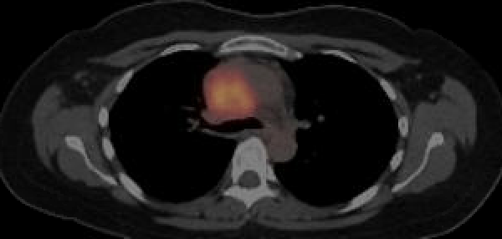
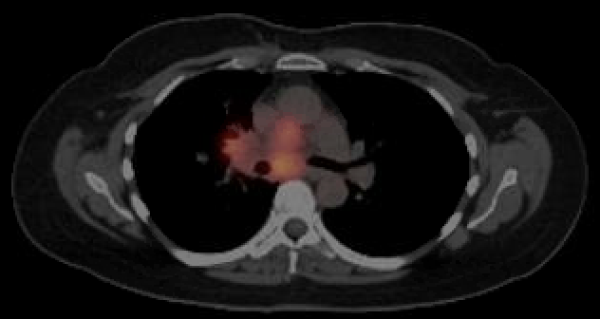
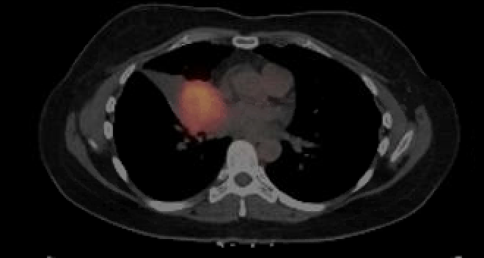
Patient Case: Key Features of AE Management in SCLC
A 50-yr-old female former smoker was diagnosed with stage IIIB SCLC in December 2022 after experiencing persistent symptoms following an initial diagnosis of COVID-19
PET/CT at diagnosis (December 2022):
Images provided courtesy of Dr Leal.

Slide 10
Patient Case: Initial Clinical Course
She underwent chemoradiation with cisplatin/etoposide but did not tolerate cisplatin due to worsening fatigue, neutropenia, and nausea/vomiting
  Completed chemotherapy with carboplatin in February 2023
Posttreatment PET/CT notable for a partial response, with decreased residual activity in all treated sites of disease in June 2023
Follow-up PET/CT in October 2023 showed progression with new sites of disease in the right supraclavicular lymph node, a right flank soft tissue mass, and stable right paratracheal, subcarinal, and right perihilar masses

Slide 11
Patient Case: Second-line Therapy Selection
Main symptoms included decreased appetite, weight loss, weakness, shortness of breath, and cough
After an informed decision-making discussion, the patient and her family elected to proceed with tarlatamab
Given her high symptom burden, high disease burden, and ECOG PS 2, inpatient tarlatamab administration with 24-hr monitoring was recommended

Slide 12
Patient Case: Inpatient Monitoring of CRS and ICANS With Tarlatamab
Following C1D1 tarlatamab 1 mg, overnight, she developed:
  Grade 1 CRS: fever with sinus tachycardia (HR: 130 beats/min), managed with acetaminophen and a 500-mL bolus NS with improvement
  Grade 2 ICANS with an ICE score of 4/10 (previously 10/10), given dexamethasone 10 mg every 6 hr per protocol
  ICE score improved to 9/10 the following morning, but she experienced 1 additional episode of fever and tachycardia, managed with acetaminophen, dexamethasone, and IV fluids
She was discharged within 48 hr, feeling improved and without fever, with her caregiver

Slide 13
Patient Case: Step-Up Dosing With Tarlatamab
The patient returned for C1D8 10 mg tarlatamab
  Overnight she developed grade 1 CRS with fever and was treated with acetaminophen and dexamethasone with improvement
  At midnight she had grade 1 ICANS with an ICE score of 9/10 that was normal (10/10) the following morning
She was discharged home within 24 hr, feeling improved and without fever

Slide 14
Patient Case: Outpatient Monitoring of CRS and ICANS
For C1D15 tarlatamab 10 mg, she was monitored in the outpatient urgent care setting with 6-hr monitoring
She reported a decrease in size of visible masses in her right leg, left neck, and right lower ribs, and a reduction in cough and shortness of breath with exertion since starting this therapy
She did well and was discharged with her caregiver after 6-hr monitoring
Follow-up
  After 2 cycles of tarlatamab, she demonstrated significant clinical benefit
  CT scans showed a significant improvement in her disease

Slide 15
DeLLphi-301: Safety of Tarlatamab in Patients With Previously Treated SCLC
Open-label phase II study in patients with ES-SCLC and 1 previous line of platinum-based CT and ≥1 other line of tx; median lines of tx: 2 (range: 1-8)
Most Common TRAEs
0 to 3 mo (n = 133)
3 to <12 mo (n = 78)
≥12 mo (n = 26)
Patients (%)
CRS
Pyrexia
Decreased Appetite
Dysgeusia
Fatigue
TRAEs led to dose interruption in 16% and discontinuation in 4% of patients
Tarlatamab demonstrated long-term tolerability, with no new safety concerns
Sands. WCLC. 2024. Abstr OA10.03.

Slide 16
DeLLphi-304: Tarlatamab Safety as 2L Therapy
Adverse Events, n (%) | Tarlatamab (n = 252) | Chemotherapy (n = 244)
CRS | 142 (56) | 3 (1)
Dysgeusia | 61 (24) | 4 (2)
Pyrexia | 69 (27) | 27 (11)
Decreased appetite | 89 (35) | 54 (22)
Hyponatremia | 43 (17) | 24 (10)
Headache | 38 (15) | 21 (9)
Constipation | 72 (29) | 54 (22)
Weight decrease | 31 (12) | 16 (7)
Vomiting | 35 (14) | 28 (11)
Dizziness | 24 (10) | 25 (10)
Cough | 31 (12) | 34 (14)
Fatigue | 72 (29) | 74 (30)
WBC count decrease | 24 (10) | 32 (13)
Adverse Events, n (%) | Tarlatamab (n = 252) | Chemotherapy (n = 244)
Asthenia | 28 (11) | 36 (15)
Pneumonia | 23 (9) | 32 (13)
Diarrhea | 28 (11) | 37 (15)
Dyspnea | 18 (7) | 28 (11)
Nausea | 61 (24) | 78 (32)
Neutrophil count decrease | 20 (8) | 42 (17)
Febrile neutropenia | 5 (2) | 28 (11)
Leukopenia | 24 (10) | 54 (22)
Platelet count decrease | 10 (4) | 44 (18)
Thrombocytopenia | 14 (6) | 62 (25)
Neutropenia | 27 (11) | 76 (31)
Anemia | 78 (31) | 156 (64)
Mountzios. NEJM. 2025;393:349.

Slide 17
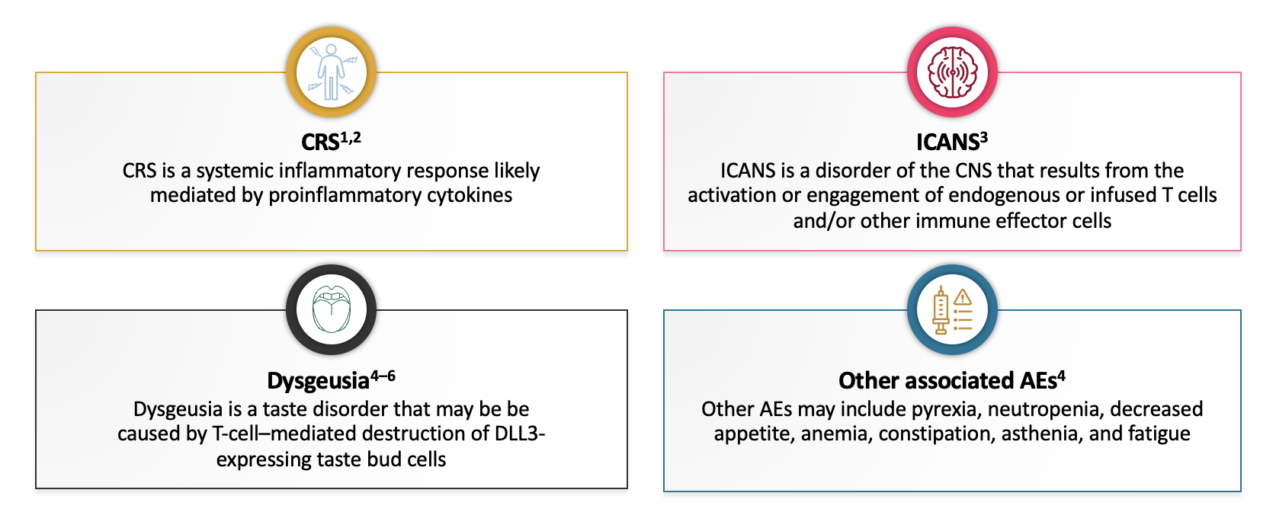




AEs Associated With Tarlatamab
CRS¹⁻³
A systemic inflammatory response likely mediated by proinflammatory cytokines
ICANS³
A CNS disorder resulting from the activation/engagement of endogenous/infused
T-cells and/or other immune effector cells
Dysgeusia⁴
A taste disorder that could be caused by T-cell–mediated destruction of DLL3-expressing taste bud cells
Other AEs⁴
May include neutropenia, pyrexia, decreased appetite, constipation, asthenia, anemia, and fatigue
1. Khadka. Immunotherapy. 2019;11:851. 2. Shimabukuro-Vornhagen. J Immunother Cancer. 2018;6:56.
3. Lee. Biol Blood Marrow Transplant. 2019;25:625. 4. Sands. Cancer. 2025;131:e35738.

Slide 18



Clinical Presentation of CRS
Fever is a defining and often initial symptom of CRS; fevers related to CRS can be high grade and last many days¹
Other clinical signs and symptoms include, but are not limited to, tachycardia, tachypnea, and headache, with potentially life-threatening complications such as cardiac dysfunction, acute respiratory distress syndrome, and renal/hepatic dysfunction^{2,3}
In severe CRS, a systemic inflammatory response may occur, presenting with symptoms such as hypotension, hypoxia, and/or organ dysfunction¹
CRS is largely confined to the first administration of tarlatamab during step-up dosing; the median time to CRS occurrence is typically 4-16 hr after infusion⁴
Fever
Hypoxia
Hypotension
1. Géraud. Eur J Cancer. 2024;205:114075. 2. Lee. Biol Blood Marrow Transplant. 2019;25:625.
3. Shimabukuro-Vornhagen. J Immunother Cancer. 2018;6:56. 4. Sands. Cancer. 2025;131:e35738.

Slide 19
CRS Grading Scale (2019)
CRS Parameter¹ | Grade 1 | Grade 2 | Grade 3 | Grade 4
Fever | ≥38°C | ≥38°C | ≥38°C | ≥38°C
With
Hypotension | None | Not requiring vasopressors | Requiring a vasopressor with/without vasopressin | Requiring multiple vasopressors (excluding vasopressin)
And/or
Hypoxia | None | Requiring low-flow nasal cannula or blow-by | Requiring high-flow nasal cannula, facemask, nonrebreather mask, or Venturi mask | Requiring positive pressure (eg, CPAP, BiPAP, intubation, mechanical ventilation)
CRS symptoms may be progressive; must include fever at onset and may include hypotension, capillary leak (hypoxia), and end-organ dysfunction
ASTCT grading scale aims to standardize definitions and provide a uniform consensus grading system²
1. Lee. Biol Blood Marrow Transplant. 2019;25:625. 2. Schubert. Ann Oncol. 2021;32:34.

Slide 20
Key Points for Managing CRS Associated With Tarlatamab
Key points for prevention | Step-up tarlatamab dosing: C1D1: 1 mg with 24 hr monitoring, C1D8: 10 mg with 24 hr monitoring, C1D15: 10 mg with 6-8 hr monitoring; then C2+ D1, D15: 10 mg with 2-8 hr monitoring Prophylaxis: Dexamethasone 8 mg IV on D1, D8; 1L IV fluid on D1, D8, D15
 | Grade 1 | Grade 2 | Grade 3 | Grade 4
Key points for management | Infection workup; Symptom management with paracetamol/ acetaminophen; IV fluids | Recommend hospitalization Grade 1 strategies PLUS supplemental O₂ if needed Consider: dexamethasone 8 mg/kg IV; tocilizumab 8 mg/kg IV | ICU Grade 2 strategies PLUS supplemental O₂; vasopressor support; dexamethasone 8 mg/kg IV and/or tocilizumab 8 mg/kg IV | ICU Grade 3 strategies PLUS supplemental O₂ (positive pressure); multiple vasopressors; dexamethasone; tocilizumab; support for organ failure (ventilation)
 |  | At the next planned dose, administer prophylaxis and monitor patients for 22-24 hr in an appropriate healthcare setting (discontinue for recurrent grade 3) |  | Permanently discontinue tarlatamab
Tarlatamab PI. Sands. Cancer. 2025;131:e35738. Géraud. Eur J Cancer. 2024;205:114075.

Slide 21
DeLLphi-301: CRS Management
Management considerations per protocol
  Supportive care such as acetaminophen, IV hydration, and/or glucocorticoids
Intervention Used for CRS, n (%) | Patients with ≥1 CRS Event (n = 70)
Tocilizumab | 8 (11.4)
Vasopressor (excluding vasopressin) | 1 (1.4)
IV fluids | 9 (12.9)
Low-flow (≤6 L/min) supplemental oxygen | 10 (14.3)
High-flow (>6 L/min) supplemental oxygen | 1 (1.4)
CRS was generally managed with supportive care; additional interventions were infrequently utilized
Sands. Cancer. 2025;131:e35738.

Slide 22





ICANS: Symptoms and Timing
ICANS may occur more commonly after CRS but can also overlap with CRS^{1,2}
ICANS symptoms are highly variable¹
Early symptoms may include mild lethargy, dysgraphia, aphasia, impaired attention, confusion, apraxia, and tremors and may progress to altered consciousness, seizures, and cerebral edema^{1,2}
Symptoms develop a median of 5 days after final dose of tarlatamab, with a median time to resolution of 6.5 days³
Confusion
Impaired attention
Tremor
Motor findings
Weakness
1. Lee. Biol Blood Marrow Transplant. 2019;25:625. 2. Maus. J Immunother Cancer. 2020;8:e001511. 3. Ahn. NEJM. 2023;389:2063.

Slide 23
Immune Effector Cell Encephalopathy (ICE) Score
Parameter | Task Example | Score
Orientation | Orientation to yr, mo, city, hospital | 4 points
Naming | Ability to name 3 objects (eg, point to a clock, pen, button) | 3 points
Following commands | Ability to follow simple commands (eg, ‘close your eyes and stick out your tongue’ or ‘show me 2 fingers’) | 1 point
Writing | Ability to write a standard sentence (eg, ‘our national bird is the bald eagle’) | 1 point
Attention | Ability to count backwards from 100 by 10 | 1 point
Lee. Biol Blood Marrow Transplant. 2019;25:625.

Slide 24
ICANS Grading Scale (2019)
Neurotoxicity Domain | Grade 1 | Grade 2 | Grade 3 | Grade 4
ICE score | 7-9 | 3-6 | 0-2 | 0 (patient is unarousable and unable to perform the tests for grading ICE)
Depressed level of consciousness | Awakens spontaneously | Awakens to voice | Awakens only to tactile stimulus | Patient is unarousable or requires vigorous or repetitive tactile stimuli to arouse; Stupor or coma
Seizure | N/A | N/A | Any clinical seizure, focal or generalized, that resolves rapidly or nonconvulsive seizures on EEG that resolve with intervention | Life-threatening prolonged seizure (>5 min) or repetitive clinical or electrical seizures without return to baseline in between
Motor weakness | N/A | N/A | N/A | Deep focal motor weakness, such as hemiparesis or paraparesis
Elevated ICP/cerebral edema | N/A | N/A | Focal/local edema on neuroimaging | Diffuse cerebral edema on neuroimaging; decerebrate or decorticate posturing; cranial nerve VI palsy; papilledema; or Cushing's triad
Key points for management: screen for alternative causes of confusion, high-dose corticosteroids, nonsedative anticonvulsant, ICU management for grade 3-4 ICANS
Lee. Biol Blood Marrow Transplant. 2019;25:625.

Slide 25





Investigator-Suggested Management of CRS and ICANS
 | Investigator-Suggested Considerations
Facilities and staff | Infusion in specialized centers with capacity for inpatient care Rapid access to a dedicated intermediate/ICU bed during the period when the patient is at highest risk of developing CRS (typically first 2 doses of tarlatamab) Adequate staff numbers for postinfusion monitoring of vital signs
Education | Educate patients on recognition of CRS and ICANS symptoms Educate HCPs (physicians, nurses, staff at local emergency centers and ICUs) on T‐cell engager–specific AE recognition and management Educate patients and caregivers on keeping a diary that provides a descriptive record of symptoms and AE timing/duration
Protocol | Develop an institution‐ and drug‐specific management protocol that can be readily accessed by all HCPs involved in patient care Develop protocol for adapting pre- and postmedication doses/monitoring based on each patient’s history of AEs
Medication | In addition to protocol‐mandated premedication, ready access to ≥2 doses of tocilizumab to treat grade ≥2 CRS quickly, if needed
Other considerations | Start infusion as early in the morning as possible to allow for longer patient monitoring by day shift staff Develop a detailed handover protocol for night shift staff Coordinate with pharmacy for optimal drug delivery Develop refined toxicity management protocols to define parameters for the outpatient setting similar to those used with CAR T-cell therapies Provide patients with key contact information
Sands. Cancer. 2025;131:e35738.

Slide 26
Implementation of Tarlatamab for SCLC Using an Outpatient Care Program
Inpatient admission
N = 48
Multidisciplinary partnership
Developed guidance protocol
Provided training and education on guideline-directed management of CRS and ICANS
Rollout occurred sequentially from the main site to satellite sites
Collaborated with community doctors and referred back to community after cycle 3
Educated patients and caregivers
Patients receive tarlatamab in outpatient infusion center
Preplanned:
10
Direct admission from ICC:
13
Admitted from home
24-hr observation in outpatient oncology immediate care center (ICC) on site
CRS: 5
CRS: 2
ICANS: 4
Infection: 5
Dexamethasone to be taken prior to return to healthcare facility for later-onset symptoms
Both: 3
Other: 1
Grade | CRS, n | ICANS, n
1 | 12 | 9
2 | 9 | 8
3 | 3 | 5
4 | 0 | 0
Carlisle. ASCO 2025. Abstr 8106.

Slide 27
Lurbinectedin for ES-SCLC
Synthetic, marine-derived tetrahydroisoquinoline alkaloid
Selective inhibitor of oncogenic transcription
Currently FDA approved for:
  First-line maintenance in combination with IV atezolizumab or SQ atezolizumab and hyaluronidase after induction chemo-IO (October 2025)
  Metastatic SCLC with progression on or after platinum-based therapy
Tumor cells
Inhibition of cell migration
CCL2
Apoptosis
Lurbinectedin
Monocyte
TAM
CCL2
CXCL8
VEGF
Reduced
cancer-related inflammation
Patel. Ther Adv Med Oncol. 2021;13:17588359211020529. Belgiovine. Br J Cancer. 2017;117:628.
Santamaría Nuñez. Mol Cancer Ther. 2016;15:2399. NCT02454972. Trigo. Lancet Oncol. 2020;21:645.

Slide 28
Phase II Study of 2L Lurbinectedin in ES-SCLC: Safety
Single-arm, open-label, phase II basket trial (Study B-005) in patients with ES-SCLC after 1 prior CT-based regimen
Laboratory Abnormality* | Patients (N = 105)
 | Grade 1/2 | Grade 3 | Grade 4
Hematologic, n (%) Anemia Leukopenia Neutropenia Thrombocytopenia | 91 (87) 53 (50) 27 (26) 39 (37) | 9 (9) 20 (19) 22 (21) 3 (3) | 0 10 (10) 26 (25) 4 (4)
Biochemical, n/N (%) Creatinine ALT γ-glutamyl transferase AST Alkaline phosphatase | 86/104 (83) 69/103 (67) 52/103 (50) 44/103 (43) 31/103 (30) | 0 5/103 (5) 13/103 (13) 2/103 (2) 3/103 (3) | 0 0 2/103 (2) 0 0
TRAE, n (%) | Patients (N = 105)
 | Grade 1/2 | Grade 3 | Grade 4
Fatigue | 54 (51) | 7 (7) | 0
Nausea | 34 (32) | 0 | 0
Decreased appetite | 22 (21) | 0 | 0
Vomiting | 19 (18) | 0 | 0
Diarrhea | 13 (14) | 1 (1) | 0
Febrile neutropenia | 0 | 2 (2) | 3 (3)
Pneumonia | 0 | 2 (2) | 0
Skin ulcer | 0 | 1 (1) | 0
*Regardless of relation to study drug.
Trigo. Lancet Oncol. 2020;21:645.

Slide 29
IMforte: Safety During Tarlatamab + Atezo Maintenance
Open-label, randomized phase III study in adults with no prior systemic tx for ES-SCLC
Grade 3/4 Adverse Event, n (%) | Lurbinectedin Plus Atezolizumab (n = 242) | Atezolizumab (n = 240)
Anemia | 20 (8) | 2 (1)
Decreased neutrophil count | 18 (7) | 0
Decreased platelet count | 17 (7) | 0
Neutropenia | 11 (5) | 1 (<1)
Thrombocytopenia | 11 (5) | 1 (<1)
Fatigue | 8 (3) | 3 (1)
Nausea | 6 (2) | 2 (1)
Increased alanine transaminase | 6 (2) | 1 (<1)
Dyspnea | 5 (2) | 4 (2)
Pneumonia | 5 (2) | 4 (2)
Hypokalemia | 5 (2) | 3 (1)
Decreased white blood cell count | 5 (2) | 0
Hyponatremia | 3 (1) | 5 (2)
Paz Ares. Lancet. 2025;405:2129.

Slide 30
Practical Considerations on Dosing Lurbinectedin
Currently FDA approved for¹:
  First-line maintenance in combination with atezolizumab after induction atezolizumab-chemo
  Metastatic SCLC with progression on or after platinum-based therapy
Dosing schedules approved for lurbinectedin:
  3.2 mg/m² Q3W IV (4 mg lyophilized powder in a single-dose vial)¹⁻³
  For moderate hepatic impairment: 1.6 mg/m² Q3W IV (avoid for severe hepatic impairment)
Lurbinectedin Dosing¹⁻³
Dosing Schedule in Study B-005 and IMForte
Lurbinectedin: 3.2 mg/m² Q3W IV infusion over 60 min
Dosing Considerations
G-CSF prophylaxis to reduce the risk of febrile neutropenia during treatment in combination with atezolizumab
Consider premedication with corticosteroids and serotonin antagonists
Advise patient to contact their HCP for any new comedication
1. Lurbinectedin PI. 2. Trigo. Lancet Oncol. 2020;21:645. 3. Paz Ares. Lancet. 2025;405:2129.

Slide 31
Lurbinectedin Dosage Modifications for AEs
Adverse Reaction | Severity | Dosage Modification
Neutropenia | Grade 4 or Any-grade febrile neutropenia | Withhold until grade ≤1 Resume at reduced dose
Thrombocytopenia | Grade 3 with bleeding or Grade 4 | Withhold until platelet ≥100,000/mm³ Resume at reduced dose
Hepatotoxicity | Grade 2 Grade ≥3 | Withhold until grade ≤1 Resume at same dose Withhold until grade ≤1 Resume at reduced dose or discontinue
Rhabdomyolysis | Grade 2 Grade ≥3 | Withhold until grade ≤1 Resume at same dose Discontinue
Other adverse reactions | Grade 2 Grade ≥3 | Withhold until grade ≤1 Resume at same dose Withhold until grade ≤1 Resume at reduced dose or discontinue
Lurbinectedin PI.

Slide 32
Practical Considerations on
Dosing Atezolizumab
Atezolizumab Dosing¹
Dosing schedule in IMpower133
Induction: 4 x 21-day cycles of atezolizumab + carboplatin/etoposide Atezolizumab 1200 mg IV over 60 min (first infusion only)* on Day 1 Carboplatin at target AUC of 5 mg/mL/min (Calvert formula dosing) by IV over 30-60 min on Day 1 Etoposide at 100 mg/m² IV over 60 min on Days 1-3
Maintenance: atezolizumab 1200 mg IV on Day 1 of 21-day cycles until unacceptable toxicity or PD
Dosing Considerations
Dose atezolizumab→ carboplatin → etoposide
Administer antiemetics for carboplatin and standard premedication for etoposide per local guidelines
Minimize premedication with corticosteroids
May premedicate with antihistamines if patient experienced an IRR during any prior infusion
Carboplatin/etoposide infusion times can be adapted per local guidelines
In 2019, FDA approved atezolizumab + carboplatin and etoposide for 1L treatment of adults with ES-SCLC.¹
3 different dosing schedules approved:¹
  840 mg Q2W
  1200 mg Q3W
  1680 mg Q4W
Only atezolizumab 1200 mg Q3W studied in IMpower133²
  Category 1 recommendation.¹
* If first infusion tolerated well, shorten to 30 mins for subsequent infusions.
1. Atezolizumab Pl. 2. J Clin. 2021;39(1):86-91. 3. NCCN. Clinical practice guidelines in oncology. Small cell lung cancer. v.3.2021. nccn.org.

Slide 33
Practical Considerations on
Dosing Durvalumab
Durvalumab Dosing²
Dosing Schedule in CASPIAN
Induction: 4 x 21-day cycles of durvalumab + platinum/etoposide* Durvalumab 1500 mg IV over 60 min† on Day 1 Platinum: Carboplatin at AUC of 5-6 mg/mL/min IV over 60 min on Day 1 or Cisplatin 75-80 mg/m² IV over 60 min on Day 1 Etoposide at 80-100 mg/m² IV over 60 min on Days 1-3
Maintenance: Durvalumab 1500 mg IV Q4W until unacceptable toxicity or PD
Dosing Considerations
Dose durvalumab → platinum → etoposide
May premedicate with corticosteroids if required for chemotherapy
In 2020, FDA approved durvalumab + etoposide and either carboplatin or cisplatin for 1L treatment of adults with ES-SCLC¹
Approved dosing schedules for durvalumab¹:
  Weight ≥30 kg: 1500 mg Q3W + CT
  x 4 cycles then 1500 mg Q4W as single agent
  Weight <30 kg: 20 mg/kg Q3W + CT
  x 4 cycles then 10 mg/kg Q2W as single agent
*May receive 2 additional cycles of platinum/etoposide if clinically indicated. †If first infusion is well tolerated, shorten to 30 min for subsequent infusions.
1. Durvalumab PI. 2. Paz-Ares. ESMO Open. 2022;7:100408.

Slide 34
Cross-Trial Comparison: Immune-Related AEs
Immune-Related AE, n (%) | IMpower133¹ |  | CASPIAN²
 | Atezo + EP (n = 198) | Placebo + EP (n = 196) | Durva + EP (n = 265)* | EP (n = 266)
Any | 82 (41.4) | 48 (24.5) | 53 (20) | 7 (3)
Hypothyroid events | 25 (12.6) | 1 (0.5) | 24 (9) | 2 (1)
Hyperthyroid events | 11 (5.6) | 5 (2.6) | 14 (5) | 0
Diarrhea/colitis | 3 (1.5) | 0 | 5 (2) | 1 (<1)
Dermatitis/rash | 40 (20.2) | 21 (10.7) | 5 (2) | 2 (1)
Hepatic events | 15 (7.6) | 9 (4.6) | 7 (3) | 0
Pneumonitis | 5 (2.5) | 5 (2.6) | 7 (3) | 2 (1)
Adrenal insufficiency | 0 | 3 (1.5) | 2 (1) | 0
Thyroiditis | NR | NR | 4 (2) | 0
Type 1 diabetes | NR | NR | 4 (2) | 0
Hypophysitis | NR | NR | 0 | 0
Pancreatic events | NR | NR | 1 (<1) | 0
Myocarditis | NR | NR | 0 | 0
Other rare/miscellaneous | NR | NR | 0 | 0
IRR | 11 (5.6) | 10 (5.1) | NR | NR
*Grade 5 irAEs in 2 patients receiving durva + EP (1 each of hepatotoxicity and interstitial lung disease) and 1 patient receiving EP (pneumonitis).
1. Liu. JCO. 2021;39:619. 2. Goldman. Lancet Oncol. 2021;22:51.

Slide 35
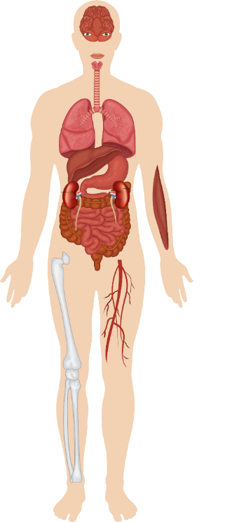
Immune-Related AEs in SCLC
Ocular
Endocrine
irAE surveillance and management is the same as for other malignancies
When IO combined with CT, safety profile for each is unchanged
  Toxicities are additive, not synergistic
Neurologic paraneoplastic syndromes considered immune mediated and often a “no go” for IO
Manage in consultation with pulmonary, GI, cardiology, nephrology, neurology, rheumatology, dermatology, others
Respiratory
Liver
Renal
Cardiovascular
Skin
Gastrointestinal
Blood
Neurologic
Musculoskeletal
Champiat. Ann Oncol. 2016;27:559. Graus. Nat Rev Clin Oncol. 2019;16:535.

Slide 36
Management of Immune-Related AEs
Mild to Moderate AEs
Severe AEs
Supportive Care*
Provide symptomatic management
If needed, delay immunotherapy until irAE is resolved to grade ≤1
If irAE does not improve,
give corticosteroids
If irAE is endocrine related,
give hormone therapy
Discontinue immunotherapy
Immediately initiate corticosteroid therapy
  eg, IV methylprednisolone
If irAE does not improve, additional immunosuppressant therapy may be needed
  eg, anti-TNF therapy
Provide inpatient and/or supportive care as needed
Monitor blood glucose levels
Give proton pump inhibitors or H2 blockers to prevent gastritis
Antimicrobial and antifungal prophylaxis
Vitamin D and calcium supplementation to prevent osteoporosis
*For long-term, high-dose steroid therapy.
Key aspects of safety during treatment with immunotherapy include early recognition, patient education, and multidisciplinary management
Refer to NCCN Guidelines® for Management of Immunotherapy-Related Toxicities
Brahmer. JCO. 2018;36:1714. NCCN. Clinical practice guidelines in oncology: Management of immunotherapy-related toxicities. v1.2025. nccn.org.

Slide 37
Take-home Messages
Tarlatamab has a manageable safety profile, with a low discontinuation rate due to treatment-related AEs (4%)¹
  CRS and ICANS primarily grade 1 or 2
  CRS occurred primarily after first or second dose of tarlatamab and was managed mostly with supportive care that included antipyretics, IV hydration, and/or glucocorticoids
  ICANS occurred mostly in cycle 1 or 2, and management strategies included supportive care (grade 1) and steroids (grade 2)
Lurbinectedin has a favorable safety profile; requires monitoring and dose adjustments as needed²
Key aspects of safety during treatment with immunotherapy include early recognition, patient education, and multidisciplinary management
1. Sands. WCLC. 2024. Abstr OA10.03. 2. Trigo. Lancet Oncol. 2020;21:645.

Slide 38
Go Online for More CCO
Coverage of SCLC!
Additional CME-Certified Medical Minutes on SCLC
Interactive Decision-Support Tool on SCLC coming soon!
clinicaloptions.com

