Slide 1
Identifying Patients Likely to Benefit From Bridging Therapy Before CAR T-Cell Infusion in R/R MM
Provided by Clinical Care Options, LLC dba Decera Clinical Education
Supported by an educational grant from Johnson & Johnson.

Slide 2
Faculty and Disclosures
Krina K. Patel, MD, MSc
Multiple Myeloma Section Chief and Research Lead
Associate Professor
University of Texas MD Anderson Cancer Center
Houston, Texas
Consultant/advisor/speaker: AbbVie, AstraZeneca, Bristol Myers Squibb, Genentech, Johnson & Johnson, Kite, Legend Biotech, Oricel, Sanofi

Slide 3
Learning Objectives
At the conclusion of this activity, learners should be able to:
Identify patients with multiple myeloma who are likely to benefit from bridging therapy prior to CAR T-cell treatment

Slide 4
About These Slides
Please feel free to use and share some or all of these slides in your noncommercial presentations to colleagues or patients
When using our slides, please retain the source attribution:
These slides may not be published, posted online, or used in commercial presentations without permission. Please contact permissions@deceraclinical.com for details
Slide credit: deceraclinical.com/education
formerly clinicaloptions.com
Notes:
Disclaimer: The materials published on the Decera Clinical Education website reflect the views of the authors of the Decera Clinical Education material, not those of Decera Clinical Education, the CME providers, or the companies providing educational grants. The materials may discuss uses and dosages for therapeutic products that have not been approved by the FDA. A qualified healthcare professional should be consulted before using any therapeutic product discussed. Readers should verify all information and data before treating patients or using any therapies described in these materials.

Slide 5

Does Bridging Therapy Improve Patient Outcomes?
Reducing disease burden through effective bridging therapy leads to better treatment outcomes
Real-world Data on Patients in Germany
Who Received Bridging Therapy
KarMMa-3 Patients Who Received Bridging Therapy
Patients with R/R MM with 2-4 lines previous regimens
Patients with R/R MM receiving ide-cell (n = 34) or cilta-cel (n = 18)
Response to Bridging
Increased disease
No disease change
Decreased disease
mPFS, Mo (95% CI)
6.9 (2.4-11.8)
15.1 (12.4-17.3)
20.7 (11.2-NR)
Patients, n
59
109
32
Response to Bridging
Stable/progressive disease
Very good partial/partial
Complete
Patients, n
23
25
4
100
100
80
80
60
60
PFS (%)
mPFS, mo
PFS (%)
40
6.9
15.1
20.7
40
20
20
0
0
0
3
6
9
12
15
18
21
24
27
30
33
0
3
6
9
12
Mo Post-CAR T-Cell Therapy
Mo Post-CAR T-Cell Therapy
Einsele. IMS 2023. Poster P-008.
Fandrei . Blood Cancer Discov. 2025;6:38.

Slide 6
CARTITUDE-1 Long-term Remission: PFS for Cilta-cel in Patients With R/R MM
Phase II trial with cilta-cel in patients R/R MM after ≥4 lines therapy
OS
PFS
100
100
80
80
60
60
Patients Alive (%)
Patients Progression-Free
and Alive (%)
40
40
20
20
0
0
0
6
12
18
24
30
36
42
48
54
60
66
72
78
0
10
20
30
40
50
60
70
Mo
Mo Since Cilta-cel Infusion
32 of 97 (33%) patients were treatment and progression free at ≥5 yr
Voorhees. ASCO 2025. Abstr 7507. Jagannath. JCO. 2025;43:2766.

Slide 7
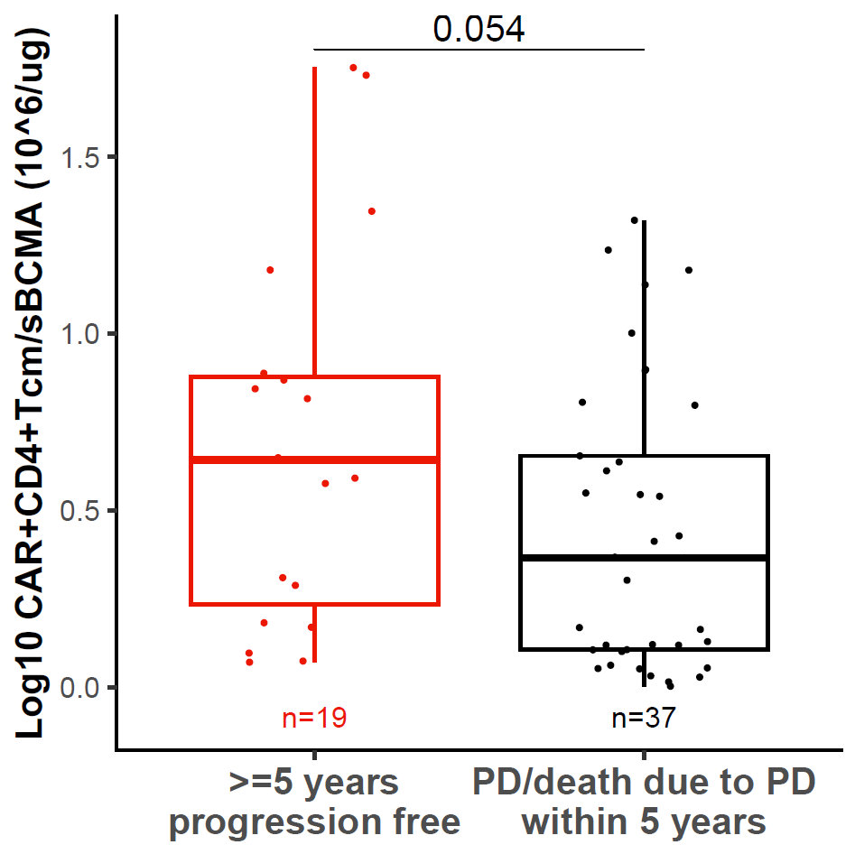
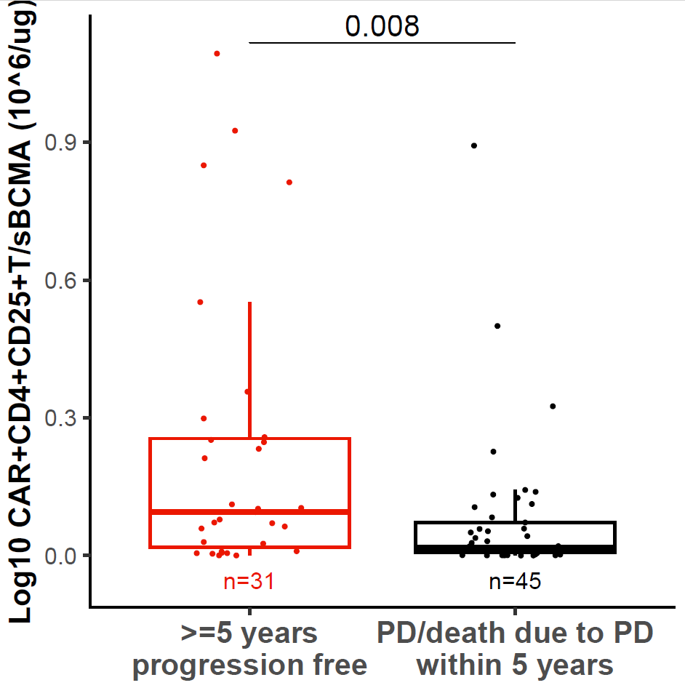
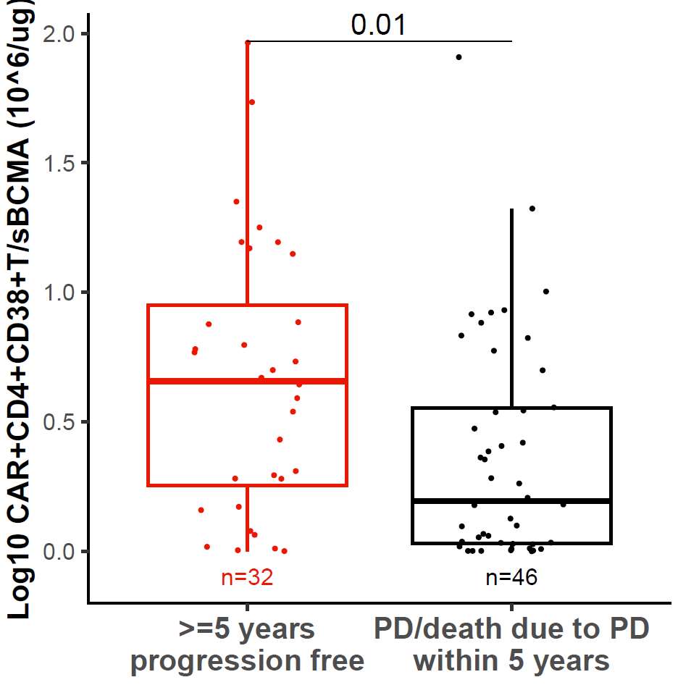
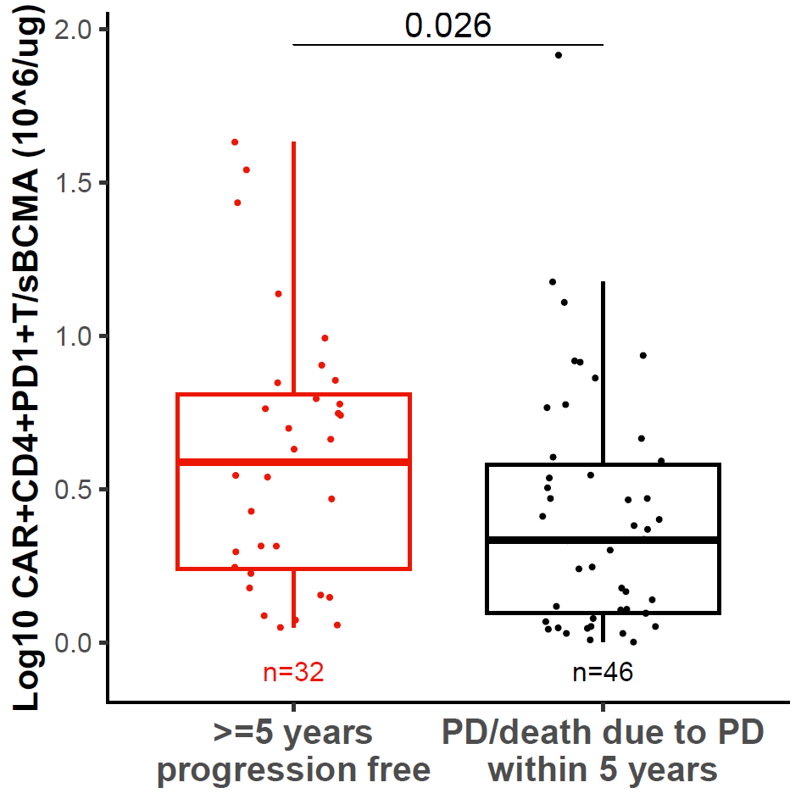
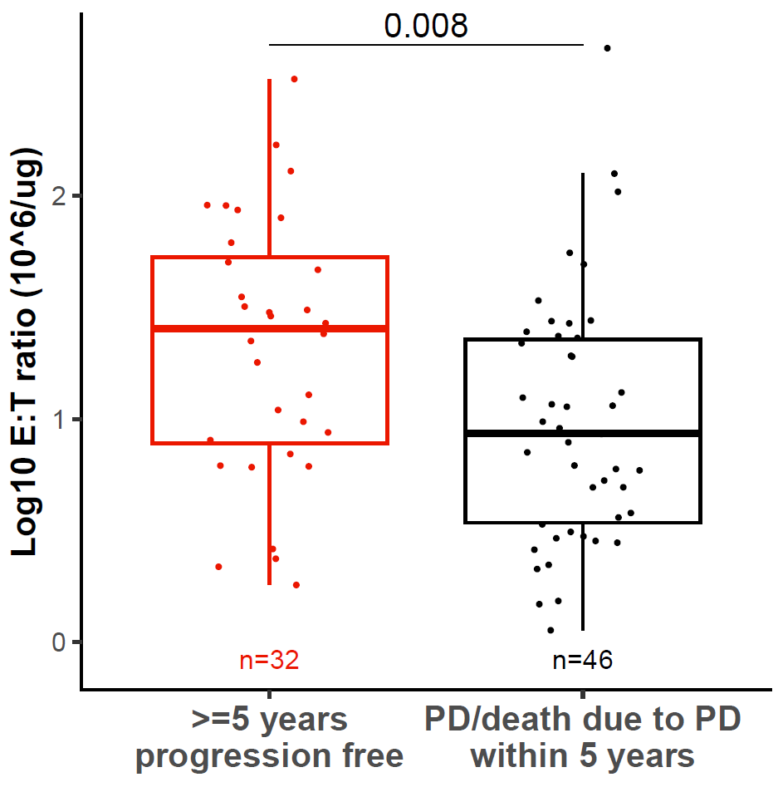
CARTITUDE-1: Higher Effector-to-Target Ratios Are Associated With Durable Outcomes
  Postinfusion E:T ratio*
CAR+ CD4+ T-cells†
T_{cm}
CD25
CD38
PD-1
CAR+ T-cells
^{c}
^{c}
^{c}
^{c}
^{c}
Log₁₀ CAR+CD4+Tcm/sBCMA (10⁶/L per μg/L)
Log₁₀ CAR+CD4+CD25+T/sBCMA (10⁶/L per μg/L)
Log₁₀ CAR+CD4+CD38+T/sBCMA (10⁶/L per μg/L)
Log₁₀ CAR+CD4+PD1+T/sBCMA (10⁶ /L per μg/L)
Log₁₀ CAR+T/sBCMA (10⁶ /L per μg/L)
PD within 5 yr
PD within 5 yr
PD within 5 yr
PD within 5 yr
PD within 5 yr
Long-term disease control was significantly associated with a higher CD4/CD8 CAR-T cell ratio, a central memory phenotype, a positive ratio of CD28/CD5, TIGIT exclusion markers, and a higher overall E:T ratio.
*E:T ratio was defined as maximal CAR+ T-cell levels normalized by preinfusion serum soluble BCMA levels. †Similar results were observed for CAR+ CD8+ T-cells.
Jagannath. JCO. 2025;43:2766.

Slide 8
Association Between Tumor Burden and CAR T-Cell Therapy Toxicity
Risk of significant delayed neurotoxicity (eg, parkinsonism) decreased from 6% in CARTITUDE-1 to 1% in CARTITUDE-4, when patients received more effective bridging therapy in earlier lines or therapy
We know risk of high-grade CRS and ICANs correlate with high tumor burden at time of cell infusion
Real-world data (ASH 2025): In >750 cilta-cel–treated patients, lack of response to bridging therapy was strongly associated with delayed neurotoxicity (including parkinsonism) and higher nonrelapse mortality; 95% of parkinsonism cases occurred in patients who did not respond to bridging
San-Miguel. N Engl J Med. 2023;389:335. Yi Lin. JCO. 2023; 41: 8009. Cohen. Blood Cancer J. 2022;12:32. Sheth. Bone Marrow Transplant. 2021;56:552. Ciltacabtagene autoleucel PI. Suidana. ASH 2025. Abstr 1034.

Slide 9
Case Study: Bridging Therapy in a Patient With High–Disease Burden
Mr S is a 64-yr-old man with R/R MM who was originally diagnosed with IgG kappa myeloma in 2017
  He received therapy with VRd x 8 cycles, deferred transplant, and went on maintenance lenalidomide for 2 yr; maintenance therapy was discontinued due to toxicity
At biochemical relapse in 2023, he was started on daratumumab pomalidomide and dexamethasone; he had a PR but discontinued treatment within 6 mo due to toxicity
He presented for a second opinion after being off therapy for over 1 yr. At evaluation:
  M-protein was 8.5 g/dL. Light chain ratio was 10, Hb 7 g/dL, creatinine 1.2 mg/dL, PET/CT with diffuse lytic lesions, but no risk of fracture and no EMD

Slide 10
Case Study: When Minimal Disease Still Requires Bridging
Mr P is a 47-yr-old Black man with IgA kappa myeloma diagnosed in 2024 with bone disease and renal insufficiency related to elevated kappa levels
  His bone marrow demonstrated 70% aberrant plasma cells, with FISH revealing t(14;16) and 1q amplification
He was started on DVRd for 4 cycles, followed by auto-SCT and then bortezomib/lenalidomide maintenance
  He initially had a CR with MRD-positive response but achieved a biochemical progression with M-protein 0.5g/dL (from 0 g/dL at nadir) 8 mo after auto-SCT

Slide 11
Clinical Pearls for Choosing Bridging Therapy
Clinical Pearls | Statements
Disease biology and dynamics | • Rate of disease progression or biochemical relapse kinetics • Overall disease volume and tumor burden • Presence of extramedullary disease • Rapid rise in M-protein or free light chains • High-risk cytogenetic features (eg, del[17p], 1q gain, t[4;14]) • Evidence of clonal evolution or new PET-avid lesions
Clinical risk and symptom burden | • Symptomatic relapse (bone pain, hypercalcemia, anemia, renal failure) • End-organ compromise or risk thereof • Need for rapid palliation or disease control
Patient-specific and functional factors | • Performance status and frailty • Comorbidities (cardiac, renal, hepatic, pulmonary) • Baseline cytopenias and marrow reserve • Prior treatment toxicities or cumulative organ injury • Patient preference and tolerance for additional therapy
Prior treatment and response kinetics | • Duration of prior response and treatment-free interval • Recent exposure or resistance to prior mechanisms of action • Steroid responsiveness (potential for short-term control)
Immune and hematologic considerations | • Lymphocyte and neutrophil counts at baseline • Avoidance of agents that impair CAR T-cell expansion or persistence • Need to preserve lymphocytes if apheresis not yet done (holding therapy) • Washout intervals relative to lymphodepletion regimen
Slide Courtesy of Krina Patel, MD, MSc
Ailawadhi. Clin Lymphoma Myeloma Leuk. 2025;000:1-9.

Slide 12
Other Factors Influencing the Use of Bridging Therapy
Clinical Pearls | Statements
Infection and supportive care factors | Risk of further cytopenia-related infections during bridging Active infection or antimicrobial use Immunosuppression and prophylaxis needs
Logistical and operational factors | Local oncology team capacity and experience to manage bridging Potential insurance authorization delays Certainty of CAR T-cell manufacturing and shipment timeline Institutional scheduling or bed availability
Socio-practical and access issues | Patient geography and travel distance to CAR T-cell center Caregiver availability and home support Financial and psychosocial stressors that may affect treatment adherence
Quality of life and goals of care | Balance between disease control and preserving fitness for CAR T-cell Patient priorities (minimizing toxicity vs maximizing stability) Symptom management, fatigue, and emotional readiness for infusion
Slide Courtesy of Krina Patel, MD, MSc
Ailawadhi. Clin Lymphoma Myeloma Leuk. 2025;000:1-9.

Slide 13
Current Challenges With Bridging Therapy Before CAR T-Cell Administration
For late-line patients, most are penta exposed, if not refractory, and do not have local access to novel targeted bispecific therapies.
  For more aggressive therapies (eg, hyper-CVAD–based regimens, DCEP, or VDT-PACE), the risk is higher for toxicity and delay to CAR T-cell infusion, as well as increased toxicity post CAR T-cell (eg, cytopenias, infections)
    How does this affect washout times?
For early-line patients (as well as some late-line patients who are slowly biochemically progressing), how much disease is needed for CAR T-cell expansion? Is there increased risk for off-tumor/on-target toxicity?
If a patient does not respond to bridging therapy, what happens next?

Slide 14
The Need for Better Biomarkers to Assess Disease Burden
How do we quantify disease burden?
    Late-line patients often have oligo-secretory or nonsecretory disease, making M-protein, light chains, and Bence-Jones protein less reliable as markers
    Baseline ferritin? (nonspecific; being explored but not validated)
    Percentage of bone marrow involvement? (limited value due to patchy disease and presence of extramedullary involvement)
    PET/CT with assessment of total disease volume, including bony disease and EMD? (useful but not standardized across centers)
Notes:
M-protein
Monoclonal protein produced by malignant plasma cells; used to track myeloma activity.
PET-CT
Positron Emission Tomography–Computed Tomography
An imaging modality used to detect metabolically active myeloma lesions, including bony and extramedullary disease.
EMD
Extramedullary disease
Myeloma that has spread outside the bone marrow (e.g., soft tissue or organ involvement).
CAR-T
Chimeric Antigen Receptor T-cell therapy
A cellular immunotherapy in which a patient’s T cells are engineered to target BCMA or other antigens on myeloma cells.
CRS
Cytokine Release Syndrome
A systemic inflammatory response caused by immune activation after CAR-T infusion.
ICANS
Immune Effector Cell-Associated Neurotoxicity Syndrome
A neurologic toxicity observed after CAR-T therapy.

Slide 15
Go Online for More Coverage of MM!
Additional CME-Certified Text Modules on CAR-T bridging therapy in MM ​
Clinical Thought Expert Commentary with updates from ASH 2025 on CAR-T bridging therapy in MM coming soon!​
deceraclinical.com/education

