Slide 1

Improving Provider Awareness About
Healthcare Equity: Improving All Patients’
Access to Care in Endometrial Cancer
Provided by Clinical Care Options, LLC, in partnership with Smart Patients
Supported by educational grants from Eisai; GSK; Karyopharm Therapeutics Inc.; Merck Sharp & Dohme, LLC; and Seagen and Genmab.

Slide 2

About These Slides
Please feel free to use, update, and share some or all of these slides in your noncommercial presentations to colleagues or patients
When using our slides, please retain the source attribution:
These slides may not be published, posted online, or used in commercial presentations without permission. Please contact permissions@clinicaloptions.com for details
Slide credit: clinicaloptions.com
Notes:
Disclaimer: The materials published on the Clinical Care Options website reflect the views of the authors of the CCO material, not those of Clinical Care Options, LLC, the CME providers, or the companies providing educational grants. The materials may discuss uses and dosages for therapeutic products that have not been approved by the United States Food and Drug Administration. A qualified healthcare professional should be consulted before using any therapeutic product discussed. Readers should verify all information and data before treating patients or using any therapies described in these materials.

Slide 3
Faculty and Disclosures
Shannon N. Westin, MD, MPH
Professor
Division of Surgery
Department of Gynecologic Oncology and Reproductive Medicine
University of Texas MD Anderson Cancer Center
Houston, Texas
Shannon N. Westin, MD, MPH: consultant/advisor/speaker: AstraZeneca, Caris, Clovis, Eisai, EQRX, Genentech/Roche, GlaxoSmithKline, ImmunoGen, Lilly, Merck, Mereo, Mersana, NGM Bio, Nuvectis, Seagen, Verastem, Vincerx, Zentalis; researcher: AstraZeneca, AvengeBio, Bayer, Bio-Path, Clovis, Genentech/Roche, GlaxoSmithKline, Mereo, Novartis, Zentalis.

Slide 4
Improving Provider Awareness About Healthcare Equity in Endometrial Cancers

Slide 5
Endometrial Cancer: Overview
Endometrial cancer (uterine or corpus cancer): most common gynecologic malignancy in the US and developed nations¹
  Incidence: 65,950 women
  12,550 women die from this disease
  Incidence has increased 5% since 2000
  Median age at diagnosis is 63 yr
Age-adjusted incidence steadily increasing and ~67% of women with EC are diagnosed with early-stage disease¹
Advanced EC is treated with surgery along with chemotherapy, and radiation therapy in appropriate cases^{2,3}
EC can be classified by histology as endometrioid or
nonendometrioid⁴
Clinical Stage^{5,6} | Outcome
Stage | 5-Yr OS, %
FIGO stage I or II | 74-91
FIGO stage III IV | 57-66 20-26
Non-Hispanic Black women have a-2 fold higher likelihood to die from endometrial cancer when compared with non-Hispanic White women¹
Data from 2004 to 2019 indicate non-Hispanic Black women were more likely to be diagnosed with regional and metastatic disease than localized disease vs White women⁷
1. National Cancer Institute. Surveillance, Epidemiology, and End Results (SEER) Program. seer.cancer.gov/statfacts/html/corp.html. 2. NCCN uterine cancer guidelines. v2.2023. www.nccn.org. 3. Makker. Oncology (Williston Park). 2019;33:239. 4. Murali. Lancet. 2014;15:E268.
5. Siegel. CA Cancer J Clin. 2013;63:11. 6. Creasman. Int J Gynacol Obstet. 2006;95:S105. 7. Chapman-Davis. Ann Surg Oncol. 2023;30:48.
Notes:
EC, endometrial cancer; FIGO, International Federation of Gynecology and Obstetrics; OS, overall survival.

Slide 6
Evaluation of Black Patients With
Postmenopausal Bleeding
Successful screening for EC requires both patient report of symptoms and appropriate workup
Black patients are less likely to report PMB and receive guideline-concordant care
Nonguideline-concordant pathways are associated with a higher rate of advanced-stage EC at diagnosis (aOR: 1.90-2.88)
Frequency of Recognition and Evaluation of PMB, by Race, Prior to Diagnosis of EC, % | White Patients (N = 4354) | Black Patients (N = 537)
Guideline-concordant care Report of PMB + ≥1 diagnostic procedure | 79 | 70*
Nonguideline-concordant care
None Report of PMB only ≥1 diagnostic procedure only Alternative bleeding characterization† ± ≥1 diagnostic procedure | 5.3 5.4 7.5 3.1 | 8.6 7.3 10.4 3.7
*P <.001. †eg, menorrhagia.
Doll. Am J Obstet Gynecol 2018;219:593.e1.
Notes:
EC, endometrial cancer; aOR, adjusted odds ratio; PMB, postmenopausal bleeding.

Slide 7
Inaccuracy of US Clinical Guidelines for
Endometrial Cancer Diagnosis Based on Race
ACOG guidelines recommend endometrial biopsy for diagnostic confirmation of EC only if endometrial thickness >4 mm via TVUS
Study assessing predicted performance ≥4 mm threshold using a simulated cohort of US Black women with PMB found:
  >50% missed cases and 8-fold higher frequency of false-negative results for Black women vs the general population
Extrinsic factors contributing to disparities in endometrial cancer diagnosis and morbidity include:
  Decrease sensitivity in screening methods
  Decreased guideline concordant care
  Decreased access to care
  Higher likelihood of diagnosis at a later stage
Romano. Ethn Dis. 2021;30:543. Chapman-Davis. Ann Surg Oncol. 2023;30:48.
Notes:
ACOG, American College of Obstetrics and Gynecology; AUC, area under the curve; EC, endometrial cancer; NPV, negative predictive value; PMB, postmenopausal bleeding; PPV, positive predicted value; TVUS, transvaginal ultrasound.

Slide 8
Risk Factors and Genetic Determinants of Poor Outcomes in Women With Endometrial Cancer
Risk factors for developing endometrial cancer¹
  70% due to excess body weight and insufficient physical activity
  30% other factors
    Lynch syndrome (40%-60%)
    Type 2 diabetes
    Previous history of polycystic ovary syndrome
    Use of postmenopausal estrogen
    Late-onset menopause
    Tamoxifen use for breast cancer
Low-grade tumors with high circulating levels of estrogen have a favorable prognosis and carry mutations²
  Aberrations in PI3K/AKT pathway including PTEN, PI3KCA are common alterations in low-grade tumors
  ER/PgR expression is high
High-risk, estrogen-independent, aggressive EC occurs more frequently in Black women³⁻⁵
  Papillary serous/ carcinosarcoma
  P53, PPP2R1A, FBXW7, and PIK3R1 mutations are more common
  HER2 protein expression and/or gene amplification is high
1. Cancer facts and figures 2021. www.cancer.org. 2. Maxwell. Clin Cancer Res. 2000;6:2999. 3. Francies. Am J Cancer Res.
2020;10:3061. 4. Kohler. Am J Obstet Gynecol. 1996;175:1246. 5. Clifford. Am J Obstet Gynecol. 1997;176:S229.
Notes:
EC, endometrial cancer; ER, estrogen receptor; PgR, progesterone receptor.

Slide 9
Increasing Incidence and Mortality of
Endometrial Cancer in the United States
Rate of Uterine Cancer Over Time by Ethnicity¹
Endometrial Cancer Survival by Race²
30
10
25
8
20
Black (AAPC = 1.5)
White (AAPC = 1.0)
AI/AN (AAPC = 1.4 [NS])
Overall (AAPC = 1.1)
Hispanic (AAPC = 1.7)
API (AAPC = 2.5)
6
Rate of Uterine Cancer
(per 100,000 Women)
Rate of Uterine Cancer Deaths
(per 100,000 Women)
15
4
10
Black (AAPC = 2.4)
White (AAPC = 0.5)
AI/AN (AAPC = 2.7)
Overall (AAPC = 0.7)
Hispanic (AAPC = 1.8)
API (AAPC = 2.0)
5
2
0
0
1999
2000
2001
2002
2003
2004
2005
2006
2007
2008
2009
2010
2011
2013
2014
1999
2000
2001
2002
2003
2004
2005
2006
2007
2008
2009
2010
2011
2012
2013
2014
2015
2012
2015
2016
Yr of diagnosis
Yr of Deaths
1. US CDC. Gynecologic Cancer Incidence, United States—2012-2016. September 2019. 2. Henley. MMWR Morb Mortal Wkly Rep. 2018;67:1333.
Notes:
AAPC, average annual percent change; AI/AN, American Indian/Alaska Native; API, Asian Pacific Islander; NS, not significant.

Slide 10
Health Disparities in Endometrial Cancer
Despite a 5-yr OS rate of >80%, Black women continue to have poor outcomes¹
Despite lower incidence for EC development, Black patients account for a higher proportion of deaths with a 5-yr OS 19% worse than White women²⁻⁴
Delay in diagnosis is a key contributor to disparity in gynecologic malignancies⁵
Black women more likely to present with advanced disease^{4,6,7}
  Identifying health disparities and promoting early diagnosis are key to improving outcomes for Black patients
  Black women are more likely to receive less care due to lack of insurance or
  low-income status
1. Rauh-Hain. Obstet Gynecol. 2015;125:843. 2. Wright. Cancer. 2009;115:1276. 3. Long. Gynecol Oncol. 2013;130:652.
4. Mukerji. Gynecol Oncol. 2018;148:527. 5. Doll. Am J Obstet Gynecol. 2018;218:474. 6. Bregar. Gynecol Oncol. 2017;145:114. 7. Sud. Gynecol Oncol. 2018;148:349
Notes:
EC, endometrial cancer; OS, overall survival.

Slide 11
High-Volume Treatment Centers Are Associated With Better Outcomes for Black Patients With EC
Black patients are more likely to receive quality care at high-volume treatment centers, which have been associated with decreased racial disparity¹
  Fewer number of surgery complications and improved outcomes have been reported for Black patients receiving treatment at high-volume centers
Adjusted 2-Yr Survival Differential Between Black and White Patients With EC, % (95% CI)² | Treatment Provider
 | High-Volume Center | Low-Volume Center
Early-stage type I tumors | 0.5 (-0.9 to 0) | -1.4 (-2.4 to -0.5)
 | P <.0001
Advanced-stage type I tumors | 1.2 (-2.9 to 5.3) | -12.4 (-24.0 to -0.9)
 | P <.0001
1. Buskwofie. Gynecol Oncol. 2018;149:329. 2. Wright. Obstet Gynecol. 2011;117:1051.
Notes:
EC, endometrial cancer.

Slide 12
Molecular Classification and
Opportunities for Expanding Access to Care Through Technology in Endometrial Cancer

Slide 13
TCGA Molecular Classification and Outcomes
100
Patients Divided Into TCGA subgroups
75
100 hypothetical patients with newly diagnosed endometrial cancer
100
50
POLE sequencing
OS Probability (%)
p53abn
POLEmut
dMMR
NSMP
95
25
POLE hotspot or exonuclease domain mutation
2 marker IHC
(PMS2 and MSH6)
Log-rank P <.001
POLE (~5%)
0
70
0
1
2
3
4
5
PMS2 or MSH6 loss
TP53 sequencing or IHC
Patients at Risk, n
p53abn
POLEmut
dMMR
NSMP
Yr Since Random Assignment
MSI (~25%)
93
51
137
129
72
50
124
122
57
50
112
113
49
49
102
105
44
48
96
94
32
37
74
69
TP53
wild-type
TP53
mutant
Copy number low (~40%)
Copy number high (~30%)
410 patients with successful molecular testing
  23% p53abn: p53 abnormal
  12% POLEmut: POLE ultramutated
  33% dMMR: mismatch repair deficient
  32% NSMP: no specific molecular profile
Prognostic value of molecular classification of high-risk endometrial cancer for benefit from chemotherapy
MacKay. Oncotarget. 2017;8:84579. León-Castillo. JCO. 2020;38:3388.
Notes:
dMMR, deficient mismatch repair; MSI, microsatellite instability; NSMP, p53-mutant and non-specific molecular profile; OS, overall survival; TCGA, The Cancer Genome Atlas.

Slide 14
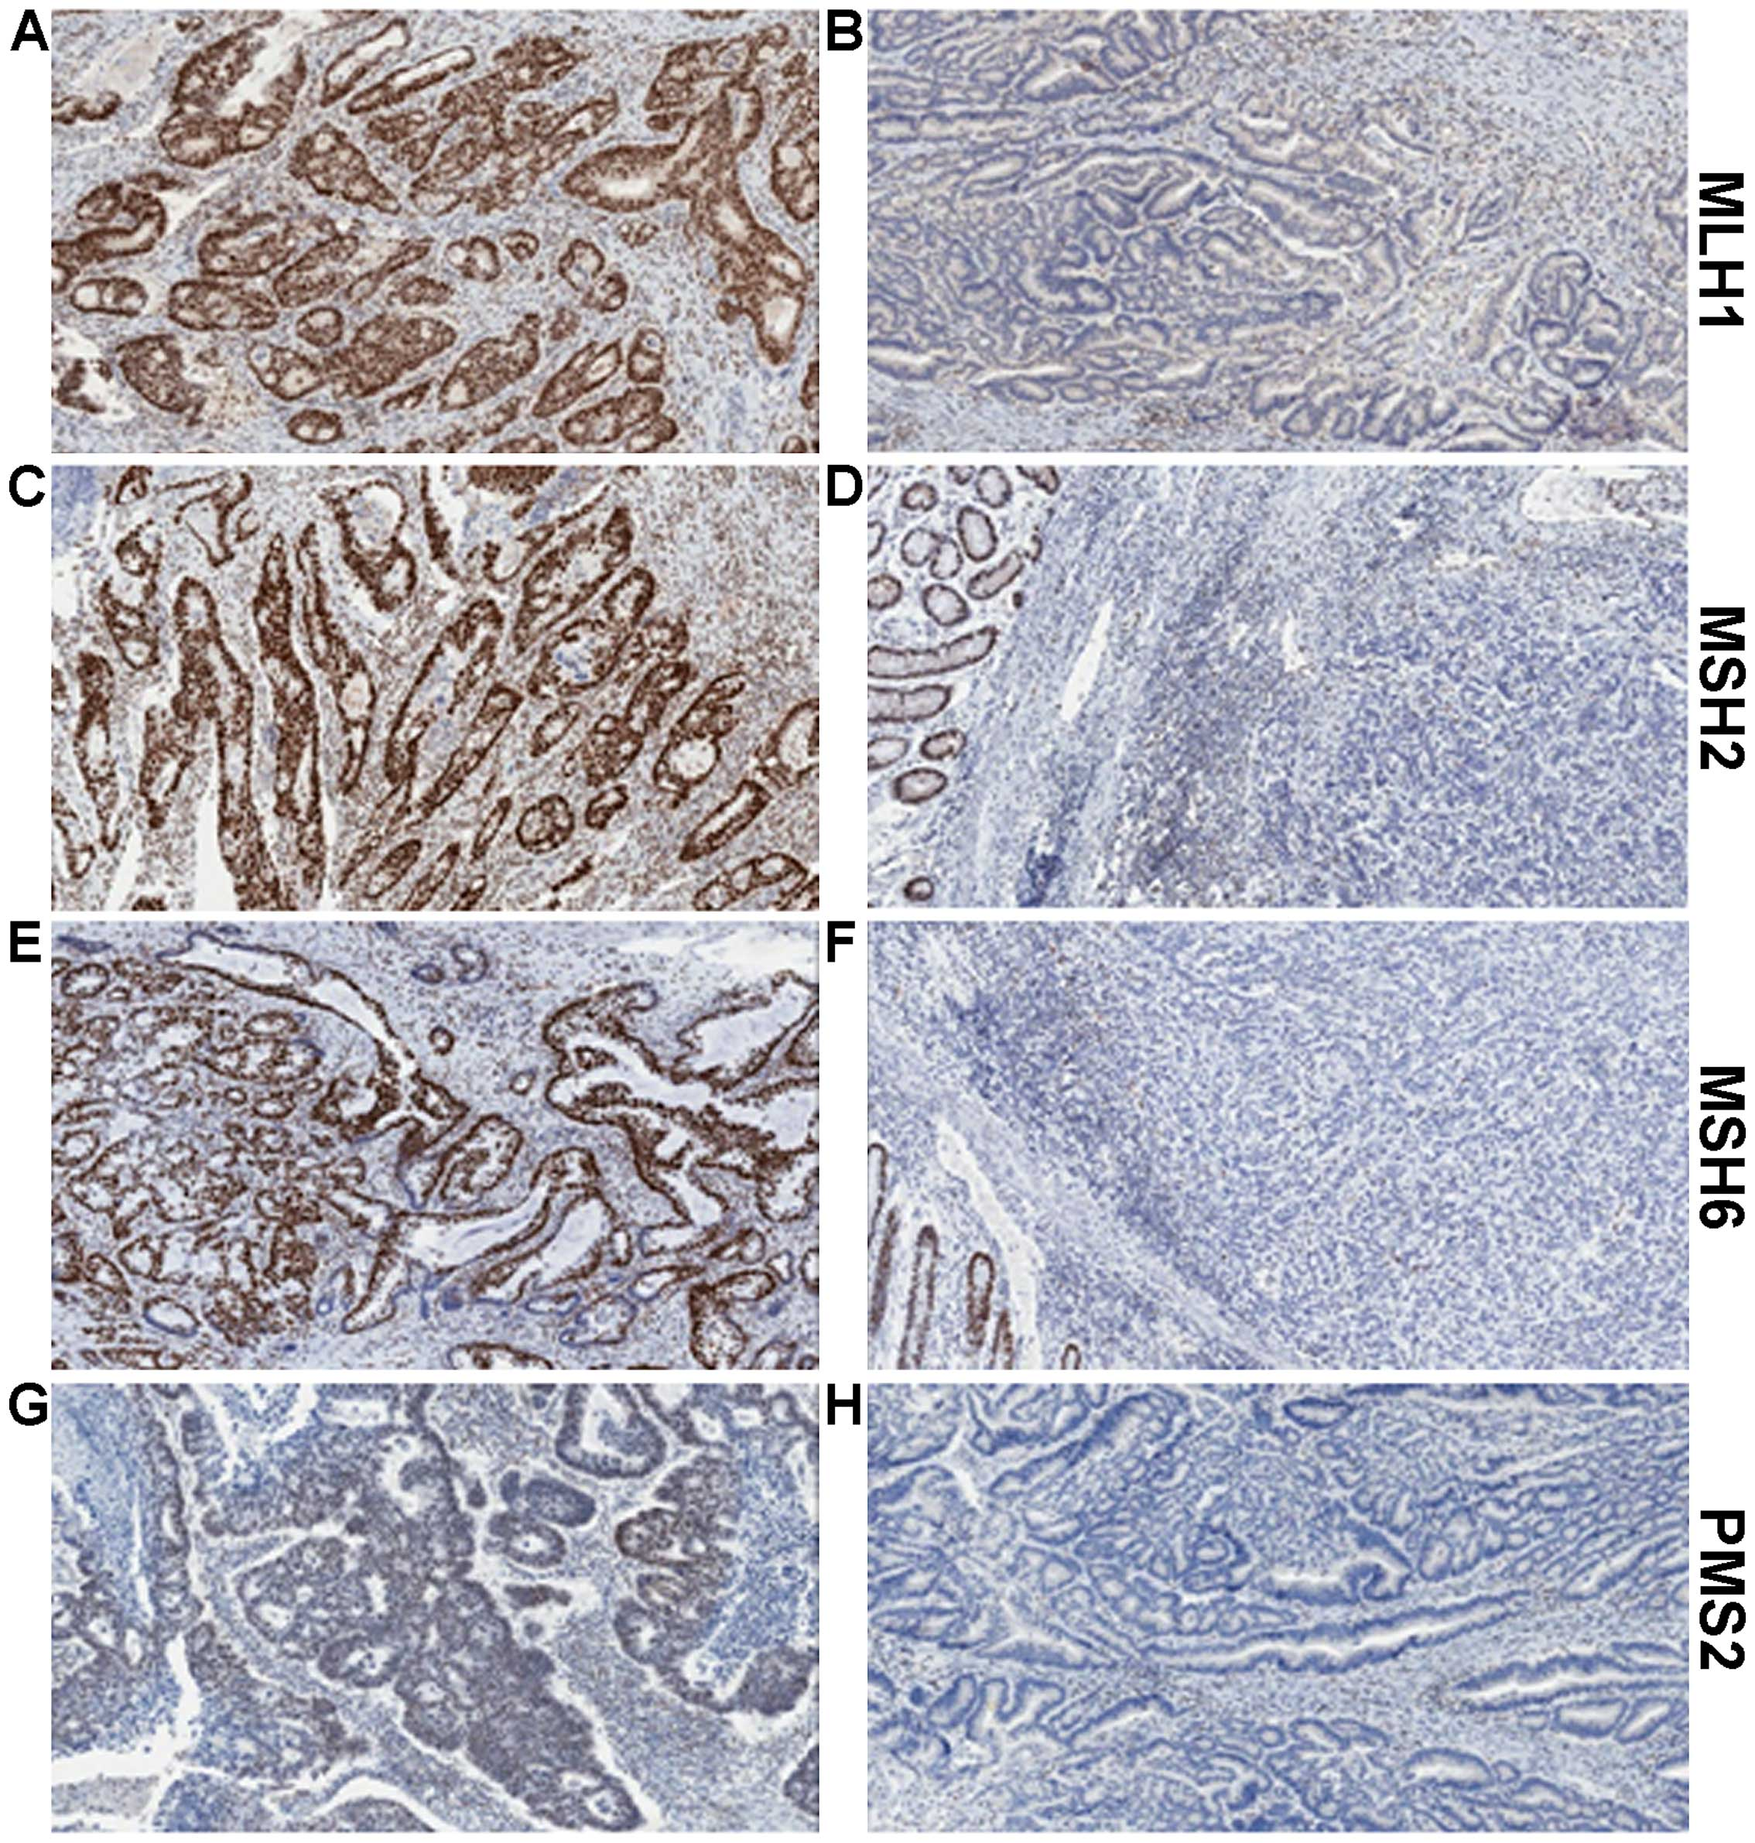
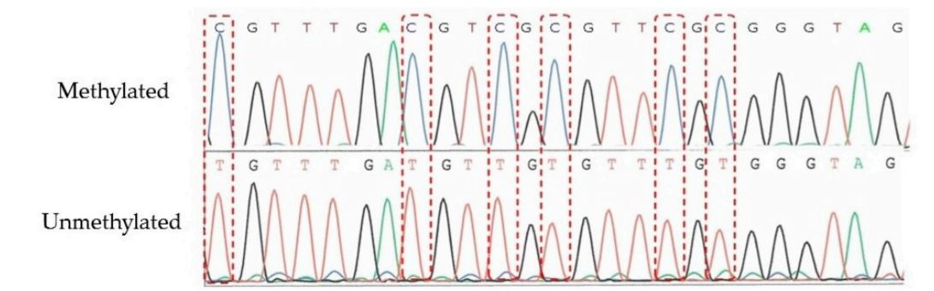
Recommendations for Molecular Testing to Inform Treatment Decisions in Endometrial Cancer
MMRd testing by IHC to test for MLH1, MSH2, MSH6, and PMS2 protein loss
Reflex testing for MLH1 promoter methylation status is recommended
if MLH1 protein loss
Methylated
Unmethylated
ACOG Practice Bulletin No. 147: Lynch syndrome. Obstet Gynecol. 2014;124:1042. Cho. Int J Gynecol Pathol. 2019;38:S11.
Concin. Int J Gynecol Cancer. 2021:12. Crosbie. Genet Med. 2019;21:2390. Ryan. Genet Med. 2019;21:2167.
Takeda. Genes (basel). 2016;7:86. Richman. Int J Oncol. 2015; 47:1189.
Notes:
MMRd, deficient mismatch repair; IHC, immunohistochemistry.

Slide 15
HER2 is an Actionable Biomarker in Patients With EC
HER2 overexpression and/or gene amplification is seen in 25%-30% of EC^{1,2}
  HER2-positive status in EC is associated with response to targeted therapy (trastuzumab)
  Carboplatin, paclitaxel,
  and trastuzumab is the recommended treatment
  for stage III/IV or recurrent HER2-positive EC³
Testing for HER2^{1,2}
Can be associated with significant intratumor heterogeneity
  5%-50% intratumor staining intensity
Parameter/Cutoff^{1,2} | Endometrial Serous Carcinoma
HER2 IHC 3+ (protein level) | >30%, strong complete or basolateral/lateral
HER2 FISH (gene amplification) | HER2/CEP17 ratio ≥2.0
1. Buza. Arch Pathol Lab Med. 2020;145:687. 2. Fader. Clin Cancer Res. 2020;26:3928. 3. NCCN uterine cancer guidelines. v.3.2021.
Notes:
EC, endometrial carcinoma; FISH, fluorescence in situ hybridization; IHC, immunohistochemistry.

Slide 16
Individualizing EC Care With Current and Emerging Practice-Changing Clinical Data
Notes:
EC, endometrial Cancer

Slide 17
Recommendations for the Management of
Newly Diagnosed or Relapsed/Recurrent EC
Initial Diagnosis
Colposcopy/Biopsy
1L
Newly Diagnosed*: Treatments¹⁻³
Local Recurrence
Systemic Recurrence
Stage I
Endometrioid
Stage II
Stage IIIA-IIIC
(lymph node involvement)
Stage IVA-IVB
(spread into bladder or
lymph nodes outside pelvis)
Surgery or RT
Surgical removal of isolated or locoregional recurrence
Surgery only if macroscopic disease removal can be achieved
Palliative RT
Reduce bleeding/pain from pelvic disease or metastases
Hormonal therapy
  Progestogens
  Aromatase inhibitor
  (letrozole, fulvestrant)
  Estrogen modulators (tamoxifen)
  Other: IO + SoC chemotherapy
  CP + pembrolizumab†
  CP + dostarlimab‡
Surgery ± RT
Frail/comorbidities: external RT and/or vaginal brachytherapy is recommended
Fertility-sparing hormonal tx
Surgery (to remove uterus, connective tissue, upper part of vagina, both fallopian tubes, and ovaries) + external RT and/or vaginal brachytherapy
Surgery, platinum-based chemotherapy* ± RT
Frail/comorbidities: external RT and/or vaginal brachytherapy recommended
High grade: omentectomy ± peritoneal biopsies
Hysterectomy to prevent excessive bleeding ± RT
Hormone tx in endometrioid type (progestin, tamoxifen, LHRH agonist, aromatase inhibitors)
Combination chemotherapy
Targeted tx (lenvatinib, bevacizumab, everolimus/letrozole, temsirolimus)
Immunotherapy (pembrolizumab)
2L+
Other systemic treatments
  Platinum tx rechallenge
  Doxorubicin + paclitaxel
  Anti−PD-1 mAb: pembrolizumab
  in MSI-high/dMMR tumors or dostarlimab in dMMR tumors
  Lenvatinib + pembrolizumab in MSI-stable/pMMR tumors
  Paclitaxel + carboplatin + trastuzumab^{4,5}
*Paclitaxel, carboplatin, doxorubicin or liposomal doxorubicin, and docetaxel.
  EBRT ± chemotherapy + brachytherapy
  Systemic tx can be considered before/after RT
  Oligometastatic: radical local tx
1. cancer.org/cancer/endometrial-cancer/treating/by-stage.html.
2. Concin. Int J Gynecol Cancer. 2021;31:12. 3. Miller. JCO. 2020;38:3841-3850.
4. Fader. Clin Cancer Res. 2020;26:3928. 5. NCCN. Clinical practice guidelines in oncology: uterine cancer. v.2.2023. nccn.org.
†NCCN category 1 (excluding carcinosarcoma): for stage III or IVA with measurable disease or stage IVB with or without measurable disease. ‡NCCN category 1: for stage IIIA, IIIB, or IIIC1 with measurable disease; stage IIIC1 with carcinosarcoma, clear-cell, serous, or mixed histology, regardless of the presence of measurable disease; and stage IIIC2 or stage IV, regardless of presence of measurable disease.
Notes:
CP, carboplatin/paclitaxel; dMMR, mismatch repair deficient; EBRT, external beam radiation therapy; EC, endometrial cancer; IO, immuno-oncology; LHRH, luteinizing hormone‒releasing hormone; mAb, monoclonal antibody; MSI, microsatellite instability; pMMR, mismatch repair proficient; RT, radiation therapy; tx, therapy.

Slide 18
Suboptimal Receipt of Guideline-Based Treatment in Black Patients Compared With White Patients
Adherence to Quality Metrics and Short- and Long-term Outcomes, % | White Women (N = 275,173) | Black Women (N = 35,035) | Adjusted RR (95% CI)
Adherence to quality metrics Time to surgery <6 wk of diagnosis Minimally invasive surgery Pelvic lymphadenectomy Adjuvant radiotherapy Chemotherapy for stage III/IV disease Perfect adherence to all 5 metrics | 75.6 72.9 74.2 52.3 73.2 50.0 | 65.8 58.5 71.3 48.1 72.7 38.3 | 0.89 (0.87-0.90) 0.87 (0.84-0.90) 0.98 (0.96-0.99) 1.02 (0.98-1.06) 0.97 (0.95-0.99) 0.84 (0.82-0.86)
Short- and long-term outcomes 30-day readmission (after surgery stage I) 30-day mortality (stage I-III) 90-day mortality (stage I-III) 5-yr mortality | 3.5 0.4 0.9 16.2 | 5.2 0.8 1.9 31.0 | 1.24 (1.10-1.39) 1.56 (1.30-1.88) 1.29 (1.13-1.46) 1.27 (1.23-1.31)
Analyses suggest optimal adherence to guideline-based care may improve outcomes for both Black and White patients, but does not eliminate racial disparities in EC outcomes
Huang. Am J Obstet Gynecol. 2020;223:396.e1.
Notes:
EC, endometrial cancer; RR, relative risk.

Slide 19
Recent Data for Approved Single-Agent Immunotherapies in Recurrent Endometrial Cancer
Parameter | KEYNOTE-158¹: Pembrolizumab in MSI-H EC Cohorts D + K (n = 99) | GARNET²: Dostarlimab
 |  | Cohort A1† MMRd EC (n = 106*) | Cohort A2† pMMR EC (n = 142)²
ORR, % (95% CI) | 48 (37-60) | 43.4 (33.8-53.4) | 13.4 (8.3-20.1)
Best overall response n (%)
CR | 11 (14) | 11 (10.4) | 3 (2.1)
PR | 27 (34) | 35 (33.0) | 16 (11.3)
SD | 14 (18) | 13 (12.3) | 31 (21.8)
PD | 23 (29) | 39 (36.8) | 77 (54.2)
Median DoR, mo (range) | NR (2.9-49.7+) | NR | NR
*3 patients were not evaluable for a response. †Median follow-up time for Cohort A1 was 13.8 mo (9.5-22.1) and Cohort A2 was 11.5 mo(11.0-25.1).
O’Malley. JCO. 2022;40:752. Oaknin. J Immunother Cancer. 2022;10:e003777.
Notes:
CR, complete response; DoR, duration of response; EC, endometrial cancer; MMRd, defective mismatch repair; MSI-H, microsatellite instability-high; NR, not reached; OS, overall survival; PFS, progression-free survival; PR, partial response; SD, stable disease.

Slide 20
Study 309/KEYNOTE-775: Lenvatinib + Pembrolizumab After Platinum in Advanced EC
FDA Accelerated Approval September 2019
FDA Priority Review May 2021
For patients with endometrial cancer
who are not MSI-H or dMMR
Confirmatory, randomized, open-label phase III study
Stratified by MMR status (pMMR vs dMMR), within pMMR by region, ECOG PS 0 vs 1, prior history of pelvic radiation
Lenvatinib 20 mg PO QD +
Pembrolizumab 200 mg IV Q3W
(n = 411)
Patients with advanced, metastatic, or recurrent EC with measurable disease after 1 previous
platinum-based CT*; ECOG PS 0/1; tissue available for MMR testing
(N = 827)
Until PD or unacceptable toxicity
Doxorubicin 60 mg/m² IV Q3W or
Paclitaxel 80 mg/m² IV QW 3 wk on/1 wk off
(n = 416)
Primary endpoints: PFS by BICR, OS
Secondary endpoints: ORR, health-related quality of life, pharmacokinetics, safety
Key exploratory endpoint: DoR
*2 prior regimens allowed if 1 was in neoadjuvant/adjuvant setting.
Makker. NEJM. 2022;386:437. Makker. JCO. 2023;41:2904.
Notes:
BICR, blinded independent central review; CT, chemotherapy DoR, duration of response; dMMR, mismatch repair deficient; EC, endometrial cancer; ECOG PS, Eastern Cooperative Oncology Group performance status; MMR, mismatch repair; ORR, overall response rate; OS, overall survival; PD, progressive disease; PFS, progression-free survival; pMMR, mismatch repair proficient.

Slide 21
Study 309/KEYNOTE-775: Baseline Characteristics
Characteristic^{1,2} | Lenvatinib + Pembrolizumab (n = 411) | Doxorubicin or Paclitaxel (n = 416)
Median age, yr (range) | 64 (30-82) | 65 (35-86)
MMR status, % pMMR/dMMR | 84.2/15.8 | 84.4/15.6
Prior history of pelvic radiation, % | 42.3 | 44.7
ECOG PS, % 0/1 | 59.9/39.9 | 57.9/42.1
Race, % White Black Asian | 63.5 4.1 20.7 | 59.1 3.4 22.1
Characteristic, %^{1,2} | Lenvatinib + Pembrolizumab (n = 411) | Doxorubicin or Paclitaxel (n = 416)
Histology Endometrioid: H/L/NS Serous Clear cell Mixed | 22.9/14.4/21.9 25.1 7.3 5.4 | 21.6/13.0/26.4 27.6 4.1 3.8
Previous lines of systemic therapy 1/≥2¹ Platinum based 1/2 Neoadjuvant/adjuvant Any | 72.3/27.7 79.3/20.2 54.5 | 66.6/33.4 75.7/24.3 60.3
Makker. NEJM. 2022;386:437. Makker. JCO. 2023;41:2904.
Notes:
dMMR, mismatch repair deficient; ECOG PS, Eastern Cooperative Oncology Group performance status; H, high; L, low; MMR, mismatch repair; NS, not specified; pMMR, mismatch repair proficient.

Slide 22
Study 309/KEYNOTE-775: Responses
Parameter | pMMR |  | Overall
 | Lenvatinib + Pembrolizumab (n = 346) | Doxorubicin or Paclitaxel (n = 351) | Lenvatinib + Pembrolizumab (n = 411) | Doxorubicin or Paclitaxel (n = 416)
ORR, % (95% CI) | 30.3 (25.5-35.5) | 15.1 (11.5-19.3) | 31.9 (27.4-36.6) | 14.7 (11.4-18.4)
 | P <.0001 |  | P <.0001
Best overall response, % CR PR SD PD Not evaluable/assessed | 5.2 25.1 48.6 15.6 0.6/4.9 | 2.6 12.5 39.6 30.8 2.0/12.5 | 6.6 25.3 47.0 14.8 1.2/5.1 | 2.6 12.0 40.1 29.6 1.9/13.7
Median DoR, mo (range) | 9.2 (1.6-23.7) | 5.7 (0-24.2) | 14.4 (1.6-23.7) | 5.7 (0-24.2)
Median time to response, mo (range) | 2.1 (1.5-9.4) | 3.5 (1.0-7.4) | 3.1 (1.5-16.3) | 2.1 (1.0-7.4)
Makker. NEJM. 2022;386:437. Makker. JCO. 2023;41:2904.
Notes:
CR, complete response; DoR, duration of response; PD, progressive disease; pMMR, mismatch repair proficient; PR, partial response; SD, stable disease.

Slide 23
Study 309/KEYNOTE-775: PFS and OS Benefit
pMMR
All Comers
100
Median PFS, Mo (95% CI)
6.7 (5.6-7.4)
3.8 (3.6-5.0)
100
Median PFS, Mo (95% CI)
7.3 (5.7-7.6)
3.8 (3.6-4.2)
LEN + pembro
Chemotherapy
Censored
LEN + pembro
Chemotherapy
Censored
80
80
60
60
Patients Without Progression (%)
HR for progression or death,
0.60 (0.50-0.72)
Patients Without Progression (%)
HR for progression or death,
0.56 (0.48-0.66)
40
40
20
20
0
0
3
6
9
12
15
18
21
24
27
30
33
36
39
42
0
0
3
6
9
12
15
18
21
24
27
30
33
36
39
42
Time (Mo)
Time (Mo)
No. at risk:
LEN + pembro | 346 | 265 | 166 | 116 | 80 | 61 | 55 | 43 | 36 | 24 | 18 | 14 | 6 | 4 | 0
Chemotherapy | 351 | 177 | 83 | 38 | 23 | 16 | 12 | 9 | 6 | 4 | 3 | 3 | 1 | 0 | 0
No. at risk:
LEN + pembro | 411 | 317 | 203 | 148 | 109 | 87 | 79 | 65 | 57 | 45 | 35 | 23 | 10 | 4 | 0
Chemotherapy | 416 | 214 | 95 | 43 | 27 | 19 | 15 | 11 | 8 | 6 | 5 | 5 | 1 | 0 | 0
100
Median OS, Mo (95% CI)
18.0 (14.9-20.5)
12.2 (11.0-14.1)
100
Median OS, Mo (95% CI)
18.7 (15.6-21.3)
11.9 (10.7-13.3)
LEN + pembro
Chemotherapy
Censored
LEN + pembro
Chemotherapy
Censored
80
80
60
60
Patients Who Were Alive (%)
HR for progression or death,
0.70 (0.58-0.83)
Patients Who Were Alive (%)
HR for progression or death,
0.65 (0.55-0.77)
40
40
20
20
0
0
3
6
9
12
15
18
21
24
27
30
33
36
39
42
45
0
0
3
6
9
12
15
18
21
24
27
30
33
36
39
42
45
Time (Mo)
Time (Mo)
No. at risk:
LEN + pembro | 346 | 322 | 285 | 242 | 214 | 188 | 171 | 148 | 124 | 95 | 65 | 41 | 20 | 7 | 2
Chemotherapy | 351 | 324 | 267 | 217 | 171 | 138 | 111 | 86 | 71 | 53 | 40 | 21 | 6 | 3 | 1
No. at risk:
LEN + pembro | 411 | 383 | 337 | 292 | 258 | 229 | 211 | 186 | 160 | 125 | 91 | 58 | 30 | 10 | 2
Chemotherapy | 416 | 378 | 305 | 246 | 196 | 158 | 129 | 104 | 84 | 64 | 49 | 28 | 6 | 3 | 1
Makker. NEJM. 2022;386:437. Makker. JCO. 2023;41:2904.
Notes:
LEN, lenvatinib; MMR, mismatch repair; OS, overall survival; pembro, pembrolizumab; PFS, progression-free survival; pMMR, mismatch repair proficient; TPC, treatment of physician choice.

Slide 24
Study 309/KEYNOTE-775: TEAEs
TEAE, % | Lenvatinib + Pembrolizumab (n = 406) |  | Doxorubicin or Paclitaxel (n = 388)
 | Any Grade | Grade ≥3* | Any Grade | Grade ≥3*
Hypertension Hypothyroidism Diarrhea Nausea Decreased appetite Vomiting Weight decrease Fatigue Arthralgia | 65.0 58.9 55.7 51.7 46.6 37.7 35.5 34.0 32.3 | 39.2 1.5 8.1 3.4 7.6 3.0 10.8 5.4 1.7 | 5.2 0.8 20.4 46.4 21.4 21.1 5.9 27.6 8.0 | 2.6 0 2.1 1.3 0.5 2.6 0.3 3.1 0
TEAE, % | Lenvatinib + Pembrolizumab (n = 406) |  | Doxorubicin or Paclitaxel (n = 388)
 | Any Grade | Grade ≥3* | Any Grade | Grade ≥3*
Proteinuria Constipation Anemia UTI Headache Neutropenia Alopecia | 30.5 28.3 28.1 27.6 26.4 9.1 5.9 | 5.2 0.7 6.9 4.2 0.5 2.0 0 | 3.4 24.5 48.7 10.3 9.0 34.0 30.9 | 0.3 0.5 15.5 1.0 0.3 26.0 0.3
*In the lenvatinib and pembrolizumab arm, 6.4% of patients suffered grade 5 AEs, and 5.2% of patients in the TPC arm suffered grade 5 AEs.
Makker. NEJM. 2022;386:437. Makker. JCO. 2023;41:2904.
Notes:
AE, adverse event; TEAE, treatment-emergent adverse event; TPC, treatment of physician choice; UTI, urinary track infection.

Slide 25
Special Considerations for Managing AEs With Lenvatinib and Pembrolizumab From KEYNOTE-775
Expert Panel Recommendations
Provide extensive patient support and education about potential for AEs
ECOG PS and lenvatinib dosing
  Good: FDA recommended starting dose of 20 mg
  Poor: Consider 14 mg or 10 mg dosing per patient-specific situation and comorbidities
Train nurses to support patients to increase adherence to treatment to maximize benefit
Consider a low threshold for dose reduction
Hypertension can become debilitating and difficult to manage
  Consider prophylactic antihypertensive medication (hydralazine)
AE | Management Recommendation
Hypertension | Control blood pressure prior to treatment and monitor during Withhold for grade 3 hypertension despite optimal antihypertensive therapy Discontinue for grade 4 hypertension
Arterial thrombotic event | Any grade: Discontinue
Serious or severe AEs* | Grade 1-3 and grade 4 laboratory abnormality: Withhold until improves to grade 0-1 or baseline, then resume at reduced dose Grade 4 AE: Permanently discontinue
*Promptly initiate management for severe diarrhea and withhold or discontinue based on severity; for grade 4 diarrhea, grade 3 or 4 pneumonitis, permanently discontinue pembrolizumab.
Lenvatinib PI. Pembrolizumab PI.
Notes:
AE, adverse event; EC, endometrial carcinoma; irAE, immune-related adverse event.

Slide 26
Immunotherapy in Frontline
Endometrial Cancer Treatment

Slide 27
Dostarlimab + CT in Primary Advanced or Recurrent EC (ENGOT-EN6/GOG-3031/RUBY): Study Design
Randomized, placebo-controlled phase III study of chemotherapy + dostarlimab in patients with histologically/cytologically advanced or recurrent endometrial cancer
Stratified by MMR status (deficient vs proficient) and previous external pelvic radiotherapy (yes vs no)
Treatment
Maintenance
Patients with stage III/IV disease or first recurrence with low potential for cure by radiation, surgery, or both; treatment naive to systemic therapy, with recurrence or progression ≥6 mo after completing treatment; ECOG PS ≤1
(N = 494)
Dostarlimab 500 mg IV Q3W
+ CT*
for 6 cycles
Dostarlimab 1000 mg IV Q6W
for up to 3 yr†
Placebo + CT*
for 6 cycles
Placebo IV Q6W
for up to 3 yr†
*Paclitaxel 175 mg/m² IV Q3W + carboplatin AUC 5 IV Q3W.
†Treatment may end after 3 yr, disease progression, toxicity, withdrawal of consent,
investigator’s decision, or death.
Primary endpoints: PFS by investigator, OS
Secondary endpoints: PFS by BICR, PFS2, ORR, DoR, DCR, HRQoL/PRO, and safety
Mirza. SGO 2023. Abstr 12. Mirza. NEJM. 2023;[Epub].
Notes:
AUC, area under the curve; BICR, blinded independent central review; CT, chemotherapy; DCR, disease control rate; DoR, duration of response; EC, endometrial cancer; ECOG, Eastern Cooperative Oncology Group; HRQoL, health-related quality of life; MMR, mismatch repair; ORR, objective response rate; OS, overall survival; PFS, progression-free survival; PFS2, second progression-free survival; PRO, patient-reported outcome; PS, performance status.

Slide 28
ENGOT-EN6/GOG-3031/RUBY: PFS
PFS in dMMR/MSI-H
2-Yr PFS Rates, % (95% CI)
PFS in Overall Population (Primary Endpoint)
61.4 (46.3-73.4)
15.7 (7.2-27.0)
100
Dostarlimab + CT
Placebo + CT
100
2-Yr PFS Rates, % (95% CI)
90
Dostarlimab + CT
Placebo + CT
36.1 (29.3-42.9)
18.1 (13.0-23.9)
80
HR: 0.28 (0.16-0.50; P <.001)
80
70
HR: 0.64 (0.51-0.80; P <.001)
60
60
PFS (%)
PFS (%)
50
40
40
30
20
20
10
0
0
0
2
4
6
8
10
12
14
16
18
20
22
24
26
28
30
32
34
36
38
0
2
4
6
8
10
12
14
16
18
20
22
24
26
28
30
32
34
36
38
Mo From Randomization
Mo From Randomization
100
2-Yr PFS, % (95% CI)
Dostarlimab + CT
Placebo + CT
28.4 (21.2-36.0)
18.8 (12.8-25.7)
80
60
HR: 0.76 (0.59-0.98)
PFS in pMMR/MSS
PFS (%)
40
20
0
38
0
2
4
6
8
10
12
14
16
18
20
22
24
26
28
30
32
34
36
38
Mirza. SGO 2023. Abstr 12. Mirza. NEJM. 2023;[Epub].
Slide credit: clinicaloptions.com
Mo From Randomization
Notes:
CT, chemotherapy; dMMR, mismatch repair deficient; MSI-H, microsatellite instability‒high; MSS, microsatellite stable; PFS, progression-free survival; pMMR, mismatch repair proficient.

Slide 29
Carboplatin + Paclitaxel ± Pembrolizumab as Frontline Treatment for Patients With EC (NRG GY018): Study Design
Randomized phase III study in patients with endometrial cancer
Stratified by MMR status (dMMR vs pMMR), ECOG PS 0 vs 1, previous adjuvant chemotherapy (yes vs no)
Pembrolizumab 200 mg IV Q3W
+ CT*
for 6 cycles
Pembrolizumab 400 mg IV Q6W
for up to 14 additional cycles
Patients with measurable stage III/IVA, stage IVB, or recurrent endometrial cancer; institutional MMR testing by IHC; ECOG PS ≤2; tissue available for MMR testing
(N = 816)
Placebo + CT*
for 6 cycles
Placebo IV Q6W
for up to 14 additional cycles
*Paclitaxel 175 mg/m² IV Q3W + carboplatin AUC 5 IV Q3W.
Primary endpoints: PFS per RECIST v1.1 by investigator in pMMR and dMMR
Secondary endpoints: safety, ORR/DoR per RECIST v1.1 by BICR or investigator by treatment arm and MMR IHC status, OS in pMMR and dMMR, PRO/QoL in pMMR, and concordance of institutional vs central MMR IHC testing
NCT03914612. Eskander. SGO 2023. Abstr 338166. Eskander. NEJM. 2023;[Epub].
Notes:
AUC, area under the curve; BICR, blinded independent central review; CT, chemotherapy; DoR, duration of response; dMMR, mismatch repair deficient; EC, endometrial cancer; ECOG, Eastern Cooperative Oncology Group; IHC, immunohistochemistry; MMR, mismatch repair; OS, overall survival; ORR, overall response rate; pMMR, mismatch repair proficient; PFS, progression-free survival; PRO, patient-reported outcome; PS, performance status; QoL, quality of life; RECIST, Response Evaluation Criteria in Solid Tumors.

Slide 30
NRG GY018: PFS (per RECIST v1.1) in dMMR and pMMR Cohorts
PFS in dMMR Cohort
PFS in pMMR Cohort
Median PFS, Mo (95% CI)
1.0
Pembrolizumab + CT
Placebo + CT
NR (30.6-NR)
7.6 (6.4-9.9)
1.0
Median PFS, Mo (95% CI)
Pembrolizumab + CT
Placebo + CT
13.1 (10.5-18.8)
8.7 (8.4-10.7)
0.8
HR: 0.30 (0.19-0.48; P <.001)
0.8
HR: 0.54 (0.41-0.71; P <.001)
0.6
0.6
PFS Probability
PFS Probability
0.4
0.4
0.2
0.2
0
0
0
6
12
18
24
30
36
0
6
12
18
24
30
36
Mo
Mo
Patients at Risk, n
Pembrolizumab + CT Placebo + CT
44
24
22
8
9
4
8
2
2
0
290
292
150
129
45
33
20
10
7
2
3
1
0
0
112
113
80
62
Addition of pembrolizumab to standard-of-care chemotherapy followed by pembrolizumab maintenance resulted in 70% and 46% reduction in risk of disease progression or death in patients with dMMR and pMMR, respectively
Eskander. SGO 2023. Abstr 338166. Eskander. NEJM. 2023;[Epub].
Notes:
CT, chemotherapy; NR, not reached; pMMR, mismatch repair proficient; PFS, progression-free survival; RECIST, Response Evaluation Criteria in Solid Tumors.

Slide 31

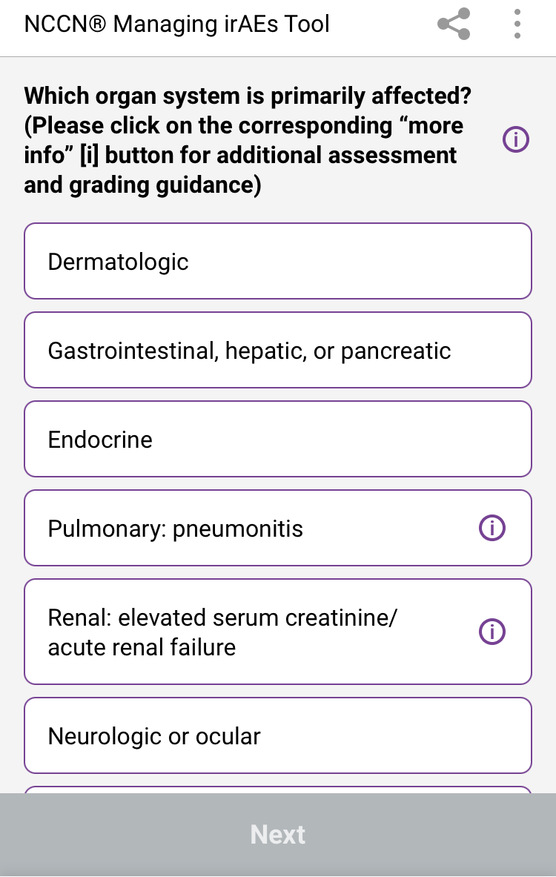
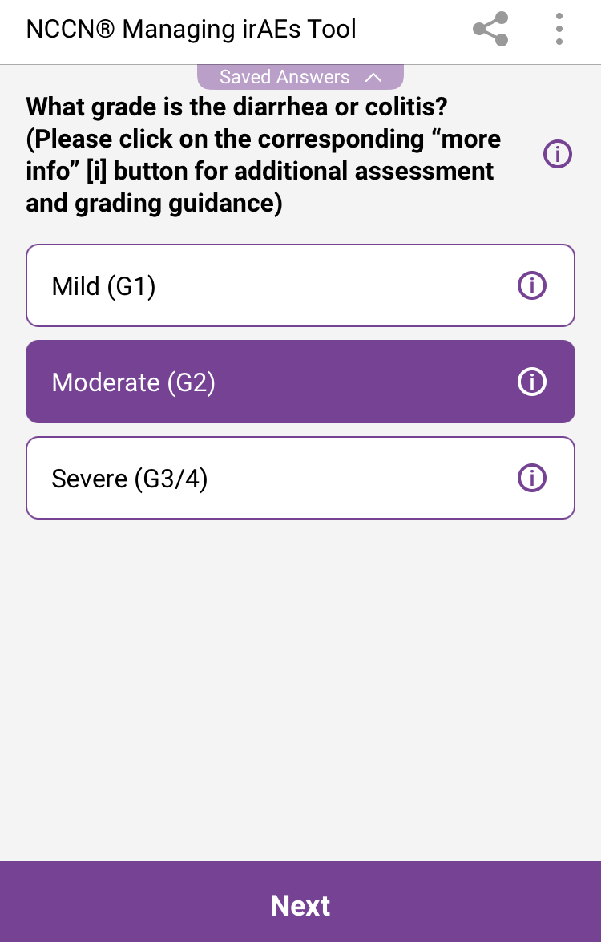
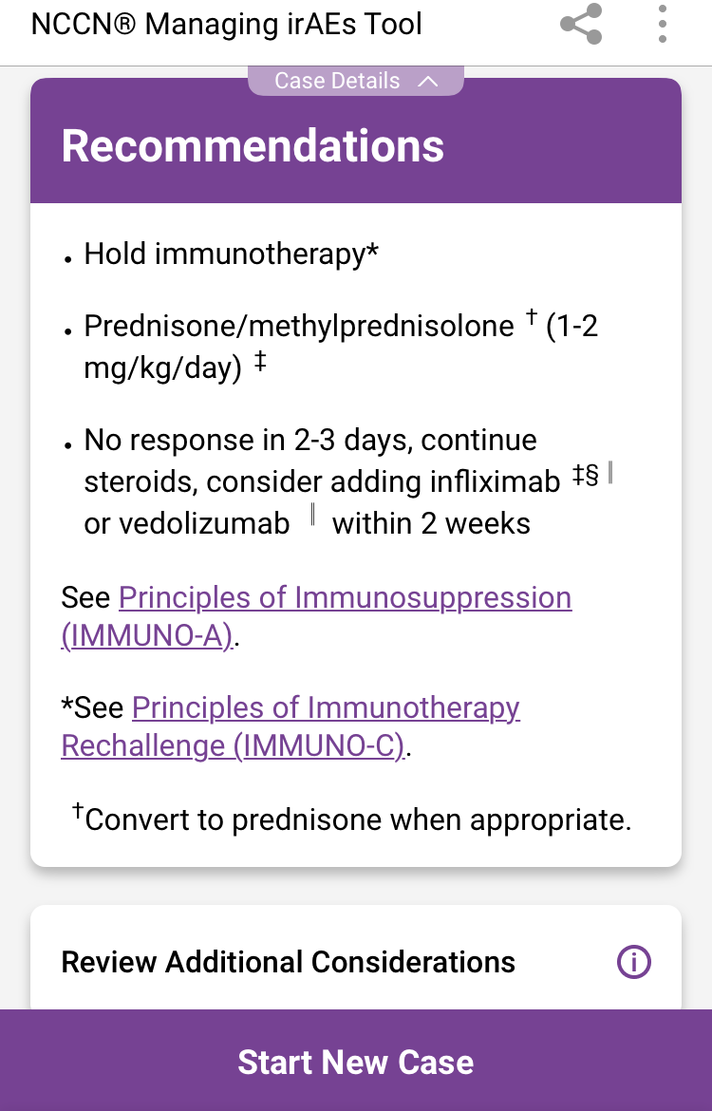
NCCN Clinical Practice Guidelines in Oncology (NCCN Guidelines®) for Managing Immune Checkpoint Inhibitor–Related Toxicities
NCCN Guidelines® for Managing Immune Checkpoint Inhibitor–Related Toxicities: Interactive Decision
Support Tool available at: clinicaloptions.com/immuneAEtool or on our app: CCO Decision Support
Notes:
irAE, immune-related adverse event.

Slide 32
SIENDO/ENGOT-EN5: Selinexor vs Placebo Maintenance in Recurrent Endometrial Cancer
Randomized, double-blind, phase III trial in patients with stage IV or first relapse of endometrial cancer with PR or CR on ≥12 wk 1L taxane-carboplatin (prior surgery, radiotherapy or hormonal therapy allowed; N = 263)
ITT Population
Median PFS, Mo (95% CI)
WT P53 Population
Median PFS, Mo (95% CI)
1.00
+
+
1.00
+
13.7 (9.20-NR)
3.7 (1.87-12.88)
+
Selinexor
Placebo
5.7 (3.81-9.20)
3.8 (3.68-7.39)
+
Selinexor
Placebo
+
+
+
+
+
+
+
0.75
+
HR: 0.705 (0.499-0.996;
P = .024)
0.75
+
+
HR: 0.375 (0.210-0.670;
P = .0003)
+
+
+
+
+
+
+
+
+
+
+
+
+
+
+
+
+
+
+
+
+
+
+
+
Probability of PFS
+
+
0.50
+
+
+
+
+
0.50
+
+
+
+
+
+
+
+
+
+
+
+
+
+
+
+
+
+
+
+
+
+
+
+
+
+
+
+
+
+
+
+
+
+
0.25
+
+
0.25
0
0
Patients at Risk, n
Selinexor
Placebo
0
3
6
9
12
15
18
0
3
6
9
12
15
18
Mo
Mo
174
89
97
50
53
25
39
19
23
11
14
10
8
10
67
36
48
18
33
11
24
9
15
6
10
5
7
5
QoL patient-reported outcomes (by EORTC QLQ-C30) showed no significant differences between treatment arms in global health, physical functioning, or symptoms including diarrhea and nausea/vomiting
NCT03555422. Vergote. SGO 2022. Abstr 249.
Notes:
1L, first-line; CR, complete response; PR, partial response; QoL, Quality of life; WT, wild type.

Slide 33
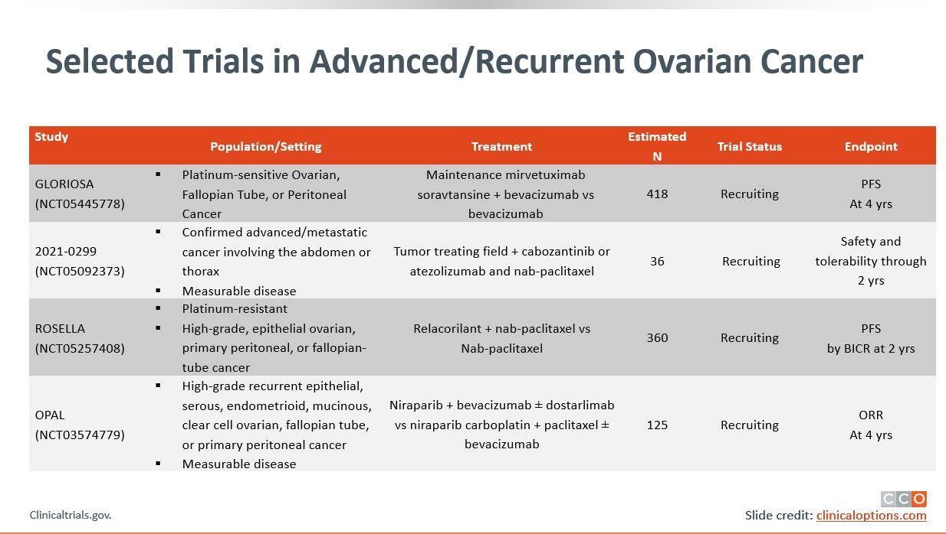
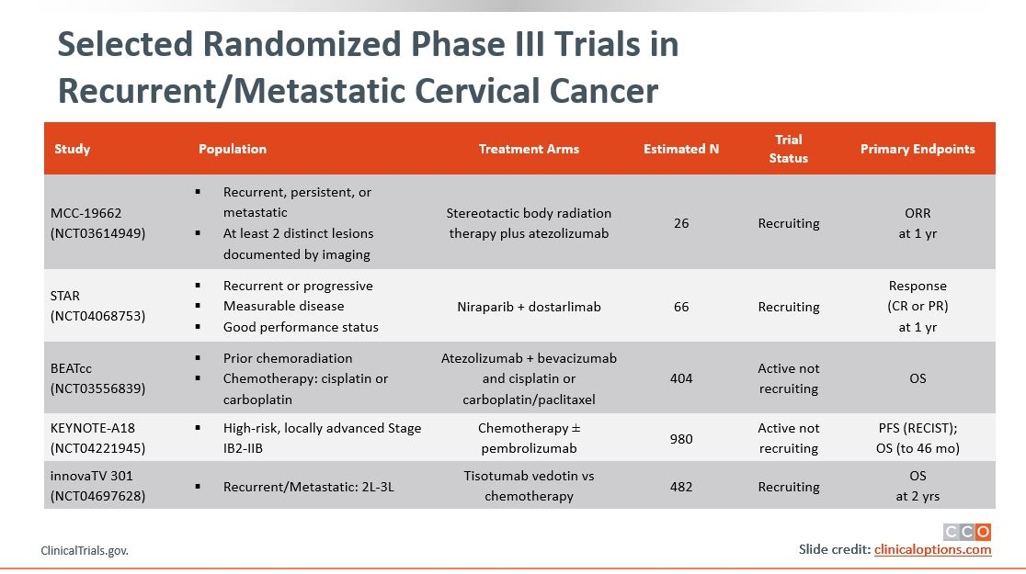
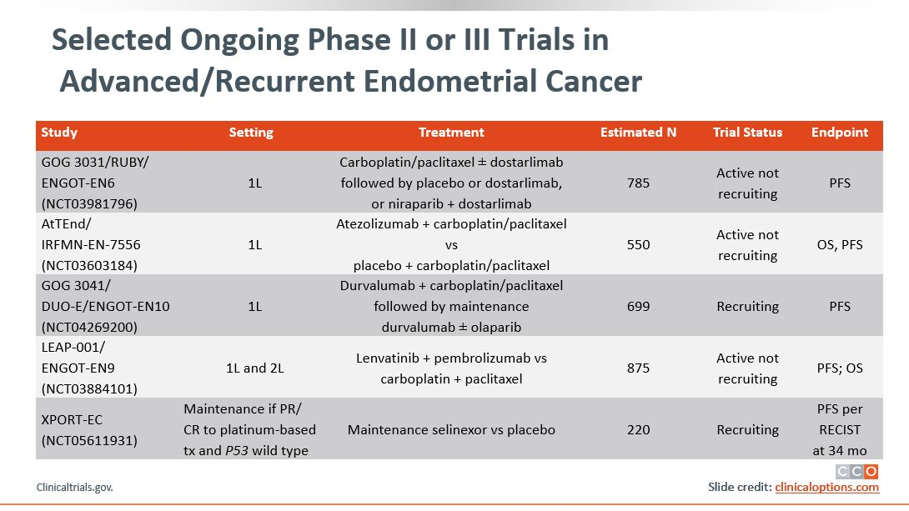
Addressing Potential Healthcare Disparities in
Clinical Trial Enrollment
To address potential disparities in care, discuss the patients’:
  Satisfaction with treatment (AEs and symptom distress associated with poorer adherence)
  Satisfaction with HCP communication
    Feeling understood and respected by their providers
    Being involved in shared decision-making
    Building trust and confidence in their providers
    Understanding disease and treatment
  Resources, support system, and ability to get to and from the clinic for visits
  Provide help in navigating insurance claims and financial assistance programs for prescribed medications
Listen to and understand each patient’s goals to help develop manageable plans for achieving healthcare goals
Visit clinicaltrials.gov/ for available clinical trials near you
Pozzar. Gynecol Oncol. 2017;147:714. Patel. Gynecol Oncol. 2020;157:323.
Igwe. Gynecol Oncol. 2016;142:520. Nyakudarika. Cancer. 2021;127:3809.
Notes:
AE, adverse event; HCP, healthcare professional.

Slide 34



Navigating the Healthcare Ecosystem:
Addressing Potential Healthcare Disparities
Communication
Improving patient–provider communication
Acknowledging patient beliefs/values
Minimizing healthcare provider bias
Increasing representation of underrepresented providers of color (MD, NP, PA) to oncology workforce
Cost
Reducing treatment costs with manufacturer grants and assistance programs
Providing grants to cover transportation costs
and dependent care
Gaps in Outcomes Research
Increasing representation of underrepresented groups of patient in clinical trials
Evaluating genetic/molecular differences in tumor biology based on race
Oncology pharmacist, nurses, and patient navigators are an integral part of oncology treatment and patient care
  Have a key role in empowering patients and their families to take charge of their health
  Can provide education, resources, and healthcare planning advice
Esnaola. ASCO 2021. Chatterjee. Front Oncol. 2016;6:36. J Onc Nav Surviv. 2019;10.

Slide 35
Take-home Messages—
Achieving Health Equity in Endometrial Cancer
Delay in diagnosis for endometrial cancer can lead to Black patients presenting with more advanced disease
  We must ensure to have an open conversation with our patients about postmenopausal bleeding and assess for appropriate work-up
  Current guidelines on screening can lead to missed (50%) diagnosis for Black women with endometrial cancer vs the general population when using transvaginal ultrasound cutoff of >4 mm for endometrial thickness
Timely/equitable access to molecular testing (MSI, POLE, P53, PD-L1, etc) may improve disease risk stratification and patient’s access to targeted therapies and improved outcomes for Black patients
Black patient education on the potential benefits of clinical trial participation and enrollment in clinical trials evaluating novel agents may increase access to care and inform data gaps in this population

Slide 36
Go Online for More CCO
Coverage of Gynecologic Malignancies!
CME/CPE/CNE-certified on-demand webcast (coming soon!)
ClinicalThought commentaries and PDF resources for gynecologic cancers that may help increase awareness about health disparities and provide additional aid to your patients
On-demand CME/CPE/CNE-certified text modules for ovarian and cervical cancer with healthcare professionals’ insight and commentary
clinicaloptions.com/oncology
clinicaloptions.com/GYNCI2022tool
clinicaloptions.com/immuneAETool
clinicaloptions.com/CervicalTool2022

