Slide 1
From Evidence to Practice – Barriers to Access and Manufacturing Delays in CAR T-Cell Therapy
Provided by Clinical Care Options, LLC
Supported by an educational grant from Johnson & Johnson.

Slide 2

About These Slides
Please feel free to use and share some or all of these slides in your noncommercial presentations to colleagues or patients
When using our slides, please retain the source attribution:
These slides may not be published, posted online, or used in commercial presentations without permission. Please contact permissions@clinicaloptions.com for details
Slide credit: clinicaloptions.com
Notes:
Disclaimer: The materials published on the Clinical Care Options website reflect the views of the authors of the CCO material, not those of Clinical Care Options, LLC, the CME providers, or the companies providing educational grants. The materials may discuss uses and dosages for therapeutic products that have not been approved by the FDA. A qualified healthcare professional should be consulted before using any therapeutic product discussed. Readers should verify all information and data before treating patients or using any therapies described in these materials.

Slide 3
Faculty and Disclosures
Noopur Raje, MD
Director, Center for Multiple Myeloma
Massachusetts General Hospital Cancer Center
Boston, Massachusetts
Consultant/advisor/speaker: AstraZeneca, Bristol Myers Squibb, Caribou Biosciences, GlaxoSmithKline, Johnson & Johnson, Moderna, Pfizer, Regeneron, Sanofi.

Slide 4
Learning Objectives
At the conclusion of this activity, learners should be able to:
Evaluate the challenges of access to and manufacturing of CAR T-cell therapy and role of bridging therapeutic strategies in patients with multiple myeloma

Slide 5





Treatment Barriers in the CAR T-Cell Administration Process
Screening per eligibility criteria of CAR T-cell therapy
Manufacturing of autologous CAR T-cells from patients’ cells
Postinfusion assessments and safety monitoring
CAR T-cell therapy administration
Patients
Apheresis
Potential Barriers in CAR T-Cell Delivery
Access issues for at risk patients
Reimbursement
Restriction of CAR T-cell therapy to specialized medical centers
Limited resources for manufacturing
Limited production slots in manufacturing centers and subsequent CAR T-cell availability in clinic
Vein-to-vein time resulting in the need for bridging therapy
Requirement that patients stay within a specified radius of CAR T-cell treatment center
Lost wages for caregivers owing to time commitments required for patient monitoring
Adapted from Mikhael. JCO Oncol Pract. 2022;18:800.
Notes:
https://ascopubs.org/doi/10.1200/OP.22.00315

Slide 6
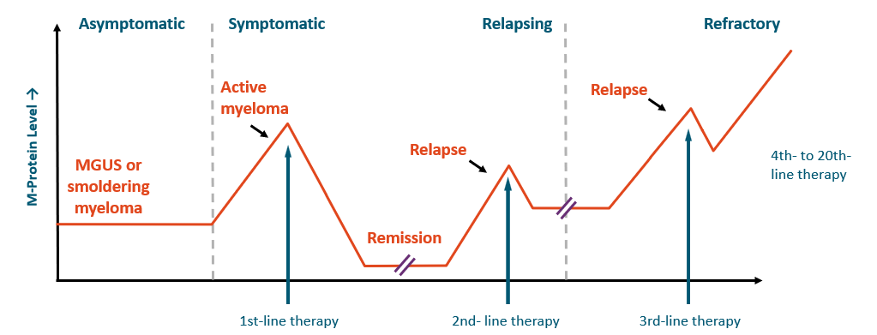
Multiple Myeloma Treatment Journey
With modern therapy, first relapse generally occurs ~4-5 yr after initial diagnosis
Many patients receive ≥5 lines of therapy over several yr and duration of remission decreases with each regimen
Treatment selection is affected by many factors
Relapse is evolving as approved drugs are used in combinations and in the upfront setting
Adapted from Borrello. Leuk Res. 2012;36:S3. Richardson. Blood Cancer J. 2018;8:109.
Notes:
MGUS, monoclonal gammopathy of undetermined significance.

Slide 7
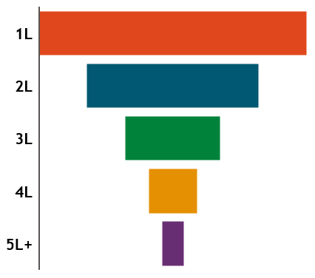
High Attrition Rates and Significant Unmet Need for Triple Class–Exposed Patients in Earlier Treatment Lines
Increasing use of all 3 classes of therapies in 1st and 2nd line, proportion of patients with TCE R/R MM increased from 10% (2017) to 25% (2020) in the 3rd-line setting ¹⁻³
US Epi⁸
Alive/treatment eligible
Approx. 30k
CARTITUDE-4⁷:
R/R MM, 1-3 prior therapies, including PI + IMiD; lenalidomide refractory
18k
KarMMa-3⁶:
R/R MM, 2-4 prior therapies, including an IMID, a PI, and an anti-CD38 antibody
12k
Treatment gap
CARTITUDE⁵:
R/R MM, ≥3 prior therapies including PI, IMiD, and anti-CD38 therapy, or double refractory to PI and IMiD
6k
KarMMa⁴:
R/R MM, ≥ 4 prior therapies, including an IMID, a PI, an anti-CD38 antibody
4k
1. NCCN. Clinical practice guidelines in oncology: multiple myeloma. v2.2026. nccn.org. 2. Delea. ASH 2023. Abstr 3773. 3. Perrot. Blood. 2021;138(suppl 1):3764. 4. Munshi. NEJM. 2021;384:705. 5. Lin. ASCO 2023. Abstr 8009.
6. Rodriguez-Otero. NEJM. 2023;388:1002. 7. San-Miguel. NEJM. 2023;389:335. 8. seer.cancer.gov/statistics-network/explorer.
Notes:
IMID, immunomodulatory drug; PI, proteasome inhibitor; R/R MM, relapsed/refractory multiple myeloma; TCE, triple class exposed.

Slide 8
Refractoriness to Multiple Agents Increases With Increasing Lines of Prior Therapy Limiting Bridging Options
Anti-CD38
IMiDs
PIs
Triple class refractory
3L
4L
5L+
Dara
Lena
Bortez
Pom
Carfil
Dara
Lena
Bortez
Pom
Carfil
Dara
Lena
Bortez
Pom
Carfil
The ideal bridging therapy contains agent(s) to which the patient’s myeloma is
not expected to be refractory, is safe, and can be administered promptly following apheresis
Anderson. Transplant Cell Ther. 2024;30:17. Bal. Br J Haematol. 2023;204:449. Dhakal. Blood Adv. 2024;8:5062.
Notes:
Bortez, bortezomib; Carfil, Carfilzomib; Dara, daratumumab; Lena, lenalidomide; Pom, pomalidomide.

Slide 9
CAR T-Cells in MM: Ide-cel and Cilta-cel
High efficacy: Both ide-cel and cilta-cel demonstrate deep and durable responses, even in heavily pretreated multiple myeloma
Manageable safety profile: Toxicities such as cytopenias, CRS, and ICANS are generally predictable and effectively managed with established protocols
Consistent real-world outcomes: Data from >1000 patients confirm clinical trial efficacy and safety
No new safety signals observed in real-world experience
Single-infusion therapy: A “one-and-done” approach that may significantly improve patients’ HRQoL
Rodriguez-Otero. NEJM. 2023;388:1002. San-Miguel. NEJM. 2023;389:335. Mateos. IMS 2024. Abstr OA-65. Voorhees. ASCO 2025. Abstr 7507. Jesús Sidana. Blood. 2025;145:85. Hansen. JCO. 2023;41:2087. Wesson. Transplant Cell Ther. 2024;30:876. Fonseca. Clin Lymphoma Myeloma Leuk. 2023;23:426.
Notes:
Cilta-cel, Ciltacabtagene Autoleucel ;CRS, Cytokine release syndrome; HRQOL, Health-related quality of life; ICANS,Immune Effector Cell-Associated Neurotoxicity Syndrome; Ide-cel, Idecabtagene Vicleucel.

Slide 10
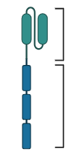
FDA-Approved Autologous CAR T-Cell Therapy for R/R MM
 | Idecabtagene Vicleucel (Ide-cel) | Ciltacabtagene Autoleucel (Cilta-cel) | Ciltacabtagene Autoleucel (Cilta-cel)
CAR type | BCMA/CD137 (4-1BB)/CD3z | 2-BCMA epitope binding domains/CD137 (4-1BB)/CD3z | 2-BCMA epitope binding domains/CD137 (4-1BB)/CD3z
Costimulatory domain | 4-1BB | 4-1BB
Vector | Lentivirus | lentivirus
LD (3 days) | Cyclophosphamide IV 300mg/m² daily + Fludarabine 30mg/m² IV daily
Pivotal trial | KarMMA-1 (R/R MM) | CARTITUDE-1 (R/R MM)
Median time from apheresis to delivery | 33 days | 29 days
BCMA CAR Construct
Antigen-recognition domain
Signaling domains
Initial approvals: patients with R/R MM after ≥4 prior LOT, including an IMiD, PI, and an anti-CD38 mAb.
Expanded indications granted (April 2024):
ide-cel after ≥2 prior LOT including an IMiD, PI, and an anti-CD38 mAb (KarMMa-3) and
cilta-cel after 1+ prior LOT including a PI and an IMiD and refractory to len (CARTITUDE-4).
Berdeja. Lancet. 2021;398:314. Ciltacabtagene autoleucel PI. Idecabtagene vicleucel PI. Image created from BioRender.com
Notes:
BCMA, B-cell maturation antigen; CAR, chimeric antigen receptor; Cilta-cel, Ciltacabtagene Autoleucel; LD, lymphodepletion; ide-cel, idecabtagene vicleucel; IMiD, immunomodulatory drug; mAb, monoclonal antibody; PI, proteasome inhibitor; R/R, relapsed refractory; MM, multiple myeloma.

Slide 11
KarMMa 3: Evaluating Dropout Before CAR T-Cell Therapy
Ide-cel
(n = 254)
Received ide-cel
N = 225 (89%)
MM patients with 2-4 prior lines of therapy
Randomized 2:1
SoC treatment (5 options)
(n = 132)
Received SoC
N = 126 (96%)
N = 29 (11%) did not receive ide-cel
24 dropped out after apheresis
Higher dropout in 3 or 4 LoT (10.5, 12.7%) vs vs 2 (5.3%)
 | No ide-cel, N = 29 | Yes ide-cel, N = 225
High risk (del 17p, t[4;14] and t[14;16]) | 79% | 37%
BMPCs ≥50% | 52% | 25%
Ailawadhi. Blood. 2024;144:2389.
Notes:
BMPCs, bone marrow plasma-cell; Ide-cel, Idecabtagene Vicleucel; MM, multiple myeloma; SoC, standard of care;

Slide 12
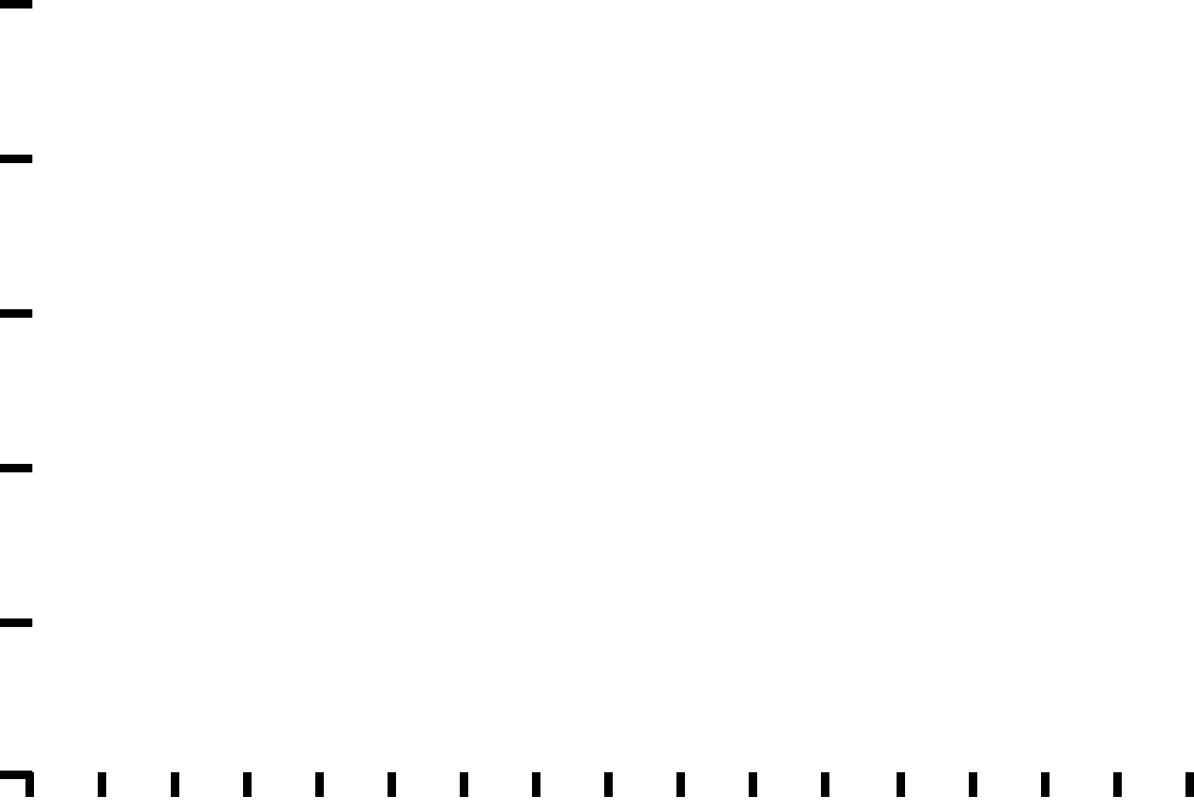
Earlier Use of CAR T-Cells: Potentially Better T-Cell Fitness
Kaplan-Meier analysis of patients with standard-risk and high-risk cytogenetics
PFS (as-treated population)
100
30-mo PFS
100
80
68.4%
80
60
CARTITUDE-4
60
% Surviving Without Progression
% Surviving Without Progression
40
54.2%
40
CARTITUDE-1
High risk, cilta-cel
Standard risk, cilta-cel
High risk, SoC
Standard risk, SoC
20
20
0
0
0
3
6
9
12
15
18
21
24
27
30
33
36
39
42
45
48
0
3
6
9
12
15
18
21
24
27
30
33
36
39
42
45
Patients at Risk, n
CARTITUDE-4
(1-3 prior LOT)
CARTITUDE-1
(≥3 prior LOT)
Mo From Cilta-cel Infusion
Mo From Cilta-cel Infusion
176
97
172
94
165
85
158
77
150
74
144
67
138
64
133
63
131
60
109
54
61
44
37
25
12
13
8
2
1
1
0
1
0
0
Patients at Risk, n
High risk, SoC
High risk, cilta-cel
Standard risk, SoC
Standard risk, cilta-cel
132
123
70
69
111
106
58
59
79
102
50
58
65
96
47
57
52
92
41
53
42
87
36
51
37
84
35
49
31
76
32
49
28
73
32
49
23
70
29
49
20
55
27
46
7
31
18
27
3
14
9
9
0
7
1
2
0
2
1
1
0
0
0
0
PFS: CARTITUDE-4 vs 1¹
Better PFS in earlier line use
Earlier in disease course: potentially better immune fitness
PFS: CARTITUDE-4 subgroups²
1. Mateos. IMS 2024. OA-65 2. Sidana. ASCO 2025. Abstr 7539.
Notes:
Slide 11:

Slide 13

What Type of Patient Is Eligible for CAR T-Cell Therapy?
Disease not likely to progress too quickly
Meets trial guidelines or product labeling
In generally good health (ECOG PS 0-2)
Attempted at least 1-4 other lines of therapy that have failed
(as per product label)
Has good organ function and lab results
Is at least 3 mo post SCT
(if this was a treatment)
Has a support system for patient journey
In general, more patients would be eligible for CAR T-cell therapy than stem cell transplantation
Dave. Curr Hematol Malig Rep. 2019;14:561. Perica. Biol Blood Marrow Transplant. 2018;24:1135.
Beaupierre. Clin J Oncol Nursing. 2019;23:27. Cohen. ASCO Educational Book. 2018; 38:e6.

Slide 14





CAR T-Cell Therapy Logistical Considerations
How far is the closest treatment center and what CAR T-cell products do they offer?
Can the patient travel or remain close to the center for extended periods of time (~4 wk)?
Does the patient have the ability to pay for treatment either through insurance coverage or other financing options?
When is the optimal time to harvest cells for best results?
Dave. Curr Hematol Malig Rep. 2019; 14:561. Perica. Biol Blood Marrow Transplant. 2018;24:1135. Beaupierre. Clin J Oncol Nursing. 2019;23:27.

Slide 15
CAR T-Cell Therapy Patient Journey
A snap-shot of the process, which underscores the need for early referrals and that effective communication is vital
Patient Identification
(Meets FDA Label)
Referral to
CAR T-Cell Specialist
T-Cell Collection
Close Monitoring
± Bridging Therapy
No age cutoff
No requirement for BCMA+
CAR centers will have variable eligibility criteria, so best to refer and let them decide
Patients can be CAR candidates who are not auto-transplant candidates
The earlier the referral, the better!
Eligibility evaluation
Insurance authorization
Consent and education
LD Chemotherapy
and T-Cell Infusion
Is the patient experiencing significant symptoms or at risk for organ function impairment?
Bridging could include steroids, palliative RT, chemotherapy, and/or newer targeted agents
LD chemo mostly outpatient
(ie, Flu/Cy x 3 days)
CAR T-cell infusion can be inpatient or outpatient
Postinfusion monitoring involves daily labs, close vital sign monitoring, and exams for at least 7 days to assess for CRS/NT
Patient remains within 2 hr of CAR center for 4 wk from infusion
Monitor for late CRS/NT and/or ongoing cytopenias
First response assessment often at 4-wk mark
Acute Post–CAR T-Cell Monitoring
Long-term Post–
CAR T-Cell Monitoring
Ciltacabtagene autoleucel PI. Idecabtagene vicleucel PI. Dave. Curr Hematol Malig Rep. 2019; 14:561.
Perica. Biol Blood Marrow Transplant. 2018;24:1135. Beaupierre. Clin J Oncol Nursing. 2019;23:27.

Slide 16
Salvage and Bridging Therapy: Community and Academic Coordination of Care
Goals of salvage therapy: to stabilize disease
  Requires washout period before apheresis
Goals of bridging therapy: reduce tumor burden, palliate symptoms, stabilize disease and QoL, and to maintain functional reserve during manufacturing period
  Limit CRS/ICANS severity by debulking
  Potential impact on CAR T-cell efficacy
Maintain frequent communication with patient, primary oncologist, and manufacturer
  Ensure workup completed
  Monitor patient’s status
Choose least toxic therapy, if possible, and allow hematologic recovery prior to LDC
  Real-life time from pheresis to infusion is >30 days
Consider avoiding immunosuppressive therapy, checkpoint inhibitors, blinatumomab; communicate when to stop salvage/bridging before apheresis
Salvage therapy may be recommended during time between referral and consult
and apheresis
For patients with rapidly proliferating disease, bridging therapy may be recommended during time between apheresis and lymphodepletion
Jain. Biol Blood Marrow Transpl. 2019;25:2305. Kansagra. Bone Marrow Transplant. 2019;54:1868.
Notes:
CAR, chimeric antigen receptor; CRS, cytokine-release syndrome; ICANS, immune effector cell–associated neurotoxicity syndrome; LDC, lymphodepleting chemotherapy; QoL, quality of life.

Slide 17
Questions and Challenges
Vein to vein time and slot access remains a challenge
What is the optimal bridging therapy to tumor reduce patients?
What do we do for patients who progress on bridging therapy?
Do we really need washout periods?
How do we identify patients who need a bridge?
With all available agents, can we now consider bispecifics to bridge patients?
Should we be concerned about heterogeneity of bridging therapies on outcomes of CAR T-cells?
Notes:
Medina-Olivares FJ, Gómez-De León A, Ghosh N. Obstacles to global implementation of CAR T cell therapy in myeloma and lymphoma. Front Oncol. 2024;14:1397613.

Slide 18
KarMMa-3: Earlier Line Treatment Improves Ability to Receive Ide-cel and Benefit From Bridging Therapy
Dropout Rate From leukapheresis to Ide-cel Infusion
Patients With Increased Disease Burden
(Post Bridging)
Patients (%)
Patients (%)
Dropout rate = % of patients who discontinued between leukapheresis and ide-cel infusion
Ailawadhi. Blood. 2024;144: 2389.
Notes:
https://ashpublications.org/blood/article/144/23/2367/526304/Moving-forward-in-good-KarMMa-in-myeloma

Slide 19
Go Online for More CCO
Coverage of MM!
Additional CME-Certified Text Modules on CAR-T bridging therapy in MM
Clinical Thought Expert Commentary with updates from ASH 2025 on CAR-T bridging therapy in MM coming soon!
clinicaloptions.com

