Slide 1
Immune Checkpoint Inhibitor–Based Therapy for Early-Stage Lung Cancer: Surgeon Perspective
Jonathan Spicer, MD, PhD, FRCS
Associate Professor of Surgery
Attending Thoracic Surgeon
Medical Director, McGill Thoracic Oncology Network
Department of Surgery
McGill University Health Center
McGill University
Montreal, Quebec
Supported by an educational grant from Genentech, a member of the Roche Group.

Slide 2

About These Slides
Please feel free to use, update, and share some or all of these slides in your noncommercial presentations to colleagues or patients
When using our slides, please retain the source attribution:
These slides may not be published, posted online, or used in commercial presentations without permission. Please contact permissions@clinicaloptions.com for details
Slide credit: clinicaloptions.com
Notes:
Disclaimer: The materials published on the Clinical Care Options Web site reflect the views of the authors of the CCO material, not those of Clinical Care Options, LLC, the CME providers, or the companies providing educational grants. The materials may discuss uses and dosages for therapeutic products that have not been approved by the United States Food and Drug Administration. A qualified healthcare professional should be consulted before using any therapeutic product discussed. Readers should verify all information and data before treating patients or using any therapies described in these materials.

Slide 3
Disclosures
Jonathan Spicer, MD, PhD, FRCS, has disclosed that he has received consulting fees from Amgen, AstraZeneca, Bristol-Myers Squibb, Merck, Protalix Biotherapeutics, and Roche and funds for research support from AstraZeneca, CLS Therapeutics, Merck, and Roche.
Notes:
This slide lists the disclosure information of the faculty involved in the development of these slides.

Slide 4

Lung Cancer: When to Operate?
Surgery: the original targeted therapy
  Remains central to cure for patients with lung cancer—however, role, timing, and pertinence at all disease stages continues to evolve
Role of surgery by disease stage:
  Stage I: surgery vs SBRT?
  Stage II: CT + surgery; surgery + CT; surgery + TKI; surgery + CT + IO; CRT?
  Stage III: CT ± RT + surgery; surgery + CT ± RT; surgery + CT + TKI; surgery + CT + IO; CRT + IO?
  Stage IV: surgery for oligometastasis—when, where, and in what order?
Slide credit: clinicaloptions.com
Notes:
CT, chemotherapy; IO, immunotherapy; SBRT, stereotactic body radiation therapy; TKI, tyrosine kinase inhibitor.

Slide 5
Randomized Trial of Perioperative CT + Surgery vs Surgery Alone in Stage IIIA NSCLC
Time to Death From Any Cause
Median OS,
Mo
3-Yr OS,
%
1.0
Patients,
n
2-Yr OS,
%
0.8
Perioperative CT + surgery
Surgery alone
28
32
64
11
60
25
56
15
0.6
OS Probability
0.4
Perioperative CT + surgery
0.2
Surgery alone
Log-rank P = .008; Wilcoxon P = .018
0.0
80
0
20
40
60
Mo
35% of patients achieved a clinical major response with 3-cycles of perioperative chemotherapy
Roth. JNCI. 1994;86:673.
Slide credit: clinicaloptions.com
Notes:
CT, chemotherapy; NSCLC, non-small-cell lung cancer; OS, overall survival.

Slide 6

Outcomes in Early-Stage NSCLC: Room for Improvement
OS* by Pathologic Stage (AJCC 8th Edition)
100
Proposed | Events/N | mOS, Mo | 24-Mo OS, % | 60-Mo OS, %
IA1 | 139/1389 | NR | 97 | 90
IA2 | 823/5633 | NR | 94 | 85
IA3 | 875/4401 | NR | 92 | 80
IB | 1618/6095 | NR | 89 | 73
IIA | 556/1638 | NR | 82 | 65
IIB | 2175/5226 | NR | 76 | 56
IIIA | 3219/5756 | 41.9 | 65 | 41
IIIB | 1215/1729 | 22.0 | 47 | 24
IIIC | 55/69 | 11.0 | 30 | 12
80
60
40
20
0
0
24
48
72
Mo
*OS per IASLC global database for patients receiving NSCLC diagnoses from 1999-2010.
Goldstraw. J Thorac Oncol. 2016;11:39.
Slide credit: clinicaloptions.com
Notes:
AJCC, American Joint Committee on Cancer; IASLC, International Association for the Study of Lung Cancer; mOS, median overall survival; NR, not reached; NSCLC, non-small-cell lung cancer; OS, overall survival.

Slide 7
Select Neoadjuvant Immunotherapy Trials for Treatment of Operable NSCLC
Neoadjuvant Immunotherapy Approach | No. of Trials | Phases
Immunotherapy monotherapy | 6 | IB, II
Combination immunotherapy | 2 | II
Combination immunotherapy and chemotherapy | 10 | II,III
Combination immunotherapy and radiation therapy | 3 | II
Huynh. Transl Lung Cancer Res. 2021;10:563.
Slide credit: clinicaloptions.com
Notes:
NSCLC, non-small-cell lung cancer.

Slide 8
Major Pathologic Response as a Surrogate Endpoint in Trials of Neoadjuvant CT for Resectable NSCLC
Retrospective evaluation of major pathologic response as a surrogate marker of survival
  Major pathologic response: ≤10% residual viable tumor after neoadjuvant chemotherapy
Assessment of % viable residual tumor
  Measure gross maximum diameter of tumor
  Cut ≥1 section per greatest tumor diameter and stain with H&E
  Measure % viable tumor cells in each slide
  Sum the % viable tumor cells in each slide and divide by number of examined slides
Percentage of Residual Viable Tumor After Neoadjuvant CT | HR for Death (95% CI)
1%-10% | 1.00
11%-30% | 2.51 (0.91-6.96)
31%-50% | 3.39 (1.40-8.22)
51%-70% | 4.57 (1.98-10.52)
71%-100% | 4.78 (2.06-11.11)
OS significantly improved with neoadjuvant CT in patients who had deeper pathologic responses (ie, ≤10% residual viable tumor)
Hellmann. Lancet Oncol. 2014;15:e42.
Slide credit: clinicaloptions.com
Notes:
CT, chemotherapy; H&E, hematoxylin and eosin; NSCLC, non-small-cell lung cancer; OS, overall survival.

Slide 9
Strategic Path to Cure for Patients With Early-Stage NSCLC
Biomarkers
Identification of biomarkers
of risk and prognosis
Immunization
Tumor-specific T-cell
clonality expansion in
peripheral blood
Biomarkers
Identification of biomarkers
of response and progression
Screening
Diagnosis
Neoadjuvant therapy
Surgery
Adjuvant therapy
Survivorship
Prehabilitation and nutrition
Program aimed at improving
functional and nutritional status
Scientific opportunities
Collection of tissue and blood samples for future biomedical research
Risk factor modification
Patient education aiming at
lung cancer prevention
Huynh. Transl Lung Cancer Res. 2021;10:563.
Slide credit: clinicaloptions.com
Notes:
NSCLC, non-small-cell lung cancer.

Slide 10
Randomized Trial of Multimodal Prehabilitation for Lung Cancer Surgery
Postoperative Clinical Outcomes | Prehabilitation (n = 52) | Rehabilitation (n = 43) | P Value
Median length of hospital stay, days (IQR) | 4 (2-5.75) | 4 (3-5) | .27
Discharge day, n (%) Postoperative Day 1-2 Postoperative Day 3-4 Postoperative Day 5+ | 22 (42) 12 (40) 18 (100) | 7 (16) 22 (61) 14 (100) | .0069 .005 .84
ED visits in 30 days, n (%) | 7 (14) | 9 (21) | .33
Readmissions in 30 days, n (%) | 4 (8) | 6 (14) | .32
Death, n (%) | 2 (4) | 0 (0) | .19
Clavien grade, n (%) 0 I II IIIa IIIb V | 25 (48) 13 (25) 9 (17) 2 (4) 1 (2) 2 (4) | 17 (40) 12 (28) 9 (21) 3 (7) 2 (5) 0 (0) | .66
Median Comprehensive Comorbidity Index (IQR) | 8.7 (0-20.9) | 8.7 (0-20.9) | .39
Patient-Reported Outcomes, n (%) | Prehabilitation (n = 52) | Rehabilitation (n = 43) | P Value
SF-36 Mental Summary Baseline Preoperative 4 wk after surgery 8 wk after surgery | 72.7 (17.6) 74.8 (16.4) 66.9 (15.2) 71.3 (16.9) | 66.8 (22.8) 68.8 (21.3) 60.5 (14.5) 70.1 (18.1) | .18 .15 .052 .76
SF-36 Physical Summary Baseline Preoperative 4 wk after surgery 8 wk after surgery | 70.3 (16.3) 73.7 (17.5) 56.6 (13.7) 69.3 (15.4) | 67.2 (21) 69.6 (19.8) 48.1 (14.3) 61.9 (16.3) | .44 .3 .006 .034
SF-36 Total Baseline Preoperative 4 wk after surgery 8 wk after surgery | 73 (16.6) 75.5 (16.6) 60.9 (14.5) 70.4 (16.4) | 68.1 (22.4) 70.3 (21.1) 53.7 (13.8) 66.3 (15.2) | .26 .2 .022 .24
Multimodal prehabilitation initiated 4 wk prior to surgery effective in recovering functional capacity in patients undergoing surgical resection
Ferreira. Ann Thorac Surg. 2020;112:1600.
Slide credit: clinicaloptions.com
Notes:
ED, emergency department; IQR, interquartile range; SF, short form.

Slide 11
Optimizing Outcomes for Locally Advanced NSCLC Using Neoadjuvant Prehabilitation Therapy
Retrospective analysis of patients with NSCLC receiving neoadjuvant therapy followed by curative-intent surgery at McGill University Health Center (2015-2020; N = 93)
  12 patients screened for prehabilitation program, including physical performance assessment, nutritional status, signs for anxiety/depression
  9 patients completed full neoadjuvant rehabilitation program
6-Min Walk Test*
Length of Hospital Stay
30
600
20
400
6-Min Walk Test (Meters)
Length of Stay (Days)
200
10
0
0
Baseline
Preop
4 Wk
Postop
Prehab
No Prehab
*Used as functional outcome parameter of prehabilitation.
Schmid. ASCO 2021. Abstr e20545.
Slide credit: clinicaloptions.com
Notes:
NSCLC, non-small-cell lung cancer; Postop, postoperative; Prehab, prehabilitation.

Slide 12
Neoadjuvant vs Adjuvant Chemotherapy for Patients With Resectable cT2-4N0-1M0 NSCLC
Retrospective propensity-matched analysis of outcomes with neoadjuvant vs adjuvant chemotherapy for cT2-4N0-1M0 NSCLC with R0 resection (N = 330)
DFS
OS
1.0
Log-rank P = .701
1.0
Log-rank P = .768
0.8
0.8
0.6
0.6
Probability of DFS
Probability of OS
0.4
5-Yr DFS,
%
0.4
5-Yr OS,
%
0.2
Neoadj CT (n = 92)
Adj CT (n = 92)
48
48
0.2
Neoadj CT (n = 92)
Adj CT (n = 92)
64
61
0
0
0
1
2
3
4
5
0
1
2
3
4
5
Yr Since Initial Treatment
Yr Since Initial Treatment
Chemotherapy Tolerance, n (%) | Neoadjuvant (n = 92; 50%) | Adjuvant (n = 92; 50%) | P Value
Received full dose of chemotherapy | 72 (78) | 58 (63) | .014
Received all cycles of chemotherapy | 84 (91) | 72 (78) | .005
Grade ≥3 AE to chemotherapy | 14 (15) | 35 (38) | .001
Brandt. J Thorac Cardiovasc Surg. 2019;157:743.
Slide credit: clinicaloptions.com
Notes:
Adj, adjuvant; AE, adverse event; CT, chemotherapy; DFS, disease-free survival; Neoadj, neoadjuvant; NSCLC, non-small-cell lung cancer; OS, overall survival.

Slide 13
Neoadjuvant Nivolumab in Patients With
Resectable Early-Stage NSCLC
Pilot study of 2 preoperative nivolumab doses in untreated, resectable stage I-IIIA NSCLC (n = 21)
Major pathologic responses occurred in 9 of 20 patients (45%; 95% CI: 23-68)
  In both PD-L1–positive and PD-L1–negative tumors
Pathological Regression in Resected Primary Tumor by Subgroup (n = 20)
0
-20
-40
Regression (%)
Regression (%)
-60
PD-L1+
PD-L1-
Unknown
-80
MPR
(-90%)
-100
Smoking Status
Histologic Subtype
RECIST Response
LN Metastases
Current/ex-smoker
Never smoked
AC
SCC
Other
PR
SD
LN+
LN-
Cytokeratin+ tumor cells (orange), CD68+ macrophages (magenta), FoxP3+ regulatory
T-cells (yellow), CD8+ T-cells (green), PD-1+ cells (red), and PD-L1+ cells (white).
Forde. NEJM. 2018;378:1976.
Slide credit: clinicaloptions.com
Notes:
AC, adenocarcinoma; LN, lymph node; MPR, major pathologic response; NSCLC, non-small-cell lung cancer; PR, partial response; RECIST, response evaluation criteria in solid tumors; SCC, squamous-cell carcinoma; SD, stable disease.

Slide 14
LCMC3: Neoadjuvant Atezolizumab in Patients With
Resectable Early-Stage NSCLC
Phase II study of 2 preoperative atezolizumab doses in untreated, resectable
stage IB-IIIB NSCLC (N = 181)
Pathologic Response in Surgery Population (n = 159)
Pathologic Response in Primary Efficacy Population (n = 144)
0
40
-10
-20
-30
21*
-40
Pathologic Regression (%)
Patients (%)
-50
20
-60
EGFR/ALK+
Regression >-90%
MPR
pCR
7*
-70
-80
-90
MPR
30/144
10/144
0
-100
MPR
pCR
Lee. WCLC 2020. Abstr PS02.05.
*Error bars indicate 95% CI.
Slide credit: clinicaloptions.com
Notes:
MPR, major pathologic response; NSCLC, non-small-cell lung cancer; pCR, pathologic complete response.

Slide 15
Phase II Trial: Neoadjuvant Atezolizumab + Chemotherapy in Early-Stage Resectable NSCLC
Phase II trial of preoperative atezolizumab with carboplatin/nab-paclitaxel in resectable stage IB-IIIA NSCLC (N = 30)
  Stage IIIA: 77%
Outcomes
  97% taken to surgery
  87% with R0 resection
  57% achieved MPR
Pathologic Response in Patients Who Underwent
Successful R0 Resection (n = 26)
10
0
0
-10
-5
-20
-30
-28
-40
Pathologic Regression (%)
-50
-45
-47
-50
-60
-70
-63
-80
-70
-71
-90
PD-L1+ (PD-L1 TPS ≥1%)
PD-L1- (PD-L1 TPS <1%)
PD-L1 unknown
MPR
(-90%)
-10
-90
-90
-91
-91
-94
-94
-97
-110
-100
-100
-100
-100
-100
-100
-100
-100
-100
-100
Best
Radiographic Response (%)
-9
+6
-4
-41
-26
-16
-43
-31
-16
-48
-48
-15
-41
-71
-34
-40
-45
-52
-37
-33
-37
-34
-46
-57
-56
-46
Stable disease
Partial response
Progressive disease
Shu. Lancet Oncol. 2020; 21:786.
Slide credit: clinicaloptions.com
Notes:
MPR, major pathologic response; NSCLC, non-small-cell lung cancer; TPS, tumor proportion score.

Slide 16
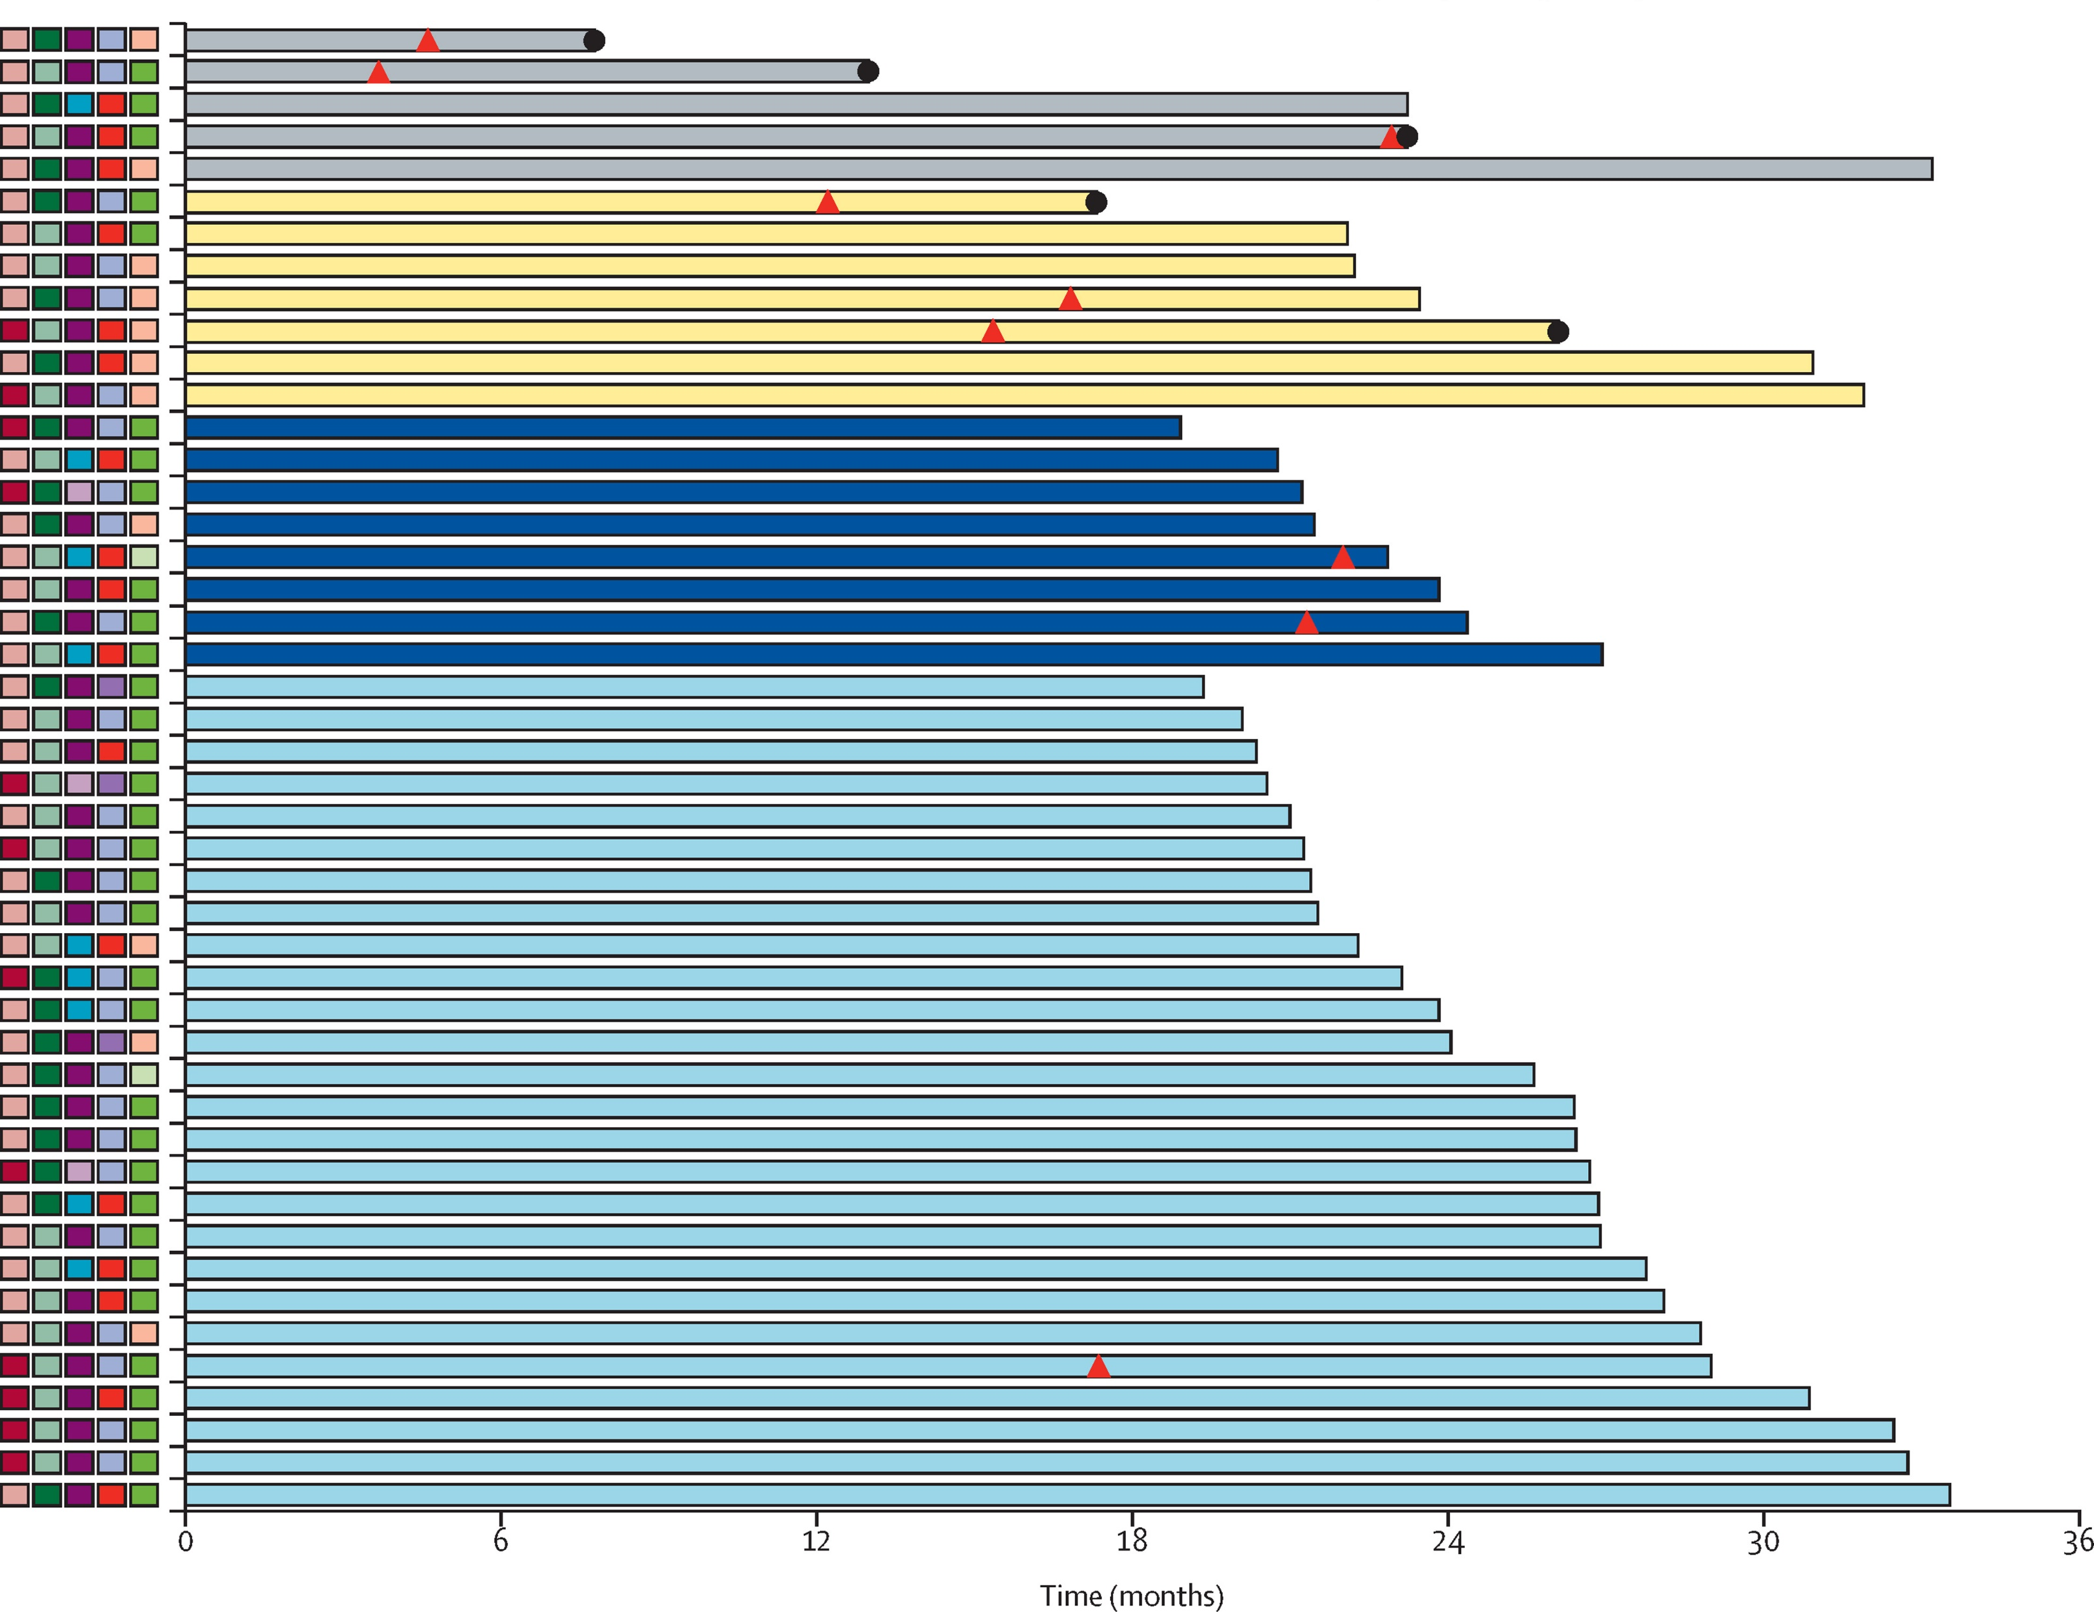
Phase II NADIM: Neoadjuvant Nivolumab + CT in Stage IIIA Resectable NSCLC
PFS in Modified ITT Population (n = 46)
Sex
Smoking status
Lymph nodes
MPR: 83%
pCR: 63%
Female
Male
Smoker
Former smoker
N2
N1
N0
Histology
RECIST version 1.1
Adenocarcinoma
Squamous
Other
Stable disease
Partial response
Complete response
Pathological response
Follow-up
Not resected
Incomplete pathologic response
Major pathologic response
Complete pathologic response
Disease progression
Died
Sex
0
6
12
18
24
30
36
LN status
Histology
RECISTv1.1
Smoking status
Provencio. Lancet Oncol. 2020;21:1413.
Slide credit: clinicaloptions.com
Notes:
CT, chemotherapy; ITT, intention-to-treat; MPR, major pathologic response; NSCLC, non-small-cell lung cancer; pCR, pathologic complete response; PFS, progression-free survival; RECIST, Response Evaluation Criteria in Solid Tumors.

Slide 17

CheckMate 816: Neoadjuvant Nivolumab + Platinum Chemotherapy for Resectable Stage IB-IIIA NSCLC
Randomized, open-label phase III trial (data cutoff: September 16, 2020; min f/u: 7.6 mo)
Stratified by stage (IB/II vs IIIA), PD-L1‖ (≥1% vs <1%), and sex
Radiologic restaging
Nivolumab 360 mg Q3W +
CT†‡ Q3W
(n = 179)
Patients with
newly diagnosed, resectable, stage IB (≥4 cm) to IIIA NSCLC*; no sensitizing EGFR mutations or ALK alterations; ECOG PS 0/1
(N = 358)
Surgery (within 6 wk post tx)
Optional adjuvant CT ± RT
Follow-up
CT†§ Q3W
(n = 179)
*By TNM 7th edition. †3 cycles. ‡NSQ: cisplatin/pemetrexed or carboplatin/paclitaxel; SQ: cisplatin/gemcitabine or carboplatin/paclitaxel. §NSQ: cisplatin/pemetrexed; SQ: cisplatin/vinorelbine, cisplatin/docetaxel, cisplatin/gemcitabine; both: carboplatin/paclitaxel. ‖PD-L1 28-8 pharmDx IHC assay. Arm evaluating nivolumab (3 mg/kg for 3 cycles) + ipilimumab (1 mg/kg for 1 cycle) not shown.
Primary endpoints: pCR (by BIPR) and EFS (by BICR)
Key secondary endpoints: OS, MPR (by BIPR), time to death or distant metastasis
Key exploratory endpoints: ORR (by BICR), feasibility of surgery, peri- and postoperative surgery related AEs
Forde. AACR 2021. Abstr CT003. Spicer. ASCO 2021. Abstr 8503. NCT02998528.
Slide credit: clinicaloptions.com
Notes:
AE, adverse event; BIPR, blind independent pathology review; CT, chemotherapy; ECOG, Eastern Cooperative Oncology Group; EFS, event-free survival; f/u, follow-up; MPR, major pathologic response; NSCLC, non-small-cell lung cancer; ORR, overall response rate; OS, overall survival; pCR, pathologic complete response; PS, performance status; RT, radiation therapy; tx, treatment.

Slide 18
CheckMate 816: Improved Pathological Response With Neoadjuvant Nivolumab + Chemotherapy
pCR (ITT; ypT0N0)*
MPR (ITT)
40
Difference: 21.6%
50
Difference: 27.9%
30
OR: 13.94
(99% Cl: 3.49-55.75)
P < .0001
40
36.9%
OR: 5.70
(99% Cl: 3.16-10.26)
pCR Rate (%)
24.0%
MPR Rate (%)
30
20
20
10
10
8.9%
2.2%
0
0
Nivo + CT
(43/179)
CT
(4/179)
Nivo + CT
(66/179)
CT
(16/179)
n/N =
n/N =
Initial report of CheckMate 816 trial showed significantly improved pCR* and MPR with tolerable safety profile for neoadjuvant nivolumab + CT vs CT alone
Forde. AACR 2021. Abstr CT003. Spicer. ASCO 2021. Abstr 8503.
Slide credit: clinicaloptions.com
*Primary endpoint.
Notes:
CT, chemotherapy; ITT, intention-to-treat; MPR, major pathologic response; Nivo, nivolumab; OR, odds ratio; pCR, pathologic complete response.

Slide 19
CheckMate 816: Pathologic Regression in Primary Tumor by Stage
Nivolumab + CT (n = 144)
CT (n = 126)
0
Patients (n = 52)
0
Patients (n = 49)
-20
-20
-40
-40
Regression in Tumor Area
With Viable Tumor Cells (%)
Regression in Tumor Area
With Viable Tumor Cells (%)
Stage IB/II
-60
-60
-80
-80
-100
≤10% viable tumor cells
-100
≤10% viable tumor cells
pCR in primary tumor
(0% viable tumor cells)
pCR in primary tumor
(0% viable tumor cells)
0
Patients (n = 89)
0
Patients (n = 77)
-20
-20
Stage IIIA
-40
-40
Regression in Tumor Area
With Viable Tumor Cells (%)
Regression in Tumor Area
With Viable Tumor Cells (%)
-60
-60
-80
-80
-100
≤10% viable tumor cells
-100
≤10% viable tumor cells
pCR in primary tumor
(0% viable tumor cells)
pCR in primary tumor
(0% viable tumor cells)
Median residual viable tumor percentage in stage IB/II and stage IIIA: nivo + CT, 28% and 8%; CT, 79% and 70%
Spicer. ASCO 2021. Abstr 8503.
Slide credit: clinicaloptions.com
Notes:
CT, chemotherapy; pCR, pathologic complete response.

Slide 20
CheckMate 816: Pathologic Response by ctDNA Clearance
ctDNA Clearance Rate (C1D1 to C3D1)
pCR Rate by ctDNA Clearance
80
80
With ctDNA Clearance
Without ctDNA Clearance
60
56
60
Patients With ctDNA Clearance (%)
pCR rate (%)
46
40
34
40
20
20
13
3
0
0
0
Nivo + CT
(24/43)
CT
(15/44)
Nivo + CT
(11/24)
CT
(2/15)
Nivo + CT
(0/19)
CT
(1/29)
n/N =
n/N =
ctDNA clearance measured using tumor-guided personalized ctDNA panel; n = 90 evaluable patients, n = 87 patients with detectable ctDNA at C1D1
Forde. AACR 2021. Abstr CT003.
Slide credit: clinicaloptions.com
Notes:
CT, chemotherapy; ctDNA, circulating tumor DNA; Nivo, nivolumab; pCR, pathologic complete response.

Slide 21
CheckMate 816: Treatment and Surgery Summary in
All Randomized Patients
Randomized patients
(N = 358)
Completed Neoadjuvant Tx
(3 cycles)
Nivolumab + CT
(n = 179)
Completed Neoadjuvant Tx
(3 cycles)
CT
(n = 179)
94%
Received Neoadjuvant Tx
98%
Received Neoadjuvant Tx
98%
85%
Median time from last dose
to definitive surgery:
5.3 wk (IQR: 4.6-6.0)
Definitive Surgery
Median time from last dose
to definitive surgery:
5.0 wk (IQR: 4.6-5.9)
Definitive Surgery
16%
Cancelled
21%
Cancelled
PD: 7%
AE: 1%
Other: 8%
PD: 10%
AE: 1%
Other: 11%
83%
Received
75%
Received
Median Duration of Surgery
184 min
Median Duration of Surgery
217 min
Spicer. ASCO 2021. Abstr 8503.
Slide credit: clinicaloptions.com
Notes:
AE, adverse event; CT, chemotherapy; IQR, interquartile range; Nivo, nivolumab; PD, progressive disease; Tx, treatment.

Slide 22
CheckMate 816: Surgery Summary by Disease Stage at Baseline
Randomized patients
(N = 358)
Nivo + CT
(n = 179)
CT
(n = 179)
Stage IB/II
(n = 65)
Stage IIIA
(n = 113)
Stage IB/II
(n = 63)
Stage IIIA
(n = 115)
Definitive surgery
Definitive surgery
Definitive surgery
Definitive surgery
12%
Cancelled
17%
Cancelled
13%
Cancelled
25%
Cancelled
PD: 5%
Other: 8%
AE: 2%
PD: 8%
Other: 7%
PD: 2%
Other: 11%
AE: 2%
PD: 14%
Other: 10%
85%
Received
83%
Received
82%
Received
72%
Received
Median duration
of surgery
169 min
Median duration
of surgery
186 min
Median duration
of surgery
210 min
Median duration
of surgery
218 min
Spicer. ASCO 2021. Abstr 8503.
Slide credit: clinicaloptions.com
Notes:
AE, adverse event; CT, chemotherapy; Nivo, nivolumab; PD, progressive disease; Tx, treatment.

Slide 23
CheckMate 816: Surgical Approach and
Type of Surgery by Disease Stage at Baseline
Surgical Approach
Type of Surgery
Patients (%)
BL stage
n/
N
88/
149
85/
135
32/
55
35/
52
56/
94
50/
83
44/
149
29/
135
16/
55
13/
52
28/
94
16/
83
17/
149
21/
135
7/
55
4/
52
10/
94
17/
83
115/
149
82/
135
41/
55
33/
52
74/
49
49/
83
24/
149
34/
135
9/
55
9/
52
16/
49
25/
83
Nivo + CT
CT
Spicer. ASCO 2021. Abstr 8503.
Slide credit: clinicaloptions.com
Notes:
BL, baseline; CT, chemotherapy; Nivo, nivolumab.

Slide 24
CheckMate 816: Completeness of Resection in
All Randomized Patients
In both arms, R0, R1, and R2 resection rates were similar regardless of baseline stage of disease
Median lymph nodes dissected also similar:
  Nivo + CT: 19.0
  (IQR: 12-25)
  CT alone: 18.5
  (IQR: 10-26)
Spicer. ASCO 2021. Abstr 8503.
Slide credit: clinicaloptions.com
Notes:
CT, chemotherapy; IQR, interquartile range; Nivo, nivolumab.

Slide 25
CheckMate 816: Hospital Stay Summary
 | Nivolumab + CT (n = 135) | CT (n = 124)
Median length of hospital stay, days (IQR) | 10.0 (7.0-14.0) | 10.0 (7.0-14.5)
Median length of hospital stay by surgery type, days (IQR) Lobectomy* Pneumonectomy* Other*† | 10.0 (7.0-15.0) 10.0 (8.0-13.0) 8.5 (4.0-13.0) | 9.0 (6.0-14.0) 11.0 (9.0-16.0) 9.0 (7.0-14.0)
Median length of hospital stay per region, days (IQR) North America‡ Europe‡ Asia‡ | 4.0 (4.0-7.0) 9.5 (8.0-14.0) 11.0 (9.0-16.0) | 6.0 (4.0-8.0) 13.0 (7.0-18.0) 13.0 (10.0-16.0)
*For nivolumab + CT and CT, respectively: lobectomy, n = 104 and n = 77; pneumonectomy, n = 23 and n = 29; other, n = 26 and n = 32. †Including bilobectomy, sleeve lobectomy, other. Patients may have received more than one surgery type. ‡For nivolumab + CT and CT, respectively: North America, n = 31 and n = 38; Europe, n = 26 and n = 11; Asia, n = 73 and n = 70.
Length of hospital stay was similar in both arms regardless of disease stage
Spicer. ASCO 2021. Abstr 8503.
Slide credit: clinicaloptions.com
Notes:
CT, chemotherapy; IQR, interquartile range.

Slide 26
CheckMate 816: Surgery-Related Complications up to
90 Days After Definitive Surgery
 | Nivolumab + CT (n = 149) |  | CT (n = 135)
 | Any Grade | Grade 3/4 | Any Grade | Grade 3/4
Surgery-related AE, % | 41 | 11 | 47 | 15
25
20
15
Grade
Patients With a Surgery-Related AE Occurring in ≥3% of Patients (%)
1/2
3/4
2
2
Nivolumab + CT
CT
10
1
16
1
5
10
10
3
7
7
2
1
6
5
4
5
1
4
4
2
3
3
3
2
3
2
2
3
2
2
3
1
3
1
1
3
1
3
0
Anemia
Pain
Wound complication
Procedural pain
Pyrexia
Pneumonia
Pneumo-thorax
Subcutaneous emphysema
Atrial
fibrillation
Cough
Pleural
effusion
Nausea
Dyspnea
Pulmonary
fistula
Non-cardiac chest pain
n = 2 grade 5 surgery-related AEs (pulmonary embolism, aortic rupture) in nivolumab + CT arm considered unrelated to study drug by investigator.
n = 2 intraoperative complications (intraoperative hemorrhage, aortic rupture) in nivolumab + CT arm deemed not related to study drug.
Spicer. ASCO 2021. Abstr 8503.
Slide credit: clinicaloptions.com
Notes:
AE, adverse event; CT, chemotherapy.

Slide 27
LCMC4 Evaluation of Actionable Drivers in Early-Stage Lung Cancers/LCRF LEADER Neoadjuvant Screening Trial
Umbrella trial evaluating the use of comprehensive molecular profiling in tissue and blood to individualize therapy selection for patients with suspected early-stage lung cancers (planned
N = 1000)
Primary endpoint: proportion of patients with actionable oncogenic drivers
Secondary endpoint: TMB
Identify driver mutations at diagnosis: EGFR, MET, ROS1, BRAF V600E, RET, HER2, ALK, TMB-H*, or TMB-L*
Patients with resectable, stage IB-IIIB lung cancer (per 8th edition of TNM for lung cancer) enrolled with local genotyping or ctDNA
Individualized neoadjuvant therapy: targeted therapy†, checkpoint inhibitor, or checkpoint inhibitor + CT
CT and PET/CT scans, repeat ctDNA
MPR and pCR rates
Correlates in persister cells
Adjuvant therapy: investigator’s choice then personalized strategies based on future research studies
*If no oncogenic driver mutation. †EGFR-, ALK-, ROS1-, MET-, BRAF-, or RET-targeted therapies.
Blumenthal. J Thorac Oncol. 2018;13:1818. NCT04712877.
Slide credit: clinicaloptions.com
Notes:
CT, chemotherapy; ctDNA, circulating tumor DNA; H, high; L, low; MPR, major pathologic response; pCR, pathologic complete response; TMB, tumor molecular burden.

Slide 28
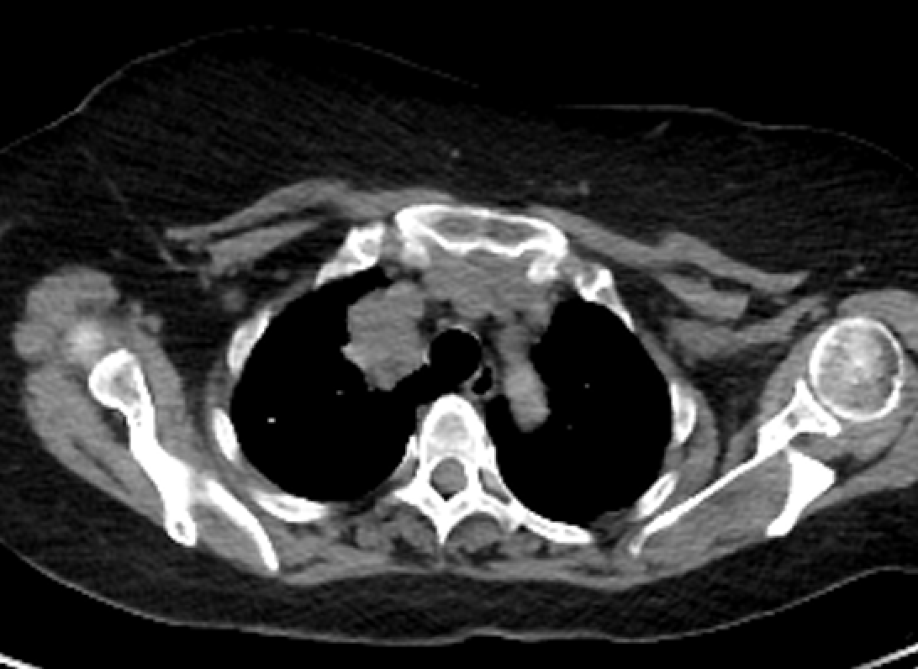
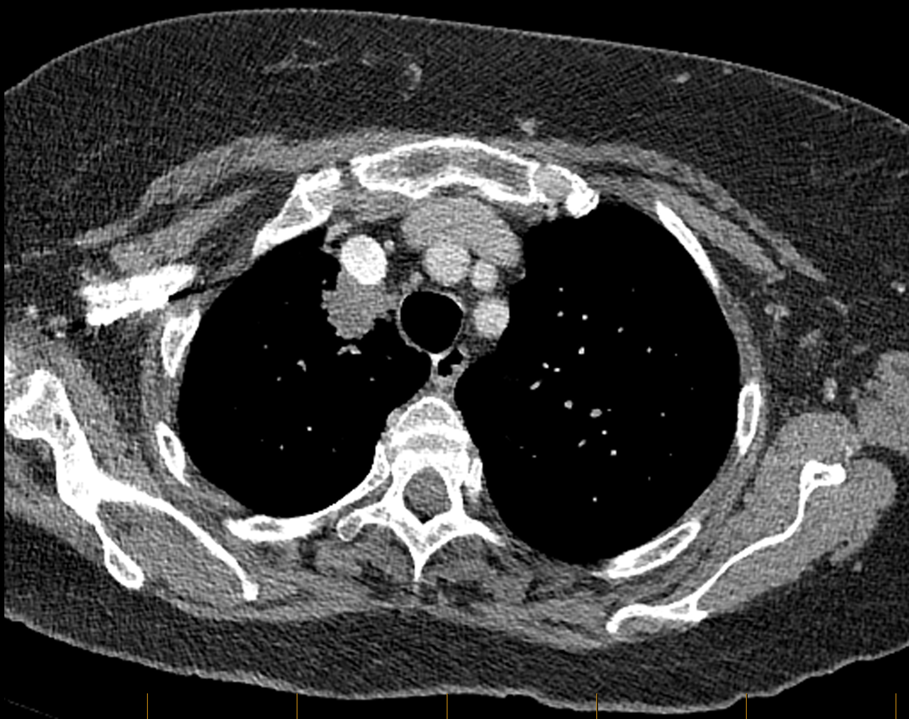
Patient Case: Neoadjuvant Alectinib in
Early-Stage NSCLC
62-yr-old female patient with T3N1 adenocarcinoma with an ALK translocation
Received 1 month of neoadjuvant alectinib followed by VATS RUL D/C POD#2
15% residual viable tumor after surgery
Clinical images courtesy of Jonathan Spicer, MD, PhD, FRCS; McGill University.
Slide credit: clinicaloptions.com
Notes:
NSCLC, non-small-cell lung cancer; VATS, Video-assisted thoracoscopic surgery.

Slide 29
Can We Predict the Occurrence of Pathological Complete Response With Perioperative IO?
MK3475-A74: prospective, randomized, open-label phase II trial of neoadjuvant pembrolizumab
ctDNA Measurements:
Screening
(28 Days)
Neoadjuvant Tx
(9 Wk)
Surgery
(Within 4-6 Wk)
Adjuvant Tx
(36 Wk)
Pembrolizumab 300 mg Q3W x 3 cycles
Anatomic Resection† + Complete Mediastinal LN Dissection‡
Pembrolizumab 400 mg Q6W x 6 cycles ±
Chemotherapy*
Q3W x 4 cycles
Patients with
stage IA3-IIA NSCLC;
eligible for resection; FEV1 >50%; DLCO >50%
(N ≈ 44)
Pembrolizumab 300 mg +
Chemotherapy*
Q3W x 3 cycles
Stratified by PD-L1 TPS <50% vs ≥50%
*Histology-specific: squamous, carbo/pac; nonsquamous, carbo/pemetrexed. †Including segmentectomy, lobectomy, bilobectomy, bronchial or vascular sleeve, or pneumonectomy. ‡3 N2 stations + 2 N1 stations.
Primary outcome: ctDNA measurement
NCT04638582.
Slide credit: clinicaloptions.com
Notes:
carbo, carboplatin; ctDNA, circulating tumor DNA; DLCO, diffused capacity of lung for carbon monoxide; FEV, forced expiratory volume; IO, immuno-oncology; LN, lymph node; NSCLC, non-small cell lung cancer; pac, paclitaxel; Tx, treatment.

Slide 30
Go Online for More CCO Coverage
Lung Cancer!
CME/CPE/CNE-certified text modules on IO for early-stage NSCLC from the point of view of various HCPs
CME/CPE/CNE-certified on-demand webcast (coming soon!) and downloadable slideset from a live webinar on IO for early-stage NSCLC
Patient-friendly downloadable PDF resource on IO for early-stage NSCLC
NSCLC Interactive Decision Support Tool featuring the latest
management recommendations from 5 NSCLC experts
clinicaloptions.com/oncology
clinicaloptions.com/LungTool
clinicaloptions.com/immuneAETool

