Slide 1
Steering Through Change: Adapting to New Guidelines in CKD Evaluation and Management
Provided by Clinical Care Options, LLC
This activity is supported by an independent medical educational grant from Boehringer Ingelheim Pharmaceuticals, Inc. and Eli Lilly and Company.

Slide 2

About These Slides
Please feel free to use and share some or all of these slides in your noncommercial presentations to colleagues or patients
When using our slides, please retain the source attribution:
These slides may not be published, posted online, or used in commercial presentations without permission. Please contact permissions@clinicaloptions.com for details
Slide credit: clinicaloptions.com
Notes:
Disclaimer: The materials published on the Clinical Care Options website reflect the views of the authors of the CCO material, not those of Clinical Care Options, LLC, the CME providers, or the companies providing educational grants. The materials may discuss uses and dosages for therapeutic products that have not been approved by the United States Food and Drug Administration. A qualified healthcare professional should be consulted before using any therapeutic product discussed. Readers should verify all information and data before treating patients or using any therapies described in these materials.

Slide 3
Faculty
Mark J. Sarnak, MD, MS
Chief, Division of Nephrology
Tufts Medical Center
Professor of Medicine
Tufts University School of Medicine
Boston, Massachusetts

Slide 4
Faculty Disclosures
The faculty reported the following financial relationships or relationships to products or devices they or their spouse/life partner have with commercial interests related to the content of this CME/CE activity:
Mark J. Sarnak, MD, MS: consultant/advisor/speaker: Akebia
Notes:
This slide lists the disclosure information of the faculty and staff involved in the development of these slides.

Slide 5
Learning Objectives
Apply the latest recommendations for early screening and detection of CKD as a model for multidisciplinary collaboration to prevent cardiovascular and kidney events
Personalize treatment recommendations for kidney and cardiovascular risk reductions tailored to individual patient needs and preferences
Notes:
CKD, chronic kidney disease.

Slide 6
CKD Overview
Abnormal kidney structure/function lasting ≥3 mo
Affects 15%-20% of adults worldwide (>800 million people)
  Impacts 37 million Americans
High association with cardiovascular disease, heart failure, and progression to kidney failure
Often asymptomatic in early stages, contributing to underdiagnosis
Rising prevalence necessitates early detection and intervention
Chawla. Kidney Int. 2012;82:516. Matsushita. Nat Rev Nephrol. 2022;18:696. Navaneethan. Am J Kidney Dis. 2024;S0272-6386(24)00977-6.
Notes:
CKD, chronic kidney disease.

Slide 7
Definition of CKD
CKD is defined as abnormal kidney structure or function present for more than 3 mo with health implications
The definition includes many different markers of kidney damage, not just decreased GFR and ACR
The cause of CKD should be actively sought
CKD is classified according to cause, GFR category, and albuminuria category to establish severity and guide the type and timing of interventions
Chen. JAMA. 2019;322:1294. KDIGO CKD Work Group. Kidney Int. 2024;105:S117.
Notes:
ACR, albumin-to-creatinine ratio; CKD, chronic kidney disease; GFR, glomerular filtration rate.

Slide 8
Definition of CKD
KDIGO CKD Work Group. Kidney Int. 2024;105:S117. CC BY-NC-ND 4.0. No changes made.
Notes:
CKD, chronic kidney disease.

Slide 9
Early Screening and Detection
KDIGO 2024 Recommendations
Prioritize screening for those with diabetes, hypertension, or cardiovascular disease, and obesity indirectly
Use both eGFR (CKD-EPI 2021 race-neutral equation) and uACR for accurate risk stratification; cystatin C improves accuracy
Continued importance of confirming CKD with repeat testing (3 mo) to distinguish from AKI or acute events
Key Updates
Emphasis on race-neutral eGFR equations for equity in healthcare delivery
Cystatin C adoption for better diagnostic precision
KDIGO CKD Work Group. Kidney Int. 2024;105:S117.
Notes:
AKI, acute kidney injury; CKD, chronic kidney disease; CKD-EPI, Chronic Kidney Disease Epidemiology Collaboration; eGFR, estimated glomerular filtration rate; KDIGO, Kidney Disease: Improving Global Outcomes; UACR, urine albumin-to-creatinine ratio.

Slide 10
Distinguish Between AKD and CKD
It is important to distinguish between AKD and CKD and to establish chronicity
KDIGO CKD Work Group. Kidney Int. 2024;105:S117. CC BY-NC-ND 4.0. No changes made.
Notes:
ACR, albumin-to-creatinine ratio; AKD, acute kidney disease; AKI, acute kidney injury; CKD, chronic kidney disease; GFR, glomerular filtration rate.

Slide 11
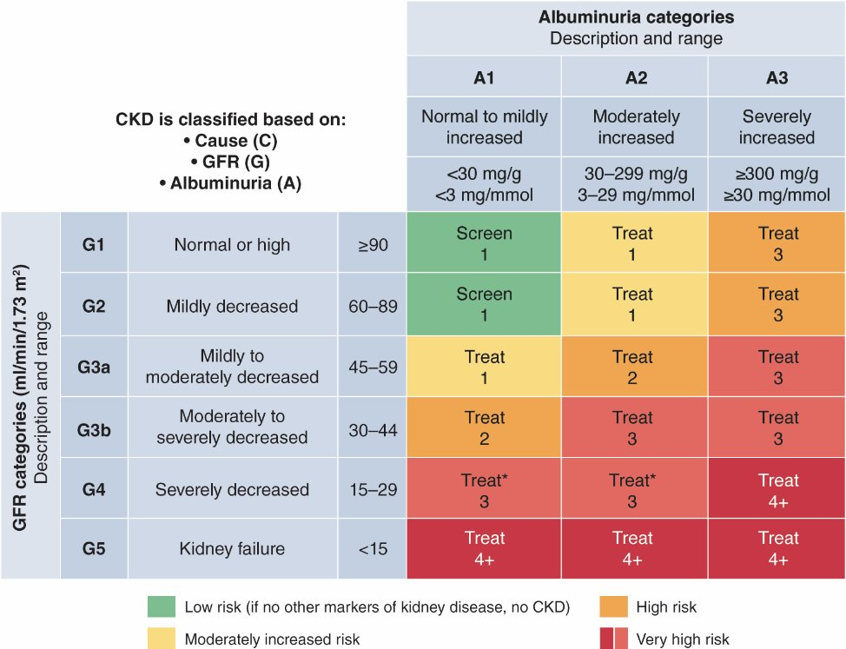
D Overview on Monitoring for Progression of CKD Based upon GFR and ACR Categories
KDIGO CKD Work Group. Kidney Int. 2024;105:S117. CC BY-NC-ND 4.0. No changes made.
Notes:
ACR, albumin-to-creatinine ratio; AKD, acute kidney disease; AKI, acute kidney injury; CKD, chronic kidney disease; GFR, glomerular filtration rate.

Slide 12
Evaluation Framework
CGA (cause, GFR category, albuminuria category) framework to stage and inform treatment
Diagnosis threshold: GFR <60 mL/min/1.73 m² or UACR ≥30 mg/g
  Inclusion of cystatin C for eGFR estimation to improve accuracy where creatinine alone may not be sufficient
Focus on chronicity: diagnosis requires ≥3 mo of abnormal kidney structure or function
Use validated risk prediction tools:
    KFRE: estimates risk of kidney failure over 2-5 yr
    AHA PREVENT tool: assesses cardiovascular risk in people with CKD
KDIGO CKD Work Group. Kidney Int. 2024;105:S117.
Notes:
AHA, American Heart Association; CKD, chronic kidney disease; eGFR, estimated glomerular filtration rate; KFRE, Kidney Failure Risk Equation; UACR, urinary albumin-to-creatinine ratio.

Slide 13
Personalized Treatment: Lifestyle Intervention
Emphasize plant-based foods, limit ultraprocessed foods
Exercise
Limit sodium intake to <2 g/d (or <5 g/d salt)
Protein intake: maintain 0.8 g/kg/body weight/d in adults with CKD G3-G5, tailored based on metabolic stability
Diet
Encourage 150 min/wk of moderate-intensity activity based on patient tolerance
Focus on achieving and maintaining a healthy BMI
Strongly recommended to reduce cardiovascular and kidney disease risk
Smoking Cessation
Weight Management
KDIGO CKD Work Group. Kidney Int. 2024;105:S117.
Notes:
BMI, body mass index; CKD, chronic kidney disease.

Slide 14
Personalized Treatment: Pharmacologic Recommendations
RAAS Inhibitors (Strong Recommendation, Level 1)
SGLT2 Inhibitors (Strong Recommendation, Level 1)
GLP-1 Receptor Agonists (Conditional Recommendations)
For all stages of CKD with albuminuria
For patients with CKD with or without diabetes and albuminuria
For patients with CKD and T2D to manage glycemia and reduce cardiovascular risks
Nonsteroidal MRA (Strong Recommendation, Level 2)
For high-risk patients typically defined as those with significant albuminuria (ACR ≥30 mg/g or ≥3 mg/mmol) with CKD and diabetes
KDIGO CKD Work Group. Kidney Int. 2024;105:S117.
Notes:
ACR, albumin-to-creatinine ratio; CKD, chronic kidney disease; eGFR, estimated glomerular filtration rate; GLP-1, glucagon-like peptide-1; MRA, mineralocorticoid receptor antagonist; RAAS, renin-angiotensin-aldosterone system; SGLT2, sodium-glucose cotransporter-2; T2D, type 2 diabetes.

Slide 15
Key Treatment Considerations
Tailor BP targets and treatments to patient characteristics (frailty, comorbidities)
  Target SBP <120 mm Hg (when tolerated) for cardiovascular protection assuming BP is measured using standardized measures
  Individualize A1C targets (6.5%-8.0%) for patients with CKD and diabetes
Engage patients in shared decision-making for symptom management and advanced care planning
KDIGO CKD Work Group. Kidney Int. 2024;105:S117. KDIGO CKD Work Group. Kidney Int. 2022;102:S1.
Notes:
A1C, glycated hemoglobin; BP, blood pressure; CKD, chronic kidney disease; SBP, systolic blood pressure.

Slide 16
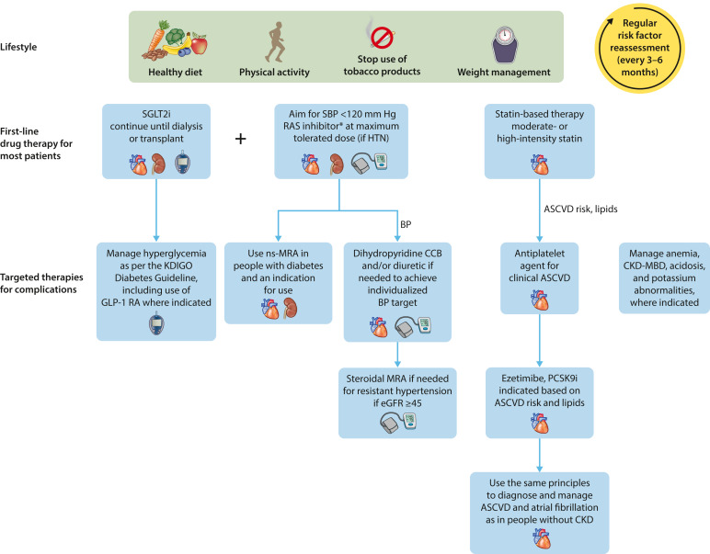
KDIGO 2024: Treatment Strategy
*ACEI or ARB as first-line therapy for BP control when albuminuria is present; otherwise, a DHP CCB or diuretic can be considered.
KDIGO CKD Work Group. Kidney Int. 2024;105:S117. CC BY-NC-ND 4.0. No changes made.
Notes:
ACEI, angiotensin-converting enzyme inhibitor; ARB, angiotensin II receptor blocker; ASCVD, atherosclerotic cardiovascular disease; BP, blood pressure; CKD, chronic kidney disease; DHP CCB, dihydropyridine calcium channel blocker; CV, cardiovascular; eGFR, estimated glomerular filtration rate; HTN, hypertension; MRA, mineralocorticoid receptor antagonist; RAS, renin-angiotensin system; SGLT2, sodium-glucose cotransporter-2.

Slide 17
Acute Changes in eGFR
Initial dips in eGFR are expected following initiation of hemodynamically active therapies (eg, RAS inhibitors, SGLT2 inhibitors, nonsteroidal MRA)
GFR reductions of ≥30% from baseline exceed the expected variability and warrant further evaluation
KDIGO CKD Work Group. Kidney Int. 2024;105:S117.
Notes:
eGFR, estimated glomerular filtration rate; MRA, mineralocorticoid receptor antagonists; RAS, renin-angiotensin system; SGLT2, sodium-glucose cotransporter-2.

Slide 18
Acute Changes in eGFR
KDIGO CKD Work Group. Kidney Int. 2024;105:S117. CC BY-NC-ND 4.0. No changes made.
Notes:
ACEI, angiotensin-converting enzyme inhibitor; AKI, acute kidney injury; ARB, angiotensin II receptor blocker; eGFR, estimated glomerular filtration rate; MRA, mineralocorticoid receptor antagonists; NSAIDs, nonsteroidal anti-inflammatory drugs; RAS, renin-angiotensin system; SGLT2, sodium-glucose cotransporter-2.

Slide 19
Manage via Medication Review
Periodically and at transitions of care, perform a thorough review of medications to assess adherence, continued indications, and potential drug interactions
Review and limit use of OTC medicines and dietary or herbal remedies that may be harmful
Validated eGFR equations using SCr are appropriate and accurate for most people presumably for dosing of medications
KDIGO CKD Work Group. Kidney Int. 2024;105:S117.
Notes:
CKD, chronic kidney disease; eGFR, estimated glomerular filtration rate; OTC, over the counter; SCr, serum creatinine.

Slide 20
Manage via Medication Review
KDIGO CKD Work Group. Kidney Int. 2024;105:S117. CC BY-NC-ND 4.0. No changes made.
Notes:
CKD, chronic kidney disease; eGFR, estimated glomerular filtration rate; OTC, over the counter; SCr, serum creatinine.

Slide 21
Symptom Control
Symptom identification and assessment is important for highlighting changes, redirection toward patient-centered care, and possibly discussions about appropriate supportive care
Shared decision-making and effective communication between HCPs and patients are key
KDIGO CKD Work Group. Kidney Int. 2024;105:S117. CC BY-NC-ND 4.0. No changes made.
Notes:
HCP, healthcare professional.

Slide 22
Symptom Control
KDIGO CKD Work Group. Kidney Int. 2024;105:S117. CC BY-NC-ND 4.0. No changes made.

Slide 23
Shared Decision-making
Collaborative process between patient and HCP that:
Engages and empowers the patient in decision-making
Provides patient with information about alternative and all treatments
Incorporates patient preferences and values into the plan
Elwyn. J Gen Intern Med. 2012;27:1361.
Notes:
HCP, healthcare professional.

Slide 24
Defining Shared Decision-making
When Needed
Options or results have health, financial, or QoL implications
  Daily management and lifestyle choices for chronic conditions
Process
HCP shares with patient information about relevant testing or treatment options
  Severity and probability for harm, benefits, and viable alternatives
Patient explores and shares preferences regarding the above
  Summarizes what they understood in their own words
A mutual decision is made
nam.edu/perspectives-2014-shared-decision-making-strategies-for-best-care-patient-decision-aids/
Notes:
HCP, healthcare professional; QoL, quality of life.

Slide 25
Advanced Care Planning
Plans to address future needs should be jointly agreed upon by patients and their family members/caregivers
Advanced care planning for those who choose supportive care is highly important
KDIGO CKD Work Group. Kidney Int. 2024;105:S117. CC BY-NC-ND 4.0. No changes made.

Slide 26
Advanced Care Planning
KDIGO CKD Work Group. Kidney Int. 2024;105:S117. CC BY-NC-ND 4.0. No changes made.
Notes:
CKD, chronic kidney disease; CV, cardiovascular; KRT, kidney replacement therapy.

Slide 27
Key Treatment Considerations and Medication Monitoring
Regular review
  Ensure adherence to prescribed therapy
  Evaluate for drug–drug interactions and ongoing indications for therapy
Monitor eGFR
  Assess therapy-related changes, especially after initiating hemodynamic-active medications (eg, RAAS inhibitors, SGLT2 inhibitors)
  A decline in eGFR ≥30% following initiation may reflect an expected hemodynamic effect but warrants further evaluation to rule out other causes (eg, volume depletion, hypotension, or AKI)
Avoid combination therapy (ACE inhibitors, ARBs, and direct renin inhibitors) due to potential risks of hypotension, hyperkalemia, and AKI
KDIGO CKD Work Group. Kidney Int. 2024;105:S117. KDIGO CKD Work Group. Kidney Int. 2022;102:S1.
Notes:
ACE, angiotensin-converting enzyme; AKI, acute kidney injury; ARB, angiotensin II receptor blocker; eGFR; estimated glomerular filtration rate; RAAS, renin-angiotensin-aldosterone system; SGLT2, sodium-glucose cotransporter 2.

Slide 28
Role of Multidisciplinary Teams
Address the complexity of CKD as a multimorbid condition
Improve adherence to guidelines through collaborative care
Empower patients in self-management practices, including treatment adherence, dietary changes, and regular monitoring
KDIGO CKD Work Group. Kidney Int. 2024;105:S117.
Notes:
CKD, chronic kidney disease.

Slide 29
Role of Multidisciplinary Teams
Team Member Roles
Nephrologist: Specialized care for disease progression
Cardiologist: Mitigate cardiovascular risk
Primary care physician: Facilitate early detection, coordinate care among specialists, and ensure adherence to lifestyle and medication plans
Dietitian: Support lifestyle modifications, create individualized meal plans, and promote dietary sodium and protein restrictions
Pharmacist: Optimize medication regimens
KDIGO CKD Work Group. Kidney Int. 2024;105:S117.
Notes:
CKD, chronic kidney disease.

Slide 30
Implementation Challenges: Barriers
Lack of time, tools, and resources
  Clinicians often have limited time to adopt new CKD-specific workflows and tools, compounded by workforce shortages, especially in underserved areas
Lack of awareness or slow adoption of new guidelines
  HCPs may struggle with integrating updated recommendations into routine practice due to a lack of accessible training and tools
Delayed referrals and limited patient engagement in self-management
  Patients are often referred late to nephrology care, and awareness of CKD risk factors and self-management strategies is low among the public
KDIGO CKD Work Group. Kidney Int. 2024;105:S117. Navaneethan. Am J Kidney Dis. 2024;S0272-6386(24)00977-6.
Notes:
CKD, chronic kidney disease; HCP, healthcare professional.

Slide 31
Overcoming Barriers to CKD Management
Harmonized clinical practice guidelines
Multidisciplinary education
Improved management of CKD
Risk mitigation strategies
Self-
management programs
Multidisciplinary care models
KDIGO CKD Work Group. Kidney Int. 2024;105:S117. Navaneethan. Am J Kidney Dis. 2024;S0272-6386(24)00977-6.
Notes:
CKD, chronic kidney disease.

Slide 32
Implementation Challenges: Solutions
Streamline education for HCPs
  Develop concise, targeted training on updated KDIGO recommendations, emphasizing tools like the CKD-EPI equation and cystatin C for risk stratification
Enhance public awareness
  Implement campaigns to educate the general population on CKD risk factors, such as diabetes, hypertension, and cardiovascular disease, with a focus on lifestyle modifications
KDIGO CKD Work Group. Kidney Int. 2024;105:S117. Navaneethan. Am J Kidney Dis. 2024;S0272-6386(24)00977-6.
Notes:
CKD, chronic kidney disease; CKD-EPI, Chronic Kidney Disease Epidemiology Collaboration; eGFR, estimated glomerular filtration rate; HCP, healthcare professional; KDIGO, Kidney Disease: Improving Global Outcomes; KFRE, Kidney Failure Risk Equation.

Slide 33
Implementation Challenges: Solutions
Provide expert guidance in digestible formats
  Create easily accessible resources, such as quick-reference guidelines and digital learning tools, to help clinicians and patients understand and apply KDIGO recommendations
Use validated clinical tools for decision support (EHR alerts)
  Incorporate tools like EHR alerts, the KFRE, and UACR/eGFR reporting to support timely decision-making and improve CKD care
KDIGO CKD Work Group. Kidney Int. 2024;105:S117. Navaneethan. Am J Kidney Dis. 2024;S0272-6386(24)00977-6.
Notes:
CKD, chronic kidney disease; eGFR, estimated glomerular filtration rate; EHR, electronic health record; HCP, healthcare professional; KDIGO, Kidney Disease: Improving Global Outcomes; KFRE, Kidney Failure Risk Equation.

Slide 34
Key Takeaways and Next Steps
Summary
Focus on early detection, optimizing treatment, and slowing disease progression, as its prevalence is rising globally
Personalized, guideline-concordant care optimizes kidney and cardiovascular health
Qin. BMC Public Health. 2024;24:3519.

Slide 35
Key Takeaways and Next Steps
Next Steps
Integrate KDIGO 2024 recommendations into your daily practice
Foster team-based care to improve outcomes
Ensure timely nephrology referrals
Empower patients through education
Qin. BMC Public Health. 2024;24:3519.
Notes:
KDIGO, Kidney Disease: Improving Global Outcomes.

Slide 36
Go Online for More CCO
Coverage of CKD!
ClinicalThoughtTM expert commentary
Ask the Experts Webinar on CKD with expert faculty commentary
clinicaloptions.com

