Slide 1
Spot the Signal: Global Radiology Training for ARIA Detection in Alzheimer’s Care
Provided by Clinical Care Options, LLC dba Decera Clinical Education
This activity is supported by an educational grant from Lilly.

Slide 2
About These Slides
Please feel free to use and share some or all of these slides in your noncommercial presentations to colleagues or patients
When using our slides, please retain the source attribution:
These slides may not be published, posted online, or used in commercial presentations without permission. Please contact permissions@deceraclinical.com for details
Slide credit: deceraclinical.com/education
Notes:
Disclaimer: The materials published on the Decera Clinical Education website reflect the views of the authors of the Decera Clinical Education material, not those of Decera Clinical Education, the CME providers, or the companies providing educational grants. The materials may discuss uses and dosages for therapeutic products that have not been approved by the FDA. A qualified healthcare professional should be consulted before using any therapeutic product discussed. Readers should verify all information and data before treating patients or using any therapies described in these materials.

Slide 3
Faculty and Disclosures
Tammie L. Benzinger, MD, PhD
Hugh Monroe Wilson Professor of Radiology
Professor of Neurological Surgery
Mallinckrodt Institute of Radiology, Neuroradiology Section
Washington University in St Louis
St Louis, Missouri
Tammie L. Benzinger, MD, PhD: consultant/advisor/speaker: Bristol Myers Squibb, Lilly (Avid Radiopharmaceuticals); researcher: Hyperfine, Lantheus (LMI, Cerveau), Lilly (Avid Radiopharmaceuticals); other financial or material support: Janssen, Siemens.
Karl-Olof Lövblad, MD
Full Professor and Head of Division
Division of Diagnostic and Interventional Neuroradiology
Diagnostic Department
Geneva University Hospitals
Geneva, Switzerland
Karl-Olof Lövblad, MD:
consultant/advisor/speaker: Biogen, Lilly.

Slide 4
Learning Objectives
Interpret ARIA-related imaging findings using validated grading scales in simulated case scenarios in alignment with current expert recommendations
Implement evidence-based MRI protocols for ARIA monitoring in patients receiving ATT
Demonstrate proficiency in documenting ARIA findings using standardized reporting templates
Collaborate with referring clinicians to effectively share actionable imaging insights for ARIA management

Slide 5
Background and US Guidelines

Slide 6
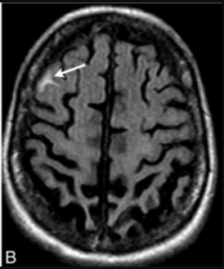
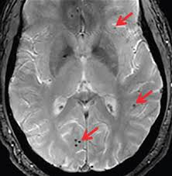

What Are Amyloid-Related Imaging Abnormalities (ARIA)?
AE associated with amyloid-targeting therapies for Alzheimer’s disease (lecanemab, donanemab)
Related to accumulation of vascular amyloid
Predictors:
    APOE genotype (E4/E4 > E4/E3 > E3/E3)
    Evidence of prior bleeds
Symptoms:
  Headache
  Confusion
  Visual changes
  Dizziness
  Nausea
  Gait difficulty
Serious ARIA can lead to:
  Seizures, including status epilepticus
  Encephalopathy
  Focal neurological deficits
  Death
    ARIA-E:
    edema/effusion
    ARIA-H:
    hemorrhage
Most often asymptomatic!
    includes micro- & macro- hemorrhage and siderosis
Hampel. Brain. 2023;146:4414.
Notes:
AE, adverse event.

Slide 7
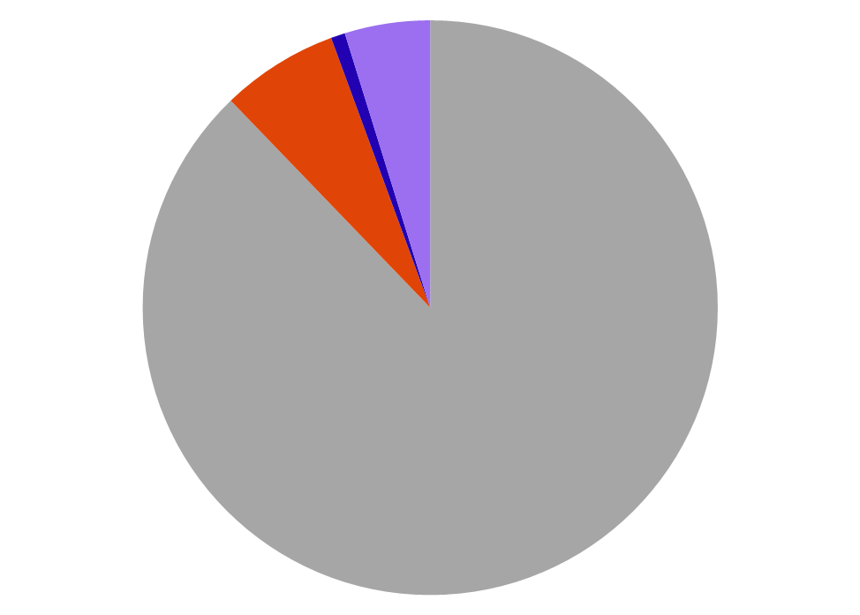
ALZ-NET Real-world ARIA Rates
However…
Clinical trial data found approximately 20% of patients developed asymptomatic ARIA on treatment
If you are not detecting ARIA in routine monitoring, you are missing them!
Patients Treated with ATT (N = 608)
Total ARIA ~12%
ARIA-E
6.6%
ARIA-H (SS)
0.8%
ARIA-H (microhemorrhage)
4.8%
Rafii. CTAD 2025. Symposium 3. Lecanemab PI. Donanemab PI.
Notes:
ARIA, amyloid-related imaging abnormalities; ATT, amyloid-targeting therapy.

Slide 8
MRI Monitoring Schedule for ATTs
US Appropriate Use Recommendations and Product Labels
Donanemab
Mo | 1 | 2 | 3 | 4 | 5 | 6 | 7 | 8-11 | 12
Tx | 350 mg† | 700 mg | 1050 mg† | 1400 mg | 1400 mg | 1400 mg | 1400 mg | 1400 mg | 1400 mg
MRI* | Within past 1 yr | Prior to 2nd tx | Prior to 3rd tx | Prior to 4th tx | -- | -- | Prior to 7th tx | -- | Selected pts
Lecanemab
Wk | 2 | 4 | 6 | 8 | 10 | 12 | 14 | 16 | 28 | 52
Tx | 10 mg/kg | 10 mg/kg | 10 mg/kg | 10 mg/kg | 10 mg/kg | 10 mg/kg | 10 mg/kg | 10 mg/kg | 10 mg/kg | 10 mg/kg
MRI* | Within past 1 yr | -- | -- | -- | Prior to 5th tx | -- | Prior to 7th tx | -- | Prior to 14th tx | Selected pts
*Perform additional MRI if ARIA symptoms occur at any time.
†Pivotal trials used 700 mg at tx 1 and 3; label update in 2025 to titrated dosing schedule associated with reduced ARIA.
Rabinovici. J Prev Alzheimers Dis. 2025;12:10015. Cummings. J Prev Alzheimers Dis. 2023;10:362.
Notes:
ARIA, amyloid-related imaging abnormalities; ATT, amyloid-targeting therapy.

Slide 9
American Society for Neuroradiology
Neuroimaging Standards For ARIA Screening and Monitoring
 | Baseline/Enrollment Evaluation | Asymptomatic Monitoring | Symptomatic Patient on Therapy
Order | MRI brain dementia without IV contrast (indication: AD therapy enrollment) | MRI brain without IV contrast (indication: AD therapy monitoring) | MRI brain without (and with) IV contrast (indication: AD therapy, new symptoms)
Protocol | AD therapy enrollment | AD therapy monitoring | AD therapy monitoring
Minimum sequences | 2D or 3D T2 FLAIR GRE* ± SWI DWI 3D T1 T2 FSE | 2D or 3D T2 FLAIR GRE* ± SWI DWI | 2D or 3D T2 FLAIR GRE* ± SWI DWI ± additional sequences
Reporting template | AD therapy enrollment | AD therapy monitoring | AD therapy monitoring
Key findings | Microhemorrhage Siderosis WM hyperintensities Infarcts | ARIA-E (edema, effusion) ARIA-H (new microhemorrhages, siderosis) | ARIA-E ARIA-H Other acute findings
Recommended communication | Standard reporting | Mild ARIA: notification required Moderate or severe ARIA: closed loop communication
*GRE must be performed with an appropriate T: 3T TE = 15-20 ms, 1.5T TE = 25-35 ms.
Cogswell. AJNR. 2025;46:24.
Notes:
ARIA, amyloid-related imaging abnormalities; DTI, diffusion tensor imaging; DWI, diffusion-weighted imaging; FSE, fast spin echo; GRE, gradient echo; SWI, susceptibility-weighted imaging; WM, white matter.

Slide 10
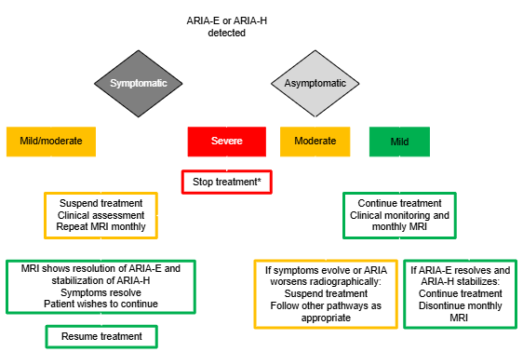
Management of ARIA with ATTs
US Appropriate Use Recommendations and Product Labels
MRI conducted as routine monitoring or due to symptoms
*Stop treatment if:
Any macrohemorrhage
>1 area of superficial siderosis
>10 microhemorrhages since treatment initiation
>2 episodes of ARIA
Radiographically severe ARIA
Serious symptoms of ARIA
Patient requires anticoagulant
Rabinovici. J Prev Alzheimers Dis. 2025;12:10015. Cummings. J Prev Alzheimers Dis. 2023;10:362.
Notes:
ARIA, amyloid-related imaging abnormalities; ATT, amyloid-targeting therapy.

Slide 11
Baseline and Monitoring MRIs

Slide 12
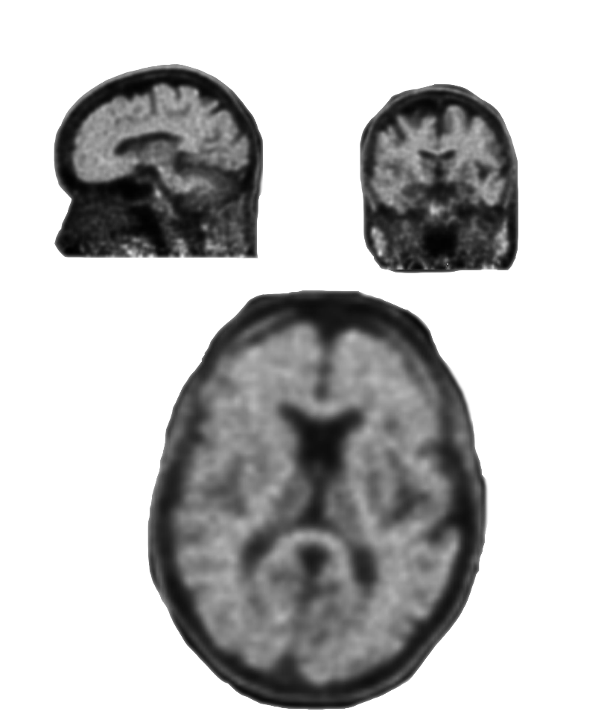
Case 1: Eligibility (Baseline)
83-year-old female with memory loss
  Lives alone in a free-standing house; cooks; does her own shopping and laundry
  Mini-Mental Status Exam (MMSE) 27/30
  Clinical Dementia Rating (CDR) 0.5
  Anticoagulants: none
  Antiplatelets: none
  ApoE 3/4
  OSH PET scan
What are the key clinical eligibility factors?
Florbetapir amyloid PET: What are the findings?
Images provided by Dr Tammie Benzinger.

Slide 13
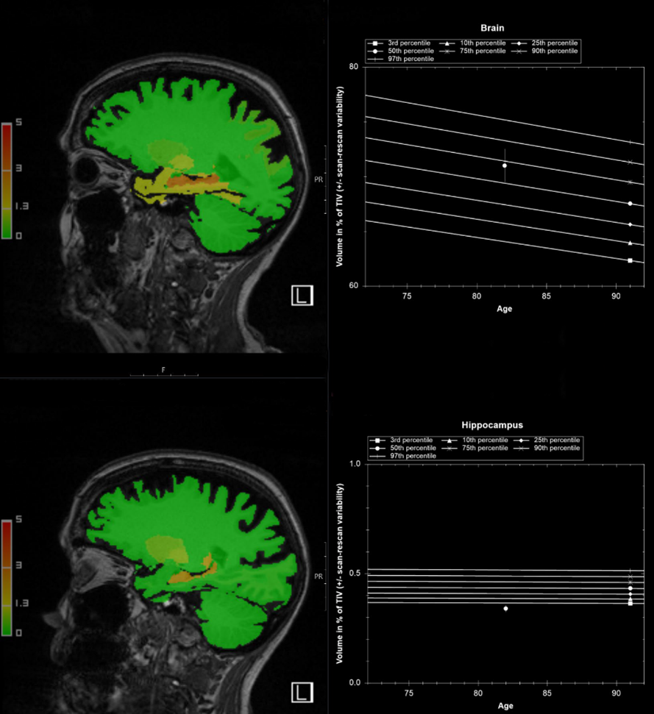
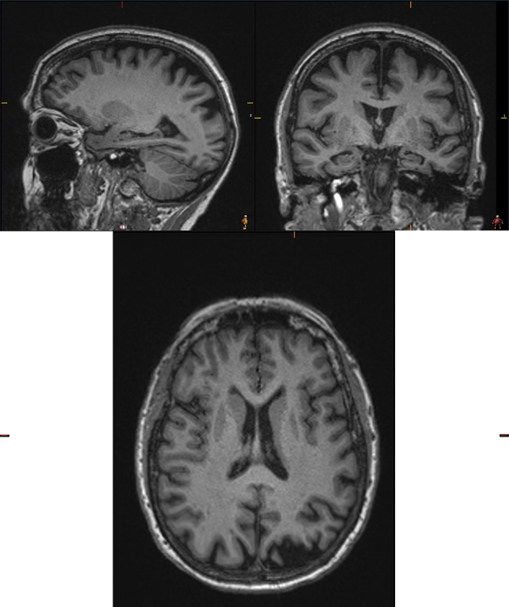
Case 1: Baseline MRI
What are the key findings to report on the brain MRI?
Images provided by Dr Tammie Benzinger.

Slide 14
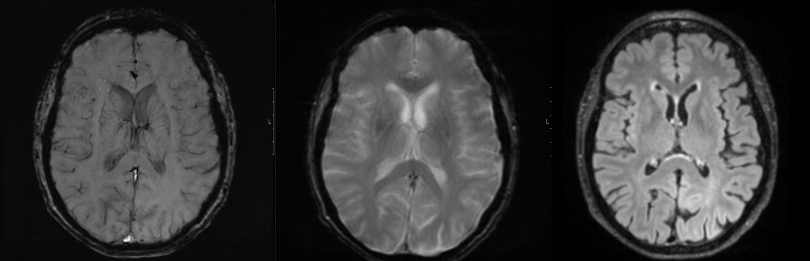
Case 1: Baseline MRI
SWI
GRE/T2*
FLAIR
Images provided by Dr Tammie Benzinger.

Slide 15
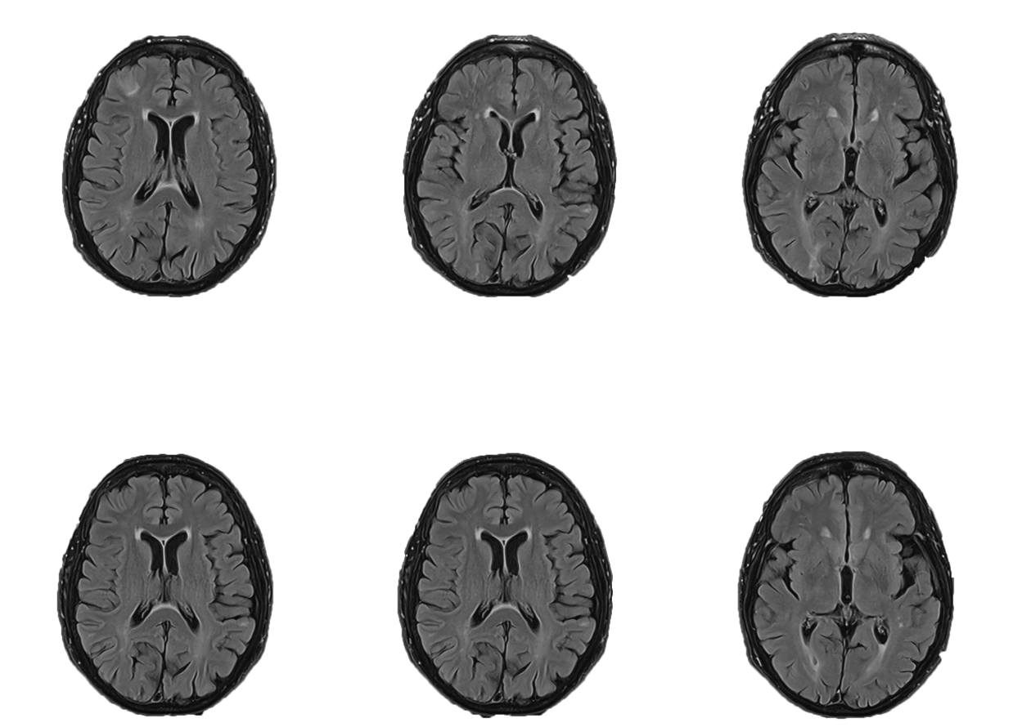
Case 1
FLAIR
Patient started on anti-amyloid immunotherapy
Monitoring MRI pre 7th infusion
CURRENT
PRIOR
Images provided by Dr Tammie Benzinger.

Slide 16
Case 1
FLAIR
Patient started on anti-amyloid immunotherapy
Monitoring MRI pre 7th infusion
CURRENT
PRIOR
Images provided by Dr Tammie Benzinger.

Slide 17
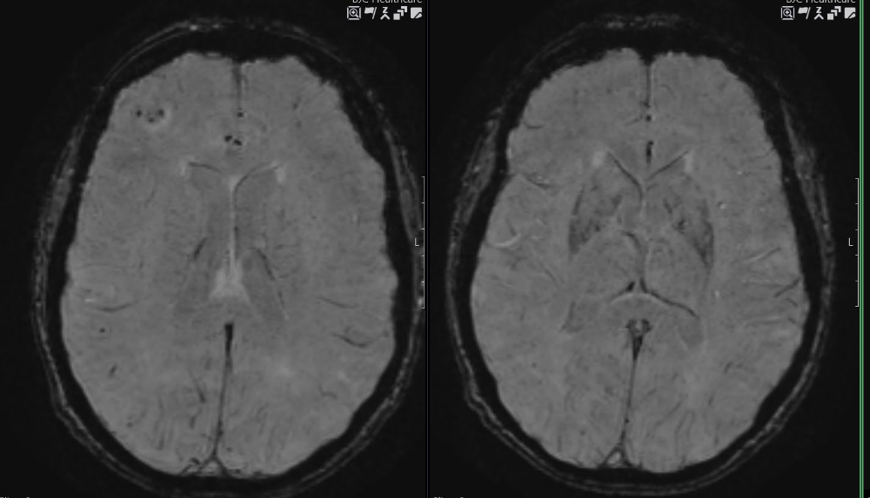
Case 1
CURRENT SWI
CURRENT SWI
Images provided by Dr Tammie Benzinger.

Slide 18
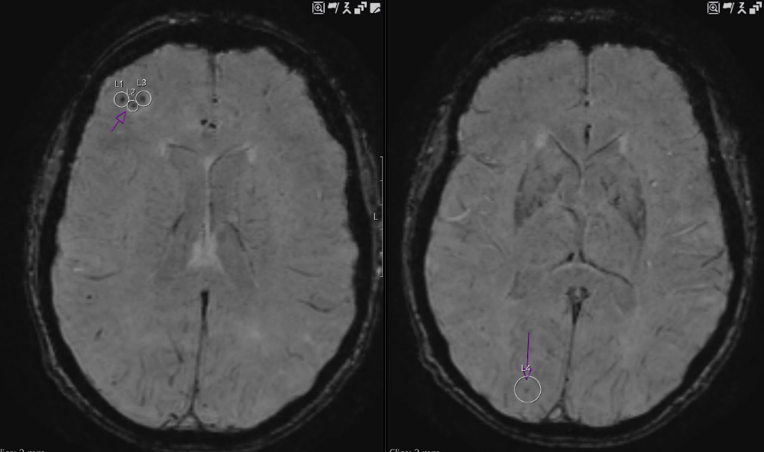
Case 1
CURRENT SWI
CURRENT SWI
Images provided by Dr Tammie Benzinger.

Slide 19
Case 1
ARIA MRI Classification Criteria (PI)
 | Radiographic Severity
ARIA Type | Mild | Moderate | Severe
ARIA-E | FLAIR hyperintensity confined to sulcus and/or cortex/subcortex white matter in 1 location <5 cm | FLAIR hyperintensity 5-10 cm in single greatest dimension, or more than 1 site of involvement, each measuring <10 cm | FLAIR hyperintensity >10 cm with associated gyral swelling and sulcal effacement; 1 or more separate/independent sites of involvement may be noted
ARIA-H microhemorrhage | ≤4 new incident microhemorrhages | 5-9 new incident microhemorrhages | 10 or more new incident microhemorrhages
ARIA-H superficial siderosis | 1 new* focal area of superficial siderosis | 2 new focal areas of superficial siderosis | >2 new focal areas of superficial siderosis
*Includes new or worsening superficial siderosis.
Lecanemab PI. Donanemab PI.
Notes:
ARIA, amyloid-related imaging abnormalities.

Slide 20
Case 1
ARIA MRI Classification Criteria (PI)
 | Radiographic Severity
ARIA Type | Mild | Moderate | Severe
ARIA-E | FLAIR hyperintensity confined to sulcus and/or cortex/subcortex white matter in 1 location <5 cm | FLAIR hyperintensity 5-10 cm in single greatest dimension, or more than 1 site of involvement, each measuring <10 cm | FLAIR hyperintensity >10 cm with associated gyral swelling and sulcal effacement; 1 or more separate/independent sites of involvement may be noted
ARIA-H microhemorrhage | ≤4 new incident microhemorrhages | 5-9 new incident microhemorrhages | 10 or more new incident microhemorrhages
ARIA-H superficial siderosis | 1 new* focal area of superficial siderosis | 2 new focal areas of superficial siderosis | >2 new focal areas of superficial siderosis
*Includes new or worsening superficial siderosis.
Lecanemab PI. Donanemab PI.

Slide 21
Case 1: Clinical Management of ARIA With ATTs
Dosing Recommendations for Patients With ARIA-E
Clinical Symptom Severity* | ARIA-E Severity on MRI
 | Mild | Moderate | Severe
Asymptomatic | May continue dosing at current dose and schedule | Suspend dosing† | Suspend dosing†
Mild | May continue dosing based on clinical judgment | Suspend dosing† | Suspend dosing†
Moderate or Severe | Suspend dosing† | Suspend dosing† | Suspend dosing†
*Mild: discomfort noticed, but no disruption of normal daily activity; Moderate: discomfort sufficient to reduce or affect normal daily activity; Severe: incapacitating, with inability to work or to perform normal daily activity.
†Suspend until MRI demonstrates radiographic resolution and symptoms, if present, resolve; consider a follow-up MRI to assess for resolution 2-4 months after initial identification. Resumption of dosing should be guided by clinical judgment.
Donanemab PI. Lecanemab PI.
Notes:
ARIA, amyloid-related imaging abnormalities.

Slide 22
Case 1: Clinical Management of ARIA With ATTs
Dosing Recommendations for Patients With ARIA-H
Clinical Symptom Severity | ARIA-H Severity on MRI
 | Mild | Moderate | Severe
Asymptomatic | May continue dosing at current dose and schedule | Suspend dosing* | Suspend dosing†
Symptomatic | Suspend dosing* | Suspend dosing* | Suspend dosing†
*Suspend until MRI demonstrates radiographic stabilization and symptoms, if present, resolve; resumption of dosing should be guided by clinical judgment; consider a follow-up MRI to assess for stabilization 2-4 months after initial identification.
†Suspend until MRI demonstrates radiographic stabilization and symptoms, if present, resolve. Use clinical judgment when considering whether to continue treatment or permanently discontinue donanemab.
Donanemab PI. Lecanemab PI.
Notes:
ARIA, amyloid-related imaging abnormalities.

Slide 23
Case 1: Summary
Each copy of the ApoE4 allele increases risk of ARIA (likelihood of underlying CAA)
Even if the findings look “bad” we need to use the standardized grading scale
Any time ARIA is new or worsening, we need to call the team so they can reassess symptoms and potentially pause therapy
We should include in our reports the recommendation to continue monitoring MRIs until ARIA-E has completely resolved and ARIA-H has stabilized
Symptoms for this patient: None
Management: Infusions on hold, will get monthly MRIs
Notes:
ARIA, amyloid-related imaging abnormalities; CAA, cerebral amyloid angiopathy.

Slide 24
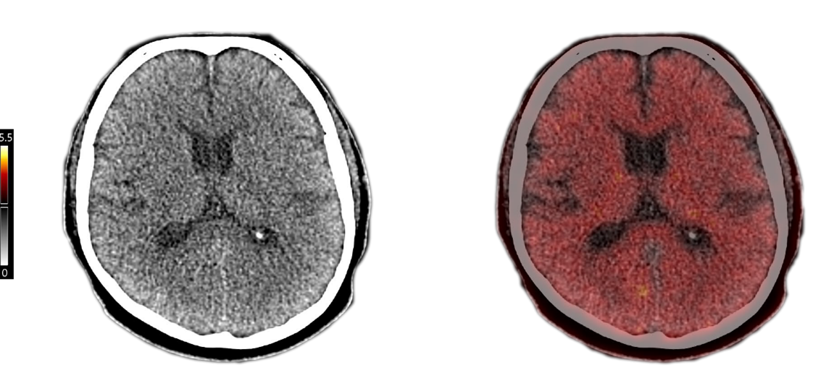
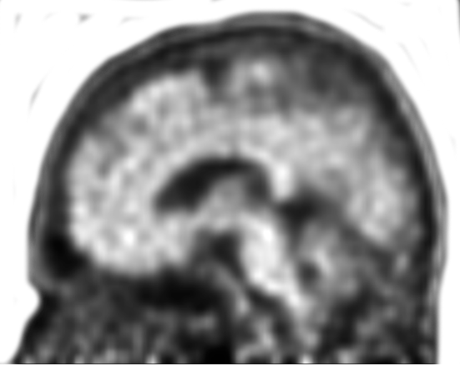
Case 2: Eligibility (Baseline)
74-yr-old male with gradual onset memory loss
  Lives with spouse; does home repairs, just installed a new thermostat; driving independently
  MMSE 23/30
  CDR 0.5
  Anticoagulants: None
  Antiplatelets: Aspirin 81 mg
  ApoE 3/4
  PET scan
What are the key clinical eligibility factors?
Florbetapir amyloid PET: What are the findings?
Images provided by Dr Tammie Benzinger.

Slide 25
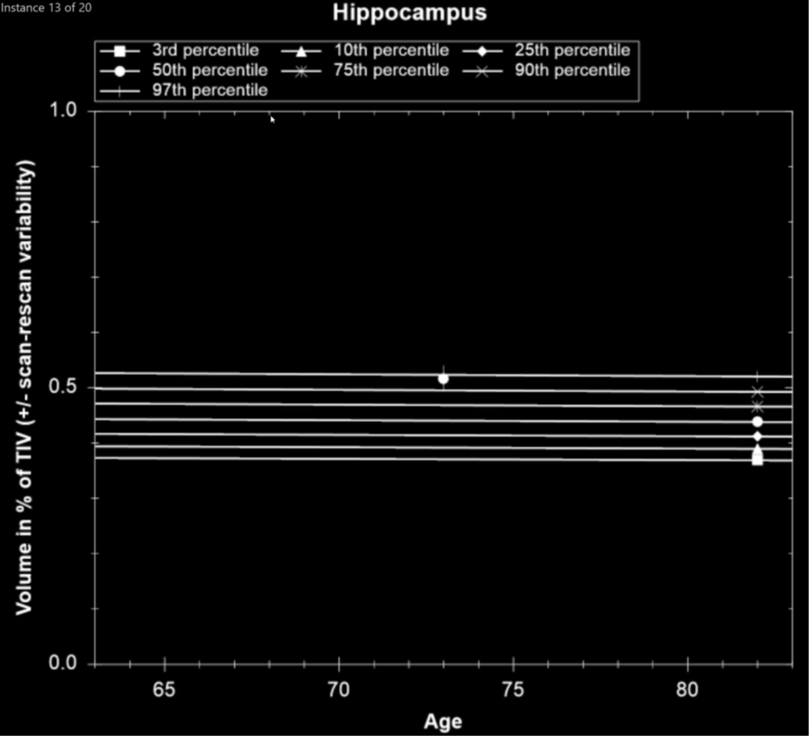
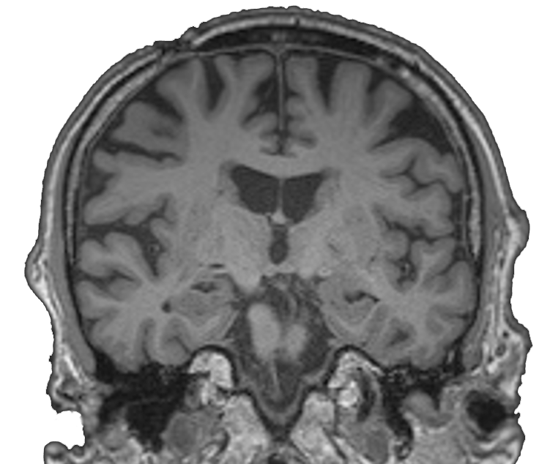
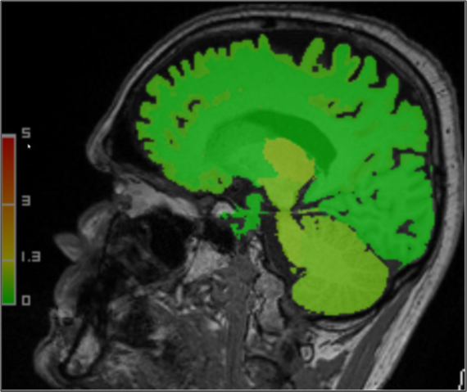
Case 2: Baseline MRI
Images provided by Dr Tammie Benzinger.

Slide 26
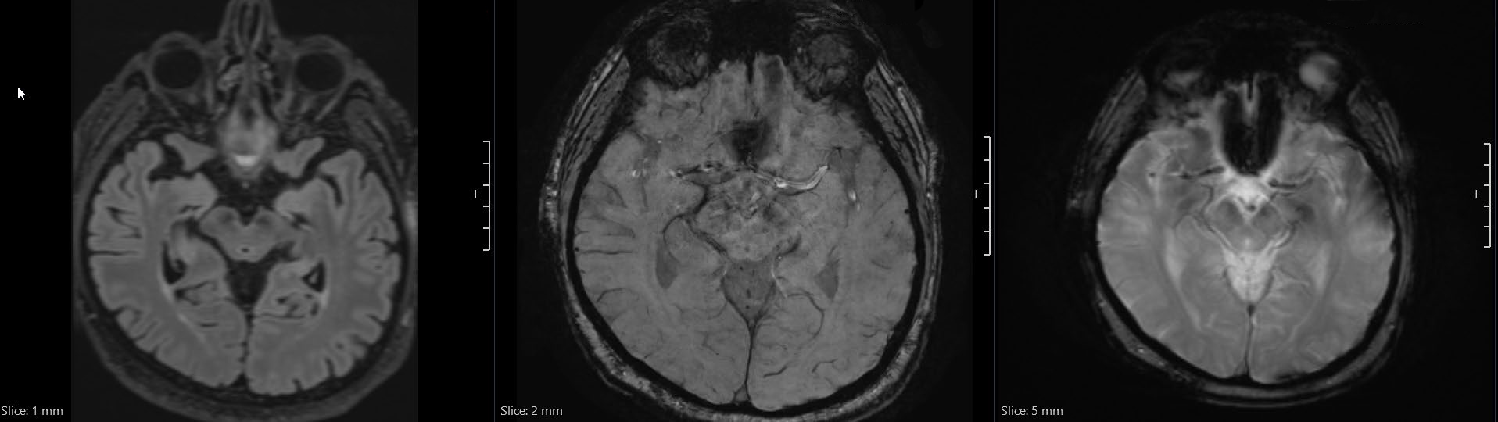
Case 2: Baseline MRI
FLAIR
SWI
GRE/T2*
Images provided by Dr Tammie Benzinger.

Slide 27
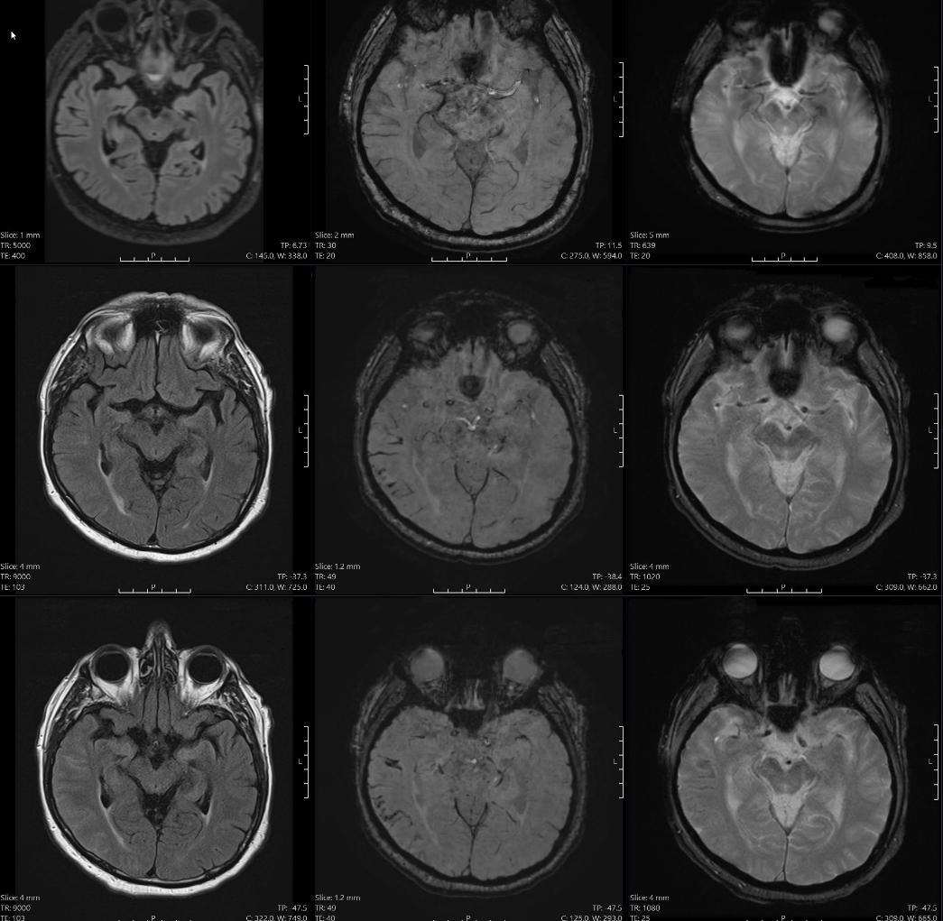
Case 2: Monitoring
FLAIR
SWI
GRE/T2*
Baseline
Monitoring
Follow-up
Images provided by Dr Tammie Benzinger.

Slide 28
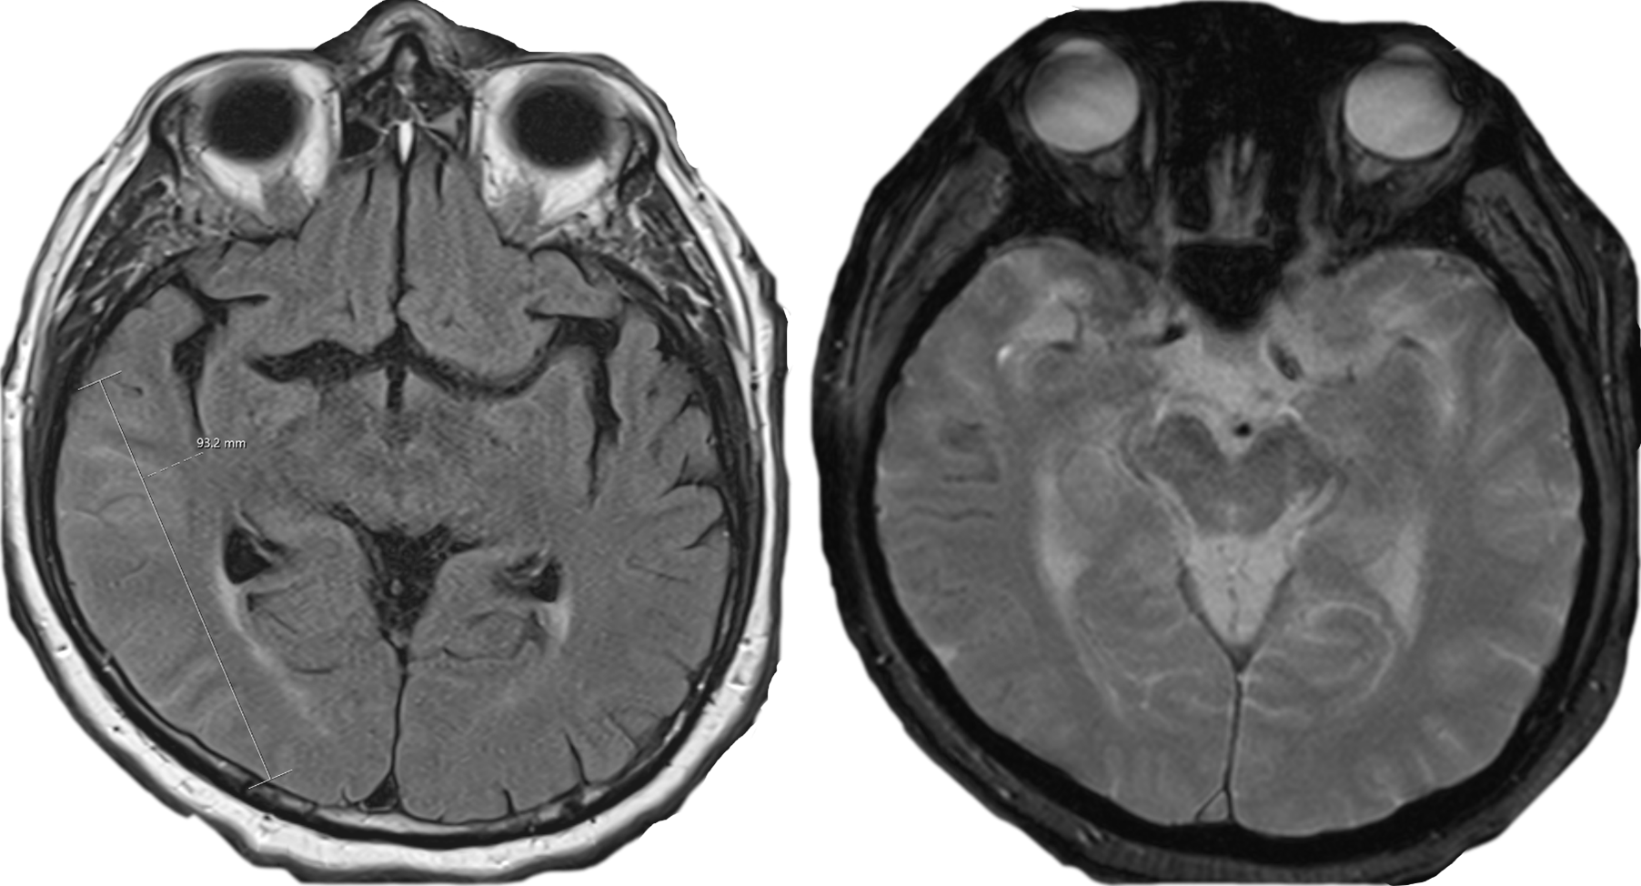
Monitoring FLAIR
Monitoring SWI
Images provided by Dr Tammie Benzinger.

Slide 29
Case 2
ARIA MRI Classification Criteria (PI)
 | Radiographic Severity
ARIA Type | Mild | Moderate | Severe
ARIA-E | FLAIR hyperintensity confined to sulcus and/or cortex/subcortex white matter in 1 location <5 cm | FLAIR hyperintensity 5-10 cm in single greatest dimension, or more than 1 site of involvement, each measuring <10 cm | FLAIR hyperintensity >10 cm with associated gyral swelling and sulcal effacement; 1 or more separate/independent sites of involvement may be noted
ARIA-H microhemorrhage | ≤4 new incident microhemorrhages | 5-9 new incident microhemorrhages | 10 or more new incident microhemorrhages
ARIA-H superficial siderosis | 1 new* focal area of superficial siderosis | 2 new focal areas of superficial siderosis | >2 new focal areas of superficial siderosis
*Includes new or worsening superficial siderosis.
Lecanemab PI. Donanemab PI.
Notes:
ARIA, amyloid-related imaging abnormalities.

Slide 30
Case 2
ARIA MRI Classification Criteria (PI)
 | Radiographic Severity
ARIA Type | Mild | Moderate | Severe
ARIA-E | FLAIR hyperintensity confined to sulcus and/or cortex/subcortex white matter in 1 location <5 cm | FLAIR hyperintensity 5-10 cm in single greatest dimension, or more than 1 site of involvement, each measuring <10 cm | FLAIR hyperintensity >10 cm with associated gyral swelling and sulcal effacement; 1 or more separate/independent sites of involvement may be noted
ARIA-H microhemorrhage | ≤4 new incident microhemorrhages | 5-9 new incident microhemorrhages | 10 or more new incident microhemorrhages
ARIA-H superficial siderosis | 1 new* focal area of superficial siderosis | 2 new focal areas of superficial siderosis | >2 new focal areas of superficial siderosis
*Includes new or worsening superficial siderosis.
Lecanemab PI. Donanemab PI.
Notes:
ARIA, amyloid-related imaging abnormalities.

Slide 31
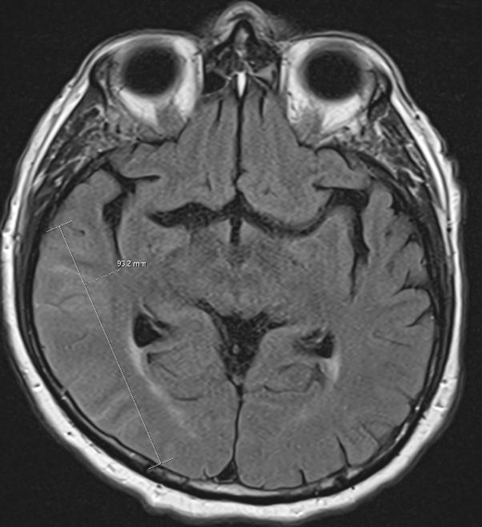
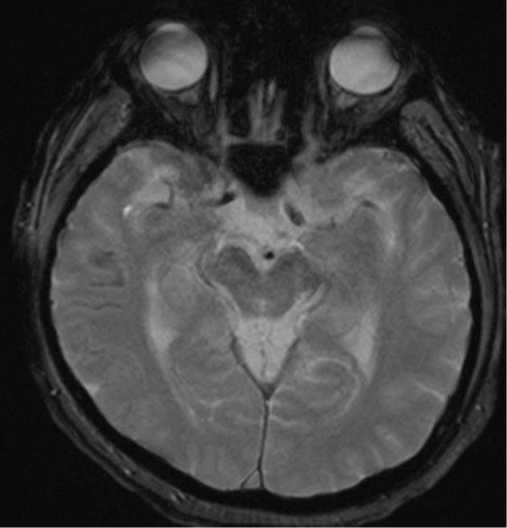
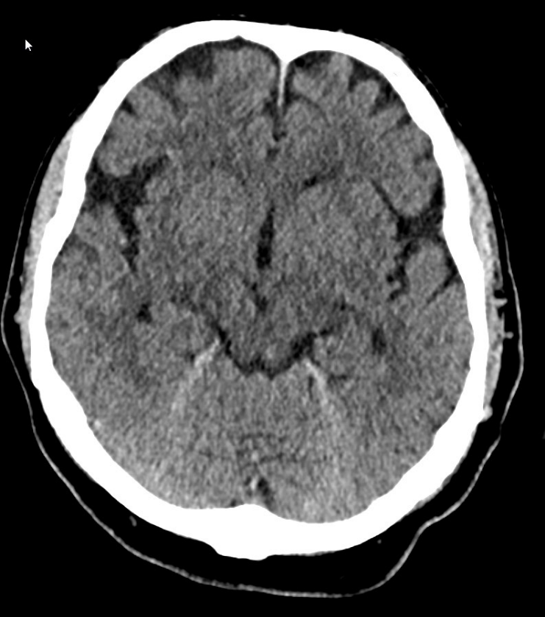
Case 2: ARIA-E Effusion on Head CT
Monitoring FLAIR
Monitoring SWI
Head CT
Images provided by Dr Tammie Benzinger.
Notes:
ARIA, amyloid-related imaging abnormalities.

Slide 32
Case 2: Lessons Learned
Correct diagnosis:
    Moderate ARIA-E
    Severe ARIA-H siderosis
You do not need a CT or CTA to work up ARIA
If you modify the templates you will get the diagnosis and classification wrong
Notes:
ARIA, amyloid-related imaging abnormalities.

Slide 33
AI-Assisted Tools
Notes:
AI, artificial intelligence.

Slide 34
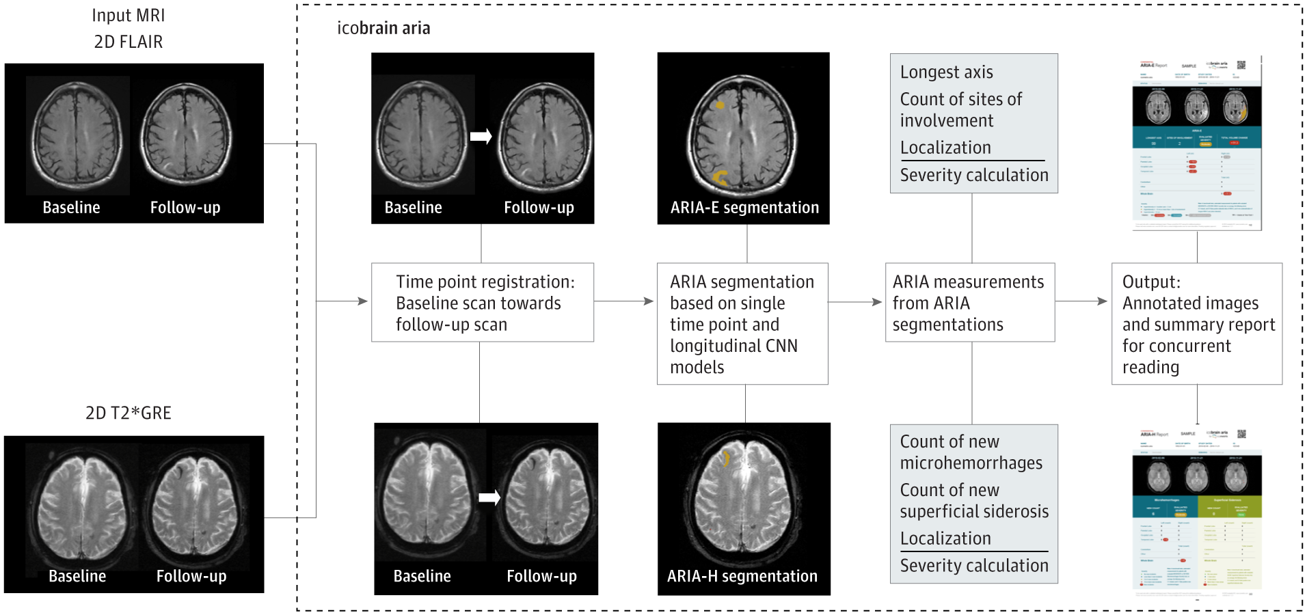
AI-Assisted Neuroimaging for ARIA Detection
FDA-cleared software:
Icobrain aria (Icometrix)
NeuroQuant Aria (Cortechs)
Sima. JAMA Netw Open. 2024;7:e240213. prnewswire.com/news-releases/fda-authorizes-the-first-ai-driven-mri-solution-for-safer-alzheimers-treatment-302305479.html. https://www.prnewswire.com/news-releases/cortechsai-highlights-groundbreaking-neuroquant-aria-technology-in-anticipation-of-growing-market-demand-302306119.html.
Image: CC-BY-NC-ND license.
Notes:
AI, artificial intelligence; ARIA, amyloid-related imaging abnormalities.

Slide 35
AI-Assisted Neuroimaging for ARIA Detection
Standardized: avoids inter-reader variability
Training datasets typically from clinical trials
    Lack of robust datasets representing real-world settings
    Rare phenomena not adequately represented in training
False positives
May have greater utility in detecting smaller or milder abnormalities
Suggested workflow:
Educate radiology and clinical team on strengths and weaknesses of tool
Perform initial read without AI
Review AI findings and reassess any flags
Final interpretation by radiologist
Sima. JAMA Netw Open. 2024;7:e240213. Petrella. AJNR Am J Neuroradiol. 2025:ajnr.A8946. Christodoulou. Biomedicines. 2025;13:2739.
Notes:
AI, artificial intelligence; ARIA, amyloid-related imaging abnormalities.

Slide 36
Workflows and Severity Scoring

Slide 37
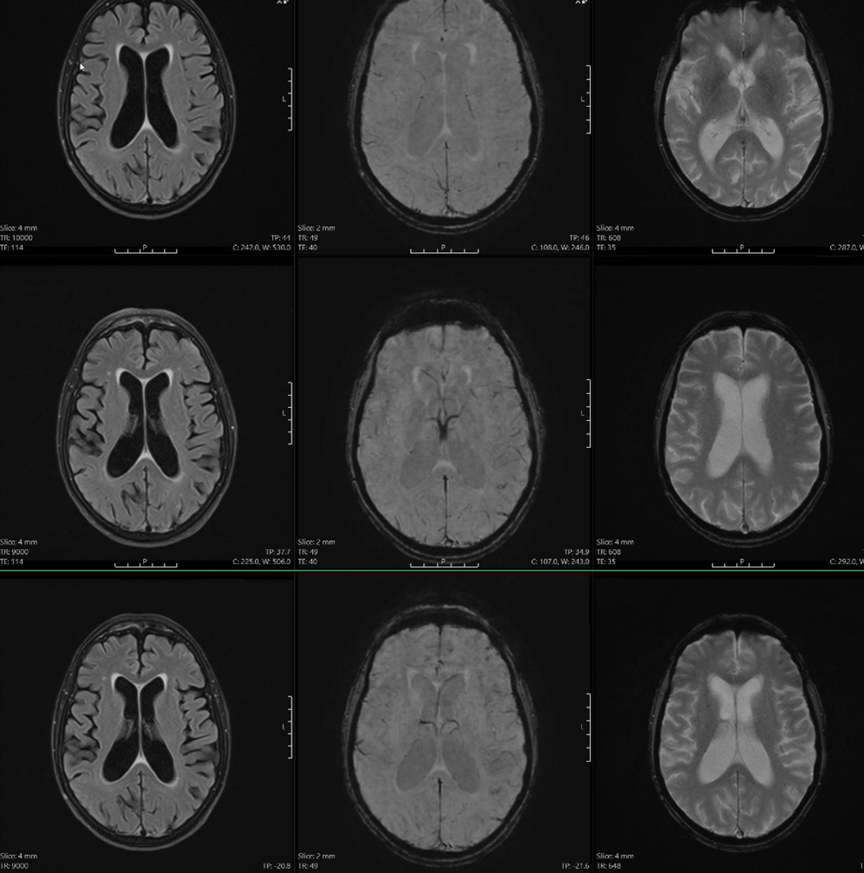
Case 3: Monitoring
FLAIR
SWI
GRE/T2*
Baseline
Monitoring
Follow-up
Images provided by Dr Tammie Benzinger.

Slide 38
Case 3: Monitoring
FLAIR
SWI
GRE/T2*
Baseline
Monitoring
Follow up
Images provided by Dr Tammie Benzinger.

Slide 39
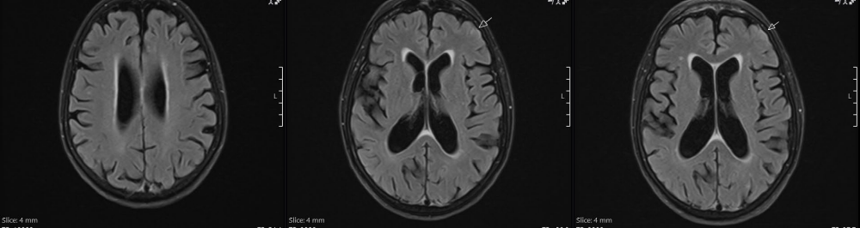
Case 3: Monitoring
Baseline FLAIR
Monitoring FLAIR
Follow-up FLAIR
Images provided by Dr Tammie Benzinger.

Slide 40
Case 3
ARIA MRI Classification Criteria (PI)
 | Radiographic Severity
ARIA Type | Mild | Moderate | Severe
ARIA-E | FLAIR hyperintensity confined to sulcus and/or cortex/subcortex white matter in 1 location <5 cm | FLAIR hyperintensity 5-10 cm in single greatest dimension, or more than 1 site of involvement, each measuring <10 cm | FLAIR hyperintensity >10 cm with associated gyral swelling and sulcal effacement; 1 or more separate/independent sites of involvement may be noted
ARIA-H microhemorrhage | ≤4 new incident microhemorrhages | 5-9 new incident microhemorrhages | 10 or more new incident microhemorrhages
ARIA-H superficial siderosis | 1 new* focal area of superficial siderosis | 2 new focal areas of superficial siderosis | >2 new focal areas of superficial siderosis
*Includes new or worsening superficial siderosis.
Lecanemab PI. Donanemab PI.

Slide 41
Case 3: Lessons Learned
Correct diagnosis:
    Mild ARIA-E (missed in May and June)
    Later developed mild ARIA-H MCH in the same region (identified in Sept, missed in June, July, and August)
Look for change from BASELINE in addition to the most recent prior
Don’t trust the report from the prior radiologist
Notes:
ARIA, amyloid-related imaging abnormalities.

Slide 42
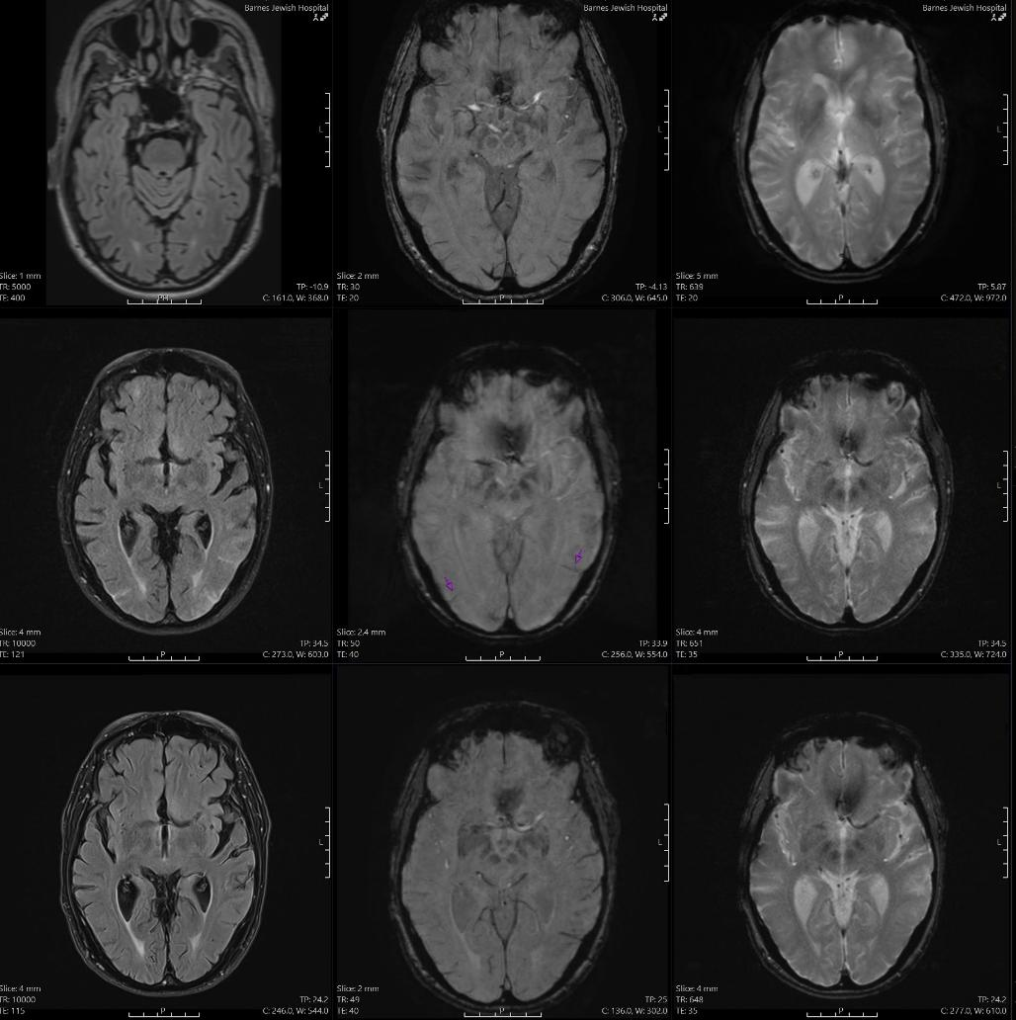
Case 4:
Monitoring
FLAIR
SWI
GRE/T2*
Baseline
Monitoring
Follow-up
Images provided by Dr Tammie Benzinger.

Slide 43
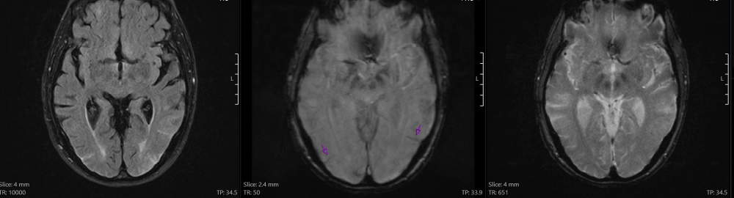
Case 4:
Monitoring
FLAIR
SWI
GRE/T2*
Baseline
Monitoring
Monitoring FLAIR
Monitoring SWI
Monitoring GRE/T2*
Images provided by Dr Tammie Benzinger.

Slide 44
Case 4
ARIA MRI Classification Criteria (PI)
 | Radiographic Severity
ARIA Type | Mild | Moderate | Severe
ARIA-E | FLAIR hyperintensity confined to sulcus and/or cortex/subcortex white matter in 1 location <5 cm | FLAIR hyperintensity 5-10 cm in single greatest dimension, or more than 1 site of involvement, each measuring <10 cm | FLAIR hyperintensity >10 cm with associated gyral swelling and sulcal effacement; 1 or more separate/independent sites of involvement may be noted
ARIA-H microhemorrhage | ≤4 new incident microhemorrhages | 5-9 new incident microhemorrhages | 10 or more new incident microhemorrhages
ARIA-H superficial siderosis | 1 new* focal area of superficial siderosis | 2 new focal areas of superficial siderosis | >2 new focal areas of superficial siderosis
*Includes new or worsening superficial siderosis
Lecanemab PI. Donanemab PI.
Notes:
ARIA, amyloid-related imaging abnormalities.

Slide 45
Case 4: Lessons Learned
Moderate ARIA-E (correctly identified)
Moderate ARIA-H Siderosis (identified only in retrospect – did not see the finding initially
Notes:
ARIA, amyloid-related imaging abnormalities.

Slide 46
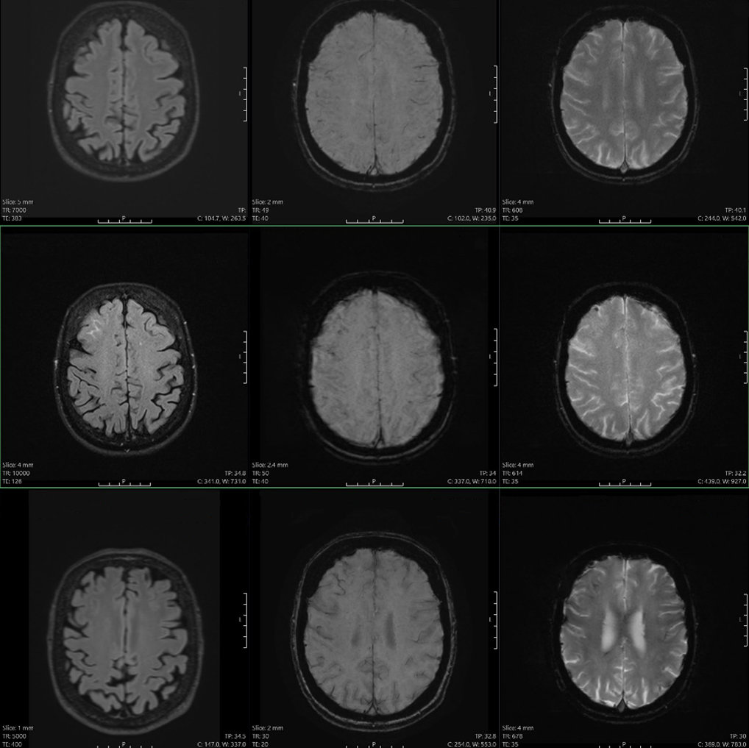
Case 5:
Monitoring
FLAIR
SWI
GRE/T2*
Baseline
Monitoring
Follow-up
Images provided by Dr Tammie Benzinger.

Slide 47
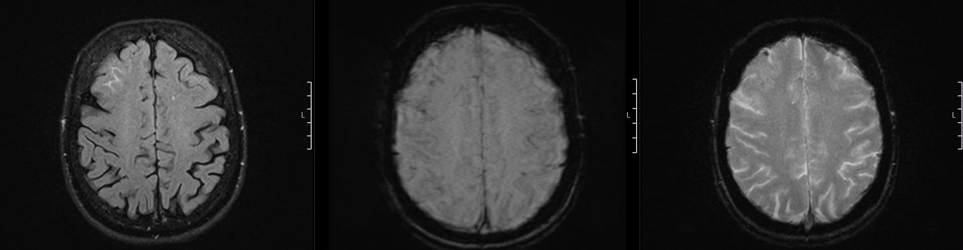
Case 5:
Monitoring
FLAIR
SWI
GRE/T2*
Baseline
Monitoring
Monitoring FLAIR
Monitoring SWI
Monitoring GRE/T2*
Images provided by Dr Tammie Benzinger.

Slide 48
Case 5
ARIA MRI Classification Criteria (PI)
 | Radiographic Severity
ARIA Type | Mild | Moderate | Severe
ARIA-E | FLAIR hyperintensity confined to sulcus and/or cortex/subcortex white matter in 1 location <5 cm | FLAIR hyperintensity 5-10 cm in single greatest dimension, or more than 1 site of involvement, each measuring <10 cm | FLAIR hyperintensity >10 cm with associated gyral swelling and sulcal effacement; 1 or more separate/independent sites of involvement may be noted
ARIA-H microhemorrhage | ≤4 new incident microhemorrhages | 5-9 new incident microhemorrhages | 10 or more new incident microhemorrhages
ARIA-H superficial siderosis | 1 new* focal area of superficial siderosis | 2 new focal areas of superficial siderosis | >2 new focal areas of superficial siderosis
*Includes new or worsening superficial siderosis
Lecanemab PI. Donanemab PI.
Notes:
ARIA, amyloid-related imaging abnormalities.

Slide 49
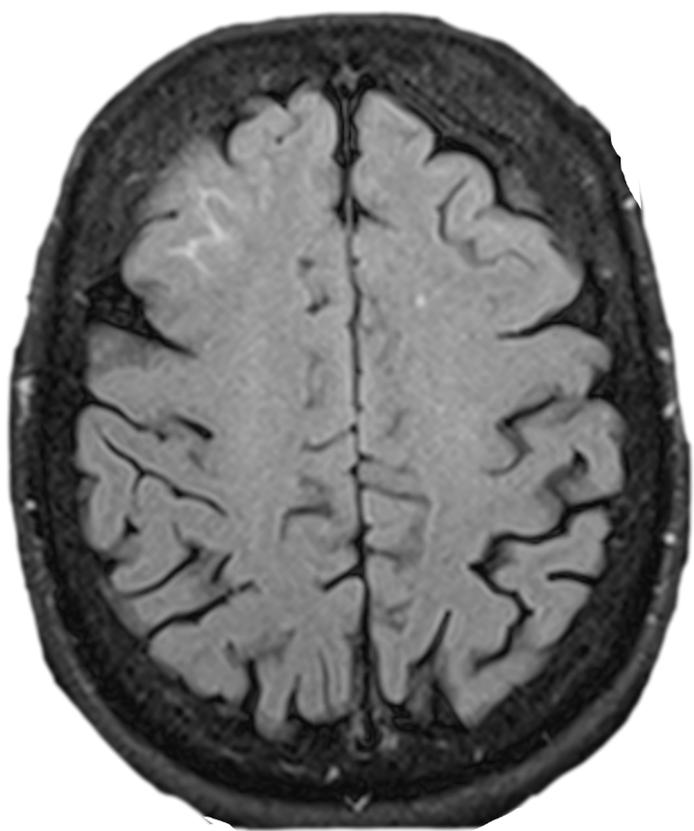
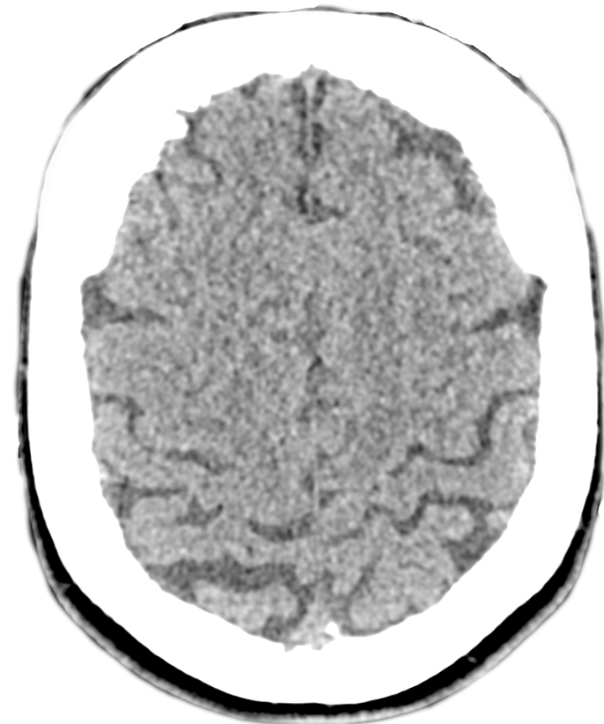
Case 5
ARIA is not easily identified on a head CT
CT and CTA are NOT indicated
Images provided by Dr Tammie Benzinger.
Notes:
ARIA, amyloid-related imaging abnormalities.

Slide 50
Case 5: Lessons Learned
Mild ARIA-E (saw the finding, but missed the diagnosis)
Moderate ARIA-H siderosis (missed 1 of the 2)
Head CT is not indicated
Notes:
ARIA, amyloid-related imaging abnormalities.

Slide 51
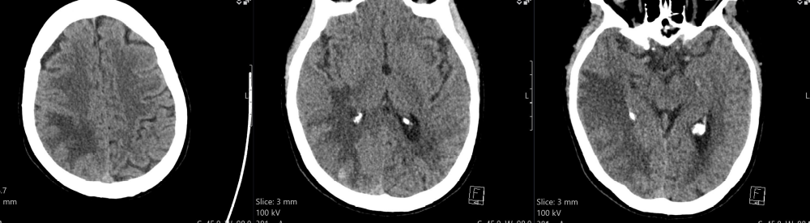
Case 6
Patient presents to the ED after an MVC, visiting family over the holidays
No medical records are available
Images provided by Dr Tammie Benzinger.
Notes:
ED, emergency department.

Slide 52
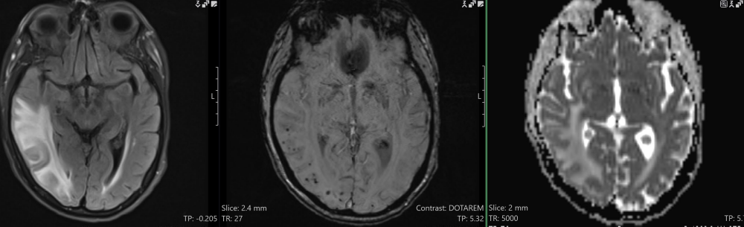
Case 6
What is the differential diagnosis?
Images provided by Dr Tammie Benzinger.

Slide 53
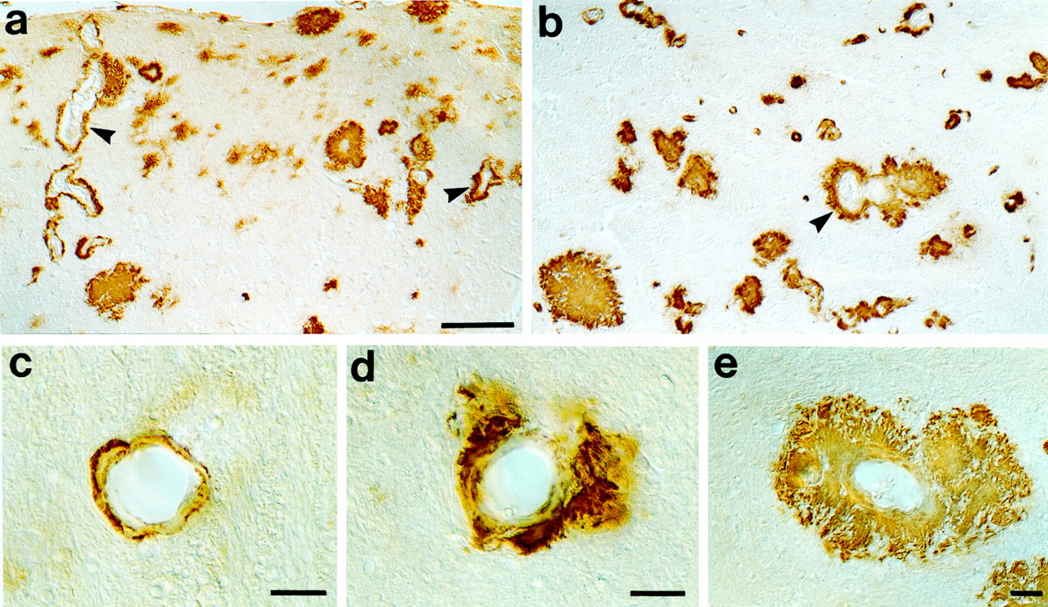
Case 6
Cerebral amyloid angiopathy related inflammation (CAA-RI)
If they have “ARIA” but have not received anti-amyloid immunotherapy, think about CAA-RI
Cerebral amyloid angiopathy: Aβ staining in mouse brain
Winkler. J Neurosci. 2001;21:1619. CC-BY 4.0 license.
Notes:
ARIA, amyloid-related imaging abnormalities.

Slide 54
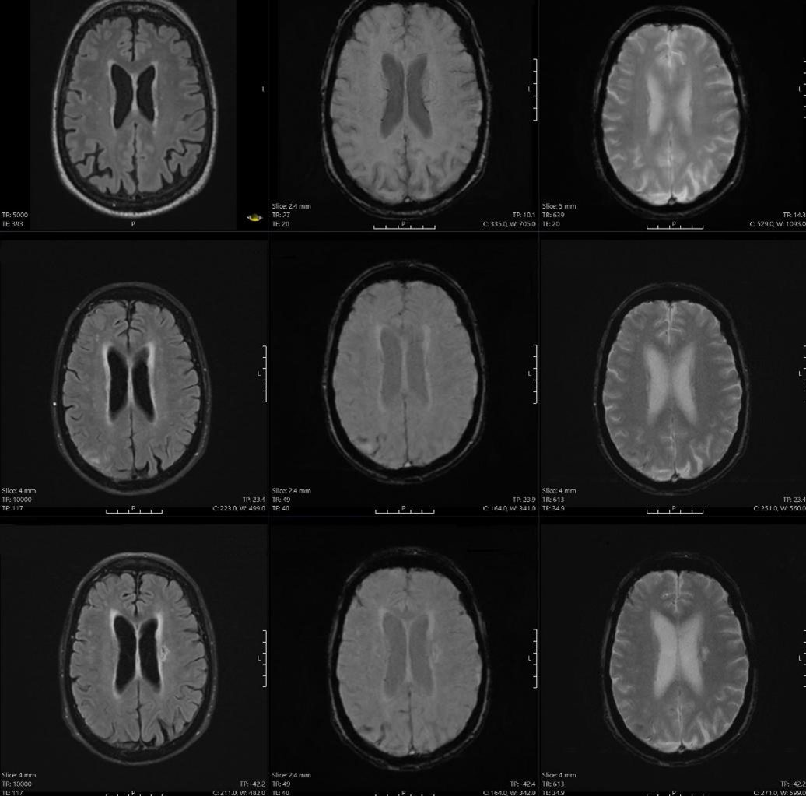
Case 7:
Monitoring
FLAIR
SWI
GRE/T2*
Baseline
Monitoring
Follow-up
Images provided by Dr Tammie Benzinger.

Slide 55
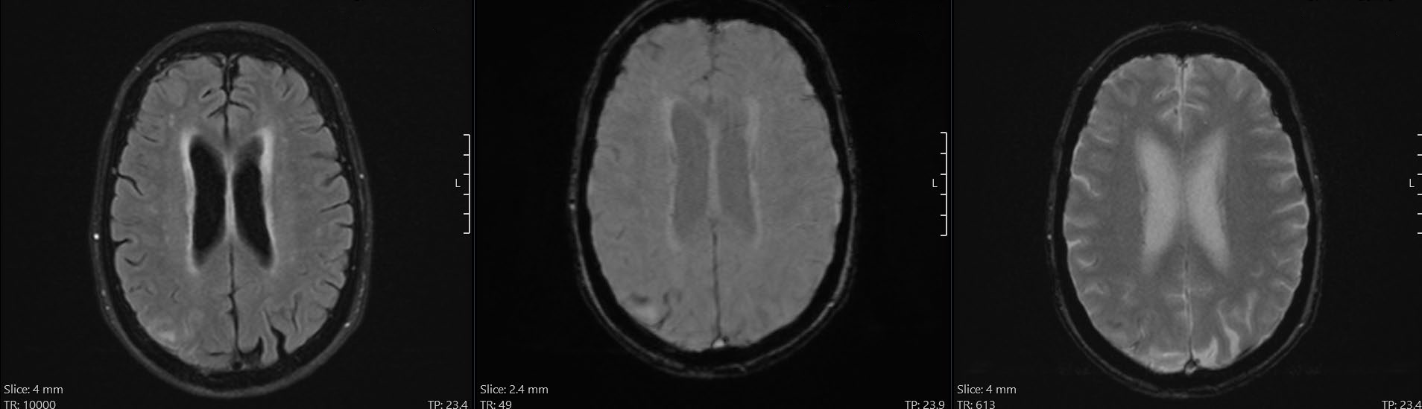
Case 7:
Monitoring
FLAIR
SWI
GRE/T2*
Baseline
Monitoring
Follow up FLAIR
Follow up SWI
Follow up GRE/T2*
Monitoring FLAIR
Monitoring SWI
Monitoring GRE/T2*
Images provided by Dr Tammie Benzinger.

Slide 56
Case 7
ARIA MRI Classification Criteria (PI)
 | Radiographic Severity
ARIA Type | Mild | Moderate | Severe
ARIA-E | FLAIR hyperintensity confined to sulcus and/or cortex/subcortex white matter in 1 location <5 cm | FLAIR hyperintensity 5-10 cm in single greatest dimension, or more than 1 site of involvement, each measuring <10 cm | FLAIR hyperintensity >10 cm with associated gyral swelling and sulcal effacement; 1 or more separate/independent sites of involvement may be noted
ARIA-H microhemorrhage | ≤4 new incident microhemorrhages | 5-9 new incident microhemorrhages | 10 or more new incident microhemorrhages
ARIA-H superficial siderosis | 1 new* focal area of superficial siderosis | 2 new focal areas of superficial siderosis | >2 new focal areas of superficial siderosis
*Includes new or worsening superficial siderosis
Lecanemab PI. Donanemab PI.
Notes:
ARIA, amyloid-related imaging abnormalities.

Slide 57
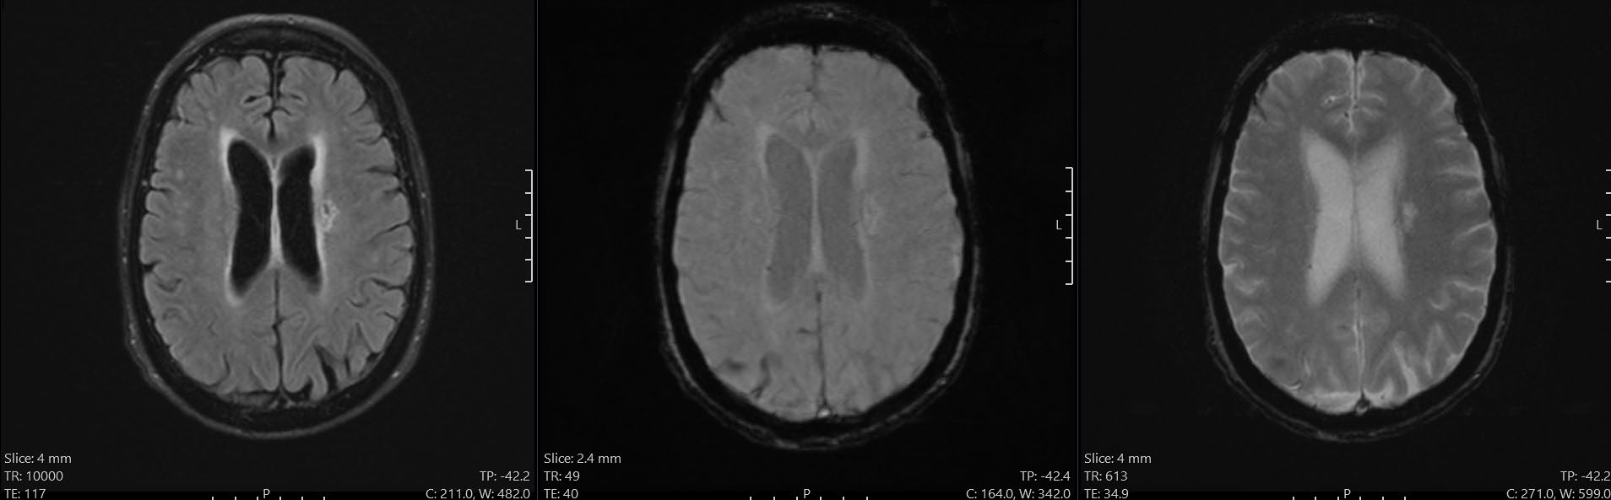
Case 7:
Monitoring
FLAIR
SWI
GRE/T2*
Baseline
Monitoring
Follow up
Follow-up FLAIR
Follow-up SWI
Follow-up GRE/T2*
Images provided by Dr Tammie Benzinger.

Slide 58
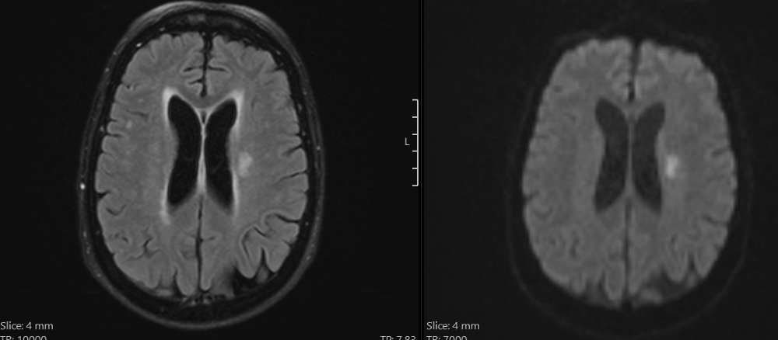
Case 7:
Monitoring
FLAIR
SWI
GRE/T2*
Baseline
Monitoring
Follow-up
Images provided by Dr Tammie Benzinger.

Slide 59
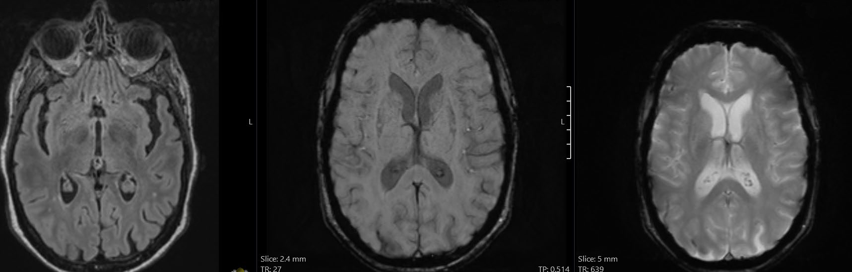
Case 7
FLAIR
SWI
GRE/T2*
Images provided by Dr Tammie Benzinger.

Slide 60
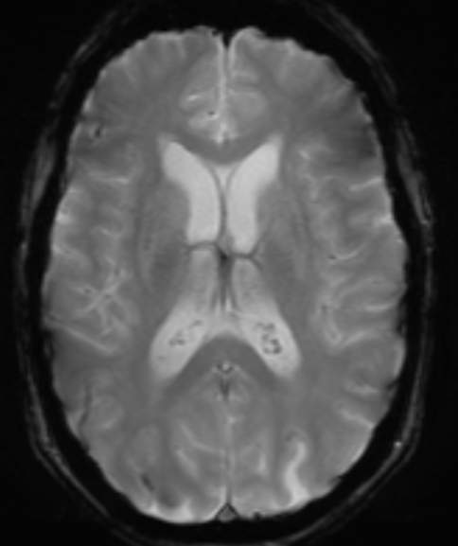
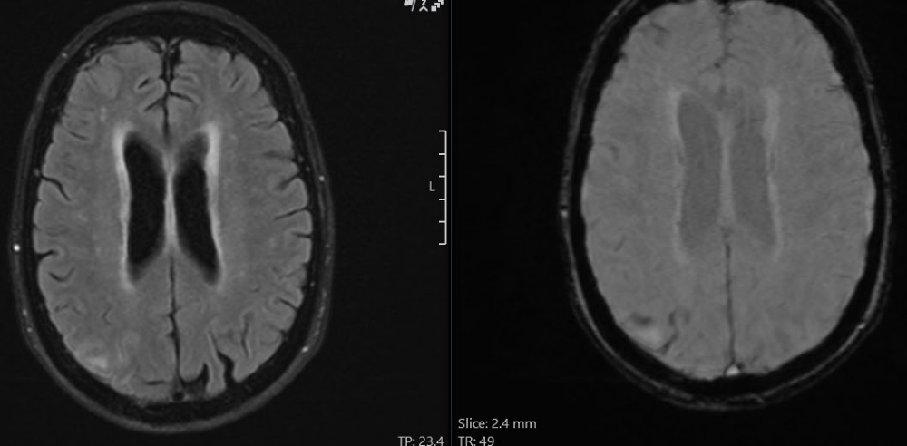
Case 7:
Lessons Learned
Baseline siderosis predicts future ARIA (underlying CAA)
ARIA-E will resolve on FLAIR
AD and vascular dementia commonly coexist; the 2nd lesion was an infarct
Patients commonly have more than 1 problem
Images provided by Dr Tammie Benzinger.
Notes:
ARIA, amyloid-related imaging abnormalities.

Slide 61
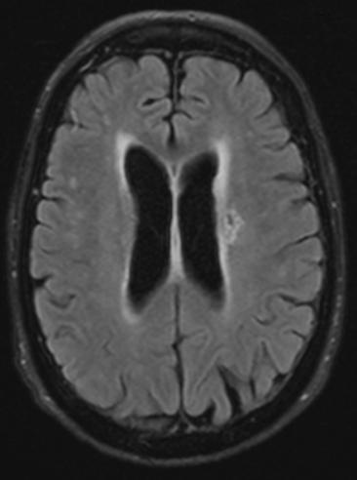
Case 7:
Lessons Learned
Baseline siderosis predicts future ARIA (underlying CAA)
ARIA-E will resolve on FLAIR
AD and vascular dementia commonly coexist; the 2nd lesion was an infarct
Patients commonly have more than 1 problem
Images provided by Dr Tammie Benzinger.
Notes:
AD, Alzheimer’s disease; ARIA, amyloid-related imaging abnormalities.

Slide 62
European Protocols

Slide 63
EMA Authorizations of Antiamyloid Therapies
First authorized:
    Lecanemab May 2025
    Donanemab Oct 2025
Indications:
    Same as US: MCI or mild dementia due to AD with confirmed amyloid pathology
    Different from US: APOE E4 noncarriers or heterozygotes only
Monitoring schedule same as US
Lecanemab SmPC. Donanemab SmPC.
Notes:
AD, Alzheimer’s disease; MCI, mild cognitive impairment.

Slide 64
Management of ARIA With ATTs
US Appropriate Use Recommendations and Product Labels
MRI conducted as routine monitoring or due to symptoms
*Stop treatment if:
Any macrohemorrhage
>1 area of superficial siderosis
>10 microhemorrhages since treatment initiation
>2 episodes of ARIA
Radiographically severe ARIA
Serious symptoms of ARIA
Patient requires anticoagulant
Rabinovici. J Prev Alzheimers Dis. 2025;12:10015. Cummings. J Prev Alzheimers Dis. 2023;10:362.
Notes:
ARIA, amyloid-related imaging abnormalities.

Slide 65
Swiss Society for Neuroradiology
Neuroimaging Standards for ARIA Screening and Monitoring
 | Baseline | Follow-up: Asymptomatic Patients | Follow-up: Symptomatic Patients
Contrast | Without IV contrast | Without IV contrast | IV contrast optional
Protocol | Baseline exam | Therapy monitoring | Symptoms under therapy
Sequence requirements | 2D or 3D T2/FLAIR GRE* (and SWI) DWI 3-DT1 T2 FSE | 2D or 3D T2/FLAIR GRE* (and SWI) DWI | 2D or 3D T2/FLAIR GRE* (and SWI) DWI (+ additional sequences)
Key findings | Microhemorrhages Siderosis White matter hyperintensities Infarcts
Recommended communication | Standard reporting | Report ARIA severity if present Mild ARIA: notification required Moderate or severe ARIA: closed loop communication | Report ARIA severity if present Mild ARIA: notification required Moderate or severe ARIA: closed loop communication
Either T2* or T2* and SWI in combination should be used for interpretation.
Lesion quantification should rely solely on T2* numeric evaluation based on current evidence.
Wiest. Neurodegener Dis. 2025.;[Erpub].
Notes:
ARIA, amyloid-related imaging abnormalities; DTI, diffusion tensor imaging; DWI, diffusion-weighted imaging; FSE, fast spin echo; GRE, gradient echo; SWI, susceptibility-weighted imaging.

Slide 66
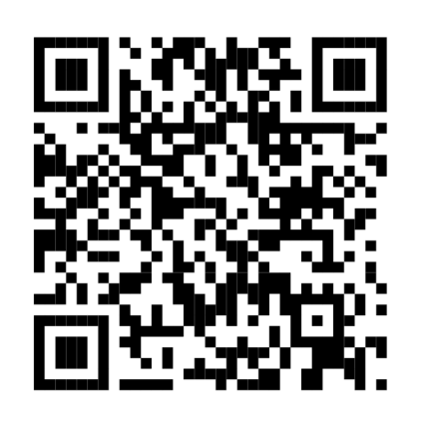
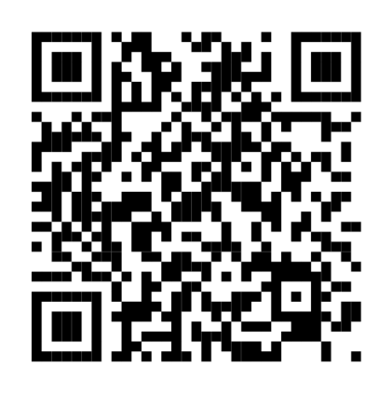
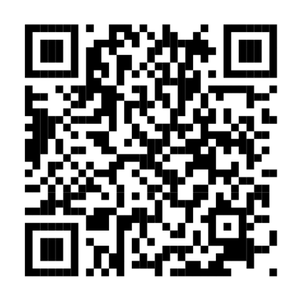
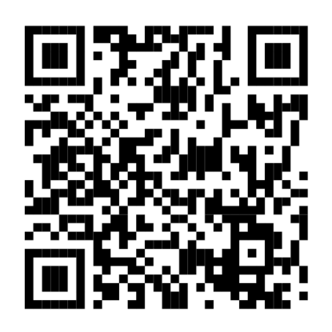

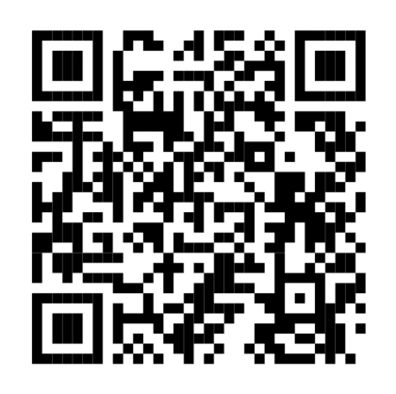

Updated Guidelines and Resources for Dementia Imaging
https://acsearch.acr.org/docs/3111292/Narrative
https://www.ajnr.org/content/43/9/E19.abstract
https://www.ajnr.org/content/46/1/24.abstract
Alzheimer’s Association (AA)/Society for Nuclear Medicine and Molecular Imaging (SNMMI) Appropriate Use for Amyloid and Tau PET, 2025
American Society for Neuroradiology (ASNR) Recommendations, 2022 & 2025
https://www.jacr.org/article/S1546-1440(25)00137-1/fulltext
https://pubmed.ncbi.nlm.nih.gov/36209379/
https://pmc.ncbi.nlm.nih.gov/articles/PMC12657122/
https://karger.com/ndd/article/doi/10.1159/000549521/939032/Clinical-practice-recommendations-of-the-Swiss
American College of Radiology (ACR) Appropriateness Criteria for Dementia Imaging, 2024
European Consensus for the Diagnosis of MCI and Early AD, European Society of Neuroradiology (ESNR) and the European Association of Nuclear Medicine (EANM), 2023
Treatment-related amyloid clearance (TRAC), Alzheimer’s & Dementia, 2025
Swiss Society for Neuroradiology (SSNR), 2025

Slide 67
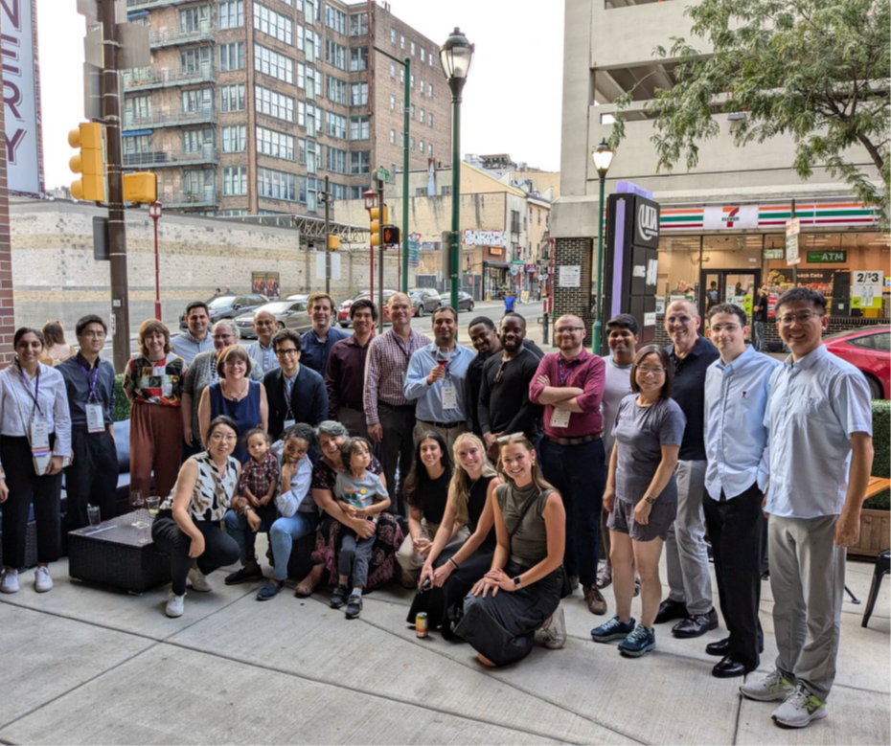
Acknowledgements
In grateful appreciation of our research participants, whose dedication has transformed our care for this patient population
Many thanks to the faculty, staff, and students in the Knight Alzheimer Research Imaging Program, to the Knight ADRC, DIAN and DIAN-TU Teams, the CCIR staff, & the long-standing support of the MIR administration & clinical colleagues

Slide 68

Go Online for More ARIA Training!
Downloadable slides and on-demand webcast from this webinar
Text-based learning module translated into Mandarin, Japanese, Spanish, Italian, and German (coming soon!)
https://www.deceraclinical.com/education/COVID19playbook

