Slide 1

HCV in Women: Updated Guidance on Screening and Management
This activity is provided by Clinical Care Options, LLC
Tatyana Kushner, MD, MSCE
Assistant Professor
Division of Liver Diseases
Icahn School of Medicine at Mount Sinai
New York, New York
This program is supported by an educational grant from Gilead Sciences, Inc..

Slide 2

Faculty
Tatyana Kushner, MD, MSCE
Assistant Professor
Division of Liver Diseases
Icahn School of Medicine at Mount Sinai
New York, New York
Tatyana Kushner, MD, MSCE, has disclosed that she has received consulting fees from Gilead Sciences.
Slide credit: clinicaloptions.com

Slide 3
Incidence of Acute HCV Is Increasing in the United States
~ 33,900 new HCV infections in 2015^{[1]}
Approximate 1:1 male:female ratio; predominantly White race^{[2]}
Highest incidence among persons 20-29 yrs of age,^{[1]} nonmetropolitan areas^{[2,3]}
Reported Cases of Acute HCV by Sex,
2002-2017^{[1]}
Reported Cases of Acute HCV,
by Age Group, 2002-2017^{[1]}
1.4
3.0
0-19 yrs
40-49 yrs
20-29 yrs
50-59 yrs
30-39 yrs
60+ yrs
1.2
Male
2.5
1.0
Female
2.0
0.8
Cases/100,000 Population
1.5
0.6
0.4
1.0
0.2
0.5
0
0
2002
2005
2008
2011
2014
2017
2002
2005
2008
2011
2014
2017
Yr
Yr
1. CDC. Viral Hepatitis Surveillance United States, 2018. 2. Suryaprasad. Clin Infect Dis. 2014;59:1411. 3. Zibbell. MMWR Morb Mortal Wkly Rep. 2015;64:453.
Slide credit: clinicaloptions.com

Slide 4
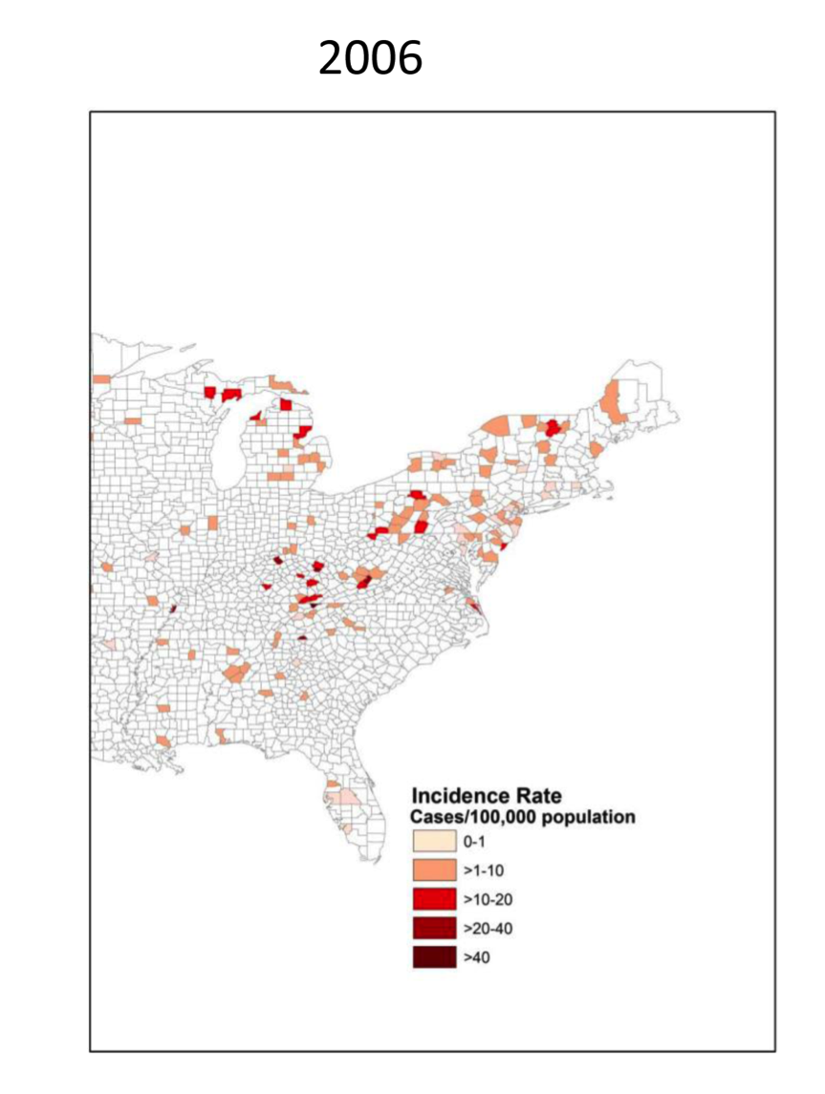
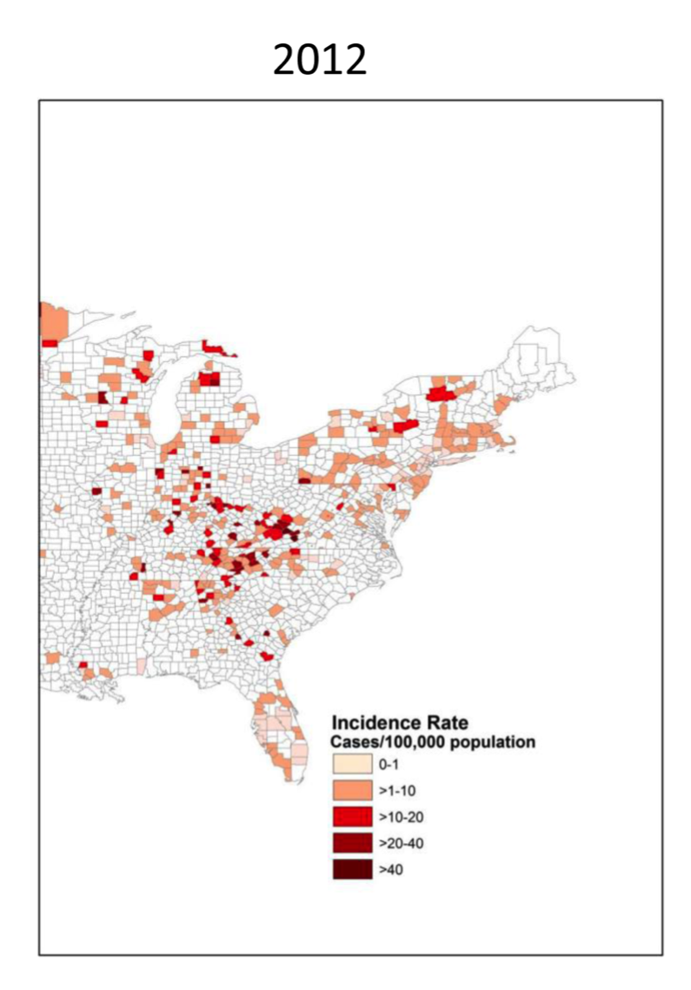
New HCV Infections in the United States: Emerging Epidemic Among Young People Who Use Heroin
HCV incidence: 13% annual increase rural; 5% annual increase urban^{[1]}
Regional doubling of first-time heroin use^{[2]}
3 of 4 had history of prescription opioid use disorder^{[2][3]}
97% initiated drug use before
20 yrs of age^{[1]}
In separate meta-analysis, HCV incidence 17% higher in women than men who inject drugs^{[3]}
2006
2012
Incidence Rate Cases/
100,000 Population
Incidence Rate Cases/
100,000 Population
0-1
> 1-10
> 10-20
> 20-40
> 40
0-1
> 1-10
> 10-20
> 20-40
> 40
1. Suryaprasad. Clin Infect Dis. 2014;59:14112. Zibbell. MMWR Morb Mortal Wkly Rep. 2015;64:453. 3. Esmaeili. J Viral Hepat. 2017;24:117.
Slide credit: clinicaloptions.com

Slide 5
HCV in Women of Childbearing Age
In pooled data from the National Notifiable Diseases Surveillance System and the Quest laboratory database
  Among women of childbearing age:
    Number of acute cases of HCV increased 3.4-fold
    Number of past or present cases doubled
    Case number higher in younger vs older women since 2013
HCV Infection Reported Among Women by Age
From 2006-2014
35,000
30,000
25,000
20,000
Cases Reported (n)
15,000
10,000
Age 15-44 yrs
Age 45-64 yrs
35,000
0
2006
2007
2008
2009
2010
2011
2012
2013
2014
Yr
Ly. Ann Intern Med. 2017;166:775.
Slide credit: clinicaloptions.com

Slide 6
Why Might Women Be at Higher HCV Risk?
Women who inject drugs have been shown to have higher incidence of HIV and higher rate of injection-related risk behaviors than men who inject drugs^{[1]}
    Higher rates of equipment and syringe sharing in women than men^{[1]}
    More women using injection equipment after their male partners^{[1]}
    More women injected by others^{[1]}
  More likely than men to have IDU sex partners^{[2]}
    Overlapping sexual and injection partnerships → increased injection risk^{[2]}
Female PWID face stigma; less likely to participate in harm reduction services^{[1]}
It is critical to counsel women on harm reduction services and safe injection practices!
1. Esmaeili. J Viral Hepat. 2017;24: 117. 2. Evans. J Urban Health. 2003;80:137.
Slide credit: clinicaloptions.com
Notes:
IDU, injection drug users ; PWID, people who inject drugs.

Slide 7
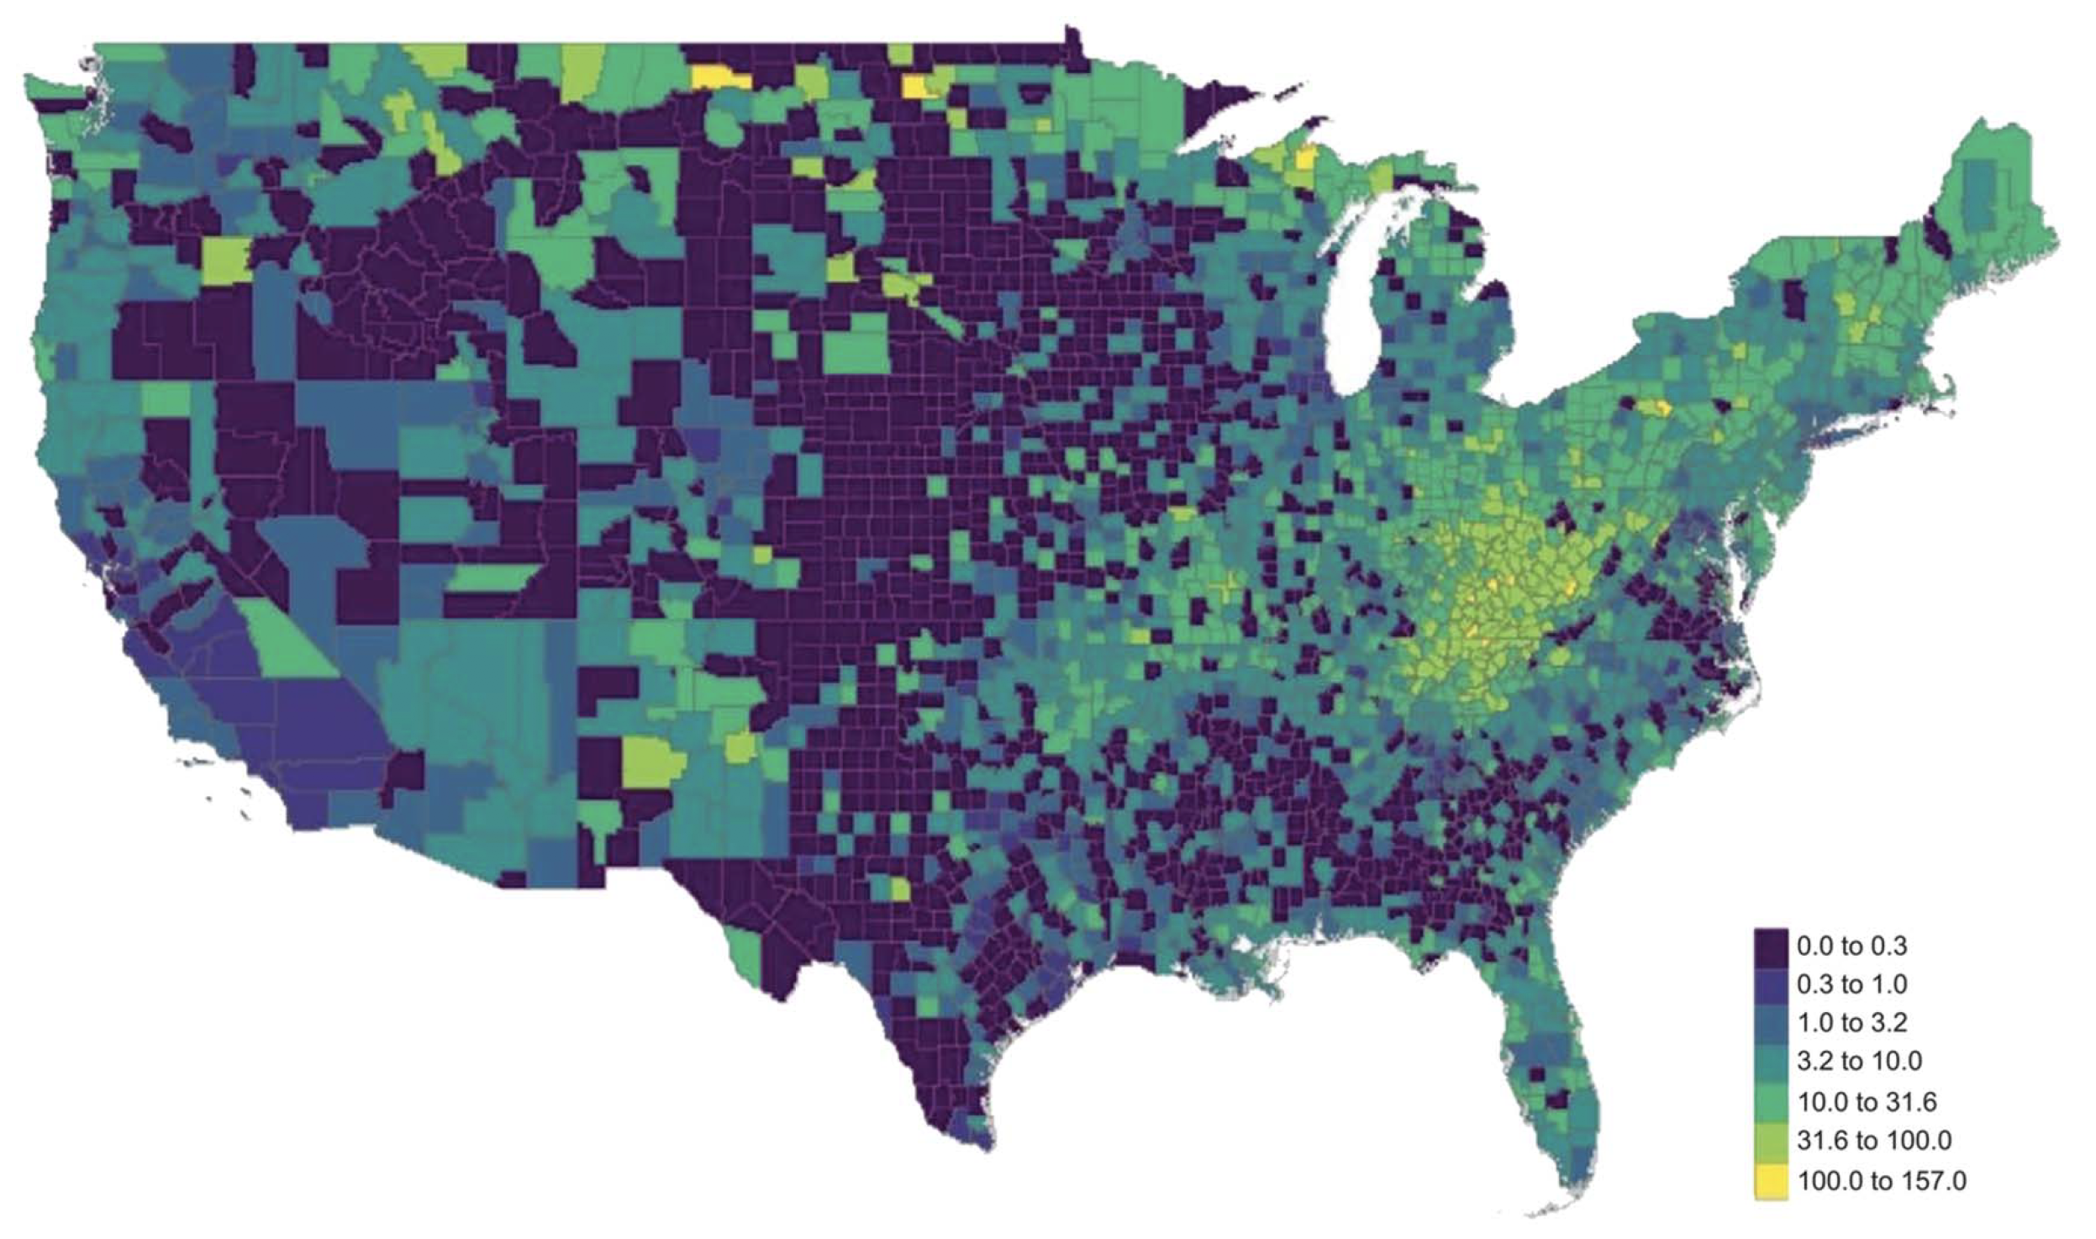
HCV in Pregnant Women, 2009-2017
Retrospective, population-based, cohort study of live births in the United States from 2009-2017 using National Center for Health Statistics birth records
Maternal HCV Prevalence by Race
Overall, reported prevalence of maternal HCV infection increased by 161% from 2009 to 2017
8
7
Non-Hispanic White
Non-Hispanic Black
Hispanic
Asian
6
5
4
Maternal HCV Prevalence per 1000 Live Births
HCV Prevalence/1000 Live Births
3
2
8
0
2009
2010
2011
2012
2013
2014
2015
2016
2017
Yr
Rossi. Obstet Gynecol. 2020;135:387.
Slide credit: clinicaloptions.com

Slide 8
AASLD/IDSA Guidance: Testing for HCV During Pregnancy
Previous HCV screening recommendation was based on risk (eg,
prior blood transfusion, PWID and shared needles, persons with HIV, persons born to mother with HCV)
In May 2018, guidance revised to recommend universal testing of pregnant women
Universal HCV Screening in Pregnancy
Recommended | Rating
As part of prenatal care, all pregnant women should be tested for HCV infection with each pregnancy, ideally at the initial visit | IIb, C
HCV Guidance: Recommendations for Testing, Managing, and Treating Hepatitis C. www.hcvguidelines.org.
Slide credit: clinicaloptions.com
Notes:
AASLD, American Association for the Study of Liver Diseases; IDSA, Infectious Diseases Society of America; PWID, people who inject drugs.

Slide 9
New HCV Screening Recommendations From the USPSTF
USPSTF recommends HCV screening in adults 18-79 yrs of age (grade B)
To whom does this apply? All adults, 18-79 yrs of age without known liver disease
What’s new? This recommendation expands the population who should be screened
  Previously, task force recommended screening adults born between 1945 and 1965 and others at high risk
“Pregnant adults should be screened. HCV prevalence has doubled in women aged 15 to 44 years from 2006 to 2014. From 2011 to 2014, 0.73% of pregnant women tested had an HCV infection, with a 68% increase in the proportion of infants born to HCV-infected mothers. Approximately 1700 infected infants are born annually to 29,000 HCV-infected mothers. Because of the increasing prevalence of HCV in women aged 15 to 44 years and in infants born to HCV-infected mothers, clinicians may want to consider screening pregnant persons younger than 18 years.”
Owens. JAMA. 2020;323:970.
Slide credit: clinicaloptions.com
Notes:
HCV, hepatitis C virus; USPSTF, US Preventive Services Task Force.

Slide 10
Further HCV Screening Recommendation Updates:
CDC and ACOG
April 10, 2020: newly released CDC recommendations include^{[1]}:
April 2020 ACOG Practice Advisory^{[2]}:
“Hepatitis C screening is recommended for all pregnant women during each pregnancy except in settings where the prevalence of HCV infection is < 0.1%.”
“The American College of Obstetricians and Gynecologists (ACOG) is actively reviewing the new guidance from the CDC and USPSTF. Updated guidance from ACOG will be posted on ACOG’s website and published in Obstetrics & Gynecology when available. ACOG is also reviewing its current guidance on the screening and management of hepatitis for pregnant individuals in ACOG Practice Bulletin No. 86, Viral Hepatitis in Pregnancy (2007).”
1. Schillie. MMWR Recomm Rep 2020;69:1. 2. ACOG. Screening for Hepatitis C Virus Infection. 2020.
Slide credit: clinicaloptions.com
Notes:
ACOG, American College of Obstetricians and Gynecologists.

Slide 11
Is Universal HCV Screening During Pregnancy
Cost-Effective?
Impact of HCV Chronic Prevalence Among
Pregnant Women on Cost-Effectiveness Ratio of Universal vs Risk-based Screening
Incremental cost-effectiveness ratio analysis comparing universal and
risk-based screening
Universal screening of ~ 5 million pregnant women in 2018 could
result in detection and treatment
of an additional 33,000 women and 300 children born with HCV
HCV screening cost-effective even in low prevalence areas and across all fibrosis stages
100,000
Scenario:
Treating F0 and above
75,000
50,000 USD
50,000
ICER (Dollars/QALY Gained)
25,000
0
0
0.1
0.2
0.3
0.4
0.5
0.6
0.7
0.8
0.9
1.0
HCV Chronic Prevalence (%)
Chaillon. Clin Infect Dis. 2019;69:1888.
Slide credit: clinicaloptions.com
Notes:
ICER, incremental cost-effectiveness ratio.

Slide 12
AASLD: Monitoring of Women With HCV During Pregnancy
Recommendation | Rating
HCV RNA and routine liver function tests are recommended at initiation of prenatal care for HCV-antibody–positive pregnant women to assess the risk of MTCT and severity of liver disease | I, B
All pregnant women with HCV infection should receive prenatal and intrapartum care that is appropriate for their individual obstetric risk(s) as there is no currently known intervention to reduce MTCT | I, B
In HCV-infected pregnant women with pruritus or jaundice, there should be a high index of suspicion for ICP with subsequent assessment of ALT, AST, and serum bile acids | I, B
HCV-infected women with cirrhosis should be counseled about the increased risk of adverse maternal and perinatal outcomes. Antenatal and perinatal care should be coordinated with a maternal–fetal medicine (ie, high-risk pregnancy) obstetrician | I, B
AASLD. HCV in Pregnancy. https://www.hcvguidelines.org/unique-populations/pregnancy.
Slide credit: clinicaloptions.com
Notes:
AASLD, American Association for the Study of Liver Diseases; ALT, alanine aminotransferase; AST, aspartate aminotransferase; ICP, intrahepatic cholestasis; MTCT, mother-to-child transmission.

Slide 13
What Is the Effect of HCV Infection on Pregnancy?
HCV may have negative effects but difficult to tease apart from effects of associated factors (eg, injection drug use)
Multicenter observational US study to assess outcomes in pregnant women with HCV (N = 772) and their infants launched in 2012^{[4,5]}
Meta-analysis of > 4,000,000 women with
> 5000 HCV infection cases^{[1,2*]}
Swedish Birth Registry: > 1 million women,
> 2000 births to HCV+ women, 2001-2011^{[3]}
Birth Outcome | OR With vs Without HCV (95% CI)
Preterm birth^{[1]} | 1.62 (1.48-1.76)
Intrauterine fetal growth restriction^{[2]} | 1.53 (1.40-1.68)
Low birth weight^{[2]} | 1.97 (1.43-2.71)
Birth Outcome | aRR With (n = 1,091,913) vs Without (n = 2056) HCV (95% CI)
Preterm birth | 1.32 (1.08-1.60)
Late neonatal death | 3.79 (1.07-13.79)
*1. 4,186,698 participants with 5218 HCV infection cases; 2. 4,185,414 participants with 5094 HCV infection cases.
1. Huang. J Viral Hepat, 2015;22:1033. 2. Huang. Medicine (Baltimore). 2016;95:e4777.
3. Stokkeland. Eur J Epidemiol. 2017;32:617. 4. NCT01959321. 5. Prasad. Obstet Gynecol. 2020;135:778
Slide credit: clinicaloptions.com
Notes:
aRR, adjusted relative risk; IUGR, intrauterine fetal growth restriction; OR, odds ratio.

Slide 14
HCV and ICP
Population-based cohort study in Sweden included 11,000 women with ICP and
11,000 healthy women^{[1]}
  ICP HR with vs without HCV: 4.16 (95% CI:
  3.14-5.15)
Meta-analysis of 3 studies of ICP in pregnancy (N = 95429) in women with (n = 308) vs without HCV^{[2]}
  ICP pooled OR with vs without HCV: 20.40
  (95% CI: 9.39-44.33)
Counsel women with HCV on the increased risk
of ICP!
1. Marschall. Hepatology. 2013;58:1385. 2. Wijarnpreecha. Clin Res Hepatol Gastroenterol. 2017;41:39.
Slide credit: clinicaloptions.com
Notes:
ICP, intrahepatic cholestasis of pregnancy.

Slide 15
AASLD: Treatment of Women of Childbearing Age
Recommendation Regarding HCV Treatment and Pregnancy | Rating
For women of reproductive age with known HCV infection, antiviral therapy is recommended before considering pregnancy, whenever practical and feasible, to reduce the risk of HCV transmission to future offspring | I, B
Counsel about benefit of antiviral treatment before pregnancy
If a woman becomes pregnant while receiving HCV DAA therapy, providers should discuss the risks vs benefits of continuing treatment
Ribavirin is contraindicated in pregnancy due to teratogenicity (wait at least 6 mos after completion of ribavirin therapy to get pregnant)
AASLD. HCV in Pregnancy. https://www.hcvguidelines.org/unique-populations/pregnancy.
Slide credit: clinicaloptions.com
Notes:
DAA, direct-acting antiviral.

Slide 16
AASLD Statement: HCV Treatment During Pregnancy
“Despite the lack of a recommendation, treatment can be considered during pregnancy on an individual basis after a patient-physician discussion about the potential risks and benefits.”^{[1]}
“For women on therapy who become pregnant, the decision to continue therapy requires careful consideration of (1) risk for virologic relapse; (2) risk of MTCT; (3) access and financial concerns; (4) patient and clinician preferences; and (5) limited safety data on DAAs in pregnancy.”^{[2]}
1. AASLD. HCV in Pregnancy. https://www.hcvguidelines.org/unique-populations/pregnancy. 2. Sarkar. Reproductive Health and Liver Disease: Practice Guidance by the American Association for the Study of Liver Diseases. Hepatology. 2020;[Epub].
Slide credit: clinicaloptions.com
Notes:
AASLD, American Association for the Study of Liver Diseases.

Slide 17
Why Consider Antiviral Therapy During Pregnancy?
Potential to reduce risk of MTCT; similar to HBV
Pregnancy is often a time when women have health insurance; opportune time to treat HCV concurrent with pregnancy care
Provides opportunity to cure HCV in women with high-risk behaviors to prevent transmission to others, including injecting partners
Slide credit: clinicaloptions.com
Notes:
MTCT, mother-to-child transmission.

Slide 18
Risk of MTCT of HCV by Maternal HIV Serostatus
Systematic review and meta-analysis of 109 studies with HCV Ab+, HCV RNA+ mothers
HIV-negative women
HIV-positive women
Author, Yr
Spencer, 1997
Granovsky, 1998
Resti, 1998
La Torre, 1998
Polatti, 2000
Ceci, 2001
Nordbo, 2002
Resiti, 2002
Caudai, 2003
Ferrero, 2003
Saez, 2004
Syriopoulou, 2005
Mast, 2005
Della Bella, 2005
Claret, 2007
Ruiz-Extremera, 2011
Prasad, 2012
Sample Size
63
25
275
56
24
60
48
739
29
105
83
55
182
28
94
128
23
Proportion, %
9.5
8.0
4.7
3.6
4.2
3.3
8.3
10.
6.9
2.9
2.4
1.8
3.8
10.7
1.1
7.0
8.7
5.8
95% CI
(3.6-19.6)
(1.0-26.0)
(2.5-7.9)
(0.4-12.3)
(0.1-21.1)
(0.4-11.5)
(2.3-20.0)
(8.1-12.6)
(0.8-22.8)
(0.6-8.1)
(0.3-8.4)
(0-9.7)
(1.6-7.8)
(2.3-28.2)
(0-5.8)
(3.3-12.9)
(1.1-28.0)
(4.2-7.8)
Weight, %
7.8
3.8
11.2
4.0
2.3
4.0
6.2
15.4
3.9
5.4
4.0
2.3
8.8
5.1
2.3
9.7
3.8
100
Author, Yr
Granovsky, 1998
Thomas, 1998
Resti, 2002
Ferrero, 2003
Ferrero, 2005
Claret, 2007
Jamieson, 2008
Ruiz-Extremera, 2011
Sample Size
47
140
158
30
36
22
48
14
Proportion, %
8.5
9.3
13.9
6.7
5.6
13.6
4.2
28.6
10.8
95% CI
(2.4-20.4)
(5.0-15.4)
(8.9-20.3)
(0.8-22.1)
(0.7-18.7)
(2.9-34.9)
(0.5-14.3)
(8.4-58.1)
(7.6-15.2)
Weight, %
11.0
23.4
28.8
6.4
6.4
8.4
6.5
9.1
100
Random effects model
Heterogeneity: I-squared = 45.9%, P = .0203
Random effects model
Heterogeneity: I-squared = 28.8%, P = .1982
0
5.8%
10.8%
5
10
15
20
25
30
35
0
5
10
15
20
25
30
35
Benova. Clin Infect Dis. 2014;59:765.
Slide credit: clinicaloptions.com
Notes:
MTCT, mother-to-child transmission.

Slide 19
Can MTCT Be Prevented During and After Pregnancy?
Variable | Studies (N) | Precision of Evidence | Summary of Findings
Elective C/S vs vaginal delivery | 4 cohort studies (N = 2080) | Low | Inconsistent results with trends in opposite directions in highest quality studies
All C/S vs vaginal delivery | 11 cohort studies (N = 2308) | Low | No association between mode of delivery and risk of HCV transmission
Invasive fetal monitoring vs none | 3 cohort studies (N = 928) | Low | Inconsistent results: 1 good quality study (N = 181) showed increased risk of HCV transmission (aOR: 6.7, 95% CI: 1.1-36); another (N = 724) showed no association (RR: 1.2, CI: 0.7-2.2)
Prolonged rupture of membranes vs no | 2 cohort studies (N = 245) | Low | Membrane rupture > 6 hrs before delivery increased risk of transmission (OR: 9.3, 95% CI: 1.5-18)
Breastfeeding | 14 cohort studies (N = 2971) | High | No association between breastfeeding women with HCV and transmission to infants
Cottrell. Ann Intern Med. 2013;158:109.
Slide credit: clinicaloptions.com
Notes:
aOR, adjusted odds ratio; C/S, Cesarean section; OR, odds ratio; RR, relative risk.

Slide 20
Recommendations of Society of Maternal and Fetal Medicine Regarding Prevention of MTCT of HCV
Recommendation | Grade of Recommendation
Amniocentesis is recommended over chorionic villus sampling given the lack of data on the latter | 2C
We recommend against cesarean delivery solely for the indication of HCV infection. | 1B
We recommend that obstetric care providers avoid internal fetal monitoring, prolonged rupture of membranes, and episiotomy in managing labor in HCV-positive women | 1B
We recommend that providers not discourage breastfeeding based on a positive HCV infection status | 1A
Hughes. Am J Obstet Gynecol. 2017;217:B2.
Slide credit: clinicaloptions.com
Notes:
MTCT, mother-to-child transmission.

Slide 21
MTCT Most Common Cause of HCV in Children
25% to 40% of infants clear HCV by 2-3 yrs of age^{[1]}
Impact of HCV infection in children on quality of life^{[1,2]}
  Reduced physical functioning^{[1,2]}
  Executive function impairment in 20% of children with HCV^{[1]}
  Worse cognitive functioning vs children without HCV^{[1]}
    Parental emotional impact and decrement in parental quality of life^{[1]}
Higher rates of cirrhosis in children who acquire HCV through MTCT^{[1]}
Hepatocellular carcinoma is second most common hepatic malignancy in children^{[1,3]}
1. Murray. Diseases of the Liver in Children. Springer. 2014. 2.Nydegger. J Gastroenterol Hepatol. 2008;23:226. 3. Modin. J Hepatol. 2019;70:371.
Slide credit: clinicaloptions.com
Notes:
HCV, hepatitis C virus; MTCT, mother to child transmission.

Slide 22
AASLD/IDSA: Screening of Children Born to Mothers With HCV Infection
Recommendation | Rating
All children born to HCV-infected women should be tested for HCV infection; testing is recommended using an antibody-based test at or after 18 mos of age | I, A
Testing with an HCV-RNA assay can be considered in the first year of life, but the optimal timing of such testing is unknown | IIa, C
Testing with an HCV-RNA assay can be considered as early as 2 mos of age | IIa, B
Repetitive HCV RNA testing prior to 18 mos of age is not recommended | III, A
Children who are anti-HCV positive after 18 mos of age should be tested with an HCV-RNA assay after age 3 to confirm chronic hepatitis C infection | I, A
The siblings of children with vertically acquired chronic HCV should be tested for HCV infection, if born from the same mother | I, C
AASLD. HCV in children. https://www.hcvguidelines.org/unique-populations/children.
Slide credit: clinicaloptions.com
Notes:
HCV, hepatitis C virus.

Slide 23
Are We Actually Testing Children?
Testing rates evaluated in children born to mothers with HCV, using HCV surveillance data from Philadelphia Department of Public Health, Hepatitis Registry
Follow-up testing not conducted in majority of infants born to mothers with HCV infection
55,623
Philadelphia Births
Jan 1, 2011 - July 1, 2013
8119
HCV+ Women
Aged 12-54 in Registry
568
Births to HCV+
Women
31
Infants Adopted, Died, or Moved
537*
Eligible Infants
*
84
Tested Children
(16%)
453
Untested Children
4
Children Confirmed Perinatal HCV Infected
23
Expected Perinatal
HCV Infected
5% of Infants Born to HCV+ Women
(5%)
*Followed for up to 20 mos after birth.
Kuncio. Clin Infect Dis. 2016;62:980.
Slide credit: clinicaloptions.com

Slide 24
AASLD/IDSA: Treatment in Children and Adolescents With HCV Infection
Recommendation | Rating
Direct-acting antiviral treatment with an approved regimen is recommended for all children and adolescents with HCV infection aged ≥ 3 yrs as they will benefit from antiviral therapy, regardless of disease severity | I, B
The presence of extrahepatic manifestations—such as cryoglobulinemia, rashes, and glomerulonephritis—as well as advanced fibrosis should lead to early antiviral therapy to minimize future morbidity and mortality | I, C
AASLD. HCV in children. https://www.hcvguidelines.org/unique-populations/children.
Slide credit: clinicaloptions.com

Slide 25
Safety of DAAs in Pregnancy
DAA | Pregnancy | Lactation | Fertility | Historical FDA Classification
Glecaprevir/ pibrentasvir | No birth defects reported in animal data | Detected in rat milk; no human data | No effect on fertility in rats; no human data | None assigned
Ledipasvir/ sofosbuvir | No birth defects reported in animal data | Detected in rat milk; no human data | No effect on fertility in rats; no human data | B*
Sofosbuvir/ velpatasvir | Increase in visceral malformations with velpatasvir alone in rabbits | Detected in rat milk; no human data | No effect on fertility in rats; no human data | None assigned
*Animal reproduction studies have failed to demonstrate a risk to the fetus and there are no adequate and well-controlled studies in pregnant women.
AASLD. Hepatology. 2020;[Epub].
Slide credit: clinicaloptions.com
Notes:
DAA, direct-acting antiviral agents.

Slide 26
HCV Treatment With LDV/SOF During Pregnancy
Open-label, phase I study of ledipasvir/sofosbuvir (LDV/SOF) for 12 wks in pregnant women with HCV
Primary endpoint: PK of LDV/SOF 90/400 mg therapy in pregnancy
Secondary endpoints: SVR12, maternal and neonatal safety, neonatal growth, MTCT rate
Wk 2 PK Visit 1*
Gestation Wk 25-26
Wk 4 PK Visit 2*
Gestation Wk 27-28
Wk 10 PK Visit 3*
Gestation Wk
33-34
Pregnant women 18-39 yrs of age with chronic GT 1, 4, 5, or 6 HCV and detectable VL at screening; HBV, HIV negative; 23-24 wks of gestation with singleton gestation and no detectable abnormalities
(N = 9)
Wk 12 EOT*
LDV/SOF 90/400 mg
SVR12
*All visits: maternal HCV VL, AEs.
Infant follow-up at delivery, 8 wks, 6 mos, 12 mos: Infant HCV VL, AEs, physical exam, growth, neurodevelopmental assessment.
Chappell. Lancet Microbe. 2020;1:e200.
Slide credit: clinicaloptions.com
Notes:
AE, adverse event; EOT, end of treatment; GT, genotype; LDV, ledipasvir; MTCT, mother-to-child transmission; PK, pharmacokinetics; SOF, sofosbuvir; VL, viral load.

Slide 27
HCV Treatment With LDV/SOF During Pregnancy: Results
9 women (100%) who completed SVR12 assessment achieved cure
HCV Viral Response to LDV/SOF
Maternal AEs and Pregnancy Outcomes | Patients
Maternal AEs related to LDV/SOF,* n (%) | 5 (56)
Maternal AEs related to LDV/SOF grade > 2, n (%) | 0
D/c of LDV/SOF due to AEs, n (%) | 0
Median gestational age at delivery, wks + days (range) | 39 + 2 (36 + 6 to 41 + 0)
Delivery, n (%) Vaginal Scheduled cesarean section Emergent cesarean section† | 5 (56) 3 (33) 1 (11)
Median Apgar scores (range) 1 min 5 min | 8 (6-9) 9 (8-9)
Median infant birth weight, kg (range) | 3.29 (2.60- 4.16)
Median infant hospital stay duration, days (range) | 3 (2-12)
Detectable HCV RNA in cord blood, n (%) | 0
Admission to neonatal intensive care unit‡, n (%) | 3 (33)
8
Participant Number
1
2
3
4
5
6
7
8
9
7
6
5
4
HCV RNA (copies/mL)
3
2
1
0
Visit
HCV viral load, log copies/mL
Screening
5.7 (5.2-6.5)
Enrollment
5.7 (5.0-6.9)
PK-1
1 (0-1.7)
PK-2
1 (0-1)
PK-3
1 (0-0)
Delivery
0 (0-1)
SVR12
0 (0-0)
*Grade 1 nausea/vomiting, n = 3; grade 1 diarrhea, n = 1; grade 2 fatigue, n = 1.
†Due to umbilical cord prolapse. ‡Shoulder dystocia, n = 1; neonatal opioid withdrawal syndrome, n = 2.
Chappell. Lancet Microbe. 2020;1:e200.
Slide credit: clinicaloptions.com
Notes:
AE, adverse events; d/c, discontinuation; LDV, ledipasvir; PK, pharmacokinetic; SOF, sofosbuvir.

Slide 28
Conclusions
HCV among women of childbearing age and during pregnancy is increasing due to opioid epidemic
Guidelines have been updated to recommend HCV screening for all pregnant women
HCV treatment recommended before pregnancy for women of childbearing age
HCV treatment during pregnancy is not currently recommended by guidelines, but can be considered on an individual basis
Slide credit: clinicaloptions.com

Slide 29
Conclusions
  Mother-to-child HCV transmission rates range from ~ 6% to ~ 11%
  Coinfection with HIV significantly increases risk of HCV MTCT
All children of mothers with HCV infection should be tested for HCV antibodies at 18 mos of age and referred to specialty care as needed
HCV treatment is currently recommended in children ≥ 3 yrs of age
Based on limited animal data, some HCV DAA agents generally safe in pregnancy
  Studies underway to determine safety and efficacy of DAA agents on pregnancy
Slide credit: clinicaloptions.com
Notes:
MTCT, mother-to-child transmission.

