Slide 1
Enhancing Outcomes in Extensive-Stage Small-Cell Lung Cancer With Recent Therapeutic Advancements for First-line Therapy
Provided by Clinical Care Options, LLC
Supported by educational grants from Boehringer Ingelheim Pharmaceuticals, Inc. and Jazz Pharmaceuticals, Inc.​

Slide 2

About These Slides
Please feel free to use and share some or all of these slides in your noncommercial presentations to colleagues or patients
When using our slides, please retain the source attribution:
These slides may not be published, posted online, or used in commercial presentations without permission. Please contact permissions@clinicaloptions.com for details
Slide credit: clinicaloptions.com
Notes:
Disclaimer: The materials published on the Clinical Care Options website reflect the views of the authors of the CCO material, not those of Clinical Care Options, LLC, the CME providers, or the companies providing educational grants. The materials may discuss uses and dosages for therapeutic products that have not been approved by the FDA. A qualified healthcare professional should be consulted before using any therapeutic product discussed. Readers should verify all information and data before treating patients or using any therapies described in these materials.

Slide 3
Faculty and Disclosures
Anne Chiang, MD, PhD, FASCO
Associate Professor of Medicine
Division of Thoracic Medical Oncology
Yale University School of Medicine
Associate Yale Cancer Center Director, Clinical Initiatives
New Haven, Connecticut
Anne Chiang, MD, PhD, FASCO: consultant/advisor/speaker: Amgen, AstraZeneca, Boehringer Ingelheim, Daiichi Sankyo, Fosun, Genentech, Janssen, Jazz, Zai Lab; researcher: Amgen, AstraZeneca, Genentech, Zai Lab.

Slide 4
Faculty and Disclosures
Carl M. Gay, MD, PhD
Associate Professor
Thoracic/Head & Neck Medical Oncology
The University of Texas MD Anderson Cancer Center
Houston, Texas
Carl M. Gay, MD, PhD: consultant/advisor/speaker: Abdera, Amgen, AstraZeneca, BeOne, BioNTech, Boehringer Ingelheim, Daiichi Sankyo, Jazz, Merck, OncoHost, Roche/Genentech.

Slide 5
Faculty and Disclosures
Daniel Morgensztern, MD
Professor of Medicine
Division of Medical Oncology
Washington University School of Medicine
St Louis, Missouri
Daniel Morgensztern, MD: consultant/advisor/speaker: AbbVie, Bayer, Bristol Myers Squibb, Johnson & Johnson/Janssen, Natera, Tubulis; researcher (paid to institution): AbbVie, AstraZeneca, Bristol Myers Squibb, Celgene, EpicentRx, Merck, Pfizer.

Slide 6
Faculty and Disclosures
Mark A. Socinski, MD
Executive Medical Director
AdventHealth Cancer Institute
Orlando, Florida
Mark A. Socinski, MD: consultant/advisor/speaker: AstraZeneca, BeiGene, Bristol Myers Squibb, Genentech, Guardant, Janssen, Jazz, Merck, Spectrum, Summit; researcher: AstraZeneca, BeiGene, Enliven, Spectrum.

Slide 7
Faculty and Disclosures
Ticiana Leal, MD
Professor
Department of Hematology & Oncology
Director, Thoracic Oncology
Medical Director, Clinical Trials Office
Winship Cancer Institute
Emory University
Atlanta, Georgia
Ticiana Leal, MD: consultant/advisor/speaker: AbbVie, Amgen, AstraZeneca, Boehringer Ingelheim, Catalyst, Genentech, Gilead, Jazz, Johnson & Johnson, Merck, Molecular Partners, Naterra, Novocure, Pfizer, Regeneron, Roche, Sanofi, Summit, Synthekine.

Slide 8
Learning Objectives
At the conclusion of this activity, learners should be able to:
Align SCLC clinical practice with updated practice guidelines for the treatment of limited-stage and extensive-stage disease
Integrate newer treatment strategies for limited- and extensive-stage SCLC into clinical practice, using best practices and an individualized approach
Mitigate and manage adverse events associated with newer targeted agents for relapsed/refractory SCLC
Notes:
This slide summarizes the target audience, goal, and learning objectives for this CME activity.

Slide 9
The Current Era of Immunotherapy (IO) Integration in Treatment of SCLC
ADRIATIC:
Durva consolidation in LS-SCLC after platinum-based chemo + RT
IMforte: Lurbinectedin plus atezolizumab as maintenance
IMpower133 and CASPIAN:
Adding IO to chemo in the frontline setting for ES-SCLC
2018
2019
2020
2024
2025
CheckMate-032 and KEYNOTE-158:
Nivo and pembro in 3L setting; subsequently withdrawn due to negative phase III trials but still in NCCN guidelines if no prior IO exposure
Study B-005:
Lurbinectedin in metastatic SCLC
≥2L on or after platinum-based chemotherapy
DeLLphi-301, -304:
Tarlatamab in
ES-SCLC ≥2L on or after platinum-based chemotherapy

Slide 10
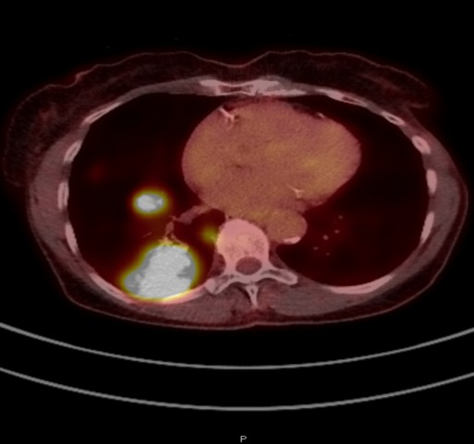
Patient Case Example: Management Considerations for ES-SCLC
83-yr-old Black woman with 40 pack-yr tobacco history presented with weight loss over several mo, worsening SOB on exertion, and abdominal discomfort
Physical exam reveals shotty neck adenopathy, right axillary LAD
PET scan of lung shows right lower lobe mass of 7.2 cm in the lung, additional tumor nodules in RLL, and extensive regional nodal involvement in right hilar, mediastinal, and axillary LNs
Brain MRI is negative
Biopsy of LN reveals small-cell carcinoma, positive for synaptophysin, Ki-67 90%
How would you treat this patient?
Image provided courtesy of Dr. Chiang.

Slide 11
Phase III Trials: Addition of Anti–PD-L1 Checkpoint Inhibitors to First-line Platinum + Etoposide in ES-SCLC
IMpower133^{1,2}
CASPIAN³
Stratified by sex, ECOG PS (0 vs 1), brain metastases (yes vs no)
Stratified by planned carboplatin vs cisplatin
Induction
Maintenance
Induction: 4 x 21-day cycles
Maintenance*
Durva + Treme + EP†
Q3W x 4 cycles
(n = 268)
D + T Q4W
until PD
Patients with measurable ES-SCLC; ECOG PS 0/1; no prior systemic therapy for ES-SCLC; treated, asymptomatic brain metastases eligible
(N = 403)
Atezolizumab +
Carboplatin/Etoposide
(n = 201)
Atezo
until PD
Patients with treatment-naive
ES-SCLC,
WHO PS 0/1, asymptomatic or treated and stable brain metastases
(N = 805)
Durvalumab + EP†
Q3W x 4 cycles
(n = 268)
Durva Q4W
until PD
Placebo +
Carboplatin/Etoposide
(n = 202)
Placebo
until PD
EP†
Q3W x 4-6 cycles
(n = 269)
Optional
PCI
*PCI per local SoC.
†Either carboplatin or cisplatin.
Coprimary endpoints: OS, PFS by investigator
Secondary endpoints: ORR, DoR, safety
Primary endpoint: OS
Secondary endpoints: PFS, ORR, safety/tolerability, PROs
1. Liu. JCO. 2021;39:619. 2. Horn. NEJM. 2018;379:2220. 3. Paz-Ares. ESMO Open. 2022;7:100408.
1. Liu. JCO. 2021;39:619. 2. Horn. NEJM. 2018;379:2220. 3. Paz-Ares. ESMO Open. 2022;7:100408.

Slide 12
IMpower133 and CASPIAN: OS With Addition of IO to CT
IMpower133: Adding Atezolizumab to Chemotherapy Improved OS¹⁻³
CASPIAN: Adding Durvalumab to Chemotherapy Improved OS⁴
 | Durvalumab + EP (n = 268) | EP (n = 269)
Events, n (%) | 228 (82.5) | 248 (92.2)
Median OS, mo (95% CI) | 12.9 (11.3-14.7) | 10.5 (9.3-11.2)
 | Atezolizumab + EP (n = 201) | Placebo + EP (n = 202)
Median OS, mo (95% CI) | 12.3 (10.8-15.8) | 10.3 (9.3-11.3)
+
100
Censored
+
+
1.0
+
+
+
+
+
+
+
+
+
+
+
+
+
+
+
+
+
80
+
0.8
12-mo OS
+
HR: 0.75 (95% CI: 0.60-0.86; nominal P = .0003)
60
51.9%
39.0%
18-mo OS
0.6
+
34.0%
21.0%
Probability of OS
36-mo OS
OS (%)
40
0.4
+
17.6%
5.8%
+
+
+
18-mo OS
+
+
+
+
+
+
+
+
+
+
+
+
+
+
20
+
+
+
0.2
+
+
+
+
+
+
+
+
+
+
+
+
+
+
+
+
+
+
+
+
+
+
+
+
+
+
+
+
32.0%
24.8%
+
+
+
+
+
+
+
+
+
+
+
+
+
+
+
+
+
+
+
+
+
+
+
+
+
+
+
+
+
+
+
+
+
+
+
+
+
+
+
+
+
+
+
+
+
+
+
+
+
+
0
HR: 0.76 (95% CI: 0.60-0.95; P = .0154*)
0
+
+
+
0
2
4
6
8
10
12
14
16
18
20
22
24
26
28
30
32
0
3
6
9
12
15
18
21
24
27
30
33
36
39
42
45
48
51
Mo
Mo
*Descriptive purposes only. Data cutoff: January 24, 2019.
IMpower133 + IMbrella A 5-yr OS: 12%; no change in median OS
No statistical improvement in OS with durvalumab + treme + EP
1. Liu. JCO. 2021;39:619. 2. Reck. Lung Cancer. 2024;196:107924.
3. Horn. AACR 2020. Abstr 9759. 4. Paz-Ares. ESMO Open. 2022;7:100408.

Slide 13
IMforte: Lurbinectedin + Atezolizumab as First-line Maintenance Therapy in ES-SCLC
International, open-label, randomized phase III study
Coprimary endpoints: IRF-assessed PFS and OS
Key secondary endpoints: investigator-assessed PFS, ORR, DoR, PFS, OS, safety, prevalence of antidrug antibodies to atezolizumab, QoL
Stratified by ECOG PS (0 vs 1), liver metastases (yes vs no), LDH, PCI (yes vs no)
Adults with histologically or cytologically confirmed
ES-SCLC; no prior systemic
tx for ES-SCLC or tx free for ≥6 mo from last CT or RT if treated with curative intent
for LS-SCLC; ECOG PS 0/1; CNS metastases not allowed
(N = 660)*
Induction
Maintenance
Atezolizumab 1200 mg IV (4 x 21-day cycles) Q3W + Carboplatin + Etoposide*
If ongoing response or SD per RECIST v1.1; AEs due to induction tx or PCI resolved to grade ≤1
Atezolizumab 1200 mg + Lurbinectedin†
3.2 mg/m² IV Q3W
Until progression, loss of clinical benefit, or unacceptable toxicity
Atezolizumab 1200 mg IV Q3W
Crossover not allowed
*PCI allowed after induction and prior to start of maintenance therapy; 2-wk window required from last dose of RT to start of maintenance. †Primary G-CSF prophylaxis and antiemetic prophylaxis mandatory.
Regulatory update: In October 2025, FDA approved lurbinectedin + atezolizumab in ES-SCLC after induction with atezolizumab + carboplatin/etoposide for first-line maintenance
NCT05091567. Paz-Ares. WCLC 2022. Abstr EP14.01-015. Paz-Ares. ASCO 2025. Abstr 8006.

Slide 14
IMforte: OS With Lurbinectedin + Atezolizumab as First-line Maintenance Therapy
OS from Randomization into Maintenance
100
OS | Lurbi + Atezo (n = 242) | Atezo (n = 241)
Events, n (%) | 113 (46.7) | 136 (56.4)
mOS, mo (95% CI) | 13.2 (11.9-16.4) | 10.6 (9.5-12.2)
Stratified HR (95% CI) | 0.73 (0.57-0.95); P = .0174
Α boundary (2-sided) | 0.0313
80
60
56.3%
OS (%)
40
44.1%
OS assessment began from randomization into maintenance phase
Median time from induction C1D1 to randomization: 3.2 mo in each arm
20
Lurbinectedin + atezolizumab
Atezolizumab
0
0
1
2
3
4
5
6
7
8
9
10
11
12
13
14
15
16
17
18
19
20
21
22
23
24
25
26
27
Mo
Patients at Risk, n
Lurbinectedin + atezolizumab
Atezolizumab
242
(0)
241
(0)
238
(0)
237
(0)
232
(0)
230
(2)
221
(3)
211
(4)
209
(8)
196
(9)
191
(19)
179
(18)
174
(33)
154
(26)
151
(43)
138
(33)
136
(50)
126
(38)
118
(60)
111
(44)
104
(67)
94
(51)
93
(72)
81
(53)
81
(76)
69
(58)
69
(81)
60
(64)
60
(85)
49
(69)
52
(91)
45
(71)
46
(95)
37
(76)
36
(101)
29
(82)
25
(108)
17
(91)
17
(113)
10
(96)
11
(118)
9
(97)
8
(121)
7
(98)
4
(125)
2
(103)
1
(128)
2
(103)
1
(128)
0
(103)
1
(128)
0
(103)
1
(128)
0
(103)
0
(128)
0
(103)
Paz-Ares. ASCO 2025. Abstr 8006. Paz-Ares. Lancet 2025.
Notes:
IMFORTE results do not count time on induction

Slide 15
Current NCCN Guidelines on Primary Treatment for
ES-SCLC
Without localized symptomatic sites of brain metastases
Localized symptomatic sites
With brain metastases
Good PS (0-2)
Poor PS (3-4) due to SCLC
Poor PS (3-4)
not due to SCLC
SVC syndrome
Lobar obstruction
Bone metastases
Spinal cord compression
Asymptomatic
Symptomatic
Primary treatment
Combination systemic tx including supportive care
Individualized tx including supportive care
Systemic tx ± RT to symptomatic sites*
Begin steroids
Systemic therapy + RT (usually sequential)
Systemic tx before starting brain RT
Brain RT prior to systemic tx unless immediate systemic tx is indicated
Begin steroids
*If high risk of fracture due to osseous structural impairment, orthopedic stabilization and palliative EBRT should be considered.
NCCN. Clinical guidelines in oncology: small cell lung cancer. v1.2026. nccn.org.

Slide 16
NCCN Guideline for Patients With SCLC Who Do Not Have a History of Smoking
In rare cases, comprehensive molecular profiling (via blood, tissue, or both) can be considered
  Especially in patients with ES-SCLC or relapsed SCLC who do not smoke if not previously done because this may change management
NCCN. Clinical guidelines in oncology: small cell lung cancer. v1.2026. nccn.org.

Slide 17
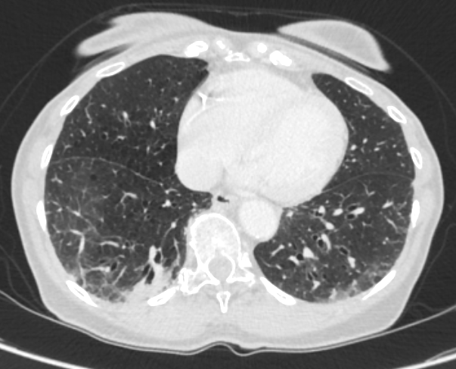
Patient Case Example: Considerations for Maintenance Therapy
Patient has excellent response to 4 cycles of carboplatin, etoposide, and atezolizumab and continues maintenance on monthly atezolizumab
Atezolizumab is tolerated well except for immunotherapy-induced lichenoid rash controlled with a topical steroid cream
Patient is on cycle 9 of maintenance atezolizumab
How long do you continue maintenance immunotherapy?
Image provided courtesy of Dr. Chiang.
Notes:
Trials both allow maintenance until progression, but continuation may also be dependent on adverse events

Slide 18
IMpower133: Safety Summary
Variable, n (%) | Atezo + CP/ET (n = 198) | Placebo + CP/ET (n = 196)
Number of AEs, n | 2291 | 1919
All-cause AEs Any grade Grade 3/4 Grade 5 Serious Leading to any tx withdrawal Leading to any dose mod/interruption Atezolizumab or placebo | 198 (100) 134 (67.7) 4 (2.0) 77 (38.9) 24 (12.1) 139 (70.2) 118 (59.6) | 189 (96.4) 124 (63.3) 11 (5.6) 69 (35.2) 6 (3.1) 119 (60.7) 102 (52.0)
Treatment-related AEs Any grade Related to atezolizumab or placebo Grade 3/4 Grade 5 | 188 (94.9) 130 (65.7) 113 (57.1) 3 (1.5) | 181 (92.3) 100 (51.0) 110 (56.1) 3 (1.5)
Variable, n (%) | Atezo + CP/ET (n = 198) | Placebo + CP/ET (n = 196)
Number of AEs, n | 2291 | 1919
AESIs Any grade Grade 3/4 Serious Treatment related Grade 3/4 Serious | 82 (41.4) 16 (8.1) 14 (7.1) 66 (33.3) 14 (7.1) 12 (6.1) | 48 (24.5) 5 (2.6) 7 (3.6) 36 (18.4) 4 (2.0) 5 (2.6)
Leading to any tx withdrawal | 8 (4.0) | 2 (1.0)
Leading to any dose modification/interruption | 24 (12.1) | 11 (5.6)
Treated with steroids or hormone replacement therapy | 40 (20.2) | 11 (5.6)
Median duration of treatment: 4.7 vs 4.1 mo (atezo vs placebo)
Total cumulative dose of atezo: 8400 mg (7 doses) vs 0
Liu. JCO. 2021;39:619.

Slide 19
IMforte: Safety During Maintenance Phase
Patients With ≥1 AE, n (%) | Lurbi + Atezo (n = 242) | Atezo (n = 240)
All-cause AEs | 235 (97.1) | 194 (80.8)
Grade 3/4 AEs Treatment-related grade 3/4 AEs | 92 (38.0) 62 (25.6) | 53 (22.1) 14.0 (5.8)
Grade 5 AEs Treatment-related grade 5 AEs* | 12 (5.0) 2 (0.8) | 6 (2.5) 1 (0.4)
Serious AEs | 75 (31.0) | 41 (17.1)
AEs leading to discontinuation of any study drug | 15 (6.2) | 8 (3.3)
AEs leading to dose interruption or modification of any study drug | 92 (38.0) | 33 (13.8)
Patients With ≥1 AE | Lurbi + Atezo (n = 242) | Atezo (n = 240)
Lurbinectedin AESI, n (%)† Grade 5 AESI | 93 (38.4) 7 (2.9) | 62 (25.8) 4 (1.7)
Atezolizumab AESI, n (%)† Grade 5 AESI Atezolizumab AESI requiring corticosteroids | 76 (31.4) 0 40 (16.5) | 54 (22.5) 0 18 (7.5)
Median treatment duration, mo Lurbinectedin Atezolizumab | 4.1 4.2 | 2.1
Median doses received, n Lurbinectedin Atezolizumab | 6.5 7.0 | 4.0
*Lurbinectedin + atezolizumab: sepsis and febrile neutropenia, both considered related to lurbinectedin; Atezolizumab: sepsis considered related to atezolizumab.
†Prespecified based on mechanism of action and independent of causal relationship assigned by the investigator.
Paz Ares. ASCO 2025. Abstr 8006. Paz Ares. Lancet. 2025;[Epub].

Slide 20
Supportive Care: Myelosuppression Management
Trilaciclib: a small molecule, selective, and reversible inhibitor of CDK4/6
  Transient G1 arrest of HSPCs in bone marrow when administered prior to CT to reduce CT-induced damage
Retrospective pooled analysis of 4 randomized, double-blind, placebo-controlled phase II/III studies
Primary endpoint
Severe (grade 4) neutropenia
11.4
52.9
P <.0001
Febrile neutropenia
3.3
P = .089
Secondary endpoints: neutrophils
9.2
G-CSF administration
28.5
P <.0001
56.3
Grade 3/4 anemia
20.3
P = .028
31.9
Secondary endpoints: RBCs
RBC transfusion on/after Wk 5
14.6
26.1
P = .025
ESA administration
3.3
P = .025
11.8
Grade 3/4 thrombocytopenia
19.5
P = .0067
Secondary endpoints: platelets
36.1
Platelet transfusion
8.1
P = .96
9.2
0
10
20
30
40
50
60
Percent of Patients
Trilaciclib prior to chemotherapy (n = 123)
Placebo prior to chemotherapy (n = 119)
Weiss. Clin Lung Cancer. 2021;22:449. Weiss. Ann Oncol. 2019;30:1613.
Daniel. Cancer Therapy and Prevention. 2021;148:2557. Ying. CTARC. 2024;42:100869.
Notes:
18 pts on extension study

Slide 21
Approaches to Improve Long-term Outcomes
Utilize active agents in earlier settings, such as limited stage, frontline, and maintenance (eg, IMforte), alone and in novel combinations
Seek to understand heterogeneity and determinants of response and resistance for a “targeted” approach
Notes:
18 pts on extension study

Slide 22
TMB Does Not Predict OS Benefit From Atezolizumab + Chemotherapy
 |  | Atezolizumab | Placebo | Placebo
Subgroup | Patients, n | Median OS, Mo |  |  |  | OS HR (95% CI)
Sex Male Female | 261 142 | 12.2 13.6 | 10.9 9.5 |  |  | 0.83 (0.63-1.10) 0.64 (0.43-0.94)
Age, yr <65 ≥65 | 217 186 | 12.1 14.4 | 11.5 9.6 |  |  | 0.94 (0.68-1.28) 0.59 (0.42-0.82)
ECOG PS 0 1 | 140 263 | 16.8 11.3 | 12.6 9.3 |  |  | 0.73 (0.48-1.10) 0.78 (0.60-1.03)
Brain mets Yes No | 35 368 | 8.5 12.6 | 9.7 10.4 |  |  | 0.96 (0.46-2.01) 0.74 (0.58-0.94)
Liver mets Yes No | 149 254 | 9.3 16.3 | 7.8 11.2 |  |  | 0.75 (0.52-1.07) 0.76 (0.56-1.01)
TMB <10 mut/Mb ≥10 mut/Mb <16 mut/Mb ≥16 mut/Mb | 134 212 266 80 | 11.8 14.9 12.5 17.1 | 9.4 11.2 10.0 11.9 |  |  | 0.73 (0.49-1.08) 0.73 (0.53-1.00) 0.79 (0.60-1.04) 0.58 (0.34-0.99)
ITT population | 403 | 12.3 | 10.3 |  |  | 0.76 (0.60-0.95)
0.25
1
2.5
Favors Atezolizumab + CE
Favors Placebo + CE
Horn. NEJM. 2018;379:2220.

Slide 23
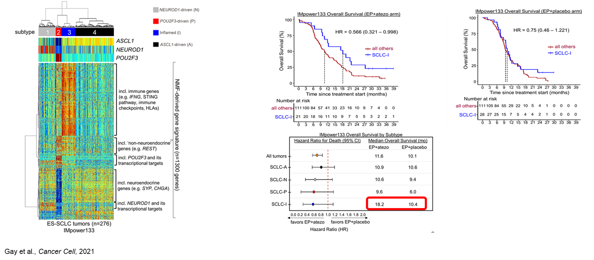
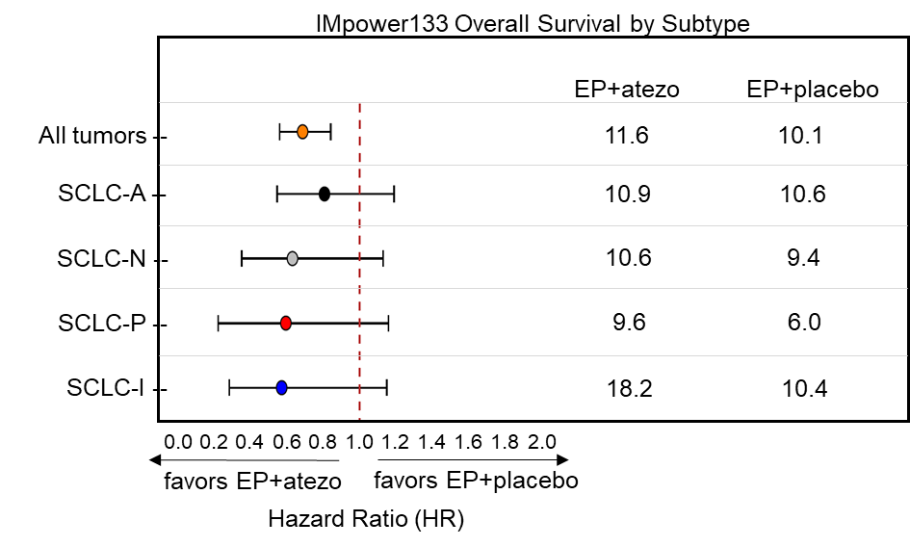
SCLC Subtypes Associated With Variable Benefit From Frontline Chemoimmunotherapy
4 subtypes defined by expression of transcription factors and inflammatory signature in IMP133
Variable OS in IMP133 EP + atezo arm on subtype-by-subtype basis
NEUROD1-driven (N)
POU2F3-driven (P)
Inflamed (I)
ASCL1-driven (A)
subtype
ASCL1
NEUROD1
POU2F3
Incl. immune genes (eg, IFNG, STING pathway, immune checkpoints, HLAs)
Incl. ‘non-neuroendocrine’ genes (eg, REST)
NMF-derived gene signature (n=1300 genes)
Incl. POU2F3 and its transcriptional targets
Incl. neuroendocrine genes (eg, SYP, CHGA)
Incl. NEUROD1 and its transcriptional targets
ES-SCLC tumors (n = 276)
IMpower133
Gay. Cancer Cell. 2021;39:346.

Slide 24
SWOG S2409-PRISM: Durvalumab vs Biomarker-Directed Novel Agents + Durvalumab in ES-SCLC
Multicohort, open-label, randomized phase II study
Primary endpoint: PFS
Key secondary endpoints: OS, safety, safety run-in for Durva + AZD5305
Step 1: Tissue Screening & Induction
(n = 838)
Step 2: Randomization
(n = 312)
Subtype I
(n = 84; 76 eligible)
Durvalumab + AZD5305
ES-SCLC screening; tissue available for testing; asymptomatic or stable treated brain lesions; provides consent after initial cycle for tissue screening; ≥4 cycles of durvalumab during induction
Durvalumab
Subtypes A/N, SLFN11 negative
(n = 84; 76 eligible)
Durvalumab + Ceralasertib
Durvalumab
Subtypes A/N, SLFN11 positive or Subtype P
(n = 134; 120 eligible)
Durvalumab + Monalizumab
Durvalumab
NCT06769126.

Slide 25
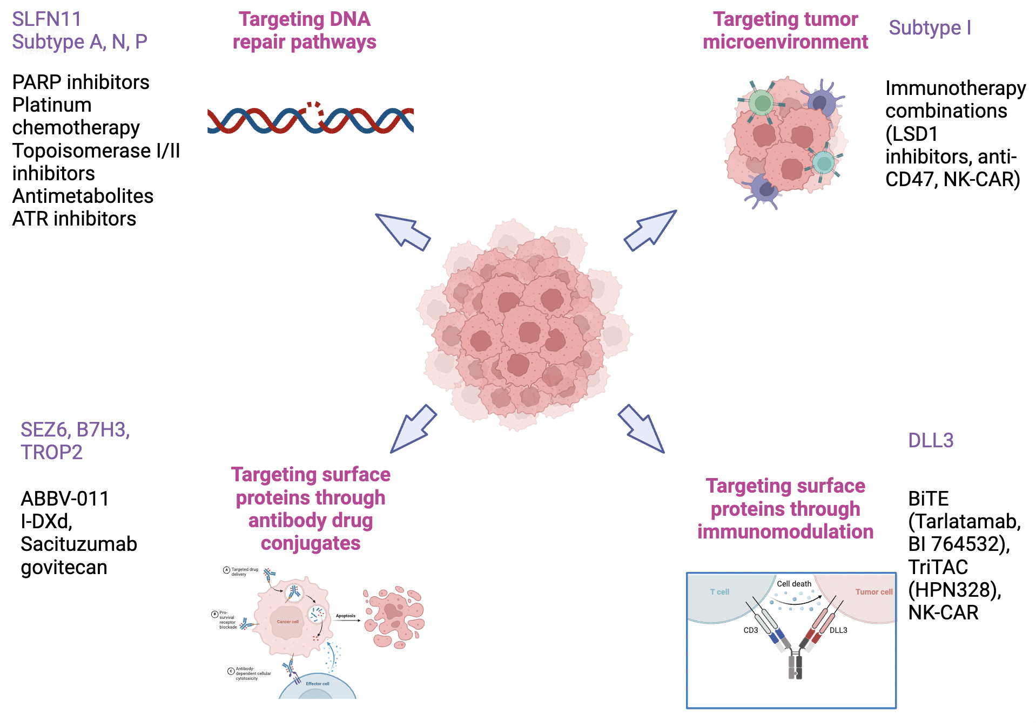
SCLC: Targeted Approaches
Targeting tumor microenvironment
Subtype I
SLFN11
Subtype A, N, P
Targeting DNA repair pathways
Immunotherapy combinations
(LSD1 inhibitors, anti-CD47, NK-CAR)
PARP inhibitors
Platinum chemotherapy
Topoisomerase I/II inhibitors
Antimetabolites
ATR inhibitors
Targeting surface proteins through antibody–drug conjugates
SEZ6, B7H3, TROP2
Targeting surface proteins through immunomodulation
DLL3
A. Targeted drug delivery
BiTE
(Tarlatamab,
BI 764532),
TriTAC
(HPN328),
NK-CAR
ABBV-011
I-DXd,
Sacituzumab govitecan
B. Prosurvival receptor blockade
T-cell
Cell death
Tumor cell
Apoptosis
CD3
DLL3
C. Antibody-dependent cellular cytoxicity
Effector cell
Kim. JAMA. 2025;333:1906.

Slide 26
ES-SCLC: Key Points
Chemoimmunotherapy with platinum/etoposide plus a PD-L1 inhibitor (atezolizumab or durvalumab) remains the frontline foundation
IMforte showed improved overall survival with lurbinectedin added to atezolizumab maintenance after induction; this regimen now has FDA approval and NCCN recommendation for eligible patients
Emerging transcriptomic subtypes, particularly the inflammatory subtype, may guide future selection
Ongoing development includes PD-1 inhibitors, bispecific antibodies, antibody–drug conjugates, and biomarker-directed combinations
Supportive care remains critical, including proactive myelosuppression management and toxicity mitigation to preserve dose intensity and quality of life

Slide 27
Go Online for More CCO
Coverage of SCLC!
Additional CME-Certified Medical Minutes on SCLC
Interactive Decision-Support Tool on SCLC coming soon!
clinicaloptions.com

