Slide 1
Biomarker Testing in Prostate Cancer:
An Essential Component in Transforming Care
Provided by Clinical Care Options, LLC in partnership with
the American Society for Clinical Pathology
Supported by an educational grant from Pfizer, Inc.

Slide 2

About These Slides
Please feel free to use and share some or all of these slides in your noncommercial presentations to colleagues or patients
When using our slides, please retain the source attribution:
These slides may not be published, posted online, or used in commercial presentations without permission. Please contact permissions@clinicaloptions.com for details
Slide credit: clinicaloptions.com
Notes:
Disclaimer: The materials published on the Clinical Care Options Web site reflect the views of the authors of the CCO material, not those of Clinical Care Options, LLC, the CME providers, or the companies providing educational grants. The materials may discuss uses and dosages for therapeutic products that have not been approved by the United States Food and Drug Administration. A qualified healthcare professional should be consulted before using any therapeutic product discussed. Readers should verify all information and data before treating patients or using any therapies described in these materials.

Slide 3
Faculty
Himisha Beltran, MD
Associate Professor of Medicine
Dana-Farber Cancer Institute
Boston, Massachusetts
Steven Christopher Smith, MD, PhD
Associate Professor of Pathology and Surgery
Director, Genitourinary and Soft Tissue Pathology
VCU School of Medicine and Massey Comprehensive Cancer Center
Richmond, Virginia

Slide 4
Faculty Disclosures
Himisha Beltran, MD: consultant/advisor/speaker: Amgen, Bayer, Janssen, Merck, Pfizer, Roche; researcher: Bristol Myers Squibb, Circle Pharma, Daiichi Sankyo, Novartis.
Steven Christopher Smith, MD, PhD, has no relevant financial relationships to disclose.

Slide 5
Prostate Cancer May Be Diagnosed at Various
Stages and Progress Through Different Pathways
De novo metastatic prostate cancer
mHSPC
High volume
Low volume
Oligometastatic
Identification of metastases
Rising PSA
Localized/locally advanced
prostate cancer
Definitive therapy
Biochemical recurrence*
Both criteria met
mCRPC
Rising PSA despite castrate levels of testosterone
In 2024, prostate cancer is the most common cancer diagnosis and second-leading cause of cancer death in US men
  299,010 new cases and 35,250 deaths
nmCRPC
*Slow PSA doubling time (eg, >10 mo) suggests indolent disease.
Siegel. CA Cancer J Clin. 2024;[Epub]. Anantharaman. Expert Rev Anticancer Ther. 2017;17:625.
NCCN. Clinical practice guidelines in oncology: prostate cancer. v.4.2023. nccn.org.
Notes:
mCRPC, metastatic castration-resistant prostate cancer; mHSPC, metastatic hormone-sensitive prostate cancer; nmCRPC, nonmetastatic castration-resistant prostate cancer; PSA, prostate-specific antigen.
Notes:
Androgen-deprivation therapy (ADT) – treatment that suppresses/blocks the action or production of male hormones
Biochemical recurrence (BCR) – symptomatic or asymptomatic rise in PSA after surgery or radiation
Castration-resistant prostate cancer (CRPC) – disease progression on ADT while with castrate level of testosterone (<50 ng/dL)
High-volume prostate cancer - visceral metastases and/or ≥4 bone metastases (≥1 outside spine or pelvis)
Hormone-sensitive prostate cancer (HSPC) – disease that has either not been treated with, or is still responsive to, ADT
Prostate specific antigen (PSA) – usually >4 ng/mL in blood of men with prostate cancer

Slide 6
Why Target DNA Repair in Prostate Cancer?

Slide 7
A Note on Nomenclature
DDR: DNA damage repair
DRD: DNA repair deficiency
HR: homologous recombination
HRR: homologous recombination repair =
HDR: homology-directed repair
HRD: homologous recombination deficiency

Slide 8
DNA Repair Pathways
Error prone
Mismatch
Single-Stranded Breaks
Double-Stranded Breaks
Mismatch Repair
Base Excision Repair
Homologous
Recombination
Nonhomologous
Recombination
MSH2/MSH6
OGG1
MLH1/PMS2
ATM
PARP1/2
MRN complex
KU70, KU80
EXO1/PCNA/RCF
XRCC1
RPA
DNA PKs
PARPi
BRCA2/FANCD
Artemis
XRCC4-XLF
Pol β
PCNA
FEN1
RAD51, FANCF
Pol δ
Pol δ
Pol ε
Pol μ
Ligase I
Ligase IV
Ligase III
Ligase I
Ligase IV
Maiorano. Crit Rev Oncol Hematol. 2023;192:104157.
Notes:
PARPi, PARP inhibitor.

Slide 9
From BER to HRR: PARP Inhibition in
Cell With HRR Function
PARP inhibitor
PARP
PARP
Single-stranded
DNA damage
Damage detected
PARP trapped on
replication fork
Double-stranded
DNA break
Double-stranded
DNA break
Homologous Recombination
Nonhomologous End Joining
Cells become reliant on HRR pathway to repair double-stranded breaks to avoid having to use error-prone non-HR pathway, which generates deletions
Maiorano. Crit Rev Oncol Hematol. 2023;192:104157.
Notes:
HRR, homologous recombination repair.

Slide 10
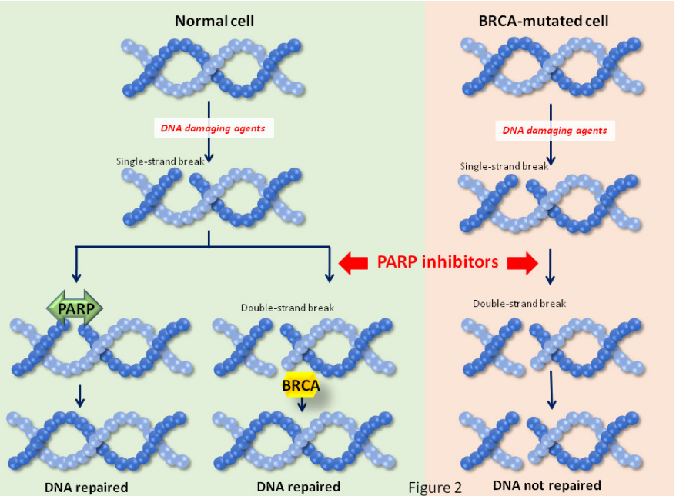
From BER to HRR: PARP Inhibition in Cell With HRR Deficiency
Normal Cell
BRCA-Mutated Cell
DNA-
damaging agents
DNA-
damaging agents
Single-stranded break
Single-stranded break
Dual cytotoxic mechanisms of PARP enzyme inhibition by PARPi
  Base excision repair blockade via catalytic inhibition
  PARP trapping on DNA, which induces double-stranded breaks
Cells with HRD are unable to repair double-stranded DNA breaks using homology-directed repair
Double-stranded break
Double-stranded break
DNA Repaired
(PARP mediated)
DNA Repaired
(HR mediated)
DNA Not Repaired
Pommier. Sci Transl Med. 2016;8:362ps17. Ocana. Oncotarget. 2017;8:22218. Creative Commons Attribution 3.0 License.
Notes:
HR, homologous recombination; HRD, homologous recombination deficiency; HRR, homologous recombination repair; PARPi, PARP inhibitor.

Slide 11

Synthetic Lethality With PARPi Is Produced by Conditional Drug Sensitivity in HRR-Deficient Cells
Singled-Stranded DNA Break
Repair?
HR Repair?
Cell Viability?
Normal Cells
Yes
Normal Cells + PARPi
Yes
HRR-Deficient Cells
Yes
HRR-Deficient Cells + PARPi
Ashworth. JCO. 2008;26:3785. Lord. Nat Rev Cancer. 2016;16:110. Lord. Science. 2017;355;1152.
Notes:
HR, homologous recombination; HRR, homologous recombination repair; PARPi, PARP inhibitor.

Slide 12
HRR Genes With Approved PARP Inhibitor Indications
BRCA2
BRIP1
BRCA1
CDK12
BARD1
CHEK1
ATR
CHEK2
PARPi
ATM
FANCA
RAD54L
FANCL
RAD51D
MLHI
RAD51C
MRE11A
RAD51B
PALB2
NBN
Olaparib PI. Rucaparib PI. Niraparib/abiraterone acetate PI. Talazoparib PI.
Notes:
HRR, homologous recombination repair.

Slide 13
HRR Mutations Occur in 25% of Patients With mCRPC
PROfound: Prevalence of Tumor HRRm Identified From Screened mCRPC Population
(N = 2792 patients successfully sequenced)¹
Prevalence of Germline HRRm in Patients With Early or Advanced Prostate Cancer^{3,4}
BRCA2: most common HRR mutation in mCRPC¹⁻⁴
Tumor testing detects both somatic and germline variants
  If only germline testing completed, ~50% of patients with HRR mutations could be missed
Gene | Prevalence Range
BRCA2 | 3.5%-5.3%
BRCA1 | 0.9%-1.3%
ATM | 0.3%-2.0%
PALB2 | 0.4%-0.6%
BRCA2 only; 8.7%
BRCA1 only; 1.0%
ATM only; 5.9%
CDK12 only; 6.3%
CHEK2 only; 1.2%
PPP2R2A only; 1.0%
Low-prevalence genes; 1.7%
No HRR gene alterations detected; ~72.1%
Co-occurring genes; 2.1%
1. de Bono. Annals Oncol. 2019;30(suppl 5):v325. 2. Pritchard. NEJM. 2016;375:433.
3. Nicolosi. JAMA Oncol 2019;5:523. 4. Lang. Int J Oncol. 2019;55:597.
Notes:
HRR, homologous recombination repair; HRRm, homologous recombination repair mutation; mCRPC, metastatic castration-resistant prostate cancer.

Slide 14




HRR Pathways Can Be Deficient in Germline DNA,
Tumor DNA, or Both
Autosomal Dominant Inheritance²
Advanced PC
and mCRPC
are enriched
with biallelic inactivation of DNA repair genes
In men with germline DDR mutations,
~ 60% have somatic alterations in the second allele¹
Mother
Somatic mutation
Somatic mutation
Possible
combinations:
Normal
Single Somatic Mutation
Double Somatic Mutation
Normal
(50%)
Normal
Chromosome with
normal copy of gene
Chromosome with defective copy of gene
Chromosome with
somatic gene inactivation
Father
Somatic mutation
Germline
mutation
⬆ Risk
Germline Mutation + Second Somatic Mutation
Risk
of cancer
(50%)
1. Pritchard. NEJM. 2016;375:443.
2. Griffiths. An Introduction to Genetic Analysis, 7th ed. W.H. Freeman; 2000.
⬆ Risk
Notes:
DDR, DNA damage repair; HRR, homologous recombination repair; mCRPC, metastatic castration-resistant prostate cancer; PC, prostate cancer.

Slide 15
HRR Mutation Testing

Slide 16
Multiple Paths for Molecular Profiling in
Prostate Cancer
TREATMENT DRIVEN
Are you a candidate for exciting new precision therapies for advanced prostate cancer?
Somatic ± Germline
RISK DRIVEN
What is your risk and your family’s risk of developing cancer, and how do we manage that risk?
Germline
Discuss and Define Patient Goals for Genetic Testing

Slide 17
Sample Sources for Biomarker Testing:
Tumor vs Liquid Biopsy
 | Tumor Biopsy | Liquid Biopsy (ie, ctDNA)
Advantages | Tumor-enriched samples Detect copy number changes, such as homozygous loss and zygosity of mutations Can measure tumor mutational burden Can identify neuroendocrine transformation | Can detect somatic mutations More convenient, less invasive to patients Can be more sensitive than tissue testing, while highly concordant Low testing failure rate (~3%) in mCRPC Serial sampling is easier
Limitations | More involved procedure than blood draw Potential for inadequate tumor sampling Tumor heterogeneity within/between sites and over time ~30% testing failure rate More difficult to do serial sampling | More likely to have fragmented DNA, potentially missing genomic coverage cfDNA yield is dependent on tumor burden, stage of disease at time of draw Potential for CHIP interference (~10%) Challenging to detect homozygous loss
Armstrong. APCCC 2021. Cheng. J Natl Compr Canc Netw. 2019;17:515.
Chowdhury. ESMO 2018. Poster 795PD. Zhao. J Clin Invest. 2022;132:e161858.
Notes:
cfDNA, cell-free DNA; CHIP, clonal hematopoiesis of indeterminate potential; mCRPC, metastatic castration-resistant prostate cancer.

Slide 18
When to Test: Prostate Cancer Disease States
Clinical metastases, hormone sensitive
Clinical metastases, hormone resistant,
1L (pre-chemo)
Clinical metastases, hormone resistant,
2L (post chemo)
Clinically
localized
disease
Biochemically Recurrent
Nonmetastatic, rising PSA, hormone resistant
CURRENT TREATMENT INDICATIONS
FAMILY COUNSELING IMPLICATIONS
Based on Scher. Clin Cancer Res. 2005;11:5223.
Notes:
1L, first line; 2L, second line; PSA, prostate-specific antigen.

Slide 19
Current Guideline Recommendations for
Somatic (Tumor) Testing
Recommend somatic testing for metastatic disease; consider for
regional disease
Recommend tumor testing for HR DNA repair genes such as:
Recommend tumor testing for MSI/dMMR in mCRPC; consider for
regional or mHSPC
Consider TMB testing in mCRPC
  ATM
  BRCA1
  BRCA2
  CDK12
  CHEK2
  FANCA
  PALB2
  RAD51D
NCCN. Clinical practice guidelines in oncology: prostate cancer. v.1.2024. nccn.org.
Lowrance. J Urol. 2023;209:1082. Ng. Oncol Ther. 2020;8:209.
Notes:
dMMR, mismatch repair deficient; mCRPC, metastatic castration-resistant prostate cancer; mHSPC, metastatic hormone-sensitive prostate cancer; MSI, microsatellite instability; TMB, tumor mutational burden.

Slide 20
Current Guideline Recommendations for
Germline Testing
Prostate Cancer Risk/Stage | Germline Testing
Very low
Low
Favorable intermediate
Unfavorable intermediate
High
Very high
Regional
Metastatic
Recommend germline testing when biomarker analysis is likely to affect:
  Treatment choice
  Clinical trial options
  Managing risk of other cancers
  Potential risk of cancer in other family members
Germline multigene testing should include:
Recommended if strong family history,* Ashkenazi Jewish ancestry, or personal history of breast cancer
Recommended for everyone
  ATM
  BRCA1
  BRCA2
  CHEK2
  HOXB13
  MLH1
  MSH2
  MSH6
  PALB2
  PMS2
*See slidenotes for definition of strong family history.
Approximately 1 in 10 men with metastatic prostate cancer have germline DDR mutations
NCCN. Clinical practice guidelines in oncology: prostate cancer. v.1.2024. nccn.org.
Lowrance. J Urol. 2023;209:1082. Ng. Oncol Ther. 2020;8:209. Pritchard. NEJM. 2016;375:443.
Notes:
DDR, DNA damage repair.

Slide 21



Germline: Critical Importance of Cascade Testing
SISTERS
Tailored screening and
risk reduction
BROTHERS
Increased risk of prostate cancer, more aggressive
Siblings and children have
50/50 chance of inheriting
same mutation; have options
to manage risk
~ 1 in 10 men with mCRPC carry an inherited DNA repair mutation
DAUGHTERS
Tailored screening and
risk reduction
SONS
Increased risk of prostate cancer, more aggressive
Pritchard. NEJM. 2016;375:443. Sokolova, Cheng. Curr Oncol Rep. 2020;22:5.
Notes:
mCRPC, metastatic castration-resistant prostate cancer.

Slide 22
Germline vs Tumor (Somatic) Testing
 | Germline Testing | Tumor (Somatic) Testing
Advantages | Performed on saliva, blood, buffy coat, or buccal smear Can be done during any point in disease course May provide information about prognosis, targeted therapy options, clinical trials May provide potentially life-saving information for blood relatives | Detects genetic mutations in tumor only that may be missed by germline-only testing Performed on tissue biopsy or cell-free DNA in blood Timing and conditions of tumor sample tested may affect quality of data May provide information about prognosis, targeted therapy options, clinical trials
Limitations | Will not identify tumor-only mutations (up to 50%, for some genes) Requires more nuanced informed consent discussion and minimum posttest genetic counseling resources | Sampling limitations around tumor content and purity affect sensitivity and specificity of detecting tumor-specific mutations Repeat testing may be needed, but many actionable mutations are truncal Does not provide information about potential cancer risk to relatives
Cheng. J Natl Compr Canc Netw. 2019;17:515. Cheng. ASCO Educational Book. 2018;38:372.

Slide 23
Counseling Patients About Genetic Testing: Considerations and Consent
Personal prostate cancer and/or family history of cancer suggests possibility of an inherited cancer syndrome
Inform the patient that testing is not perfect but may find genetic mutations that may have contributed to the development of prostate cancer and may affect treatment options
Options to reduce the risk of cancer may be available to their family members, if they share the same mutation
Federal GINA laws protect health insurance and employment, but not life or long-term care insurance
Potential test results: cancer-associated mutation, VUS, or no cancer gene mutations detected
Consent for testing and follow-up genetic counseling depending on results
Notes:
GINA; Genetic Information Nondiscrimination Act; VUS, variant of uncertain significance.

Slide 24
Tips for Reading a Tumor Testing Report
Make sure prostate cancer genes are covered by the test
Types of alterations detected by test
  Mutations, deletions, rearrangements/fusions, copy number variants?
Mutation status of prostate cancer genes of interest
  Want to know if normal (wild-type)
MSI and TMB status
  Identifies eligibility for ICI-based therapy; not all reports provide this
Casolino. CA Cancer J Clin. 2024;[Epub]. Chi. APCCC 2022. How to read a genomics report.
Notes:
ICI, immune checkpoint inhibitor; MSI, microsatellite instability; TMB, tumor mutational burden.

Slide 25
PARP Inhibitor Monotherapy

Slide 26
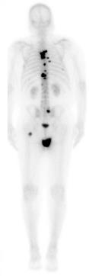
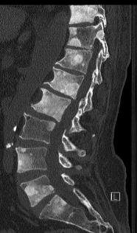
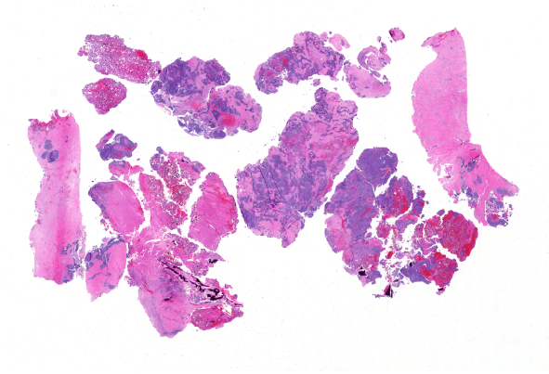
Patient Case 1: Man With PALB2-Mutated
Metastatic CRPC Progressing on AAP + ADT
64 yr of age, Caucasian ancestry
Progressive mets,
epidural mass w/
spinal cord compression
OSH Bx: GG3 7/12 cores
Bone mets
Early salvage RT
+ ADT
8 yr ago
Present
Rising PSA, intermittent ADT
c/b insurance, incarceration
OSH RP: GG4 (5 + 3 = 8)
pT3a, N0
+ posterolateral
Intraductal/cribriform
Abiraterone
+ prednisone
Notes:
AAP, abiraterone acetate + prednisone; ADT, androgen deprivation therapy; Bx, biopsy; c/b, complicated by; CRPC, castration-resistant prostate cancer; GG, Grade Group; mets, metastases; OSH, outside hospital; PSA, prostate-specific antigen; RP, radical prostatectomy; RT, radiation therapy.

Slide 27
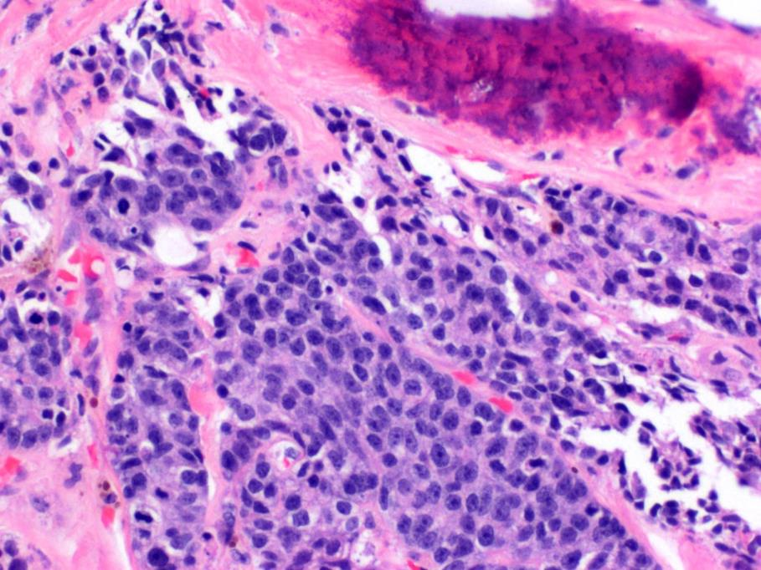
Patient Case 1: Pathology and Biomarker Testing
No histologic evidence
for neuroendocrine transformation
PALB2 deleterious variant detected from comprehensive genomic profiling of tumor

Slide 28
FDA Indications for PARP Inhibitor Monotherapy in Prostate Cancer
Olaparib |  |  |  | Rucaparib
Deleterious/suspected deleterious germline or somatic HRR gene–mutated mCRPC that progressed following prior enzalutamide or abiraterone tx Select using approved companion diagnostic |  |  |  | Deleterious BRCA mutation–associated mCRPC treated with AR-directed tx and taxane-based chemotherapy (accelerated approval) Select using approved companion diagnostic
Approved HRR genes: |  |  |  | Approved genes:
ATM BARD1 BRCA1 BRCA2 | BRIP1 CDK12 CHEK1 CHEK2 | FANCL PALB2 RAD51B RAD51C | RAD51D RAD54L | BRCA1 BRCA2
Patients also should receive GnRH analogue or have had bilateral orchiectomy
Continue PARP inhibitor until PD or unacceptable toxicity
Olaparib PI. Rucaparib PI. NCCN. Clinical practice guidelines in oncology: prostate cancer. v.4.2023. nccn.org.
Notes:
AR, androgen receptor; GnRH, gonadotropin hormone-releasing hormone; HRR, homologous recombination repair; mCRPC, metastatic castration-resistant prostate cancer; PD, progressive disease; tx, treatment.

Slide 29
Key Phase II/III Trials of PARPi Monotherapy in mCRPC
Parameter | Phase III PROfound: Olaparib vs ARPI Switch (N = 387)^{1,2} | Phase II TRITON2: Rucaparib (N = 277)³⁻⁶ | Phase III TRITON3: Rucaparib vs Physician’s Choice (N = 405)^{7,8}
Prior therapy status | Required: PD on enza/abi Prior docetaxel: 39%-46% | Required: PD after 1-2 prior NHA and 1 prior taxane CT; no prior PARPi | Required: PD after 1 ARPI; no prior CT for mCRPC or PARPi Prior docetaxel for HSPC: 21%-23%
HRR testing | Required: Prospective central testing of archival or recent tissue biopsy from primary or metastatic disease using FoundationOne CDx NGS | Required: Prospective central testing of plasma, archival tumor, or screening tumor tissue Central testing by Foundation Medicine Central germline testing by Color Genomics | Required: Prospective local or central testing of plasma and/or tissue Central testing by Foundation Medicine NGS Central germline testing by Color Health
Eligible HRR genes | Germline or somatic deleterious or suspected deleterious mutation(s) in ≥1 of 15-gene panel (any zygosity): Cohort A: ATM, BRCA1, BRCA2 Cohort B: BARD1, BRIP1, CDK12, CHEK1, CHEK2, FANCL, PALB2, PPP2R2A, RAD51B, RAD51C, RAD51D, RAD54L | Germline or somatic deleterious mutation in 15-gene panel (any zygosity): ATM, BARD1, BRCA1, BRCA2, BRIP1, CDK12, CHEK2, FANCA, NBN, PALB2, RAD51, RAD51B, RAD51C, RAD51D, RAD54L | Germline or somatic deleterious mutation in 3-gene panel (any zygosity): ATM, BRCA1, BRCA2
Primary endpoint | Imaging-based PFS per BICR in cohort A | ORR per blinded IRR | Imaging-based PFS per IRR in BRCA-altered population
1. NCT02987543. 2. de Bono. NEJM. 2020;382:2091. 3. NCT02952534. 4. Abida. JCO. 2020;38:3763.
5. Abida. Clin Cancer Res. 2020;26:2487. 6. Abida. Eur Urol. 2023;84:321. 7. NCT02975934. 8. Fizazi. NEJM. 2023;388:719.
Notes:
Abi, abiraterone; ARPI, androgen receptor pathway inhibitor; BICR, blinded independent central review; CT, chemotherapy; enza, enzalutamide; HSPC, hormone-sensitive prostate; cancer; IRR, independent radiology review; mCRPC, metastatic castration-resistant prostate cancer; NGS, next-generation sequencing; NHA, novel hormonal agent; ORR, objective response rate; PARPi, PARP inhibitor; PD, progressive disease; PFS, progression-free survival.

Slide 30
PROfound: rPFS and OS With Olaparib in Cohort A
With BRCA1, BRCA2, or ATM Mutations
rPFS by BICR¹
OS²
 | Median rPFS, Mo
Olaparib (n = 162) | 7.4
ARPI switch (n = 83) | 3.6
 | Median OS, Mo
Olaparib (n = 162) | 19.1
ARPI switch (n = 83) | 14.7
1.00
100
0.80
80
HR: 0.34 (95% CI: 0.25-0.47; P <.001)
60
0.60
Probability of rPFS
OS (%)
0.40
40
0.20
20
HR: 0.69 (95% CI: 0.50-0.97; P = .02)
0
0
0
1
2
3
4
5
6
7
8
9
10
11
12
13
14
15
16
17
18
19
20
21
Patients at Risk, n
Olaparib
ARPI switch
0
2
4
6
8
10
12
14
16
18
20
22
24
26
28
30
32
34
Patients at Risk, n
Olaparib
ARPI switch
Mo Since Randomization
Mo
162
83
149
79
126
47
116
44
102
22
101
20
82
13
77
12
56
7
53
6
42
3
37
3
26
3
24
2
18
2
11
1
11
1
3
1
2
1
0
0
0
0
0
0
162
83
155
79
150
74
142
69
136
64
124
58
107
50
101
43
91
37
71
27
56
18
44
15
30
11
18
9
6
6
2
3
1
1
0
0
HR for rPFS of 0.49 (95% CI: 0.38-0.63; P <.001) in overall population (including those in cohort B with rarer HRR mutations)
1. de Bono. NEJM. 2020;382:2091. 2. Hussain. NEJM. 2020;383:2345.
Notes:
ARPI, androgen receptor pathway inhibitor; BICR, blinded independent central review; HRR, homologous recombination repair; OS, overall survival; rPFS, radiographic progression-free survival.

Slide 31
PROfound: rPFS With Olaparib by Subgroup
Subgroup
HR for Progression or Death (95% CI)
All patients
Previous taxane use
0.49 (0.38-0.63)
Median Imaging-Based PFS by BICR
Yes
No
0.39 (0.29-0.53)
0.77 (0.50-1.22)
81
47
10.84 (9.17-13.08)
Measurable disease at baseline
BRCA2
3.48 (1.74-3.65)
Yes
No
0.41 (0.30-0.56)
0.64 (0.43-0.98)
61
28
5.09 (3.61-5.52)
Metastases at baseline
CDK12
2.20 (1.71-4.83)
Bone only
Visceral
Other
0.57 (0.35-0.94)
0.42 (0.28-0.64)
0.57 (0.37-0.90)
62
24
5.36 (3.61-6.21)
ATM
4.70 (1.84-7.26)
ECOG PS at baseline
0
1
2
0.67 (0.46-1.00)
0.45 (0.32-0.64)
0.31 (0.10-1.13)
BRCA1
8
5
2.07 (1.38-5.52)
1.84 (1.71-3.71)
Age at randomization
<65 yr
≥65 yr
0.53 (0.34-0.85)
0.52 (0.39-0.70)
CHEK2
7
5
5.59 (1.64-11.99)
Region
3.35 (1.38-NR)
Asia
Europe
North and South America
0.67 (0.44-1.04)
0.48 (0.33-0.71)
0.43 (0.26-0.73)
6
4
2.69 (1.77-3.91)
PPP2R2A
NR
PSA at baseline
4
1
10.89 (1.61-14.75)
≥ Median
< Median
0.46 (0.33-0.65)
0.65 (0.44-0.96)
RAD51B
Gene alteration
Frequency
1.77
BRCA1
0.41 (0.13-1.39)
RAD54L
3
2
7.20 (3.71-7.39)
BRCA2
0.21 (0.13-0.32)
2.41 (1.81-3.02)
ATM
1.04 (0.61-1.87)
CDK12
0.74 (0.44-1.31)
0
Olaparib
ARPI switch
CHEK2
0.87 (0.23-4.13)
2
4
6
8
10
PPP2R2A
6.61 (1.41-46.41)
Median Imaging-Based PFS (Mo)
RAD54L
0.33 (0.05-2.54)
0.06
1.00
0.25
4.00
16.00
Olaparib Better
Control Better
de Bono. NEJM. 2020;382:2091.
Notes:
ARPI, androgen receptor pathway inhibitor; BICR, blinded independent central review; ECOG, Eastern Cooperative Oncology Group; NR, not reached; PFS, progression-free survival; PS, performance status; PSA, prostate-specific antigen; rPFS, radiographic progression-free survival.

Slide 32
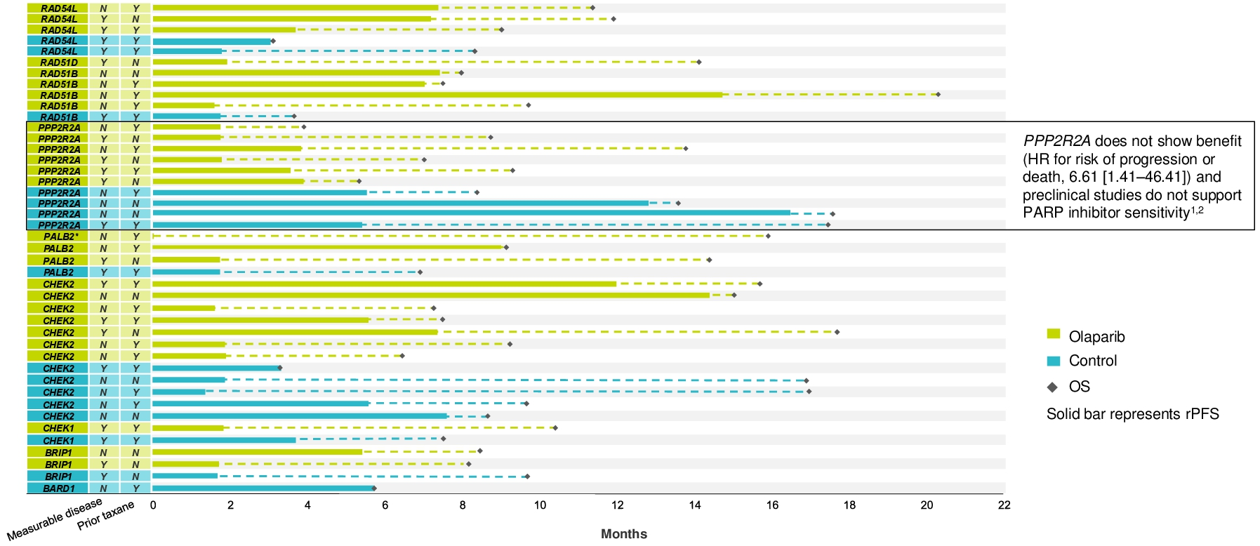
PROfound: Antitumor Activity of Olaparib in mCRPC With Rare HRR Gene Alterations
Olaparib
ARPI switch
OS
Solid bar: rPFS
OS unadjusted for crossover (66% of overall population in control arm crossed over to olaparib after PD).
*Patient censored on Day 1 due to no evaluable bone scans by BICR; treated for 459 days.
de Bono. ASCO GU 2021. Abstr 126.
Notes:
ARPI, androgen receptor pathway inhibitor; BICR, blinded independent central review; HRR, homologous recombination repair; mCRPC, metastatic castration-resistant prostate cancer; OS, overall survival; PD, progressive disease; rPFS, radiographic progression-free survival.

Slide 33
TRITON2: Antitumor Activity With Rucaparib in mCRPC With BRCA1/BRCA2 Mutations
Patient population: mCRPC after 1-2 lines of next-generation ADT and 1 taxane-based chemotherapy
Antitumor Activity in Independent Radiology Review–Evaluable Population (n = 62*)
60
Population | ORR, % (95% CI)
Overall (n = 62) | 43.5 (31.0-56.7)
BRCA1 (n = 9) | 33.3 (7.5-70.1)
BRCA2 (n = 53) | 45.3 (31.6-59.6)
Germline (n = 21) | 42.9 (21.8-66.0)
Somatic (n = 41) | 43.9 (28.5-60.3)
40
64.5% with ≥30% reduction
20
0
o
Change From Baseline in Sum of Target Lesions (%)
-20
o
o
-40
o
+
+
+
+
o
+
+
o
+
+
+
-60
+ Confirmed radiographic response
o Ongoing
Germline
Somatic
o
+
o
+
+
+
+
+
+
+
+
+
o
+
-80
o
o
o
+
o
o
+
+
+
-100
+
+
+
o
o
BRCA1
BRCA2
*1 patient was not evaluable.
Abida. JCO. 2020;38:3763.
Notes:
ADT, androgen deprivation therapy; mCRPC, metastatic castration-resistant prostate cancer; ORR, overall response rate.

Slide 34
TRITON2: Antitumor Activity of Rucaparib in mCRPC With HRR Gene Alterations
Confirmed Response in IRR-Evaluable Population, n (%) | BRCA1/2 (n = 81) | PALB2 (n = 4) | ATM (n = 23) | CHEK1 (n = 9) | CHEK2 (n = 4) | Other (n = 12)
Confirmed ORR per IRR* 95% CI | 37 (46; 35-57) | 4 (100; 40-100) | 0 (0; 0-15) | 0 (0; 0-34) | 0 (0; 0-60) | 3 (25; 6-57)
CR | 8 (9.9) | 0 | 0 | 0 | 0 | 2 (17)†
PR | 29 (36) | 4 (100) | 0 | 0 | 0 | 1 (8.3)‡
SD | 34 (42) | 0 | 17 (74) | 6 (67) | 7 (75) | 6 (50)
PD | 8 (9.9) | 0 | 5 (22) | 2 (22) | 1 (25) | 2 (17)
NE | 2 (2.5) | 0 | 1 (4.3) | 1 (11) | 0 | 1 (8.3)
PSA50 RR in efficacy population, n/N % (95% CI) | 92/172 53 (46-61) | 6/11 55 (23-83) | 2/59 3.4 (0.4-12) | 1/15 6.7 (0.2-32) | 1/4 14 (0.4-58) | 3/13 23 (5-54)
*Per modified criteria of RECIST/PCWG3. †n = 1 with FANCA mutation; n = 1 with BRIP1 mutation and co-occurring homozygous BRCA2 deletion. ‡n = 1 with RAD51B mutation.
Abida. Eur Urol. 2023;84:321.
Notes:
CR, complete response; HRR, homologous recombination repair; IRR, independent radiology review; mCRPC, metastatic castration-resistant prostate cancer; NE, not evaluable; ORR, objective response rate; PCWG3, Prostate Cancer Clinical Trials Working Group 3; PD, progressive disease; PR, partial response; PSA50, confirmed prostate-specific antigen response of ≥50% decrease from baseline; RECIST, Response Evaluation Criteria in Solid Tumors; SD, stable disease.

Slide 35
TRITON3: rPFS With Rucaparib in BRCA-Altered Subgroup
100
Median rPFS, Mo | BRCA Altered | ITT
Rucaparib (n = 270) | 11.2 | 10.2
Physician’s choice (n = 135) | 6.4 | 6.4
Docetaxel (n = 75) ARPI (n = 60) | 8.3 4.5 | 8.3 4.5
HR (95% CI) | 0.50 (0.36-0.69; P <.001) | 0.61 (0.47-0.80; P <.001)
 | 0.50 (0.36-0.69; P <.001) | 0.61 (0.47-0.80; P <.001)
80
60
rPFS (%)
40
20
0
0
3
6
9
12
15
18
21
24
27
30
33
36
39
42
45
Mo
OS data immature (events in 54%) but suggest longer median OS with rucaparib (24.3 vs 20.8 mo with physician’s choice) in BRCA-altered subgroup
Phase III TRITON3 showed significantly prolonged rPFS with rucaparib in patients with mCRPC before treatment with docetaxel, but accelerated approval is for mCRPC post docetaxel treatment
Fizazi. NEJM. 2023;388:719.
Notes:
ITT, intention-to-treat; mCRPC, metastatic castration-resistant prostate cancer; OS, overall survival; rPFS, radiographic progression-free survival.

Slide 36
PARP Inhibitor Combination Therapy

Slide 37
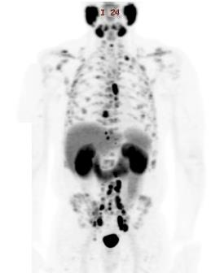
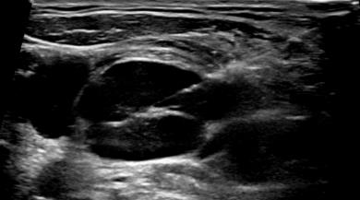
Patient Case 2: Man With BRCA2-Mutated
Metastatic CRPC
57 yr of age, African ancestry
Innumerable bone and LN mets on PSMA PET
OSH Bx: GG5 12/12 cores
Early salvage RT
Interim ADT
6 yr ago
Present
Progressive LAD, rapid growth of supraclavicular LN
PSA nadir 0.3, sporadic follow-up during pandemic
OSH RP: GG5 (4 + 5 = 9)
pT3b, N0M0
+ 2 mm base
Intraductal/cribriform
PSA 283,
asymptomatic
Notes:
ADT, androgen deprivation therapy; Bx, biopsy; CRPC, castration-resistant prostate cancer; GG, Grade Group; LAD, lymphadenopathy; LN, lymph node; mets, metastases; OSH, outside hospital; PSMA, prostate-specific membrane antigen; PSA, prostate-specific antigen; RP, radical prostatectomy; RT, radiation therapy.

Slide 38
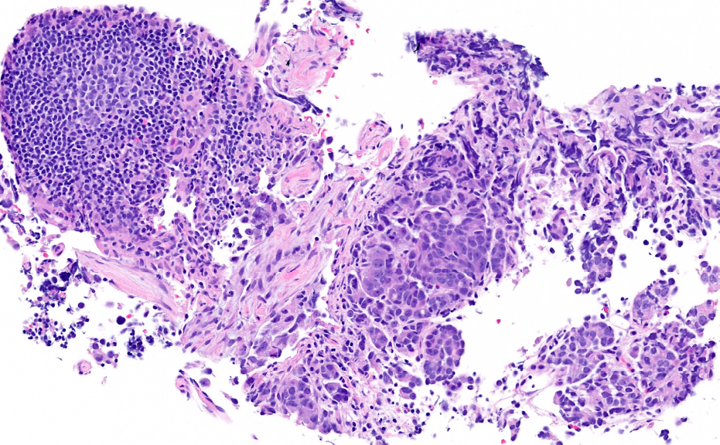
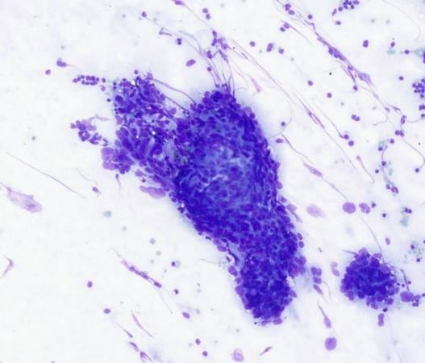
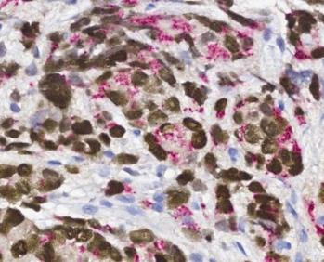
Patient Case 2: Pathology and Biomarker Testing
Limited Core Sample From Aspiration of Rapidly Growing Supraclavicular LN
IHC Markers for Prostatic Lineage Confirm Prostate Adenocarcinoma
Smear Section of Aspiration Used for Testing
NKX3.1
p501S
Institutional NGS panel (150 genes) performed on aspirate and identified:
  TMPRSS2-ERG fusion—confirms prostatic lineage; along with IHC markers
  BRCA2 frameshift mutation
Notes:
IHC, immunohistochemistry; LN, lymph node; NGS, next-generation sequencing.

Slide 39
Rationale for Cotargeting AR Signaling and PARP
Preclinical evidence for potential synthetic lethality
  PARP-1 interacts with androgen signaling
  Castration-resistant tumor cells exhibit increased PARP-1 activity
  Preclinically, PARP-1–inhibition synergizes with AR-targeted therapy
  NHTs inhibit transcription of several HRR genes, inducing HRR deficiency and increasing sensitivity to PARP inhibition
PARP Inhibitor Synergizes With Castration in
Mouse Xenograft Models of Prostate Cancer
100
AR+
HT-sensitive prostate cancer
80
60
Tumors Doubling (%)
Control
Castration
PARP inhibitor
Castration + PARP inhibitor
40
20
0
0
20
40
60
Days After Start of Treatment
Polkinghorn. Cancer Discov. 2013;3:1245. Schiewer. Cancer Discov. 2012;2:1134.
Asim. Nat Commun. 2017;29:374. Li. Sci Signal. 2017;10:eaam7479. Schiewer. Cancer Discov. 2012;2:1134.
Notes:
AR, androgen receptor; HRR, homologous recombination repair; HT, hormone therapy; NHT, novel hormone therapy.

Slide 40
FDA Indications for PARP Inhibitor Combinations in mCRPC
Niraparib + AAP | Olaparib + AAP | Talazoparib + Enzalutamide
Adults with deleterious or suspected deleterious BRCA-mutated mCRPC Select using approved companion diagnostic | Adults with deleterious or suspected deleterious BRCA-mutated mCRPC Select using approved companion diagnostic | Adults with HRR gene–mutated mCRPC Select based on presence of HRR gene mutations Approved diagnostic not currently available
Approved genes: | Approved genes: | Approved HRR genes:
BRCA1 BRCA2 | BRCA1 BRCA2 | ATM ATR BRCA1 BRCA2 | CDK12 CHEK2 FANCA MLH1 | MRE11A NBN PALB2 RAD51C
Patients should also receive GnRH analogue or have had bilateral orchiectomy
Continue PARP inhibitor until PD or unacceptable toxicity
Niraparib and abiraterone acetate PI. Olaparib PI. Talazoparib PI.
Notes:
AAP, abiraterone acetate + prednisone; GnRH, gonadotropin hormone-releasing hormone; HRR, homologous recombination repair; mCRPC, metastatic castration-resistant prostate cancer; PD, progressive disease.

Slide 41
Key Phase III Trials of 1L PARPi Combinations in mCRPC
Parameter | PROpel: Olaparib + AAP vs Pbo + AAP (All Comers: N = 796)^{1,2} | MAGNITUDE: Niraparib + AAP vs Pbo + AAP (All Comers: N = 670)^{3,4} | TALAPRO-2: Talazoparib + Enza vs Pbo + Enza (All Comers: N = 805)⁵
Prior therapy status | Required: No prior systemic tx for mCRPC; prior docetaxel permitted for neo/adjuvant and mHSPC settings Prior tx: docetaxel, 24.3%-24.7%; NHA, 0.3% | Required: No prior tx for mCRPC (AAP for ≤4 mo permitted); prior systemic tx permitted for nmCRPC or mHSPC Prior tx: taxane, 19.3%-20.9%; ARPI: 2.4%-3.8%; AAP for mCRPC: 22.7%-23.6% | Required: No prior tx for CRPC or mCRPC; prior docetaxel and abiraterone or orteronel for HSPC permitted Prior tx: docetaxel, 21%-23%; NHA, 6%-7%
HRR testing | Not required for enrollment; optional retrospective assessment in >98% of patients using tumor tissue and/or blood FoundationOne CDx (tissue) FoundationOne Liquid CDx (ctDNA) Germline blood testing: Myriad MyRisk* | Required: Prospective local or central testing of archival or recent tissue or plasma FoundationOne® CDx (tissue) Resolution HRD liquid biopsy assay (ctDNA) AmoyDx blood and tissue assays Accredited local lab tests | Required: Prospective central testing of archival or recent tissue and/or blood FoundationOne CDx FoundationOne Liquid CDx
Eligible HRR genes | Any germline or somatic deleterious or suspected deleterious mutation in 14-gene panel: ATM, BARD1, BRCA1, BRCA2, BRIP1, CDK12, CHEK1, CHEK2, FANCL, PALB2, RAD51B, RAD51C, RAD51D, RAD54L | HRRm positive (n = 423): pathogenic germline or somatic alteration in 9-gene panel (any zygosity): ATM, BRCA1, BRCA2, BRIP1, CDK12, CHEK2, FANCA, HDAC2, PALB2 HRRm negative (n = 247): closed for futility | Cohort 1 (HRR nondeficient/unknown) Cohort 2 (HRRm): germline or somatic homozygous deletions and/or putative deleterious alterations in ≥1 of 12-gene panel (biallelic only): ATM, ATR, BRCA1, BRCA2, CDK12, CHEK2, FANCA, MLH1, MRE11A, NBN, PALB2, RAD51C
Primary endpoint | Imaging-based PFS per investigator | rPFS per BICR | rPFS in ITT (all-comers) per BICR
*Could not assess CDK12, CHEK1, FANCL, RAD51B, RAD54L.
1. Clarke. NEJM Evid. 2022;1. 2. Saad. Lancet Oncol. 2023;24:1094. 3. Chi. JCO. 2023;41:3339.
4. Chi. Ann Oncol. 2023;34:772. 5. Agarwal. Lancet. 2023;204:291.
Notes:
1L, first-line; AAP, abiraterone acetate + prednisone; ARPI, androgen receptor pathway inhibitor; BICR, blinded independent central review; CRPC, castration-resistant prostate cancer; ctDNA, circulating tumor DNA; enza, enzalutamide; HRR, homologous recombination repair; ITT, intention-to-treat; mCRPC, metastatic castration-resistant prostate cancer; mHSPC, metastatic hormone-sensitive prostate cancer; NHA, novel hormonal agent; nmCRPC, nonmetastatic castration-resistant prostate cancer; pbo, placebo; PFS, progression-free survival; rPFS, radiographic progression-free survival; tx, therapy.

Slide 42
PROpel: rPFS With Olaparib + AAP in mCRPC
Primary Endpoint: rPFS in ITT by Investigator Assessment
rPFS in BRCA-Mutated Subgroup
1.0
1.0
0.8
0.8
Olaparib + AAP
Olaparib + AAP
0.6
0.6
Probability of rPFS
Probability of rPFS
0.4
0.4
0.2
Placebo + AAP
0.2
Placebo + AAP
0
0
0
1
2
3
4
5
6
7
8
9
10
11
12
13
14
15
16
17
18
19
20
21
22
23
24
25
26
27
28
0
1
2
3
4
5
6
7
8
9
10
11
12
13
14
15
16
17
18
19
20
21
22
23
24
25
26
27
28
29
30
31
Mo From Random Assignment
Mo Since Randomization
Outcome | Olaparib + AAP (n = 399) | Placebo + AAP (n = 397)
Events, n (%) | 168 (42.1) | 226 (56.9)
Median rPFS, mo | 24.8 | 16.6
HR (95% CI) | 0.66 (0.54-0.81; P <.001)
Outcome | Olaparib + AAP (n = 47) | Placebo + AAP (n = 38)
Events, n (%) | 14 (29.8) | 28 (73.7)
Median rPFS, mo | NR | 8.4
HR (95% CI) | 0.23 (0.12-0.43)
rPFS benefit maintained at final prespecified OS analysis
Clarke. NEJM Evid. 2022;1. Saad. Lancet Oncol. 2023;24:1094.
Notes:
AAP, abiraterone acetate + prednisone; ITT, intention-to-treat; mCRPC, metastatic castration-resistant prostate cancer; NR, not reached; OS, overall survival; rPFS, radiographic progression-free survival.

Slide 43
PROpel: Final OS in BRCA-Mutated Population
100
80
60
OS (%)
40
 | Events/Patients (%) | Median OS, Mo
Olaparib + AAP | 13/47 (28) | NR
Placebo + AAP | 25/38 (66) | 23.0
 | HR: 0.29 (95% CI: 0.14-0.56)
20
0
Patients at Risk, n
(Censored)
Olaparib + AAP
Placebo + AAP
0
2
4
6
8
10
12
14
16
18
20
22
24
26
28
30
32
34
36
38
40
42
44
46
48
Mo Since Randomization
47
(0)
38
(0)
47
(0)
38
(0)
47
(0)
37
(0)
47
(0)
36
(1)
45
(0)
34
(1)
42
(1)
34
(1)
41
(1)
31
(2)
41
(1)
30
(2)
39
(1)
26
(3)
38
(1)
22
(3)
37
(1)
21
(3)
35
(2)
19
(3)
35
(2)
16
(3)
35
(2)
15
(3)
34
(2)
14
(3)
34
(2)
12
(3)
33
(3)
12
(3)
29
(5)
11
(4)
21
(13)
8
(5)
13
(21)
3
(10)
8
(26)
2
(11)
5
(29)
0
(13)
0
(34)
0
(13)
0
(34)
0
(13)
No significant improvement in OS in ITT population (HR: 0.81; 95% CI: 0.67-1.00; P = .054); improved OS in patients with HRRm (HR: 0.66; 95% CI: 0.45-0.95)
Saad. Lancet Oncol. 2023;24:1094.
Notes:
AAP, abiraterone acetate + prednisone; HRRm, homologous recombination repair mutation; ITT, intention-to-treat; NR, not reached; OS, overall survival.

Slide 44
MAGNITUDE: rPFS With Niraparib + AAP in mCRPC
HRRm+ Cohort
Median follow-up: 18.6 mo
BRCA1/2-Mutated Cohort
Median follow-up: 16.7 mo
100
100
80
80
60
Nira + AAP: 16.5 mo
60
Nira + AAP: 16.6 mo
Patients Without Events (%)
Patients Without Events (%)
40
40
20
Placebo + AAP: 13.7 mo
20
Placebo + AAP: 10.9 mo
HR: 0.73 (95% CI: 0.56-0.96; P = .0217)
HR: 0.53 (95% CI: 0.36-0.79; P = .0014)
0
0
0
3
6
9
12
15
18
21
24
27
30
0
3
6
9
12
15
18
21
24
27
30
Patients at Risk, n
Mo From Randomization
Patients at Risk, n
Mo From Randomization
Nira + AAP
Placebo + AAP
212
211
192
182
167
149
129
102
96
78
64
53
45
35
21
15
10
9
2
2
0
0
Nira + AAP
Placebo + AAP
113
112
103
97
90
77
65
43
45
28
31
20
18
11
9
5
4
2
1
0
0
0
rPFS by central review
Chi. JCO. 2023;41:3339. Chi. ASCO GU 2022. Abstr 12.
Notes:
AAP, abiraterone acetate + prednisone; HRRm, homologous recombination repair mutation; mCRPC, metastatic castration-resistant prostate cancer; nira, niraparib; rPFS, radiographic progression-free survival.

Slide 45
MAGNITUDE: OS
HRRm+ Cohort
Second interim analysis
Median follow-up: 26.8 mo
BRCA1/2-Mutated Cohort
Final analysis
Median follow-up: 35.9 mo
100
100
Nira + AAP
mOS: 29.3 mo
Events: 90
80
80
60
60
Nira + AAP
mOS: 30.4 mo
Patients Without Event (%)
Placebo + AAP
mOS: 32.2 mo
Events: 89
Patients Without Event (%)
40
40
20
20
Placebo + AAP
mOS: 28.6 mo
HR: 1.01 (95% CI: 0.75-1.36)
P = .9480
HR: 0.788 (95% CI: 0.554-1.120)
Nominal P = .1828
0
0
0
3
6
9
12
15
18
21
24
27
30
33
36
39
0
3
6
9
12
15
18
21
24
27
30
33
36
39
42
45
48
Patients at Risk, n
Nira + AAP
Placebo + AAP
Mo From Randomization
Patients at Risk, n
Nira + AAP
Placebo + AAP
Mo From Randomization
212
211
207
206
200
203
189
193
178
177
163
165
139
144
112
106
82
80
62
59
29
26
13
14
1
2
0
0
113
112
111
110
107
109
101
104
95
94
86
87
83
80
77
70
70
60
65
58
47
33
35
25
24
18
14
8
6
5
3
1
0
0
Prespecified multivariate analysis accounting for baseline characteristics
  HRRm+ HR: 0.82 (95% CI: 0.60-1.10; nominal P = .1821)
  BRCA1/2-mutated HR: 0.663 (95% CI: 0.464-0.947; nominal P = .0237)
Chi. Ann Oncol. 2023;34:772. Chi. ESMO 2023. Abstr LBA85.
Notes:
AAP, abiraterone acetate + prednisone; HRRm, homologous recombination repair mutation; m, median; nira, niraparib; OS, overall survival.

Slide 46
TALAPRO-2: rPFS With Talazoparib + Enzalutamide in mCRPC
rPFS in Cohort 1: All Comers
(Primary Endpoint)¹
Median f/u: 24.6-24.9 mo
rPFS in Cohort 2: HRR Gene Deficient²
Median f/u: 16.8-17.5 mo
x
x
100
x
x
x
x
x
100
x
x
x
x
x
x
x
x
x
x
x
x
x
x
x
x
x
x
x
x
x
x
x
x
x
x
x
x
x
x
x
x
x
x
x
x
x
x
x
x
x
x
x
x
x
x
x
x
x
x
x
x
x
x
x
x
x
x
x
x
x
x
x
80
x
x
x
x
x
x
80
x
x
x
x
x
x
x
x
x
x
x
x
x
x
x
x
x
x
x
x
x
x
x
x
x
x
x
x
x
x
x
x
x
x
x
x
x
x
x
x
x
x
x
x
x
x
x
x
x
x
x
x
x
x
x
x
x
x
x
x
x
x
x
x
x
x
x
x
x
x
x
x
x
60
60
x
x
x
x
x
x
x
x
x
x
x
x
x
x
x
x
x
x
x
x
x
x
x
x
x
x
x
x
x
x
x
x
x
x
x
x
x
x
x
x
x
x
x
x
x
x
x
x
x
x
x
x
x
x
x
x
x
x
x
x
x
x
x
x
x
x
x
x
x
x
x
Probability of rPFS
rPFS (%)
x
x
x
x
x
x
x
x
x
x
x
x
x
x
x
x
x
x
x
x
x
x
40
x
x
40
x
x
x
x
x
x
x
x
x
x
x
x
x
x
x
x
x
x
x
x
x
x
x
x
x
x
20
x
x
20
x
x
0
0
0
2
4
6
8
10
12
14
16
18
20
22
24
26
28
30
32
34
36
38
40
0
42
2
4
6
8
10
12
14
16
18
20
22
24
26
28
30
32
34
36
38
40
42
Patients at Risk, n
(Censored)
Tala + Enza
Pbo + Enza
Mo
Mo
Patients at Risk, n
Tala + Enza
Pbo + Enza
200
199
191
171
180
149
168
131
163
126
131
96
107
67
86
51
82
47
60
38
49
29
45
25
34
21
26
11
21
7
19
7
9
4
4
0
2
0
1
0
402
(0)
403
(0)
379
(14)
346
(20)
353
(27)
311
(35)
326
(35)
279
(47)
318
(39)
272
(50)
285
(48)
237
(63)
256
(55)
200
(75)
234
(62)
185
(80)
226
(63)
179
(82)
0
0
0
0
209
(73)
154
(90)
193
(79)
140
(95)
175
(92)
124
(109)
136
(126)
96
(130)
97
(159)
68
(153)
67
(186)
43
(172)
61
(192)
42
(173)
29
(223)
14
(199)
13
(238)
3
(209)
2 (249)
1
(211)
2 (249)
1
(211)
1
(250)
1
(211)
0
(251)
0
(212)
 | Events/Patients | Median PFS, Mo
Tala + enza | 151/402 | NR
Pbo + enza | 191/403 | 21.9
 | Stratified HR: 0.63 (95% CI: 0.51-0.78; P <.0001)
 | Events/Patients | Median PFS, Mo
Tala + enza | 66/200 | NR
Pbo + enza | 104/199 | 13.8
 | Stratified HR: 0.45 (95% CI: 0.33-0.61; P <.0001)
rPFS by BICR
1. Agarwal. Lancet. 2023;402:291. 2. Fizazi. Nat Med. 2024;30:257.
Notes:
BICR, blinded independent central review; enza, enzalutamide; f/u, follow-up; HRR, homologous recombination repair; mCRPC, metastatic castration-resistant prostate cancer; NR, not reached; pbo, placebo; PFS, progression-free survival; rPFS, radiographic progression-free survival; tala, talazoparib.

Slide 47
TALAPRO-2 Cohort 2: rPFS by HRR Gene Mutation
All HRR deficient
BRCA1 only
BRCA2 only
PALB2 only
CDK12 only
ATM only
CHEK2 only
BRCA cluster
PALB2 cluster
CDK12 cluster
ATM cluster
Other gene cluster
65/198
2/8
11/55
3/6
12/28
12/35
8/24
15/71
3/7
13/35
16/43
18/42
104/197
5/9
40/60
4/5
18/30
7/22
8/24
54/84
6/8
23/36
9/29
12/40
Subgroup
Events/N
Median, Mo
NR/13.8
20.0/11.7
NR/11.0
NR/8.6
21.9/13.8
NR/27.7
22.1/NR
NR/11.0
NR/8.3
21.9/13.8
27.9/27.7
21.1/NR
HR (95% CI)
0.44 (0.32-0.60)
0.17 (0.02-1.51)
0.19 (0.10-0.38)
0.56 (0.12-2.51)
0.49 (0.23-1.02)
0.76 (0.30-1.94)
0.90 (0.34-2.39)
0.20 (0.11-0.36)
0.46 (0.12-1.87)
0.38 (0.19-0.76)
0.90 (0.39-2.04)
1.51 (0.73-3.15)
2-Sided P Value
<.001
.074
<.0001
.44
.055
.58
.83
<.0001
.27
.0045
.80
.26
Tala + Enza
Placebo + Enza
Hierarchy
0.01
0.1
1.0
10.0
Favors Tala + Enza
Favors Placebo + Enza
rPFS by BICR
Fizazi. ASCO 2023. Abstr 5004. Fizazi. Nat Med. 2023;30:257.
Notes:
BICR, blinded independent central review; HRR, homologous recombination repair; enza, enzalutamide; NR, not reached; rPFS, radiographic progression-free survival; tala, talazoparib.

Slide 48
TALAPRO-2 Cohort 2: OS Interim Analysis
 | Events/Patients (%) | Median OS, Mo
Tala + enza | 43/200 (22) | NR
Pbo + enza | 53/199 (27) | 33.7
 | Stratified HR: 0.69 (95% CI: 0.46-1.03; P = .07)
1.0
x
x
x
x
x
x
x
x
x
x
x
x
x
x
x
x
x
x
x
x
x
x
x
x
x
x
x
x
x
x
x
x
x
x
x
x
x
x
x
x
x
x
x
x
x
x
x
x
x
x
x
x
x
x
x
x
x
x
x
x
x
x
x
x
x
x
x
x
x
x
x
x
x
x
x
x
x
x
x
x
x
x
x
x
x
x
x
x
x
x
x
x
x
x
x
x
x
x
x
x
x
x
x
x
0.8
x
x
x
x
x
x
x
x
x
x
x
x
x
x
x
x
x
x
x
x
x
x
x
x
x
x
x
x
x
x
x
x
x
x
x
x
x
x
x
x
x
x
x
x
x
x
x
x
x
x
x
x
x
x
x
x
x
x
x
x
x
x
x
x
x
x
x
x
x
x
x
x
x
x
x
x
x
x
x
x
x
x
x
x
x
x
x
x
x
x
x
x
x
x
x
x
x
x
x
x
x
x
x
x
0.6
x
x
x
x
x
x
x
x
x
x
x
x
x
x
Probability of OS
x
x
x
x
x
x
x
x
x
x
0.4
x
0.2
0
0
2
4
6
8
10
12
14
16
18
20
22
24
26
28
30
32
34
36
38
40
42
Patients at Risk, n
Tala + enza
Pbo + enza
Mo
200
199
199
198
197
190
193
184
187
176
172
159
152
140
130
116
118
99
103
83
90
74
79
60
59
44
43
36
31
27
27
23
19
11
9
5
5
1
1
0
0
0
0
0
OS data immature
Fizazi. Nat Med. 2024;30:257.
Notes:
Enza, enzalutamide; NR, not reached; OS, overall survival; pbo, placebo; tala, talazoparib.

Slide 49
Phase II BRCAAway: AAP vs Olaparib vs Olaparib + AAP in mCRPC With BRCA1/2 or ATM Mutations
Randomized, open-label, multicenter phase II trial
Patients with mCRPC
  Inactivating somatic or germline alteration(s) in BRCA1/2 (>75%) and/or ATM
  No prior CT for mCRPC, no prior PARPi or ARPI
  Prior antiandrogen tx permitted with washout ≥4 wk, prior RT or surgery permitted if recovered and occurred ≥14 days
  ECOG PS 0-2
(N = 61)
Abiraterone* 1000 mg QD
(n = 19)
Until radiographic progression or unacceptable toxicity
Crossover between AAP and olaparib monotherapy arms allowed upon PD
Olaparib 300 mg BID
(n = 21)
Olaparib 300 mg BID +
Abiraterone* 1000 mg QD
(n = 21)
*Prednisone 5 mg BID given with abiraterone.
Primary endpoint: PFS by RECIST 1.1, PCWG3, clinical assessment, or death
Key secondary endpoints: ORR, PSA RR, safety
Hussein. ASCO GU 2024. Abstr 19. NCT03012321.
Notes:
AAP, abiraterone acetate + prednisone; ARPI, androgen receptor pathway inhibitor; CT, chemotherapy; ECOG, Eastern Cooperative Oncology Group; mCRPC, metastatic castration-resistant prostate cancer; ORR, objective response rate; PARPi, PARP inhibitor; PCWG3, Prostate Cancer Clinical Trials Working Group 3; PD, progressive disease; PFS, progression-free survival; PS, performance status; PSA, prostate-specific antigen; RECIST, Response Evaluation Criteria in Solid Tumors; RR, response rate; RT, radiation therapy; tx, therapy.

Slide 50
BRCAAway: Efficacy Outcomes
Outcome | AAP (n = 19) | Olaparib (n = 21) | Olaparib + AAP (n = 21)
Median PFS, mo (95% CI) | 8.4 (2.9-17) | 14 (8.4-20) | 39 (22-NR)
ORR, % (95% CI) | 22 (6.4-48) | 14 (3-36) | 33 (15-57)
PSA RR, % (95% CI) | 61 (36-83) | 67 (43-85) | 95 (76-100)
Undetectable PSA RR, % (95% CI) | 17 (3.6-41) | 14 (3-36) | 33 (15-57)
Participants receiving combination therapy had significantly greater PFS compared with those receiving either abiraterone/prednisone or olaparib alone
  Olaparib + AAP vs AAP: HR: 0.28 (95% CI: 0.13-0.65)
  Olaparib + AAP vs olaparib: HR: 0.32 (95% CI: 0.14-0.75)
Hussein. ASCO GU 2024. Abstr 19.
Notes:
AAP, abiraterone acetate + prednisone; NR, not reached; ORR, objective response rate; PFS, progression-free survival; PSA, prostate-specific antigen; RR, response rate.

Slide 51
Considerations When Selecting Patients for a
PARPi/ARPI Combination Regimen
Genomic status
  For BRCAm: niraparib + AAP, olaparib + AAP, talazoparib + enzalutamide
  For HRRm (including BRCAm): talazoparib + enzalutamide
Prior therapy
  Clinical trials were designed for first-line population with no prior NHA
  (~5% had prior NHA in MAGNITUDE and TALAPRO-2)
Safety considerations
  Differences in safety profile of NHA (AAP vs enzalutamide)
  No known differences in efficacy or safety between PARP inhibitors
  Combination regimens have manageable but increased toxicities compared with monotherapy
Notes:
AAP, abiraterone acetate + prednisone; ARPI, androgen receptor pathway inhibitor; HRRm, homologous recombination repair mutation; NHA, novel hormonal agent; PARPi, PARP inhibitor.

Slide 52
Take-home Points and Open Questions
Testing for DNA repair alterations is endorsed by guidelines and should be considered for all patients with metastatic prostate cancer (both germline and somatic) and may guide therapy choice and family counseling
Open questions
  Are all PARPi and ARPI + PARPi combos the same?
    Differences in PARP trapping activity and dosing across trials
  Biomarker differences: BRCA vs non-BRCA vs non-HRR?
  What is best way to test? Primary tumor, metastatic biopsy, ctDNA
  If prior ADT + abiraterone for mHSPC:
    Add niraparib or olaparib?
    Switch to enzalutamide/talazoparib combo?
    Switch to single-agent PARPi?
Notes:
ADT, androgen deprivation therapy; ARPI, androgen receptor pathway inhibitor; ctDNA, circulating tumor DNA; HRR, homologous recombination repair; mHSPC, metastatic hormone-sensitive prostate cancer; PARPi, PARP inhibitor.

Slide 53
Go Online for More CCO
Coverage of Prostate Cancer!
Downloadable PDF with a testing algorithm infographic
Discussions between medical oncology and pathology experts captured in a podcast and a CME-certified text module with downloadable slides
ClinicalThought commentary
clinicaloptions.com

