Slide 1
Optimizing Outcomes for Patients with RCC
Provided by Clinical Care Options, LLC
Katy Beckermann, MD, PhD
Assistant Professor
Internal Medicine, Division of Hematology/Oncology
Vanderbilt University
Nashville, Tennessee
Supported by educational grants from AVEO Pharmaceuticals, Inc.; Bristol Myers Squibb; and Exelixis, Inc.

Slide 2

About These Slides
Please feel free to use and share some or all of these slides in your noncommercial presentations to colleagues or patients
When using our slides, please retain the source attribution:
These slides may not be published, posted online, or used in commercial presentations without permission. Please contact permissions@clinicaloptions.com for details
Slide credit: clinicaloptions.com
Notes:
Disclaimer: The materials published on the Clinical Care Options website reflect the views of the authors of the CCO material, not those of Clinical Care Options, LLC, the CME providers, or the companies providing educational grants. The materials may discuss uses and dosages for therapeutic products that have not been approved by the United States Food and Drug Administration. A qualified healthcare professional should be consulted before using any therapeutic product discussed. Readers should verify all information and data before treating patients or using any therapies described in these materials.

Slide 3
Disclosures
The faculty reported the following relevant financial relationships or relationships to products or devices they have with ineligible companies related to the content of this educational activity:
Katy Beckermann, MD, PhD: consultant/advisor/speaker: Alpine Bioscience, Aravive, AstraZeneca, Aveo, Bristol-Myers Squibb, Exelixis, Merck, Sanofi, Seagen; researcher (paid to institution): Aravive, Arsenal, Bristol Myers Squibb.
Notes:
This slide lists the disclosure information of the faculty and staff involved in the development of these slides.

Slide 4
Trials of Tyrosine Kinase Inhibitors as
Adjuvant Treatment in RCC
Trial | Therapy | N | Histology | Stage | Starting Dose | Minimum Dose | Significant Difference?
Trial | Therapy | N | Histology | Stage | Starting Dose | Minimum Dose | DFS | OS*
ASSURE¹ | Sunitinib Sorafenib Placebo | 1943 | 79% ccRCC ccRCC was primary endpoint | > pT1b, grade 3/4, or N+ | 50 or 37.5 mg (Su)/ 400 mg (So) | 25 mg (Su)/ 40 mg (So) | No | No
S-TRAC^{2,3} | Sunitinib Placebo | 615 | ccRCC | > pT3b or N+ | 50 mg | 37.5 mg | Yes | No
PROTECT^{4,5} | Pazopanib Placebo | 1538 | ccRCC or mostly ccRCC | pT2 (grade 3/4), ≥pT3, or N+ | 600 mg | 400 mg | No | No
ATLAS⁶ | Axitinib Placebo | 724 | ccRCC | ≥pT2 and/or N+, any Fuhrman grade | 5 mg BID | 1 mg BID | No | No
SORCE⁷ | Sorafenib Placebo | 1711 | 84% had clear cell histology ccRCC and non-cc | Intermediate or high risk of relapse as per Leibovich risk model | 400 mg BID or 400 mg QD | 400 mg EOD | No | No
*Studies included OS as secondary endpoint and may not be powered to show an improvement.
1. Haas. Lancet. 2016;387:2008. 2. Ravaud. NEJM. 2016;375:2246. 3. Motzer. Eur Urol. 2018;73:62. 4. Motzer. JCO. 2017;35:3916.
5. Motzer. Eur Urol. 2021;79:334. 6. Gross-Goupil. Ann Oncol. 2018;29:2371. 7. Eisen. JCO. 2020;38:4064.
Notes:
cc, clear-cell; ccRCC, clear-cell renal cell carcinoma; DFS, disease-free survival; OS, overall survival; RCC, renal cell carcinoma; So, sorafenib; Su, sunitinib.

Slide 5
KEYNOTE-564: Adjuvant Pembrolizumab vs
Placebo for ccRCC
Multicenter, randomized, double-blind phase III trial of adjuvant therapy
Primary endpoint: DFS per investigator
  Met in first interim analysis
Stratified by M0 vs M1 NED; M0 group further stratified by ECOG PS 0 vs 1 and US vs non-US
~1 yr*
Patients with histologically confirmed ccRCC and nephrectomy
≤12 wk prior to randomization;
no previous systemic therapy;
ECOG PS 0/1; tissue sample for PD-L1 assessment required
(N = 994)
Pembrolizumab 200 mg Q3W
(n = 496)
Placebo Q3W
(n = 498)
*Equivalent to ≤17 cycles.
Secondary endpoints: OS, safety
  P value boundary for OS significance: .0000095
Choueiri. ASCO GU 2022. Abstr 290. Powles. Lancet Oncol. 2022;23:1133.
Notes:
ccRCC, clear-cell renal cell carcinoma; DFS, disease-free survival; ECOG, Eastern Cooperative Oncology Group; NED, no evidence of disease; PS, performance status; RCC, renal cell carcinoma.

Slide 6
KEYNOTE-564: Eligibility Criteria
Histologically confirmed clear-cell RCC with:
Intermediate-risk to high-risk disease
  pT2, grade 4 or sarcomatoid differentiation with N0, M0
  pT3, any grade with N0, M0
High-risk disease
  pT4, any grade with N0, M0
  Any pT, any grade with N+, M0
M1 no evidence of disease with M1 disease in addition to primary tumor at diagnosis, and complete resection at time of nephrectomy or within 1 yr after nephrectomy
Choueiri. ASCO GU 2022. Abstr 290. Powles. Lancet Oncol. 2022;23:1133..
Notes:
RCC, renal cell carcinoma.

Slide 7
KEYNOTE-564 30-Mo Follow-up: DFS (Primary Endpoint)
100
24-mo rate
78.3%
80
60
67.3%
DFS (%)
Events, n
114
169
Median DFS, Mo (95% CI)
NR (NR-NR)
NR (40.5-NR)
40
Pembrolizumab
Placebo
20
HR: 0.63 (95% CI: 0.50-0.80; nominal P <.0001)
0
0
5
10
15
20
25
30
35
40
45
50
Patients at Risk, n
Pembrolizumab
Placebo
Mo
496
498
458
437
416
389
389
356
361
325
255
230
135
125
77
74
37
33
0
1
0
0
Choueiri. ASCO GU 2022. Abstr 290. Powles. Lancet Oncol. 2022;23:1133.
Notes:
DFS, disease-free survival; ITT, intention-to-treat; NR, not reached.

Slide 8
KEYNOTE-564 30-Mo Follow-up: DFS by Recurrence Risk
Intermediate-High Risk
High Risk
M1 NED
100
24-mo rate
100
24-mo rate
100
24-mo rate
81.1%
Pembro
Placebo
78.4%
80
80
80
72.0%
48.7%
60
60
60
DFS (%)
DFS (%)
DFS (%)
37.9%
40
Pembro
Placebo
40
40
35.4%
Pembro
Placebo
20
20
20
HR: 0.68 (95% CI: 0.52-0.89)
HR: 0.60 (95% CI: 0.33-1.10)
HR: 0.28 (95% CI: 0.12-0.66)
0
0
0
Patients
at Risk, n
Pembro
Placebo
0
5
10
15
20
25
30
35
40
45
50
Patients
at Risk, n
Pembro
Placebo
0
5
10
15
20
25
30
35
40
45
Patients
at Risk, n
Pembro
Placebo
0
5
10
15
20
25
30
35
40
45
Mo
Mo
Mo
422
433
392
390
358
352
337
326
314
300
225
214
118
117
66
70
34
32
0
0
0
0
40
36
35
23
29
18
25
16
21
13
14
7
10
4
6
2
1
1
0
0
29
29
27
24
25
19
13
14
22
12
14
9
6
4
4
2
2
0
0
0
 | Events | Median DFS, Mo (95% CI)
Pembro (n = 422) | 87 | NR (NR-NR)
Placebo (n = 433) | 127 | NR (40.5-NR)
 | Events | Median DFS, Mo (95% CI)
Pembro (n = 40) | 20 | 22.4 (11.1-NR)
Placebo (n = 36) | 23 | 11.4 (2.9-NR)
 | Events | Median DFS, Mo (95% CI)
Pembro (n = 29) | 7 | NR (25.7-NR)
Placebo (n = 29) | 19 | 11.6 (5.6-NR)
Choueiri. ASCO GU 2022. Abstr 290. Powles. Lancet Oncol. 2022;23:1133.
Notes:
DFS, disease-free survival; ITT, intention-to-treat; NED, no evidence of disease; NR, not reached; Pembro, pembrolizumab.

Slide 9
KEYNOTE-564 Subgroup Analysis:
DFS by UISS Risk Group and Disease Stage
 |  |  |  | 24-Mo Rate, %
 | Events/N (%) | HR (95% CI) |  | Pembrolizumab | Placebo
ITT | 283/994 (28.5) | 0.63 (0.50-0.80) |  | 78.3 | 67.3
UISS intermediate | 179/732 (24.5) | 0.65 (0.48-0.88) |  | 81.5 | 72.4
UISS high | 78/195 (40.0) | 0.77 (0.49-1.20) |  | 65.0 | 55.9
UISS M1 NED | 26/58 (44.8) | 0.28 (0.12-0.66) |  | 78.4 | 37.9
AJCC stage 2 | 19/41 (46.3) | 0.74 (0.30-1.83) |  | 57.3 | 47.4
AJCC stage 3 | 227/870 (26.1) | 0.67 (0.52-0.88) |  | 79.9 | 70.7
AJCC stage 4 | 37/82 (45.1) | 0.37 (0.19-0.74) |  | 72.4 | 41.5
T2, G4, N0, M0 or T3, G1-2, N0, M0 | 69/328 (21.0) | 0.79 (0.49-1.27) |  | 83.5 | 78.3
T3, G3-4, N0, M0 | 145/523 (27.7) | 0.63 (0.45-0.88) |  | 79.3 | 68.0
T4, N0, M0 | 9/22 (40.9) | 0.63 (0.17-2.36) |  | 63.6 | 54.5
N1, M0 | 34/54 (63.0) | 0.57 (0.29-1.12) |  | 42.8 | 27.4
M1 NED | 26/58 (44.8) | 0.28 (0.12-0.66) |  | 78.4 | 37.9
0.1
0.5
1
2
3
4
HR (95% CI)
Favors Pembrolizumab
Favors Placebo
Choueiri. GU ASCO 2023. Abstr 679.
Notes:
AJCC, American Joint Committee on Cancer; DFS, disease free survival; ITT, intention to treat; NED, no evidence of disease; UISS, UCLA Integrated Staging System.

Slide 10
KEYNOTE-564 30-Mo Follow-up: OS (Secondary Endpoint)
100
80
60
OS (%)
Events, n
23(4.6%)
43(8.6%)
Median OS, Mo (95% CI)
NR (NR-NR)
NR (NR-NR)
40
Pembrolizumab
Placebo
20
HR: 0.52 (CI 95%: 0.31-0.86)
0
0
5
10
15
20
25
30
35
40
45
50
Patients at Risk, n
Pembrolizumab
Placebo
Mo
496(3)
498(0)
489(3)
494(3)
485(5)
486(4)
482(7)
481(5)
477(8)
474(6)
360(117)
352(115)
231(245)
219(241)
146(328)
138(317)
63(411)
61(394)
8(465)
9(446)
0(473)
0(455)
Powles. Lancet Oncol. 2022;23:1133.
Notes:
NR, not reached; OS, overall survival.

Slide 11
Trials of Immunotherapy in Nonmetastatic RCC
Trial | Therapy | N | Histology | Stage | Regimen | Significant Difference?
Trial | Therapy | N | Histology | Stage | Starting Dose | DFS | OS*
PROSPER¹ | Neoadjuvant/ Adjuvant Nivolumab Observation | 819 | 83% with ccRCC | Clinical stage ≥T2 or TanyN+ RCC planned for nephrectomy | Nivolumab 480 mg IV every 4 wk (1 dose prior to surgery; 9 doses adjuvant) | No | No
IMmotion² | Adjuvant Atezolizumab Placebo | 778 | ccRCC or sarcomatoid component | T2 grade 4; T3a Grade 3/4;T3b/c or T4 any grade; TXN+ any grade; M1 | Atezolizumab 1200 mg IV every 3 wk for 16 cycles or 1 yr | No | No
CheckMate914³ | Adjuvant Nivolumab + Ipilimumab Nivolumab + Placebo Placebo | 816 | Predominant ccRCC | pT2a grade 3/4 N0M0; T2b(any) N0M0; T3 (any) N0M0; T4 (any )N0M0; any T N1M0 | Nivolumab 240 mg IV every 2 wk x 12 doses Ipilimumab 1 mg/kg IV every 6 wk x 4 doses | No | NA
*Studies included OS as secondary endpoint and may not be powered to show an improvement.
1. Allaf. ESMO 2022. Abstr LBA67. 2. Pal. Lancet. 2022;400:1103. 3. Motzer. Lancet. 2023;[Epub].
Notes:
ccRCC, clear-cell renal cell carcinoma; DFS, disease-free survival; NA, not available, OS, overall survival; RCC, renal cell carcinoma.

Slide 12

Who Should Get Adjuvant Treatment?
ccRCC with pT3 or higher disease
M1 NED within 1 yr
Collective urology/medical oncology/patient determination
Slide credit: clinicaloptions.com
Notes:
ccRCC, clear-cell renal cell carcinoma; NED, no evidence of disease.

Slide 13
Understanding the Role of Risk in the Treatment of Metastatic RCC
IMDC Criteria for Metastatic RCC
Favorable: 0 risk factors
Intermediate: 1-2 risk factors
Poor: 3+ risk factors
OS by Risk Group
100
Favorable
Intermediate
Poor
Karnofsky performance score <80%
Time from initial diagnosis to targeted tx <1 yr
Hemoglobin <LLN
Calcium >10 mg/dL
Platelet count >ULN
Neutrophil count >ULN
0.75
80
0.53
60
OS (%)
40
20
0.07
0
0
12
24
36
48
60
Mo Since Therapy Initiation
No. of Events/No. at Risk
Favorable
Intermediate
Poor
11/133
61/301
94/152
16/110
50/182
19/36
4/62
17/82
1/3
2/22
2/18
0/1
0/3
0/3
0/0
International Kidney Cancer Coalition. Heng. JCO. 2009;27:5794.
Slide credit: clinicaloptions.com
Notes:
IMDC, International Metastatic Renal Cell Carcinoma Database; LLN, lower limit of normal; RCC, renal cell carcinoma; OS, overall survival; Tx treatment; ULN, upper limit of normal.

Slide 14
CARMENA: Sunitinib Is Noninferior to Nephrectomy + Sunitinib in mRCC
100
Overall Survival (ITT)
Nephrectomy → sunitinib
Sunitinib alone
80
Median follow-up: 61.5 mo (range: 0-100.7)
60
Patients Who Were Alive (%)
40
20
65.1%
59.3%
44.6%
37.1%
30.6%
26.3%
0
0
12
24
36
48
60
72
84
96
106
Mo
Patients at Risk, n
Nephrectomy → sunitinib
Sunitinib alone
226
224
132
144
74
90
47
51
30
29
18
16
8
5
2
2
1
1
0
0
Méjean. Eur Urol. 2021;80:417.
Notes:
ITT, intention-to-treat; mRCC, metastatic renal cell carcinoma.

Slide 15
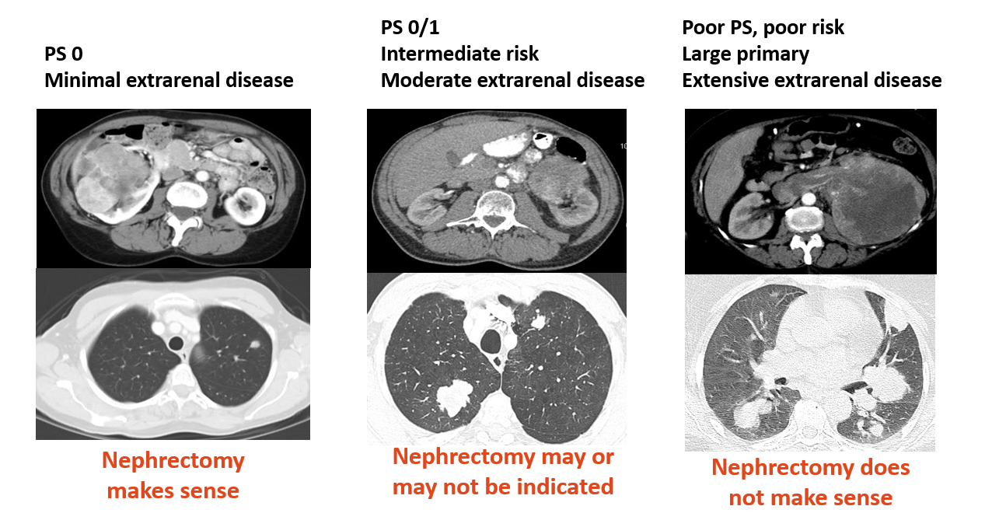
Considerations for Nephrectomy
Notes:
PS, performance status.

Slide 16
Current Therapeutic Landscape Advanced
Renal Cell Carcinoma: First-line Therapy
Risk Stratification (IMDC)
First Line
Clinical trial
Axitinib + pembrolizumab
Cabozantinib + nivolumab
Lenvatinib + pembrolizumab
Consider VEGF TKIs in certain circumstances
KPS < 80%
Hb < LLN
Neutrophilia
Platelets > ULN
Calcium > ULN
Time from Dx to systemic therapy <1 yr
Favorable risk
Intermediate risk
Clinical trial
Axitinib + pembrolizumab
Cabozantinib + nivolumab
Lenvatinib + pembrolizumab
Ipilimumab + nivolumab
Poor risk
NCCN. Clinical practice guidelines in oncology: kidney cancer. v.3.2023.
Notes:
Dx, diagnosis; Hb, hemoglobin; IMDC, International Metastatic Renal Cell Carcinoma Database Consortium; KPS, Karnofsky performance status; LLN, lower limit of normal; ULN, upper limit of normal.

Slide 17
CheckMate 214: Nivolumab + Ipilimumab vs
Sunitinib for Untreated Advanced RCC
Median OS, Mo (95% CI)
47.0 (35.4-57.4)
26.6 (22.1-33.5)
Median OS, Mo (95% CI)
74.1 (64.6-74.1)
68.4 (56.7-NE)
1.0
Nivo + ipi (n = 425)
Sunitinib (n = 422)
Nivo + ipi (n = 125)
Sunitinib (n = 124)
1.0
HR: 0.68 (95% CI: 0.58-0.81; P <.0001)
HR: 0.94 (95% CI: 0.65-1.37; P = .7673)
0.8
0.8
63%
0.6
0.6
FAVORABLE RISK
Intermediate/Poor Risk
Probability of OS
43%
Probability of OS
55%
0.4
0.4
0.2
31%
INTERMEDIATE/
POOR RISK
0.2
0
0
0
6
12
18
24
30
36
42
48
54
60
66
72
78
0
6
12
18
24
30
36
42
48
54
60
66
72
78
Mo
Mo
Patients at Risk, n
Nivo + ipi
Sunitinib
Patients at Risk, n
Nivo + ipi
Sunitinib
425
422
372
353
332
291
306
237
270
206
241
184
220
169
207
151
196
137
181
125
163
112
79
58
2
3
0
0
125
124
121
119
112
114
105
110
102
104
96
97
89
88
84
83
78
76
75
67
73
59
59
50
3
3
0
0
Minimum f/u: 5 yr
Motzer. Cancer. 2022;128:2085.
Notes:
f/u, follow-up; Ipi, ipilimumab; NE, not estimable; Nivo, nivolumab; OS, overall survival; RCC, renal cell carcinoma.

Slide 18
KEYNOTE-426: First-line Pembrolizumab + Axitinib vs Sunitinib in Advanced or Metastatic RCC
Median OS, Mo (95% CI)
Pembro + axi 45.7 (43.6-NR)
Sunitinib 40.1 (34.3-44.2)
Events, n Median OS
Pembro + axi 26 NR
Sunitinib 24 NR
HR: 0.73 (95% CI: 0.60-0.88; P <.001)
HR: 1.06 (95% CI: 0.60-1.86; P = .58*)
End of Pembro Treatment
100
81%
72%
100
95.6%
*Nominal P value.
67%
59%
85.3%
63%
54%
80
94.6%
80
87.7%
60
60
OS (%)
OS (%)
40
ALL RISK
INTENTION TO TREAT
40
FAVORABLE
RISK
20
20
Median f/u: 42.8 mo
Minimum f/u: 35.6 mo
Median f/u: 30.6 mo
0
0
0
432
429
6
407
379
12
384
336
18
345
306
24
318
279
30
286
252
36
259
224
42
141
110
48
16
12
54
0
0
0
6
12
18
24
30
36
42
Patients at Risk, n
Mo
Patients at Risk, n
Mo
Pem + Axi
Sunitinib
Pem + Axi
Sunitinib
138
131
134
129
131
123
126
118
110
108
63
60
12
9
0
0
Rini. ASCO 2021. Abstr 4500. Powles. Lancet Oncol. 2020;21:1563.
Notes:
Axi, axitinib; f/u, follow-up; NR, not reached; Pem, pembrolizumab; Pembro, pembrolizumab; OS, overall survival; RCC, renal cell carcinoma.

Slide 19
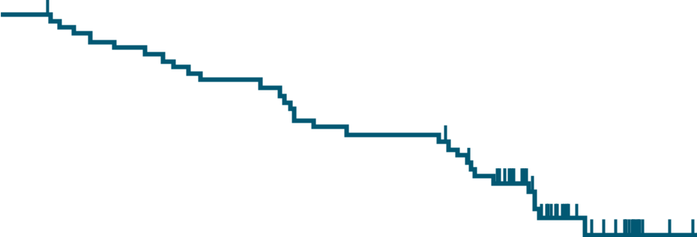
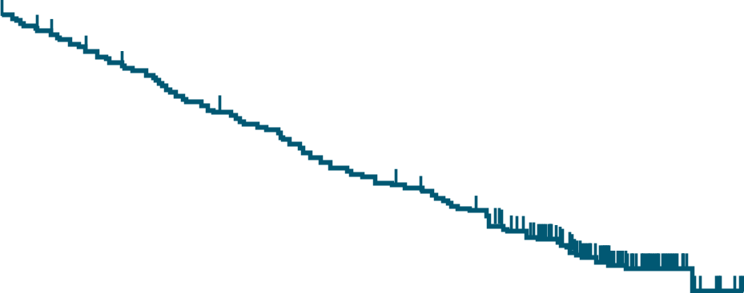
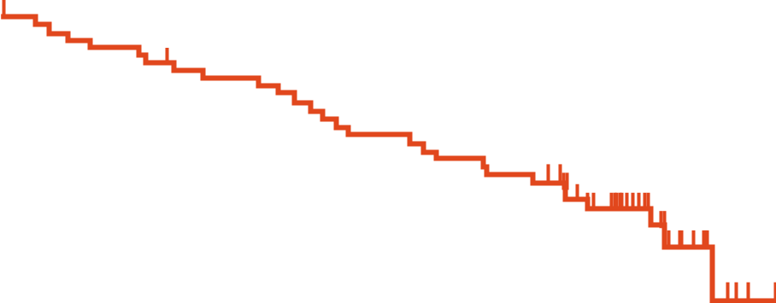
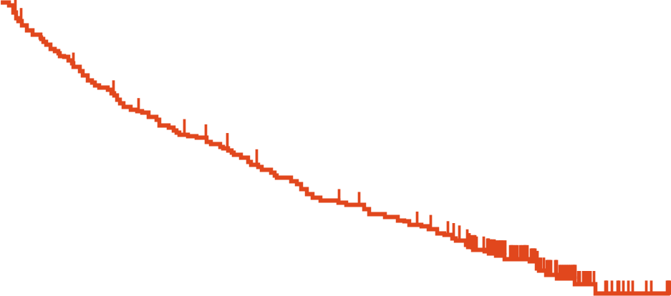
CheckMate 9ER: First-line Nivolumab + Cabozantinib vs Sunitinib in Advanced or Metastatic RCC
OS: ITT Population
OS: Favorable Risk
100
Median OS, Mo (95% CI)
Nivo + Cabo | 49.5 (40.3-NE)
Sun | 35.5 (29.2-42.3)
HR: 0.70 (0.56-0.87)
100
Median OS, Mo (95% CI)
Nivo + Cabo | NR (40.7-NE)
Sun | 47.6 (43.6-NE)
HR: 1.07 (0.63-1.79)
86.3%
79.0%
87.3%
75
75
68.4%
68.8%
58.7%
70.1%
OS (%)
OS (%)
50
49.5%
50
25
ALL RISK
INTENTION TO TREAT
25
FAVORABLE
RISK
0
0
0
6
12
18
24
30
36
42
48
54
0
6
12
18
24
30
36
42
48
54
Mo
Mo
Patients at Risk, n
Nivo + Cabo | 323 | 298 | 272 | 250 | 222 | 207 | 180 | 97 | 25 | 0
Sun | 328 | 276 | 240 | 217 | 189 | 168 | 150 | 83 | 17 | 0
Patients at Risk, n
Nivo + Cabo | 74 | 70 | 67 | 63 | 56 | 55 | 48 | 26 | 9 | 0
Sun | 72 | 68 | 63 | 61 | 55 | 52 | 49 | 27 | 5 | 0
Burotto. GU ASCO 2023. Abstr 603.
Notes:
Cabo, cabozantinib; ITT, intention to treat; NE, not estimable; Nivo, nivolumab; OS, overall survival; RCC, renal cell carcinoma; Sun, sunitinib.

Slide 20
CLEAR: First-line Lenvatinib + Pembrolizumab or Everolimus vs Sunitinib in Advanced RCC
100
Median OS, Mo (95% Cl)
Len + Pembro NR (33.6-NE)
Len + Eve NR (NE)
Sunitinib NR (NE)
80
Sunitinib
60
Len + Pembro
OS (%)
Len + Eve
Len + Pembro vs Sunitinib:
HR: 0.66 (95% CI: 0.49-0.88;
P = .005)
40
ALL RISK
INTENT TO TREAT
20
Len + Eve vs Sunitinib:
HR: 1.15 (95% CI: 0.88-1.50;
P = .3)
Median follow-up: 27 mo
0
Patients at Risk, n
Len + Pembro
Len + Eve
Sunitinib
0
355
357
357
3
342346
332
6
338
321
307
9
327
299
289
12
313
277
264
15
280
246
236
18
253
205
207
21
222
183
186
24
188154
169
27
129
109
112
30
66
46
60
33
26
22
25
36
10
8
7
39
2
2
2
42
0
0
2
45
1
48
0
51
Mo
Motzer. NEJM. 2021;384:1289.
Notes:
Eve, everolimus; Len, lenvatinib; NE, not estimable; NR, not reached; OS, overall survival; Pembro, pembrolizumab; RCC, renal cell carcinoma.

Slide 21

First-line IO Combination Trials in mRCC
 | CheckMate 214¹ Ipi/Nivo vs Sun (n = 550 vs n = 546) | KEYNOTE-426² Axi/Pembro vs Sun (n = 432 vs n = 429) | CheckMate 9ER³ Cabo/Nivo vs Sun (n = 323 vs n = 328) | CLEAR⁴ Len/Pembro vs Sun (n = 355 vs n = 357)
mOS, mo HR (CI) | 55.7 vs 38.4 0.72 (0.62-0.85) | 45.7 vs 40.1 0.73 (0.60-0.88) | 37.7 vs 34.3 0.70 (0.55-0.90) | NR vs NR 0.72 (0.55-0.93)
Landmark OS 12 mo Landmark OS 24 mo | 83% vs 78% 71% vs 61% | 90% vs 79% 74% vs 66% | 86% vs 76% (est.) 70.3% vs 60.3% | 90% vs 79% (est.) 79% vs 70%
mPFS, mo HR (CI) | 12.2 vs 12.3 0.86 (0.73-1.01) | 15.7 vs 11.1 0.68 (0.58-0.80) | 16.6 vs 8.3 0.56 (0.46-0.68) | 23.9 vs 9.2 0.39 (0.32-0.49)
ORR, % | 39 vs 32 | 60 vs 40 | 56 vs 28 | 71 vs 36
CR, % | 12 vs 3 | 10 vs 4 | 12 vs 5 | 16 vs 4
Median f/u, mo | 67.7 | 42.8 | 32.9 | 33.7
Primary PD, % | 18 | 11 | 6 | 5
Prognostic risk, % Favorable Intermediate Poor | 23 61 17 | 32 55 13 | 23 58 19 | 31 59 9
Prior nephrectomy, % | 82 | 83 | 69 | 74
Subsequent systemic tx for Sun arm, % | Overall (68) IO (42) | Overall (69) IO (48) | Overall (40) IO (29) | Overall (71) IO (53)
Tx discontinuation due to AEs, % | 23 vs 13 | 20 vs 18 | 27 vs 10 | 18.5 (len) / 25 (pembro) / 9.7 (len + pembro) vs 10
1. Motzer. Cancer. 2022;128:2085. 2. Powles. Lancet Oncol. 2020;21:1563.
3. Motzer. Lancet Oncol. 2022;23:888. 4. Motzer. NEJM. 2021;384:1289.
Adapted from
@brian_rini and @Uromigos
(podcasts: https://anchor.fm/the-Uromigos)
Notes:
Axi, axitinib; Cabo, cabozantinib; CR, complete response; f/u, follow-up; IO, immuno-oncology; Len, lenvatinib; mOS, median overall survival; mPFS, medial progression-free survival; mRCC, metastatic renal cell carcinoma; Nivo, nivolumab; NR, not reached; ORR, overall response rate; PD, progressive disease; Pembro, pembrolizumab; Sun, sunitinib; tx, treatment.

Slide 22
Cross-Trial Comparison of Response in ITT Population
ORR
Rate of PD
ORR (%)
Rate of PD (%)
Motzer. Cancer. 2022;128:2085. Powles. Lancet Oncol. 2020;21:1563.
Motzer. Lancet Oncol. 2022;23:888. Motzer. NEJM. 2021;384:1289.
Notes:
Axi, axitinib; Cabo, cabozantinib; ITT, intention-to-treat; Len, lenvatinib; Nivo, nivolumab; ORR, overall response rate; PD, progressive disease; Pembro, pembrolizumab.

Slide 23
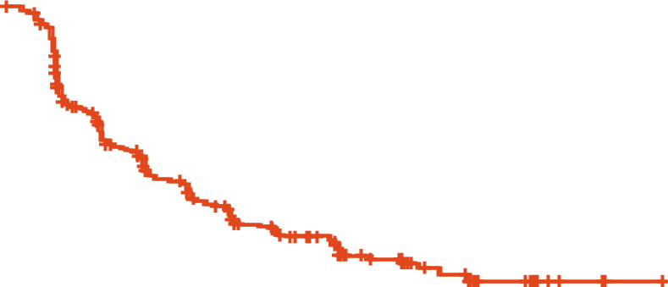
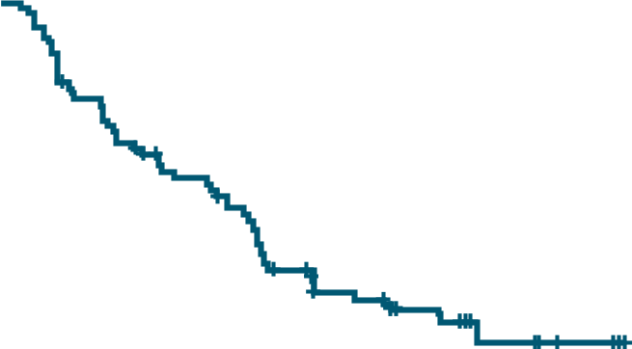
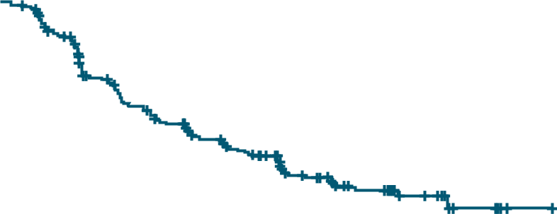
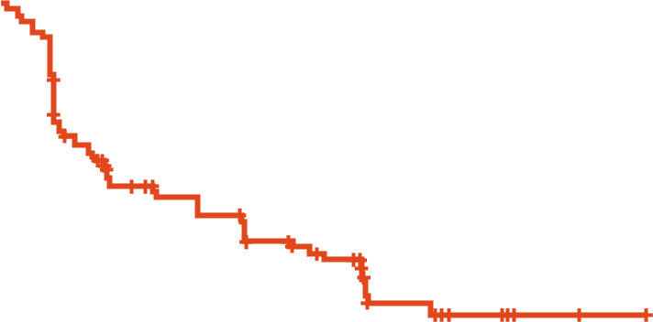
COSMIC-313: Ipi/Nivo ± Cabozantinib in Advanced RCC
Randomized, placebo-controlled, phase III study of ipilimumab/nivolumab ± cabozantinib in first-line intermediate-risk/poor-risk advanced RCC
  Primary endpoint: PFS per RECIST v1.1 in the PITT population
Intermediate (n = 642)
Poor (n = 213)
1.0
1.0
 | Events, n | Median PFS, Mo (95% CI)
Cabo + Ipi + Nivo | 131 | 17.9 (14.1-NE)
Pbo + Ipi + Nivo | 161 | 11.3 (8.4-15.3)
 | Events, n | Median PFS, Mo (95% CI)
Cabo + Ipi + Nivo | 55 | 9.5 (8.3-15.8)
Pbo + Ipi + Nivo | 55 | 11.2 (6.0-14.2)
0.8
0.8
0.6
0.6
Probability of PFS
Probability of PFS
0.4
0.4
0.2
0.2
0
HR: 0.68 (95% CI: 0.54-0.86)
0
HR: 0.93 (95% CI: 0.64-1.35)
0
3
6
9
12
15
18
21
24
27
30
0
3
6
9
12
15
18
21
24
27
30
Mo
Mo
Cabo + Ipi + Nivo | 321 | 278 | 211 | 182 | 133 | 81 | 48 | 28 | 10 | 1 | 0
Pbo + Ipi + Nivo | 321 | 226 | 170 | 146 | 105 | 57 | 30 | 16 | 4 | 1 | 0
Cabo + Ipi + Nivo | 107 | 79 | 58 | 50 | 29 | 18 | 8 | 5 | 0
Pbo + Ipi + Nivo | 106 | 69 | 51 | 47 | 35 | 14 | 7 | 3 | 1 | 0
Powles. GU ASCO 2023. Abstr 605.
Notes:
Cabo, cabozantinib; Ipi, ipilimumab; NE, not evaluable; Nivo, nivolumab; Pbo, placebo; PFS, progression-free survival; PITT, progression-free survival ITT; RCC, renal cell carcinoma; RECIST, Response Evaluation Criteria in Solid Tumors.

Slide 24
COSMIC-313: Safety
Event, n (%) | Intermediate Risk |  | Poor Risk
Event, n (%) | Cabo + Ipi + Nivo (n = 321) | Pbo + Ipi + Nivo (n = 320) | Cabo + Ipi + Nivo (n = 105) | Pbo + Ipi + Nivo (n = 104)
TRAE | 319 (99) | 302 (94) | 102 (97) | 85 (82)
Grade 3/4 TRAE Immune-mediated ALT increase AST increase | 329 (74) 166 (52) 95 (30) 70 (22) | 134 (42) 81 (25) 22 (7) 15 (5) | 70 (67) 50 (48) 16 (15) 16 (15) | 40 (38) 19 (18) 4 (4) 5 (5)
Grade 5 TRAEs ≤100 days | 4 (1)* | 2 (1)† | 1 (1)‡ | 2 (2)§
TRAE leading to discontinuation Any tx component Cabo or Pbo Nivo Ipi All tx components (due to same AE) | 163 (51) 97 (30) 94 (29) 117 (36) 46 (14) | 82 (26) 44 (14) 60 (19) 40 (13) 16 (5) | 30 (29) 21 (20) 15 (14) 12 (11) 5 (5) | 21 (20) 15 (14) 16 (15) 11 (11) 4 (4)
High-dose steroids for AE | 192 (60) | 119 (37) | 54 (51) | 30 (29)
*GI hemorrhage, hepatic failure, immune-mediated hepatitis, respiratory failure.
†Sudden death. ‡Acute hepatic failure. §Myocarditis, perforated ulcer.
Powles. GU ASCO 2023. Abstr 605.
Notes:
AE, adverse event; Cabo, cabozantinib; GI, gastrointestinal; Ipi, ipilimumab; Nivo, nivolumab; Pbo, placebo; TRAE, treatment-related adverse reaction; tx, treatment.

Slide 25
First-line Combination Therapies for Advanced RCC
Use of IMDC risk stratification or other risk models may help predict prognosis and guide choice of first-line therapy for patients with advanced RCC
  Favorable risk: consider treatment with ICI + VEGFR TKI; watch and wait or single-agent VEGFR TKI can be considered in select patients
  Intermediate/poor risk: consider treatment with ICI + VEGFR TKI or ICI + ICI combination
Consider disease characteristics (eg, risk category) and patient preferences (eg, dosage forms) to decide among available treatment options
Notes:
ICI, immune checkpoint inhibitor; IMDC, International Metastatic Renal Cell Carcinoma Database; RCC, renal cell carcinoma.

Slide 26
Therapeutic Landscape of Advanced RCC:
Second-line Therapy and Beyond
Sequencing VEGF TKIs
Before Era of IO Combinations
Options for Second Line +
Clinical trial
VEGF TKI
ICI
VEGF TKI + ICI
VEGF TKI + mTOR inhibitor
ICI + ICI
mTOR inhibitor
METEOR: cabozantinib
Phase II: lenvatinib + everolimus
Novel Targets
Phase I/II: belzutifan
Sequencing VEGF TKIs
Following Frontline IO
TIVO-3: tivozanib
Keynote-146: lenvatinib + pembrolizumab
CaboPoint: cabozantinib
NCCN. Clinical practice guidelines in oncology: kidney cancer. v.3.2023.
Notes:
ICI, immune checkpoint inhibitor; IO, immuno-oncology; RCC, renal cell carcinoma.

Slide 27
Phase III METEOR Trial: Cabozantinib vs Everolimus
After Prior VEGF TKI Therapy
1.0
Median
OS, Mo
21.4
17.1
Deaths,
n
198
232
0.8
Cabozantinib (n = 330)
Everolimus (n = 328)
Overall, 5% of patients received previous therapy with an ICI
ORR with cabozantinib: 17% vs 3% with everolimus alone
HR: 0.70 (95% Cl: 0.58-0.85; P = .0002)
0.6
Probability of OS
0.4
0.2
0
0
3
6
9
12
15
18
21
24
27
30
33
36
39
Mo
Patients at Risk, n
Cabozantinib
Everolimus
330
328
318
308
297
364
266
231
240
205
213
177
188
148
163
121
114
82
76
54
30
23
6
3
3
0
0
0
Motzer. Br J Cancer. 2018;118:1176.
Notes:
ICI, immune checkpoint inhibitor; ORR, objective response rate; OS, overall survival.

Slide 28
Phase II Trial of Lenvatinib, Everolimus, or Lenvatinib + Everolimus After Prior VEGF TKI
100
Lenvatinib + everolimus
Single-agent lenvatinib
Single-agent everolimus
80
Overall, 3% of patients received previous therapy with an ICI
ORR with lenvatinib + everolimus: 43% vs 6% with everolimus alone
60
OS (%)
40
Lenvatinib + everolimus vs everolimus
HR: 0.51 (95% CI: 0.30-0.88; P = .024)
Lenvatinib + everolimus vs lenvatinib
HR: 0.75 (95% CI: 0.43-1.30; P = .32)
Lenvatinib vs everolimus
HR: 0.68 (95% CI: 0.41-1.41; P = .12)
20
0
0
3
6
9
12
15
18
21
24
27
Patients at Risk, n
Lenvatinib + everolimus
Single-agent lenvatinib
Single-agent everolimus
OS (Mo)
51
52
50
48
50
46
46
45
42
44
42
38
38
37
30
35
31
27
29
26
20
21
16
14
14
7
8
6
4
2
Motzer. Lancet Oncol. 2015;16:1473.
Notes:
ICI, immune checkpoint inhibitor; ORR, objective response rate; OS, overall survival.

Slide 29
TIVO-3: Phase III Trial With Tivozanib vs Sorafenib in
Advanced RCC After VEGF TKI Therapy (Prior IO Allowed)
100
+
Tivozanib
Sorafenib
Censored
+
+
Overall, 26% of patients received previous therapy with an ICI + TKI
ORR: 18% with tivozanib vs 8% with sorafenib
80
+
+
+
60
49.6%
(42-57)
PFS (%)
+
+
40
+
+
+
31.2%
(24-39)
+
24.2%
(18-31)
20
+
18.3%
(13-25)
35.1%
(27-43)
18.4%
(12-25)
+
13.9%
(9-20)
12.3%
(8-18)
8.8%
(5-14)
4.8%
(2-10)
9.2%
(5-15)
+
7.6%
(4-13)
3.2%
(1-7)
2.4%
(1-6)
1.6%
(0-5)
+
0
0%
Patients at Risk, n
Tivozanib
Sorafenib
0
6
12
18
24
30
36
42
48
175
175
79
45
45
23
34
11
25
6
18
4
16
3
12
2
9
1
Rini. Lancet Oncol. 2020;21:95. Atkins. ASCO GU 2022. Abstr 362.
Notes:
ICI, immune checkpoint inhibitor; IO, immuno-oncology; PFS, progression free survival; ORR, overall response rate; RCC, renal cell carcinoma.

Slide 30
CaboPoint: Cabozantinib Following Checkpoint Inhibitor–Based Combination Therapy for Advanced ccRCC
Ongoing nonrandomized, international, open-label phase II study
  Cohort A: PD after Ipi/Nivo
  Cohort B: PD after checkpoint inhibitor/VEGF TKI
  Primary endpoint: ORR (per RECIST v1.1) in Cohort A by ICR
 | Cohort A (n = 60) | Cohort B (n = 28) | Overall (N = 88)
ORR, % (95% CI) | 31.7 (20.3-45.0) | 25.0 (10.7-44.9) | 29.5 (20.3-40.2)
Best overall response, n (%) CR PR SD PD | 0 19 (33.3) 29 (50.9) 9 (15.8) | 1 (4.0) 6 (24.0) 13 (52.0) 5 (20.0) | 1 (1.2) 25 (30.5) 42 (51.2) 14 (17.1)
Albiges. GU ASCO 2023. Abstr 606.
Notes:
ccRCC, clear-cell renal cell carcinoma; CR, complete response; Ipi, ipilimumab; Nivo, nivolumab; ORR, overall response rate; PD, progressive disease; PR, partial response; SD, stable disease.

Slide 31
Phase Ib/II KEYNOTE-146/Study 111: Response to Lenvatinib + Pembrolizumab by Previous Therapy
A multicenter, open-label phase Ib/II study, mRCC cohort (N = 145)
  Patients received 0-2 lines of previous therapy
Event | IO Naive (n = 17) | Previous IO (n = 104)
ORR at 24 wk, % (95% CI) | 41.2 (18.4-67.1) | 55.8 (45.7-65.5)
Best objective response, % CR PR SD PD NE | 0 52.9 41.2 5.9 0 | 0 62.5 29.8 3.8 3.8
ORR, % (95% CI) | 52.9 (27.8-77.0) | 62.5 (52.5-71.8)
Median PFS: 12.2 mo (95% CI: 9.5-17.7)
Lee. Lancet Oncol. 2021;22:946.
Notes:
CR, complete response; IO, immuno-oncology; mRCC, metastatic renal cell carcinoma; NE, not estimable; ORR, objective response rate; PD, progressive disease; PFS, progression-free survival; PR, partial response; SD, stable disease.

Slide 32
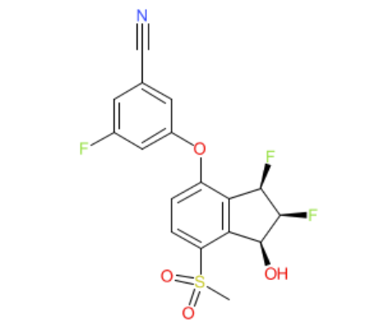
Belzutifan in Advanced Clear-Cell RCC: Study Design
Dose-escalation/expansion phase I/II study of belzutifan (MK-6482), a potent, selective,
oral small-molecule HIF-2α inhibitor with antitumor activity in clear-cell RCC
  Current analysis: updated follow-up of dose-expansion cohort in advanced clear-cell RCC
Adult patients with previously treated advanced clear-cell RCC with
≥1 previous therapy;
ECOG PS 0/1
(N = 55)
Belzutifan 120 mg PO QD*
Until PD or unacceptable toxicity
*21-day DLT period in dose-escalation.
Belzutifan
Structure
Normal Oxygen Levels
Hypoxia
HIF-α
HIF-2α
inhibitor
HIF-β
CACGTG
CACGTG
Proteasomal degradation
HRE site
HIF complex
Bauer. ASCO GU 2021. Abstr 273. Choueiri. Nat Med. 2021;27:802. Jonasch. ASCO 2022. Abstr 4509.
Notes:
DLT, dose-limiting toxicity; ECOG, Eastern Cooperative Oncology Group; PD, progressive disease; PS, performance status; RCC, renal cell carcinoma.

Slide 33
Belzutifan in Advanced RCC: Max Change
From Baseline in Target Lesions
ORR: 25% (CR: 2%; PR: 24%); DCR: 80%
PFS
100
Best objective response (n = 55)
CR
PR
SD
PD
NE
*Prior treatment with IO and VEGF
100
 | Events, n (%) | Median PFS, Mo (Range)
Belzutifan (n = 55) | 27 (49) | 14.5 (7.3-22.1)
80
60
80
40
60
20
*
*
*
*
PFS (%)
*
40
*
*
*
*
*
*
Best Change in Target Lesion Size From Baseline (%)
0
*
*
*
*
*
*
*
*
20
-20
*
*
*
*
*
*
*
*
*
-40
0
0
5
10
15
20
25
30
35
40
45
-60
*
Mo
*
*
*
*
Patients at Risk, n
55 | 31 | 19 | 14 | 11 | 9 | 9 | 8 | 3 | 0
-80
*
*
-100
*
Jonasch. ASCO 2022. Abstr 4509.
Notes:
CR, complete response; DCR, disease control rate; IO, immuno-oncology; NE, not estimable; ORR, overall response rate; PD, progressive disease; PFS, progression-free survival; PR, partial response; RCC, renal cell carcinoma; SD, stable disease.

Slide 34
Considerations for Treatment After Progression
Treatment options for second-line therapy and beyond are guided by:
  Previous treatment received
  Strength of evidence
  Toxicity profile and patient comorbidities
  Patient and physician preference and financial concerns
Various therapeutic options can be used to sequence therapy at each progression depending on what a patient previously received

Slide 35
Ongoing Phase III Trials in the Post-IO Setting
Title | Inclusion | Treatment Arms
MK-6482-005: Phase III Trial of Belzutifan vs Everolimus in Advanced RCC After PD-1/PD-L1 and TKI Therapy (n = 736)^{1,2} | Clear-cell RCC Prior therapy with PD-1/PD-L1 inhibitor and VEGF TKI, as monotherapy or in combination ≤3 prior therapies | Belzutifan vs Everolimus
CONTACT-03: Phase III Trial of Atezo + Cabo vs Cabo in Advanced RCC After PD-1/PD-L1 Therapy (n = 500)^{3,4} | Clear-cell RCC or non–clear-cell RCC (papillary or unclassified) Prior first- or second-line therapy with PD-1/PD-L1 inhibitor as immediate preceding therapy No more than 1 previous PD-1/PD-L1 inhibitor | Atezolizumab + cabozantinib vs Cabozantinib
TiNivo-2: Phase III Trial of Tivozanib + Nivolumab vs Tivozanib in Advanced RCC After IO Therapy (n = 326)^{5,6} | Clear-cell RCC PD during or following ≥6 wk of treatment with an IO therapy ≤2 previous lines of therapy | Nivolumab + tivozanib vs Tivozanib
1. NCT04195750. 2. Choueiri. GU ASCO 2021. Abstr TPS368. 3. NCT04338269. 4. Pal. GU ASCO 2021. Abstr TPS370.
5. NCT04987203. 6. Choueiri. GU ASCO 2022. Abstr TPS405.
Slide credit: clinicaloptions.com
Notes:
Atezo, atezolizumab; Cabo, cabozantinib; IO, immuno-oncology; PD, progressive disease; RCC, renal cell carcinoma.

Slide 36
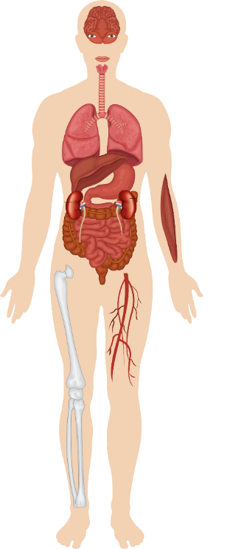
A New Spectrum of Adverse Events With IO-Based Therapy
Encephalitis
Aseptic meningitis
Hypophysitis
Dry mouth
Uveitis
Orbital inflammation
Hypothyroidism
Pneumonitis
Hepatitis
Cardiotoxicity
Pancreatitis
Autoimmune diabetes
Adrenal
insufficiency
Rash and vitiligo
Enterocolitis
Pruritus
Myalgia/myositis
Arthralgia
Michot. Eur J Cancer. 2016;54:139. Steven. Rheumatology (Oxford). 2019;58(suppl 7):vii29.
Winer. J Thorac Dis. 2018;10(suppl 3):S480. Robert. ASCO 2017. Education session: checkpoint inhibitor immunotherapy.
Notes:
IO, immuno-oncology.

Slide 37
Time of Onset and Toxicity Grade of Immune-Related
Adverse Events in Patients Receiving PD-1/PD-L1 Antibodies
Colitis
Endocrinopathy
Nephritis
Liver toxicity
Skin, rash, or pruritus
Pneumonitis
Toxicity Grade
4
6
8
10
12
14
>30
Duration of Treatment (Wk)
Martins. Nat Rev Clin Oncol. 2019:16;563.

Slide 38
Rates of AEs in IO-Based Combination Therapy for RCC
Grade 3/4 AE, % | Ipi/Nivo (CheckMate 214)¹ | Nivo/Cabo (CheckMate 9ER)² | Pembro/Axi (KEYNOTE-426)³ | Pembro/Lenvatinib (CLEAR)⁴
Diarrhea and/or colitis | 5.8 | 6.9 | 12.7 | 9.7
Hypertension | 0 | 12.5 | 22 | 27.6
Fatigue | 4.4 | 3.4 | 3 | 4.3
Rash | 1.6 | 1.9 | NR | 3.7
Maculopapular rash | 1.5 | 0.3 | NR | NR
Adrenal insufficiency | 2 | 2 | 1 | 1.1
Hypophysitis | 2.7 | 0.3 | 1 | 0.6
Diabetes mellitus | <1 | NR | <1 | 0.3
Increased AST | 3.7 | 3.4 | 6.8 | 2.6
Increased ALT | 5.1 | 5.3 | 13 | 3.1
Increased lipase | 10 | 6.2 | NR | 9.7
Increased amylase | 6 | 3.1 | NR | 7.4
Pneumonitis | 1.1 | 0.9 | <1* | 2
*1 episode of grade 5 pneumonitis.
1. Motzer. Lancet Oncol. 2019;20:1370. 2. Choueiri. NEJM. 2021;384:829.
3. Powles. Lancet Oncol. 2020;21:1563. 4. Motzer. NEJM. 2021;384:1289.
Notes:
AE, adverse event; ALT, alanine aminotransferase; AST, aspartate aminotransferase; Axi, axitinib; Ipi, ipilimumab; Nivo, nivolumab; NR, not reported; Pembro, pembrolizumab; RCC, renal cell carcinoma.

Slide 39
General Guidelines for Management of irAEs
Consult promptly with relevant specialists for affected organ systems (eg, GI, dermatology)
For steroid-refractory AEs, consider adding infliximab, mycophenolate mofetil, etc
  Diarrhea → consider adding infliximab or vedolizumab; fecal transplantation an investigational approach
  Hepatitis → consider adding mycophenolate mofetil
Grade 1: Asymptomatic to Mild Symptoms
  Observation
  Supportive care
  Continue ICI therapy or consider holding ICI as needed due to patient discomfort
Grade 2: Moderate Symptoms
  Local or noninvasive intervention indicated
  Hold ICI; consider redose if AE resolves to grade ≤1
  Consider low-dose steroids (prednisone
  0.5-1 mg/kg/day)
  May be able to continue treatment
Grade 3: Medically Significant but
Not Immediately Life-threatening
  Discontinue ICI
  Monitor closely (likely inpatient)
  Start high-dose steroids (prednisone 1-2 mg/kg/day)
  Slow steroid taper over ≥1 mo once toxicity resolves to grade ≤1 → If not improving in 1-3 days, increase immunosuppression
Grade 4: Life-threatening Consequences
  Urgent intervention
  Permanently discontinue ICI therapy
Brahmer. JCO. 2018;36:1714.
Slide credit: clinicaloptions.com
Notes:
AE, adverse event; GI, gastrointestinal; ICI, immune checkpoint inhibitor; irAE, immune-related adverse event.

Slide 40
Expert Consensus on Managing AEs Associated
With IO/VEGF TKI Combination Therapy
Abnormality
Management
Therapy Outcome
Grade 1 diarrhea
Monitor and continue
both agents
No improvement
Grade 2 diarrhea
Hold axitinib for 1-2 days and continue ICI
Improvement
Consider intermittent schedule and/or dose reduction for axitinib
No improvement
Hold ICI and start corticosteroids
Improvement
Consider restarting axitinib, followed
by ICI rechallenge
Grade 3/4 diarrhea
Hold both agents and consider immediate intervention and referral to specialist/hospitalization
If initially grade 3: Consider restarting axitinib, followed by ICI rechallenge
Improvement
If initially grade 4: Permanently discontinue ICI and consider TKI monotherapy
Grünwald. Br J Cancer. 2020;123:898. McGregor. Cancer Treat Rev. 2022; 103:102333
Slide credit: clinicaloptions.com
Notes:
AE, adverse event; ICI, immune checkpoint inhibitor; IO, immuno-oncology; TKI, tyrosine kinase inhibitor.

Slide 41
Go Online for More CCO
Coverage of RCC!
Capsule Summaries of all the key data from ASCO GU 2023
Interactive Decision Support Tool on metastatic clear cell RCC (coming soon!)
CME-certified Text Module reviewing the key information on treatment selection and adverse event management in RCC
Expert authored ClinicalThought commentary (coming soon!)
clinicaloptions.com

