Slide 1
In It for the Long Haul: Expert Perspectives on the Need for Chronic Obesity Management
Provided by Clinical Care Options, LLC. in partnership with Practicing Clinicians Exchange.
Supported by an educational grant from Novo Nordisk.

Slide 2

About These Slides
Please feel free to use and share some or all of these slides in your noncommercial presentations to colleagues or patients
When using our slides, please retain the source attribution:
These slides may not be published, posted online, or used in commercial presentations without permission. Please contact permissions@clinicaloptions.com for details
Slide credit: clinicaleducationalliance.com
Notes:
Disclaimer: The materials published on the Clinical Care Options Web site reflect the views of the authors of the CCO material, not those of Clinical Care Options, LLC, the CME providers, or the companies providing educational grants. The materials may discuss uses and dosages for therapeutic products that have not been approved by the United States Food and Drug Administration. A qualified healthcare professional should be consulted before using any therapeutic product discussed. Readers should verify all information and data before treating patients or using any therapies described in these materials.

Slide 3
Faculty
Christopher D. Still, DO, FACP, FTOS
Professor of Medicine
Department of Clinical Sciences
Geisinger Commonwealth School of Medicine
Medical Director, Center for Nutrition & Weight Management
Director, Center for Obesity and Metabolic Research
Geisinger Health System
Danville, Pennsylvania
Notes:
This slide lists the faculty who were involved in the production of these slides.

Slide 4
Disclosures
The faculty reported the following relevant financial relationships or relationships to products or devices they have with ineligible companies related to the content of this educational activity:
Christopher D. Still, DO, FACP, FTOS: consultant/advisor/speaker: Lilly, Novo Nordisk; researcher: Regeneron.
Notes:
This slide lists the disclosure information of the faculty and staff involved in the development of these slides.

Slide 5
Learning Objectives
Discuss with patients the rationale for the duration of obesity treatment, including effects on related complications

Slide 6
Obesity as a Chronic Disease
Biological mechanisms with compensatory response
  Metabolic adaptations, hormonal changes, neural adaptations
Clinical evidence for chronicity
  Weight regain: ~2/3 of weight regained within 1 yr of treatment cessation
  Recurrence rates: >80% of weight regained by 5 yr without treatment
  Biological persistence: compensatory changes persist for yr
Comparable to diabetes or hypertension, which require continuous medication
Martins. Am J Clin Nutr. 2020;112:1170. van Baak. Curr Obes Rep. 2025;14:28. Hall. Med Clin North Am. 2018;102:183.

Slide 7
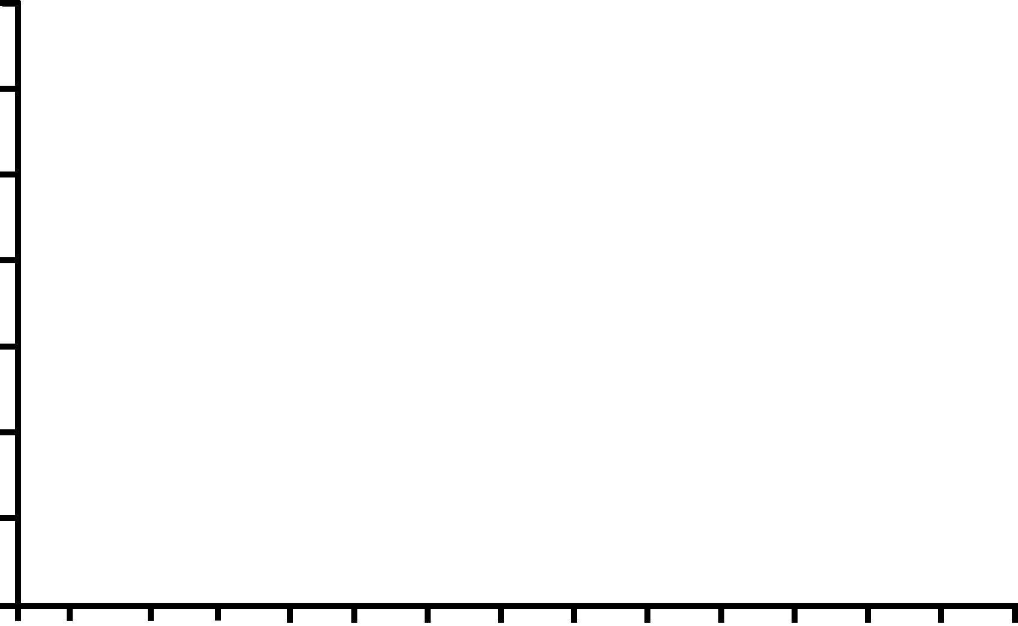
Weight Loss Is Sustained Over Years With Semaglutide or Tirzepatide
SURMOUNT-1: Sustained Weight Loss
With Tirzepatide (~3 Yr)
SELECT: Sustained Weight Loss
With Semaglutide (~4 Yr)
Weight loss ≥5 to <10%
(n = 5; 3%)
Weight loss ≥10 to <15%
(n = 14; 9%)
Sema 2.4 mg
Placebo
Weight loss ≥15 to <20%
(n = 21; 14%)
Weight loss ≥20%
(n = 104; 69%)
0
0
-2
-5
-6.6%
-1.5%
-4
-10
-12.2%
P<.0001
-15
Change in Body Weight (%)
Mean Change in Body Weight (%)
-6
-17.3%
-20
-8
-10.2%
-25
-10
-30
-29.9%
-12
-35
0
12
26
39
52
65
78
91
104
117
130
143
156
169
182
195
208
221
0
12
24
36
48
60
72
85
98
111
124
137
150
163
176
Wk
Wk
Ryan. Nat Med. 2024;30:2049. Ard. ADA 2025. Presentation 144-OR.

Slide 8
Long-term Outcomes With AOMs
Sustained weight loss: 12%-15% with semaglutide, 8% with liraglutide, and ~20% with tirzepatide over 1-2 yr of treatment
Health benefits: positive impacts on cardiometabolic markers and/or anthropometry measures across 6 major AOMs
Durability issue: discontinuing therapy, especially a GLP‑1 RA, leads to weight regain starting at ~8 wk and reaching 2.5 kg by 20 wk
Drucker. Diabetes Care. 2024;47:1873. Pi-Sunyer. NEJM. 2015;373:11. Liu. eClinicalMedicine. 2024;79:103020. Wu. BMC Med. 2025;23:398.
Notes:
AOM, antiobesity medication; RA, receptor agonist.

Slide 9
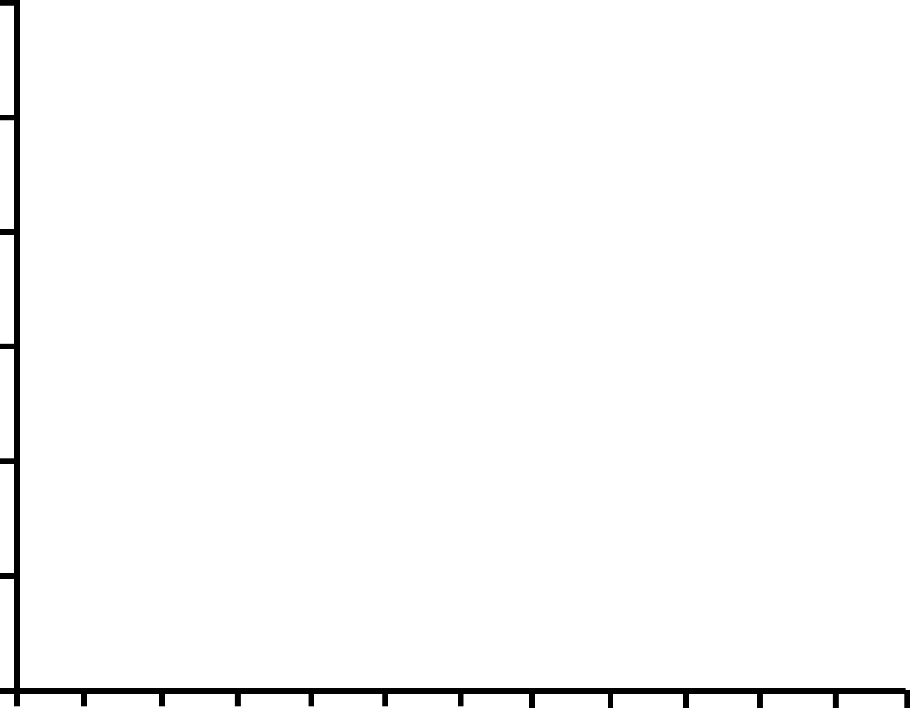
Weight and BMI Regain Trajectory After AOM Discontinuation
1
Weight change (kg)
BMI change
0
-1
-2
-3
-4
-5
-5
0
5
10
15
20
25
30
35
40
45
50
55
Wk
Wu. BMC Med. 2025;23:398.
Notes:
AOM, antiobesity medication.

Slide 10
Weight Recurrence Following GLP-1 RA Cessation
STEP-1 Extension (Semaglutide)¹
SURMOUNT-4 (Tirzepatide)²
68-wk treatment phase
52-wk off-treatment extension phase
Lead-in period
2
0
Tirzepatide
0
Placebo
-2
-5
-9.5
-9.9
-4
-10
-6
Semaglutide
2.4 mg
Percentage change in total body weight
-8
-15
Percentage Change in Total Body Weight
Placebo
-10
-12
-20
-14
-25.8
-25.3
-25
Overall mean baseline body weight: 107.3 kg
-16
-18
-30
0
0
4
8
12
16
20
24
28
32
36
40
52
64
76
88
Hybrid imputation
4
8
12
16
20
28
36
44
52
60
68
75
80
104
120
Wk Since Randomization
Wk After Lead-in Period Start
1. Wilding. Diabetes Obes Metab. 2022;24:1553. 2. Aronne. JAMA. 2024;331:38.
Notes:
RA, receptor agonist.

Slide 11
Additional Indications for Semaglutide and Tirzepatide Obesity Management Formulations
Agent | Dose | Indication(s)
Semaglutide | 2.4 or 1.7 mg once weekly | Reduce excess body weight and maintain weight reduction in long term* Patients aged ≥12 yr with obesity Adults with overweight and ≥1 weight-related comorbid condition
 |  | Reduce risk of MACE in adults with established CVD and obesity or overweight*
 |  | Treat MASH with moderate to advanced fibrosis (F2/3) in adults
Tirzepatide | 5, 10, or 15 mg once weekly | Reduce excess body weight and maintain weight reduction in long term* Adults with obesity Adults with overweight and ≥1 weight-related comorbid condition
 | 10 or 15 mg once weekly | Treat moderate to severe obstructive sleep apnea in adults with obesity
*Treatment in combination with a reduced-calorie diet and increased physical activity.
Semaglutide PI. Tirzepatide PI.
Notes:
CVD, cardiovascular disease; MACE, major adverse cardiovascular event.

Slide 12
Clinical Benefits of AOMs Beyond Weight Loss
SELECT
Semaglutide reduced risk of MACE (composite CV death, nonfatal MI, nonfatal stroke) by 20% vs placebo in adults with obesity + established CVD
ESSENCE
Semaglutide significantly improved liver histology (steatohepatitis resolution and fibrosis improvement) vs placebo in adults with MASH + fibrosis 2/3
SURMOUNT-OSA
Tirzepatide significantly reduced AHI scores and improved sleep-related PROs vs placebo in adults with obesity + moderate to severe OSA
Lincoff. NEJM. 2023;389:2221. Sanyal. NEJM. 2025;392:2089. Malhotra. NEJM. 2024;391:1193.
Notes:
AHI, apnea-hypopnea index; AOM, antiobesity medication, CV, cardiovascular; CVD, cardiovascular disease; MACE, major adverse cardiovascular disease; MASH, metabolic dysfunction–associated steatohepatitis, MI, myocardial infarction; OSA, obstructive sleep apnea; PRO, patient-reported outcomes.

Slide 13
Strategies for Long-term Weight Maintenance
Continue AOM—stopping therapy leads to weight regain (STEP-1, SURMOUNT-4)
Behavioral reinforcement with nutrition counseling, physical activity, sleep optimization, and structured follow-up visits
Multidisciplinary support via behavioral health, dietitians, and group programs that help address emotional/environmental triggers
Monitoring and follow-up of weight, waist circumference, and labs for comorbidities; use digital tools for accountability
Relapse management includes normalizing small fluctuations and intervening early if there is >3%-5% weight regain
Wilding. Diabetes Obes Metab. 2022;24:1553. Aronne. JAMA. 2024;331:38.
Montesi. Diabetes Metab Syndr Obes. 2016;9:37. Rubino. Lancet Diabetes Endocrinol. 2025;13:221.
Notes:
AOM, antiobesity medication.

Slide 14
Communicating Obesity as a Chronic Disease
Set expectations early:
  Obesity is a chronic, relapsing condition like hypertension or diabetes
  Long-term management is expected, not failure
Normalize treatment duration:
  AOMs often are continued lifelong like antihypertensive or cholesterol therapy
  Stopping therapy may lead to weight regain (physiology, not willpower)
Emphasize health, not just weight:
  Focus on reducing complications (CVD, OSA, T2D, MASLD)
  Highlight quality-of-life, function, and energy improvements
Rubino. Lancet Diabetes Endocrinol. 2025;13:221. Wilding. Diabetes Obes Metab. 2022;24:1553. Aronne. JAMA. 2024;331:38.
Notes:
AOM, antiobesity medication; CVD, cardiovascular disease; MASLD, metabolic dysfunction–associated steatotic liver disease; OSA, obstructive sleep apnea; T2D, type 2 diabetes.

Slide 15
Communicating Obesity as a Chronic Disease
Address stigma and language:
  Use person-first language (“person with obesity”)
  Reinforce that obesity is not simply about willpower, but biology and environment
Empower with partnership:
  Frame treatment as a collaboration (medications + lifestyle modifications + ongoing support)
  Encourage patient engagement in shared decision-making
Rubino. Lancet Diabetes Endocrinol. 2025;13:221. Palad. Am J Clin Nutr. 2018;108:201.

Slide 16
Framing Chronic Treatment to Patients
Communication strategies:
  Use the chronic care model
  Present evidence for weight regain
  Focus on health outcomes
Address common concerns:
  Safety
  Cost
  Dependency
Conversation example:
  “Do I need to take this forever?”
  “Obesity is a chronic condition that requires ongoing management. Research shows that when treatment stops, weight typically returns. Think of it like blood pressure medication—it works while you’re taking it."
Patient education tools:
  Weight trajectory graphs
  Health benefit trackers
  Shared decision-making
Grudniewicz. Patient. 2023;16:569.

Slide 17
Strategies for Maintenance Treatment
Pharmacotherapy
  Continue in the long-term, optimize dose, and consider combination therapy if response is inadequate
Lifestyle modifications
  Behavioral support (self-monitoring, relapse prevention)
  Sustainable dietary patterns (protein focus, balanced carbs)
  Regular physical activity (200-300 min/wk, including resistance training)
Follow-up and monitoring
  Visits every 1-3 mo, then every 3-6 mo thereafter
  Track weight, body composition, cardiometabolic markers, quality of life, adherence, and adverse effects
Rubino. Lancet Diabetes Endocrinol. 2025;13:221. Wadden. Am Psychol. 2020;75:235.

Slide 18
Go Online for More CCO/PCE
Coverage of Obesity!
ClinicalThought expert commentary with patient perspective
Text modules
Additional CME/CE-certified slideset on obesity with expert faculty commentary on all the key studies
clinicaloptions.com
practicingclinicians.com

