Slide 1
Brain Health Champions: Prevention of Cognitive Decline Through Patient Engagement and Risk Management
Provided by Clinical Care Options, LLC
Supported by an educational grant from Lilly.

Slide 2

About These Slides
Please feel free to use and share some or all of these slides in your noncommercial presentations to colleagues or patients
When using our slides, please retain the source attribution:
These slides may not be published, posted online, or used in commercial presentations without permission. Please contact permissions@clinicaloptions.com for details
Slide credit: clinicaloptions.com
Notes:
Disclaimer: The materials published on the Clinical Care Options Web site reflect the views of the authors of the CCO material, not those of Clinical Care Options, LLC, the CME providers, or the companies providing educational grants. The materials may discuss uses and dosages for therapeutic products that have not been approved by the United States Food and Drug Administration. A qualified healthcare professional should be consulted before using any therapeutic product discussed. Readers should verify all information and data before treating patients or using any therapies described in these materials.

Slide 3
Program Chair and Disclosures
Anton P. Porsteinsson, MD
William B. and Sheila Konar Professor of Psychiatry, Neurology, Neuroscience, and Medicine
Director, Alzheimer's Disease Care, Research and Education Program (AD-CARE)
University of Rochester School of Medicine and Dentistry
Rochester, New York
Anton P. Porsteinsson, MD: other financial or material support: Acadia, Athira, Axsome, Biogen, Bristol Myers Squibb, Eisai, Lundbeck, Novartis, ONO, Otsuka, Xenon; researcher (paid to institution): Alector, Athira, Biogen, Cassava, DOD, Eisai, Genentech/Roche, Lilly, Vaccinex; advisory board: Alzheon, Athira, Cognition Therapeutics; data and safety monitoring board: Acadia, Bristol Myers Squibb.

Slide 4
Faculty and Disclosures
Alireza Atri, MD, PhD
Chief Medical Officer, Banner Research
Phoenix, Tucson and Sun City, Arizona
Director, Banner Sun Health Research Institute
Sun City, Arizona
Alireza Atri, MD, PhD: researcher (paid to institution): Alzheon, Athira, Biogen, Biohaven, Eisai, Lilly, Vivoryon; consultant/advisor: AriBio, Axsome, Eisai, Lantheus, Life Molecular Imaging, Lundbeck, Merck, Novo Nordisk, ONO, Prothena, Vaxxinity.
Sharon A. Brangman, MD
Distinguished Service Professor
Chair, Department of Geriatrics
Director, Upstate Center of Excellence for Alzheimer’s Disease
SUNY Upstate Medical University
Syracuse, New York
Sharon A. Brangman, MD: consultant/advisor/speaker: Eisai.

Slide 5
Faculty and Disclosures
Sharon Cohen, MD, FRCPC
Behavioural Neurologist
Medical Director and Site Principal Investigator
Toronto Memory Program
Toronto, Ontario, Canada
Sharon Cohen, MD, FRCPC: researcher: AbbVie, AgeneBio, Alector, Alnylam, Alzheon, Anavex, Biogen, Cassava Sciences, Eisai, GlaxoSmithKline, Inmune Bio, Janssen, Lilly, Novo Nordisk, Retispec, Roche, UCB Biopharma; consultant/advisor/speaker: Alnylam, Biogen, Biohaven, Bristol Myers Squibb, Cassava Sciences, Cognivue, Cogstate, Eisai, GlaxoSmithKline, Inmune Bio, Kisbee Therapeutics, Lilly, Lundbeck, Novartis, Novo Nordisk, Parexel, Retispec, Roche, SciNeuro Pharmaceuticals.
Elizabeth Poynor, MD, PhD
Chair of Women’s Health and Gynecology
Atria Institute
New York, New York
Elizabeth Poynor, MD, PhD, has no relevant financial relationships to disclose.

Slide 6
Agenda and Learning Objectives
What is brain health? Why is it important to optimize brain health?
  Learning objective: Assess the benefits of optimizing brain health and preventing cognitive decline before it occurs
What is the natural progression of AD and how can it be assessed?
  Learning objective: Analyze the evidence for the use of testing to detect AD pathology before symptoms emerge
How can we influence the development of AD through modifiable risk factors?
  Learning objective: Evaluate for known modifiable risk factors for cognitive decline and dementia at patient visits
What strategies can be used for discussing brain health with patients?
  Learning objective: Implement effective practices for discussing brain health and cognitive decline prevention with patients during routine care
Notes:
AD, Alzheimer’s disease.

Slide 7
What is brain health? Why is it important to optimize brain health?

Slide 8
The Current and Emerging Brain Health Crisis
Currently, 6.9 million Americans are living with AD
  Estimated to increase to 13.8 million by 2060
Healthcare system faces:
  Shortage of dementia care specialists
  Underprepared infrastructure
  Growing aging population
Current screening and diagnosis: Too little, too late
Projected Population ≥65 With AD in the US
Ages 65-74
Ages 75-84
Ages 85+
14
13.8
12.7
12
11.2
10
8.5
8
Millions
6.1
6
4
2
0
2020
2030
2040
2050
2060
Yr
2024 Alzheimer's disease facts and figures. Alzheimers Dement. 2024;20:3708.
Notes:
AD, Alzheimer’s disease.

Slide 9
Current Clinical Trials in AD Prevention
New disease-modifying medicines will be most effective if administered early
Trial | Agent | Patient Population | Primary Endpoints | Status/Findings
AHEAD 3-45 (combination of A3 and A4-5) | Lecanemab | Age 55-80 yr, cognitively unimpaired, elevated and intermediate PET amyloid | A3: PET A4-5: Cognitive composite | Ongoing
Trailblazer-Alz-3 | Donanemab | Age 65-80 yr, cognitively unimpaired, p-tau | Time to clinical dementia progression | Ongoing
DIAN-TU 002 Primary Prevention Study in Dominantly Inherited Alzheimer’s | Remternetug | APP, PSEN1, or PSEN2 mutation, cognitively unimpaired, no amyloid buildup | Amyloid and biomarkers | Initiated 2024
Sperling. NEJM. 2023;389:1096. Rafii. Alzheimers Dement. 2022;19:1227. NCT05552157.
Notes:
AD, Alzheimer’s disease.

Slide 10
Brain Health Across the Lifetime
AAN 2023 Platform and Position Statement
Brain health: a continuous state of attaining and maintaining the optimal neurologic function that best supports one’s physical, mental, and social well-being through every stage of life
Optimize QoL, independence, fulfillment
Provide effective intervention, rehabilitation, recovery
Proactively prevent injury, maximize potential
Reach an ideal individual potential
Maturity and senescence
Adulthood
Develop best possible foundation
Youth and adolescence
Fetal and childhood development
Rost. Neurology. 2023;101:570.
Notes:
AAN, American Academy of Neurology; QoL, quality of life.

Slide 11
The Brain Health Imperative in the 21st Century
AAN 2023 Platform and Position Statement
AAN’s Positions on Brain Health
1. | Brain health is key to neurologic health and a core function of neurology
2. | Brain health is foundational to the overall health of communities throughout the United States and worldwide
3. | Brain health requires collaboration between the many disciplines that share a mission to promote prevention of neurologic diseases, optimal mental health, and well-being of individuals across the life span
AAN’s National Brain Health Vision by 2050
1. | Brain health research leads to an accumulation of a critical body of knowledge and scientific breakthroughs
2. | Preventive neurology is a thriving cross-disciplinary field that develops new leaders in brain health
3. | Evidence-based practice guidelines on brain health for all ages are available and continuously updated
4. | A “brain health visit” is a standard of care and part of a “well visit” at every stage across the life span
5. | Education on brain health across the life span is widely available and results in a highly aware and engaged public
6. | National Brain Health Plan is established to guide scientific research, care, and public engagement priorities
AAN’s Brain Health Goals
1. | Accelerate scientific discovery in brain health through cross-disciplinary collaboration
2. | Optimize brain health through integration of preventive care practices
3. | Enhance public and patient engagement to advance public policy in brain health
Rost. Neurology. 2023;101:570.
Notes:
AAN, American Academy of Neurology.

Slide 12





Determinants of Brain Health Across the Life Course
WHO Position Paper 2022
Physical health:
Maternal health, intrauterine environment
Genetic and epigenetic factors
Nutrition
Infections
Noncommunicable diseases
Health behaviors
Traumatic injuries
Healthy environments:
Safe use of chemicals
Protection from radiation
Healthy and safe workplaces and agricultural practices
Air and water quality
Stable climate
Access to preserved nature and health-supportive built environments
Safety and security:
Physical safety
Financial security
Humanitarian crises and emergencies
Learning and social connection:
Education
Lifelong learning
Nurturing care
Social connection/ social isolation
Social networks
Access to quality services:
Integrated care at all health/social care levels
Skilled workforce and interdisciplinary teams
Access to essential medicines, diagnostics and health products
Carer support
who.int/publications/i/item/9789240054561.
Notes:
WHO, World Health Organization.

Slide 13
Example Intersectoral Actions to Address Brain Health
WHO Position Paper 2022
For example:
Increase access to perinatal, child, and adolescent health care, including neurodevelopmental assessments
Design school curricula to teach children and adolescents about brain health promotion in an age-appropriate way
Dedicate funding for housing protection programs
Ensure availability of public transportation to access health facilities within the community
Implement employment protection schemes for carers
Health and social care sector
Education
Legislature and governance
Finance and economy
Employment
Infrastructure, urban planning, and housing
Ecology, nature, and climate
Physical health
Healthy environments
X
=
Safety and security
Learning and social connection
Access to quality services
who.int/publications/i/item/9789240054561.

Slide 14
What is the natural progression of AD and how can it be assessed?
Notes:
AD, Alzheimer’s disease.

Slide 15
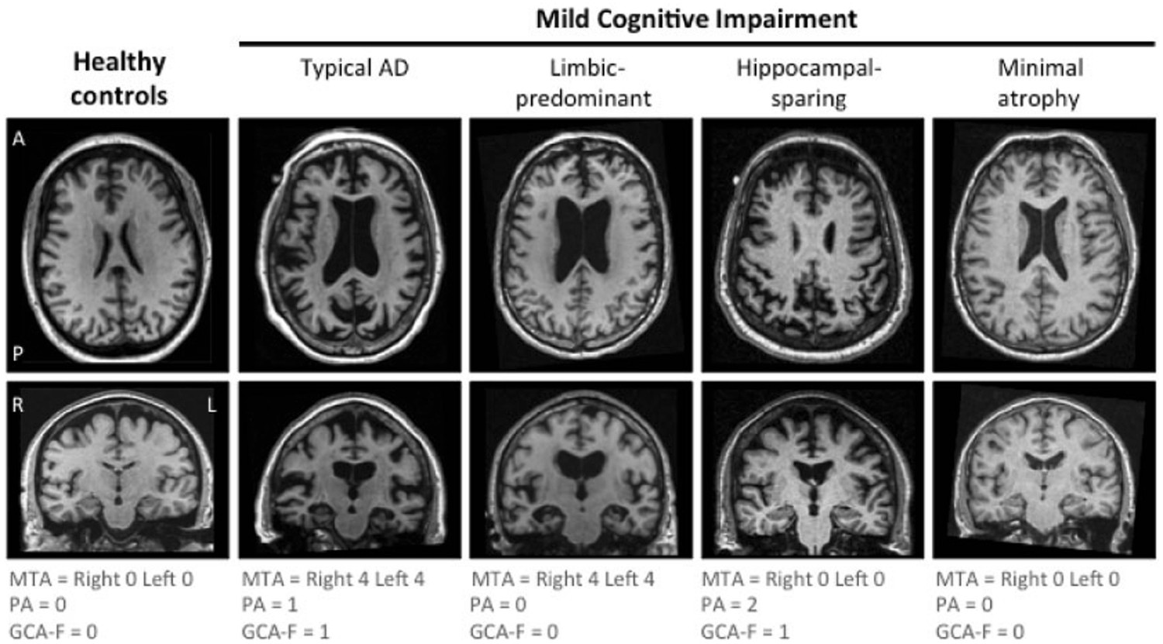
AD Is a Continuum
AD-related pathophysiologic changes begin decades before symptoms appear
Cognitively normal
Mild cognitive impairment
Dementia
10-30 yr
Biomarker changes
Structural changes
Symptoms
Typical AD diagnosis
Opportunity for early diagnosis
Healthy brain
AD-related atrophy
Atri. Med Clin North AM. 2019;103:263. Younes. Front Aging Neurosci. 2019;11:74.
Notes:
AD, Alzheimer’s disease.

Slide 16
How Is AD Currently Defined?
Research-oriented diagnostic criteria consider AD as the presence of biomarkers, with or without clinical symptoms
In clinical settings, biomarker testing can support or refute a diagnosis of AD suspected due to cognitive impairment
 | AA 2024 | IWG 2024
Definition of AD | Biologic (“AD should be defined biologically not based on a clinical syndrome”) | Clinical-biologic (“AD is a clinical-biologic construct”)
Possible implications for the diagnosis in a clinical setting | Presence of any abnormal core 1 AD biomarker (ie, fluid Aβ42/40, p-tau, etc) is sufficient | Presence of objective cognitive deficits and AD biomarkers is needed
 | A biomarker-positive cognitively normal person can be diagnosed with AD | A biomarker-positive cognitively normal person cannot be diagnosed with AD*
Possible implications in diagnostic disclosure of individual’s status | Cognitively normal persons with 1 positive core 1 AD biomarker can be told they have AD | Cognitively normal persons with positive AD biomarker can be told they are at risk for AD*
Possible implications for phase III preventive clinical trials | Biomarkers could be primary endpoints in clinical trials | Biomarkers cannot be primary endpoints in clinical trials
 | Demonstration of efficacy on clinical parameters may not be necessary | Demonstration of efficacy on clinical parameters is necessary
*Except in cases fulfilling the requirements for presymptomatic AD.
Dubois. JAMA Neurol. 2024;81:1304. Jack. Alzheimers Dement. 2024;20:5143.
Notes:
AA, Alzheimer’s Association; AD, Alzheimer’s disease; IWG, International Working Group.

Slide 17
NIA-AA Syndromal Staging of Cognitive Continuum
Cognitively Unimpaired
  Cognitive performance within individual’s expected range, based on clinical judgment and/or on cognitive test performance (although may be impaired/abnormal based on population norms)
  Some may report subjective cognitive decline and/or demonstrate subtle decline on serial cognitive testing
Mild Cognitive Impairment
  Cognitive performance below individual’s expected range,* based on clinical judgment and/or on cognitive test performance (although may be impaired/abnormal based on population norms)
  Must additionally have decline from baseline, reported by the individual, an observer, and/or longitudinal cognitive testing/behavioral assessments
  Performs daily life activities independently but may have detectable mild functional impact on more complex activities
Dementia
  Substantial progressive cognitive impairment* that affects several domains and/or neurobehavioral symptoms, reported by the individual, an observer, and/or longitudinal cognitive testing
  Primary feature differentiating dementia from MCI: Clearly evident functional impact on daily life: no longer fully independent/requires assistance with daily life activities
  May be subdivided into mild, moderate, and severe
*For MCI and dementia: Cognitive impairment may be not present as primarily amnestic, and neurobehavioral changes commonly coexist and may be a prominent part of the presentation.
Jack. Alzheimers Dement. 2018;14:535.
Notes:
MCI, mild cognitive impairment; NIA-AA, National Institute on Aging and the Alzheimer's Association.

Slide 18
What Should Clinical Evaluation Include?
Focused history and neurologic exam
Standard laboratory testing as in dementia
Structural brain imaging (MRI or CT)
Biomarkers?
Cognitive assessment
Screening
MMSE: Lacks precision (identifies general memory or language deficits, not executive functioning) MoCA: More sensitive; assesses memory, visuospatial, executive, and language function, and orientation to time and place Both take ~10 min, no extensive training needed
VS
Neuropsychological testing
Helpful but not always available Expensive Helps predict decline (which cognitive domain[s], degree of abnormality)
Porsteinsson. J Prev Alz Dis. 2021;3:371.
Notes:
MMSE, mini-mental state examination; MoCA, Montreal Cognitive Assessment.

Slide 19
Brain Health in the Primary Care Setting
Include cognitive screening in annual Medicare visit
Incorporate questions into screening when rooming patients
Train medical assistants to administer Mini-Cog, MMSE, or MoCA when rooming patients aged 65 or older
Notes:
MMSE, Mini-Mental State Examination; MoCA, Montreal Cognitive Assessment.

Slide 20
Available AD Biomarkers
FDA-approved AD biomarkers for identification of anti-Aβ treatment candidates
Rapidly emerging and newly validated biomarkers for AD
CSF
Aβ42/40, Aβ42/total tau, or Aβ42/p-tau
Imaging
Elevated Aβ on visual read of PET
Blood
Aβ42:40, p-tau, NfL, or GFAP
Good concordance between CSF and PET for Aβ plaque burden
Tau PET results can support diagnosis and help predict treatment benefit but should not be used in isolation for treatment decision-making
Limitations include invasiveness of CSF collection, lack of access to advanced imaging, and costs of imaging
May be useful for diagnosis and monitoring treatment response
Not yet recommended for use in isolation for treatment decision-making
Must be interpreted within the context of medical history, clinical examination, cognitive testing, and other biomarker results
More cost effective relative to CSF and imaging approaches
Cummings. J Prev Alzheimers Dis. 2022;9:221. Cummings. J Prev Alzheimers Dis. 2023;10:362. Angioni. J Prev Alzheimers Dis. 2022;9:569.
Notes:
Aβ, amyloid-beta; AD, Alzheimer’s disease; CSF, cerebral spinal fluid; GFAP, glial fibrillary acidic protein; NfL, Neurofilament light; PET, positron emission tomography.

Slide 21
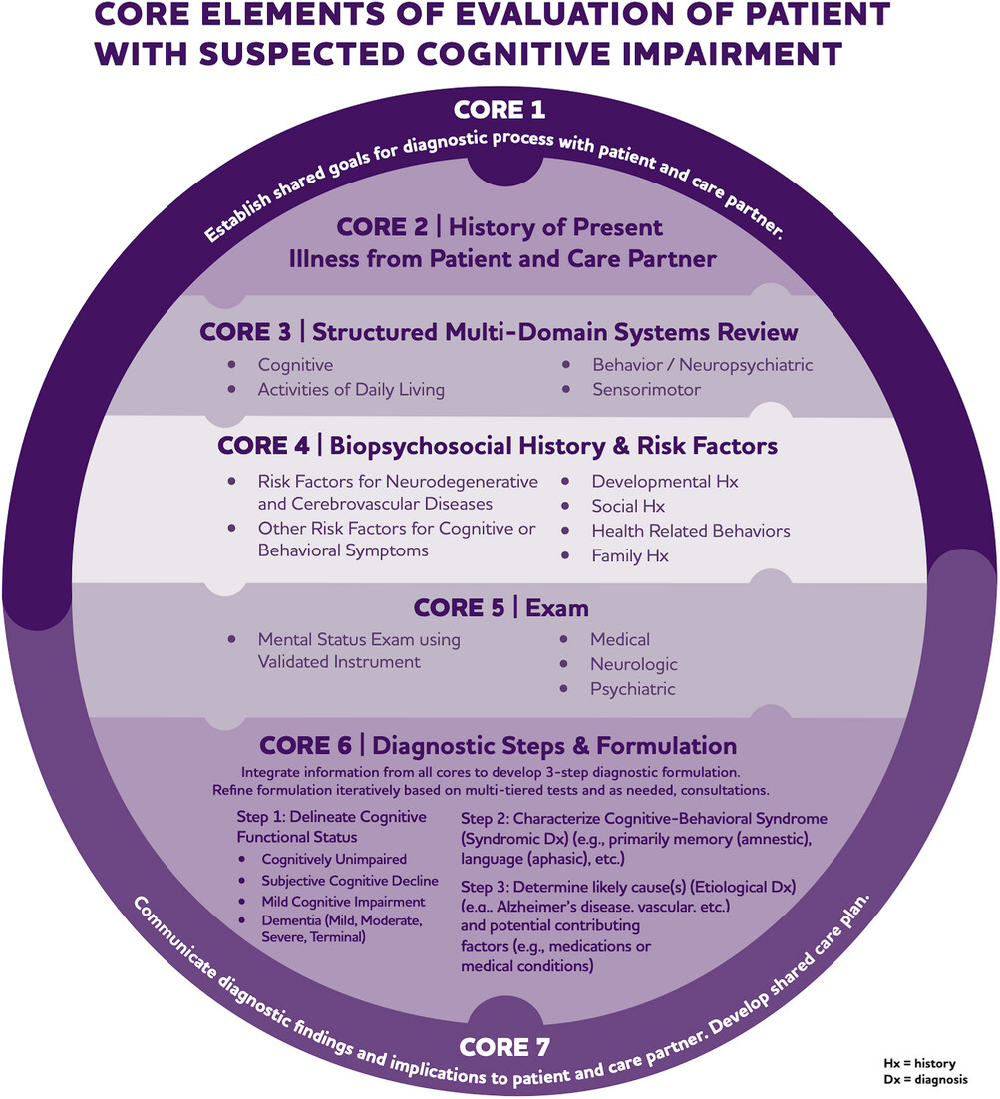
Alzheimer's Association
DETeCD-ADRD Clinical
Practice Guideline 2024
7 core elements comprise a recommended process for patients who may be exhibiting symptoms and/or signs of cognitive impairment due to AD or ADRD
Atri. Alzheimers Dement. 2024:1. CC BY-NC-ND 4.0
Notes:
AD, Alzheimer’s disease; ADRD, Alzheimer’s disease related dementias (including frontotemporal lobar degeneration (FTLD), Lewy body disease (LBD), vascular contributions to cognitive impairment and dementia (VCID), mixed etiology dementias, and others).

Slide 22
How can we influence the development of AD through modifiable risk factors?
Notes:
AD, Alzheimer’s disease.

Slide 23
Modifiable Risk Factors Greatly Contribute to Dementia Risk
Lancet Commission 2024
Modifiable Risk Factors: Actionable conditions across the life course that impact dementia risk
Possible Mechanisms for Reducing Dementia Risk
Address risk factors
Early life
5%: Less education
Reduce diabetes
Manage cholesterol
Minimize hypertension
Stop smoking
Reduce obesity
Reduce air pollution
Prevent head injury
Higher education or continue cognitive activity
Prevent and address hearing loss
Increase social contact
45% of dementia risk is due to modifiable factors
7%: Hearing loss
Prevent or treat depression
Physical activity
Minimize alcohol intake
7%: High LDL cholesterol*
Midlife
3%: Depression
3%: Traumatic brain injury
2%: Physical inactivity
Decrease vascular damage
Reduce dementia neuropathy
Reduce stress and inflammation
Build cognitive and brain reserve
2%: Diabetes
2%: Smoking
2%: Hypertension
1%: Obesity
1%: Excessive alcohol
Late life
5%: Social isolation
Prevent and delay dementia
3%: Air pollution
2%: Visual loss*
*Factors added between 2020 and 2024 Lancet Commission reports.
Livingston. Lancet. 2024;404:572.
Notes:
LDL, low-density lipoprotein.

Slide 24
American Heart Association
2021 Primary Care Agenda for Brain Health
Identified “Life’s Simple 7” in 2017
  Modifiable risk factors to maintain brain health and prevent cognitive decline
  Can emerge before adulthood
  Can be routinely identified and managed by primary care HCPs
6 more factors added in 2021
“Life’s Simple 7” Identified in 2017
Current smoking | Never or quit >12 mo ago
Body mass index | <25 kg/m²
Physical activity | ≥150 min/wk moderate intensity, ≥75 min/wk vigorous intensity, or combination
Healthy Diet Score | 4–5 components*
Total cholesterol | <200 mg/dL†
Blood pressure | <120/<80 mm Hg†
Fasting plasma glucose | <100 mg/dL†
6 Additional Factors Added in 2021
Depression | Sleep disorders
Social isolation | Less education
Excessive alcohol use | Hearing loss
*Components of Healthy Diet Score: Low glycemic load, high cereal fiber, high folate, high marine omega-3 fatty acid, a high ratio of polyunsaturated to saturated fat, low transfat content.
†Untreated values.
Lazar. Stroke. 2021;52:e295.
Notes:
HCP, healthcare professional.

Slide 25
Diet Can Influence Cognitive Decline and AD Pathology
Association of Diet With Cognitive Decline in Seniors
Mediterranean-DASH Diet Intervention for Neurodegenerative Delay (MIND Diet)
0.3
0.2
0.1
0
10 Brain Healthy Food Groups |  | 5 Unhealthy Food Groups
Green leafy vegetables Other vegetables Nuts Berries Beans | Whole grains Seafood Poultry Olive oil Wine | Red meats Butter and stick margarine Cheese Pastries and sweets Fried/fast food
-0.1
Global Cognitive Score
-0.2
N = 960
-0.3
-0.4
MIND Score High
MIND Score Mid
MIND Score Low
-0.5
-0.6
-0.7
0
1
2
3
4
5
6
7
8
9
10
Yr on Study
Association of Diet With AD Pathology at Autopsy
1.0
N = 581
P = .0349
0.9
0.8
Global AD Pathology
(Square Root)
Scored from 0-15 based on higher consumption of healthy foods and lower consumption of unhealthy foods (15 being most healthy)
0.7
0.6
0.5
4
6
8
10
12
MIND Diet Score
Morris. Alzheimers Dementia. 2015;11:1015. Agarwal. Neurology. 2023;100:2259.
Notes:
AD, Alzheimer’s disease.

Slide 26
Lifelong Cognitive Stimulation Reduces Dementia Risk
Meta-analysis of European cohort studies (total N = 107,896) found lower prevalence of dementia associated with high cognitive stimulation at work and/or school over the lifetime
  Effect seen even with >10 yr between assessed cognitive stimulation and age of dementia
Previous studies showed no/low impact of leisure activities and/or cognitive interventions
  Suggests that cumulative duration of cognitive stimulation is key factor
Association of Cognitive Stimulation Over the Life Course With Incident Dementia
Cognitive stimulation
Total population
(n)
Population
with dementia
(n)
Incidence per
10000 person-yr
Education
At work
HR (95% Cl)
Low
Low
High
High
Low
High
Low
High
55540
14005
24984
13367
768
138
162
75
8.1
5.9
4.1
3.5
1 (ref)
0.80 (0.66-0.97)
0.73 (0.61-0.89)
0.63 (0.49-0.82)
0.5
1.0
2.0
Reduced risk
Increased risk
Kivimaki. BMJ. 2021;374:n1804.

Slide 27
Dementia Is Higher in Socially Isolated Individuals
Social participation comprises many aspects:
  Social activity engagement
  Social contact
  Social network
  Social interaction
  Loneliness
  Social support
Linked in large-scale biobank analyses to proteomic signatures of inflammation, antiviral responses, and complement systems impacting CVD, stroke, and mortality
Tied closely to socioeconomic deprivation, so may be most effectively targeted via policy supporting groups at risk
Potential Mechanisms for Influence of Social Participation on Dementia Risk
Predisposing factors
Socioeconomic status
Personality and developmental experience
Social participation
Aging
General cognitive and social cognitive abilities
Cultural factors
Social-ecological environment
Components of social participation
More social activity engagement
More contact with other people
Receiving support from others and reducing loneliness
Mechanisms
Reducing stress and inflammation
Reducing depression
Building cognitive brain reserve
Healthier lifestyle and lower vascular damage
Dementia and cognitive decline
Reducing dementia risk
Sommerlad. Nat Aging. 2023;3:532. Shen. Nature Human Behavior. 2025;[Epub].
Notes:
CVD, cardiovascular disease.

Slide 28
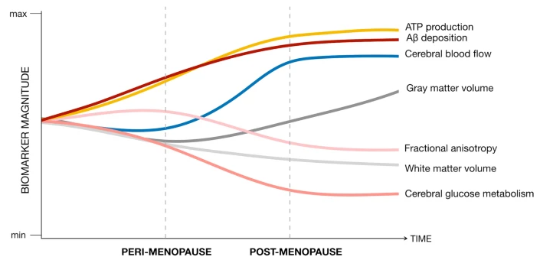
Cognitive Effects of Perimenopause
The perimenopause transition occurs at average age 51 with 1- to 5-yr duration
High variability in circulating levels of 17β-estradiol (may decline steadily or involve high spikes in individual women)
Estrogen receptors involved in numerous neurologic functions
Pronounced decrease in brain glucose metabolism (distinct from effects of aging in matched male cohorts)
Hormonal therapy may ameliorate any of these effects somewhat
Decrease in cognitive performance (memory, learning) associated with perimenopause, with rebound to previous levels in postmenopause
Relevant to AD, Aβ deposition increases
Mosconi. Scientific Reports. 2021;11:10867. Greendale. Neurology. 2009;72:1850. Brinton. Nat Rev Endocrinol. 2015;11:393.
Notes:
Aβ, amyloid-β; AD, Alzheimer’s disease; ATP, adenosine 5′-triphosphate.

Slide 29
What strategies can be used for discussing brain health with patients?

Slide 30
54% Would Want to Know if They Had MCI due to AD
Alzheimer’s Association Survey
Reasons for Seeking Early Diagnosis
Random Sample of 2434 US Adults [27% ≥60 Yr]
Individuals receiving a diagnosis are more likely to:
  Establish a living will or power of attorney
  Reside with an adult child to receive help
  Move from a 1-family home
  Reduce financial responsibilities
Respondents indicated that access to effective DMTs would increase their likelihood of pursuing screening or AD testing
100
80
60
70
70
67
66
Percentage
61
55
54
52
48
40
47
43
20
0
4
It would allow me and my family to plan for the future
It would help rule out reversible causes
It would allow me to participate in clinical trials
It would allow for earlier treatment of symptoms
It would help me understand what is happening
Other reasons
I could begin treatment with new approved medications
I could begin health measures to preserve existing function
I could address safety issues ahead of time
It would allow for better management of other conditions
It would give me more time to assemble medical and caregiving teams
It would encourage me and my family to seek education and support resources
2022 Alzheimer's disease facts and figures. Alzheimers Dement. 2022;18:700.
rand.org/pubs/research_briefs/RBA2643-1.html.
Notes:
AD, Alzheimer’s disease; DMT, disease-modifying therapy; MCI, mild cognitive impairment.

Slide 31
Only 40% Would Talk to Their Doctor About Symptoms Right Away
Alzheimer’s Association Survey
Reasons for Not Seeking Early Diagnosis
Random Sample of 2434 US Adults [27% ≥60 Yr]
Black and Hispanic Americans were less likely to want to know if they have AD at an early stage compared with White Americans
Black, Hispanic, and Asian Americans were twice as likely as White Americans to cite access to healthcare as a concern for seeing a doctor about cognitive symptoms
100
80
60
Percentage
40
34
31
20
28
26
19
17
0
13
10
Treatment for Alzheimer’s disease are limited
People would treat me differently if I were diagnosed
A diagnosis of Alzheimer’s disease might be inaccurate
Diagnosing Alzheimer’s disease would involve a lot of tests
A diagnosis of Alzheimer’s disease would be difficult for me to accept
There is no cure for Alzheimer’s disease, so it doesn’t matter
Diagnostic tests for Alzheimer’s disease may not be covered by insurance
I can manage any problems I would have through lifestyle, diet, or other means
2022 Alzheimer's disease facts and figures. Alzheimers Dement. 2022;18:700.
Notes:
AD, Alzheimer’s disease.

Slide 32
Cost and Financial Concerns Impede Screening
RAND Health and Retirement Study
Concerns of increase in health insurance costs were cited as barriers to testing
Demand for testing and treatment was higher among those with higher income and/or larger support network
Respondents Who Would Undergo Testing at Various Costs
100
90
79.6
77.2
Test cost
$0
$100
$300
80
RAND economists recommend making cognitive testing free of charge (included in regular medical checkups or with financial support)
Annual cognitive checkups have been covered by Medicare since 2011 as part of the annual wellness visit mandated by the Affordable Care Act, but not all HCPs incorporate them
60
54.5
Probability (%)
52.6
50
40
40.1
43.8
30
20
10
0
Cognitive
Assessment
Early-Detection
Test
rand.org/pubs/research_briefs/RBA2643-1.html.
Notes:
HCP, healthcare professional.

Slide 33
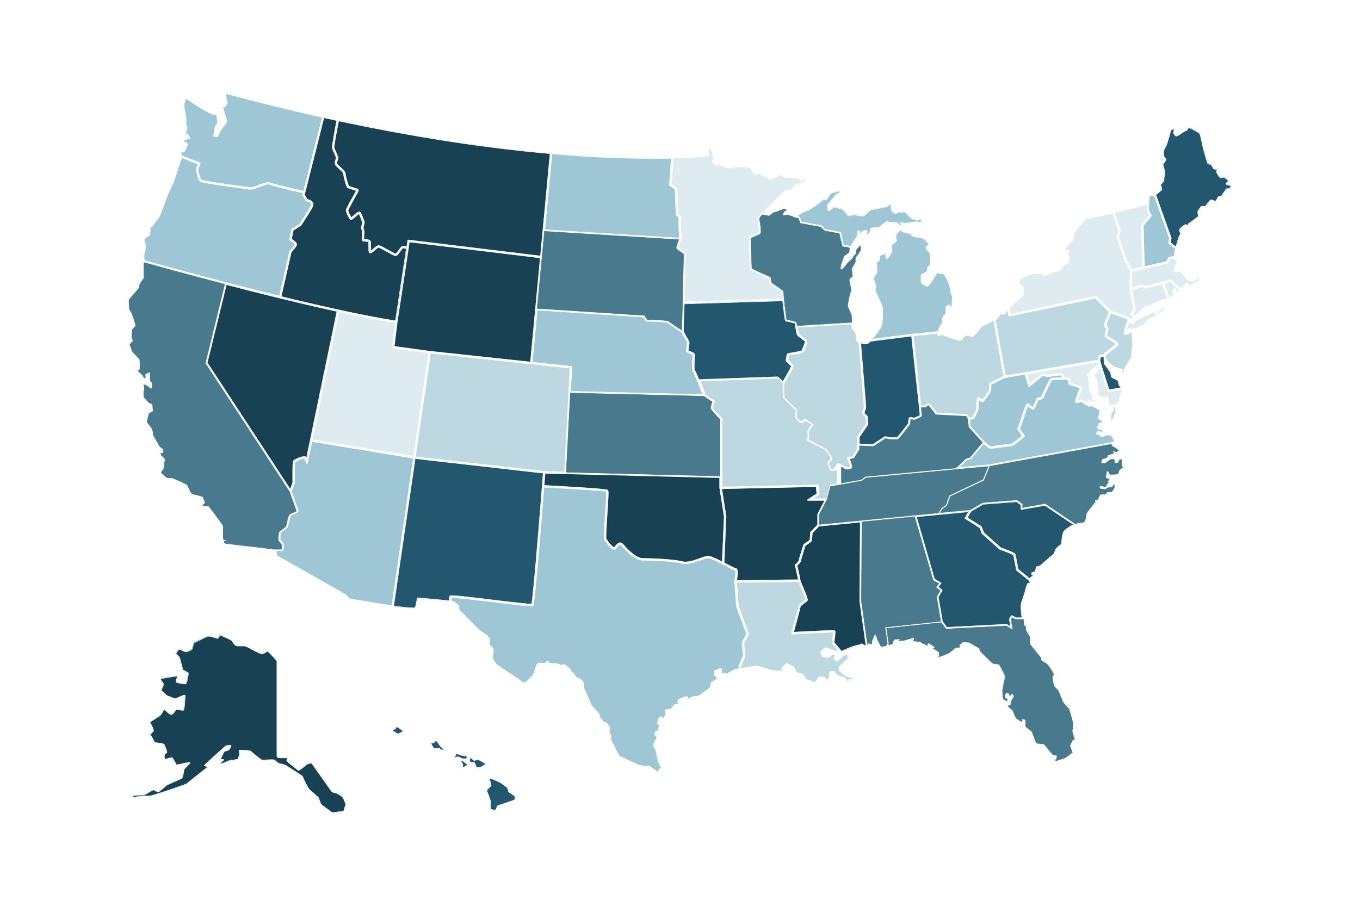
Wait Times for Testing
RAND Simulation Modeling
With current healthcare capacity, wait time to see a dementia specialist averages 18 mo and is about 3x longer in rural vs urban areas
Greater involvement of primary care in diagnosis and treatment could decrease wait times and increase confidence in diagnosis
Wait Time to See Dementia Specialist
Estimated Impact of Increased Primary Care Involvement in Triage and Diagnosis
57%
22%
Blood biomarkers in primary care
Diagnosis and treatment management by PCP or specialist
-36%
-57%
Average Wait for Treatment (Mo)
Percentage Change in Number Treated
Percentage Change in Average Wait Time
12-44
44-57
57-62
62-70
70-84
>84
rand.org/pubs/research_briefs/RBA2643-1.html.
Notes:
PCP, primary care provider.

Slide 34
Implementation of Brain Health Discussions in Practice
Integration Into Routine Patient Visits
Communication Strategies
  Recommended screening frequency:
    Every 1-5 yr beginning in early adulthood
  Practice settings for discussions:
    Primary care
    Neurology
    Psychiatry
    OB/GYN
  Embed questions about cognition within the standard medical review of systems
  Use patient-centered communication approaches
  Incorporate family members when appropriate
  Focus on positive lifestyle modifications
  Link brain health to overall wellness
Liss. J Intern Med. 2021;290:310. Baranowski. Appl Physiol Nutr Metab. 2020;45:1055.

Slide 35
Go Online for More CCO
Coverage of Brain Health!
Downloadable slides of all the key data presented today
On-demand webcast to revisit today’s expert-led discussion and key learnings (coming soon!)
ClinicalThought commentaries featuring expert perspectives in preventing cognitive decline
Text modules offering expert-informed strategies in improving patient care (coming soon!)
clinicaloptions.com

