Slide 1
PADMA: ET + Palbociclib vs Standard Chemotherapy in High-Risk HR+/HER2- MBC
CCO Independent Conference Coverage*
of the 2024 San Antonio Breast Cancer Symposium,
December 10-13, 2024; San Antonio, Texas
*CCO is an independent medical education company that provides state-of-the-art medical information to healthcare professionals through conference coverage and other educational programs.
Provided by Clinical Care Options, LLC
Supported by educational grants from Lilly, Merck Sharp & Dohme LLC, and Novartis Pharmaceuticals Corporation.
Notes:
ET, endocrine therapy; HR, hormone receptor; MBC, metastatic breast cancer.

Slide 2

About These Slides
Please feel free to use and share some or all of these slides in your noncommercial presentations to colleagues or patients
When using our slides, please retain the source attribution:
These slides may not be published, posted online, or used in commercial presentations without permission. Please contact permissions@clinicaloptions.com for details
Slide credit: clinicaloptions.com
Notes:
Disclaimer: The materials published on the Clinical Care Options website reflect the views of the authors of the CCO material, not those of Clinical Care Options, LLC, the CME providers, or the companies providing educational grants. The materials may discuss uses and dosages for therapeutic products that have not been approved by the United States Food and Drug Administration. A qualified healthcare professional should be consulted before using any therapeutic product discussed. Readers should verify all information and data before treating patients or using any therapies described in these materials.

Slide 3
PADMA: Background
For patients with HR+/HER2- MBC, international guidelines suggest first-line treatment with ET plus CDK4/6 inhibitor¹⁻³
Because of lacking prospective data comparing SoC chemotherapy with ET, many patients with HR+/HER2- MBC received chemotherapy as first-line treatment before this trial was initiated^{4,5}
PADMA: a prospective, randomized phase IV trial comparing first-line treatment with a CDK4/6 inhibitor plus ET vs SoC single-agent chemotherapy with or without maintenance ET in patients with high-risk MBC⁶
Current analysis reports on TTF in patients with HR+/HER2- MBC with an indication for chemotherapy in the first-line setting treated in the PADMA trial⁷
1. Gennari. Ann Oncol. 2021;32:1475. 2. Sukhun. JCO Global Oncol. 2024;10:e23000285. 3. Cardoso. Breast. 2024;76:103756.
4. Yuan. Ann Transl Med. 2021;9:831. 5. Werutsky. Clin Breast Cancer. 2021;21:e688. 6. NCT03355157. 7. Loibl. SABCS 2024. Abstr LB1-03.
Notes:
ET, endocrine therapy; HR, hormone receptor; MBC, metastatic breast cancer; OS, overall survival; PFS, progression-free survival; SoC, standard of care; TTF, time to treatment failure.

Slide 4
PADMA: Study Design
Prospective, open-label, multicenter, randomized phase IV trial
Primary endpoint: TTF*
Key secondary endpoints: PFS, OS, safety, tolerability, and treatment compliance
Stratified by endocrine resistant vs sensitive and symptomatic vs asymptomatic metastatic disease
Men and women with HR+/HER2- MBC and an indication for single-agent CT; no previous tx for metastatic/relapsed disease; no asymptomatic bone-only oligometastases; no untreated CNS metastases; >6 mo life expectancy
(N = 150)
ET + Palbociclib
(n = 61)
ET + palbociclib: AI or fulvestrant
± GnRH agonist
ET maintenance: tamoxifen, AI, or fulvestrant ± GnRH agonist
Single-agent chemotherapy: paclitaxel, capecitabine, epirubicin, or vinorelbine
Physician’s Choice CT
± ET Maintenance Therapy
(n = 59)
*Time to discontinuation due to progression, toxicity, patient preference, or death.
NCT03355157. Loibl. SABCS 2024. Abstr LB1-03.
Notes:
AI, aromatase inhibitor; CNS, central nervous system; CT, chemotherapy; ET, endocrine therapy; GnRH, gonadotropin-releasing hormone; HR, hormone receptor; MBC, metastatic breast cancer; OS, overall survival; PFS, progression-free survival; TTF, time to treatment failure; tx, treatment.

Slide 5
PADMA: Baseline Characteristics
Characteristic | Palbociclib + ET (n = 61) | CT Based (n = 59) | Overall (n = 120)
Median age, yr (range) | 63 (42-85) | 62 (31-80) | 62 (31-85)
Postmenopausal status, n (%) | 54 (88.5) | 52 (88.1) | 106 (88.3)
Liver metastases, n (%) | 28 (45.9) | 22 (37.3) | 50 (41.7)
Endocrine resistant,* n (%) | 17 (27.9) | 21 (35.6) | 38 (31.7)
Metastasis at initial diagnosis, n (%) | 20 (33.3) | 24 (40.7) | 44 (37.0)
Prior (neo)adjuvant CT, n (%) | 29 (47.5) | 25 (42.4) | 54 (45.0)
HER2-low (IHC 1-2),† n (%) | 41 (73.2) | 30 (58.8) | 71 (66.4)
Pathogenic variants in tissue,‡ n (%) PIK3CA BRCA1/2 ESR1 | 11 (18.0) 3 (4.9) 1 (1.6) | 16 (27.1) 4 (6.8) 1 (1.7) | 27 (22.5) 7 (5.8) 2 (1.7)
*According to clean data; defined as relapse on or within 12 mo after ending adjuvant ET.
†From metastasis (n = 47); otherwise from initial diagnosis if available (n = 24).
‡n = 81.
Loibl. SABCS 2024. Abstr LB1-03.
Notes:
CT, chemotherapy; ET, endocrine therapy; IHC, immunohistochemistry.

Slide 6
PADMA: Treatment Exposure (as Treated)
Parameter | Palbociclib + ET (N = 62) | CT (N = 59)
Chemotherapy of physicians’ choice, n (%) Capecitabine Paclitaxel Vinorelbine | -- -- -- | 40 (69.0) 17 (29.3) 1 (1.7)
Received ET maintenance post CT, n (%) | -- | 13 (22.4)
Type of ET, n (%) Aromatase inhibitor Tamoxifen Fulvestrant | 48 (77.4) -- 14 (22.6) | 9 (15.5) 3 (5.2) 1 (1.7)
Median duration of palbociclib or CT, wk (range) | 51.0 (1.0-322.0) | 19.5 (2.0-122.0)
Loibl. SABCS 2024. Abstr LB1-03.
Notes:
CT, chemotherapy; ET, endocrine therapy.

Slide 7

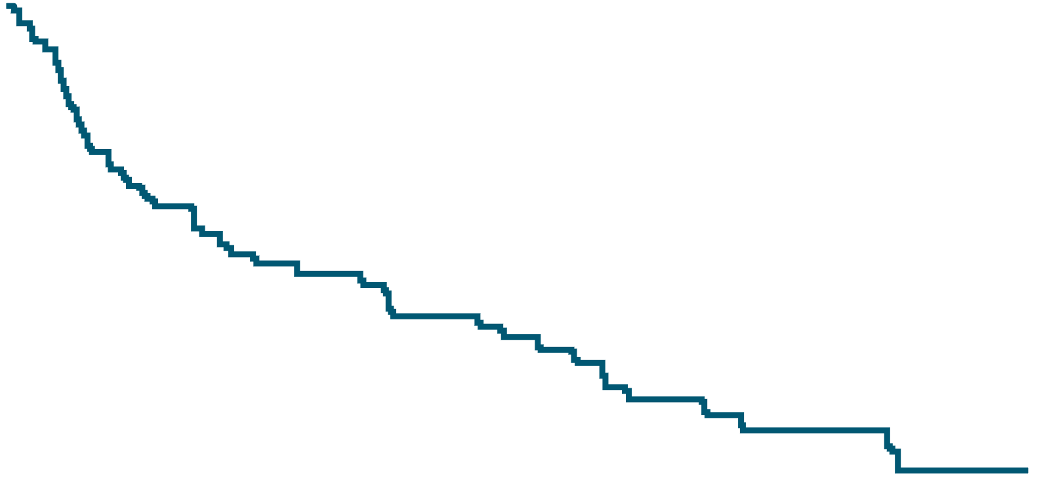
PADMA: TTF (Primary Endpoint)
100
 | Palbociclib + ET (n = 61) | CT (n = 59)
TTF events, n (%) | 45 (73.8) | 55 (93.2)
Median TTF, mo | 17.2 | 6.1
 | Hazard ratio: 0.46 (95% CI: 0.31-0.69); P < .001
90
80
70
60
+
+
50
+
Treatment Failure Rate (%)
+
+
40
+
30
Median follow-up: 36.8 mo (range: 0-74.4)
+
+
+
20
+
+
+
+
10
0
+
0
6
12
18
24
30
36
42
48
TTF (Mo)
CT based
Palbo + ET
59
61
31
41
10
30
6
26
5
21
3
13
2
8
1
6
1
2
Loibl. SABCS 2024. Abstr LB1-03. Reproduced with permission.
Notes:
CT, chemotherapy; ET, endocrine therapy; Palbo, palbociclib; TTF, time to treatment failure.

Slide 8
PADMA: TTF in Subgroups
Subgroup | Patients, n | Hazard Ratio (95% CI) | P Value
Overall | 120 | 0.461 | < .001
Response to ET Hormone resistant Hormone sensitive | 38 82 | 0.590 0.430 | .162 .001
Symptoms Symptomatic Asymptomatic | 54 66 | 0.527 0.399 | .036 .003
Liver metastases No Yes | 70 50 | 0.469 0.353 | .007 .003
Patient Subgroup | Patients, n | Hazard Ratio | P Value
No. of systems with metastases 1/2 >2 | 75 45 | 0.359 0.642 | < .001 .170
Metastasis at primary diagnosis M0 M1 | 76 44 | 0.417 0.481 | .001 .042
Prior CT in early BC No Yes | 66 54 | 0.603 0.293 | .073 < .001
HR status in ER positive ER+, PgR- ER+, PgR+ | 25 94 | 0.553 0.412 | .192 < .001
Loibl. SABCS 2024. Abstr LB1-03.
Notes:
BC, breast cancer; CT, chemotherapy; ER, estrogen receptor; ET, endocrine therapy; PgR, progesterone receptor; TTF, time to treatment failure.

Slide 9
PADMA: PFS and OS (Secondary Endpoints)
PFS | Palbociclib + ET (n = 61) | CT (n = 59)
Events, n (%) | 40 (65.6) | 50 (84.7)
Median PFS, mo | 18.7 | 7.8
Hazard ratio (95% CI) P value | 0.45 (0.29-0.70) <.001
OS | Palbociclib + ET (n = 61) | CT (n = 59)
Events, n (%) | 25 (41.0) | 24 (40.7)
Median OS, mo | 46.1 | 36.8
 | Proportional hazard not assumed
Loibl. SABCS 2024. Abstr LB1-03.
Notes:
CT, chemotherapy; ET, endocrine therapy; OS, overall survival; PFS, progression-free survival.

Slide 10
PADMA: Safety Summary
TRAEs, n (%) | Palbociclib + ET (n = 62) |  | CT Based (n = 58)
 | Any Grade | Grade 3/4 | Any Grade | Grade 3/4
Any TRAE | 60 (96.8) | 37 (59.7) | 55 (94.8) | 16 (27.6)
Any hematologic TRAE | 60 (96.8) | 34 (54.8) | 34 (58.6) | 4 (6.9)
Any nonhematologic TRAE | 51 (82.3) | 12 (19.4) | 54 (93.1) | 13 (22.4)
Treatment-related serious AE | 7 (11.3) | 5 (8.1) | 6 (10.3) | 6 (10.3)
Treatment-related death* | 1 (1.6) | -- | 0 | --
*Septic shock.
Hematologic AEs more commonly experienced in the palbociclib plus ET arm vs CT arm (P <.001), whereas nonhematologic AEs were similar
Loibl. SABCS 2024. Abstr LB1-03.
Notes:
AE, adverse event; CT, chemotherapy; TRAE, treatment-related adverse event.

Slide 11
PADMA: Investigators’ Conclusions
PADMA met its primary endpoint, showing a significant and clinically meaningful improvement in both TTF and PFS for first-line ET + palbociclib vs single-agent CT in high-risk HR+/HER2- MBC with a chemotherapy indication
  Median TTF: 17.2 vs 6.1 mo (hazard ratio: 0.46; 95% CI: 0.31-0.69; P <.001)
  Median PFS: 18.7 vs 7.8 mo (hazard ratio: 0.45; 95% CI: 0.29-0.70; P <.001)
At a median follow-up of 36.8 mo, a numerical trend for improved median OS was observed (46.1 vs 36.8 mo) in favor of palbociclib + ET vs single-agent chemotherapy
The safety profile was as expected
Investigators conclude that these results support international guidelines recommending ET + CDK4/6 inhibitor as SoC first-line therapy for HR+/HER2- MBC
Loibl. SABCS 2024. Abstr LB1-03.
Notes:
CT, chemotherapy; ET, endocrine therapy; HR, hormone receptor; MBC, metastatic breast cancer; OS, overall survival; PFS, progression-free survival; SoC, standard of care; TTF, time to treatment failure.

Slide 12
Go Online for More CCO
Coverage of SABCS 2024!
Capsule Summaries of all the key data
Additional CME-certified analysis with expert faculty commentary on key studies from the conference
clinicaloptions.com

