Slide 1
OpACIN-neo and PRADO: Effect of
Response-Directed Treatment Personalization on Survival After Neoadjuvant Immune Checkpoint Blockade in Stage III Melanoma
CCO Independent Conference Highlights*
of the 2023 ASCO Annual Meeting, June 2-6, 2023, Chicago, Illinois
*CCO is an independent medical education company that provides state-of-the-art medical information to healthcare professionals through conference coverage and other educational programs.
Supported by educational grants from Merck Sharp & Dohme Corp. and Regeneron Pharmaceuticals, Inc.

Slide 2

About These Slides
Please feel free to use and share some or all of these slides in your noncommercial presentations to colleagues or patients
When using our slides, please retain the source attribution:
These slides may not be published, posted online, or used in commercial presentations without permission. Please contact permissions@clinicaloptions.com for details
Slide credit: clinicaloptions.com
Notes:
Disclaimer: The materials published on the Clinical Care Options website reflect the views of the authors of the CCO material, not those of Clinical Care Options, LLC, the CME providers, or the companies providing educational grants. The materials may discuss uses and dosages for therapeutic products that have not been approved by the United States Food and Drug Administration. A qualified healthcare professional should be consulted before using any therapeutic product discussed. Readers should verify all information and data before treating patients or using any therapies described in these materials.

Slide 3
OpACIN-neo and PRADO: Background
Neoadjuvant immunotherapy induces pathologic responses that are associated with favorable relapse-free survival rates in patients with high-risk stage III melanoma¹
OpACIN-neo trial evaluated the activity and safety of various neoadjuvant regimens of ipilimumab + nivolumab followed by TLND without adjuvant systemic therapy²
PRADO is an extension of the OpACIN-neo trial that evaluated a personalized approach of using pathologic response following neoadjuvant immunotherapy for further treatment decisions³
Current analysis of OpACIN-neo and PRADO reports the impact of TLND on
long-term survival in patients with stage III melanoma achieving major pathologic response after neoadjuvant immunotherapy and the impact on survival of adjuvant systemic therapy in patients with pathologic nonresponse⁴
1. Menzies. Nat Med. 2021;27:301. 2. Versluis. Ann Oncol. 2023;34:420.
3. Reijers. Nat Med. 2022;28:1178. 4. Reijers. ASCO 2023. Abstr 101.
Notes:
TLND, therapeutic lymph node dissection.

Slide 4
OpACIN-neo and PRADO: Study Design
OpACIN-neo: randomized, multicenter, open-label phase II trial
Primary endpoints:
OpACIN-neo: grade 3/4 irAEs within first 12 wk, RR* at Wk 6, pRR at Wk 6
PRADO: pRR in marked index lymph node and
RFS at 24 mo
Stage IIIB/C de novo or recurrent melanoma; measurable dx*; WHO PS ≤1; no prior IO or RT
(N = 86)
IPI 3 mg/kg IV + NIVO 1 mg/kg IV
2 cycles Q3W (n = 30)
TLND
1:1:1
IPI 1 mg/kg IV + NIVO 3 mg/kg IV
2 cycles Q3W (n = 30)
TLND
Follow-up
IPI 3 mg/kg IV (Q3W) → NIVO 3 mg/kg IV (Q2W)
2 cycles each (n = 26)
TLND
PRADO: nonrandomized, open-label extension of OpACIN-neo study
Marked
index
node
resection
MPR
(≤10% viable tumor)
No
TLND
Follow-up
CT + ultrasound Q12W
Stage IIIB/C de novo or recurrent melanoma; measurable dx*; WHO PS 0/1; no prior IO or RT
(N = 99)
IPI 1 mg/kg IV
+
NIVO 3 mg/kg IV
2 cycles Q3W
pPR
(>10 to ≤50% viable tumor)
TLND
Follow-up
CT Q12W
pNR
(>50% viable tumor)
TLND
NIVO or DAB + TRAM
(if BRAF+) ± RT
Follow-up CT Q12W
*By RECIST 1.1.
Reijers. ASCO 2023. Abstr 101. Versluis. Ann Oncol. 2023;34:420. NCT02977052.
Notes:
DAB, dabrafenib; dx, diagnosis; IO, immunotherapy; IPI, ipilimumab; irAE, immune-related adverse event; MPR, major pathologic response; NIVO, nivolumab; pNR, pathologic nonresponse; pPR, pathologic partial response; pRR, pathologic response rate; PS, performance status; RECIST, Response Evaluation Criteria in Solid Tumors; RFS, relapse-free survival; RR, response rate; RT, radiotherapy; TLND, therapeutic lymph node dissection; TRAM, trametinib.

Slide 5
OpACIN-neo and PRADO: Baseline Characteristics
Characteristic | MPR Group |  | pNR Group
Characteristic, % | TLND (n = 53) | No TLND (n = 59) | No Adjuvant ST (n = 23) | Adjuvant ST (n = 17)
Median age, yr (range) | 60 (20-85) | 60 (35-83) | 53 (18-82) | 50 (19-72)
Male sex, n (%) | 35 (66) | 42 (71) | 8 (35) | 11 (65)
T-stage, n (%)* 1-2 3-4 Tx MUP | 29 (55) 9 (17) 0 15 (28) | 26 (44) 24 (41) 0 9 (15) | 7 (30) 8 (35) 0 8 (35) | 7 (41) 7 (41) 1 (6) 2 (12)
With ulceration, n (%) | 11 (21) | 13 (22) | 5 (22) | 5 (29)
Median sum of target lesion (range) | 23 (14-70) | 25 (14-73) | 24 (14-64) | 24 (15-90)
BRAF^{V600E}/K positive, n (%) | 19 (36) | 21 (36) | 9 (40) | 7 (41)
TMB high, n (%) | 21 (40) | 26 (44) | 7 (30) | 3 (18)
IFNγ high, n (%) | 19 (36) | 23 (39) | 4 (17) | 2 (12)
PD-L1 status, n (%) >50% 1%-50% <1% | 4 (7.5) 16 (30) 20 (38) | 7 (12) 18 (31) 20 (34) | 3 (13) 3 (13) 14 (61) | 0 2 (12) 9 (53)
*P = .017 for TLND vs no TLND in MPR group.
Reijers. ASCO 2023. Abstr 101.
Notes:
IFN, interferon; MPR, major pathologic response; MUP, melanoma of unknown primary; pNR, pathologic nonresponse; ST, systemic therapy; TLND, therapeutic lymph node dissection; TMB, tumor mutational burden.

Slide 6
OpACIN-neo and PRADO: Pathologic Response Rates
n = 1
n = 1
100
n = 2
n = 6
22% pNR
21% pNR
Not evaluable
Distant metastasis
pNR (≥50 viable tumor)
pPR (>10 - ≤50% viable tumor)
MPR (≤10% viable tumor)
80
14% pPR
11% pPR
60
61% MPR
Pathologic response (%)
60% MPR
40
20
0
OpACIN-neo
(n = 86)
pRR 74%
PRADO
(n = 99)
pRR 72%
Reijers. ASCO 2023. Abstr 101. Reproduced with permission.
Notes:
MPR, major pathologic response; pNR, pathologic nonresponse; pPR, pathologic partial response; pRR, pathologic response rate.

Slide 7
OpACIN-neo and PRADO: Survival Outcomes in
Patients Who Achieved MPR ± TLND
RFS
DMFS
98%
100
96%
96%
100
98%
93%
93%
98%
98%
80
80
60
60
Relapse-free survival (%)
Distant metastasis-free survival (%)
40
40
20
20
Log-rank P = .47
Log-rank P = .92
0
0
0
6
12
18
24
30
36
0
6
12
18
24
30
36
Patients at Risk, n
TLND
No TLND
Time from surgery (months)
Patients at Risk, n
TLND
No TLND
Time from surgery (months)
53
59
53
57
51
56
51
55
51
55
51
50
50
32
53
59
53
59
51
59
51
59
51
58
51
53
50
33
Reijers. ASCO 2023. Abstr 101. Reproduced with permission.
Notes:
DMFS, distant metastasis‒free survival; MPR, major pathologic response; RFS, relapse-free survival; TLND, therapeutic lymph node dissection.

Slide 8
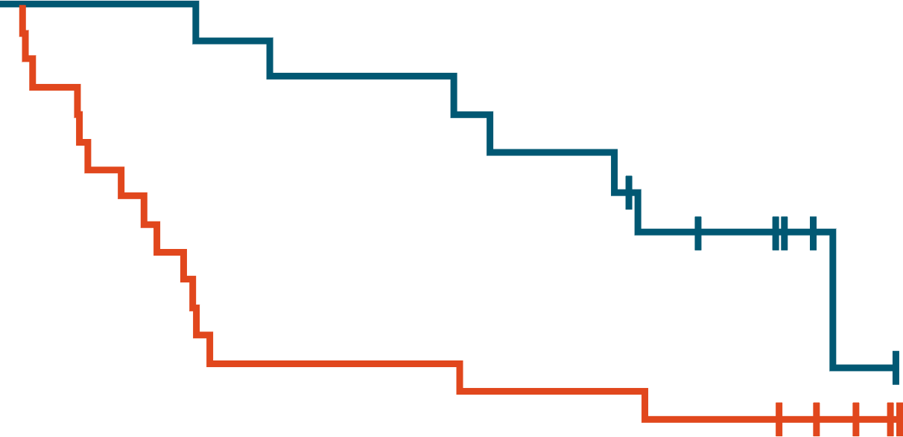
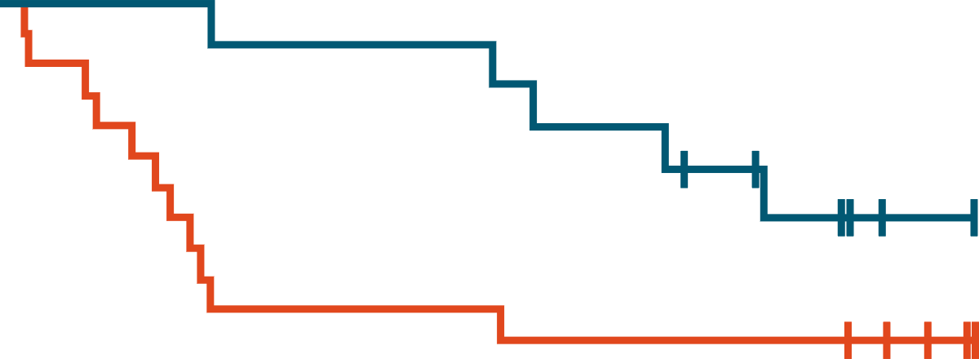
OpACIN-neo and PRADO: Survival Outcomes in
Patients With pNR ± Adjuvant Systemic Therapy
RFS
DMFS
100
100
82%
80
77%
80
70%
64%
60
60
Relapse-free survival (%)
Distant metastasis-free survival (%)
52%
52%
40
40
39%
35%
20
20
Log-rank P = .10
Log-rank P = .24
0
0
0
6
12
18
24
30
36
0
6
12
18
24
30
36
Patients at Risk, n
Adj ST
No Adj ST
Time from surgery (months)
Patients at Risk, n
Adj ST
No Adj ST
Time from surgery (months)
17
23
17
16
16
10
15
10
13
9
10
8
4
7
17
23
17
18
16
13
16
13
14
12
12
12
5
11
Reijers. ASCO 2023. Abstr 101. Reproduced with permission.
Notes:
Adj, adjuvant; DMFS, distant metastasis‒free survival; pNR, pathologic nonresponse; RFS, relapse-free survival; ST, systemic therapy.

Slide 9
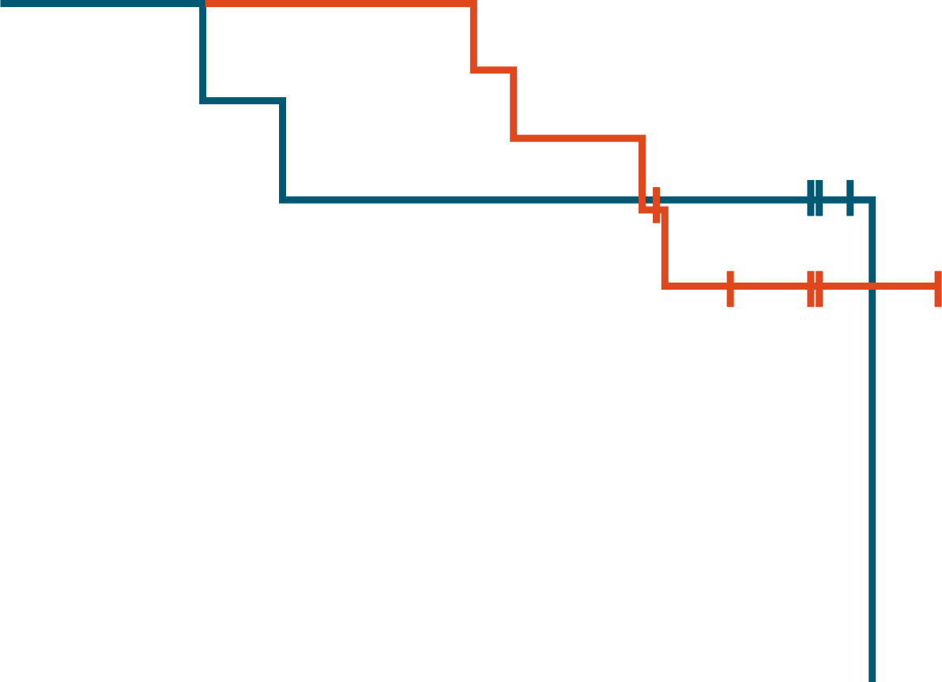

OpACIN-neo and PRADO: Survival Outcomes in Patients With pNR by Adjuvant PD-1 Inhibitor or BRAF/MEK Inhibitor Therapy
RFS
DMFS
100
100
86%
86%
80%
80
71%
80
80%
60
71%
60
Relapse-free survival (%)
Distant metastasis-free survival (%)
56%
58%
40
40
20
20
Log-rank P = .78
Log-rank P = .13
0
0
0
6
12
18
24
30
36
0
6
12
18
24
30
36
Patients at Risk, n
DAB + TRAM
NIVO
Time from surgery (months)
Patients at Risk, n
DAB + TRAM
NIVO
Time from surgery (months)
10
7
10
7
10
6
10
5
8
5
5
5
2
2
10
7
10
7
10
6
10
6
8
6
6
6
2
3
BRAF+ patients received DAB + TRAM; BRAF- patients received NIVO.
Reijers. ASCO 2023. Abstr 101. Reproduced with permission.
Notes:
DAB, dabrafenib; DMFS, distant metastasis‒free survival; NIVO, nivolumab; pNR, pathologic nonresponse; RFS, relapse-free survival; TRAM, trametinib.

Slide 10
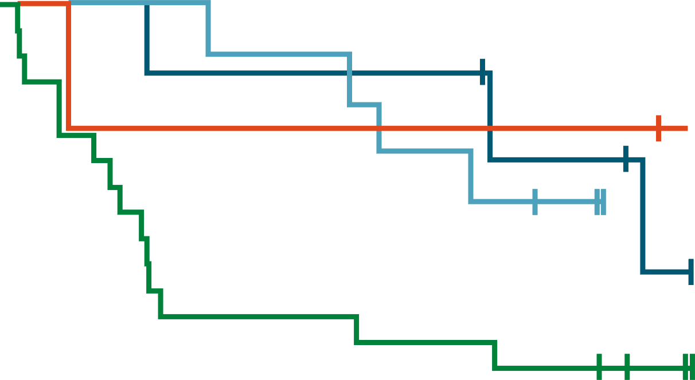
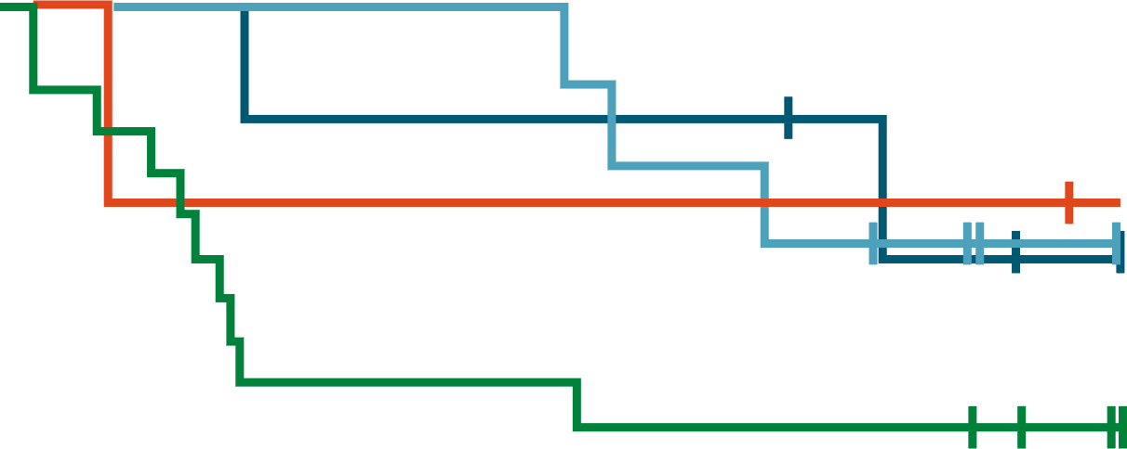
OpACIN-neo and PRADO: Survival Outcomes in
Patients With pNR ± Adjuvant Systemic Therapy and RT
RFS
DMFS
100
Adj ST only
100
86%
86%
75%
Adj ST only
80%
80
Adj ST + RT
75%
69%
80
Adj ST + RT
75%
Adj RT only
70%
Adj RT only
75%
60
60
70%
Relapse-free survival (%)
60%
Distant metastasis-free survival (%)
69%
No Adj
40
40
47%
47%
No Adj
32%
20
26%
20
0
0
0
6
12
18
24
30
36
0
6
12
18
24
30
36
Patients at Risk, n
Adj ST+/RT+
Adj ST+/RT-
Adj ST-/RT+
Adj ST-/RT-
Time from surgery (months)
Patients at Risk, n
Adj ST+/RT+
Adj ST+/RT-
Adj ST-/RT+
Adj ST-/RT-
Time from surgery (months)
7
10
4
19
7
10
3
13
6
10
3
7
6
9
3
7
6
7
3
6
4
6
3
5
4
0
3
4
7
10
4
19
7
10
3
15
6
10
3
10
6
10
3
10
6
8
3
9
5
7
3
9
4
1
3
8
Reijers. ASCO 2023. Abstr 101. Reproduced with permission.
Notes:
Adj, adjuvant; DMFS, distant metastasis‒free survival; pNR, pathologic nonresponse; RFS, relapse-free survival; RT, radiotherapy; ST, systemic therapy.

Slide 11
OpACIN-neo and PRADO: Investigators’ Conclusions
Omission of TLND in patients with high-risk melanoma who achieve a major pathologic response to neoadjuvant IPI + NIVO does not appear to affect survival outcomes
  These patients are unlikely to derive further benefit from adjuvant systemic therapy use
Adjuvant systemic therapy improved survival outcomes for patients who achieved a pathologic nonresponse following neoadjuvant immune checkpoint inhibitor therapy
  For these patients, adjuvant anti‒PD-1 blockade may lead to more favorable survival outcomes compared with adjuvant BRAF/MEK inhibition
Investigators concluded that adjuvant radiotherapy may be beneficial to patients
who are ineligible to receive adjuvant systemic therapy, such as patients with
BRAF wild-type stage III melanoma who are experiencing high-grade irAEs following neoadjuvant immune checkpoint inhibitor therapy
Reijers. ASCO 2023. Abstr 101.
Notes:
IPI, ipilimumab; irAE, immune-related adverse event; NIVO, nivolumab; TLND, therapeutic lymph node dissection.

Slide 12
Go Online for More CCO
Coverage of ASCO 2023!
Capsule Summaries of all the key data
Additional CME/CE-certified analyses with expert faculty commentary on key studies in:
Breast cancer
Gastrointestinal cancers
Gynecologic cancers
Hematologic malignancies
Lung cancer
Skin cancer
clinicaloptions.com

