Slide 1

Redefining the Future of PDAC: Preparing for RAS(ON)-Targeted Therapies
Provided by Clinical Care Options, LLC dba Decera Clinical Education.
Supported by an educational grant from Revolution Medicines, Inc.

Slide 2
About These Slides
Please feel free to use and share some or all of these slides in your noncommercial presentations to colleagues or patients
When using our slides, please retain the source attribution:
Slide credit: deceraclinical.com/education
These slides may not be published, posted online, or used in commercial presentations without permission. Please contact permissions@deceraclinical.com for details
Notes:
Disclaimer: The materials published on the Decera Clinical Education website reflect the views of the authors of the Decera Clinical Education material, not those of Decera Clinical Education, the CME providers, or the companies providing educational grants. The materials may discuss uses and dosages for therapeutic products that have not been approved by the FDA. A qualified healthcare professional should be consulted before using any therapeutic product discussed. Readers should verify all information and data before treating patients or using any therapies described in these materials.

Slide 3
Faculty
Christopher Lieu, MD, FASCO
Professor of Medicine
Division of Medical Oncology
University of Colorado Cancer Center
Aurora, Colorado
Wungki Park, MD, MS
Assistant Attending, Gastrointestinal Oncology Service
Member, David M. Rubenstein Center for Pancreatic Cancer Research
Assistant Professor of Medicine, Weill Cornell Medical College
Memorial Sloan Kettering Cancer Center
New York, New York

Slide 4
Disclosures
The faculty reported the following relevant financial relationships or relationships to products or devices they have with ineligible companies related to the content of this educational activity:
Christopher Lieu, MD, FASCO: researcher (paid to institution): Genentech, Janssen; consultant/advisor/speaker: Pfizer.
Wungki Park, MD, MS: researcher: Astellas, Lepu Bio, Merck; consultant/advisor/speaker: Astellas, Curio, EPICS, Expert Pharma, Innovent Biologics, Integrity, KeyQuest, Regeneron, Revolution Medicines; other financial or material support: Amgen, DAVA Oncology.

Slide 5
Brief Overview of Therapeutic Needs in PDAC

Slide 6
Pancreatic Cancer Incidence Is Rising
57,500
Estimated new cases: Both sexes
Estimated new cases: Male
Estimated new cases: Female
Estimated deaths: Both sexes
Estimated deaths: Male
Estimated deaths: Female
52,500
47,500
42,500
37,500
Number
32,500
27,500
22,500
ACS Pancreatic Cancer USA 2026:
67,530 cases
52,740 deaths
17,500
12,500
2001
2002
2003
2004
2005
2006
2007
2008
2009
2010
2011
2012
2013
2014
2015
2006
2017
2018
2019
2020
Hu. World J Gastroenterol. 2021;27:4298. ACS. Cancer Stat Facts: Pancreatic Cancer. 2026.

Slide 7
Prognosis of Pancreatic Adenocarcinoma
All PDAC is high risk
(lowest survival of any cancer type by organ)
Majority of PDAC is unresectable/metastatic at diagnosis
100
100
All races
White
Black
All races
White
Black
80
80
60
60
5-Yr Survival (%)
Stage Distribution (%)
47
46
48
44
43
40
40
40
28
28
27
20
16
16
16
13
12
20
15
15
15
11
11
11
10
3
3
3
0
0
Localized
Regional
Distant
All stages
Localized
Regional
Distant
All stages
Siegel. CA Cancer J Clin. 2024;74:12.

Slide 8
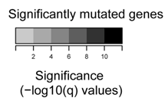
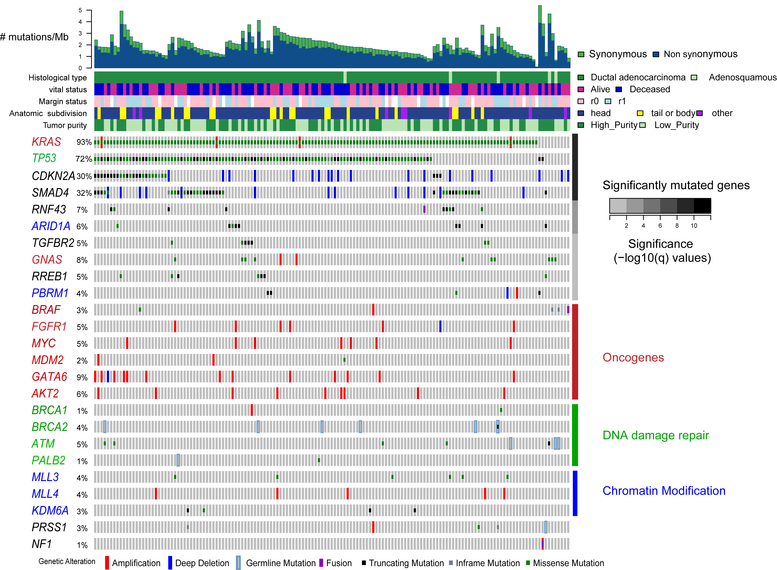
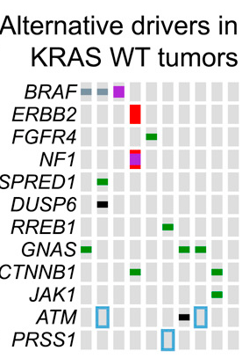
Molecular Pathogenesis of PDAC
TCGA: genomic, transcriptomic, and proteomic profiling of 150 resected (stage I-III) PDAC specimens
Most common somatic mutations: KRAS, TP53, CDKN2A, SMAD4
Non-KRAS drivers: BRAF, HER2, GNAS, CTNNB1
DDR: 11%
dMMR: 2% to 3%
Predicted pathogenic germline mutations in 8% of patients: BRCA2, ATM, PALB2, PRSS1
Cancer Genome Atlas Research Network. Cancer Cell. 2017;32:185.

Slide 9




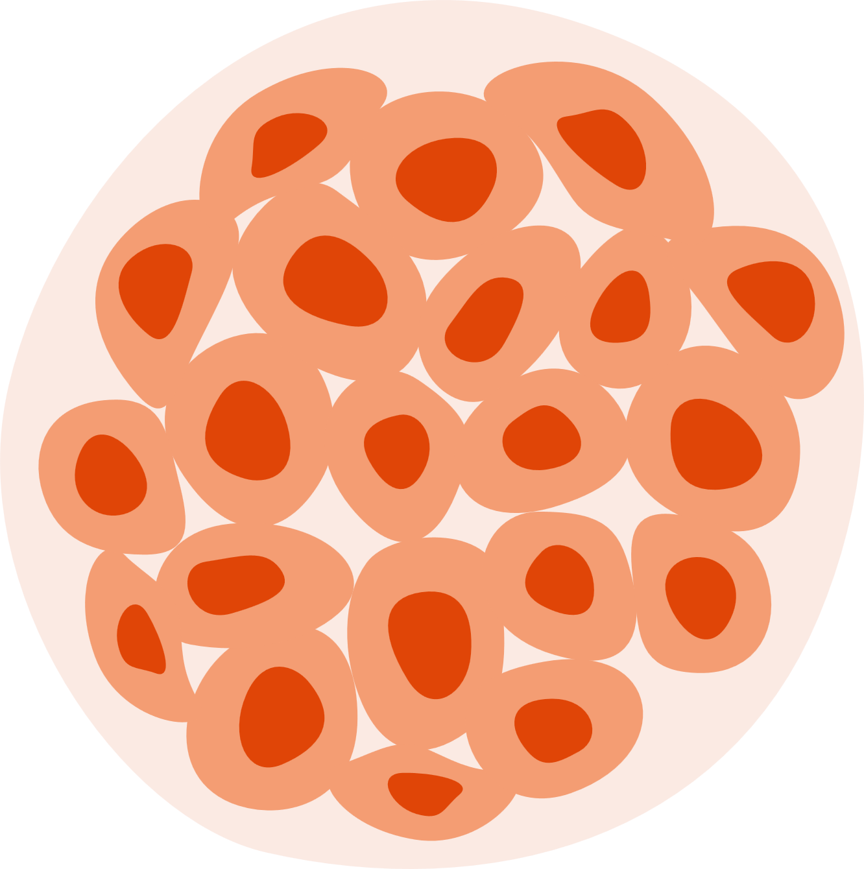
Genetic and Biomarker Testing Are Critical
Germline
Testing
or
(All patients)
(preferred)
Tumor
Testing
or
(At least advanced patients)
(preferred)

Slide 10
KRAS Mutations and PDAC

Slide 11
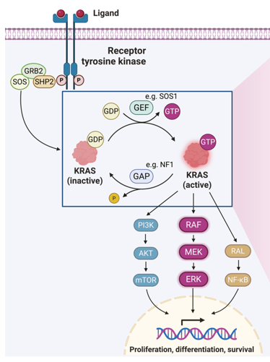
KRAS: Biology
3,400,000 patients are diagnosed with RAS-mutated cancer each year
Mutated RAS preferentially signals through the RAF pathway
Awad. NEJM. 2021;344:2382. Tanaka. Cancer Discov. 2021:11:1913.
Riedl. Cancer Cell. 2026;44:471. https://creativecommons.org/licenses/by/4.0/.

Slide 12
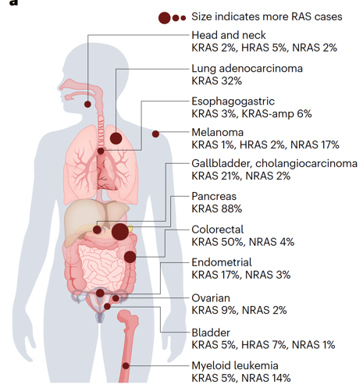
KRAS: Distribution and Prognosis
Lung
adenocarcinoma
G12C
G12D
G12V
G12A/S
G12R
G13X
Q61X
Others
OS
1.0
G12C
G12D
G12V
G12R
WT
Other
0.8
Colorectal Cancer
0.6
Survival Probability
0.4
0.2
0
0
10
20
30
40
50
60
70
Pancreatic Cancer
Time Since Start of First-line Therapy (Mo)
KRAS mutations portend worse prognosis in PDAC
Norton. JAMA Netw Open. 2025;8:e2453588. Singhal. Nat Med. 2024;30:969.

Slide 13
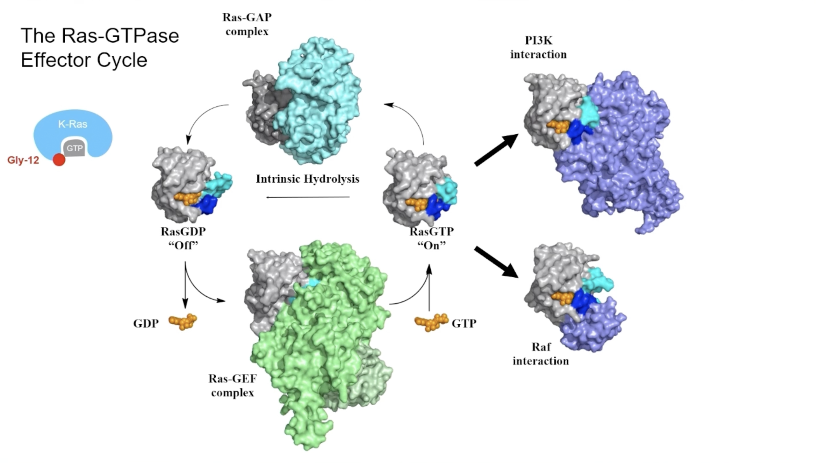
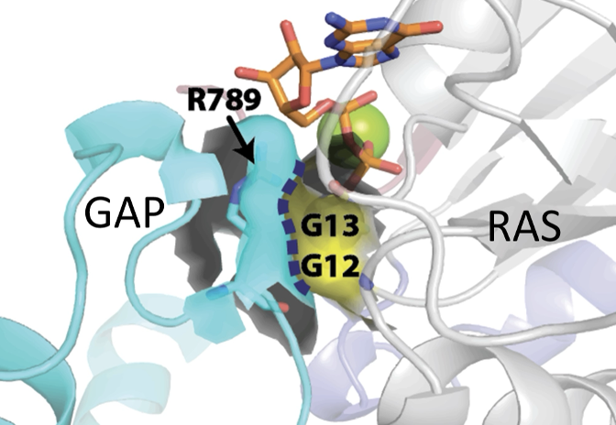
The RAS-GTPase Effector Cycle
100
80
60
^{K}hydrolysis 10-⁵ (per s)
40
20
0
WT
G12A
G12C
G12D
G12R
G12V
G13D
Q61L
Q61H
Not all KRAS mutations are equally locked ON
Scheffzek. Science. 1997;277:333. Hunter. Mol Cancer Res. 2015;13:1325.

Slide 14
Chemotherapy for Metastatic PDAC

Slide 15
PRODIGE 4-ACCORD 11: 1L FOLFIRINOX vs Gemcitabine for mPDAC
Phase III study of FOLFIRINOX vs gemcitabine for patients with untreated metastatic pancreatic cancer who were <76 yr of age and had ECOG PS 0/1 (N = 342)
100
Median OS, Mo
100
Median PFS, Mo
FOLFIRINOX
Gemcitabine
11.1
6.8
FOLFIRINOX
Gemcitabine
6.4
3.3
75
75
HR: 0.57 (95% CI: 0.45-0.73; P <.001)
HR: 0.47 (95% CI: 0.37-0.59; P <.001)
OS (%)
50
50
PFS (%)
25
25
0
0
0
3
6
9
12
15
18
21
24
27
30
33
36
39
42
0
3
6
9
12
15
18
21
24
27
30
33
36
Mo
Mo
Conroy. NEJM. 2011;364:1817.
Notes:
15

Slide 16
MPACT: 1L Gemcitabine + Nab-Paclitaxel vs Gemcitabine for mPDAC
Phase III study of gemcitabine + nab-paclitaxel vs gemcitabine in patients with metastatic pancreatic cancer, no previous treatment for metastatic disease, KPS ≥70 (N = 861)
Median OS, Mo
Median PFS, Mo
100
Gemcitabine + nab-paclitaxel
Gemcitabine
8.5
6.7
100
Gemcitabine + nab-paclitaxel
Gemcitabine
5.5
3.7
80
HR: 0.72 (95% CI: 0.62-0.83; P <.001)
80
HR: 0.69 (95% CI: 0.58-0.82; P <.001)
60
60
OS (%)
PFS (%)
40
40
20
20
0
0
0
3
6
9
12
15
18
21
24
27
30
33
36
39
0
3
6
9
12
15
18
21
24
Mo
Mo
Von Hoff. NEJM. 2013;369:1691.

Slide 17
NAPOLI 3: 1L NALIRIFOX vs Nab-Paclitaxel + Gemcitabine for mPDAC
Phase III study of liposomal irinotecan + 5-FU + leucovorin + oxaliplatin vs gemcitabine + nab-paclitaxel for patients with metastatic pancreatic cancer, no previous treatment for metastatic disease (N = 770)
Arm
NALIRIFOX
Gem + Nab-P
Median (95% CI)
7.4 (6.0-7.7)
5.6 (5.3-5.8)
HR (95% CI)
0.69 (0.58-0.83)
P Value
<.0001
Arm
NALIRIFOX
Gem + Nab-P
Median (95% CI)
11.1 (10.0-12.1)
9.2 (8.3-10.6)
HR (95% CI)
0.83 (0.70-0.99)
P Value
.04
100
100
80
80
60
60
PFS (%)
OS (%)
40
40
20
20
0
0
0
2
4
6
8
10
12
14
16
18
20
22
24
0
2
4
6
8
10
12
14
16
18
20
22
24
26
28
30
Time (Mo)
Time (Mo)
Wainberg. Lancet. 2023;402:1272.

Slide 18
Key Trials of First-line Treatment for mPDAC
Regimens | ORR (%) | OS (Mo)
FOLFIRINOX vs Gem | 31.6 vs 9.4 | 11.1 vs 6.8
Gem/Nab-P vs Gem | 23 vs 7 | 8.5 vs 6.7
NALIRIFOX vs Gem/Nab-P | 42 vs 36 | 11.1 vs 9.2
FOLFIRINOX vs Gem/Nab-P | 29 vs 30 | 8.5 vs 9.7
FOLFIRINOX vs Gem/Nab-P | 32.4 vs 35.4 | 14.0 vs 17.1
Conroy. NEJM. 2011;364:1817. Von Hoff. NEJM. 2013;369:1691. Wainberg. Lancet. 2023;402:1272. Knox. JCO. 2025;43:3355.
Ohba. JCO. 2025;43:3345.

Slide 19
Targeted Therapy for Metastatic PDAC

Slide 20
POLO: Maintenance Olaparib vs Placebo After First-line Platinum-Based Therapy in Metastatic Pancreatic Cancer
Randomized, double-blind phase III trial of olaparib vs placebo in patients with metastatic pancreatic cancer and deleterious/suspected deleterious germline BRCA1/2 mutation, ≥16 wk of first-line platinum-based therapy without progression (4-8 wk from last dose) (N = 154)
3315 patients screened; 247 had germline BRCA mutation (7.5%)
100
 | Olaparib (n = 92) | Placebo (n = 62)
Median OS, mos | 19.0 | 19.2
HR (95% CI) | 0.83 (0.56-1.22; P = .3487)
80
60
OS (%)
40
33.9%
20
Olaparib (n = 92)
Placebo (n = 62)
17.8%
0
0
2
4
6
8
10
12
14
16
18
20
22
24
26
28
30
32
34
36
38
40
42
44
46
48
50
52
54
56
58
60
62
64
66
68
Mo
Golan. NEJM. 2019;381:317. Kindler. JCO. 2022;40:3929.

Slide 21
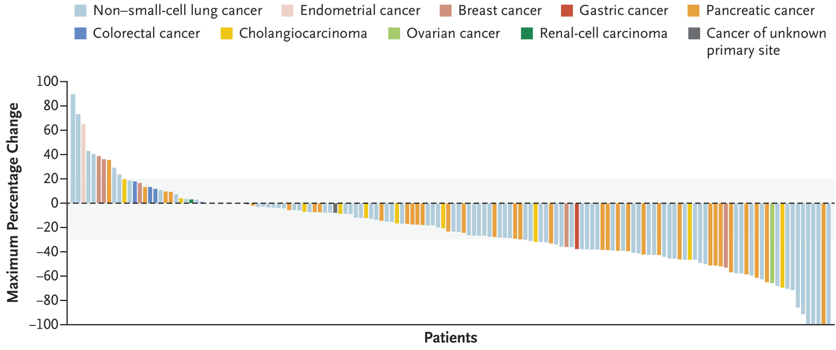

Zenocutuzumab (Bispecific HER2/HER3-Targeted Antibody) for mPDAC
eNRGy: phase II study of zenocutuzumab for patients with advanced NRG1 fusion–positive solid tumors who were not candidates for standard therapy (N = 204)
FDA accelerated approval for adults with advanced, unresectable, or metastatic pancreatic adenocarcinoma with a NRG1 gene fusion with disease progression on or after prior systemic therapy
Schram. NEJM. 2025;392:566.

Slide 22
Targeting KRAS G12C in mPDAC: Sotorasib
CodeBreaK100: phase I/II trial of sotorasib for patients with locally advanced or metastatic KRAS p.G12C–mutant solid tumors previously receiving ≥1 systemic therapy or intolerant or ineligible for available therapies (mPDAC cohort, n = 38)
Confirmed Best Objective Response
Objective Response
Best Overall Response
100
60
Partial Response
Stable Disease
Progressive Disease
70
63
40
60
24/38
20
50
0
40
Percentage From Baseline
Percentage of Patients
-20
30
21
95% CI, 10-37
21
-40
20
8/38
13
-60
8/38
10
5/38
-80
0
0
Partial or
complete response
Complete response
Partial response
Stable disease
Progressive disease
-100
Patients
Strickler. NEJM. 2023;388:33. Strickler. ASCO Plenary 2022. Abstr 360490.

Slide 23
Targeting KRAS G12C in mPDAC: Adagrasib
KRYSTAL-1: phase I/II trial of adagrasib for patients with KRAS p.G12C mutation–positive unresectable or metastatic solid tumors who had progressed on standard of care or who had no available standard of care
Outcome, n (%) | PDAC (n = 10) | Other GI Cancers (n = 17) | Overall GI Cancers (n = 27)
ORR | 5 (50) | 6 (35) | 11 (41)
Best overall response
CR | 0 (0) | 0 (0) | 0 (0)
PR | 5 (50) | 6 (35) | 11 (41)
SD | 5 (50) | 11 (65) | 16 (59)
DCR | 10 (100) | 17 (100) | 27 (100)
Best Tumor Change From Baseline (PDAC, n = 10)
20
0
SD
SD
-20
Maximum % Change From Baseline
SD
SD
PR
-40
PR
PR
SD
-60
PR
PR
-80
Bekaii-Saab. ASCO GI 2022. Abstr 519.

Slide 24
Targeted Therapies for PDAC
Alteration | Incidence (%) | Targeted Therapies
Germline BRCA1/2 mutation | 4-7 | Olaparib (PARPi)
MSI-H/dMMR | 1-2 | Pembrolizumab (tissue-agnostic approval)
NTRK fusion | <1 | Larotrectinib, entrectinib, or repotrectinib (tissue-agnostic approvals)
BRAF V600E mutation | 2-3 | Dabrafenib/trametinib (tissue-agnostic approval)
RET fusion | <1 | Selpercatinib (tissue-agnostic approval)
HER2 positive | 1-7 | Trastuzumab deruxtecan (tissue-agnostic approval)
NRG1 fusion | ~1 | Zenocutuzumab
KRAS G12C mutation | 1-2 of KRAS mutations | Sotorasib or adagrasib (off label)
NGS recommended for all metastatic PDAC
NCCN. Clinical practice guidelines in oncology: pancreatic adenocarcinoma. v.1.2026. nccn.org.
Reiss. ASCO Educational Book. 2025;45:e473204.

Slide 25
From RAS Biology to RAS Therapeutics

Slide 26
Why This Matters Now
Historically undruggable
Now multiple classes entering clinic
KRAS mutated in ~95% PDAC

Slide 27
Multi-Allele Targeting: Pan-RAS Inhibitors

Slide 28
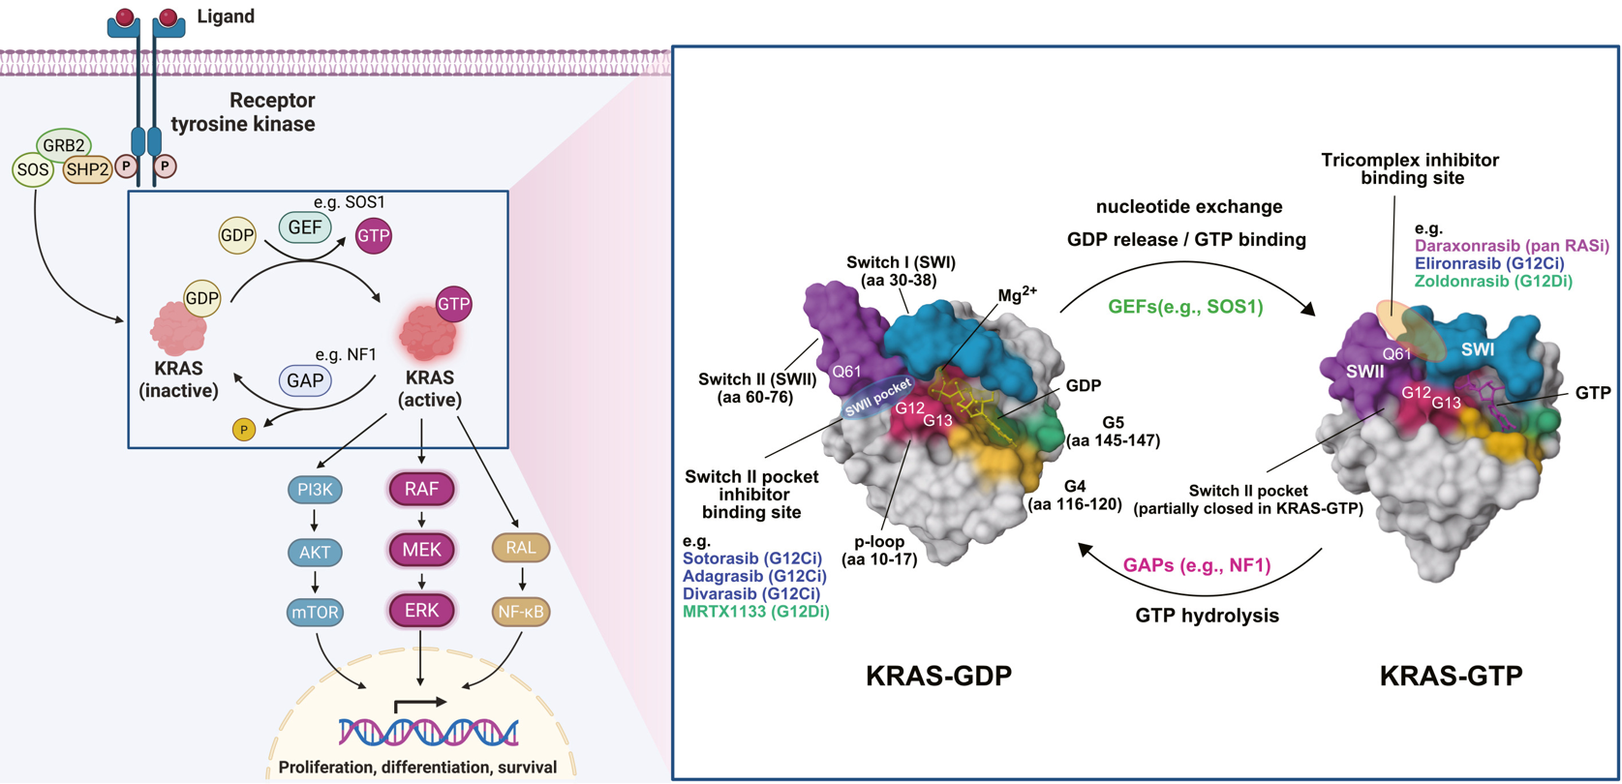
How to Think About RAS-Targeted Therapy in PDAC in 2026
Riedl. Cancer Cell. 2026;44:471. https://creativecommons.org/licenses/by/4.0/.

Slide 29
Off-State vs On-State, Allele-Specific vs Pan-KRAS/RAS Inhibition
Mutant-selective on-state inhibitor
Tricomplex mutant-selective on-state inhibitors
GDP
GTP
GTP
KRAS^{G12C}
KRAS^{G12C}
KRAS^{G12D}
RMC-4998
Zoldonrasib
BB0-8520
CypA
CypA
GTP
KRAS^{G12C}
Tricomplex RAS multi-on-state inhibitor
GTP
GTP
RAS^{WT}
RAS^{Mut}
Daraxonrasib
Mutation-selective degrader
Pan-KRAS “off-state” degrader
Setidegrasib
ACBI3
Ub
E2
Ub
E2
E3 ligase
VHL
KRAS^{G12D}
KRAS^{G12D}
26S proteasome
GTP
26S proteasome
Adapted from Cox. Science. 2024;385:1274.
Riedl. Cancer Cell. 2026;44:471.

Slide 30
Why Pan-RAS Matters: Different RAS Alleles Account for 95% of KRAS Mutations in PDAC
G12D
n = 892
KRAS variant
G12D
G12V
G12R
40
100
G12V
n = 706
G12D 40%
30
G12V 30%
75
Pan-RAS
P = .061
Prevalence (%)
G12R
n = 352
P = .003
20
50
OS (%)
G12R 15%
Q61H
n = 111
G12C 1%
10
25
Other
n = 70
G12C
n = 26
Q61R
n = 37
Q61 6%
0
0
Prevalence KRAS variants
98% KRAS substitutions G12 (91%), Q61 (7%)
G12R vs G12D (smoking 40% vs 55%)
0
12
24
36
48
60
72
84
Time From Sample Collection (Mo)

Slide 31
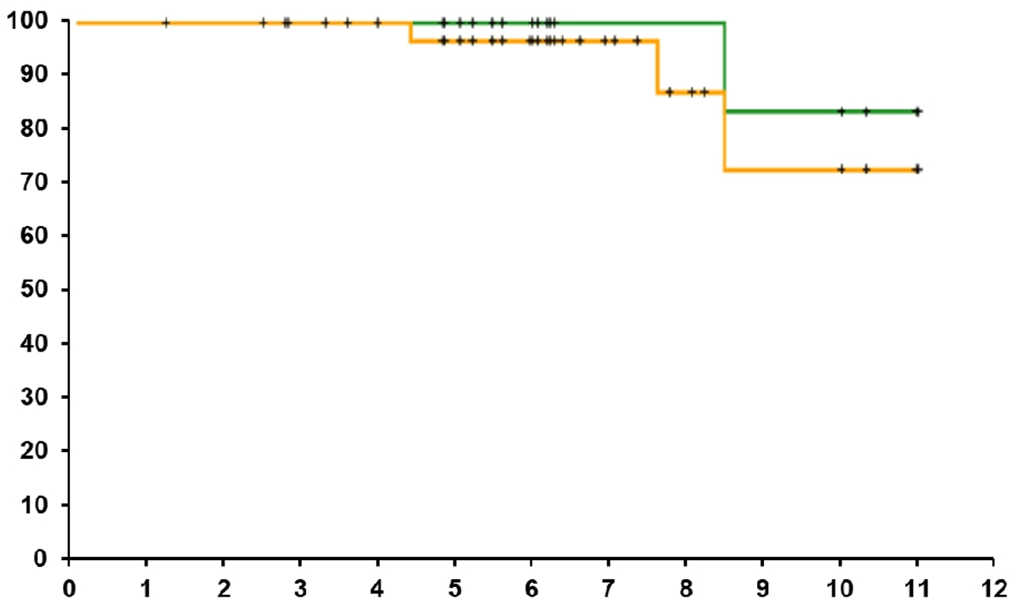
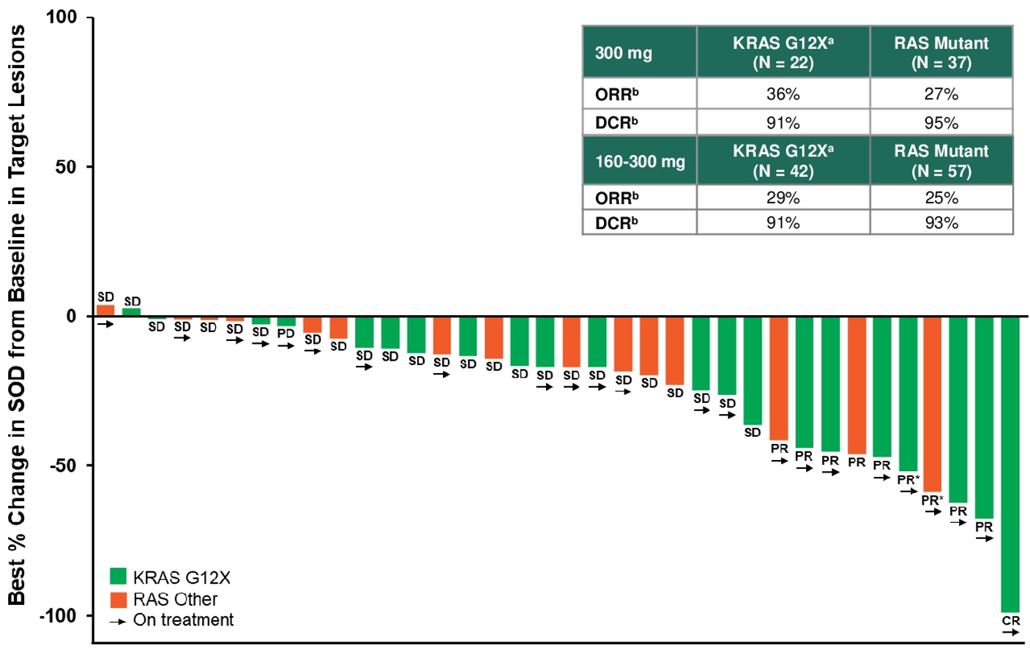
Daraxonrasib for Previously Treated Advanced PDAC With
KRAS G12 Mutations
Phase I/II study of daraxonrasib (RMC-6236) for patients with advanced solid tumors with KRAS G12 mutations (current report includes patients with previously treated PDAC treated with varied doses in dose escalation/optimization/expansion cohorts)
Outcome (300 mg), % | KRAS G12X (n = 22) | RAS Mutant (n = 37)
ORR | 36% | 27%
DCR | 91% | 95%
Outcome (160-300 mg), %
ORR | 29% | 25%
DCR | 91% | 93%
KRAS G12X
Outcome (300 mg) | KRAS G12X (n = 22) | RAS Mutant (n = 37)
Median PFS, mo | 8.8 | 8.5
Median OS, mo | NE | NE
6-mo OS, % | 100 | 97
Outcome (160-300 mg)
Median PFS, mo | 8.5 | 7.6
Median OS, mo | 14.5 | 14.5
6-mo OS, % | 89 | 91
RAS Mutant
OS (%)
Best Change in SOD From Baseline in Target Lesions (%)
KRAS G12X
RAS Other
On treatment
Mo
Garrido-Laguna. ASCO GI 2025. Abstr 722. NCT05379985.

Slide 32
Daraxonrasib: Safety
TRAEs, n (%) | 160-300 mg (N = 127) |  | 300 mg (n = 76)
 | Any Grade | Grade ≥3 | Any Grade | Grade ≥3
Any | 124 (98) | 37 (29) | 73 (96) | 26 (34)
Occurring in ≥15% of patients
Rash | 115 (91) | 10 (8) | 69 (91) | 6 (8)
Diarrhea | 61 (48) | 3 (2) | 40 (53) | 3 (4)
Nausea | 54 (43) | 0 (0) | 29 (38) | 0 (0)
Vomiting | 39 (31) | 0 (0) | 27 (36) | 0 (0)
Stomatitis | 39 (31) | 4 (3) | 26 (34) | 3 (4)
Fatigue | 25 (20) | 1 (1) | 12 (16) | 1 (1)
Paronychia | 17 (13) | 0 (0) | 10 (13) | 0 (0)
Mucosal inflammation | 16 (13) | 1 (1) | 13 (17) | 1 (1)
Other select TRAEs
Anemia | 11 (9) | 7 (6) | 6 (8) | 5 (7)
ALT increased | 10 (8) | 3 (2) | 5 (7) | 3 (4)
AST increased | 9 (7) | 2 (2) | 4 (5) | 1 (1)
Neutrophil count decreased | 7 (6) | 2 (2) | 5 (7) | 2 (3)
Garrido-Laguna. ASCO GI 2025. Abstr 722. NCT05379985.

Slide 33
Learning From CRC (BEACON and BREAKWATER): Earlier Line and Chemo Combinations to Prevent Polygenic Resistance
BEACON (Previously Treated)
BREAKWATER (1L)
Regimen | Median OS, mo | HR vs SOC | HR vs EC + mFOLFOX6
EC + mFOLFOX6 | 30.3 | 0.49 (P <.001) | --
EC | 19.5 | 0.69 | 1.45
SOC | 15.1 | -- | --
Median OS, Mo (95% CI)
9.3 (8.0-11.3)
5.9 (5.1-7.1)
1.0
Encorafenib + cet
IRI/FOLFIRI + cet
0.8
HR: 0.61 (95% CI: 0.48-0.77)
100
0.6
Probability of Survival
80
0.4
60
Estimated Percentage
of Patients Alive
0.2
40
EC+mFOLFOX6
EC
Standard Care
20
0
0
3
6
9
12
15
18
21
24
27
0
Mo
0
6
12
18
24
30
36
42
Mo
Tabernero. JCO. 2021;39:273. Elez. NEJM.. 2025;392:2425.

Slide 34
Randomized Phase III Studies With Daraxonrasib
1° Endpoint(s)
PFS, OS in RAS G12X–mutant population
RASolute 302
Daraxonrasib 300 mg QD
Adults with mPDAC previously treated with 5-FU or gem-based regimen in metastatic setting; documented RAS mutation status
(planned N = 501)
Investigator’s choice CT
(Gem/nab-paclitaxel, mFOLFIRINOX, nal-IRI/5-FU/LV, FOLFOX)
RASolute 303
Daraxonrasib
Adults with mPDAC, no prior treatment in metastatic setting; documented RAS mutation status
(planned N = 900)
Daraxonrasib + Gem/nab-paclitaxel
PFS, OS
Gem/nab-paclitaxel
NCT06625320. Wolpin. ASCO 2025. Abstr TPS4230. NCT07491445.

Slide 35
Randomized Phase III Studies With Daraxonrasib
1° Endpoint(s)
DFS
RASolute 304
Adjuvant Daraxonrasib
Adults with PDAC with successful (R0/R1) curative intent surgical resection and no evidence of recurrent or metastatic disease; completed perioperative multiagent chemotherapy documented RAS mutation status
(planned N = 500)
SoC Observation
NCT07252232.

Slide 36
Allele-Specific Targeting: G12D

Slide 37
Zoldonrasib (RMC-9805) for mPDAC With
KRAS G12D Mutations
Phase I study of zoldonrasib ± daraxonrasib for patients with advanced solid tumors with KRAS G12D mutations (current report includes previously treated PDAC treated with zoldonrasib)
    Zoldonrasib: oral RAS(ON) G12D-selective covalent tricomplex inhibitor
Response for Patients With PDAC Treated with 1200 mg Daily (QD, N = 20 or BID, N = 20)
ORR, % (n) | 30 (12)
DCR (CR + PR + SD), % (n) | 80 (32)
TRAEs in Patients Treated With 1200 mg Daily, n (%) | Gr 1 | Gr 2 | Gr 3 | Any Gr
Occurring in ≥10%
Nausea | 23 (23) | 4 (4) | 0 | 27 (27)
Diarrhea | 16 (16) | 4 (4) | 0 | 20 (20)
Vomiting | 13 (13) | 2 (2) | 0 | 15 (15)
Rash | 10 (10) | 0 | 0 | 10 (10)
Other
AST increased | 5 (5) | 0 | 1 (1) | 6 (6)
ALT increased | 3 (3) | 1 (1) | 0 | 4 (4)
Stomatitis | 0 | 0 | 0 | 0
Dose reduction | 4 (4) | 0 | 0 | 4 (4)
Treatment d/c | 0 | 0 | 0 | 0
100
50
Best% Change in SOD From Baseline in Target Lesions
0
-50
1200 mg daily (QD or BID)
<1200 mg daily (QD or BID)
-100
Spira. ASCO GI 2025. Abstr 724.

Slide 38
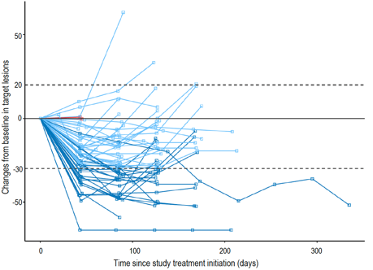
GFH275 for Previously Treated Advanced KRAS G12D–Mutant PDAC
Phase I/II study; GFH275 binds both GDP- and GTP-bound KRAS G12D
Outcome | N = 59
ORR, % | 40.7
Best overall response, n (%)
Partial response | 24 (40.7)
Stable disease | 33 (55.9)
Progressive disease | 2 (3.4)
DCR, % | 96.7
Zhou. ESMO 2025. Abstr LBA84.

Slide 39
HRS-4642 + Gem/Nab-Paclitaxel for Previously Untreated Advanced KRAS G12D–Mutant PDAC
Phase Ib/II study; HRS-4642 is a noncovalent, long-acting KRAS G12D inhibitor
20
Outcome | n = 30 (Previously Untreated)
ORR, % | 63.3
DCR, % | 93.3
BOR, n (%)
PR | 19 (63.3)
SD | 9 (30.0)
PD | 1 (3.3)
No postbaseline assessment | 1 (3.3)
10
0
-10
-20
-30
Best Change of Diameter in Target Lesion From Baseline (%)
-40
BOR
-50
PR
SD
PD
-60
-70
-80
-90
Wang. ESMO 2025. Abstr 2215O.

Slide 40
INCB161734 ± Chemotherapy for Previously Treated Advanced KRAS G12D-Mutated PDAC
Phase I trial; INCB161734 is a selective ON/OFF KRAS G12D inhibitor
600 mg daily
600 mg daily
+ CT
(n = 15)
87% (13)
27% (4)
1200 mg daily + CT
(n = 8)
88% (7)
50% (4)
100
1200 mg daily
(n = 41)
78% (32)
37% (15)
100
1200 mg daily
80
1200 mg daily
80
60
DCR, % (n)
ORR, % (n)
60
DCR, % (n)
ORR, % (n)
40
40
20
20
Best Change From Baseline (%)
Best Change From Baseline (%)
0
0
-20
-20
-40
-40
-60
-60
-80
-80
-100
-100
Wainberg. ASCO GI 2026. Abstr 654.

Slide 41
TSN1611 for Previously Treated Advanced
KRAS G12D-Mutated PDAC
Phase I/II study; TSN1611 targets both the active (GTP-bound/ON) and inactive (GDP-bound/OFF) forms of KRAS G12D
60
PR
SD
PD
50
2nd-3rd Line PDAC N = 23
PR | 7
SD | 12
PD | 4
ORR (95% CI) | 30.4% (13.2-52.9)
DCR (95% CI) | 82.6% (61.2-95.0)
40
30
20
10
Best Change of Target
Lesions From Baseline (%)
0
-10
-20
-30
-40
-50
-60
-70
2L
2L
3L
3L
2L
3L
2L
2L
2L
2L
2L
2L
2L
2L
3L
3L
3L
3L
2L
3L
2L
2L
2L
Li. ASCO GI 2026. Abstr 710.

Slide 42
Setidegrasib (ASP3082) ± Chemotherapy for Advanced KRAS G12D–Mutated PDAC
Phase I study; setidegrasib is a novel KRAS G12D–targeted protein degrader
Ongoing phase III study of setidegrasib + mFOLFIRINOX or NALIRIFOX as 1L therapy for mPDAC with KRAS G12D mutation (NCT07409272)
Response rates
ORR, n (%) | 5/21 (23.8)
DCR, n (%) | 12/21 (57.1)
Response rates
ORR, n (%) | 7/12 (58.8)
DCR, n (%) | 10/12 (83.3)
100
100
80
80
60
2L setidegrasib 600 mg
3L setidegrasib 600 mg
60
1L setidegrasib 600 mg + mFOLFIRINOX
40
PD
PD
40
20
PD
PD
SD
SD
SD
SD
PD
20
SD
Best Change From Baseline (%)
PD
0
Best Change From Baseline (%)
SD
0
-20
PD
-20
SD
SD
SD
PR*
-40
PR
PR
SD
-40
PR
PR*
-60
PR
PR
PR
-60
PR
PR
PR
PR
-80
-80
Park. NEJM. 2026;[Epub]. Kasi. ASCO GI 2026. Abstr 704

Slide 43
Immune Activation in the KRAS Era

Slide 44
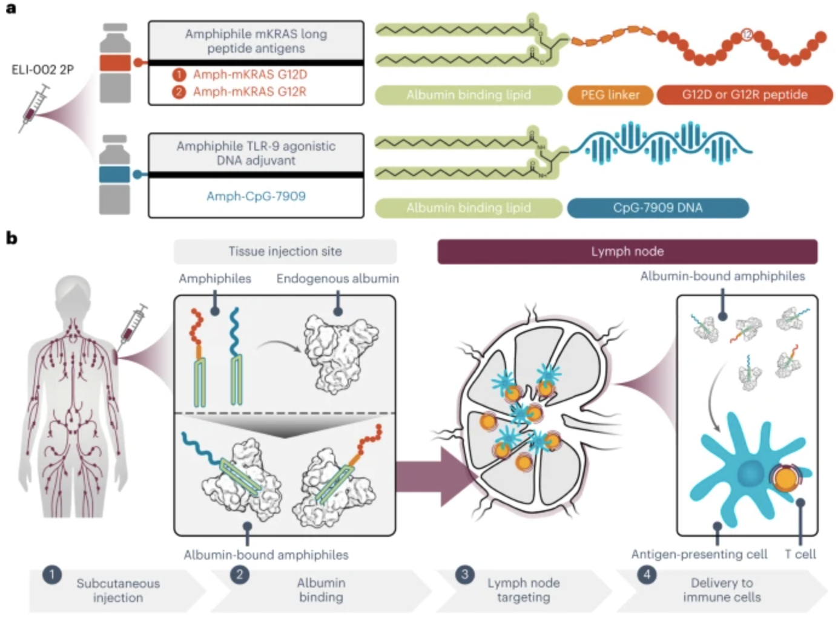
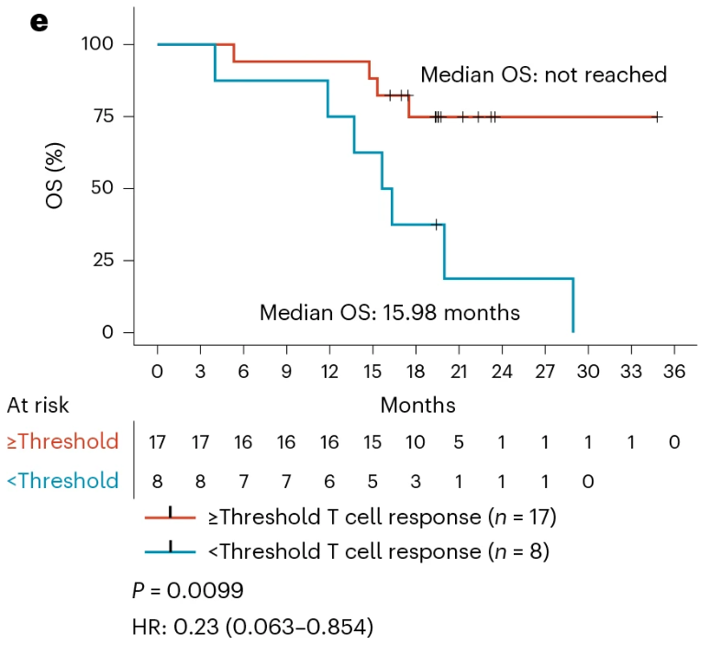
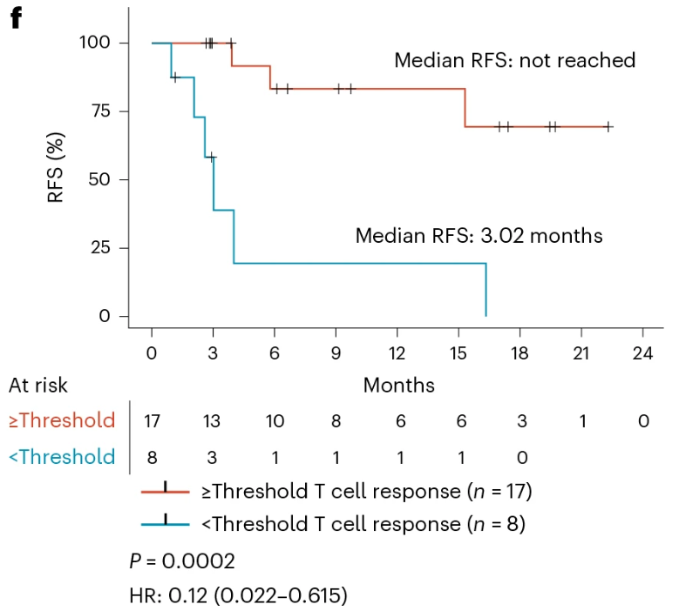
AMPLIFY-201: ELI-002 2P Vaccine for Patients With KRAS G12D/R–Mutated PDAC or CRC and MRD After Locoregional Treatment
Phase I study: ELI-002 2P is a lymph node–targeted vaccine including modified KRAS G12D and G12R mKRAS long peptides
Pant. Nat Med. 2024;30:531. Wainberg. Nat Med. 2025;31:3648.

Slide 45
Class Comparison: RAS Inhibition
Approach | Strength | Limitation
Pan-(K)RAS | Effective in broad indications | Broad adverse events
Allele-specific | Precise and less adverse events | Narrower indication
Degrader | Different mechanism removing the protein | Early in clinical development
Vaccine | Different mechanism using immune system | Early in clinical development

Slide 46
Go Online for More Coverage of Pancreatic Cancer
Text module with expert discussion of these slides
Podcast with additional expert insights into RAS-targeted therapies for PDAC
deceraclinical.com/education

