Slide 1
Oncology Team Training: Improving Clinical Outcomes in Patients Receiving Immune Checkpoint Inhibitors for Solid Tumors
Provided by Clinical Care Options, LLC dba Decera Clinical Education
Supported by an educational grant from Merck Sharp & Dohme LLC.

Slide 2
About These Slides
Please feel free to use and share some or all of these slides in your noncommercial presentations to colleagues or patients
When using our slides, please retain the source attribution:
These slides may not be published, posted online, or used in commercial presentations without permission. Please contact permissions@deceraclinical.com for details
Slide credit: deceraclinical.com/education
Notes:
Disclaimer: The materials published on the Decera Clinical Education website reflect the views of the authors of the Decera Clinical Education material, not those of Decera Clinical Education, the CME providers, or the companies providing educational grants. The materials may discuss uses and dosages for therapeutic products that have not been approved by the FDA. A qualified healthcare professional should be consulted before using any therapeutic product discussed. Readers should verify all information and data before treating patients or using any therapies described in these materials.

Slide 3
Faculty
Patrick Forde, MD, PhD
Medical Oncologist
Professor & Chair of Immuno-Oncology, Trinity College Dublin
Professor of Oncology, Johns Hopkins University
Baltimore, Maryland
Zev A. Wainberg, MD
Professor of Medicine and Surgery
Co-Director, GI Oncology Program
UCLA School of Medicine
Los Angeles, California

Slide 4
Disclosures
The faculty reported the following relevant financial relationships or relationships to products or devices they have with ineligible companies related to the content of this educational activity:
Patrick Forde, MD, PhD: research grants: AstraZeneca, BioNTech, Bristol Myers Squibb, Novartis, Regeneron, Roche, Summit; consultant: Ascendis, AstraZeneca, BioNTech, Bristol Myers Squibb, CureVac, G1, Genelux, Genentech, Gritstone, Janssen, Novartis, Novocure, Regeneron.
Zev A. Wainberg, MD: consultant/advisor/speaker: Alligator, Amgen, Arcus, AstraZeneca, Bayer, Bristol Myers Squibb, Daiichi Sankyo, Ipsen, Janssen, Lilly, Merck, Novartis, Pfizer, Rev Med.

Slide 5
Learning Objectives
At the conclusion of this activity, learners should be able to:
Determine optimal immunotherapy strategies based on clinical experience, expert perspectives, and consensus guidelines for patients with solid tumors
Identify, assess, and manage immune-related adverse events in patients with solid tumors receiving ICI monotherapy or ICI-based combination regimens
Select optimal ICI-based treatment strategies for patients in special populations with liver disease and CNS metastases
Actively engage patients receiving ICI-based therapy in their treatment plan

Slide 6
Determining Optimal Immunotherapy Strategies for Individual Patients With Solid Tumors (Lung, Colorectal, or Melanoma)
Provided by Clinical Care Options, LLC dba Decera Clinical Education
Supported by an educational grant from Merck Sharp & Dohme LLC.

Slide 7
Mechanisms of Action, Safety/Efficacy Data for Immune Checkpoint Inhibitor Combinations

Slide 8
PD-1/PD-L1 Mechanism of Action
Effector Phase: Tumor Microenvironment
PD-1 Inhibitors
Cemiplimab
Dostarlimab
Nivolumab
Pembrolizumab
Retifanlimab
Tislelizumab
Toripalimab
PD-L1 Inhibitors
Atezolizumab
Avelumab
Cosibelimab
Durvalumab
LAG-3 Inhibitor
Relatlimab (used in combination with nivolumab)
PD-1/PD-L1 MoA
Anti–PD-1/PD-L1 MoA
Tumor cell or
immune cell
Tumor cell or
immune cell
PD-L1
Anti–
PD-L1
PD-L1
Downregulation
of T-cell
activity
MHC
TCR
MHC
TCR
Increased T-cell
activity
PD-1
Anti–
PD-1
PD-1
Tumor cell death
T-cell
T-cell
Fernandes. Int J Mol Sci. 2023;24:4044.

Slide 9
CTLA-4 Mechanism of Action
Priming Phase: Lymph Node
CTLA-4 MoA
Anti–CTLA-4 MoA
CTLA-4 Inhibitors Ipilimumab
Tremelimumab
Dendritic
cell
Dendritic
cell
CD80
CD86
CD80
CD86
T-cell
proliferation
Inhibition
of T-cell
activation
MHC
TCR
MHC
TCR
CTLA-4
CD28
Anti–
CTLA-4
CTLA-4
T-cell
migration to
tumor tissue
CD28
T-cell
T-cell
Fernandes. Int J Mol Sci. 2023;24:4044.

Slide 10
Approved Immune Checkpoint Inhibitor Therapies
Agent* Name | Blocks PD-1 | Blocks PD-L1 | Blocks CTLA-4 | Blocks PD-1 + LAG-3
Atezolizumab |  | x
Avelumab |  | x
Cemiplimab | x
Cosibelimab |  | x
Dostarlimab | x
Durvalumab |  | x
Ipilimumab |  |  | x
Nivolumab | x
Nivolumab + relatlimab |  |  |  | x
Pembrolizumab | x
Retifanlimab |  | x
Tislelizumab | x
Toripalimab | x
Tremelimumab |  |  | x
*Become familiar with dosing, frequency, combinations.
Atezolizumab PI. Avelumab PI. Cemiplimab. PI. Cosibelimab PI. Dostarlimab PI. Durvalumab PI. Ipilimumab PI. Nivolumab PI. Nivolumab and relatlimab-rmbw PI. Pembrolizumab PI. Retifanlimab PI. Tislelizumab PI. Toripalimab PI. Tremelimumab PI.

Slide 11

Rationale for Combining Immune Checkpoint Inhibition With Chemotherapy
Different modalities to attack cancer cells
  Aids in decreasing subsets of cancer cells resistant to just
  one modality
    ICI resistance partly due to broad tumor antigen heterogeneity
  Allows targeting wider subset of cancer cells
CT
CT + ICI
ICI
Directly kills cancer cells
Prevents cell division
Induces neoantigen formation
CT “primes” for ICI by increasing tumor antigen release and exposure to immune system
ICI promotes deeper, durable responses
Enhances immune response to cancer cells
Leonetti. Drug Resist Updates. 2019;46:100644. Attili. Crit Rev Oncol Hematol. 2017;119:30.

Slide 12
Recent Approval of Immune Checkpoint Inhibitor Products in Subcutaneous Formulation
Product
FDA Approval
Atezolizumab and hyaluronidase-tqjs¹
9/12/2024
Nivolumab and hyaluronidase-nvhy²
12/27/2024
Pembrolizumab and berahyaluronidase alfa-pmph³
9/19/2025
Future?
1. Atezolizumab and hyaluronidase-tqjs PI. 2. Nivolumab and hyaluronidase-nvhy PI.
3. Pembrolizumab and berahyaluronidase alfa-pmph PI.

Slide 13
IMscin001 Part 1: SC Atezolizumab in Patients With Locally Advanced or Metastatic NSCLC
Multicenter, 2-part, open-label, dose-finding phase Ib study
Part 1
Atezolizumab 1800 mg + rHuPH20 SC once (thigh), then Atezolizumab 1200 mg IV Q3W
(n = 13)
Cohort 1
Adults with locally advanced or metastatic NSCLC; no previous cancer immunotherapy; previously failed platinum-based chemotherapy ≤6 mo from enrollment; ECOG PS 0/1; measurable disease (RECIST v1.1)
(N = 67)
Atezolizumab 1200 mg + rHuPH20 SC (thigh) Q2W x 3 cycles, then Atezolizumab 1200 mg IV Q3W
(n = 15)
Until loss of clinical benefit, disease progression, unacceptable toxicity, or consent withdrawal
Cohort 2
Atezolizumab 1800 mg + rHuPH20 SC abdomen Q3W x 1 cycle, then thigh Q3W x 2 cycles, then Atezolizumab 1200 mg IV Q3W
(n = 39)
Cohort 3
Primary endpoint (Part 1): SC dose yielding a serum trough concentration (C_{trough}) comparable to IV administration
Secondary endpoints: C_{max} of atezolizumab, T_{max} of atezolizumab, AUC_{last}, concentration at specific times during SC administration, safety
NCT03735121. Felip. Clin Pharmacol Drug Dev. 2021;10:1142.

Slide 14
IMscin001 Part 1: Atezolizumab Serum Concentration Over Time and SC vs IV C_{trough} (Primary Endpoint)
Serum Atezolizumab Concentration Over Time
C_{trough} per SC administration cohort in cycle 1
  Cohort 1 C_{trough}: 121 μg/mL
  Cohort 2 C_{trough}: 83.2 μg/mL
  Cohort 3 C_{trough}: 97.3 μg/mL
Bioavailability for injections in thigh: 82.9%
Bioavailability for injections in abdomen: 71.1%
PK parameters for C_{trough}, C_{max}, and AUC₀₋₂₁ were 20%, 28%, and 27% lower following atezolizumab 1800 mg injection in the abdomen vs thigh (cohort 1)
C_{max} was reached within 3-4 days in each cohort
SC safety profile was consistent with that of atezolizumab IV and comparable across cohorts
400
Cohort 1 (n = 13)
Cohort 2 (n = 14)
Cohort 3 (n = 30)
300
200
Atezolizumab Mean Concentration (μg/mL)
100
0
0
1
2
3
4
5
6
7
8
9
12
13
14
15
16
17
18
19
20
21
10
11
Days
1800 mg Q3W SC dosing yields high probability of exposure equivalent to 1200 mg with IV dosing
NCT03735121. Felip. Clin Pharmacol Drug Dev. 2021;10:1142.

Slide 15
IMscin001 Part 2: SC vs IV Atezolizumab in Previously Treated LA or Metastatic NSCLC
Multicenter, open-label, randomized phase III noninferiority study
Atezolizumab 1875 mg + rHuPH20 SC* Q3W
(n = 247)
Adults with locally advanced or metastatic NSCLC; no previous cancer immunotherapy; previously failed platinum-based chemotherapy ≤6 mo from enrollment; ECOG PS 0/1; measurable disease (RECIST v1.1)
(N = 371)
Until PD (per RECIST v1.1), loss of clinical benefit, or unacceptable toxicity
Atezolizumab 1200 mg
IV Q3W†
(n = 124)
1-sided hypothesis testing noninferiority analyses were by the Hochberg procedure. Lower bound of 90% CI for geometric mean ratio was compared with a predefined noninferiority margin of 0.8 as the
lower bound bioequivalence range recommended by FDA and EMA guidelines
*Administered as a ready-to-use <10-min injection in anterior thigh. †Treatment crossover was not allowed.
Coprimary endpoints (Part 2): C_{trough} of atezolizumab at cycle 1, model-predicted AUC from Days 0-21
Key secondary endpoints: steady state exposure, ORR, PFS, OS, safety, immunogenicity
NCT03735121. Burotto. Ann Oncol. 2023;34:693. Burotto. J Thorac Oncol. 2024;19:1460.

Slide 16
IMscin001 Part 2: Cycle 1 C_{trough} and AUC on Days 0-21 (Coprimary Endpoints)
Observed Cycle 1 C_{trough}
Model-predicted AUC from Days 0-21:
SC atezolizumab: 2907 μg/mL
IV atezolizumab: 3328 μg/mL
  GMR SC vs IV: 0.87
Other efficacy data:
Median PFS SC vs IV: 2.8 vs 2.9 mo
(HR: 1.05; 95% CI: 0.83-1.33)
Median OS SC vs IV: 10.9 vs 10.1 mo
(HR: 1.0; 95% CI: 0.78-1.27)
ORR SC vs IV: 11.0% vs 10.5%
Antiatezolizumab antibody development for SC vs IV: 20.6% vs 14.3%
Median administration time SC vs IV: 7.1 (95% CI: 6.6-7.4) vs 40.0 min (95% CI: 37.5-45.0)
150
89
85
100
Cycle 1 Observed
C_{trough} (μg/mL)
50
0
SC
IV
Atezolizumab
GMR
(90% Cl)
1.05
(0.88-1.24)
Cycle 1 C_{trough} SC vs IV: 89 μg/mL vs 85 μg/mL; GMR: 1.05
NCT03735121. Burotto. Ann Oncol. 2023;34:693. Burotto. J Thorac Oncol. 2024;19:1460. Burotto. ESMO. 2025; Abstr 1854P.

Slide 17
MK-3475A-D77: CT + IV or SC Pembrolizumab With Berahyaluronidase alfa as 1L Treatment in NSCLC
International, open-label, randomized phase III noninferiority trial
Stratified by PS (0 vs 1), histology (squamous vs nonsquamous), PD-L1 TPS (<50% vs ≥50%), geographic region (E Asia vs
N America/W Europe/Australia/New Zealand vs RoW)
2 Cycles
Up to 16 Cycles
Adults with histologically confirmed stage IV squamous or nonsquamous NSCLC; no previous systemic therapy; no previous radiation therapy to the lung ≤6 mo of start and/or no prior radiotherapy within 2 wk from start or being treated for radiation-related toxicity with corticosteroids; no EGFR/ALK/ROS1-sensitizing mutations, no pneumonitis/ILD
(N = 377)
Pembrolizumab 790 mg + Berahyaluronidase alfa SC Q6W + CT* Q3W
(n = 251)
Pembrolizumab 790 mg
+ Berahyaluronidase alfa SC Q6W + Pemetrexed maintenance (nonsquamous only)
Pembrolizumab 400 mg IV Q6W + CT* Q3W
(n = 126)
Pembrolizumab 400 mg IV Q6W
+ Pemetrexed maintenance (nonsquamous only)
*Pemetrexed + investigator’s choice cisplatin/carboplatin then pemetrexed maintenance (nonsquamous) or carboplatin + investigator’s choice paclitaxel/nab-paclitaxel (squamous).
Coprimary endpoints: AUC of pembrolizumab (cycle 1; AUC_{0-6wk}), steady state of pembrolizumab (cycle 3; C_{trough})
Key secondary endpoints: immunogenicity, ORR, PFS, DoR by BICR, OS, safety and tolerability, QoL
NCT05722015. Felip. ELCC 2025. Abstr 8MO. Felip. Ann Oncol. 2025;36:775.

Slide 18
MK-3475A-D77: Efficacy Summary
Survival Outcomes | Pembrolizumab SC + CT (n = 251) | Pembrolizumab IV + CT (n = 126)
Median PFS, mo (95% CI) | 8.1 (6.3-8.3) | 7.8 (6.2-9.7)
HR (95% CI) | 1.05 (0.78-1.43)
Median OS, mo | NR | NR
HR (95% CI) | 0.81 (0.53-1.22)
Response and Duration of Response | Pembrolizumab SC + CT | Pembrolizumab IV + CT
ORR, % (95% CI) | 45.4 (39.1-51.8) | 42.1 (33.3-51.2)
ORR ratio (95% CI) | 1.08 (0.85-1.37)
Median DoR, mo (95% CI) | 9.1 (6.9-NR) | 8.0 (7.4-NR)
Across patient subgroups, the efficacy outcomes for SC and IV pembrolizumab were comparable
Felip. Ann Oncol. 2025;36:775.

Slide 19
MK-3475A-D77: Safety Summary
70
64.3
Treatment-Related Adverse Events (≥10% incidence)
Grade
60
52.2
1/2
3-5
50
41.8
Pembrolizumab SC + CT
40
Pembrolizumab IV + CT
Incidence (%)
31.0
28.3
27.0
27.9
30
25.4
22.3
21.4
20
13.1
13.1
11.9
12.4
11.1
11.6
15.9
9.5
10.3
10.4
7.9
8.4
10.3
6.8
10
0
Anemia
Neutropenia
Thrombo-
cytopenia
Leukopenia
Nausea
AST
Increased
Fatigue
Hypo-
thyroidism
ALT
Increased
Pruritus
Alopecia
Decreased
Appetite
Treatment-Related AEs, n (%) | Pembrolizumab SC + CT (n = 251) | Pembrolizumab IV + CT (n = 126)
Any Grade 3-5 Serious Discontinued SC or IV pembrolizumab Discontinued Resulted in death | 226 (90) 118 (47.0) 53 (21.1) 21 (8.4) 38 (15.1) 9 (3.6) | 121 (96.0) 60 (47.6) 25 (19.8) 11 (8.7) 15 (11.9) 3 (2.4)
Injection Site AE, n (%) | Pembrolizumab SC + CT (n = 251)
Any Erythema Hemorrhage Induration Pain Reaction | 6 (2.4) 1 (0.4) 1 (0.4) 1 (0.4) 1 (0.4) 2 (0.8)
Felip. Ann Oncol. 2025;36:775.

Slide 20
CheckMate 67T: SC Nivolumab (+ Hyaluronidase) vs
IV Nivolumab in Advanced/Metastatic ccRCC
International, open-label, randomized noninferiority phase III study
Coprimary endpoints: time-averaged serum concentration over 28 days (C_{avgd28}), minimum serum concentration at steady state (C_{minss})
Key secondary endpoints: ORR by BICR, PK, safety, immunogenicity
Stratified by IMDC risk group (favorable vs intermediate vs poor), baseline body weight (<80 kg vs ≥80 kg)
  Patients were enrolled across 73 sites in 17 countries
  Minimum follow-up: 8 mo
Nivolumab 1200 mg + rHuPH20 SC* Q4W
(n = 248)
Adults with advanced or metastatic ccRCC; measurable disease (RECIST v1.1); received ≤2 previous systemic therapies with intolerance or progression on/after last tx regimen and ≤6 mo prior to randomization; no previous ICI; Karnofsky PS ≥70
(N = 495)
Until PD, unacceptable toxicity, consent withdrawal, completion of 2 yr of treatment, or death
Nivolumab 3 mg/kg IV Q2W
(n = 247)
*Average injection time <5 min.
NCT04810078. George. ASCO GU 2024. Abstr LBA360. Albiges. Ann Oncol. 2025;36:99.

Slide 21
CheckMate 67T: PK Noninferiority
Parameter | Nivo SC + rHuPH20 (n = 242) | Nivo IV (n = 245) | Geometric Mean Ratio (90% CI)
Geometric mean C_{avgd28}, µg/mL (90% CI) | 77.373 (74.555-80.297) | 36.875 (35.565-38.235) | 2.098 (2.001-2.200)
Geometric mean C_{minss}, µg/mL (90% CI) | 122.227 (114.552-130.416) | 68.901 (64.676-73.402) | 1.774 (1.633-1.927)
Noninferiority for the coprimary PK endpoints was met
George. ASCO GU 2024. Abstr LBA360. Albiges. Ann Oncol. 2025;36:99.

Slide 22
CheckMate 67T: Additional Efficacy/Safety Data
Primary Data Analysis
Secondary Data Analysis
Parameter | Nivolumab + rHuPH20 SC (n = 248) | Nivolumab IV (n = 247)
ORR,* % (95% CI) | 24.2 (19.0-30.0) | 18.2 (13.6-23.6)
Relative risk (95% CI) | 1.33 (0.94-1.87)
Median PFS,* mo (95% CI) | 7.23 (5.13-7.49) | 5.65 (5.29-7.39)
ADA positive, n/N (%) | 46 /202 (22.8) | 15/215 (7.0)
Efficacy Endpoint | Nivolumab + rHuPH20 SC (n = 248) | Nivolumab IV (n = 247)
Best overall response, n (%) CR PR SD PD UTD | 5 (2.0) 61 (24.6) 89 (35.9) 63 (25.4) 30 (12.1) | 7 (2.8) 44 (17.8) 104 (42.1) 66 (26.7) 26 (10.5)
ORR,* % (95% CI) | 26.6 (21.2-32.6) | 20.6 (15.8-26.2)
Risk ratio (95% CI) | 1.28 (0.93-1.77)
Safety, n (%) | Nivolumab + rHuPH20 SC (n = 247) | Nivolumab IV (n = 245)
Grade 3/4 AE | 87 (35.2) | 100 (40.8)
Treatment-related AE | 24 (9.7) | 36 (14.7)
Serious AE | 52 (21.1) | 56 (22.9)
Treatment-related SAE | 16 (6.5) | 16 (16.5)
Median TTR, mo (range) | 3.71 (1.7-11.3) | 3.68 (1.6-13.8)
OS, % (95% CI) 6 mo 12 mo | 83.8 (78.5-87.9) 72.4 (66.2-77.6) | 86.4 (81.3-90.2) 72.9 (66.7-78.2)
*By BICR.
*By BICR.
1. George. ASCO GU 2024. Abstr LBA360. 2. Albiges. ESMO 2024. Abstr 1691P. 3. Adamczyk. ONS. 2025; Abstr 16944.

Slide 23
Practical Considerations for SC vs IV ICI Administration
Pros of SC Administration | Cons With IV Administration
Save patient time = 26 hr/yr | IV use warrants separate infusion appointments
Open up chair time, so we can treat more patients | Treatment burden high on patients
IV access not needed | IV access required
No more than “1 poke” for administration | Sometimes more than “1 poke” is needed
Outpatient clinic setting/infusion center | Infusion center
Atezolizumab
IV: First infusion over 60 min, with subsequent infusions over 30 min
SC: 15 mL 1875 mg atezolizumab and 30,000 units hyaluronidase into the thigh over approximately 7 min Q3W
Nivolumab
  IV: over 30 min
  SC [variable by tumor type]: between 600 mg/10,000 units Q2W or 1200 mg/20,000 units into abdomen or thigh Q4W over 3-5 min
Pembrolizumab
  IV: over 30 min
  SC: 395 mg/4800 units (2.4 mL) Q3W or 790 mg/9,600 units (4.8 mL) Q6W for adult solid tumors where intravenous pembrolizumab is indicated
*NSCLC
Atezolizumab SC PI. Nivolumab SC PI. Pembrolizumab SC PI.

Slide 24
Takeaways: Acquisition, Administration, Billing, and Reimbursement*
Pricing parity between IV and SC ($15,575/4 wk)
Specialty GPO (McKesson, Cardinal) should give favorable bulk pricing/ discount with contract
Reimbursement are expected to be in favor; therefore, there should be expectation of no loss
Potential for SC vs IV administration to have an impact on revenue
We must be creative at being self sustainable in the changing environment
*AWP as of May 2025.

Slide 25
Key Discussion Topics for Immunotherapy

Slide 26
Immunotherapy Discussion Topics
Pathologic complete response with neoadjuvant ICI
Assessment and understanding of pseudoprogression while on ICIs
Assessment and management of progression after ICI treatment in solid tumors
Role of ICIs in special populations
      ICIs in patients with autoimmune disease?
      Liver disease?
      CNS metastases?

Slide 27
Pathologic Response Assessment After Neoadjuvant Immunotherapy
Similarities/differences in pathologic response assessment with chemotherapy vs immunotherapy
  Major pathologic response defined as ≤10% viable tumor cells
  Features of immune-related pathologic response criteria* present in responders include:
    Proliferative fibrosis
    Neovascularization
    Cholesterol clefts
    High number of infiltrating lymphocytes with macrophages and tertiary lymphoid structures
Image Not Available For Distribution
*Calculated as RTV divided by tumor bed, including RTV plus regression bed plus necrosis.
†Calculated based on chemotherapy response assessment.
Cottrell. Ann Oncol. 2018;29:1853.

Slide 28
KEYNOTE-671: Pembro or Pbo + Plt-Based Neoadj CT Followed by Resection and Adj Pembro or Pbo in Early-Stage NSCLC
International, double-blind, randomized phase III trial
Stratified by disease stage (II vs III), PD-L1 TPS (<50% vs ≥50%), histology (squamous vs nonsquamous), geographic region (East Asia vs other)
Pembrolizumab 200 mg IV Q3W +
Cisplatin + Gemcitabine or Pemetrexed* for up to 4 cycles
(n = 397)
Pembrolizumab 200 mg IV Q3W
for up to
13 cycles
Patients with resectable
stage II, IIIA, or IIIB (N2) NSCLC with no prior therapy; able to undergo surgery; evaluable for PD-L1; ECOG PS 0/1
(N = 797)
Surgery†
Placebo IV Q3W +
Cisplatin + Gemcitabine or Pemetrexed* for up to 4 cycles
(n = 400)
Surgery†
Placebo
IV Q3W for up to
13 cycles
*Cisplatin 75 mg/m² IV Q3W + gemcitabine 1000 mg/m² IV on Days 1, 8 Q3W for squamous histology only; cisplatin 75 mg/m² IV Q3W + pemetrexed 500 mg/m² IV Q3W for nonsquamous histology only. †RT administered if microscopic positive margins, gross residual disease, or extracapsular nodal extension following surgery and for patients who did not undergo planned surgery for any reason other than local progression or metastatic disease.
Coprimary endpoints: EFS per investigator, OS
Key secondary endpoints: mPR, pCR per blinded independent pathology review, safety
Wakelee. ASCO 2023. Abstr LBA100. Wakelee. NEJM. 2023;389:491.

Slide 29
KEYNOTE-671: Neoadj Pembrolizumab + Platinum CT for Resectable Stage II, IIIA, or IIIB (N2) NSCLC
mPR
pCR
50
50
45
△ 19.2% (13.9%-24.7%;
P <.00001)
45
△ 14.2% (10.1%–18.7%;
P <.00001)
40
30.%
(25.7%-35.0%)
40
35
35
30
30
pCR, % (95% CI)
18.%
(14.5%-22.3%)
mPR, % (95% CI)
25
25
20
11.0%
(8.1%-14.5%)
20
15
15
10
10
4.0%
(2.3%-6.4%)
5
5
0
0
Pembro Arm
(n = 397)
Placebo Arm
(n = 400)
Pembro Arm
(n = 397)
Placebo Arm
(n = 400)
Wakelee. ASCO 2023. Abstr LBA100. Wakelee. NEJM. 2023;389:491. Spicer. Lancet. 2024;404:1240.
Liberman. Ann Thorac Surg. 2026;121:281.

Slide 30
KEYNOTE-671: EFS and OS (Coprimary Endpoints)
EFS
OS
100
Pembrolizumab group
Placebo group
100
Pembrolizumab group
Placebo group
50
50
60
60
Event-Free Survival (%)
Overall Survival (%)
40
40
20
20
HR: 0.72 (95% CI: 0.56-0.93;
1-sided P = .0052)
HR: 0.59 (95% CI: 0.48-0.72)
0
0
0
6
12
18
24
30
36
42
48
54
60
66
0
6
12
18
24
30
36
42
48
54
60
66
No. at Risk
(No. Censored)
Pembro group
Placebo group
Mo Since Randomization
Mo Since Randomization
397
(0)
400
(0)
339
(8)
308
(13)
282
(13)
232
(16)
250
(18)
189
(22)
196
(54)
128
(50)
142
(95)
87
(81)
102
(129)
66
(97)
62
(164)
34
(123)
37
(187)
18
(146)
10
(223)
6
(146)
0
(223)
1
(151)
0
(223)
0
(152)
397
(0)
400
(0)
371
(1)
379
(2)
347
(1)
347
(4)
327
(4)
319
(5)
277
(38)
256
(45)
205
(95)
176
(106)
148
(145)
125
(147)
108
(182)
77
(190)
69
(218)
38
(219)
32
(255)
20
(236)
4
(283)
4
(252)
0
(287)
0
(256)
Wakelee. ASCO 2023. Abstr LBA100. Wakelee. NEJM. 2023;389:491. Spicer. Lancet. 2024;404:1240.

Slide 31
KEYNOTE-671: Immune-Mediated AEs and
Infusion Reactions Across Treatment Phases
12
Grade
11
11.1
1/2
3/4
Pembro + CT arm
Placebo + CT arm
10
9
8
7
6
5.6
5.6
Incidence (%)
5
4
3
3.3
2
1.8
2.3
1.8
1.5
1
1.3
1.3
1.0
0.8
0
0
0.3
0.5
0.5
0.5
0
0.5
0
0
0
Pneumonitis
Severe skin reactions
Colitis
Infusion reactions
Thyroiditis
Hepatitis
Hypophysitis
Pancreatitis
Hypothyroidism
Hyperthyroidism
Vasculitis
Events That Occurred in ≥2 Participants
Wakelee. ASCO 2023. Abstr LBA100. Wakelee. NEJM. 2023;389:491.

Slide 32
CheckMate 816: Neoadjuvant Nivolumab + CT in Resectable NSCLC
Open-label, randomized phase III trial
Coprimary endpoints: pCR (by BIPR), EFS (by BICR)
Key secondary endpoints: OS, MPR (by BIPR), time to death or distant metastasis
Current post hoc analysis evaluates the association of pathologic response and EFS in patients
who had surgery and pathologically evaluable samples (path-evaluable patient population)
Radiologic Restaging
Stratified by stage (IB/II vs IIIA), PD-L1* (≥1% vs <1%), sex
Nivolumab 360 mg Q3W +
CT Q3W x 3 cycles
(n = 179)
Patients with newly diagnosed,
resectable, stage IB (≥4 cm)
to IIIA NSCLC†; no sensitizing EGFR mutations or ALK alterations; ECOG PS 0/1
(N = 358)
Surgery (within 6 wk post tx)
Optional adjuvant
CT ± RT
Follow-up
CT Q3W x 3 cycles
(n = 179)
*PD-L1 28-8 pharmDx IHC assay. †By TNM 7th edition.
Provencio-Pulla. ASCO 2022. Abstr LBA8511. Spicer. NEJM. 2025;393:741. Forde. NEJM. 2025;393:741

Slide 33
CheckMate 816: Neoadj Nivolumab + Platinum CT for Resectable Stage IB-IIIA NSCLC
Primary Endpoint: ITT (ypT0N0)*
Patients With Resection‡ (ypT0N0)
40
OR: 13.94 (99% CI: 3.49-55.75†;
P <.0001)
40
30
30.5
pCR Rate (%)
30
Difference: 21.6%†
20
24.0 (95% CI: 18.0-31.0)
10
3.2
0
pCR Rate (%)
20
Nivolumab + CT
(43/141)
CT
(4/126)
n/N =
10
Primary Tumor Only in ITT (ypT0)
40
2.2 (95% CI: 0.6-5.6)
30
25.7
pCR Rate (%)
0
20
Nivolumab + CT
(43/179)
CT
(4/179)
10
n/N =
2.8
0
pCR rate in exploratory nivolumab + ipilimumab arm (ITT): 20.4% (95% CI: 13.4%-29.0%)
Nivolumab + CT
(46/179)
CT
(5/179)
n/N =
pCR defined as 0% residual viable tumor cells in primary lung tumor and sampled LNs. *In ITT population, those who did not undergo surgery categorized as nonresponders in primary analysis. †Calculated using stratified Cochran–Mantel–Haenszel method. ‡Patients who underwent definitive surgery with evaluable pathology sample.
Provencio-Pulla. ASCO 2022. Abstr LBA8511. Spicer. NEJM. 2025;393:741. Forde. NEJM. 2025;393:741

Slide 34
CheckMate 816: Neoadj Nivolumab + Platinum CT for Resectable Stage IB-IIIA NSCLC: OS Outcomes
Median follow-up at final analysis for OS: 68.4 mo
Parameter | Nivolumab + CT (n = 179) | CT (n = 179)
5-yr OS rate, % | 65.4 | 55.0
HR (95% CI) P value | 0.72 (0.523-0.998) .048
5-yr OS rate in pCR subgroups, % (95% CI) If pCR If no pCR | 95.3 (82.7-98.8) 55.7 (46.9-63.7) | -- --
5-yr OS rate if presurgery ctDNA clearance, % Yes No | 75.0 52.6 | -- --
Provencio-Pulla. ASCO 2022. Abstr LBA8511. Spicer. NEJM. 2025;393:741. Forde. NEJM. 2025;393:741

Slide 35
NICHE-3: Neoadjuvant Nivolumab + Relatlimab for Locally Advanced dMMR Colon Cancer
Investigator-initiated, multicenter, nonrandomized phase II trial
Primary endpoint: pathologic response rate
Patients with previously untreated, resectable, dMMR (by IHC) colon adenocarcinoma; no signs of perforation/obstruction; no distant metastases; locally advanced stage (≥cT3 and/or N+); no autoimmune disease or use of steroids or immunosuppressive agents
(n = 53)
Nivolumab 480 mg +
Relatlimab 480 mg
8 wk and 4 wk prior to surgery
Surgery
Follow-up
Simon 2-stage design required ≥15/19 responders in first stage to continue accrual of 40 patients into second stage
Verschoor. ESMO 2023. Abstr LBA31; Gooyer. Nat Med. 2024;30:3284.

Slide 36
NICHE-3: Response and pCR Rate (Primary Endpoint)
At median 8-mo follow-up, all patients were alive and 98% were disease free
Lymph node status
Negative
Positive
Pathologic response,
primary tumor
Complete response
Partial response
Major response
No response
0
-20
-40
Pathologic Tumor Regression (%)
-60
-80
-100
Primary endpoint met
  Pathologic complete response in 97%
Adjuvant chemotherapy
  2 patients had lymph-node metastases
  1 nonresponder; 1 had major pathologic response
  Both decline adj chemotherapy following counsel
Verschoor. ESMO 2023. Abstr LBA31. Gooyer. ESMO 2024. Abstr 503O Gooyer. Nat Med. 2024;30:3284.

Slide 37
Dostarlimab for Locally Advanced dMMR Rectal Cancer
Single-arm phase II study
Primary objectives:
    Overall response to dostarlimab ± chemoRT
    Sustained cCR 12 mo after completion of dostarlimab (if no surgery) or pCR (if surgery) after completion of dostarlimab ± chemoRT
Radiologic and
endoscopic evaluation
If residual
disease
If residual
disease
ChemoRT
Surgery
Patients with stage II/III dMMR rectal cancer
(target N = 47)
Dostarlimab
500 mg IV Q3W
x 9 cycles
If cCR
If cCR
Nonoperative
follow-up
every 4 mo
Cercek. NEJM. 2022;386:2363. Cercek. ASCO 2024. Abstr LBA3512.

Slide 38
Dostarlimab for Locally Advanced dMMR Rectal Cancer:
Key Findings
3
AE, n (%) | All Grades | Grade 3/4
Dermatologic
Pruritus | 6 (13) | 0
Rash/dermatitis | 10 (21) | 0
Gastrointestinal
Diarrhea | 4 (9) | 0
Nausea | 4 (9) | 0
Constitutional
Fatigue | 5 (11) | 0
Fever | 3 (6) | 0
Endocrine
Hypothyroidism | 5 (11) | 0
2
4
1
7
5
6
9
10
11
8
100% cCR
42 patients who completed dostarlimab
12
15
17
13
14
16
18
19
21
23
27
22
29
Subjects
24
Median follow-up:
17.9 mo (0.3-50.5)
28
30
29
25
28
34
36
32
37
35
38
31
cCR
On treatment
End of treatment evaluation
Time of cCR
40
39
43
42
41
44
33
45
46
47
48
0
3
6
9
12
15
18
21
24
27
30
33
36
39
42
45
48
51
Mo
Cercek. ASCO 2024. Abstr LBA3512.

Slide 39
Phase III Randomized Trials of ICI vs Chemotherapy as First-line Therapy for dMMR/MSI-H mCRC
KEYNOTE-177 (Final Analysis)
Checkmate 8HW
 | Median PFS, Mo (95% CI)
Pembro | 16.5 (5.4-38.1)
CT | 8.2 (6.1-10.2)
 | HR: 0.59 (95% CI: 0.45-0.79)
 | Median PFS, Mo (95% CI)
Nivo + Ipi | NR (34.3-NE)
CT | 6.2 (4.7-9.0)
100
100
71
(95% CI: 64-77)
80
80
+
63
(95% CI: 56-70)
+
+
+
+
+
+
+
+
+
+
+
+
+
+
+
+
+
+
+
+
+
+
+
+
+
+
+
+
+
+
+
+
+
60
60
+
+
+
+
+
+
+
+
+
+
+
+
+
+
+
+
+
+
+
+
+
+
+
+
+
+
+
PFS (%)
Patients (%)
+
40
40
24
(95% CI: 14-34)
55%
38%
42%
11%
15
(95% CI: 7-25)
20
20
0
0
0
4
8
12
16
20
24
28
32
36
40
44
48
52
56
60
0
3
6
9
12
15
18
21
24
27
30
33
36
39
42
45
Mo
Mo
Andre. ASCO 2021. Abstr 3500. Andre. NEJM. 2024;391:2014.

Slide 40
CheckMate 142: PFS With Nivolumab ± Ipilimumab for
MSI-H/dMMR Metastatic CRC
Multicohort, nonrandomized phase II study
Cohort 1
2L+ Nivo†
(n = 74)
13.8
4.7-38.2
Cohort 2
2L+ Nivo + Ipi†
(n = 119)
NR
32.8-NE
Cohort 3
1L Nivo + Ipi†
(n = 45)
NR
28.8-NE
100
80
Median PFS,* mo
95% CI
1L Nivo + Ipi
60
54%
NA‡
PFS* (%)
2L+ Nivo + Ipi
40
51%
52%
36%
34%
2L+ Nivo
20
5-yr follow-up
0
0
6
12
18
24
30
36
42
48
54
60
66
72
78
84
90
Mo
*Per investigator. †Cohorts not randomized, nor was trial designed for formal comparison. ‡Median follow-up for cohort 3: 47.6 mo.
Overman. ASCO 2022. Abstr 3510. Lenz. JCO.2022;40:161.

Slide 41
CheckMate 142: OS With Nivolumab ± Ipilimumab for MSI-H/dMMR Metastatic CRC
Cohort 1
2L+ Nivo*
(n = 74)
44.2
20.9-75.1
Cohort 2
2L+ Nivo + Ipi*
(n = 119)
NR
NE
Cohort 3
1L Nivo + Ipi*
(n = 45)
NR
NE
100
Median OS, mo
95% CI
80
1L Nivo + Ipi
72%
NA†
60
71%
68%
2L+ Nivo + Ipi
OS (%)
40
49%
2L+ Nivo
46%
20
5-yr follow-up
0
0
6
12
18
24
30
36
42
48
54
60
66
72
78
84
90
Mo
*Cohorts not randomized, nor was trial designed for formal comparison. †Median follow-up for cohort 3: 47.6 mo.
Overman. ASCO 2022. Abstr 3510. Lenz. JCO.2022;40:161.

Slide 42
Immune Checkpoint Inhibitors in mCRC
ICI | FDA Indication(s) | Evidence
Pembrolizumab | For treatment of patients with unresectable or metastatic MSI-H/dMMR CRC (including initial therapy) | KEYNOTE-177 (first-line setting)
 | Subsequent therapy for previously treated patients with MSI-H/dMMR or TMB-H solid tumors | Multiple studies, including KEYNOTE-158
Nivolumab ± ipilimumab | Subsequent therapy for previously treated patients with MSI-H/dMMR solid tumors who have progressed after initial chemotherapy Treatment of adults and pediatric patients 12 yr of age or older with unresectable or MSI-H or mismatch repair deficient dMMR CRC | CheckMate-142 CheckMate-8HW
Dostarlimab | Accelerated approval: subsequent therapy for previously treated patients with dMMR solid tumors who progress on or after treatment and have no other acceptable options | GARNET phase I (basket trial)
André. JCO. 2021;39:Abstr 3500. André. Ann Oncol. 2022;33:1052. André. JCO. 2022;40: Abst. 201. Diaz. Lancet Oncol. 2022;23:659. Dostarlimab PI. Lenz. JCO. 2022;40:161. Morris. JCO. 2022;[Epub]. NCCN. Clinical practice guidelines in oncology: colon cancer. v2.2022. nccn.org. NCCN. Clinical practice guidelines in oncology: rectal cancer. v3.2022. nccn.org. Nivolumab PI. Pembrolizumab PI.

Slide 43
Assessment and Understanding of Pseudo Progression While on an ICI
Pseudoprogression is an uncommon (up to 10%) yet possible phenomenon with ICIs
    Tumors temporarily enlarge due to immune cell infiltration before shrinking
    Can distinguish pseudoprogression from true progression using short-interval (4-6 wk) radiologic reassessment
    Monitor patient for symptoms but may continue tx in patients who are stable and based on iRECIST criteria
Image Not Available For Distribution
Gonugunta. J Med Case Rep. 2022;16:289. CC BY 4.0.

Slide 44
Pseudo Progression Examples in and Skin Cancer
Skin Cancer (Liver Metastases)
Image Not Available For Distribution

Slide 45
Role of ICIs in Special Populations
Autoimmune disease present¹⁻³
Often excluded from clinical trials
Risk of flares: ~30%-42%
New adverse effects: ~ 33%-42%
Patients with rheumatologic, dermatologic, or gastrointestinal (eg, IBD) disorders may be at higher risk for flares than those with endocrine or neurologic conditions
CNS disease present^{4,5}
Intracranial activity observed with both single-agent and dual immunotherapy
Intracranial response rates: ~5%-55%
Asymptomatic brain metastases not requiring corticosteroids often derive the most benefit
Liver disease present⁶⁻⁸
Patients with liver disease were often excluded from clinical trials of ICIs
Safety profile is similar vs patients without liver disease (ie, HBV and HCV)
ICI treatment is safe and efficacious in patients with liver disease
1. dailynews.ascopubs.org. 2. www.cancer.gov. 3. Rakshit. J Thorac Dis. 2020;12:7032. 4. Caponnetto. Cancer Immunol Immunother. 2018;67:703. 5. Kamath. Front Oncol. 2018;8:414. 6. da Fonseca. JCO Glob Oncol. 2025;11:e2500128. 7. Rimassa.
J Hepatol. 2025;83:899. 8. Alkrekshi. Oncologist. 2021;26[Epub].

Slide 46
Assessing and Managing irAEs Associated With Immunotherapy Combination Regimens in Solid Tumors

Slide 47
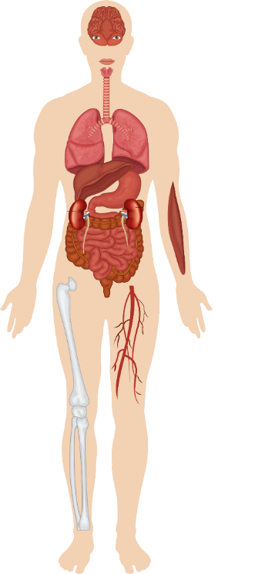
Spectrum of
Immune-Related Toxicity
Ocular
Uveitis
Conjunctivitis
Scleritis, episcleritis
Blepharitis
Retinitis
Endocrine
Hyper or hyperthyroidism
Hypophysitis
Adrenal insufficiency
Diabetes
Immunotherapies present with a novel spectrum of AEs that differ in important ways from those associated with chemotherapy and targeted agents
    Immune-related AEs or immune-mediated AEs
    Occur through an imbalance of tolerance and drug-induced immunity
Respiratory
Pneumonitis
Pleuritis
Sarcoidlike granulomatosis
Liver
Hepatitis
Renal
Nephritis
Cardiovascular
Myocarditis
Pericarditis
Vasculitis
Skin
Rash
Pruritus
Vitiligo
DRESS
Stevens-Johnson
Gastrointestinal
Colitis/diarrhea
Ileitis
Pancreatitis
Gastritis
Blood
Hemolytic anemia
Thrombocytopenia
Neutropenia
Hemophilia
Neurologic
Neuropathy
Guillain-Barré
Myelopathy
Meningitis
Encephalitis
Myasthenia
Musculoskeletal
Arthritis
Dermatomyositis
Champiat. Ann Oncol. 2016;27:559.

Slide 48

General AE Management Strategy
Educate
Identify
Collaborate
Act
Track
Educate medical personnel, patients, and caregivers.
Track the evolution of the patient. Adjust treatment as needed. Look out for relapse.
Identify early signs of toxicity by performing regular follow-ups.
Chemotherapy
Immunotherapy
Act fast and efficient. Conduct the necessary assessments but do not wait to begin management.
Collaborate with organ specialist and toxicity experts to identify the responsible drug.
Rached. Cancer Treat Rev. 2024;127:102751.

Slide 49
General Management of irAEs
Steroids (PO/IV): 0.5-2 mg/kg/day prednisone or equivalent; slow taper over 4-6 wk
For some irAEs, ICI can be restarted after resolution (eg, rash/pruritus)
Managed in outpatient/
community setting
Generally requires
hospital admission
Referral to specialist
Strong immunosuppressive tx
Oral steroids
IV steroids
Increasing intensity of treatment required
Stop treatment
Symptomatic and supportive care
Grade 1
Grade 2
Grade 3
Grade 4
Mild
Moderate
Severe
Very severe
Haanen. Ann Oncol. 2022;33:1217. NCCN. Clinical practice guidelines in oncology:
management of immune checkpoint inhibitor-related toxicities. v.1.2026. nccn.org.

Slide 50
General Recommendations for Managing AEs With Chemoimmunotherapy
Parameter | CT | ICI
Typical timing/pattern | Rapid onset after administration Cyclical onset/recovery | Onset may be after several cycles Persists/worsens over time
General Management Strategies
Hold dose | Yes | Yes
Reduce dose | Yes | No
Switch to less toxic agent | Yes | No
Steroids useful | Rarely (depends on toxicity) | Yes
Permanently discontinue | Yes (if severe) | Yes (if severe)
Hoffner. Cancer Treat Rev. 2020;85:101979. Madden. Clin J Oncol Nurs. 2017;21:30

Slide 51
VEGF(R) Inhibition + ICI in the Clinic
Combination anti-VEGF(R) + anti–PD-1/PD-L1 therapy demonstrated benefit in ICI-naive patients with multiple tumor types, leading to FDA approvals¹⁻⁶
    RCC: axitinib/pembrolizumab,⁷ axitinib/avelumab,⁸ cabozantinib/nivolumab,⁹ lenvatinib/pembrolizumab¹⁰
    Endometrial carcinoma: lenvatinib/pembrolizuamb¹¹
    Hepatocellular carcinoma: bevacizumab/atezolizumab¹²
Preliminary antitumor activity and safety with pembrolizumab + ramucirumab reported in patients with advanced NSCLC in a multicohort phase I trial^{13,14}
    Pembrolizumab: anti–PD-1 monoclonal antibody⁶
    Ramucirumab: monoclonal antibody targeting extracellular domain of VEGFR-2¹⁵
1. Atezolizumab PI. 2. Avelumab PI. 3. Axitinib PI. 4. Lenvatinib PI. 5. Nivolumab PI. 6. Pembrolizumab PI. 7. Plimack. Eur Urol. 2023;84:449. 8. Choueri. Ann Oncol. 2020;31:1030. 9. Motzer. ASCO GU 2025. Abstr 439. 10. Choueri. Lancet Oncol. 2023;24:228. 11. Makker. NEJM. 2022;386:437. 12. Cheng. J Hepatol. 2022;76:862. 13. Herbst. Lancet Oncol. 2019;20:1109. 14. Herbst. J Thorac Oncol. 2021;16:289.
15. Ramucirumab PI.

Slide 52
Grade 1/2 Colitis Management
Patient Considerations
Educate all patients about and to contact their HCP for: abdominal pain, nausea, cramping, blood/mucus in stool, changes in bowel habits, abdominal distention, or constipation
For grade ≥2 consider permanently discontinuing CTLA-4 agents and restarting PD-1/PD-L1 agents if recovery to grade ≤1; concurrent immunosuppressant maintenance therapy is only considered if clinically indicated and on a case-by-case basis
Grade
Management
Continue ICI; may hold ICI temporarily and resume if toxicity remains grade 1 or resolves
If infections have been ruled out, consider loperamide as supportive care (not applicable if colitis-related symptoms) as temporary measure
Recommend dietary changes and monitor for dehydration
Monitor closely by phone, EMR, for changes every 3 days, until stabilized
Consider gastroenterology consult for prolonged grade 1 cases; consider endoscopy with biopsy
Grade 1: Increased but fewer than 4 stools per day vs baseline; modest increase in ostomy output vs baseline
Grade 2: Increase of 4-6 stools per day vs baseline; moderate increase in ostomy output vs baseline
Conduct same management as for grade 1 and consider gastroenterology consult
Unless transient diarrhea, administer corticosteroids with 1.0 mg/kg/day prednisone or equivalent until symptoms resolve to grade 1, then taper for 4-6 wk
Consider adding narrow spectrum/more potent anti-TNF (infliximab) or anti-integrins (vedolizumab) in patients with refractory colitis (eg, no decrease in grade in 3 days) or with high-risk endoscopic features
EGD or colonoscopy recommended for grade ≥2, stratifying patients accordingly
Fecal calprotectin 116 μg/g may be considered as surrogate for endoscopy and histologic remission
Resumption of PD-1/PD-L1 is considered lower risk for flare-up vs CTLA-4
Adapted from: Schneider. JCO. 2021;39:36.

Slide 53
Grade 3/4 Colitis Management
Grade
Management
Follow management for grade 2 as well as grade 3
Give corticosteroids (dose of 1-2 mg/kg/day prednisone or equivalent) until symptoms improve to grade 1, then taper over 4-6 wk; if concern for upper GI inflammation, consider methylprednisolone
Consider infliximab or vedolizumab in addition to steroids in patients with high-risk endoscopic features on initial exam or inadequate response to steroids with persistent symptoms after 3 days
Consider hospitalization if dehydration or electrolyte imbalance
Repeat colonoscopy if immunosuppression refractory
Consider permanent discontinuation of CTLA-4 agents
Grade 3: ≥7 stools/day more than baseline; innocence; hospitalization is indicated; increase in ostomy output severe vs baseline; limited self-care
Grade 4: Life-threatening; urgent intervention required
Follow grade 2/3 recommendations; permanently discontinue treatment and provide inpatient care
Administer 1-2 mg/kg/day methylprednisolone or equivalent until symptoms resolve to
grade 1, then taper over 4-6 wk
If inadequate response to steroids after 3 days, consider infliximab or vedolizumab
Consider lower GI endoscopy if symptoms remain refractory to treatment or to rule out new infections
Additional Considerations
Consider fecal transplant, JAK inhibitor (tofacitinib), IL-12–blocking antibody if patient is refractory to immunosuppressants
Concomitant irAE-related hepatitis and colitis are rare, but these can be managed by permanent discontinuation of ICI and immunosuppressant agents (prednisone and mycophenolate) that work systematically for both conditions
Infliximab is contraindicated for hepatic irAE; evaluate enteritis/gastritis with endoscopy/biopsy and manage as with colitis
Adapted from: Schneider. JCO. 2021;39:36.

Slide 54
Management of Immune-Related Hepatobiliary Toxicities: AST/ALT Elevations
HCPs should consider differential diagnosis for viral etiology, disease-related hepatic dysfunction, and other causes of drug-induced liver injury; consider CK, aldolase, and ferritin to rule out other causes of elevated ALT/AST, as well as abdominal ultrasound
Management Strategies by Grade
Grade 1 (<3x ULN) | Grade 2 (3-5x ULN) | Grade 3 (>5-20x ULN) | Grade 4 (>20x ULN)
Consider withholding ICI Perform liver testing with greater frequency | Withhold ICI Consider prednisone 0.5-1 mg/kg/day Perform liver testing Q3-5 days Monitor PT/INR periodically | Withhold ICI Perform liver testing Q1-5 days depending on magnitude and rate of change | Discontinue ICI Perform liver testing Q1-3 days
 |  | Start prednisone/IV methylprednisolone 0.5-1 mg/kg/day Consider mycophenolate mofetil or other steroid-sparing immunosuppressant if no improvement after 1-2 days Urgent referral to GI/hepatology if no improvement after 7 days or if 2 immunosuppressants not sufficient within additional 7 days Consider inpatient tx, especially if synthetic hepatic dysfunction present
Infliximab not generally recommended for marked transaminase elevations due to rare potential for immune‐mediated hepatitis.
NCCN. Clinical practice guidelines in oncology: management of immune checkpoint inhibitor-related toxicities. v.1.2026. nccn.org. Infliximab PI. Reynolds. Oncologist. 2018;23:991.

Slide 55
Resources

Slide 56
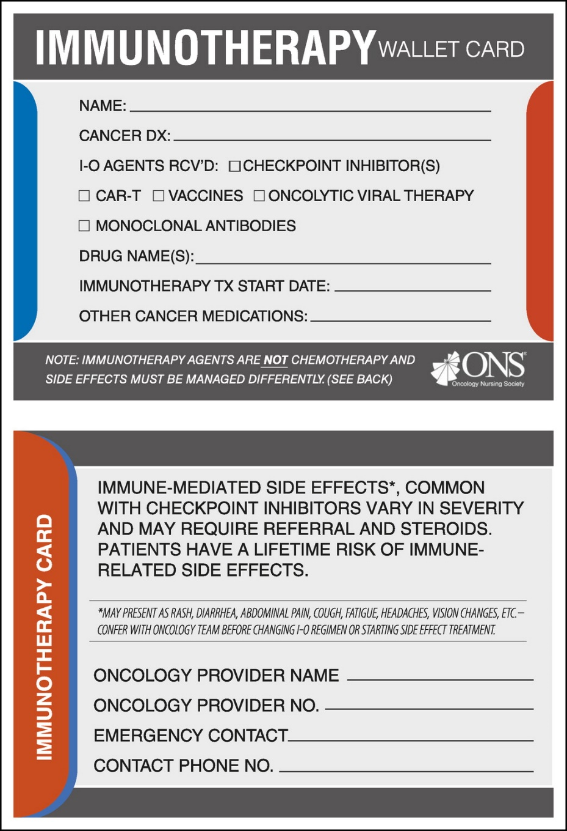
Counseling Patients and Caregivers
Set evidence-based expectations for benefits
    Many patients have high expectations due to popular success stories (eg, Jimmy Carter’s metastatic melanoma and pembrolizumab)
Benefits take longer to emerge compared with chemotherapy and targeted therapy
    Patients with large tumor burden and/or rapidly progressing disease often cannot wait
Emphasize importance of monitoring and promptly reporting symptoms
    Contact the oncology care team if experiencing any new signs or symptoms
    Report any visits to the emergency department and other HCPs
Carry an immunotherapy wallet card
at all times
Educate on irAE management
    Discontinuing ICIs because of AEs does NOT worsen survival¹
    Treating irAEs with steroids does NOT worsen response or survival^{2,3}
1. Schadendorf. JCO. 2017;35:3807. 2. Horvat. JCO. 2015;33:3193. 3. Weber. JCO. 2017;35:785.

Slide 57
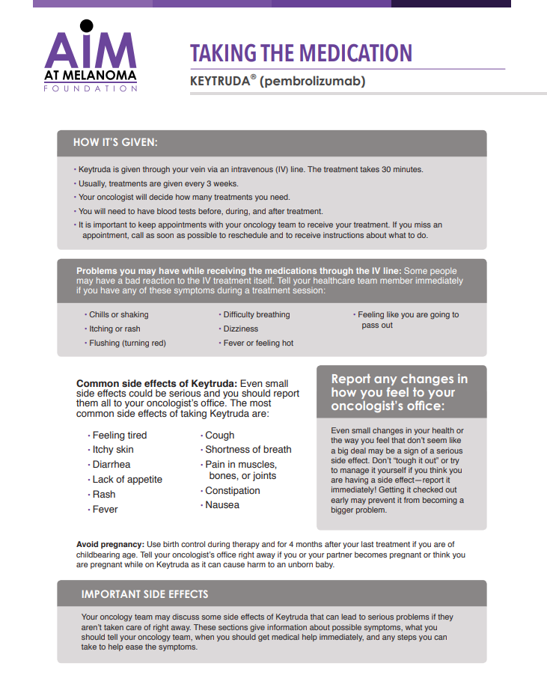

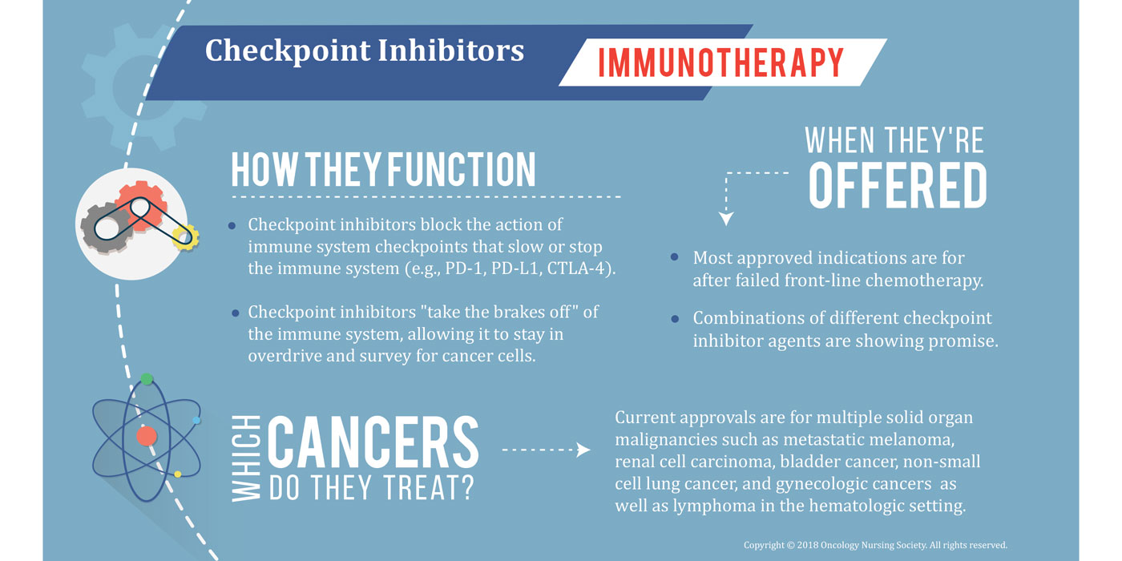
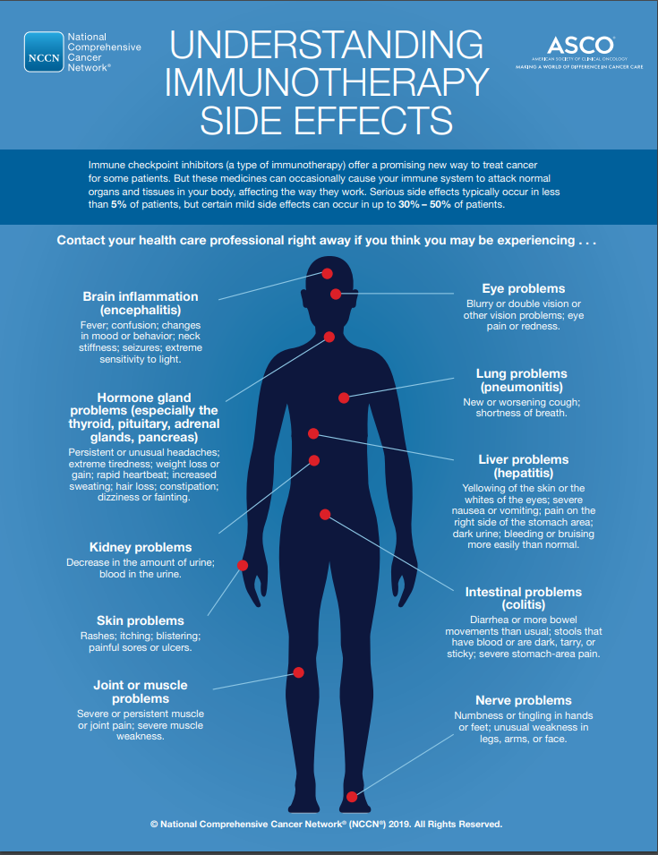
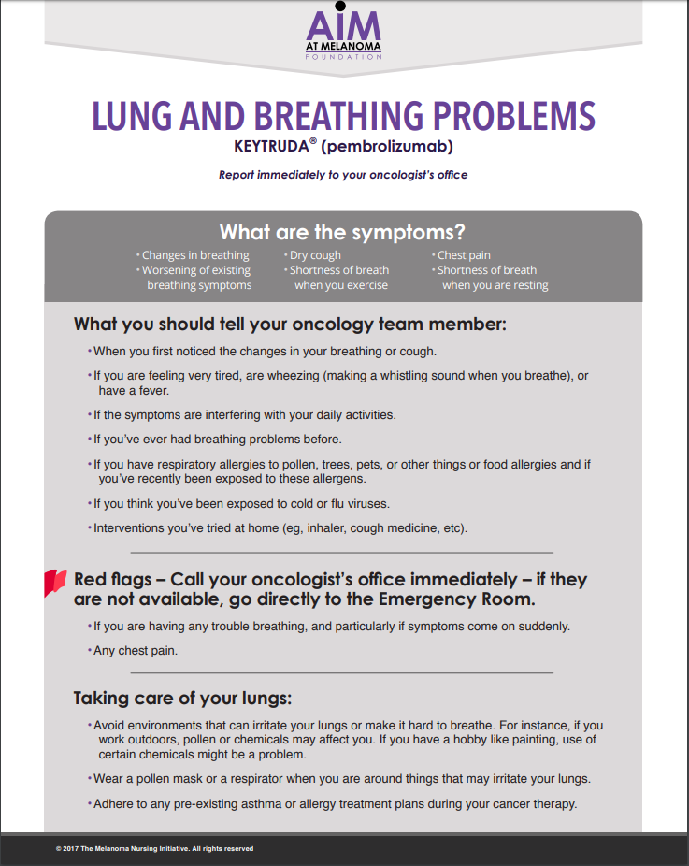
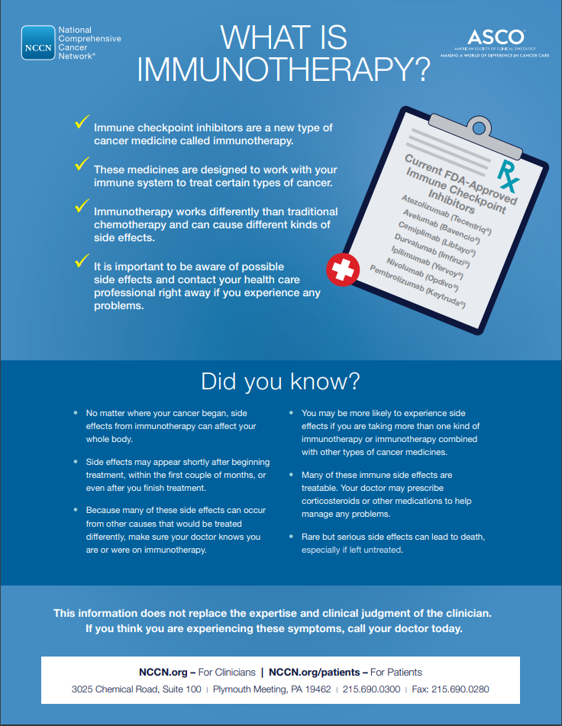
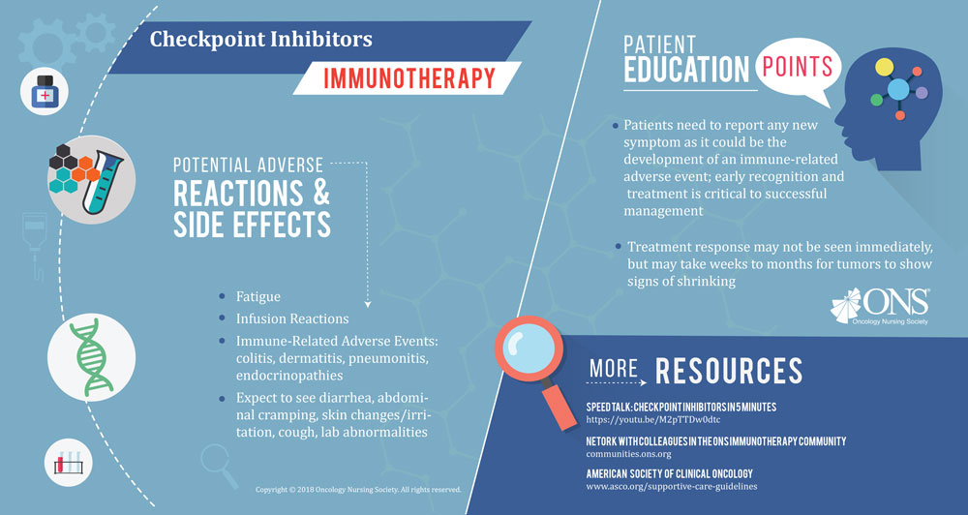
Patient Resources
cancer.net/about-us/
asco-rs-patient-education-materials/
asco-answers-fact-sheets
voice.ons.org/news-and-views/immunotherapy-treatments-impact-on-oncology-nurses
sitcancer.org/connectedold/p/patient
aimwithimmunotherapy.org/patient-action-plans/

Slide 58
Question and Answer Session

Slide 59
Go Online for More Coverage of Solid Tumors!
Downloadable slidesets from today’s presentation
FAQ commentary from today’s presentation (coming soon!)
Interactive Decision Support Tool individualizing guideline recommendations for management of chemoimmunotherapy-related AEs
deceraclinical.com/oncology
deceraclinical.com/chemoIOAEtool

