Slide 1

ProCE Pharmacy Education Series: Tackling the Patient Burden of Systemic Mastocytosis: Pharmacy-Focused Strategies to Improve Patient Outcomes
Provided by ProCE, LLC.
Supported by an educational grant from Blueprint Medicines Corporation.

Slide 2
About These Slides
Please feel free to use, update, and share some or all of these slides in your noncommercial presentations to colleagues or patients
When using our slides, please retain the source attribution:
These slides may not be published, posted online, or used in commercial presentations without permission. Please contact info@ProCE.com for details
Slide credit: ProCE.com
Notes:
Disclaimer: The materials published on the Clinical Care Options website reflect the views of the authors of the CCO material, not those of Clinical Care Options, LLC, the CME providers, or the companies providing educational grants. The materials may discuss uses and dosages for therapeutic products that have not been approved by the United States Food and Drug Administration. A qualified healthcare professional should be consulted before using any therapeutic product discussed. Readers should verify all information and data before treating patients or using any therapies described in these materials.

Slide 3
Faculty
Jonathan A. Bernstein, MD
Adjunct Professor of Clinical Medicine
Department of Internal Medicine, Division of Rheumatology, Allergy and Immunology
University of Cincinnati Medical Center
Partner
Advanced Allergy Services
Bernstein Clinical Research Center
Past President of American Academy of Allergy, Asthma, and Immunology
Cincinnati, Ohio
Ryan Haumschild, PharmD, MS, MBA, CPEL
Vice President of Pharmacy, Ambulatory
Emory Healthcare
Winship Cancer Institute
Atlanta, Georgia

Slide 4
Disclosures
The faculty reported the following relevant financial relationships or relationships to products or devices they have with ineligible companies related to the content of this educational activity:
Jonathan A. Bernstein, MD: independent contractor: Blueprint Medicine, Celldex, Cogent, Jasper, Telios.
Ryan Haumschild, PharmD, MS, MBA, CPEL, has no relevant financial relationships to disclose.

Slide 5
Learning Objectives
Describe the key drivers of SM that lead to its heterogeneous presentation
Apply safety and efficacy data for new SM therapies to optimize patient outcomes
Implement strategies to address barriers to optimal care in patients with SM

Slide 6
What Do You Know About Systemic Mastocytosis?
Improving Awareness of Systemic Mastocytosis Subtypes/Indolent Systemic Mastocytosis

Slide 7
What Is Mastocytosis?
Neoplastic disorder with substantial increase and accumulation of clonal mast cells (MCs)
  Cutaneous mastocytosis (CM): skin only
  Systemic mastocytosis (SM): extracutaneous organs, with or without skin involvement
  Mast cell sarcoma (MSC)
SM is not the same as mast cell activation syndrome (MCAS)
  MCAS is a hyperactivation disorder of clonal or nonclonal MCs
  Symptoms due to mast cell activation can be similar for SM and MCAS
Akin. J Allergy Clin Immunol Pract. 2024;12:1727.

Slide 8
Classification of Systemic Mastocytosis
Broad SM Category | WHO 5th Edition | International Consensus Classification
Nonadvanced | Bone marrow mastocytosis
 | Indolent SM | Indolent SM (bone marrow mastocytosis included as an indolent SM variant)
 | Smoldering SM | Smoldering SM
Advanced | Aggressive SM | Aggressive SM
 | SM with associated hematologic neoplasm | SM with an associated myeloid neoplasm
 | Mast cell leukemia | Mast cell leukemia
Ustun. Blood Adv. 2025 Jan 24:bloodadvances.2024012612.
Gotlib. J Natl Compr Canc Netw. 2024;22:e240030.
Notes:
SM, systemic mastocytosis.

Slide 9
Systemic Mastocytosis: Epidemiology and Pathway to Diagnosis
SM prevalence: 1 in 10,000
  ≈32,000 people in the US
  Orphan disease in US: <200,000 people
Diagnoses within SM (percent of SM patients)
  ISM: >90%
  SM with hematologic disorder: 6.0% (very rare)
  MC leukemia: 0.5% (very rare)
Mean of 6.5 yr from symptom onset to diagnosis for patients with MC disease
Time From Symptom Onset to Diagnosis
12 (12)
12 (13)
12 (11)
11 (14)
7 (14)
(n = 80)
(n = 149)
(n = 13)
(n = 13)
(n = 61)
Brockow. Immunol Allergy Clin North Am. 2014;34:283. Tse. J Allergy Clin Immunol Glob. 2024;3:100316.
Van Doormall. J Allergy Clin Immunol. 2013;131:1429. Jennings. J Allergy Clin Immunol Pract. 2014;2:70.
Notes:
AdvSM, advanced systemic mastocytosis; CM, cutaneous mastocytosis; ISM, indolent systemic mastocytosis; MC, mast cell; SD, standard deviation; SM, systemic mastocytosis; SSM, smoldering systemic mastocytosis.

Slide 10
Why Is Systemic Mastocytosis Presentation So Heterogeneous?
Variability in MCs and MC activation
  Anatomic and microenvironmental impact on MCs
  Surface receptors directing MC response (eg, CD2, CD25, CD30)
  Mediator profiles
Impact of high MC counts in a range of tissues/organs; organ damage/failure caused by MC infiltration is particularly evident in advanced SM
Mutational heterogeneity
  90% of patients with SM carry a somatic point mutation of KIT
  Somatic mutations in other genes (TET2, SRSF2, ASXL1, RUNX1, JAK2, RAS) have been associated with advanced SM
Akin. J Allergy Clin Immunol Pract. 2024.12:1727. Rufer. Leukemia. 2025;39:675. Ustun. Blood Adv. 2025;[Epub].
Notes:
MC, mast cell; SM systemic mastocytosis.

Slide 11
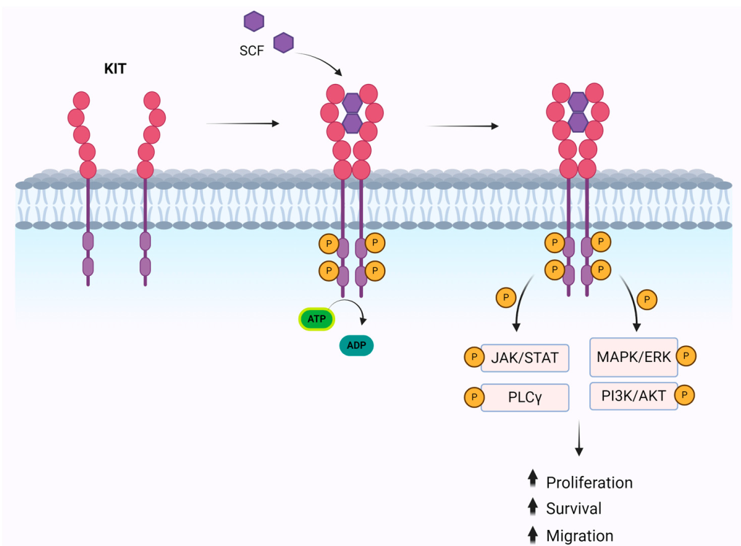
KIT Mutations as Drivers of Systemic Mastocytosis
>90% of people with mastocytosis have a
KIT somatic point mutation
  Result: ligand-independent activation (gain of function)
  Ultimate result: mast cell survival and accumulation
D816V is most common mutation (85%-90% of adult cases), but there are also others
Cilloni. Int J Mol Sci. 2024;25:10885. CC BY 4.0. No changes made.
Ustun. Blood Adv. 2025;[Epub].

Slide 12
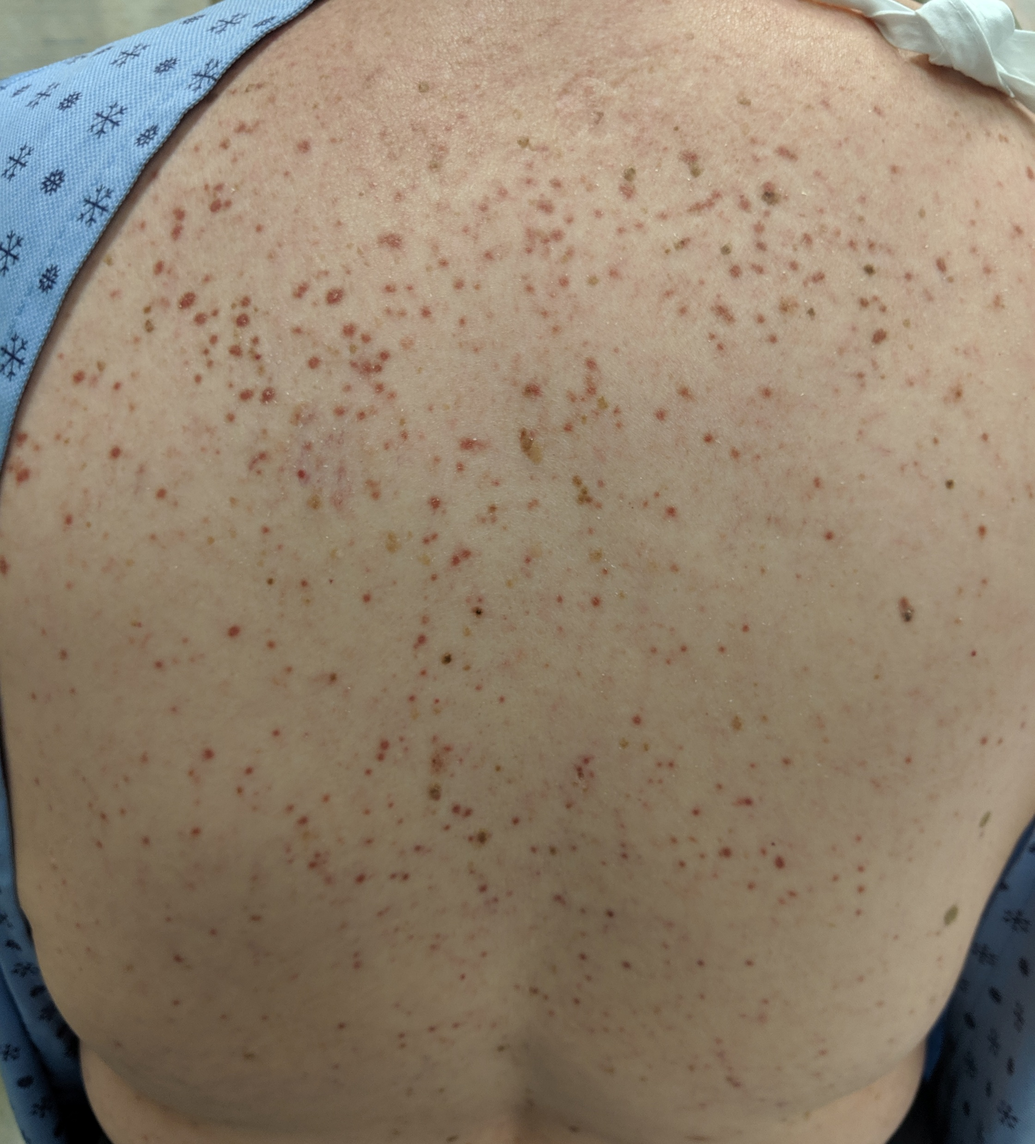
Skin Lesions of Mastocytosis
Maculopapular lesions (small, monomorphic) can be present as part of indolent SM or as isolated CM in adults
Typically larger and polymorphic lesions in children
Present in >80% of patients
In adults, often start on thighs, spread to trunk, distal extremities, and neck over time
Hartmann. J Allergy Clin Immunol. 2016;137:35. https://commons.wikimedia.org/wiki/File:Mastocytosis2019.jpg. CC BY-SA 4.0. No changes made.
Notes:
CM, cutaneous mastocytosis; SM, systemic mastocytosis.

Slide 13
Systemic Mastocytosis Clinical Presentation
System: Presentation Cutaneous, GI, CV, and bone symptoms/signs are among the most common | Histamine | Tryptase | IL-6 | PAF | PGD2 | Neurotensin | TNF | CRH | IL-8 | IL-33 | PGD2 | Chymase | INF | Renin | VIP | Serotonin | RANKL | CysLTs
Cutaneous: pruritus, flushing, urticaria, angioedema | X | X | X | X |  |  | X |  | X | X | X
CV: syncope, near syncope, lightheadedness, tachycardia | X | X | X | X |  |  | X |  |  |  |  | X |  | X
GI: abdominal cramping, esophageal reflux, nausea, vomiting, diarrhea | X | X | X | X | X | X | X |  |  |  |  |  |  |  | X | X
Musculoskeletal: bone pain, aches, osteopenia, osteoporosis |  | X | X |  |  |  | X |  |  |  | X |  |  |  |  |  | X
Neurologic: anxiety, depression, decreased concentration, memory impairment, insomnia, migraines | X |  | X | X | X | X | X | X
Respiratory: nasal congestion and pruritus, shortness of breath, wheezing, throat swelling | X |  | X | X | X |  |  |  |  |  |  |  |  |  |  |  |  | X
Systemic: fatigue, generalized malaise, weight loss | X |  | X |  |  |  | X | X
Veitch. Hematology Am Soc Hematol Educ Program. 2023;2023:396.
Notes:
CV, cardiovascular; GI, gastrointestinal.

Slide 14
Common Triggers in Systemic Mastocytosis
Extremes or change in temperature
Stress
Fatigue
Food/beverage
Medications
Infection
Hymenoptera venom
Surgery/procedures
Jennings. Immunol Allergy Clin North Am. 2018;38:505.

Slide 15
Diagnostic Algorithm for Mastocytosis
Suspicion
MC activation symptoms or anaphylaxis and/or elevated serum tryptase
Adult-onset mastocytosis in the skin (biopsy proven)
Evaluation
Biopsy (BM or involved organ)
Molecular testing for KIT D816V or other activating
KIT mutation
OR
MC immunophenotyping
Screen for FIP1L1::PDGFRA if eosinophilia is present and
KIT D816V is negative
NCCN. Clinical practice guidelines in oncology: systemic mastocytosis. V.1.2025. nccn.org.
Notes:
BM, bone marrow; MC, mast cell.

Slide 16
Diagnostic Criteria for Systemic Mastocytosis
Major | Multifocal dense aggregates of mast cells (≥15 cells in aggregates) in bone marrow and/or other extracutaneous organs
Minor | ≥25% of mast cells with atypical morphology Aberrant CD2, CD25, and/or CD30 expression on mast cells KIT D816V or other activating KIT mutation Baseline serum tryptase >20 ng/mL in the absence of associated myeloid neoplasm
WHO 5th Edition | International Consensus Classification
1 major + 1 minor criteria | 1 major criterion
OR | OR
≥3 minor criteria | ≥3 minor criteria
NCCN. Clinical practice guidelines in oncology: systemic mastocytosis. V.1.2025. nccn.org.

Slide 17
Identifying Systemic Mastocytosis Subtypes
SM Variant (SM criteria met) | Skin Lesions | B- or C-Findings | Other
Indolent SM | Typical | ≤1 B-finding | Without skin lesions: ≤1 B-finding and/or basal tryptase ≥125 ng/mL and/or dense SM in extramedullary organ
Bone marrow mastocytosis | None | None | Basal tryptase <125 ng/mL No dense SM infiltrates in extramedullary organ
Smoldering SM |  | ≥2 B-findings No C-findings
SM with associated hematologic neoplasm |  |  | WHO criteria for hematologic neoplasm
Aggressive SM |  | ≥1 C-finding
MC leukemia |  | C-findings variable | ≥20% MC in BM smears Peripheral blood: ≥10% MC (classic), <10% MC (aleukemic)
B-findings: higher SM burden (high MC burden, non-MC cytopenia, hepatomegaly, splenomegaly, lymphadenopathy)
C-findings: organ damage due to MC infiltration
Valent. Hemasphere. 2021;5:e646.
Notes:
MC, mast cell; SM, systemic mastocytosis.

Slide 18
New and Emerging Therapies for
Systemic Mastocytosis

Slide 19
Considerations for Nonadvanced and Aggressive/ Advanced SM
Referral to specialized centers is strongly recommended
Baseline DXA scan
Counsel patients regarding signs and symptoms of disease
Counsel patients to avoid known triggers of MC activation, such as extreme temperature fluctuations, stress, insect stings, venom (eg, Hymenoptera, spiders)
Carry injectable epinephrine (2 autoinjectors) to manage anaphylaxis
Assess symptom burden and quality of life using questionnaires (MQLQ, MSAF)
NCCN. Clinical practice guidelines in oncology: systemic mastocytosis. V.1.2025. nccn.org.
Notes:
DXA, dual-energy x-ray absorptiometry; MC, mast cell; MQLQ, Mastocytosis Quality of Life Questionnaire; MSAF, Mastocytosis Symptom Assessment Form; SM, systemic mastocytosis.

Slide 20
Stepwise Prophylactic Treatment Approach for Chronic Mast Cell Mediator-Related Symptoms
Organ Involvement | Stepwise Treatment
Skin: pruritus, flushing, urticaria, angioedema dermatographism | H1 blockers and H2 blockers Leukotriene receptor antagonist Aspirin | 4. Ketotifen* 5. Topical cromolyn sodium (cream/ointment 1%-4%)†
GI: diarrhea, abdominal cramping, nausea, vomiting | H2 blockers Cromolyn sodium Proton pump inhibitors | 4. Leukotriene receptor antagonist 5. Ketotifen*
Neurologic: headache, poor concentration and memory, brain fog | H1 blockers and H2 blockers Cromolyn sodium | 3. Aspirin 4. Ketotifen*
CV: presyncope, tachycardia | H1 blockers and H2 blockers Corticosteroids | 3. Omalizumab
Pulmonary: wheezing, throat swelling | H1 blockers and H2 blockers Corticosteroids | 3. Omalizumab
Naso-ocular: nasal stuffiness, nasal pruritus, conjunctival injection | H1 blockers Corticosteroids | 3. Cromolyn sodium
*Available as a compounded agent. †Standard doses need to be titrated. Higher doses may be necessary for symptoms refractory to standard dose treatment.
NCCN. Clinical practice guidelines in oncology: systemic mastocytosis. V.1.2025. nccn.org.
Notes:
CV, cardiovascular; GI, gastrointestinal; LABA, long-acting β-adrenergic agonists.

Slide 21
Options Other Than Antimediator Therapies
Symptomatic ISM or SSM
Preferred regimens
  Clinical trial
  Avapritinib (ISM only, if platelets ≥50 x 10⁹/L)
Inadequate response/intolerance
  Preferred: clinical trial
  In certain circumstances: cladribine OR peginterferon alfa-2a ± prednisone OR midostaurin
Aggressive SM
Preferred regimens
  Clinical trial
  Avapritinib (ISM only, if platelets ≥50 x 10⁹/L)
  Midostaurin
Other recommended
  Cladribine
  Peginterferon alfa-2a ± prednisone
Some circumstances (imatinib)
Inadequate response/intolerance: subsequent line, allogeneic HCT
NCCN. Clinical practice guidelines in oncology: systemic mastocytosis. V.1.2025. nccn.org.
Notes:
HCT, hematopoietic cell transplantation; ISM, indolent systemic mastocytosis; SM, systemic mastocytosis; SSM, smoldering systemic mastocytosis.

Slide 22
Characteristics of KIT Inhibitors
Agent | Mechanism | Notes
Midostaurin | Multikinase inhibitor; activity against D816V and WT KIT | FDA approved for treatment of advanced SM (ASM, SM-AHN, MCL) in adults
Imatinib | KIT inhibitor | FDA approved for treatment of ASM in adults without KIT D816V mutation (or unknown mutation status)
Avapritinib | Highly selective KIT D816V inhibitor (negligible activity against WT KIT) | FDA approved for advanced SM (ASM, SM-AHN, MCL) and ISM in adults with platelet counts ≥50 x 10⁹/L Crosses blood–brain barrier Higher potency vs midostaurin based on KIT D816V IC₅₀
Elenestinib (BLU-263) | Selective KIT D816V inhibitor | Investigational Limited CNS penetration and daily dosing
Bezuclastinib (CGT9486) | Selective KIT D816V inhibitor | Investigational Low CNS penetration, high selectivity, favorable pharmacokinetics
Tremblay. J Blood Med. 2024;15:421. Midostaurin PI. Imatinib PI. Avapritinib PI.
Notes:
ASM, aggressive systemic mastocytosis; CNS, central nervous system; ISM, indolent systemic mastocytosis; MCL, mast cell leukemia; SM, systemic mastocytosis; SM-AHN, systemic mastocytosis with associated hematologic neoplasm.

Slide 23
Avapritinib vs Placebo in ISM: PIONEER Part 2
Patients (N = 212) with moderate to severe ISM symptoms (TSS ≥28)
Uncontrolled symptoms despite ≥2 antimediator drugs
Groups
  Avapritinib 25 mg once daily (n = 141)
  Placebo (n = 71) best supportive care
Following 24 wk with avapritinib or placebo, patients were eligible to receive avapritinib for up to 5 yr
Gotlib. NEJM Evidence. 2023;2:EVIDoa2200339.
Notes:
ISM, indolent systemic mastocytosis; TSS, total symptom score.

Slide 24
Avapritinib vs Placebo in ISM: PIONEER Part 2—Results
Significantly greater improvement in symptom score and measures of mast cell burden with avapritinib vs placebo
P <.001
P <.001
P <.001
P = .005
Gotlib. NEJM Evidence. 2023;2:EVIDoa2200339.
Notes:
BM, bone marrow; VAF, variant allele fraction.

Slide 25
Long-term Improvements in QoL and Symptoms With Avapritinib in ISM: PIONEER
Mean change in TSS: -17.51 (Wk 96) and -20.07 (Wk 144)
Mastocytosis QoL Score
Total Symptom Score
Individual Domain Symptom Scores
Avapritinib
96 Wk
(n = 164)
Avapritinib
144 Wk
(n=113)
Avapritinib
96 Wk
(n = 140)
Avapritinib
144 Wk
(n=117)
Gastrointestinal Domain
Skin Domain
Neurocognitive Domain
Symptoms Change
(Mean TSS Change From Baseline)
Symptoms Change
(Mean Symptom Score Change)
QoL Change (Mean % Change From Baseline in MC-QoL)
Change in symptom score at 96 wk
Change in symptom score at 144 wk
Data cut-off: September 2024
Castells. 2025 AAAAI/WAO Joint Congress. Abstr 534.
Notes:
ISM, indolent systemic mastocytosis; MC-QoL, mast cell quality of life; QoL, quality of life; TSS, total symptom score;.

Slide 26
Avapritinib vs Best Available Therapy in Advanced SM
Pooled data from several studies
  Avapritinib group: phase I EXPLORER,
  phase II PATHFINDER
  Best available therapy group: retrospective chart review (6 sites)
Outcomes (AVA vs BAT)
  Better survival, HR: 0.48 (95% CI: 0.29-0.79;
  P = .004)
  Longer duration of treatment, HR: 0.36
  (95% CI: 0.26-0.51; P <.001)
  60% greater reduction in serum tryptase levels, P <.001
P <.05 after 3 mo
Avapritinib response rates are also high in patients who received prior systemic therapy
Reiter. Leukemia. 2022;36:2108. Reiter. Blood Adv. 2022;6:5750.
Notes:
AVA, avapritinib; BAT, best available therapy; IPTW, inverse probability of treatment weighting; SM, systemic mastocytosis.

Slide 27
Avapritinib: Dosing and Administration
Dosage and Administration
ISM dosage: 25 mg orally once daily
Advanced SM dosage: 200 mg orally once daily
Administer on an empty stomach (at least 1 hr before or 2 hr after a meal)
Do not repeat dose if vomiting occurs; do not make up for missed dose within 8 hr of next dose
See prescribing information regarding dose reduction/modification for adverse reactions
Avapritinib PI.
Notes:
ISM, indolent systemic mastocytosis; SM, systemic mastocytosis.

Slide 28
Avapritinib: Safety—Warnings and Precautions, Common Adverse Reactions (No Contraindications)
Intracranial hemorrhage
  2.9% of patients with GIST or advanced SM in clinical trials
  No events in ISM PIONEER study
  Fatal events: <1% of patients in trials
Cognitive effects: withhold avapritinib, depending on severity
Photosensitivity: advise patients to avoid direct UV exposure
Embryo-fetal toxicity
  Can cause fetal harm
  Advise people of reproductive potential of potential risk to fetus and effective contraception
  NOTE: Per guidelines on SM management and pregnancy, cladribine and TKIs are not recommended
Most Common Adverse Reactions in Clinical Trials
Advanced SM (≥20% incidence): edema, diarrhea, nausea, and fatigue/asthenia
ISM (≥10% incidence): eye edema, dizziness, peripheral edema, flushing
Avapritinib PI. Gotlib. J Natl Compr Canc Netw. 2018;16:1500.
Notes:
GIST, gastrointestinal stromal tumor; ISM, indolent systemic mastocytosis; SM, systemic mastocytosis; TKI, tyrosine kinase inhibitor.

Slide 29
Bezuclastinib and Elenestinib:
Investigational Selective KIT Inhibitors
Bezuclastinib and Elenestinib in Nonadvanced SM
KIT Inhibitor/Trial Information | Improved Symptoms | Reduced Tryptase | Reduced KIT D816V | Reduced MC Burden | Favorable Safety
Elenestinib (HARBOR) Part 1 of phase II/III trial for ISM | X | X | X | X | X
Bezuclastinib (SUMMIT) Part 1 of phase II trial in for nonadvanced SM | X | X | X | X | X
In the ongoing phase II Apex trial for advanced SM, bezuclastinib
Reduced SM burden (tryptase, MC burden, KIT D816V)
Was associated with progression-free survival rate of 82% at 24 mo
Had favorable safety and tolerability
Tashi. ASH 2023. Abstr 76. Rein. 2024 EHA Hybrid Conference. Abstr P1055. DeAngelo. ASH 2024. Abstr 659.
Notes:
ISM, indolent systemic mastocytosis; MC, mast cell; SM, systemic mastocytosis.

Slide 30
Other Emerging Therapies
Masitinib
Phase III
TL-895
Phase II/III
ISM or myelofibrosis
Severe indolent or smoldering SM
Bruton tyrosine kinase inhibitor
NCT04333108. NCT04655118.
Notes:
ISM, indolent systemic mastocytosis; SM, systemic mastocytosis.

Slide 31
Unmasking the Patient Burden:
Pharmacist-Focused Strategies to Improve Care

Slide 32
Anaphylaxis Checklist for Pharmacists*
Dispense prescribed epinephrine devices
  Prescribed device
  Appropriate dose (weight based)
  Check that 2 devices have been prescribed
  Remind patients to check the expiration date
  Check that patients have an action plan
  Reinforce that patients should always carry their device
Provide epinephrine device education
  Teach patients how to use their device using a trainer
  Educate patients on correct storage
  Ensure patients understand that epinephrine is the first line for anaphylaxis, not antihistamines
Provide telepharmacy options for patients in rural areas†
Be prepared for an anaphylaxis emergency
  Train staff on signs/symptoms, positioning, epinephrine administration
  Display action plans
Educate people with SM on the increased risk of anaphylaxis they face
*Modified from source developed by the Australasian Society of Clinical immunology and Allergy. †Expert perspective.
allergy.org.au/hp/anaphylaxis/anaphylaxis-checklist-for-pharmacists
Notes:
SM, systemic mastocytosis.

Slide 33
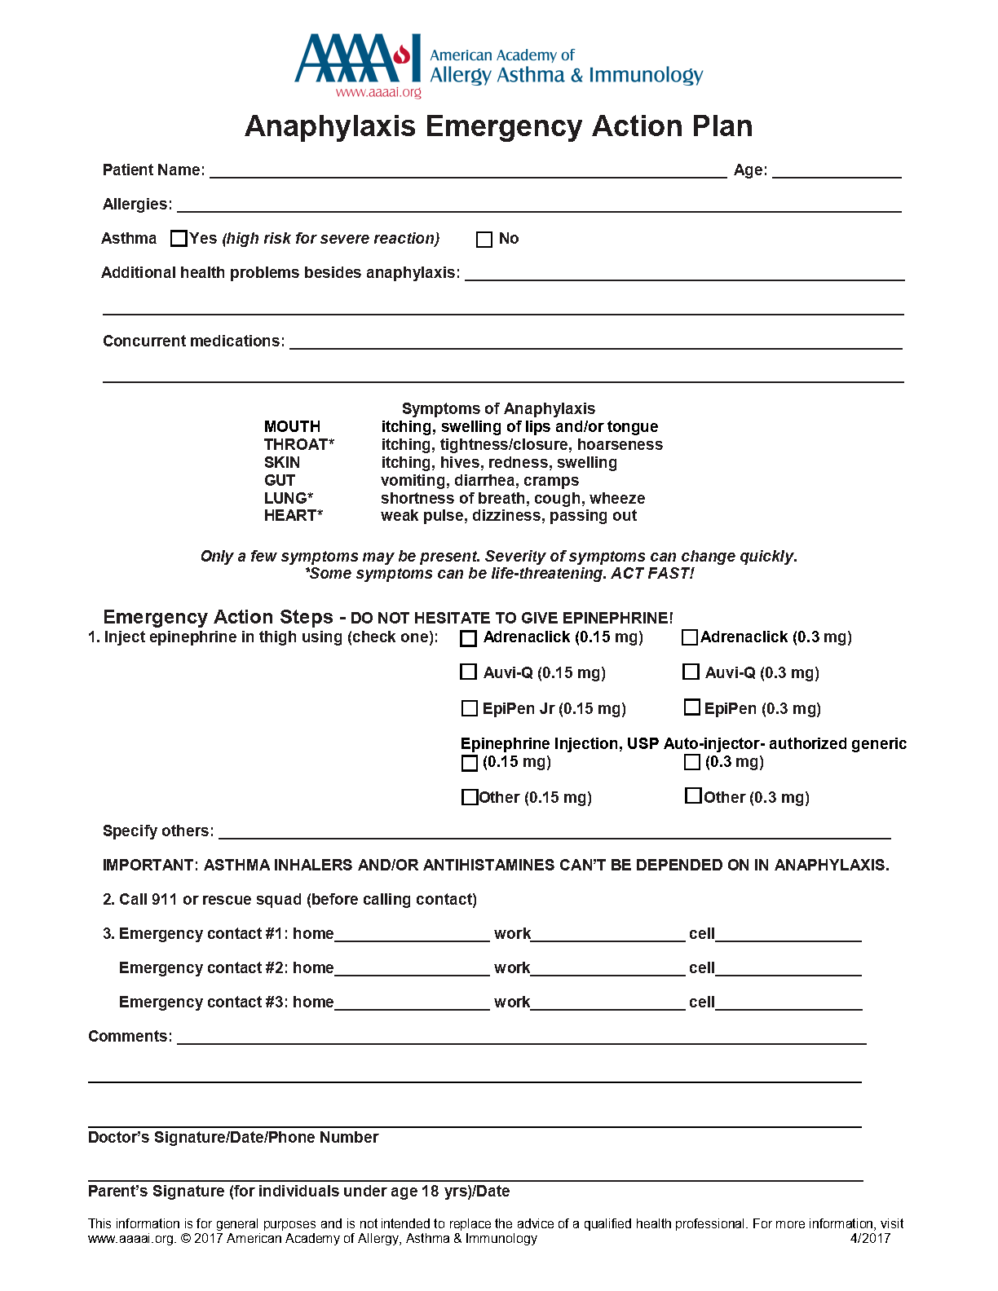
Patient Anaphylaxis Education
Patients should know that anaphylaxis is common in SM
  Reported prevalence: 24%-49%
  TouchStone SM Patient Survey found that within 1 yr:
    30% had ≥1 ED visit for anaphylaxis
    14% used epinephrine ≥2 times
Patients need to know anaphylaxis symptoms and have a treatment plan that outlines when epinephrine should be used
Gotlib. J Natl Compr Canc Netw. 2018;16:1500. Mesa. Cancer. 2022;128:3691. NCCN. Clinical practice guidelines in oncology: systemic mastocytosis. V.1.2025. nccn.org. www.aaaai.org/aaaai/media/medialibrary/pdf%20documents/libraries/anaphylaxis-emergency-action-plan.pdf.
Notes:
ED, emergency department; SM, systemic mastocytosis.

Slide 34
Polypharmacy Is Common in Systemic Mastocytosis
Case Example: Interventions for a Patient With ISM and Refractory Symptoms
Patients routinely use multiple medications to manage SM
  >50% use ≥3 prescription medications
  >60% use ≥3 over-the-counter medications
Risk of polypharmacy increases when
  Multiple HCPs and pharmacies are involved without proper interprofessional communication
  There is not an HCP who knows the patient’s full regimen
Problem/Symptom | Treatment
Osteoporosis | Bisphosphonates
Hymenoptera allergy | Allergen desensitization
MC mediator symptoms | Medications to target MC mediators (eg, antihistamines, cromolyn)
Anaphylaxis | Epinephrine
Cutaneous lesions | Antihistamines, topical corticosteroids, phototherapy, omalizumab
Depression | Antidepressant
GERD, PUD | Proton pump inhibitors
Hamilton. Front Allergy. 2024;5:1401187. Mesa. Cancer. 2022;128:3691. Sherman. US Pharm. 2017;42:HS-14-HS-20.
Notes:
GERD, gastroesophageal reflux disease; HCP, healthcare professional; ISM, indolent systemic mastocytosis; MC, mast cell; PUD, peptic ulcer disease SM, systemic mastocytosis.

Slide 35
Including Patients in Discussions About Medications Can Reduce the Risk of Polypharmacy
Patients can help reduce polypharmacy risk by:
Bringing a current list of medications to appointments
Talking with their HCP before starting nonprescription treatments
Talking with their HCP about how long a medication should be taken, if a medication can be stopped
Reviewing medications prescribed after hospital discharge with their HCP
Trying to get all medications from 1 pharmacy
Asking about deprescribing
New Treatments Can Change the Therapeutic Landscape
In the PIONEER trial, patients using the KIT D816V inhibitor avapritinib were more likely to reduce or discontinue symptom-directed polypharmacy (best supportive care)
Polypharmacy Change, % | Avapritinib (n = 141) | Placebo (n = 71)
Decreased | 21 | 13
Discontinued | 3 | 0
Vordenberg. JAMA. 2023;330:672. Akin. J Allergy Clin Immunol. 2024;153(supp):AB225.
Notes:
HCP, healthcare professional.

Slide 36
Multidisciplinary Care Is Often Needed for
Systemic Mastocytosis
Case Example: Multidisciplinary Care for a Patient With ISM and Refractory Symptoms
Guidelines strongly recommend referring people who have or may have SM to specialized centers
Problem/Symptom | Specialist(s) Involved
Osteoporosis | Endocrinologist
Hymenoptera allergy | Allergist/Immunologist
MC mediator symptoms | Allergist/Immunologist
Anaphylaxis | Allergist/Immunologist
Cutaneous lesions | Dermatologist Dermatopathologist Allergist/Immunologist
Depression | Psychiatrist
GERD, PUD | Gastroenterologist
Hepatosplenomegaly, lymphadenopathy | Gastroenterologist, Allergist/Immunologist, Hematologist
SM diagnosis | Pathologist experienced with SM assessment
NCCN. Clinical practice guidelines in oncology: systemic mastocytosis. V.1.2025. nccn.org. Hamilton. Front Allergy. 2024;5:1401187.
Notes:
GERD, gastroesophageal reflux disease; ISM, indolent systemic mastocytosis; MC, mast cell; PUD, peptic ulcer disease; SM, systemic mastocytosis.

Slide 37
Key Takeaways
Refer patients for further assessment if SM is suspected, preferably to a center that specialized in SM care
Treatment options for people with SM include antimediator and cytoreductive therapies
KIT mutations, especially KIT D816V, are drivers of SM pathophysiology, and selective KIT inhibitors are important emerging treatment options
People with SM commonly receive many treatments and need treatment adjustments, communication with patients and SM care team HCPs is critical for optimal care
Notes:
HCP, healthcare professional; SM, systemic mastocytosis.

Slide 38
Go Online for More ProCE
Coverage of Systemic Mastocytosis!
Downloadable slideset to use as a self-study resource or in your own presentations​
Text Module that provides pharmacist-specific considerations for optimal SM management - Coming soon!​
Podcast covering key take-home messages and summarizing questions from the live webinar – Coming soon!
proce.com

