Slide 1
Conference to Clinic: A New Paradigm of Precision Medicine in Progressing Desmoid Tumors
Bernd Kasper, MD, PhD
Associate Professor
Mannheim University Medical Center
University of Heidelberg
Mannheim Cancer Center, Sarcoma Unit
Mannheim, Germany
Supported by an educational grant from SpringWorks Therapeutics, Inc.

Slide 2

About These Slides
Please feel free to use and share some or all of these slides in your noncommercial presentations to colleagues or patients
When using our slides, please retain the source attribution:
These slides may not be published, posted online, or used in commercial presentations without permission. Please contact permissions@clinicaloptions.com for details
Slide credit: clinicaloptions.com
Notes:
Disclaimer: The materials published on the Clinical Care Options Web site reflect the views of the authors of the CCO material, not those of Clinical Care Options, LLC, the CME providers, or the companies providing educational grants. The materials may discuss uses and dosages for therapeutic products that have not been approved by the United States Food and Drug Administration. A qualified healthcare professional should be consulted before using any therapeutic product discussed. Readers should verify all information and data before treating patients or using any therapies described in these materials.

Slide 3
Disclosures
The faculty reported the following relevant financial relationships or relationships to products or devices they have with ineligible companies related to the content of this educational activity:
Bernd Kasper, MD, PhD: consultant/advisor/speaker: Ayala, Bayer, Boehringer Ingelheim, GlaxoSmithKline, PharmaMar, SpringWorks; researcher: PharmaMar, Rain Therapeutics, SpringWorks.

Slide 4
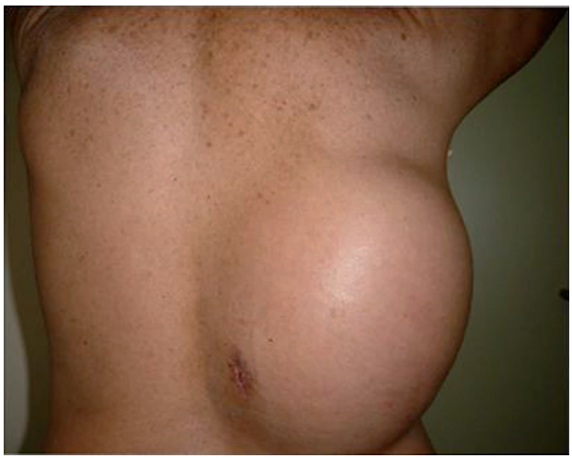
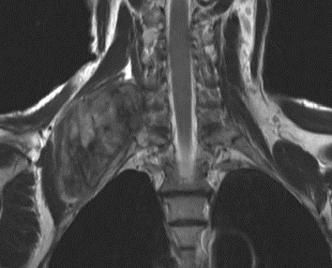
Desmoid Tumors: Background
DTs are rare, locally aggressive, and invasive soft-tissue tumors that are challenging to manage due to variable presentation, unpredictable disease course, and lack of approved therapies
∼5-6 cases/1 million of the population per yr
Female predominance and peak at ~30 yr of age
1500-1700 cases annually in US
90%-95% DTs are sporadic; 5%-10% arise in context of FAP
Driven by mutations in CTNNB1 (beta-catenin) or APC
Mechanistic rationale exists for using GSIs in DT treatment as DTs highly express Notch which can be blocked by GSIs
Kasper. Eur J Cancer. 2015;51:127. Hughes. Clin Cancer Res. 2015;21:7.
Riedel. Cancer. 2022;128:3027. Kasper. Oncologist. 2011;16:682.
Notes:
DT, desmoid tumor; FAP, familial adenomatous polyposis; GSI, gamma secretase inhibitor.

Slide 5
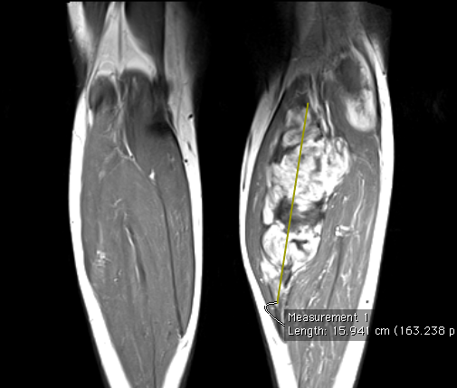
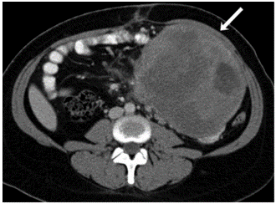
Desmoid Tumors: Presentation
DTs start as a painless or minimally painful mass with a history of slow growth
DTs usually grow as a single lesion and can result in tissue/organ infiltration but do not metastasize
DT can clinically lead to:
  Chronic pain
  Functional deficits and debility
  Disfiguration
  Psychological problems
  Decreased QoL
  Death
Zhang. Oncology Letters 2021;21:1. Riedel. Cancer. 2022;128:3027.
Braschi-Amirfarzan. Radiographics. 2016;36:767.
Notes:
DT, desmoid tumor; QoL, quality of life.

Slide 6
Desmoid Consensus Initiative:
Current Treatment Algorithm
Diagnosis
(core needle biopsy)
Active surveillance
Active surveillance continued if tumor stable or shrinking
Progression
Systemic therapy
(unless abdominal wall tumor)
Surgical resection for abdominal wall tumors
Further/subsequent progression(s)
Other systemic therapies (surgery, radiation, chemotherapy, other)
Adapted from The Desmoid Tumor Working Group. EJC. 2020;127:96.

Slide 7
Treatment Landscape for Desmoid Tumors
Active surveillance
Surgery
Radiotherapy
Systemic treatment
Antihormonal therapy (+ NSAID)
Chemotherapy
TKIs
Investigational agents
Indications for treatment: life-threatening, compromised organ function, pain, limited movement, tumor growth
Individualize treatment to optimize tumor control and improve symptoms
Kasper. Oncologist 2011;16:682. Gounder. 2020.126:531.
Notes:
NSAID, nonsteroidal anti-inflammatory drug; TKI, tyrosine kinase inhibitor.

Slide 8
Chemotherapy
  MTX + vinblastine¹
  MTX + vinorelbine² or vinorelbine alone³
  Anthracycline-based regimens⁴
  Pegylated liposomal doxorubicin⁵⁻⁷
  Indication: Nonresectable, rapidly growing, symptomatic, and/or life-threatening DT should preferably be treated with chemotherapy
1. Skapek. JCO. 2007;25:501. 2. Palassini. Cancer. 2017;23:86. 3. Mir. ASCO 2016. Abstr 11050. 4. de Camargo. Cancer. 2010;116:2258.
5. Constantinidou. EJC. 2009;45:2930. 6. Constantinidou. Acta Oncol. 2011;50:455. 7. Pang. ASCO 2016. Abstr 11032.
Notes:
DT, desmoid tumor; MTX, methotrexate.

Slide 9
Selected Chemotherapy Regimens
No randomized studies!
Reference | Chemotherapy Regimen | N | Responses | Follow-up, Mo
Patel | Doxorubicin 60-90 mg/m² + dacarbazine 750-1000 mg/m² (median of 5 cycles) | 12 | 2 CR 4 PR 2 SD | 28-235
Gega | Doxorubicin 20 mg/m² Days 1-4 + dacarbazine 150 mg Days 1-4; Q28 days x 4-5 cycles | 7 | 3 CR 4 PR | 33-108
Constantinidou | Pegylated liposomal doxorubicin 50 mg/m²; Q28 days | 12 | 4 PR 7 SD | 7-39
Wehl | Pegylated liposomal doxorubicin 20-50 mg/m²; Q21 days | 4 | 4 PR | NR
Azzarelli | Vinblastine 6 mg/m² + methotrexate 30 mg/m²; weekly (median 1 yr of therapy) | 27 | 4 OR 19 SD | 6-96
Weiss | Vinorelbine 20 mg/m² + methotrexate 50 mg/m²; weekly | 13 | NR | <12
Skapek | Vinblastine 5 mg/m² + methotrexate 30 mg/m²; weekly x 26 wk, then every other week x 26 wk | 27 | 8 PR 10 SD | 5-37
Pilz | VAIA, VAC, cyclophosphamide + ifosfamide | 19 | 4 CR 5 PR | NR
Kasper. Oncologist. 2011;16:682.
Notes:
CR, complete response; NR, not reported; OR, objective response; PR, partial response; SD, stable disease; VAC, vincristine/dactinomycin/cyclophosphamide; VAIA, vincristine/doxorubicin/ifosfamide/dactinomycin.

Slide 10
Alliance A091105: Sorafenib vs Placebo in
Advanced and Refractory Desmoid Tumors
Randomized, double blind, placebo-controlled phase III study
100
90
Sorafenib
80
70
60
 | Patients, n | Events, n | Median PFS, Mo (95% CI)
Sorafenib | 49 | 7 | NE (NE-NE)
Placebo | 35 | 22 | 11.3 (5.7-NE)
HR: 0.13 (95% CI: 0.05-0.31; P <.001)
PFS (%)
50
40
Placebo
30
20
10
0
0
3
6
9
12
15
18
21
24
27
30
33
36
Mo
Gounder. NEJM. 2018;379:2417.
Notes:
NE, not evaluable; PFS, progression-free survival.

Slide 11
DESMOPAZ: Pazopanib vs MTX + Vinblastine in PDT
40
Pazopanib Best OR
Noncomparative, randomized,
open-label phase II study
30
PD
SD
PR
20
10
0
-10
Change in Tumor Size From Baseline (%)
-20
-30
-40
-50
Pazopanib PFS
-60
100
100
MTX + Vinblastine PFS
-70
Patients (n = 46)
80
80
40
30
MTX + Vinblastine Best OR
60
60
20
PFS (%)
10
40
40
0
-10
Change in Tumor Size From Baseline (%)
-20
20
20
-30
-40
0
0
-50
0
6
12
18
24
30
36
0
6
12
18
24
30
36
-60
Patient at Risk, n
(Censored)
Mo
Mo
-70
-80
46 (1) | 42 (9) | 30 (8) | 16 (6) | 10 (9) | 1 (1) | 0
20 (1) | 15 (3) | 12(2) | 10 (3) | 7 (6) | 1 (1) | 0
Patients (n = 20)
Toulmonde. Lancet Oncol. 2019;20:1263.
Notes:
MTX, methotrexate; OR, overall response; PD, progressive disease; PDT, progressive desmoid tumor; PFS, progression-free survival; PR, partial response; SD, stable disease.

Slide 12
Efficacy Summary of TKIs in Desmoid Tumors
Study | N | Inclusion Criteria | Treatment and Dose* | Treatment Duration | ORR, % | 6-Mo PFS, % | 12-Mo PFS, % | 24-Mo PFS, %
Heinrich | 19 | Heavily pretreated patients | Imatinib 800 mg | 325 days | 16 | 53 | 37 | NE
Penel | 35 | Radiological evidence for PD | Imatinib 400 mg | 1 yr | 11 | 80 | 67 | 55
Chugh | 49 | Locally advanced disease | Imatinib 200-600 mg | Until PD | 6 | 84 | 66 | NE
Kasper | 38 | RECIST PD | Imatinib 800 mg | 2 yr | 19 | 65 | 59 | 45
Gounder | 50 | Progressive or symptomatic | Sorafenib 400 mg | Until PD | 33 | NE | 89 | 81
Toulmonde | 48 | RECIST PD | Pazopanib 800 mg | 1 yr | 37 | 84 | 86 | 67
*All administered once daily.
Kasper. Cancer. 2020;126:5213.
Notes:
NE, not evaluated; ORR, overall response rate; PD, progressive disease; PFS, progression-free survival; RECIST, Response Evaluation Criteria in Solid Tumors; TKI, tyrosine kinase inhibitor.

Slide 13
Gamma Secretase Inhibitors
No regulatory-approved therapies
for the treatment of DT
Chemotherapy and TKIs have
long-term toxicity concerns and tolerability issues
GSIs block Notch, which is highly expressed in DTs, and mechanistically leads to rationale for use of GSIs in the treatment of DTs
2 GSIs currently under development for DT treatment: nirogacestat and AL102
Wnt
pathway
Notch
pathway
Notch
Extracellular
Plasma
membrane
Wnt
Intracellular
DvI
GSK3β
Axin
APC
β-catenin
NICD
Canonical Wnt signaling
HES1
Crosstalk
Tcf4
Messersmith. Clin Cancer Res. 2015;21:60. Kummar. JCO. 2017;35:1561. Kasper. Cancer. 2020;126:5213.
Kasper. ESMO 2022. Abstr LBA2. Gounder. ESMO 2022. Abstr 1488MO.
Notes:
DT, desmoid tumor; GSI, gamma secretase inhibitor; TKI, tyrosine kinase inhibitor.

Slide 14
DeFi: Nirogacestat vs Placebo in Progressive DTs
Randomized, multicenter, double-blind, placebo-controlled phase III trial
(data cutoff: April 7, 2022)
Primary endpoint: PFS
Secondary endpoints: ORR, patient-reported outcomes (symptom burden,
physical function, QoL)
Stratified by intra- vs extra-abdominal tumor
28-day Cycles
Adult patients with histologically confirmed progressive DT per RECIST; newly diagnosed nonsurgical candidate or R/R disease after ≥1 treatment
(N = 142)
Nirogacestat 150 mg BID
(n = 70)
Open-label Extension*
Radiographic
PD or withdrawal
Nirogacestat
150 mg BID
Placebo BID
(n = 72)
*Patients randomized to placebo who experienced PD or patients randomized to nirogacestat who experienced PD but are deriving clinical benefit from treatment are eligible to continue open-label nirogacestat
Kasper. ESMO 2022. Abstr LBA2.
Notes:
DT, desmoid tumor; PD, progressive disease; PFS, progression-free survival; ORR, objective response rate; QoL, quality of life; RECIST, Response Evaluation Criteria in Solid Tumors; R/R relapsed/refractory.

Slide 15
DeFi: PFS
1.0
0.9
0.8
0.7
0.6
Probability of PFS
0.5
0.4
0.3
0.2
 | Events, n | mPFS, mo (95% CI) | HR (95% CI)
Nirogacestat (n = 70) | 12 | NE (NE-NE) | 0.29 (0.15-0.55) P <.001
Placebo (n = 72) | 37 | 15.1 (8.4-NE)
0.1
0
0
2
4
6
8
10
12
14
16
18
20
22
24
26
28
30
32
Mo
Patients at Risk, n
Nirogacestat | 70 | 63 | 56 | 52 | 52 | 47 | 46 | 44 | 44 | 41 | 26 | 26 | 17 | 12 | 4 | 4 | 0
Placebo | 72 | 67 | 58 | 47 | 45 | 40 | 32 | 29 | 27 | 25 | 10 | 8 | 6 | 5 | 1 | 1 | 0
Median follow-up time was 19.2 mo for nirogacestat and 10.9 mo for placebo
Kasper. ESMO 2022. Abstr LBA2.
Notes:
m, median; NE, not estimable; PFS, progression-free survival.

Slide 16
DeFi: ORR
Outcome | Nirogacestat (n = 70) | Placebo (n = 72)
ORR (CR + PR), n (%) [95% CI] | 29 (41) [30.2-54.5] | 6 (8) [3.1-17.3]
 | P <.001
Best overall response, n (%) CR PR SD PD Not evaluable | 5 (7) 24 (34) 35 (50) 1 (1) 4 (6) | 0 6 (8) 55 (76) 10 (14) 1 (1)
Median time to objective response, mo (range) | 5.6 (2.6-19.4) | 11.1 (2.8-16.4)
Median KM estimate of objective response duration, mo (95% CI) | NE (NE-NE) | NE (8.3-NE)
Kasper. ESMO 2022. Abstr LBA2.
Notes:
CR, complete response; KM, Kaplan Meier; NE, not estimable; ORR, objective response rate; PD, progressive disease; PR, partial response; SD, stable disease.

Slide 17
DeFi: Patient-Reported Secondary Endpoints
Nirogacestat significantly improved patient-reported outcomes compared with placebo with durable responses noted throughout treatment
  Pain
  DT-specific symptom severity
  Physical/role functioning
  QoL
Change From Baseline to Cycle 10 Analysis Visit
Outcome Measure (LS Mean) | Nirogacestat | Placebo | Difference
BPI-SF Worst Pain Intensity | -1.5 | -0.04 | -1.5 P <.001
GODDESS DTSS Total Symptom Score | -1.2 | 0.4 | -1.6 P <.001
GODDESS DTIS Physical Functioning Impact Score | -0.7 | 0.2 | -0.8 P <.001
Kasper. ESMO 2022. Abstr LBA2.
Notes:
BPI-SF, Brief Pain Inventory-Short Form; DT, desmoid tumor; DTIS, desmoid tumor impact scale; DTSS, Desmoid Tumor symptom scale; GODDESS, Gounder/Desmoid Tumor Research Foundation Desmoid Symptom/Impact Scale; LS, least squares; QoL, quality of life;

Slide 18
DeFi: Safety
TEAE, (%) | Nirogacestat (n = 69) |  | Placebo (n = 72)
 | Any Grade | Grade ≥3 | Any Grade | Grade ≥3
Any TEAE | 69 (100) | 39 (57) | 69 (96) | 12 (17)
TEAE in ≥25% of patients Diarrhea Nausea Fatigue Low phos Rash Headache Stomatitis | 58 (84) 37 (54) 35 (51) 29 (42) 22 (32) 20 (29) 20 (29) | 11 (16) 1 (1) 2 (3) 2 (3) 4 (6) 0 3 (4) | 25 (35) 28 (39) 26 (36) 5 (7) 4 (6) 11 (15) 3 (4) | 1 (1) 0 0 0 0 0 0
95% of all TEAEs were grade 1/2
Cycle 1 was the most common timeframe for TEAE onset
Safety Parameter | Nirogacestat (n = 69) | Placebo (n = 72)
Median study drug exposure, mo (range) | 20.6 (0.3-33.6) | 11.4 (0.2-32.5)
Median dose intensity, mg/day (range) | 288.3 (169-300) | 300.0 (239-300)
TEAE leading to death, n (%) | 0 | 1 (1)
TEAE leading to dose reduction, n (%) | 29 (42) | 0
TEAE leading to discontinuation, n (%) | 14 (20) | 1 (1)
Kasper. ESMO 2022. Abstr LBA2.
Notes:
Phos, phosphorus; TEAE, treatment-emergent adverse event;

Slide 19
DeFi: Ovarian Dysfunction
OD: composite adverse event associated with clinical manifestations and changes in female reproductive hormones
DeFi serum hormone collection at baseline, cycles 1, 2, 4, and every 3 cycles thereafter
36 women of childbearing potential in study
  Nirogacestat: 75% experienced OD
    Median time to onset of OD: 8.9 wk
    Median duration of OD: 21.3 wk
  Placebo: 0% experienced OD
27/36 women of childbearing potential reported OD
(75%)
11 discontinued nirogacestat for
any reason
(41%)
14 patients receiving ongoing nirogacestat
(52%)
2 patients
lost to follow-up after discontinuing nirogacestat
(7%)
OD resolved in
11 patients
(100%)
OD resolved in 9 patients
(64%)
Unresolved OD in
5 patients
(36%)
OD status unknown
Thurston. Obstet Gynecol Clin North Am. 2011;38:489. Mauri. Front Endocrinol. 2020;11:1. Kasper. ESMO 2022. Abstr LBA2.
Notes:
OD, ovarian dysfunction.

Slide 20
RINGSIDE: AL102 in Progressing Desmoid Tumors
Multicenter, randomized, 2-part phase II/III study
  Part A (phase II): open label, dose finding; Part B (phase III): double blind, placebo controlled
Primary endpoint: safety
Secondary endpoints: reduction in tumor volume
Phase II (Part A)
AL102 1.2 mg QD
(n = 14)
Patients aged ≥18 yr; R/R DT or tx naive with DT growth in previous 18 mo; MRI measurable lesion
(N = 42)
AL102 4 mg (2 days on, 5 days off)
(n = 14)
Radiographic
PD or withdrawal
AL102 2 mg (2 days on, 5 days off)
(n = 14)
Gounder. ESMO 2022. Abstr 1488M0.
Notes:
DT, desmoid tumor; PD, progressive disease; R/R, relapsed/refractory; tx, treatment.

Slide 21
RINGSIDE Part A:
Safety
TRAE in ≥20%, n (%) | 1.2 mg QD (n = 14) |  | 4 mg BIW (n = 14) |  | 2 mg BIW (n = 14)
 | Any Grade | Grade 3 | Any Grade | Grade 3 | Any Grade | Grade 3
GI disorders Diarrhea Nausea Dry mouth Stomatitis | 11 (79) 5 (36) 5 (36) 6 (43) | 1 (7) -- -- 1 (7) | 8 (57) 5 (36) 5 (36) 2 (14) | 1 (7) -- -- -- | 7 (50) 3 (21) -- -- | -- -- -- --
Fatigue | 5 (36) | -- | 5 (36) | -- | 5 (36) | --
AST Increased | 2 (14) | -- | 3 (21) | -- | 1 (7) | --
Hypophosphatemia | 4 (29) | -- | 1 (7) | -- | 2 (14) | --
Amenorrhea | 1 (7) | -- | 3 (21) | -- | -- | --
Skin/tissue disorders Alopecia Dry skin Pruritus Maculopapular rash Rash Dermatitis acneiform Hair color changes | 5 (36) 6 (43) 6 (43) 4 (29) - 4 (29) 3 (21) | -- -- -- -- -- -- -- | 3 (21) 3 (21) 2 (14) 1 (7) 3 (21) - 1 (7) | -- -- -- -- -- -- -- | 1 (7) -- -- 1 (7) 2 (14) 1 (7) -- | -- -- -- -- 1 (7) -- --
AEs consistent with
MoA of GSIs
AEs leading to discontinuation: diarrhea, stomatitis, increased ALT, and rash
No grade 4/5 AEs
4 SAEs deemed unrelated to study drug
Gounder. ESMO 2022. Abstr 1488M0.
Notes:
AE, adverse event; ALT, alanine aminotransferase; AST, aspartate aminotransferase; GI, gastrointestinal; GSI, gamma secretase inhibitor; MoA, mechanism of action; SAE, serious adverse event; TRAE, treatment-related adverse event.

Slide 22
RINGSIDE Part A: Wk 16 Early Volume and
RECIST Response
Volume
Central RECIST
116
Activity noted in all dose arms
PR (central) observed at 16 wk (confirmed 28 wk)
442
+20%
-30%
Patients (n = 29)
Gounder. ESMO 2022. Abstr 1488M0.
Notes:
PR, partial response; RECIST, Response Evaluation Criteria in Solid Tumors.

Slide 23
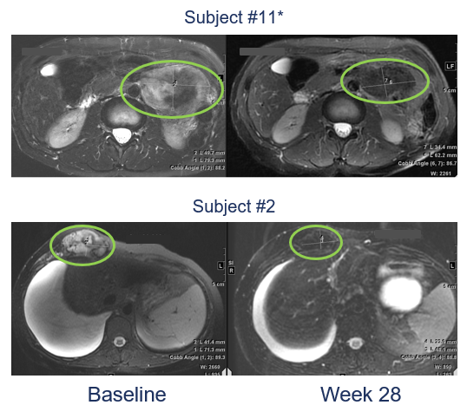
RINGSIDE Part A: T2 Changes
T2 intensity Reduction in
19 Patients at Wk 16
T2 Intensity and Size Reduction in
2 Patients at Wk 28
MRI T2
Patient #11
101
Patient #2
1.2 mg QD
4 mg BIW
2 mg BIW
Baseline
Wk 28
Gounder. ESMO 2022. Abstr 14880.

Slide 24
Additional Ongoing Trials for Treatment of DTs
Drug Name | Type of Agent | Phase | Patient Population | Primary Endpoint | Clinical Trial Number
Nirogacestat | GSI | II | Pediatric patients with inoperable DTs | PFS, safety | NCT04195399
Tegavivint | β-catenin inhibitor | I/II | R/R solid tumors (including DTs) in patients aged 1-30 yr | Safety, tolerability | NCT04851119
Vactosertib + imatinib | TGFβR1 inhibitor + TKI | I/II | Adults with advanced DTs | Safety, tolerability | NCT03802084
Nivolumab + ipilimumab | Immunotherapy | II | Adults with rare tumors (including DTs) | ORR | NCT02834013
Sirolimus | mTOR inhibitor | I/II | Children and young adults with desmoid-type fibromatosis | mTOR pathway activation | NCT01265030
Riedel. Cancer. 2022;128:3027.
Notes:
DT, desmoid tumor; GSI, gamma secretase inhibitor; mTOR, mammalian target of rapamycin; ORR, overall response rate; PFS, progression-free survival; R/R relapsed/refractory; TKI, tyrosine kinase inhibitor.

Slide 25
Summary and Outlook:
Medical Treatment Options for DT
No recommendation for antihormonal therapies in consensus guideline
Chemotherapy may be indicated in rapidly growing, symptomatic, or life-threatening DT
  MTX + vinblastine is the chemotherapy of choice in the pediatric patient population
  For younger patients, pegylated liposomal doxorubicin may be preferred
  Consider long-term toxicity of therapy administered
TKIs (sorafenib, pazopanib) demonstrated clinical activity in randomized trials and are used in clinical practice but tolerability is limited
No drugs currently have regulatory approval in any country for DT and therefore, procurement/reimbursement may be difficult
Emerging GSIs promise to be effective agents with manageable safety profiles
Nirogacestat will most likely be the first FDA-approved drug for DT and may become the standard of care for patients with DT requiring systemic therapy
Notes:
DT, desmoid tumor; GSI, gamma secretase inhibitor; MTX, methotrexate; TKI, tyrosine kinase inhibitor.

Slide 26
Go Online for More CCO
Coverage of Desmoid Tumors!
Review on expert authored ClinicalThought commentary on desmoid tumors requiring treatment
clinicaloptions.com

