Slide 1

Novel Immunotherapy Approaches
Targeting TIGIT: Updates and Perspectives for the Oncology Care Team
Supported by an educational grant from Genentech, a member of the Roche Group.

Slide 2

About These Slides
Please feel free to use, update, and share some or all of these slides
in your noncommercial presentations to colleagues or patients
When using our slides, please retain the source attribution:
These slides may not be published, posted online, or used in commercial presentations without permission. Please contact permissions@clinicaloptions.com for details
Slide credit: clinicaloptions.com
Notes:
Disclaimer: The materials published on the Clinical Care Options website reflect the views of the authors of the CCO material, not those of Clinical Care Options, LLC, the CME providers, or the companies providing educational grants. The materials may discuss uses and dosages for therapeutic products that have not been approved by the United States Food and Drug Administration. A qualified healthcare professional should be consulted before using any therapeutic product discussed. Readers should verify all information and data before treating patients or using any therapies described in these materials.

Slide 3
Faculty
Diwakar Davar, MD
Assistant Professor, Melanoma and Phase I Therapeutics
Division of Hematology/Oncology
Department of Medicine
University of Pittsburgh Hillman Cancer Center
Pittsburgh, Pennsylvania
Diwakar Davar, MD, has disclosed that he has received funds for research support from Arcus, CellSight, Checkmate, GlaxoSmithKline/Tesaro, Immunocore, and Merck and consulting fees from Checkmate, Finch,
Shionogi, and Vedanta.
Notes:
This slide lists the faculty who were involved in the production of these slides.

Slide 4
Faculty
Jyoti D. Patel, MD
Professor of Medicine
Division of Hematology and Oncology
Medical Director for Thoracic Oncology
Assistant Director for Clinical Research
Associate Vice Chair of Clinical Research
Department of Medicine
Robert H. Lurie Comprehensive Cancer Center
Northwestern University
Chicago, Illinois
Jyoti D. Patel, MD, has disclosed that she has received funds for research support from AstraZeneca and consulting fees from AbbVie and Takeda.
Notes:
This slide lists the faculty who were involved in the production of these slides.

Slide 5

PD-1/PD-L1 Mediate Immune Evasion and
ICIs Targeting PD-1/PD-L1 Facilitate Tumor Killing
Binding of PD-L1 to PD-1 inhibits
T-cell killing of tumor cells
Blocking PD-1 or PD-L1 allows for T-cell activation and killing of tumor cells
Activated
T-cell
Tumor
Activated
T-cell
Tumor
+ PD-1/PD-L1 ICI
Anti–PD-1
Cemiplimab
Nivolumab
Pembrolizumab
Anti–PD-L1
Atezolizumab
Avelumab
Durvalumab
TCR
Antigen
TCR
Antigen
TCR
MHC
+ PD-1/PD-L1 ICI
MHC
MHC
PD-1
PD-L1
PD-1
PD-1
PD-L1
PD-L1
Inhibitory signals
Negative regulation blocked
by antibody binding
Adapted from Ribas. NEJM. 2012;366:2517.
Slide credit: clinicaloptions.com
Notes:
ICI, immune checkpoint inhibitor; MHC, major histocompatibility complex; TCR, T-cell receptor.

Slide 6
Current FDA Approvals of ICIs for Metastatic NSCLC
Pembrolizumab: In combination
with pemetrexed/platinum as 1L
for metastatic, nonsq; no EGFR or ALK mut; in combination with carboplatin and paclitaxel/paclitaxel protein-bound as 1L for metastatic, sq
Nivolumab + ipilimumab: 1L metastatic with tumor PD-L1 expression ≥1%; no EGFR or ALK mut
Pembrolizumab: PD during or following platinum-containing CT (and targeted therapy if EGFR or ALK positive) if PD-L1 TPS ≥1%
Nivolumab + ipilimumab: In combination with 2 cycles of
platinum-doublet CT as 1L metastatic; no EGFR or ALK mut
Pembrolizumab: 1L metastatic
with tumor PD-L1 TPS ≥50%;
no EGFR or ALK mut
Pembrolizumab: 1L metastatic with tumor PD-L1 TPS ≥1%; no EGFR or ALK mut
2015
2016
2017
2018
2019
2020
2021
Atezolizumab: In combination with paclitaxel protein-bound/carboplatin as 1L metastatic, nonsq NSCLC;
no EGFR or ALK mut
Atezolizumab: 1L metastatic
with tumor cell PD-L1 expression ≥50% or PD-L1 stained tumor-infiltrating immune cells ≥10%
of the tumor area; no EGFR or
ALK mut
Nivolumab: PD during or following platinum-containing CT (and targeted therapy if EGFR or ALK mut)
Atezolizumab: PD during or following platinum-containing CT (and targeted therapy if EGFR or ALK mut)
Atezolizumab: In combination with bevacizumab/paclitaxel/carboplatin
as 1L metastatic, nonsq; no EGFR
or ALK mut
Cemiplimab: 1L metastatic with tumor PD-L1 TPS ≥50%; no EGFR, ALK, or ROS1 mut
Slide credit: clinicaloptions.com
Notes:
1L, first-line; CT, chemotherapy; ICI, immune checkpoint inhibitor; nonsq, nonsquamous; NSCLC, non-small-cell lung cancer; mut, mutation; PD, progressive disease; sq, squamous; TPS, tumor proportion score.

Slide 7
PD-1 Inhibition + Chemo or PD-1 + CTLA-4 Inhibition Produces Significant Responses in Advanced 1L NSCLC
PD-1 inhibition plus chemotherapy produces responses in 48% to 58% in 1L NSCLC¹⁻²; responses are observed regardless of histology (sq vs nsq) and PD-L1 score (<1%, 1%-49% vs ≥50%).
Combination Ipi/Nivo produces responses in 36%³; the addition of 2 cycles of platinum-doublet chemotherapy increases response rates⁴
100
ORR: 36% (CheckMate-227, sq and nsqNSCLC)
100
ORR: 58% (KEYNOTE-407, sqNSCLC)
Nivo + Ipi + CT
CT
80
Pembro + CT
Placebo + CT
80
1-yr OS
60
62
Median OS, Mo (95% CI)
17.1 (15.2-19.9)
13.9 (12.2-15.1)
60
2-yr OS
OS (%)
OS (%)
54
40
40
40
Median OS, Mo (95% CI)
15.9 (13.2-NE)
11.3 (9.5-14.8)
20
30
20
0
0
0
3
6
9
12
15
18
21
24
27
30
33
36
39
42
45
0
3
6
9
12
15
18
21
100
ORR: 38% (CheckMate-9LA, sq and nsqNSCLC)
100
ORR: 48% (KEYNOTE-189, nsqNSCLC)
80
Median OS, Mo (95% CI)
15.8 (13.9-19.7)
11.0 (9.5-12.7)
80
63%
60
60
OS (%)
OS (%)
38%
40
40
47%
Median OS, Mo (95% CI)
NR
11.3
20
20
26%
0
0
0
3
6
9
12
15
18
21
0
3
6
9
12
15
18
21
24
27
30
33
36
39
Mo
Mo
1. Paz-Ares. NEJM. 2018;379:2040. 2. Gandhi. NEJM. 2018;378:2078.
3. Hellmann. NEJM. 2019;381:2020. 4. Reck. ESMO Open. 2021;6:100273.
Slide credit: clinicaloptions.com
Notes:
1L, first-line; CT, chemotherapy; Ipi, ipilimumab; NE, not estimable; Nivo, nivolumab; NR, not reached; NSCLC, non-small-cell lung cancer; nsq, nonsquamous; ORR, overall response rate; OS, overall survival; sq, squamous.

Slide 8
Immunotherapy Responses Depend on Factors
That Sculpt Tumor Growth and Antitumor Immunity
Host Immune System
Tumor Genome
and Epigenome
Human Microbiome
Our Second Genome
Tumor Microenvironment
Sepich-Poore. Science 2021;371:eabc4552.
Slide credit: clinicaloptions.com

Slide 9
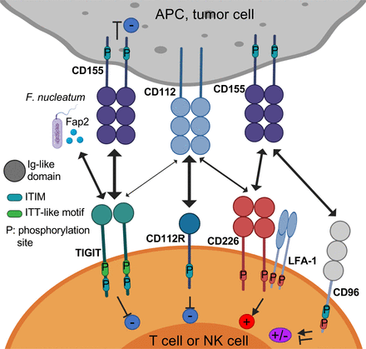
TIGIT/CD226/CD96/CD112R Axis in Cancer
Chauvin. J Immunother Cancer. 2020;8:e000957. This is an open-access article distributed in accordance with the Creative Commons Attribution Non Commercial (CC BY-NC 4.0) license. See creativecommons.org/licenses/by-nc/4.0.
Slide credit: clinicaloptions.com
Notes:
APC, antigen-presenting cell; NK, natural killer; TIGIT, T-cell immunoreceptor with Ig and ITIM domains.

Slide 10
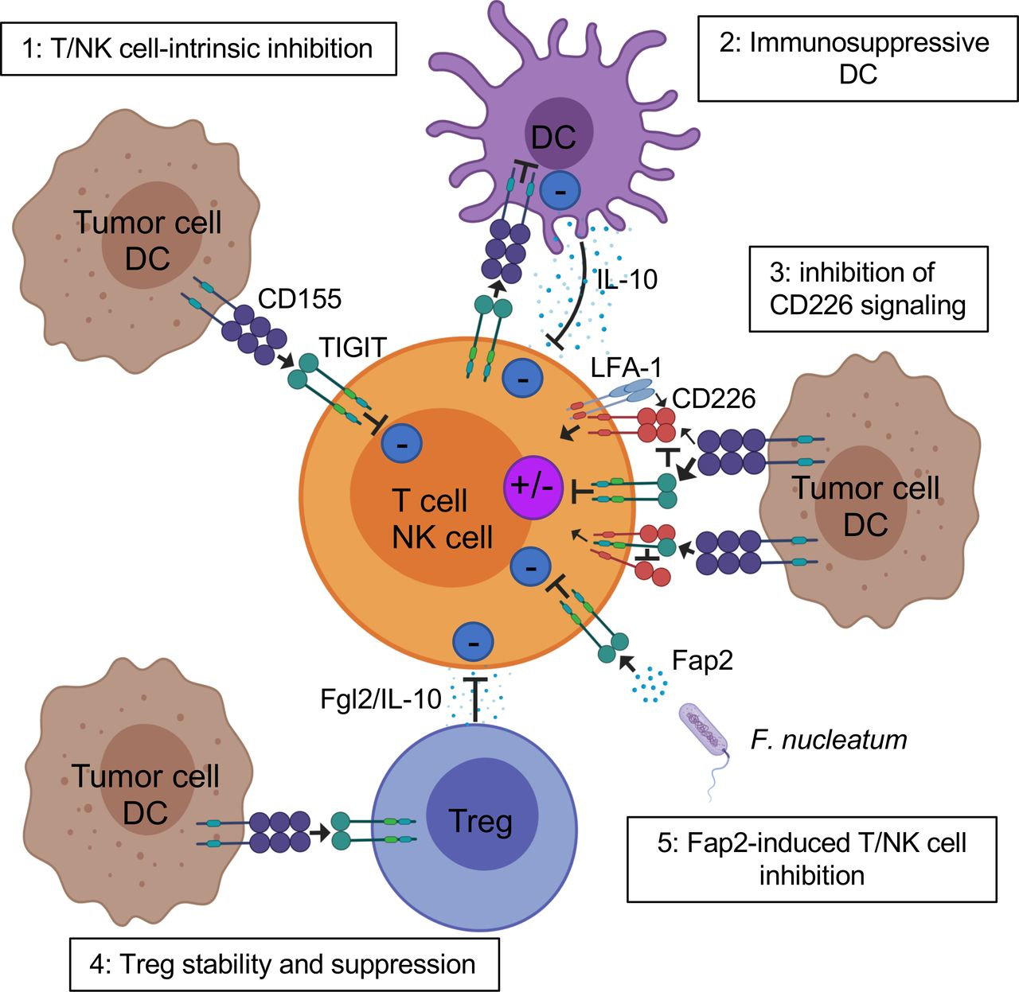
TIGIT Axis Inhibits Innate and Adaptive Immunity Through Multiple Mechanisms
Chauvin. J Immunother Cancer. 2020;8:e000957. This is an open access article distributed in accordance with the Creative Commons Attribution Non Commercial (CC BY-NC 4.0) license. See http://creativecommons.org/licenses/by-nc/4.0.
Slide credit: clinicaloptions.com
Notes:
DC, dendritic cell; NK, natural killer; TIGIT, T-cell immunoreceptor with Ig and ITIM domains.

Slide 11
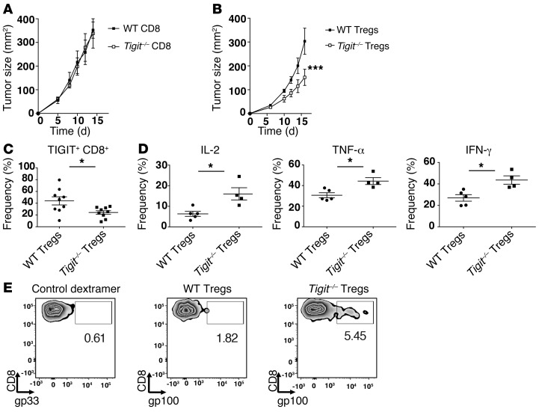
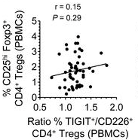
TIGIT Suppresses Antitumor Immune Responses by Augmenting Treg-Mediated Immune Suppression
TIGIT marks suppressive Foxp3+ Tregs¹
TIGIT/CD226 ratio in Tregs in metastatic melanoma correlates with high Treg frequencies²
Ratio MFI <5.6
Ratio MFI >5.6
1.0
0.8
0.6
P = 0.039
Progression-Free Survival Probability
0.4
0.2
0.0
0
10
20
30
40
50
Mo
1. Kurtulus. J Clin Invest. 2015;125:4053. 2. Fourcade. JCI Insight. 2018;3:e1211157.
Slide credit: clinicaloptions.com
Notes:
TIGIT, T-cell immunoreceptor with Ig and ITIM domains; Treg, regulatory T-cell; WT, wild-type.

Slide 12
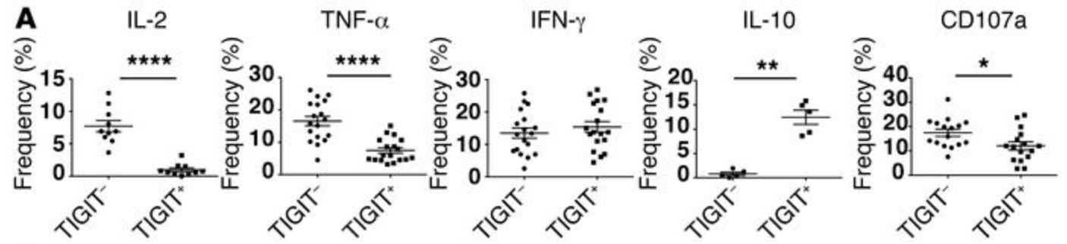
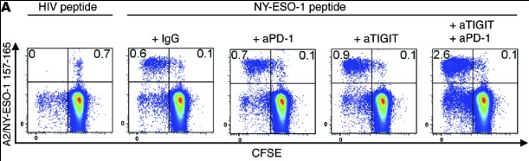
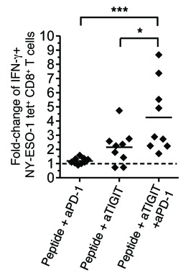
TIGIT Marks Dysfunctional CD8+ T-Cells,
Alleviated by TIGIT Blockade
TIGIT expression is associated with CD8+ T-cell dysfunction¹
TIGIT blockade alone or in combination with PD-1 blockade increases antigen-specific CD8+ T-cells²
*P <.05. **P <.01. ***P <.001. ****P <.0001.
1. Kurtulus. J Clin Invest. 2015;125:4053. 2. Chauvin. J Clin Invest. 2015;125:2046.
Slide credit: clinicaloptions.com
Notes:
TIGIT, T-cell immunoreceptor with Ig and ITIM domains.

Slide 13
Effects of TIGIT Blockade Upon T-Cells and NK Cells are Dependent on Different Factors
High CD155 expression is associated with poor clinical outcome with ICI therapy¹
IL-15 and TIGIT blockade/deletion combine to suppress experimental lung metastasis of melanoma²
Anti-PD Monotherapy
Anti-PD-1/Anti-CTLA4 Combination
BRAF-directed targeted therapy
****
****
100
100
100
**
***
HR = 1.037
P = 0.9176
400
**
300
***
***
50
50
50
PFS
PFS
PFS
Number of B16F10 Lung metastases
200
HR = 1.377
P = 0.2608
HR = 2.886
P = 0.0070
0
0
0
100
0
1
2
3
4
0
1
2
3
4
0
1
2
3
4
Years
Years
Years
0
WT
aCD226
aTIGIT
IL-15/IL-15R
-
-
-
+
-
-
-
-
+
+
-
+
-
+
-
+
+
-
-
+
+
+
+
+
CD155 low
CD155 high
1. Lepletier. Clin Cancer Res. 2020;14:3671. 2. Chauvin. Clin Cancer Res. 2020;26:5520.
Slide credit: clinicaloptions.com
*P <.05. **P <.01. ***P <.001. ****P <.0001.

Slide 14
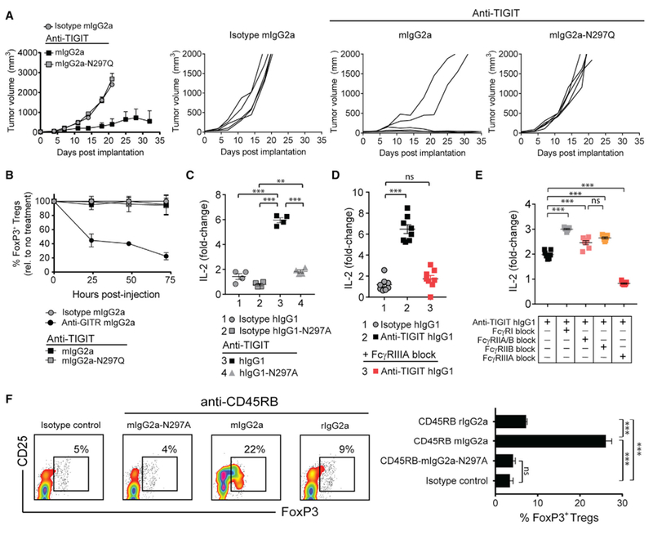
Importance of Fc Engagement in Mediating the Functional Effects of TIGIT Blockade on T-Cells
Tumor antigen-specific T-cell responses by TIGIT (and CTLA) targeting mAbs require intact FcγR co-engagement
Effect of TIGIT blockade upon IL-2 production
by peptide-stimulated T-cells requires Fc-active TIGIT mAb (red square), abrogated by Fc-inactivated TIGIT mAb (purple square)
This effect is Fc-FcγR dependent upon
co-engagement (purple square) and abrogated
by either glycosylated or deglycosylated
FcγR-specific mAbs
**P<.01. ***P <.001.
Slide credit: clinicaloptions.com
Waight. Cancer Cell. 2018;33:1033.
Notes:
CTLA, cytotoxic T lymphocyte–associated antigen; FcγR, Fcγ receptor; mAb, monoclonal antibody; TIGIT, T-cell immunoreceptor with Ig and ITIM domains.

Slide 15
Tiragolumab (MTIG7192A) is an Anti-TIGIT mAb
That Blocks TIGIT/PVR Interaction
Tiragolumab is a fully human IgG1 κ Fc-active
anti-TIGIT mAb that blocks binding of TIGIT with PVR^{1,2}
In preclinical models, combination TIGIT and PD-L1 blockade with mAb acts synergistically to control tumors and improve survival; these effects are T-cell dependent³
Tumor cell
Tumor cell
10,000
Control
Anti-PD-L1
Anti-TIGIT
100
80
Anti-TIGIT + anti-PD-L1
PD-L1
1,000
60
PVR
PVR
PD-L1
Median Tumor Volume (mm³)
Control
Anti-PD-L1
Anti-TIGIT
Survival (%)
PD-L1 mAb
100
***
40
Tiragolumab
Anti-TIGIT + anti-PD-L1
PD-1
20
TIGIT
TIGIT
PD-1
10
Complete response
0
0
10
20
30
60
0
20
40
60
Day
Day
T-cell/NK cell
T-cell/NK cell
1,000
Naive
CR, CD8-depleted
Median Tumor Volume (mm³)
TIGIT binds to PVR, resulting
in inhibitory response
Blocking TIGIT binding restores antitumor response and complements PD-1/PD-L1 activity
100
CR, no depletion
Complete response
10
***P <.001.
0
5
10
15
20
Day
1. Rodriguez-Abreu. ASCO 2020. Abstr 9503. 2. Manieri. Trends Immunol. 2017;38:20. 3. Johnston. Cancer Cell. 2014;26:923.
Slide credit: clinicaloptions.com
Notes:
mAb, monoclonal antibody; NK, natural killer; PVR, poliovirus receptor; TIGIT, T-cell immunoreceptor with Ig and ITIM domains.

Slide 16
Phase Ia/Ib Study of Tiragolumab ± Atezolizumab in Advanced Solid Tumors
Phase 1a: Tiragolumab
Phase Ib: Tiragolumab
+ Atezolizumab
Phase Ia:
Tiragolumab
(n = 24)
No objective responses
Phase Ib:
Tiragolumab
+ Atezolizumab
(n = 49)
Expansion Cohorts: Tiragolumab
+ Atezolizumab
in PD-L1+ Immunotherapy Naive
Dose Expansion
Dose Escalation
Dose Escalation
Dose Expansion
1200 mg
1200 mg
1200 mg + Atezo
600 mg
600 mg
600 mg + Atezo
600 mg + Atezo
400 mg
400 mg
400 mg + Atezo
400 mg + Atezo
100 mg
100 mg + Atezo
NSCLC
No DLTs observed
Exposure of tiragolumab increased with dose and the PK was not altered in combination with atezolizumab
30 mg
30 mg + Atezo
Other solid tumors
8 mg
8 mg + Atezo
2 mg
2 mg + Atezo
Bendell. AACR 2020. Abstr CT302.
Slide credit: clinicaloptions.com
Notes:
Atezo, atezolizumab; CR, complete response; DLT, dose-limiting toxicity; H/N SCC, head and neck squamous cell carcinoma; NSCLC, non-small-cell lung cancer; PK, pharmacokinetic; PR, partial response.

Slide 17
Phase Ib: Responses in Immunotherapy-Naive
PD-L1+ NSCLC Expansion
PD | PD | PD | SD | SD | SD | SD | PR | PR | PR | PR | CR | CR
2L | 4L | 3L | 3L | 2L | 3L | 2L | 2L | 2L | 2L | 3L | 1L | 3L
Sq | Nonsq | Sq | Nonsq | Nonsq | Nonsq | Sq | Nonsq | Sq | Sq | Nonsq | Sq | Nonsq
20
0
‒20
‒40
Best % Change in SLD
‒60
ORR: 46% (6/13)
DCR: 85% (11/13)
‒80
‒ 100
PD-L1
SP142
TC/IC 0 or 1
TC/IC 2 or 3
Line of Therapy
Histology
Bendell. AACR 2020. Abstr CT302.
Slide credit: clinicaloptions.com
Notes:
1L, first-line; 2L, second-line; 3L, third-line; 4L, fourth-line; CR, complete response; DCR, disease control rate; IC, immune cell; nonsq, nonsquamous; NSCLC, non-small-cell lung cancer; ORR, objective response rate; PD, progressive disease; PR, partial response; SD, stable disease; SLD, sum of longest diameter; sq, squamous; TC, tumor cell.

Slide 18
Immune-Mediated AEs With
Tiragolumab ± Atezolizumab
 | Phase Ia: Tiragolumab (n = 24) | Phase Ib: Tiragolumab + Atezolizumab (n = 49)
All immune-mediated AE, n (%) | 4 (17) | 29 (59)
Grade 3-5 immune-mediated AE | 0 | 2 (4)
Infusion-related reaction | 2 (8) | 4 (8)
Rash | 2 (8) | 14 (29)
Hepatitis | 1 (4) | 10 (20)
Pancreatitis | 1 (4) | 1 (2)
Hyperthyroidism | 0 | 4 (8)
Hypothyroidism | 0 | 3 (6)
Anemia | 0 | 1 (2)
Bendell. AACR 2020. Abstr CT302.
Slide credit: clinicaloptions.com
Notes:
AE, adverse event.

Slide 19
CITYSCAPE: Phase II Trial of Tiragolumab + Atezolizumab vs Atezolizumab in Patients With PD-L1+ NSCLC
Randomized, double-blind phase II trial
Primary endpoint: ORR and PFS
Secondary endpoints: Safety, DoR, OS, PROs, efficacy analysis by PD-L1
Stratification by PD-L1 TPS (1-49% vs ≥50%), histology (nonsquamous vs squamous), tobacco use (yes vs no)
Tiragolumab 600 mg IV Q3W
+ Atezolizumab 1200 mg IV Q3W
Patients with stage IV NSCLC,
no previous systemic therapy; EGFR/ALK wild type and tumor
PD-L1 TPS ≥1% by 22C3 IHC
(N = 135)
PD or loss of clinical benefit
Placebo 600 mg IV Q3W
+ Atezolizumab 1200 mg IV Q3W
Cho. ESMO 2021. Abstr LBA2. Rodriguez-Abreu. ASCO 2020. Abstr 9503.
Slide credit: clinicaloptions.com
Notes:
ALK, anaplastic lymphoma kinase; DoR, duration of response; IHC, immunohistochemistry; NSCLC, non-small-cell lung cancer; ORR, overall response rate; OS, overall survival; PD, progressive disease; PFS, progression-free survival; PROs, patient-reported outcomes; TPS, tumor proportion score.

Slide 20
CITYSCAPE: Overall Response Rate with Atezolizumab ± Tiragolumab
Confirmed ORR at Median Follow-up of 5.9 Mo
ITT (N = 135)
PD-L1 TPS ≥50% (n = 58)
PD-L1 TPS 1-49% (n = 77)
Response, % (95% CI)
Tiragolumab +
Atezolizumab
(n = 67)
Placebo +
Atezolizumab
(n = 68)
Tiragolumab +
Atezolizumab
(n = 29)
Placebo +
Atezolizumab
(n = 29)
Tiragolumab +
Atezolizumab
(n = 38)
Placebo +
Atezolizumab
(n = 39)
Updated data cutoff: December 2, 2019
Rodriguez-Abreu. ASCO 2020. Abstr 9503.
Slide credit: clinicaloptions.com
Notes:
ITT, intention-to-treat; ORR, overall response rate; TPS, tumor proportion score.

Slide 21
CITYSCAPE: Progression-Free Survival with Atezolizumab ± Tiragolumab
PD-L1 TPS ≥50% (n = 58)
PD-L1 TPS 1-49% (n = 77)
 | Events n (%) | Median PFS, mo (95% CI) | PFS HR (95% CI) | ORR, % | Median DoR mo (95% CI)
Tira + atezo | 21 (72.4) | 16.6 (5.5‒22.3) | 0.29* | 69.0 | 15.7 (9.1‒NE)
Placebo + atezo | 28 (96.6) | 4.1 (2.1‒6.8) | (0.15‒0.53) | 24.1 | 8.2 (5.6‒10.4)
 | Events n (%) | Median PFS, mo (95% CI) | PFS HR (95% CI) | ORR, % | Median DoR mo (95% CI)
Tira + atezo | 36 (94.7) | 4.0 (1.6‒5.6) | 1.07* | 15.8 | 17.8 (8.3‒24.2)
Placebo + atezo | 36 (92.3) | 3.6 (1.4‒5.5) | (0.67‒1.71) | 17.9 | 18.8 (15.9‒22.8)
100
100
80
80
60
60
PFS (%)
PFS (%)
40
40
20
12-month rate: 51.0%
12-month rate: 21.8%
20
12-month rate: 24.9%
12-month rate: 20.5%
0
0
0
3
6
9
12
15
18
21
24
27
30
33
0
3
6
9
12
15
18
21
24
27
30
33
Mo
Mo
No. at risk
T + A | 29 | 26 | 19 | 17 | 14 | 13 | 11 | 9 | 8 | 8 | 7 | NE
P + A | 29 | 17 | 9 | 7 | 6 | 2 | 1 | 1 | NE | NE | NE | NE
No. at risk
T + A | 38 | 22 | 12 | 12 | 9 | 6 | 5 | 3 | 3 | 1 | 1 | 1
P + A | 39 | 21 | 12 | 8 | 8 | 8 | 8 | 5 | 4 | 3 | 2 | 2
* Unstratified.
Median follow-up of 30.4 mo
Cho. ESMO IO 2021. Abstr LBA2.
Slide credit: clinicaloptions.com
Notes:
Atezo, atezolizumab; DoR, duration of response; NE, not estimable; ORR, overall response rate; PFS, progression-free survival; tira, tiragolumab; TPS, tumor proportion score.

Slide 22
CITYSCAPE: Overall Survival with Atezolizumab ± Tiragolumab
PD-L1 TPS ≥50% (n = 58)
PD-L1 TPS 1-49% (n = 77)
 | Events n (%) | Median OS, mo (95% CI) | HR (95% CI)
Tira + atezo | 8 (27.6) | NE (30.3‒NE) | 0.23*
Placebo + atezo | 21 (72.4) | 12.8 (4.7‒24.2) | (0.10‒0.53)
 | Events n (%) | Median OS, mo (95% CI) | HR (95% CI)
Tira + atezo | 32 (84.2) | 13.3 (8.0‒20.7) | 1.16*
Placebo + atezo | 28(71.8) | 14.5 (8.3‒25.6) | (0.70‒1.94)
100
100
80
80
60
60
OS (%)
OS (%)
40
40
20
12-mo rate: 81.9%
12-mo rate: 56.1%
24-mo rate: 78.2%
24-mo rate: 33.7%
20
12-mo rate: 54.4%
12-mo rate: 59.5%
24-mo rate: 24.5%
24-mo rate: 35.0%
0
0
0
3
6
9
12
15
18
21
24
27
30
33
36
0
3
6
9
12
15
18
21
24
27
30
33
36
Mo
Mo
No. at risk
T + A | 29 | 29 | 24 | 23 | 22 | 21 | 21 | 21 | 21 | 20 | 15 | 4 | NE
P + A | 29 | 25 | 18 | 17 | 15 | 13 | 11 | 10 | 9 | 8 | 3 | NE | NE
No. at risk
T + A | 38 | 34 | 28 | 23 | 20 | 18 | 14 | 12 | 9 | 8 | 5 | 4 | NE
P + A | 39 | 35 | 28 | 24 | 22 | 17 | 16 | 13 | 12 | 9 | 5 | 2 | NE
* Unstratified.
Median follow-up of 30.4 mo
Cho. ESMO IO 2021. Abstr LBA2.
Slide credit: clinicaloptions.com
Notes:
A, atezolizumab; Atezo, atezolizumab; NE, not estimable; OS, overall survival; P, placebo; T, tiragolumab; tira, tiragolumab; TPS, tumor proportion score.

Slide 23
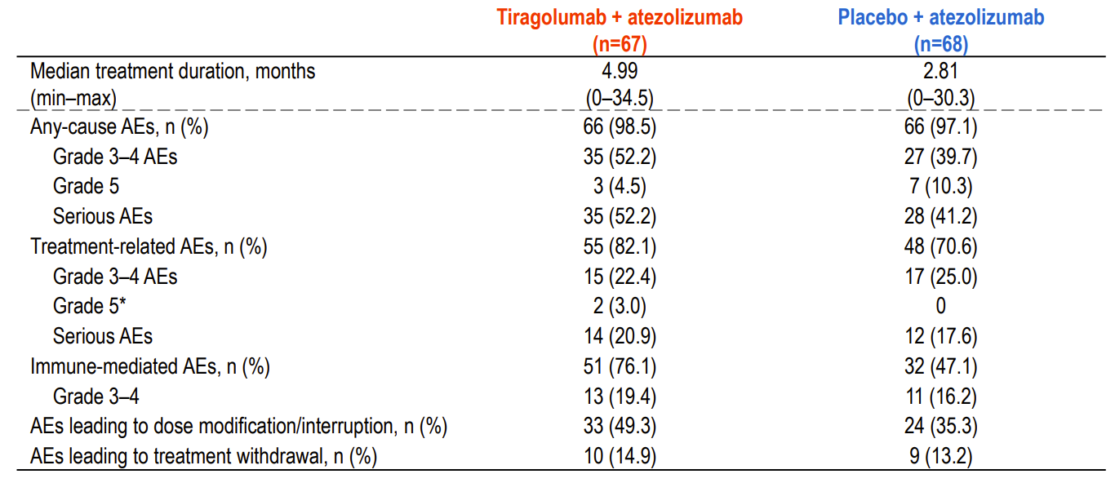
CITYSCAPE: Safety with Atezolizumab ± Tiragolumab
Event | Tiragolumab + Atezo (n = 67) | Placebo + Atezo (n = 68)
Median treatment duration, mo (range) | 4.99 (0-34.5) | 2.81 (0-30.3)
Any-cause AEs, n (%) | 66 (98.5) | 66 (97.1)
Grade 3/4 | 35 (52.2) | 27 (39.7)
Grade 5 | 3 (4.5) | 7 (10.3)
Serious AEs | 35 (52.2) | 28 (41.2)
Treatment-related AEs, n (%) | 55 (82.1) | 48 (70.6)
Grade 3/4 | 15 (22.4) | 17 (25.0)
Grade 5 | 2 (3.0) | 0
Serious AEs | 14 (20.9) | 12 (17.6)
Immune-mediated AEs, n (%) | 51 (76.1) | 32 (47.1)
Grade 3/4 | 13 (19.4) | 11 (16.2)
AEs leading to dose modification/interruption, n (%) | 33 (49.3) | 24 (35.3)
AEs leading to treatment discontinuation, n (%) | 10 (14.9) | 9 (13.2)
Median follow-up of 30.4 mo
Cho. ESMO IO 2021. Abstr LBA2.
Slide credit: clinicaloptions.com
Notes:
AE, adverse event; atezo, atezolizumab.

Slide 24
SKYSCRAPER-01: Atezolizumab ± Tiragolumab in Previously Untreated Advanced PD-L1–Selected NSCLC
Phase III randomized, double-blind, placebo-controlled study
Primary endpoint: PFS, OS
Secondary endpoints: ORR, DoR, TTCD, safety, PK/PD
Patients with locally advanced or recurrent NSCLC and no previous systemic therapy for metastatic NSCLC; high tumor PD-L1 expression (≥50%) and no known EGFR^{mut} or ALK fusion; ECOG PS 0/1
(N = 635)
Tiragolumab 600 mg IV +
Atezolizumab 1200 mg IV Q3W
Placebo +
Atezolizumab 1200 mg IV Q3W
NCT04294810.
Slide credit: clinicaloptions.com
Notes:
DoR, duration of response; ECOG, Eastern Cooperative Oncology Group; NSCLC, non-small-cell lung cancer; ORR, overall response rate; OS, overall survival; PD, pharmacodynamics; PFS, progression-free survival; PK, pharmacokinetics; PS, performance status; TTCD, time to confirmed deterioration.

Slide 25
Phase I Trial of Vibostolimab + Pembrolizumab in Patients With NSCLC
First-in-human, open-label phase I trial, part B expansion cohort
Primary endpoint: safety and tolerability
Secondary endpoints: ORR, DoR, PFS
Patients with advanced or metastatic NSCLC, either no previous systemic therapy or with PD on any number
of therapies including ≥1
platinum-based CT but no previous anti–PD-1/PD-L1 therapy
(N = 41)
Vibostolimab 200 mg IV Q3W +
Pembrolizumab 200 mg IV Q3W
For ≤35 cycles
Niu. Ann Oncol. 2022;33:169. Niu. ESMO 2020. Abstr 1410P.
Slide credit: clinicaloptions.com
Notes:
CT, chemotherapy; DoR, duration of response; NSCLC, non-small-cell lung cancer; ORR, overall response rate; PD, pharmacodynamic; PFS, progression-free survival.

Slide 26
Phase I Trial of Vibostolimab + Pembrolizumab in Patients With NSCLC: Baseline Characteristics
Event | Vibostolimab + Pembro (n = 41)
Median age, yr (range) | 62 (47-80)
Male, n (%) | 28 (68)
ECOG PS, n (%)
0 | 7 (17)
1 | 34 (83)
Previous lines of therapy for advanced NSCLC, n (%)
None | 11 (27)
First-line | 12 (29)
Second-line | 8 (20)
Third-line or greater | 10 (24)
PD-L1 status,* n (%)
TPS <1% | 12 (29)
TPS ≥1% | 13 (32)
Median follow-up:
11 mo (range: 7-18)
* Assessed using PD-L1 IHC 22C3 assay. Data unavailable for 16 patients (39%) due to quality of sample.
Niu. ESMO 2020. Abstr 1410P.
Slide credit: clinicaloptions.com
Notes:
ECOG, Eastern Cooperative Oncology Group; IHC, immunohistochemistry; NSCLC, non-small-cell lung cancer; PS, performance status; TPS, tumor proportion score.

Slide 27
Phase I Trial of Vibostolimab + Pembrolizumab in Patients With NSCLC: Safety
All-Cause AEs With Incidence ≥15%, n (%) | Vibostolimab + Pembro (n = 41)
 | Any Grade | Grade 3-5
All-cause AEs | 40 (98) | 18 (44)
Pruritis | 15 (37) | 0
Hypoalbuminemia | 13 (32) | 1 (2)
Pyrexia | 13 (32) | 0
Fatigue | 8 (20) | 0
Rash | 8 (20) | 1 (2)
Headache | 7 (17) | 0
Decreased lymphocyte count | 7 (17) | 3 (7)
Serious all-cause AEs | 12 (29) | –
All-cause AEs leading to discontinuation | 3 (7) | –
All-cause AEs leading to death | 3 (7) | –
Treatment-Related AEs With Incidence ≥10%, n (%) | Vibostolimab + Pembro (n = 41)
 | Any Grade | Grade 3-5
Treatment-related AEs | 34 (83) | 6 (15)
Pruritis | 14 (34) | 0
Hypoalbuminemia | 12 (29) | 0
Pyrexia | 8 (20) | 0
Decreased lymphocyte count | 7 (17) | 3 (7)
Fatigue | 5 (12) | 0
Rash | 5 (12) | 1 (2)
Infusion-related reaction | 4 (10) | 0
Serious treatment-related AEs | 4 (10) | –
Treatment-related AEs leading to d/c | 1 (2) | –
Treatment-related AEs leading to death | 0 | –
Niu. ESMO 2020. Abstr 1410P.
Slide credit: clinicaloptions.com
Notes:
AE, adverse event; d/c, discontinuation; NSCLC, non-small-cell lung cancer; pembro, pembrolizumab.

Slide 28
Phase I Trial of Vibostolimab + Pembrolizumab in Patients With NSCLC: Investigator-Assessed Response
Best Change From Baseline in Target Lesions*
Response Duration
100
TPS ≥1%
TPS <1%
Missing
+
80
+
60
+
+
x
+
+
40
20% tumor growth
+
+
+
x
20
+
x
x
+
x
+
Change From Baseline in Target Lesions (%)
+
x
0
+
+
x
x
Discontinued
Ongoing
Complete response
Partial response
Progressive disease
Last done
Death
-20
+
x
x
+
+
x
+
-40
+
x
x
30% tumor growth
+
x
+
-60
+
+
x
+
+
-80
+
x
+
+
x
+
x
x
-100
+
x
+
+
x
0
2
4
6
8
10
12
14
16
18
20
22
24
26
*Includes all patients with at least 1 post-baseline target lesion measurement (n = 35).
Database cutoff date: March 3, 2020.
Time Since Start of Treatment (Mo)
Niu. ESMO 2020. Abstr 1410P.
Slide credit: clinicaloptions.com
Notes:
NSCLC, non-small-cell lung cancer; TPS, tumor proportion score.

Slide 29
Phase I Trial of Vibostolimab + Pembrolizumab in Patients With NSCLC: PFS
Median PFS, Mo (95% CI) | Vibostolimab + Pembro (n = 41)
All patients (N = 41) | 5.4 (2.1-8.2)
TPS ≥1% (n = 13) | 8.4 (3.9-10.2)
TPS <1% (n = 12) | 4.1 (1.9-NR)
100
90
80
70
60
Progression-Free Survival (%)
50
40
30
20
10
0
0
2
4
6
8
10
12
14
16
18
20
22
Mo
Patients
at Risk
41
27
21
19
15
12
9
8
8
4
3
0
Niu. ESMO 2020. Abstr 1410P.
Slide credit: clinicaloptions.com
Notes:
NR, not reached; NSCLC, non-small-cell lung cancer; pembro, pembrolizumab; PFS, progression-free survival; TPS, tumor proportion score.

Slide 30
SKYSCRAPER-07: Atezolizumab ± Tiragolumab in Unresectable Esophageal SCC Without Progression After Definitive Chemoradiation
Phase III randomized, double-blinded, placebo-controlled study
Primary endpoint: PFS (arm A vs C), OS (arm A vs C and arm B vs C)
Secondary endpoints: PFS (arm B vs C and arm A vs B), OS (arm A vs B), ORR, DoR, safety, PK/PD
Patients with
unresectable squamous cell carcinoma of the esophagus who received definitive chemoradiation,
ECOG PS 0/1,
(N = 750)
Arm A:
Atezolizumab 1200 mg + Tiragolumab 600 mg Q3W
Randomized 1:1:1
Arm B:
Atezolizumab 1200 mg + Placebo Q3W
Arm C:
Placebo + Placebo Q3W
NCT04543617.
Slide credit: clinicaloptions.com
Notes:
DoR, duration of response; ECOG, Eastern Cooperative Oncology Group; ORR, overall response rate; OS, overall survival; PD, pharmacodynamics;
PFS, progression-free survival; PK, pharmacokinetics; PS, performance status; SCC, squamous cell carcinoma.

Slide 31
SKYSCRAPER-02: Carboplatin and Etoposide ± Tiragolumab in Untreated ES-SCLC
Phase III randomized, double-blinded, placebo-controlled study
March 2022 press release: tiragolumab + atezolizumab and chemotherapy did not meet coprimary endpoint of PFS
  Await presentation of complete data at upcoming meeting
Tiragolumab 600 mg IV +
Atezolizumab 1200 mg IV + CE* Q3W
Patients with untreated ES-SCLC; measurable
disease; ECOG PS 0/1; no symptomatic or actively progressing CNS metastases
(N = 490)
Placebo +
Atezolizumab 1200 mg IV + CE* Q3W
*CE = carboplatin Day 1 + etoposide Days 1-3 x 4 cycles.
NCT04256421.
Slide credit: clinicaloptions.com
Notes:
CNS, central nervous system; ECOG, Eastern Cooperative Oncology Group; ES-SCLC, extensive-stage small-cell lung cancer; PFS, progression-free survival; PS, performance status.

Slide 32
Multiple TIGIT mAb Are Currently in Development
Agent | Fc Structure | Indication | Phase
AB-154 (domvanalimab) | Fc inactive | NSCLC, melanoma | II/III
AB-308 | Fc active | Advanced solid tumors | I
BGB-A1217 (ociperlimab) | Fc active | Advanced solid tumors | I/II/III
BMS-986207 | Nondisclosed | Advanced solid tumors | I/II
COM-902 | Nondisclosed | Advanced solid tumors | I
EOS-448 | Fc active | Advanced solid tumors | I/II
IBI-939 | Nondisclosed | Advanced solid tumors, lung | I
JS006 | Nondisclosed | Advanced solid tumors | I
MK-7684 (vibostolimab) | Nondisclosed | Advanced solid tumors, NSCLC, ES-SCLC | I/II/III
Tiragolumab | Fc active | Advanced solid tumors, cervical, esophageal/gastric/GEJ, head and neck, melanoma, NSCLC, rectal, SCLC | I/II/III
Clinicaltrials.gov.
Slide credit: clinicaloptions.com
Notes:
ES-SCLC, extensive-stage small-cell lung cancer; GEJ, gastroesophageal junction; mAb, monoclonal antibodies; NSCLC, non-small-cell lung cancer; TIGIT, T-cell immunoreceptor with Ig and ITIM domains.

Slide 33
Additional Select Phase III Trials of
Anti-TIGIT Therapies in Lung Cancer
Trial | Setting | Comparator | NCT
Domvanalimab
PACIFIC-8 | NSCLC, stage III, unresectable | Durvalumab + domvanalimab following concurrent chemoradiation | NCT05211895
 | NSCLC, locally advanced/metastatic | Zimberelimab vs chemo vs zimberelimab + domvanalimab | NCT04736173
Ociperlimab
 | NSCLC, PD-L1 high, metastatic, 1L | Ociperlimab with tislelizumab vs pembrolizumab | NCT04746924
Tiragolumab
SKYSCRAPER-03 | NSCLC, stage III, unresectable | Atezolizumab + tiragolumab vs durvalumab | NCT04513925
SKYSCRAPER-06 | NSCLC (nonsq), advanced, untreated | Tiragolumab with atezolizumab + pemetrexed and carbo-/cisplatin vs pembrolizumab + pemetrexed and carbo-/cisplatin | NCT04619797
Vibostolimab
MK-7684A-006/KEYVIBE-006 | NSCLC, stage III | Pembrolizumab/vibostolimab in combination with concurrent chemoradiotherapy followed by pembrolizumab/vibostolimab vs concurrent chemoradiotherapy followed by durvalumab | NCT05298423
MK-7684A-007/KEYVIBE-007 | NSCLC, metastatic, 1L | Pembrolizumab/vibostolimab with chemo vs pembrolizumab with chemo | NCT05226598
MK-7684A-008/KEYVIBE-008 | ES-SCLC, first-line | Pembrolizumab/vibostolimab vs atezolizumab in combination with chemo | NCT05224141
MK-7684A-003 | NSCLC (PD-L1+), metastatic, 1L | Pembrolizumab/vibostolimab vs pembrolizumab | NCT04738487
Clinicaltrials.gov.
Slide credit: clinicaloptions.com
Notes:
1L, first-line; ES-SCLC, extensive-stage small-cell lung cancer; nonsq, nonsquamous; NSCLC, non-small-cell lung cancer; TIGIT, T-cell immunoreceptor with Ig and ITIM domains.

Slide 34
Summary
TIGIT is an inhibitory immune checkpoint that forms a complex axis regulating antitumor immunity with its costimulatory and coinhibitory partners
  TIGIT blockade restores antitumor immune activity by augmenting T-cell and NK cell function, and/or suppressing Treg-mediated immune suppression
  TIGIT and PD-1/PD-L1 blockade have additive activity
Numerous therapies targeting the TIGIT pathway are currently in development and are being evaluated in various stages of clinical trials in advanced solid tumors
In the phase II CITYSCAPE trial, the combination of tiragolumab + atezolizumab has shown improved outcomes in the first-line setting for advanced NSCLC with PD-L1 TPS ≥50%; the phase III SKYSCRAPER-01 trial is ongoing
Slide credit: clinicaloptions.com
Notes:
irAE, immune-related adverse event; NK, natural killer; NSCLC, non-small-cell lung cancer; PVR, poliovirus receptor; TIGIT, T-cell immunoreceptor with Ig and ITIM domains; TPS, tumor proportion score.

Slide 35
Go Online for More CCO Coverage of Novel Immunotherapy Approaches
Targeting TIGIT!
Podcasts with expert faculty discussion on the role of TIGIT and emerging targeted therapies
ClinicalThought commentaries on targeting TIGIT
Additional slideset on therapies targeting TIGIT with expert faculty commentary on mechanisms, emerging agents, and key studies
clinicaloptions.com/oncology
Notes:
TIGIT, T-cell immunoreceptor with Ig and ITIM domains.

