Slide 1
More Than Just an Itch: The Patient Impact of Cholestatic Pruritus in PBC
Provided by Clinical Care Options, LLC
Christopher L. Bowlus, MD
Lena Valente Professor and Chief
Division of Gastroenterology and Hepatology
University of California, Davis
Sacramento, California
This educational activity is supported by an educational grant from GlaxoSmithKline.

Slide 2
Faculty Information and Disclosures
Christopher L. Bowlus, MD
Lena Valente Professor and Chief
Division of Gastroenterology and Hepatology
University of California, Davis
Sacramento, California
Christopher L. Bowlus, MD: researcher (paid to institution): Calliditas, Chemomab, COUR Pharmaceuticals, CymaBay, Gilead, GlaxoSmithKline,
Hanmi, Intercept, Ipsen, Mirum, Novartis, Novo Nordisk, Pliant, Viking, Zydus; consultant/advisor/speaker: Chemomab, CymaBay, GlaxoSmithKline, Invea, Ipsen, NGM Bio, Pliant.

Slide 3
Learning Objectives
Recognize the burden of cholestatic pruritus for patients with PBC, including the physical, emotional, and social impacts
Utilize tools to assess and monitor pruritus in patients with PBC
Develop individualized treatment plans for patients with cholestatic pruritus associated with PBC
Notes:
PBC, primary biliary cholangitis.

Slide 4
Not Just an Itch:
The Burden of Cholestatic Pruritus in PBC

Slide 5
Symptoms Experienced by People With PBC
Fatigue or brain fog: up to 80%
Pruritus: 20%-70%
Sjögren and/or Sicca syndrome: up to 35%
Abdominal pain: up to 17%
Xanthelasmas and xanthomas: frequency not reported
Asymptomatic: variable frequency (often asymptomatic at diagnosis)
Prince. Gastroenterology. 2002;123:1044. Deng. Ann Hepatol. 2022;27:100746.
Lindor. Hepatology. 2019;69:394. EASL Collaborators. J Hepatol. 2017;67:145. Rigopoulou. Gut. 2005;54:528.
Notes:
PBC, primary biliary cholangitis.

Slide 6

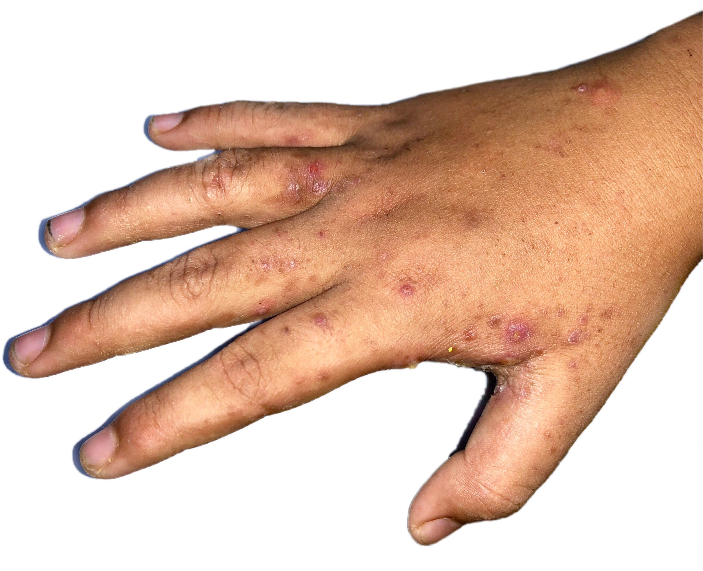
Cholestatic Pruritus
Pruritus due to cholestasis of any origin
Itch
Impaired bile flow

Slide 7
Conditions Associated With Cholestatic Pruritus
Intrahepatic Cholestasis of Pregnancy
Alagille Syndrome
Primary Biliary Cholangitis
Inherited Cholestasis Syndromes
Malignancy Biliary Tract Obstruction
Primary Sclerosing Cholangitis
Chronic Viral Hepatitis
Nonmalignant Biliary Tract Obstruction
Cirrhosis
0
10
20
30
40
50
60
70
80
90
100
Patients Experiencing Itch (%)
Bunchorntavakul. Clin Liver Dis. 2012;16:331.
Kamath. J Pediatr Gastroenterol Nutr. 2018;67:148. Kode. Curr Hepatol Rep. 2024;23:123.

Slide 8




Mechanisms of Cholestatic Pruritus
Proposed Pathogenesis of Pruritus Associated With Cholestasis
Pruritic
response
Pruritogens
(eg, lysophospholipids and
sulfated progesterone metabolites)
Bile acids?
Imam. J Gastroenterol Hepatol. 2012;27:1150. Beuers. Nat Rev Gastroenterol Hepatol. 2023;20:26.

Slide 9
Health Utility of Cholestatic Pruritus
Health Utility Of People With Cholestatic Pruritus Compared With Liver-Related and Other Conditions¹
Cholestatic pruritus has a negative impact on health-related quality of life and health utility in people with PBC¹
  Health utility scores range from
  0 (death) to 1 (perfect health)
Impairments due to severe itch are comparable to people with severe Parkinson disease^{1,2}
1.0
0.9
0.8
0.7
0.6
Mean Utility Index Score
0.5
0.4
0.3
0.2
0.1
0
Hepatitis C
(Cortesi 2020)
PBC
(Cortesi 2020)
End-Stage Renal Disease (Yang 2015)
Heart Failure
(Squire 2017)
Hepatocellular Carcinoma (Cortesi 2020)
PBC and Mild Pruritus (GLIMMER)
PBC and Severe Pruritus (GLIMMER)
PBC and Moderate Pruritus (GLIMMER)
COPD (Nolan 2015)
Severe Parkinson Disease (Alvarado-Bolaños 2015)
1. Smith. EASL International Liver Congress 2022. Poster 1916. 2. Hirschfield. EMJ Hepatol. 2022;10:22.
Notes:
COPD, chronic obstructive pulmonary disease; PBC, primary biliary cholangitis.

Slide 10




Impact of Pruritus on
Quality of Life
Sleep deprivation
Fatigue
Depression/ suicidal ideation
Inability to work
Tey. Clin Dermatol. 2013;31:31. Mayo. Dig Dis Sci. 2023;68:995.

Slide 11
Assessing the Itch: Patient Evaluation

Slide 12
Pruritus Evaluation: Guideline Recommendations
AASLD 2018¹
“The symptoms of PBC significantly impair quality of life and do not typically improve with UDCA or OCA treatment. Therefore, they warrant separate evaluation and treatment.”
EASL 2017²
“EASL recommends evaluation of
all patients for the presence of symptoms, particularly pruritus,
sicca complex, and fatigue.”
1. Lindor. Hepatology. 2019;69:394. 2. EASL Collaborators. J Hepatol. 2017;67:145.
Notes:
AASLD, American Association for the Study of Liver Diseases; EASL, European Association for the Study of the Liver; OCA, obeticholic acid; PBC, primary biliary cholangitis; UDCA, ursodeoxycholic acid.

Slide 13


United Kingdom PBC Care Delivery Audit
Evaluation of PBC symptoms is lacking, despite symptoms being predictive of quality of life^{1,2}
PBC Foundation patient experience survey found that 40% of people with PBC had not been asked about their symptoms in previous 12 mo³
Fatigue Assessment During Past 24 Mo¹
Pruritus Assessment During Past 24 Mo¹
0
20
40
60
80
100
0
20
40
60
80
100
Unassessed people
Assessed people
1. Abbas. JHEP Rep. 2023;6:100931. 2. Dyson. Ailment Pharmacol Ther. 2016;44:1039. 3. Mitchell. Gut. 2022;71:A39.
Notes:
PBC, primary biliary cholangitis.

Slide 14


Pruritus Assessment Tools
Visual Analogue Scale
Numerical Rating Scale
  Patients rate itch at “worst moment during the previous
  24 hr” from 0 (no itching) to
  10 (worst itch imaginable)
Worst possible
itching
No itching
0
2
4
6
8
10
Scores ≥5 indicate severe itching
“Mark a line anywhere on the scale that best aligns with the severity of your itching”
Elman. Br J Dermatol. 2010;162:587. Mayo. Dig Dis Sci. 2023;68:995. Fujino. BMC Gastroenterol. 2019;19:169.
Kwatra. Dermatol Ther (Heidelb). 2023;13:2403. Düll. Clin Liver Dis. 2022;26:727.

Slide 15

Pruritus Assessment Tools
5-D Itch Scale
  Duration
  Degree
  Direction
  Disability
  Distribution
PBC-40
  40 questions in 6 domains
  General symptoms, itch, fatigue, cognition, social, and emotional
These tools are frequently used in clinical trials, but itch sensations are subjective, fluctuate, and can be difficult to objectify
Notes:
PBC, primary biliary cholangitis.

Slide 16
More than Scratching the Itch:
Management Strategies for Cholestatic Pruritus

Slide 17





Nonpharmacologic Treatments for PBC Pruritus
Topical moisturizers
Avoidance of irritating fabrics
Cool showers
Fragrance-free soaps and laundry detergents
Light bedding
Pate. BMJ Open Gastroenterol. 2019;6:e000256.
Notes:
PBC, primary biliary cholangitis.

Slide 18
Drug and Nondrug Management of Pruritus
Increase pruritogen excretion
Bile acid resins
(eg, cholestyramine)
AASLD Guidelines:
First line
Reduce pruritogen production and modify metabolism in liver and/or intestines
Modulate central itch/pain pathway
Rifampin
Naltrexone
Sertraline
AASLD Guidelines:
Second line
If failure of second-line agents
Other Options:
Plasmapheresis
Molecular absorbance recirculating system
Nasobiliary drainage
UV light therapy
Topical therapy
Liver transplant
Emerging Therapies:
Maralixibat, odevixibat (approved for ALGS and PFIC)
Bezafibrate (Orphan Drug Status in US)
PPAR agonists
Gabapentin
Phenobarbital
In clinical trials: linerixibat, volixibat
Kode. Curr Hepatol Rep. 2024;23:123. Vander Does. Am J Clin Dermatol. 2022;23:647. Lindor. Hepatology. 2019;69:394.
Notes:
AASLD, American Association for the Study of Liver Diseases; ALGS, Alagille syndrome; PFIC, progressive familial intrahepatic cholestasis; UV, ultraviolet.

Slide 19
First-line PBC Pruritus Treatment: Bile Acid Resins
Medication | Dose | Considerations
Cholestyramine | 4-16 g/day Start 2x/day and can increase to 6x/day in divided doses | Other medications must be given 1 hr prior or 4 hr after Nausea, bloating, constipation, diarrhea Poor taste
Colesevelam | 3.75 g/day or 1.875 g/day in 2 doses | Nausea, bloating, constipation, diarrhea (similar frequency to cholestyramine) Available in tablet form
Colestipol | 2-16 g/day in divided doses | ↑ constipation Nausea, diarrhea, bloating Available in tablet form
Lindor. Hepatology. 2018;69:394. Cholestyramine PI. Colesevelam PI. Colestipol PI.
Notes:
PBC, primary biliary cholangitis.

Slide 20
Beyond First-line Treatments for PBC Pruritus
Medication | Dose | Considerations
Rifampin | 150-600 mg/day | Hepatoxicity in 10%-15% Contraindicated in severe liver disease; avoid if total bilirubin >2.5 mg/dL Drug–drug interactions Red-colored urine, tears
Naltrexone | 50 mg/day Begin at 12.5 mg and increase dose every 3-7 days | Withdrawal symptoms (nausea, headache, abdominal pain)
Sertraline | 75-100 mg/day | Effect is independent of improvement in depression
Lindor. Hepatology. 2018;69:394. Rifampin PI. Naltrexone PI. Sertraline PI.
Notes:
PBC, primary biliary cholangitis.

Slide 21
PPAR Agonists for PBC Pruritus
Alpha
Fenofibrate
Phase III ELATIVE trial
Elafibranor
Bezafibrate
Seladelpar
Phase II trial
Gamma
Delta
Colapietro. J Transl Autoimmun. 2023;6:100188.
Kowdley. NEJM. 2024;390:795. Kremer. Liver Int. 2022;42:112.
Notes:
PBC, primary biliary cholangitis.

Slide 22
ELATIVE: Elafibranor for PBC
Double-blind, placebo-controlled phase III trial in people with PBC who did not respond well to ursodeoxycholic acid (included people with PBC-related pruritus)
Wk
4
13
26
39
52
2
1
0
Change From Baseline in
PBC-40 Itch Score Over Time
(LS Mean ± 95% CI)
-1
-2
-0.7
-0.2
-0.1
-1.4
-0.6
-0.7
LS mean difference with placebo: -2.3
(95% CI: -4.0 to -0.7)
-3
-2.1
-1.9
-2.5
-2.5
-4
Elafibranor 80 mg
Placebo
-5
Kowdley. NEJM. 2024;390:795.
Notes:
LS, least squares; PBC, primary biliary cholangitis.

Slide 23
Phase II Study of Seladelpar
Open-label, uncontrolled phase II study of seladelpar 5-10 mg in people with moderate to severe PBC-related pruritus
VAS Change >20 Points at 1 Yr
No Pruritus
Mild
Moderate
Severe/Very Severe
Baseline VAS:
VAS = 0
0 < VAS <40
40 ≤ VAS <70
70 ≤ VAS ≤100
100
80
Worsened
No change
Improved
60
Patients (%)
40
20
0
5/10 mg
10 mg
5/10 mg
10 mg
5/10 mg
10 mg
5/10 mg
10 mg
n =
7
11
22
22
9
11
3
4
Kremer. Liver Int. 2022;42:112.
Notes:
PBC, primary biliary cholangitis; VAS, Visual Analogue Scale.

Slide 24
FITCH Trial: Bezafibrate
Randomized, double-blind, placebo-controlled trial in patients with PBC, PSC, or SSC with moderate to severe pruritus (N = 74)
AEs in n = 5 patients receiving bezafibrate: mouth or lower back pain, malaise, intensified itch and jaundice after halting treatment
  Other studies: diarrhea, nausea, decreased appetite
100
Primary Endpoint: All Patients (N = 74)
100
Primary Endpoint:
Patients With PBC (n = 26)
80
80
60
Bezafibrate 40 mg QD
Placebo
60
55
≥50% Reduction in VAS Score (%)
45
>50% Reduction in VAS Score (%)
40
40
P = .003
20
11
20
13
P = .04
n =
(17/38)
(4/36)
n =
(6/11)
(2/15)
0
0
All Patients
PBC
de Vries. Gastroenterology. 2021;160:734. accessdata.fda.gov/scripts/opdlisting/oopd/detailedIndex.cfm?cfgridkey=937523. medicinenet.com/bezafibrate/article.htm.
Notes:
AE, adverse event; BZA, bezafibrate; OCA, obeticholic acid; PBC, primary biliary cholangitis; PSC, primary sclerosing cholangitis; SSC, secondary sclerosing cholangitis; VAS, Visual Analogue Scale.

Slide 25
Ileal Bile Acid Transport Inhibitors
Medication | Dose | Considerations
Maralixibat | 190-380 µg/kg/day | Approved for pruritus in ALGS and PFIC Abdominal pain, diarrhea
Odevixibat | 40-120 µg/kg/day | Approved for pruritus in ALGS and PFIC Abdominal pain, diarrhea
Phase IIb dose-ranging trial of linerixibat (GLIMMER) for PBC-related pruritus completed
Ongoing studies of linerixibat (phase III GLISTEN trial) and volixibat (phase II VANTAGE trial) in patients with PBC-related pruritus
Maralixibat PI. Odevixibat PI. Levy. Clin Gastroenterol Hepatol. 2023;21:1902. NCT04950127. NCT05050136.
Notes:
ALGS, Alagille syndrome; PBC, primary biliary cholangitis; PFIC, progressive familial intrahepatic cholestasis.

Slide 26
GLIMMER Trial: Linerixibat
Randomized, multicenter, parallel-group trial in N = 147 patients with PBC and moderate to severe pruritus treated with linerixibat vs placebo
Diarrhea and abdominal pain most frequent AE; identified linerixibat dose for phase III trials
LS Mean Change in MWDI Score in ITT Population
Post Hoc Analysis of LS Mean Change in MWDI Score in Patients With Moderate to Severe Pruritus at Baseline
Linerixibat
Linerixibat
20 mg
QD
(n = 16)
90 mg
QD
(n = 20)
180 mg
QD
(n = 22)
40 mg
BID
(n = 22)
90 mg
BID
(n = 21)
20 mg
QD
(n = 13)
90 mg
QD
(n = 15)
180 mg
QD
(n = 16)
40 mg
BID
(n = 15)
90 mg
BID
(n = 19)
Placebo
(n = 35)
Placebo
(n = 24)
0
0
-1
-1
-2
-2
LS Mean Change From Baseline in MWDI Score With 95% CI
LS Mean Change From Baseline in MWDI Score With 95% CI
-3
-3
-4
-4
-5
-5
P = .0374
-6
-6
Levy. Clin Gastroenterol Hepatol. 2023;21:1902.
Notes:
AE, adverse event; ITT, intention-to-treat; LS, least squares; MWDI, mean worst daily itch; PBC, primary biliary cholangitis; PP, per protocol.

Slide 27
Take-home Points
Cholestastic pruritus is a frequent and often severe symptom associated with PBC and may dramatically reduce a patient’s QoL
Evaluating pruritus at each visit is key to understanding its impact on QoL and if treatments are achieving symptom control
Nonpharmacologic options for mild pruritus include moisturizer use, cool showers, and avoidance of irritating fabrics or soaps
Pharmacologic options for moderate to severe pruritus include
bile acid resins, PPAR agonists, rifampin, naltrexone, sertraline
Additional therapeutic classes (eg, IBAT inhibitors) represent promising treatment advances to help patients with pruritus
Notes:
PBC, primary biliary cholangitis; QoL, quality of life.

