Slide 1
Class in Session: DLL3 as a Therapeutic Target in Small-Cell Lung Cancer
Hossein Borghaei, DO, MS
Professor and Chief, Thoracic Medical Oncology
The Gloria and Edmund M. Dunn Chair in Thoracic Oncology
Fox Chase Cancer Center
Philadelphia, Pennsylvania
This activity is supported by educational funding provided by Amgen.

Slide 2

About These Slides
Please feel free to use and share some or all of these slides in your noncommercial presentations to colleagues or patients
When using our slides, please retain the source attribution:
These slides may not be published, posted online, or used in commercial presentations without permission. Please contact permissions@clinicaloptions.com for details
Slide credit: clinicaloptions.com
Notes:
Disclaimer: The materials published on the Clinical Care Options website reflect the views of the authors of the CCO material, not those of Clinical Care Options, LLC, the CME providers, or the companies providing educational grants. The materials may discuss uses and dosages for therapeutic products that have not been approved by the FDA. A qualified healthcare professional should be consulted before using any therapeutic product discussed. Readers should verify all information and data before treating patients or using any therapies described in these materials.

Slide 3
Disclosures
Hossein Borghaei, MS, DO: researcher: Amgen, Bristol-Myers Squibb, Lilly; consultant/advisor/speaker: Amgen, AstraZeneca, Axiom, BeiGene, Boehringer Ingelheim, Bristol-Myers Squibb, BioNTech, Daiichi Sankyo, Da Volterra, EMD Serono, Genentech, Genmab, Guardant, iTEO, Janssen, Jazz, Lilly, Merck, Mirati, Natera, Novartis, Oncocyte, Pfizer, PharmaMar, Puma, Regeneron, Takeda; data and safety monitoring board: Incyte, Novartis, Springworks, Takeda; stock options: Inspirna, Nucleai, Sonnetbio.

Slide 4
Small-Cell Lung Cancer
SCLC accounts for ~13% of all lung cancers in the US
Previously called oat-cell carcinoma
Associated with a history of significant tobacco use
Unique biology: rapid proliferation, abrupt presentation, bulky central tumor, hematogenous metastases at onset
Poor outcomes
US Lung Cancer Incidence by Histology
2010-2014
Other
Large-cell carcinoma
Small-cell carcinoma
3%
2%
Adenocarcinoma
Other
non-small-
cell carcinomas
Squamous and
transitional cell carcinoma
Oronsky. Neoplasia. 2017;19:842. Alvarado-Luna. Transl Lung Cancer Res. 2016;5:26.
Howlander. SEER Cancer Statistics Review, 1975-2014.
Slide credit: clinicaloptions.com
Notes:
SCLC, small-cell lung cancer.

Slide 5
SCLC: Staging and General Approach to Treatment
Limited-stage SCLC: ~1/3 of diagnoses¹
Extensive-stage SCLC: ~2/3 of diagnoses¹
  Can be safely treated with definitive radiation (corresponds to TNM stages I-III)
  Treatment: radiation or surgery + chemotherapy followed by PCI
  Median OS: 28-30 mo (clinical trial)²
  Prognosis: 5-yr OS of ~30%
  Most still recur
  Stage IV disease (TxNxM1a/b) or T3-4 because of multiple lung nodules or volume too large to be treated with definitive radiation
  Treatment: chemo + immunotherapy
  Median OS: ~1 yr
  Prognosis: 5-yr relative survival of 3%³
    Newer data from CASPIAN show 3-yr OS rate of 17.6%⁴
Ongoing need for efficacious treatments for all patients with SCLC
1. Rudin. Nat Rev Dis Primers. 2021;7:3. 2. Bogart. J Clin Oncol. 2023;JCO2201359.
3. American Cancer Society. Lung cancer survival rates. 4. Paz-Ares. ESMO Open. 2022;7:100408.
Slide credit: clinicaloptions.com
Notes:
OS, overall survival; PCI, prophylactic cranial irradiation; SCLC, small-cell lung cancer.

Slide 6
What Is DLL3?
DLL3 is an inhibitory ligand of the Notch signaling pathway
The Notch pathway is thought to be involved in cell proliferation, malignant transformation, and epithelial-mesenchymal transformation
DLL3 expression is related to key neuroendocrine transcription factor ASCL1
Tumor
cell
Notch
Notch
DLL3
Proliferation
Survival
Tumor
cell
ASCL1
Yao. Oncologist. 2022;27:940. Leonetti. Cell Oncol (Dordr). 2019;42:261. Sahlgren. Regen Med. 2006;1:195.
Notes:
ASCL1, achaete-scute homolog 1; DLL3, delta-like ligand 3; SCLC, small-cell lung cancer.

Slide 7
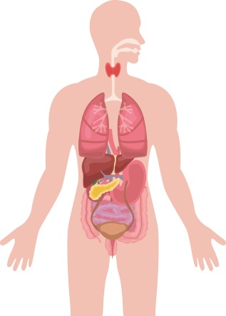


DLL3 Expression in Neuroendocrine Neoplasms
Representative Prevalence of DLL3 in NEN
In normal tissue, DLL3 expression is absent or low and confined to the cytoplasm
DLL3 overexpression is characteristic of NEN and is commonly found on the tumor cell surface
~85% of SCLC tumors overexpress DLL3
Respiratory
LCNEC: ~37-80% (~54%)
Typical Carcinoid: (12%*)
Atypical Carcinoid: (24%*)
Medullary thyroid carcinoma
80% (47%*)
Merkel cell (skin)
~90% (52-59%)
Stomach
29%
Pancreas
19-50% (21%†)
Small intestine
22%
Gastroenteropancreatic
77%
Bladder
68%
Prostate
NEPC ~76%
CRPC-Adeno 13%
Cervix Uteri
81% (49%*)
*Prevalence of high DLL3 expression (ie, ≥50% of DLL3-expressing cells).
†Strongly positive for DLL3.
Yao. Oncologist. 2022;27:940. Leonetti. Cell Oncol (Dordr). 2019;42:261.
Notes:
CRPC, castration-resistant prostate cancer; DLL3, delta-like ligand 3; LCNEC, large cell neuroendocrine carcinoma; NEPC, neuroendocrine prostate cancer.

Slide 8
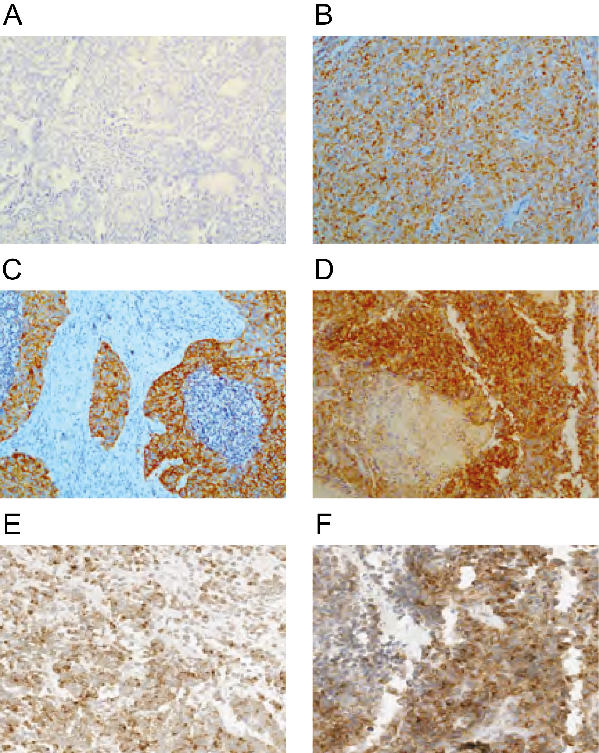
DLL3 IHC Staining by Site of Origin
Typical carcinoid
DLL3 negative
Atypical carcinoid
Moderate DLL3
Large-cell neuroendocrine carcinoma
Strong diffuse DLL3
SCLC
>50% positive cells
Adenocarcinoma with neuroendocrine component
80% positive cells
Neuroendocrine prostate cancer
90% positive cells
Yao. Oncologist. 2022;27:940.
Notes:
IHC, immunohistochemistry; SCLC, small cell lung cancer.

Slide 9
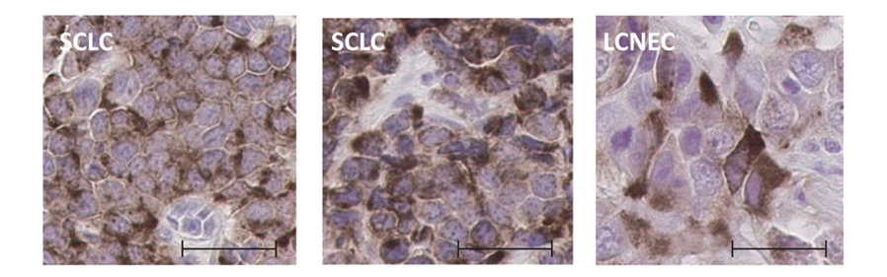
Elevated Expression of DLL3 in SCLC and LCNEC
DLL3 mRNA Expression by qPCR
DLL3 Surface Expression by IHC
10⁹
300
10⁷
250
200
10⁵
H-Score for
Membranous DLL3
Relative Expression
150
10³
100
10¹
50
10⁻¹
0
LCNEC PDX
Normal Lung
LCNEC
R/R SCLC
SCLC PDX
SCLC
Normal Tissues
Naive SCLC
NSCLC-Adeno
NSCLC-SqCC
Saunders. Sci Transl Med. 2015;7:302ra136.
Slide credit: clinicaloptions.com
Notes:
Adeno, adenocarcinoma; DLL3, delta-like 3 protein; IHC, immunohistochemistry; LCNEC, large-cell neuroendocrine; NSCLC, non-small-cell lung cancer; PDX, patient-derived xenograft; qPCR, quantitative polymerase chain reaction; R/R, relapsed/refractory; SCLC, small-cell lung cancer; SqCC, squamous cell carcinoma.

Slide 10
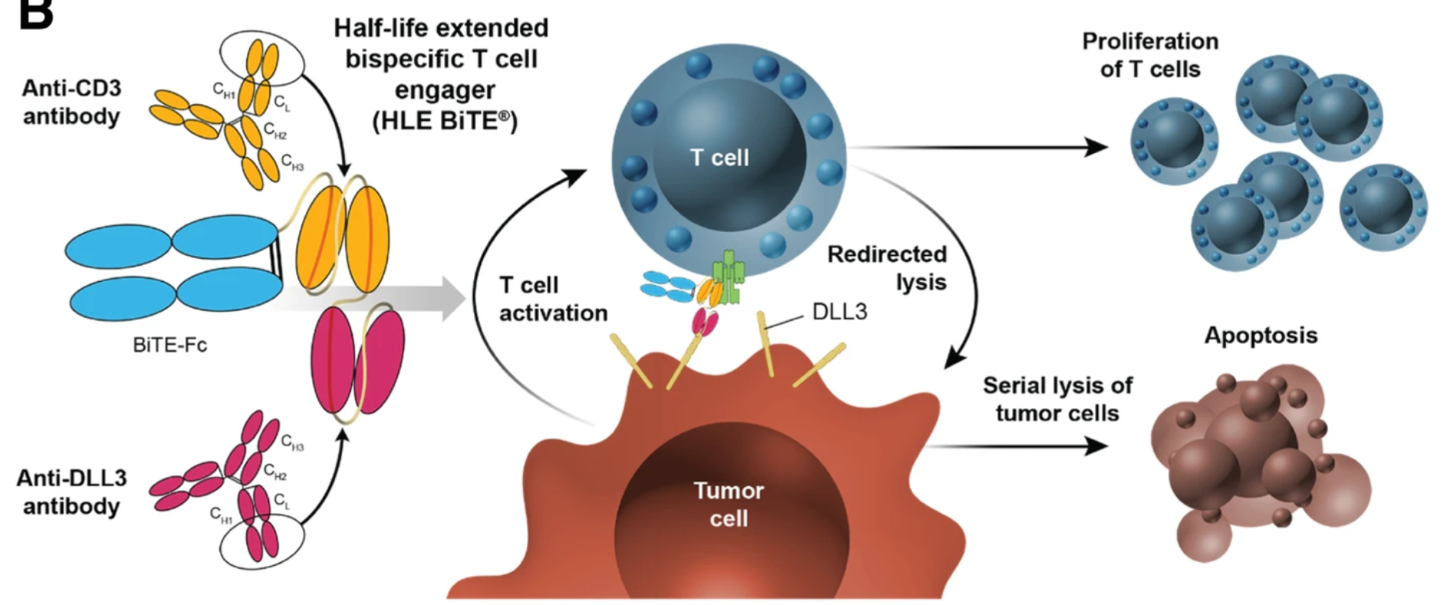
Tarlatamab: Mechanism of Action
Tarlatamab is a bispecific T-cell engager immune therapy that binds DLL3 and CD3, leading to T-cell–mediated tumor lysis^{1,2}
1. Giffin. Clin Cancer Res. 2021;27:1526. 2. Owen. J Hematol Oncol. 2019;12:61. Figure used under terms and conditions of the Creative Commons Attribution 4.0 International license (CC BY 4.0: https://creativecommons.org/licenses/by/4.0/).
Notes:
CD3, cluster of differentiation 3; DLL3, delta-like ligand 3; Fc, fragment crystallizable; SCLC, small cell lung cancer.

Slide 11
DeLLphi-300: Phase I Study of Tarlatamab in
Patients With Relapsed/Refractory SCLC
First-in-human, nonrandomized phase I dose exploration and expansion study
  Data cutoff of July 19, 2022; median follow-up time of 8.7 mo (range: 0.2-31.8)
Primary Objectives: Evaluate safety and tolerability in SCLC; determine MTD or RP2D
Secondary Objectives: Characterize PK; evaluate preliminary antitumor activity*
Exploratory Objectives: Evaluate immunogenicity of tarlatamab; assess biomarker expression
Patients with relapsed/refractory SCLC that has progressed or recurred following ≥1 previous platinum-based chemotherapy regimen (can include a PD-L1 inhibitor if indicated); ECOG PS ≤2; no untreated or symptomatic brain mets
(N = 107)
Dose Escalation Phase
Dose Expansion Phase
Tarlatamab
0.003-100 mg
(n = 73)
Tarlatamab
100 mg
(n = 34)
*Antitumor activity assessed using modified RECIST 1.1 every 8 wk (± 1 wk).
Paz-Ares. J Clin Oncol. 2023;[Epub].
Slide credit: clinicaloptions.com
Notes:
ECOG, Eastern Cooperative Oncology Group; mets, metastases; MTD, maximum tolerated dose; PK, pharmacokinetics; PS, performance status; RECIST, Response Evaluation Criteria in Solid Tumors; RP2D, recommended phase II dose; SCLC, small-cell lung cancer.

Slide 12
DeLLphi-300: Baseline Characteristics
Baseline Characteristic | All Patients (N = 107)
Median age, yr (IQR) | 63 (58-69)
Men/women, n (%) | 61 (57)/46 (43)
Current/former smoker, n (%) | 14 (13)/81 (76)
ECOG PS 0/1/2, n (%) | 40 (37)/66 (62)/1 (1)
Prior lines of therapy, n (%) 1 2 ≥3 | 30 (28) 45 (42) 32 (30)
Median number of prior therapies, n (IQR) | 2 (1-3)
Prior radiotherapy, n (%) | 85 (79)
Prior anti–PD-1/PD-L1, n (%) | 53 (50)
Baseline Characteristic | All Patients (N = 107)
Most recent line platinum-treated patients, n (%) Platinum sensitive Platinum resistant Platinum refractory | 54 (50) 22 (21) 26 (24)
Extensive stage disease at initial diagnosis, n (%) | 100 (93)
Liver/brain metastases, n (%) | 54 (50)/39 (36)
Median sum of diameters of target lesions, mm (IQR) | 75 (43-108)
Paz-Ares. J Clin Oncol. 2023;[Epub].
Notes:
ECOG, Eastern Cooperative Oncology Group; PS, performance status.

Slide 13
DeLLphi-300: Response
120
Confirmed ORR: 23.4% (95% CI: 15.7%-32.5%)
36.4% of patients with target lesion shrinkage ≥30%
100
80
60
40
SD
20
SD
SD
SD
SD
SD
SD
NE
0
SD
Best % Change From Baseline in Sum of Diameters
SD
-20
SD
SD
SD
SD
SD
SD
SD
SD
-40
Includes patients with ≥9 wk of follow-up
PR
SD
PR
SD^
PR**
SD^
SD^
PR
PR
PR
PR
PR
SD^
-60
SD^
PR**
PR
PR
PR
PR
PR
PR
SD^
PR
PR
PR**
-80
PR**
PR
PR
0.003 mg (n = 1)
0.3 mg (n = 9)†
30 mg (n = 7)†
0.01 mg (n = 1)
1 mg (n = 8)
100 mg (n = 13)†
0.3 mg (n = 1)
3 mg (n = 9)†
100 mg
(dose expansion) (n = 28)†
0.1 mg (n = 1)
10 mg (n = 16)†
PR
PR
PR
-100
SD
CR
CR
PR
SD^
-120
†Step dosing with 1-mg run-in dose.
**Patients had an initial PR and still have potential for future confirmative scans.
^Patients had an initial response but did not have confirmation of response on the subsequent scan.
Unlabeled = Patients with unconfirmed or confirmed PD
Paz-Ares. J Clin Oncol. 2023;[Epub].
Notes:
CR, complete response; NE, not evaluable; ORR, objective response rate; PR, partial response; SD, stable disease.

Slide 14
DeLLphi-300: Response
DoR in Confirmed Responders
(N = 25)
Response by Modified RECIST 1.1, n (%) |  | Patients (N = 107)
ORR, % (95% CI)
Confirmed |  | 23 (15.7-32.5)
Confirmed and unconfirmed |  | 25 (17.3-34.6)
Disease control rate, % (95% CI) |  | 51 (41.5-61.2)
Best overall response, n (%)
Confirmed CR | 2 (2) | 2 (2)
Confirmed PR | 23 (22) | 23 (22)
Stable disease | 30 (28) | 30 (28)
Progressive disease | 9 (8) | 9 (8)
Could not be evaluated* | 34 (32) | 34 (32)
No assessment | 9 (8) | 9 (8)
Cohort
0.3 mg (n=1)
1 mg (n=1)
3 mg (n=4) †
10 mg (n=6) †
30 mg (n=1) †
100 mg (n=4) †
100 mg
(expansion)
(n=8) †
First response (PR or better)
Disease progression
Ongoing treatment
Death
† = step dosing with 1-mg run-in dose.
0
10
20
30
40
50
60
70
80
90
100
Wk
Median DoR: 12.3 mo (95% CI: 6.6-14.9)
  11 responders had treatment ongoing as of data cutoff
Median time to response was 1.81 mo (IQR: 1.68-1.91)
*32 patients with PD at postbaseline scan did not have further confirmation scan.
Paz-Ares. J Clin Oncol. 2023;[Epub].
Notes:
CR, complete response; DoR, duration of response; IQR, interquartile range; ORR, objective response rate; PD, progressive disease; PR, partial response; RECIST, Response Evaluation Criteria in Solid Tumors.

Slide 15
DeLLphi-300: Survival
Progression-Free Survival
Overall Survival
100
Tarlatamab (N = 107)
Median PFS: 3.7 (95% CI: 2.1-5.4)
100
Tarlatamab (N = 107)
Median OS: 13.2 (95% CI: 10.5-NR)
80
80
60
60
PFS (%)
OS (%)
40
40
20
20
0
0
0
2
4
6
8
10
12
14
16
18
20
0
2
4
6
8
10
12
14
16
18
20
22
24
Mo
Mo
Patients at Risk, n
Patients at Risk, n
107
57
38
28
22
17
14
8
6
2
0
107
91
76
61
52
44
33
15
14
9
4
1
0
Survival analysis included patients with ≥6 mo of follow-up to allow sufficient data maturity before data cutoff
Paz-Ares. J Clin Oncol. 2023;[Epub].
Notes:
NR, not reached.

Slide 16
DeLLphi-300: Treatment-Related AEs
AE, n (%) | All Patients (N = 107)
 | Any Grade | Grade ≥3
Any AE | 107 (100) | 61 (57)
Any SAE | 55 (51) | 30 (28)
Any AE resulting in discontinuation* | 4 (4) | 3 (3)
Any TRAE | 97 (91) | 33 (31)
TRAEs ≥10% CRS Pyrexia Dysgeusia Fatigue Nausea Decreased appetite Vomiting Anemia Asthenia Neutropenia Headache | 56 (52) 40 (37) 24 (22) 23 (22) 21 (20) 14 (13) 13 (12) 12 (11) 12 (11) 12 (11) 11 (10) | 1 (1) 2 (2) 0 3 (3) 0 0 0 1 (1) 2 (2) 8 (7) 0
AEs of Interest, n (%) | All Patients (N = 107)
 | Any Grade | Grade ≥3
CRS | 56 (52) | 1 (1)
Neurologic events | 53 (50) | 7 (7)
Neutropenia | 17 (16) | 10 (9)
CRS generally occurred in cycle 1 and rarely recurred in subsequent cycles
  8/107 patients (7.5%) required tocilizumab for CRS
Neurologic events were predominantly grade 1 and presented as dysgeusia or headache
  Most common grade ≥3 treatment-related NE: confusion (n = 5, 1 patient with grade 4)
Grade 4 treatment-related neutropenia occurred in
4 patients (4%)
  No treatment-related cases of febrile neutropenia
*Encephalopathy (n = 1), ICANS (n = 1), and pneumonitis (n = 2, including one grade 5 pneumonitis).
Paz-Ares. J Clin Oncol. 2023;[Epub].
Slide credit: clinicaloptions.com
Notes:
AE, adverse event; CRS, cytokine-release syndrome, ICANS, immune effector cell-associated neurotoxicity; NE, neurologic events; SAE, serious adverse event; TRAE, treatment-related adverse event.

Slide 17
HPN328: Mechanism of Action
HPN328 is a DLL3-targeted T-cell engaging agent with 3 binding domains
  Anti-DLL3 (for target engagement)
  Anti-albumin (for half-life extension)
  Anti-CD3 (for T-cell engagement)
T-cell
CD3
Anti-CD3Ɛ
Cytolytic
synapse
Anti-albumin
Anti-DLL3
DLL3
Tumor cell
Johnson. ASCO 2022. Abstr 8566.
Notes:
DLL3, delta-like ligand 3.

Slide 18
Phase I Study of HPN328 in Patients With Relapsed/Refractory SCLC or Other NEN
First-in-human, nonrandomized phase I dose exploration and expansion study
  Data cutoff of April 21, 2022
Primary Objectives: Evaluate safety and tolerability in SCLC; determine MTD or RP2D; characterize PK
Secondary Objectives: Determine preliminary activity* and immunogenicity
Dose Escalation/
Escalation Phase
Patients with SCLC relapsed following platinum-based chemotherapy regimen OR other malignancies with high-grade neuroendocrine features relapsed/refractory to SoC; ECOG PS ≤2;
no untreated brain mets
(N = 18)
Dose Expansion Phase
HPN328 IV Q1W
0.015-12 mg
HPN328 IV Q1W
MTD or RP2D
Premedication with dexamethasone, acetaminophen, and histamine blockers
*Antitumor activity assessed using modified RECIST 1.1 every 9 wk (± 1 wk).
Johnson. ASCO 2022. Abstr 8566.
Slide credit: clinicaloptions.com
Notes:
ECOG, Eastern Cooperative Oncology Group; MTD, maximum tolerated dose; NEN, neuroendocrine neoplasm; PK, pharmacokinetics; PS, performance status; RECIST, Response Evaluation Criteria in Solid Tumors; RP2D, recommended phase II dose; SCLC, small-cell lung cancer; SoC, standard of care.

Slide 19
Phase I HPN328: Characteristics and Time on Treatment
Treatment Duration
Characteristic, n (%) | N = 18
Diagnosis SCLC NEPC Other NEN* | 11 (61) 2 (11) 5 (28)
Metastases Brain Liver | 7 (39) 9 (50)
Prior therapies 1 2 3 4 5 | 5 (28) 5 (28) 3 (17) 3 (17) 2 (11)
Prior immune checkpoint inhibitor | 14 (78) [SCLC: 11 (100)]
Dose (mg)/ # Prior lines
(*Checkpoint inhibitor)
0.015
4
0.045
1*
-38%
0.135
1*
4*
0.405
2*
5*
1*
-53%
1.215
5*
4*
Ongoing
Dose increase
SCLC; <1.215 mg/wk
SCLC; ≥1.215 mg/wk
NEPC
NEN other
Prior checkpoint inhibitor
Confirmed partial response
Maximum % decrease from baseline sum of target lesion diameters
2*
1
3.6
3*
-65%
3.6-7.2
1
-5%
3
-7%
*
3*
-21%
2*
-11%
-X%
2.0-12.0
2*
2*
*Retroperitoneal (unknown primary), colon, pancreas, thymic, bladder.
0
9
18
27
36
45
Time on Treatment (Wk)
Johnson. ASCO 2022. Abstr 8566.
Notes:
NEN, neuroendocrine neoplasm; NEPC, neuroendocrine prostate cancer; SCLC, small-cell lung cancer.

Slide 20
Phase I HPN328: Target Lesion Response
7/18 (39%): any decrease
  (5 SCLC, 1 NEPC, 1 NEN [thymic atypical carcinoid])
1 confirmed PR (SCLC, 2L) ongoing treatment at
32 wk
3/11 (27%) SCLC patients had >30% decrease
4/6 (67%) SCLC patients treated with ≥1.215 mg/wk had any decrease
100
Change in Sum of Target Lesions
80
60
40
20
+20%
0
SD
PD
SD
SD
SD
PR
PD†
Maximum % Change From Baseline
PD
PD
PD
PD
PD
PD
PD
PD
PD
SD
SD
-20
30%
-40
SCLC; <1.215 mg/wk
SCLC; ≥1.215 mg/wk
NEPC
NEN other
Prior checkpoint inhibitor
Confirmed partial response (RECIST) v1.1)
(Best overall response) RECIST v1.1
-60
-80
*
-100
BOR
3.6
1
1.215
2*
2.0-12.0
2*
0.015
4
0.405
5*
0.405
2*
1.215
4*
2.0-12.0
2*
0.135
1*
0.405
4*
1.215
5*
3.6-7.2
1
3.6-7.2
3
2.0-12.0
2*
3.6-7.2
3*
0.045
1*
1.215
1*
3.6-7.2
3*
†New brain metastases identified at Wk 2. Overall response: PD; target lesion response: PR.
Johnson. ASCO 2022. Abstr 8566.
Notes:
NEN, neuroendocrine neoplasm; NEPC, neuroendocrine prostate cancer; PR, partial response; SCLC, small-cell lung cancer.

Slide 21
Phase I HPN328: Safety
 | N = 18
AE, n (%) | All Grades | Grade ≥3
Any AE | 18 (100) | 10 (56)
Any TRAE | 15 (83) | 1 (6)
Dysgeusia | 7 (39) | 0
Fatigue | 7 (39) | 0
Hypotension | 7 (39) | 1 (6)
Constipation | 6 (33) | 0
Hyponatremia | 6 (33) | 1 (6)
Nausea | 6 (33) | 0
Vomiting | 6 (33) | 0
Anemia | 5 (28) | 2 (11)
Chills | 5 (28) | 0
 | N = 18
AE, n (%) | All Grades | Grade ≥3
Pyrexia | 5 (28) | 0
ALT increased | 4 (22) | 1 (6)
AST increased | 4 (22) | 1 (6)
CRS* | 4 (22) | 0
Diarrhea | 3 (17) | 0
Dry skin | 3 (17) | 0
Dyspnea | 3 (17) | 0
Headache | 3 (17) | 0
Neutropenia | 3 (17) | 2 (11)
Weight decreased | 3 (17) | 0
MTD not reached; no DLTs
Grade 1/2 CRS: 4 (22%)
  No grade ≥3 CRS
No ICANS
No discontinuation because of AEs
*Grade 2: 2/4 patients treated at 1.215 mg and 1 patient at 3.6 mg. Grade 1: 1/4 patients at 3.6 mg.
Johnson. ASCO 2022. Abstr 8566.
Notes:
AE, adverse event; ALT, alanine transaminase; AST, aspartate transferase CRS, cytokine-release syndrome, DLT, dose-limiting toxicity; ICANS, immune effector cell–associated neurotoxicity syndrome; MTD, maximum tolerated dose; TRAE, treatment-related adverse event.

Slide 22
Ongoing Trials of DLL3-Targeting Agents in SCLC
Trial | Phase | Treatment | Eligibility Criteria | Locations
Currently enrolling
DeLLphi-301 NCT05060016 | II | Tarlatamab monotherapy | SCLC, 3L+ | Global
DeLLphi-303 NCT05361395 | Ib | Tarlatamab with SoC | SCLC, 1L | Global
NCT04471727 | I/II | HPN328 | SCLC and other cancers | US
NCT04429087 | I | BI764532 (DLL3/CD3 bispecific Ab) | SCLC and other NET DLL3+ | US, Germany, Japan, Spain
Opening in 2023
DeLLphi-304 NCT05740566 | III | Tarlatamab monotherapy | SCLC, 2L (prior platinum-based therapy) | TBD
Notes:
Ab, antibody; DLL3, delta-like ligand 3; NET, neuroendocrine tumor; SCLC, small-cell lung cancer; SoC, standard of care.

Slide 23
Conclusions
DLL3 targeting is an active area of investigation in SCLC
Bispecific T-cell engagers offer a potential treatment strategy
The observed tolerability and efficacy in early-phase trials require confirmation in larger studies which are ongoing
Patient selection based on DLL3 expression requires further exploration
Notes:
DLL3, delta-like ligand 3; SCLC, small-cell lung cancer.

Slide 24
Go Online for More CCO
Coverage of Lung Cancer!
CME-certified text module associated with this downloadable slideset
ClinicalThought expert commentary on the potential clinical impact of DLL3-targeted therapy (coming soon!)
clinicaloptions.com

