Slide 1
Addressing the Disproportionate Burden of Moderate to Severe Atopic Dermatitis in Patients With Skin of Color: Expert Perspectives for NPs and PAs
Provided by Partners for Advancing Clinical Education (PACE).
This activity is supported by an educational grant from Sanofi and Regeneron Pharmaceuticals.

Slide 2

About These Slides
Please feel free to use and share some or all of these slides in your noncommercial presentations to colleagues or patients
When using our slides, please retain the source attribution:
These slides may not be published, posted online, or used in commercial presentations without permission. Please contact pce@practicingclinicians.com for details
Slide credit: practicingclinicians.com
Notes:
Disclaimer: The materials published on the Practicing Clinicians Exchange website reflect the views of the authors of the PCE material, not those of Practicing Clinicians Exchange, the CME providers, or the companies providing educational grants. The materials may discuss uses and dosages for therapeutic products that have not been approved by the United States Food and Drug Administration. A qualified healthcare professional should be consulted before using any therapeutic product discussed. Readers should verify all information and data before treating patients or using any therapies described in these materials.

Slide 3
Faculty
Victoria Garcia-Albea, PNP, DCNP
Director, Lahey Dermatology Nurse Practitioner Training Program
Lahey Dermatology
Burlington, Massachusetts
Notes:
This slide lists the faculty who were involved in the production of these slides.

Slide 4
Disclosures
The faculty reported the following relevant financial relationships or relationships to products or devices they have with ineligible companies related to the content of this educational activity:
Victoria Garcia-Albea, PNP, DCNP: consultant/advisor/speaker: Sanofi Genzyme,
Sun Pharma.
Notes:
This slide lists the disclosure information of the faculty and staff involved in the development of these slides.

Slide 5
Learning Objectives
Apply effective strategies for diagnosing moderate to severe AD in patients with skin of color
Incorporate quality of life considerations and updated guidelines into management strategies for patients with moderate to severe AD and skin of color
Implement strategies for addressing patient- and practice-level disparities in moderate to severe AD care among patients with skin of color
Notes:
AD, atopic dermatitis.

Slide 6
Understanding the Associated Burden of Moderate to Severe AD in Patients With Skin of Color
Notes:
AD, atopic dermatitis.

Slide 7
Epidemiology, Pathogenesis, and Comorbidities
Affects 3% to 20% of children
  Onset most common between 3 and 6 mo of age
    Of those diagnosed with AD, 60% develop the condition by age 1 and 85% develop it by age 5
Up to 60% of cases persist into adulthood
1 in 4 adults with AD report adult onset of symptoms
Cycles of flares and worsening symptoms
  Real-world evidence in patients with moderate to severe AD revealed:
    Average of 7.5 flares per yr
    74.2% experienced either no remission or <3 mo of remission in the past 12 mo
Notes:
AD, atopic dermatitis.

Slide 8
Epidemiology of AD in Racial and Ethnic Minorities
16.5 million adults with AD in US
13% Asian or Pacific Islander
11% White American
10% Black
13% Native American
Those living in urban areas are more likely to have AD than those from rural or suburban areas
Higher prevalence of AD in Black children in urban areas
9.6 million children with AD in US
16.1% European American
19.3% Black
aafp.org/atopic-dermatitis-in-America/. Chovatiya. Arch Dermatol Res. 2022;314:739. Davis. J Allergy Clin Immunol. 2021;147:1579. Kantor. Expert Rev Clin Immunol. 2017;13:15. McKenzie. Ann Allergy Asthma Immunol. 2019;123:173. nationaleczema.org/research/eczema-facts/.
Notes:
AD, atopic dermatitis.

Slide 9
Social Determinants of Health
Economic Stability
Employment
Income
Neighborhood and Physical Environment
Housing
Education
Literacy
Language
Early childhood education
Expenses
Debt
Medical bills
Support
Transportation
Safety
Parks and playgrounds
Walkability
Zip code
Vocational training
Higher education
Food
Hunger
Access to healthy options
Community and Social Context
Social integration
Support systems
Community engagement
Discrimination
Stress
Healthcare System
Health coverage
HCP availability
HCP linguistic and cultural competency
Quality of care
Health Outcomes
Mortality, morbidity, life expectancy, healthcare expenditures, health status, functional limitations
kff.org/racial-equity-and-health-policy/issue-brief/beyond-health-care-the-role-of-social-determinants-in-promoting-health-and-health-equity/.

Slide 10
Impact of Health Disparities on AD Outcomes
Racial and ethnic minorities are more likely to:
  Have treatment-resistant disease
  Experience poor social determinants of health
    Lower socioeconomic status (income <$30,000/yr)
    Living in older homes or multiple homes
    Lower education level
  Have impaired QoL
Black and Hispanic patients have more moderate to severe disease
More AD-related office visits for Black and Asian children
Notes:
AD, atopic dermatitis, QoL, quality of life.

Slide 11

Impact of Environment on AD
Social
Anthropogenic
  Stress triggers symptoms
  Strong social support can be of benefit
  Air quality and pollution
  Climate factors
    Changing climate
    Temperature
    UV exposure
    Humidity
Nutritive
  Diet impact on allergic symptoms
    Diverse diet beneficial
Kantor. Expert Rev Clin Immunol. 2017;13:15. Luschkova. Allergol Select. 2021;5:244.
Notes:
AD, atopic dermatitis.

Slide 12
Economic Factors Impacting Black Patients
Black patients with AD:
  Were younger
  Had a lower household income
  Were more likely to have Medicaid coverage
  Were more likely to live in urban areas
  Had poorer AD control
  Had more frequent skin infections
Black race was associated with:
  Higher OOP costs for prescription medications
  Prescriptions not covered by their insurance
  Increased ED visits
  Outpatient laboratory testing
Higher odds of harmful financial impact
Increased OOP costs and significant household financial impact
Notes:
AD, atopic dermatitis; ED, emergency department; OOP, out of pocket.

Slide 13
Evaluating Atopic Dermatitis in
Patients With Skin of Color

Slide 14
Comorbidities of AD
Atopic and allergic conditions
Asthma
Food allergies
Immune-mediated conditions
Depression, anxiety, and self-harm
Allergic rhinitis, conjunctivitis, eosinophilic esophagitis
Alopecia areata
Urticaria
Mental health and substance use
Substance use
Attention deficit hyperactivity disorder (ADHD) and autism spectrum disorders
Cardiovascular diseases
Metabolic disorders
Bone health
Skin infections
Hypertension
Coronary and peripheral artery disease
Heart failure
Thromboembolic diseases
Obesity
Dyslipidemia
Osteoporosis
Fractures
Notes:
AD, atopic dermatitis.

Slide 15
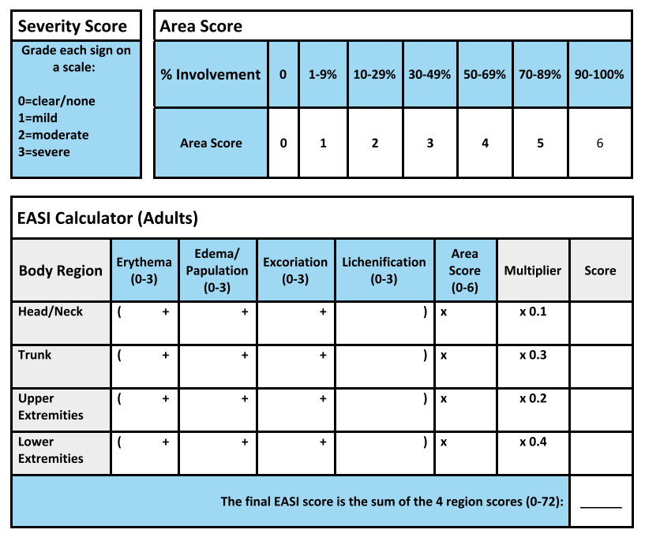
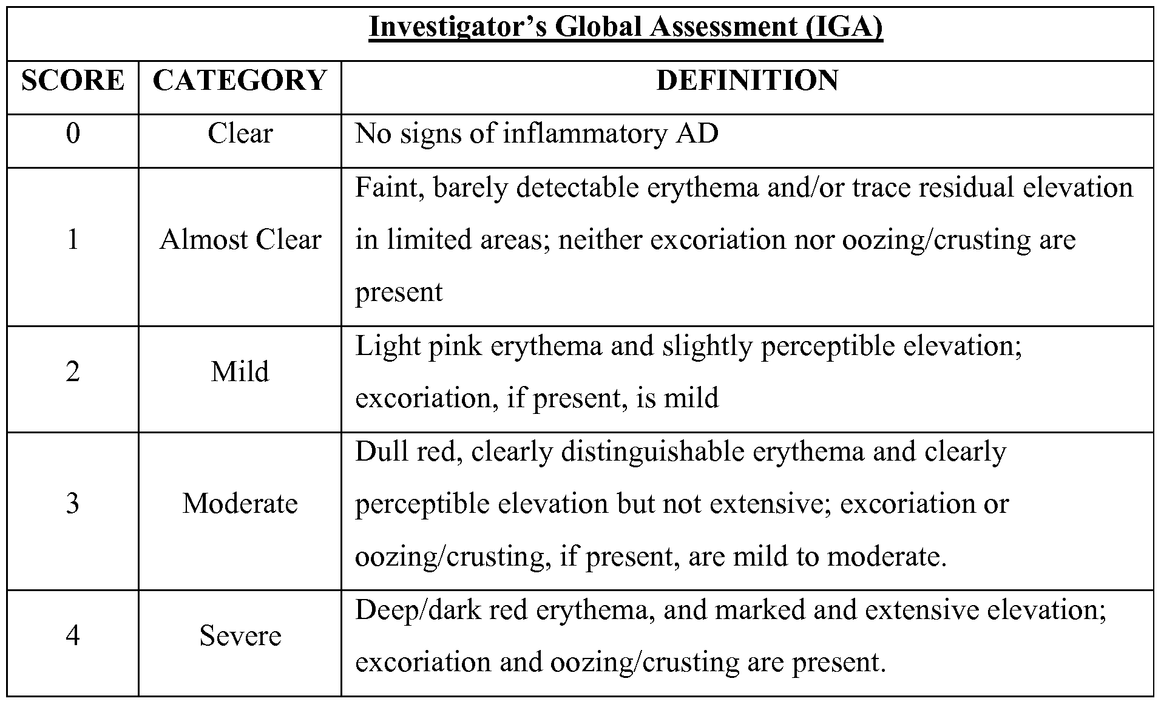
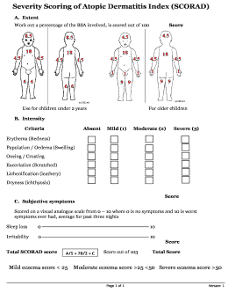
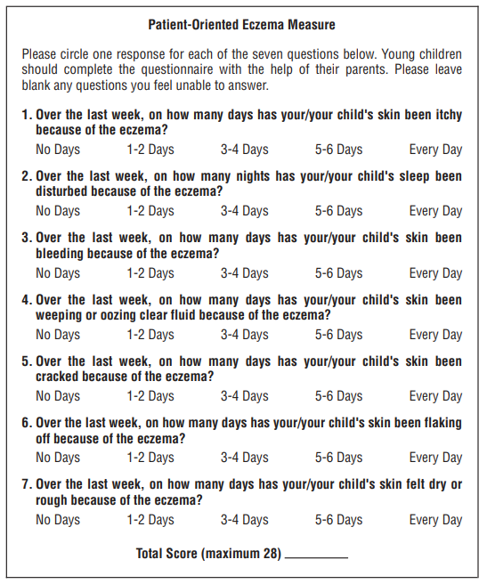
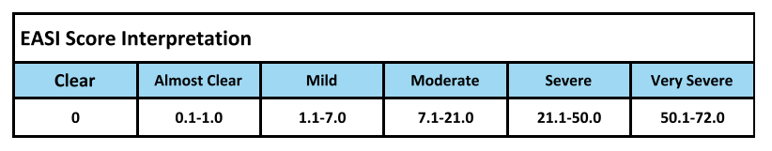
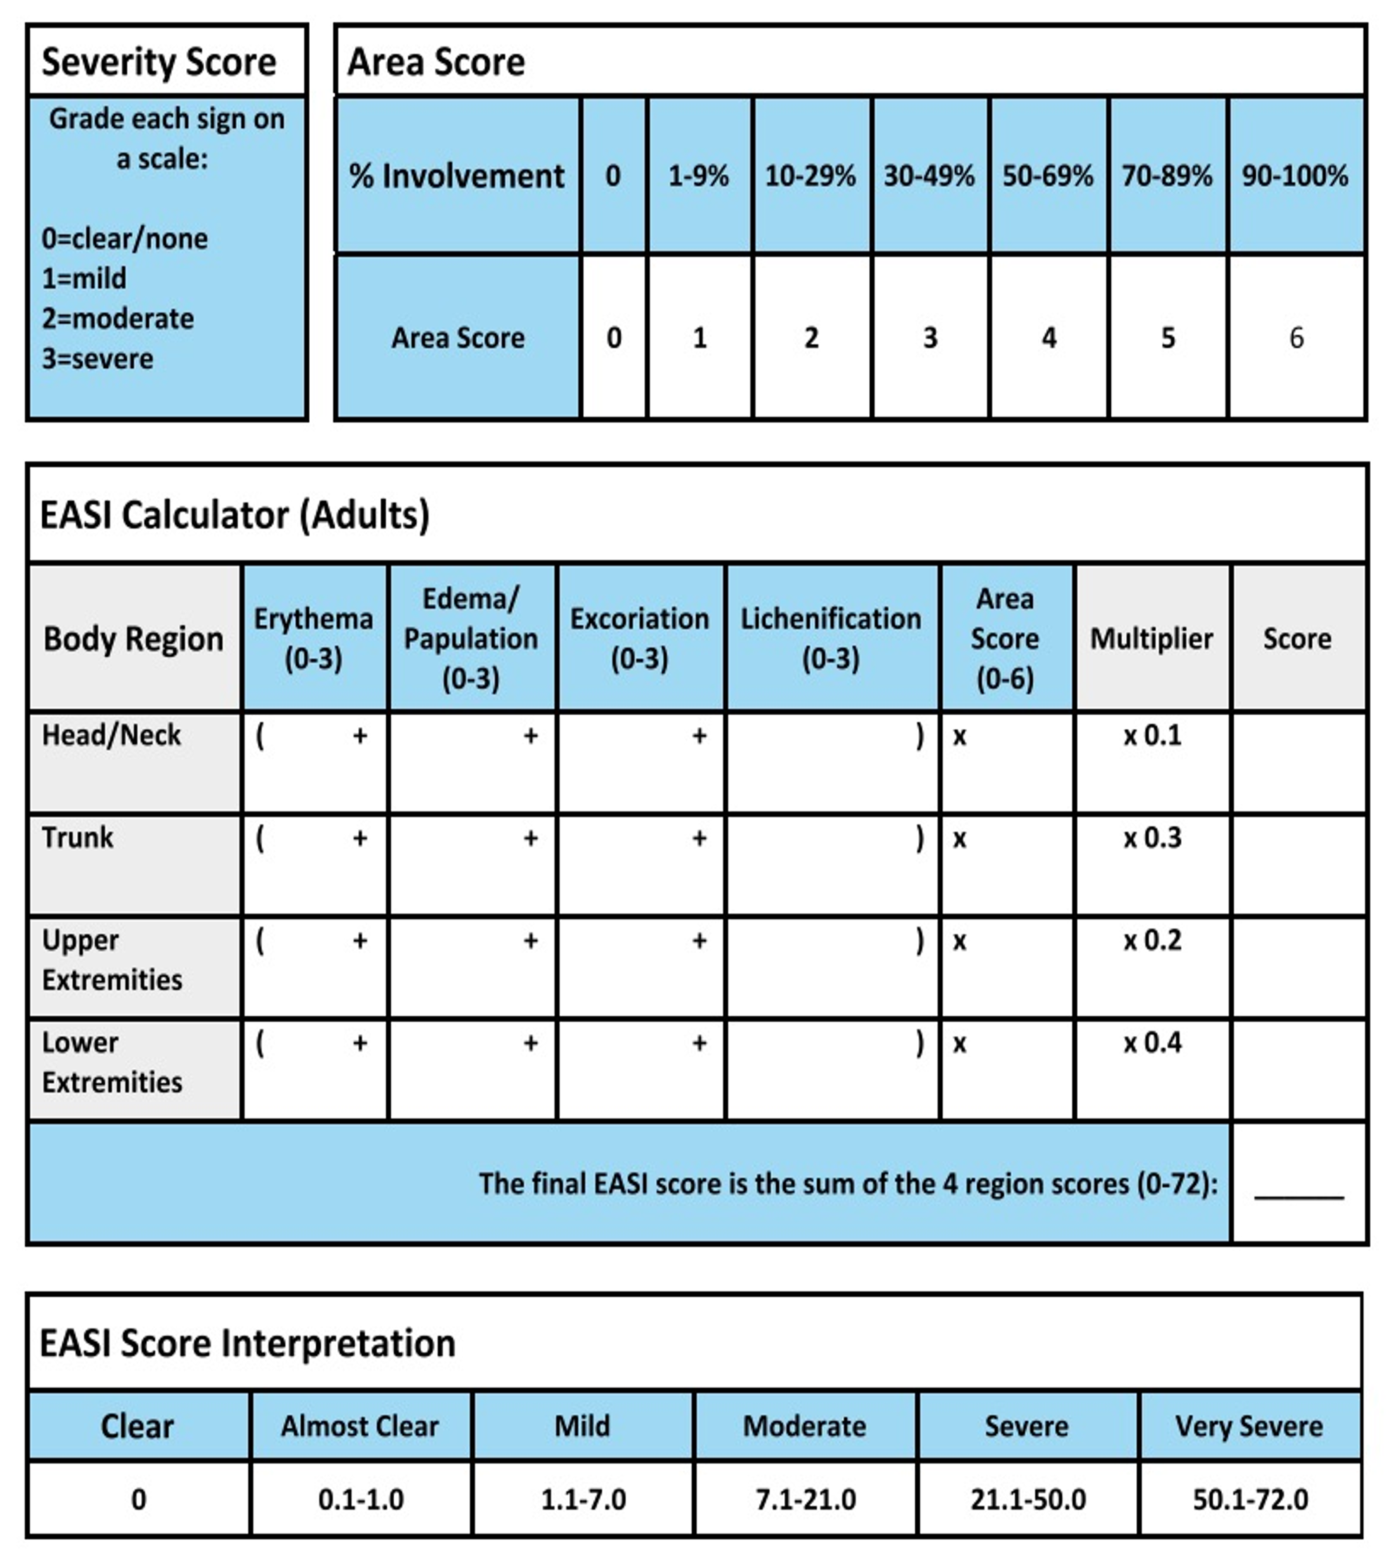
Clinical Assessment Tools
Eczema Area and
Severity Index
(EASI)
Investigator Global Assessment
(IGA)
SCORing Atopic
Dermatitis
(SCORAD)
Patient-Oriented
Eczema Measure
(POEM)
Hanifin. Dermatitis. 2022;33:187. Futamura. J Am Acad Dermatol. 2016;74:288.
European Task Force on AD. Dermatology. 1993;186:23. Charman. Arch Dermatol. 2004;140:1513.

Slide 16






Atopic Dermatitis Control Tool: ADCT
Validated, brief and easily scored patient self-assessment tool
6 questions to evaluate the different dimensions of AD control identified as relevant by patients and clinicians
Can be self-administered by patients or used in routine consultations
Designed to help facilitate meaningful patient–HCP discussion on control of AD in every day clinical practice
Overall severity of AD symptoms
Frequency of intense episodes of itching
Extent of
AD-related
bother
Frequency of sleep impact
Impact of AD on daily activities
Impact of AD
on mood or
emotions
Pariser. Curr Med Res Opin. 2019;doi:10.1080/03007995.2019.1699516. Simpson. BMC Dermatol. 2019;19:15.
Notes:
AD, atopic dermatitis; HCP, healthcare professional.

Slide 17
ADCT Measurements
Over the last week, how would you rate your eczema-related symptoms? | (None) 0 Points | (Mild) 1 Point | (Moderate) 2 Points | (Severe) 3 Points | (Very Severe) 4 Points
Over the last week, how many days did you have intense episodes of itching because of your eczema? | (Not at all) 0 Points | (1-2 days) 1 Point | (3-4 days) 2 Points | (5-6 days) 3 Points | (Every day) 4 Points
Over the last week, how bothered have you been by your eczema? | (Not at all) 0 Points | (A little) 1 Point | (Moderately) 2 Points | (Very) 3 Points | (Extremely) 4 Points
Over the last week, how many nights did you have trouble falling or staying asleep because of your eczema? | (No nights) 0 Points | (1-2 nights) 1 Point | (3-4 nights) 2 Points | (5-6 nights) 3 Points | (Every night) 4 Points
Over the last week, how much did your eczema affect your daily activities? | (Not at all) 0 Points | (A little) 1 Point | (Moderately) 2 Points | (A lot) 3 Points | (Extremely) 4 Points
Over the last week, how much did your eczema affect your mood or emotions? | (Not at all) 0 Points | (A little) 1 Point | (Moderately) 2 Points | (A lot) 3 Points | (Extremely) 4 Points
AD may not be well controlled if…
  ADCT score is ≥7
  ≥1 answer is in a colored box on the ADCT table
  ADCT score has increased by ≥5 points since last assessed
Pariser. Curr Med Res Opin. 2020;36:367. Simpson. BMC Dermatol. 2019;19:15.
Notes:
AD, atopic dermatitis; ADCT, Atopic Dermatitis Control Tool.

Slide 18
Challenges and Strategies for Improving Health Equity of Patients With Skin of Color

Slide 19
AAD Guideline Algorithm 2024
Key
Strong recommendation in favor of the intervention
Conditional recommendation in favor of the intervention
Strong recommendation against the intervention
Conditional recommendation against the intervention
FDA
FDA indicated for atopic dermatitis
Adults With Atopic Dermatitis
Severity Assessment:
Assessment of signs of disease, severity of symptoms, and comorbidities
Extent of the negative impact on QoL
Exacerbating Factor Avoidance
Identify relevant trigger factors (allergens, irritants, etc) and counsel patients on how to avoid triggers
Baseline Therapy
Moisturizers/Emollients
Baseline Management
Bathing Practices
Notes:
AAD, American Academy of Dermatology; FDA, Food and Drug Administration; QoL, quality of life.

Slide 20

Updates on Topical and Maintenance Treatment for Mild to Severe AD
Mild to Severe
Maintenance Therapy
Ongoing Maintenance With Topical Therapies
Inadequate Control
Topical Therapies
Reactive as needed for inflamed areas or proactive application to maintain control in recurrently inflamed sites
Shared decision-making is important for long-term treatment; consider patient satisfaction with current treatment and ability to adhere to maintain control
If topical therapy and basic management are optimized, consider alternative diagnosis, such as contact dermatitis or cutaneous lymphoma
Consider additional treatment with phototherapy and/or systemic agents
TCS
FDA
TCIs
FDA
Crisaborole ointment
FDA
Optimized Topical Therapy
for Inflamed Areas
Ruxolitinib cream
FDA
Wet dressings
Roflumilast*
FDA
Notes:
AD, atopic dermatitis; TCI, topical calcineurin inhibitor; TCS, topical corticosteroid.

Slide 21
Updates on Systemic Therapies for Moderate to Severe AD
Moderate to Severe
Photography and
Systemic Therapy
Systemic Therapies
Dupilumab
Methotrexate
Topical agents can be used concurrently with phototherapy or systemic agents for maintenance of response, rescue, or treatment of flares
Tralokinumab
Azathioprine
Biologics
Lebrikizumab*
Immunosuppressants
Cyclosporine
Upadacitinib
Mycophenolate mofetil
Phototherapy
JAK Inhibitors
Abrocitinib
Systemic corticosteroids
FDA
Baricitinib
Notes:
AD, atopic dermatitis; FDA, Food and Drug Administration; JAK, Janus kinase.

Slide 22
Dupilumab Efficacy by Racial Subgroup: Wk 16
Subgroup analysis from phase III RCTs: LIBERTY AD SOLO 1, SOLO 2, and CHRONOS
Eczema Area and Severity Index
Subgroup
White
Dupilumab Q2W vs placebo
Dupilumab QW vs placebo
Asian
Dupilumab Q2W vs placebo
Dupilumab QW vs placebo
Black
Dupilumab Q2W vs placebo
Dupilumab QW vs placebo
Placebo Change (SE)
-14.91 (0.703)
-14.91 (0.703)
-10.97 (1.664)
-10.97 (1.664)
-11.88 (1.947)
-11.88 (1.947)
Dupilumab Change (SE)
-25.36 (0.693)
-25.47 (0.651)
-24.23 (1.615)
-25.46 (1.455)
-20.02 (2.722)
-19.98 (1.925)
Favors Dupilumab
Favors Placebo
-30
-20
-10
0
10
20
LS Mean Difference
Alexis. J Drugs Dermatol. 2019;18:804.
Notes:
LS, least squares; RCT, randomized controlled trial; SE, standard error.

Slide 23
Dupilumab Safety by Racial Subgroup: Wk 16
AE, n (%) | Asian |  |  | Black |  |  | White
 | PBO (n = 188) | DUP 300 Q2W (n = 128) | DUP 300 QW (n = 184) | PBO (n = 53) | DUP 300 Q2W (n = 27) | DUP 300 QW (n = 47) | PBO (n = 509) | DUP 300 Q2W (n = 402) | DUP 300 QW (n = 517)
≥1 TEAE | 128 (68.1) | 83 (64.8) | 121 (65.8) | 24 (45.3) | 12 (44.4) | 26 (55.3) | 362 (71.1) | 292 (72.6) | 372 (72.0)
≥1 TE-SAE | 7 (3.7) | 1 (0.8) | 1 (0.5) | 0 | 1 (3.7) | 0 | 22 (4.3) | 11 (2.7) | 13 (2.5)
≥1 TEAE causing discontinuation | 7 (3.7) | 0 | 3 (1.6) | 1 (1.9) | 0 | 0 | 12 (2.4) | 6 (1.5) | 12 (2.3)
Conjunctivitis | 6 (3.2) | 13 (10.2) | 15 (8.2) | 1 (1.9) | 1 (3.7) | 3 (6.4) | 29 (5.7) | 45 (11.2) | 80 (15.5)
Alexis. J Drugs Dermatol. 2019;188:804.
Notes:
AE, adverse event; Dup, dupilumab; PBO, placebo; TEAE, treatment-emergent adverse events; TE-SAE, treatment-emergent serious adverse events.

Slide 24
Lebrikizumab Efficacy by Racial Subgroup: Wk 16
Subgroup analysis from phase IIb RCT (NCT03443024)
Overall
White
Black
Other
100
80
†
60.6
*
56.1
62.9
63.2
58.3
60.0
60
50.5
52.9
53.5
43.4
Patients (%)
40.2
40
34.4
27.7
27.9
24.3
20
16.5
n =
73
37
26
10
80
42
28
10
75
40
23
12
52
26
16
10
0
LEB 125 mg Q4W
LEB 250 mg Q4W
LEB 250 mg Q2W
Placebo Q2W
*P <.01; †P <.001.
Guttman-Yassky. JAMA Dermatol. 2020;156:411.
Notes:
LEB, Lebrikizumab; RCT, randomized controlled trial.

Slide 25
Lebrikizumab Safety by Racial Subgroup: Wk 16
AE, n (%) | Other |  | Black |  | White
 | PBO (n = 10) | LEB (n = 32) | PBO (n = 16) | LEB (n = 77) | PBO (n = 26) | LEB (n = 119)
≥1 TEAE | 4 (40.0) | 19 (59.4) | 5 (31.3) | 40 (51.9) | 15 (57.7) | 68 (57.1)
Discontinuation because of TEAE | 0 | 1 (3.1) | 1 (6.3) | 1 (1.3) | 0 | 7 (5.9)
Other TEAEs of note Nasopharyngitis URTIs Conjunctivitis Herpesvirus infection | 0 0 0 1 (10.0) | 3 (9.4) 2 (6.3) 1 (3.1) 0 | 1 (6.3) 1 (6.3) 0 0 | 4 (5.2) 4 (5.2) 2 (2.6) 4 (5.2) | 1 (3.8) 2 (7.7) 0 1 (3.8) | 8 (6.7) 11 (9.2) 3 (2.5) 4 (3.4)
Armstrong. RAD 2020. Abstr 191.
Notes:
AE, adverse event; LEB, lebrikizumab; PBO, placebo; TEAE, treatment-emergent adverse event; URTI, upper respiratory tract infection.

Slide 26
Tralokinumab Efficacy by Racial Subgroup: Wk 56
Subgroup analysis from phase III ECZTEND*
Asian (n = 167)
Black (n = 75)
White (n = 743)
EASI-75
EASI-90
IGA 0/1
EASI ≤7
100
88
87
78
83
81
80
74
72
64
69
51
60
53
Responders (%)
37
40
20
n =
10
0
*Data as observed.
Mayo. SKIN. 2023;7:s144.
Notes:
EASI, Eczema Area and Severity Index; IGA, Investigator Global Assessment; RCT, randomized controlled trial.

Slide 27
Tralokinumab Safety by Racial Subgroup: Wk 56
 | Asian (n = 203; PYE = 386.2) |  | Black (n = 108; PYE = 169.7) |  | White (n = 1081; PYE = 1808.0)
 | n (%) | Rate (nE/100 PYE) | n (%) | Rate (nE/100 PYE) | n (%) | Rate (nE/100 PYE)
All AEs | 162 (798) | 167.8 | 71 (65.7) | 142.6 | 850 (78.6) | 208.2
Severity Mild Moderate Severe | 142 (70.4) 67 (33.0) 10 (4.9) | 130.2 34.7 2.8 | 57 (52.8) 35 (32.4) 7 (6.5) | 101.9 35.3 5.3 | 717 (66.3) 503 (46.5) 80 (7.4) | 134.1 66.8 7.4
Serious AEs | 12 (5.9) | 3.4 | 7 (6.5) | 4.7 | 81 (7.5) | 5.4
Trial withdrawal due to AE | 2 (1.0) | 0.5 | 2 (1.9) | 1.2 | 20 (2.8) | 1.7
Mayo. SKIN. 2023;7:s144.
Notes:
AE, adverse event; nE, number of events; PYE, patient-years of exposure.

Slide 28
Abrocitinib Efficacy by Racial Subgroup and Skin Type: Wk 12
Post hoc analysis of pooled data from phase II and III RCTs: NCT02780167, MONO-1, and MONO-2
Placebo
Abrocitinib 100 mg QD
Abrocitinib 200 mg QD
Race
FST
White
Black
Asian
FST I-III
FST IV-VI
100
100
100
100
100
80
80
80
80
80
c
c
c
c
c
c
c
60
64
c
61
64
c
60
a
60
60
c
60
c
60
Patients, % (95% CI)
48
c
b
c
c
c
a
48
c
c
c
46
40
40
40
40
40
39
38
24
c
40
c
c
b
23
a
26
a
c
20
27
20
16
20
11
20
20
27
a
a
14
8
13
16
10
13
14
13
4
11
0
3
0
0
0
0
3
0
0
2
4
6
8
10
12
0
2
4
6
8
10
12
0
2
4
6
8
10
12
0
2
4
6
8
10
12
0
2
4
6
8
10
12
Wk
Wk
Wk
Wk
Wk
Patients at Risk, n
Abrocitinib 200 mg QD
Abrocitinib 100 mg QD
Placebo
226
251
141
230
248
140
229
251
139
224
250
136
30
31
22
29
31
21
30
31
22
29
31
22
85
80
37
84
78
39
85
79
39
85
79
39
245
235
136
246
232
135
247
235
134
244
234
132
113
131
72
113
129
73
114
130
74
111
130
73
Alexis. Ann Allergy Asthma Immunol. 2024;132:383.
Notes:
FST, Fitzpatrick skin type; RCT, randomized controlled trial.

Slide 29
Abrocitinib by Racial Subgroup: Wk 12
AE, n (%) | Asian |  |  | Black |  |  | White
 | PBO (n = 39) | ABR 100 (n = 80) | ABR 200 (n = 85) | PBO (n = 22) | ABR 100 (n = 31) | ABR 200 (n = 30) | PBO (n = 142) | ABR 100 (n = 254) | ABR 200 (n = 232)
≥1 TEAE | 16 (41) | 47 (59) | 55 (65) | 10 (46) | 23 (74) | 20 (67) | 86 (61) | 177 (70) | 175 (75)
≥1 TE-SAE | 0 | 2 (3) | 1 (1) | 0 | 0 | 1 (3) | 6 (4) | 11 (4) | 7 (3)
Discontinuation because of TEAE | 2 (5) | 3 (4) | 3 (4) | 4 (18) | 2 (7) | 3 (10) | 19 (13) | 22 (9) | 16 (7)
Most frequent TEAE (≥10% in any group) Nasopharyngitis Nausea Headache | 1 (3) 0 2 (5) | 8 (10) 6 (8) 5 (6) | 8 (10) 15 (18) 9 (11) | 0 1 (5) 0 | 2 (7) 3 (10) 1 (3) | 1 (3) 5 (17) 3 (10) | 16 (11) 3 (2) 4 (3) | 43 (17) 16 (6) 20 (8) | 24 (10) 37 (16) 19 (8)
Alexis. Ann Allergy Asthma Immunol. 2024;132:383.e3.
Notes:
ABR, abrocitinib; AE, adverse event; PBO, placebo; TEAE, treatment-emergent adverse events; TE-SAE, treatment-emergent serious adverse events.

Slide 30
Upadacitinib: EASI 75 at Wk 16
Asian
Black
White
Post hoc analysis of pooled data from phase III RCTs: Measure Up 1, Measure Up 2, and AD Up
100
Measure Up 1/2
AD Up
80
76.6
77.7
78.3
74.1
73.1
67.2
64.4
65.7
62.5
61.4
60
55.8
53.8
Proportion of Patients Achieving EASI 75 at Wk 16
44.4
40
26.3
21.6
22.3
20
13.0
13.9
n =
86/
128
24/
43
236/
366
99/
133
19/
26
298/
389
16/
125
8/
37
52/
377
40/
64
12/
19
134/
204
47/
61
7/
13
171/
218
13/
60
8/
18
59/
225
0
UPA 15 mg
UPA 30 mg
PBO
UPA 15 mg
UPA 30 mg
PBO
Thyssen. J Eur Acad Dermatol Venereol. 2023;37(9):1971-1880.
Notes:
EASI, Eczema Area and Severity Index; PBO, placebo; RCT, randomized controlled trial; UPA, upadacitinib.

Slide 31






Patient-Directed Strategies to Address Disparities
Expand office hours to include nights and weekends
Increase appointment flexibility and offer urgent visits
24-hr telephone service for patients
Telehealth visits to decrease travel and lost productivity/absence
Tailor education for varying needs and allot adequate time
Assist with medication access and adherence
acaai.org/news/black-and-hispanic-children-in-the-u-s-have-more-severe-eczema-than-white-children/.

Slide 32
Strategies to Address Systemic Contributors to Healthcare Disparities
Increase diversity and minority representation among HCPs and staff
Facilitate diversity
in referrals and screening into
clinical trials
Increase education and awareness
for HCPs
Strengthen
patient–provider relationships
ama-assn.org/sites/ama-assn.org/files/corp/media-browser/public/public-health/iom_1.pdf.
acaai.org/news/black-and-hispanic-children-in-the-u-s-have-more-severe-eczema-than-white-children/.
Notes:
HCP, healthcare professional.

Slide 33

Shared Decision-making in AD
Actively listen and engage patients and/or caregivers
Accommodate varying economic and
appointment needs
Facilitate closer follow-up when needed and desired
Consider patient goals, preferences, and
cultural skincare practices
Assist with medication access and support resources
Bass. J Clin Med. 2015;4:231. Eichenfield. Pediatrics. 2015;136:554. O’Toole. J Cutan Med Surg. 2013;17:276. Sidbury. J Am Acad Dermatol. 2014;71:1218. Stalder. Allergy. 2017;71:1713.
Notes:
AD, atopic dermatitis.

Slide 34


Resources to Facilitate Shared Decision-making
Office-based resources
Education tools
  Conducive environment, human resources, and leadership support
  Multidisciplinary clinics
    Medical/nursing assistants, pharmacists, staff to assist with therapy access, psychosocial supports, robust referral team and network, etc
  Internal training for clinic staff and HCPs
  Decision aids or worksheets to discuss with the patient
    EczemaWise: NEA website/app tool
    Provide information about each therapy option in concise, patient-friendly manner
Notes:
HCP, healthcare professional; NEA, National Eczema Association.

Slide 35
Employing Motivational Interviewing
Engage
Build rapport, patient’s point of view, form alliance
Ask permission
Focus
What does the patient want to discuss?
Present evidence of risks and benefits in patient-friendly language
Advantage/disadvantage of not making change
Evoke
Patient’s ideas and solutions
WAIT?? – LISTEN
Ask open ended questions
  What do you think . . . ?
  Tell me more about . . . ?
  How do you believe you can . . . ?
Plan
Collaboratively identify next steps involved to move toward change
  “How would you do that? What do you believe is the first/next step? What can I do to support you?”
motivationalinterviewing.org/sites/default/files/MATCH.pdf.

Slide 36
Crafting an Individualized Plan
Create an individualized
action plan
Green Zone
(clear skin and no itching)
Yellow Zone
(mild rash and itching)
Red Zone
(severe rash and itching)
Instead of scratching, I can…
Take a bath or shower with warm water once daily
Use a gentle cleanser, avoid scrubbing
Apply moisturizer at least twice daily
Avoid my triggers and irritants, like…
_____________________,
_____________________,
_____________________,
_____________________,
and _________________.
Continue Green Zone practices
Apply ______________ _______times per day
to itchy areas
Do not put moisturizer on over medicine
If itching during the day, use________________
If itching during the night, use___________
Also take/do ___________________
Increase baths to twice daily maximum
Increase moisturizer
Apply ______________ _______ times per day
to itchy areas
If itching during the day,
use ___________________
If itching during the night,
use ___________________
Also take/do____________
Call your healthcare provider if there are signs of infection
Apply moisturizer
Apply cool compress and moisturizer
Pat the itchy skin
Something else…
I like to_____________,
___________________,
and _______________.

Slide 37
Faculty Insights and Key Takeaways
Variable presentation and severity in AD; an individualized approach is
key for improving patient and disease-related outcomes
Systemic therapies have demonstrated efficacy and tolerability across racial/ethnic subgroups and should be incorporated into treatment plans when indicated
Engaging patients in shared decision-making is imperative to improving
self-management, adherence, and quality of life
Develop patient-specific plan to address barriers to care in AD to optimize outcomes and address disparities of care
Integrate processes at the practice and policy levels to help address healthcare disparities at a broader level
Notes:
AD, atopic dermatitis.

Slide 38
Go Online for More PCE
Coverage of Atopic Dermatitis!
Text module featuring expert-led discussion and key learnings
CME/CE-certified ClinicalThoughts with expert insights on strategies to address healthcare disparities in patients with atopic dermatitis
practicingclinicians.com

