Slide 1
EMBER: Phase Ia/b Study of Imlunestrant, a
Next-Generation Oral SERD, in Advanced
ER+/HER2- Breast Cancer
CCO Independent Conference Highlights*
of the European Society for Medical Oncology 2023 Congress October 20-24, 2023
*CCO is an independent medical education company that provides state-of-the-art medical information to healthcare professionals through conference coverage and other educational programs.
Provided by Clinical Care Options, LLC
Supported by educational grants from AstraZeneca; Bristol Myers Squibb; Daiichi Sankyo, Inc.; Exelixis, Inc.; Gilead Sciences, Inc.; Lilly; and Regeneron Pharmaceuticals, Inc.
Notes:
ER, estrogen receptor; SERD, selective estrogen receptor degrader.

Slide 2

About These Slides
Please feel free to use and share some or all of these slides in your noncommercial presentations to colleagues or patients
When using our slides, please retain the source attribution:
These slides may not be published, posted online, or used in commercial presentations without permission. Please contact permissions@clinicaloptions.com for details
Slide credit: clinicaloptions.com
Notes:
Disclaimer: The materials published on the Clinical Care Options website reflect the views of the authors of the CCO material, not those of Clinical Care Options, LLC, the CME providers, or the companies providing educational grants. The materials may discuss uses and dosages for therapeutic products that have not been approved by the United States Food and Drug Administration. A qualified healthcare professional should be consulted before using any therapeutic product discussed. Readers should verify all information and data before treating patients or using any therapies described in these materials.

Slide 3
EMBER: Background
Imlunestrant: investigational, next-generation oral SERD with brain penetrance
  Imlunestrant delivers continuous ER target inhibition¹
Phase Ia/b EMBER trial is evaluating imlunestrant alone and in combination with other agents for ER+/HER2- advanced breast cancer
  Previous report determined safety profile, PK, and RP2D of 400 mg QD for monotherapy imlunestrant²
Current analysis updates data with imlunestrant monotherapy and reports data with imlunestrant + alpelisib or everolimus³
1. VandeKopple. ESMO Breast Cancer 2023. Abstract 41P. 2. Jhaveri. Cancer Research. 2023;83:PD13-12.
3. Jhaveri. ESMO 2023. Abstr 383MO.
Notes:
ER, estrogen receptor; PK, pharmacokinetics; RP2D, recommended phase II dose; SERD, selective estrogen receptor degrader

Slide 4
EMBER: Phase Ia/Ib Trial of the Oral SERD Imlunestrant in Advanced ER+/HER2- Breast Cancer
Multicenter, open-label, phase Ia/b dose-escalation/expansion trial
Primary endpoint: RP2D
Key secondary endpoints: ORR, DoR, DCR, CBR, PFS, safety, PK
Phase Ib Dose Expansion
(Physician’s choice of enrollment*)
Phase Ia Dose Escalation
Patients with ER+/HER2- aBC; endocrine sensitive
or untreated de novo aBC; ≤3 prior tx for aBC in
phase Ia and ≤2 (including CDK4/6 inhibitor) in phase Ib
(estimated N = 500)
Imlunestrant
PO QD, i3+3 (200-1200 mg)
Imlunestrant
400 mg PO QD
Imlunestrant PO QD 400 mg or 800 mg
+ Everolimus 10 mg QD
Imlunestrant PO QD 400 mg or 800 mg
+ Alpelisib 300 mg QD
*PIK3CA mutation required for alpelisib cohort.
Jhaveri. ESMO 2023. Abstr 383MO.
Notes:
aBC, advanced breast cancer; DCR, disease control rate; DLT, dose limiting toxicities; ER, estrogen receptor; ORR, overall response rate; PFS, progression-free survival; PK, pharmacokinetics; tx, treatment.

Slide 5
EMBER: Baseline Characteristics
 | Imlunestrant Monotherapy* (n = 114) | Imlunestrant† + Everolimus (n = 42) | Imlunestrant‡ + Alpelisib (n = 21)
Median age, yr (range) | 63 (32-95) | 57 (31-76) | 65 (34-78)
ECOG PS 0, n (%) | 72 (63) | 30 (71) | 14 (67)
Premenopausal, n (%) | 13 (11) | 4 (10) | 1 (5)
Visceral metastases, n (%) | 72 (63) | 20 (48) | 10 (48)
Measurable disease at baseline, n (%) | 76 (67) | 28 (67) | 12 (57)
Median prior tx for aBC, n (range) Endocrine therapy, n (%) Fulvestrant, n (%) AI, n (%) CDK4/6 inhibitors, n (%) Chemotherapy, n (%) | 2 (0-8) 109 (96) 59 (52) 89 (78) 106 (93) 29 (25) | 1 (1-2) 42 (100) 13 (31) 30 (71) 42 (100) 8 (19) | 1 (1-2) 21 (100) 9 (43) 12 (57) 21 (100) 3 (14)
ESR1 mutation centrally detected, n/N§ (%) | 53/108 (49) | 20/42 (48) | 9/19 (47)
PIK3CA mutation centrally detected, n/N§ (%) | 40/109 (37) | 7/42 (17) | 16║/19 (84)
*Comprising phase Ia and Ib patients: n = 21 at 200 mg, n = 51 at 400 mg, n = 42 at ≥600 mg. †Imlunestrant at 800 mg (n =6) and at 400 mg (n = 36).
‡Imlunestrant at 800 mg (n = 2), at 400 mg (n = 19). §In patients with evaluable sample. ║No ctDNA detected (n = 2); no PIK3CA variant detected (n = 1 ).
Jhaveri. ESMO 2023. Abstr 383MO.
Notes:
aBC, advanced breast cancer; AI, aromatase inhibitor; ECOG, Eastern Cooperative Oncology Group; PS, performance status; tx, treatment.

Slide 6
EMBER: Progression-Free Survival
PFS: Imlunestrant Monotherapy
PFS: Imlunestrant + Everolimus or Alpelisib
N | Events | Median (95% CI)
114 | 93 | 4.3 (3.6-7.1)
48 | 40 | 6.5 (3.7-8.3)
N | Events | Median (95% CI)
42 | 22 | 15.9 (11.3-19.1)
21 | 13 | 9.2 (3.7-11.1)
Imlunestrant all
Imlunestrant 2L
post-CDK4/6i
Imlunestrant + everolimus
Imlunestrant + alpelisib
100
100
75
75
50
50
PFS, (%)
PFS, (%)
25
25
0
0
0
3
6
9
12
15
18
21
24
27
30
0
3
6
9
12
15
18
21
24
27
30
Patients at Risk, n
Mo
Patients at Risk, n
Mo
114
48
65
33
44
22
27
12
19
7
15
5
9
4
7
3
4
1
1
0
0
0
42
21
32
16
25
10
23
6
19
2
15
0
7
0
3
0
0
0
0
0
0
0
Jhaveri. ESMO 2023. Abstr 383MO. Reproduced with permission.
Notes:
PFS, progression-free survival.

Slide 7
EMBER: Tumor Response in Patients With Measurable Disease at Baseline
100
Imlunestrant Monotherapy (N = 73)
Imlunestrant + Everolimus
(n = 25)
Imlunestrant + Alpelisib
(n = 12)
75
CR
PR
SD
PD
Ongoing
Yes
No/not detected
Single
Multiple
Helical domain
Kinase domain
Other domains
50
25
Best Change in Tumor Size, (%)
0
-25
-50
-75
-100
Fulvestrant
CDK4/6
ESR1
PIK3CA
 | Imlunestrant Monotherapy (n = 114) | Imlunestrant + Everolimus (n = 42) | Imlunestrant+ Alpelisib (n = 21)
ORR, n/N (%) | 6/76 (8) | 6/28 (21) | 7/12 (58)
CBR, n (%) | 48 (42) | 26 (62) | 13 (62)
Jhaveri. ESMO 2023. Abstr 383MO. Reproduced with permission.
Notes:
CBR, clinical benefit rate; ORR, objective response rate.

Slide 8
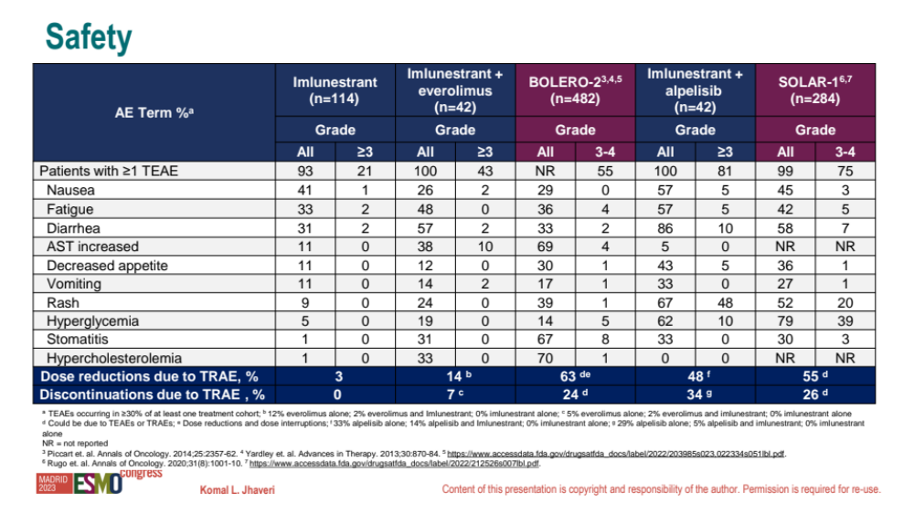
EMBER: Treatment-Emergent Adverse Events in ≥30% of Any Treatment Cohort
Adverse Event, % | Imlunestrant Monotherapy (n = 114) |  | Imlunestrant + Everolimus (n = 42) |  | Imlunestrant+ Alpelisib (n = 21)
 | All Grade | Grade ≥3 | All Grade | Grade ≥3 | All Grade | Grade ≥3
Patients with ≥1 TEAE | 93 | 21 | 100 | 43 | 100 | 81
Nausea | 41 | 1 | 26 | 2 | 57 | 5
Fatigue | 33 | 2 | 48 | 0 | 57 | 5
Diarrhea | 31 | 2 | 57 | 2 | 86 | 10
AST increased | 11 | 0 | 38 | 10 | 5 | 0
Decreased appetite | 11 | 0 | 12 | 0 | 43 | 5
Vomiting | 11 | 0 | 14 | 2 | 33 | 0
Rash | 9 | 0 | 24 | 0 | 67 | 48
Hyperglycemia | 5 | 0 | 19 | 0 | 62 | 10
Stomatitis | 1 | 0 | 31 | 0 | 33 | 0
Hypercholesterolemia | 1 | 0 | 33 | 0 | 0 | 0
Dose reductions due to TRAE, % | 3 |  | 14* |  | 48‡
Discontinuations due to TRAE, % | 0 |  | 7† |  | 34§
*12% everolimus alone, 2% everolimus and imlunestrant, 0% imlunestrant alone. †5% everolimus alone, 2% everolimus and imlunestrant, 0% imlunestrant alone.
‡33% alpelisib alone, 14% alpelisib and imlunestrant, 0% % imlunestrant alone. §29% alpelisib alone, 5% alpelisib and imlunestrant, 0% imlunestrant alone.
Jhaveri. ESMO 2023. Abstr 383MO.
Notes:
AST, aspartate aminotransferase; TEAE, treatment-emergent adverse event; TRAE, treatment-related adverse event

Slide 9
EMBER: Investigators’ Conclusions
In this analysis of CDK4/6 inhibitor pretreated patients with advanced ER+/HER2- breast cancer, imlunestrant alone and in combination with everolimus or alpelisib demonstrated robust efficacy
  Median PFS was 4.3 mo with imlunestrant alone, 15.9 mo with imlunestrant plus everolimus, and 9.2 mo with imlunestrant plus alpelisib
No new safety signals with imlunestrant monotherapy
Toxicities with imlunestrant in combination consistent with known safety profiles of alpelisib and everolimus plus endocrine therapy
Phase III trials of imlunestrant are ongoing
  EMBER-3 (NCT04975308): imlunestrant + ET or abemaciclib after previous ET
  EMBER-4 (NCT05514054): adjuvant imlunestrant vs adjuvant ET
Jhaveri. ESMO 2023. Abstr 383MO.
Notes:
ER, estrogen receptor; ET, endocrine therapy; PFS, progression-free survival.

Slide 10
Go Online for More CCO
Coverage of ESMO 2023!
Capsule Summaries of all the key data
CME-certified text module with expert faculty commentary on all the key studies
clinicaloptions.com

