Slide 1
Combatting Stigma: PrEP in Asia
A collaboration between Clinical Care Options, LLC and Albert Einstein College of Medicine, in partnership with Institute for HIV Research and Innovation (IHRI).
Supported by an educational grant from Gilead Sciences, Inc.

Slide 2

About These Slides
Please feel free to use and share some or all of these slides in your noncommercial presentations to colleagues or patients
When using our slides, please retain the source attribution:
These slides may not be published, posted online, or used in commercial presentations without permission. Please contact permissions@clinicaloptions.com for details
Slide credit: clinicaloptions.com
Notes:
Disclaimer: The materials published on the Clinical Care Options Web site reflect the views of the authors of the CCO material, not those of Clinical Care Options, LLC, the CME providers, or the companies providing educational grants. The materials may discuss uses and dosages for therapeutic products that have not been approved by the United States Food and Drug Administration. A qualified healthcare professional should be consulted before using any therapeutic product discussed. Readers should verify all information and data before treating patients or using any therapies described in these materials.

Slide 3
Faculty and Disclosures
Iskandar Azwa, MD
Associate Professor in Infectious Diseases
Faculty of Medicine
University Malaya
Kuala Lumpur, Malaysia
Iskandar Azwa, MD, has no relevant financial relationships to disclose.

Slide 4
Learning Objectives
Take steps to start providing PrEP for key populations who can benefit, as a crucial component of reducing barriers to PrEP uptake
Apply a solid understanding of PrEP regimens and essential aspects of PrEP delivery to proactively incorporate PrEP into services for key populations
Notes:
PrEP, pre-exposure prophylaxis.

Slide 5
Case: Addressing PrEP Stigma
Dr Wong, a primary care provider, is committed to offering and scaling up PrEP as a key HIV prevention option in his practice
However, he frequently encounters stigma-related challenges when discussing condom use alongside PrEP
  Some patients are concerned that using PrEP without condoms will be perceived by HCPs as sexually irresponsible
  Some colleagues hesitate to discuss condomless sex with PrEP users or insist that condoms and PrEP must be used together for HIV prevention when asked, reinforcing stigma around patient choices
Notes:
HCP, healthcare professional; PrEP, pre-exposure prophylaxis.

Slide 6
Understanding Stigma
STIGMA
  Personal characteristics or attributes that confer negative judgement or value and are considered socially “discrediting”
SEXUAL STIGMA
  Negative attitudes towards individuals based on their sexual behavior, orientation, or gender identity
INTERSECTIONAL STIGMA
  Related to clients’ social class, gender, sexual, and/or racial identities
PrEP STIGMA
  Linked to HIV and sexual stigma
  People who utilize PrEP may be stereotyped as sexually irresponsible and promiscuous
Golub. Curr HIV/AIDS Rep. 2018;15:190. Calabrese. Curr HIV/AIDS Rep. 2020;17:579.
Notes:
PrEP, pre-exposure prophylaxis.

Slide 7
Stigma as a Barrier to PrEP Uptake
Patients’ fear of judgement
HCPs’ bias
Stereotype of PrEP use as sexually irresponsible, promiscuous, or immoral can discourage PrEP uptake and persistence
Focusing on high-risk behaviors and populations can perpetuate stigma
Concerns about sexual risk compensation can make HCPs less willing to prescribe PrEP
Risk-based implementation strategies
Leads to misconceptions about who “deserves” PrEP
Undermines policy, funding, and infrastructure that support PrEP
Calabrese. Curr HIV/AIDS Rep. 2020;17:579.
Notes:
HCP, healthcare professional; PrEP, pre-exposure prophylaxis.

Slide 8

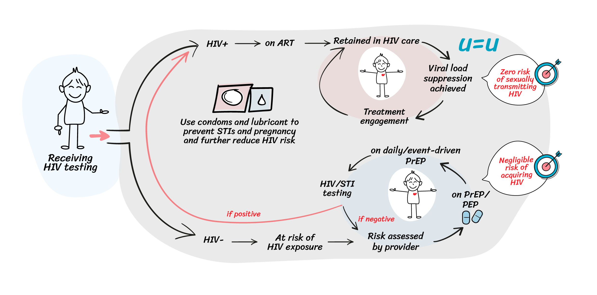
Utilizing an HIV Status–Neutral Approach Can Shift Paradigms of HIV Treatment and Prevention
Person-centered, not disease-first
HIV Test
Active engagement regardless of status
Negative test: Immediately engage in
PrEP or PEP
Positive test: Immediately engage in
ART
Continuously engage in clinical care
with negligible risk of
transmitting or acquiring HIV
Phanuphak. Curr HIV/AIDS Rep. 2020;17:422.
Image reproduced with permission: http://creativecommons.org/licenses/by/4.0/.
Notes:
ART, antiretroviral therapy; PEP, postexposure prophylaxis; PrEP, pre-exposure prophylaxis.

Slide 9
Strategies for Prescribers to Address PrEP Stigma
Encourage sexual history taking and open conversations on sexual health without shame
  Normalize PrEP discussion as a prevention option for all sexually active patients as part of routine care, irrespective of perceived risk
  Emphasize sexual relationships, pleasure, and satisfaction as an integral part of sexual health rather than absence/presence of STIs
Provide nonjudgmental, culturally sensitive care
Use inclusive language and shared decision-making
Use positive “gain-framing” focusing on empowerment and health promotion in a sex positive way (increased intimacy, reduced HIV anxiety)
Concerns around risk compensation and changes in sexual behavior
do not medically justify withholding information or access to PrEP
Golub. Curr HIV/AIDS Rep. 2018;15:190. Mitchell. Lancet Public Health. 2021;6:e608. Sewell. Curr HIV/AIDS Rep. 2021;18:48.
cdc.gov/hivnexus/hcp/sexual-history/.
Notes:
PrEP, pre-exposure prophylaxis; STI, sexually transmitted infection.

Slide 10

Ensuring Stigma-Free Communications Around PrEP
Evolve your “safer sex” messaging to normalize condom-free sex
  Condoms are an option for STI prevention but are not necessary to prevent sexual transmission of HIV when on PrEP
Create safe spaces in clinic
  Promote representation and visibility of key populations in clinic
Provide HCP training and sensitization
  Anti-stigma training to reduce biases and improve cultural competence
Engage the community
  Involve community leaders and influencers to promote positive messaging
Golub. Curr HIV/AIDS Rep. 2018;15:190. Mitchell. Lancet Public Health. 2021;6:e608. Sewell. Curr HIV/AIDS Rep. 2021;18:48.
cdc.gov/hiv/clinicians/transforming-health/health-care-providers/sexual-history.html.
Notes:
HCP, healthcare professional; PrEP, pre-exposure prophylaxis; STI, sexually transmitted infection.

Slide 11
Framing PrEP as a Positive Health Choice
Emphasize that taking PrEP is about empowerment and self care, not risk
Acknowledge the stigma, but reinforce the benefits of PrEP
Present PrEP as a routine prevention option for all sexually active persons, similar to contraception and HPV vaccines
Share real-world data showing PrEP users do not necessarily increase their overall risk behaviors
Willie. BMC Infect Dis. 2021;21:1102. Kerr. J Racial Ethn Health Disparities. 2021;8:901. who.int/tools/prep-implementation-tool.
Notes:
HPV, human papillomavirus; PrEP, pre-exposure prophylaxis.

Slide 12
Normalizing Condomless Sex in PrEP Discussions
Reframe the discussion to focus on patient autonomy and shared decision-making
Emphasize that PrEP is highly effective in preventing HIV, with or without condoms
Use neutral language that does not imply moral judgement around condom use
Acknowledge that many people use PrEP because they prefer not to use condoms to prevent HIV
Golub. Curr HIV/AIDS Rep. 2018;15:190. Calabrese. Curr HIV/AIDS Rep. 2020;17:579. Haire. PLoS One. 2021;16:e0255731.
Notes:
PrEP, pre-exposure prophylaxis.

Slide 13
Go Online for More CCO
Coverage of HIV!
Didactic modules to review the latest data and recommendations for HIV care and prevention
Downloadable slides of key data to review and share
Downloadable resources that you can use in your practice
ClinicalThought commentaries featuring expert perspectives
clinicaloptions.com

