Slide 1

Smarter. Stronger. Together. Optimizing Outcomes and an Equitable Healthcare Experience for All Patients With Gynecologic Cancers
Provided by Clinical Care Options, LLC, in partnership with Smart Patients.
Supported by educational grants from Eisai; GSK; Karyopharm Therapeutics Inc.; Merck Sharp & Dohme, LLC; and Seagen and Genmab.

Slide 2

About These Slides
Please feel free to use, update, and share some or all of these slides in your noncommercial presentations to colleagues or patients
When using our slides, please retain the source attribution:
These slides may not be published, posted online, or used in commercial presentations without permission. Please contact permissions@clinicaloptions.com for details
Slide credit: clinicaloptions.com
Notes:
Disclaimer: The materials published on the Clinical Care Options Web site reflect the views of the authors of the CCO material, not those of Clinical Care Options, LLC, the CME providers, or the companies providing educational grants. The materials may discuss uses and dosages for therapeutic products that have not been approved by the United States Food and Drug Administration. A qualified healthcare professional should be consulted before using any therapeutic product discussed. Readers should verify all information and data before treating patients or using any therapies described in these materials.

Slide 3
Program Chairs
Ritu Salani, MD, MBA
Professor and Division Director
OB/GYN and Gynecologic Oncology
University of California, Los Angeles
Los Angeles, California
Eloise Chapman-Davis, MD, FACOG
Gynecologic Oncologist
Associate Professor of OB/GYN
Department of OB/GYN
Division of Gynecologic Oncology
Weill Cornell Medicine-
New York Presbyterian Hospital
New York, New York
Notes:
This slide lists the faculty for those who were involved in the production of these slides.

Slide 4
Program Chairs
The faculty reported the following relevant financial relationships or relationships to products or devices they have with ineligible companies related to the content of this educational activity:
Ritu Salani, MD, MBA: consultant: Arcus, Genentech, GlaxoSmithKline, Instil Bio, Merck, Regeneron, Seagen.
Eloise Chapman-Davis, MD, FACOG, has no relevant financial relationships to disclose.
Notes:
This slide lists the disclosures for those who were involved in the production of these slides.

Slide 5
Improving Provider Awareness About Inequities in Ovarian Cancer

Slide 6
Ovarian Cancer: Overview
Fifth leading cause of cancer deaths in women despite only 1.1% of all new cancer cases¹
  5-yr survival: 49% (overall),
  30% (distant metastasis)
  57% of women diagnosed have distant/metastatic disease
Median age at diagnosis is 63 yr¹
19,880 estimated new cases in 2022¹
High rate of disease recurrence^{2,3}
  Women diagnosed with stage III: 70% to 90%
  Women diagnosed with stage IV: 90% to 95%
Black women may present
with more advanced disease compared with White women⁴
1. National Cancer Institute. Surveillance, Epidemiology, and End Results (SEER) Program. seer.cancer.gov/statfacts/html/ovary.html.
2. Ovarian Cancer Research Alliance. ocrahope.org/patients/about-ovarian-cancer/recurrence. 3. Hanker. Ann Oncol. 2012;23:2605.
4. Morris. Cancer Causes Control. 2010;21:1203.
Slide credit: clinicaloptions.com
Notes:
PFS, progression-free survival.

Slide 7
Ovarian Cancer: Healthcare Disparities
Suboptimal treatment and poorer survival rates have been reported in^{1,2}:
  Older women
  Black women
  Low-income women
  Women with public health insurance coverage or no insurance coverage
  And women of Hispanic/Hispanic descent
Psychosocial issues, eg, lack of support systems, inability to travel longer distances, language barriers, and living in rural areas can affect patient adherence and ability to receive optimal care³
Women with Medicare or Medicaid may be less likely to receive germline and/or somatic testing than women with private insurance⁴
1. Graham. Ann Cancer Epidemiol. 2019;3:10.21037. 2. Taylor. Gynecol Oncol. 2018;151:269.
3. Kaufman. J Cancer Metastasis Treat. 2019;5:13. 4. Huang. Gynecol Oncol. 2019;153:297.
Slide credit: clinicaloptions.com

Slide 8
Ovarian Cancer: Racial/Ethnic Differences Exist Regarding Risk and Survival for All Histologic Subtypes
All Types
Serous
Clear Cell
100
100
100
NHW
NHB
Hispanic
Asian
NHW
NHB
Hispanic
Asian
NHW
NHB
Hispanic
Asian
80
80
80
60
60
60
5-Yr OS Rate
5-Yr OS Rate
5-Yr OS Rate
40
40
40
20
20
20
0
0
0
Localized
Regional
Distant
Localized
Regional
Distant
Localized
Regional
Distant
Black women have a lower incidence of ovarian cancer, yet experience worse 5-yr survival outcomes
Park. Cancer Epidemiol Biomarkers Prev. 2017;26:1511.
Slide credit: clinicaloptions.com
Notes:
NHB, non-Hispanic Black; NHW, non-Hispanic White; OS, overall survival.

Slide 9
High-Volume Treatment Centers Are Associated With Better Outcomes for Black Patients With Ovarian Cancer
Ovarian Cancer Survival by
Hospital and Physician Volume
53.1% of patients with ovarian cancer treated in LV hospital by LV physician
Race and socio-demographic status independently associated with increased likelihood of receiving care in LV hospital by LV physician
  Black OR: 0.99
  Hispanic OR: 1.72
  Asian/Pacific OR: 1.57
  Medicaid insurance OR: 2.51
  Low socioeconomic status OR: 2.84
100
80
60
P <.0001
OS Probability (%)
40
HV hospital and HV physician
LV hospital and HV physician
HV hospital and LV physician
LV hospital and LV physician
20
0
0
10
20
30
40
50
60
Mo
Bristow. Gynecol Oncol. 2014;132:403. Long. Am J Obstet Gynecol. 2015;212:468.e1.
Slide credit: clinicaloptions.com
Notes:
HV, high-volume; LV, low volume; LVH low volume hospital; OR, odds ratio.

Slide 10
Patients With Ovarian Cancer Who Do Not Receive Guideline-Recommended Care Have Poor Outcomes
56% of patients with ovarian cancer do not receive guideline-based care¹
  25% of patients with OC received care at low-volume centers
  Treatment at low volume centers was an independent predictor of worse disease-specific OS
Black patients are likely to have a reduction in the dose of chemotherapy, delay in treatment, or early discontinuation of therapy²
Parameter, HR (95% CI) | HR for Disease-Specific OS
Deviation from NCCN guideline-recommended care | 1.33 (1.26-1.41)
Treatment at low-volume institution | 1.08 (1.01-1.16)
1. Chatterjee. Front Oncol. 2016;6:36. 2. Bandera. Clin Cancer Res. 2016;22:5909.
Slide credit: clinicaloptions.com
Notes:
NCCN, national comprehensive cancer network; OC, ovarian cancer; OS, overall survival.

Slide 11
Expanded Participation in Clinical Trials May Overcome Health Disparities in Ovarian Cancer
A retrospective study showed that White race was associated with significantly better OS but that more underrepresented women of color participation in clinical trials could overcome this health disparity
OS in Patients Never Enrolled on a Clinical Trial
OS in Patients
Enrolled on ≥1 Clinical Trial
100
100
Median OS, Mo
Median OS, Mo
80
White 71.4
Underrepresented 24.5
80
White 53.5
Underrepresented 50.9
White
60
60
OS Probability (%)
White
OS Probability (%)
40
40
Underrepresented
20
20
Underrepresented
P = .0591
P = .6269
0
0
0
25
50
75
100
125
150
175
200
0
25
50
75
100
125
150
175
Mo
Mo
HR when controlling for age and commute distance for White patients vs minorities:
0.398 (95% CI: 0.216-0.732)
HR when controlling for age and commute distance for White patients vs minorities:
0.841 (95% CI: 0.505-1.401)
Patel. SGO 2018. Abstr 6.
Slide credit: clinicaloptions.com
Notes:
OS, overall survival.

Slide 12
Risk Factors, Screening, and
Molecular Testing in Ovarian Cancer

Slide 13
Genetic Testing in Ovarian Cancer: Current Guidelines
Epithelial ovarian cancer
  Germline testing for BRCA1, BRCA2, and other ovarian cancer susceptibility genes
    Recommended for all patients at disease diagnosis regardless of family history of ovarian/
    breast cancer
    If not performed at initial diagnosis, testing should be offered as soon as possible
  Somatic tumor testing for BRCA1, BRCA2, and likely pathogenic variants
    Recommended for patients without germline mutations
    At disease recurrence, offer somatic tumor testing (BRCA1, BRCA2) and consider dMMR testing
Clear cell, mucinous, or endometrioid ovarian cancer
  Offer somatic tumor testing for dMMR, particularly with recurrent disease
Konstantinopoulos. JCO. 2020;38:1222.
Slide credit: clinicaloptions.com
Notes:
dMMR, defective mismatch repair.

Slide 14
Alterations in HR Repair Genes in
High-Grade Serous Ovarian Cancers
Other (some may be HR deficient via upregulation
of miRNAs or other mechanisms)
BRCA1 germline mutations 8%
HR Deficient
Other 21%
BRCA1 somatic mutations 3%
BRCA2 germline mutations 6%
50% of high-grade serous ovarian cancers harbor alterations in HR repair genes:
  Mutations
  Deletions
  Amplifications, or
  Promoter methylation
BRCA2 somatic mutations 3%
NER mutations 4% to 8%
BRCA1 promoter methylation 10%
MMR mutations 3%
CDK12 mutations 3%
RAD51C promoter methylation 2%
FA gene mutations 2%
Cyclin E1 amplification 15%
Core RAD gene mutations 1.5%
EMSY amplification 6%
HR DNA-damage gene mutations 2%
HR Proficient
PTEN homozygous loss 7%
Possibly HR Deficient
Konstantinopoulos. Cancer Discov. 2015;5:1137.
Slide credit: clinicaloptions.com
Notes:
FA, Fanconi anemia; HR, homologous recombination; miRNA, microRNA; MMR mismatch repair; NER, nucleotide excision repair.

Slide 15
Suboptimal Adoption of Germline BRCA1/2 or HRD Testing Among Black and White Patients With OC
Guideline-Recommended Genetic Testing in Women With OC According to Race
(Between 2013 and 2014)
100
80
60
Proportion Tested (%)
40
20
0
Non-Hispanic White
Black
Asian
Hispanic
Kurian. JCO. 2019;37:1305.
Slide credit: clinicaloptions.com
Notes:
HRD, homologous recombination deficiency; OC, ovarian cancer.

Slide 16
Guideline Recommendations for the Management of Advanced or Recurrent Ovarian Cancer
Surgery and Adjuvant Chemotherapy¹
Targeted Therapy¹
Immunotherapy¹
  Platinum doublet
  Other options (single agents or combinations)
    – Gemcitabine
    – Liposomal doxorubicin
    – Topotecan
  Bevacizumab
  Niraparib
  Olaparib
  Rucaparib
  Entrectinib or larotrectinib (for NTRK fusion–positive solid tumors)
  Selpercatinib in RET gene fusion–positive tumors²
  Pembrolizumab
  (for MSI-H or dMMR solid tumors or TMB-H tumors ≥10 mutations/ megabase and no other treatment options)
  Dostarlimab (for dMMR advanced solid tumors)³
1. National Comprehensive Cancer Network. Ovarian Cancer (v.1.2023). 2. Selpercatinib PI. 3. Dostarlimab PI.
Slide credit: clinicaloptions.com
Notes:
dMMR, defective mismatch repair; MSI-H, high microsatellite instability; TMB-H, high tumor mutational burden.

Slide 17
Current Updates and FDA Approvals for
PARP Inhibitors in Advanced Ovarian Cancer
Frontline Maintenance | Any BRCA or HRD mutation status, CR or PR to frontline platinum-based chemotherapy: Niraparib Germline or somatic BRCA-mutated, CR or PR to frontline platinum-based chemotherapy: Olaparib HRD positive, CR or PR to frontline platinum-based chemotherapy: Olaparib + bevacizumab
Recurrent Maintenance | Deleterious BRCA mutation (germline and/or somatic) or HRD status, and platinum-sensitive (CR or PR) disease Olaparib (only if fewer than 3 previous chemotherapy regimens) Rucaparib (only if fewer than 2 previous chemotherapy regimens) Deleterious (or suspected) germline BRCA mutation and platinum-sensitive (CR or PR) disease Niraparib (only if fewer than 3 previous chemotherapy regimens)
Niraparib PI. Olaparib PI. Rucaparib PI.
Notes:
CR, complete response; HRD, homologous recombination deficiency; PR, partial response.

Slide 18
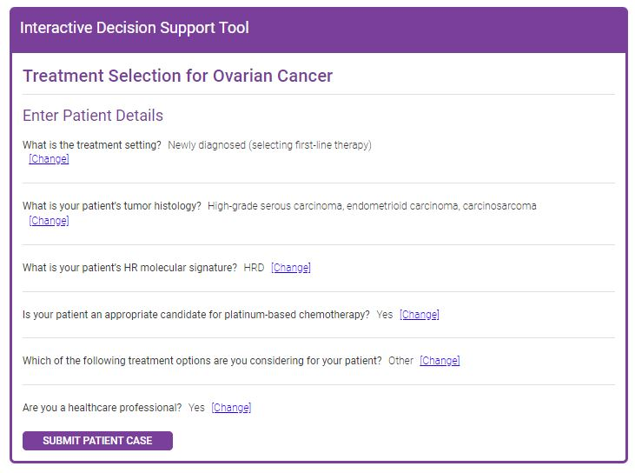


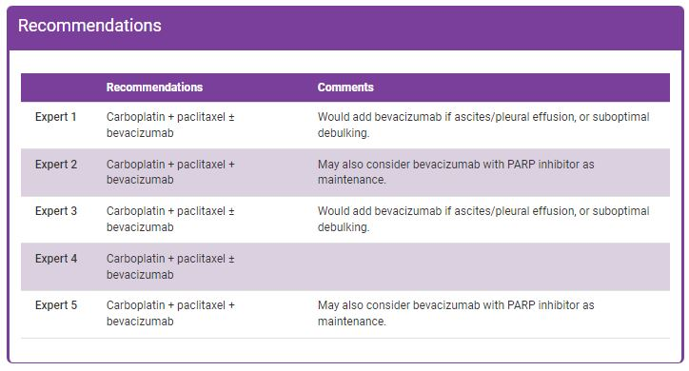
Interactive Decision Support Tools for
Advanced Gynecologic Cancers
Endometrial/
ovarian cancer Tool
Cervical cancer
Tool
HCP enters patient characteristics
Recommendations from 5 experts
Tool available at: https://www.clinicaloptions.com/GYNCI2022tool or as an app in your app store
Notes:
HCP, healthcare professional.

Slide 19
Therapy in Platinum-Refractory/Resistant
Ovarian Cancer

Slide 20

Mirvetuximab Soravtansine in Platinum-Resistant OC With High FRα Expression (SORAYA): Study Design
FDA Accelerated Approval November 14, 2022
For adult patients with FRα-positive ovarian, fallopian tube, or primary peritoneal cancer refractory or resistant to platinum-based chemotherapy and 1-3 previous chemotherapies
Global, single-arm phase III study
Patients with platinum-resistant
ovarian cancer (recurrence within
6 mo after last platinum dose) with
1-3 prior regimens; high-grade serous; prior bevacizumab; tumors with high FRα membrane staining by IHC*
(N = 106)²
Mirvetuximab Soravtansine 6 mg/kg
IV every 3 wk
Until PD, unacceptable toxicity, physician/patient decision
Mirvetuximab dosing adjusted
per ideal body weight
Meaningful activity seen in patients with FRα-high PROC
*High expression defined as ≥75% of cells staining positive with ≥2+ staining intensity.
Outcome | By Investigator (N = 105) | BICR Assessed (N = 96)
ORR, n (%) [95% CI] | 34 (32.4) [23.6-42.2] | 30 (30.2) [21.3-41.4]
Median DoR, mo (95% CI) | 6.9 (5.6-9.7) | NR (5.0-NR)
Median PFS, mo (95% CI) | 4.3 (3.7-5.2) | 5.5 (3.8-6.9)
Primary endpoints: ORR by investigator
1. Moore. Ann Oncol.2021;32:757. Matulonis. J Clin Oncol.2023;[Epub].
Slide credit: clinicaloptions.com
Notes:
DoR, duration of response; FRα, folate receptor α; IHC, immunohistochemistry; OC, ovarian cancer; ORR, overall response rate; PD, progressive disease; PFS, progression-free survival; PROC, platinum-resistant ovarian cancer.

Slide 21
Mirvetuximab Soravtansine vs Investigator’s Choice of Chemotherapy in FR𝝰-High PROC (MIRASOL): Study Design
Global, open-label, randomized phase III trial
Stratified by chemotherapy (paclitaxel, PLD, or topotecan) and prior lines of therapy (1 vs 2 vs 3)
Patients with platinum-resistant epithelial ovarian, primary peritoneal, or fallopian tube cancer (PFI ≤6 mo); FRα high (IHC PS2+ in ≥75% of cells); 1-3 prior lines; prior bevacizumab, PARPi allowed; BRCA mutation allowed;
primary platinum-refractory disease
(primary PFI <3 mo) excluded
(N = 453)
Mirvetuximab Soravtansine
6 mg/kg AIBW Q3W
Investigator’s Choice of Chemotherapy
Paclitaxel, PLD, or topotecan
Primary endpoint: PFS by investigator (BICR for sensitivity analysis)
Secondary endpoints: ORR by investigator, OS, PROs, safety, DoR,
CA-125 response, PFS2
Moore. ASCO 2023. Abstr LBA5507.
Notes:
AIBW, adjusted ideal body weight; BICR, blinded independent central review; DoR, duration of response; FRα, folate receptor α; IHC, immunohistochemistry; ORR, objective response rate; OS, overall survival; PARPi, PARP inhibitor; PFI, platinum-free interval; PFS, progression-free survival; PFS2, time from randomization until second disease progression; PLD, pegylated liposomal doxorubicin; PRO, patient-reported outcome; PS2+, positive staining intensity ≥2.

Slide 22
MIRASOL: Baseline Characteristics
Characteristics | Mirvetuximab Soravtansine (n = 227) | Chemotherapy (n = 226)
Median age, yr (range) | 63 (32-88) | 62 (29-87)
Stage at initial diagnosis, n (%) I-II III IV | 9 (4) 137 (60) 76 (33) | 9 (4) 147 (65) 65 (29)
BRCA mutation, n (%) | 29 (13) | 36 (16)
Prior systemic therapies, n (%) 1 2 3 | 29 (13) 90 (40) 108 (48) | 34 (15) 88 (39) 104 (46)
Prior exposure, n (%) Bevacizumab PARP inhibitor Taxanes | 138 (61) 124 (55) 227 (100) | 143 (63) 127 (56) 224 (99)
Primary platinum-free interval, n (%) ≤12 mo/>12 mo | 146 (64)/80 (35) | 142 (63)/84 (37)
Platinum-free interval, n (%) ≤3 mo/>3 to ≤6 mo | 88 (39)/138 (61) | 99 (44)/124 (55)
Moore. ASCO 2023. Abstr LBA5507.
Notes:
PARPi, PARP inhibitor.

Slide 23
MIRASOL: PFS by Investigator (Primary Endpoint)
 | Mirvetuximab Soravtansine (n = 227) | Chemotherapy (n = 226)
mPFS, mo (95% CI) | 5.62 (4.34-5.95) | 3.98 (2.86-4.47)
HR (95% CI) | 0.65 (0.52-0.81)
P value | <.0001
1.0
0.8
0.6
Patients (%)
0.4
Mirvetuximab soravtansine
Chemotherapy
Censored
0.2
0
0
3
6
9
12
15
18
21
24
27
Mo
Patients at Risk, n
Mirvetuximab soravtansine
Chemotherapy
227
226
151
98
89
48
38
19
18
5
10
3
3
2
3
1
1
0
0
Moore. ASCO 2023. Abstr LBA5507.
Notes:
IC Chemo, investigator’s choice of chemotherapy; m, median; MIRV, mirvetuximab soravtansine; PFS, progression-free survival.

Slide 24
MIRASOL: Best ORR by Investigator
Best Overall Response, n (%) | Mirvetuximab Soravtansine (n = 227) | Chemotherapy (n = 226)
ORR | 96 (42) | 36 (16)
CR | 12 (5) | 0
PR | 84 (37) | 36 (16)
SD | 86 (38) | 91 (40)
PD | 31 (14) | 62 (27)
NE | 14 (6) | 37 (16)
Mirvetuximab Soravtansine
Chemotherapy
100
100
80
80
60
60
40
40
20
20
0
0
Best Percent Change from Baseline
Best Percent Change from Baseline
-20
-20
-40
-40
-60
-60
-80
-80
-100
-100
Moore. ASCO 2023. Abstr LBA5507.
Notes:
CR, complete response; NE, not evaluable; ORR, objective response rate; PD, progressive disease; PR, partial response; SD, stable disease.

Slide 25
MIRASOL: OS
 | Mirvetuximab Soravtansine (n = 227) | Chemotherapy (n = 226)
mOS, mo (95% CI) | 16.46 (14.46-24.57) | 12.75 (10.91-14.36)
HR (95% CI) | 0.067 (0.50-0.89)
P value | .0046
1.0
0.8
0.6
Patients (%)
0.4
Mirvetuximab soravtansine
Chemotherapy
Censored
0.2
0
0
3
6
9
12
15
18
21
24
27
30
Mo
Patients at Risk, n
Mirvetuximab soravtansine
Chemotherapy
227
226
204
185
175
157
128
107
82
68
53
39
28
18
15
9
9
5
4
2
0
0
Moore. ASCO 2023. Abstr LBA5507.
Notes:
IC Chemo, investigator’s choice of chemotherapy; m, median; MIRV, mirvetuximab soravtansine; OS, overall survival.

Slide 26
MIRASOL: Outcomes by Prior Bevacizumab
Bevacizumab Naive
Bevacizumab Treated
1.0
 | MIRV (n = 89) | CT (n = 83)
mPFS, mo (95% CI) | 7.0 (5.6-8.4) | 5.6 (3.0-6.5)
HR (95% CI) | 0.66 (0.46-0.94)
P value | .0210
1.0
 | MIRV (n = 138) | CT (n = 143)
mPFS, mo (95% CI) | 4.4 (4.0-5.8) | 3.0 (2.5-4.3)
HR (95% CI) | 0.64 (0.49-0.84)
P value | .0011
0.8
0.8
0.6
0.6
PFS
0.4
0.4
Mirvetuximab soravtansine
Chemotherapy
Censored
0.2
0.2
0
0
0
3
6
9
12
15
18
21
24
27
0
3
6
9
12
15
18
21
24
Mo
Mo
 | MIRV (n = 89) | CT (n = 83)
mOS, mo (95% CI) | 20.2 (14.8-NE) | 14.4 (11.8-16.7)
HR (95% CI) | 0.51 (0.31-0.86)
P value | .0099
 | MIRV (n = 138) | CT (n = 143)
mOS, mo (95% CI) | 15. 4 (11.3-17.5) | 10.9 (9.4-13.3)
HR (95% CI) | 0.74 (0.54-1.04)
P value | .0789
1.0
1.0
0.8
0.8
OS
0.6
0.6
0.4
0.4
0.2
0.2
0
0
0
3
6
9
12
15
18
21
24
27
0
3
6
9
12
15
18
21
24
27
30
Mo
Mo
Moore. ASCO 2023. Abstr LBA5507.
Notes:
BEV, bevacizumab; CT, chemotherapy; m, median; MIRV, mirvetuximab soravtansine; OS, overall survival; PFS, progression-free survival.

Slide 27
MIRASOL: Overall Safety Summary
Parameter, n (%) | Mirvetuximab Soravtansine (n = 218) | Chemotherapy (n = 207)
Any TEAE Grade ≥3 | 210 (96) 91 (42) | 194 (94) 112 (54)
SAEs | 52 (24) | 68 (33)
Discontinuations due to TEAEs | 20 (9) | 33 (16)
Deaths on study drug or within ≤ 30 days of last dose | 5 (2) | 5 (2)
Dose reductions due to TEAEs | 74 (34) | 50 (24)
Dose delays due to TEAEs | 117 (54) | 111 (54)
Discontinuations due to TEAEs | 20 (9) | 33 (16)
Moore. ASCO 2023. Abstr LBA5507.
Notes:
SAE, serious adverse event; TEAE, treatment-emergent adverse event.

Slide 28
MIRASOL: Selected TEAE
TEAEs
60
59
59
Grade
All 3+
MIRV (N=218)
Chemo (N=207)
50
45
41
41
40
33
35
32
32
Frequency (%)
29
29
29
29
28
30
27
26
22
20
11
13
11
12
13
10
10
9
7
8
6
6
4
4
4
3
4
2
4
3
<1
23
3
31
<1
12
1
20
<1
1
27
1
5
0
1
1
1
2
2
1
2
1
8
1
9
0
0
0
0
0
Pac
Pac
Pac
Pac
Pac
Pac
Pac
Pac
Pac
PLD
PLD
PLD
Pac
Pac
PLD
PLD
PLD
PLD
PLD
PLD
Topo
Topo
Topo
PLD
PLD
Topo
Topo
Topo
Topo
Topo
Topo
MIRV
MIRV
MIRV
MIRV
Topo
Topo
MIRV
MIRV
MIRV
MIRV
MIRV
MIRV
MIRV
Peripheral
Neuropathy
Blurred
Vision
Keratopathy
Dry Eye
Neutropenia
Anemia
Thrombocytopenia
Alopecia
Diarrhea
Nausea
Stomatitis
Hematologic
General
Gastrointestinal
Ocular
Moore. ASCO 2023. Abstr LBA5507.
Notes:
IC Chemo, investigator’s choice of chemotherapy; MIRV, mirvetuximab soravtansine; Pac, paclitaxel; PLD, pegylated liposomal doxorubicin; TEAE, treatment-emergent adverse event; Topo, topotecan.

Slide 29
Promoting Enrollment on Clinical Trials and Acknowledging Patient Preferences

Slide 30
Lower Participation of Black vs White Patients in Clinical Trials
Participants in GOG Studies Based on Tumor Site | Race, n (%) |  |  | P Value
Stage | White (N = 37,617) | Black (N = 3686) | Other (N = 3956)
Ovary | 23,269 (87) | 1258 (5) | 2290 (8) | <.001
Endometrial | 9289 (87) | 850 (8) | 590 (5) | <.001
Cervix | 4421 (65) | 1340 (20) | 1038 (15) | <.001
Sarcoma | 638 (70) | 238 (26) | 38 (4) | <.010
Despite disproportionately higher rates of health care disparities, underrepresented patients of color remain underrepresented in clinical trials
Scalici. Gynecol Oncol. 2015;138:441.
Slide credit: clinicaloptions.com
Notes:
GOG, Gynecologic Oncology Group.

Slide 31
Lower Enrollment of Black vs White Patients on Clinical Trials
Enrollment in GOG Studies Based on Tumor Site | White:Black Enrollment Ratios Based on Age-Adjusted Incidence of Each Cancer |  | Fold Difference in Ratios
Stage | Expected | Observed
Ovary | 1 to 0.74 | 1 to 0.05 | 14.8-fold
Endometrial | 1 to 0.90 | 1 to 0.09 | 9.8-fold
Cervix | 1 to 1.34 | 1 to 0.30 | 4.5-fold
Sarcoma | 1 to 1.94 | 1 to 0.37 | 5.2-fold
Increasing underrepresented patients of color enrollment is important for providing insight into objective racial differences in tumor biology, treatment responses, and survival
Scalici. Gynecol Oncol. 2015;138:441.
Slide credit: clinicaloptions.com
Notes:
GOG, Gynecologic Oncology Group.

Slide 32
Factors Affecting Willingness to Participate in
Clinical Trials
Need for better medical information, including:
  Direction/recommendations by provider
  Information about risks/benefits and treatment alternatives
  Description of the clinical trial process
Testimonials from patients like them who participated in clinical trials
Help with logistical barriers (eg, transportation, access to dependent care)
Emotional support
Patients are often not asked about participation in clinical trials
  Just ASK™ Increasing Diversity in Cancer Clinical Research program
Factors found not to be correlated with willingness to participate in clinical trials included:
  Race
  Psychological stressors (anxiety and depression)
Patel. Gynecol Oncol. 2020;157:323. Igwe. Gynecol Oncol. 2016;142:520. Esnaola. ASCO 2021. 2. http://dukecancerinstitute.org/news/homegrown-just-ask-program-rolls-out-nationally. Accessed: Jan 15, 2023.
Slide credit: clinicaloptions.com

Slide 33
Benefits of Diverse Enrollment on Clinical Trials: Better Data on Health Disparities and Access to SoC Treatments
SoCs are stablished in the setting of clinical trials^{1,2}
Clinical trials may help ensure timely and equitable access to needed healthcare services¹
  Increasing access to novel therapies
  Increasing adherence to diagnostics/follow-up care
Increased enrollment of underrepresented patients of color on clinical trials is essential for adequately describing true racial difference in gynecologic malignancies^{1,3}
  Skepticism, lack of encouragement to participate in clinical trial by provider, and lack of referral procedures for clinical staff remain as barriers to enrollment of racial minorities on clinical trials
1. Scalici. Gynecol Oncol. 2015;138:441. 2. Igwe. Gynecol Oncol. 2016;142:520. 3. Durant. Cancer 2014;120:1097.
Slide credit: clinicaloptions.com
Notes:
SoC, standard of care.

Slide 34
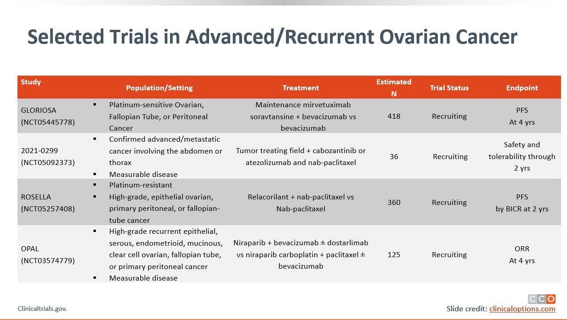
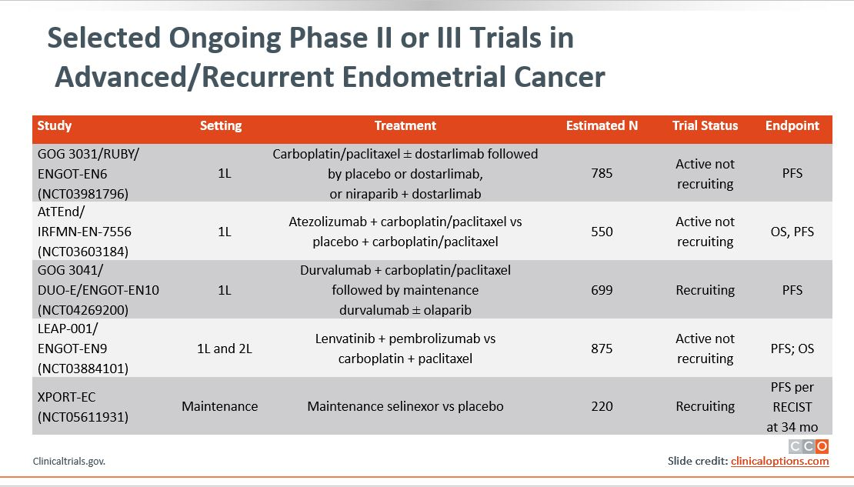
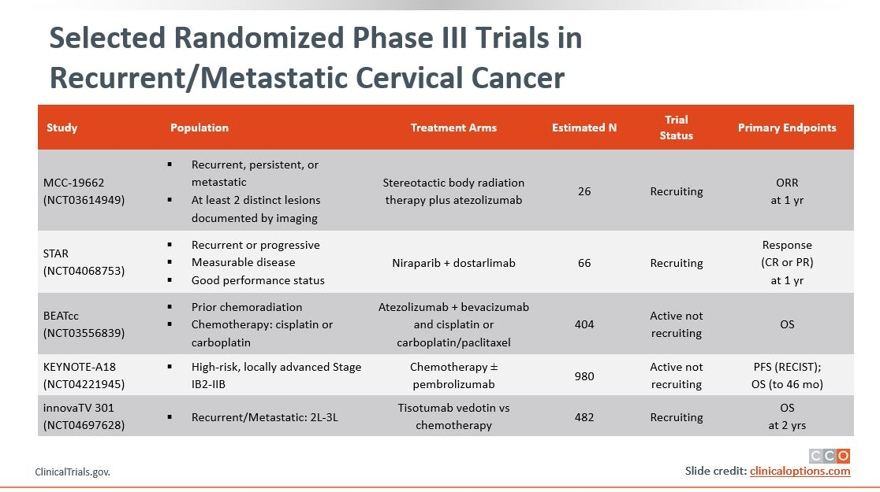
Addressing Potential Healthcare Disparities in
Clinical Trial Enrollment
To address potential disparities in care, discuss the patients’:
  Satisfaction with treatment (AEs and symptom distress associated with poorer adherence)
  Satisfaction with HCP communication
    Feeling understood and respected by their providers
    Being involved in shared decision-making
    Building trust and confidence in their providers
    Understanding disease and treatment
  Resources, support system, and ability to get to and from the clinic for visits
  Provide help in navigating insurance claims and financial assistance programs for prescribed medications
Listen to and understand each patient’s goals to help develop manageable plans for achieving healthcare goals
Visit clinicaltrials.gov/ for available clinical trials near you
Pozzar. Gynecol Oncol. 2017;147:714. Patel. Gynecol Oncol. 2020;157:323.
Igwe. Gynecol Oncol. 2016;142:520. Nyakudarika. Cancer. 2021;127:3809.
Slide credit: clinicaloptions.com
Notes:
AE, adverse event; HCP, healthcare professional.
SPEAKER notes:
Remember to suggest to see the supplemental section for additional slides including selected trials for ovarian, endometrial, and cervical cancer.

Slide 35



Navigating the Healthcare Ecosystem:
Addressing Potential Healthcare Disparities
Communication
Improving patient–provider communication
Acknowledging patient beliefs/values
Minimizing healthcare provider bias
Increasing representation of underrepresented providers of color (MD, NP, PA) to oncology workforce
Cost
Reducing treatment costs with manufacturer grants and assistance programs
Providing grants to cover transportation costs
and dependent care
Gaps in Outcomes Research
Increasing representation of underrepresented groups of patient in clinical trials
Evaluating genetic/molecular differences in tumor biology based on race
Oncology pharmacists, nurses, and patient navigators are an integral part of oncology treatment and patient care
  Have a key role in empowering patients and their families to take charge of their health
  Can provide education, resources, and healthcare planning advice
Esnaola. ASCO 2021. Chatterjee. Front Oncol. 2016;6:36. J Onc Nav Surviv. 2019;10.
Slide credit: clinicaloptions.com

Slide 36
Improving Provider Awareness
About Inequities in Endometrial Cancer

Slide 37
Endometrial Cancer: Overview
Endometrial cancer (uterine or corpus cancer): most common gynecologic malignancy in the US and developed nations¹
  Incidence: 65,950 women
  12,550 women die from this disease
  Incidence has increased 5% since 2000
  Median age at diagnosis is 63 yr
Age-adjusted incidence steadily increasing and ~67% of women with EC are diagnosed with early-stage disease¹
Advanced EC is treated with surgery along with chemotherapy, and radiation therapy in appropriate cases^{2,3}
EC can be classified by histology as endometrioid or
nonendometrioid⁴
Clinical Stage^{5,6} | Outcome
Stage | 5-Yr OS, %
FIGO stage I or II | 74-91
FIGO stage III IV | 57-66 20-26
Non-Hispanic Black women have a-2 fold higher likelihood to die from endometrial cancer when compared with non-Hispanic White women¹
Data from 2004 to 2019 indicate non-Hispanic Black women were more likely to be diagnosed with regional and metastatic disease than localized disease vs White women⁷
1. National Cancer Institute. Surveillance, Epidemiology, and End Results (SEER) Program. seer.cancer.gov/statfacts/html/corp.html. 2. NCCN uterine cancer guidelines. v.1.2023. www.nccn.org. 3. Makker. Oncology (Williston Park). 2019;33:239. 4. Murali. Lancet. 2014;15:E268.
5. Siegel. CA Cancer J Clin. 2013;63:11. 6. Creasman. Int J Gynacol Obstet. 2006;95:S105. 7. Chapman-Davis. Ann Surg Oncol. 2023;30:48.
Slide credit: clinicaloptions.com
Notes:
EC, endometrial cancer; FIGO, International Federation of Gynecology and Obstetrics; OS, overall survival.

Slide 38
Evaluation of Black Women With
Postmenopausal Bleeding
Successful screening for EC requires both patient report of symptoms and appropriate workup
Black women are less likely to report PMB and receive guideline-concordant care
Nonguideline-concordant pathways are associated with a higher rate of advanced-stage EC at diagnosis (aOR: 1.90-2.88)
Frequency of Recognition and Evaluation of PMB, by Race, Prior to Diagnosis of EC, % | White Women (N = 4354) | Black Women (N = 537)
Guideline-concordant care Report of PMB + ≥1 diagnostic procedure | 79 | 70*
Nonguideline-concordant care
None Report of PMB only ≥1 diagnostic procedure only Alternative bleeding characterization† ± ≥1 diagnostic procedure | 5.3 5.4 7.5 3.1 | 8.6 7.3 10.4 3.7
*P <.001. †eg, menorrhagia.
Doll. Am J Obstet Gynecol 2018;219:593.e1.
Slide credit: clinicaloptions.com
Notes:
EC, endometrial cancer; aOR, adjusted odds ratio; PMB, postmenopausal bleeding.

Slide 39
Inaccuracy of US Clinical Guidelines for
Endometrial Cancer Diagnosis Based on Race
ACOG guidelines recommend endometrial biopsy for diagnostic confirmation of EC only if endometrial thickness >4 mm via TVUS
Study assessing predicted performance ≥4 mm threshold using a simulated cohort of US Black women with PMB found:
  >50% missed cases and 8-fold higher frequency of false-negative results for Black women vs the general population
Extrinsic factors contributing to disparities in endometrial cancer diagnosis and morbidity include:
  Decrease sensitivity in screening methods
  Decreased guideline concordant care
  Decreased access to care
  Higher likelihood of diagnosis at a later stage
Romano. Ethn Dis. 2021;30:543. Chapman-Davis. Ann Surg Oncol. 2023;30:48.
Slide credit: clinicaloptions.com
Notes:
ACOG, American College of Obstetrics and Gynecology; AUC, area under the curve; EC, endometrial cancer; NPV, negative predictive value; PMB, postmenopausal bleeding; PPV, positive predicted value; TVUS, transvaginal ultrasound.

Slide 40
Risk Factors and Genetic Determinants of Poor Outcomes in Women With Endometrial Cancer
Risk factors for developing endometrial cancer¹
  70% due to excess body weight and insufficient physical activity
  30% other factors
    Lynch syndrome (40%-60%)
    Type 2 diabetes
    Previous history of polycystic ovary syndrome
    Use of postmenopausal estrogen
    Late-onset menopause
    Tamoxifen use for breast cancer
Low-grade tumors with high circulating levels of estrogen have a favorable prognosis and carry mutations²
  Aberrations in PI3K/AKT pathway including PTEN, PI3KCA are common alterations in low-grade tumors
  ER/PgR expression is high
High-risk, estrogen-independent, aggressive EC occurs more frequently in Black women³⁻⁵
  Papillary serous/ carcinosarcoma
  P53, PPP2R1A, FBXW7, and PIK3R1 mutations are more common
  HER2 protein expression and/or gene amplification is high
1. Cancer facts and figures 2021. www.cancer.org. 2. Maxwell. Clin Cancer Res. 2000;6:2999. 3. Francies. Am J Cancer Res.
2020;10:3061. 4. Kohler. Am J Obstet Gynecol. 1996;175:1246. 5. Clifford. Am J Obstet Gynecol. 1997;176:S229.
Slide credit: clinicaloptions.com
Notes:
EC, endometrial cancer; ER, estrogen receptor; PgR, progesterone receptor.

Slide 41
Increasing Incidence and Mortality of
Endometrial Cancer in the United States
Rate of Uterine Cancer Over Time by Ethnicity¹
Endometrial Cancer Survival by Race²
30
10
25
8
20
Black (AAPC = 1.5)
White (AAPC = 1.0)
AI/AN (AAPC = 1.4 [NS])
Overall (AAPC = 1.1)
Hispanic (AAPC = 1.7)
API (AAPC = 2.5)
6
Rate of Uterine Cancer
(per 100,000 Women)
Rate of Uterine Cancer Deaths
(per 100,000 Women)
15
4
10
Black (AAPC = 2.4)
White (AAPC = 0.5)
AI/AN (AAPC = 2.7)
Overall (AAPC = 0.7)
Hispanic (AAPC = 1.8)
API (AAPC = 2.0)
5
2
0
0
1999
2000
2001
2002
2003
2004
2005
2006
2007
2008
2009
2010
2011
2013
2014
1999
2000
2001
2002
2003
2004
2005
2006
2007
2008
2009
2010
2011
2012
2013
2014
2015
2012
2015
2016
Yr of diagnosis
Yr of Deaths
1. US CDC. Gynecologic Cancer Incidence, United States—2012-2016. September 2019. 2. Henley. MMWR Morb Mortal Wkly Rep. 2018;67:1333.
Slide credit: clinicaloptions.com
Notes:
AAPC, average annual percent change; AI/AN, American Indian/Alaska Native; API, Asian Pacific Islander; NS, not significant.

Slide 42
Health Disparities in Endometrial Cancer
Despite a 5-yr OS rate of >80%, Black women continue to have poor outcomes¹
Despite lower incidence for EC development, Black patients account for a higher proportion of deaths with a 5-yr OS 19% worse than White women²⁻⁴
Delay in diagnosis is a key contributor to disparity in gynecologic malignancies⁵
Black women more likely to present with advanced disease^{4,6,7}
  Identifying health disparities and promoting early diagnosis are key to improving outcomes for Black patients
  Black women are more likely to receive less care due to lack of insurance or
  low-income status
1. Rauh-Hain. Obstet Gynecol. 2015;125:843. 2. Wright. Cancer. 2009;115:1276. 3. Long. Gynecol Oncol. 2013;130:652.
4. Mukerji. Gynecol Oncol. 2018;148:527. 5. Doll. Am J Obstet Gynecol. 2018;218:474. 6. Bregar. Gynecol Oncol. 2017;145:114. 7. Sud. Gynecol Oncol. 2018;148:349
Slide credit: clinicaloptions.com
Notes:
EC, endometrial cancer; OS, overall survival.

Slide 43
High-Volume Treatment Centers Are Associated With Better Outcomes for Black Patients With EC
Black patients are more likely to receive quality care at high-volume treatment centers, which have been associated with decreased racial disparity¹
  Fewer number of surgery complications and improved outcomes have been reported for Black patients receiving treatment at high-volume centers
Adjusted 2-Yr Survival Differential Between Black and White Patients With EC, % (95% CI)² | Treatment Provider
 | High-Volume Center | Low-Volume Center
Early-stage type I tumors | 0.5 (-0.9 to 0) | -1.4 (-2.4 to -0.5)
 | P <.0001
Advanced-stage type I tumors | 1.2 (-2.9 to 5.3) | -12.4 (-24.0 to -0.9)
 | P <.0001
1. Buskwofie. Gynecol Oncol. 2018;149:329. 2. Wright. Obstet Gynecol. 2011;117:1051.
Slide credit: clinicaloptions.com
Notes:
EC, endometrial cancer.

Slide 44
Molecular Classification and
Opportunities for Expanding Access to Care Through Technology in Endometrial Cancer

Slide 45
TCGA Molecular Classification and Outcomes
100
Patients Divided Into TCGA subgroups
75
100 hypothetical patients with newly diagnosed endometrial cancer
100
50
POLE sequencing
OS Probability (%)
p53abn
POLEmut
dMMR
NSMP
95
25
POLE hotspot or exonuclease domain mutation
2 marker IHC
(PMS2 and MSH6)
Log-rank P <.001
POLE (~5%)
0
70
0
1
2
3
4
5
PMS2 or MSH6 loss
TP53 sequencing or IHC
Patients at Risk, n
p53abn
POLEmut
dMMR
NSMP
Yr Since Random Assignment
MSI (~25%)
93
51
137
129
72
50
124
122
57
50
112
113
49
49
102
105
44
48
96
94
32
37
74
69
TP53
wild-type
TP53
mutant
Copy number low (~40%)
Copy number high (~30%)
410 patients with successful molecular testing
  23% p53abn: p53 abnormal
  12% POLEmut: POLE ultramutated
  33% dMMR: mismatch repair deficient
  32% NSMP: no specific molecular profile
Prognostic value of molecular classification of high-risk endometrial cancer for benefit from chemotherapy
MacKay. Oncotarget. 2017;8:84579. León-Castillo. JCO. 2020;38:3388.
Slide credit: clinicaloptions.com
Notes:
dMMR, deficient mismatch repair; MSI, microsatellite instability; NSMP, p53-mutant and non-specific molecular profile; OS, overall survival; TCGA, The Cancer Genome Atlas.

Slide 46
Individualizing EC Care With Current and Emerging Practice-Changing Clinical Data
Notes:
EC, endometrial Cancer

Slide 47
Recommendations for the Management of
Newly Diagnosed or Relapsed/Recurrent EC
Initial diagnosis
Colposcopy/biopsy
1L
Newly Diagnosed*: Treatments¹⁻³
Local Recurrence
Systemic Recurrence
Stage I
Endometrioid
Stage II
Stage IIIA-IIIC
(lymph node involvement)
Stage IVA-IVB
(spread into bladder or lymph nodes outside pelvis)
Surgery or RT
Surgical removal of isolated or locoregional recurrence
Surgery only if macroscopic disease removal can be achieved
Palliative RT
Reduce bleeding/ pain from pelvic disease or metastases
Hormonal therapy
  Progestogens
  Aromatase inhibitor (letrozole, fulvestrant)
  Estrogen modulators (tamoxifen)
  Other: IO+ SOC chemotherapy
  CP + pembrolizumab †
  CP + dostarlimab ‡
Surgery ± RT
Frail/comorbidities: external RT and/or vaginal brachytherapy is recommended
Fertility sparing hormonal tx
Surgery (to remove uterus, connective tissue, upper part of vagina, both fallopian tubes and ovaries) + external RT and/or vaginal brachytherapy
Surgery, platinum-based chemotherapy* ± RT
Frail/comorbidities: external RT and/or vaginal brachytherapy recommended
High grade: omentectomy ± peritoneal biopsies
Hysterectomy to prevent excessive bleeding ± RT
Hormone tx in endometrioid type (progestin, tamoxifen, LHRH agonist, aromatase inhibitors)
Combination chemotherapy
Targeted tx (lenvatinib, bevacizumab, everolimus/letrozole, temsirolimus)
Immunotherapy (pembrolizumab)
2L+
Other systemic treatments
  Platinum-tx rechallenge
  Doxorubicin + paclitaxel
  Anti−PD-1 mAb: pembrolizumab
  in MSI-high/dMMR or dostarlimab in dMMR tumors
  Lenvatinib + pembrolizumab in MSI-stable/pMMR tumors
  Paclitaxel + carboplatin + trastuzumab^{4,5}
  EBRT ± chemotherapy + brachytherapy
  Systemic tx can be considered before/after RT
  Oligometastatic: radical local tx
*Paclitaxel, carboplatin, doxorubicin or liposomal doxorubicin, and docetaxel.
1. American Cancer Society. www.cancer.org/cancer/endometrial-cancer/treating/by-stage.html. 2. Concin. Int J Gynecol Cancer. 2021;31:12. 3. Concin. Int J Gynecol Cancer. 2021;31:12. 4. Miller. JCO. 2020;38:3841-3850. 5. Fader. Clin Cancer Res. 2020;26:3928. 6. NCCN uterine cancer guidelines. v2.2023. www.nccn.org.
†NCCN category 1 (excluding carcinosarcoma): for stage III or IVA with measurable disease or stage IVB with or without measurable disease. ‡NCCN category 1: for stage IIIA, IIIB, or IIIC1 with measurable disease, stage IIIC1 with carcinosarcoma, clear-cell, serous, or mixed histology regardless of the presence of measurable disease; and stage IIIC2 or stage IV regardless of the presence of measurable disease.
Slide credit: clinicaloptions.com
Notes:
CP, carboplatin and paclitaxel; dMMR, defective mismatch repair; EBRT, external beam radiation; EC, endometrial cancer; IO, immuno-oncology agent; LHRH, luteinizing hormone-releasing hormone; mAb, monoclonal antibody; MSI, microsatellite instability; pMMR, mismatch repair proficient; RT, radiation therapy; Tx, therapy.

Slide 48
Suboptimal Receipt of Guideline-Based Treatment in Black Patients Compared With White Patients
Adherence to Quality Metrics, % | White Women (N = 275,173) | Black Women (N = 35,035) | Adjusted RR (95% CI)
Adherence to quality metrics Time to surgery <6 wk of diagnosis Minimally invasive surgery Pelvic lymphadenectomy Adjuvant radiotherapy Chemotherapy for stage III/IV disease Perfect adherence to all 5 metrics | 75.6 72.9 74.2 52.3 73.2 50.0 | 65.8 58.5 71.3 48.1 72.7 38.3 | 0.89 (0.87-0.90) 0.87 (0.84-0.90) 0.98 (0.96-0.99) 1.02 (0.98-1.06) 0.97 (0.95-0.99) 0.84 (0.82-0.86)
Short- and long-term outcomes 30-day readmission (after surgery stage I) 30-day mortality (stage I-III) 90-day mortality (stage I-III) 5-yr mortality | 3.5 0.4 0.9 16.2 | 5.2 0.8 1.9 31.0 | 1.24 (1.10-1.39) 1.56 (1.30-1.88) 1.29 (1.13-1.46) 1.27 (1.23-1.31)
Analyses suggest optimal adherence to guideline-based care may improve outcomes for both Black and White patients, but does not eliminate racial disparities in EC outcomes
Huang. Am J Obstet Gynecol. 2020;223:396.e1.
Slide credit: clinicaloptions.com
Notes:
EC, endometrial cancer; RR, relative risk.

Slide 49
Recent Data for Approved Single-Agent Immunotherapies in Recurrent Endometrial Cancer
Parameter | KEYNOTE-158¹: Pembrolizumab in MSI-H EC Cohorts D + K (n = 99) | GARNET²: Dostarlimab
 |  | Cohort A1† MMRd EC (n = 106*) | Cohort A2† pMMR EC (n = 142)²
ORR, % (95% CI) | 48 (37-60) | 43.4 (33.8-53.4) | 13.4 (8.3-20.1)
Best overall response n (%)
CR | 11 (14) | 11 (10.4) | 3 (2.1)
PR | 27 (34) | 35 (33.0) | 16 (11.3)
SD | 14 (18) | 13 (12.3) | 31 (21.8)
PD | 23 (29) | 39 (36.8) | 77 (54.2)
Median DoR, mo (range) | NR (2.9-49.7+) | NR | NR
*3 patients were not evaluable for a response. †Median follow-up time for Cohort A1 was 13.8 mo (9.5-22.1) and Cohort A2 was 11.5 mo (11.0-25.1).
O’Malley. JCO. 2022;40:752. Oaknin. J Immunother Cancer. 2022;10:e003777.
Slide credit: clinicaloptions.com
Notes:
CR, complete response; DoR, duration of response; EC, endometrial cancer; MMRd, defective mismatch repair; MSI-H, microsatellite instability-high; NR, not reached; OS, overall survival; PFS, progression-free survival; PR, partial response; SD, stable disease.

Slide 50
Study 309/KEYNOTE-775: Lenvatinib + Pembrolizumab After Platinum in Advanced EC
FDA Accelerated Approval September 2019
FDA Priority Review May 2021
For patients with endometrial cancer
who are not MSI-H or dMMR
Confirmatory, randomized, open-label phase III study
Stratified by MMR status (pMMR vs dMMR), within pMMR by region, ECOG PS 0 vs 1, prior history of pelvic radiation
Lenvatinib 20 mg PO QD +
Pembrolizumab 200 mg IV Q3W
(n = 411)
Patients with advanced, metastatic, or recurrent EC with measurable disease after 1 previous
platinum-based CT*; ECOG PS 0/1; tissue available for MMR testing
(N = 827)
Until PD or unacceptable toxicity
Doxorubicin 60 mg/m² IV Q3W or
Paclitaxel 80 mg/m² IV QW 3 wk on/1 wk off
(n = 416)
Primary endpoints: PFS by BICR, OS
Secondary endpoints: ORR, health-related quality of life, pharmacokinetics, safety
Key exploratory endpoint: DoR
*2 prior regimens allowed if 1 was in neoadjuvant/adjuvant setting.
Makker. NEJM. 2022;386:437. Makker. JCO. 2023;[Epub].
Notes:
BICR, blinded independent central review; CT, chemotherapy DoR, duration of response; dMMR, mismatch repair deficient; EC, endometrial cancer; ECOG PS, Eastern Cooperative Oncology Group performance status; MMR, mismatch repair; ORR, overall response rate; OS, overall survival; PD, progressive disease; PFS, progression-free survival; pMMR, mismatch repair proficient.

Slide 51
Study 309/KEYNOTE-775: Baseline Characteristics
Characteristic^{1,2} | Lenvatinib + Pembrolizumab (n = 411) | Doxorubicin or Paclitaxel (n = 416)
Median age, yr (range) | 64 (30-82) | 65 (35-86)
MMR status, % pMMR/dMMR | 84.2/15.8 | 84.4/15.6
Prior history of pelvic radiation, % | 42.3 | 44.7
ECOG PS, % 0/1 | 59.9/39.9 | 57.9/42.1
Race, % White Black Asian | 63.5 4.1 20.7 | 59.4 3.4 20.1
Characteristic, %^{1,2} | Lenvatinib + Pembrolizumab (n = 411) | Doxorubicin or Paclitaxel (n = 416)
Histology Endometrioid: H/L/NS Serous Clear cell Mixed | 22.9/14.4/22.1 25.1 7.3 5.4 | 21.6/13.0/26.4 27.6 4.1 3.8
Previous lines of systemic therapy 1/≥2¹ Platinum based 1/2 Neoadjuvant/adjuvant Any | 72.3/27.7 79.3/20.2 54.5 | 66.6/33.4 75.7/24.3 60.3
1. Makker. SGO 2021. Abstr 11512. 2. Makker. NEJM. 2022;386:437. Makker. JCO. 2023;[Epub].
Notes:
dMMR, mismatch repair deficient; ECOG PS, Eastern Cooperative Oncology Group performance status; H, high; L, low; MMR, mismatch repair; NS, not specified; pMMR, mismatch repair proficient.

Slide 52
Study 309/KEYNOTE-775: Responses
Parameter¹ | pMMR |  | Overall
 | Lenvatinib + Pembrolizumab (n = 346) | Doxorubicin or Paclitaxel (n = 351) | Lenvatinib + Pembrolizumab (n = 411) | Doxorubicin or Paclitaxel (n = 416)
ORR, % ² | 32.4 | 15.1 | 33.8 | 14.7
Best overall response, % CR² PR SD PD Not evaluable/assessed | 5.8 25.1 48.6 15.6 0.6/4.9 | 2.6 12.5 39.6 30.8 2.0/12.5 | 7.5 25.3 47.0 14.8 1.2/5.1 | 2.6 12.0 40.1 29.6 1.9/13.7
Median DoR, mo (range)² | 9.3 (1.6+ ─ 39.5+) | 5.7 (0.0+ ─ 37.1+) | 12.9 (1.6+ ─ 39.5+) | 5.7 (0.0+ ─ 37.1+)
Median time to response, mo (range) | 2.1 (1.5-9.4) | 3.5 (1.0-7.4) | 3.1 (1.5-16.3) | 2.1 (1.0-7.4)
More patients in the pembrolizumab plus lenvatinib arm experienced tumor volume reduction vs the chemotherapy arm²
1. Makker. NEJM. 2022;386:437. 2. Makker. JCO. 2023;[Epub].
Notes:
CR, complete response; DoR, duration of response; PD, progressive disease; pMMR, mismatch repair proficient; PR, partial response; SD, stable disease.

Slide 53
Study 309/KEYNOTE-775: PFS and OS Benefit
pMMR
All Comers
100
Median PFS, Mo (95% CI)
6.7 (5.6-7.4)
3.8 (3.6-5.0)
100
Median PFS, Mo (95% CI)
7.3 (5.7-7.6)
3.8 (3.6-4.2)
LEN + pembro
Chemotherapy
Censored
LEN + pembro
Chemotherapy
Censored
80
80
60
60
Patients Without Progression (%)
HR for progression or death,
0.60 (0.50-0.72)
Patients Without Progression (%)
HR for progression or death,
0.56 (0.48-0.66)
40
40
20
20
0
0
3
6
9
12
15
18
21
24
27
30
33
36
39
42
0
0
3
6
9
12
15
18
21
24
27
30
33
36
39
42
Time (Mo)
Time (Mo)
No. at risk:
LEN + pembro | 346 | 265 | 166 | 116 | 80 | 61 | 55 | 43 | 36 | 24 | 18 | 14 | 6 | 4 | 0
Chemotherapy | 351 | 177 | 83 | 38 | 23 | 16 | 12 | 9 | 6 | 4 | 3 | 3 | 1 | 0 | 0
No. at risk:
LEN + pembro | 411 | 317 | 203 | 148 | 109 | 87 | 79 | 65 | 57 | 45 | 35 | 23 | 10 | 4 | 0
Chemotherapy | 416 | 214 | 95 | 43 | 27 | 19 | 15 | 11 | 8 | 6 | 5 | 5 | 1 | 0 | 0
100
Median OS, Mo (95% CI)
18.0 (14.9-20.5)
12.2 (11.0-14.1)
100
Median OS, Mo (95% CI)
18.7 (15.6-21.3)
11.9 (10.7-13.3)
LEN + pembro
Chemotherapy
Censored
LEN + pembro
Chemotherapy
Censored
80
80
60
60
Patients Who Were Alive (%)
HR for progression or death,
0.70 (0.58-0.83)
Patients Who Were Alive (%)
HR for progression or death,
0.65 (0.55-0.77)
40
40
20
20
0
0
3
6
9
12
15
18
21
24
27
30
33
36
39
42
45
0
0
3
6
9
12
15
18
21
24
27
30
33
36
39
42
45
Time (Mo)
Time (Mo)
No. at risk:
LEN + pembro | 346 | 322 | 285 | 242 | 214 | 188 | 171 | 148 | 124 | 95 | 65 | 41 | 20 | 7 | 2
Chemotherapy | 351 | 324 | 267 | 217 | 171 | 138 | 111 | 86 | 71 | 53 | 40 | 21 | 6 | 3 | 1
No. at risk:
LEN + pembro | 411 | 383 | 337 | 292 | 258 | 229 | 211 | 186 | 160 | 125 | 91 | 58 | 30 | 10 | 2
Chemotherapy | 416 | 378 | 305 | 246 | 196 | 158 | 129 | 104 | 84 | 64 | 49 | 28 | 6 | 3 | 1
Makker. NEJM. 2022;386:437. Makker. JCO. 2023;[Epub].
Notes:
LEN, lenvatinib; MMR, mismatch repair; OS, overall survival; pembro, pembrolizumab; PFS, progression-free survival; pMMR, mismatch repair proficient; TPC, treatment of physician choice.

Slide 54
Study 309/KEYNOTE-775: TEAEs
TEAE, % | Lenvatinib + Pembrolizumab (n = 406) |  | Doxorubicin or Paclitaxel (n = 388)
 | Any Grade | Grade ≥3* | Any Grade | Grade ≥3*
Hypertension Hypothyroidism Diarrhea Nausea Decreased appetite Vomiting Weight decrease Fatigue Arthralgia | 65.0 58.9 55.7 51.7 46.6 37.7 35.5 34.0 32.3 | 39.2 1.5 8.1 3.4 7.6 3.0 10.8 5.4 1.7 | 5.2 0.8 20.4 46.4 21.4 21.1 5.9 27.6 8.0 | 2.6 0 2.1 1.3 0.5 2.6 0.3 3.1 0
TEAE, % | Lenvatinib + Pembrolizumab (n = 406) |  | Doxorubicin or Paclitaxel (n = 388)
 | Any Grade | Grade ≥3* | Any Grade | Grade ≥3*
Proteinuria Constipation Anemia UTI Headache Neutropenia Alopecia | 30.5 28.3 28.1 27.6 26.4 9.1 5.9 | 5.2 0.7 6.9 4.2 0.5 2.0 0 | 3.4 24.5 48.7 10.3 9.0 34.0 30.9 | 0.3 0.5 15.5 1.0 0.3 26.0 0.3
*In the lenvatinib and pembrolizumab arm, 6.4% of patients suffered grade 5 AEs, and 5.2% of patients in the TPC arm suffered grade 5 AEs.
Makker. NEJM. 2022;386:437. Makker. JCO. 2023;[Epub].
Notes:
AE, adverse event; TEAE, treatment-emergent adverse event; TPC, treatment of physician choice; UTI, urinary track infection.

Slide 55
Special Considerations for Managing AEs With Lenvatinib and Pembrolizumab From KEYNOTE-775
Expert Panel Recommendations
Provide extensive patient support and education about potential for AEs
ECOG PS and lenvatinib dosing
  Good: FDA recommended starting dose of 20 mg
  Poor: Consider 14 mg or 10 mg dosing per patient-specific situation and comorbidities
Train nurses to support patients to increase adherence to treatment to maximize benefit
Consider a low threshold for dose reduction
Hypertension can become debilitating and difficult to manage
  Consider prophylactic antihypertensive medication (hydralazine)
AE | Management Recommendation
Hypertension | Control blood pressure prior to treatment and monitor during Withhold for grade 3 hypertension despite optimal antihypertensive therapy Discontinue for grade 4 hypertension
Arterial thrombotic event | Any grade: Discontinue
Serious or severe AEs* | Grade 1-3 and grade 4 laboratory abnormality: Withhold until improves to grade 0-1 or baseline, then resume at reduced dose Grade 4 AE: Permanently discontinue
*Promptly initiate management for severe diarrhea and withhold or discontinue based on severity; for grade 4 diarrhea, grade 3 or 4 pneumonitis, permanently discontinue pembrolizumab.
Lenvatinib PI. Pembrolizumab PI.
Slide credit: clinicaloptions.com
Notes:
AE, adverse event; EC, endometrial carcinoma; irAE, immune-related adverse event.

Slide 56
NRG GY018: Carboplatin + Paclitaxel ± Pembrolizumab as Frontline Treatment for Patients With EC
Randomized phase III study CT plus pembrolizumab in patients with stage II or IVA, stage IVB, or recurrent endometrial cancer, with pathologic report positive for institutional MMR testing by IHC, and ECOG PS ≤2
PFS in dMMR Cohort
PFS in pMMR Cohort
Median PFS, Mo (95% CI)
1.0
Pembrolizumab + CT
Placebo + CT
NR (30.6-NR)
7.6 (6.4-9.9)
1.0
Median PFS, Mo (95% CI)
0.9
0.9
Pembrolizumab + CT
Placebo + CT
13.1 (10.5-18.8)
8.7 (8.4-10.7)
0.8
HR: 0.30 (0.19-0.48) P < .001
0.8
0.7
0.7
HR: 0.54 (0.41-0.71) P = < .001
0.6
0.6
0.5
0.5
PFS Probability
0.4
0.4
0.3
0.3
0.2
0.2
0.1
0.1
0
0
0
6
12
18
24
30
36
0
6
12
18
24
30
36
Mo
Mo
Patients at Risk, n
Pembrolizumab + CT Placebo + CT
112
113
80
62
44
24
22
8
9
4
8
2
2
0
290
292
150
129
45
33
20
10
7
2
3
1
0
0
Addition of pembrolizumab to standard of care chemotherapy followed by pembrolizumab maintenance, resulted in a 70% and 46% reduction in the risk of disease progression or death in patients with dMMR and pMMR, respectively
Eskander. N Engl J Med. 2023;[Epub]
Notes:
CT, chemotherapy; EC, endometrial cancer; ECOG PS, Eastern Cooperative Oncology Group Performance Status; HR, hazard ratio; ITT, intention-to-treat; MMR, mismatch repair; NR, not reached; pMMR, proficient mismatch repair; PFS, progression-free survival.

Slide 57
ENGOT-EN6/GOG-3031/RUBY:
PFS by INV and BICR in dMMR/MSI-H Population
PFS | INV | CT + Pembrolizumab (n = 411) | BICR | CT + Pembrolizumab (n = 411)
 | Placebo + CT (n = 65) | Dostarlimab + CT (n = 53) | Placebo + CT (n = 65) | Dostarlimab + CT (n = 53)
Median PFS, mo (95% CI) | 7.7 (5.6-9.7) | NR (11.8-NR) | 9.5 (7.0-11.7) | NR (NR-NR)
12 mo, % | 24.4 | 63.5 | 36.2 | 70.8
24 mo, % | 15.7 | 61.4 | 26.0 | 66.3
 | HR 0.28 (95% CI: 0.162-0.495) P <.0001 |  | HR 0.29 (95% CI: 0.158-0.543) P_{nominal} <.0001
High concordance between INV and BICR, with agreement determination of event/censoring achieved for 83.0% with dostarlimab + CT and 78.5% with placebo + CT
PFS maturity: 55.9% (INV), 44.9% (BICR)
Powell. ASCO 2023. Abstr 5503. Mirza. NEJM. 2023;388:2145
Notes:
BICR, blinded independent central review; CT, chemotherapy; dMMR, mismatch repair deficient; INV, investigator; MSI-H, microsatellite instability‒high; NR, not reached; PFS, progression-free survival.

Slide 58
ENGOT-EN6/GOG-3031/RUBY:
PFS by INV and BICR in Overall Population
PFS | INV | CT + Pembrolizumab (n = 411) | BICR | CT + Pembrolizumab (n = 411)
 | Placebo + CT (n = 249) | Dostarlimab + CT (n = 245) | Placebo + CT (n = 249) | Dostarlimab + CT (n = 245)
Median PFS, mo (95% CI) | 7.9 (7.6-9.5) | 11.8 (9.6-17.1) | 8.8 (7.7-9.7) | 13.0 (9.8-22.8)
12 mo, % | 29.0 | 48.2 | 36.8 | 51.1
24 mo, % | 18.1 | 36.1 | 25.4 | 42.5
 | HR 0.64 (95% CI: 0.507-0.800) P <.0001 |  | HR 0.66 (95% CI: 0.517-0.853) P_{nominal} = .0006
High concordance between INV and BICR, with agreement on occurrence achieved for 83.3% with dostarlimab + CT and 81.9% with placebo + CT
PFS maturity: 63.2% (INV), 52.2% (BICR)
Powell. ASCO 2023. Abstr 5503. Mirza. NEJM. 2023;388:2145.
Notes:
BICR, blinded independent central review; CT, chemotherapy; INV, investigator; NR, not reached; PFS, progression-free survival.

Slide 59
ENGOT-EN6/GOG-3031/RUBY: Response by INV and BICR
Response in dMMR/MSI-H Population | INV | CT + Pembrolizumab (n = 411) | BICR | CT + Pembrolizumab (n = 411)
 | Placebo + CT (n = 65) | Dostarlimab + CT (n = 53) | Placebo + CT (n = 65) | Dostarlimab + CT (n = 53)
ORR, % (95% CI) CR PR | 69.0 (55.5-80.5) 20.7 48.3 | 77.6 (63.4-88.2) 30.6 46.9 | 63.3 (49.9-75.4) 13.3 50.0 | 77.1 (62.7-88.0) 22.9 54.2
DCR, % (95% CI) | 87.9 (76.6-95.0) | 89.8 (77.8-96.6) | 91.7 (81.6-97.2) | 91.7 (80.0-97.7)
Median DoR, mo (95% CI) | 5.4 (3.9-8.1) | NR (10.1-NR) | 6.9 (5.5-10.1) | NR (13.1-NR)
Response in Overall Population | INV | CT + Pembrolizumab (n = 411) | BICR | CT + Pembrolizumab (n = 411)
 | Placebo + CT (n = 249) | Dostarlimab + CT (n = 245) | Placebo + CT (n = 249) | Dostarlimab + CT (n = 245)
ORR, % (95% CI) CR PR | 64.8 (58.1-71.2) 19.6 45.2 | 70.3 (63.6-76.3) 25.0 45.3 | 59.4 (52.7-65.8) 14.8 44.5 | 68.2 (61.6-74.2) 20.6 47.5
DCR, % (95% CI) | 87.7 (82.6-91.7) | 90.1 (85.3-93.8) | 86.9 (81.8-91.0) | 88.3 (83.4-92.2)
Median DoR, mo (95% CI) | 6.2 (4.4-6.7) | 10.6 (8.2-17.6) | 6.7 (5.7-8.3) | 12.9 (8.2-NR)
Powell. ASCO 2023. Abstr 5503. Mirza. NEJM. 2023;388:2145
Notes:
BICR, blinded independent central review; CR, complete response; CT, chemotherapy; DCR, disease control rate; DoR, duration of response; dMMR, mismatch repair deficient; INV, investigator; MSI-H, microsatellite instability‒high; NR, not reached; ORR, overall response rate; PR, partial response.

Slide 60
ENGOT-EN6/GOG-3031/RUBY: HRQoL/PROs
Overall
dMMR/MSI-H
Improvement
Improvement
20
20
Change From BL Score, Mean (95% CI)
0
0
Change From BL Score, Mean (95% CI)
-20
-20
Deterioration
Dostarlimab + CT
Placebo + CT
Deterioration
Dostarlimab + CT
Dostarlimab + CT
Placebo + CT
Dostarlimab + CT
Placebo + CT
C2
C3
C4
C5
C6
C7
C9
C2
C3
C4
C5
C6
C7
C9
C10
C11
C12
C13
C14
C15
C16
C17
C19
C20
C21
C22
C23
C25
C26
C10
C11
C12
C13
C14
C15
C16
C17
C19
C20
C21
C22
C23
C25
C8
C18
C28
C8
C18
C26
C28
BL
C24
C27
BL
C24
C27
No.
Cycle
No.
Cycle
Dostarlimab + CP
Placebo + CP
238
242
228
232
219
224
213
219
205
210
196
204
Dostarlimab + CP
Placebo + CP
178
181
153
151
140
132
125
105
106
82
93
68
85
57
79
55
75
50
70
46
69
41
55
40
47
36
41
31
31
24
25
19
20
17
14
11
13
6
8
5
5
3
2
3
51
64
49
61
47
58
46
53
46
57
43
54
39
48
36
39
34
31
34
27
31
19
29
14
27
14
25
13
25
11
25
10
25
9
22
9
17
9
15
9
12
8
11
5
9
4
8
4
7
2
5
2
4
2
1
1
Mirza. SGO 2023. Abstr 12.
Notes:
CP, carboplatin/paclitaxel; CT, chemotherapy; dMMR, mismatch repair deficient; EORTC QLQ-C30, European Organization for the Research and Treatment of Cancer Quality of Life Questionnaire; MSI-H, microsatellite instability‒high; HRQoL, health-related quality of life; pMMR, mismatch repair proficient; PRO, patient-reported outcome.

Slide 61
ENGOT-EN6/GOG-3031/RUBY: Carboplatin + Paclitaxel ± Dostarlimab in Primary Advanced/Recurrent EC
Randomized, placebo-controlled, phase III study of chemotherapy + dostarlimab in patients with histologically/cytologically advanced (stage III/IV), or recurrent endometrial cancer, and ECOG PS ≤1
PFS in dMMR/MSI-H
PFS in pMMR/MSS
2-yr PFS Rates, % (95% CI)
2-yr PFS Rates, % (95% CI)
Dostarlimab + CT
Placebo + CT
61.4 (46.3-73.4)
15.7 (7.2-27.0)
100
100
90
90
Dostarlimab + CT
Placebo + CT
28.4 (21.2-36.0)
18.8 (12.8-25.7)
80
HR: 0.28 (0.16-0.50)
P < .001
80
70
70
HR: 0.76 (0.59-0.98)
60
60
PFS (%)
50
50
40
40
30
30
20
20
10
10
0
0
0
2
4
6
8
10
12
14
16
18
20
22
24
26
28
30
32
34
36
38
0
2
4
6
8
10
12
14
16
18
20
22
24
26
28
30
32
34
36
38
Mo From Randomization
Mo From Randomization
Patients at Risk, n
Dostarlimab + CT Placebo + CT
53
65
48
57
44
54
39
34
34
26
31
14
30
12
29
12
28
11
27
8
25
8
19
7
13
4
9
3
9
3
4
2
1
1
0
0
192
184
172
162
153
146
118
110
96
77
74
60
64
47
61
45
56
37
51
34
41
31
33
25
21
16
14
11
13
10
8
3
1
1
0
1
1
0
Statistically significant and clinically meaningful PFS seen in patients with dMMR/MSI-H and overall population; benefit also was seen in pMMR/MSS population (HR: 0.76)
Mirza. N Engl J Med. 2023;[Epub].
Notes:
EC, endometrial cancer; ECOG PS, Eastern Cooperative Oncology Group Performance Status; HR, hazard ratio; MMR, mismatch repair; NR, not reached; pMMR, proficient mismatch repair; PFS, progression-free survival.

Slide 62

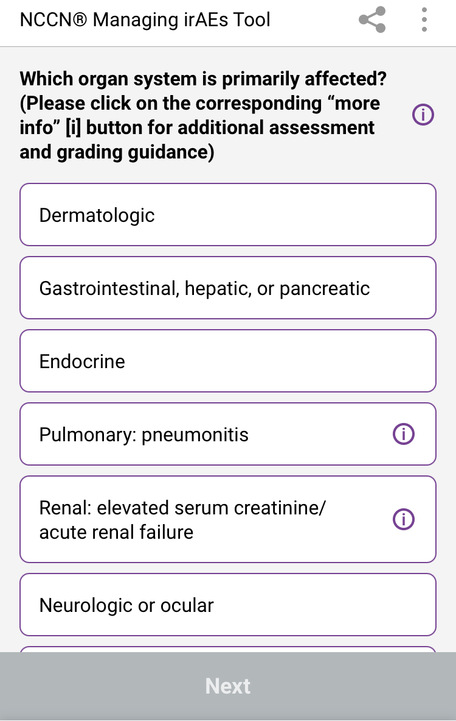
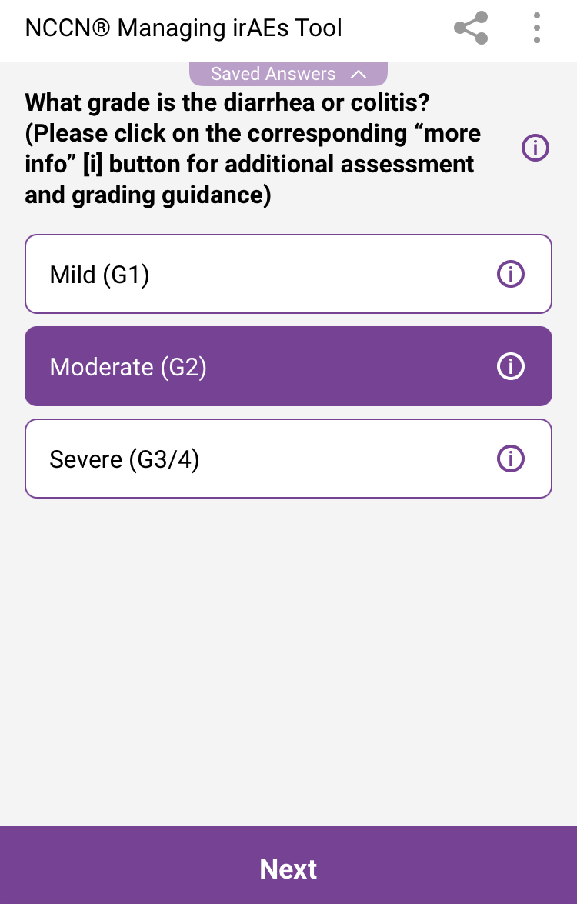
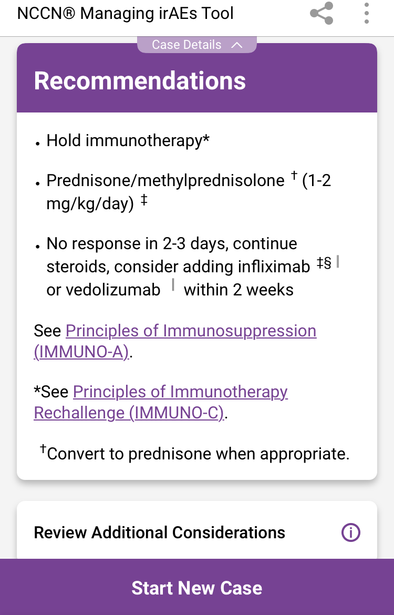
NCCN Clinical Practice Guidelines in Oncology (NCCN Guidelines®) for Managing Immune Checkpoint Inhibitor–Related Toxicities
NCCN Guidelines® for Managing Immune Checkpoint Inhibitor–Related Toxicities: Interactive Decision
Support Tool available at: clinicaloptions.com/immuneAEtool or on our app: CCO Decision Support
Notes:
irAE, immune-related adverse event.

Slide 63
Long-Term Follow-Up From SIENDO/ENGOT-EN5: PFS With Selinexor vs Pbo Maintenance in Recurrent EC
ASCO Plenary: July 2023
Randomized, double-blind, phase III trial in patients with stage IV or first relapse of endometrial cancer with PR or CR on ≥12 wk 1L taxane-carboplatin (prior surgery, radiotherapy or hormonal therapy allowed; N = 263)
TP53 WT
TP53 Mut/Abn
Median PFS, Mo (95% CI)
Median PFS, Mo (95% CI)
Selinexor
Placebo
27.4 (13.1-NR)
5.2 (2.0-13.1)
4.2 (3.6-5.6)
5.4 (3.7-7.2)
1.0
1.0
Selinexor
Placebo
0.75
HR: 0.42 (0.25-0.70; P = .0003)
0.75
HR: 1.34 (0.89-2.02;
P = .9202)
0.50
0.50
PFS Probability
PFS Probability
0.25
0.25
0
0
0
3
6
9
12
15
18
21
24
27
30
33
36
0
3
6
9
12
15
18
21
24
27
30
33
36
No. at Risk
Selinexor
Placebo
Mo
No. at Risk
Selinexor
Placebo
Mo
77
36
62
22
50
17
47
17
41
12
35
9
27
8
20
7
15
6
12
6
7
4
7
3
4
2
79
47
46
34
25
17
16
13
12
11
8
9
4
8
3
6
3
6
2
3
0
3
0
3
0
2
Median FU: 25.3 mo
Median FU: 22.9 mo
Most common (>30%) all grade AEs with selinexor included nausea, vomiting, and diarrhea; no significant differences for QoL, and patient-reported outcomes (by EORTC QLQ-C30) between treatment arms were observed
NCT03555422. Vergote. SGO 2022. Abstr 249. Slomovitz. ASCO 2023. Abstr 427956.
Notes:
AEs, adverse events; EC, endometrial cancer; FU, follow-up; MSS, microsatellite stable; MSI-H, microsatellite instability high; NR, not reached; Pbo, placebo; PFS, progression-free survival; pMMR, mismatch repair proficient; WT, wild type.

Slide 64
Long-Term Follow-Up From SIENDO/ENGOT-EN5: PFS Based on Genomic Instability Status
ASCO Plenary: July 2023
TP53 WT/ MSS(pMMR)
TP53 WT/ MSI-H (dMMR)
Median PFS, Mo (95% CI)
Median PFS, Mo (95% CI)
Selinexor
Placebo
NR (20.8-NR)
4.9 (2.0-NR)
13.1 (3.6-NR)
3.7 (1.9-NR)
Selinexor
Placebo
1.0
1.0
HR: 0.32 (0.16-0.66; P = .0006)
HR: 0.45 (0.16-1.27;
P = .0643)
0.75
0.75
0.50
0.50
PFS Probability
PFS Probability
0.25
0.25
0
0
0
3
6
9
12
15
18
21
24
27
30
33
36
0
3
6
9
12
15
18
21
24
27
30
33
36
No. at Risk
Selinexor
Placebo
Mo
No. at Risk
Selinexor
Placebo
Mo
47
23
42
14
36
10
36
10
32
8
27
7
21
6
15
5
13
4
10
4
5
2
5
2
3
1
20
9
13
5
11
4
9
4
9
3
8
2
6
2
5
2
2
2
2
2
2
2
2
1
1
1
Median FU: 27.2 mo
Median FU: 22.9 mo
NCT03555422. Vergote. SGO 2022. Abstr 249. Slomovitz. ASCO 2023. Abstr 427956.
Notes:
FU, follow-up; MSS, microsatellite stable; MSI-H, microsatellite instability high; NR, not reached; pMMR, mismatch repair proficient; PFS, progression-free survival; WT, wild type.

Slide 65
Navigating the Healthcare Ecosystem: Improving Equitable Diagnosis/ Treatment for Black Patients With EC
Increasing access to guideline-concordant evaluation and treatment options to improve outcomes
  Evaluation of postmenopausal bleeding
  Minimally invasive surgery is associated with fewer complications
  Chemotherapy ± EBRT
  Brachytherapy
  Other
Addressing barriers to overcome health disparities including⁵
  Socioeconomic factors (insurance support)
  Coordination of advocacy groups
  Institute patient navigator systems
  Social support and addressing
    Transportation assistance
    Dependent care assistance
  Qualitative research centered on patient perspectives and beliefs
1. Doll. Am J Obstet Gynecol. 2018;219:593.e1. 2. Huang. Am J Obstet Gynecol. 2020;223:396.e1. 3. Kaspers. Am J Obstet Gynecol. 2020;223:398.e1. 4. Paskett. Am J Obstet Gynecol. 2020;223:309. 5. Chapman-Davis. Ann Surg Oncol. 2023;30:48.
Slide credit: clinicaloptions.com
Notes:
EBRT, external beam radiation therapy.

Slide 66
Navigating the Healthcare Ecosystem:
Expanding Access to Care Through Technology
Novel early-detection strategies to reduce health disparities in EC screening¹
Technology-based approaches (gamification, smartphone apps, AI, health promotion outside of the physical clinic) hold promise for early EC detection, which may help reduce morbidity and mortality
Healthcare policy is needed for addressing the needs of underserved populations along with continued provider awareness and education²
Proposed Future Approach to EC Risk Stratification and Diagnosis
Self-report through app utilizing AI starting at 40 yr:
Vaginal bleeding assessment
Menopause symptoms
Obesity score
Prior endometrial biopsy
Family history
If at high-risk for EC:
App recommends self collection for adipokines, insulin sensitivity, genetics, inflammation, vaginal molecular testing utilizing tampon
If at low risk for EC:
Reassess yearly
Low-risk self-collection:
Diet, exercise, hormone therapy, metformin, coach patients on behavior change, reassess yearly
High-risk self-collection:
See healthcare professional, biopsy, discuss behavior modification, bariatric surgery, hysterectomy
1. DeStephano. Cancer Prev Res. 2020;13:563. 2. Chapman-Davis. Ann Surg Oncol. 2023;30:48.
Slide credit: clinicaloptions.com
Notes:
AI, artificial intelligence; EC, endometrial cancer.

Slide 67
Improving Provider Awareness
About Inequities in Cervical Cancer

Slide 68
Cervical Cancer: Overview
Third most common gynecologic cancer in the United States
Corresponds to ~740 deaths/day worldwide
>90% caused by human papillomavirus
Nearly 100% preventable
  HPV vaccination is key
Risk Factors for Developing Cervical Cancer
Primary risk factor: HPV infection
(>150 related viruses)
  Infection can occur on skin surface and tissue lining the genitals, anus, mouth, and throat
  Can spread during skin-to-skin contact
  Some HPV viruses can cause warts on hands and feet, and others affect the lips or tongue
HPV infection is common, and in most people, the body can clear the infection by itself
Other risk factors: unprotected sex, smoking, weakened immune system
cancer.org/cancer/cervical-cancer/causes-risks-prevention/risk-factors. Sellors. IARC 2003. ISBN-13.
Siegel. CA Cancer J Clin. 2023;73:17. who.int/health-topics/cervical-cancer. Stark. Acta Facultatis Medicae Naissensis. 2018;35:5.
Siegel. CA Cancer J Clin. 2023;73:17. Small. Cancer. 2017;123:2404. who.int/health-topics/cervical-cancer
Slide credit: clinicaloptions.com
Notes:
HPV, human papilloma virus.

Slide 69
Cervical Cancer: Challenges
12
Rate of new cases
10
Death rate
8
Rate per 100,000 Persons
6
4
2
0
1992
1996
2000
2004
Yr
2008
2012
2016
2020
Steady but disproportionate decline in both the incidence and death rates
in cervical cancer reflect lack of effective salvage treatments for those with recurrent disease
seer.cancer.gov/statfacts/html/cervix.html
Slide credit: clinicaloptions.com

Slide 70
Cervical Cancer: US Incidence and Mortality Rates by Race
Rate per 100,000 Women | Overall | White | Black | Hispanic/ Latinx | Other
Incidence* | 7.5 | 7.0 | 8.6 | 9.3 | --
Mortality† | 2.2 | 2.1 | 3.2 | 2.4 | 1.8‡
*Based on data recorded in 2018. †Based on data recorded in 2020.
‡Reflects death rates for American Indian/Alaska Native and Asian/Pacific Islander populations.
Black and Hispanic/Latina women have a higher incidence of cervical cancer and worse mortality compared with White women
www.kff.org/other/state-indicator/cervical-cancer-rate-by-re
Slide credit: clinicaloptions.com

Slide 71
Cervical Cancer: Incidence per 100,000 Women by State
Southern states have a disproportionately high incidence of cervical cancer
  West Virginia: 10.5
  Kentucky: 8.9
  Alabama: 8.3
  Louisiana: 9.5
  Mississippi: 8.7
4.3-6.0
9.2-10.8
6.1-7.5
Missing
7.7-9.1
N/A
kff.org/other/state-indicator/cervical-cancer-rate-by-re
Slide credit: clinicaloptions.com
Notes:
N/A, not available.

Slide 72
Low Rates of Vaccination May Contribute to High Incidence Rates of Cervical Cancer
Adolescents Who Are Up to Date on HPV Vaccinations (%)
≤39%
40% to 49%
50% to 59%
≥60%
HPV vaccination is recommended up to age 26 years of age
Adults 27 through 45 years, not previously vaccinated, might consider HPV vaccination after speaking with their doctor
cdc.gov/hpv
Slide credit: clinicaloptions.com
Notes:
HPV, human papillomavirus.

Slide 73
Mistrust and Limited Access to HCPs May Result in Lower HPV Vaccination Rates Among Women of Color
Distrust and lack of access are driven by isolation, racial differences in communication, lack of insurance, and/or transportation
Low availability of HCPs (pediatricians) in rural areas may contribute to low vaccination rates
Poor health literacy cited as reason for lack of screening or distrust of HPV vaccine
Staples. Vaccine. 2021;39:5385.
Slide credit: clinicaloptions.com
Notes:
HCP, healthcare professional; HPV, human papillomavirus.

Slide 74
Leveraging Community Pharmacies as “Vaccines for Children” Providers May Help Increase HPV Vaccination
Overcoming economic barriers, lack of access, and low awareness/education about vaccines in rural, medically underserved areas
  Community pharmacy in Alabama was enlisted as Vaccines for Children provider of free vaccines to eligible adolescents in 8-mo pilot study
  Demographic characteristics of vaccinated adolescents
    Black: 62.9%
    White: 33.7%
    Other: 3.4%
HPV Vaccination in Adolescents 10-18 Yr of Age,
July 29, 2019 - March 10, 2020 (N = 55)
40
35
30
25
HPV Vaccine Administered (%)
20
15
10
5
0
HPV + Tdap + MCV
HPV Only
HPV + Tdap
HPV + MCV
HPV + Flu
HPV + Tdap + Flu
Daniel. BMC Public Health. 2021;21:1266.
Slide credit: clinicaloptions.com
Notes:
HPV, human papillomavirus; MCV, meningococcal conjugate vaccine; Tdap, tetanus, diphtheria, pertussis.

Slide 75
Screening and
HPV Testing in Cervical Cancer

Slide 76
ACS/USPSTF Guidelines on
Cervical Cancer Screening Frequency
HPV testing as primary screening target
Women aged 21-29 yr: screening every 3 yr with cervical cytology alone
Women aged 30-65 yr
  Screening every 3 yr with cervical cytology alone
  Screening every 5 yr with hrHPV testing alone
  Screening every 5 yr with hrHPV testing in combination with cytology (cotesting)
Considers previous patient health history in the selection of testing frequency
USPSTF. JAMA. 2018;320:674. Fontham. CA Cancer J Clin. 2020;70:321.
Slide credit: clinicaloptions.com
Notes:
ACOG, American College of Obstetricians and Gynecologists; ASCCP, American Society for Colposcopy and Cervical Pathology; HPV, human papillomavirus; hrHPV, high-risk human papillomavirus; USPSTF, US Preventive Services Task Force.

Slide 77
Health Disparities in Screening for Cervical Cancer
Cervical Cancer Screening in Previous 5 Yr for Women Aged 18-66 Yr With ≥1 Pap Test
(United States, June 2017)
Predictor | Pap Test in Previous 5 Yr (n = 482) |  | HPV Test in Previous 5 Yr (n = 333)
 | OR (95% CI) | P Value | OR (95% CI) | P Value
Race: White vs Black | 2.49 (1.12-4.54) | .02 | 1.56 (0.89-2.72) | .12
Education (vs ≥4-yr college degree as reference) High school diploma or less Some college 2-yr college degree | 0.30 (0.14-0.66) 0.53 (0.23-1.22) 0.46 (0.20-1.09) | .002 .13 .07 | 1.11 (0.57-2.17) 1.03 (0.53-2.04) 0.94 (0.46-1.93) | .75 .92 .86
Health insurance: government provided vs private | 1.91 (1.08-3.37) | .03 | 1.38 (0.80-2.35) | .24
Annual household income: <$30,000 vs ≥$30,000 | 0.82 (0.47-1.42) | .47 | 0.53 (0.31-0.92) | .02
Other significant determinants not listed above included knowledge score (for HPV test) and age (for both Pap and HPV test).
Johnson. Public Health Rep. 2020;135:483.
Slide credit: clinicaloptions.com
Notes:
HPV, human papilloma virus; OR, odds ratio; Pap, Papanicolaou.

Slide 78
Barriers to Cervical Cancer Screening for White, Black, and Hispanic Women
Patients (%)
P = .002
P = .046
Akinlotan. J Community Health. 2017;42:770.
Slide credit: clinicaloptions.com

Slide 79
Navigating the Healthcare Ecosystem: Expanding
Access to Care for Underrepresented Women of Color
Underrepresented Women Screened for Cervical Cancer
in a Randomized Trial According to
Intervention (%) (N = 601)¹
Studies document the feasibility and effectiveness of mailed HPV self-sampling for cervical cancer screening among underrepresented women¹⁻⁵
  42 of 49 (86%) women who were HPV positive were successfully navigated to follow-up Pap smear and/or colposcopy
  Only 2 of 265 women who completed HPV self-sampling required repeat testing due to inadequate sample collection
1. Carrasquillo. J Gen Intern Med. 2018;33:1077. 2. Kobetz. Cancer Causes Control. 2018;29:793. 3. Scarinci. Womens
Health Issues. 2013;23:e123. 4. Wong. Int J Environ Res Public Health. 2020;17:6245. 5. Zhu. J Gen Intern Med. 2021;1.
Slide credit: clinicaloptions.com
Notes:
CHW, community health worker; HPV, human papilloma virus; Pap, Papanicolaou.

Slide 80
Individualizing Cervical Cancer Care With Current and Emerging Practice-Changing Clinical Data for Cervical Cancer

Slide 81


Cervical Cancer:
Treatment Options
Initial diagnosis
Colposcopy/biopsy¹⁻³
Cervical dysplasia
Early disease
Locally advanced disease
Metastatic disease
FIGO IVB not amenable to local Tx (surgery → adjuvant Tx)
CIN 2/3
FIGO I_{A1},
no LVSI
FIGO I_{A2}–I_{B1},
no LVSI
FIGO I_{A1}–I_{A2} + LVSI
FIGO I_{B1} not meeting conservative surgery criteria, FIGO I_{B2} ,
FIGO II_{A1}
FIGO I_{B3}, II_{A2}, II_{B}, III, IV_{A}
Cone biopsy
Cryotherapy
Laser therapy
LEEP
Surgery followed by
adjuvant treatment depending
on risk factors
Platinum-based CT + pembrolizumab
$±$ bevacizumab
CRT (preferred for I_{B3}, II_{A2}; required for II_{B}, III, IV_{A}) or surgery (I_{B3}, II_{A2} only)
1L
Surgery (preferred)
or CRT
Tisotumab vedotin^{1,4}, Pembrolizumab^{1,5} (PD-L1+/ MSI-H/dMMR/TMB-H), nivolumab¹ for PD-L1+, selpercatinib¹ for RET fusion, larotrectinib or entrectinib for NTRK gene fusion¹, bevacizumab¹, or single-agent CT¹
2L+
NCCN. Clinical practice guidelines in oncology: cervical cancer. v.1.2023. nccn.org. 2. cancer.gov/publications/dictionaries/cancer-terms/def/cin-2-3. 3. SEER Cancer Stat Facts: Cervical Cancer. National Cancer Institute. Bethesda, MD. 4. Tisotumab vedotin PI. 5. Pembrolizumab PI
Slide credit: clinicaloptions.com
Notes:
1L, first line; 2L, second line; CIN, cervical intraepithelial neoplasia; CPS, combined positive score; CT, chemotherapy; dMMR, mismatch repair deficient; FIGO, International Federation of Gynaecology and Obstetrics; LEEP, loop electrosurgical excision procedure; LVSI, lymphovascular space invasion; MSI-H: microsatellite instability high; TMB-H, tumor mutational burden high.

Slide 82
Black and White Women With Cervical Cancer Receive Different Treatments
Overall Treatment Received
Impact of Brachytherapy Use
1.0
80
White
Black
Non-Black/no BT
Black/no BT
Non-Black/BT
Black/BT
*
0.8
70
60
*
0.6
50
*
Adjusted OS (Probability)
40
*
0.4
Patients (%)
30
0.2
20
*
10
0
0
2
4
6
8
10
12
0
Surgery
CT
CT and EBRT
EBRT
Without Brachytherapy
Brachytherapy
No Treatment
Follow-up (Yr)
*P <.01
Non-Black/no BT
Black/no BT
Non-Black/BT
Black/BT
12725
3042
12805
3027
6784
1458
8387
1977
3653
821
4644
1083
1897
396
2742
595
894
185
1210
314
324
63
484
104
60
9
65
17
Fleming. PLoS One. 2014;9:e104344.
Notes:
CT, chemotherapy; EBRT, external beam radiation therapy.

Slide 83
Uniformity of Treatment and Guideline-Concordant Care May Help Reduce Health Disparities in Cervical Cancer
Adjusted Likelihood of Receipt of Guideline-Adherent Care Based on Hospital Volume
Trends in Receipt of Guideline-Based Care by Race
65
70
Non-Hispanic White
Non-Hispanic Black
Hispanic
60
65
55
60
Patients Receiving
Guideline-Based Care (%)
55
50
Predicted Probability (%)
45
50
Non-Hispanic White
Non-Hispanic Black
Hispanic
45
40
40
35
P <.05
35
30
2004
2005
2006
2007
2008
2009
2010
2011
2012
30
Low-Volume Hospitals
Intermediate-Volume Hospitals
High-Volume Hospitals
Research indicates that when appropriate guideline-based care for cervical cancer is provided, a survival improvement is observed regardless of race, ethnicity, stage, and hospital volume
Uppal. Obstet Gynecol. 2017;129:295.
Slide credit: clinicaloptions.com

Slide 84
Black Patients With Cervical Cancer Who Receive Care Comparable With White Women Achieve Similar Survival Outcomes
Parameter | Overall | White | Black | P Value
Mean age, yr | 44.1 | 41.8 | 44.4 | NR
Histology, % Squamous Adenocarcinoma Adenosquamous | 75 12 6 | 74 13 6 | 78 10 7 | .58
Grade, % 1 2 3 | 13 48 39 | 16 45 39 | 12 49 39 | .58
Stage, % I II III IV | 72 15 11 4 | 71 14 12 3 | 73 16 10 1 | .56
100
White
Black
80
60
OS Probability (%)
P = .59
40
20
0
0
12
24
36
48
60
72
84
96
108
120
132
Mo
Farley. Cancer. 2001;91:869.
Slide credit: clinicaloptions.com
Notes:
NR, not reported; OS, overall survival.

Slide 85
Clinical Advances in the Management of Cervical Cancer

Slide 86
KEYNOTE-158 Phase II Basket Trial (Update):
Pembrolizumab Monotherapy in Advanced CC
FDA Approval June 2018
For patients with cervical cancer who are
PD-L1+ (CPS1 ≥1), MSI-H, or dMMR status
Adult patients with advanced squamous cell carcinoma that progressed on or intolerant to ≥ first-line standard therapy; ECOG PS 0/1; tumor sample for biomarker analysis
(N = 98)
Pembrolizumab 200 mg Q3W
For 2 yr or until unacceptable toxicity, progression, or withdrawal
Primary endpoint: ORR per RECIST v1.1 per BICR
  Overall ORR: 14% (PD-L1 positive: 17%;
  0% ORR in PD-L1 negative)
  Median PFS: 2.1 mo
  An updated analysis of cervical cancer cohort with median 36.9 mo of follow-up showed:
    Median OS: 9.3 mo
    No new safety signals
Chung. JCO. 2019;37:1470. Chung. SGO 2021. Abstr 41.
Slide credit: clinicaloptions.com
Notes:
CPS, combined positive score; dMMR, deficient mismatch repair; DCR, disease control rate; DoR, duration of response; ECOG PS, Eastern Cooperative Oncology Group performance status; MSI-H: microsatellite instability–high; ORR, objective response rate; OS, overall survival; PFS, progression-free survival; RECIST, Response Evaluation Criteria in Solid Tumors.

Slide 87
Pembrolizumab + CT ± Bevacizumab vs Placebo + CT ±
Bevacizumab in CC (KEYNOTE-826): Study Design
FDA Approval October 2021
Pembrolizumab in combination with chemotherapy, with or without bevacizumab, for patients with persistent, recurrent or metastatic cervical cancer whose tumors express PD-L1 (CPS ≥1), as determined by an FDA-approved test.
International, randomized, double-blind phase III trial
Stratified by metastatic disease (yes vs no), PD-L1 CPS (<1 vs 1 to <10 vs ≥10), planned bevacizumab (yes vs no)
Pembrolizumab* 200 mg IV Q3W +
CT † IV Q3W ±
Bevacizumab 15 mg/kg IV Q3W
Adults with persistent, recurrent, or metastatic cervical cancer; no prior systemic chemotherapy; ECOG PS 0-1
(N = 548)
Treatment until death, radiographic progression, unacceptable toxicity, or study completion
Placebo* IV Q3W +
CT† IV Q3W ±
Bevacizumab 15 mg/kg IV Q3W
*≤35 cycles pembrolizumab/placebo. †CT: ≤6 cycles: paclitaxel 175 mg/m² + (cisplatin 50 mg/m² or carboplatin AUC 5 mg/mL/min).
Dual primary endpoints: OS and PFS
Secondary endpoints: ORR, DoR, 12-mo PFS, safety
Exploratory endpoints: PROs assessed per EuroQol EQ-5D-5L VAS
Colombo. NEJM. 2021;385:1856. Pembrolizumab PI. Tewari. ASCO 2022. Abstr 5506.
Notes:
AUC, area under the curve; CPS, combined positive score; CT, chemotherapy; DoR, duration of response; ECOG, Eastern Cooperative Oncology Group; EuroQol EQ-5D-5L VAS, European Quality of Life 5-dimension, 5-level visual analogue scale; ORR, overall response rate; OS, overall survival; PFS, progression-free survival; PRO, patient-reported outcome; PS, performance status; RECIST, Response Evaluation Criteria in Solid Tumors.

Slide 88
KEYNOTE-826: Baseline Characteristics
Characteristic | Pembro* (n = 308) | Placebo* (n = 309)
Median age, yr (range) | 51 (25-82) | 50 (22-79)
ECOG PS 1, n (%) | 128 (41.6) | 139 (45.0)
PD-L1 CPS, n (%) <1 1 to <10 ≥10 | 35 (11.4) 115 (37.3) 158 (51.3) | 34 (11.0) 116 (37.5) 159 (51.5)
Prior therapy, n (%) CRT or RT with surgery CRT or RT only Surgery only None | 71 (23.1) 156 (50.6) 23 (7.5) 58 (18.8) | 79 (25.6) 142 (46.0) 24 (7.8) 64 (20.7)
Characteristic, n (%) | Pembro* (n = 308) | Placebo* (n = 309)
Stage at initial diagnosis† I II III IIIA IIIB IVA IVB | 67 (21.8) 85 (27.6) 5 (1.6) 4 (1.3) 46 (14.9) 7 (2.3) 94 (30.5) | 58 (18.8) 93 (30.1) 8 (2.6) 8 (2.6) 42 (13.6) 4 (1.3) 96 (31.1)
Disease status at entry Metastatic‡ Persistent/recurrent with distant metastases Persistent/recurrent without distant metastases | 58 (18.8) 199 (64.6) 51 (16.6) | 64 (20.7) 179 (57.9) 66 (21.4)
Bevacizumab use during study | 196 (63.6) | 193 (62.5)
Study population was ~60% non-Hispanic White and ~40% non-White
*Arm also included CT ± bevacizumab. †Per FIGO 2009/NCCN 2017 criteria. ‡Includes patients with para-aortic lymph node involvement. These patients were diagnosed with stage IVB disease and entered the study with no prior treatment for cervical cancer.
Colombo. NEJM. 2021;385:1856.
Notes:
CT, chemotherapy; CPS, combined positive score; CRT, chemoradiotherapy; ECOG PS, Eastern Cooperative Oncology Group performance status; Pembro, pembrolizumab; RT, radiotherapy.

Slide 89
KEYNOTE-826: PFS and OS
PFS | Pembrolizumab* | Placebo | HR (95% CI) | P Value
ITT population, n Median, mo PD-L1 CPS ≥1,† n Median, mo PD-L1 CPS ≥10, n Median, mo | 308 10.4 273 10.4 158 10.4 | 309 8.2 275 8.2 158 8.1 | 0.96 (0.53-0.79) 0.62 (0.50-0.77) 0.58 (0.44-0.77) | .001 .001 .001
OS | Pembrolizumab* | Placebo | HR (95% CI) | P Value
ITT population, n 24 mo OS, % PD-L1 CPS ≥1,† n 24 mo OS, % PD-L1 CPS ≥10, n 24 mo OS, % | 308 50.4 273 53.0 158 54.4 | 309 40.4 275 41.7 158 44.6 | 0.67 (0.54-0.84) 0.64 (0.50-0.81) 0.61 (0.44-0.84) | .001 .001 .001
*Arm also included CT ± bevacizumab. †FDA approval.
Colombo. NEJM. 2021;385:1856.
Slide credit: clinicaloptions.com
Notes:
CPS, combined positive score; ITT, intention-to-treat; OS, overall survival; PFS, progression-free survival.

Slide 90
KEYNOTE-826: PFS/OS Across Protocol-Specified Subgroups
PFS
OS
No. of Events/ No. of Patients
HR for Disease Progression or Death (95% Cl)
No. of Events/ No. of Patients
Subgroup
Subgroup
HR for Death (95% Cl)
Overall
Age
<65 yr
≥65 yr
Overall
Age
<65 yr
≥65 yr
406/617
0.65 (0.53-0.79)
312/617
0.67 (0.54-0.84)
345/517
61/100
0.63 (0.50-0.78)
0.77 (0.42-1.42)
265/517
47/100
0.64 (0.50-0.82)
0.88 (0.47-1.64)
Race
White
Non-White
Race
White
Non-White
239/360
139/221
0.70 (0.53-0.91)
0.64 (0.45-0.90)
189/360
107/221
0.68 (0.50-0.91)
0.70 (0.47-1.04)
ECOG PS score
0
1
ECOG PS score
0
1
197/348
207/267
0.65 (0.48-0.87)
0.69 (0.52-0.93)
141/348
169/267
0.68 (0.49-0.96)
0.68 (0.50-0.94)
PD-L1 combined positive score
<1
1 to <10
≥10
PD-L1 combined positive score
<1
1 to <10
≥10
51/69
152/231
203/317
0.94 (0.52-1.70)
0.68 (0.49-0.94)
0.58 (0.44-0.77)
40/69
118/231
154/317
1.00 (0.53-1.89)
0.67 (0.46-0.97)
0.61 (0.44-0.84)
Concomitant bevacizumab
Yes
No
Concomitant bevacizumab
Yes
No
234/389
172/228
0.61 (0.47-0.79)
0.74 (0.54-1.01)
166/389
146/228
0.63 (0.47-0.87)
0.74 (0.53-1.04)
Metastatic disease at diagnosis
Yes
No
Metastatic disease at diagnosis
Yes
No
137/190
269/427
0.92 (0.64-1.30)
0.58 (0.45-0.75)
104/190
208/427
0.84 (0.56-1.26)
0.61 (0.46-0.80)
0.25
0.5
1.0
2.0
4.0
0.25
0.5
1.0
2.0
4.0
Pembrolizumab Better
Placebo Better
Pembrolizumab Better
Placebo Better
Colombo. NEJM. 2021;385:1856.
Notes:
ECOG PS, Eastern Cooperative Oncology Group performance status; OS, overall survival; PFS, progression-free survival.

Slide 91
Pembrolizumab + CT ± Bevacizumab vs Placebo + CT ±
Bevacizumab in CC: KEYNOTE-826 Final OS Analysis
FDA Approval October 2021
Pembrolizumab in combination with chemotherapy, with or without bevacizumab, for patients with persistent, recurrent or metastatic cervical cancer whose tumors express PD-L1 (CPS ≥1), as determined by an FDA-approved test.
International, randomized, double-blind phase III trial
Stratified by metastatic disease at diagnosis (yes vs no), PD-L1 CPS
(<1 vs 1 to <10 vs ≥10), planned bevacizumab (yes vs no)
Pembrolizumab* 200 mg IV Q3W +
CT† IV Q3W ±
Bevacizumab 15 mg/kg IV Q3W
(n = 308)
Adults with persistent, recurrent, or metastatic cervical cancer; no prior systemic chemotherapy; ECOG PS 0/1
(N = 617)
Treatment until death, radiographic progression, unacceptable toxicity, or study completion
Placebo* IV Q3W +
CT† IV Q3W ±
Bevacizumab 15 mg/kg IV Q3W
(n = 309)
*≤35 cycles pembrolizumab/placebo. †CT: ≤6 cycles: paclitaxel
175 mg/m² + (cisplatin 50 mg/m² or carboplatin AUC 5 mg/mL/min).
Dual primary endpoints: OS and PFS per RECIST v1.1 by investigator
Secondary endpoints: ORR, DoR, 12-mo PFS, safety
Monk. ASCO 2022. Abstr 5500.
Notes:
AUC, area under the curve; CPS, combined positive score; CT, chemotherapy; DoR, duration of response; ECOG, Eastern Cooperative Oncology Group; ORR, overall response rate; OS, overall survival; PFS, progression-free survival; PS, performance status; RECIST, Response Evaluation Criteria in Solid Tumors.

Slide 92
KEYNOTE-826: Baseline Characteristics (All Comers)
Characteristic | Pembro (n = 308) | Placebo (n = 309)
Median age, yr (range) | 51 (25-82) | 50 (22-79)
ECOG PS 1, n (%) | 128 (41.6) | 139 (45.0)
Squamous cell carcinoma, n (%) | 235 (76.3) | 211 (68.3)
PD-L1 CPS, n (%) <1 1 to <10 ≥10 | 35 (11.4) 115 (37.3) 158 (51.3) | 34 (11.0) 116 (37.5) 159 (51.5)
Prior therapy, n (%) Chemoradiation or radiation with surgery Chemoradiation or radiation only Surgery only None | 71 (23.1) 156 (50.6) 23 (7.5) 58 (18.8) | 79 (25.6) 142 (46.0) 24 (7.8) 64 (20.7)
Characteristic, n (%) | Pembro (n = 308) | Placebo (n = 309)
Stage at diagnosis* I II III IIIA IIIB IVA IVB | 67 (21.8) 85 (27.6) 5 (1.6) 4 (1.3) 46 (14.9) 7 (2.3) 94 (30.5) | 58 (18.8) 93 (30.1) 8 (2.6) 8 (2.6) 42 (13.6) 4 (1.3) 96 (31.1)
Disease status at study entry Metastatic Persistent or recurrent with distant metastases Persistent or recurrent without distant metastases | 58 (18.8) 199 (64.6) 51 (16.6) | 64 (20.7) 179 (57.9) 66 (21.4)
Bevacizumab used during study | 196 (63.6) | 193 (62.5)
*Per FIGO 2009/NCCN 2017 criteria.
Monk. ASCO 2023. Abstr 5500.
Notes:
CPS, combined positive score; ECOG, Eastern Cooperative Oncology Group; FIGO, International Federation of Gynecology and Obstetrics; NCCN, National Comprehensive Cancer Network; Pembro, pembrolizumab; PS, performance status.

Slide 93
KEYNOTE-826: Final Analysis of OS
Outcome | PD-L1 CPS ≥1 |  | PD-L1 CPS ≥10 |  | All-Comers
Outcome | Pembro (n = 273) | Placebo (n = 275) | Pembro (n = 158) | Placebo (n = 159) | Pembro (n = 308) | Placebo (n = 309)
Median OS, mo | 28.6 | 16.5 | 29.6 | 17.4 | 26.4 | 16.8
 | HR: 0.60 (95% CI: 0.49-0.74)* |  | HR: 0.58 (95% CI: 0.44-0.78)* |  | HR: 0.63 (95% CI: 0.52-0.77)*
12-mo OS, % | 75.5 | 63.2 | 75.9 | 61.6 | 74.9 | 63.7
24-mo OS, % | 53.5 | 39.4 | 54.4 | 42.5 | 52.1 | 38.7
*Nominal P <.0001
Similar OS benefit with pembrolizumab regardless of concomitant bevacizumab
Monk. ASCO 2023. Abstr 5500.
Notes:
CPS, combined positive score; OS, overall survival; Pembro, pembrolizumab.

Slide 94
KEYNOTE-826: Final Analysis of PFS
Outcome | PD-L1 CPS ≥1 |  | PD-L1 CPS ≥10 |  | All-Comers
Outcome | Pembro (n = 273) | Placebo (n = 275) | Pembro (n = 158) | Placebo (n = 159) | Pembro (n = 308) | Placebo (n = 309)
Median PFS, mo | 10.5 | 8.2 | 10.4 | 8.1 | 10.4 | 8.2
 | HR: 0.58 (95% CI: 0.47-0.71)* |  | HR: 0.52 (95% CI: 0.40-0.68)* |  | HR: 0.61 (95% CI: 0.50-0.74)*
12-mo PFS, % | 45.6 | 33.7 | 44.7 | 33.5 | 44.7 | 33.1
*Nominal P <.0001
Monk. ASCO 2023. Abstr 5500.
Notes:
CPS, combined positive score; Pembro, pembrolizumab; PFS, progression-free survival.

Slide 95
KEYNOTE-826: Final Analysis of ORR and DoR
Outcome | PD-L1 CPS ≥1 |  | PD-L1 CPS ≥10 |  | All-Comers
Outcome | Pembro (n = 273) | Placebo (n = 275) | Pembro (n = 158) | Placebo (n = 159) | Pembro (n = 308) | Placebo (n = 309)
ORR CR PR | 68.5 25.6 42.9 | 50.9 14.5 36.4 | 69.6 24.7 44.9 | 50.3 12.6 37.7 | 66.2 24.7 41.6 | 51.5 14.2 37.2
Median DoR, mo (range) | 19.2 (1.3+ to 40.9+) | 10.4 (1.5+ to 40.7+) | 28.3 (1.3+ to 40.9+) | 10.1 (2.1+ to 38.3+) | 18.0 (1.3+ to 40.9+) | 10.4 (1.5+ to 40.7+)
Monk. ASCO 2023. Abstr 5500.
Notes:
CR, complete response; DoR, duration of response; ORR, overall response rate; Pembro, pembrolizumab; PR, partial response.

Slide 96
KEYNOTE-826: Updated Safety and Treatment Exposure
Outcome, n (%) | Pembro (n = 307) | Placebo (n = 309)
All-cause AE Grade ≥3 Serious Led to death Led to d/c of any treatment Led to d/c of all treatment | 305 (99.3) 253 (82.4) 157 (51.1) 16 (5.2) 125 (40.7) 17 (5.5) | 307 (99.4) 233 (75.4) 132 (42.7) 15 (4.9) 91 (29.4) 15 (4.9)
TRAEs Grade ≥3 Serious Led to death Led to d/c of any treatment Led to d/c of all treatment | 298 (97.1) 212 (69.1) 94 (30.6) 2 (0.7) 102 (33.2) 9 (2.9) | 300 (97.1) 201 (65.0) 73 (23.6) 4 (1.3) 77 (24.9) 6 (1.9)
irAEs Grade ≥3 Serious Led to death Led to d/c of any treatment Led to d/c of all treatment | 106 (34.5) 37 (12.1) 24 (7.8) 2 (0.7) 20 (6.5) 2 (0.7) | 51 (16.5) 9 (2.9) 7 (2.3) 0 1 (0.3) 0
Treatment parameter | Pembro (n = 307) | Placebo (n = 309)
Median number of cycles Any treatment Pembro or placebo Chemotherapy Bevacizumab | 14 13 6 13 | 11 11 6 11
Median treatment duration, mo | 10.0 | 7.7
Mean treatment duration, mo | 14.4 | 10.8
Monk. ASCO 2023. Abstr 5500.
Notes:
AE, adverse event; d/c, discontinuation; irAE, immune-related adverse event; Pembro, pembrolizumab.

Slide 97
KEYNOTE-826: Updated Safety
All-Cause AEs ≥20% in Either Arm, % | Pembro (n = 307) | Placebo (n = 309)
Anemia | 61.2 | 54.0
Alopecia | 56.4 | 57.9
Nausea | 39.7 | 43.7
Diarrhea | 37.1 | 30.7
Fatigue | 29.0 | 27.5
Constipation | 29.0 | 33.3
Arthralgia | 26.7 | 24.9
Vomiting | 26.7 | 27.2
Neuropathy peripheral | 26.4 | 25.9
Hypertension | 25.7 | 23.3
UTI | 24.1 | 26.5
Neutropenia | 23.5 | 19.4
Peripheral sensory neuropathy | 23.1 | 25.9
Asthenia | 20.8 | 21.4
Decreased appetite | 20.2 | 16.8
Thrombocytopenia | 19.9 | 20.1
Immune-Mediated AEs ≥2 in Either Arm, % | Pembro (n = 307) | Placebo (n = 309)
Hypothyroidism | 19.2 | 10.0
Hyperthyroidism | 8.5 | 3.2
Colitis | 5.2 | 1.6
Severe skin reactions | 4.6 | 0.3
Thyroiditis | 3.6 | 0.3
Pneumonitis | 2.3 | 0.3
Hepatitis | 1.6 | 0.3
Adrenal insufficiency | 1.3 | 0
Pancreatitis | 1.3 | 0.3
Myositis | 0.7 | 0
Type 1 diabetes mellitus | 0.7 | 0
Vasculitis | 0.7 | 0
Nephritis | 0.7 | 0
Monk. ASCO 2023. Abstr 5500.
Notes:
AE, adverse event; Pembro, pembrolizumab; UTI, urinary tract infection

Slide 98
Cervical Cancer Studies Summary
Phase III SHAPE trial of RH vs SH in LRESCC: simple hysterectomy was noninferior to radical hysterectomy as assessed by 3-yr pelvic recurrence rate (2.52% vs 2.17%) and was associated with fewer urologic surgical complications, better QoL, and better sexual health measures in patients with early/low-risk cervical cancer¹
Following an adequate and rigorous preoperative assessment, simple hysterectomy can now be considered the new standard of care for patients with low-risk early-stage cervical cancer (low-risk was defined as: stage IA2-IB1 ≤2 cm, <10 mm depth of stromal, invasion by LEEP/cone, and <50% depth of stromal invasion by preoperative MRI
KEYNOTE-826: after a follow-up of 39.1 mo, the addition of pembrolizumab to chemotherapy ± bevacizumab continues to demonstrate clinically significantly prolonged OS and PFS in persistent/recurrent/ metastatic CC²
  OS and PFS benefit with pembrolizumab was observed in the ITT population and in CPS ≥1 and
  CPS ≥10 patient subgroups
  Benefit was consistent across subgroups including those with or without bevacizumab
  Safety outcomes were as expected based on individual agent profiles with no new safety signals
Investigators concluded that the findings provide further support for the use of first-line pembrolizumab plus chemotherapy ± bevacizumab as a new standard of care for women with persistent, recurrent, or metastatic cervical cancer
1. Plante. ASCO 2023. Abstr LBA5511. 2. Monk. ASCO 2023. Abstr 5500.
Notes:
CCTG, Canadian Cancer Trials Group; CPS, combined positive score; HPV, human papilloma virus; IHC, immunohistochemistry; ITT, intention-to-treat; LACC, locally advanced cervical cancer; LEEP, loop electrosurgical excision procedure; QoL, quality of life; PFS, progression-free survival.

Slide 99
innovaTV 204: International, Multicenter, Phase II Study of Tisotumab Vedotin in Recurrent/Metastatic CC
FDA Approval September 2021
Tisotumab vedotin is approved by the FDA for recurrent or metastatic cervical cancer with disease progression on or after chemotherapy
Recurrent or extrapelvic metastatic cervical cancer
progressed during or after doublet chemotherapy with bevacizumab (if eligible);
received ≤2 prior systemic regimens; ECOG PS 0/1
(N = 102*)
Tumor responses assessed using CT or MRI at baseline, every 6 wk for the first 30 wk, and
every 12 wk thereafter
Tisotumab vedotin
2.0 mg/kg IV Q3W
(n = 101)
Until PD or unacceptable toxicity
Confirmed Best Overall Response
Primary endpoint: ORR per RECIST v1.1 by IRC
Secondary endpoint: ORR per RECIST v1.1 by investigator, DoR, TTR, PFS by IRC and investigator, OS, and safety
Exploratory endpoint:
biomarker analysis and safety
Parameter | Tisotumab Vedotin (N = 101)
ORR, % (95% CI) | 24 (15.9-33.3)
Median DoR, mo (95% CI) | 8.3 (4.2- NR)
Race: 95% White
*Study sample size calculated assuming a confirmed ORR of 21% to 25% with tisotumab vedotin
and to provide ≥80% power to exclude an ORR of ≤11%.
Coleman. Lancet Oncol. 2021;22:609. NCT03438396.
Slide credit: clinicaloptions.com
Notes:
DoR, duration of response; ECOG PS, Eastern Cooperative Oncology Group performance status; IRC, independent review committee; ORR, overall response rate; OS, overall survival; PD, progressive disease; PFS, progression-free survival; RECIST, Response Evaluation Criteria in Solid Tumors; TTR; time to relapse.

Slide 100
Phase II innovaTV 204: Prespecified AEs of Interest
100
Ocular, Bleeding, and Peripheral Neuropathy TRAEs
N = 101
 | Ocular | Bleeding | Peripheral Neuropathy
Time to onset (median, mo) | 1.4 | 0.3 | 3.1
Events resolved, % | 86 | 90 | 21
Time to resolution§ (median, mo) | 0.7 | 0.5 | 0.6
Patients (%)
80
Grade 1
2
Grade 2
60
Grade 3
2
40
27
3
7
20
34
9
25
17
0
Ocular TRAEs
Bleeding TRAEs
Peripheral Neuropathy
TRAEs
Ocular AEs were mostly mild to moderate, resolved, and manageable with an eye care plan
Most bleeding events were grade 1 epistaxis (28%), and majority resolved
Most peripheral neuropathy events (known MMAE-related toxicity) were grade 1 and manageable with dose modifications;
resolution was limited by follow-up period
Patients should be seen by an eye care provider to examine their eyes before starting treatment, prior to each dose, and as needed for any new or worsening signs and symptoms of ocular AEs
Coleman. Lancet Oncol. 2021;22:609. Tisotumab vedotin PI.
Notes:
AE, adverse event; MMAE, monomethyl auristatin E; SMQ, standardized MedDRA queries; TRAE, treatment-related adverse event.

Slide 101
Take-home Messages—
Achieving Health Equity For All in Gynecologic Cancers
Inequality in gynecologic cancer care leads to Black patients presenting with more advanced disease and receipt of non-guideline concordant care including lower participation in clinical trials
  Timely/equitable access to care can improve outcomes for Black patients
  Leverage patient navigators to increase access to care for Black patients with gynecologic cancers
Current guidelines on screening can lead to missed (50%) diagnosis for Black women with endometrial cancer vs the general population
  Black patient education and receipt of treatment at high-volume centers may result in improved outcomes
  Increased participation of Black patients in clinical trials of novel agents can inform data gaps
Low vaccination rate is a key contributor to higher incidence of cervical cancer in Black and Hispanic vs White women, and low adoption of brachytherapy in Black patients is associated with lower survival vs White patients
  Providing targeted health education and leveraging community pharmacies improved vaccination rates
  Use of brachytherapy, and novel agents, can improve outcomes for all patients with cervical cancer regardless of race
Slide credit: clinicaloptions.com

Slide 102
Go Online for More CCO
Coverage of Gynecologic Malignancies!
Downloadable slideset from today’s meeting and CME/CPE/CNE-certified on-demand webcast (coming soon!)
ClinicalThought™ commentaries and PDF resources for gynecologic cancers that may help increase awareness on health disparities and provide additional aid to your patients
On-demand CME/CPE/CNE-certified text modules with healthcare professionals' insight and commentary
clinicaloptions.com/oncology
clinicaloptions.com/GYNCI2022tool
clinicaloptions.com/immuneAETool
clinicaloptions.com/CervicalTool2022

Slide 103
Supplemental Slides

Slide 104
Ovarian Cancer

Slide 105
Risk Factors and Disease-Related Determinants of
Poor Outcomes in Ovarian Cancer
Risk factors for developing ovarian cancer¹
Older age (≥65 yr and older)
Excess weight (obesity; low physical activity)
Inherited mutations in BRCA1 or BRCA2
Postmenopausal use of estrogen with or without progesterone
Family history of ovarian, breast, or colorectal cancer (familial cancer syndromes)
Peutz-Jeghers or Lynch syndrome
Having children later or never having a full-term pregnancy
Other (smoking, alcohol consumption, infertility tx)
Factors affecting prognosis^{2,3}
Low-volume tumors are associated with a favorable prognosis
  No upper abdominal disease or extra pelvic disease >1 cm
  Lesser residual disease following surgery (< vs ≥1 cm; ≤ vs >3 cm)
Tumors with unfavorable outcomes³
  FIGO stage I vs II vs III vs IV
  Mucinous or clear cell carcinoma histology
  Distant disease
1. Momenimovahed. Int J Womens Health. 2019;11:287. 2. Hoppenot. Gynecol Oncol. 2018;148:204. 3. Chang. PLoS One. 2018;13:e0194993.
Slide credit: clinicaloptions.com
Notes:
FIGO, International Federation of Gynaecology and Obstetrics; tx, treatment.

Slide 106
Ovarian Cancer: Screening and Histologic Classification
OC: difficult to detect due to nonspecific early symptoms^{1,2}
  Bloating, urinary symptoms, pelvic/abdominal pain, heavy or irregular bleeding
  No evidence to support general population screening for OC
OC methods of detection*: serum CA 125 (≥35 U/mL), TVU, germline BRCA1/2 testing†
Histopathology and Molecular Assessment
 | HG Serous | LG Serous | Clear Cell | Endometrioid | Mucinous
Mutations or molecular alterations³ | TP53; BRCA1/2; NF1; RB1; CDK12; HRD | BRAF; KRAS; NRAS; ERBB2 | ARID1A; PIK3CA; PTEN; CTNNB1; PPP2R1α; dMMR⁴ | ARID1A; PIK3CA; PTEN; PPP2R1α; dMMR | KRAS; HER2 amplification
Available targeted therapies⁴ | PARPi; ICIs? | Hormonal therapy; ICIs? | ICIs | Hormonal therapy; PARPi for high grade; ICIs | ICIs?
*Routine screening not recommended. †BRCA1/2 carriers may pursue genetic counseling and/or consider contraception as preventative measure.
1. Menon. Obstet Gynecol. 2018;131:909. 2. US Preventive Services Task Force. JAMA.
2018;319:588. 3. Banerjee. Clin Cancer Res. 2013;19:961. 4. Lheureux. CA Cancer J Clin. 2019;69:280.
Slide credit: clinicaloptions.com
Notes:
dMMR, mismatch repair deficiency; ER, estrogen receptor; HG, high-grade; HRD, homologous recombination deficiency; ICI, immune checkpoint inhibitor; LG, low-grade; OC, ovarian cancer; PARPi, PARP inhibitor; Progesterone receptor; TVU, transvaginal ultrasound.

Slide 107
Contribution of Non-BRCA Mutations to HRD in Ovarian Cancer
Mutation frequency in 28 HR genes analyzed (~250 patients)
  Low frequency of mutations found in 16 genes
  No mutations found in 12 genes
14
12
10
Non-BRCA HR Gene
Cumulative Frequency
13%
HRD From
Other Causes
24%
8
Other
HRD Genes
7%
IC₅₀ Fold Change vs NT4
HRD Negative
50%
6
4
BRCA2
7%
BRCA1
12%
2
0
NBN
ATM
RPA1
ATRX
CHEK1
PALB2
BRIP1
BRCA1
FANCC
CHEK2
BRCA2
FANCA
RAD51
RAD50
FANCM
RAD51B
FANCD2
RAD51D
Norquist. SGO 2016. Abstr 1.
Slide credit: clinicaloptions.com
Notes:
HR, homologous recombination; HRD, homologous recombination deficiency; IC₅₀, half maximal inhibitory concentration; NT4, neurotrophin 4.

Slide 108
Screening for Actionable Biomarkers in Ovarian Cancer
Understanding the HRD Status Result
Final myChoice CDx Result Factors
tBRCA Status and GIS
GIS Distribution in Combine Breast and Ovarian Cancer Training Set
GIS | tBRCA | Final myChoice CDx Status
Positive | Negative | Positive
Positive | Positive | Positive
Negative | Positive | Positive
Negative | Negative | Negative
2 biologically distinct
tumor subgroups
● BRCA intact (n = 790)
● BRCA deficient (n = 268)
100
The cutoff was placed so that 95% of BRCA-deficient tumors scored “HRD positive”
80
HRD (–)
HRD (+)
60
Number of Samples
40
HRD Status: POSITIVE
GIS: positive (≥42)
Tumor mutation BRCA1/BRCA2 status: positive for a clinically significant mutation
20
Test
Readout
0
[0,5]
(10,15]
(20,25]
(30,35]
(40,45]
(50,55]
(60,65]
(70,75]
(80,85]
(90,95]
HRD Score
1. Cancer Genome Atlas Research Network. Nature. 2012;490:61. 2. Cancer Genome Atlas Research Network. Nature. 2011;474:609. 3. Hennessy. JCO. 2010;28:3570. 4. Myriad. myriad.com/products-services/precision-medicine/mychoice-cdx. 5. Timms. Br Ca Res. 2014;16:475. 6. Telli. Clin Cancer Res. 2016;22:3764.
Slide credit: clinicaloptions.com
Notes:
CDx, companion diagnostics; HRD, homologous recombination deficiency; GIS, genomic instability score; tBRCA, tumor mutation BRCA.

Slide 109
Recent Advances With PARP Inhibitor Maintenance in Patients With Newly Diagnosed Ovarian Cancer
Parameter | PRIMA¹ | PRIME² (Study performed only in China) | SOLO-1³ 7-Yr Follow-up | ATHENA-MONO⁴ | ATHENA-MONO⁴ | PAOLA-1⁵
Treatment | Niraparib vs placebo | Niraparib vs placebo | Olaparib vs placebo | Rucaparib vs placebo | Rucaparib vs placebo | Olaparib-Bev vs Bev
BICR or investigator | BICR | BICR | Investigator | Investigator (primary) | BICR | Investigator
ITT, N Median PFS, mo (HR) [95% CI] | 733 13.8 vs 8.2 (0.62) [0.50-0.76] | 384 24.8 vs 8.3 (0.45)[0.34-0.60] | - | 538 20.2 vs 9.2 (0.52) [0.40-0.68] | 538 25.9 vs 9.1 (0.47) [0.36-0.63] | 806 22.1 vs 16.6 (0.59) [0.49-0.72]
BRCAwt/HRp, n Median PFS, mo (HR) [95% CI] | 249 8.1 vs 5.4 (0.68) [0.49-0.94] | 127* 14.0 vs 5.5 (0.41) [0.25-0.65] | - | 238 12.1 vs 9.1 (0.65) [0.45-0.95] | 238 12.0 vs 6.4 (0.60) [0.40-0.89] | 277 16.5 vs 16.2 (1.00) [0.75-1.35]*
BRCAwt/HRd, n Median PFS, mo (HR) [95% CI] | 150 19.6 vs 8.2 (0.50) [0.31-0.83] | 132† 24.8 vs 11.1 (0.58) [0.36-0.93] | - | 119 20.3 vs 9.2 (0.58) [0.33-1.01] | 119 27.8 vs 9.1 (0.46) [0.26-0.81] | 152 28.1 vs 16.6 (0.43) [0.28-0.66]*
BRCAm/HRd, n Median PFS, mo (HR) [95% CI] | 223 22.1 vs 10.9 (0.40) [0.27-0.62] | 125‡ NR vs 10.8 (0.40) [0.23-0.68] | 391 56.0 vs 13.8 (0.33) [0.25-0.43] | 115 NR vs NR (0.48) [0.23-1.0] | 115 NR vs NR (0.48) [0.23-1.0] | 237 37.2 vs 21.7 (0.31) [0.20-0.47]*
Median duration of follow-up, mo | 13.8 | 27.5 | 57.6 | 26.1 | 26.1 | 22.9
*Non-gBRCAm/HRp. †Non-gBRCAm/HRd. ‡gBRCAm population.
1. Gonzalez-Martin. NEJM. 2019;381:2391. 2. Li. SGO 2022. Abstr 244. 3. Banerjee. Lancet Oncol. 2021;22:1721. 4. Monk. JCO. 2022;40:3952. 5. Ray-Coquard. NEJM. 2019;381:2416.
Notes:
Bev, bevacizumab; BICR, blinded independent central review; HR, hazard ratio; HRd, homologous recombination deficient; HRp, homologous recombination proficient; ITT, intention to treat; NR, not reached; OC, ovarian cancer; PARPis, Poly(ADP-ribose) polymerase inhibitors; PFS, progression-free survival.

Slide 110
PARP Inhibitor AEs of Interest
SOLO1¹
Olaparib (n = 260)
Placebo (n = 130)
PAOLA-1²
Olaparib + Bevacizumab (n = 535)
Placebo + Bevacizumab (n = 267)
Nausea
0.8
Fatigue/Asthenia
53
5
1
32
Fatigue/Asthenia
3.8
1.5
Nausea
53
2
1
22
Vomiting
0.4
0.8
Hypertension
46
19
30
60
Anemia
21.5
1.5
Anemia
41
17
<1
10
Diarrhea
3.1
Lymphopenia
24
7
1
9
All grades (frequency ≥25%)
Arthralgia
22
1
1
24
All grades (frequency ≥15%)
Constipation
Grade ≥3 (frequency ≥5%)
Vomiting
22
1
2
11
Grade ≥3
Dysgeusia
All grades (frequency ≥25%)
Abdominal pain
19
1
2
20
All grades (frequency ≥15%)
Arthralgia
Grade ≥3 (frequency ≥5%)
Diarrhea
18
2
2
17
4.6
Neutropenia
18
6
3
16
Grade ≥3
Neutropenia
8.5
Leukopenia
18
2
1
10
100
75
50
25
0
0
25
50
75
100
Urinary Tract Infection
15
<1
1
10
AEs (%)
100
75
50
25
0
0
25
50
75
100
Niraparib (n = 484)
AEs (%)
PRIMA³
Placebo (n = 244)
Anemia
63
31
18
31
1
1
Nausea
57
1
1
28
Thrombocytopenia
46
29
4
Constipation
39
19
Fatigue
2
<1
30
35
<1
Platelet Count Decreased
28
13
1
Neutropenia
7
All grades
26
13
1
Headache
26
<1
15
Grade ≥3
Insomnia
25
<1
14
All grades
<1
Grade ≥3
1. Moore. NEJM. 2018;379:2495.
2. Ray-Coquard. NEJM. 2019;381:2416. 3. González-Martín. NEJM. 2019;381:2391.
Vomiting
<1
12
22
<1
100
80
60
40
20
0
20
40
60
80
100
Slide credit: clinicaloptions.com
Adverse Events (%)
Notes:
AE, adverse event; GI, gastrointestinal.

Slide 111
PARP Inhibitor AEs in Frontline Maintenance
AEs, % | SOLO-1¹ | PRIMA² | PAOLA-1³
Any AE | 98 | 99 | --
Grade >3 AE | 40 | 71 | --
Serious AE | 21 | 32 | 31*
AE leading to dose interruption | 52 | 80 | 54
AE leading to dose reduction | 29 | 71 | 41
AE leading to treatment discontinuation | 12 | 12 | 20
MDS/AML | 1 | 0.8⁴ | --
New primary malignancy | 3 | -- | --
*Serious AEs in >5% of patients included hypertension (19%) and anemia (17%).
1. Bradley. SGO 2021. Abstr 38. 2. Gonzalez-Martin. NEJM. 2019;381:2391. 3. Olaparib PI. 4. Niraparib PI.
Notes:
AE, adverse event; AML, acute myeloid leukemia; MDS, myelodysplastic syndrome.

Slide 112
Proactive Management of Hematologic AEs
Prior to starting PARPi, confirm that blood counts have recovered from previous chemotherapy to normal or grade 1
Exclude other potential causes (eg, iron, B₁₂, folate for anemia)
Dose reduction and/or interruption according to prescribing information
Investigate for potential MDS/AML if hematologic toxicities do not resolve
Tookman. Ther Adv Med Oncol. 2020;12:1758835920921980. Niraparib PI. Olaparib PI. Rucaparib PI.
Slide credit: clinicaloptions.com
Notes:
AE, adverse event; AML, acute myelogenous leukemia; MDS, myelodysplastic syndrome; PARPi, PARP inhibitor.

Slide 113
General Principles for Managing Hematologic AEs With PARP Inhibitors: Anemia, Neutropenia
AE | Grade 1 | Grade 2 | Grade 3/4
Anemia | Monitor and continue | Withhold for maximum of 28 days Monitor blood counts weekly until Hb ≥9 g/dL, then resume at reduced dose Discontinue if Hb has not returned to acceptable concentrations after 28 days | Consider transfusion Withhold for maximum of 28 days Resume at reduced dose; discontinue if already at lowest dose Discontinue if Hb has not returned to acceptable concentrations after 28 days
Neutropenia | Monitor and continue | Withhold for maximum of 28 days Monitor blood counts weekly until neutrophil counts ≥1500 cells/μL, then resume at reduced dose Discontinue if neutrophils have not returned to acceptable concentrations after 28 days | Withhold for maximum of 28 days Resume at reduced dose; discontinue if already at lowest dose Discontinue if neutrophils have not returned to acceptable concentrations after 28 days
LaFargue. Lancet Oncol. 2019;20:e15. Niraparib PI. Olaparib PI. Rucaparib PI.
Slide credit: clinicaloptions.com
Notes:
AE, adverse event; Hb, hemoglobin.

Slide 114
General Principles for Managing Hematologic AEs With PARP Inhibitors: Thrombocytopenia
AE | Grade 1 | Grade 2 | Grade 3/4
Thrombocytopenia | 1st occurrence (PLT <100,000/μL) Monitor CBC at least weekly Withhold for maximum of 28 days until PLT ≥100,000/μL; resume at same or reduced dose If PLT <75,000/μL, resume at reduced dose 2nd occurrence (PLT <100,000/μL) Withhold for maximum of 28 days Monitor CBC weekly until PLT ≥100,000/μL; then resume at reduced dose Discontinue if PLTs have not returned to acceptable concentrations after 28 days or if already on lowest dose | Withhold for maximum of 28 days Monitor CBC weekly until PLT ≥100,000/μL; then resume at reduced dose If PLT <75,000/μL, reduce dose | Platelet transfusion if PLT <10,000/μL or bleeding Consider withholding anticoagulation and antiplatelet drugs Resume at reduced dose Discontinue if already at lowest dose
LaFargue. Lancet Oncol. 2019;20:e15. Niraparib PI. Olaparib PI. Rucaparib PI.
Slide credit: clinicaloptions.com
Notes:
AE, adverse event; CBC, complete blood count; PLT, platelet.

Slide 115
Selected Trials in Advanced/Recurrent Ovarian Cancer
Study | Population/Setting | Treatment | Estimated N | Trial Status | Endpoint
GLORIOSA (NCT05445778) | Platinum-sensitive Ovarian, Fallopian Tube, or Peritoneal Cancer | Maintenance mirvetuximab soravtansine + bevacizumab vs bevacizumab | 418 | Recruiting | PFS At 4 yrs
2021-0299 (NCT05092373) | Confirmed advanced/metastatic cancer involving the abdomen or thorax Measurable disease | Tumor treating field + cabozantinib or atezolizumab and nab-paclitaxel | 36 | Recruiting | Safety and tolerability through 2 yrs
ROSELLA (NCT05257408) | Platinum-resistant High-grade, epithelial ovarian, primary peritoneal, or fallopian-tube cancer | Relacorilant + nab-paclitaxel vs Nab-paclitaxel | 360 | Recruiting | PFS by BICR at 2 yrs
OPAL (NCT03574779) | High-grade recurrent epithelial, serous, endometrioid, mucinous, clear cell ovarian, fallopian tube, or primary peritoneal cancer Measurable disease | Niraparib + bevacizumab ± dostarlimab vs niraparib carboplatin + paclitaxel ± bevacizumab | 125 | Recruiting | ORR At 4 yrs
Clinicaltrials.gov.
Notes:
1L, first line; 2L, second line; BICR, blinded independent review committee; EC, endometrial cancer; inv, investigator; OS, overall survival; PFS, progression-free survival.

Slide 116
Endometrial Cancer

Slide 117
Screening, Histology Profile, and Disease Prognosis
Screening for EC¹
Symptoms: postmenopausal bleeding
Methods: transvaginal ultrasound, endometrium biopsy, genetic testing if previous family history of EC
Guidelines on risk stratification²
Histopathologic type, grade, myometrial invasion, and LVSI (no/focal/substantial) recommended in all patients
Molecular subtyping recommended to better define risk groups
Histopathology and Molecular Assessment³
Histology | Endometrioid | Endometrioid | Serous | Clear Cell
Grade | Low | High | High | High
Metastasis | Uncommon | Lymph nodes, distant organs | Lymph nodes, peritoneal, distant organs | Lymph nodes, peritoneal +/-
Prognosis | Favorable | Poor | Poor* | Poor*†
Molecular markers ER/PgR expression PTEN expression DNA MMR loss Aberrant P53 HER2⁴ | + -/+ -/+ - - | +/- -/+ -/+ -/+ - | -/+ + - + + | - + -/+ -/+ -
*Frequently diagnosed at advanced stages. †When diagnosed at an early stage, prognosis is better than that of serous carcinoma of the same stage.
1. PDQ endometrial cancer screening. www.cancer.gov/types/uterine/hp/endometrial-screening-pdq. 2. Concin.
Int J Gynecol Cancer. 2021:12. 3. Murali. Lancet Oncol. 2014;15:E268. 4. Buza. Arch Pathol Lab Med. 2020;145:687.
Slide credit: clinicaloptions.com
Notes:
EC, endometrial cancer; ER, estrogen receptor; LVSI, lymph vascular space invasion; MMR, mismatch repair; PgR, progesterone receptor.

Slide 118
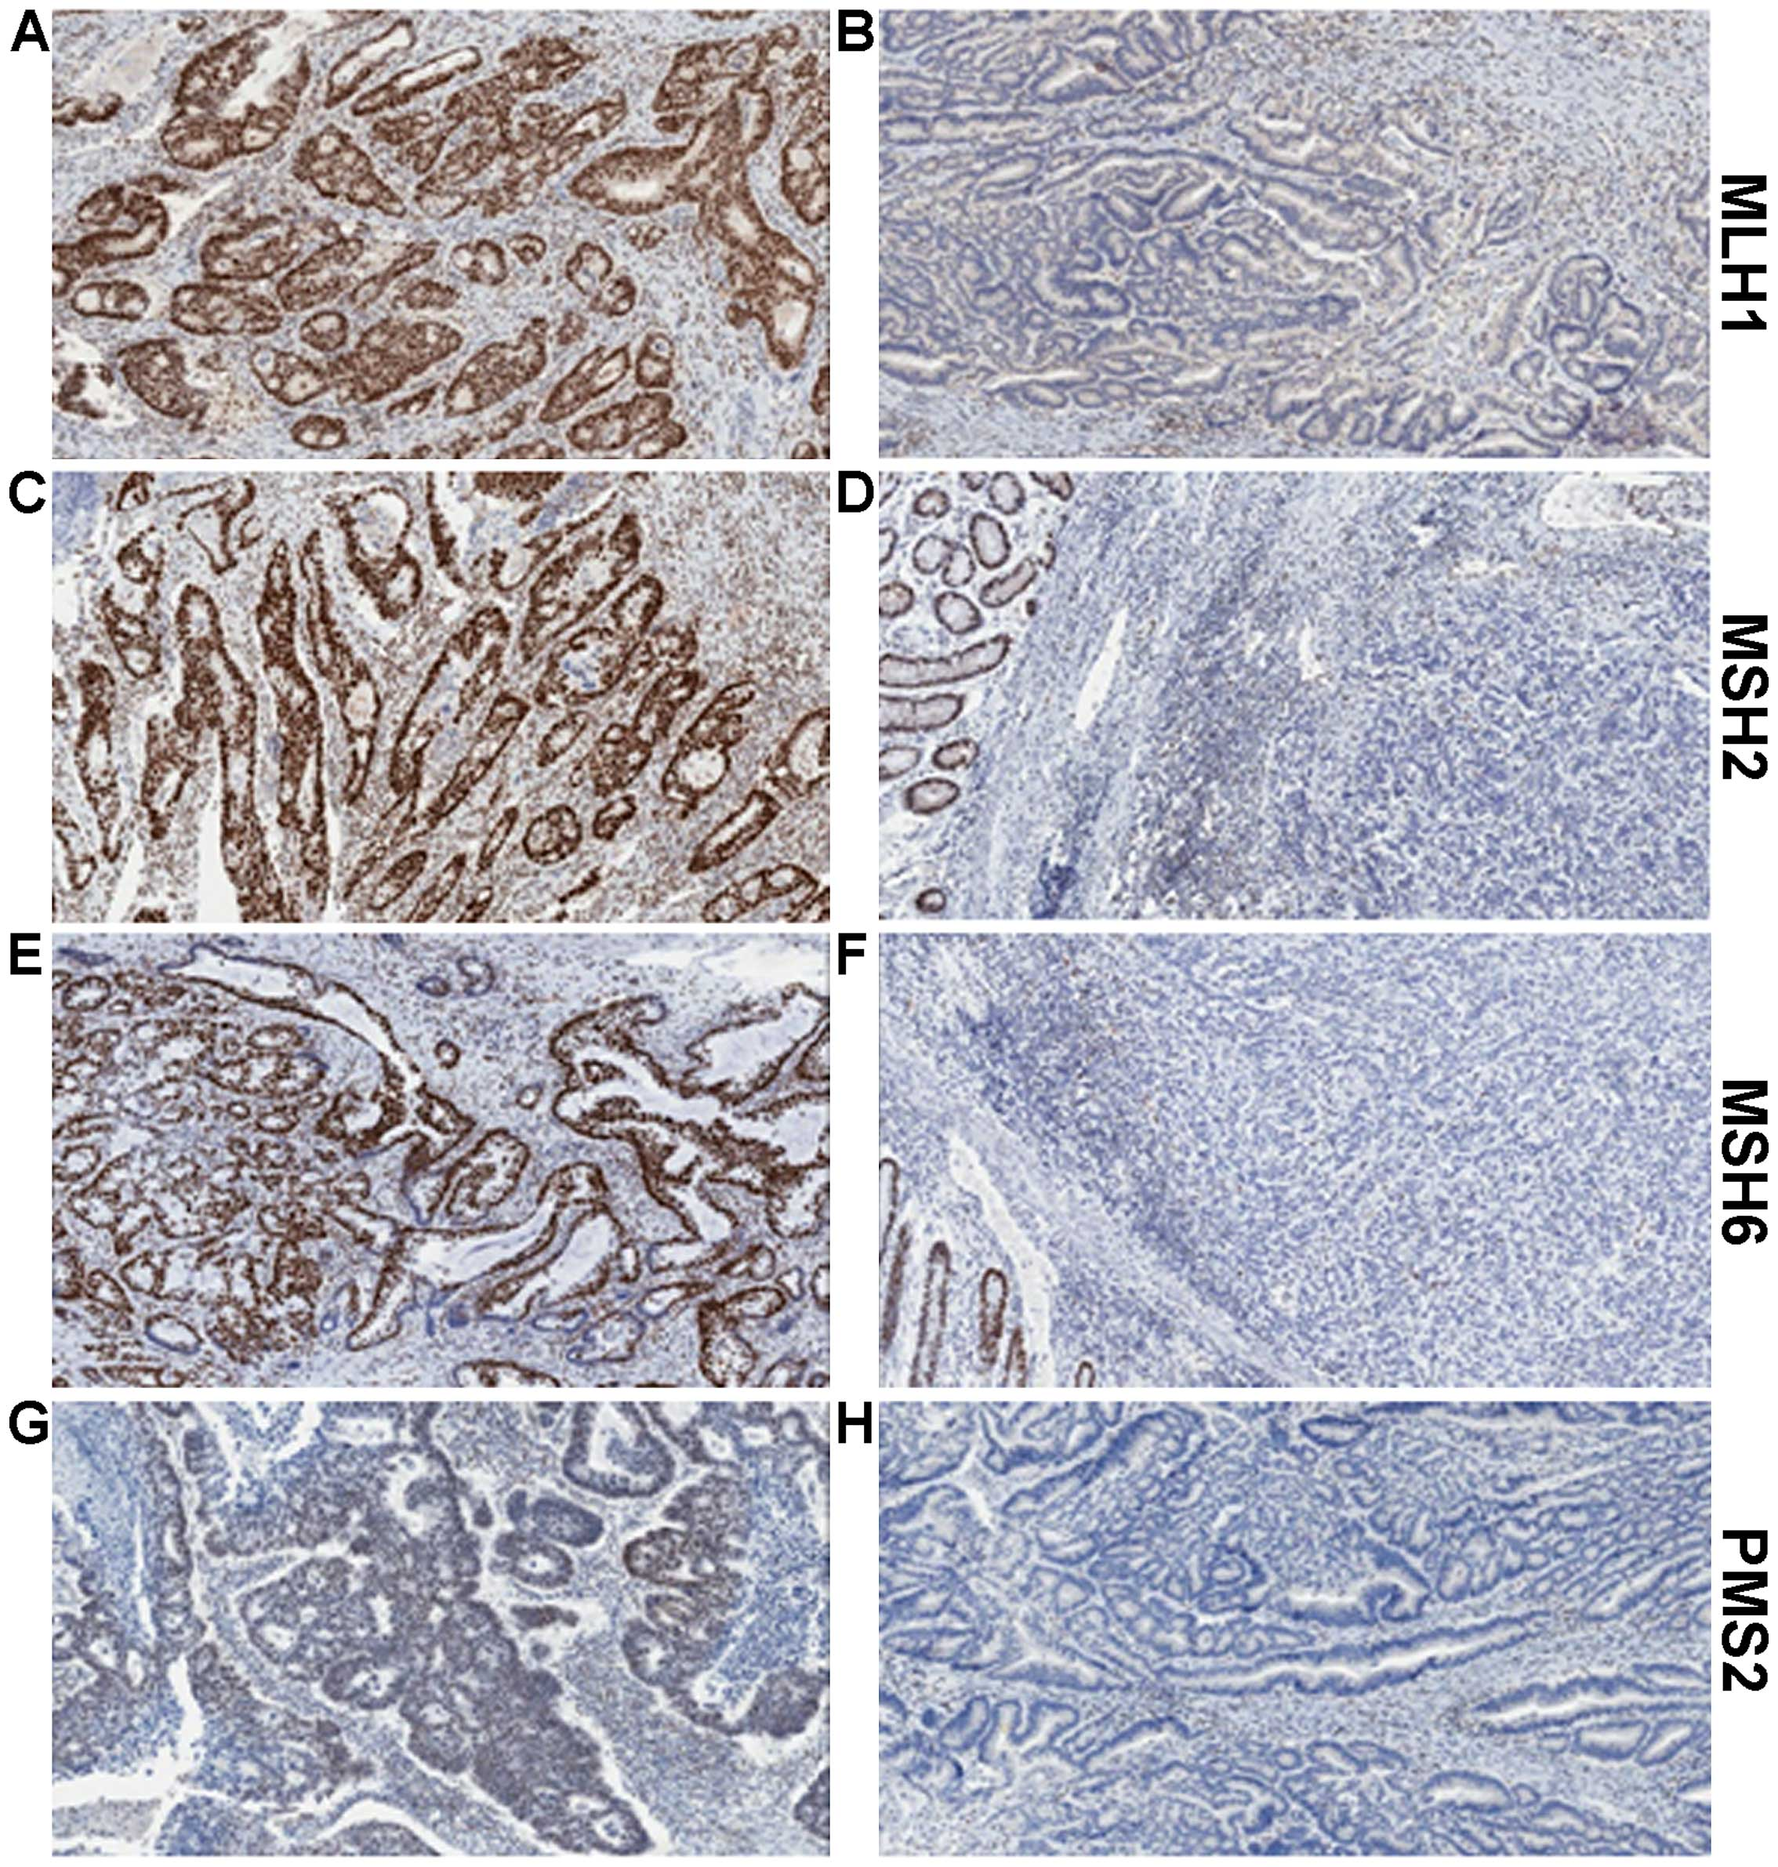
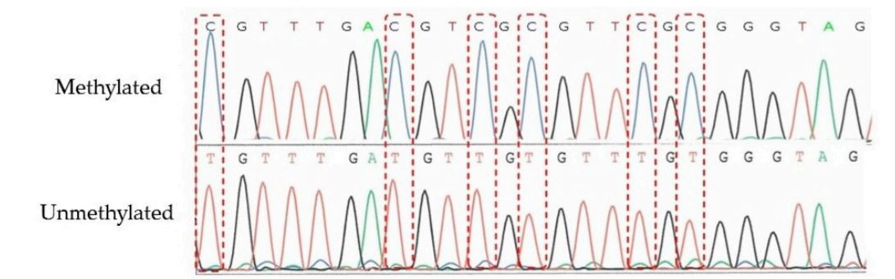
Recommendations for Molecular Testing to Inform Treatment Decisions in Endometrial Cancer
MMRd testing by IHC to test for MLH1, MSH2, MSH6, and PMS2 protein loss
Reflex testing for MLH1 promoter methylation status is recommended
if MLH1 protein loss
Methylated
Unmethylated
ACOG Practice Bulletin No. 147: Lynch syndrome. Obstet Gynecol. 2014;124:1042. Cho. Int J Gynecol Pathol. 2019;38:S11.
Concin. Int J Gynecol Cancer. 2021:12. Crosbie. Genet Med. 2019;21:2390. Ryan. Genet Med. 2019;21:2167.
Takeda. Genes (basel). 2016;7:86. Richman. Int J Oncol. 2015; 47:1189.
Slide credit: clinicaloptions.com
Notes:
MMRd, deficient mismatch repair; IHC, immunohistochemistry.

Slide 119
HER2 is an Actionable Biomarker in Patients With EC
HER2 overexpression and/or gene amplification is seen in 25%-30% of EC^{1,2}
  HER2-positive status in EC is associated with response to targeted therapy (trastuzumab)
  Carboplatin, paclitaxel,
  and trastuzumab is the recommended treatment
  for stage III/IV or recurrent HER2-positive EC³
Testing for HER2^{1,2}
Can be associated with significant intratumor heterogeneity
  5%-50% intratumor staining intensity
Parameter/Cutoff^{1,2} | Endometrial Serous Carcinoma
HER2 IHC 3+ (protein level) | >30%, strong complete or basolateral/lateral
HER2 FISH (gene amplification) | HER2/CEP17 ratio ≥2.0
1. Buza. Arch Pathol Lab Med. 2020;145:687. 2. Fader. Clin Cancer Res. 2020;26:3928. 3. NCCN uterine cancer guidelines. v.3.2021.
Slide credit: clinicaloptions.com
Notes:
EC, endometrial carcinoma; FISH, fluorescence in situ hybridization; IHC, immunohistochemistry.

Slide 120
GOG-3007: Everolimus + Letrozole vs Tamoxifen + MPA in Recurrent/Persistent Advanced Endometrioid EC
Randomized phase II trial
Everolimus 10 mg/day +
Letrozole 2.5 mg PO daily x 28-day cycles
(n = 37)
Patients with advanced (stage III/IV) persistent or recurrent measurable endometrioid EC that is unlikely to be cured with surgery or radiotherapy
(N = 74)
Until PD or
unacceptable
Toxicity
Tamoxifen 20 mg PO twice daily on Days 1-28 +
Medroxyprogesterone Acetate 200 mg
PO on Days 8-14 and 22-28 x 28-day cycles
(n = 36)
Primary endpoint: ORR per RECIST 1.1 criteria
Secondary endpoints: PFS, OS, safety
Slomovitz. SGO 2018. Abstr 1. NCT02228681.
Slide credit: clinicaloptions.com
Notes:
EC, endometrial cancer; ORR, overall response rate; PD, progressive disease; PFS, progression-free survival; RECIST, Response Evaluation Criteria in Solid Tumors.

Slide 121
GOG-3007: Efficacy Outcomes
PFS by Regimen
Outcome | Everolimus + Letrozole (n = 37) | Tamoxifen + MPA (n = 36)
ORR (ITT), % | 24 | 22
ORR (NPC), % | 53 | 43
CBR, % | 78 | 69
Median PFS, mo | 6.3 | 3.8
Median OS, mo | NR | 16.6
10
8
6
Everolimus, Letrozole
Events
26
31
Total
37
37
PFS Probability (%)
4
2
Tamoxifen and MPA
0
0
6
12
18
24
Mo on Study
10
OS by Regimen
8
Everolimus, Letrozole
6
OS Probability (%)
4
Tamoxifen and MPA
Events
13
20
Total
37
37
2
0
0
6
12
18
24
Mo on Study
Slomovitz. SGO 2018. Abstr 1. NCT02228681.
Notes:
CBR, clinical benefit rate; ITT, intent to treat; MPA, medroxyprogesterone acetate; NPC, negative peritoneal cytology; NR, not reached; ORR, overall response rate; OS, overall survival; PFS, progression-free survival.

Slide 122
Study 309/KEYNOTE-775: Responses
Parameter | pMMR |  | Overall
 | Lenvatinib + Pembrolizumab (n = 346) | Doxorubicin or Paclitaxel (n = 351) | Lenvatinib + Pembrolizumab (n = 411) | Doxorubicin or Paclitaxel (n = 416)
ORR, % (95% CI) | 30.3 (25.5-35.5) | 15.1 (11.5-19.3) | 31.9 (27.4-36.6) | 14.7 (11.4-18.4)
 | P <.0001 |  | P <.0001
Best overall response, % CR PR SD PD Not evaluable/assessed | 5.2 25.1 48.6 15.6 0.6/4.9 | 2.6 12.5 39.6 30.8 2.0/12.5 | 6.6 25.3 47.0 14.8 1.2/5.1 | 2.6 12.0 40.1 29.6 1.9/13.7
Median DoR, mo (range) | 9.2 (1.6-23.7) | 5.7 (0-24.2) | 14.4 (1.6-23.7) | 5.7 (0-24.2)
Median time to response, mo (range) | 2.1 (1.5-9.4) | 3.5 (1.0-7.4) | 3.1 (1.5-16.3) | 2.1 (1.0-7.4)
Makker. NEJM. 2022;386:437.
Slide credit: clinicaloptions.com
Notes:
CR, complete response; DoR, duration of response; PD, progressive disease; pMMR, mismatch repair proficient; PR, partial response; SD, stable disease.

Slide 123
Study 309/KEYNOTE-775: TEAEs
TEAE, % | Lenvatinib + Pembrolizumab (n = 406) |  | Doxorubicin or Paclitaxel (n = 351)
 | Any Grade | Grade ≥3* | Any Grade | Grade ≥3*
Hypertension Hypothyroidism Diarrhea Nausea Decreased appetite Vomiting Weight decrease Fatigue Arthralgia | 64.0 57.4 54.2 49.5 44.8 36.7 34.0 33.0 30.5 | 37.9 1.2 7.6 3.4 7.9 2.7 10.3 5.2 1.7 | 5.2 0.8 20.1 46.1 21.1 20.9 5.7 27.6 8.0 | 2.3 0 2.1 1.3 0.5 2.3 0.3 3.1 0
TEAE, % | Lenvatinib + Pembrolizumab (n = 406) |  | Doxorubicin or Paclitaxel (n = 351)
 | Any Grade | Grade ≥3* | Any Grade | Grade ≥3*
Proteinuria Anemia Constipation UTI Headache Asthenia Neutropenia Alopecia | 28.8 26.1 25.9 25.6 24.9 23.6 7.4 5.4 | 5.4 6.2 0.7 3.9 0.5 5.9 1.7 0 | 2.8 48.7 24.7 10.1 8.8 24.5 33.8 30.9 | 0.3 14.7 0.5 1.0 0.3 3.9 25.8 0.5
*In the lenvatinib and pembrolizumab arm, 5.7% of patients suffered grade 5 AEs (including events of gastrointestinal disorder [1.2%], cardiac disorder [0.5%], general disorder [1.5%], and infections [0.7%]), and 4.9% of patients in the TPC arm suffered grade 5 AEs (including cardiac disorder [1%], general disorder [1.3%], infections [1.5%], and subdural hematoma [0.3%]).
Makker. NEJM. 2022;386:437.
Notes:
AE, adverse event; TEAE, treatment-emergent adverse event; TPC, treatment of physician choice; UTI, urinary track infection.

Slide 124
Selected Ongoing Phase II or III Trials in
Advanced/Recurrent Endometrial Cancer
Study | Setting | Treatment | Estimated N | Trial Status | Endpoint
AtTEnd/ IRFMN-EN-7556 (NCT03603184) | 1L | Atezolizumab + carboplatin/paclitaxel vs placebo + carboplatin/paclitaxel | 550 | Active not recruiting | OS, PFS
GOG 3041/ DUO-E/ENGOT-EN10 (NCT04269200) | 1L | Durvalumab + carboplatin/paclitaxel followed by maintenance durvalumab ± olaparib | 699 | Recruiting | PFS
LEAP-001/ ENGOT-EN9 (NCT03884101) | 1L and 2L | Lenvatinib + pembrolizumab vs carboplatin + paclitaxel | 875 | Active not recruiting | PFS; OS
XPORT-EC (NCT05611931) | Maintenance | Maintenance selinexor vs placebo | 220 | Recruiting | PFS per RECIST at 34 mo
Clinicaltrials.gov.
Notes:
1L, first line; 2L, second line; EC, endometrial cancer; OS, overall survival; PFS, progression-free survival.

Slide 125
Cervical Cancer

Slide 126
Cervical Cancer:
Screening and Histologic/Cytologic Classification
Regular screening can help discover early disease if present^{1,2}
Testing modalities can include Pap tests, HPV tests, or both
Histology and Cytology Assessment³
Stage in Natural History | Histology | Adenocarcinoma | Adenosquamous Carcinoma | Cytology
 | Dysplasia Nomenclature | CIN Nomenclature | LAST Nomenclature | Pap Classification | Bethesda System
Infection | Negative Squamous atypia | Negative Squamous atypia |  | I II | NILM ASC-US
Precancer | Mild to severe dysplasia* | CIN1 CIN2 CIN3 | LSIL HSIL | II IV | LSIL HSIL
Cancer | Carcinoma | Carcinoma |  | V | Carcinoma
*Including carcinoma in situ.
1. cancer.org/cancer/cervical-cancer/detection-diagnosis-staging/screening-tests.
2. choosingwisely.org/patient-resources/cervical-cancer-screening. 3. Schiffman. Cancer Epidemiol Biomarkers Prev. 2013;22:553.
Slide credit: clinicaloptions.com
Notes:
ASC-US, atypical squamous cells of undetermined significance; CIN, cervical intraepithelial neoplasia; HPV, human papilloma virus; HSIL, high-grade squamous intraepithelial lesion; LAST, lower anogenital squamous terminology; LSIL, low-grade squamous intraepithelial lesion; NILM, negative for intraepithelial lesion or malignancy; Pap, Papanicolaou.

Slide 127
Additional Molecular Testing in Cervical Cancer
NCCN guidelines recommend testing for molecular biomarkers in women with recurrent progressive or metastatic cervical cancer
  PD-L1 (CPS ≥1%)
  MMR/MSI
  NTRK gene fusion testing
  TMB testing through validated and/or FDA-approved assay
  HPV testing
  RET fusion testing
NCCN. Clinical practice guidelines in oncology: cervical cancer. v.1.2023. nccn.org.
Slide credit: clinicaloptions.com
Notes:
MMR, mismatch repair; MSI, microsatellite instability; NCCN, National Comprehensive Cancer Network; TCGA, The Cancer Genome Atlas;
TMB, tumor mutational burden.

Slide 128
Paclitaxel + Cisplatin or Topotecan ± Bevacizumab in Cervical Cancer (GOG 240.2): Mature OS Results
ITT Population
*Not Previously Irradiated
100
 | Bev (n = 227) | No Bev (n = 225)
Events, n (%) | 178 (79) | 170 (75)
Median OS, mo | 16.8 | 13.3
100
 | Bev (n = 46) | No Bev (n = 45)
Events, n | 24 | 34
Median OS, mo | 24.5 | 16.8
80
80
60
60
HR: 0.64 (95% CI: 0.37-1.10; P = .11)
OS Probability (%)
HR: 0.77 (95% CI: 0.62-0.95; P = .0068)
OS Probability (%)
40
40
20
20
0
0
0
12
24
36
48
60
0
12
24
36
48
60
Mo
Mo
Bev
No Bev
227
225
142
114
75
54
30
17
6
2
0
0
Bev
No Bev
46
45
34
29
22
13
9
4
2
1
0
0
*Underpowered
Study population was ~75% non-Hispanic White and ~15% African American
Tewari. Lancet. 2017;390:1654.
Slide credit: clinicaloptions.com
Notes:
Bev, bevacizumab; ITT, intention-to-treat; OS, overall survival.

Slide 129
KEYNOTE-826: PFS and OS in Key Patient Subgroups
(All Comers)
Outcome | Median PFS, Mo |  |  | Median OS, Mo
 | Pembro | Placebo | HR (95% CI) | Pembro | Placebo | HR (95% CI)
Overall (N = 617) | 10.4 | 8.2 | 0.65 (0.53-0.79) | 24.4 | 16.5 | 0.67 (0.54-0.84)
Histology Squamous (n = 447) Nonsquamous (n = 169) | 10.4 11.6 | 6.9 8.4 | 0.63 (0.50-0.80) 0.66 (0.43-1.00) | 23.5 NR | 14.2 21.3 | 0.61 (0.47-0.80) 0.76 (0.47-1.23)
Platinum use Carboplatin (n = 495) Cisplatin (n = 120) | 10.2 15.2 | 7.4 8.4 | 0.69 (0.55-0.86) 0.47 (0.28-0.77) | 21.4 NR | 15.9 21.3 | 0.69 (0.54-0.89) 0.59 (0.32-1.09)
Concomitant bevacizumab Yes (n = 389) No (n = 228) | 15.2 6.3 | 10.2 6.2 | 0.61 (0.47-0.79) 0.74 (0.54-1.01) | NR 16.8 | 24.7 12.6 | 0.63 (0.47-0.87) 0.74 (0.53-1.04)
Prior CRT only Yes (n = 243) No (n = 374) | 10.3 10.4 | 6.3 8.4 | 0.62 (0.45-0.86) 0.69 (0.53-0.90) | 21.3 NR | 12.6 19.4 | 0.64 (0.45-0.91) 0.71 (0.53-0.97)
Tewari. ASCO 2022. Abstr 5506. Colombo. NEJM. 2021;385:1856.
Slide credit: clinicaloptions.com
Notes:
CRT, chemoradiotherapy; NR, not reached; OS, overall survival; pembro, pembrolizumab; PFS, progression-free survival.

Slide 130
KEYNOTE-826: ORR and DoR
PD-L1 CPS ≥1
All-Comer
PD-L1 CPS ≥10
100
68.1%
(62.2-73.6)
100
65.9%
(60.3-71.2)
100
69.6%
(61.8-76.7)
80
50.2%
(44.1-56.2)
80
50.8%
(45.1-56.5)
80
49.1%
(41.1-57.1)
60
60
60
ORR, % (95% CI)
40
PR: 45.4%
40
PR: 44.5%
40
PR: 47.5%
PR: 37.1%
PR: 37.9%
20
PR: 37.7%
20
20
CR: 22.2%
CR: 22.7%
CR: 13.1%
CR: 21.4%
CR: 12.9%
CR: 11.3%
0
0
0
Pembro + CT ± Bev
Placebo + CT ± Bev
Pembro + CT ± Bev
Placebo + CT ± Bev
Pembro + CT ± Bev
Placebo + CT ± Bev
100
100
100
Pembro + CT ± Bev
Placebo + CT ± Bev
80
80
80
60
60
60
Ongoing Response (%)
40
40
Median (range)
18.0 mo (1.3+ to 24.2+)
10.4 mo (1.5+ to 22.0+)
40
Median (range)
18.0 mo (1.3+ to 24.2+)
10.4 mo (1.5+ to 22.0+)
Median (range)
21.1 mo (1.3+ to 24.2+)
9.4 mo (2.1+ to 21.5+)
20
20
20
0
0
0
0
3
6
9
12
15
18
21
24
27
0
3
6
9
12
15
18
21
24
27
0
3
6
9
12
15
18
21
24
27
Mo
Mo
Mo
Colombo. ESMO 2021. Abstr LBA2. Colombo. NEJM. 2021;385:1856.
Notes:
Bev, bevacizumab; CPS, combined positive score; CR, complete response; CT, chemotherapy; DoR, duration of response; ORR, objective response rate; Pembro, pembrolizumab; PR, partial response.

Slide 131
KEYNOTE-826: Safety Overview
Event, n (%) | All-Cause AEs |  | Treatment-Related AEs |  | Immune-Mediated AEs†
 | Pembro* (n = 307) | Placebo* (n = 309) | Pembro* (n = 307) | Placebo* (n = 309) | Pembro* (n = 307) | Placebo* (n = 309)
Any grade | 305 (99.3) | 307 (99.4) | 298 (97.1) | 300 (97.1) | 104 (33.9) | 47 (15.2)
Grade ≥3 | 251 (81.8) | 232 (75.1) | 210 (68.4) | 198 (64.1) | 35 (11.4) | 9 (2.9)
Serious | 153 (49.8) | 131 (42.4) | 93 (30.3) | 71 (23.0) | 22 (7.2) | 7 (2.3)
Led to death | 14 (4.6) | 14 (4.5) | 2 (0.7)‡ | 4 (1.3)§ | 1 (0.3)‡ | 0
Led to discontinuation Any treatment All treatment | 115 (37.5) 18 (5.9) | 82 (26.5) 15 (4.9) | 96 (31.3) 10 (3.3) | 69 (22.3) 6 (1.9) | 16 (5.2) 3 (1.0) | 1 (0.3) 0
*Arm also include CT ± bevacizumab. †Events were considered regardless of attribution to treatment by the investigator. ‡Autoimmune encephalitis (also immune mediated) and intestinal perforation. §Embolism, female genital tract fistula, large intestine perforation, and pulmonary sepsis.
TRAE = treatment-related adverse event.
Median tx duration Pembro vs placebo: 10.0 vs 7.7 mo
  Pembro or placebo: 13 vs 11 mo
  Bevacizumab: 13 vs 11 mo
Slide credit: clinicaloptions.com
Colombo. ESMO 2021. Abstr LBA2. Colombo. NEJM. 2021;385:1856.
Notes:
AE, adverse event; CT, chemotherapy; Pembro, pembrolizumab; tx, treatment.

Slide 132
Selected Randomized Phase III Trials in Recurrent/Metastatic Cervical Cancer
Study | Population | Treatment Arms | Estimated N | Trial Status | Primary Endpoints
MCC-19662 (NCT03614949) | Recurrent, persistent, or metastatic At least 2 distinct lesions documented by imaging | Stereotactic body radiation therapy plus atezolizumab | 26 | Recruiting | ORR at 1 yr
STAR (NCT04068753) | Recurrent or progressive Measurable disease Good performance status | Niraparib + dostarlimab | 66 | Recruiting | Response (CR or PR) at 1 yr
BEATcc (NCT03556839) | Prior chemoradiation Chemotherapy: cisplatin or carboplatin | Atezolizumab + bevacizumab and cisplatin or carboplatin/paclitaxel | 404 | Active not recruiting | OS
KEYNOTE-A18 (NCT04221945) | High-risk, locally advanced Stage IB2-IIB | Chemotherapy ± pembrolizumab | 980 | Active not recruiting | PFS (RECIST); OS (to 46 mo)
innovaTV 301 (NCT04697628) | Recurrent/Metastatic: 2L-3L | Tisotumab vedotin vs chemotherapy | 482 | Recruiting | OS at 2 yrs
ClinicalTrials.gov.
Notes:
CRT, chemoradiotherapy; CT, chemotherapy; OS, overall survival.

