Slide 1
TRIANGLE: Phase III Trial of Ibrutinib + CIT
With or Without ASCT vs CIT Followed by ASCT in Younger Patients With Previously Untreated MCL
CCO Independent Conference Highlights*
of the 2022 ASH Annual Meeting; December 10-13, 2022;
New Orleans, Louisiana
*CCO is an independent medical education company that provides state-of-the-art medical information to healthcare professionals through conference coverage and other educational programs.
Supported by educational grants from AbbVie, Amgen, AstraZeneca, Epizyme, GSK, Incyte Corporation,
Jazz Pharmaceuticals, Karyopharm Therapeutics Inc., Novartis Pharmaceuticals Corporation, Sanofi, and Seagen.
Notes:
ASCT, autologous stem cell transplant; CIT, chemoimmunotherapy; MCL, mantle cell lymphoma.

Slide 2

About These Slides
Please feel free to use and share some or all of these slides in your noncommercial presentations to colleagues or patients
When using our slides, please retain the source attribution:
These slides may not be published, posted online, or used in commercial presentations without permission. Please contact permissions@clinicaloptions.com for details
Slide credit: clinicaloptions.com
Notes:
Disclaimer: The materials published on the Clinical Care Options website reflect the views of the authors of the CCO material, not those of Clinical Care Options, LLC, the CME providers, or the companies providing educational grants. The materials may discuss uses and dosages for therapeutic products that have not been approved by the United States Food and Drug Administration. A qualified healthcare professional should be consulted before using any therapeutic product discussed. Readers should verify all information and data before treating patients or using any therapies described in these materials.

Slide 3
TRIANGLE: Background
High-dose CIT followed by ASCT and rituximab maintenance is current standard of care for younger patients with MCL¹
Ibrutinib has shown promising efficacy in both previously untreated older patients with MCL and relapsed MCL^{2,3}
European MCL Network phase III TRIANGLE trial is evaluating ibrutinib + CIT with or without ASCT vs standard CIT followed by ASCT in previously untreated younger patients with MCL^{3,4}
  Current analysis presented efficacy and safety data from phase III TRIANGLE study⁵
1. Kle Gouill. NEJM. 2017;377:1250. 2. Wang. NEJM. 2022;386:2482.
3. Dreyling. Hemasphere. 2022;6:e712. 4. NCT02858258. 5. Dreyling. ASH 2022. Abstr 1.
Notes:
ASCT, autologous stem cell transplant; CIT, chemoimmunotherapy; MCL, mantle cell lymphoma.

Slide 4
TRIANGLE: Study Design
Randomized, open-label, 3-arm phase III trial
Arm A + I*:
R-CHOP + I/R-DHAP x 3
(n = 292)
ASCT
2-yr I
maintenance
Observation
Patients with previously untreated stage II-IV MCL; aged ≤65 yr; suitable for high-dose cytarabine and ASCT; ECOG PS 0-2
(N = 870)
Arm I*:
R-CHOP + I/R-DHAP x 3
(n = 290)
2-yr I
maintenance
Observation
Arm A*:
R-CHOP/R-DHAP x 3
(n = 288)
ASCT
Observation
*R maintenance was added following national guidelines in all 3 arms (arm A + I: 57%; arm I: 54%; arm A: 58%).
Primary endpoint: FFS
Secondary endpoints: response rates, PFS, RD, OS, safety
Dreyling. ASH 2022. Abstr 1.
Notes:
ASCT, autologous stem cell transplant; ECOG Eastern Cooperative Oncology Group; FFS, failure-free survival; I, ibrutinib; MCL, mantle cell lymphoma; OS, overall survival; PS, performance status.

Slide 5
TRIANGLE: Baseline Characteristics and
Responses at End of Induction Therapy
Characteristic, % | A + I* (n = 292) | I* (n = 290) | A* (n = 288)
Median age, yr (range) | 57 (36-68) | 58 (27-65) | 57 (31-65)
Male, % | 74 | 79 | 76
Ann Arbor stage (n = 864), % I II III IV | 0 4 7 89 | 0 6 10 84 | 0 4 8 88
ECOG PS >1, % | 1 | 2 | 2
MIPI, % Low Intermediate High | 58 27 15 | 58 27 16 | 58 27 14
No MCL, n | 4 (1 NHL NOS, 1 HD, 2 MZL) | 2 (1 HCL, 1 DLBCL) | 2 (1 CLL, 1 FL)
Response | A + I* | I* | A* | A + I/I
ED, n (%) | 1 (0.4) | 0 | 1 (0.4) | 1 (0.2)
PD, n (%) | 3 (1) | 3 (1) | 11 (4) | 6 (1)
SD, n (%) | 1 (0.4) | 2 (0.7) | 4 (1) | 3 (0.5)
PR, n (%) | 152 (54) | 148 (53) | 158 (58) | 300 (54)
CR, n (%) | 124 (44) | 125 (45) | 98 (36) | 249 (45)
CR + PR, n (%) | 276 (98) | 273 (98) | 256 (94) | 549 (98)
Total, n | 281 | 278 | 272 | 559
NE, n | 8 | 10 | 11 | 18
ND, n | 3 | 2 | 5 | 5
Combined arms (A + I/I) yielded significantly
higher CR (P = .0203) and ORR (P = .0025) rates
vs control (A)
In MCL younger R-CHOP/R-DHAP group, CR rates were 38%, and ORR was 94%
*A + I arm: IR-CHOP/R-DHAP + ASCT + I; I arm: IR-CHOP/R-DHAP + I. I: ibrutinib; A arm: R-CHOP/R-DHAP + ASCT.
Dreyling. ASH 2022. Abstr 1.
Notes:
ASCT, autologous stem cell transplant; CR, complete response; CLL, chronic lymphocytic leukemia; DLBCL, diffuse large B-cell lymphoma; ECOG Eastern Cooperative Oncology Group; FL, follicular lymphoma; HCL, hairy cell leukemia; HD, Hodgkin disease; I, ibrutinib; MCL, mantle cell lymphoma; MIPI, Mantle Cell Lymphoma International Prognostic Index; MZL, marginal zone lymphoma; NHL, non-Hodgkin lymphoma; NE, not evaluable; NOS, not otherwise specified; ORR, overall response rate; PD, progressive disease; PR, partial response; PS, performance status; SD, stable disease.

Slide 6
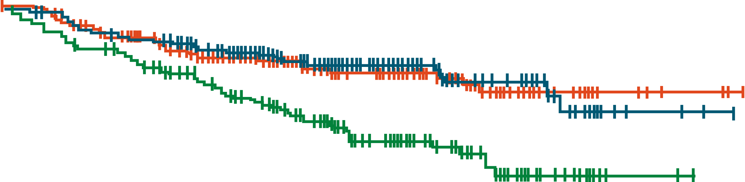
TRIANGLE: FFS (Primary Endpoint)
FFS
1.0
0.8
0.6
FFS Probability
Median follow-up: 31 mo
0.4
A + I, median not reached
I, median not reached
A, median not reached
0.2
0
0
292
290
288
6
270
269
252
12
253
257
237
18
226
229
206
24
184
180
162
30
137
133
126
36
109
100
85
42
65
68
54
48
40
34
27
54
17
16
12
60
3
4
2
66
1
3
0
72
Time From Randomization (Mo)
Patients at Risk, n
A + I
I
A
A + I arm: IR-CHOP/R-DHAP + ASCT + I; I arm: IR-CHOP/R-DHAP + I. I: ibrutinib.
Dreyling. ASH 2022. Abstr 1. Reproduced with permission.
Notes:
ASCT, autologous stem cell transplant; FFS, failure-free survival.

Slide 7
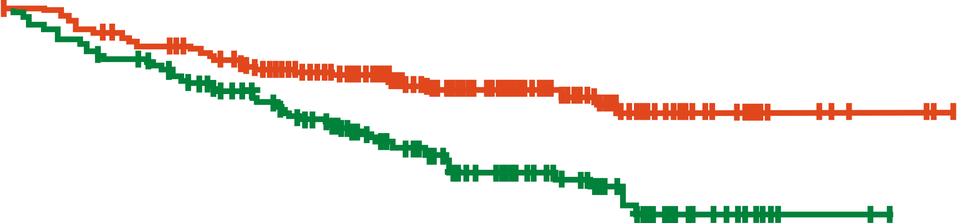
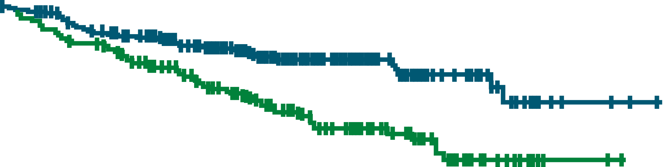
TRIANGLE: FFS
FFS*
FFS†
1.0
1.0
0.8
0.8
0.6
0.6
FFS Probability
FFS Probability
0.4
3-Yr FFS Rate
A: 72%; I: 86%
HR (A vs I): 1.77
P = .9979
0.4
3-Yr FFS Rate
A: 72%; I: 86%
HR (A vs I): 1.77
P = .9979
Median follow-up: 31 mo
Median follow-up: 31 mo
I, median not reached
A, median not reached
A + I, median not reached
A, median not reached
0.2
0.2
0
0
0
288
290
6
252
269
12
237
257
18
206
229
24
162
180
30
126
133
36
85
100
42
54
68
48
12
16
54
12
16
60
2
4
66
0
3
72
0
0
288
292
6
252
270
12
237
253
18
206
226
24
162
184
30
126
137
36
85
109
42
54
65
48
27
40
54
12
17
60
2
3
66
0
1
72
0
Time From Randomization (Mo)
Time From Randomization (Mo)
Patients at Risk, n
I
A
Patients at Risk, n
A + I
A
*A arm: R-CHOP/R-DHAP + ASCT; I arm: IR-CHOP/R-DHAP + I. I: ibrutinib.
†A arm: R-CHOP/R-DHAP + ASCT; A + I arm: IR-CHOP/R-DHAP + ASCT + I.
In treatment subgroups, no differential efficacy seen by rituximab maintenance; trend favoring high-risk biology
Dreyling. ASH 2022. Abstr 1. Reproduced with permission.
Notes:
ASCT, autologous stem cell transplant; FFS, failure-free survival; I, ibrutinib.

Slide 8
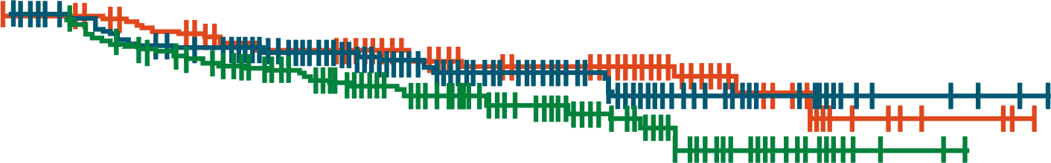
TRIANGLE: OS
OS*
1.0
0.8
0.6
OS Probability
0.4
Data still premature to evaluate statistical significance for OS
Median follow-up: 31 mo
A + I, median not reached
I, median not reached
A, median not reached
3-Yr OS Rate
A + I: 91%
I: 92%
A: 86%
0.2
0
0
292
290
288
6
280
281
270
12
262
272
256
18
238
248
230
24
195
197
181
30
142
145
145
36
113
109
97
42
67
77
63
48
42
38
32
54
19
16
15
60
4
4
2
66
2
3
0
72
Time From Randomization (Mo)
Patients at Risk, n
A + I
I
A
*A arm: R-CHOP/R-DHAP + ASCT; A + I arm: IR-CHOP/R-DHAP + ASCT + I; I arm: IR-CHOP/R-DHAP + I. I: ibrutinib.
Dreyling. ASH 2022. Abstr 1. Reproduced with permission.
Notes:
ASCT, autologous stem cell transplant; OS, overall survival.

Slide 9
TRIANGLE: Grade 3-5 AEs (Induction) in >2% of Patients
R-CHOP/R-DHAP (N=287)
IR-CHOP/R-DHAP (N=579)
Blood and lymphatic system disorder
Gastrointestinal disorders
Infections and infestations
Metabolism and nutrition disorders
General disorders and administration site conditions
Investigations
Renal and urinary disorders
Vascular disorders
Nervous system disorders
Cardiac disorders
Respiratory, thoracic and mediastinal disorders
71%
Grade 3-5 AEs by Preferred Term, n (%) | R-CHOP/R-DHAP (n = 287) | IR-CHOP/R-DHAP (n = 579)
Thrombocytopenia | 169 (59) | 351 (61)
Neutropenia | 134 (47) | 283 (49)
Anemia | 62 (22) | 140 (24)
Febrile neutropenia | 44 (15) | 88 (15)
Leukopenia | 25 (9) | 70 (12)
Lymphopenia | 15 (5) | 38 (7)
76%
13%
12%
9%
12%
7%
13%
6%
6%
4%
7%
5%
7%
Grade 5 AEs by System Organ Class, n (%) | R-CHOP/R-DHAP (n = 287) | IR-CHOP/ R-DHAP (n = 579)
GI disorders | 2 (1) | 0
Infections and infestations | 1 (0) | 1 (0)
Psychiatric disorders | 0 | 1 (0)
5%
6%
3%
5%
2%
3%
3%
3%
0%
10%
20%
30%
40%
50%
60%
70%
80%
Dreyling. ASH 2022. Abstr 1. Reproduced with permission.
Notes:
AE, adverse event; GI, gastrointestinal.

Slide 10
TRIANGLE: Grade 3-5 AEs (ASCT) in >2% of Patients
Grade 3-5 AEs by Preferred Term, n (%) | R-CHOP/R-DHAP (n = 245) | IR-CHOP/R-DHAP (n = 254)
Thrombocytopenia | 119 (49) | 111 (44)
Neutropenia | 88 (36) | 88 (33)
Anemia | 50 (20) | 56 (22)
Febrile neutropenia | 49 (20) | 56 (22)
Leukopenia | 42 (17) | 42 (17)
Lymphopenia | 9 (4) | 7 (3)
R-CHOP/R-DHAP (N=287)
IR-CHOP/R-DHAP (N=579)
Blood and lymphatic system disorders
General disorders and administration site conditions
Gastrointestinal disorders
Infections and infestations
Metabolism and nutrition disorders
Investigations
Respiratory, thoracic and mediastinal disorders
Vascular disorders
Skin and subcutaneous tissue disorders
59%
59%
20%
21%
21%
20%
17%
20%
11%
Grade 5 AEs by System Organ Class, n (%) | R-CHOP/R-DHAP (n = 245) | IR-CHOP/ R-DHAP (n = 254)
Infections and infestations | 4 (2) | 5 (2)
GI disorders | 1 (0) | 1 (0)
Respiratory, thoracic, and mediastinal disorders | 1 (0) | 1 (0)
Blood and lymphatic system disorders | 0 | 1 (0)
Congenital, familial, and genetic disorders | 1 (0) | 0
General disorders and administration site conditions | 1 (0) | 0
Nervous system disorders | 1 (0) | 0
8%
5%
5%
4%
5%
3%
4%
1%
4%
0%
10%
20%
30%
40%
50%
60%
Dreyling. ASH 2022. Abstr 1. Reproduced with permission.
Notes:
AE, adverse event; GI, gastrointestinal.

Slide 11
TRIANGLE: Grade 3-5 AEs (Maintenance/Follow-up) in
>2% of Patients
A (N=238)
A+I (N=230)
I (N=230)
Grade 3-5 AEs by Preferred Term, n (%) | A + I* (n = 230) | I* (n = 268) | A* (n = 238)
Neutropenia | 101 (44) | 62 (23) | 40 (17)
Febrile neutropenia | 14 (6) | 7 (3) | 6 (3)
Thrombocytopenia | 13 (6) | 8 (3) | 5 (2)
Leukopenia | 10 (4) | 6 (2) | 4 (2)
Anemia | 6 (3) | 4 (1) | 4 (2)
Lymphopenia | 1 (0) | 5 (2) | 3 (1)
Blood and lymphatic system disorder
Infections and infestations
Gastrointestinal disorders
Nervous system disorders
Cardiac disorders
General disorders and administration site conditions
Musculoskeletal and connective tissue disorders
Neoplasms benign, malignant and unspecified
Investigations
Injury, poisoning and complications
Respiratory, thoracic and mediastinal disorders
Vascular disorders
Metabolism and nutrition disorders
Skin and subcutaneous tissue disorders
21%
50%
13%
28%
19%
25%
3%
6%
4%
1%
5%
4%
1%
3%
4%
2%
3%
4%
2%
3%
Grade 5 AEs by System Organ Class, n (%) | A + I* (n = 230) | I* (n = 268) | A* (n = 238)
Infections and infestations | 2 (1) | 2 (1) | 3 (1)
Neoplasms benign, malignant, and unspecified (including cysts and polyps) | 1 (0) | 0 | 1 (0)
Cardiac disorders | 0 | 1 (0) | 0
Respiratory, thoracic, and mediastinal disorders | 1 (0) | 0 | 0
Vascular disorders | 0 (0) | 0 | 1 (0)
3%
3%
3%
(incl cysts and polyps)
3%
1%
5%
1%
0%
2%
3%
1%
3%
1%
1%
1%
3%
0%
2%
3%
0%
3%
0%
0%
10%
20%
30%
40%
50%
Dreyling. ASH 2022. Abstr 1. Reproduced with permission.
Notes:
AE, adverse event.

Slide 12
TRIANGLE: Cause of Death
Cause of Death, n (%) | A + I* (n = 292) | I* (n = 290) | A* (n = 288)
All cause | 25 (8.6) | 23 (7.9) | 39 (13.5)
Lymphoma | 4 (1.4) | 11 (3.8) | 16 (5.6)
Concomitant disease | 7 (2.4) | 5 (1.7) | 11 (3.8)
Lymphoma and concomitant disease | 1 (0.3) | 1 (0.3) | 0
Secondary malignancy | 2 (0.7) | 0 | 1 (0.3)
Therapy | 3 (1.0) | 0 | 4 (1.4)
Therapy and concomitant disease | 0 | 0 | 1 (0.3)
Unknown | 8 (2.7) | 6 (2.1) | 6 (2.1)
*A arm: R-CHOP/R-DHAP + ASCT; A + I arm: IR-CHOP/R-DHAP + ASCT + I; I arm: IR-CHOP/R-DHAP + I. I: ibrutinib.
Dreyling. ASH 2022. Abstr 1.
Notes:
ASCT, autologous stem cell transplant.

Slide 13
TRIANGLE: Investigators’ Conclusions
In this analysis of phase III TRIANGLE study, addition of ibrutinib to standard CIT ± ASCT yielded strong efficacy with acceptable safety in younger patients with previously untreated MCL
Based on primary endpoint of FFS, ASCT + ibrutinib is superior to ASCT standard of care arm, and ASCT standard of care arm is not superior to ibrutinib without ASCT
  No conclusion yet as to whether ASCT adds to ibrutinib, but safety profile favors ibrutinib-only arm
Numerical OS benefit observed in ibrutinib-containing arms vs control arm, but data are immature
Dreyling. ASH 2022. Abstr 1.
Notes:
ASCT, autologous stem cell transplant; CIT, chemoimmunotherapy; FFS, failure-free survival; MCL, mantle cell lymphoma; OS, overall survival.

Slide 14
Go Online for More CCO
Coverage of ASH 2022!
Short slideset summaries and additional CME-certified analyses with expert faculty commentary on key studies in:
Acute and chronic leukemias
Lymphomas and chronic lymphocytic leukemia
Myelodysplastic syndromes and myeloproliferative neoplasms
Myeloma
Nonmalignant hematology
clinicaloptions.com/oncology

