Slide 1
MANIFEST: Pelabresib (CPI-0610)
Monotherapy in Patients With Myelofibrosis
CCO Independent Conference Coverage Highlights*
of the 2021 ASH Annual Meeting, December 11-14, 2021
Atlanta, Georgia
*CCO is an independent medical education company that provides state-of-the-art medical information to healthcare professionals through conference coverage and other educational programs.
Provided by Clinical Care Options, LLC
This program is supported by educational grants from AbbVie; AstraZeneca; Daiichi Sankyo, Inc.; GlaxoSmithKline; Incyte Corporation; Jazz Pharmaceuticals; Merck Sharp & Dohme Corp.; and Novartis Pharmaceuticals Corporation.

Slide 2

About These Slides
Please feel free to use, update, and share some or all of these slides in your noncommercial presentations to colleagues or patients
When using our slides, please retain the source attribution:
These slides may not be published, posted online, or used in commercial presentations without permission. Please contact permissions@clinicaloptions.com for details
Slide credit: clinicaloptions.com
Notes:
Disclaimer: The materials published on the Clinical Care Options website reflect the views of the authors of the CCO material, not those of Clinical Care Options, LLC, the CME providers, or the companies providing educational grants. The materials may discuss uses and dosages for therapeutic products that have not been approved by the United States Food and Drug Administration. A qualified healthcare professional should be consulted before using any therapeutic product discussed. Readers should verify all information and data before treating patients or using any therapies described in these materials.

Slide 3
MANIFEST: Background
Pelabresib (CPI-0610) is a novel first-in-class, selective, oral small molecule inhibitor of the BET proteins¹
  BET target genes regulate cytokine production, erythrocyte differentiation, and megakaryocyte differentiation
The ongoing MANIFEST trial is evaluating the safety and efficacy of pelabresib in MF in different patient populations and cohorts
  Current preliminary analysis is focused on arm 1, which is evaluating pelabresib monotherapy in pretreated patients with MF who are refractory to, intolerant of, or ineligible for JAK inhibitor therapy²
  Arm 2 is evaluating pelabresib as an “add-on” to ruxolitinib in patients with MF with suboptimal responses to ruxolitinib or with disease progression³
  Arm 3 is evaluating pelabresib + ruxolitinib as first-line therapy in patients with MF³
1. Albrecht. J Med Chem. 2016;59:1330. 2. Kremyanskaya. ASH 2021. Abstr 141. 3. Verstovsek. ASH 2021. Abstr 2568.
Slide credit: clinicaloptions.com
Notes:
MF, myelofibrosis.

Slide 4
MANIFEST (Arm 1): Study Design
Arm 1 of an ongoing global, open-label phase II trial (data cutoff: September 10, 2021)
TD Cohort 1A (n = 36)
Pelabresib starting dose 125 mg once daily
(14d on and 7d off)
Patients with MF no longer on ruxolitinib; DIPSS ≥ Int-2; platelet count ≥75 x 10⁹/L; TD cohort ≥2 units of RBC transfusions/mo for 12 wk; non-TD cohort with BL spleen size >450 cm³
(N = 86)
Non-TD Cohort 1B (n = 50)
Pelabresib starting dose 125 mg once daily
(14d on and 7d off)
Primary endpoints:
  TD cohort 1A: TD to TI conversion
  Non-TD cohort 1B: SVR35 at 24 wk
Secondary endpoints:
  TD cohort 1A: SVR35 and TSS50 at 24 wk
  Non-TD cohort 1B: TSS50 at 24 wk
Kremyanskaya. ASH 2021. Abstr 141.
Slide credit: clinicaloptions.com
Notes:
BL, baseline; DIPSS, Dynamic International Prognostic Scoring System; MF, myelofibrosis; RBC, red blood cell; SVR35, ≥35% reduction in spleen volume from BL after 24 weeks; TD, transfusion-dependent; TI, transfusion-independent; TSS, total symptom score; TSS50, total symptom score response defined as ≥50% total symptom score reduction from BL after 24 weeks.

Slide 5
MANIFEST (Arm 1): Baseline Patient Characteristics
Characteristic | All Patients (N = 86) | Cohort 1A (TD) (n = 35) | Cohort 1B (Non-TD) (n = 50)
Mean age, yr | 70 | 73 | 69
Male, n (%) | 47 (55) | 23 (66) | 23 (46)
DIPSS, n (%) Int-1 Int-2 High | 7 (8) 54 (63) 22 (26) | 0 22 (63) 12 (34) | 7 (14) 31 (62) 10 (20)
MF type, n (%) Primary MF Post PV MF Post ET MF | 54 (63) 15 (17) 12 (14) | 21 (60) 5 (14) 7 (20) | 33 (66) 10 (20) 5 (10)
Median prior lines of therapy, n (range) | 2 (1-9) | 2 (1-9) | 2 (1-7)
Median hemoglobin, n (range) Hemoglobin <10 g/dL, n (%) | 9 (6-15) 65 (76) | 9 (6-10) 31 (89) | 9 (6-15) 34 (68)
Median platelet (x 10⁹/L), n (range) | 168 (68-1262) | 163 (79-1262) | 185 (68-895)
Median spleen volume, cm³ (range) | 1837 (281-9155) | 1356 (281-8352) | 2046 (525-9155)
Median TSS, n (range) HMR3, n (%) | 21 (1-56) 39 (45) | 16 (1-56) 21 (60) | 25 (8-52) 18 (36)
Mutations, n (%) ASXL1 JAK2 V617F CALR MPL Triple negative | 30 (35) 52 (61) 19 (22) 7 (8) 3 (4) | 16 (46) 22 (63) 7 (20) 4 (11) 1 (2.9) | 14 (28) 30 (60) 11 (22) 3 (6) 2 (4)
Kremyanskaya. ASH 2021. Abstr 141.
Slide credit: clinicaloptions.com
Notes:
DIPSS, Dynamic International Prognostic Scoring System; ET, essential thrombocythemia; Int-1, intermediate-1; int-2, intermediate-2; MF, myelofibrosis; PV, polycythemia vera; TD, transfusion-dependent; TSS, total symptom score.

Slide 6
MANIFEST (Arm 1): Patient Population
Characteristic, n (%) | All Patients (N = 86)
JAKi exposure
Ineligible; no prior JAKi therapy | 14 (16)
JAKi intolerant; received ≥1 JAKi and discontinued due to AE | 21 (24)
JAKi refractory/resistant: received ≥1 JAKi and had suboptimal response or progression | 48 (56)
Unknown | 3 (3)
Kremyanskaya. ASH 2021. Abstr 141.
Slide credit: clinicaloptions.com
Notes:
AE, adverse event; JAKi, JAK inhibitor.

Slide 7
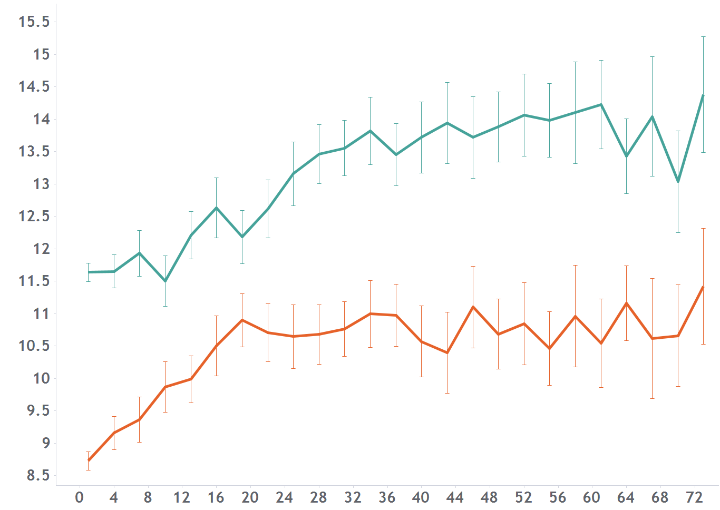
MANIFEST (Arm 1): Anemia Improvement
Arm 1B Non-TD Cohort: Mean Hgb Over Time*
Outcome | Non-TD Cohort 1B
Hemoglobin response, % (n/N) All patients JAKi refractory/resistant JAKi ineligible JAKi intolerant | 38 (18/47) 34 (11/32) 66 (2/3) 41 (5/12)
15.5
15.0
Baseline Hgb <10 g/dL
Baseline Hgb ≥10 g/dL
14.5
14.0
13.5
13.0
12.5
Mean Hemoglobin (g/dL) +/- SEM
12.0
11.5
11.0
Outcome | TD Cohort 1A (n = 25)
TD to TI conversion, n (%) | 4 (16)
Median TI duration, wk (range) | 41 (31-53)
Median time to TI conversion, wk | 32
10.5
10.0
9.5
9.0
8.5
1
4
7
10
13
16
19
22
25
28
31
34
37
40
43
46
49
52
55
58
61
64
67
70
73
Wk
N
33
23
29
26
26
21
19
17
16
16
16
14
15
13
11
10
10
10
10
7
8
7
7
7
5
14
12
11
11
10
9
10
8
7
7
6
6
6
6
5
6
5
5
5
4
5
4
5
3
5
*Hgb values within 12 wk after transfusion are excluded; 3 patients NE due to missing baseline.
Kremyanskaya. ASH 2021. Abstr 141. Reproduced with permission.
Slide credit: clinicaloptions.com
Notes:
Hgb, hemoglobin; JAKi, JAK inhibitor; NE, nonevaluable; TD, transfusion-dependent; TI, transfusion-independent.

Slide 8
MANIFEST (Arm 1): SVR Percentage Change at Wk 24
60
Ineligible
Intolerant
Refractory/resistant
Parameter | Arm 1 Cohorts 1A and 1B (N = 64)
SVR35, n (%) | 7 (11)
SVR25, n (%) | 20 (31)
Median spleen volume, % change | -24
Mean spleen volume, % change | -17
40
20
0
% Change From Baseline
-20
-40
Primary endpoint of non-TD cohort was SVR35 at Wk 24; 11% (7) of patients reached SVR35
-60
-80
-100
Kremyanskaya. ASH 2021. Abstr 141. Reproduced with permission.
Slide credit: clinicaloptions.com
Notes:
SVR35, ≥35% reduction in spleen volume from BL after 24 weeks; TD, transfusion-dependent.

Slide 9
MANIFEST (Arm 1): TSS Percentage Change at Wk 24
40
Parameter | Arm 1 Cohorts 1A and 1B (N = 64)
TSS50, n (%) | 18 (28)
Median TSS, % change | -40
Mean TSS, % change | -40
Ineligible
Intolerant
Refractory/resistant
Unknown
20
0
-20
% Change From Baseline
-40
-60
-80
-100
Kremyanskaya. ASH 2021. Abstr 141. Reproduced with permission.
Slide credit: clinicaloptions.com
Notes:
TSS, total symptom score; TSS50, total symptom score response defined as ≥50% total symptom score reduction from BL after 24 weeks.

Slide 10
MANIFEST (Arm 1): Secondary Outcomes
BMF improvement*
Hgb response†
Bone marrow fibrosis improved by
1 grade in 16.7% of patients and
by ≥2 grades in 6.7% of patients
71% of patients with bone marrow fibrosis improvement also had hemoglobin responses
Multiple cytokines associated with
MF and inflammation were downregulated following pelabresib therapy
  Downregulations were observed as early as day 14 and sustained through 24 wk
6.7
Improved ≥2 grade
Improved 1 grade
16.7
71%
No change
Worsened ≥1 grade
Other (missing/
discontinued)
46%
43.3
Patients (%)
10.0
33%
23.3
N = 30
Wk 24
*Exploratory endpoint: patients evaluable if nonmissing baseline bone marrow assessment.
†Secondary endpoint: postbaseline mean Hgb increase of ≥1.5 g/dL for any 12-wk RBC transfusion–free period.
Kremyanskaya. ASH 2021. Abstr 141. Reproduced with permission.
Slide credit: clinicaloptions.com
Notes:
BMF, bone marrow fibrosis; Hgb, hemoglobin; MF, myelofibrosis; RBC, red blood cell.

Slide 11
MANIFEST (Arm 1): Safety
TEAE, n (%) | All Grade (N = 86) | Grade 3 (N = 86) | Grade 4 (N = 86)
Hematological events Thrombocytopenia Anemia | 33 (38) 21 (24) | 16 (19) 13 (15) | 3 (4) 0
Nonhematological GI events Diarrhea Nausea Constipation | 29 (34) 28 (33) 18 (21) | 5 (6) 0 1 (1) | 0 0 0
Other nonhematological events Asthenic conditions Dysgeusia Respiratory tract infection Pruritus | 28 (33) 20 (23) 20 (23) 19 (22) | 2 (2) 0 4 (5) 2 (2) | 0 0 0 0
≥1 TEAE was reported by 78 patients (91%), ≥1 SAE was reported by 21 patients (24%), and ≥1 grade ≥3 TEAE was reported by 51 patients (59%)
TEAEs leading to pelabresib discontinuation occurred in 16 patients (19%)
There were no deaths while patients were receiving treatment
Kremyanskaya. ASH 2021. Abstr 141.
Slide credit: clinicaloptions.com
Notes:
GI, gastrointestinal; SAE, serious adverse event; TEAE, treatment-emergent adverse event.

Slide 12
MANIFEST (Arm 1): Investigators’ Conclusions
In this preliminary analysis of pretreated patients with MF who are refractory to, intolerant of, or ineligible for JAK inhibitor therapy, pelabresib monotherapy demonstrated clinical activity¹
  Spleen volume reduction, symptom reduction, and hemoglobin benefit were observed
  Exploratory analysis showed bone marrow fibrosis improvement
TEAEs were primarily low grade
A global, randomized, placebo-controlled, double-blind phase III MANIFEST-2
trial is evaluating ruxolitinib with or without pelabresib in patients with
JAK inhibitor–naive MF (NCT04603495)
1. Kremyanskaya. ASH 2021. Abstr 141.
Slide credit: clinicaloptions.com
Notes:
MF, myelofibrosis; TEAE, treatment-emergent adverse event.

Slide 13
Go Online for More CCO
Coverage of ASH 2021!
Short slideset summaries and additional CME-certified analyses with expert faculty commentary on key studies in:
Acute and chronic leukemias
Lymphomas and chronic lymphocytic leukemia
Myelodysplastic syndromes and myeloproliferative neoplasms
Myeloma
Nonmalignant hematology
clinicaloptions.com/oncology

