Slide 1
MASH Matters: New Evidence and Its Application to Endocrinology and Primary Care Practice
Provided by Clinical Care Options, LLC in partnership with Practicing Clinicians Exchange, LLC
Supported by an educational grant from Novo Nordisk.

Slide 2

About These Slides
Please feel free to use and share some or all of these slides in your noncommercial presentations to colleagues or patients
When using our slides, please retain the source attribution:
These slides may not be published, posted online, or used in commercial presentations without permission. Please contact permissions@clinicaloptions.com for details
Slide credit: clinicaleducationalliance.com
Notes:
Disclaimer: The materials published on the Clinical Care Options Web site reflect the views of the authors of the CCO material, not those of Clinical Care Options, LLC, the CME providers, or the companies providing educational grants. The materials may discuss uses and dosages for therapeutic products that have not been approved by the United States Food and Drug Administration. A qualified healthcare professional should be consulted before using any therapeutic product discussed. Readers should verify all information and data before treating patients or using any therapies described in these materials.

Slide 3
Faculty
Kenneth Cusi, MD, FACP, FACE
Professor of Medicine​
Division of Endocrinology, Diabetes, and Metabolism​
University of Florida​
Gainesville, Florida
Notes:
This slide lists the faculty who were involved in the production of these slides.

Slide 4
Disclosures
The faculty reported the following relevant financial relationships or relationships to products or devices they have with ineligible companies related to the content of this educational activity:
Kenneth Cusi, MD, FACP, FACE: researcher: Boehringer Ingelheim, Echosens, Inventiva, LabCorp, Perspectum; consultant/advisor/speaker: 89Bio, Arrowhead, Boehringer Ingelheim, Bristol Myers Squibb, Dexcom, Echosens, GlaxoSmithKline, Lilly, MGM, Novo Nordisk, Sagimet Biosciences, Terns, Zealand.
Notes:
This slide lists the disclosure information of the faculty and staff involved in the development of these slides.

Slide 5
Learning Objectives
Employ recommended noninvasive testing methods and biomarkers to diagnose, stage, and monitor patients with MASLD/MASH
Evaluate the efficacy and safety data for current and emerging treatments for MASH and outcomes on related cardiometabolic comorbidities
Recognize the role of multidisciplinary team members in the comprehensive management of MASLD/MASH

Slide 6
Noninvasive Testing Methods and Biomarkers

Slide 7
Screening for MASLD/MASH
Primary care, endocrinologists, gastroenterologists, and obesity specialists should screen for MASLD with advanced fibrosis
Step 1: Identify patients at risk
≥2 metabolic risk factors
Type 2 diabetes
Steatosis on any imaging modality or elevated aminotransferases
Step 2: History and laboratory tests: Excessive alcohol intake, CBC, liver function tests
Step 3: Noninvasive testing for fibrosis
(FIB-4 is a calculated value based on age, AST, ALT, and platelet count)
FIB-4 <1.3
FIB-4 1.3 to 2.67
FIB-4 >2.67
INDETERMINATE RISK
Step 4: Liver stiffness measurement
LSM <8 kPa
LSM 8-12 kPa
LSM >12 kPa
LOW RISK
Repeat NIT in 2-3 yr unless clinical circumstances change
INDETERMINATE RISK
Refer to hepatologist for liver biopsy or MR elastography or monitoring with re-eval of risk in 2-3 yr
HIGH RISK
Refer to hepatologist
Kanwal. Gastroenterology. 2021;161:1657.
Notes:
ALT, alanine aminotransferase; AST, aspartate aminotransferase; CBC, complete blood count; LSM, liver stiffness measurement; MASH, metabolic dysfunction–associated steatohepatitis; MASLD, metabolic dysfunction–associated steatotic liver disease; NIT, noninvasive testing.

Slide 8
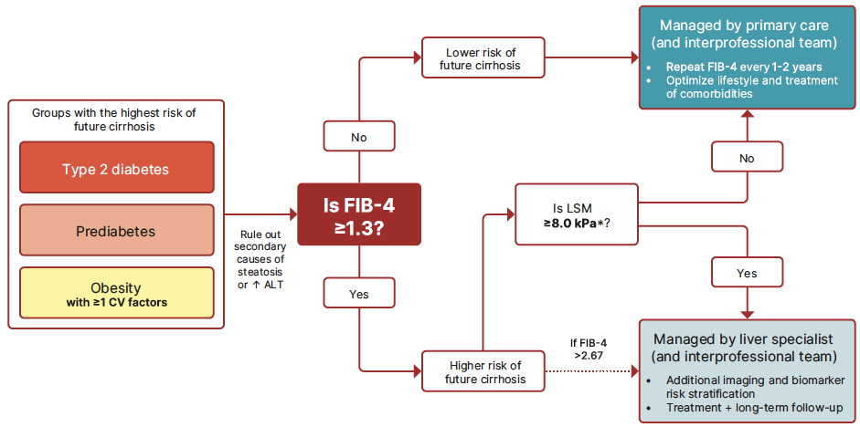
ADA 2025 Diagnostic Algorithm: Risk Stratification and Cirrhosis Prevention in Patients With MASLD
*If no LSM, consider doing a blood-based ELF as a diagnostic alternative. Refer to specialist for ELF scores ≥9.8.
Cusi et al. Diabetes Care 2025;48:1–26
Notes:
CV, cardiovascular; ELF, enhanced liver fibrosis test; FIB-4, fibrosis-4; LSM, liver stiffness measurement; MASLD, metabolic dysfunction–associated steatotic liver disease.

Slide 9







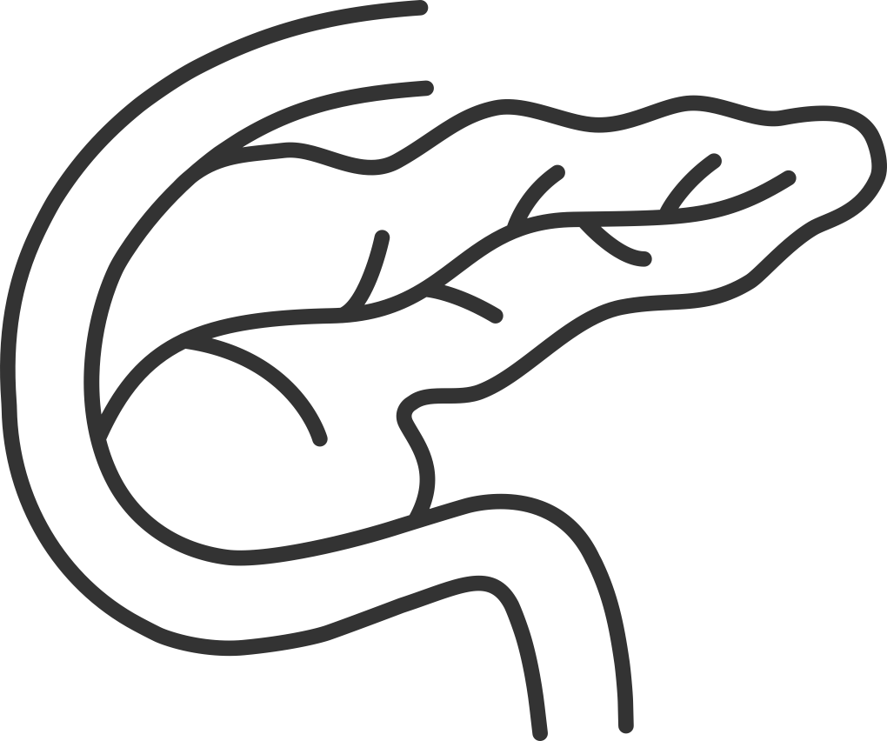
Endocrine Factors Associated With MASLD
Obesity
Hypogonadism
MASLD
MASH
Cirrhosis
PCOS
Hypothyroidism
T2D
GH Deficiency
Belfort-DeAguiar. J Clin Endocrinol Metab. 2023;108:483.
Notes:
GH, growth hormone; MASLD, metabolic dysfunction–associated steatotic liver disease; MASH, metabolic steatohepatitis; PCOS, polycystic ovary syndrome; T2D, type 2 diabetes.

Slide 10
Guideline Recommendations:
Who Is at Risk for MASH and Advanced Fibrosis?
AASLD¹
Advanced fibrosis screening recommended in persons at high risk (T2D, obesity with metabolic complications, family history) Increasing number of metabolic diseases = increasing risk of progressive liver disease
ADA²
MASLD/MASH with fibrosis screening recommended in persons with T2D or prediabetes, especially in persons with obesity, cardiometabolic risk factors, or current cardiovascular disease, or incidental hepatic steatosis on imaging or elevated plasma aminotransferases
AACE³
MASLD/MASH with fibrosis screening recommended in persons with T2D or prediabetes, especially in persons with obesity, cardiometabolic risk factors, or features of metabolic syndrome, or incidental hepatic steatosis on imaging, or elevated plasma aminotransferases
AASLD, ADA, and ACCE guidelines call out patients with T2D as warranting workup
1. Rinella. Hepatology. 2023;77:1797.
2. ADA Professional Practice Committee. Diabetes Care. 2025;48:S59. 3. Cusi. ACCE. Endocrine Practice. 2022;28:528
Notes:
AACE, American Association of Clinical Endocrinology; AASLD, American Association for the Study of Liver Diseases; ADA, American Diabetes Association; ALT, alanine aminotransferase; EASD, European Association for the Study of Diabetes; EASL, European Association for the Study of the Liver; EASO, European Association for the Study of Obesity; MASH, metabolic dysfunction–associated steatohepatitis; MASLD, metabolic dysfunction–associated steatotic liver disease; T2D, type 2 diabetes.

Slide 11
Commonly Used Noninvasive Tests
Clinical or Laboratory Scores
Imaging
Simple
Proprietary
Measurement of liver fat:
  CAP
  MRI-PDFF
Measurement of liver fibrosis:
  Vibration-controlled transient elastography (FibroScan) and FAST score
  2D shear wave elastography
  Magnetic resonance elastography
Corrected T1 (Liver MultiScan)
FIB-4
MASLD fibrosis score
SAFE score
APRI
Enhanced Liver Fibrosis test
NIS2+, PRO C3
  Not FDA approved yet, used in clinical trials
Dawod. Front Med (Lausanne). 2024;11:1499013. Marks. Metab Target Organ Damage. 2024;4:28.
Huang. Liver Int. 2017;37:121. Madsen. Aliment Pharmacol Ther. 2021;54:699.
Notes:
APRI, aspartate-to-platelet ratio index; AST, aspartate aminotransferase; FAST, FibroScan-AST; FIB-4, fibrosis-4; MASLD, metabolic dysfunction–associated steatotic liver disease; PDFF, proton density fat fraction; SAFE, steatosis-associated fibrosis estimator.

Slide 12
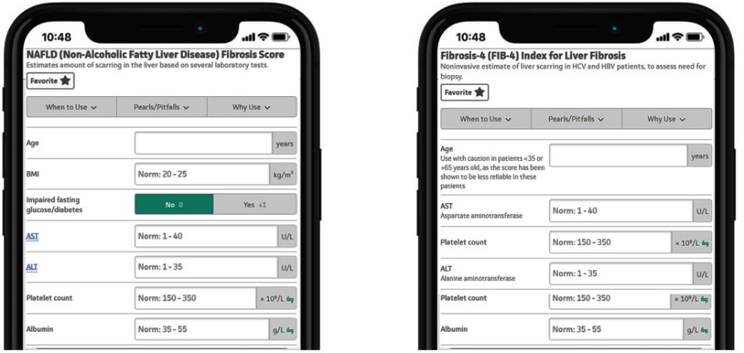
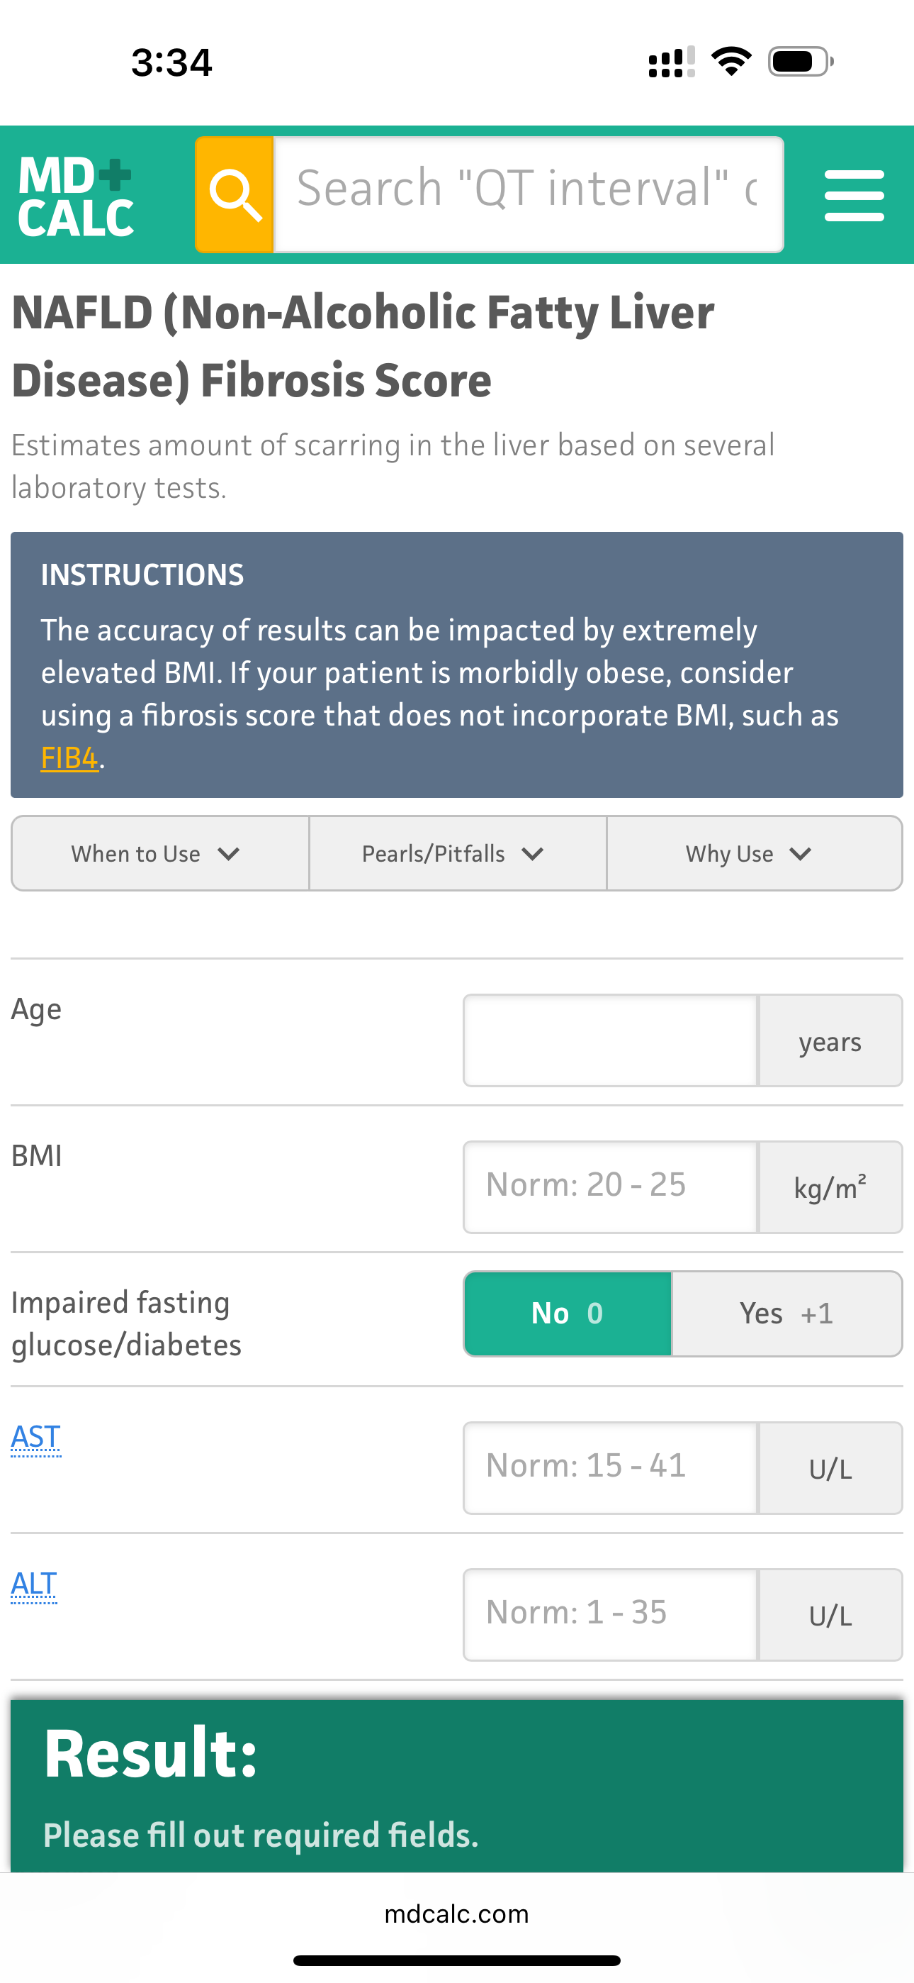
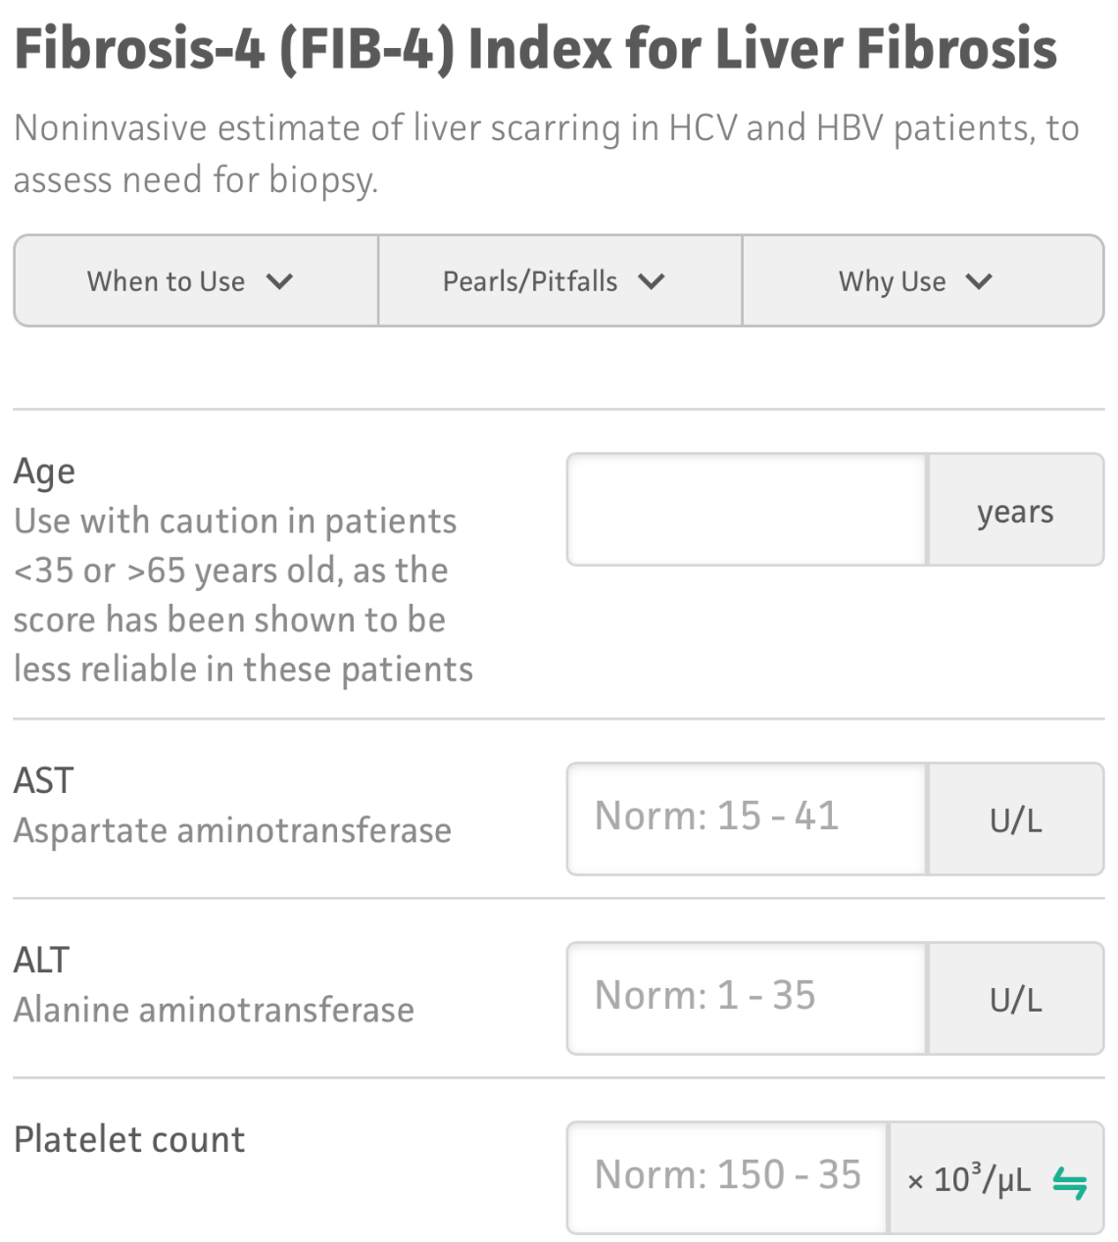
MASLD Fibrosis Score and FIB-4 Score:
Online Calculators Easily Interpret Noninvasive Tests
Based on patients’ age, platelet count, AST, and ALT ± other lab values
mdcalc.com.
Notes:
ALT, alanine aminotransferase; AST, aspartate aminotransferase; FIB-4, fibrosis-4.

Slide 13
Emerging MASH Therapies
Notes:
MASH, metabolic dysfunction–associated steatohepatitis.

Slide 14
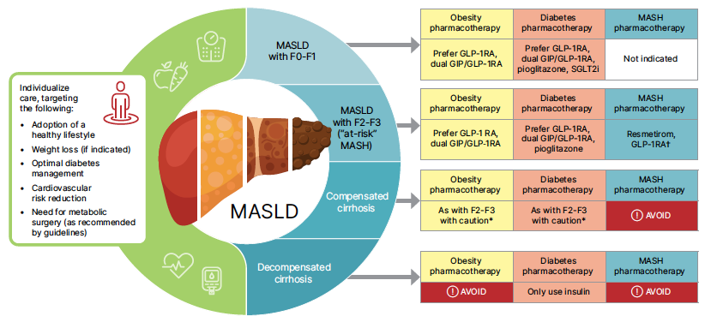
ADA 2025 Treatment Algorithm: MASLD in Patients With Prediabetes or Diabetes
Cusi et al. Diabetes Care 2025;48:1–26
Notes:
ADA, American Diabetes Association; MASLD, metabolic dysfunction–associated steatotic liver disease; SGLT2, sodium-glucose cotransporter 2.

Slide 15
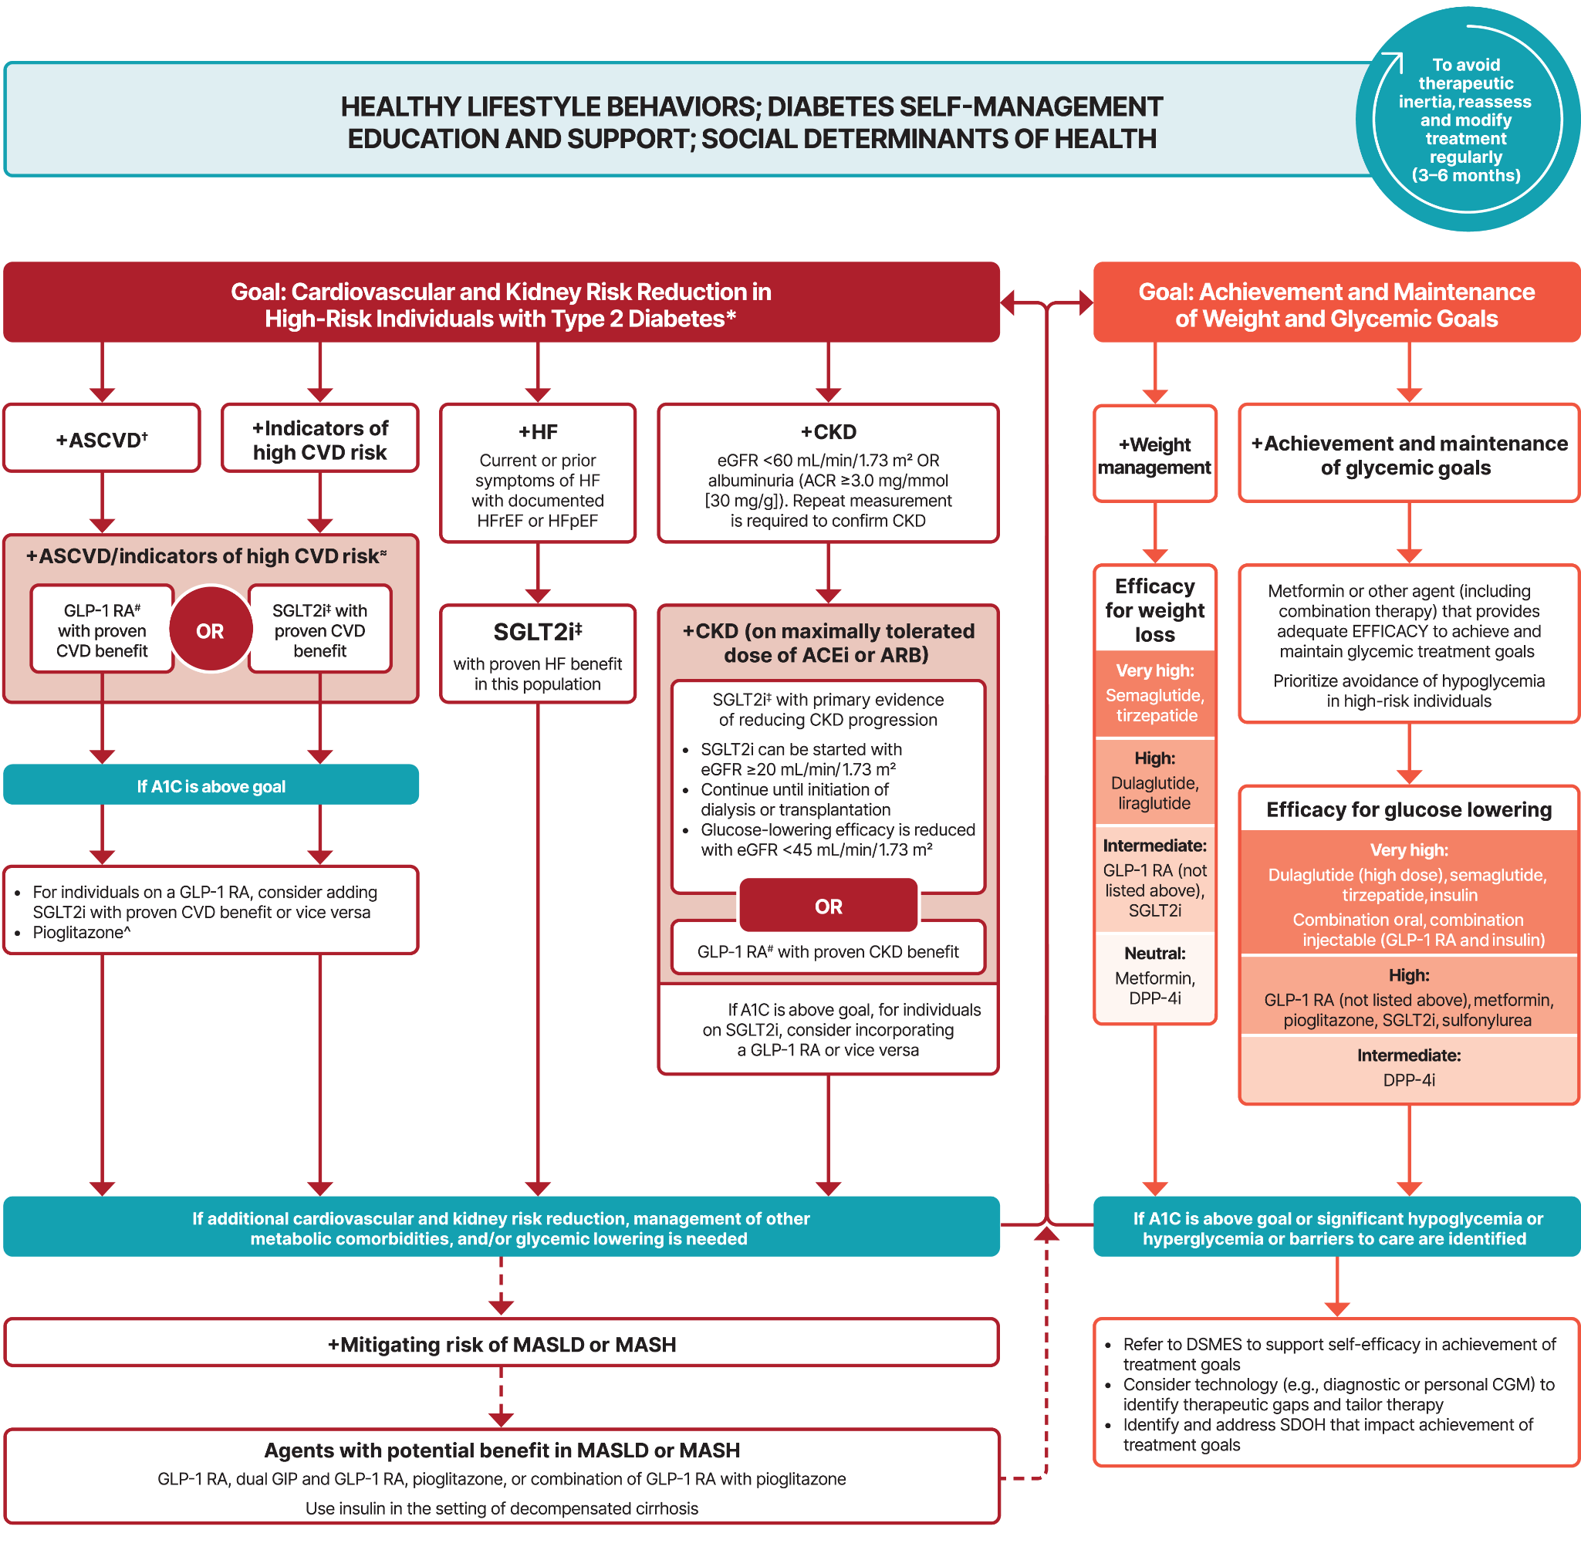

ADA 2025 Treatment Algorithm:
Pharmacologic Management of T2D
American Diabetes Association Professional Practice Committee. Diabetes Care. 2025;48:S181.
Copyright © 2025 American Diabetes Association. All rights reserved.
Notes:
ADA, American Diabetes Association; MASH, metabolic dysfunction–associated steatohepatitis; MASLD, metabolic dysfunction–associated steatotic liver disease; SGLT2, sodium-glucose cotransporter 2; T2D, type 2 diabetes.

Slide 16




Role of GLP-1 in MASH
CNS
Pancreas
Hypothalamic or hindbrain GLP-1 R+ neurons
GLP-1 R+ β-cell
↓ Food intake
↑ Insulin secretion
Adipocyte
Insulin
↑ Weight loss
↑ Adipose nutrient uptake
GLP-1 RA
Fatty acids
↓ Liver lipids
↓ Liver lipids
Glucose
↓ TG secretion
↓ Chylomicron secretion
↓ De novo lipogenesis
↓ VLDL secretion
↓ Glucose production
↑ Insulin
↓ Glucagon
↓ Chylomicron synthesis
↑ Glucose uptake
↓ Gut motility
Liver
Direct effect
Indirect effect
Gut
Yabut. Endocr Rev. 2023;44:14.
Notes:
CNS, central nervous system; MASH, metabolic dysfunction–associated steatohepatitis; TG, triglycerides; VLDL, very low–density lipoprotein.

Slide 17
ESSENCE: Semaglutide in Patients With MASH
Multicenter, double-blind, placebo-controlled, randomized phase III trial
Primary endpoints: steatohepatitis resolution with no liver fibrosis worsening and liver fibrosis improvement with no steatohepatitis worsening (part 1/interim analysis); cirrhosis-free survival (part 2)
Key secondary endpoints: weight loss, combined steatohepatitis resolution and liver fibrosis improvement, liver enzyme levels, noninvasive fibrosis markers, and safety
Stratified by T2D diagnosis, fibrosis stage, and region
Semaglutide 2.4 mg SC QW
(n = 534)
Adults with histologically confirmed MASH, fibrosis stage 2/3, and NAS ≥4
(N = 1205)
Interim analysis at Wk 72 of first 800 patients
Placebo
(n = 266)
NCT04822181. Sanyal. NEJM. 2025;392:2089.
Notes:
MASH, metabolic dysfunction–associated steatohepatitis; NAS, Nonalcoholic Fatty Liver Disease Activity Score; T2D, type 2 diabetes.

Slide 18
ESSENCE: Primary Endpoints Interim Analysis
Steatohepatitis Resolution With no Liver Fibrosis Worsening
Liver Fibrosis Reduction With no Steatohepatitis Worsening
Estimated difference: 28.7
(95% CI: 21.1-36.2; P <.001)
100
100
70
70
Estimated difference: 14.4
(95% CI: 7.5-21.3; P <.001)
62.9
60
60
50
50
40
40
36.8
Patients (%)
34.3
Patients (%)
30
30
22.4
20
20
10
10
0
0
Semaglutide 2.4 mg
(n = 534)
Placebo
(n = 266)
Semaglutide 2.4 mg
(n = 534)
Placebo
(n = 266)
Sanyal. NEJM. 2025;392:2089.

Slide 19
ESSENCE: Secondary Endpoints Interim Analysis
Enhanced Liver Fibrosis Score
Liver Stiffness per VCTE
10.2
13
10.0
Placebo
12
11
Placebo
9.8
10
9.6
Mean Score
Liver Stiffness (kPa)
9
9.4
8
9.2
Semaglutide
7
Semaglutide
0
0
0
24
48
72
0
48
72
Wk
Wk
No. of patients
Placebo 266 252 246 237
Semaglutide 534 511 504 492
No. of patients
Placebo 216 204 193
Semaglutide 417 399 381
Sanyal. NEJM. 2025;392:2089.
Notes:
VCTE, vibration-controlled transient elastography.

Slide 20
ESSENCE: Safety
Any AEs 86.3% (semaglutide) vs 79.7% (placebo)
Serious AEs 13.4% in both groups
Discontinuation due to AEs 2.6% (semaglutide) vs 3.3% (placebo)
Most common AEs Gastrointestinal (nausea, diarrhea, constipation, vomiting)
No liver-specific or new safety concerns identified
Sanyal. NEJM. 2025;392:2089.
Notes:
AE, adverse event.

Slide 21
ESSENCE: Interim Analysis Conclusions
Semaglutide 2.4 mg QW demonstrated significant histologic improvements in patients with MASH and stage 2/3 fibrosis
  Higher rates of steatohepatitis resolution and fibrosis reduction observed with semaglutide vs placebo
Semglutide also improved cardiometabolic risk factors, which are common in this population (obesity, T2D)
The safety profile was acceptable and consistent with known effects of semaglutide, especially as it relates to gastrointestinal AEs
These findings support semaglutide as a promising therapeutic option for MASH in patients with moderate to advanced fibrosis, potentially addressing both hepatic and systemic metabolic disease burdens
Sanyal. NEJM. 2025;392:2089.
Notes:
AE, adverse event; T2D, type 2 diabetes.

Slide 22
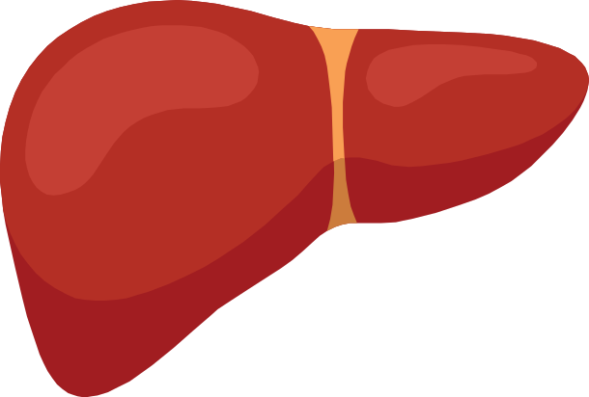
Resmetirom and the THR-β Pathway
Mitophagy Mitochondrial biogenesis
Lipid droplet
FFA
THR-β
THR-β
ATP
FAO
Healthy liver
DNL
THR-β
TAG
TCA
Acetyl-CoA
Cholesterol
DI01
T3
THR-β
T4
rT3
Injured liver (MASH)
Local “intrahepatic hypothyroidism”
Sinha. Nat Rev Endocrinol. 2018;14:259.
Notes:
MASH, metabolic dysfunction–associated steatohepatitis.

Slide 23
MAESTRO-NASH: Resmetirom in Patients With MASH
Multinational, double-blind, placebo-controlled, randomized phase III trial
Coprimary endpoints: NASH resolution at Wk 52, improvement in fibrosis by ≥1 stage with no worsening of NAFLD score
Key secondary endpoint: Percent LDL-C change from baseline at Wk 24
Resmetirom 80 mg
PO QD
(n = 322)
Adults with NASH*;
FibroScan kPa consistent with
F2-F3; CAP ≥280; NASH on liver biopsy: NAS ≥4 with fibrosis stage 1-3; ≥8% liver fat on MRI-PDFF; ≥3 metabolic risk factors
(N = 966)
At Wk 52, patients on baseline GLP-1 RA with ≥5% weight loss were evaluated for NASH resolution and fibrosis improvement as liver biopsy endpoints
Resmetirom 100 mg
PO QD
(n = 323)
Placebo
(n = 321)
*NASH is used instead of MASH to align with the terminology employed in referenced studies.
NCT03900429. Harrison. NEJM. 2024;390:497.
Notes:
CAP, controlled attenuation parameter; LDL-C, low-density lipoprotein cholesterol; MRI-PDFF, magnetic resonance imaging-proton density fat fraction; NAFLD, nonalcoholic fatty liver disease; NAS, Nonalcoholic Fatty Liver Disease Activity Score; NASH, nonalcoholic steatohepatitis; PDFF, proton density fat fraction.

Slide 24
MAESTRO-NASH: Primary Endpoints
MASH Resolution With no Fibrosis Worsening*
Fibrosis Improvement (≥1 Stage) With No MASH Worsening*
100
P <.001
100
P <.001
30%
P <.001
30
p<0.0001
30
P <.001
p<0.0001
26%
26%
p<0.0001
p<0.0001
25
25
24%
p=0.0002
20
20
Patients (%)
Patients (%)
15
15
14%
10%
10
10
5
5
0
0
Placebo
(n = 318)
Resmetirom
80 mg
(n = 316)
Resmetirom
100 mg
(n = 321)
Placebo
(n = 318)
Resmetirom
80 mg
(n = 316)
Resmetirom
100 mg
(n = 321)
*Liver biopsy (ITT) at Wk 52.
Harrison. NEJM. 2024;390:497. Resmetirom PI. Gastroenterol Hepatol (N Y). 2024;20(12 suppl 11):8.
Notes:
ITT, intention to treat; MASH, metabolic dysfunction–associated steatohepatitis.

Slide 25
MAESTRO-NASH: Safety
100
Placebo (n = 321)
Resmetirom 80 mg (n = 322)
Resmetirom 100 mg (n = 323)
80
60
Patients (%)
40
33.4
27.0
22.0
18.9
20
15.6
12.5
11.5
10.9
12.7
0
Diarrhea
Nausea
Serious Adverse Event
Harrison. NEJM. 2024;390:497. Resmetirom PI.

Slide 26
SYNERGY-NASH: Tirzepatide in Patients With MASH and Moderate to Severe Fibrosis
Multicenter, dose-finding, double-blind, placebo-controlled phase II trial
Primary endpoint: MASH resolution without fibrosis worsening at 52 wk
Fibrosis improvement: ≥1 stage of fibrosis reduced in up ≤55% of patients in tirzepatide arms vs 30% of patients in placebo arm
Safety profile: most common AEs were mild/moderate gastrointestinal symptoms
Stratified by T2D status and geographic location
Tirzepatide 5 mg SC QW for 52 wk (n = 47)
Adults with MASH and stage II/III fibrosis with or without T2D
(N = 190)
Tirzepatide 10 mg SC QW for 52 wk (n = 47)
Liver biopsy done
at Wk 52
Tirzepatide 15 mg SC QW for 52 wk (n = 48)
Placebo (n = 48)
NCT04166773. Loomba. NEJM. 2024;391:299.
Notes:
AE, adverse event; MASH, metabolic dysfunction–associated steatohepatitis; T2D, type 2 diabetes.

Slide 27
SYNERGY-NASH: MASH Resolution and Fibrosis Improvement
MASH Resolution With No Fibrosis Worsening at Wk 52
Treatment Regimen Estimand:
≥1 Fibrosis Stage Decrease With No MASH Worsening
100
100
80
62
80
56
55*
60
60
51*
51*
44
Patients (%)
Patients (%)
40
40
30
20
10
20
0
0
Placebo
(n = 48)
TZP 5 mg
(n = 47)
TZP 10 mg
(n = 47)
TZP 15 mg
(n = 48)
Placebo
(n = 48)
TZP 5 mg
(n = 47)
TZP 10 mg
(n = 47)
TZP 15 mg
(n = 48)
Relative difference
to PBO (95% CI)
-
33.8
(17.3-50.3)
45.7
(29.2-62.2)
52.6
(36.5-68.8)
Relative difference
to PBO (95% CI)
-
25.2
(4.7-45.7)
21.6
(1.1-42.1)
21.3
(0.6-42.0)
Loomba. NEJM. 2024;391:299.
Notes:
MASH, metabolic dysfunction–associated steatohepatitis; PBO, placebo; TZP, tirzepatide.

Slide 28
Survodutide (Dual GLP-1/Glucagon RA) in MASH*
MASH Improvement With No
Fibrosis Worsening
≥1 Fibrosis Stage Decrease
100
100
P <.001
80
62
80
60
47
43
60
Participants (%)
34
36
34
Participants (%)
40
40
22
14
20
20
0
0
Survodutide 2.4 mg
(n = 73)
Survodutide 4.8 mg
(n = 72)
Survodutide 6.0 mg
(n = 74)
Placebo
(n = 74)
Survodutide 2.4 mg
(n = 73)
Survodutide 4.8 mg
(n = 72)
Survodutide 6.0 mg
(n = 74)
Placebo
(n = 74)
↓ Mean body weight loss: -10% (2.4 mg), -13% (4.8 and 6 mg), and -1% (placebo)
*Patients (N = 293) received treatment for 48 wk.
Sanyal. NEJM 2024;391:311.
Notes:
MASH, metabolic dysfunction–associated steatohepatitis; RA, receptor agonist.

Slide 29
Phase III Trials for MASH F2-F3 Without Cirrhosis
Compound | Mechanism | Status: Phase III trials | Route
Lanifibranor | Pan-PPAR agonist | NATiV3 ongoing | Oral
Resmetirom* | THR-β agonist | MAESTRO-NASH ongoing; accelerated approval | Oral
Pegozafermin | FGF21 analogue | ENLIGHTEN-Fibrosis ongoing | Injectable
Efruxifermin | FGF21 analogue | HARMONY ongoing | Injectable
Survodutide | Dual glucagon/GLP-1 receptor agonist | LIVERAGE ongoing | Injectable
Semaglutide | GLP-1 receptor agonist | ESSENCE ongoing | Injectable
*FDA approved for treatment of MASH and fibrosis stages F2-F3.
NCT04849728. NCT03900429. Resmetirom PI. NCT06318169. NCT04767529. NCT06632457. NCT04822181.
Updated Nov 2024/Noureddin
Notes:
MASH, metabolic dysfunction–associated steatohepatitis.

Slide 30
Phase III Trials for MASH Cirrhosis
Compound | Mechanism | Endpoints | Route
Resmetirom* | THR-β agonist | Liver-related outcomes | Oral
Efruxifermin | FGF21 analogue | Liver-related outcomes Histology | Injectable
Pegozafermin | FGF21 analogue | Liver-related outcomes Histology | Injectable
Survodutide | Dual GCGR/GLP-1 receptor agonist | Liver-related events | Injectable
*FDA approved for treatment of MASH and fibrosis stages F2-F3.
Updated Nov 2024/Noureddin
Harrison. NEJM. 2024;390:497. Noureddin. NEJM. 2025;[Epub]. liverdiseasenews.com/news/two-phase-3-pegozafermin-clinical-trials-mash-participants/. liverdiseasenews.com/news/survodutide-wins-fdas-breakthrough-therapy-treatment-fatty-liver-disease/.
Notes:
MASH, metabolic dysfunction–associated steatohepatitis.

Slide 31
Multidisciplinary Care in MASLD/MASH Management
Notes:
MASH, metabolic dysfunction–associated steatohepatitis; MASLD, metabolic dysfunction–associated steatotic liver disease.

Slide 32
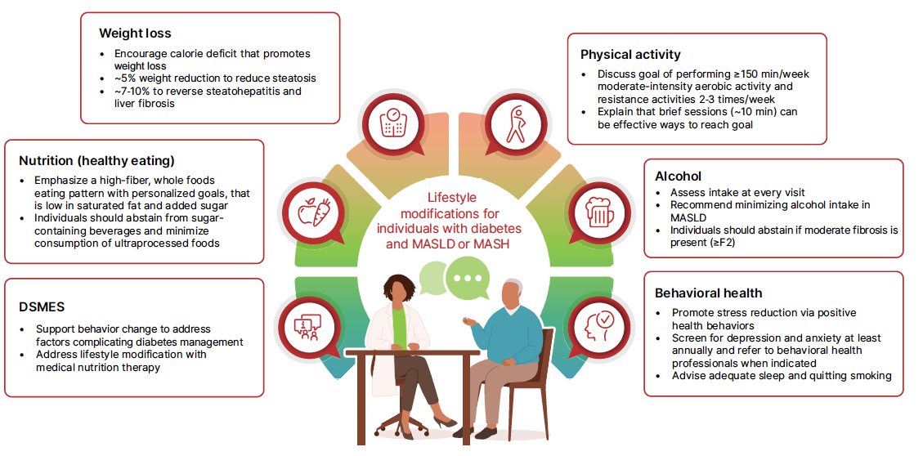
Multidisciplinary Care Advances the Treatment of Patients With MASH
Cusi et al. Diabetes Care 2025;48:1–26
Notes:
A1C, glycated hemoglobin; ALT, alanine aminotransferase; LDL, low-density lipoprotein; MASH, metabolic dysfunction–associated steatohepatitis; MASLD, metabolic dysfunction–associated steatotic liver disease; SBP, systolic blood pressure

Slide 33
Summary of Updates at AACE, ADA, and ENDO 2025
Early identification and risk stratification
  ADA: Routine MASLD screening in patients with T2D using FIB-4 and VCTE-LSM
Noninvasive testing – rapidly evolving
Management
  Multidisciplinary approach
  Emphasize lifestyle changes
  Optimize pharmacotherapy for weight-loss (GLP-1RA and dual GIP/GLP-1RA) and glucose-lowering (GLP-1RA and duals, pioglitazone) agents with benefit in MASH.
  Consider referral to liver specialists for additional care and consideration for resmetirom therapy
Emerging therapeutic strategies – multiple new agents in development
Cusi. Diabetes Care. 2025;48:1057. American Diabetes Association Professional Practice Committee. Diabetes Care. 2025;48:S181.
Notes:
AACE, American Association of Clinical Endocrinology; ADA, American Diabetes Association; ENDO, Endocrine Society; FIB-4, Fibrosis-4; HCP, healthcare professional; MASLD, metabolic dysfunction–associated steatotic liver disease; T2D, type 2 diabetes; VCTE, vibration-controlled transient elastography.

