Slide 1
Learning Objectives​
At the conclusion of this activity, learners should be able to:​
Identify subpopulations of patients with breast cancer most likely to benefit from a specific treatment plan based on predictive biomarkers
Apply recently presented data to clinical practice to expand treatment options and improve outcomes for patients with breast cancer
Evaluate new data on novel agents and therapeutic approaches for patients with breast cancer

Slide 2
Advanced Breast Cancer

Slide 3
DESTINY-Breast06: Trastuzumab Deruxtecan vs CT in Previously Treated HR+/HER2-Low or HER2-Ultralow MBC
Multicenter, open-label, randomized phase III trial
Stratified by: prior CDK4/6 inhibitor use (yes vs no); HER2 IHC 1+ vs 2+/ISH- vs 0; prior taxane in nonmetastatic setting (yes vs no)
Patients with HR+ metastatic breast cancer with PD on ≥2 previous ET ± targeted therapy (no prior CT) for MBC*; HER2 low (IHC 1+, or 2+/ISH-) or HER2 ultralow (IHC† >0 <1+) based on central IHC assessment using most recent evaluable IHC sample
(N = 866)
T-DXd
5.4 mg/kg Q3W
(n = 436)
1:1
Until PD or toxicity
Physician’s choice of CT
(capecitabine, paclitaxel, or nab-paclitaxel)
(n = 430)
*Also allowed: 1 prior line for MBC and PD ≤6 mo of starting 1L ET + CDK4/6 inhibitor or 1 prior line for MBC and recurrence ≤24 mo of starting adjuvant ET.
†HER2 IHC >0 defined by any IHC staining up to 10% of tumor cells.
Primary endpoint: PFS (per BICR) in HER2-low population
Key secondary endpoint: OS in HER2-low population, PFS (per BICR) and OS in ITT
Other secondary endpoints: PFS (per INV) in HER2-low population, ORR and DoR (per BICR/INV) in HER2-low population and ITT, safety and tolerability, PROs
Curigliano. ASCO 2024. Abstr LBA1000. NCT04494425.
Notes:
1L, first line; BICR, blinded-independent central review; CT, chemotherapy; DoR, duration of response; ET, endocrine therapy; HR, hormone receptor; IHC, immunohistochemistry; INV, investigator assessed; ISH, in situ hybridization; ITT, intention-to-treat; MBC, metastatic breast cancer; ORR, objective response rate; OS, overall survival; PD, progressive disease; PFS, progression-free survival; PRO, patient-reported outcome; T-DXd, trastuzumab deruxtecan.

Slide 4
DESTINY-Breast06: Baseline Characteristics
Characteristic | HER2-low |  | ITT |  | HER2-ultralow
 | T-DXd (n = 359) | CT (n = 354) | T-DXd (n = 436) | CT (n = 430) | T-DXd (n = 76) | CT (n = 76)
Median age, yr (range) | 58 (28-87) | 57 (32-83) | 58 (28-87) | 57 (32-83) | 58 (33-85) | 57.5 (34-82)
Female, n (%) | 359 (100) | 353 (99.7) | 436 (100) | 429 (99.8) | 76 (100) | 76 (100)
ECOG PS 1, n (%) | 148 (41.2) | 128 (36.2) | 178 (40.8) | 163 (37.9) | 30 (39.5) | 35 (46.1)
HER2 status, n (%) IHC 0 with membrane staining IHC 1+ IHC 2+/ISH- | — 238 (66.3) 117 (32.6) | — 234 (66.1) 118 (33.3) | 76 (17.4) 239 (54.8) 117 (26.8) | 76 (17.7) 234 (54.4) 118 (27.4) | 76 (100) — — | 76 (100) — —
ER/PR status, n (%) ER+/PR+ ER+/PR- ER-/PR+ | 206 (57.4) 141 (39.3) 3 (0.8) | 193 (54.5) 152 (42.9) 2 (0.6) | 253 (58.0) 167 (38.3) 3 (0.7) | 237 (55.1) 181 (42.1) 2 (0.5) | 46 (60.5) 26 (34.2) — | 44 (57.9) 29 (38.2) —
Primary endocrine resistance, n (%) | 105 (29.2) | 116 (32.8) | 128 (29.4) | 140 (32.6) | 23 (30.3) | 24 (31.6)
De novo disease at diagnosis, n (%) | 111 (30.9) | 104 (29.4) | 133 (30.5) | 132 (30.7) | 22 (28.9) | 28 (36.8)
Bone-only disease at baseline, n (%) | 11 (3.1) | 10 (2.8) | 13 (3.0) | 13 (3.0) | 2 (2.6) | 3 (3.9)
Visceral disease at baseline, n (%) | 309 (86.1) | 299 (84.5) | 376 (86.2) | 364 (84.7) | 66 (86.8) | 65 (85.5)
Liver metastases at baseline, n (%) | 243 (67.7) | 232 (65.5) | 296 (67.9) | 283 (65.8) | 52 (68.4) | 51 (67.1)
Curigliano. ASCO 2024. Abstr LBA1000.
Notes:
CT, chemotherapy; ECOG PS, Eastern Cooperative Oncology Group performance status; ER, estrogen receptor; IHC, immunohistochemistry; ISH, in situ hybridization; ITT, intention-to-treat; PR, progesterone receptor; T-DXd trastuzumab deruxtecan.

Slide 5
DESTINY-Breast06: Prior Treatment
Prior Therapy for MBC | HER2 Low |  | ITT |  | HER2 Ultralow
 | T-DXd (n = 359) | CT (n = 354) | T-DXd (n = 436) | CT (n = 430) | T-DXd (n = 76) | CT (n = 76)
Median ET lines, n (range) | 2 (1-4) | 2 (1-5) | 2 (1-4) | 2 (1-5) | 2 (1-4) | 2 (1-5)
No. of ET lines, n (%) 1 ≤6 mo on 1L ET + CDK4/6i 2 ≥3 | 54 (15.1) 33 (9.2) 242 (67.6) 62 (17.3) | 67 (19.0) 33 (9.4) 236 (67.0) 49 (13.9) | 65 (14.9) 37 (8.5) 295 (67.8) 75 (17.2) | 82 (19.2) 40 (9.3) 288 (67.3) 58 (13.6) | 11 (14.5) 4 (5.3) 52 (68.4) 13 (17.1) | 15 (19.7) 7 (9.2) 52 (68.4) 9 (11.8)
Prior ET therapies, n (%) Monotherapy With CDK4/6i With other targeted therapy | 189 (52.6) 318 (88.6) 120 (33.4) | 183 (51.7) 316 (89.3) 105 (29.7) | 230 (52.8) 388 (89.0) 143 (32.8) | 223 (51.9) 385 (89.5) 127 (29.5) | 41 (53.9) 69 (90.8) 22 (28.9) | 40 (52.6) 69 (90.8) 22 (28.9)
Prior adjuvant/neoadjuvant therapies, n (%) ET Cytotoxic CT Taxane Anthracycline | 227 (63.2) 192 (53.5) 151 (42.1) 167 (46.5) | 218 (61.6) 196 (55.4) 151 (42.7) 173 (48.9) | 275 (63.1) 228 (52.3) 179 (41.1) 197 (45.2) | 256 (59.5) 234 (54.4) 177 (41.2) 206 (47.9) | 48 (63.2) 36 (47.4) 28 (36.8) 30 (39.5) | 38 (50.0) 38 (50.0) 26 (34.2) 33 (43.4)
Curigliano. ASCO 2024. Abstr LBA1000.
Notes:
CT, chemotherapy; ET, endocrine therapy; ITT, intention-to-treat; MBC, metastatic breast cancer; T-DXd trastuzumab deruxtecan.

Slide 6
DESTINY-Breast06: Efficacy
HER2-Low Population | T-DXd (n = 359) | CT (n = 354) | HR (95% CI) | P Value
Median PFS by BICR, mo Primary endpoint | 13.2 | 8.1 | 0.62 (0.51-0.74) | <.0001
12-mo OS rate,* % | 87.6 | 81.7 | 0.83 (0.66-1.05) | .1181
HER2-ITT Population | T-DXd (n = 436) | CT (n = 430) | HR (95% CI) | P Value
Median PFS by BICR, mo | 13.2 | 8.1 | 0.63 (0.53-0.75) | <.0001
12-mo OS rate,† % | 87.0 | 81.1 | 0.81 (0.65-1.00) | NR
HER2-Ultralow Population | T-DXd (n = 76) | CT (n = 76) | HR (95% CI) | P Value
Median PFS by BICR, mo | 13.2 | 8.3 | 0.78 (0.50-1.21) | NR
12-mo OS rate, % | 84.0 | 78.7 | 0.75 (0.43-1.29) | NR
T-DXd showed consistent PFS benefit across prespecified patient subgroups, regardless of age, HER2-low status, prior exposure to CDK4/6i or taxane, number of prior ET lines, endocrine resistance, or liver metastases
*20.1% of patients in the CT arm received T-DXd after CT discontinuation. †17.9% of patients in the CT arm received T-DXd after CT discontinuation.
Curigliano. ASCO 2024. Abstr LBA1000.
Notes:
BICR, blinded independent central review; CDK4/6i, CDK4/6 inhibitor; CT, chemotherapy; ET, endocrine therapy; ITT, intention-to-treat; NR, not reported; PFS, progression-free survival; OS, overall survival; T-DXd trastuzumab deruxtecan.

Slide 7
DESTINY-Breast06: Antitumor Activity
 | HER2 Low |  | ITT |  | HER2 Ultralow
Outcome | T-DXd (n = 359) | CT (n = 354) | T-DXd (n = 436) | CT (n = 430) | T-DXd (n = 76) | CT (n = 76)
Confirmed ORR, n (%) CR PR | 203 (56.5) 9 (2.5) 194 (54.0) | 114 (32.2) 0 (0) 114 (32.2) | 250 (57.3) 13 (3.0) 237 (54.4) | 134 (31.2) 0 (0) 134 (31.2) | 47 (61.8) 4 (5.3) 43 (56.6) | 20 (26.3) 0 (0) 20 (26.3)
SD, n (%) | 125 (34.8) | 170 (48.0) | 148 (33.9) | 212 (49.3) | 22 (28.9) | 42 (55.3)
CBR, n (%) | 275 (76.6) | 190 (53.7) | 334 (76.6) | 223 (51.9) | 58 (76.3) | 33 (43.4)
Median DoR, mo | 14.1 | 8.6 | 14.3 | 8.6 | 14.3 | 14.1
Curigliano. ASCO 2024. Abstr LBA1000.
Notes:
CBR, clinical benefit rate; CR, complete response; CT, chemotherapy; DoR, duration of response; ITT, intention-to-treat; ORR, objective response rate; PR, partial response; SD, stable disease; T-DXd trastuzumab deruxtecan.

Slide 8
DESTINY-Breast06: TEAEs and AEs of Special Interest
Treatment-Related TEAE in ≥20% of Patients, % | T-DXd (n = 434) |  | CT (n = 417)
 | Any Grade | Grade ≥3 | Any Grade | Grade ≥3
Nausea | 65.9 | 1.6 | 23.5 | 0.2
Fatigue | 46.8 | 3.7 | 34.3 | 1.4
Alopecia | 45.4 | 0 | 19.4 | 0.2
Neutropenia | 37.6 | 20.7 | 27.6 | 16.5
Increased transaminases | 29.3 | 2.3 | 11.0 | 0
Anemia | 28.1 | 5.8 | 19.4 | 2.4
Vomiting | 27.2 | 1.4 | 9.4 | 0
Diarrhea | 23.7 | 1.8 | 22.5 | 2.4
Decreased appetite | 23.5 | 1.4 | 9.4 | 0.5
Leukopenia | 23.3 | 6.9 | 14.6 | 5.5
PPE | 0.5 | 0 | 32.4 | 6.7
Left ventricular dysfunction, n (%) | T-DXd (n = 434) | CT (n = 417)
Decreased ejection fraction (any) Grade 1/2 Grade 3/4 Grade 5 | 35 (8.1) 32 (7.3) 3 (0.7) 0 | 12 (2.9) 11 (2.6) 1 (0.2) 0
Cardiac failure (any) Grade 1/2 Grade 3/4 Grade 5 | 0 0 0 0 | 3 (0.7) 1 (0.2) 2 (0.4) 0
ILD/Pneumonitis,* n (%) | (n = 434) | (n = 417)
Any grade Grade 1/2 Grade 3/4 Grade 5 | 49 (11.3) 43 (9.9) 3 (0.7) 3 (0.7) | 1 (0.2) 1 (0.2) 0 0
*Adjudicated as treatment related.
Curigliano. ASCO 2024. Abstr LBA1000.
Notes:
AE, adverse event; CT, chemotherapy; ILD, interstitial lung disease; PPE, palmar-plantar erythrodysesthesia; T-DXd trastuzumab deruxtecan; TEAE, treatment-emergent adverse event.

Slide 9
postMONARCH: Abemaciclib + Fulvestrant vs Fulvestrant for HR+/HER2- Adv BC Post CDK4/6i + ET
Global, double-blind, placebo-controlled, randomized phase III trial
Primary endpoint: PFS by investigator
Key secondary endpoints: OS, PFS by BICR, ORR, CBR, DCR, DoR, safety, QoL, PK
Stratified by geographic region, visceral mets, prior CDK4/6i tx duration
Adults with HR+/HER2- advanced/metastatic BC; PD on 1L CDK4/6i + AI for advanced disease or recurrence on/after CDK4/6i + ET in adjuvant setting; ECOG PS ≤1
(N = 368)
Abemaciclib PO + Fulvestrant IM
(n = 182)
All patients scanned Q8W for 12 mo, then Q12W thereafter
Placebo PO + Fulvestrant IM
(n = 186)
NCT05169567. Kalinsky. ASCO 2024. Abstr LBA1001.
Notes:
1L, first-line; AI, aromatase inhibitor; BC, breast cancer; BICR, blinded independent central review; CBR, clinical benefit rate; CDK4/6i, CDK4/6 inhibitor; DCR, disease control rate; DoR, duration of response; ECOG, Eastern Cooperative Oncology Group; ET, endocrine therapy; HR, hormone receptor; ORR, overall response rate; OS, overall survival; PD, progressive disease; PFS, progression-free survival; PK, pharmacokinetics; PS, performance status; QoL, quality of life.

Slide 10
postMONARCH: Baseline Characteristics
Characteristic, % | Abemaciclib + Fulvestrant (n = 182) | Placebo + Fulvestrant (n = 186)
Median age, yr (range) ≥65 yr | 58 (27-86) 31 | 61 (28-85) 37
Female sex | 99 | 100
Race White Asian Black | 82 12 4 | 82 15 2
Hispanic/Latino ethnicity | 15 | 15
Geographic region Other (including EU) United States Asia | 73 15 12 | 72 15 13
ECOG PS 0 1 | 57 43 | 58 43
Characteristic, % | Abemaciclib + Fulvestrant (n = 182) | Placebo + Fulvestrant (n = 186)
Measurable disease | 72 | 68
HR status ER+ PgR+ | 100 79 | 99 81
Metastases Visceral Liver Bone only | 62 37 18 | 59 38 23
Evaluable ctDNA, n (%) ESR1 mutation PIK3CA/AKT/PTEN alteration | 161 (88) 40 46 | 159 (85) 51 52
Kalinsky. ASCO 2024. Abstr LBA1001.
Notes:
ctDNA, circulating tumor DNA; ECOG, Eastern Cooperative Oncology Group; ER, estrogen receptor; HR, hormone receptor; PgR, progesterone receptor; PS, performance status.

Slide 11
postMONARCH: Prior Treatment History at Baseline
Prior Treatment History | Abemaciclib + Fulvestrant (n = 182) | Placebo + Fulvestrant (n = 186)
Setting of prior CDK4/6i therapy, % Advanced disease Adjuvant | 100 0 | 98 2
Prior CDK4/6i therapy, % Palbociclib Ribociclib Abemaciclib | 59 34 8 | 59 33 8
Prior CDK4/6i therapy duration, % ≥12 mo or recurrence after adjuvant therapy <12 mo or recurrence on adjuvant therapy | 71 29 | 77 22
Median prior CDK4/6i therapy duration, mo (range) Palbociclib Ribociclib Abemaciclib | 19 (2-110) 19 15 26 | 21 (3-87) 23 18 21
Kalinsky. ASCO 2024. Abstr LBA1001.
Notes:
CDK4/6i, CDK4/6 inhibitor.

Slide 12
postMONARCH: PFS
Investigator-Assessed PFS
BICR-Assessed PFS
27% and 45% PFS-related event risk reduction with abemaciclib + fulvestrant per investigator and BICR assessment, respectively
PFS by BICR affected by informative censoring: 51% with abemaciclib + fulvestrant vs 38% with fulvestrant monotherapy
PFS benefit consistent across subgroups including by age, region, metastases, duration of prior CDK4/6i
 | Abemaciclib + Fulvestrant | Placebo + Fulvestrant
Median PFS, mo (95% CI) | 6.0 (5.6-8.6) | 5.3 (3.7-5.6)
 | HR: 0.73 (95% CI: 0.57-0.95; P = .02)
 | Abemaciclib + Fulvestrant | Placebo + Fulvestrant
Median PFS, mo (95% CI) | 12.9 (9.5-NR) | 5.6 (3.9-7.7)
 | HR: 0.55 (95% CI: 0.39-0.77; P = .0004)
100
100
6-mo PFS rate:
80
80
68%
6-mo
PFS rate:
60
50%
60
PFS (%)
PFS (%)
40
40
45%
20
37%
20
0
0
Patients
at Risk, n
A + F
P + F
0
3
6
9
12
15
18
21
Patients
at Risk, n
A + F
P + F
0
3
6
9
12
15
18
21
Mo
Mo
182
186
124
114
80
62
61
47
21
17
9
7
2
3
0
0
182
186
117
100
74
50
54
39
21
13
6
5
1
1
0
0
Kalinsky. ASCO 2024. Abstr LBA1001. Reproduced with permission.
Notes:
BICR, blinded independent central review; CDK4/6i, CDK4/6 inhibitor; NR, not reached; PFS, progression-free survival.

Slide 13
postMONARCH: PFS in Key Subgroups
Median Investigator-Assessed PFS, Mo | Abemaciclib + Fulvestrant | Placebo + Fulvestrant | HR (95% CI) | P Value
Prior CDK4/6i therapy duration ≥12 mo or recurrence after adjuvant therapy (n = 273) <12 mo or recurrence on adjuvant therapy (n = 93) | 7.0 5.5 | 5.4 3.0 | 0.70 (0.52-0.94) 0.80 (0.50-1.29) | 0.63
Visceral metastases No (n = 147) Yes (n = 221) | 11.1 5.4 | 5.6 3.7 | 0.53 (0.34-0.83) 0.87 (0.64-1.17) | 0.07
ESR1 mutation* Detected (n = 145) Not detected (n = 175) | NR NR | NR NR | 0.79 (0.54-1.15) 0.79 (0.55-1.13) | .98
PIK3CA/AKT1/PTEN alteration* Detected (n = 156) Not detected (n = 164) | NR NR | NR NR | 0.86 (0.60-1.23) 0.73 (0.51-1.06) | .55
*Exploratory analysis.
Kalinsky. ASCO 2024. Abstr LBA1001.
Notes:
CDK4/6i, CDK4/6 inhibitor; NR, not reported; PFS, progression-free survival.

Slide 14
postMONARCH: ORR
Abemaciclib + fulvestrant improved ORR vs placebo + fulvestrant
ORR, % | Abemaciclib + Fulvestrant (n = 182)* | Placebo + Fulvestrant (n = 186)† | P Value
By investigator | 17 | 7 | .0145
By BICR | 23 | 8 | .0008
*n = 131 with measurable disease.
†n = 127 with measurable disease.
Kalinsky. ASCO 2024. Abstr LBA1001.
Notes:
BICR, blinded independent central review; ORR, overall response rate.

Slide 15
postMONARCH: Safety
AE in ≥15% of Patients, % | Abemaciclib + Fulvestrant (n = 181) |  | Placebo + Fulvestrant (n = 185)
 | Any Grade | Grade ≥3 | Any Grade | Grade ≥3
Any | 97 | 55 | 82 | 20
Diarrhea | 75 | 4 | 17 | 2
Neutropenia | 41 | 25 | 3 | 0
Anemia | 35 | 11 | 15 | 4
Fatigue | 33 | 3 | 23 | 1
Nausea | 33 | 3 | 18 | 0
Abdominal pain | 24 | 2 | 16 | 0
Vomiting | 20 | 2 | 6 | 0
Thrombocytopenia | 18 | 4 | 6 | 2
Decreased appetite | 18 | 1 | 7 | 0
Leukopenia | 18 | 8 | 3 | 0
Increased AST | 15 | 6 | 11 | 2
Increased ALT | 13 | 4 | 10 | 2
Arthralgia | 12 | 1 | 12 | 1
Increased creatinine | 11 | 0 | 2 | 0
AE in ≥15% of Patients, % | Abemaciclib + Fulvestrant (n = 181) |  | Placebo + Fulvestrant (n = 185)
 | Any Grade | Grade ≥3 | Any Grade | Grade ≥3
Cough | 11 | 0 | 7 | 0
VTE | 5 | 2 | 3 | 1
ILD | 3 | 1 | 1 | 0
1 treatment-related death occurred on abemaciclib + fulvestrant arm (pneumonia)
AE-related treatment modifications more frequent with abemaciclib + fulvestrant vs placebo + fulvestrant
  Dose reduction: 30% vs 3%
  Discontinuation: 6% vs 0%
Kalinsky. ASCO 2024. Abstr LBA1001.
Notes:
AE, adverse event; ALT, alanine aminotransferase; AST, aspartate aminotransferase; Gr, grade; ILD, interstitial lung disease; VTE, venous thromboembolism.

Slide 16
SACI-IO HR+: Phase II Trial of Sacituzumab Govitecan ± Pembrolizumab in HR+/HER2- Metastatic Breast Cancer
Multicenter, randomized, open-label phase II trial (data cutoff: March 9, 2024)
Primary endpoints: PFS in ITT population
Key secondary endpoints: PFS in patients with PD-L1 CPS ≥1, OS, ORR, DoR, TTR, CBR, safety
Patients with HR+/HER2- locally advanced or MBC; ≥1 prior ET for MBC or progression ≤12 mo of adjuvant ET; ≤1 prior CT for MBC; no prior topoisomerase I inhibitor ADC, irinotecan, or PD-1/PD-L1 inhibitor; no active brain metastases or leptomeningeal disease
(N = 110‡)
Sacituzumab Govitecan* +
Pembrolizumab†
Until PD or unacceptable toxicity
Sacituzumab Govitecan*
*10 mg/kg IV on Day 1 and 8 of each 21-day cycle.
†200 mg IV on Day 1 of each 21-day cycle.
‡110 patients randomized, 104 patients included in analysis.
Garrido-Castro. ASCO 2024. Abstr LBA1004.
Notes:
ADC, antibody–drug conjugate; CBR, clinical benefit rate; CPS, combined positive score; CT, chemotherapy; DoR, duration of response; ET, endocrine therapy; HR, hormone receptor; ITT, intention-to-treat; MBC, metastatic breast cancer; ORR, objective response rate; OS, overall survival; PD, progressive disease; PFS, progression-free survival; TTR, time to response.

Slide 17
SACI-IO HR+: Baseline Characteristics
Characteristic | SG + Pembro (n = 52) | SG (n = 52)
Median age, yr (range) | 56.5 (31-81) | 57 (27-80)
Female sex at birth, n (%) | 50 (96.2) | 52 (100)
Race, n (%) White Black Asian Other (Incl. American Indian, Alaskan native) | 40 (76.9) 4 (7.7) 4 (7.7) 4 (7.7) | 44 (84.6) 3 (5.8) 1 (1.9) 4 (7.7)
ER expression ≥10%, n (%) | 49 (94.2) | 50 (96.2)
PD-L1 status, n (%) Negative CPS ≥1 CPS 1-9 CPS ≥10 Not tested | 35 (67.3) 16 (30.8) 13 (25.0) 3 (5.8) 1 (1.9) | 28 (53.8) 24 (46.2) 20 (38.5) 4 (7.7) 0
Characteristic, n (%) | SG + Pembro (n = 52) | SG (n = 52)
Presentation at diagnosis De novo MBC Recurrent MBC | 10 (19.2) 42 (80.8) | 13 (25.0) 39 (75.0)
Liver metastasis at BL | 40 (76.9) | 41 (78.8)
Brain metastasis at BL | 4 (7.7) | 5 (9.6)
Prior (neo)adjuvant CT | 28 (66.7) | 28 (71.8)
Prior CDK4/6 inhibitor | 47 (90.4) | 45 (86.5)
Prior CT regimens for MBC 0 1 | 27 (51.9) 25 (48.1) | 26 (50.0) 26 (50.0)
Garrido-Castro. ASCO 2024. Abstr LBA1004.
Notes:
BL, baseline; CPS, combined positive score; CT, chemotherapy; ER, estrogen receptor; HR, hormone receptor; MBC, metastatic breast cancer; SG, sacituzumab govitecan.

Slide 18
SACI-IO HR+: PFS in ITT (Primary Endpoint)
1.0
 | SG + Pembro (n = 52) | SG (n = 52)
Median PFS, mo | 8.12 | 6.22
HR (95% CI) | 0.81 (0.51-1.28)
P value | .37
0.8
0.6
PFS
0.4
Median follow-up: 12.5 mo
0.2
SG + Pembro
SG
0
0
6
12
18
24
Mo From Randomization
Patient at Risk (No. Censored), n
SG + Pembro
SG
52 (1)
52 (0)
25 (5)
23 (5)
11 (9)
5 (11)
3 (11)
0 (14)
1 (13)
0 (14)
Garrido-Castro. ASCO 2024. Abstr LBA1004. Reproduced with permission.
Notes:
ITT, intention-to-treat; Pembro, pembrolizumab; PFS, progression-free survival; SG, sacituzumab govitecan.

Slide 19
SACI-IO HR+: PFS by PD-L1 IHC Status
PD-L1 Positive (CPS ≥1)
PD-L1 Negative (CPS <1)
1.0
1.0
0.8
0.8
0.6
0.6
PFS
PFS
0.4
0.4
0.2
SG + Pembro
SG
0.2
0
0
0
6
12
18
0
6
12
18
Mo From Randomization
Mo From Randomization
Patient at Risk (No. Censored), n
SG + Pembro
SG
SG + Pembro
SG
Patient at Risk (No. Censored), n
16 (0)
24 (0)
10 (0)
10 (4)
4 (3)
2 (6)
0 (5)
0 (6)
35 (1)
28 (0)
14 (5)
13 (1)
6 (6)
3 (5)
2 (6)
0 (8)
 | SG + Pembro (n = 16) | SG (n = 24)
Median PFS, mo | 11.05 | 6.68
HR (95% CI) | 0.62 (0.29-1.36)
P value | .23
 | SG + Pembro (n = 35) | SG (n = 28)
Median PFS, mo | 5.36 | 5.07
HR (95% CI) | 1.06 (0.59-1.90)
P value | .84
Garrido-Castro. ASCO 2024. Abstr LBA1004. Reproduced with permission.
Notes:
IHC, immunohistochemistry; Pembro, pembrolizumab; PFS, progression-free survival; SG, sacituzumab govitecan.

Slide 20
SACI-IO HR+: OS and Response
Endpoint | SG + Pembro (n = 52) | SG (n = 52) | HR (95% CI) | P
Median OS, mo PD-L1 positive (CPS ≥1) PD-L1 negative (CPS <1) | 18.52 18.52 16.55 | 17.96 12.50 18.03 | 0.65 (0.33-1.28) 0.61 (0.18-2.04) 0.68 (0.29-1.59) | .21 .42 .38
ORR, n (%) PD-L1 positive PD-L1 negative | 11 (21.2) 3 (18.8) 8 (22.9) | 9 (17.3) 5 (20.8) 4 (14.3) | — | .80
Clinical benefit rate, n (%) | 26 (50.0) | 24 (46.2) | — | .84
Median duration of response, mo | 12.9 | 4.5 | — | .31
Median time to objective response, mo | 2.3 | 4.1 | — | .68
Garrido-Castro. ASCO 2024. Abstr LBA1004.
Notes:
HR, hormone receptor; ORR, objective response rate; OS, overall survival; SG, sacituzumab govitecan.

Slide 21
SACI-IO HR+: TEAEs and TRAEs
TEAEs Occurring in ≥15% in Either Arm, % | SG + Pembro (n = 52) |  | SG (n = 52)
 | Grade ≥2 | Grade 3/4 | Grade ≥2 | Grade 3/4
Neutrophil count decreased | 69.2 | 53.8 | 59.6 | 44.2
Anemia | 34.6 | 5.8 | 26.9 | 9.6
WBC count decreased | 26.9 | 23.1 | 15.4 | 7.7
Lymphocyte count decreased | 15.4 | 11.5 | 5.8 | 1.9
Diarrhea | 23.1 | 5.8 | 38.5 | 7.7
Nausea | 28.8 | 3.8 | 32.7 | 9.6
Alopecia | 42.3 | — | 38.5 | —
Fatigue | 38.5 | 1.9 | 34.6 | 5.8
Anorexia | 11.5 | 0 | 17.3 | 0
Overall safety profile for SG + pembro vs SG alone
  Any TEAE: 98.1% vs 96.2%
    TEAEs leading to d/c: 5.8% vs 1.9%
  Any TRAE: 92.3% vs 94.2%
Garrido-Castro. ASCO 2024. Abstr LBA1004.
Notes:
d/c, discontinuation; Pembro, pembrolizumab; SG, sacituzumab govitecan; TEAE, treatment-emergent adverse event; TRAEs, treatment-related adverse events; WBC, white blood cell.

Slide 22
SACI-IO HR+: irAEs Attributed to Pembrolizumab
TRAEs, % | SG + Pembro (n = 52)
 | Grade ≥2 | Grade 3/4
Hypothyroidism | 5.8 | 0
Hypoalbuminemia | 3.8 | 0
Increased alanine aminotransferase | 3.8 | 1.9
Increased alkaline phosphatase | 3.8 | 1.9
Increased aspartate aminotransferase | 1.9 | 1.9
Acute kidney injury | 1.9 | 1.9
Viral hepatitis | 1.9 | 1.9
Adrenal insufficiency | 1.9 | 0
Arthralgia | 1.9 | 0
Increased blood bilirubin | 1.9 | 0
Dyspnea | 1.9 | 0
Pneumonitis | 1.9 | 0
Pruritus | 1.9 | 0
Garrido-Castro. ASCO 2024. Abstr LBA1004.
Notes:
HR, hormone receptor; irAE, immune-related adverse event; Pembro, pembrolizumab; SG, sacituzumab govitecan; TRAE, treatment-related adverse event.

Slide 23
DESTINY-Breast07: Trastuzumab Deruxtecan ± Pertuzumab for Previously Untreated HER2+ MBC
Multicenter, randomized, open-label, 2-part modular phase Ib/II study; data presented from interim analysis of part 2 dose-expansion phase
Primary endpoints: safety and tolerability
Key secondary endpoints: ORR, PFS per investigator (by RECIST v1.1), DoR
Stratified by HR status, disease status, PD-L1 status
T-DXd 5.4 mg/kg IV Q3W
(n = 75)
Previously untreated HER2+* advanced or metastatic BC with measurable disease; no or previously treated/stable brain mets;
≥12-mo DFI from adjuvant anti-HER2 therapy or CT; ECOG PS 0/1
(N = 125)
T-DXd 5.4 mg/kg IV Q3W +
Pertuzumab 420 mg IV Q3W with 840-mg loading dose
(n = 50)
T-DXd + Durvalumab
(not presented)
*IHC 3+ or IHC 2+/ISH+.
Andre. ASCO 2024. Abstr 1009.
Notes:
BC, breast cancer; CT, chemotherapy; DFI, disease-free interval; DoR, duration of response; ECOG, Eastern Cooperative Oncology Group; HR, hormone receptor; IHC, immunohistochemistry; ISU, in situ hybridization; mets, metastases; ORR, objective response rate; PFS, progression-free survival; PS, performance status; RECIST, Response Evaluation Criteria in Solid Tumors; T-DXd, trastuzumab deruxtecan.

Slide 24
DESTINY-Breast07: Baseline Characteristics
Characteristic | T-DXd (n = 75) | T-DXd + Pertuzumab (n = 50)
Median age, yr (range) | 57.0 (33.0-80.0) | 56.5 (24.0-75.0)
Female, n (%) | 74 (98.7) | 50 (100)
Race, n (%) White Asian Black/African American Not reported Other | 52 (69.3) 20 (26.7) 2 (2.7) 1 (1.3) 0 | 37 (74.0) 12 (24.0) 0 0 1 (2.0)
HER2 status, n (%) IHC 3+ IHC 2+/ISH+ IHC 2+ | 60 (80.0) 14 (18.7) 1 (1.3) | 41 (82.0) 9 (18.0) 0
Characteristic | T-DXd (n = 75) | T-DXd + Pertuzumab (n = 50)
HR status, n (%) Positive Negative | 47 (62.7) 28 (37.3) | 34 (68.0) 16 (32.0)
Disease status, n (%) Recurrent* De novo | 27 (36.0) 48 (64.0) | 20 (40.0) 30 (60.0)
ECOG PS, n (%) 0 1 | 49 (65.3) 26 (34.7) | 37 (74.0) 13 (26.0)
*Prior HER2-directed therapy in patients with recurrent disease.
T-DXd arm (n = 27): trastuzumab (51.9%), pertuzumab (14.8%), T-DM1 (7.4%)
T-DXd + pertuzumab arm (n = 20): trastuzumab (65%), pertuzumab (10%), T-DM1 (0%)
Andre. ASCO 2024. Abstr 1009.
Notes:
ECOG, Eastern Cooperative Oncology Group; HR, hormone receptor; IHC, immunohistochemistry; ISH, in situ hybridization; PS, performance status; T-DM1, trastuzumab emtansine; T-DXd, trastuzumab deruxtecan.

Slide 25
DESTINY-Breast07: Response and PFS
T-DXd Monotherapy (n = 75)
T-DXd + Pertuzumab (n = 50)
100
Patients with recurrent disease
Patients with de novo disease
100
Patients with recurrent disease
Patients with de novo disease
75
75
50
50
25
25
Best Change From Baseline in Target Lesion Size (%)
Best Change From Baseline in Target Lesion Size (%)
0
0
-25
-25
-50
-50
-75
-75
-100
-100
Confirmed ORR, % (80% CI) 76.0 (68.5-82.5)
Confirmed ORR, % (80% CI) 84.0 (75.3-90.5)
Complete response, n (%) 6 (8.0)
Partial response, n (%) 51 (68.0)
Complete response, n (%) 10 (20.0)
Partial response, n (%) 32 (64.0)
Median DoR, mo (range) NE (2.1-28.5)
12-mo PFS, % (80% CI) 80.8 (73.7-86.1)
Median DoR, mo (range) NE (4.5-28.3)
12-mo PFS, % (80% CI) 89.4 (81.9-93.9)
Response by RECIST v1.1 (investigator).
Andre. ASCO 2024. Abstr 1009. Reproduced with permission.
Notes:
DoR, duration of response; NE, not evaluable; ORR, objective response rate; PFS, progression-free survival; T-DXd, trastuzumab deruxtecan.

Slide 26
DESTINY-Breast07: Response by Subgroup
Response by Disease Status, n (%) | T-DXd |  | T-DXd + Pertuzumab
Disease status | Recurrent (n = 27) | De novo (n = 48) | Recurrent (n = 20) | De novo (n = 30)
cORR [80% CI] CR PR | 19 (70.4) [56.4-81.9] 4 (14.8) 15 (55.6) | 38 (79.2) [69.7-86.6] 2 (4.2) 36 (75.0) | 16 (80.0) [63.9-91.0] 6 (30.0) 10 (50.0) | 26 (86.7) [75.1-94.1] 4 (13.3) 22 (73.3)
SD | 6 (22.2) | 8 (16.7) | 4 (20.0) | 3 (10.0)
PD | 1 (3.7) | 2 (4.2) | 0 | 1 (3.3)
NE | 1 (3.7) | 0 | 0 | 0
Response by HR Status, n (%) | Positive (n = 47) | Negative (n = 28) | Positive (n = 34) | Negative (n = 16)
cORR (80% CI) CR PR | 36 (76.6) [66.8-84.5] 4 (8.5) 32 (68.1) | 21 (75.0) [61.5-85.5] 2 (7.1) 19 (67.9) | 30 (88.2) [77.9-94.8] 6 (17.6) 24 (70.6) | 12 (75.0) [56.1-88.6] 4 (25.0) 8 (50.0)
SD | 9 (19.1) | 5 (17.9) | 4 (11.8) | 3 (18.8)
PD | 2 (4.3) | 1 (3.6) | 0 | 1 (6.3)
NE | 0 | 1 (3.6) | 0 | 0
Andre. ASCO 2024. Abstr 1009.
Notes:
cORR, confirmed objective response rate; CR, complete response; HR, hormone receptor; NE, not evaluable; PD, progressive disease; PR, partial response; SD, stable disease; T-DXd, trastuzumab deruxtecan.

Slide 27
DESTINY-Breast07: Safety Overview
AE, n (%) | T-DXd (n = 75) | T-DXd + Pertuzumab (n = 50)
Any AE | 75 (100) | 50 (100)
Any AE grade ≥3 | 39 (52.0) | 31 (62.0)
AE associated with change in T-DXd Interruption Dose reduction Discontinuation | 44 (58.7) 12 (16.0) 8 (10.7) | 32 (64.0) 8 (16.0) 8 (16.0)
Any serious AE | 13 (17.3) | 13 (26.0)
AE leading to death | 1 (1.3)* | 0
AESI Pneumonitis (adjudicated as ILD related to T-DXd) Grade 1 Grade 2 Grade 3 LV dysfunction (possibly related to T-DXd) | 7 (9.3) 2 (2.7) 5 (6.7) 0 5 (6.7) | 7 (14.0) 0 6 (12.0) 1 (2.0) 2 (4.0)
*Investigator reported as non–treatment-related post-acute COVID-19 syndrome.
Andre. ASCO 2024. Abstr 1009.
Notes:
AE, adverse event; AESI, adverse event of special interest; ILD, interstitial lung disease; LV, left ventricular; T-DXd, trastuzumab deruxtecan.

Slide 28
DESTINY-Breast07: Adverse Events in >20% of Patients
AE, % | T-DXd (n = 75) |  | T-DXd + Pertuzumab (n = 50)
 | Any Grade | Grade ≥3 | Any Grade | Grade ≥3
Nausea | 71 | 4 | 68 | 0
Vomiting | 36 | 3 | 40 | 0
Neutropenia* | 36 | 27 | 38 | 24
Diarrhea | 35 | 3 | 62 | 6
Alopecia | 35 | 0 | 44 | 2
Asthenia | 28 | 1 | 32 | 0
COVID-19 | 24 | 1 | 44 | 2
Anemia | 24 | 4 | 40 | 14
Decreased appetite | 24 | 0 | 22 | 0
Constipation | 23 | 0 | 22 | 0
Fatigue | 16 | 0 | 28 | 0
Increased AST | 15 | 1 | 24 | 0
*Including neutropenia, decreased neutrophil count, febrile neutropenia.
Andre. ASCO 2024. Abstr 1009.
Notes:
AE, adverse event; AST, aspartate aminotransferase; T-DXd, trastuzumab deruxtecan.

Slide 29
Early Breast Cancer

Slide 30
I-SPY 2.2: Neoadjuvant Dato-DXd + Durvalumab in
High-Risk Stage II-III HER2-Negative Breast Cancer
Multicenter, open-label, adaptive phase II platform trial for evaluating novel agents as neoadjuvant therapy followed by SoC therapy^{1,2}
  Incorporates multiple sequential regimens
Primary endpoint: pCR
Block A: Investigational agents across response-predictive subtypes (no chemotherapy)
Block B: Optimal therapy based on response-predictive subtypes and SoC; investigational agents may be added to improve response
b: Chemotherapy with or without immunotherapy per SoC
Patients with
stage II-III,
HER2-negative,
high-risk breast cancer via
70-gene assay
(N = 106)
Dato-DXd +
Durvalumab x 4 Cycles
(N = 106)
Paclitaxel ±
Carboplatin ±
PD-1 Inhibitor (n = 66)
Doxorubicin +
Cyclophosphamide ±
PD-1 Inhibitor
(n = 26)
Surgery
(n = 20)
preRCB*
preRCB
Surgery
(n = 35)
Surgery
(n = 35)
*preRCB determined at end of each block by MRI and ≥1 core biopsy of original tumor bed ± LN.
1. Wang. Curr Breast Cancer Rep. 2019;11:303. 2. Shatsky. ASCO 2024. Abstr LBA501.
Notes:
Dato-DXd, datopotamab deruxtecan; LN, lymph node; pCR, pathologic complete response; preRCB, predictive residual cancer burden; SoC, standard of care.

Slide 31
I-SPY 2.2: Baseline Characteristics
Characteristic | Dato-DXd + Durvalumab (N = 106)
Median age, yr (range) | 50.0 (25.0-77.0)
Ethnicity, n (%) Hispanic/Latino Not Hispanic/Latino Missing | 13 (12.3) 81 (76.4) 12 (11.3)
Race, n (%) Asian Black White Missing/other | 12 (11.3) 9 (8.5) 63 (59.4) 22 (20.8)
Characteristic, n (%) | Dato-DXd + Durvalumab (N = 106)
Response-predictive subtype HR+ immune- DRD- HR- immune- DRD- Immune+ Immune+ (HR+) Immune+ (HR-) Immune- DRD+ Immune- DRD+ (HR+) Immune- DRD+ (HR-) | 25 (23.6) 23 (21.7) 47 (44.3) 16 (15.1) 31 (29.2) 11 (10.4) 1 (0.9) 10 (9.4)
HR+ | 42 (39.6)
HR- | 64 (60.4)
Shatsky. ASCO 2024. Abstr LBA501.
Notes:
Dato-DXd, datopotamab deruxtecan; DRD, DNA repair deficiency; HR, hormone receptor.

Slide 32
I-SPY 2.2: Efficacy of Neoadjuvant
Dato-DXd Plus Durvalumab
Response-Predictive Subtype | n | pCR | Non-pCR* | Modeled Rate, % (95% CI) | Threshold, % | P Value (> Threshold)
HR+ immune- DRD- | 25 | 0 | 23 | 3 (0-7) | 15 | .00
HR- immune- DRD- | 23 | 2 | 14 | 13 (3-23) | 15 | .33
Immune+ | 47 | 20 | 11 | 65 (47-83) | 40 | .99
Immune- DRD+ | 11 | 3 | 6 | 24 (4-44) | 40 | .06
Receptor Subtype | n | pCR | Non-pCR* | Modeled Rate, % (95% CI) | Threshold, % | P Value (> Threshold)
HR+ | 42 | 4 | 29 | 18 (6-30) | 15 | .68
HR- | 64 | 21 | 25 | 44 (32-56) | 40 | .74
*Includes patients with positive biopsy for invasive cancer after Block A or non-pCR after Block B or C.
Datopotamab deruxtecan + durvalumab deemed effective among patients in immune+ subtype
Shatsky. ASCO 2024. Abstr LBA501.
Notes:
Dato-DXd, datopotamab deruxtecan; DRD, DNA repair deficiency; HR, hormone receptor; pCR, pathologic complete response.

Slide 33
I-SPY 2.2: Safety
1 reported case of ILD
Prophylactic dexamethasone mouthwash was provided for stomatitis
Nausea
 | Dato-DXd + Durvalumab (N = 106)
irAE, n | Gr 1 | Gr 2 | Gr 3 | Gr 4
Rash | 0 | 4 | 4 | 0
Pruritus | 1 | 2 | 0 | 0
Adrenal insufficiency | 0 | 2 | 0 | 0
Type 1 diabetes mellitus | 0 | 0 | 1 | 0
Pneumonitis | 0 | 1 | 0 | 0
Hypothyroidism | 0 | 1 | 0 | 0
Colitis | 0 | 0 | 0 | 1
Autoimmune hepatitis | 0 | 0 | 1 | 0
Acute kidney injury | 0 | 0 | 1 | 0
Stomatitis
Fatigue
Rash
Constipation
Alopecia
Grade
1
2
3
4
Ocular events
Headache
Decreased appetite
Cough
0
10
20
30
40
50
60
70
80
90
100
Discontinuation rates due to AEs:
  Dato-DXd: 2%
  Durvalumab: 5%
1 fatal AE: grade 5 cardiac arrest in Block B in
70-yr-old with history of hypertension
Patients (n)
Shatsky. ASCO 2024. Abstr LBA501. Reproduced with permission.
Notes:
AE, adverse event; Dato-DXd, datopotamab deruxtecan; Gr, grade; ILD, interstitial lung disease; irAE, immune-related adverse event.

Slide 34
A-BRAVE: Adjuvant Avelumab vs Observation in
High-Risk Early TNBC Post (Neo)adjuvant CT
Open-label, randomized phase III trial (median f/u: 52.1 mo)
Coprimary endpoints: DFS, DFS in postneoadjuvant population
Key secondary endpoints: OS, DFS in PD-L1–positive patients, safety
Exploratory objectives: biomarker analysis
Stratified by adjuvant therapy (pN2-3 any T, pT2N1, pT3-4
N0-3) or postneoadjuvant patients (residual invasive disease in breast and/or axillary lymph nodes)
Adults with high-risk TNBC; previous locoregional and systemic therapy with curative intent; prior (neo)adjuvant anthracycline and taxane CT; tissue for
PD-L1 expression; ECOG PS ≤1
(N = 477)
Avelumab 10 mg/kg IV Q2W x 52 wk
(n = 238)
Follow-up assessment
3 times during first yr of therapy, every 4 mo during second yr, then every 6 mo thereafter
Observation
(n = 239)
Adjuvant ET allowed for ER 1%-9% at treating physician’s discretion; radiotherapy allowed where indicated.
NCT02926196. Conte. ASCO 2024. Abstr LBA500.
Notes:
CT, chemotherapy; DFS, disease-free survival; ECOG, Eastern Cooperative Oncology Group; ER, estrogen receptor; ET, endocrine therapy; OS, overall survival; PS, performance status; TNBC, triple-negative breast cancer.

Slide 35
A-BRAVE: Baseline Characteristics
Characteristic, n (%) | Avelumab (n = 235) | Observation (n = 231)
Median age, yr (range) | 50.9 (28.3-78.6) | 51.9 (28.8-79.9)
ER and PgR <10% | 231 (98.3) | 226 (97.8)
HER2 status 0 1+/2+ (ISH-) | 150 (64.1) 84 (35.7) | 147 (63.9) 83 (35.9)
gBRCA mutated | 24 (10.2) | 27 (11.7)
 | Adjuvant Population
 | Avelumab ( n = 40) | Observation (n = 43)
AJCC stage at surgery II III | 20 (50.0) 20 (50.0) | 22 (51.2) 21 (48.8)
 | Postneoadjuvant Population
Characteristic, n (%) | Avelumab (n = 195) | Observation (n = 188)
AJCC stage at surgery ypT1/ypN0 ≥ ypT2/ypN0 Any ypT/ypN1 Any ypT/≥ ypN2 | 93 (47.7) 31 (15.9) 49 (25.1) 22 (11.3) | 85 (45.2) 38 (20.2) 42 (22.3) 23 (12.2)
RCB 1 2 3 Under evaluation | 8 (4.1) 98 (50.3) 26 (13.1) 63 (32.3) | 17 (9.0) 77 (41.0) 18 (9.6) 76 (40.4)
Adjuvant capecitabine | 57 (24.2) | 42 (18.2)
Conte. ASCO 2024. Abstr LBA500.
Notes:
AJCC, American Joint Committee on Cancer; ER, estrogen receptor; PgR, progesterone receptor; RCB, residual cancer burden.

Slide 36
A-BRAVE: DFS and OS
Outcome in ITT, % | Avelumab (n = 235) | Observation (n = 231) | Difference | HR (95% CI) | P Value
3-yr DFS | 68.3 | 63.2 | 5.1 | 0.81 (0.61-1.09) | .172
3-yr OS | 84.8 | 76.3 | 8.5 | 0.66 (0.45-0.97) | .035
3-yr DDFS | 75.4 | 67.9 | 7.5 | 0.70 (0.50-0.96) | .0277
Outcome in Postneoadjuvant Population, % | Avelumab (n = 195) | Observation (n = 188) | Difference | HR (95% CI) | P Value
3-yr DFS | 66.9 | 60.7 | 6.2 | 0.80 (0.58-1.10) | .170
Conte. ASCO 2024. Abstr LBA500.
Notes:
DDFS, distant disease–free survival; DFS, disease-free survival; ITT, intention-to-treat; OS, overall survival.

Slide 37
A-BRAVE: Safety
Treatment Discontinuation, n (%) | Avelumab (n = 235)
Any reason | 65 (27.9)
AEs irAEs, n/N | 20 (30.8) 17/20
Disease recurrence | 33 (50.8)
Patient decision | 7 (10.8)
Other reasons | 5 (7.7)
irAEs, n (%) | Avelumab (n = 235) |  | Observation (n = 231)
 | Any Gr | Gr ≥3 | Any Gr | Gr ≥3
Hypothyroidism | 31 (13.2) | -- | 5 (2.2) | --
Hyperthyroidism | 11 (4.7) | -- | 1 (0.4) | --
Adrenal insufficiency | 2 (0.8) | -- | -- | --
Colitis/diarrhea | 17 (7.2) | 1 (0.4) | 1 (0.4) | --
Hypertransaminases | 11 (4.7) | 3 (1.3) | 2 (0.9) | --
Increased lipase | 5 (2.1) | 3 (1.3) | -- | --
Increased amylase | 4 (1.7) | 3 (1.3) | -- | --
Myocarditis | 1 (0.4) | -- | -- | --
Uveitis | 1 (0.4) | -- | -- | --
2 patients decided to discontinue treatment after C2, and 5 others decided after C8, C10, C11, C16, and C23, respectively
Other reasons for discontinuing therapy:
  1 to each: lung cancer, COVID-19 emergency, lost to follow-up
  2 medical decisions (at C18 and C24 each)
Conte. ASCO 2024. Abstr LBA500.
Notes:
AE, adverse event; Gr, grade; irAE, immune-related adverse event.

Slide 38
NATALEE: Subgroup Analysis of Adj Ribociclib + NSAI vs NSAI Alone in Stage II/III Node-Negative HR+/HER2- EBC
International, randomized, open-label phase III trial (data cutoff: July 21, 2023; median f/u: 33 mo)
Stratified by stage (II vs III), menopausal status (men and premenopausal vs postmenopausal women),
prior (neo)adjuvant CT (yes vs no), geography (N America/W Europe/Oceania vs rest of world)
Pre/postmenopausal women and men with HR+/HER2- EBC; stage IIA (either N0 with grade 2 and Ki-67 ≥20%, Oncotype DX
RS ≥26, or high risk via genomic risk profiling, N0 with grade 3, or N1), stage IIB, or stage III disease; prior ET up to 12 mo permitted;
prior (neo)adjuvant CT permitted
(N = 5101)
Ribociclib 400 mg PO QD for 3 wk on/1 wk off for 3 yr + NSAI* for ≥5 yr
(n = 2549)
*Letrozole or anastrozole. Men and premenopausal women also received goserelin 3.6 mg/28 days.
NSAI* for ≥5 yr
(n = 2552)
Primary endpoint: iDFS (STEEP criteria)
Key secondary endpoints: recurrence-free survival, DDFS, OS, PROs, PK, safety
Current report of N0 disease: Stage IIA grade 3 or grade 2 and Ki-67 ≥20%, Oncotype DX Breast Recurrence Score ≥26, or high-risk per genomic risk profiling; stage IIB/III N0 included
NCT03701334. Slamon. ASCO 2023. Abstr LBA500. Yardley. ASCO 2024. Abstr 512.
Notes:
Adj, adjuvant; CT, chemotherapy; DDFS, distant disease‒free survival; EBC, early breast cancer; ET, endocrine therapy; f/u, follow-up; HR, hormone receptor; iDFS, invasive disease‒free survival; NSAI, nonsteroidal aromatase inhibitor; OS, overall survival; PK, pharmacokinetics; PRO, patient-reported outcome; RS, recurrence score; STEEP, Standardized Definitions for Efficacy End Points.

Slide 39
NATALEE N0 Subgroup Analysis: Baseline Characteristics
Characteristic, n (%) | Ribociclib + NSAI (n = 285) | NSAI Alone (n = 328)
Median age, yr (range) | 55 (29-81) | 55 (24-89)
Disease stage IIA G2 Ki-67 ≥20% Ki-67 <20% + high genomic risk Ki-67 <20% + unknown genomic risk G3 IIB III | 212 (74) 104 (49) 70 (33) 6 (3) 28 (13) 104 (49) 48 (17) 25 (9) | 241 (73) 128 (53) 91 (38) 11 (5) 26 (11) 109 (45) 44 (13) 40 (12)
Characteristic, n (%) | Ribociclib + NSAI (n = 285) | NSAI Alone (n = 328)
T status 1 2 3 4 | 0 (0) 212 (74) 48 (17) 25 (9) | 3 (1) 241 (73) 44 (13) 40 (12)
Grade 1 2 3 | 5 (2) 149 (52) 127 (45) | 8 (2) 178 (54) 138 (42)
Prior ET | 169 (59) | 204 (62)
Prior CT Neoadjuvant Adjuvant | 205 (72) 90 (32) 121 (42) | 232 (71) 99 (30) 136 (41)
Yardley. ASCO 2024. Abstr 512.
Notes:
CT, chemotherapy; NSAI, nonsteroidal aromatase inhibitor.

Slide 40
NATALEE N0 Subgroup Analysis: Efficacy
(iDFS, DDFS, DRFS)
iDFS in N0 Subgroup
Efficacy Outcome | Ribociclib + NSAI (n = 285) | NSAI Alone (n = 328)
DDFS No. of events 3-yr rate, % (95% CI) | 17 94.3 (90.6-96.6) | 27 91.5 (87.6-94.2)
 | HR: 0.703 (0.383-1.290)
DRFS No. of events 3-yr rate, % (95% CI) | 12 96.3 (93.0-98.1) | 23 92.5 (88.8-95.1)
 | HR: 0.580 (0.298-1.170)
100
80
60
iDFS (%)
40
 | Ribociclib + NSAI | NSAI Alone
Events, n/N (%) | 20/285 (7.0) | 31/328 (9.5)
3-yr iDFS, % | 93.2 | 90.6
HR: 0.723 (95% CI: 0.412-1.268) | Hazard ratio: 0.723 (95% CI: 0.412-1.268)
20
0
0
6
12
18
24
30
36
42
48
54
Patients at Risk, n
Ribociclib + NSAI
NSAI alone
Mo
285
328
262
300
258
294
250
287
244
276
235
258
177
188
67
80
5
5
0
0
Median follow-up: 38.7 mo
Yardley. ASCO 2024. Abstr 512. Reproduced with permission.
Notes:
DDFS, distant disease‒free survival; DRFS, distant recurrence‒free survival; iDFS, invasive disease‒free survival; NSAI, nonsteroidal aromatase inhibitor.

Slide 41
NATALEE N0 Subgroup Analysis: Safety
AE of Special Interest, n (%) | Ribociclib + NSAI (n = 283) |  | NSAI Alone (n = 318)
 | Any Gr | Gr ≥3 | Any Gr | Gr ≥3
Neutropenia | 168 (59) | 111 (39) | 19 (6) | 5 (2)
Liver-related Increased ALT Increased AST | 86 (30) 69 (24) 61 (22) | 29 (10) 28 (10) 16 (6) | 32 (10) 13 (4) 14 (4) | 5 (2) 2 (<1) 3 (<1)
QT interval prolongation ECG QT prolonged | 15 (5) 11 (4) | 3 (1) 1 (<1) | 4 (1) 1 (<1) | 3 (<1) 0 (0)
ILD pneumonitis | 6 (2) | 0 (0) | 2 (<1) | 0 (0)
Other AEs, n (%)
Arthralgia | 105 (37) | 4 (1) | 146 (46) | 5 (2)
Nausea | 58 (20) | 1 (<1) | 21 (7) | 0 (0)
Headache | 58 (20) | 1 (<1) | 40 (13) | 0 (0)
Fatigue | 61 (22) | 3 (1) | 47 (15) | 1 (<1)
Diarrhea | 47 (17) | 4 (1) | 22 (7) | 0 (0)
VTE | 4 (1) | 1 (<1) | 0 (0) | 0 (0)
Safety profile consistent among N0 subgroup and
ITT population
AE led to discontinuation: 24% with ribociclib + NSAI
No febrile neutropenia reported
Yardley. ASCO 2024. Abstr 512.
Notes:
AE, adverse event; ALT, alanine aminotransferase; AST, aspartate aminotransferase; Gr, grade; ILD, interstitial lung disease; ITT; intention-to-treat; NSAI, nonsteroidal aromatase inhibitor; VTE, venous thromboembolism.

Slide 42
RxPONDER Subset Analysis: Serum AMH and Adjuvant CT for Premenopausal Patients With HR+/HER2- EBC
Stratified by RS (0-13 vs 14-25), menopausal status
(pre vs post), axillary surgery (ALND vs SLNB)
Adults with HR+/HER2- EBC and
1-3 positive LN without distant mets*;
able to receive adjuvant taxane
and/or anthracycline-based CT†;
axillary staging by SLNB or ALND;
RS 0-25‡
(N = 5015)
Chemotherapy Followed by ET
(n = 2509)
Baseline characteristics generally well balanced between treatment arms
ET Alone
(n = 2506)
*Protocol amended to exclude patients with pN1mic as only nodal disease after 2493 patients randomized. †Approved CT regimens: TC, FAC (or FEC), AC/T (or EC/T), FAC/T (or FEC/T); AC alone or CMF not allowed. ‡Patients with RS > 25 recommended to be treated with CT followed ET off study.
Kalinsky. NEJM 2021;385:2336. Kalinsky. ASCO 2024. Abstr 505.
Notes:
ALND, axillary lymph node dissection; AMH, anti-Müllerian hormone; CT, chemotherapy; EBC, early breast cancer; ET, endocrine therapy; HR, hormone receptor; LN, lymph nodes; mets, metastases; RS, recurrence score; SLNB, sentinel lymph node biopsy.

Slide 43
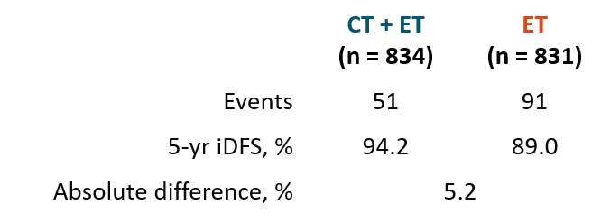
RxPONDER Subset Analysis: iDFS by Menopausal Status
Premenopausal*
No significant iDFS difference for postmenopausal women
Subset analysis found less iDFS benefit in “premenopausal” women
≥50 yr of age
Low serum anti-Müllerian hormone and inhibin B are markers of diminished ovarian reserve
Current analysis assessed benefit with chemotherapy in patients <55 yr of age using serum markers of ovarian function/reserve
1.0
0.8
0.6
iDFS Probability
0.4
0.2
0
HR: 0.54 (95% CI: 0.38-0.76; P = .0004)
0
1
2
3
4
5
6
7
8
9
Patients at
Risk, n
CT + ET
is
Yr Since Randomization
834
831
763
760
704
699
625
602
535
529
454
429
272
245
116
99
34
31
1
2
*Last menstrual period <6 mo or 6-12 mo and <50 yr.
Kalinsky. NEJM 2021;385:2336. Kalinsky. ASCO 2024. Abstr 505.
Notes:
CT, chemotherapy; ET, endocrine therapy; iDFS, invasive disease–free survival.

Slide 44
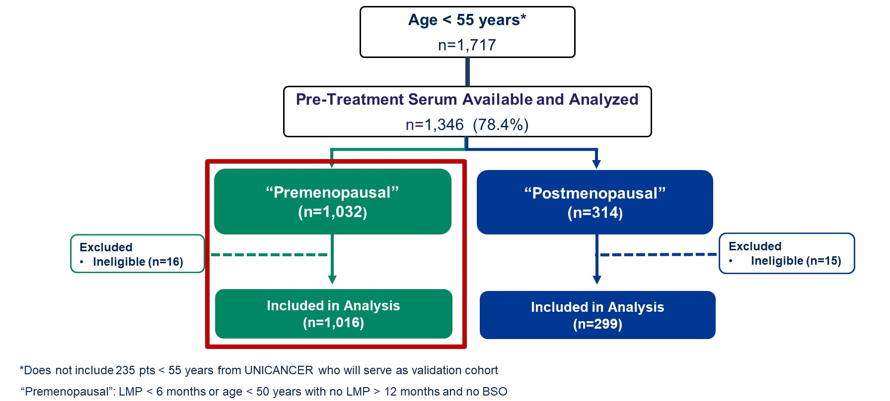
RxPONDER Subset Analysis: Premenopausal Patient Population
Kalinsky. ASCO 2024. Abstr 505.

Slide 45
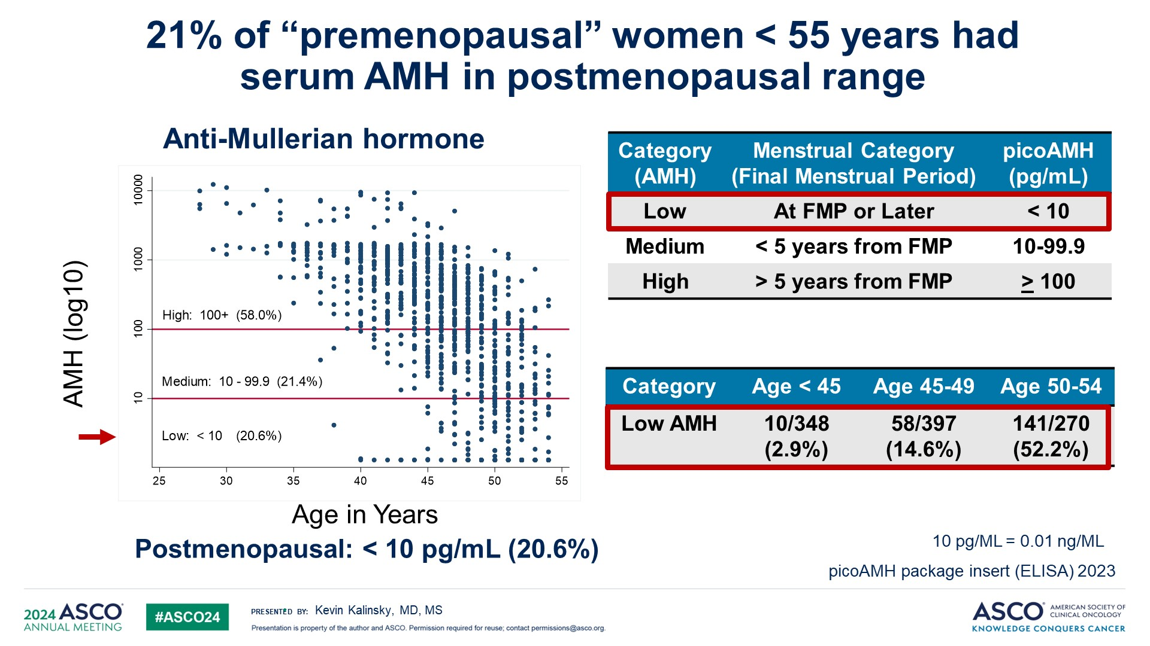
RxPONDER Subset Analysis: Serum AMH in Premenopausal Women <55 Yr of age
Kalinsky. ASCO 2024. Abstr 505. Reproduced with permission.
Notes:
AMH, anti-Müllerian hormone; FMP final menstrual period.

Slide 46
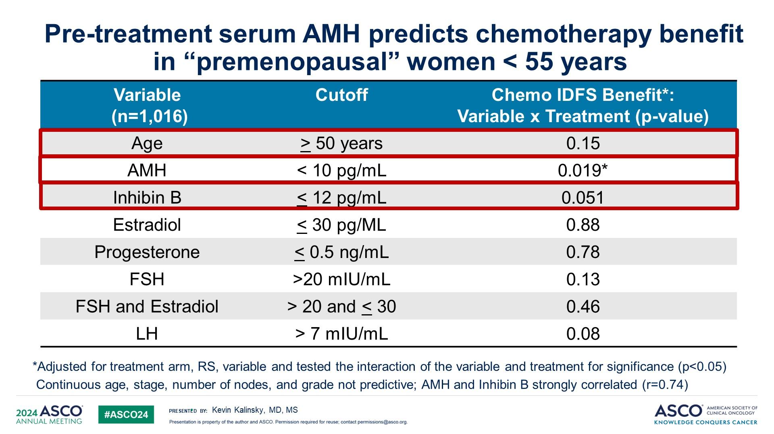
RxPONDER Subset Analysis: Serum Hormone Levels and CT Benefit in Premenopausal Women <55 Yr of Age
Kalinsky. ASCO 2024. Abstr 505.
Notes:
AMH, anti-Müllerian hormone.

Slide 47
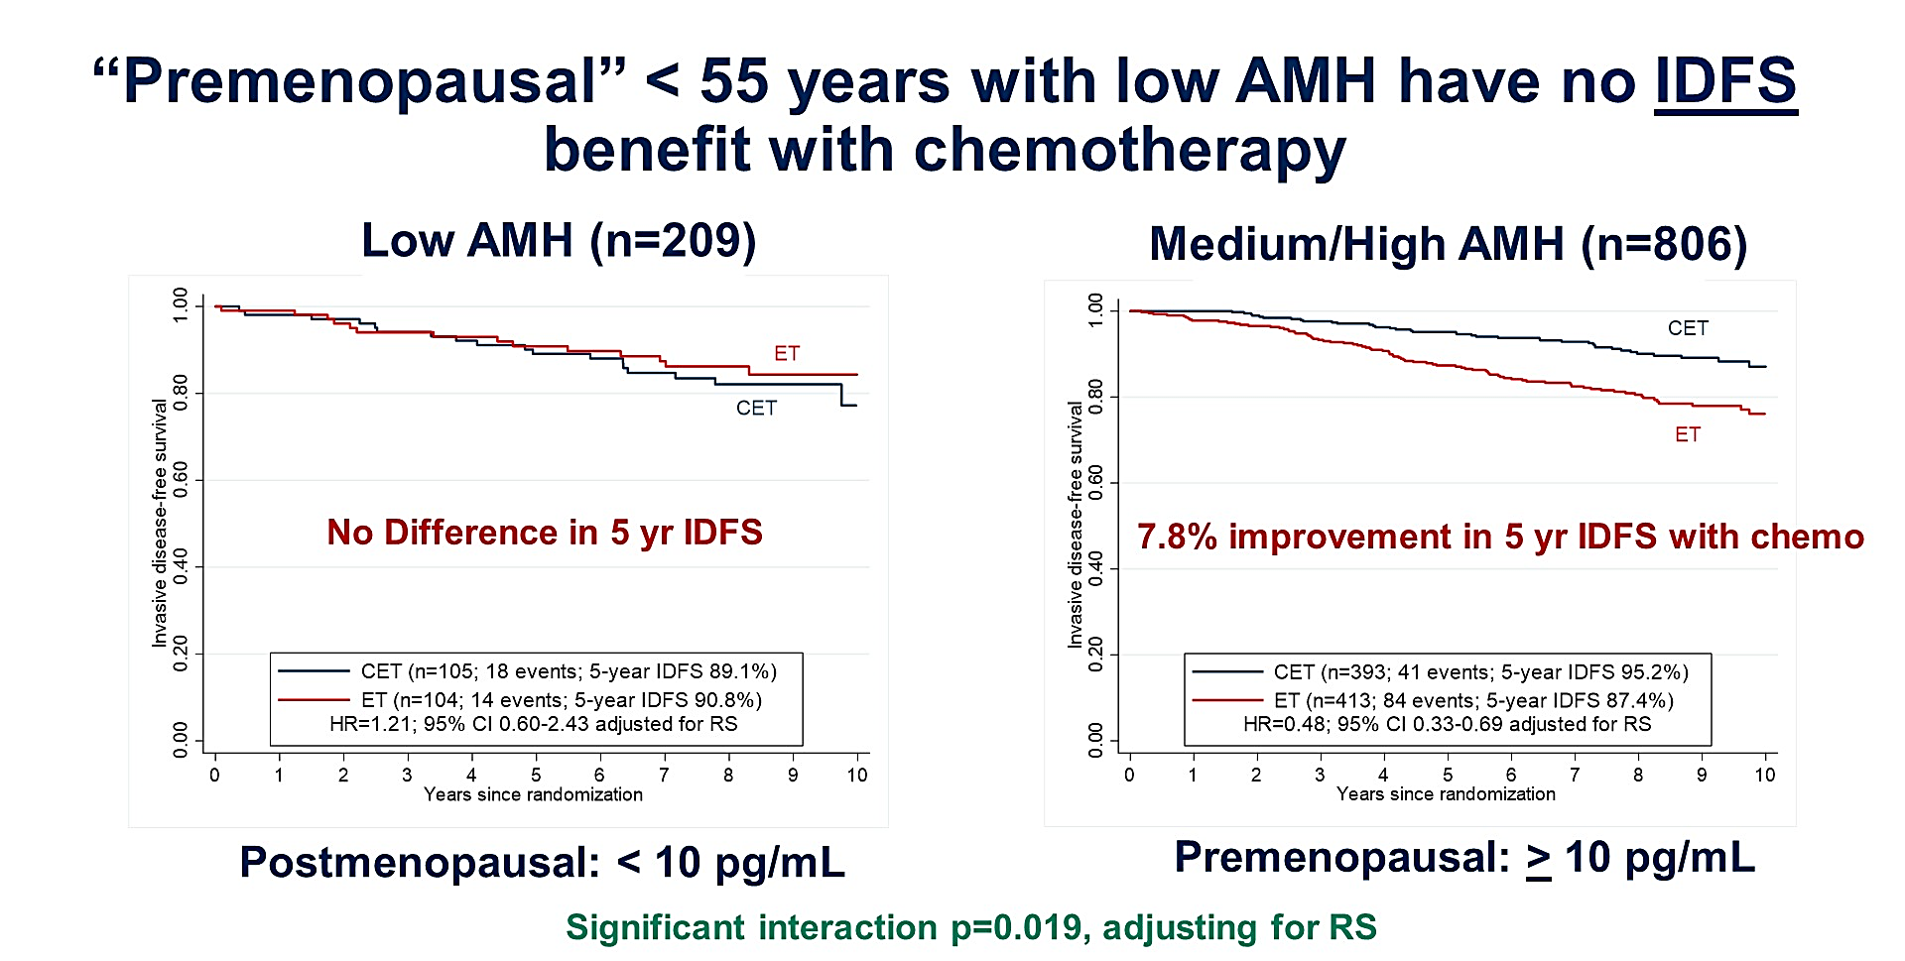
RxPONDER Subset Analysis: Serum AMH Level and iDFS in Premenopausal Women <55 Yr of Age
Kalinsky. ASCO 2024. Abstr 505. Reproduced with permission.
Notes:
AMH, anti-Müllerian hormone; iDFS, invasive disease–free survival.

Slide 48
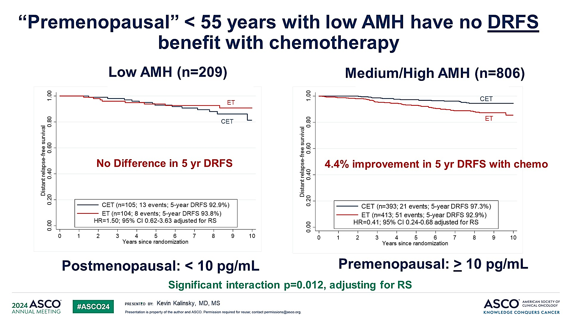
RxPONDER Subset Analysis: Serum AMH Level and DRFS in Premenopausal Women <55 Yr of Age
Kalinsky. ASCO 2024. Abstr 505. Reproduced with permission.
Notes:
AMH, anti-Müllerian hormone; DRFS, distant relapse-free survival.

Slide 49
Go Online for More CCO
Coverage of Breast Cancer!
Downloadable slideset of all key data presented today (available now)​
CME-certified on-demand webcast to revisit today’s expert presentation and discussions (coming soon)
Capsule Summaries of all the key breast cancer data​ from ASCO 2024
Additional CME/CE-certified analyses on breast cancer with expert faculty commentary on all the key studies (coming soon)
clinicaloptions.com

