Slide 1
Individualizing CLL Therapy: Frontline Treatment
Provided by Clinical Care Options, LLC in partnership with CLL Society.
Supported by educational grants from AbbVie Inc.; AstraZeneca; Beigene, Ltd.; and Bristol Myers Squibb.

Slide 2

About These Slides
Please feel free to use and share some or all of these slides in your noncommercial presentations to colleagues or patients
When using our slides, please retain the source attribution:
These slides may not be published, posted online, or used in commercial presentations without permission. Please contact permissions@clinicaloptions.com for details
Slide credit: clinicaloptions.com
Notes:
Disclaimer: The materials published on the Clinical Care Options Web site reflect the views of the authors of the CCO material, not those of Clinical Care Options, LLC, the CME providers, or the companies providing educational grants. The materials may discuss uses and dosages for therapeutic products that have not been approved by the United States Food and Drug Administration. A qualified healthcare professional should be consulted before using any therapeutic product discussed. Readers should verify all information and data before treating patients or using any therapies described in these materials.

Slide 3
Faculty
Jeremy S. Abramson, MD, MMSc
Director, Center for Lymphoma
Massachusetts General Hospital
Associate Professor of Medicine
Harvard Medical School
Boston, Massachusetts
Farrukh Awan, MD
Professor of Internal Medicine
Director of Lymphoid Malignancies Program
Harold C. Simmons Comprehensive Cancer Center
University of Texas Southwestern Medical Center
Dallas, Texas
Shuo Ma, MD, PhD
Professor of Medicine
Division of Hematology-Oncology
Department of Medicine
Robert H. Lurie Comprehensive Cancer Center
Northwestern University
Feinberg School of Medicine
Chicago, Illinois
Notes:
This slide lists the faculty who were involved in the production of these slides.

Slide 4
Faculty Disclosures
Jeremy S. Abramson, MD, MMSc: consultant/advisor/speaker: AbbVie, AstraZeneca, BeiGene, Bristol Myers Squibb, Caribou Biosciences, Cellectar, Genentech/Roche, Gilead, Incyte, Interius, Lilly, Novartis, Seagen, Takeda; researcher: Bristol Myers Squibb, Cellectis, Genentech/ Roche, Merck, Mustang Bio, Seagen.
Farrukh Awan, MD: consultant/advisor/speaker: AbbVie, Adaptive Biotechnologies, ADC Therapeutics, AstraZeneca, BeiGene, Bristol Myers Squibb, Caribou Biosciences, Dava Oncology, Genmab, Incyte, Kite Pharma, Loxo Oncology; researcher: AbbVie/Pharmacyclics.
Shuo Ma, MD, PhD: researcher: AbbVie, AstraZeneca, BeiGene, Carna, Juno, Loxo; consultant/advisor/speaker: AbbVie, AstraZeneca, BeiGene, Bristol Myers Squibb, Janssen, Lilly.

Slide 5
Learning Objectives
At the conclusion of this activity, learners should be able to:
Select first-line therapy for treatment-naive CLL/SLL, taking into consideration available evidence, expert and guideline recommendations, toxicity profiles, prognostic variables, comorbidities, duration, and patient preference
Appraise intraclass differences in selectivity, binding, efficacy, and adverse event profiles of agents used to treat CLL/SLL with the similar mechanism of action
Plan individualized treatment approaches for relapsed/refractory CLL/SLL based on optimal sequencing strategies recommended in the NCCN Guidelines (eg assessment of response/intolerance to first-line therapy, testing for resistant mutations, and patient eligibility for therapy)
Evaluate emerging data for CLL/SLL across the disease spectrum, including novel combinations, noncovalent reversible BTK inhibitors, and CAR T-cell therapy

Slide 6
First-Generation Covalent BTK Inhibitor (cBTKi): Earlier Role as 1L Therapy for CLL
Outcomes with ibrutinib in combination with rituximab in CLL
  Superior to CIT in younger and older patients
  Superior to FCR in patients ≤65 yr in PFS and OS
Phase III E1912 Trial: Overall¹
Phase III NCRI FLAIR Trial: Overall²
1.0
100
IR
IR
mPFS: NR
78%
80
0.8
FCR
FCR
0.6
51%
60
Probability of PFS
HR: 0.37 (95% CI: 0.27-0.51;
P <.0001)
PFS (%)
HR: 0.44 (95% CI: 0.32-0.60;
P <.001)
0.4
40
mPFS: 66.53 mo
6-yr PFS: 73%
Median age: 58 yr (8% >65 yr)
Cardiac deaths: n = 1
20
0.2
Median age: 63 yr (54% >65 yr)
Cardiac deaths: n = 9
0
0
0
1
2
3
4
5
6
7
0
12
24
36
48
60
72
Yr
Mo From Randomization
1. Shanafelt. Blood. 2022;140:112. 2. Hillmen. Blood. 2021;138:642.
Notes:
1L, first line; CIT, chemoimmunotherapy; CLL, chronic lymphocytic leukemia; FCR, fludarabine/cyclophosphamide/rituximab; mPFS, median progression-free survival; NR, not reached; OS, overall survival; PFS, progression-free survival.

Slide 7
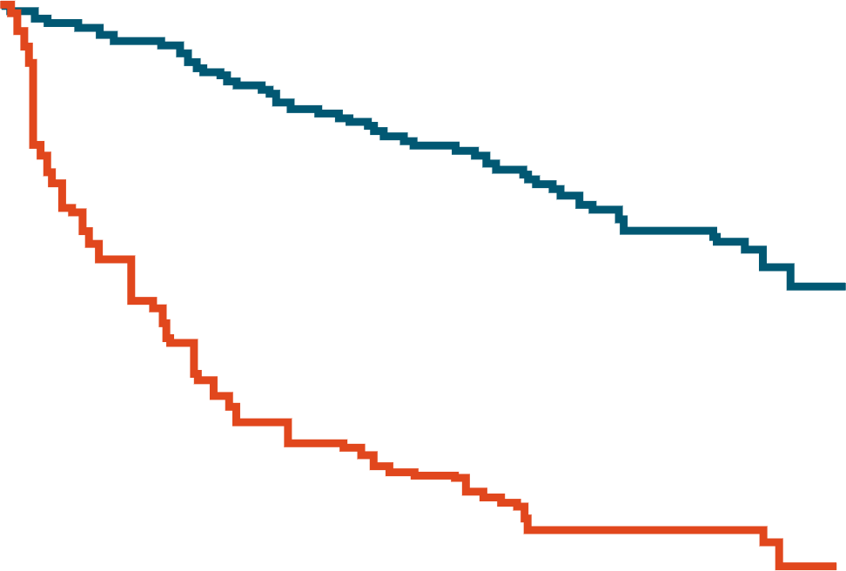
First-Generation Covalent BTK Inhibitor (cBTKi): Earlier Role as 1L Therapy for CLL
Outcomes with ibrutinib alone or in combination with rituximab in CLL
  Superior to chlorambucil in patients ≥65 yr in PFS and OS (RESONATE-2)
  Superior to BR in patients ≥65 yr in PFS
  Associated with a-fib, bleeding, bruising, hypertension, myalgias, arthralgias, and diarrhea
    Treatment was discontinued in 41% of patients in the RESONATE-2 trial, mostly due to AEs
RESONATE-2 Trial: Overall^{1,2}
(Patients aged ≥65 yr with untreated CLL)
A041202 Trial: Overall³
(Patients aged ≥65 yr with untreated CLL)
100
100
mOS: NR
1.0
80
80
Ibrutinib
0.8
76%
Ibrutinib
Chlorambucil
76%
IR
60
mPFS: NE
60
0.6
Ibrutinib
PFS (%)
OS (%)
mOS: 89 mo
OS not captured for chlorambucil arm for patients with PD after a median 5 yr follow-up
47%
Probability of PFS
mPFS: 44.9 mo
40
40
0.4
BR
mPFS: 15.0 mo
20
Chlorambucil
20
0.2
0
0
6
12
18
24
30
36
42
48
54
60
66
72
78
84
90
96
0
0
6
12
18
24
30
36
42
48
54
60
66
72
78
84
90
96
0
0
6
12
18
24
30
36
42
48
54
60
66
72
78
Mo
Mo
Mo
1. Barr. Blood Adv. 2022;6:3440. 2. Burger. Leukemia. 2020;34:787. 3. Woyach. Blood. 2024;143:1616.
Notes:
1L, first line; AE, adverse event; a-fib, atrial fibrillation; BR, bendamustine/rituximab; CLL, chronic lymphocytic leukemia; IR, ibrutinib/rituximab; mOS, median overall survival; mPFS, median progression-free survival; NE, not estimable; NR, not reached; OS, overall survival; PD, progressive disease; PFS, progression-free survival.

Slide 8
Next-Generation Covalent BTK Inhibitor (cBTKi):
Fewer AEs and Superior to CIT
Acalabrutinib ± obinutuzumab is superior to CIT in PFS
Zanubrutinib is superior to CIT in PFS
Lower rates of atrial fibrillation, hypertension, serious bleeding
Discontinuation due to AEs was approximately 10%
ELEVATE-TN
SEQUOIA
100
A + O
100
82.4%
Zanu
78%
Median PFS: NR
80
80
O + Clb
A
BR
Zanubrutinib
Censored
60
62%
60
50%
PFS (%)
A + O vs O + Clb
HR: 0.14 (95% CI:0.10-0.20;
P <.0001)
A vs O + Clb
HR: 0.24 (95% CI: 0.17-0.32;
P <.0001)
A + O vs A
HR: 0.58 (95% CI: 0.39- 0.86;
P = .0229)
PFS Probability (%)
Median PFS: NR
BR
40
Median
PFS: 27.8 mo
40
Median PFS, Mo | Median PFS, Mo
BR | 42.2
Zanu | NE
HR: 0.30 (95% CI: 0.21-0.43; P <.0001)
A + O
A
O + Clb
17%
20
20
0
0
0
6
12
18
24
30
36
42
48
54
60
66
72
78
84
90
0
3
6
9
12
15
18
21
24
27
30
33
36
39
42
45
48
51
54
57
Mo
Mo
Sharman. ASH 2023. Abstr 636. Ramakrishnan. ASH 2023. Abstr 1902.
Notes:
A, acalabrutinib; AE, adverse event; BR, bendamustine/rituximab; Clb, chlorambucil; CIT, chemoimmunotherapy; O, obinutuzumab; NE, not estimable; NR, not reached; PFS, progressive disease; Zanu, zanubrutinib

Slide 9
ELEVATE-RR: Cumulative Incidence of Any-Grade AEs of Special Interest
80
Bleeding Events
Diarrhea
Arthralgia
Acalabrutinib:Ibrutinib
Acalabrutinib:Ibrutinib
Acalabrutinib:Ibrutinib
HR: 0.63 (95% CI: 0.49-0.82)
HR: 0.61 (95% CI: 0.46-0.80)
HR: 0.61 (95% CI: 0.41-0.90)
60
40
Cumulative Event Rate (%)
20
0
0
3
6
9
12
15
18
21
24
27
30
33
36
39
42
45
48
51
54
57
0
3
6
9
12
15
18
21
24
27
30
33
36
39
42
45
48
51
54
57
0
3
6
9
12
15
18
21
24
27
30
33
36
39
42
45
48
51
54
57
Mo
Mo
Mo
Acalabrutinib
Ibrutinib
Byrd. JCO. 2021;39:3441. Hillmen. EHA 2021. Abstr S145.
Notes:
AE, adverse event.

Slide 10
ALPINE: Cumulative Incidence of Any-Grade Atrial Fibrillation/Flutter and Hypertension
Atrial Fibrillation or Flutter
Hypertension
50
Events,
n (%)
22 (6.8)
53 (16.4)
100
40
Zanubrutinib
Ibrutinib
2-sided descriptive P = .0001
80
30
60
Cumulative Incidence (%)
Cumulative Incidence (%)
+
+
+
+
+
+
+
+
+
+
+
+
+
+
+
+
+
+
+
+
+
+
+
+
+
+
+
+
+
+
+
+
+
+
+
+
+
20
+
40
+
+
+
+
+
+
+
+
+
+
+
+
+
+
+
+
+
+
+
+
+
+
+
+
+
+
+
+
+
+
+
+
+
+
+
+
+
+
+
+
+
+
+
+
+
+
+
+
+
+
+
+
+
+
+
+
+
+
+
+
+
+
+
+
+
+
+
+
+
+
+
+
+
+
+
+
+
+
+
+
+
+
+
+
+
+
+
+
+
+
+
+
+
+
+
+
+
+
+
+
+
+
+
+
+
+
+
+
+
+
+
+
+
+
+
+
+
+
+
+
+
+
+
+
+
+
+
+
+
+
+
+
+
+
+
+
+
+
+
+
+
+
+
+
+
+
+
+
+
+
+
+
+
+
+
+
+
+
+
+
+
+
+
+
+
+
+
+
+
+
+
+
+
+
+
+
+
+
+
+
+
+
+
+
+
+
+
+
+
+
+
+
+
+
+
+
+
+
+
+
+
+
+
+
+
+
+
+
+
+
10
20
+
+
+
+
+
+
+
+
+
+
+
+
+
+
+
+
+
+
+
+
+
+
+
+
+
+
+
+
+
+
+
+
+
+
+
+
+
+
+
+
+
+
+
+
+
+
+
+
+
+
+
+
+
+
+
+
+
+
+
+
+
+
+
+
+
+
+
+
+
+
+
+
+
+
+
+
+
+
+
+
+
+
+
+
+
+
+
+
+
+
+
+
+
+
+
+
+
+
+
+
+
+
+
+
+
+
+
+
+
+
+
+
+
+
+
+
+
+
+
+
+
+
+
+
+
+
+
+
+
+
+
Data cutoff: 15 Sept 2023
+
+
+
+
+
+
+
+
+
+
+
+
+
+
+
+
+
+
+
+
+
+
+
+
+
+
+
+
+
+
+
+
+
+
+
+
0
0
0
3
6
9
12
15
18
21
24
27
30
33
36
39
42
45
48
51
54
57
60
0
3
6
9
12
15
18
21
24
27
30
33
36
39
42
45
48
51
54
57
60
Mo From Randomization
Mo From Randomization
Patients at Risk, n
Zanubrutinib
Ibrutinib
Patients at Risk, n
Zanubrutinib
Ibrutinib
324
324
312
295
302
278
294
260
288
247
277
229
268
210
261
200
250
190
242
177
231
167
221
165
180
133
144
104
127
90
122
85
58
47
14
10
3
2
0
1
0
0
324
324
296
280
279
253
262
231
247
221
232
207
220
185
215
172
196
164
188
150
175
140
165
136
133
108
108
79
91
69
86
64
37
32
10
7
1
2
0
2
0
0
Brown. ASH 2023. Abstr 202.

Slide 11
CLL14: First-line Obinutuzumab + Venetoclax or Chlorambucil (Time Limited)
Progression-Free Survival
Overall Survival
STOP
Median observation time: 65.4 mo
STOP
100
100
90
90
n = 216
80
n = 216
80
70
70
n = 216
60
60
PFS (%)
OS (%)
50
50
End of treatment
40
End of treatment
n = 216
40
30
30
20
Ven + Obin
Clb + Obin
20
Ven + Obin
Clb + Obin
10
10
0
0
0
6
12
18
24
30
36
42
48
54
60
66
72
0
6
12
18
24
30
36
42
48
54
60
66
72
Mo to Event (PFS) From Randomization
Mo to Event (OS) From Randomization
PFS | Ven + Obin | Clb + Obin | HR (95% CI) | P Value
Median PFS, mo | NR | 36.4 | 0.35 (0.26-0.46) | <.0001
5-yr PFS rate, % | 62.6 | 27.0
OS | Ven + Obin | Clb + Obin | HR (95% CI) | P Value
Median OS, mo | NR | NR | 0.72 (0.48-1.09) | .12
5-yr OS rate, % | 81.9 | 77.0
Al-Sawaf. Nature Commun. 2023;14:2147. Al-Sawaf. EHA 2022. Abstr S148.
Notes:
Clb, chlorambucil; NR, not reached; Obin, obinutuzumab; OS, overall survival; PFS, progression-free survival; Ven, venetoclax.

Slide 12
CLL14: Most Frequent Grade ≥3 Adverse Events With Obinutuzumab + Venetoclax or Chlorambucil
Grade ≥3 Adverse Event, % | Venetoclax + Obinutuzumab (n = 212) |  | Chlorambucil + Obinutuzumab (n = 214)
 | During Treatment | After Treatment | During Treatment | After Treatment
Neutropenia | 51.9 | 4.0 | 47.2 | 1.9
Thrombocytopenia | 14.2 | 0.5 | 15.0 | 0
Anemia | 7.5 | 2.0 | 6.1 | 0.5
Febrile neutropenia | 4.2 | 1.0 | 3.3 | 0.5
Leukopenia | 2.4 | 0 | 4.7 | 0
Pneumonia | 3.8 | 3.0 | 3.3 | 1.4
Infusion-related reaction | 9.0 | 0 | 9.8 | 0.5
Tumour lysis syndrome | 1.4 | 0 | 3.3 | 0
Al-Sawaf. Nature Commun. 2023;14:2147. Al-Sawaf. EHA 2022. Abstr S148.

Slide 13
GAIA/CLL13: Time-Limited First-line Venetoclax + Anti-CD20 Ab ± Ibrutinib for CLL
Multicenter, randomized, open-label phase III study with recruitment in 10 countries (DE, AT, CH, NL, BE, DK, SE, FI, IE, IL)
Stratified by age (≤65 vs >65 yr), stage, and region
28-day cycles
Ibrutinib + Venetoclax + Obinutuzumab†§#
(n = 230)
12 cycles V, 6 cycles O,
continuation of I up to cycle 36
allowed if MRD detectable
Fit patients with CLL
(CIRS ≤6, CrCl ≥70 mL/min);
no previous therapy for CLL; no TP53 mutation or del(17p)
(N = 920)
Venetoclax + Obinutuzumab†§
(n = 230)
12 cycles V, 6 cycles O
Venetoclax + Rituximab†‡
(n = 230)
12 cycles V, 6 cycles R
CIT: FCR or BR*
(n = 230)
6 cycles
Primary endpoints: MRD negativity (<1 CLL cell per 10,000 leukocytes analyzed [0.01%]) for venetoclax + obinutuzumab vs CIT; PFS for I + V + obinutuzumab vs CIT
*≤65 yr, FCR; >65 yr: BR. †V standard ramp-up 20-400 mg, then 400 mg/day, cycles 3-12. ‡Rituximab 375/500 mg/m² Day 1, cycles 1-6. §Obinutuzumab 1000 mg Day 1, 8, 15 of cycle 1, then Day 1 of cycles 2-6. #Ibrutinib 420 mg/day from Day 1, cycle 1.
Eichhorst. NEJM. 2023;388:1739. NCT02950051.
Notes:
BR, bendamustine/rituximab; CIRS, cumulative illness rating scale; CIT, chemoimmunotherapy; CLL, chronic lymphocytic leukemia; CrCl, creatinine clearance; FCR, fludarabine/cyclophosphamide/rituximab; I, ibrutinib; MRD, measurable residual disease; O, obinutuzumab; PFS, progression-free survival; R, rituximab; V, venetoclax.
FCR, fludarabine 25 mg/m² Days 1-3, cyclophosphamide 250 mg/m² Days 1-3, rituximab 375/500 mg/m² Day 1.
BR, bendamustine 90 mg/m² Days 1+2, rituximab 375/500 mg/m² Day 1.

Slide 14
GAIA/CLL13: Efficacy
uMRD in PB at 15 Mo
PFS at 3 Yr
Regimen | Median PFS, Mo | 3-Yr PFS, %
I + V + O | NR | 90.5
V + O | NR | 87.7
V + R | 52.3 | 80.8
CIT | 52.0 | 75.5
1.0
0.8
0.6
Median follow-up: 38.8 mo (range: 0-59.2)
PFS (Proportion)
0.4
HR (97.5% CI; P Value)
I + V + O vs CIT: 0.32 (0.19-0.54; <.000001)
V + O vs CIT: 0.42 (0.26-0.68; <.0001)
V + R vs CIT: 0.79 (0.53-1.18; .183)
0.2
0
12
24
36
48
60
Mo From Start of Treatment
CIT | 229 | 197 | 172 | 98 | 28
V + R | 237 | 226 | 212 | 119 | 32
V + O | 229 | 221 | 208 | 125 | 42
I + V + O | 231 | 227 | 217 | 132 | 44
Eichhorst. NEJM. 2023;388:1739. Eichhorst. ASH 2021. Abstr 71. Eichhorst. EHA 2022. Abstr LB2365.
Notes:
CIT, chemoimmunotherapy; I, ibrutinib; ITT, intention-to-treat; NR, not reached; O, obinutuzumab; PB, peripheral blood; PFS, progression-free survival; R, rituximab; uMRD, of undetectable measurable residual disease; V, venetoclax.

Slide 15
CAPTIVATE: 4-Yr Follow-up Analysis From FD Cohort of First-line Ibrutinib + Venetoclax for CLL/SLL
PFS
OS
100
100
All patients
uIGHV
All patients
del(17p)/TP53
80
Treatment period
80
Treatment period
uIGHV
60
del(17p)/TP53
60
PFS (%)
OS (%)
40
40
del(17p)/TP53 Mutation
(n = 27)
63
(41-79)
Unmutated IGHV
(n = 89)
73
(62-81)
All Treated Patients
(n = 159)
79
(71-84)
del(17p)/TP53 Mutation
(n = 27)
96
(76-99)
Unmutated IGHV
(n = 89)
97
(90-99)
All Treated Patients
(n = 159)
98
(94-99)
20
20
4-yr PFS rate, % (95% CI)
4-yr OS rate, % (95% CI)
0
0
0
6
12
18
24
30
36
42
48
0
6
12
18
24
30
36
42
48
Patients at Risk, n
del(17p)/TP53 mutation
Unmutated IGHV
All treated patients
Mo
Mo
27
89
159
26
85
153
26
85
152
21
79
144
21
79
143
19
73
132
19
72
130
14
59
115
13
58
111
27
89
159
26
86
155
26
86
154
25
84
151
25
84
150
25
83
149
25
83
149
25
82
148
24
79
143
Ghia. ICML 2023. Abstr 155. Reproduced with permission.
Slide credit: clinicaloptions.com
Notes:
FD, fixed duration; OS, overall survival; PFS, progression-free survival; uMRD, undetectable measurable residual disease.

Slide 16

Frontline Covalent BTK Inhibitor (cBTKi) vs Venetoclax + Obinutuzumab: Factors to Consider
Ven + Obin
cBTKi
Superior to CIT
Requires continuous dosing
More data in patients with del(17p)/TP53 mutations
Convenience (no infusions,
TLS monitoring)
Associated with cardiac and bleeding events
Superior to CIT
Potential for 1 yr time-limited therapy
Potential for cost saving if 1 yr of therapy is durable
Requires ramp up period with TLS monitoring and prophylaxis
No known cardiac or bleeding risks
Brem. Blood Adv. 2022;6:1361. Molica. Int J Hematol Oncol. 2020;9:IJH31.
Notes:
BR, bendamustine/rituximab; CIT, chemoimmunotherapy; BTKi, BTK inhibitor; FCR, fludarabine/cyclophosphamide/rituximab; Obin, obinutuzumab; TLS, tumor lysis syndrome; Ven, venetoclax.

Slide 17
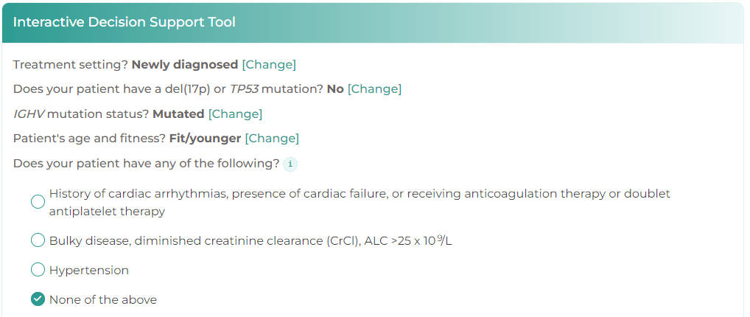
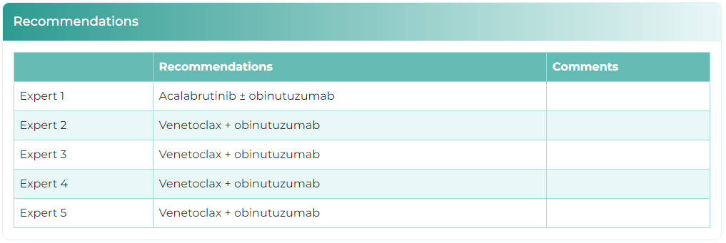


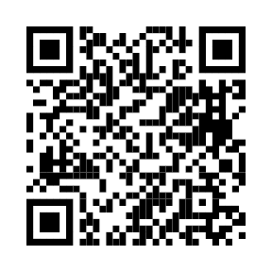
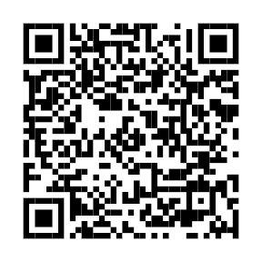
CCO Online Treatment Decision Support Tool for CLL
To use the tool, patient characteristics can be entered; expert recommendations based on those same characteristics are provided
Expert panel: Farrukh Awan, Jennifer Brown, Nicole Lamanna, Sameer Parikh, Jennifer Woyach
Available at: clinicaloptions.com/CLLtool or on our app: AliCEA Mobile
Notes:
AE, adverse event; NCCN, National Comprehensive Cancer Network.

Slide 18
Go Online for More CCO
Coverage of CLL
Additional CME-certified text module including expert discussion of later-line therapy for CLL
Online CLL treatment decision support tool providing expert recommendations for your cases
Expert-authored commentaries examining key topics in CLL management
clinicaloptions.com
clinicaloptions.com/CLLtool

