Slide 1
IMerge: Phase III Trial of Imetelstat vs
Placebo for Transfusion-Dependent
Lower-Risk MDS Relapsed/Refractory to ESAs
CCO Independent Conference Highlights*
of the 2023 ASCO Annual Meeting, June 2-6, 2023, Chicago, Illinois
*CCO is an independent medical education company that provides state-of-the-art medical information to healthcare professionals through conference coverage and other educational programs.
Supported by educational grants from AbbVie, Geron, Jazz Pharmaceuticals, Lilly, Merck Sharp & Dohme Corp., and Novartis.
Notes:
ESA, erythropoiesis-stimulating agent; MDS, myelodysplastic syndromes.

Slide 2

About These Slides
Please feel free to use and share some or all of these slides in your noncommercial presentations to colleagues or patients
When using our slides, please retain the source attribution:
These slides may not be published, posted online, or used in commercial presentations without permission. Please contact permissions@clinicaloptions.com for details
Slide credit: clinicaloptions.com
Notes:
Disclaimer: The materials published on the Clinical Care Options website reflect the views of the authors of the CCO material, not those of Clinical Care Options, LLC, the CME providers, or the companies providing educational grants. The materials may discuss uses and dosages for therapeutic products that have not been approved by the United States Food and Drug Administration. A qualified healthcare professional should be consulted before using any therapeutic product discussed. Readers should verify all information and data before treating patients or using any therapies described in these materials.

Slide 3
IMerge: Background
Imetelstat is a first-in-class competitive telomerase inhibitor^{1,2}
  Targets cancer cells with unusually active telomerase, leading to recovery of hematopoiesis^{3,4}
The IMerge study enrolled patients with lower-risk and transfusion-dependent, non-del(5q) MDS R/R to or ineligible for ESAs to receive imetelstat⁵
  In the phase II portion of the trial, 8-wk RBC-TI rate was 42% with a median TI duration of 86 wk
Current analysis of phase III portion of IMerge assessed RBC-TI, HI-E, and safety with imetelstat vs placebo in the same patient population⁶
1. Asai. Cancer Res. 2003;63:3931. 2. Herbert. Oncogene. 2005;24:5262. 3. Mosoyan. Leukemia. 2017;31:2458. 4. Wang. Blood Adv. 2018;25:2378. 5. Steensma. JCO. 2021;39:48. 6. Zeidan. ASCO 2023. Abstr 7004.
Notes:
ESA, erythropoiesis-stimulating agent; HI-E, hematologic improvement-erythroid; MDS, myelodysplastic syndromes; RBC, red blood cell; R/R, relapsed/refractory; TI, transfusion independence.

Slide 4
IMerge: Study Design
International, double-blind, randomized phase III trial
Primary endpoint: 8-wk RBC-TI
Key secondary endpoints: 24-wk RBC-TI, TI duration, HI-E, safety
Key exploratory endpoints: changes in VAF, PRO (FACIT-Fatigue)
Stratified by transfusion burden (4-6 vs >6 U) and IPSS-R category (low vs intermediate 1)
Patients with low-risk or intermediate 1–risk MDS
(IPSS-R); R/R to ESA or EPO >500 mU/mL
(ESA ineligible); RBC transfusion dependent
(≥4 U/8 wk over 16 wk prestudy); non-del(5q);
no prior lenalidomide or HMAs
(N = 178)
Imetelstat
7.5 mg/kg IV Q4W
(n = 118)
2:1
Placebo
(n = 60)
Zeidan. ASCO 2023. Abstr 7004.
Notes:
ESA, erythropoiesis-stimulating agent; EPO, erythropoietin; FACIT, Functional Assessment of Chronic Illness Therapy; HI-E, hematologic improvement-erythroid; HMA, hypomethylating agent; IPSS-R, Revised International Prognostic Scoring System; MDS, myelodysplastic syndromes; PRO, patient-reported outcomes; RBC, red blood cell; R/R, relapsed/refractory; TI, transfusion independence; VAF, variant allele frequency

Slide 5
IMerge: Baseline Characteristics
 | Imetelstat (n = 118) | Placebo (n = 60)
Median age, yr (range) | 72 (44-87) | 73 (39-85)
Male, n (%) | 71 (60) | 40 (67)
Median time since MDS diagnosis, yr (range) | 3.5 (0.1-26.7) | 2.8 (0.2-25.7)
WHO classification, n (%) RS- RS+ | 44 (37) 73 (62) | 23 (38) 37 (62)
Baseline IPSS-R risk, n (%) Low Intermediate-1 | 80 (68) 38 (32) | 39 (65) 21 (35)
 | Imetelstat (n = 118) | Placebo (n = 60)
Median Hb, g/dL (range) | 7.9 (5.3-10.1) | 7.8 (6.1-9.2)
Median prior RBC transfusion burden, RBC U/8 wk (range) | 6 (4-33) | 6 (4-13)
Prior RBC transfusion burden, n (%) ≥4 to ≤6 U/8 wk ≥7 U/8 wk | 62 (53) 56 (48) | 33 (55) 27 (45)
Median sEPO, mU/mL (range) | 174.9 (6.0-4460.0) | 277.0 (16.9-5514.0)
sEPO level,* n (%) ≤500 mU/mL >501 mU/mL | 87 (74) 26 (22) | 36 (60) 22 (37)
Prior ESA use, n (%) | 108 (92) | 52 (87)
Prior luspatercept use, n (%) | 7 (6) | 4 (7)
*Data missing for 5 patients in imetelstat group and 2 in placebo group.
Zeidan. ASCO 2023. Abstr 7004.
Notes:
ESA, erythropoiesis stimulating agent; Hb, hemoglobin; IPSS-R, Revised International Prognostic Scoring System; MDS, myelodysplastic syndromes; RBC, red blood cell; RS, ring sideroblast; sEPO, serum erythropoietin; WHO, World Health Organization

Slide 6
IMerge: Rates of Durable RBC-TI Over Time
Transfusion Independence
Imetelstat (N = 118)
Placebo (N = 60)
50
40
P <0.001
39.8
P <.001
P < .001
30
31.4
Patients (%)
28.0
20
15.0
P= .012
10
6.7
3.3
13.6
1.7
0
8-week TI
16-week TI
24-week TI
1-year TI
A single continuous RBC-TI period was achieved by most 8-wk responders to imetelstat (83%)
Zeidan. ASCO 2023. Abstr 7004. Reproduced with permission.
Notes:
RBC, red blood cell; TI, transfusion independence

Slide 7
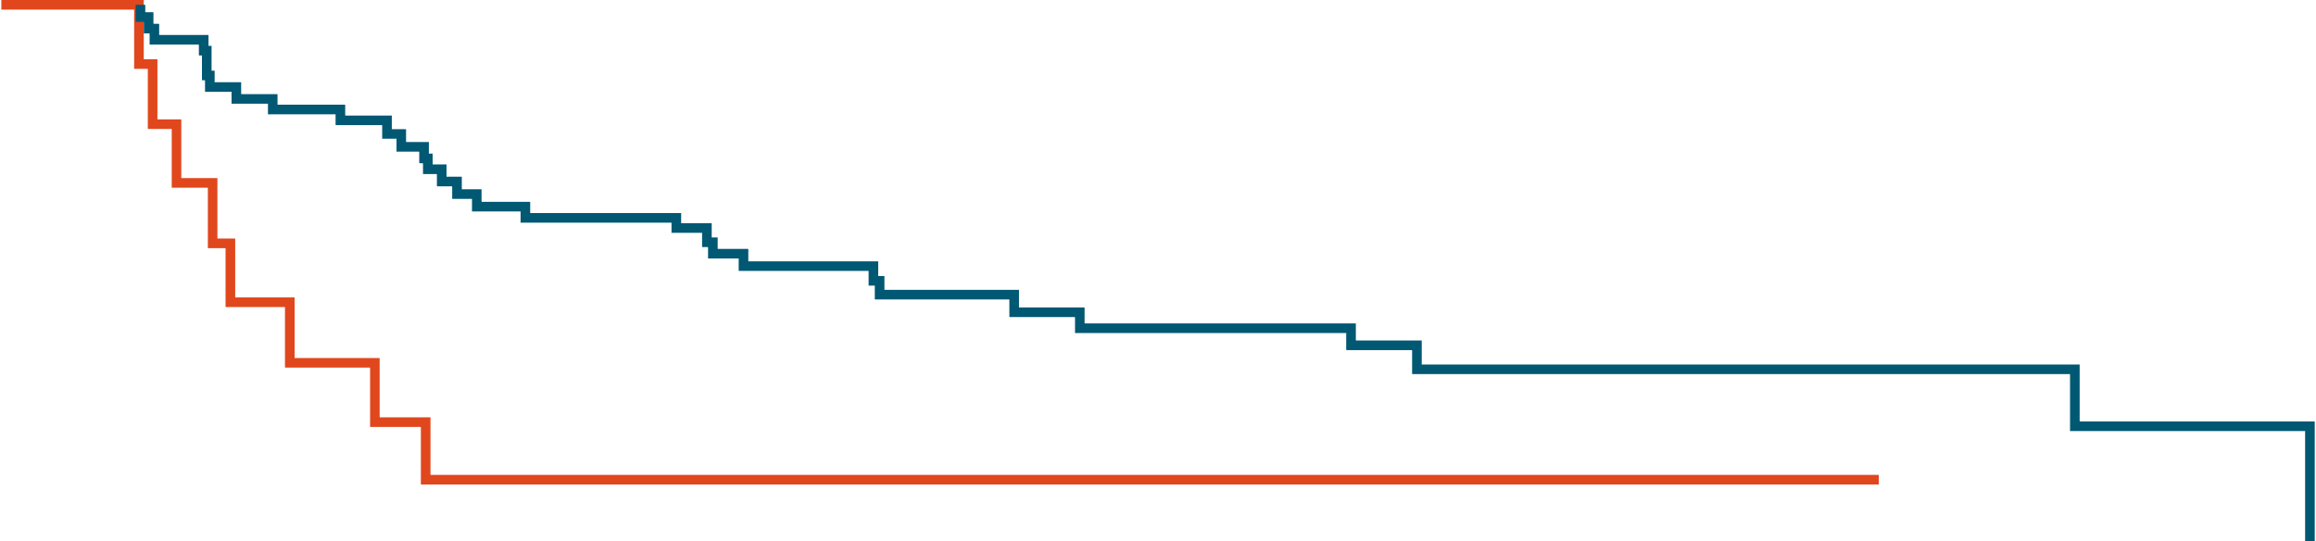

IMerge: Duration of Transfusion Independence Among Patients Achieving 8-Wk RBC-TI
100
8-wk TI Responders | Imetelstat (n = 47) | Placebo (n = 9) | HR (95% CI) | P Value
Median duration of TI, wk (95% CI) | 51.6 (26.9-83.9) | 13.3 (8.0-24.9) | 0.23 (0.09-0.57) | <.001
80
60
Imetelstat
Placebo
Patients (%)
40
20
0
0
47
9
8
47
9
16
37
4
24
33
2
32
27
1
40
26
1
48
20
1
56
16
1
64
13
1
72
11
1
80
11
1
88
8
1
96
6
1
104
5
1
112
3
0
120
3
128
1
136
1
144
0
Patients at Risk, n
Imetelstat
Placebo
Wks
Zeidan. ASCO 2023. Abstr 7004. Reproduced with permission.
Notes:
RBC, red blood cell; TI, transfusion independence

Slide 8
IMerge: 8-Wk RBC-TI Rate in Key Patient Subgroups
 |  | Imetelstat, n/N (%) | Placebo, n/N (%) | % Difference (95% CI) | P-Value
Overall |  | 47/118 (39.8) | 9/60 (15.0) | 24.8 (9.9-36.9) | <0.001
WHO category
RS+ |  | 33/37 (45.2) | 7/37 (18.9) | 26.3 (5.9-42.2) | 0.016
RS- |  | 14/44 (31.8) | 2/23 (8.7) | 23.1 (-1.3 to 40.6) | 0.038
Prior RBC transfusion burden per IWG 2006
4-6 units/8 weeks |  | 28/62 (45.2) | 7/33 (21.2) | 23.9 (1.9-41.1) | 0.027
>6 units/8 weeks |  | 19/56 (33.9) | 2/27 (7.4) | 26.5 (4.7-41.8) | 0.023
IPSS risk category
Low |  | 32/80 (40.0) | 8/39 (20.5) | 19.5 (-0.1 to 35.2) | 0.034
Intermediate-1 |  | 15/38 (39.5) | 1/21 (4.8) | 34.7 (8.8-52.4) | 0.004
Baseline sEPO
≤500 mU/mL |  | 39/87 (44.8) | 7/36 (19.4) | 25.4 (5.3-40.7) | 0.011
>500 mU/mL |  | 7/26 (26.9) | 2/22 (9.1) | 17.8 (-8.2 to 40.3) | 0.107
-20
0
20
40
60
Favors Placebo
Favors imetelstat
Zeidan. ASCO 2023. Abstr 7004. Reproduced with permission.
Notes:
IPSS, International Prognostic Staging System; IWG, International Working Group; RBC, red blood cell; RS, ring sideroblast; sEPO, serum erythropoietin; TI, transfusion independence; WHO, World Health Organization.

Slide 9
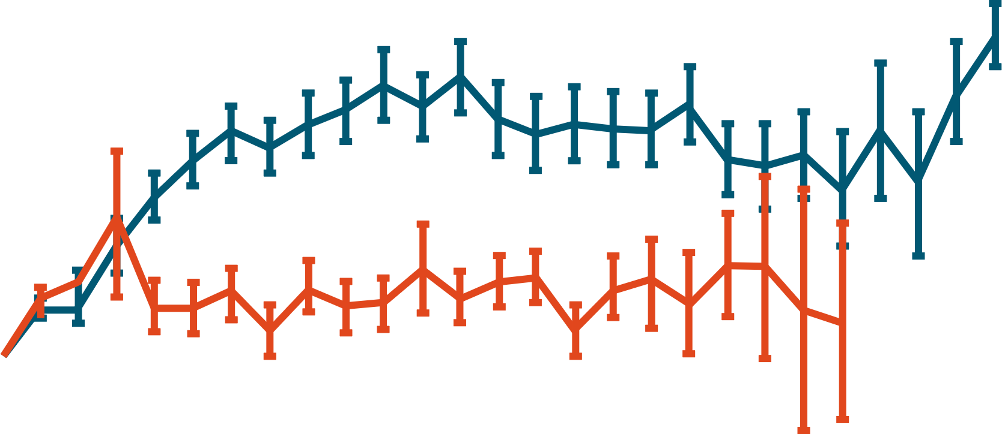
IMerge: Hemoglobin Responses
8-Wk TI Responders
Entire Cohort: Mean Change in Hb
Imetelstat
Placebo
Parameter, median g/dL (range) | Imetelstat (n = 47) | Placebo (n = 9)
Hb rise | 3.6 (-0.1- to 13.8) | 0.8 (-0.2 to 1.7)
Hb peak | 11.3 (8.0 to 21.9) | 8.9 (7.9 to 9.7)
5
4
3
Mean Change in Hgb (g/dL ±SE)
2
1
0
-1
0
1
5
9
13
17
21
25
29
33
37
41
45
49
53
57
61
65
69
73
77
81
85
89
93
97
101
Wks
Zeidan. ASCO 2023. Abstr 7004. Reproduced with permission.
Notes:
Hb, hemoglobin; TI, transfusion independence

Slide 10
IMerge: HI-E Responses (IWG 2018)
Response, n (%) | Imetelstat (n = 118) | Placebo (n = 60) | % Difference (P Value)
Entire cohort | 50 (42.4) | 8 (13.3) | 29 (<.001)
Patients with LTB | Imetelstat (n = 21) | Placebo (n = 18) | % Difference (P Value)
HI-E response (16-wk RBC-TI) | 7 (33.3) | 4 (22.2) | 11.1 (.562)
Patients with HTB | Imetelstat (n = 97) | Placebo (n = 42) | % Difference (P Value)
Major HI-E-response (16 wk RBC-TI) | 30 (30.9) | 0 (0) | 30.9 (<.001)
Minor HI-E response (50% RBC units reduction in 16 wk) | 43 (44.3) | 4 (9.5) | 34.8 (<.001)
Zeidan. ASCO 2023. Abstr 7004. Reproduced with permission.
Notes:
HI-E, hematologic improvement-erythroid; HTB, high transfusion burden; IWG, International Working Group; LTB, low transfusion burden; RBC, red blood cell; TI, transfusion independence.

Slide 11
IMerge: Most Common AE
AEs in ≥10% of Patients, n (%) | Imetelstat (n = 118) |  | Placebo (n = 59)
 | Any Grade | Grade 3/4 | Any Grade | Grade 3/4
Hematologic Thrombocytopenia Neutropenia Anemia Leukopenia | 89 (75) 87 (74) 24 (20) 12 (10) | 73 (62) 80 (68) 23 (19) 9 (8) | 6 (10) 4 (7) 6 (10) 1 (2) | 5 (8) 2 (3) 4 (7) 0
Other Asthenia COVID-19 Headache Diarrhea ALT increased Peripheral edema Hyperbilirubinemia Pyrexia Constipation | 22 (19) 22 (19) 15 (13) 14 (12) 14 (12) 13 (11) 11 (9) 9 (8) 9 (8) | 0 2 (2) 1 (1) 1 (1) 3 (3) 0 1 (1) 2 (2) 0 | 8 (14) 8 (14) 3 (5) 7 (12) 4 (7) 8 (14) 6 (10) 7 (12) 7 (12) | 0 3 (5) 0 1 (2) 2 (3) 0 1 (2) 0 0
Most often reported during cycles 1-3, grade 3/4 neutropenia and thrombocytopenia were the most commonly reported AE
Nonhematologic AE were mostly low grade
~75% of patients receiving imetelstat had dose modifications due to AEs and <15% discontinued treatment due to AEs
No cases of Hy’s law or treatment-related liver injury
  Grade 3 LFT laboratory abnormalities were consistent between treatment arms
Zeidan. ASCO 2023. Abstr 7004.
Notes:
AE, adverse event; ALT, alanine aminotransferase; LFT, liver function test.

Slide 12
IMerge: Duration and Management of Cytopenias (Grade 3/4)
Event | Imetelstat (n = 118) | Placebo (n = 59)
Thrombocytopenia (grade 3/4) Duration, median wk (range) Resolved within 4 wk, % | 1.4 (0.1-12.6) 86.3 | 2.0 (0.3-11.6) 44.4
Neutropenia (grade 3/4) Duration, median wk (range) Resolved within 4 wk, % | 1.9 (0-15.9) 81.0 | 2.2 (1.0-4.6) 50.0
Bleeding events (grade ≥3) | 3 (2.5) | 1 (1.7)
Infections (grade ≥3) | 13 (11.0) | 8 (13.6)
Febrile neutropenia (grade 3) | 1 (0.8) | 0
Median duration of grade 3/4 thrombocytopenia and neutropenia was <2 wk
  >80% resolved to grade ≤2 within 4 wk
Clinical ramifications of infection and bleeding were low and similar between treatment arms
Myeloid growth factors (≥1 dose) were used mostly within cycles 2-4 in the imetelstat (n = 41) and placebo (n = 2) arms
Zeidan. ASCO 2023. Abstr 7004.

Slide 13
IMerge: Impact of Treatment on VAF of Genes Often Mutated in MDS
75
Imetelstat
Placebo
P=.032
50
P=.146
P<.001
P=.019
25
0
Maximum % Change in Variant Allele Frequency in Blood
-25
-50
-75
-100
N=78
N=38
N=35
N=12
N=18
N=8
N=10
N=6
SF3B1
TET2
DNMT3A
ASXL1
Zeidan. ASCO 2023. Abstr 7004. Reproduced with permission.
Notes:
MDS, myelodysplastic syndromes; VAF, variant allele frequency.

Slide 14
IMerge: Correlation of SF3B1 VAF Reduction With Clinical Outcomes With Imetelstat Treatment
Maximum Increase in Hb vs
Maximum Reduction in SF3B1 VAF
Longest RBC-TI Duration vs
Maximum Reduction in SF3B1 VAF
14
150
Fit
95% Confidence Limits
12
10
Imetelstat (N = 67)
P-Value: <.001
Pearson Correlation Coefficient: -0.626
Imetelstat (N = 78)
P-Value: <.001
Pearson Correlation Coefficient: -0.549
8
100
6
Change in Central Hgb (gdL)
Longest TI Duration (Weeks)
4
50
2
0
-2
0
-100
-90
-80
-70
-60
-50
-40
-30
-20
-10
0
10
-100
-80
-60
-40
-20
0
20
SF3B1 VAF Change (%)
SF3B1 VAF Change (%)
TET2, DNMT3A, or ASXL21 VAF reductions correlated with longer RBC-TI duration
Zeidan. ASCO 2023. Abstr 7004. Reproduced with permission.
Notes:
RBC, red blood cell; TI, transfusion independence; VAF, variant allele frequency.

Slide 15
IMerge: Investigators’ Conclusions
In this analysis of patients with transfusion-dependent lower-risk MDS, imetelstat provided significantly higher rates of RBC-TI at 8 wk compared with placebo
(39.8% vs 15.0%, respectively)
  RBC-TI of 28.0% at 24 weeks, with median duration almost 1 yr in 8-wk responders
  Sustained increase in Hb and HI-E rate
  Consistently higher rate of 8 wk RBC-TI across key patient subgroups
Safety results consistent with prior clinical experience with no new safety signals
Investigators concluded that the reduction in VAF of commonly mutated genes in MDS and their correlation with selected study endpoints support the disease-modifying potential of imetelstat
Zeidan. ASCO 2023. Abstr 7004.
Notes:
Hb, hemoglobin; HI-E, hematologic improvement-erythroid; MDS, myelodysplastic syndromes; RBC, red blood cell; TI, transfusion independent; VAF, variant allele frequency.

Slide 16
Go Online for More CCO
Coverage of ASCO 2023!
Capsule Summaries of all the key data
Additional CME/CE-certified analyses with expert faculty commentary on key studies in:
Breast cancer
Gastrointestinal cancers
Gynecologic cancers
Hematologic malignancies
Lung cancer
Skin cancer
clinicaloptions.com

